Slide 1
Overview of this week
Debugging tips for ML algorithms
Graph algorithms
A prototypical graph algorithm: PageRank
In memory
Putting more and more on disk …
Sampling from a graph
What is a good sample? (graph statistics)
What methods work? (PPR/RWR)
HW: PageRank-Nibble method + Gephi

Slide 2
Common statistics for graphs
William Cohen

Slide 3
Why I’m talking about graphs
Lots of large data is graphs
Facebook, Twitter, citation data, and other social networks
The web, the blogosphere, the semantic web, Freebase, Wikipedia, Twitter, and other information networks
Text corpora (like RCV1), large datasets with discrete feature values, and other bipartite networks
nodes = documents or words
links connect document → word or word → document
Computer networks, biological networks (proteins, ecosystems, brains, …), …
Heterogeneous networks with multiple types of nodes
people, groups, documents

Slide 4
A question
How do you explore a dataset?
compute statistics (e.g., feature histograms, conditional feature histograms, correlation coefficients, …)
sample and inspect
run a bunch of small-scale experiments
How do you explore a graph?
compute statistics (degree distribution, …)
sample and inspect
how do you sample?

Slide 5
A question
How do you explore a graph?
compute statistics (degree distribution, …)
sample and inspect
how do you sample?
This is the next assignment:
Sampling from a graph

Slide 7
Degree distribution
Plot cumulative degree
X axis is degree
Y axis is #nodes that have degree at least k
Typically use a log-log scale
Straight lines are a power law; normal curve dives to zero at some point
Left: trust network in epinions web site from Richardson & Domingos

Slide 10
Homophily
Another def’n: excess edges between common neighbors of v

Slide 12
An important question
How do you explore a dataset?
compute statistics (e.g., feature histograms, conditional feature histograms, correlation coefficients, …)
sample and inspect
run a bunch of small-scale experiments
How do you explore a graph?
compute statistics (degree distribution, …)
sample and inspect
how do you sample?

Slide 13
Overview of this week
Debugging tips for ML algorithms
Graph algorithms
A prototypical graph algorithm: PageRank
In memory
Putting more and more on disk …
Sampling from a graph
What is a good sample? (graph statistics)
What sampling methods work? (PPR/RWR)
HW: PageRank-Nibble method + Gephi

Slide 14
KDD 2006

Slide 15
Brief summary
Define goals of sampling:
“scale-down” – find G’<G with similar statistics
“back in time”: for a growing G, find G’<G that is similar (statistically) to an earlier version of G
Experiment on real graphs with plausible sampling methods, such as
RN – random nodes, sampled uniformly
…
See how well they perform

Slide 16
Brief summary
Experiment on real graphs with plausible sampling methods, such as
RN – random nodes, sampled uniformly
RPN – random nodes, sampled by PageRank
RDP – random nodes sampled by in-degree
RE – random edges
RJ – run PageRank’s “random surfer” for n steps
RW – run RWR’s “random surfer” for n steps
FF – repeatedly pick r(i) neighbors of i to “burn”, and then recursively sample from them

Slide 17
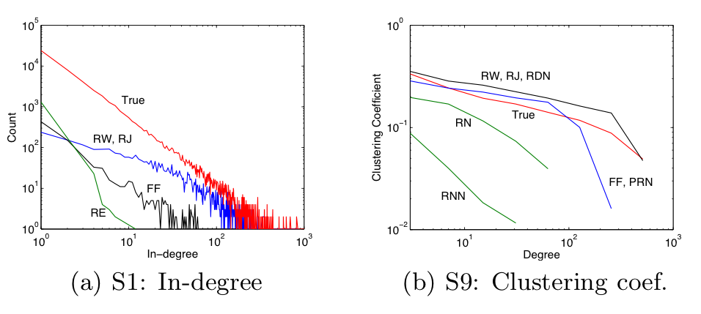
10% sample – pooled on five datasets

Slide 18
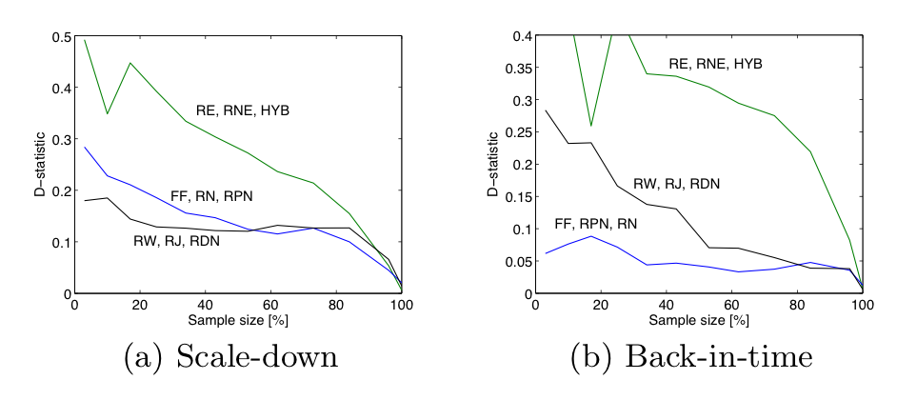
d-statistic measures agreement between distributions
D=max{|F(x)-F’(x)|} where F, F’ are cdf’s
max over nine different statistics

Slide 19
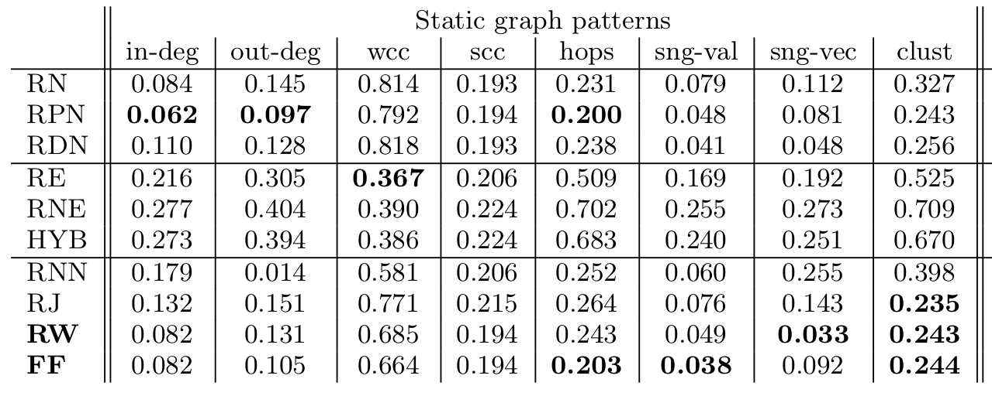

Slide 20
Goal
An efficient way of running RWR on a large graph
can use only “random access”
you can ask about the neighbors of a node, you can’t scan thru the graph
common situation with APIs
leads to a plausible sampling strategy
Jure & Christos’s experiments
some formal results that justify it….

Slide 21
FOCS 2006

Slide 22
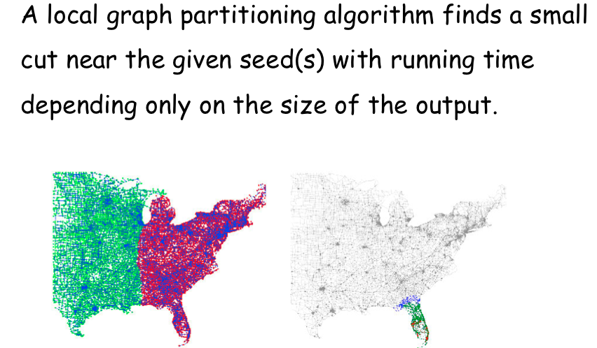
What is Local Graph Partitioning?
Global
Local

Slide 23
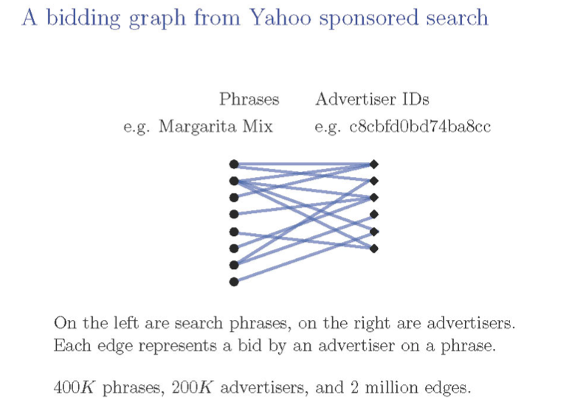
What is Local Graph Partitioning?

Slide 24
What is Local Graph Partitioning?

Slide 25
What is Local Graph Partitioning?

Slide 26
What is Local Graph Partitioning?
Global
Local

Slide 27
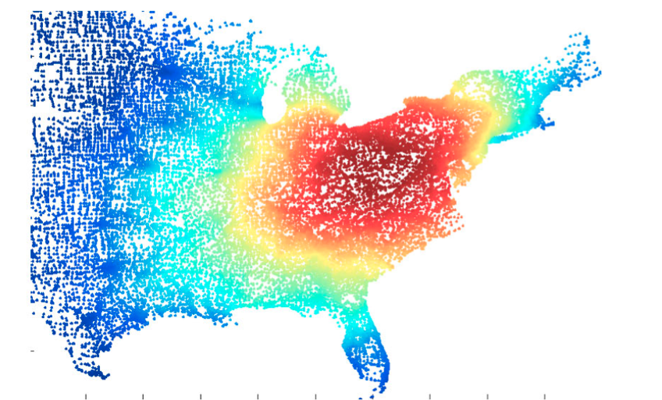
Key idea: a “sweep”
Order all vertices in some way v_{i,1}, v_{i,2}, ….
Say, by personalized PageRank from a seed
Pick a prefix v_{i,1}, v_{i,2}, …. v_{i,k} that is “best”
….

Slide 28
What is a “good” subgraph?
the edges leaving S
vol(S) is sum of deg(x) for x in S
for small S: Prob(random edge leaves S)

Slide 29
Key idea: a “sweep”
Order all vertices in some way v_{i,1}, v_{i,2}, ….
Say, by personalized PageRank from a seed
Pick a prefix S={ v_{i,1}, v_{i,2}, …. v_{i,k} } that is “best”
Minimal “conductance” ϕ(S)
You can re-compute conductance incrementally as you add a new vertex so the sweep is fast

Slide 30
Main results of the paper
An approximate personalized PageRank computation that only touches nodes “near” the seed
but has small error relative to the true PageRank vector
A proof that a sweep over the approximate PageRank vector finds a cut with conductance sqrt(α ln m)
unless no good cut exists
no subset S contains significantly more pass in the approximate PageRank than in a uniform distribution

Slide 31
Result 2 explains Jure & Christos’s experimental results with RW sampling:
RW approximately picks up a random subcommunity (maybe with some extra nodes)
Features like clustering coefficient, degree should be representative of the graph as a whole…
which is roughly a mixture of subcommunities

Slide 32
Main results of the paper
An approximate personalized PageRank computation that only touches nodes “near” the seed
but has small error relative to the true PageRank vector
This is a very useful technique to know about…

Slide 33
Random Walks
avoids messy “dead ends”….

Slide 34
Random Walks: PageRank

Slide 35
Random Walks: PageRank

Slide 36
Flashback: Zeno’s paradox
1+0.1+0.01+0.001+0.0001+… = ?
Lance Armstrong and the tortoise have a race
Lance is 10x faster
Tortoise has a 1m head start at time 0
0
1
So, when Lance gets to 1m the tortoise is at 1.1m
So, when Lance gets to 1.1m the tortoise is at 1.11m …
So, when Lance gets to 1.11m the tortoise is at 1.111m … and Lance will never catch up -?
unresolved until calculus was invented

Slide 37
Zeno: powned by telescoping sums
Let x be less than 1. Then
Example: x=0.1, and 1+0.1+0.01+0.001+…. = 1.11111 = 10/9.

Slide 38
Graph = Matrix Vector = Node → Weight
M
v
 | A | B | C | D | E | F | G | H | I | J
A | _ | 1 | 1 |  |  | 1
B | 1 | _ | 1
C | 1 | 1 | _
D |  |  |  | _ | 1 | 1
E |  |  |  | 1 | _ | 1
F | 1 |  |  | 1 | 1 | _
G |  |  |  |  |  |  | _ |  | 1 | 1
H |  |  |  |  |  |  |  | _ | 1 | 1
I |  |  |  |  |  |  | 1 | 1 | _ | 1
J |  |  |  |  |  |  | 1 | 1 | 1 | _
 | A
A | 3
B | 2
C | 3
D
E
F
G
H
I
J
C
A
B
G
I
H
J
F
D
E
M

Slide 39
Racing through a graph?
Let W[i,j] be Pr(walk to j from i)and let α be less than 1. Then:
The matrix (I- αW) is the Laplacian of αW.
Generally the Laplacian is (D- A) where D[i,i] is the degree of i in the adjacency matrix A.

Slide 40
Random Walks: PageRank

Slide 41
Approximate PageRank: Key Idea
By definition PageRank is fixed point of:
Claim:
Proof:
define a matrix for the pr operator:
R_{α}s=pr(α,s)

Slide 42
Approximate PageRank: Key Idea
By definition PageRank is fixed point of:
Claim:
Proof:

Slide 43
Approximate PageRank: Key Idea
By definition PageRank is fixed point of:
Claim:
Recursively compute PageRank of “neighbors of s” (=sW), then adjust
Key idea in apr:
do this “recursive step” repeatedly
focus on nodes where finding PageRank from neighbors will be useful

Slide 44
Approximate PageRank: Key Idea
p is current approximation (start at 0)
r is set of “recursive calls to make”
residual error
start with all mass on s
u is the node picked for the next call

Slide 45
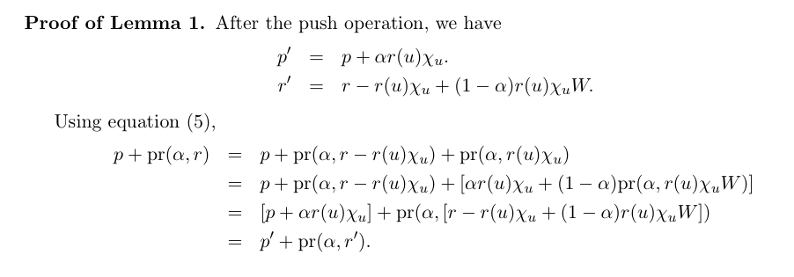
Analysis
linearity
re-group & linearity
pr(α, r - r(u)χ_{u}) +(1-α) pr(α, r(u)χ_{u}W) = pr(α, r - r(u)χ_{u} + (1-α) r(u)χ_{u}W)

Slide 46
Approximate PageRank: Algorithm

Slide 47
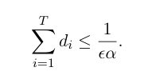
Analysis
So, at every point in the apr algorithm:
Also, at each point, |r|₁ decreases by α*ε*degree(u), so: after T push operations where degree(i-th u)=d_{i}, we know
which bounds the size of r and p

Slide 48
Analysis
With the invariant:
This bounds the error of p relative to the PageRank vector.

Slide 49
Comments – API
p,r are hash tables – they are small (1/εα)
Could implement with API:
List<Node> neighbor(Node u)
int degree(Node u)
push just needs p, r, and neighbors of u
d(v) = api.degree(v)

Slide 50
Comments - Ordering
might pick the largest r(u)/d(u) … or…

Slide 51
Comments – Ordering for Scanning
Scan repeatedly through an adjacency-list encoding of the graph
For every line you read u, v₁,…,v_{d(u)} such that r(u)/d(u) > ε:
benefit: storage is O(1/εα) for the hash tables, avoids any seeking

Slide 52
Possible optimizations?
Much faster than doing random access the first few scans, but then slower the last few
…there will be only a few ‘pushes’ per scan
Optimizations you might imagine:
Parallelize?
Hybrid seek/scan:
Index the nodes in the graph on the first scan
Start seeking when you expect too few pushes to justify a scan
Say, less than one push/megabyte of scanning
Hotspots:
Save adjacency-list representation for nodes with a large r(u)/d(u) in a separate file of “hot spots” as you scan
Then rescan that smaller list of “hot spots” until their score drops below threshold.

Slide 53
Putting this together
Given a graph
that’s too big for memory, and/or
that’s only accessible via API
…we can extract a sample in an interesting area
Run the apr/rwr from a seed node
Sweep to find a low-conductance subset
Then
compute statistics
test out some ideas
visualize it…

