Slide 1
Scheduling for Learning and Learning for Scheduling
Weina Wang
Carnegie Mellon University
BNL 2021

Slide 2
Outline
Theory for scheduling and resource orchestration
Achieving zero queueing delay for parallel jobs
Job dispatching with unknown service rates
Conclusions and future directions

Slide 3
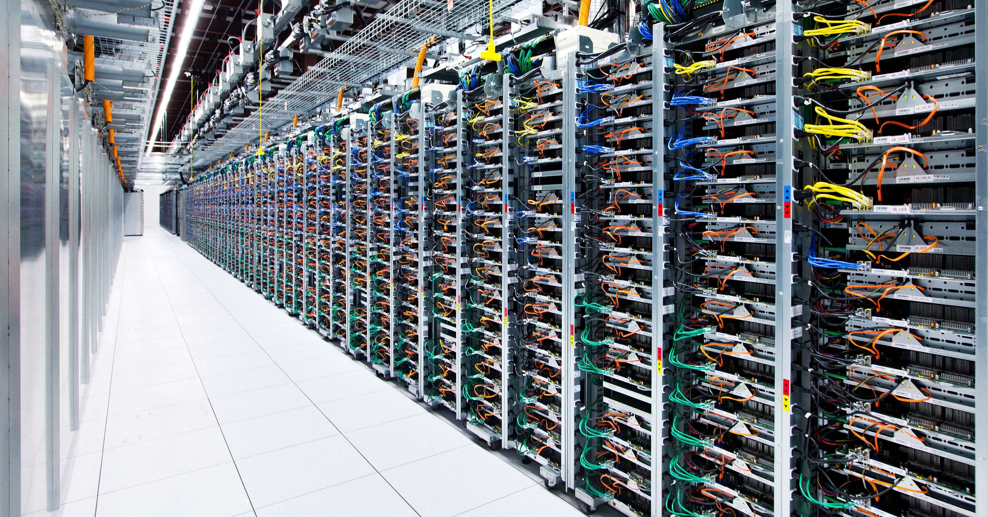
Large-scale computing clusters
Amazon EC2
iCloud

Slide 4
large number of servers
Performance
huge amount of data
(job delay)
network

Slide 5
Goal: Characterize and optimize delay through
better scheduling
Model: Stochastic dynamical system

Slide 6
How to analyze and optimize job delay?
“job ⟶ computation”
Extensively-studied:
random routing
round-robin
JSQ (join-the-shortest-queue), JSQ-d
…
?
Model:
...
...
servers
1
2
3
4
5
10⁴

Slide 7
How to analyze and optimize job delay?
“job ⟶ computation requiring data A”
A
“job ⟶ computation”
Balancing tradeoffs between queueing delay
& data transfer delay
?
Model:
...
...
servers
+
data
1
2
3
4
5
10⁴
A
C
A
B
A
B
B
C
processing is faster
processing is slower

Slide 8
How to analyze and optimize job delay?
A
“job ⟶ computation requiring data A”
A
Jointly assigning jobs and allocating bandwidth
?
Model:
...
...
servers
+
data
+
network
1
2
3
4
5
10⁴
A
C
A
B
A
B
B
C

Slide 9
Challenges and opportunities
Large scale
Parallelism in workload
Heterogeneity and uncertainty

Slide 10
Outline
Theory for scheduling and resource orchestration
Achieving zero queueing delay for parallel jobs
Wentao Weng and Weina Wang, ACM SIGMETRICS 2021
Job dispatching with unknown service rates
Conclusions and future directions

Slide 11
Load balancing
JSQ (Join-the-shortest-queue) is delay optimal
[Winston 1977, Weber 1978, …]
job
?
...
...
servers
1
2
3
4
5
10⁴

Slide 12
Zero queueing delay
queueing delay
= overall delay – time in service
load: $λ=1−N^{−α}, 0<α<0.5$
$$𝔼\left[queueing delay\right] \underset{→}{ N→∞ } 0$$
job
?
...
...
servers
1
2
3
4
5
N

Slide 13
Sampling overhead
JSQ: N samples per job
Power-of-d-choices:
d samples per job
[Vvedenskaya et al. 1996, Mitzenmacher 1996, etc.]
load: $λ=1−N^{−α}, 0<α<0.5$
job
?
What is the minimum d for achieving zero queueing delay?
Zero queueing delay when $d≥\frac{4\log{N}}{1−λ}$
Non-zero queueing delay when $d=O\left(\frac{1}{1−λ}\right)$
...
...
servers
1
2
3
4
5
N
[Mukherjee et al. 2018, Liu and Ying 2018, 2018’, 2019, etc ]

Slide 14
Jobs with parallel components
Job
A
B
C
“job with 3 tasks”
Tasks A, B, C: each runs 3000 simulations independently
e.g., Monte Carlo simulations for reinforcement learning, mini-batch gradient descent, …

Slide 15
Load balancing for parallel jobs
Job delay: job not done until all its tasks are done
“job with 3 tasks”
k
?
sample kd queues
What is the minimum d for achieving zero queueing delay?
...
...
1
2
3
4
5
N

Slide 16
Zero queueing delay for parallel jobs
Minimum overall delay of a job: all tasks enter service immediately
T* = max of k independent task service times
Zero queueing delay:
$$\frac{𝔼\left[delay\right]−𝔼\left[T^{∗}\right]}{𝔼\left[T^{∗}\right]}→0 as N→∞$$
...
...
1
2
3
4
5
N

Slide 17
Batch-filling
[Ying, Srikant, Kang 2015]
Example: d = 2
“job with 3 tasks”
sample 3 x d = 6 queues
...
...
1
2
3
4
5
N

Slide 18
Load balancing for parallel jobs
Job delay: job not done until all its tasks are done
“job with 3 tasks”
k
?
sample kd queues
What is the minimum d for achieving zero queueing delay?
Easier or harder compared to non-parallel jobs?
...
...
1
2
3
4
5
N

Slide 19
Results
Zero queueing delay can be achieved when
$$d=ω\left(\frac{1}{\left(1−λ\right)\log{k}}\right)$$
Non-zero queueing delay happens when
$$d=e^{o\left({\log{\frac{1}{1−λ}}}/{\log{k}}\right)}$$
Non-parallel case lower bound: non-zero queueing when
$$d=O\left(\frac{1}{1−λ}\right)$$
load: $λ=1−N^{−α}, 0<α<0.5$
job has k tasks
...
...
N
1
2
3
4
5

Slide 20
Take-away message
Utilizing the parallel structure reduces the sampling overhead needed for achieving zero queueing delay
Parallel:
Zero queueing is possible when $d=ω\left(\frac{1}{\left(1−λ\right)\log{k}}\right)$
Non-parallel:
Zero queueing is possible when $d=ω\left(\frac{1}{1−λ}\right)$
“job with k tasks”
?
...
...
...
...

Slide 21
Outline
Theory for scheduling and resource orchestration
Achieving zero queueing delay for parallel jobs
Job dispatching with unknown service rates
Tuhinangshu Choudhury, Gauri Joshi, Weina Wang and Sanjay Shakkottai, ACM MobiHoc 2021
Conclusions and future directions

Slide 22
Load balancing
How to minimize delay when service rates are heterogeneous?
job
?
...
...
servers
1
2
3
4
5
N
service rate
$$μ$$
$$μ_{1}$$
$$μ$$
$$μ_{2}$$
$$μ$$
$$μ_{3}$$
$$μ$$
$$μ_{4}$$
$$μ$$
$$μ_{5}$$
$$μ$$
$$>$$
$$>$$
$$>$$
$$>$$
$$>$$
$$>$$
$$μ_{N}$$

Slide 23
Optimal Weighted Random Routing
arrival rate $λ$
job
$p_{i}^{∗}= \frac{μ_{i}}{λ} −\frac{\sqrt{μ_{i}\left(1−μ_{i}\right)}}{\sum_{j=1}^{3}{\sqrt{μ_{j}\left(1−μ_{j}\right)}}}\left(\frac{\sum_{i=1}^{3}{μ_{i}}}{λ}−1\right)$, for $i=1, 2, 3$
$$p_{4}^{∗}=0$$
$$p_{1}$$
$$p_{2}$$
$$p_{3}$$
$$p_{4}$$
What if the service rates are unknown?
servers
1
2
3
4
$$μ_{1}$$
$$>$$
$$μ_{2}$$
$$>$$
$$μ_{3}$$
$$>$$
$$μ_{4}$$

Slide 24
Sampling service times
Can we learn the service rates to mimic the Optimal Weighted Random Routing (OWRR)?
arrival rate $λ$
job
Regret
$$Ψ\left(t\right)=\sum_{i=1}^{N}{𝔼\left[Q_{i}\left(t\right)−Q_{i}^{∗}\left(t\right)\right]}$$
$Q_{i}\left(t\right)$: queue length at server $i$ under policy
$Q_{i}^{∗}\left(t\right)$: queue length at server $i$ under OWRR
servers
1
2
3
4
⏱
service time ~ Exp($μ_{4}$)
$$μ_{1}$$
$$>$$
$$μ_{2}$$
$$>$$
$$μ_{3}$$
$$>$$
$$μ_{4}$$

Slide 25
$ε_{t}$-Exploration algorithm
job
Regret
$$Ψ\left(t\right)≤O\left(\frac{\ln{t}\sqrt{\ln{t}}}{\sqrt{t}}\right)+O\left(\frac{poly(ln{t)}}{t}\right)$$
w.p. $ε_{t}=min\left\{1,\frac{N\ln{t}}{t}\right\}$
w.p. ${1−ε}_{t}$
exploration
exploitation
route to a server randomly
route to server $i$ w.p. ${\hat{p}}_{i}\left(t\right)$
exploitation error
exploration error
update ${\hat{μ}}_{i}(t)$
servers
1
2
3
4
$$μ_{1}$$
$$>$$
$$μ_{2}$$
$$>$$
$$μ_{3}$$
$$>$$
$$μ_{4}$$

Slide 26
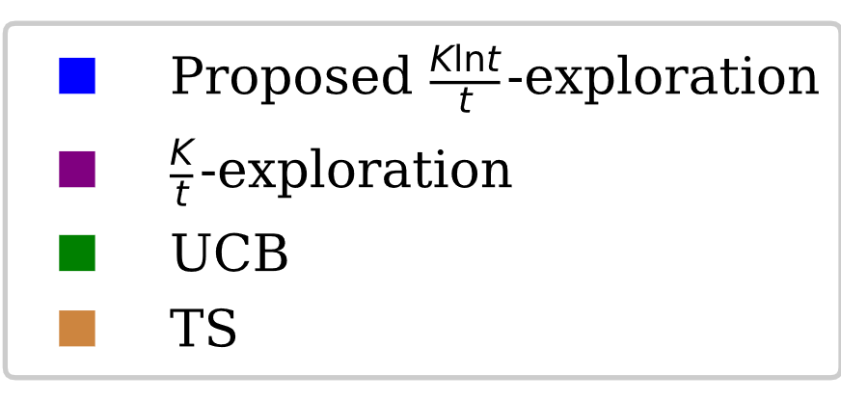
Simulations
6 servers, $μ_{i}=2μ_{i+1}$
Cumulative total queue length regret
$$λ=0.2$$
$$λ=0.4$$
$$λ=0.7$$

Slide 27
Outline
Theory for scheduling and resource orchestration
Achieving zero queueing delay for parallel jobs
Job dispatching with unknown service rates
Conclusions and future directions

Slide 28
Conclusions
A lot more research needs to be done to understand job delay for modern workloads such as machine learning related jobs
Learning-based scheduling can combat heterogeneity and uncertainty in the computing environment

Slide 29
Future direction
Scheduling machine learning jobs
More general job structure
Training-loss guided scheduling
...
...

Slide 30
Future direction
Learning the environment for scheduling
...
...

Slide 31
Future direction
Scheduling for the edge
Cloud
📱
📱
📱
📱
📱
📱
📱

Slide 32
THANK YOU! weinaw@cs.cmu.edu

