Slide 1
Traffic Cozmo
Xinze Deng
Bolaji Bankole
Cognitive Robotics S2019

Slide 2
Problem Statement

Slide 3
How do we make Cozmo follow any race track pattern and recognize when to start, stop, slow down, based on external signals such as traffic lights?

Slide 4
Approach: Line Following

Slide 5
Approach: Line Following
4 sets of training data
800+ images total
4 output nodes from 3 layer neural network
Forward, left, right, lost
Recovery from lost position
Back up until familiar image comes to sight
CrossEntropyLoss() function

Slide 6
Approach: Light Detection
openCV: filter for red clusters of pixels
Based on threshold value
Look at top 50% of image
Cozmo at set head angle

Slide 7
Demo Videos

Slide 8
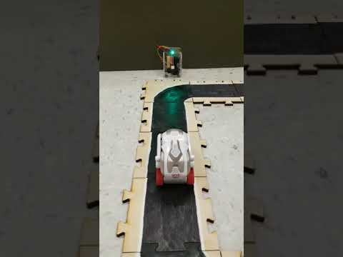

Slide 9
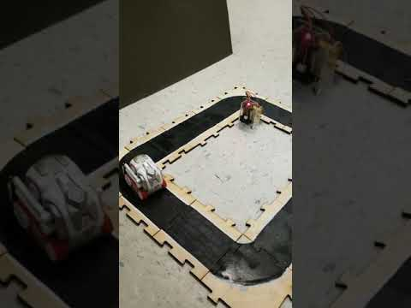

Slide 10
Results

Slide 11
Results & Observations
Line following works 70% of the time
Gets distracted by other objects
Trained on many different tracks, adjust model to avoid “jack of all trades, master of none” situation
Light Detection
Lagging behind due to wireless
Need more image filtering
Can use ML training for Light detection as well

Slide 12
Future Work
Custom tracks with different bend radius
More than one cozmo on the course at a time
Faster image processing
Decision making based on previous actions

