Slide 1

14-513
18-613

Slide 2
The Memory Hierarchy
15-213/14-513/15-513: Introduction to Computer Systems
9th Lecture, Sept 24, 2024

Slide 3
Announcements
Tomorrow:
  Written Assignment 2 peer review due
  Written Assignment 3 due
  Written Assignment 4 goes out
Thursday:
  Lab 3 (attack lab) due
  Lab 4 (cache lab) goes out
Friday:
  Recitation: Caches and C Review
Sunday:
  Bootcamp: C Programming

Slide 4
Processors need Data
Most computations need complex input, have side effects, etc
  This data is stored in “memory”
But what is “memory”?

Slide 5
Writing & Reading Memory
Write
  Transfer data from CPU to memory
  movq %rax, 8(%rsp)
  “Store” operation
Read
  Transfer data from memory to CPU
  movq 8(%rsp), %rax
  “Load” operation

Slide 6


Slide 7
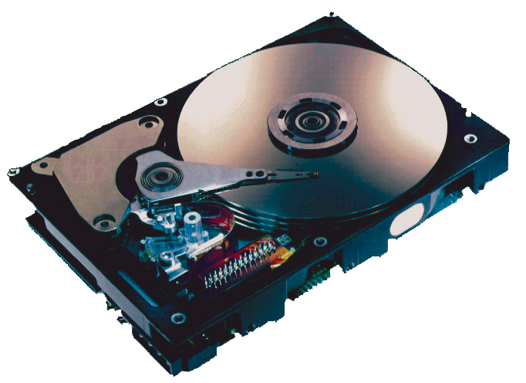
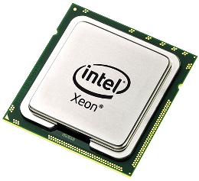

Slide 8
The CPU-Memory Gap
The gap widens between DRAM, disk, and CPU speeds.
Disk
SSD
DRAM
CPU

Slide 9
“Memory Wall” or Von Neumann bottleneck
The performance gap between computation and data storage
Three approaches:
  Build a hierarchy (covered in 213)
  Find other stuff to do (346, 418)
  Move computation (346, 7xx?)

Slide 10
Today
The memory abstraction CSAPP 6.1.1
RAM : main memory building block CSAPP 6.1.1
Locality of reference CSAPP 6.2
The memory hierarchy CSAPP 6.3
The memory mountain CSAPP 6.6.1
Storage technologies and trends CSAPP 6.1.2-6.1.4

Slide 11
Modern Connection between CPU and Memory
A bus is a collection of parallel wires that carry address, data, and control signals.
Buses are typically shared by multiple devices.
CPU chip
Register file
ALU
Memory bus
Main
memory
Memory Controller

Slide 12
Memory Read Transaction (1)
CPU places address A on the memory bus.
Register file
Load operation: movq A, %rax
%rax
ALU
Main memory
A
0
Memory Controller
x
A

Slide 13
Memory Read Transaction (2)
Main memory reads A from the memory bus, retrieves word x, and places it on the bus.
Register file
Load operation: movq A, %rax
%rax
ALU
Main memory
x
0
Memory Controller
x
A

Slide 14
Memory Read Transaction (3)
CPU reads word x from the bus and copies it into register %rax.
Register file
Load operation: movq A, %rax
%rax
ALU
x
Main memory
0
Memory Controller
x
A

Slide 15
Memory Write Transaction (1)
CPU places address A on bus. Main memory reads it and waits for the corresponding data word to arrive.
Register file
Store operation: movq %rax, A
%rax
ALU
y
Main memory
0
A
Memory Controller
A

Slide 16
Memory Write Transaction (2)
CPU places data word y on the bus.
Register file
Store operation: movq %rax, A
%rax
ALU
y
Main memory
y
0
Memory Controller
A

Slide 17
Memory Write Transaction (3)
Main memory reads data word y from the bus and stores it at address A.
Register file
Store operation: movq %rax, A
%rax
ALU
y
Main memory
0
Memory Controller
y
A

Slide 18
Today
The memory abstraction
RAM : main memory building block
Locality of reference
The memory hierarchy
The memory mountain
Storage technologies and trends

Slide 19
Random-Access Memory (RAM)
Key features
  RAM is traditionally packaged as a chip.
    or embedded as part of processor chip
  Basic storage unit is normally a cell (one bit per cell).
  Multiple RAM chips form a memory.
RAM comes in two varieties:
  SRAM (Static RAM)
  DRAM (Dynamic RAM)

Slide 20
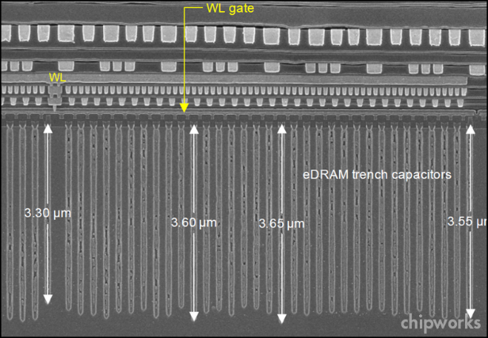
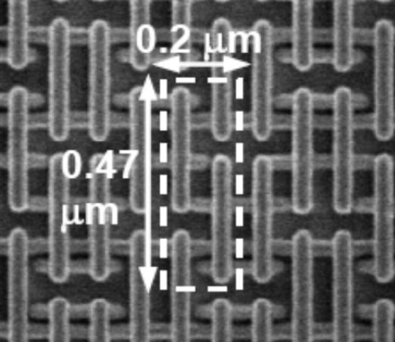
RAM Technologies
DRAM
1 Transistor + 1 capacitor / bit
  Capacitor oriented vertically
Must refresh state periodically
SRAM
6 transistors / bit
Holds state indefinitely (but will still lose data on power loss)

Slide 21
SRAM vs DRAM Summary
Trans. Access Needs Needs
per bit time refresh? EDC? Cost Applications
SRAM 6 or 8 1x No Maybe 100x Cache memories
DRAM 1 10x Yes Yes 1x Main memories,
frame buffers
EDC: Error detection and correction
Trends
  SRAM scales with semiconductor technology
    Reaching its limits
  DRAM scaling limited by need for minimum capacitance
    Aspect ratio limits how deep can make capacitor
    Also reaching its limits

Slide 22
Enhanced DRAMs (Hidden Slide, Extra Detail for Modern Systems)
Operation of DRAM cell has not changed since its invention
  Commercialized by Intel in 1970.
DRAM cores with better interface logic and faster I/O :
  Synchronous DRAM (SDRAM)
    Uses a conventional clock signal instead of asynchronous control
  Double data-rate synchronous DRAM (DDR SDRAM)
    Double edge clocking sends two bits per cycle per pin
    Different types distinguished by size of small prefetch buffer:
      DDR (2 bits), DDR2 (4 bits), DDR3 (8 bits), DDR4 (16 bits)
    By 2010, standard for most server and desktop systems
    Intel Core i7 supports DDR3 and DDR4 SDRAM

Slide 23
Today
The memory Abstraction
DRAM : main memory building block
Locality of reference
The memory hierarchy
The memory mountain
Storage technologies and trends

Slide 24
The CPU-Memory Gap
The gap widens between DRAM, disk, and CPU speeds.
Disk
SSD
DRAM
CPU
Notes:
Effective CPU cycle time = CPU cycle time / number of cores

Slide 25
Locality to the Rescue!
The key to bridging this CPU-Memory gap is an important property of computer programs known as locality.

Slide 26
Locality
Principle of Locality: Many Programs tend to use data and instructions with addresses near or equal to those they have used recently.
Temporal locality:
  Recently referenced items are likely
  to be referenced again in the near future
Spatial locality:
  Items with nearby addresses tend
  to be referenced close together in time

Slide 27
Locality Example
sum = 0;
for (i = 0; i < n; i++)
sum += a[i];
return sum;
Spatial or Temporal
Locality?
Data references
  Reference array elements in succession (stride-1 reference pattern).
  Reference variable sum each iteration.
Instruction references
  Reference instructions in sequence.
  Cycle through loop repeatedly.
spatial
temporal
spatial
temporal

Slide 28
Qualitative Estimates of Locality
Claim: Being able to look at code and get a qualitative sense of its locality is a key skill for a professional programmer.
Question: Does this function have good locality with respect to array a?
int sum_array_rows(int a[M][N])
{
int i, j, sum = 0;
for (i = 0; i < M; i++)
for (j = 0; j < N; j++)
sum += a[i][j];
return sum;
}
Hint: array layout
is row-major order
Answer: yes
a
[0]
[0]
a
[0]
[N-1]
a
[1]
[0]
a
[1]
[N-1]
a
[M-1]
[0]
a
[M-1]
[N-1]
• • •
• • •
• • •
• • •

Slide 29
Locality Example
Question: Does this function have good locality with respect to array a?
int sum_array_cols(int a[M][N])
{
int i, j, sum = 0;
for (j = 0; j < N; j++)
for (i = 0; i < M; i++)
sum += a[i][j];
return sum;
}
Answer: no
Stride N reference
pattern
Note: If M is very small
then good locality. Why?
• • •
a
[0]
[0]
a
[0]
[N-1]
• • •
a
[1]
[0]
a
[1]
[N-1]
• • •
• • •
a
[M-1]
[0]
a
[M-1]
[N-1]
Notes:
Access to a[0][0] fetches cache line with a[0][1], a[0][2], etc. With small M, this cache line will still be in cache when later access these items.

Slide 30
Locality Example
Question: Can you permute the loops so that the function scans the 3-d array a with a stride-1 reference pattern (and thus has good spatial locality)?
int sum_array_3d(int a[M][N][N])
{
int i, j, k, sum = 0;
for (i = 0; i < N; i++)
for (j = 0; j < N; j++)
for (k = 0; k < M; k++)
sum += a[k][i][j];
return sum;
}
Answer: make j the inner loop

Slide 31
Today
The memory abstraction
DRAM : main memory building block
Locality of reference
The memory hierarchy
The memory mountain
Storage technologies and trends

Slide 32
Memory Hierarchies
Some fundamental and enduring properties of hardware and software:
  Fast storage technologies cost more per byte, have less capacity, and require more power (heat!).
  The gap between CPU and main memory speed is widening.
  Well-written programs tend to exhibit good locality.
These properties complement each other well for many types of programs.
They suggest an approach for organizing memory and storage systems known as a memory hierarchy.

Slide 33
Memory size affects latency & energy
CPU
CPU
Small Memory
Big Memory
Signals have further to travel
Fan out to more locations

Slide 34
Example Memory
Hierarchy
L0:
Regs
CPU registers hold words retrieved from the L1 cache.
Smaller,
faster,
and
costlier
(per byte)
storage
devices
L1:
L1 cache
(SRAM)
L1 cache holds cache lines retrieved from the L2 cache.
L2:
L2 cache
(SRAM)
L2 cache holds cache lines
retrieved from L3 cache.
L3:
L3 cache
(SRAM)
L3 cache holds cache lines
retrieved from main memory.
Larger,
slower,
and
cheaper
(per byte)
storage
devices
L4:
Main memory
(DRAM)
Main memory holds disk blocks retrieved from local disks.
L5:
Local secondary storage
(local disks)
Local disks hold files retrieved from disks
on remote servers.
L6:
Remote secondary storage
(e.g., Web servers)
Notes:
Note: Text in red describes an inclusive memory hierarchy. Latest Intel CPUs have exclusive L2s, i.e. any data item in L2 is NOT in L3.

Slide 35
Hierarchy provides the illusion of large & fast memory
CPU
Memory
Hierarchy
Small Memory
Big Memory
(rarely accessed)

Slide 36
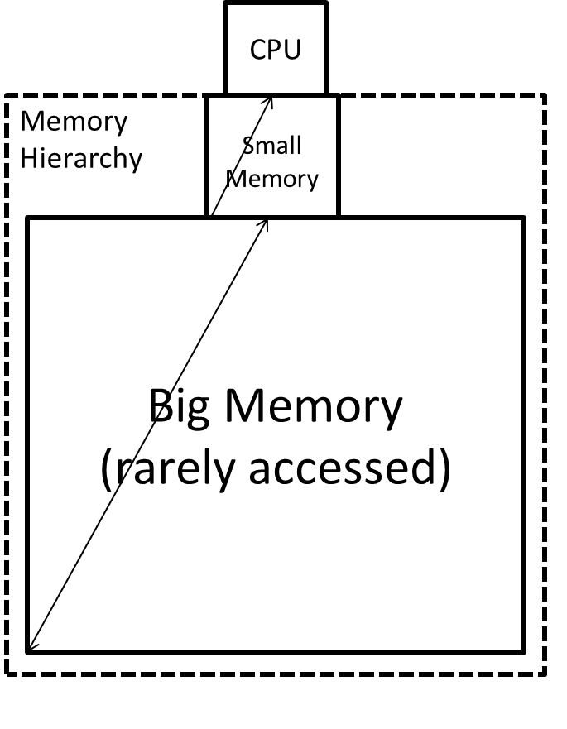
Caches
Cache: A smaller, faster storage device that acts as a staging area for a subset of the data in a larger, slower device.
Fundamental idea of a memory hierarchy:
  For each k, the faster, smaller device at level k serves as a cache for the larger, slower device at level k+1.
Why do memory hierarchies work?
  Because of locality: programs tend to access the data at level k more often than they access the data at level k+1.
  Thus, the storage at level k+1 can be slower, and thus larger and cheaper per bit.
Big Idea (Ideal): The memory hierarchy creates a large
pool of storage that costs as much as the cheap storage
near the bottom, but that serves data to programs at
the rate of the fast storage near the top.

Slide 37
Cache vs Memory
Caches are invisible (transparent) to software
  Managed by hardware in response to loads & stores
  Performance & energy improve without software changes
  Caveat: Recent CPUs have some instructions to manage cache (e.g., prefetch, invalidate, partition…)
Memory is visible to software
  I.e., addressable directly by instructions (memory address, registers)
  Some optimization opportunities, but only w/ software changes

Slide 38
General Cache Concepts
Smaller, faster, more expensive
memory caches a subset of
the blocks
Cache
8
4
9
14
10
3
Data is copied in block-sized transfer units
4
10
Larger, slower, cheaper memory
viewed as partitioned into “blocks”
Memory
0
1
2
3
4
4
5
6
7
8
9
10
10
11
12
13
14
15

Slide 39
General Cache Concepts: Hit
Request: 14
Data in block b is needed
Cache
Block b is in cache:
Hit!
8
9
14
3
14
Memory
0
1
2
3
4
5
6
7
8
9
10
11
12
13
14
15

Slide 40
General Cache Concepts: Miss
Request: 12
Data in block b is needed
Cache
Block b is not in cache:
Miss!
8
9
14
3
12
Block b is fetched from
memory
12
Request: 12
Block b is stored in cache
Placement policy:
determines where b goes
Replacement policy:
determines which block
gets evicted (victim)
Memory
0
1
2
3
4
5
6
7
8
9
10
11
12
12
13
14
15

Slide 41
General Caching Concepts:
3 Types of Cache Misses
Cold (compulsory) miss
  Cold misses occur because this is the first reference to the block.
Capacity miss
  Occurs when the set of active cache blocks (working set) is larger than the cache.
Conflict miss
  Most caches limit blocks at level k+1 to a small subset (sometimes a singleton) of the block positions at level k.
    E.g. Block i at level k+1 must be placed in block (i mod 4) at level k.
  Conflict misses occur when the level k cache is large enough, but multiple data objects all map to the same level k block.
    E.g. Referencing blocks 0, 8, 0, 8, 0, 8, ... would miss every time.

Slide 42
General Caching Concepts:
3 Types of Cache Misses
Cold (compulsory) miss
  Misses with an infinitely large cache with no placement restrictions.
Capacity miss
  Additional misses from finite-sized cache (and still no placement restrictions).
Conflict miss
  Additional misses due to actual placement policy.

Slide 43
Examples of Caching in the Mem. Hierarchy
Where is it Cached?
Cache Type
What is Cached?
Latency (cycles)
Managed By
Registers
4-8 byte words
CPU core
0
Compiler
TLB
Address translations
On-Chip TLB
0
Hardware MMU
L1 cache
64-byte blocks
On-Chip L1
4
Hardware
L2 cache
64-byte blocks
On-Chip L2
10
Hardware
Virtual Memory
4-KB pages
Main memory
100
Hardware + OS
Buffer cache
Parts of files
Main memory
100
OS
Disk cache
Disk sectors
Disk controller
100,000
Disk firmware
Network buffer cache
Parts of files
Local disk
10,000,000
NFS client
Browser cache
Web pages
Local disk
10,000,000
Web browser
Web cache
Web pages
Remote server disks
1,000,000,000
Web proxy server

Slide 44
Quiz Time!
Canvas Quiz: Day 9 – Memory Hierarchy

Slide 45
Working Set, Locality, and Caches
Working Set: The set of data a program is currently “working on”
  Definition of “currently” depends on context, e.g., in this loop
  Includes accesses to data and instructions
Principle of Locality: Programs tend to use data and instructions with addresses near or equal to those they have used recently
  Nearby addresses: Spatial Locality
  Equal addresses: Temporal locality
Caches take advantage of temporal locality by storing recently used data, and spatial locality by copying data in block-sized transfer units
  Locality reduces working set sizes
  Caches are most effective when the working set fits in the cache

Slide 46
Today
The memory abstraction
RAM : main memory building block
Locality of reference
The memory hierarchy
The memory mountain
Storage technologies and trends

Slide 47
Intel Core i7 Cache Hierarchy
Processor package
Core 0
Core 3
L1 i-cache and d-cache:
  32 KB, 8-way,
  Access: 4 cycles
L2 unified cache:
  256 KB, 8-way,
  Access: 10 cycles
L3 unified cache:
  8 MB, 16-way,
  Access: 40-75 cycles
Block size: 64 bytes for all caches.
Regs
Regs
L1
d-cache
L1
i-cache
L1
d-cache
L1
i-cache
…
L2 unified cache
L2 unified cache
L3 unified cache
(shared by all cores)
Main memory

Slide 48
The Memory Mountain
Read throughput (read bandwidth)
  Number of bytes read from memory per second (MB/s)
Memory mountain: Measured read throughput as a function of spatial and temporal locality.
  Compact way to characterize memory system performance.

Slide 49
Memory Mountain Test Function
long data[MAXELEMS]; /* Global array to traverse */
/* test - Iterate over first "elems" elements of
* array "data" with stride of "stride“,
* using 4x4 loop unrolling.
*/
int test(int elems, int stride) {
long i, sx2=stride*2, sx3=stride*3, sx4=stride*4;
long acc0 = 0, acc1 = 0, acc2 = 0, acc3 = 0;
long length = elems, limit = length - sx4;
/* Combine 4 elements at a time */
for (i = 0; i < limit; i += sx4) {
acc0 = acc0 + data[i];
acc1 = acc1 + data[i+stride];
acc2 = acc2 + data[i+sx2];
acc3 = acc3 + data[i+sx3];
}
/* Finish any remaining elements */
for (; i < length; i++) {
acc0 = acc0 + data[i];
}
return ((acc0 + acc1) + (acc2 + acc3));
}
Call test() with many combinations of elems
and stride.
For each elems and stride:
1. Call test() once to warm up the caches.
2. Call test() again and measure the read throughput(MB/s)
mountain/mountain.c

Slide 50
The Memory Mountain
Core i7 Haswell
2.1 GHz
32 KB L1 d-cache
256 KB L2 cache
8 MB L3 cache
64 B block size
Aggressive prefetching
L1
Ridges
of temporal locality
L2
L3
Slopes
of spatial locality
Mem
Notes:
Slopes of spatial locality – increase stride, degrade throughput because burn through blocks faster
Ridges of temporal – if after warm up, whole dataset in cache, every thing’s a hit.
Prefetching – do better than we expect.

Slide 51
Today
The memory abstraction
RAM : main memory building block
Locality of reference
The memory hierarchy
The memory mountain
Storage technologies and trends

Slide 52
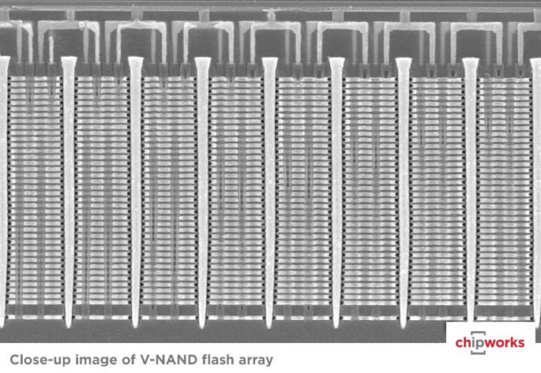
Storage Technologies
Magnetic Disks
Store on magnetic medium
Electromechanical access
Nonvolatile (Flash) Memory
Store as persistent charge
Implemented with 3-D structure
  100+ levels of cells
  3-4 bits data per cell

Slide 53
What’s Inside A Disk Drive?
Spindle
Arm
Platters
Actuator
Electronics
(including a
processor
and memory!)
SCSI
connector
Image courtesy of Seagate Technology

Slide 54
Disk Geometry
Disks consist of platters, each with two surfaces.
Each surface consists of concentric rings called tracks.
Each track consists of sectors separated by gaps.
Tracks
Surface
Track k
Gaps
Spindle
Sectors

Slide 55
Disk Access – Service Time Components
After BLUE read
Seek for RED
Rotational latency
After RED read
Data transfer
Seek
Rotational
latency
Data transfer
Note: Disk access time dominated by seek time and rotational latency.
Orders of magnitude slower than DRAM!
Notes:
Goal:
Show the inefficeincy of current disk requests.
Conveyed Ideas:
Rotational latency is wasted time that can be used to service tasks
Background Information:
None.
Slide Background:
None.
Kill text and arrows

Slide 56
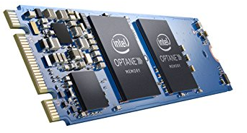
Nonvolatile Memories
DRAM and SRAM are volatile memories
  Lose information if powered off.
Nonvolatile memories retain value even if powered off
  Read-only memory (ROM): programmed during production
  Electrically eraseable PROM (EEPROM): electronic erase capability
  Flash memory: EEPROMs, with partial (block-level) erase capability
    Wears out after about 100,000 erasings
  3D XPoint (Intel Optane) & emerging NVMs
    New materials
Uses for Nonvolatile Memories
  Firmware programs stored in a ROM (BIOS, controllers for disks, network cards, graphics accelerators, security subsystems,…)
  Solid state disks (replacing rotating disks)
  Disk caches

Slide 57
Solid State Disks (SSDs)
I/O bus
Requests to read and
write logical disk blocks
Solid State Disk (SSD)
Flash
translation layer
DRAM
Buffer
Flash memory
Block 0
Block B-1
…
…
…
Page 0
Page 1
Page P-1
Page 0
Page 1
Page P-1
Pages: 512KB to 4KB, Blocks: 32 to 128 pages
Data read/written in units of pages.
Page can be written only after its block has been erased.
A block wears out after about 10,000 repeated writes.

Slide 58
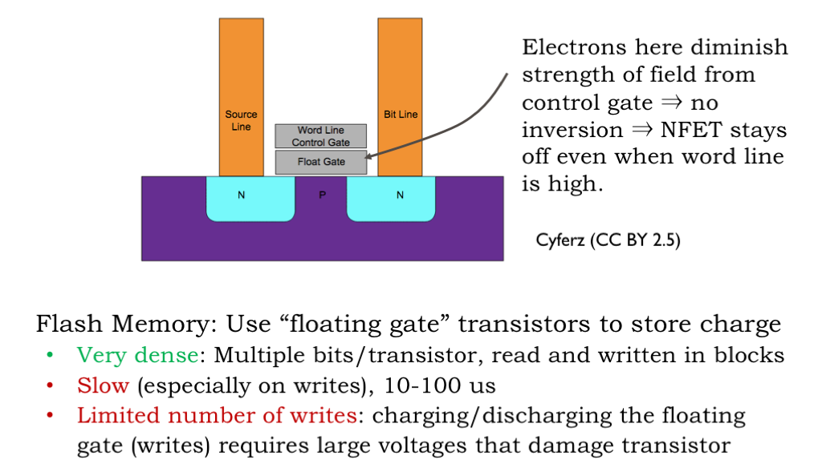
Non-Volatile Storage: Flash

Slide 59
SSD Performance Characteristics
Benchmark of Samsung 970 EVO Plus
Sequential access faster than random access
  Common theme in the memory hierarchy
  DQ = deep queue, issuing many concurrent reads (latency hurts!)
Random writes are tricky
  Erasing a block takes a long time (~1 ms), but the SSD has a pool of pre-erased blocks
  Modifying a block page requires all other pages to be copied to new block.
  But the SSD has a write cache that it accumulates writes into…
https://ssd.userbenchmark.com/SpeedTest/711305/Samsung-SSD-970-EVO-Plus-250GB
Sequential read throughput 2,221 MB/s Sequential write tput 1,912 MB/s
Random ST throughput 61.7 MB/s Random write tput 165 MB/s
Random DQ throughput 947 MB/s Random DQ write 1028 MB/s

Slide 60
SSD Tradeoffs vs Rotating Disks
Advantages
  No moving parts → faster, less power, more rugged
Disadvantages
  Have the potential to wear out
    Mitigated by “wear leveling logic” in flash translation layer
    E.g. Samsung 940 EVO Plus guarantees 600 writes/byte of writes before they wear out
    Controller migrates data to minimize wear level
  In 2023, about 1.67 times more expensive per byte (1 TB drive)
Where are rotating disks still used?
  Bulk storage – video, huge datasets / databases, etc.
  Cheap storage – desktops

Slide 61
Summary
The speed gap between CPU, memory and mass storage continues to widen.
Well-written programs exhibit a property called locality.
Memory hierarchies based on caching close the gap by exploiting locality.
Flash memory progress outpacing all other memory and storage technologies (DRAM, SRAM, magnetic disk)
  Able to stack cells in three dimensions

Slide 62
Supplemental slides

Slide 63
The Memory Mountain
Core i5 Haswell
3.1 GHz
32 KB L1 d-cache
256 KB L2 cache
8 MB L3 cache
64 B block size
Aggressive prefetching
L1
Ridges
of temporal locality
L2
L3
Slopes
of spatial locality
Mem

Slide 64
Cache Capacity Effects from Memory Mountain
Core i7 Haswell
3.1 GHz
32 KB L1 d-cache
256 KB L2 cache
8 MB L3 cache
64 B block size
Main Memory
L3
L2
L1
Slice through memory mountain with stride=8

Slide 65
Cache Block Size Effects from Memory Mountain
Core i7 Haswell
2.26 GHz
32 KB L1 d-cache
256 KB L2 cache
8 MB L3 cache
64 B block size
Miss rate = s/8
Miss rate = 1.0
Stride s

Slide 66
Modeling Block Size Effects from Memory Mountain
Core i7 Haswell
2.26 GHz
32 KB L1 d-cache
256 KB L2 cache
8 MB L3 cache
64 B block size
Stride s

Slide 67
2008 Memory Mountain
Core 2 Duo
2.4 GHz
32 KB L1 d-cache
6MB L2 cache
64 B block size
No prefetching

Slide 68
Storage Trends
SRAM
Metric 1985 1990 1995 2000 2005 2010 2015 2015:1985
$/MB 2,900 320 256 100 75 60 320 116
access (ns) 150 35 15 3 2 1.5 200 115
DRAM
Metric 1985 1990 1995 2000 2005 2010 2015 2015:1985
$/MB 880 100 30 1 0.1 0.06 0.02 44,000
access (ns) 200 100 70 60 50 40 20 10
typical size (MB) 0.256 4 16 64 2,000 8,000 16.000 62,500
Disk
Metric 1985 1990 1995 2000 2005 2010 2015 2015:1985
$/GB 100,000 8,000 300 10 5 0.3 0.03 3,333,333
access (ms) 75 28 10 8 5 3 3 25
typical size (GB) 0.01 0.16 1 20 160 1,500 3,000 300,000

Slide 69
CPU Clock Rates
Inflection point in computer history
when designers hit the “Power Wall”
1985 1990 1995 2003 2005 2010 2015 2015:1985
CPU 80286 80386 Pentium P-4 Core 2 Core i7(n) Core i7(h)
Clock
rate (MHz) 6 20 150 3,300 2,000 2,500 3,000 500
Cycle
time (ns) 166 50 6 0.30 0.50 0.4 0.33 500
Cores 1 1 1 1 2 4 4 4
Effective
cycle 166 50 6 0.30 0.25 0.10 0.08 2,075
time (ns)
(n) Nehalem processor
(h) Haswell processor

Slide 70
Conventional DRAM Organization
d x w DRAM:
  d⋅ w total bits organized as d supercells of size w bits
16 x 8 DRAM chip
cols
0
1
2
3
2 bits
/
0
addr
1
rows
Memory
controller
2
supercell
(2,1)
(to/from cores)
3
8 bits
/
data
Internal row buffer

Slide 71
Reading DRAM Supercell (2,1)
Step 1(a): Row access strobe (RAS) selects row 2.
Step 1(b): Row 2 copied from DRAM array to row buffer.
16 x 8 DRAM chip
Cols
RAS = 2
0
1
2
3
2
/
0
addr
1
Memory
controller
Rows
2
8
/
3
data
Internal row buffer

Slide 72
Reading DRAM Supercell (2,1)
Step 2(a): Column access strobe (CAS) selects column 1.
Step 2(b): Supercell (2,1) copied from buffer to data lines, and eventually back to the CPU.
Step 3: All data written back to row to provide refresh
16 x 8 DRAM chip
Cols
CAS = 1
0
1
2
3
2
/
0
addr
To Cores
1
Memory
controller
Rows
2
supercell
(2,1)
3
8
/
data
supercell
(2,1)
Internal row buffer

Slide 73
Memory Modules
addr (row = i, col = j)
: supercell (i,j)
DRAM 0
64 MB
memory module
consisting of
eight 8Mx8 DRAMs
DRAM 7
bits
56-63
bits
48-55
bits
40-47
bits
32-39
bits
24-31
bits
16-23
bits
8-15
bits
0-7
63
56
55
48
47
40
39
32
31
24
23
16
15
8
7
0
63
56
55
48
47
40
39
32
31
24
23
16
15
8
7
0
Memory
controller
64-bit word main memory address A
64-bit word

Slide 74
Disk Operation (Multi-Platter View)
Read/write heads
move in unison
from cylinder to cylinder
Arm
Spindle

Slide 75
Disk Access Time
Average time to access some target sector approximated by:
  T_{access} = T_{avg seek} + T_{avg rotation} + T_{avg transfer}
Seek time (T_{avg seek})
  Time to position heads over cylinder containing target sector.
  Typical T_{avg seek} is 3—9 ms
Rotational latency (T_{avg rotation})
  Time waiting for first bit of target sector to pass under r/w head.
  T_{avg rotation} = 1/2 x 1/RPMs x 60 sec/1 min
  Typical rotational rate = 7,200 RPMs
Transfer time (T_{avg transfer})
  Time to read the bits in the target sector.
  T_{avg transfer} = 1/RPM x 1/(avg # sectors/track) x 60 secs/1 min
time for one rotation (in minutes)
fraction of a rotation to be read

Slide 76
Disk Access Time Example
Given:
  Rotational rate = 7,200 RPM
  Average seek time = 9 ms
  Avg # sectors/track = 400
Derived:
  T_{avg rotation} = 1/2 x (60 secs/7200 RPM) x 1000 ms/sec = 4 ms
  T_{avg transfer} = 60/7200 x 1/400 x 1000 ms/sec = 0.02 ms
  T_{access} = 9 ms + 4 ms + 0.02 ms
Important points:
  Access time dominated by seek time and rotational latency.
  First bit in a sector is the most expensive, the rest are free.
  SRAM access time is about 4 ns/doubleword, DRAM about 60 ns
    Disk is about 40,000 times slower than SRAM,
    2,500 times slower than DRAM.

Slide 77
Disk Capacity
Capacity: maximum number of bits that can be stored.
  Vendors express capacity in units of gigabytes (GB) or terabytes (TB), where 1 GB = 10⁹ Bytes and 1 TB = 10¹² Bytes
Capacity is determined by these technology factors:
  Recording density (bits/in): number of bits that can be squeezed into a 1 inch segment of a track.
  Track density (tracks/in): number of tracks that can be squeezed into a 1 inch radial segment.
  Areal density (bits/in²): product of
  recording and track density.
Tracks

Slide 78
Disk Operation (Single-Platter View)
The disk surface
spins at a fixed
rotational rate
The read/write head
is attached to the end
of the arm and flies over
the disk surface on
a thin cushion of air.
spindle
spindle
spindle
spindle
spindle
By moving radially, the arm can position the read/write head over any track.

Slide 79
I/O Bus
CPU chip
Register file
ALU
System bus
Memory bus
I/O
bridge
Main
memory
Bus interface
I/O bus
Expansion slots for
other devices such
as network adapters.
USB
controller
Graphics
adapter
Disk
controller
Mouse
Keyboard
Monitor
Disk

Slide 80
Reading a Disk Sector (1)
CPU chip
CPU initiates a disk read by writing a command, logical block number, and destination memory address to a port (address) associated with disk controller.
Register file
ALU
Main
memory
Bus interface
I/O bus
USB
controller
Graphics
adapter
Disk
controller
mouse
keyboard
Monitor
Disk

Slide 81
Reading a Disk Sector (2)
CPU chip
Register file
Disk controller reads the sector and performs a direct memory access (DMA) transfer into main memory.
ALU
Main
memory
Bus interface
I/O bus
USB
controller
Graphics
adapter
Disk
controller
Mouse
Keyboard
Monitor
Disk

Slide 82
Reading a Disk Sector (3)
CPU chip
When the DMA transfer completes, the disk controller notifies the CPU with an interrupt (i.e., asserts a special “interrupt” pin on the CPU).
Register file
ALU
Main
memory
Bus interface
I/O bus
USB
controller
Graphics
adapter
Disk
controller
Mouse
Keyboard
Monitor
Disk

