Slide 1

Exceptional Control Flow
15-213/15-513: Introduction to Computer Systems
18th Lecture, October 31, 2024

Slide 2
Recall: Simple Shell Implementation
Basic loop
  Read line from command line
  Execute the requested operation
    Built-in command (only one implemented is quit)
    Load and execute program from file
int main(int argc, char** argv)
{
char cmdline[MAXLINE]; /* command line */
while (1) {
/* read */
printf("> ");
fgets(cmdline, MAXLINE, stdin);
if (feof(stdin))
exit(0);
/* evaluate */
eval(cmdline);
}
...
Execution is a sequence of read/evaluate steps
shellex.c
Notes:
Try:
./shellx
>/bin/ls –l csapp.c
>./delay 5
>./delay 5 &
>/bin/ls csapp.c
>quit

Slide 3
Recall: Simple Shell eval Function
void eval(char *cmdline)
{
char *argv[MAXARGS]; /* Argument list execve() */
char buf[MAXLINE]; /* Holds modified command line */
int bg; /* Should the job run in bg or fg? */
pid_t pid; /* Process id */
strcpy(buf, cmdline);
bg = parseline(buf, argv);
if (argv[0] == NULL)
return; /* Ignore empty lines */
if (!builtin_command(argv)) {
if ((pid = fork()) == 0) { /* Child runs user job */
if (execve(argv[0], argv, environ) < 0) {
printf("%s: Command not found.\n", argv[0]);
exit(0);
}
}
/* Parent waits for foreground job to terminate */
if (!bg) {
int status;
if (waitpid(pid, &status, 0) < 0)
unix_error("waitfg: waitpid error");
}
else
printf("%d %s", pid, cmdline);
}
return;
}
Parse command line into argv; return true if ends in ‘&’
If not builtin, fork creates child
execve runs job
shellex.c
shellex.c

Slide 4

Recall: Simple Shell eval Function
void eval(char *cmdline)
{
char *argv[MAXARGS]; /* Argument list execve() */
char buf[MAXLINE]; /* Holds modified command line */
int bg; /* Should the job run in bg or fg? */
pid_t pid; /* Process id */
strcpy(buf, cmdline);
bg = parseline(buf, argv);
if (argv[0] == NULL)
return; /* Ignore empty lines */
if (!builtin_command(argv)) {
if ((pid = fork()) == 0) { /* Child runs user job */
if (execve(argv[0], argv, environ) < 0) {
printf("%s: Command not found.\n", argv[0]);
exit(0);
}
}
/* Parent waits for foreground job to terminate */
if (!bg) {
int status;
if (waitpid(pid, &status, 0) < 0)
unix_error("waitfg: waitpid error");
}
else
printf("%d %s", pid, cmdline);
}
return;
}
Parse command line into argv; return true if ends in ‘&’
If not builtin, fork creates child
execve runs job
fg job: waitpid waits for child
bg job: don’t wait
(Oops: zombies!)
shellex.c

Slide 5
Problem with Simple Shell Example
Shell designed to run indefinitely
  Should not accumulate unneeded resources
    Memory
    Child processes
    File descriptors
Our example shell correctly waits for & reaps foreground jobs
But what about background jobs?
  Will become zombies when they terminate
  Will never be reaped because shell (typically) will not terminate
  Could run the entire computer out of memory
    More likely, run out of PIDs
Notes:
A shell needs to run indefinitely, it needs to reap background processes, but it can’t block in wait() for them because it needs to read the next command instead. How does it know when to call wait()
More generally, how can we write code that needs to react to more than one possible external event, whichever comes first?
This motivates today’s topic: Exceptional Control Flow

Slide 6
Today
Exceptional Control Flow
Exceptions
Signals

Slide 7
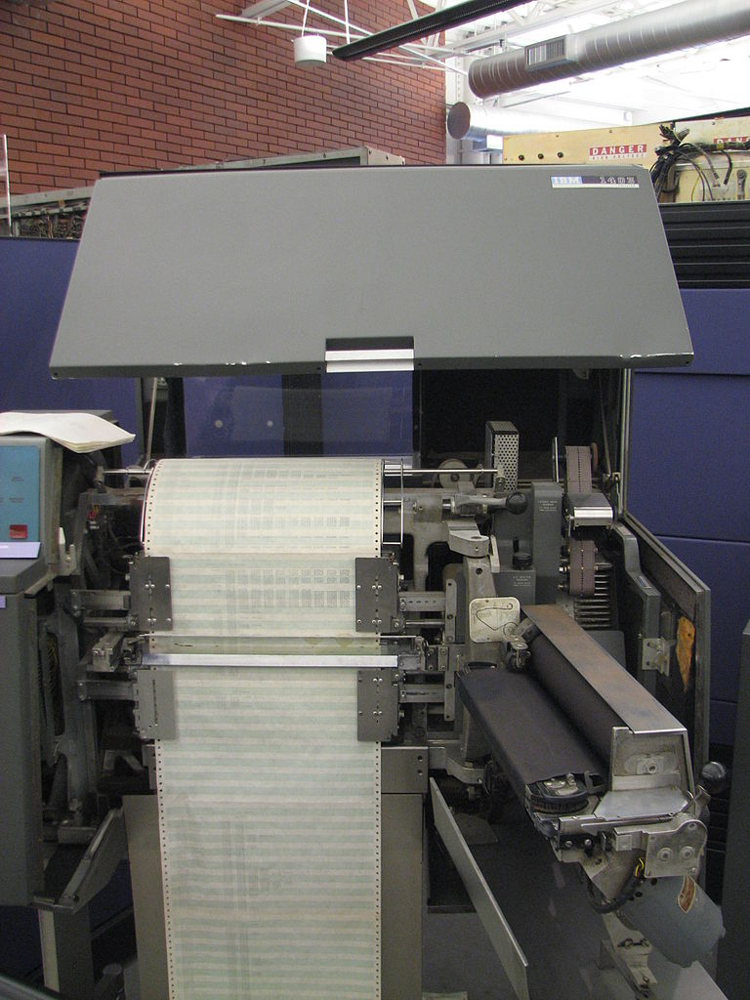
Printers Used to Catch on Fire
Notes:
Before we can talk about how a process reacts to multiple kinds of external event, though, we need to talk about how the CPU reacts to external events.
And once again we’re going back to the 1960s. The external events people were worried about, when they designed the CPU mechanism for external events that we still use today, were things like ‘the line printer has caught fire’. This thing could print so fast that if it wasn’t kept very clean and lubricated, the friction of the paper running through the machine would set the paper on fire.

Slide 8
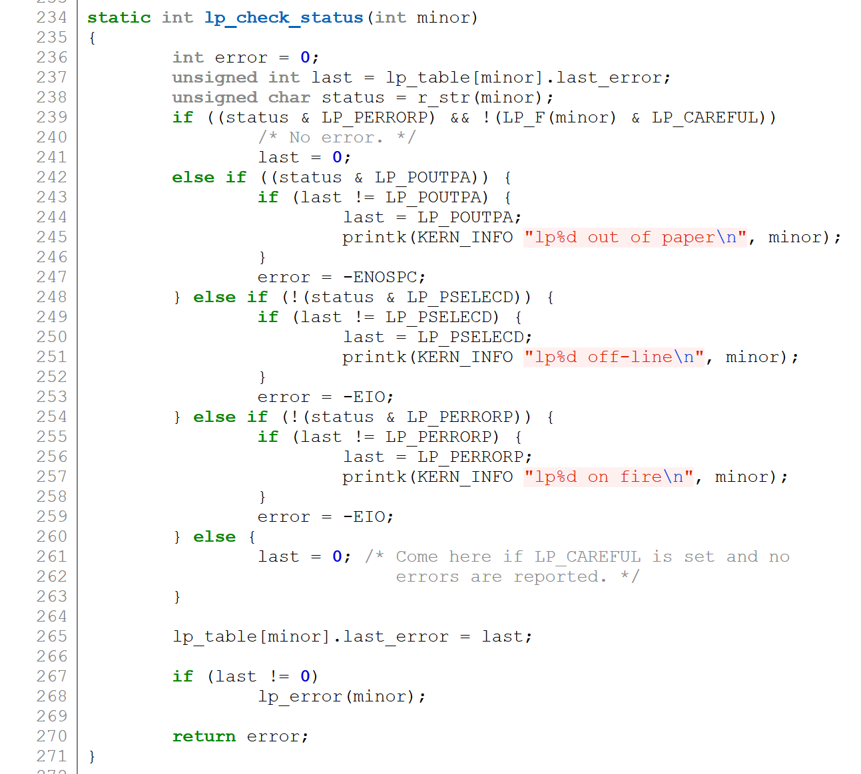
Highly Exceptional Control Flow
https://git.kernel.org/pub/scm/linux/kernel/git/torvalds/linux.git/tree/drivers/char/lp.c?h=v5.0-rc3
Notes:
As a joking nod to history, even today, the Linux kernel uses “lp0 on fire” – lp0, line printer number zero – as its error message when something’s gone generically wrong with a directly connected printer.
But again, the question for today is, “how does the computer even know?”

Slide 9
Recall: Control Flow
Processors do only one thing:
  From startup to shutdown, each CPU core simply reads and executes (interprets) a sequence of instructions, one at a time *
  This sequence is the CPU’s control flow (or flow of control)
Physical control flow
<startup>
inst₁
inst₂
inst₃
…
inst_{n}
<shutdown>
Time
* Externally, from an architectural
viewpoint (internally, the CPU
may use parallel out-of-order
execution)

Slide 10
Altering the Control Flow
Up to now: two mechanisms for changing control flow:
  Jumps and branches
  Call and return
  React to changes in program state
Insufficient for a useful system:
Difficult to react to changes in system state
  Data arrives from a disk or a network adapter
  Instruction divides by zero
  User hits Ctrl-C at the keyboard
  System timer expires
System needs mechanisms for “exceptional control flow”

Slide 11
Exceptional Control Flow
Exists at all levels of a computer system
Low level mechanisms
  1. Exceptions
    Change in control flow in response to a system event
    (i.e., change in system state)
    Implemented using combination of hardware and OS software
Higher level mechanisms
  2. Process context switch -- covered last lecture
    Implemented by OS software and hardware timer
  3. Signals
    Implemented by OS software
  4. Nonlocal jumps: setjmp() and longjmp()-- see Supplemental Slides
    Implemented by C runtime library

Slide 12
Today
Exceptional Control Flow
Exceptions
Signals

Slide 13
Exceptions
An exception is a transfer of control to the OS kernel in response to some event (i.e., change in processor state)
  Kernel is the memory-resident part of the OS
  Examples of events: Divide by 0, arithmetic overflow, page fault,
  I/O request completes, typing Ctrl-C
User code
Kernel code
Event
I_current
Exception
I_next
Exception processing
by exception handler
Return to I_current
Return to I_next
Abort
Notes:
Three options after exception handler completes

Slide 14
Exception Tables
Exception
numbers
Code for
exception handler 0
Each type of event has a
unique exception number k
k = index into exception table
(a.k.a. interrupt vector)
Handler k is called each time
exception k occurs
Exception
Table
Code for
exception handler 1
0
1
Code for
exception handler 2
2
...
n-1
...
Code for
exception handler n-1

Slide 15
Taxonomy of Hardware ECF
ECF
Asynchronous
Synchronous
Interrupts
Traps
Faults
Aborts

Slide 16
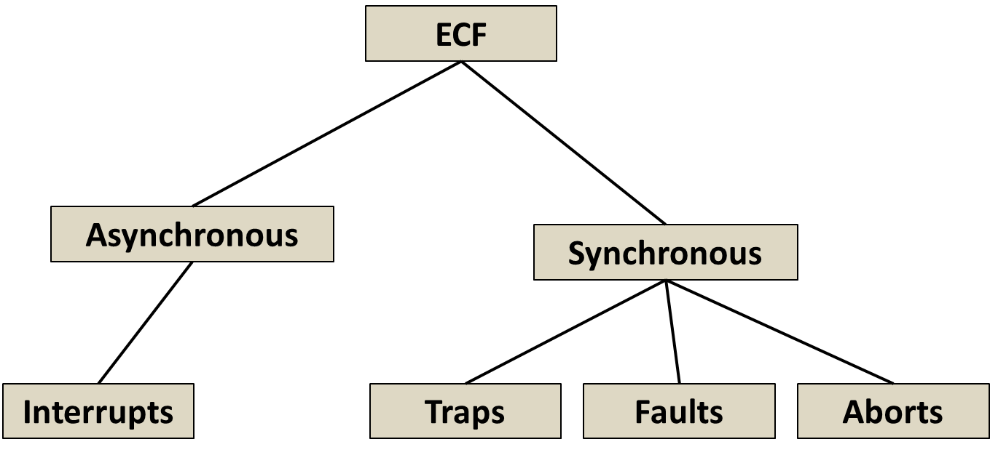
Asynchronous Exceptions (Interrupts)
Caused by events external to the processor
  Indicated by setting the processor’s interrupt pin
  Handler returns to “next” instruction
Examples:
  Timer interrupt
    Every few ms, an external timer chip triggers an interrupt
    Used by the kernel to take back control from user programs
  I/O interrupt from external device
    Hitting Ctrl-C at the keyboard
    Arrival of a packet from a network
    Arrival of data from a disk

Slide 17
Synchronous Exceptions
Caused by events that occur as a
result of executing an instruction:
  Traps
    Intentional, set program up to “trip the trap” and do something
    Examples: system calls, gdb breakpoints
    Returns control to “next” instruction
  Faults
    Unintentional but possibly recoverable
    Examples: page faults (recoverable), protection faults (unrecoverable), floating point exceptions
    Either re-executes faulting (“current”) instruction or aborts
  Aborts
    Unintentional and unrecoverable
    Examples: illegal instruction, parity error, machine check
    Aborts current program

Slide 18
System Calls
Each x86-64 system call has a unique ID number
Examples:
Number | Name | Description
0 | read | Read file
1 | write | Write file
2 | open | Open file
3 | close | Close file
4 | stat | Get info about file
57 | fork | Create process
59 | execve | Execute a program
60 | _exit | Terminate process
62 | kill | Send signal to process

Slide 19
System Call Example: Opening File
User calls: open(filename, options)
Calls __open function, which invokes system call instruction syscall
00000000000e5d70 <__open>:
...
e5d79: b8 02 00 00 00 mov $0x2,%eax # open is syscall #2
e5d7e: 0f 05 syscall # Return value in %rax
e5d80: 48 3d 01 f0 ff ff cmp $0xfffffffffffff001,%rax
...
e5dfa: c3 retq
User code
Kernel code
%rax contains syscall number
Other arguments in %rdi, %rsi, %rdx, %r10, %r8, %r9
Return value in %rax
Negative value is an error corresponding to negative errno
syscall
Exception
cmp
Open file
Returns

Slide 20
System Call Example: Opening File
Almost like a function call
Transfer of control
On return, executes next instruction
Passes arguments using calling convention
Gets result in %rax
One key difference
Executed by Kernel
  Different set of privileges
And other differences:
  E.g., “address” of “function” is in %rax
  Uses errno
  Etc.
User calls: open(filename, options)
Calls __open function, which invokes system call instruction syscall
00000000000e5d70 <__open>:
...
e5d79: b8 02 00 00 00 mov $0x2,%eax # open is syscall #2
e5d7e: 0f 05 syscall # Return value in %rax
e5d80: 48 3d 01 f0 ff ff cmp $0xfffffffffffff001,%rax
...
e5dfa: c3 retq
User code
Kernel code
%rax contains syscall number
Other arguments in %rdi, %rsi, %rdx, %r10, %r8, %r9
Return value in %rax
Negative value is an error corresponding to negative errno
syscall
Exception
cmp
Open file
Returns

Slide 21
Fault Example: Page Fault
int a[1000];
main ()
{
a[500] = 13;
}
User writes to memory location
That portion (page) of user’s memory
is currently on disk
80483b7: c7 05 10 9d 04 08 0d movl $0xd,0x8049d10
User code
Kernel code
Exception: page fault
movl
Copy page from disk to memory
Return and reexecute movl

Slide 22
Fault Example: Invalid Memory Reference
int a[1000];
main ()
{
a[5000] = 13;
}
80483b7: c7 05 60 e3 04 08 0d movl $0xd,0x804e360
User code
Kernel code
Exception: page fault
movl
Detect invalid address
Signal process
Sends SIGSEGV signal to user process
User process exits with “segmentation fault”

Slide 23
Today
Exceptional Control Flow
Exceptions
Signals

Slide 24
Problem with Simple Shell Example
Background jobs become zombies
  Shell does not wait for background job to complete
  Parent process (shell) needs to learn when a child process (bg job)
  has completed, so that it can reap the child
Solution: ECF to the rescue!
  The kernel will interrupt regular processing to alert us when a background process completes
  In Unix, the alert mechanism is called a signal

Slide 25
Signals
A signal is a small message that notifies a process that an event of some type has occurred in the system
  Akin to exceptions and interrupts
  Sent from the kernel (sometimes at the request of another process) to a process
  Signal type is identified by small integer ID’s (1-30)
  Only information in a signal is its ID and the fact that it arrived
ID | Name | Default Action | Corresponding Event
2 | SIGINT | Terminate | User typed ctrl-c
9 | SIGKILL | Terminate | Kill program (cannot override or ignore)
11 | SIGSEGV | Terminate | Segmentation violation
14 | SIGALRM | Terminate | Timer signal
17 | SIGCHLD | Ignore | Child stopped or terminated

Slide 26
Signal Concepts: Sending a Signal
Kernel sends a signal to a destination process by updating some state in the context of the destination process
Kernel sends a signal for one of the following reasons:
  Kernel has detected a system event such as divide-by-zero (SIGFPE) or the termination of a child process (SIGCHLD)
  Another process has invoked the kill system call to explicitly request the kernel to send a signal to the destination process
Notes:
Terminology problem: The book talks about signals being “delivered” and it means this. The manpages, on the other hand, use “delivered” to mean a different thing that I’m going to talk about next. Watch out for that. I’m going to avoid saying “delivered” from now on.

Slide 27
Signal Concepts: Sending a Signal
Process B
User level
Process A
Process C
kernel
Pending for A
Blocked for A
Pending for B
Blocked for B
Pending for C
Blocked for C

Slide 28
Signal Concepts: Sending a Signal
Process B
User level
Process A
Process C
Sends to C
kernel
Pending for A
Blocked for A
Pending for B
Blocked for B
Pending for C
Blocked for C

Slide 29
Signal Concepts: Sending a Signal
Process B
User level
Process A
Process C
kernel
Pending for A
Blocked for A
Pending for B
Blocked for B
1
Pending for C
Blocked for C

Slide 30
Signal Concepts: Sending a Signal
Process B
User level
Process A
Process C
kernel
Received by C
Pending for A
Blocked for A
Pending for B
Blocked for B
1
Pending for C
Blocked for C

Slide 31
Signal Concepts: Sending a Signal
Process B
User level
Process A
Process C
kernel
Pending for A
Blocked for A
Pending for B
Blocked for B
0
Pending for C
Blocked for C

Slide 32
Signal Concepts: Receiving a Signal
A destination process receives a signal when it is forced by the kernel to react in some way to the signal
Some possible ways to react:
  Ignore the signal (do nothing)
  Terminate the process (with optional core dump)
  Catch the signal by executing a user-level function called signal handler
    Akin to a hardware exception handler being called in response to an asynchronous interrupt:
(1) Signal received by process
(2) Control passes
to signal handler
I_{curr}
I_{next}
(3) Signal handler runs
(4) Signal handler
returns to
next instruction
Notes:
This is the process that the manpages call “delivering” a signal.

Slide 33
Signal Concepts: Pending and Blocked Signals
A signal is pending if sent but not yet received
  There can be at most one pending signal of each type
  Important: Signals are not queued
    If a process has a pending signal of type k, then subsequent signals of type k that are sent to that process are discarded
A process can block the receipt of certain signals
  Blocked signals can be sent, but will not be received until the signal is unblocked
  Some signals cannot be blocked (SIGKILL, SIGSTOP) or can only be blocked when sent by other processes (SIGSEGV, SIGILL, etc)
A pending signal is received at most once
Notes:
“blocked when sent by other processes” – this is the set of signals that are normally triggered by CPU exceptions. If you block them, the kernel honors the block when some other process sends the signal (kill -11 pid) but not when the CPU exception happens.

Slide 34
Signal Concepts: Pending/Blocked Bits
Kernel maintains pending and blocked bit vectors in the context of each process
  pending: represents the set of pending signals
    Kernel sets bit k in pending when a signal of type k is sent
    Kernel clears bit k in pending when a signal of type k is received
  blocked: represents the set of blocked signals
    Can be set and cleared by using the sigprocmask function
    Also referred to as the signal mask.

Slide 35
Signal Concepts: Sending a Signal
Process B
User level
Process A
Process C
Sends to C
kernel
Pending for A
Blocked for A
Pending for B
Blocked for B
1
Pending for C
Blocked for C

Slide 36
Sending Signals: Process Groups
Every process belongs to exactly one process group
Shell
pid=10
pgid=10
pid=20
pgid=20
Fore-
ground
job
Back-
ground
job #1
Back-
ground
job #2
pid=32
pgid=32
pid=40
pgid=40
Background
process group 32
Background
process group 40
Child
Child
pid=21
pgid=20
pid=22
pgid=20
getpgrp()
Return process group of current process
setpgid()
Change process group of a process (see text for details)
Foreground
process group 20

Slide 37
Sending Signals with /bin/kill Program
/bin/kill program sends arbitrary signal to a process or process group
Examples
  /bin/kill –9 24818
  Send SIGKILL to process 24818
  /bin/kill –9 –24817
  Send SIGKILL to every process in process group 24817
linux> ./forks 16
Child1: pid=24818 pgrp=24817
Child2: pid=24819 pgrp=24817
linux> ps
PID TTY TIME CMD
24788 pts/2 00:00:00 tcsh
24818 pts/2 00:00:02 forks
24819 pts/2 00:00:02 forks
24820 pts/2 00:00:00 ps
linux> /bin/kill -9 -24817
linux> ps
PID TTY TIME CMD
24788 pts/2 00:00:00 tcsh
24823 pts/2 00:00:00 ps
linux>
Notes:
./delay 100 &
ps
kill -9 XXX
ps

Slide 38
Sending Signals from the Keyboard
Typing ctrl-c (ctrl-z) causes the kernel to send a SIGINT (SIGTSTP) to every job in the foreground process group
  SIGINT – default action is to terminate each process
  SIGTSTP – default action is to stop (suspend) each process
Shell
pid=10
pgid=10
pid=20
pgid=20
Fore-
ground
job
Back-
ground
job #1
Back-
ground
job #2
pid=32
pgid=32
pid=40
pgid=40
Background
process group 32
Background
process group 40
Child
Child
pid=21
pgid=20
pid=22
pgid=20
Foreground
process group 20

Slide 39
Example of ctrl-c and ctrl-z
bluefish> ./forks 17
Child: pid=28108 pgrp=28107
Parent: pid=28107 pgrp=28107
<types ctrl-z>
Suspended
bluefish> ps w
PID TTY STAT TIME COMMAND
27699 pts/8 Ss 0:00 -tcsh
28107 pts/8 T 0:01 ./forks 17
28108 pts/8 T 0:01 ./forks 17
28109 pts/8 R+ 0:00 ps w
bluefish> fg
./forks 17
<types ctrl-c>
bluefish> ps w
PID TTY STAT TIME COMMAND
27699 pts/8 Ss 0:00 -tcsh
28110 pts/8 R+ 0:00 ps w
STAT (process state) Legend:
First letter:
S: sleeping
T: stopped
R: running
Second letter:
s: session leader
+: foreground proc group
See “man ps” for more
details
Notes:
Can also use kill command:
./forks 17 &
kill (parent) (Only kills parent)
./forks 17 &
kill (child) (Child becomes a zombie)

Slide 40
Sending Signals with kill Function
void fork12()
{
pid_t pid[N];
int i;
int child_status;
for (i = 0; i < N; i++)
if ((pid[i] = fork()) == 0) {
/* Child: Infinite Loop */
while(1)
;
}
for (i = 0; i < N; i++) {
printf("Killing process %d\n", pid[i]);
kill(pid[i], SIGINT);
}
for (i = 0; i < N; i++) {
pid_t wpid = wait(&child_status);
if (WIFEXITED(child_status))
printf("Child %d terminated with exit status %d\n",
wpid, WEXITSTATUS(child_status));
else
printf("Child %d terminated abnormally\n", wpid);
}
}
forks.c
Notes:
Interesting to use interpositioning code
setenv LD_PRELOAD ./myfork.so
setenv CHILD
./forks 12

Slide 41
Receiving Signals
Suppose kernel is returning from an exception handler and is ready to pass control to process p
Process q
Process p
user code
kernel code
context switch
Time
user code
kernel code
context switch
user code

Slide 42
Receiving Signals
Suppose kernel is returning from an exception handler and is ready to pass control to process p
Kernel computes pnb = pending & ~blocked
  The set of pending nonblocked signals for process p
If (pnb == 0)
  Pass control to next instruction in the logical flow for p
Else
  Choose least nonzero bit k in pnb and force process p to receive signal k
  The receipt of the signal triggers some action by p
  Repeat for all nonzero k in pnb
  Pass control to next instruction in logical flow for p

Slide 43

Quiz
https://canvas.cmu.edu/courses/42532/quizzes/127190

Slide 44
Default Actions
Each signal type has a predefined default action, which is one of:
  The process terminates
  The process stops until restarted by a SIGCONT signal
  The process ignores the signal
Notes:
This is different from CPU exception handlers. If your OS doesn’t provide an exception handler for all possible CPU exceptions, the entire computer will crash when the CPU tries to invoke a missing exception handler.

Slide 45
Installing Signal Handlers
The signal function modifies the default action associated with the receipt of signal signum:
  handler_t *signal(int signum, handler_t *handler)
Different values for handler:
  SIG_IGN: ignore signals of type signum
  SIG_DFL: revert to the default action on receipt of signals of type signum
  Otherwise, handler is the address of a user-level signal handler
    Called when process receives signal of type signum
    Referred to as “installing” the handler
    Executing handler is called “catching” or “handling” the signal
    When the handler executes its return statement, control passes back to instruction in the control flow of the process that was interrupted by receipt of the signal
Notes:
Warning: This slide deck talks about the signal function because it’s simpler, but you should use another function called sigaction, instead.

Slide 46
Signal Handling Example
void sigint_handler(int sig) /* SIGINT handler */
{
printf("So you think you can stop the bomb with ctrl-c, do you?\n");
sleep(2);
printf("Well...");
fflush(stdout);
sleep(1);
printf("OK. :-)\n");
exit(0);
}
int main(int argc, char** argv)
{
/* Install the SIGINT handler */
if (signal(SIGINT, sigint_handler) == SIG_ERR)
unix_error("signal error");
/* Wait for the receipt of a signal */
pause();
return 0;
}
sigint.c
Notes:
Try running:
./sigint
ctrl-C
Code not entirely reliable, if there’s a delay in pause

Slide 47
Signals Handlers as Concurrent Flows
A signal handler is a separate logical flow (not process) that runs concurrently with the main program
But, this flow exists only until returns to main program
Process A
while (1)
;
Process A
handler(){
…
}
Process B
Time

Slide 48
Another View of Signal Handlers as Concurrent Flows
Process A
Process B
Signal sent
to process A
I_{curr}
user code (main)
kernel code
context switch
user code (main)
kernel code
context switch
Signal received
by process A
user code (handler)
kernel code
I_{next}
user code (main)

Slide 49
Nested Signal Handlers
Handlers can be interrupted by other handlers
Main program
Handler S
Handler T
(2) Control passes to handler S
(1) Program catches signal s
I_{curr}
(4) Control passes to handler T
(3) Program catches signal t
(7) Main program resumes
I_{next}
(6) Handler S
returns to main program
(5) Handler T
returns to handler S

Slide 50
Blocking and Unblocking Signals
Implicit blocking mechanism
  Kernel blocks any pending signals of type currently being handled
  e.g., a SIGINT handler can’t be interrupted by another SIGINT
Explicit blocking and unblocking mechanism
  sigprocmask function
Supporting functions
  sigemptyset – Create empty set
  sigfillset – Add every signal number to set
  sigaddset – Add signal number to set
  sigdelset – Delete signal number from set

Slide 51
Temporarily Blocking Signals
sigset_t mask, prev_mask;
sigemptyset(&mask);
sigaddset(&mask, SIGINT);
/* Block SIGINT and save previous blocked set */
sigprocmask(SIG_BLOCK, &mask, &prev_mask);
/* Code region that will not be interrupted by SIGINT */
/* Restore previous blocked set, unblocking SIGINT */
sigprocmask(SIG_SETMASK, &prev_mask, NULL);
…

Slide 52
Safe Signal Handling
Handlers are tricky because they are concurrent with main program and share the same global data structures
  Shared data structures can become corrupted.
We’ll explore concurrency issues later in the term
For now here are some guidelines to help you avoid trouble

Slide 53
Guidelines for Writing Safe Handlers
G0: Keep your handlers as simple as possible
  e.g., set a global flag and return
G1: Call only async-signal-safe functions in your handlers
  printf, sprintf, malloc, and exit are not safe!
G2: Save and restore errno on entry and exit
  So that other handlers don’t overwrite your value of errno
G3: Protect accesses to shared data structures by temporarily blocking all signals
  To prevent possible corruption
G4: Declare global variables as volatile
  To prevent compiler from storing them in a register
G5: Declare global flags as volatile sig_atomic_t
  flag: variable that is only read or written (e.g. flag = 1, not flag++)
  Flag declared this way does not need to be protected like other globals

Slide 54
Async-Signal-Safety
Function is async-signal-safe if either reentrant (e.g., all variables stored on stack frame, CS:APP3e 12.7.2) or non-interruptible by signals
Posix guarantees 117 functions to be async-signal-safe
  Source: “man 7 signal-safety”
  Popular functions on the list:
    _exit, write, wait, waitpid, sleep, kill
  Popular functions that are not on the list:
    printf, sprintf, malloc, exit
    Unfortunate fact: write is the only async-signal-safe output function
Notes:
Resume here in July 2024

Slide 55
Safe Formatted Output: Option #1
Use the reentrant SIO (Safe I/O library) from csapp.c in your handlers
  ssize_t sio_puts(char s[]) /* Put string */
  ssize_t sio_putl(long v) /* Put long */
  void sio_error(char s[]) /* Put msg & exit */
void sigint_handler(int sig) /* Safe SIGINT handler */
{
sio_puts("So you think you can stop the bomb"
" with ctrl-c, do you?\n");
sleep(2);
sio_puts("Well...");
sleep(1);
sio_puts("OK. :-)\n");
_exit(0);
}
sigintsafe.c

Slide 56
Safe Formatted Output: Option #2
Use the new & improved reentrant sio_printf!
  Handles restricted class of printf format strings
    Recognizes: %c %s %d %u %x %%
    Size designators ‘l’ and ‘z’
void sigint_handler(int sig) /* Safe SIGINT handler */
{
sio_printf("So you think you can stop the bomb"
" (process %d) with ctrl-%c, do you?\n",
(int) getpid(), 'c');
sleep(2);
sio_puts("Well...");
sleep(1);
sio_puts("OK. :-)\n");
_exit(0);
}
sigintsafe.c

Slide 57
Incorrect Signal Handling
volatile int ccount = 0;
void child_handler(int sig) {
int olderrno = errno;
pid_t pid;
if ((pid = wait(NULL)) < 0)
Sio_error("wait error");
ccount--;
sio_puts("Handler reaped child ");
sio_putl((long)pid);
sio_puts(" \n");
sleep(1);
errno = olderrno;
}
void fork14() {
pid_t pid[N];
int i;
ccount = N;
signal(SIGCHLD, child_handler);
for (i = 0; i < N; i++) {
if ((pid[i] = fork()) == 0) {
sleep(1);
exit(0); /* Child exits */
}
}
while (ccount > 0) /* Parent spins */
;
}
Pending signals are not queued
  For each signal type, one bit indicates whether or not signal is pending…
  …thus at most one pending signal of any particular type.
You can’t use signals to count events, such as children terminating.
This code is incorrect!
N == 5
whaleshark> ./forks 14
Handler reaped child 23240
Handler reaped child 23241
. . .(hangs)
forks.c
Notes:
./forks 14
Hangs.
Multiple children signal before handler runs once. Children waiting to be reaped are dropped because handler only gets one per invocation.

Slide 58
Correct Signal Handling
Must wait for all terminated child processes
  Put wait in a loop to reap all terminated children
void child_handler2(int sig)
{
int olderrno = errno;
pid_t pid;
while ((pid = wait(NULL)) > 0) {
ccount--;
sio_puts("Handler reaped child ");
sio_putl((long)pid);
sio_puts(" \n");
}
if (errno != ECHILD)
sio_error("wait error");
errno = olderrno;
}
whaleshark> ./forks 15
Handler reaped child 23246
Handler reaped child 23247
Handler reaped child 23248
Handler reaped child 23249
Handler reaped child 23250
whaleshark>
Notes:
Run with delays for both child & parent

Slide 59
Synchronizing Flows to Avoid Races
SIGCHLD handler for a simple shell
  Blocks all signals while running critical code
void handler(int sig)
{
int olderrno = errno;
sigset_t mask_all, prev_all;
pid_t pid;
sigfillset(&mask_all);
while ((pid = waitpid(-1, NULL, 0)) > 0) { /* Reap child */
sigprocmask(SIG_BLOCK, &mask_all, &prev_all);
deletejob(pid); /* Delete the child from the job list */
sigprocmask(SIG_SETMASK, &prev_all, NULL);
}
if (pid != 0 && errno != ECHILD)
sio_error("waitpid error");
errno = olderrno;
}
procmask1.c
Notes:
Procmask save, restore. Man for first arg meaning. Typical use here.

Slide 60
Synchronizing Flows to Avoid Races
Simple shell with a subtle synchronization error because it assumes parent runs before child
int main(int argc, char **argv)
{
int pid;
sigset_t mask_all, prev_all;
int n = N; /* N = 5 */
sigfillset(&mask_all);
signal(SIGCHLD, handler);
initjobs(); /* Initialize the job list */
while (n--) {
if ((pid = fork()) == 0) { /* Child */
execve("/bin/date", argv, NULL);
}
sigprocmask(SIG_BLOCK, &mask_all, &prev_all); /* Parent */
addjob(pid); /* Add the child to the job list */
sigprocmask(SIG_SETMASK, &prev_all, NULL);
}
exit(0);
}
procmask1.c
Notes:
Note: still busted; date finishes before addjob runs. Sigchildhandler runs deletejob before addjob completes. (due to not yet blocked.
./procmask1
setenv CHILD
./procmask1
Cntl-C to stop infinite loop

Slide 61
Corrected Shell Program Without Race
int main(int argc, char **argv)
{
int pid;
sigset_t mask_all, mask_one, prev_one;
int n = N; /* N = 5 */
sigfillset(&mask_all);
sigemptyset(&mask_one);
sigaddset(&mask_one, SIGCHLD);
signal(SIGCHLD, handler);
initjobs(); /* Initialize the job list */
while (n--) {
sigprocmask(SIG_BLOCK, &mask_one, &prev_one); /* Block SIGCHLD */
if ((pid = fork()) == 0) { /* Child process */
sigprocmask(SIG_SETMASK, &prev_one, NULL); /* Unblock SIGCHLD */
execve("/bin/date", argv, NULL);
}
sigprocmask(SIG_BLOCK, &mask_all, NULL); /* Parent process */
addjob(pid); /* Add the child to the job list */
sigprocmask(SIG_SETMASK, &prev_one, NULL); /* Unblock SIGCHLD */
}
exit(0);
}
procmask2.c
Notes:
./procmask2

Slide 62
Explicitly Waiting for Signals
Handlers for program explicitly waiting for SIGCHLD to arrive
volatile sig_atomic_t pid;
void sigchld_handler(int s)
{
int olderrno = errno;
pid = waitpid(-1, NULL, 0); /* Main is waiting for nonzero pid */
errno = olderrno;
}
void sigint_handler(int s)
{
}
waitforsignal.c

Slide 63
Explicitly Waiting for Signals
int main(int argc, char **argv) {
sigset_t mask, prev;
int n = N; /* N = 10 */
signal(SIGCHLD, sigchld_handler);
signal(SIGINT, sigint_handler);
sigemptyset(&mask);
sigaddset(&mask, SIGCHLD);
while (n--) {
sigprocmask(SIG_BLOCK, &mask, &prev); /* Block SIGCHLD */
if (fork() == 0) /* Child */
exit(0);
/* Parent */
pid = 0;
sigprocmask(SIG_SETMASK, &prev, NULL); /* Unblock SIGCHLD */
/* Wait for SIGCHLD to be received (wasteful!) */
while (!pid)
;
/* Do some work after receiving SIGCHLD */
printf(".");
}
printf("\n");
exit(0);
}
Similar to a shell waiting
for a foreground job to
terminate.
waitforsignal.c

Slide 64
Explicitly Waiting for Signals
while (!pid)
;
Program is correct, but very wasteful
  Program in busy-wait loop
Possible race condition
  Between checking pid and starting pause, might receive signal
Safe, but slow
  Will take up to one second to respond
Solution: sigsuspend
while (!pid) /* Race! */
pause();
while (!pid) /* Too slow! */
sleep(1);
Notes:
Pause race case – can deadlock if we start waiting in pause after the handler has already run

Slide 65
Waiting for Signals with sigsuspend
int sigsuspend(const sigset_t *mask)
Equivalent to atomic (uninterruptable) version of:
sigprocmask(SIG_SETMASK, &mask, &prev);
pause();
sigprocmask(SIG_SETMASK, &prev, NULL);

Slide 66
Waiting for Signals with sigsuspend
int main(int argc, char **argv) {
sigset_t mask, prev;
int n = N; /* N = 10 */
signal(SIGCHLD, sigchld_handler);
signal(SIGINT, sigint_handler);
sigemptyset(&mask);
sigaddset(&mask, SIGCHLD);
while (n--) {
sigprocmask(SIG_BLOCK, &mask, &prev); /* Block SIGCHLD */
if (fork() == 0) /* Child */
exit(0);
/* Wait for SIGCHLD to be received */
pid = 0;
while (!pid)
sigsuspend(&prev);
/* Optionally unblock SIGCHLD */
sigprocmask(SIG_SETMASK, &prev, NULL);
/* Do some work after receiving SIGCHLD */
printf(".");
}
printf("\n");
exit(0);
}
sigsuspend.c

Slide 67
Supplemental slides

Slide 68
Nonlocal Jumps: setjmp/longjmp
Powerful (but dangerous) user-level mechanism for transferring control to an arbitrary location
  Controlled to way to break the procedure call / return discipline
  Useful for error recovery and signal handling
int setjmp(jmp_buf j)
  Must be called before longjmp
  Identifies a return site for a subsequent longjmp
  Called once, returns one or more times
Implementation:
  Remember where you are by storing the current register context, stack pointer, and PC value in jmp_buf
  Return 0

Slide 69
setjmp/longjmp (cont)
void longjmp(jmp_buf j, int i)
  Meaning:
    return from the setjmp remembered by jump buffer j again ...
    … this time returning i instead of 0
  Called after setjmp
  Called once, but never returns
longjmp Implementation:
  Restore register context (stack pointer, base pointer, PC value) from jump buffer j
  Set %eax (the return value) to i
  Jump to the location indicated by the PC stored in jump buf j

Slide 70
setjmp/longjmp Example
Goal: return directly to original caller from a deeply-nested function
/* Deeply nested function foo */
void foo(void)
{
if (error1)
longjmp(buf, 1);
bar();
}
void bar(void)
{
if (error2)
longjmp(buf, 2);
}

Slide 71
setjmp/longjmp Example (cont)
jmp_buf buf;
int error1 = 0;
int error2 = 1;
void foo(void), bar(void);
int main()
{
switch(setjmp(buf)) {
case 0:
foo();
break;
case 1:
printf("Detected an error1 condition in foo\n");
break;
case 2:
printf("Detected an error2 condition in foo\n");
break;
default:
printf("Unknown error condition in foo\n");
}
exit(0);
}

Slide 72
Limitations of Nonlocal Jumps
Works within stack discipline
  Can only long jump to environment of function that has been called but not yet completed
Before longjmp
After longjmp
jmp_buf env;
P1()
{
if (setjmp(env)) {
/* Long Jump to here */
} else {
P2();
}
}
P2()
{ . . . P2(); . . . P3(); }
P3()
{
longjmp(env, 1);
}
env
P1
P1
P2
P2
P2
P3

Slide 73
Limitations of Long Jumps (cont.)
Works within stack discipline
  Can only long jump to environment of function that has been called but not yet completed
P1
jmp_buf env;
P1()
{
P2(); P3();
}
P2()
{
if (setjmp(env)) {
/* Long Jump to here */
}
}
P3()
{
longjmp(env, 1);
}
P2
env
At setjmp
P1
env
P2
X
P2 returns
P1
env
P3
X
At longjmp

Slide 74
Putting It All Together: A Program
That Restarts Itself When ctrl-c’d
#include "csapp.h"
sigjmp_buf buf;
void handler(int sig)
{
siglongjmp(buf, 1);
}
int main()
{
if (!sigsetjmp(buf, 1)) {
Signal(SIGINT, handler);
Sio_puts("starting\n");
}
else
Sio_puts("restarting\n");
while(1) {
Sleep(1);
Sio_puts("processing...\n");
}
exit(0); /* Control never reaches here */
}
greatwhite> ./restart
starting
processing...
processing...
processing...
restarting
processing...
processing...
restarting
processing...
processing...
processing...
Ctrl-c
Ctrl-c
restart.c

