Slide 1
Floating Point
15-213: Introduction to Computer Systems – Recitation
January 24, 2011
Carnegie Mellon

Slide 2
Today: Floating Point
Carnegie Mellon
Data Lab
Floating Point Basics
  Representation
  Interpreting the bits
  Rounding
Floating Point Examples
  Number to Float
  Float to Number

Slide 3
Data Lab
Carnegie Mellon
Due tomorrow at 11:59pm
Any questions?

Slide 4
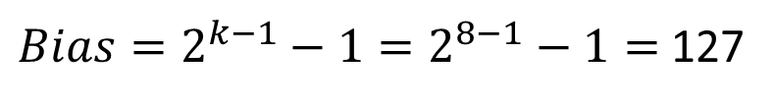
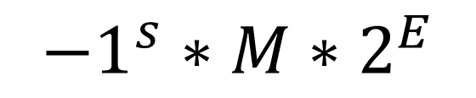

Representation
Carnegie Mellon
Basic format of bit representation (single precision):
Sign
Exponent
Fraction (Mantissa)
1-bit
8-bits
23-bits
$${−1}^{s}∗M∗2^{E}$$
Where E is based on the Bias
$Bias=2^{k−1}−1=2^{8−1}−1=$ 127
$k=$ exponent bits

Slide 5




Interpreting the Bits
Carnegie Mellon
0000
Denormalized
$$E=−Bias+1$$
$$Fraction=0.FFF$$
Exponent
EEEE
Normalized
$$E=Exponent −Bias$$
$$Fraction=1.FFF$$
1111
Special
000
Infinity
Positive/Negative
S EEEE FFF
Fraction
8-bit floating point number
FFF
NaN

Slide 6
Rounding
Carnegie Mellon
Round to even
  Like regular rounding except for the exactly half case
  If the last rounded bit is 1 round up, else round down
1.10 1001 | Greater then 0.5, round up | 1.11
1.10 0110 | Less than 0.5, round down | 1.10
1.11 1000 | Round to even up | 10.00
1.10 1000 | Round to even down | 1.10

Slide 7
Number to Float
Carnegie Mellon
Convert: -5
S EEEE FFF
8-bit floating point number

Slide 8

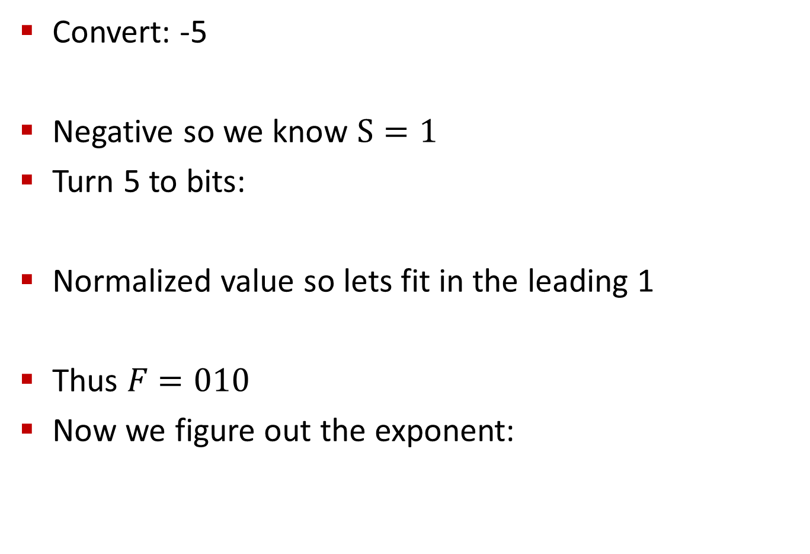



Number to Float
Carnegie Mellon
Convert: -5
Negative so we know $S=1$
Turn 5 to bits:
Normalized value so lets fit in the leading 1
Thus $F=010$
Now we figure out the exponent:
$$Bias=2^{4−1}−1=2^{3}−1=7$$
$$5_{10}={101}_{2}$$
$${1.01}_{2}$$
$${{101}_{2}→1.01}_{2} x 2^{2}$$

Slide 9


Number to Float
Carnegie Mellon
Calculate the exponent bits:
So the exponent is 9, in bits:
Answer: $1 1001 {010}_{2}$
$$E=Exponent−Bias→2=Exponent−7→Exponent=2+7=9$$
$$Exponent={1001}_{2}$$

Slide 10
Number to Float
Carnegie Mellon
Convert: 6/512

Slide 11




Number to Float
Carnegie Mellon
Convert: 6/512
Is it denormalized? Check the largest denormalized:
Denormalized, we know the exponent is going to be:
So we know the form of the answer is going to be:
Lets remove the decimal point to make it a bit easier:
The fraction bits are the top of the fraction:
$$0 000 {111}_{2}={0.111}_{2} x 2^{−6}={111}_{2} x 2^{−9}=7 x 2^{−9}=7/512$$
$$E=−Bias+1=−7+1=−6$$
$$0.FFF x 2^{−6}$$
$$FFF x 2^{−9}$$
$$6_{10}={110}_{2}$$

Slide 12
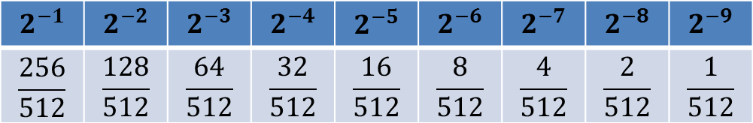
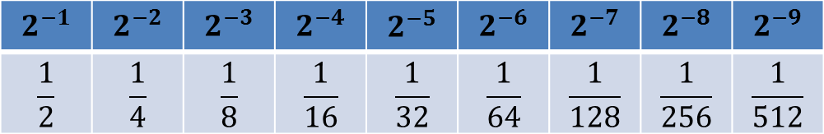

Number to Float
Carnegie Mellon
Why does that work? Lets remove the decimal point to make it a bit easier to see:
Remembering that these are fractions:
We can see the table in terms on 512ths:
We want 6 512ths which are the bits we used.
$$0.110 x 2^{−6}=110 x 2^{−9}$$
$$2^{−1}$$ | $$2^{−2}$$ | $$2^{−3}$$ | $$2^{−4}$$ | $$2^{−5}$$ | $$2^{−6}$$ | $$2^{−7}$$ | $$2^{−8}$$ | $$2^{−9}$$
$$\frac{1}{2}$$ | $$\frac{1}{4}$$ | $$\frac{1}{8}$$ | $$\frac{1}{16}$$ | $$\frac{1}{32}$$ | $$\frac{1}{64}$$ | $$\frac{1}{128}$$ | $$\frac{1}{256}$$ | $$\frac{1}{512}$$
$$2^{−1}$$ | $$2^{−2}$$ | $$2^{−3}$$ | $$2^{−4}$$ | $$2^{−5}$$ | $$2^{−6}$$ | $$2^{−7}$$ | $$2^{−8}$$ | $$2^{−9}$$
$$\frac{256}{512}$$ | $$\frac{128}{512}$$ | $$\frac{64}{512}$$ | $$\frac{32}{512}$$ | $$\frac{16}{512}$$ | $$\frac{8}{512}$$ | $$\frac{4}{512}$$ | $$\frac{2}{512}$$ | $$\frac{1}{512}$$

Slide 13

Number to Float
Carnegie Mellon
Putting it all together: $0 0000 110$

Slide 14
Number to Float
Carnegie Mellon
Convert: 27

Slide 15

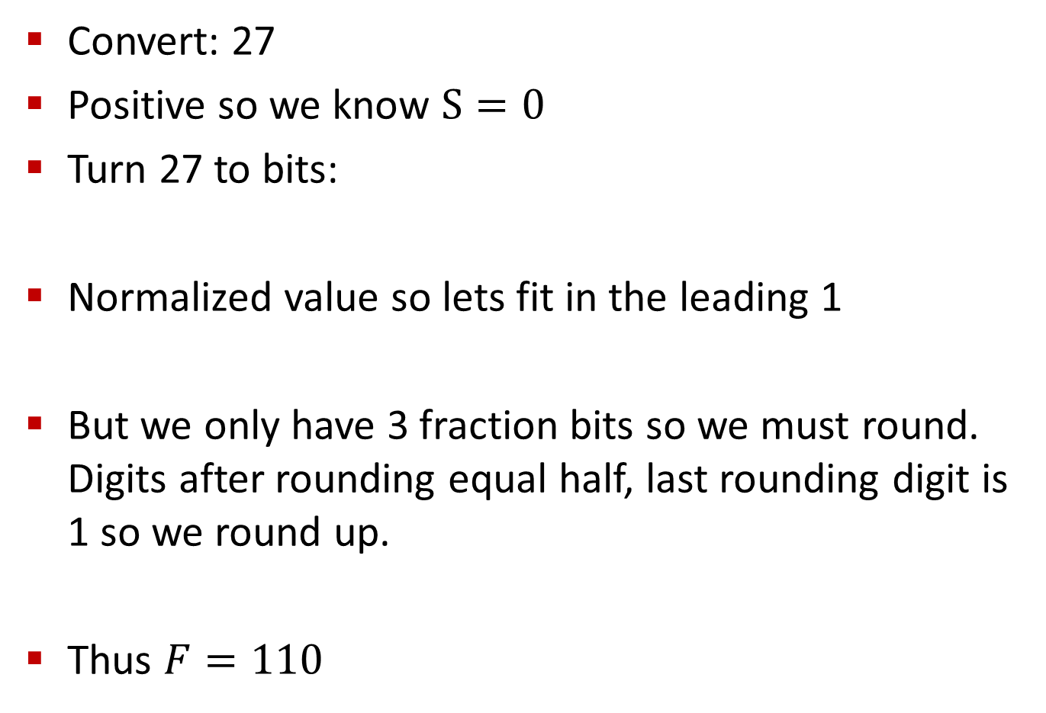


Number to Float
Carnegie Mellon
Convert: 27
Positive so we know $S=0$
Turn 27 to bits:
Normalized value so lets fit in the leading 1
But we only have 3 fraction bits so we must round. Digits after rounding equal half, last rounding digit is 1 so we round up.
Thus $F=110$
$${27}_{10}={11011}_{2}$$
$${1.1011}_{2}$$
$${1.1011}_{2}={1.110}_{2}$$

Slide 16



Number to Float
Carnegie Mellon
Calculate the exponent :
Calculate the exponent bits:
So the exponent is 11, in bits:
Answer: $0 1011 {110}_{2}$
$${{11100}_{2}→1.1100}_{2} x 2^{4}$$
$$E=Exponent−Bias→4=Exponent−7→Exponent=4+7=11$$
$$Exponent={1011}_{2}$$

Slide 17
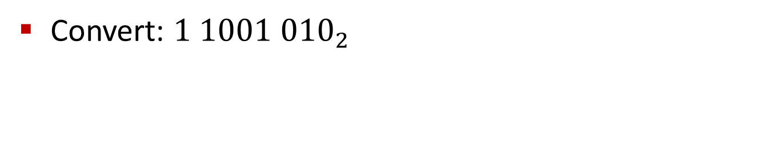
Float to Number
Carnegie Mellon
Convert: $1 1001 {010}_{2}$

Slide 18

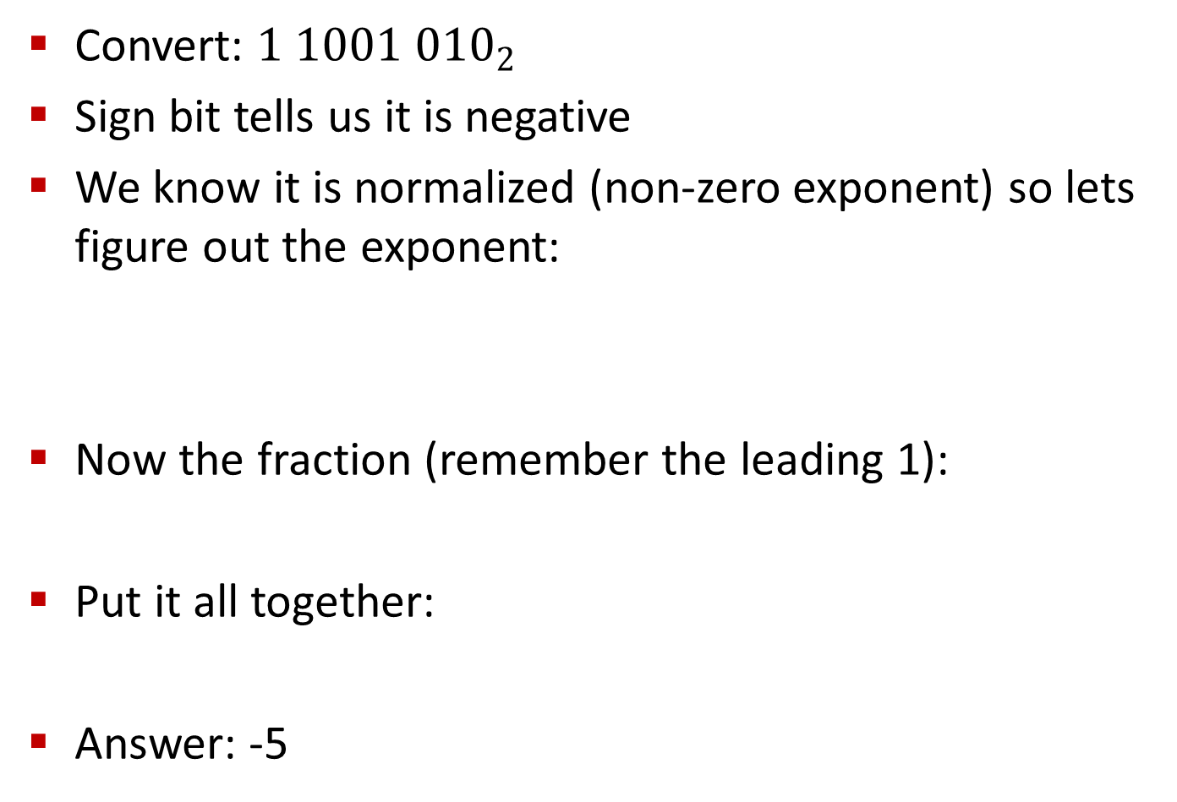



Float to Number
Carnegie Mellon
Convert: $1 1001 {010}_{2}$
Sign bit tells us it is negative
We know it is normalized (non-zero exponent) so lets figure out the exponent:
Now the fraction (remember the leading 1):
Put it all together:
Answer: -5
$${1001}_{2}=9_{10}$$
$$E=Exponent−Bias→9−7=2$$
$${1.010}_{2}$$
$${1.010}_{2} x 2^{2}={101}_{2}=5_{10}$$

Slide 19

Float to Number
Carnegie Mellon
Convert: $0 0000 110$

Slide 20

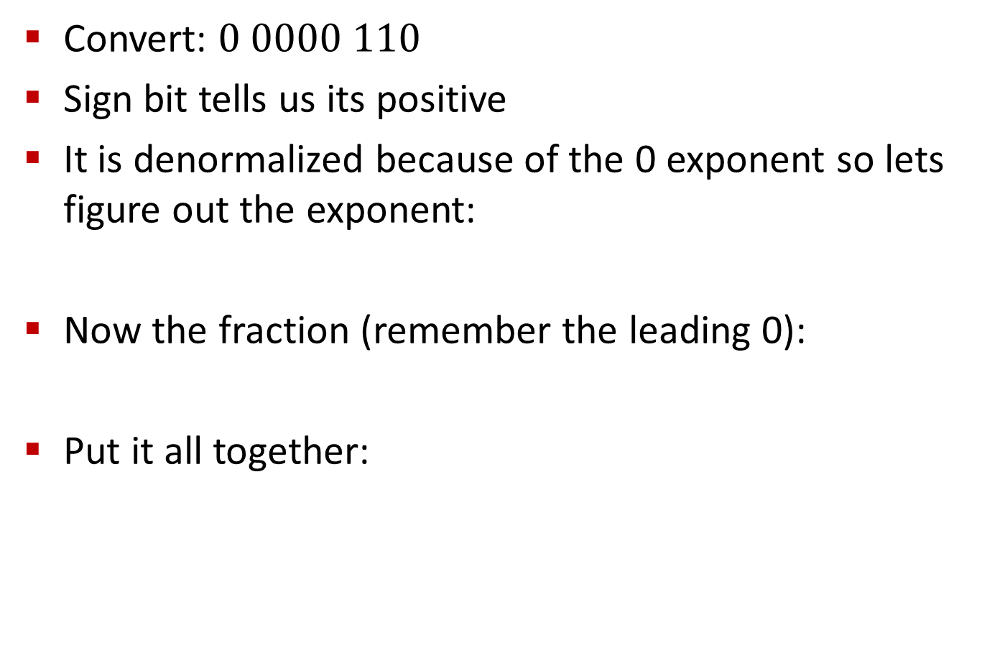


Float to Number
Carnegie Mellon
Convert: $0 0000 110$
Sign bit tells us its positive
It is denormalized because of the 0 exponent so lets figure out the exponent:
Now the fraction (remember the leading 0):
Put it all together:
$$E=−Bias+1→−7+1=−6$$
$$0.110 x 2^{−6}$$
$${0.110}_{2} x 2^{−6}={0.000000110}_{2}$$

Slide 21
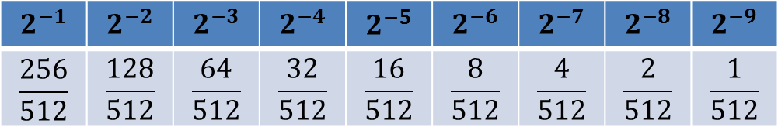
Float to Number
Carnegie Mellon
Put it all together:
Now lets examine our fraction chart:
Answer: 6/512
$${0.110}_{2} x 2^{−6}={0.000000110}_{2}$$
$$2^{−1}$$ | $$2^{−2}$$ | $$2^{−3}$$ | $$2^{−4}$$ | $$2^{−5}$$ | $$2^{−6}$$ | $$2^{−7}$$ | $$2^{−8}$$ | $$2^{−9}$$
$$\frac{256}{512}$$ | $$\frac{128}{512}$$ | $$\frac{64}{512}$$ | $$\frac{32}{512}$$ | $$\frac{16}{512}$$ | $$\frac{8}{512}$$ | $$\frac{4}{512}$$ | $$\frac{2}{512}$$ | $$\frac{1}{512}$$

Slide 22

Float to Number
Carnegie Mellon
Convert: $0 1011 {110}_{2}$

Slide 23





Float to Number
Carnegie Mellon
Convert: $0 1011 {110}_{2}$
Sign bit tells us it is positive
We know it is normalized (non-zero exponent) so lets figure out the exponent:
Now the fraction (remember the leading 1):
Put it all together:
Answer: 28
$${1011}_{2}={11}_{10}$$
$$E=Exponent−Bias→11−7=4$$
$${1.110}_{2}$$
$${1.110}_{2} x 2^{4}={11100}_{2}={28}_{10}$$

Slide 24
Questions?
Carnegie Mellon

