Slide 1

14-513
18-613

Slide 2
Thread Level Parallelism
18-213/18-613: Introduction to Computer Systems
25th Lecture, December 5, 2023

Slide 3
Today
Parallel Computing Hardware CSAPP 12.6
Consistency Models CSAPP 12.6
Thread-Level Parallelism CSAPP 12.6

Slide 4
Today
Parallel Computing Hardware
  Multicore
    Multiple separate processors on single chip
  Hyperthreading
    Efficient execution of multiple threads on single core
Consistency Models
  What happens when multiple threads are reading & writing shared state
Thread-Level Parallelism
  Splitting program into independent tasks
    Example: Parallel summation
    Examine some performance artifacts
  Divide-and conquer parallelism
    Example: Parallel quicksort

Slide 5
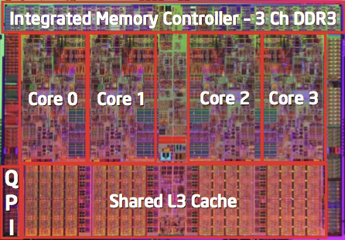
Typical Multicore Processor
Core 0
Core n-1
Regs
Regs
L1
d-cache
L1
i-cache
…
L1
d-cache
L1
i-cache
L2 unified cache
L2 unified cache
L3 unified cache
(shared by all cores)
Main memory
Multiple processors operating with coherent view of memory

Slide 6
Out-of-Order Processor Structure
Instruction Control
Instruction
Cache
Instruction Decoder
Registers
Op. Queue
PC
Functional Units
Data Cache
Int
Arith
Int
Arith
FP
Arith
Load /
Store
Instruction control dynamically converts program into stream of operations
Operations mapped onto functional units to execute in parallel

Slide 7
Hyperthreading Implementation
Instruction Control
Instruction
Cache
Instruction Decoder
Reg A
Op. Queue A
Reg B
Op. Queue B
PC A
PC B
Functional Units
Data Cache
Int
Arith
Int
Arith
FP
Arith
Load /
Store
Replicate instruction control to process K instruction streams
K copies of all registers
Share functional units

Slide 8
Benchmark Machine
Get data about machine from /proc/cpuinfo
Shark Machines
  Intel Xeon E5520 @ 2.27 GHz
  Nehalem, ca. 2010
  8 Cores
  Each can do 2x hyperthreading

Slide 9
Exploiting parallel execution
So far, we’ve used threads to deal with I/O delays
  e.g., one thread per client to prevent one from delaying another
Multi-core CPUs offer another opportunity
  Spread work over threads executing in parallel on N cores
  Happens automatically, if many independent tasks
    e.g., running many applications or serving many clients
  Can also write code to make one big task go faster
    by organizing it as multiple parallel sub-tasks
Shark machines can execute 16 threads at once
  8 cores, each with 2-way hyperthreading
  Theoretical speedup of 16X
    never achieved in our benchmarks

Slide 10
Memory Consistency
int a = 1;
int b = 100;
Thread1:
Wa: a = 2;
Rb: print(b);
Thread2:
Wb: b = 200;
Ra: print(a);
What are the possible values printed?
  Depends on memory consistency model
  Abstract model of how hardware handles concurrent accesses

Slide 11
Non-Coherent Cache Scenario
int a = 1;
int b = 100;
Write-back caches, without coordination between them
Thread1:
Wa: a = 2;
Rb: print(b);
Thread2:
Wb: b = 200;
Ra: print(a);
Thread1 Cache
Thread2 Cache
a: 2
b:100
a:1
b:200
print 1
print 100
Main Memory
At later points, a:2 and b:200
are written back to main memory
a:1
b:100

Slide 12
Snoopy Caches
int a = 1;
int b = 100;
Tag each cache block with state
  Invalid Cannot use value
  Shared Readable copy
  Exclusive Writeable copy
Thread1:
Wa: a = 2;
Rb: print(b);
Thread2:
Wb: b = 200;
Ra: print(a);
Thread1 Cache
Thread2 Cache
E
a: 2
E
b:200
Main Memory
a:1
b:100

Slide 13
Snoopy Caches
int a = 1;
int b = 100;
Tag each cache block with state
  Invalid Cannot use value
  Shared Readable copy
  Exclusive Writeable copy
Thread1:
Wa: a = 2;
Rb: print(b);
Thread2:
Wb: b = 200;
Ra: print(a);
Thread1 Cache
Thread2 Cache
E
S
a: 2
a: 2
S
a:2
print 2
S
b:200
E
S
b:200
b:200
print 200
Main Memory
When cache sees request for one of its E-tagged blocks
  Supply value from cache
  (Note: value in memory may be stale)
  Set tag to S
a:1
b:100

Slide 14
Memory Consistency
int a = 1;
int b = 100;
Thread consistency
constraints
Wa
Rb
Thread1:
Wa: a = 2;
Rb: print(b);
Thread2:
Wb: b = 200;
Ra: print(a);
Wb
Ra
What are the possible values printed?
  Depends on memory consistency model
  Abstract model of how hardware handles concurrent accesses

Slide 15
Memory Consistency
int a = 1;
int b = 100;
Thread consistency
constraints
Wa
Rb
Thread1:
Wa: a = 2;
Rb: print(b);
Thread2:
Wb: b = 200;
Ra: print(a);
Wb
Ra
What are the possible values printed?
  Depends on memory consistency model
  Abstract model of how hardware handles concurrent accesses
Sequential consistency
  As if only one operation at a time, in an order consistent with the order of operations within each thread
  Thus, overall effect consistent with each individual thread but otherwise allows an arbitrary interleaving

Slide 16
Sequential Consistency Example
Thread consistency
constraints
int a = 1;
int b = 100;
Wa
Rb
Thread1:
Wa: a = 2;
Rb: print(b);
Thread2:
Wb: b = 200;
Ra: print(a);
Wb
Ra
Rb
Wb
Ra
100, 2
Wa
Rb
Ra
200, 2
Wb
Ra
Rb
2, 200
Ra
Wa
Rb
1, 200
Wb
Ra
Rb
2, 200
Wa
Rb
Ra
200, 2
Impossible outputs
  100, 1 and 1, 100
  Would require reaching both Ra and Rb before either Wa or Wb

Slide 17
Non-Coherent Cache Scenario
int a = 1;
int b = 100;
Write-back caches, without coordination between them
Thread1:
Wa: a = 2;
Rb: print(b);
Thread2:
Wb: b = 200;
Ra: print(a);
Thread1 Cache
Thread2 Cache
a: 2
b:100
a:1
b:200
print 1
print 100
Main Memory
Sequentially consistent?
No!
a:1
b:100

Slide 18
Non-Sequentially Consistent Scenario
Coherent caches, but thread consistency constraints violated due to operation reordering
int a = 1;
int b = 100;
Thread1:
Wa: a = 2;
Rb: print(b);
Thread2:
Wb: b = 200;
Ra: print(a);
a:2
b:200
3
4
2
1
Thread1 Cache
Thread2 Cache
b:100
a:1
print 1
print 100
Main Memory
a:1
b:100
Arch lets reads finish before writes b/c single thread accesses different memory locations
Notes:
Note: OoO execution is actually not the cause of this (on x86 and often elsewhere) it is compiler reordering or buffering in the memory system post-retirement.

Slide 19
Non-Sequentially Consistent Scenario
int a = 1;
int b = 100;
Thread1 Cache
Thread2 Cache
Thread1:
Wa: a = 2;
Rb: print(b);
Thread2:
Wb: b = 200;
Ra: print(a);
3
4
b:100
a:1
2
1
Why Reordered? Writes take long time. Buffer write, let read go ahead. Instruction-level parallelism
Thread1 Write Buffer
Thread2 Write Buffer
a:2
b:200
Main Memory
a:1
b:100
Fix: Add SFENCE instructions between Wa & Rb and Wb & Ra
Notes:
Note: OoO execution is actually not the cause of this (on x86 and often elsewhere) it is compiler reordering or buffering in the memory system post-retirement.

Slide 20
Memory Models
Sequentially Consistent:
  Each thread executes in proper order, any interleaving
To ensure, requires
  Proper cache/memory behavior
  Proper intra-thread ordering constraints

Slide 21
Today
Parallel Computing Hardware
  Multicore
    Multiple separate processors on single chip
  Hyperthreading
    Efficient execution of multiple threads on single core
Consistency Models
  What happens when multiple threads are reading & writing shared state
Thread-Level Parallelism
  Splitting program into independent tasks
    Example: Parallel summation
    Examine some performance artifacts
  Divide-and conquer parallelism
    Example: Parallel quicksort

Slide 22
Summation Example
Sum numbers 0, …, N-1
  Should add up to (N-1)*N/2
Partition into K ranges
  ⎣N/K⎦ values each
  Each of the t threads processes 1 range
  Accumulate leftover values serially
Method #1: All threads update single global variable
  1A: No synchronization
  1B: Synchronize with pthread semaphore
  1C: Synchronize with pthread mutex
    “Binary” semaphore. Only values 0 & 1

Slide 23
Accumulating in Single Global Variable: Declarations
typedef unsigned long data_t;
/* Single accumulator */
volatile data_t global_sum;
/* Mutex & semaphore for global sum */
sem_t semaphore;
pthread_mutex_t mutex;
/* Number of elements summed by each thread */
size_t nelems_per_thread;
/* Keep track of thread IDs */
pthread_t tid[MAXTHREADS];
/* Identify each thread */
int myid[MAXTHREADS];

Slide 24
Accumulating in Single Global Variable: Declarations
typedef unsigned long data_t;
/* Single accumulator */
volatile data_t global_sum;
/* Mutex & semaphore for global sum */
sem_t semaphore;
pthread_mutex_t mutex;
/* Number of elements summed by each thread */
size_t nelems_per_thread;
/* Keep track of thread IDs */
pthread_t tid[MAXTHREADS];
/* Identify each thread */
int myid[MAXTHREADS];

Slide 25
Accumulating in Single Global Variable: Declarations
typedef unsigned long data_t;
/* Single accumulator */
volatile data_t global_sum;
/* Mutex & semaphore for global sum */
sem_t semaphore;
pthread_mutex_t mutex;
/* Number of elements summed by each thread */
size_t nelems_per_thread;
/* Keep track of thread IDs */
pthread_t tid[MAXTHREADS];
/* Identify each thread */
int myid[MAXTHREADS];

Slide 26
Accumulating in Single Global Variable: Operation
nelems_per_thread = nelems / nthreads;
/* Set global value */
global_sum = 0;
/* Create threads and wait for them to finish */
for (i = 0; i < nthreads; i++) {
myid[i] = i;
Pthread_create(&tid[i], NULL, thread_fun, &myid[i]);
}
for (i = 0; i < nthreads; i++)
Pthread_join(tid[i], NULL);
result = global_sum;
/* Add leftover elements */
for (e = nthreads * nelems_per_thread; e < nelems; e++)
result += e;
Thread ID
Thread routine
Thread arguments
(void *p)

Slide 27
Thread Function: No Synchronization
void *sum_race(void *vargp)
{
int myid = *((int *)vargp);
size_t start = myid * nelems_per_thread;
size_t end = start + nelems_per_thread;
size_t i;
for (i = start; i < end; i++) {
global_sum += i;
}
return NULL;
}

Slide 28
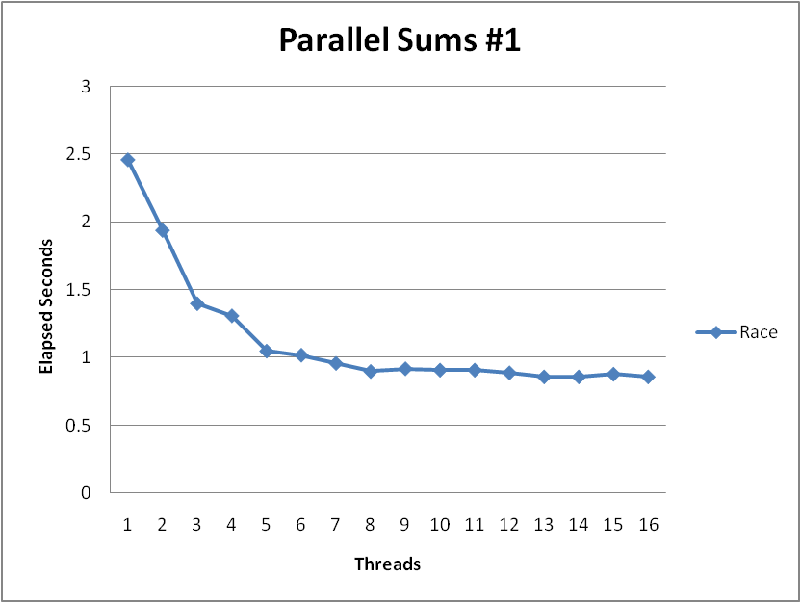
Unsynchronized Performance
N = 2³⁰
Best speedup = 2.86X
Gets wrong answer when > 1 thread!
Why?

Slide 29
Thread Function: Semaphore / Mutex
Semaphore
void *sum_sem(void *vargp)
{
int myid = *((int *)vargp);
size_t start = myid * nelems_per_thread;
size_t end = start + nelems_per_thread;
size_t i;
for (i = start; i < end; i++) {
sem_wait(&semaphore);
global_sum += i;
sem_post(&semaphore);
}
return NULL;
}
sem_wait(&semaphore);
global_sum += i;
sem_post(&semaphore);
Mutex
pthread_mutex_lock(&mutex);
global_sum += i;
pthread_mutex_unlock(&mutex);

Slide 30
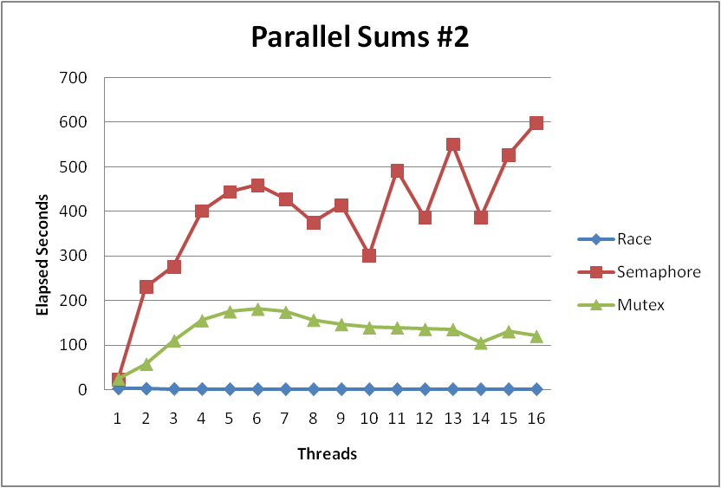
Semaphore / Mutex Performance
What is main reason for poor performance?
Terrible Performance
  2.5 seconds ➔ ~10 minutes
Mutex 3X faster than semaphore
Clearly, neither is successful

Slide 31
Separate Accumulation
Method #2: Each thread accumulates into separate variable
  2A: Accumulate in contiguous array elements
  2B: Accumulate in spaced-apart array elements
  2C: Accumulate in registers
/* Partial sum computed by each thread */
data_t psum[MAXTHREADS*MAXSPACING];
/* Spacing between accumulators */
size_t spacing = 1;

Slide 32
Separate Accumulation: Operation
nelems_per_thread = nelems / nthreads;
/* Create threads and wait for them to finish */
for (i = 0; i < nthreads; i++) {
myid[i] = i;
psum[i*spacing] = 0;
Pthread_create(&tid[i], NULL, thread_fun, &myid[i]);
}
for (i = 0; i < nthreads; i++)
Pthread_join(tid[i], NULL);
result = 0;
/* Add up the partial sums computed by each thread */
for (i = 0; i < nthreads; i++)
result += psum[i*spacing];
/* Add leftover elements */
for (e = nthreads * nelems_per_thread; e < nelems; e++)
result += e;

Slide 33
Thread Function: Memory Accumulation
Where is the mutex?
void *sum_global(void *vargp)
{
int myid = *((int *)vargp);
size_t start = myid * nelems_per_thread;
size_t end = start + nelems_per_thread;
size_t i;
size_t index = myid*spacing;
psum[index] = 0;
for (i = start; i < end; i++) {
psum[index] += i;
}
return NULL;
}

Slide 34
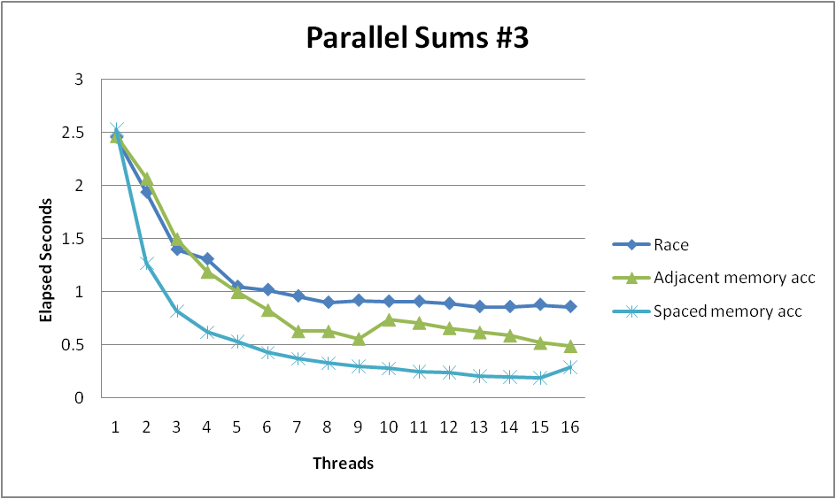
Memory Accumulation Performance
Clear threading advantage
  Adjacent speedup: 5 X
  Spaced-apart speedup: 13.3 X (Only observed speedup > 8)
Why does spacing the accumulators apart matter?

Slide 35
False Sharing
0
7
8
15
psum
…
…
Cache Block m
Cache Block m+1
Coherence maintained on cache blocks
To update psum[i], thread i must have exclusive access
  Threads sharing common cache block will keep fighting each other for access to block

Slide 36
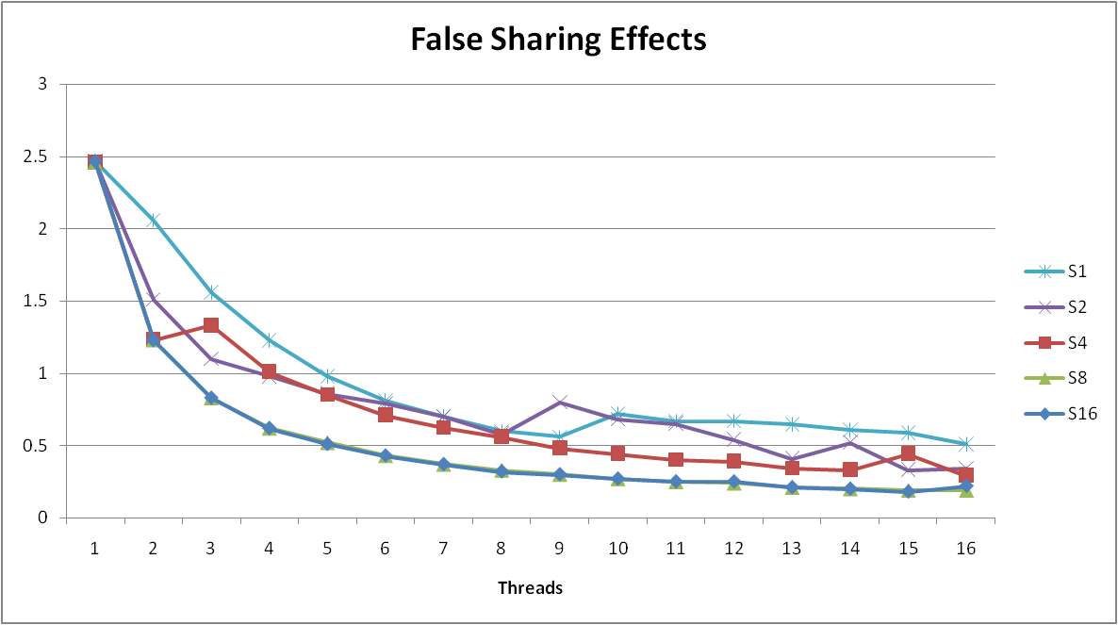
False Sharing Performance
  Best spaced-apart performance 2.8 X better than best adjacent
Demonstrates cache block size = 64
  8-byte values
  No benefit increasing spacing beyond 8

Slide 37
Thread Function: Register Accumulation
void *sum_local(void *vargp)
{
int myid = *((int *)vargp);
size_t start = myid * nelems_per_thread;
size_t end = start + nelems_per_thread;
size_t i;
size_t index = myid*spacing;
data_t sum = 0;
for (i = start; i < end; i++) {
sum += i;
}
psum[index] = sum;
return NULL;
}

Slide 38
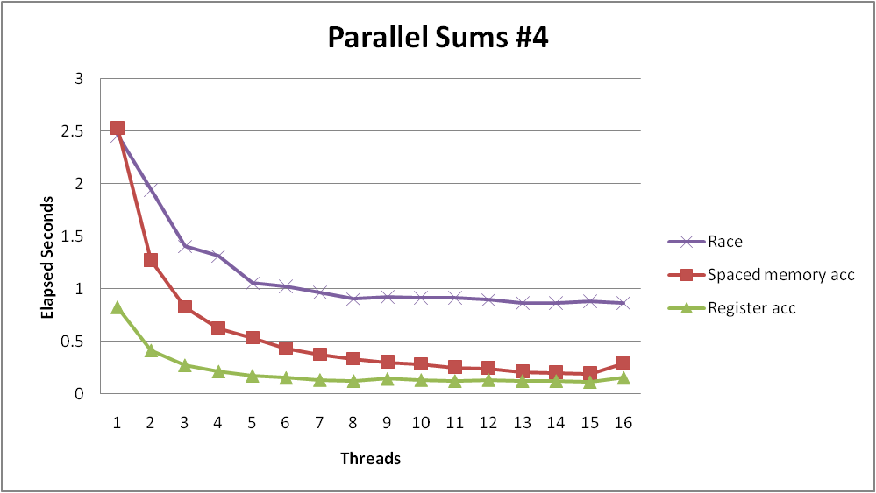
Register Accumulation Performance
Clear threading advantage
  Speedup = 7.5 X
2X better than fastest memory accumulation
Beware the speedup metric!
Notes:
Speedup *over what*?

Slide 39
Lessons learned
Sharing memory can be expensive
  Pay attention to true sharing
  Pay attention to false sharing
Use registers whenever possible
  (Remember cachelab)
  Use local cache whenever possible
Deal with leftovers
When examining performance, compare to best possible sequential implementation

Slide 40
Quiz Time!
Canvas Quiz: Day 25 – Thread Level Parallelism

Slide 41
A More Substantial Example: Sort
Sort set of N random numbers
Multiple possible algorithms
  Use parallel version of quicksort
Sequential quicksort of set of values X
  Choose “pivot” p from X
  Rearrange X into
    L: Values ≤ p
    R: Values > p
  Recursively sort L to get L′
  Recursively sort R to get R′
  Return L′ : p : R′

Slide 42
Sequential Quicksort Visualized
X
p
L
p
R
p2
L2
p2
R2
•
•
•
L′

Slide 43
Sequential Quicksort Visualized
X
L′
p
R
p3
L3
p3
R3
•
•
•
R′
L′
p
R′

Slide 44
Sequential Quicksort Code
void qsort_serial(data_t *base, size_t nele) {
if (nele <= 1)
return;
if (nele == 2) {
if (base[0] > base[1])
swap(base, base+1);
return;
}
/* Partition returns index of pivot */
size_t m = partition(base, nele);
if (m > 1)
qsort_serial(base, m);
if (nele-1 > m+1)
qsort_serial(base+m+1, nele-m-1);
}
Sort nele elements starting at base
  Recursively sort L or R if has more than one element

Slide 45
Parallel Quicksort
Parallel quicksort of set of values X
  If N ≤ Nthresh, do sequential quicksort
  Else
    Choose “pivot” p from X
    Rearrange X into
      L: Values ≤ p
      R: Values > p
    Recursively spawn separate threads
      Sort L to get L′
      Sort R to get R′
    Return L′ : p : R′

Slide 46
Parallel Quicksort Visualized
X
p
L
p
R
p2
p3
L2
p2
R2
p
L3
p3
R3
•
•
•
•
•
•
L′
p
R′

Slide 47
Thread Structure: Sorting Tasks
X
• • •
Task Threads
Task: Sort subrange of data
  Specify as:
    base: Starting address
    nele: Number of elements in subrange
Run as separate thread

Slide 48
Small Sort Task Operation
X
• • •
Task Threads
Sort subrange using serial quicksort

Slide 49
Large Sort Task Operation
X
L
p
R
Partition Subrange
• • •
X
L
p
R
Spawn 2 tasks
• • •

Slide 50
Top-Level Function (Simplified)
void tqsort(data_t *base, size_t nele) {
init_task(nele);
global_base = base;
global_end = global_base + nele - 1;
task_queue_ptr tq = new_task_queue();
tqsort_helper(base, nele, tq);
join_tasks(tq);
free_task_queue(tq);
}
Sets up data structures
Calls recursive sort routine
Keeps joining threads until none left
Frees data structures

Slide 51
Recursive sort routine (Simplified)
/* Multi-threaded quicksort */
static void tqsort_helper(data_t *base, size_t nele,
task_queue_ptr tq) {
if (nele <= nele_max_sort_serial) {
/* Use sequential sort */
qsort_serial(base, nele);
return;
}
sort_task_t *t = new_task(base, nele, tq);
spawn_task(tq, sort_thread, (void *) t);
}
Small partition: Sort serially
Large partition: Spawn new sort task

Slide 52
Sort task thread (Simplified)
/* Thread routine for many-threaded quicksort */
static void *sort_thread(void *vargp) {
sort_task_t *t = (sort_task_t *) vargp;
data_t *base = t->base;
size_t nele = t->nele;
task_queue_ptr tq = t->tq;
free(vargp);
size_t m = partition(base, nele);
if (m > 1)
tqsort_helper(base, m, tq);
if (nele-1 > m+1)
tqsort_helper(base+m+1, nele-m-1, tq);
return NULL;
}
Get task parameters
Perform partitioning step
Call recursive sort routine on each partition (if size of part > 1)

Slide 53
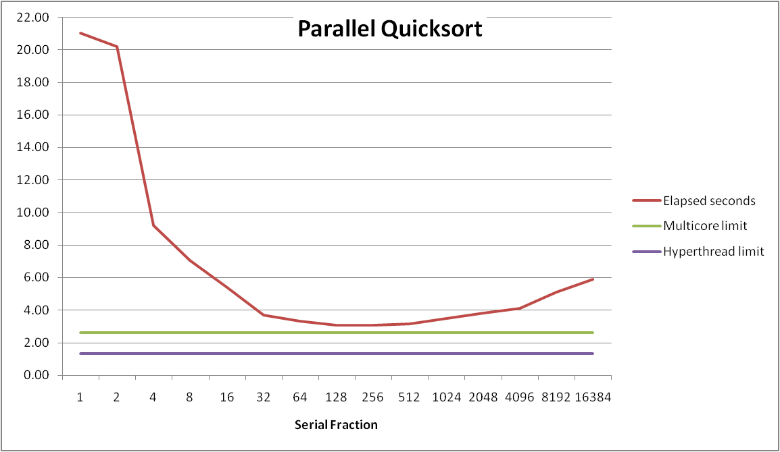
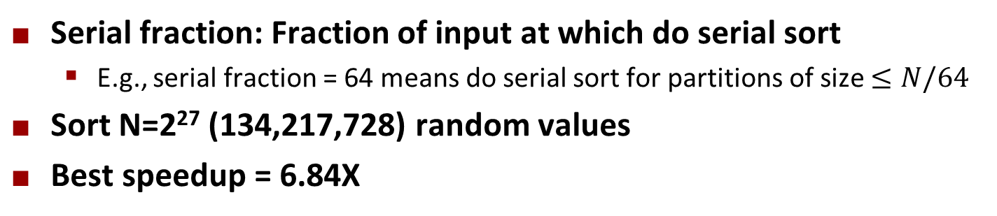
Parallel Quicksort Performance
Serial fraction: Fraction of input at which do serial sort
  E.g., serial fraction = 64 means do serial sort for partitions of size $≤N/64$
Sort N=2²⁷ (134,217,728) random values
Best speedup = 6.84X

Slide 54
Parallel Quicksort Performance
Good performance over wide range of fraction values
  Serial Fraction too small: Not enough parallelism
  Serial Fraction too large: Thread overhead too high

Slide 55
Amdahl’s Law
Overall problem
  T Total sequential time required
  p Fraction of total that can be sped up (0 ≤ p ≤ 1)
  k Speedup factor
Resulting Performance
  T_{k} = pT/k + (1-p)T
    Portion which can be sped up runs k times faster
    Portion which cannot be sped up stays the same
  Maximum possible speedup
    k = ∞
    T∞ = (1-p)T

Slide 56
Amdahl’s Law Example
Overall problem
  T = 10 Total time required
  p = 0.9 Fraction of total which can be sped up
  k = 9 Speedup factor
Resulting Performance
  T₉ = 0.9 * 10/9 + 0.1 * 10 = 1.0 + 1.0 = 2.0 (a 5x speedup)
Maximum possible speedup
  T∞ = 0.1 * 10.0 = 1.0 (a 10x speedup)
    With infinite parallel computing resources!
  Limit speedup shows algorithmic limitation

Slide 57
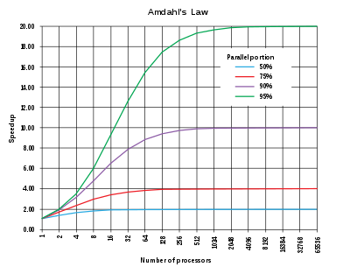
Amdahl’s Law Example

Slide 58
Amdahl’s Law & Parallel Quicksort
Sequential bottleneck
  Top-level partition: No speedup
  Second level: ≤ 2X speedup
  k^{th} level: ≤ 2^{k-1}X speedup
Implications
  Good performance for small-scale parallelism
  Would need to parallelize partitioning step to get large-scale parallelism
    Parallel Sorting by Regular Sampling
      H. Shi & J. Schaeffer, J. Parallel & Distributed Computing, 1992

Slide 59
Parallelizing Partitioning Step
X₁
X₂
X₃
X₄
p
Parallel partitioning based on global p
L₁
R₁
L₂
R₂
L₃
R₃
L₄
R₄
Reassemble into partitions
L₁
L₂
L₃
L₄
R₁
R₂
R₃
R₄

Slide 60
Experience with Parallel Partitioning
Could not obtain speedup
Speculate: Too much data copying
  Could not do everything within source array
  Set up temporary space for reassembling partition

Slide 61
Lessons Learned
Must have parallelization strategy
  Partition into K independent parts
  Divide-and-conquer
Inner loops must be synchronization free
  Synchronization operations very expensive
Watch out for hardware artifacts
  Need to understand processor & memory structure
  Sharing and false sharing of global data
Beware of Amdahl’s Law
  Serial code can become bottleneck
You can do it!
  Achieving modest levels of parallelism is not difficult
  Set up experimental framework and test multiple strategies

