Slide 1
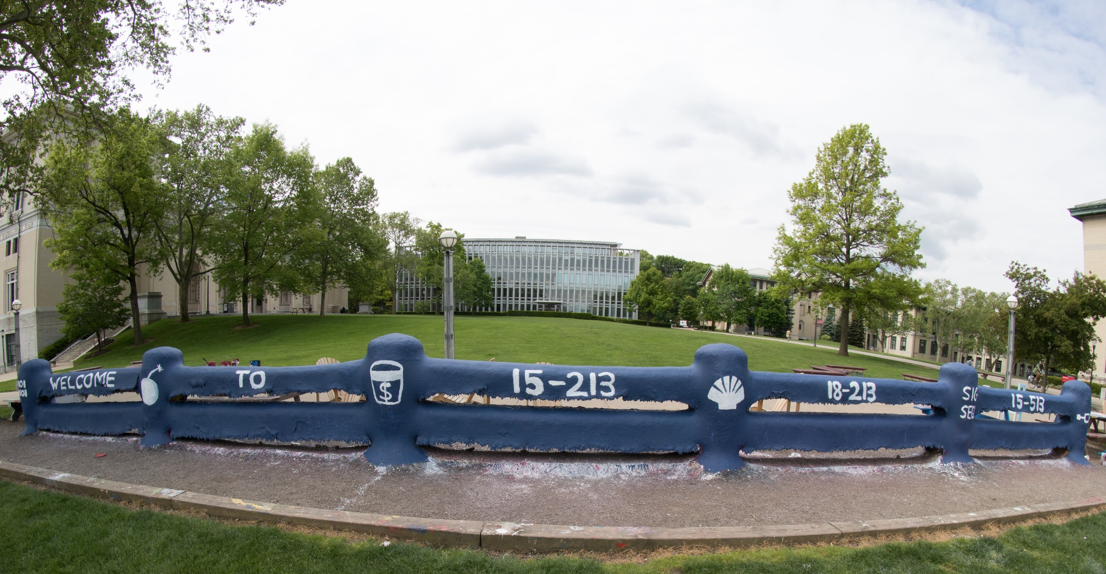
14-513
18-613

Slide 2
Machine-Level Programming IV: Data 18-213/18-613: Introduction to Computer Systems 7th Lecture, May 30^{th,} 2023

Slide 3
Announcements
Lab 2 (bomblab) due Wednesday
Turns in automatically via Autolab
Lab 3 (attacklab) out Wednesday
As usual, homework due on Thursdays
Goes out on Tuesdays
Live for 1.5 weeks
Available on Canvas
Lab 0 last hand-in Monday, June 5th (Less than one week)

Slide 4
Autolab CLI
Command-line tool that lets you access some Autolab features, including submitting assignments, from the command-line
/afs/cs/academic/class/18213-m23/bin/autolabv3
You might want to alias this or add it to your path so you don’t have to type this long thing each time you want to use it.
Your group TA can help if you are unfamiliar
It needs to be authorized to access your account:
1) /afs/cs/academic/class/18213-m23/bin/autolabv3 setup
2) It produces a 6 letter/number key
3) Feed that key in here: https://ics.autolabproject.com/activate
You need to activate the CLI for your account even if you don’t intend to (directly) use it
Attacklab uses it to make your submissions each time you achieve a phase.

Slide 5
Today
Arrays
One-dimensional
Multi-dimensional (nested)
Multi-level
Structures
Allocation
Access
Alignment
Floating Point

Slide 6
Array Allocation
Basic Principle
T A[L];
Array of data type T and length L
Contiguously allocated region of L * sizeof(T) bytes in memory
char string[12];
x
x + 12
int val[5];
x
x + 4
x + 8
x + 12
x + 16
x + 20
double a[3];
x
x + 8
x + 16
x + 24
char *p[3];
x
x + 8
x + 16
x + 24

Slide 7
Array Access
Basic Principle
T A[L];
Array of data type T and length L
Identifier A can be used as a pointer to array element 0: Type T*
Reference Type Value
val[4] int 3
val int *
val+1 int *
&val[2] int *
val[5] int
*(val+1) int
val + i int *
int val[5];
1
5
2
1
3
x
x + 4
x + 8
x + 12
x + 16
x + 20

Slide 8
Array Access
Basic Principle
T A[L];
Array of data type T and length L
Identifier A can be used as a pointer to array element 0: Type T*
Reference Type Value
val[4] int 3
val int * x
val+1 int * x + 4
&val[2] int * x + 8
val[5] int ??
*(val+1) int 5 //val[1]
val + i int * x + 4 * i //&val[i]
int val[5];
1
5
2
1
3
x
x + 4
x + 8
x + 12
x + 16
x + 20

Slide 9
Array Example
#define ZLEN 5
typedef int zip_dig[ZLEN];
zip_dig cmu = { 1, 5, 2, 1, 3 };
zip_dig mit = { 0, 2, 1, 3, 9 };
zip_dig ucb = { 9, 4, 7, 2, 0 };
zip_dig cmu;
1
5
2
1
3
16
20
24
28
32
36
zip_dig mit;
0
2
1
3
9
36
40
44
48
52
56
zip_dig ucb;
9
4
7
2
0
56
60
64
68
72
76
Declaration “zip_dig cmu” equivalent to “int cmu[5]”
Example arrays were allocated in successive 20 byte blocks
Not guaranteed to happen in general

Slide 10
Array Accessing Example
zip_dig cmu;
1
5
2
1
3
16
20
24
28
32
36
int get_digit
(zip_dig z, int digit)
{
return z[digit];
}
Register %rdi contains starting address of array
Register %rsi contains array index
Desired digit at %rdi + 4*%rsi
Use memory reference (%rdi,%rsi,4)
x86-64
# %rdi = z
# %rsi = digit
movl (%rdi,%rsi,4), %eax # z[digit]

Slide 11
Array Loop Example
#define ZLEN 5
void zincr(zip_dig z) {
size_t i;
for (i = 0; i < ZLEN; i++)
z[i]++;
}
# %rdi = z
movl $0, %eax # i = 0
jmp .L3 # goto middle
.L4: # loop:
addl $1, (%rdi,%rax,4) # z[i]++
addq $1, %rax # i++
.L3: # middle
cmpq $4, %rax # i:4
jbe .L4 # if <=, goto loop
rep; ret

Slide 12
Understanding Pointers & Arrays #1
Decl | A1 , A2 |  |  | *A1 , *A2
 | Comp | Bad | Size | Comp | Bad | Size
int A1[3]
int *A2
A1
Allocated pointer
Unallocated pointer
A2
Allocated int
Unallocated int
Comp: Compiles (Y/N)
Bad: Possible bad pointer reference (Y/N)
Size: Value returned by sizeof

Slide 13
Understanding Pointers & Arrays #1
Decl | A1 , A2 |  |  | *A1 , *A2
 | Comp | Bad | Size | Comp | Bad | Size
int A1[3] | Y | N | 12 | Y | N | 4
int *A2 | Y | N | 8 | Y | Y | 4
A1
Allocated pointer
Unallocated pointer
A2
Allocated int
Unallocated int
Comp: Compiles (Y/N)
Bad: Possible bad pointer reference (Y/N)
Size: Value returned by sizeof

Slide 14
Understanding Pointers & Arrays #2
Decl | An |  |  | *An |  |  | **An
 | Cmp | Bad | Size | Cmp | Bad | Size | Cmp | Bad | Size
int A1[3]
int *A2[3]
int (*A3)[3]
A1
A2
A3
Allocated pointer
Unallocated pointer
Allocated int
Unallocated int

Slide 15
Understanding Pointers & Arrays #2
Decl | An |  |  | *An |  |  | **An
 | Cmp | Bad | Size | Cmp | Bad | Size | Cmp | Bad | Size
int A1[3] | Y | N | 12 | Y | N | 4 | N | - | -
int *A2[3] | Y | N | 24 | Y | N | 8 | Y | Y | 4
int (*A3)[3] | Y | N | 8 | Y | Y | 12 | Y | Y | 4
A1
A2
A3
Allocated pointer
Unallocated pointer
Allocated int
Unallocated int

Slide 16
Multidimensional (Nested) Arrays
Declaration
T A[R][C];
2D array of data type T
R rows, C columns
Array Size
R * C * sizeof(T) bytes
Arrangement
Row-Major Ordering
A[0][0]
• • •
A[0][C-1]
•
•
•
•
•
•
A[R-1][0]
• • •
A[R-1][C-1]
int A[R][C];
• • •
A
[0]
[0]
A
[0]
[C-1]
• • •
A
[1]
[0]
A
[1]
[C-1]
• • •
• • •
A
[R-1]
[0]
A
[R-1]
[C-1]
4*R*C Bytes
Notes:
Board: show 3D example: a[2][3][2] to illustrate the idea of row major as enumerating indices from right to left

Slide 17
Nested Array Example
#define PCOUNT 4
typedef int zip_dig[5];
zip_dig pgh[PCOUNT] =
{{1, 5, 2, 0, 6},
{1, 5, 2, 1, 3 },
{1, 5, 2, 1, 7 },
{1, 5, 2, 2, 1 }};
zip_dig
pgh[4];
1
5
2
0
6
1
5
2
1
3
1
5
2
1
7
1
5
2
2
1
76
96
116
136
156
“zip_dig pgh[4]” equivalent to “int pgh[4][5]”
Variable pgh: array of 4 elements, allocated contiguously
Each element is an array of 5 int’s, allocated contiguously
“Row-Major” ordering of all elements in memory

Slide 18
Nested Array Row Access
Row Vectors
A[i] is array of C elements of type T
Starting address A + i * (C * sizeof(T))
int A[R][C];
A[0]
A[i]
A[R-1]
• • •
A
[0]
[0]
A
[0]
[C-1]
• • •
• • •
A
[i]
[0]
A
[i]
[C-1]
• • •
• • •
A
[R-1]
[0]
A
[R-1]
[C-1]
A
A+(i*C*4)
A+((R-1)*C*4)

Slide 19
Nested Array Row Access Code
1
5
2
0
6
1
5
2
1
3
1
5
2
1
7
1
5
2
2
1
pgh
pgh[2]
int *get_pgh_zip(int index)
{
return pgh[index];
}
# %rdi = index
leaq (%rdi,%rdi,4),%rax # 5 * index
leaq pgh(,%rax,4),%rax # pgh + (20 * index)
Row Vector
pgh[index] is array of 5 int’s
Starting address pgh+20*index
Machine Code
Computes and returns address
Compute as pgh + 4*(index+4*index)

Slide 20
Nested Array Element Access
Array Elements
A[i][j] is element of type T, which requires K bytes
Address A + i * (C * K) + j * K = A + (i * C + j) * K
int A[R][C];
A[0]
A[i]
A[R-1]
• • •
A
[0]
[0]
A
[0]
[C-1]
• • •
• • • • • •
A
[i]
[j]
• • •
• • •
A
[R-1]
[0]
A
[R-1]
[C-1]
A
A+(i*C*4)
A+((R-1)*C*4)
A+(i*C*4)+(j*4)

Slide 21
Nested Array Element Access Code
1
5
2
0
6
1
5
2
1
3
1
5
2
1
7
1
5
2
2
1
pgh
pgh[1][1]
int get_pgh_digit(int index, int dig)
{
return pgh[index][dig];
}
leaq (%rdi,%rdi,4), %rax # 5*index
addl %rax, %rsi # 5*index+dig
movl pgh(,%rsi,4), %eax # M[pgh + 4*(5*index+dig)]
Array Elements
pgh[index][dig] is int
Address: pgh + 20*index + 4*dig
= pgh + 4*(5*index + dig)

Slide 22
Multi-Level Array Example
zip_dig cmu = { 1, 5, 2, 1, 3 };
zip_dig mit = { 0, 2, 1, 3, 9 };
zip_dig ucb = { 9, 4, 7, 2, 0 };
Variable univ denotes array of 3 elements
Each element is a pointer
8 bytes
Each pointer points to array of int’s
#define UCOUNT 3
int *univ[UCOUNT] = {mit, cmu, ucb};
cmu
1
5
2
1
3
univ
16
20
24
28
32
36
160
36
mit
0
2
1
3
9
168
16
ucb
36
40
44
48
52
56
176
56
9
4
7
2
0
56
60
64
68
72
76

Slide 23
Element Access in Multi-Level Array
int get_univ_digit
(size_t index, size_t digit)
{
return univ[index][digit];
}
salq $2, %rsi # 4*digit
addq univ(,%rdi,8), %rsi # p = univ[index] + 4*digit
movl (%rsi), %eax # return *p
ret
Computation
Element access Mem[Mem[univ+8*index]+4*digit]
Must do two memory reads
First get pointer to row array
Then access element within array

Slide 24
Array Element Accesses
Nested array
Multi-level array
int get_pgh_digit
(size_t index, size_t digit)
{
return pgh[index][digit];
}
int get_univ_digit
(size_t index, size_t digit)
{
return univ[index][digit];
}
Accesses looks similar in C, but address computations very different:
Mem[pgh+20*index+4*digit]
Mem[Mem[univ+8*index]+4*digit]

Slide 25
N X N Matrix Code
#define N 16
typedef int fix_matrix[N][N];
/* Get element A[i][j] */
int fix_ele(fix_matrix A,
size_t i, size_t j)
{
return A[i][j];
}
Fixed dimensions
Know value of N at compile time
Variable dimensions, explicit indexing
Traditional way to implement dynamic arrays
Variable dimensions, implicit indexing
Now supported by gcc
#define IDX(n, i, j) ((i)*(n)+(j))
/* Get element A[i][j] */
int vec_ele(size_t n, int *A,
size_t i, size_t j)
{
return A[IDX(n,i,j)];
}
/* Get element A[i][j] */
int var_ele(size_t n, int A[n][n],
size_t i, size_t j) {
return A[i][j];
}

Slide 26
16 X 16 Matrix Access
Array Elements
int A[16][16];
Address A + i * (C * K) + j * K
C = 16, K = 4
/* Get element A[i][j] */
int fix_ele(fix_matrix A, size_t i, size_t j) {
return A[i][j];
}
# A in %rdi, i in %rsi, j in %rdx
salq $6, %rsi # 64*i
addq %rsi, %rdi # A + 64*i
movl (%rdi,%rdx,4), %eax # Mem[A + 64*i + 4*j]
ret

Slide 27
n X n Matrix Access
Array Elements
size_t n;
int A[n][n];
Address A + i * (C * K) + j * K
C = n, K = 4
Must perform integer multiplication
/* Get element A[i][j] */
int var_ele(size_t n, int A[n][n], size_t i, size_t j) {
return A[i][j];
}
# n in %rdi, A in %rsi, i in %rdx, j in %rcx
imulq %rdx, %rdi # n*i
leaq (%rsi,%rdi,4), %rax # A + 4*n*i
movl (%rax,%rcx,4), %eax # A + 4*n*i + 4*j
ret
Notes:
Why multiply?

Slide 28
Example: Array Access
#include <stdio.h>
#define ZLEN 5
#define PCOUNT 4
typedef int zip_dig[ZLEN];
int main(int argc, char** argv) {
zip_dig pgh[PCOUNT] =
{{1, 5, 2, 0, 6},
{1, 5, 2, 1, 3 },
{1, 5, 2, 1, 7 },
{1, 5, 2, 2, 1 }};
int *linear_zip = (int *) pgh;
int *zip2 = (int *) pgh[2];
int result =
pgh[0][0] +
linear_zip[7] +
*(linear_zip + 8) +
zip2[1];
printf("result: %d\n", result);
return 0;
}
linux> ./array
result: 9
Notes:
Stop and ask students to work out what this might print.

Slide 29
Example: Array Access
#include <stdio.h>
#define ZLEN 5
#define PCOUNT 4
typedef int zip_dig[ZLEN];
int main(int argc, char** argv) {
zip_dig pgh[PCOUNT] =
{{1, 5, 2, 0, 6},
{1, 5, 2, 1, 3 },
{1, 5, 2, 1, 7 },
{1, 5, 2, 2, 1 }};
int *linear_zip = (int *) pgh;
int *zip2 = (int *) pgh[2];
int result =
pgh[0][0] +
linear_zip[7] +
*(linear_zip + 8) +
zip2[1];
printf("result: %d\n", result);
return 0;
}
linux> ./array
result: 9

Slide 30
Today
Arrays
One-dimensional
Multi-dimensional (nested)
Multi-level
Structures
Allocation
Access
Alignment
Floating Point

Slide 31
Structure Representation
r
struct rec {
int a[4];
size_t i;
struct rec *next;
};
a
i
next
0
16
24
32
Structure represented as block of memory
Big enough to hold all of the fields
Fields ordered according to declaration
Even if another ordering could yield a more compact representation (due to alignment rules—coming soon)
Compiler determines overall size + positions of fields
Machine-level program has no understanding of the structures in the source code

Slide 32
Generating Pointer to Structure Member
r
r+4*idx
struct rec {
int a[4];
size_t i;
struct rec *next;
};
a
i
next
0
16
24
32
Generating Pointer to Array Element
Offset of each structure member determined at compile time
Compute as r + 4*idx
int *get_ap
(struct rec *r, size_t idx)
{
return &r->a[idx];
}
# r in %rdi, idx in %rsi
leaq (%rdi,%rsi,4), %rax
ret

Slide 33
Following Linked List #1
struct rec {
int a[4];
size_t i;
struct rec *next;
};
C Code
Loop assembly code
r
long length(struct rec*r) {
long len = 0L;
while (r) {
len ++;
r = r->next;
}
return len;
}
a
i
next
0
16
24
32
Register | Value
%rdi | r
%rax | len
.L11: # loop:
addq $1, %rax # len ++
movq 24(%rdi), %rdi # r = Mem[r+24]
testq %rdi, %rdi # Test r
jne .L11 # If != 0, goto loop

Slide 34
Following Linked List #2
struct rec {
int a[4];
size_t i;
struct rec *next;
};
C Code
r
void set_val
(struct rec *r, int val)
{
while (r) {
size_t i = r->i;
// No bounds check
r->a[i] = val;
r = r->next;
}
}
a
i
next
0
16
24
32
Element i
Register | Value
%rdi | r
%rsi | val
.L11: # loop:
movq 16(%rdi), %rax # i = Mem[r+16]
movl %esi, (%rdi,%rax,4) # Mem[r+4*i] = val
movq 24(%rdi), %rdi # r = Mem[r+24]
testq %rdi, %rdi # Test r
jne .L11 # if !=0 goto loop

Slide 35
Structures & Alignment
Unaligned Data
Aligned Data
Primitive data type requires B bytes implies
Address must be multiple of B
struct S1 {
char c;
int i[2];
double v;
} *p;
c
i[0]
i[1]
v
p
p+1
p+5
p+9
p+17
c
3 bytes
i[0]
i[1]
4 bytes
v
p+0
p+4
p+8
p+16
p+24
Multiple of 4
Multiple of 8
Multiple of 8
Multiple of 8

Slide 36
Alignment Principles
Aligned Data
Primitive data type requires B bytes
Address must be multiple of B
Required on some machines; advised on x86-64
Motivation for Aligning Data
Memory accessed by (aligned) chunks of 4 or 8 bytes (system dependent)
Inefficient to load or store datum that spans cache lines (64 bytes). Intel states should avoid crossing 16 byte boundaries.
[Cache lines will be discussed in Lecture 11.]
Virtual memory trickier when datum spans 2 pages (4 KB pages)
[Virtual memory pages will be discussed in Lecture 17.]
Compiler
Inserts gaps in structure to ensure correct alignment of fields

Slide 37
Specific Cases of Alignment (x86-64)
1 byte: char, …
no restrictions on address
2 bytes: short, …
lowest 1 bit of address must be 02
4 bytes: int, float, …
lowest 2 bits of address must be 002
8 bytes: double, long, char *, …
lowest 3 bits of address must be 0002

Slide 38
Satisfying Alignment with Structures
Within structure:
Must satisfy each element’s alignment requirement
Overall structure placement
Each structure has alignment requirement K
K = Largest alignment of any element
Initial address & structure length must be multiples of K
Example:
K = 8, due to double element
struct S1 {
char c;
int i[2];
double v;
} *p;
Internal padding
c
3 bytes
i[0]
i[1]
4 bytes
v
p+0
p+4
p+8
p+16
p+24
Multiple of 4
Multiple of 8
Multiple of 8
Multiple of 8

Slide 39
Meeting Overall Alignment Requirement
For largest alignment requirement K
Overall structure must be multiple of K
struct S2 {
double v;
int i[2];
char c;
} *p;
External padding
 | v |  |  |  |  |  |  | i[0] |  |  |  | i[1] |  |  |  | c | 7 bytes
p+0 |  |  |  |  |  |  | p+8 |  |  |  |  |  |  |  | p+16 |  |  |  |  |  |  |  | p+24
Multiple of K=8

Slide 40
Arrays of Structures
struct S2 {
double v;
int i[2];
char c;
} a[10];
Overall structure length multiple of K
Satisfy alignment requirement for every element
 | a[0] |  |  |  |  | a[1] |  |  |  |  | a[2] |  |  |  |  | • • •
a+0 |  |  |  |  | a+24 |  |  |  |  | a+48 |  |  |  |  | a+72
 | v |  |  |  |  |  |  | i[0] |  |  |  | i[1] |  |  |  | c | 7 bytes
a+24 |  |  |  |  |  |  | a+32 |  |  |  |  |  |  |  | a+40 |  |  |  |  |  |  |  | a+48

Slide 41
Accessing Array Elements
struct S3 {
short i;
float v;
short j;
} a[10];
Compute array offset 12*idx
sizeof(S3), including alignment spacers
Element j is at offset 8 within structure
Assembler gives offset a+8
Resolved during linking
 | a[0] |  |  |  |  | • • • |  |  |  | a[idx] |  |  |  | • • |  |  | •
a+0 |  |  |  |  | a+12 |  |  |  | a+12*idx
 |  |  |  |  | i | 2 bytes |  | v |  |  | j | 2 bytes
 |  |  |  | a+12*idx |  |  |  |  |  | a+12*idx+8
short get_j(int idx)
{
return a[idx].j;
}
# %rdi = idx
leaq (%rdi,%rdi,2),%rax # 3*idx
movzwl a+8(,%rax,4),%eax
Notes:
Give the pseudo-code for the assembly, which field / element is being accessed?

Slide 42
Saving Space
Put large data types first
Effect (largest alignment requirement K=4)
struct S4 {
char c;
int i;
char d;
} *p;
struct S5 {
int i;
char c;
char d;
} *p;
c
3 bytes
i
d
3 bytes
12 bytes
i
c
d
2 bytes
8 bytes

Slide 43
Example Struct Exam Question
http://www.cs.cmu.edu/~213/oldexams/exam1-f12.pdf

Slide 44
Example Struct Exam Question
a
X
X
X
X
X
X
X
b
b
b
b
b
b
b
b
c
c
c
c
d
d
d
X
e
e
e
e
e
e
e
e
f
f
f
f
f
f
f
|
f
http://www.cs.cmu.edu/~213/oldexams/exam1-f12.pdf

Slide 45
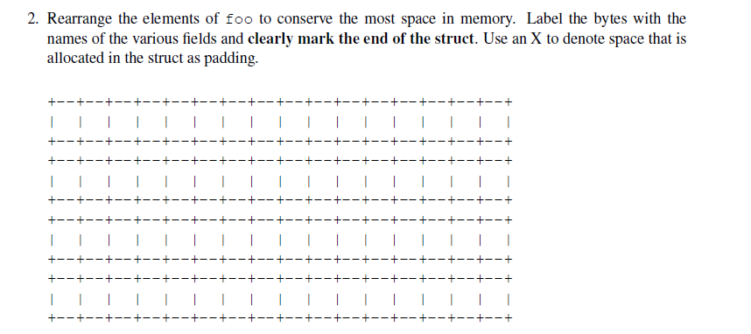
Example Struct Exam Question (Cont’d)
http://www.cs.cmu.edu/~213/oldexams/exam1-f12.pdf

Slide 46
Example Struct Exam Question (Cont’d)
a
d
d
d
c
c
c
c
b
b
b
b
b
b
b
b
e
e
e
e
e
e
e
e
f
f
f
|
f
f
f
f
f
http://www.cs.cmu.edu/~213/oldexams/exam1-f12.pdf

Slide 47
Union Allocation
Principles
Overlay union elements
Allocate according to largest element
Can only use one field at a time
union U1 {
char c;
int i[2];
double v;
} *up;
c
i[0]
i[1]
struct S1 {
char c;
int i[2];
double v;
} *sp;
v
up+0
up+4
up+8
c
i[0]
i[1]
v
sp+0
sp+4
sp+8
sp+16
sp+24

Slide 48
Using Union to Access Bit Patterns
typedef union {
float f;
unsigned u;
} bit_float_t;
float bit2float(unsigned u) {
bit_float_t arg;
arg.u = u;
return arg.f;
}
u
f
0
4
unsigned float2bit(float f) {
bit_float_t arg;
arg.f = f;
return arg.u;
}
Get direct access to bit representation of float
bit2float generates float with given bit pattern
NOT the same as (float) u
float2bit generates bit pattern from float
NOT the same as (unsigned) f

