Slide 1
Plan
Today
Wrap-up regularization (for now)
MLE
    Probability / likelihood
    Maximum likelihood estimation
    Probabilistic formulation of linear and logistic regression

Slide 2
Wrap up Neural Nets
Switch to regression slides

Slide 3

10-315
Introduction to ML
MLE and
Probabilistic Formulation of Machine Learning
Instructor: Pat Virtue

Slide 4
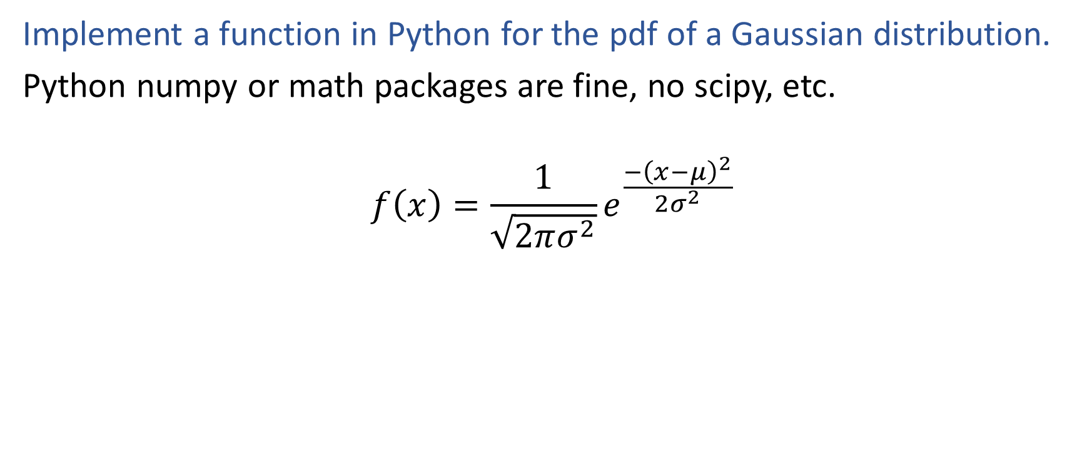
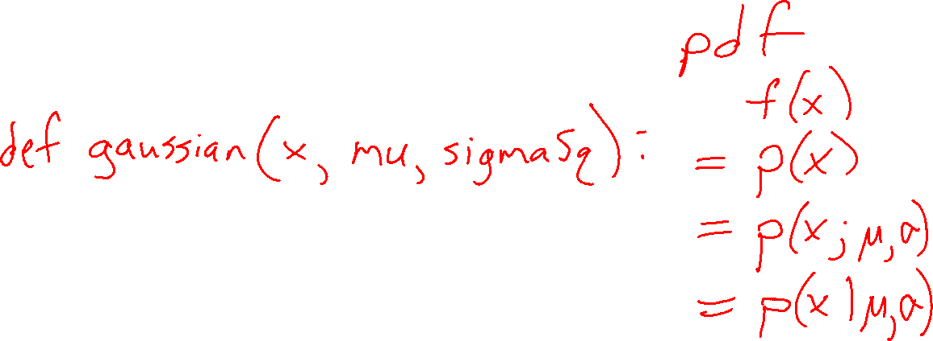
Poll 1: Exercise
Implement a function in Python for the pdf of a Gaussian distribution.
Python numpy or math packages are fine, no scipy, etc.
$$f\left(x\right)=\frac{1}{\sqrt{2πσ^{2}}}e^{\frac{−{\left(x−μ\right)}^{2}}{2σ^{2}}}$$

Slide 5
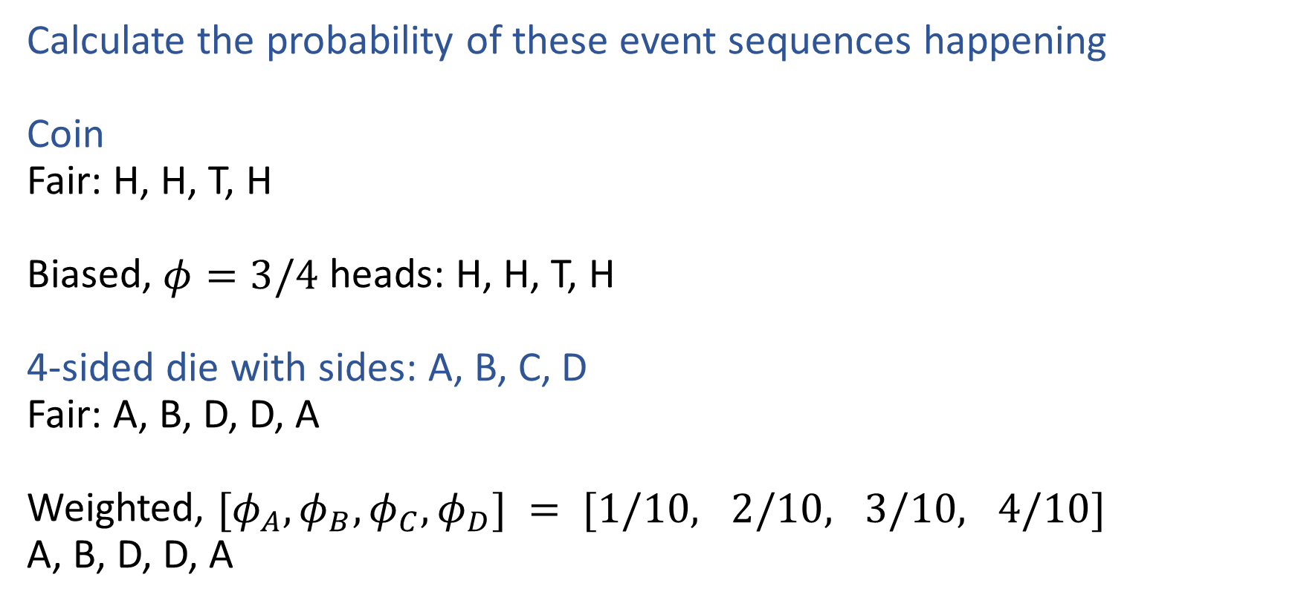
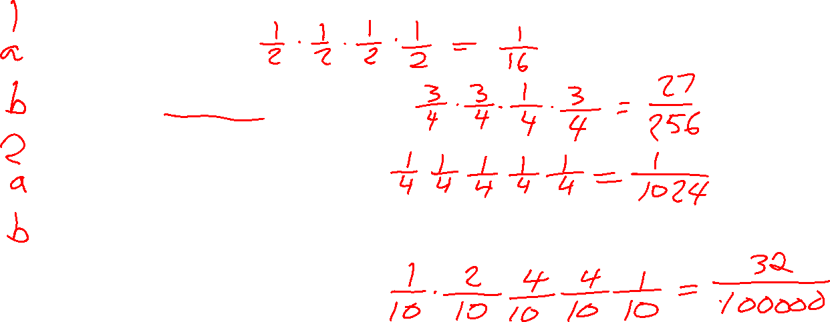
Exercises
Calculate the probability of these event sequences happening
Coin
Fair: H, H, T, H
Biased, $φ=3/4$ heads: H, H, T, H
4-sided die with sides: A, B, C, D
Fair: A, B, D, D, A
Weighted, $[φ_{A}, φ_{B},φ_{C}, φ_{D}] = [1/10, 2/10, 3/10, 4/10]$
A, B, D, D, A

Slide 6
Probability

Slide 7
Probability Vocab
Outcomes
Sample space
Events
Probability
Random variable
Discrete random variable
Continuous random variable
Probability mass function
Probability density function
Parameters

Slide 8
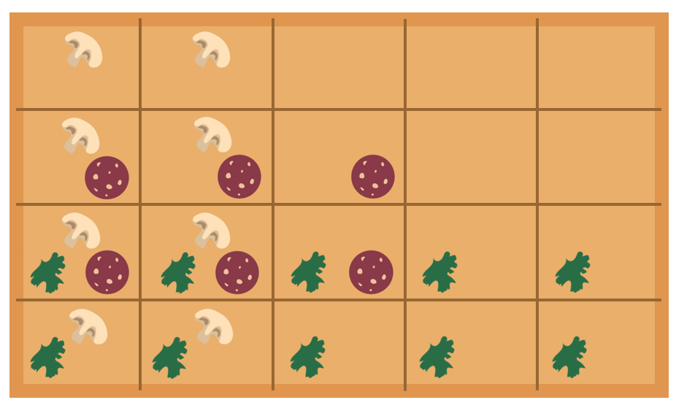




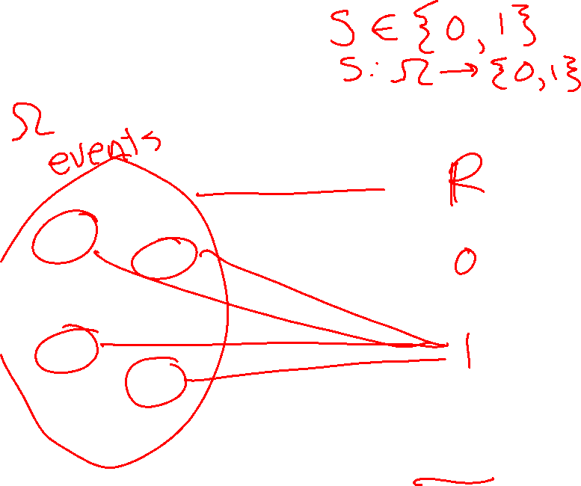
Example
Random variable for spinach or no spinach
Random variable
Distribution
Sample space
Values
Probabilities or Densities
Icons: CC, https://openclipart.org/detail/296791/pizza-slice

Slide 9
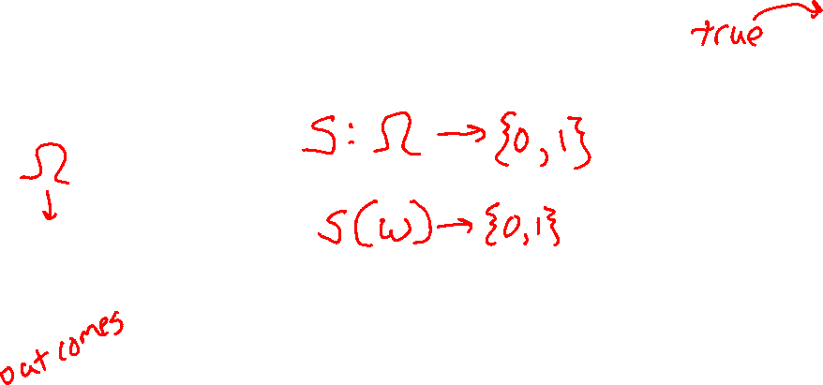
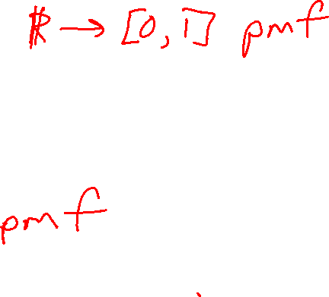
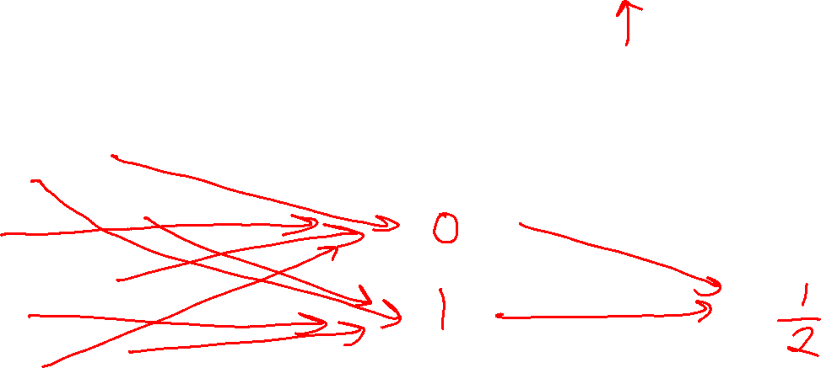
Example
Random variable for spinach or no spinach
Random variable
Distribution
Sample space
Values
Probabilities or Densities
Icons: CC, https://openclipart.org/detail/296791/pizza-slice

Slide 10
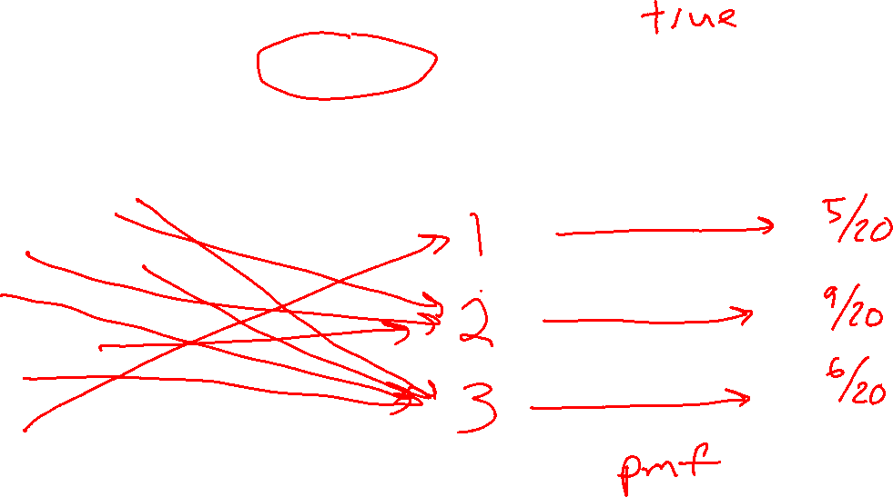

Example
Random variable for topping type with
three categories: none, non-meat, meat
Random variable
Distribution
Sample space
Values
Probabilities or Densities
Icons: CC, https://openclipart.org/detail/296791/pizza-slice

Slide 11
Example
Random variable for topping type with
three categories: none, non-meat, meat
Random variable
Distribution
Sample space
Values
Probabilities or Densities
Icons: CC, https://openclipart.org/detail/296791/pizza-slice

Slide 12
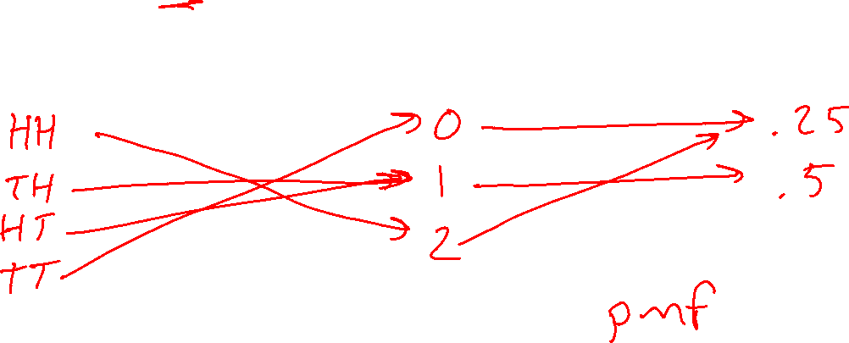
Example
Random variable for number of heads after two flips of a fair coin
Random variable
Distribution
Sample space
Values
Probabilities or Densities
Icons: CC, https://openclipart.org/detail/296791/pizza-slice

Slide 13
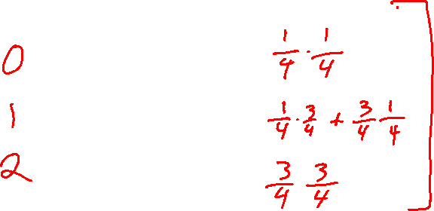
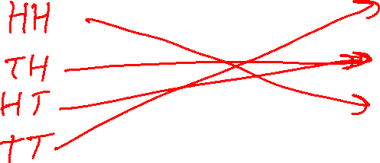
Example
Random variable for number of heads after two flips of a biased coin that lands heads 75%
Random variable
Distribution
Sample space
Values
Probabilities or Densities
Icons: CC, https://openclipart.org/detail/296791/pizza-slice

Slide 14
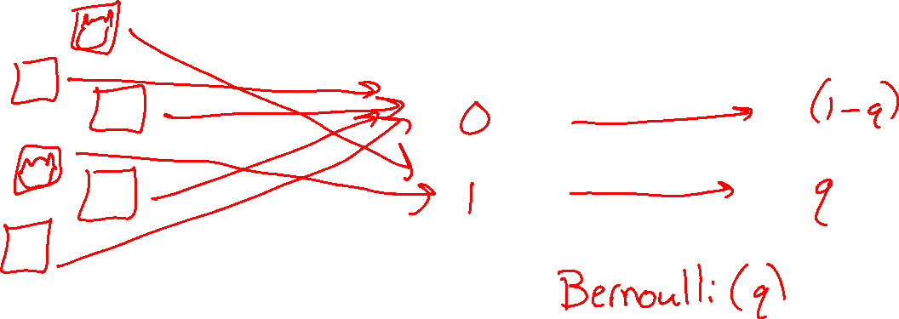
Example
Random variable for cat in picture or not
Random variable
Distribution
Sample space
Values
Probabilities or Densities
Icons: CC, https://openclipart.org/detail/296791/pizza-slice

Slide 15
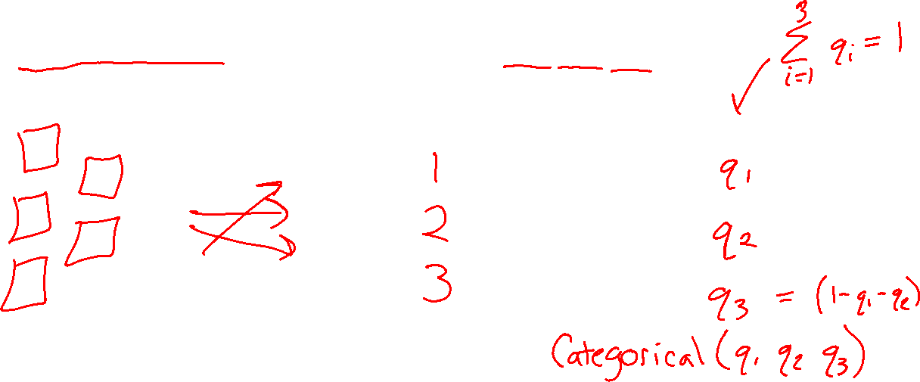
Example
Random variable for animal species in picture assuming one animal picture and available species: dog, cat, pig
Random variable
Distribution
Sample space
Values
Probabilities or Densities
Icons: CC, https://openclipart.org/detail/296791/pizza-slice

Slide 16
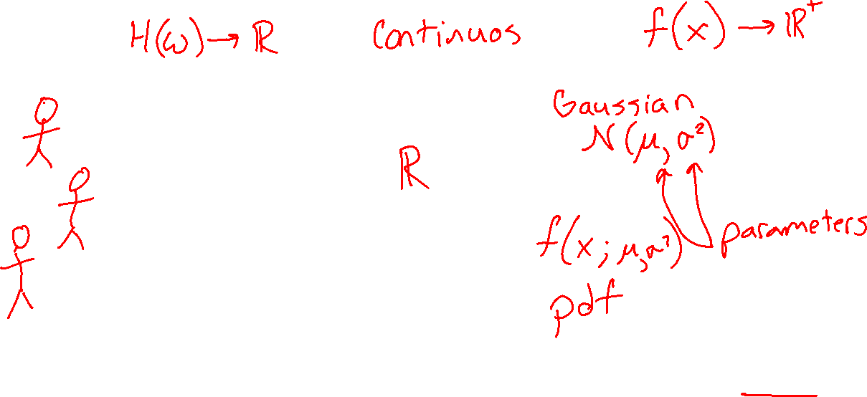
Example
Random variable for height of student
Random variable
Distribution
Sample space
Values
Probabilities or Densities
Icons: CC, https://openclipart.org/detail/296791/pizza-slice

Slide 17
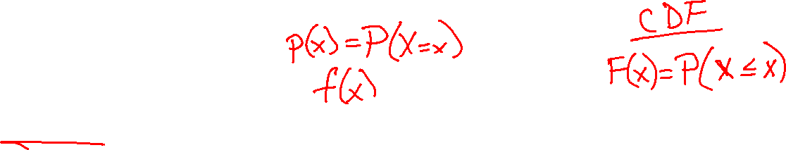
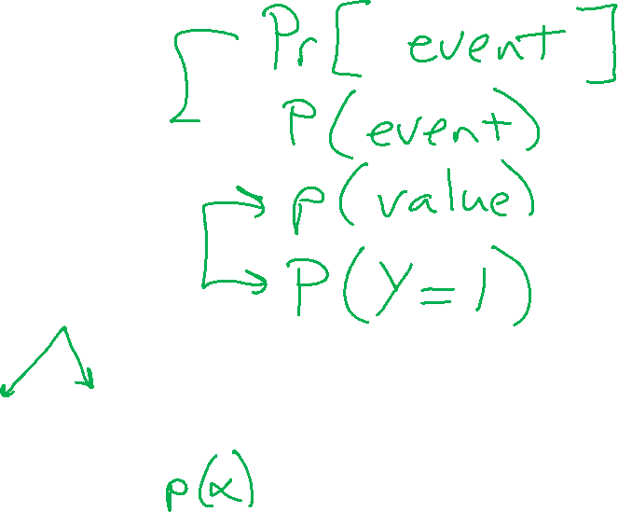
Probability Vocab
Outcomes
Sample space
Events
Probability
Random variable
Discrete random variable
Continuous random variable
Probability mass function
Probability density function
Parameters

Slide 18
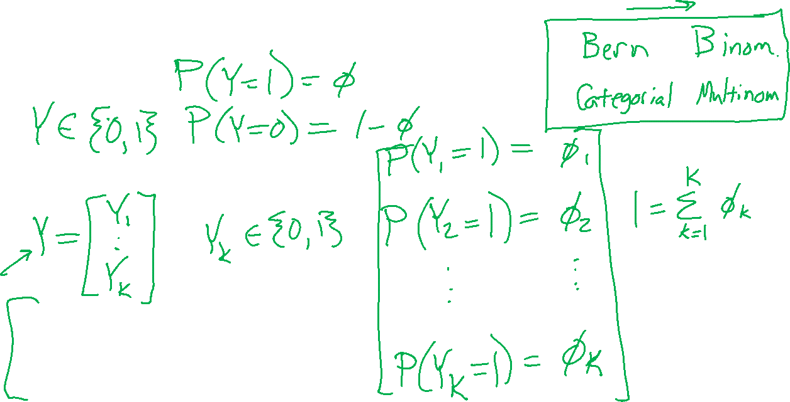
Example Discrete Distributions
Bernoulli
Categorical
Binomial
Multinomial
Uniform

Slide 19
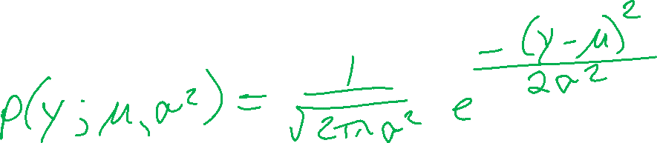
Example Continuous Distributions
Gaussian
Beta
Laplace

Slide 20
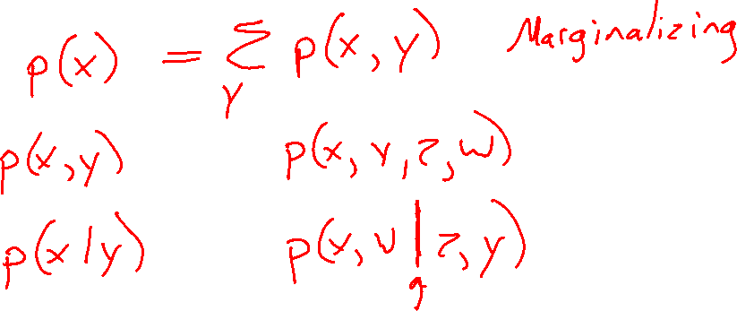
Probability Vocab
Marginal
Joint
Conditional

Slide 21
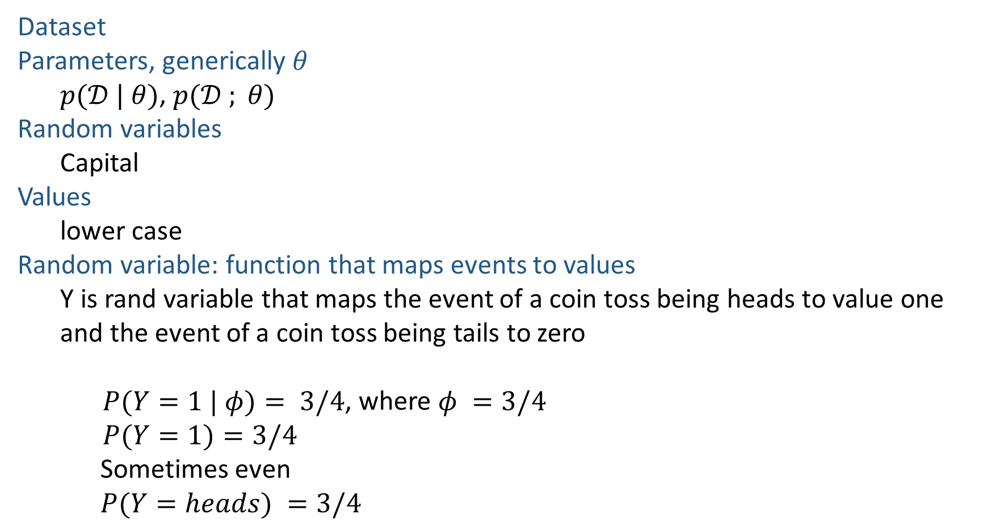
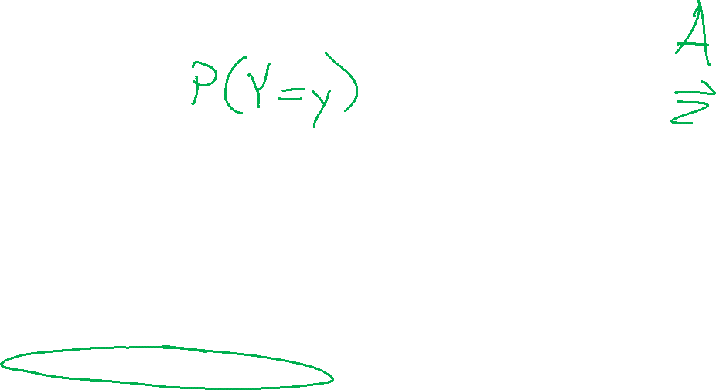
Notation
Dataset
Parameters, generically $θ$
  $p(𝒟 | θ)$, $p(𝒟 ; θ)$
Random variables
  Capital
Values
  lower case
Random variable: function that maps events to values
  Y is rand variable that maps the event of a coin toss being heads to value one and the event of a coin toss being tails to zero
    $P(Y=1 | φ)= 3/4$, where $φ =3/4$
    $P(Y=1)=3/4$
  Sometimes even
  $P(Y=heads) =3/4$

Slide 22
Probability Toolbox
  Algebra
  Three axioms of probability
  Theorem of total probability
  Definition of conditional probability
  Product rule
  Bayes’ theorem
  Chain rule
  Independence
  Conditional independence

Slide 23

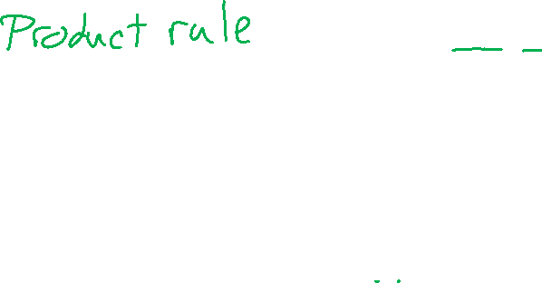
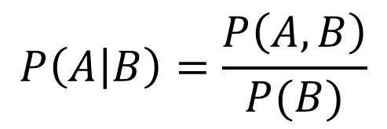
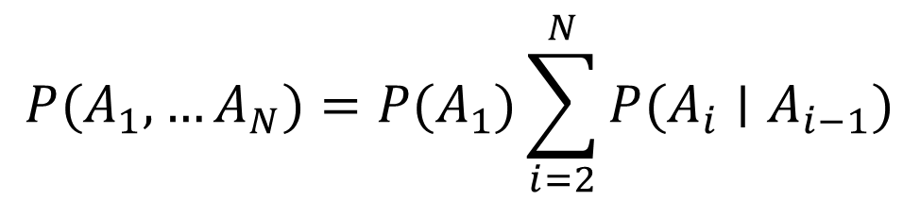
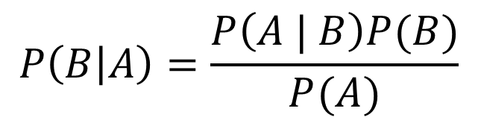
Probability Tools Summary
Adding to the toolbox
Definition of conditional probability
Chain Rule
Bayes’ theorem
Chain Rule…
$$P\left(A | B\right)=\frac{P\left(A, B\right)}{P(B)}$$
$$P(A,B)=P\left(A | B\right)P(B)$$
$$P\left(B | A\right)=\frac{P\left(A | B\right)P(B)}{P(A)}$$
$$P(A_{1},…A_{N})=P(A_{1})\sum_{i=2}^{N}{P(A_{i}∣A_{i−1})}$$

Slide 24
Likelihood

Slide 25

Likelihood
Likelihood: The probability (or density) of random variable $Y$ taking on value $y$ given the distribution parameters, $θ$.

Slide 26
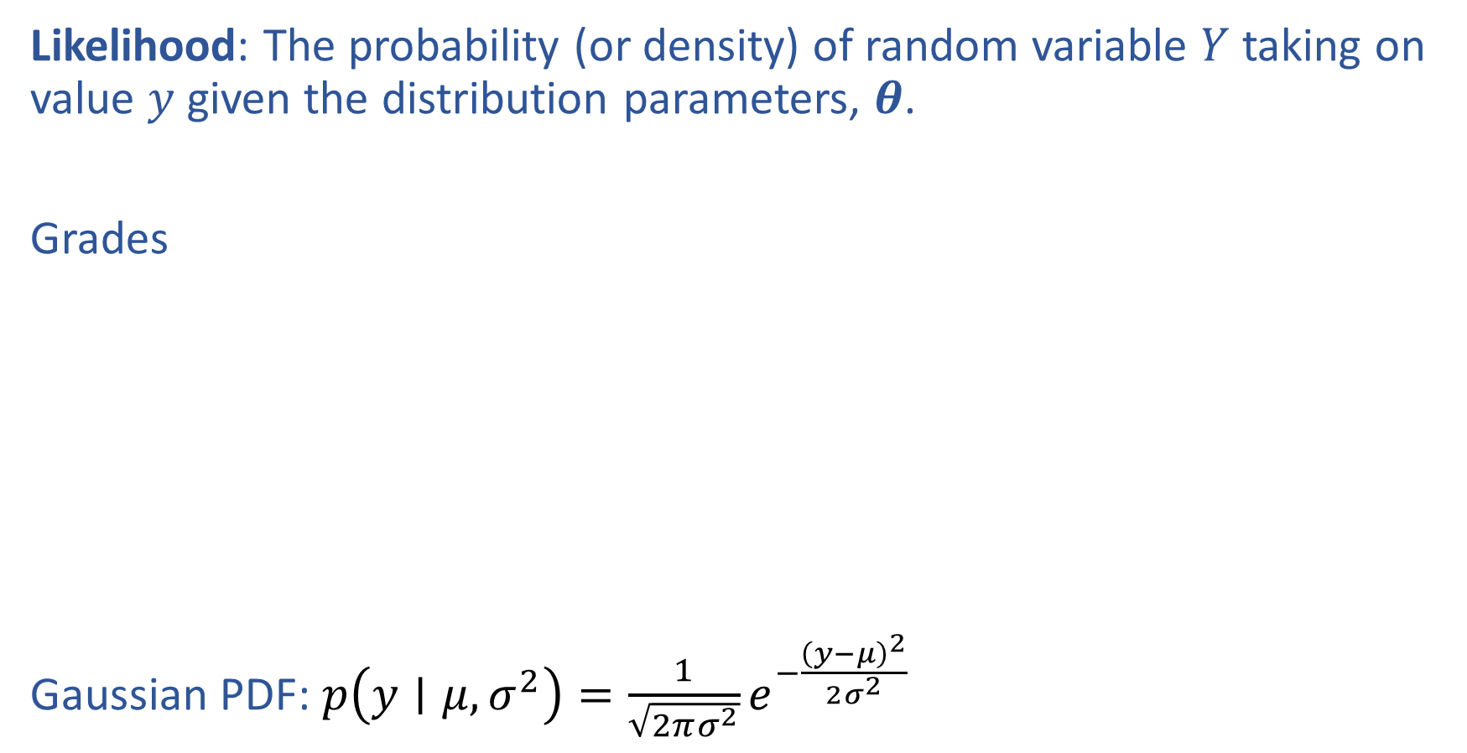
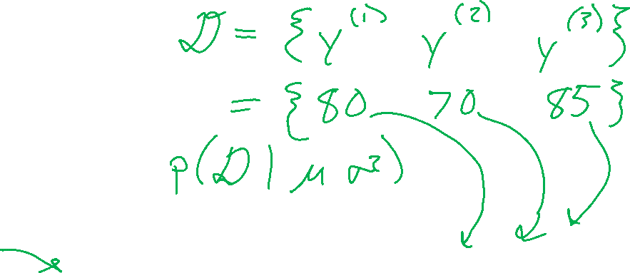
Likelihood
Likelihood: The probability (or density) of random variable $Y$ taking on value $y$ given the distribution parameters, $θ$.
Grades
Gaussian PDF: $p\left(y∣μ, σ^{2}\right)=\frac{1}{\sqrt{2πσ^{2}}}e^{−\frac{{\left(y−μ\right)}^{2}}{2σ^{2}}}$

Slide 27
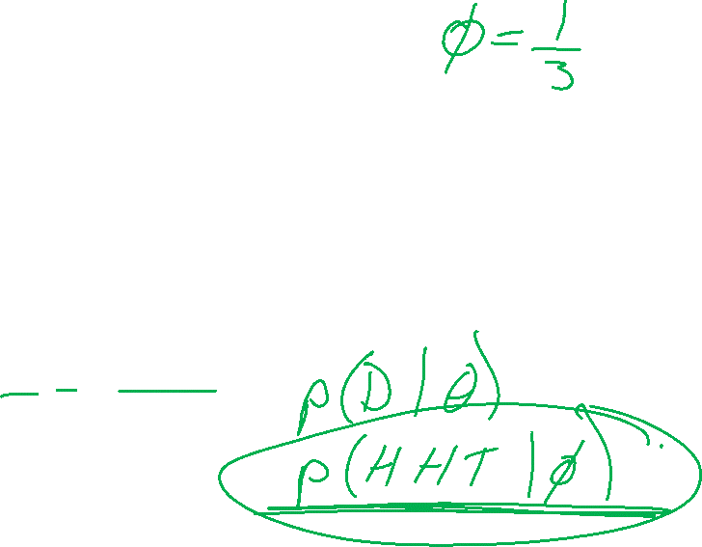
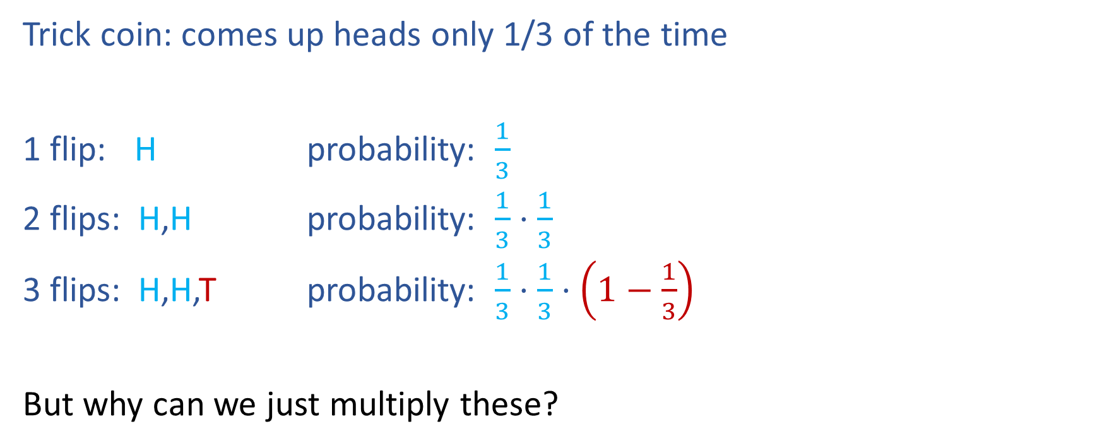
Likelihood
Trick coin: comes up heads only 1/3 of the time
1 flip: H probability: $\frac{1}{3}$
2 flips: H,H probability: $\frac{1}{3}⋅\frac{1}{3}$
3 flips: H,H,T probability: $\frac{1}{3}⋅\frac{1}{3}⋅\left(1−\frac{1}{3}\right)$
But why can we just multiply these?

Slide 28
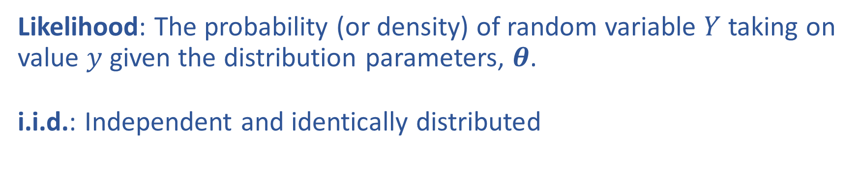
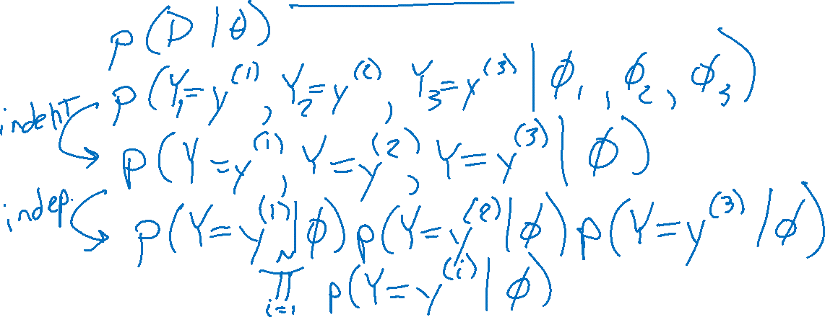
Likelihood and i.i.d
Likelihood: The probability (or density) of random variable $Y$ taking on value $y$ given the distribution parameters, $θ$.
i.i.d.: Independent and identically distributed

Slide 29
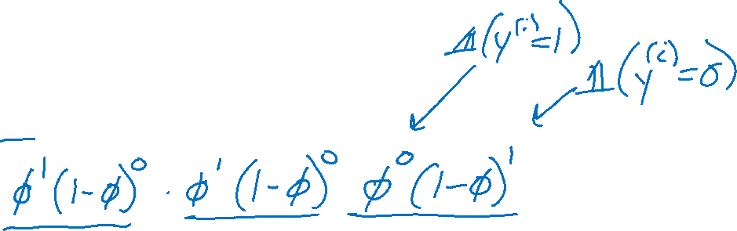
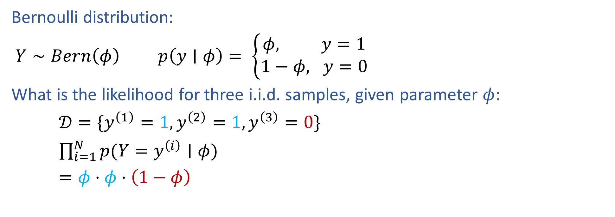
Bernoulli Likelihood
Bernoulli distribution:
$Y∼Bern\left(φ\right)$ $p\left(y∣φ\right)= \left\{\begin{aligned}φ, y=1 \\ 1−φ, y=0\end{aligned}\right.$
What is the likelihood for three i.i.d. samples, given parameter $φ$:
$𝒟=\{y^{\left(1\right)}=1, y^{\left(2\right)}=1,y^{\left(3\right)}=0\}$
$\prod_{i=1}^{N}{p(Y=y^{\left(i\right)}∣φ)}$
$=φ⋅φ⋅\left(1−φ\right)$

Slide 30
MLE
Maximum likelihood estimation

Slide 31
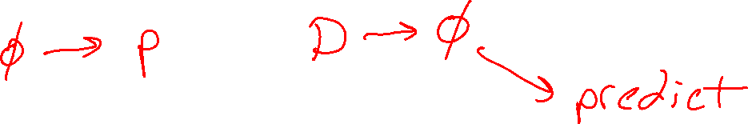
From Probability to Statistics

Slide 32
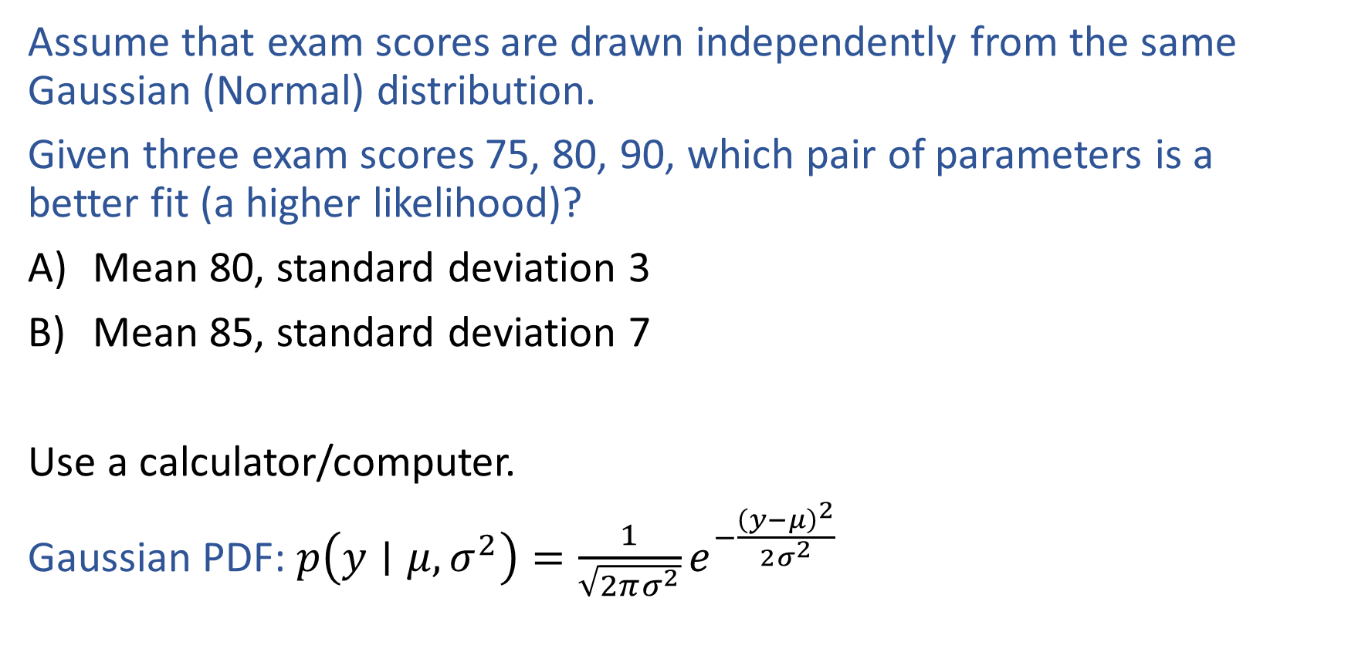
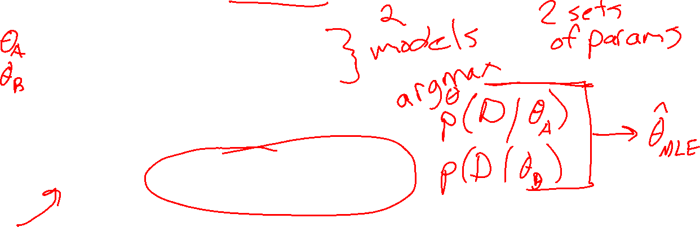
Poll 2
Assume that exam scores are drawn independently from the same Gaussian (Normal) distribution.
Given three exam scores 75, 80, 90, which pair of parameters is a better fit (a higher likelihood)?
Mean 80, standard deviation 3
Mean 85, standard deviation 7
Use a calculator/computer.
Gaussian PDF: $p\left(y∣μ, σ^{2}\right)=\frac{1}{\sqrt{2πσ^{2}}}e^{−\frac{{\left(y−μ\right)}^{2}}{2σ^{2}}}$

Slide 33
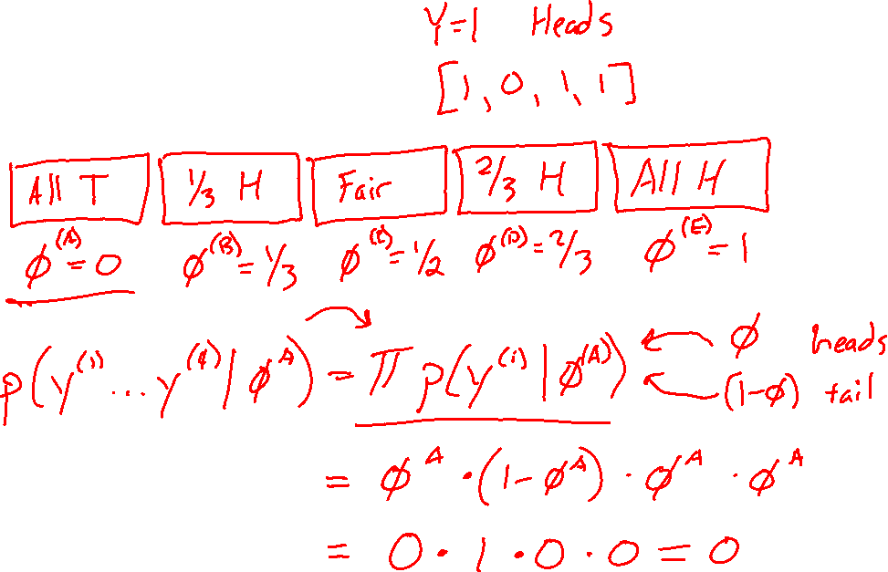

Likelihood
Trick coin

Slide 34
Likelihood
Trick coin

Slide 35
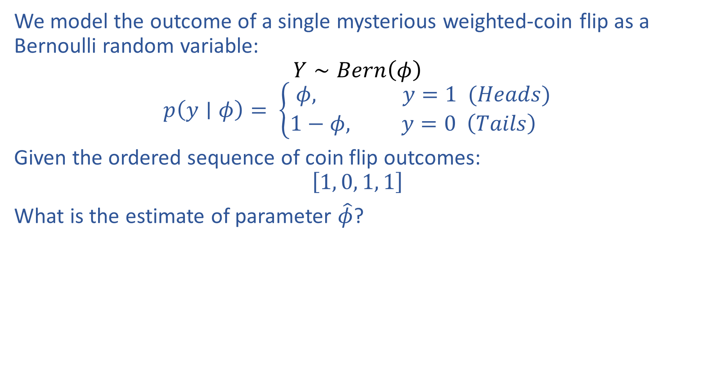
Estimating Parameters with Likelihood
We model the outcome of a single mysterious weighted-coin flip as a Bernoulli random variable:
$$Y∼Bern\left(φ\right)$$
$$p\left(y∣φ\right)= \left\{\begin{aligned}φ, y=1 (Heads) \\ 1−φ, y=0 \left(Tails\right) \end{aligned}\right.$$
Given the ordered sequence of coin flip outcomes:
$$\left[1, 0, 1, 1\right]$$
What is the estimate of parameter $\hat{φ}$?

Slide 36
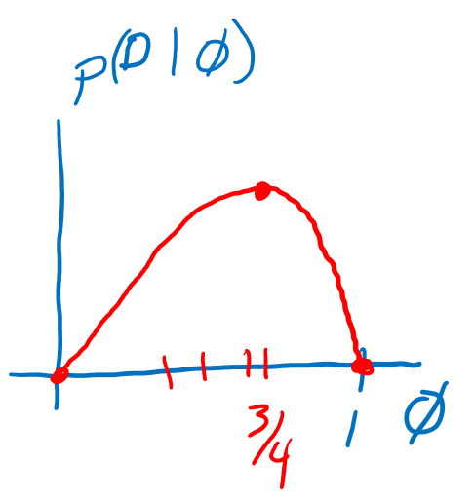
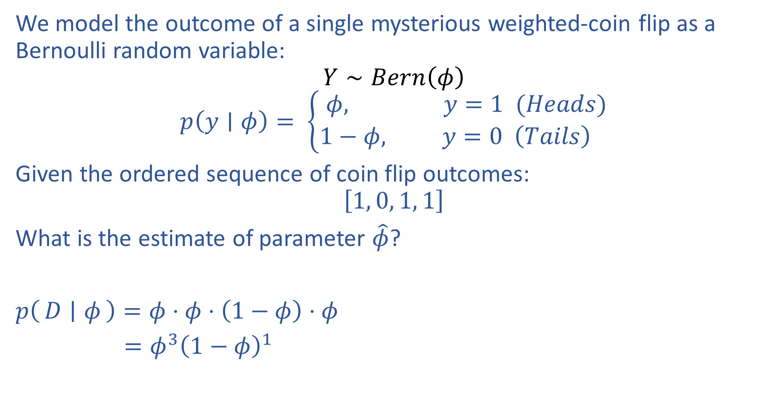
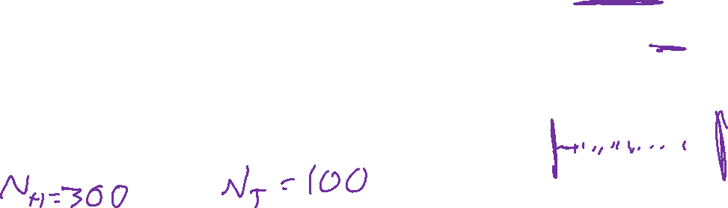
Estimating Parameters with Likelihood
We model the outcome of a single mysterious weighted-coin flip as a Bernoulli random variable:
$$Y∼Bern\left(φ\right)$$
$$p\left(y∣φ\right)= \left\{\begin{aligned}φ, y=1 (Heads) \\ 1−φ, y=0 \left(Tails\right) \end{aligned}\right.$$
Given the ordered sequence of coin flip outcomes:
$$\left[1, 0, 1, 1\right]$$
What is the estimate of parameter $\hat{φ}$?
$p\left(D ∣ φ\right)=φ⋅φ⋅\left(1−φ\right)⋅φ$
$=φ^{3}{\left(1−φ\right)}^{1}$

Slide 37
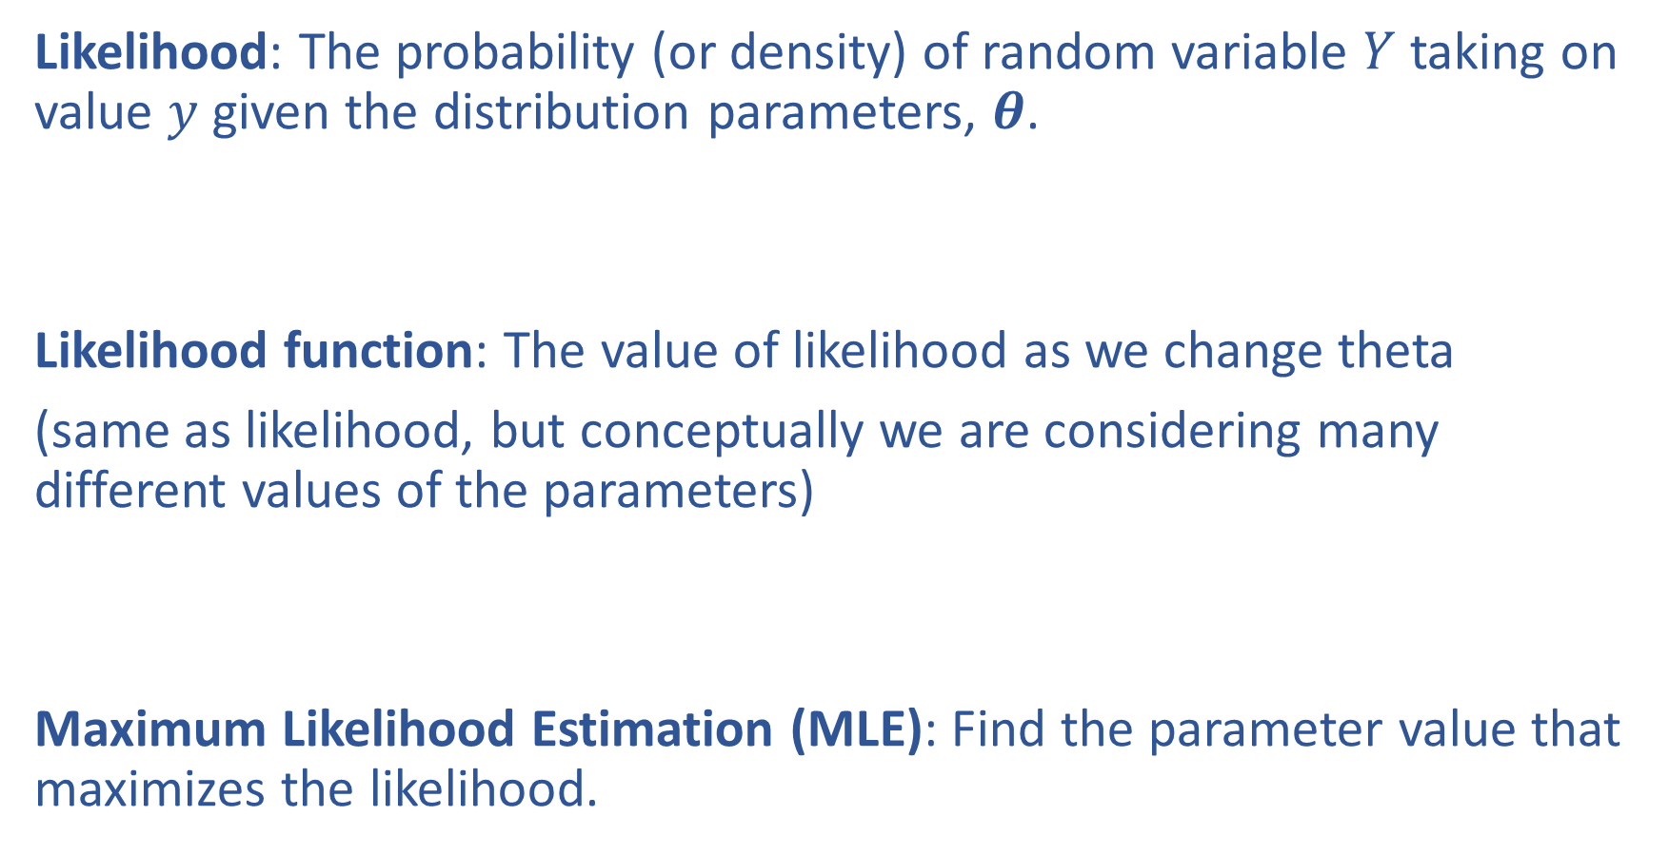
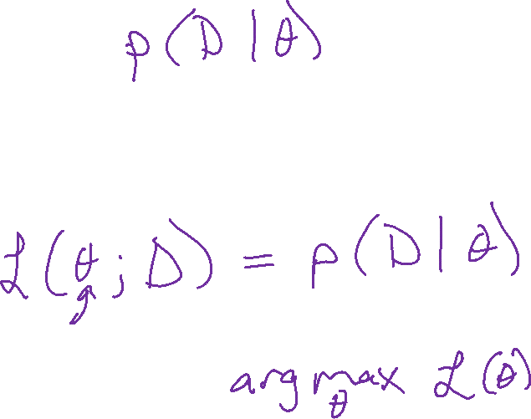
Likelihood and Maximum Likelihood Estimation
Likelihood: The probability (or density) of random variable $Y$ taking on value $y$ given the distribution parameters, $θ$.
Likelihood function: The value of likelihood as we change theta
(same as likelihood, but conceptually we are considering many different values of the parameters)
Maximum Likelihood Estimation (MLE): Find the parameter value that maximizes the likelihood.

Slide 38

MLE as Data Increases
Given the ordered sequence of coin flip outcomes:
$$\left[1, 0, 1, 1\right]$$
$$p(𝒟∣φ)=\prod_{i}^{N}{p\left(y^{\left(i\right)} ∣ φ\right)} = φ^{N_{y=1}}{\left(1−φ\right)}^{N_{y=0}}$$
What happens as we flip more coins?

Slide 39
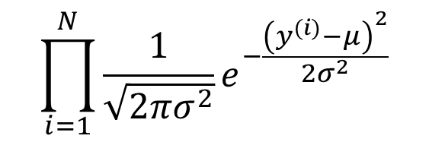

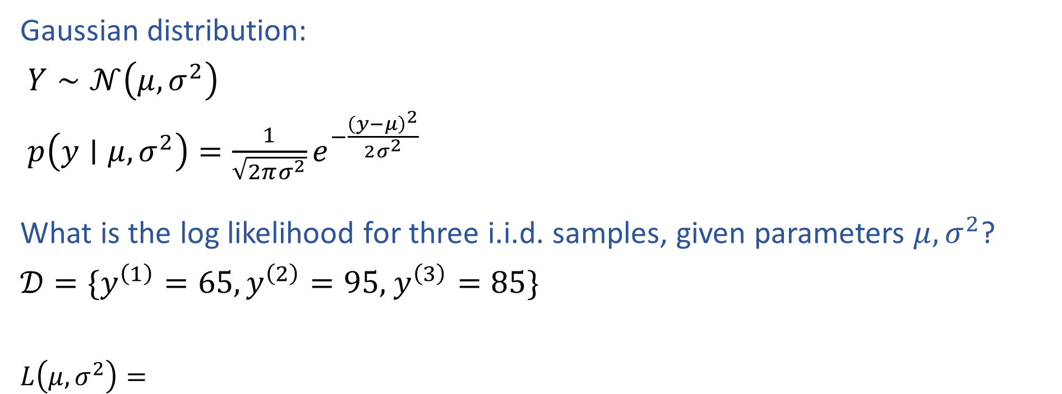
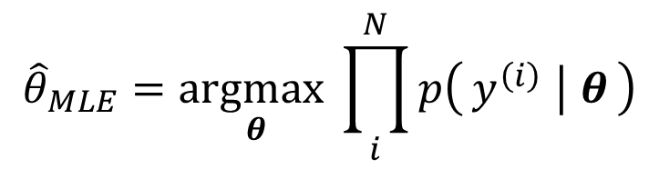
MLE for Gaussian
Gaussian distribution:
$Y∼𝒩\left(μ, σ^{2}\right)$
$p\left(y∣μ, σ^{2}\right)=\frac{1}{\sqrt{2πσ^{2}}}e^{−\frac{{\left(y−μ\right)}^{2}}{2σ^{2}}}$
What is the log likelihood for three i.i.d. samples, given parameters $μ, σ^{2}$?
$𝒟=\{y^{\left(1\right)}=65,y^{\left(2\right)}=95,$ $y^{\left(3\right)}=85\}$
$L\left(μ, σ^{2}\right)=$
$$\prod_{i=1}^{N}{\frac{1}{\sqrt{2πσ^{2}}}e^{−\frac{{\left(y^{(i)}−μ\right)}^{2}}{2σ^{2}}}}$$
$${\hat{θ}}_{MLE}=\underset{θ}{argmax}\prod_{i}^{N}{p\left(y^{\left(i\right)} ∣ θ\right)}$$

Slide 40
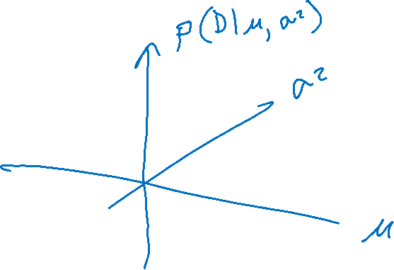


MLE for Gaussian
Assume that exam scores are drawn independently from the same Gaussian (Normal) distribution.
Given three exam scores 75, 80, 90, which pair of parameters is the best fit (the highest likelihood)?
$$p\left(𝒟 | μ, σ^{2}\right)=\prod_{i=1}^{N}{\frac{1}{\sqrt{2πσ^{2}}}e^{−\frac{{\left(y^{(i)}−μ\right)}^{2}}{2σ^{2}}}}$$

Slide 41


MLE
Principle of Maximum Likelihood Estimation:
Choose the parameters that maximize the likelihood of the data.
Maximum Likelihood Estimate (MLE)
θ₂
θ^{MLE}
L(θ)
L(θ₁, θ₂)
θ^{MLE}
θ₁
Slide credit: CMU MLD Matt Gormley

Slide 42


Likelihood and Log Likelihood
Likelihood: The probability (or density) of random variable $Y$ taking on value $y$ given the distribution parameters, $θ$.
Likelihood function: The value of likelihood as we change theta
(same as likelihood, but conceptually we are considering many different values of the parameters)

Slide 43

Likelihood and Log Likelihood
Likelihood: The probability (or density) of random variable $Y$ taking on value $y$ given the distribution parameters, $θ$.
Likelihood function: The value of likelihood as we change theta
(same as likelihood, but conceptually we are considering many different values of the parameters)

Slide 44

Maximum Likelihood Estimation
MLE of parameter $θ$ for i.i.d. dataset $𝒟={\left\{y^{(i)}\right\}}_{i=1}^{N}$
${\hat{θ}}_{MLE}=\underset{θ}{argmax}{p(𝒟∣θ)}$

Slide 45


Recipe for Estimation
MLE
Formulate the likelihood, $p(𝒟∣θ)$
Set objective $J(θ)$ equal to negative log of likelihood
$J\left(θ\right)=−\log{p\left(𝒟 ∣ θ\right)}$
Compute derivative of objective, $∂J/∂θ$
Find $\hat{θ}$, either
    Set derivate equal to zero and solve for $θ$
    Use (stochastic) gradient descent to step towards better $θ$

Slide 46




MLE for Gaussian
Gaussian distribution:
$Y∼𝒩\left(μ, σ^{2}\right)$
$p\left(y∣μ, σ^{2}\right)=\frac{1}{\sqrt{2πσ^{2}}}e^{−\frac{{\left(y−μ\right)}^{2}}{2σ^{2}}}$
What is the log likelihood for three i.i.d. samples, given parameters $μ, σ^{2}$?
$𝒟=\{y^{\left(1\right)}=65,y^{\left(2\right)}=95,$ $y^{\left(3\right)}=85\}$
$L\left(μ, σ^{2}\right)=$
$ℓ\left(μ, σ^{2}\right)=$
$$\prod_{i=1}^{N}{\frac{1}{\sqrt{2πσ^{2}}}e^{−\frac{{\left(y^{(i)}−μ\right)}^{2}}{2σ^{2}}}}$$
$${\hat{θ}}_{MLE}=\underset{θ}{argmax}\prod_{i}^{N}{p\left(y^{\left(i\right)} ∣ θ\right)}$$
$$\sum_{i=1}^{N}{−log\sqrt{2πσ^{2}}−\frac{{\left(y^{(i)}−μ\right)}^{2}}{2σ^{2}}}$$
$${\hat{θ}}_{MLE}=\underset{θ}{argmax}\sum_{i}^{N}{log p\left(y^{\left(i\right)} ∣ θ\right)}$$

Slide 47
Probabilistic Formulation for ML
MLE for Linear and Logistic Regression

Slide 48

Using Statistics for Machine Learning

Slide 49
Recipe for Estimation
MLE
Formulate the likelihood, $p(𝒟∣θ)$
Set objective $J(θ)$ equal to negative log of likelihood
$J\left(θ\right)=−\log{p\left(𝒟 ∣ θ\right)}$
Compute derivative of objective, $∂J/∂θ$
Find $\hat{θ}$, either
    Set derivate equal to zero and solve for $θ$
    Use (stochastic) gradient descent to step towards better $θ$

Slide 50



M(C)LE for Logistic Regression
Learn to predict if a patient has cancer ($Y=1$) or not ($Y=0$) given the input of just one test results, $X_{A}$ and $X_{B}$
$${\hat{θ}}_{MLE}=\underset{θ}{argmax}\prod_{i}^{N}{{\frac{1}{1+{e^{−θ^{T}x}}^{\left(i\right)}}}^{𝕀\left(y^{\left(i\right)}=1\right)}{\left(1−\frac{1}{1+{e^{−θ^{T}x}}^{\left(i\right)}}\right)}^{𝕀\left(y^{(i)}=0\right)}}$$

Slide 51

M(C)LE for Logistic Regression
Learn to predict if a patient has cancer ($Y=1$) or not ($Y=0$) given the input of just one test results, $X_{A}$ and $X_{B}$
$${\hat{θ}}_{MLE}=\underset{θ}{argmax}\prod_{i}^{N}{p\left(y^{\left(i\right)} ∣ x^{\left(i\right)}, θ\right)}$$

Slide 52


M(C)LE for Multi-class Logistic Regression
Learn to predict if probability of output belonging to class $k$, $Y_{k}$ , given input $X$, $P(Y_{k}=1∣X, θ_{1}, …, θ_{K})$
$${\hat{Θ}}_{MLE}=\underset{Θ}{argmax}\prod_{i}^{N}{\prod_{k}^{K}{{\frac{{e^{θ_{k}^{T}x}}^{\left(i\right)}}{\sum_{l=1}^{K}{{e^{θ_{l}^{T}x}}^{\left(i\right)}}}}^{𝕀\left(y_{k}^{\left(i\right)}=1\right)}}}$$

Slide 53


M(C)LE for Multi-class Logistic Regression
Learn to predict if probability of output belonging to class $k$, $Y_{k}$ , given input $X$, $P(Y_{k}=1∣X, θ_{1}, …, θ_{K})$
$$L\left(Θ;𝒟\right)=\prod_{i}^{N}{\prod_{k}^{K}{{\frac{{e^{θ_{k}^{T}x}}^{\left(i\right)}}{\sum_{l=1}^{K}{{e^{θ_{l}^{T}x}}^{\left(i\right)}}}}^{𝕀\left(y_{k}^{\left(i\right)}=1\right)}}}$$

Slide 54


M(C)LE for Linear Regression
Probabilistic interpretation of linear regression
$${\hat{θ}}_{MLE}=\underset{θ}{argmax}\prod_{i}^{N}{p\left(y^{\left(i\right)} ∣ x^{\left(i\right)}, θ\right)}$$

Slide 55


M(C)LE for Linear Regression
Probabilistic interpretation of linear regression
$${\hat{θ}}_{MLE}=\underset{θ}{argmax}\prod_{i}^{N}{p\left(y^{\left(i\right)} ∣ x^{\left(i\right)}, θ\right)}$$

Slide 56


M(C)LE for Linear Regression
Probabilistic interpretation of linear regression
$$L\left(θ;𝒟\right)=\prod_{i}^{N}{p\left(y^{\left(i\right)} ∣ x^{\left(i\right)}, θ\right)}$$

