Slide 1
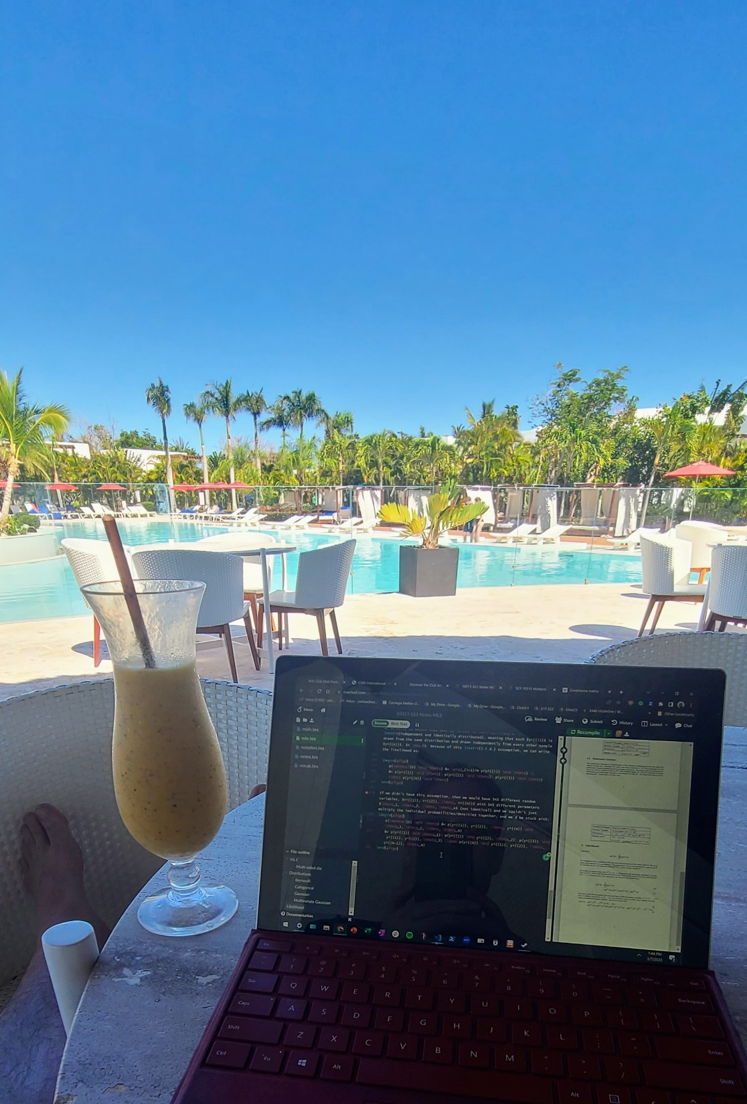
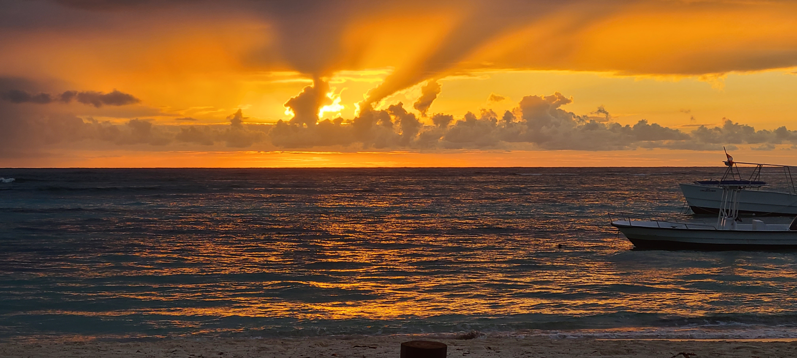

Welcome back!

Slide 2
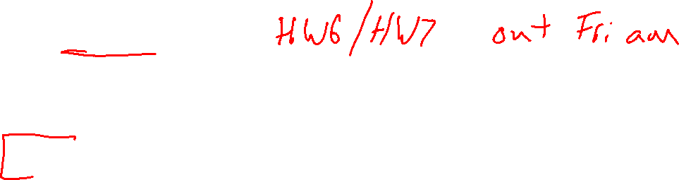
Course Updates
Feedback – Thanks!
HW Schedule
MLE “Pre”-reading for Wednesday
Help

Slide 3
Where are we?

Slide 4

Plan
Today
Applications
    ML design
    ML model cards
    Toolkits for neural networks
    Neural networks for imaging
    Neural networks for language

Slide 5

10-315
Introduction to ML
ML Applications &
Neural Networks for Imaging and Language
Instructor: Pat Virtue

Slide 6
Model Design

Slide 7
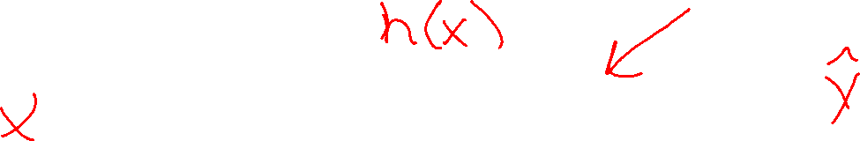
Reminder: Machine Learning Tasks
Using (training) data to learn a model that we’ll later use for prediction
Training Data
Model
Training
Prediction
Model
Input
Predicted
Output

Slide 8
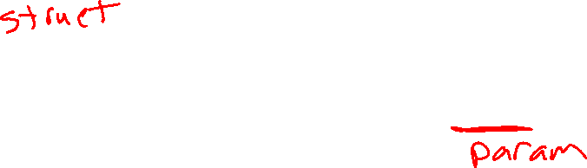
Training Input
Training Output
Model
Training
Training
Training Error
Prediction
Training Input
Training Output Predicted
Training Output (Measured)
Model
Prediction
Testing Input
Testing Output Predicted
Testing Output (Measured)
Model
Testing
Testing Error

Slide 9

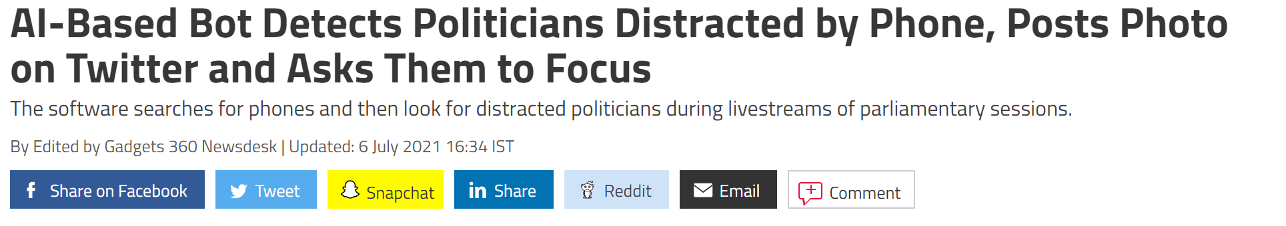
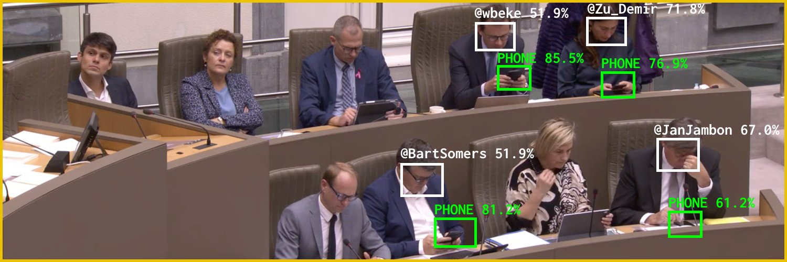
AI in the News
News:
https://gadgets.ndtv.com/social-networking/news/flemish-scrollers-ai-ml-bot-tool-software-belgium-politicians-distracted-phone-detect-troll-twitter-2480493
Source: Twitter @Flemish Scroller

Slide 10
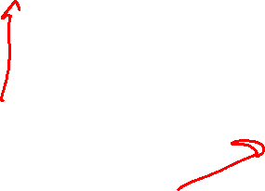
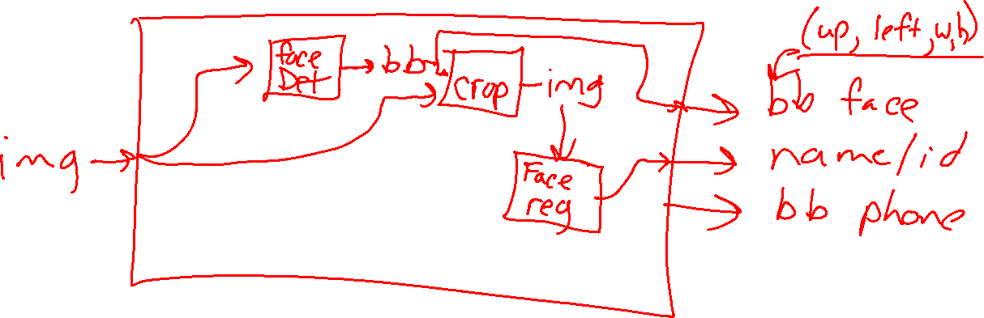
ML App Design
Distracted Politician Detection
Design the app by connecting smaller input/output ML Tasks
Image credit: Twitter @Flemish Scroller

Slide 11
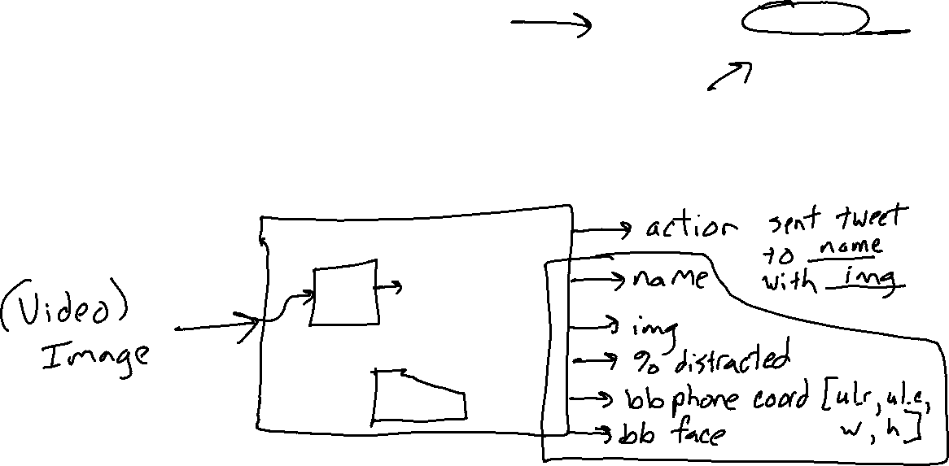
Input/Output
Distracted Politician Detection
Design the app by connecting smaller input/output ML Tasks
Image credit: Twitter @Flemish Scroller

Slide 12
ML App Design
Distracted Politician Detection
What is the performance measure?
Image credit: Twitter @Flemish Scroller

Slide 13
ML App Design
Distracted Politician Detection
What data do we need?
Image credit: Twitter @Flemish Scroller

Slide 14
ML App Design
Distracted Politician Detection
What can go wrong
Image credit: Twitter @Flemish Scroller

Slide 15
ML Model Cards
Mitchell, Margaret, et al.
"Model cards for model reporting.“
Proceedings of the conference on fairness, accountability, and transparency. 2019.

Slide 16
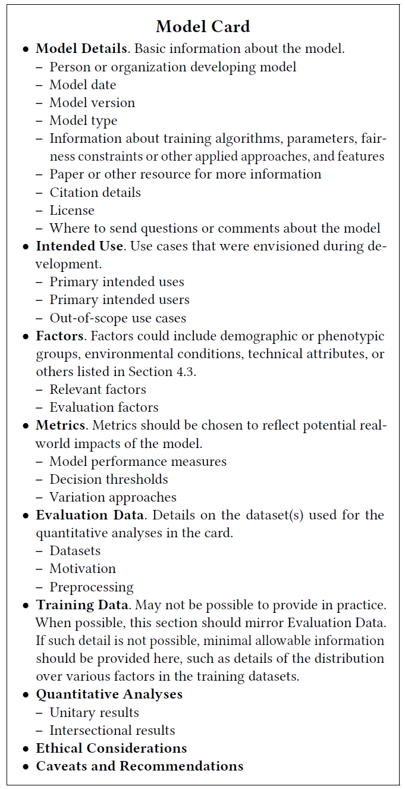

ML Model Cards

Slide 17

Exercise: ML Model Hunt
Search the web to find the model card for a real-world model

Slide 18
Teachable Machine
Transfer learning / fine-tuning

Slide 19
Neural Network Toolkits
Pytorch

Slide 20
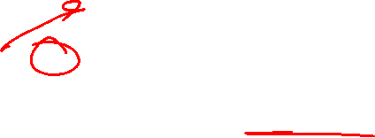
Network Network Toolkits
Pytorch in this course
Already used behind the scenes in HW1
HW7 transfer learning and exploration
Mini-project if you want

Slide 21
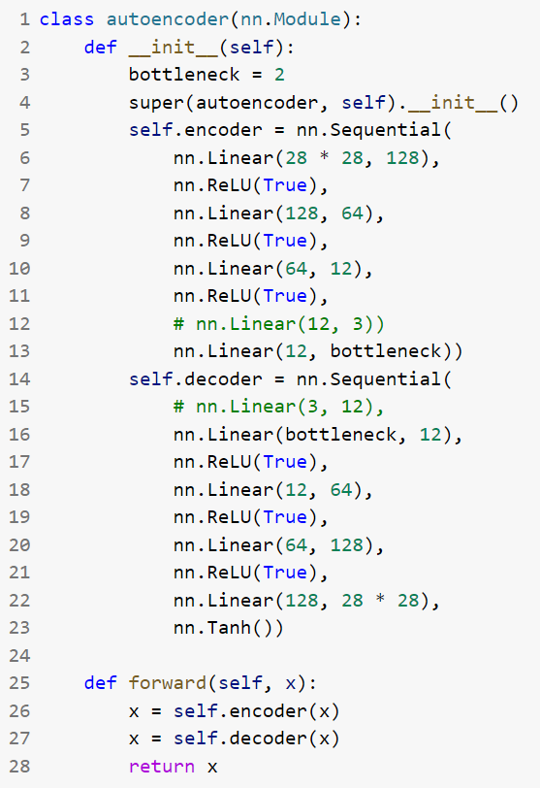
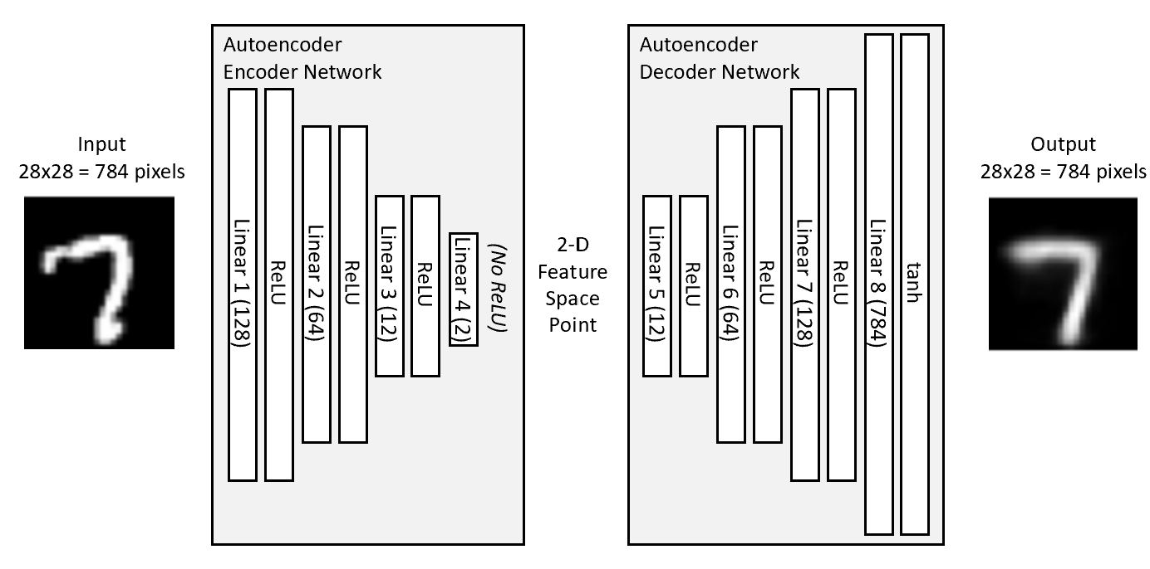
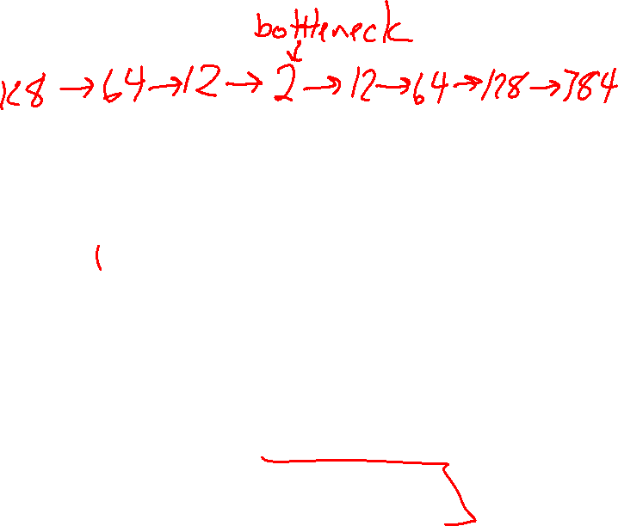
Pytorch for HW1 Networks
Autoencoder
Source: https://github.com/L1aoXingyu/pytorch-beginner/blob/master/08-AutoEncoder/simple_autoencoder.py

Slide 22
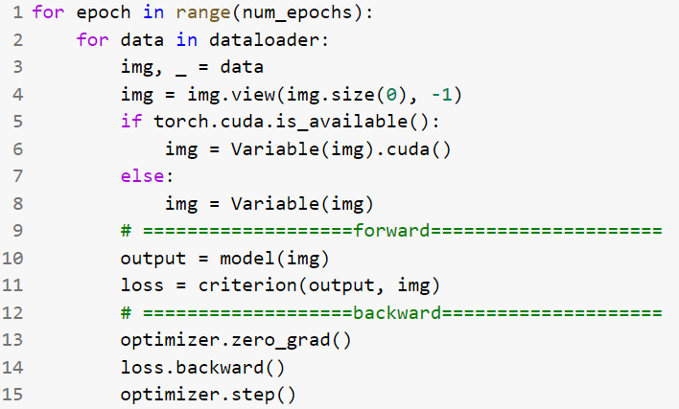
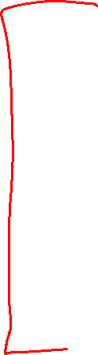
Pytorch for HW1 Networks
Autoencoder
Source: https://github.com/L1aoXingyu/pytorch-beginner/blob/master/08-AutoEncoder/simple_autoencoder.py

Slide 23
Convolutional Neural Networks

Slide 24
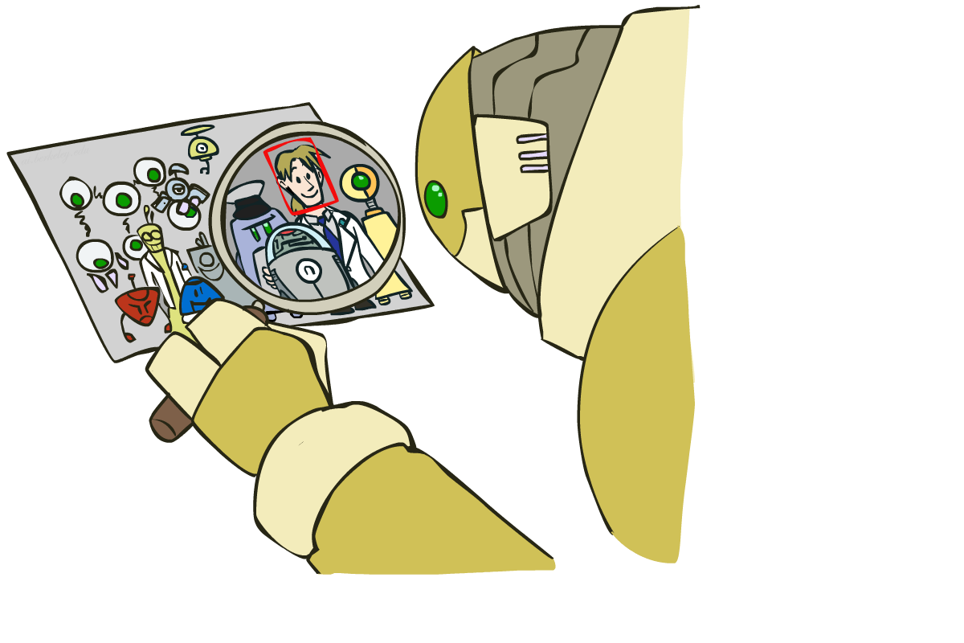
Computer Vision: How far along are we?

Slide 25
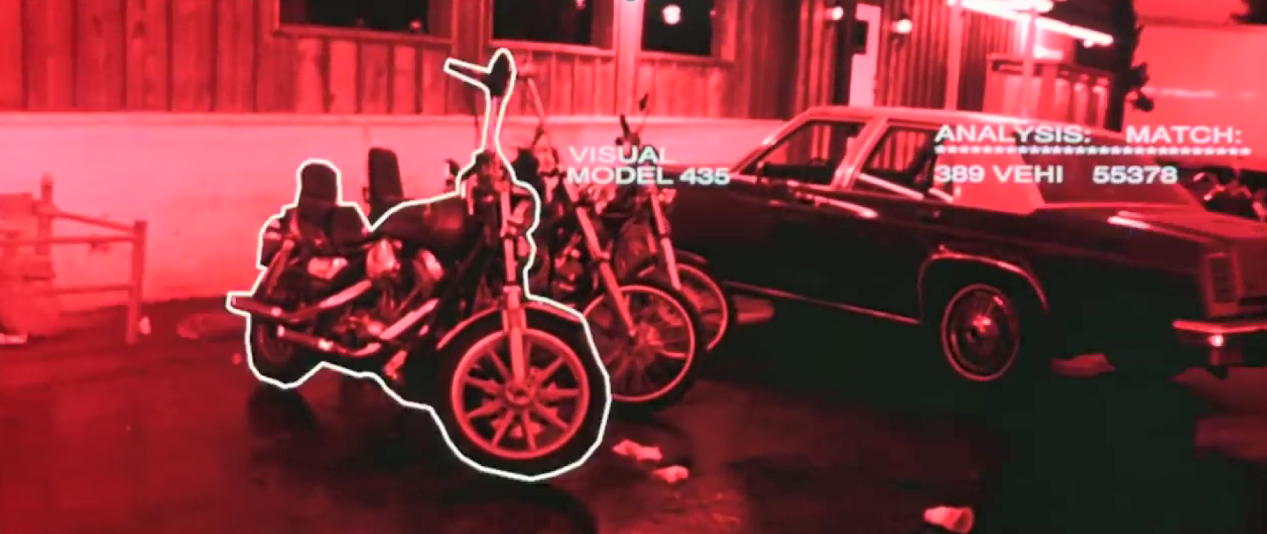
Computer Vision: How far along are we?
Terminator 2, 1991 https://www.youtube.com/watch?v=9MeaaCwBW28

Slide 26
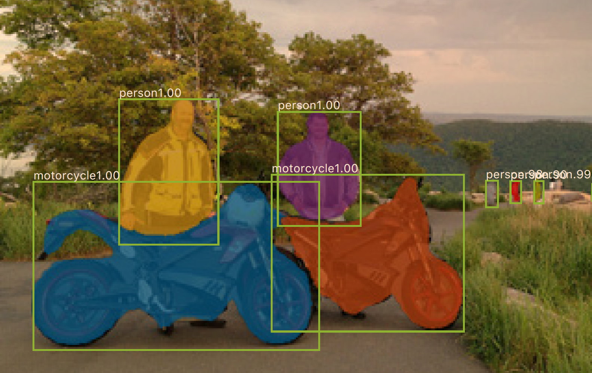

Computer Vision: How far along are we?
0.2 seconds per image
(2017)
Mask R-CNN
He, Kaiming, et al. "Mask R-CNN." Computer Vision (ICCV), 2017 IEEE International Conference on. IEEE, 2017.

Slide 27
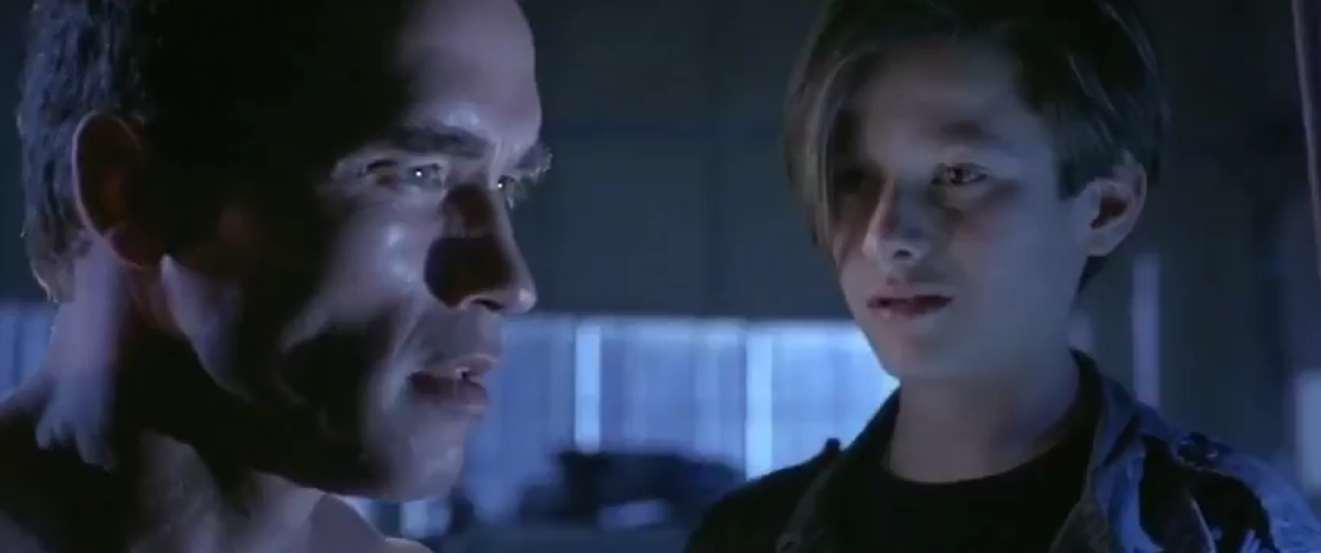
Computer Vision: How far along are we?
“My CPU is a neural net processor, a learning computer”
Terminator 2, 1991

Slide 28
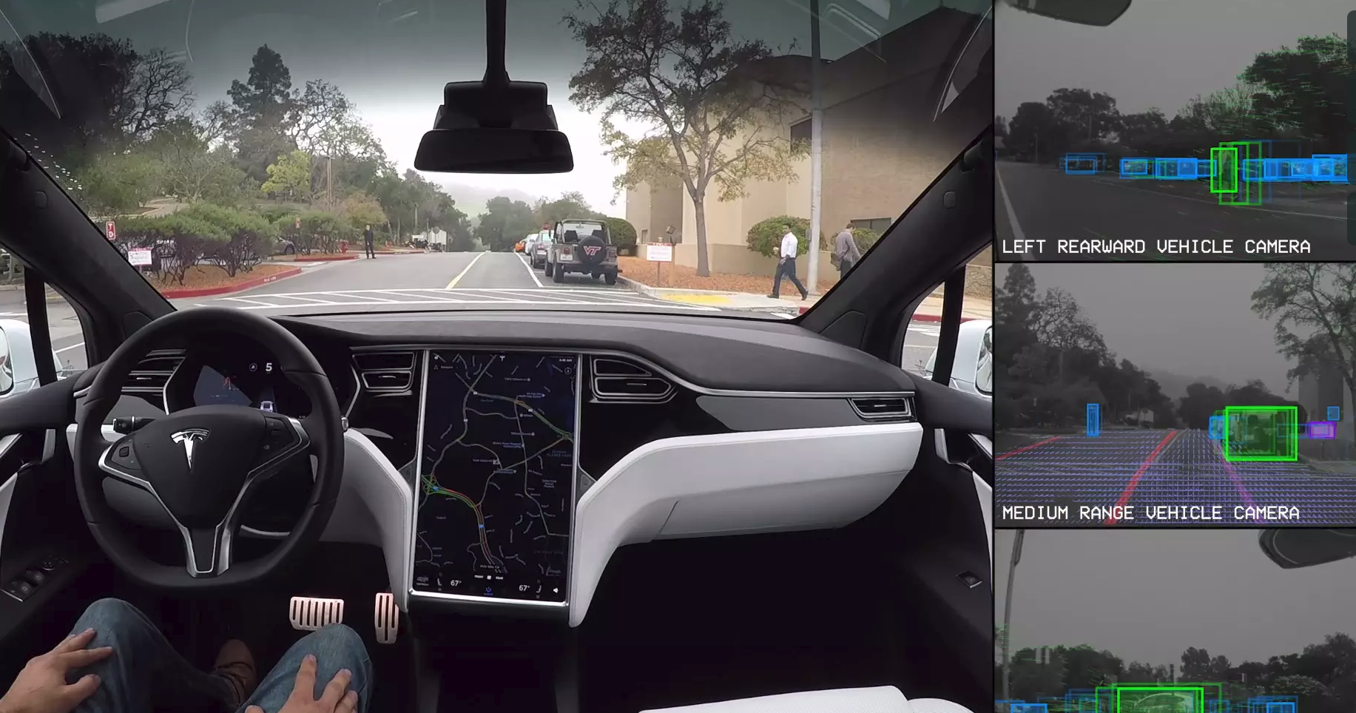
Computer Vision: Autonomous Driving
Tesla, Inc: https://vimeo.com/192179726

Slide 29
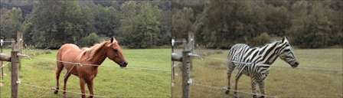
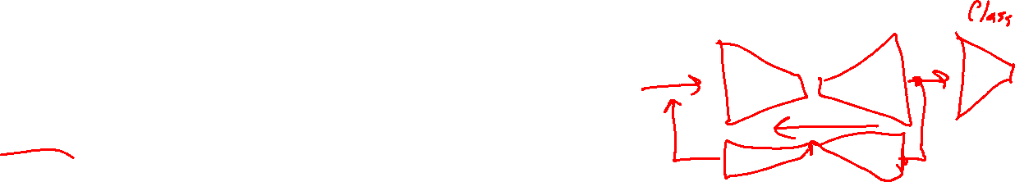
Computer Vision: Domain Transfer
CycleGAN
Jun-Yan Zhu*, Taesung Park*, Phillip Isola, and Alexei A. Efros. "Unpaired Image-to-Image Translation using Cycle-Consistent Adversarial Networks", ICCV 2017.

Slide 30
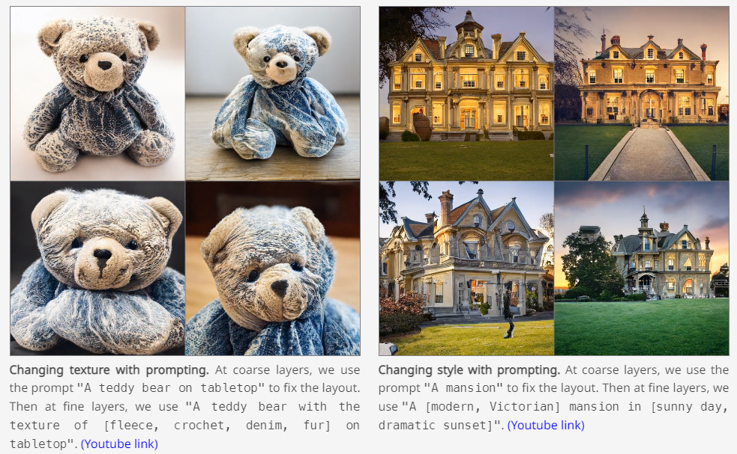
Text to Image
GigaGAN
https://mingukkang.github.io/GigaGAN/
Minguk Kang, Jun-Yan Zhu, Richard Zhang, Jaesik Park, Eli Shechtman, Sylvain Paris, Taesung Park. "Scaling up GANs for Text-to-Image Synthesis", CVPR 2023.

Slide 31
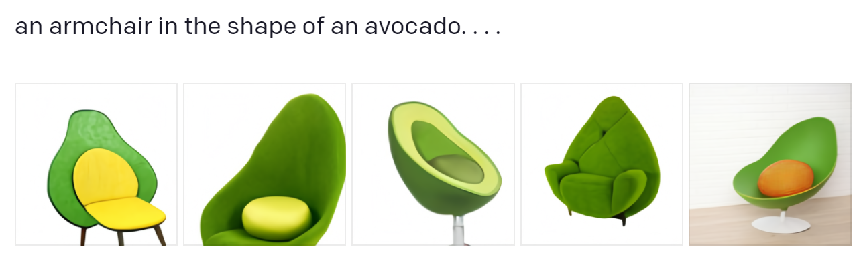
Text to Image
DALL-E
https://openai.com/blog/dall-e/
https://openai.com/dall-e-2/

Slide 32
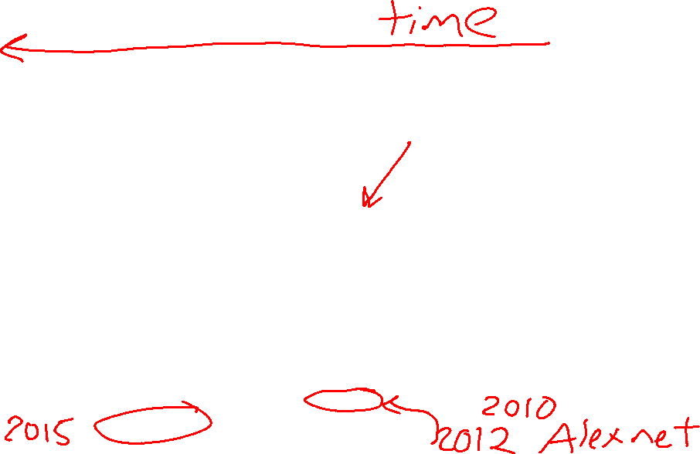
CNNs for Image Recognition
Slide from Kaiming He

Slide 33
Convolutional Neural Networks
Measuring the current state of computer vision
Why convolutional neural networks
      Old school computer vision
      Image features and classification
Convolution “nuts and bolts”

Slide 34
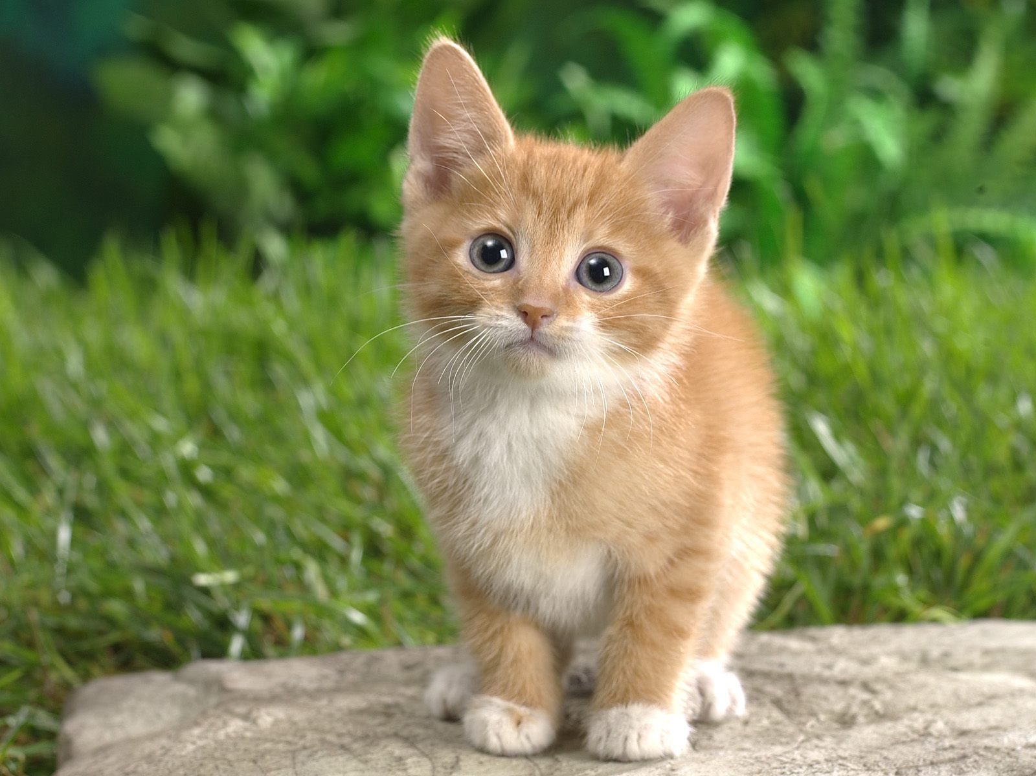
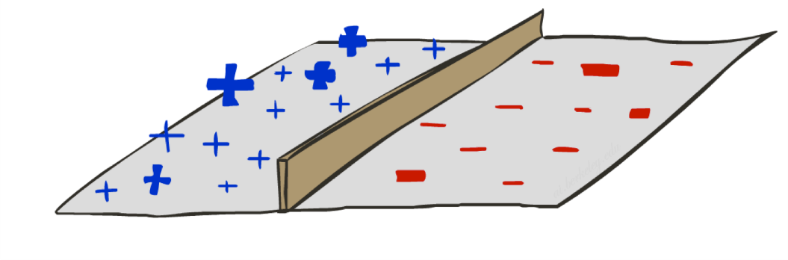

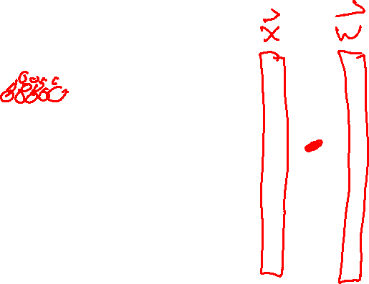
Image Classification
What’s the problem with just directly classifying raw pixels in high dimensional space?
Not CAT
CAT
CAT

Slide 35
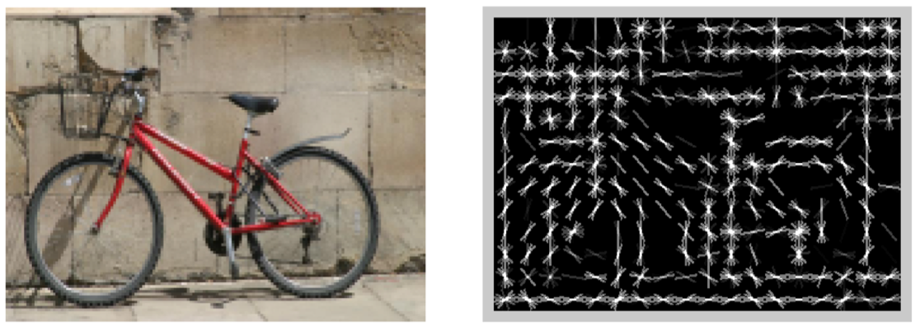
Image Classification
[Dalal and Triggs, 2005]

Slide 36
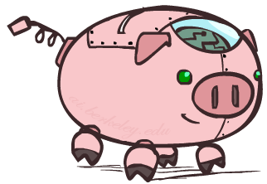
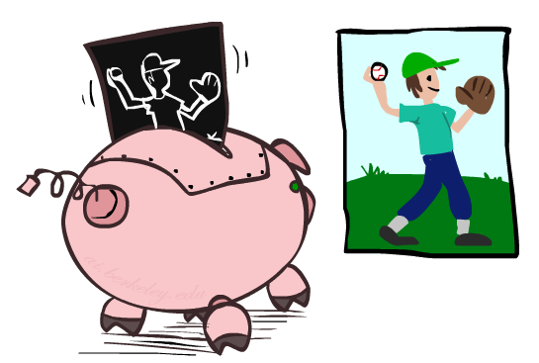

HoG Filter
HoG: Histogram of oriented gradients
[Dalal and Triggs, 2005]

Slide 37
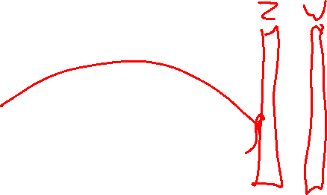
Image Classification
HOG features passed to a linear classifier (logistic regression / SVM)
Not CAT
CAT
CAT

Slide 38
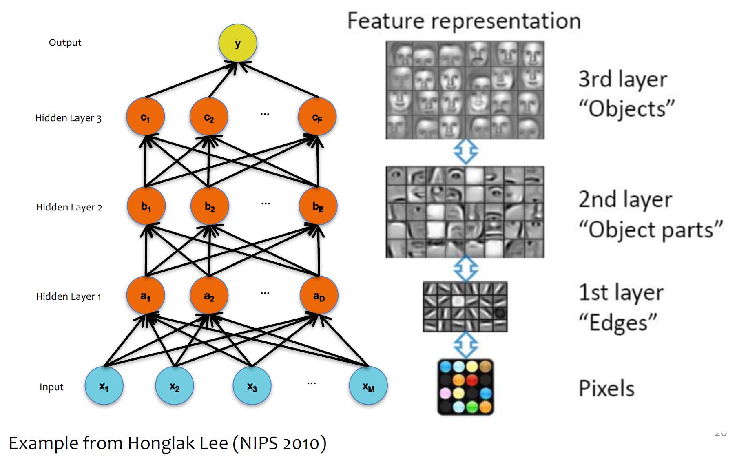
Classification: Learning Features

Slide 39
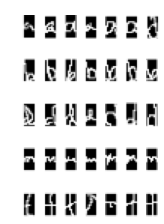
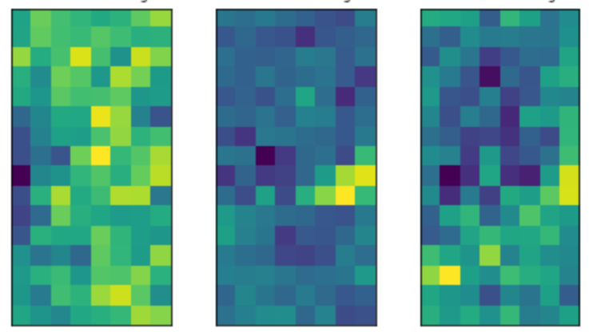
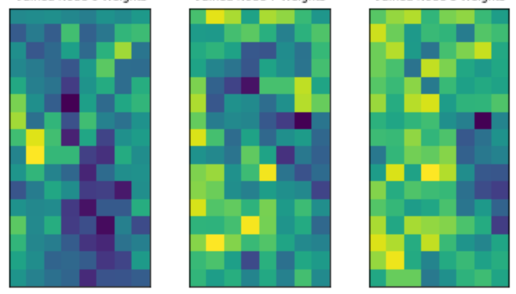
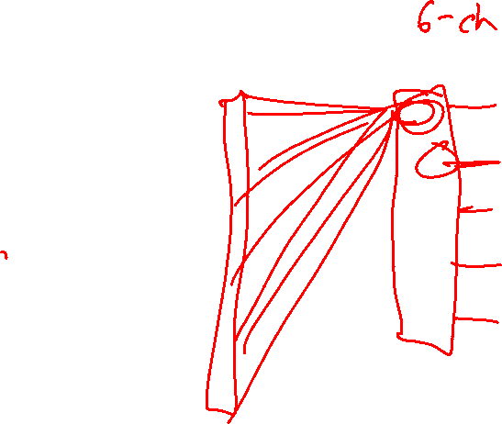
Classification: Learning Features
Weights from
fully-connected layer
Input features

Slide 40
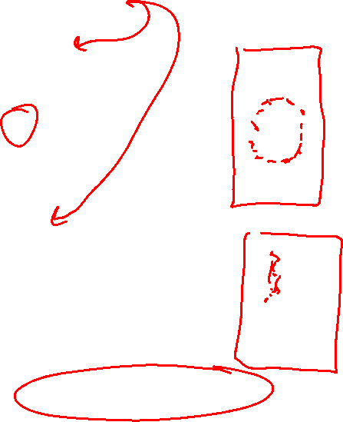
Classification: Learning Features
Weights from
fully-connected layer
Input features
Vocab: channels

Slide 41
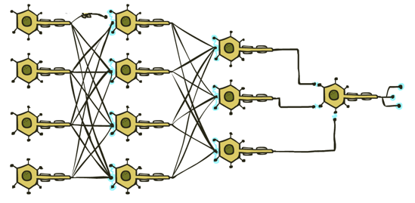
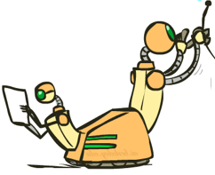
Classification: Deep Learning
Fully connected neural network?
CAT

Slide 42
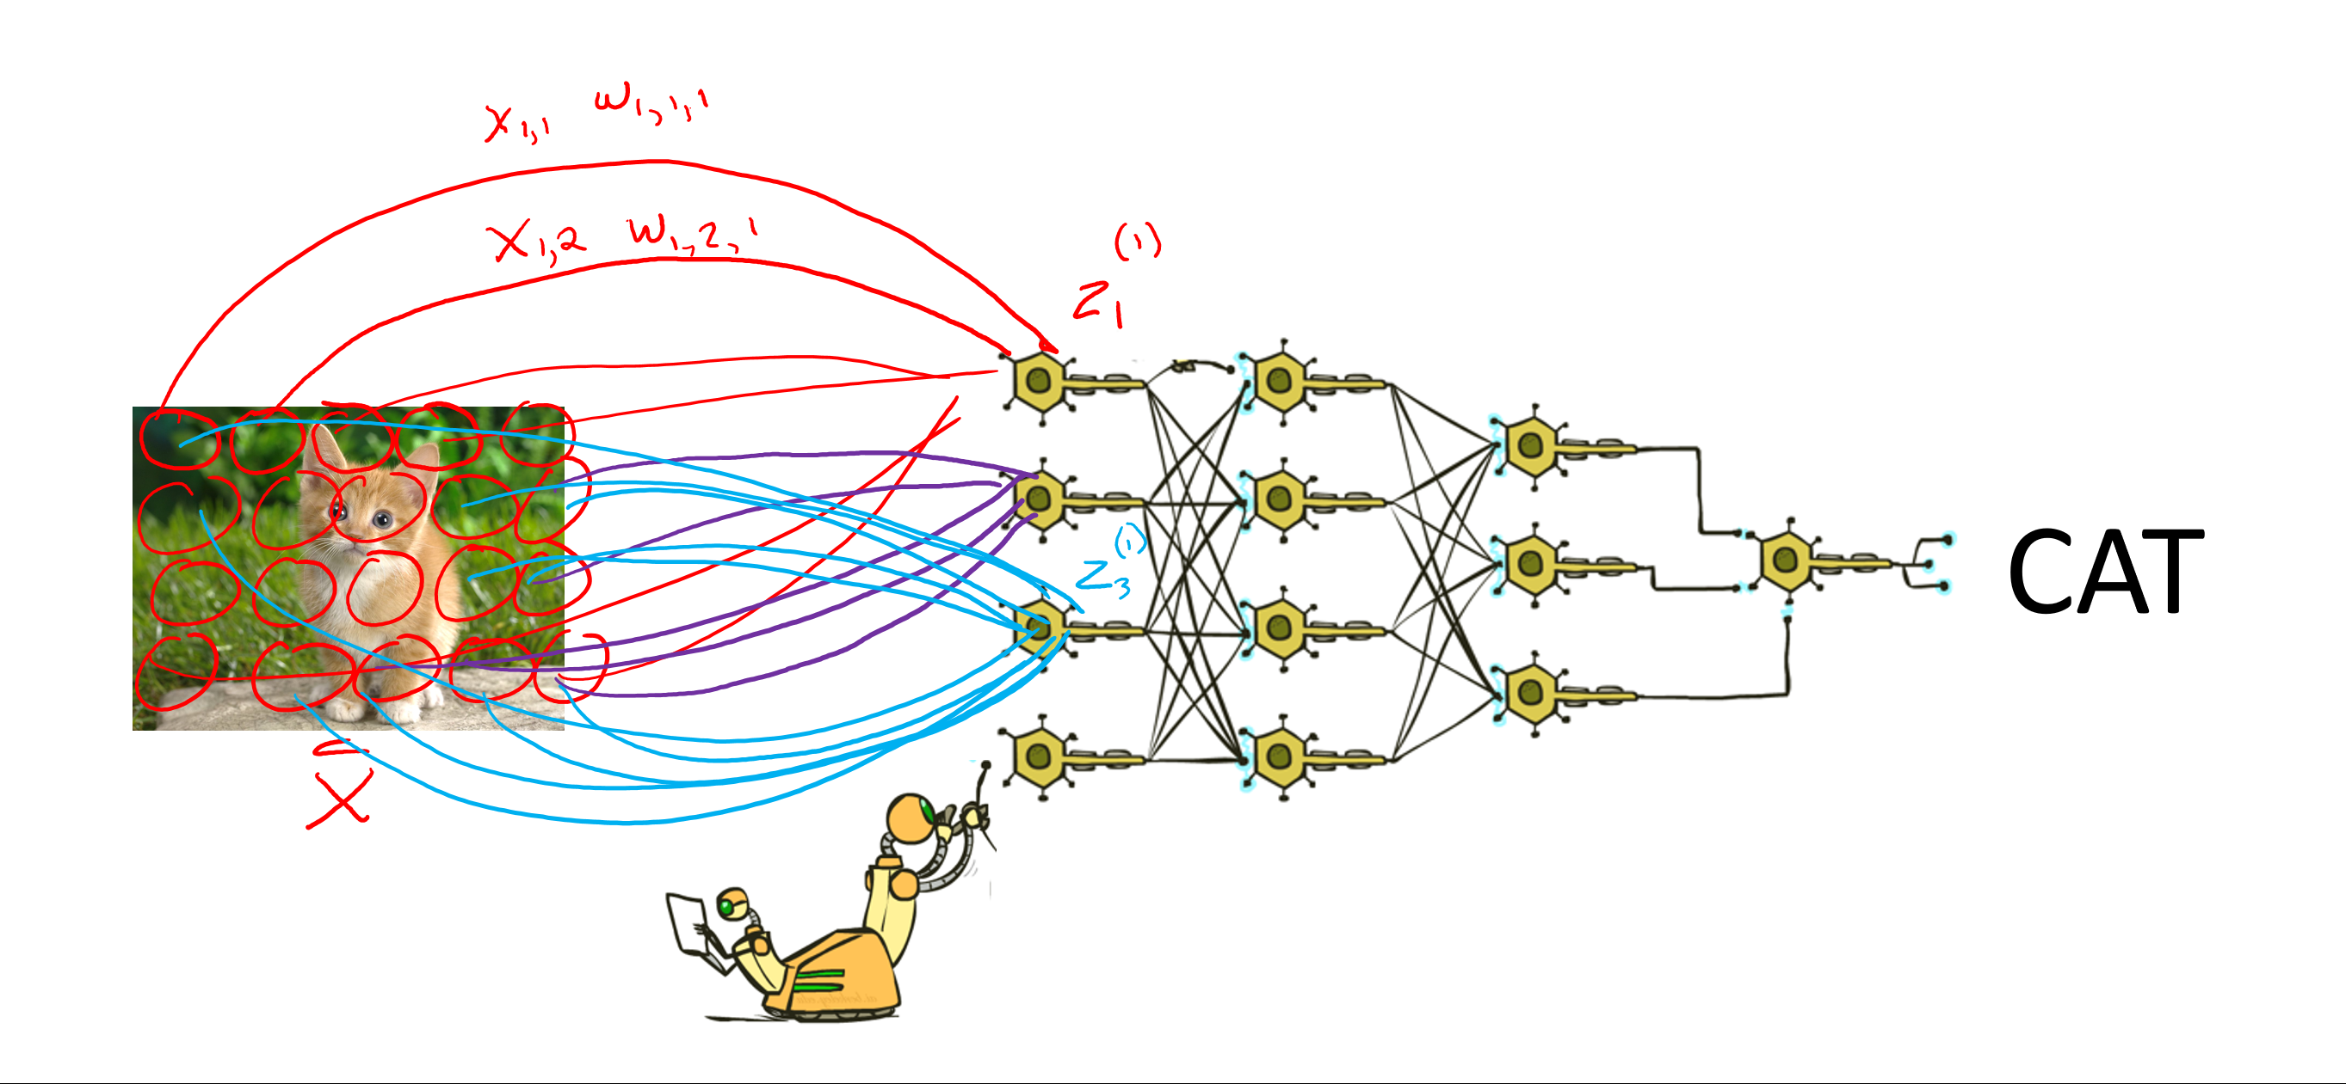
Classification: Deep Learning
CAT
Lost spatial content after first layer
Not spatially invariant
Too many weights to learn

Slide 43
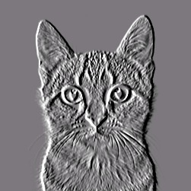
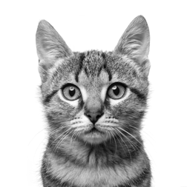
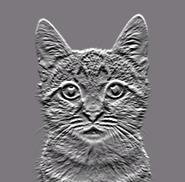
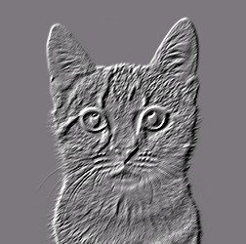
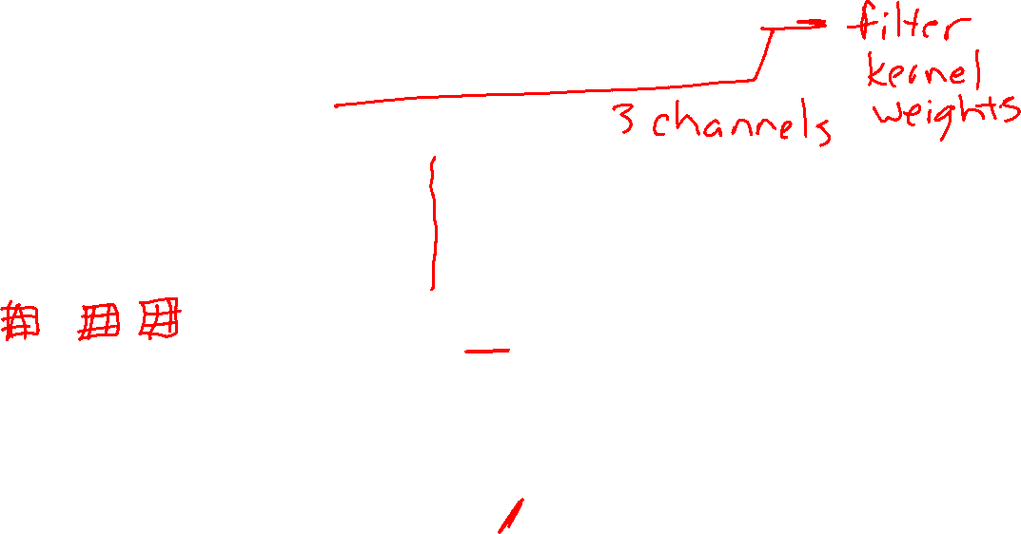
Convolutional Neural Networks
Convolution
CAT

Slide 44
Convolution
-1 | 0 | 1
-1 | 0 | 1
-1 | 0 | 1

Slide 45
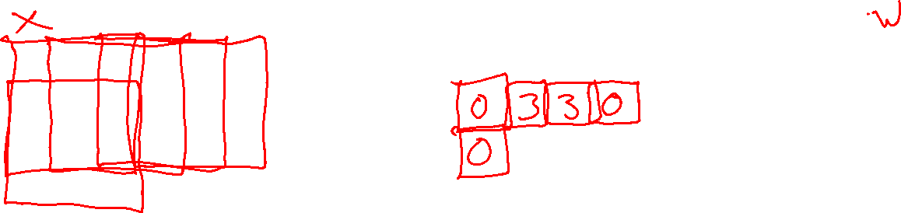
Convolution
0 | 0 | 0 | 1 | 1 | 1 | 1 | 0 | 0 | 0
0 | 0 | 0 | 1 | 1 | 1 | 1 | 0 | 0 | 0
0 | 0 | 0 | 1 | 1 | 1 | 1 | 0 | 0 | 0
0 | 0 | 0 | 1 | 1 | 1 | 1 | 0 | 0 | 0
0 | 0 | 0 | 1 | 1 | 1 | 1 | 0 | 0 | 0
0 | 0 | 0 | 1 | 1 | 1 | 1 | 0 | 0 | 0
0 | 0 | 0 | 1 | 1 | 1 | 1 | 0 | 0 | 0
0 | 0 | 0 | 1 | 1 | 1 | 1 | 0 | 0 | 0
0 | 0 | 0 | 1 | 1 | 1 | 1 | 0 | 0 | 0
0 | 0 | 0 | 1 | 1 | 1 | 1 | 0 | 0 | 0
-1 | 0 | 1
-1 | 0 | 1
-1 | 0 | 1

Slide 46
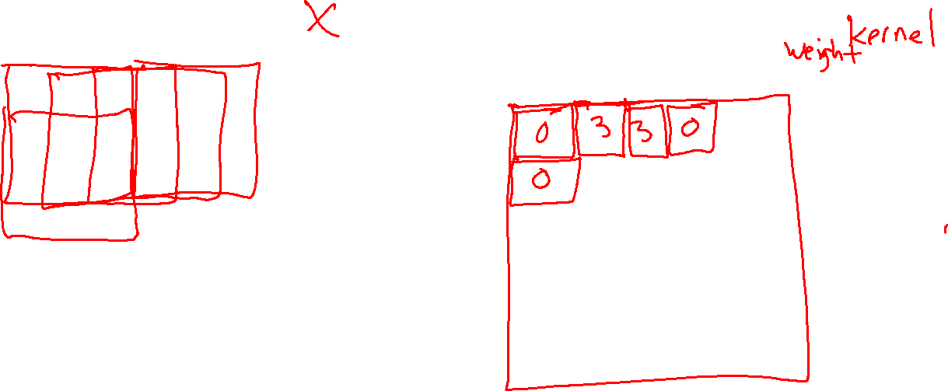
Convolution
0 | 0 | 0 | 1 | 1 | 1 | 1 | 0 | 0 | 0
0 | 0 | 0 | 1 | 1 | 1 | 1 | 0 | 0 | 0
0 | 0 | 0 | 1 | 1 | 1 | 1 | 0 | 0 | 0
0 | 0 | 0 | 1 | 1 | 1 | 1 | 0 | 0 | 0
0 | 0 | 0 | 1 | 1 | 1 | 1 | 0 | 0 | 0
0 | 0 | 0 | 1 | 1 | 1 | 1 | 0 | 0 | 0
0 | 0 | 0 | 1 | 1 | 1 | 1 | 0 | 0 | 0
0 | 0 | 0 | 1 | 1 | 1 | 1 | 0 | 0 | 0
0 | 0 | 0 | 1 | 1 | 1 | 1 | 0 | 0 | 0
0 | 0 | 0 | 1 | 1 | 1 | 1 | 0 | 0 | 0
-1 | 0 | 1
-1 | 0 | 1
-1 | 0 | 1

Slide 47

Convolution
-1 | 0 | 1
-1 | 0 | 1
-1 | 0 | 1

Slide 48

Convolution
Signal processing definition
$$z\left[i,j\right]= \sum_{u=−∞}^{∞}{\sum_{v=−∞}^{∞}{x\left[i−u, j−v\right]⋅w[u},v]}$$
Relaxed definition
  Drop infinity; don’t flip kernel
$$z\left[i,j\right]= \sum_{u=0}^{K−1}{\sum_{v=0}^{K−1}{x\left[i+u, j+v\right]⋅w[u},v]}$$
-1 | 0 | 1
-2 | 0 | 2
-1 | 0 | 1

Slide 49

Convolution
Relaxed definition
$$z\left[i,j\right]= \sum_{u=0}^{K−1}{\sum_{v=0}^{K−1}{x\left[i+u, j+v\right]⋅w[u},v]}$$
for i in range(0, im_width - K + 1):
for j in range(0, im_height - K):
im_out[i,j] = 0
for u in range(0, K):
for v in range(0, K):
im_out[i,j] += im[i+u, j+v] * kernel[u,v]
GPU!!
-1 | 0 | 1
-2 | 0 | 2
-1 | 0 | 1

Slide 50
Convolution: Padding
0 | 0 | 1 | 1 | 1 | 1 | 0 | 0
0 | 0 | 1 | 1 | 1 | 1 | 0 | 0
0 | 0 | 1 | 1 | 1 | 1 | 0 | 0
0 | 0 | 1 | 1 | 1 | 1 | 0 | 0
0 | 0 | 1 | 1 | 1 | 1 | 0 | 0
0 | 0 | 1 | 1 | 1 | 1 | 0 | 0
0 | 0 | 1 | 1 | 1 | 1 | 0 | 0
0 | 0 | 1 | 1 | 1 | 1 | 0 | 0
0 | 2 | 2 | 0 | 0 | -2 | -2 | 0
0 |  |  |  |  |  |  | 0
0 |  |  |  |  |  |  | 0
0 |  |  |  |  |  |  | 0
0 |  |  |  |  |  |  | 0
0 |  |  |  |  |  |  | 0
0 |  |  |  |  |  |  | 0
0 | 2 | 2 | 0 | 0 | -2 | -2 | 0
3 | 3 | 0 | 0 | -3 | -3
3 | 3 | 0 | 0 | -3 | -3
3 | 3 | 0 | 0 | -3 | -3
3 | 3 | 0 | 0 | -3 | -3
3 | 3 | 0 | 0 | -3 | -3
3 | 3 | 0 | 0 | -3 | -3

Slide 51




Exercise: Which kernel goes with which output image?
Input
K1
K2
K3
-1 | 0 | 1
-2 | 0 | 2
-1 | 0 | 1
-1 | -2 | -1
0 | 0 | 0
1 | 2 | 1
0 | 0 | -1 | 0
0 | -2 | 0 | 1
-1 | 0 | 2 | 0
0 | 1 | 0 | 0
Im1
Im2
Im3

Slide 52
Exercise: Which kernel goes with which output image?
Input
K1
K2
K3
-1 | 0 | 1
-2 | 0 | 2
-1 | 0 | 1
-1 | -2 | -1
0 | 0 | 0
1 | 2 | 1
0 | 0 | -1 | 0
0 | -2 | 0 | 1
-1 | 0 | 2 | 0
0 | 1 | 0 | 0
Im1
Im2
Im3

Slide 53

Convolutional Neural Networks
Convolution
-1 | 0 | 1
-2 | 0 | 2
-1 | 0 | 1
-1 | -2 | -1
0 | 0 | 0
1 | 2 | 1
CAT
0 | 0 | -1 | 0
0 | -2 | 0 | 1
-1 | 0 | 2 | 0
0 | 1 | 0 | 0

Slide 54



Convolutional Neural Networks
Pooling
Convolution
-1 | 0 | 1
-2 | 0 | 2
-1 | 0 | 1
-1 | -2 | -1
0 | 0 | 0
1 | 2 | 1
0 | 0 | -1 | 0
0 | -2 | 0 | 1
-1 | 0 | 2 | 0
0 | 1 | 0 | 0

Slide 55
Convolution: Stride=2
0 | 0 | 0 | 1 | 1 | 1 | 1 | 0 | 0 | 0
0 | 0 | 0 | 1 | 1 | 1 | 1 | 0 | 0 | 0
0 | 0 | 0 | 1 | 1 | 1 | 1 | 0 | 0 | 0
0 | 0 | 0 | 1 | 1 | 1 | 1 | 0 | 0 | 0
0 | 0 | 0 | 1 | 1 | 1 | 1 | 0 | 0 | 0
0 | 0 | 0 | 1 | 1 | 1 | 1 | 0 | 0 | 0
0 | 0 | 0 | 1 | 1 | 1 | 1 | 0 | 0 | 0
0 | 0 | 0 | 1 | 1 | 1 | 1 | 0 | 0 | 0
0 | 0 | 0 | 1 | 1 | 1 | 1 | 0 | 0 | 0
0 | 0 | 0 | 1 | 1 | 1 | 1 | 0 | 0 | 0
.25 | .25
.25 | .25

Slide 56

Stride: Max Pooling
Stanford CS 231n, Spring 2017

Slide 57
Convolutional Neural Networks
Pooling
Convolution
-1 | 0 | 1
-2 | 0 | 2
-1 | 0 | 1
-1 | -2 | -1
0 | 0 | 0
1 | 2 | 1
0 | 0 | -1 | 0
0 | -2 | 0 | 1
-1 | 0 | 2 | 0
0 | 1 | 0 | 0

Slide 58


Convolutional Neural Networks
Pooling
Convolution
-1 | 0 | 1
-2 | 0 | 2
-1 | 0 | 1
-1 | -2 | -1
0 | 0 | 0
1 | 2 | 1
0 | 0 | -1 | 0
0 | -2 | 0 | 1
-1 | 0 | 2 | 0
0 | 1 | 0 | 0

Slide 59
Convolutional Neural Networks
Pooling
Convolution
-1 | 0 | 1
-2 | 0 | 2
-1 | 0 | 1
-1 | -2 | -1
0 | 0 | 0
1 | 2 | 1
0 | 0 | -1 | 0
0 | -2 | 0 | 1
-1 | 0 | 2 | 0
0 | 1 | 0 | 0

Slide 60

Convolutional Neural Networks
Lenet5 – Lecun, et al, 1998
  Convnets for digit recognition
LeCun, Yann, et al. "Gradient-based learning applied to document recognition." Proceedings of the IEEE 86.11 (1998): 2278-2324.

Slide 61
Question:
How big many convolutional weights between S2 and C3?
  S2: 6 channels @14x14
  Conv: 5x5, pad=0, stride=1
  C3: 16 channels @ 10x10

Slide 62
Question:
How big many convolutional weights between S2 and C3?
  S2: 6 channels @14x14
  Conv: 5x5, pad=0, stride=1
  C3: 16 channels @ 10x10
One image in C3 is actually the result of a 3D convolution
Kernel_1: 6x5x5
C3_1: 1x10x10
S2: 6x14x14

Slide 63
Question:
How big many convolutional weights between S2 and C3?
  S2: 6 channels @14x14
  Conv: 5x5, pad=0, stride=1
  C3: 16 channels @ 10x10
Each image in C3 convolved S2 convolved with a different 3D kernel
Kernel_2: 6x5x5
C3_2: 1x10x10
Kernel_1: 6x5x5
C3_1: 1x10x10
S2: 6x14x14

Slide 64
Question:
How big many convolutional weights between S2 and C3?
  S2: 6 channels @14x14
  Conv: 5x5, pad=0, stride=1
  C3: 16 channels @ 10x10
The 16 images in C3 are the result of doing 16 3D convolutions of S2 with 16 different 6x5x5 kernels.
Assuming no bias term, this is 16x6x5x5 weights!
Kernels: 16@6x5x5
S2: 6x14x14
C3: 16@10x10

Slide 65

Convolutional Neural Networks
Alexnet – Krizhevsky, et al, 2012
  Convnets for image classification
  More data & more compute power
Krizhevsky, Alex, Ilya Sutskever, and Geoffrey E. Hinton. "ImageNet classification with deep convolutional neural networks." NIPS, 2012.

Slide 66
CNNs for Image Recognition
Slide from Kaiming He

Slide 67
Natural Language Processing

Slide 68







NLP Sub-tasks
Many different operations to help process language
Images: https://www.youtube.com/watch?v=CMrHM8a3hqw

Slide 69
Language Models

Slide 70

Language Model
Generate highly probable next words
https://transformer.huggingface.co/doc/gpt2-large

Slide 71

Probabilistic language models
We haven’t covered probability much yet, but with apologies for some forward references, a (probabilistic) language model aims at providing a probability distribution over every word, given all the words before it
$$P\left({word}_{i}\right|{word}_{1},…, {word}_{i−1})$$
E.g., you probably have a pretty good sense of what the next word should be:
  “Data science is the study and practice of how we can extract insight and knowledge from large amounts of”
  $$P\left({word}_{i}=“data”\right|{word}_{1},…, {word}_{i−1})= ?$$
  $$P\left({word}_{i}=“pizza”\right|{word}_{1},…, {word}_{i−1})= ?$$

Slide 72

Building language models
Building a language model that captures the true probabilities of natural language is still a distant goal
Instead, we make simplifying assumptions to build approximate tractable models
N-gram model: the probability of a word depends only on the $n−1$ words preceding it
$$P\left({word}_{i}\right|{word}_{1},…, {word}_{i−1})≈P({word}_{i}|{word}_{i−n+1},…, {word}_{i−1})$$
This puts a hard limit on the context that we can use to make a prediction, but also makes the modeling more tractable
  “large amounts of data” vs. “large amounts of pizza”

Slide 73

Estimating probabilities
A simple way (but not the only way) to estimate the conditional probabilities is simply by counting
$$P\left({word}_{i} | {word}_{i−n+1},…, {word}_{i−1}\right)=\frac{\#\left({word}_{i−n+1},…,{word}_{i}\right)}{\#\left({word}_{i−n+1},…, {word}_{i−1}\right)}$$
E.g.:
$$P\left(“data” | “large amounts of”\right)=\frac{\#\left(“large amounts of data”\right)}{\#\left(“large amounts of”\right)}$$

Slide 74


Example of estimating probabilities
Very short corpus:
“The goal of this lecture is to explain the basics of free text processing”
Using an 2-gram model
$$P\left({word}_{i} | {word}_{i−1}=“of”\right)= ?$$

Slide 75

Probability Models
Example: Speech Recognition
“artificial $⋅⋅⋅⋅⋅⋅⋅⋅⋅⋅⋅$”
Find most probable next word given “artificial” and the audio for second word.

Slide 76


Probability Models
Example: Speech Recognition
“artificial $⋅⋅⋅⋅⋅⋅⋅⋅⋅⋅⋅$”
Find most probable next word given “artificial” and the audio for second word.
Which second word gives the highest probability?
$$P\left(limb \right| artificial, audio)$$
$$P\left(intelligence\right| artificial, audio)$$
$$P\left(flavoring \right| artificial, audio)$$
Break down problem
n-gram probability * audio probability
$P\left(limb \right| artificial)$ * $P(audio∣limb$)
$P\left(intelligence\right| artificial)$ *$P(audio∣intelligence$)
$P\left(flavoring \right| artificial)$ *$P(audio∣flavoring$)

Slide 77
N-gram Training
Where do the n-gram probabilities come from?
Google n-grams demo

Slide 78
NLP Can Be Huge
N-gram probabilities
Vocabulary size: 50,000

Slide 79
NLP Training
Self-supervised
Example: Jane Austen, Pride and Prejudice
Vanity and pride are different things, though the words are often used synonymously. A person may be proud without being vain. Pride relates more to our opinion of ourselves, vanity to what we would have others think of us.

Slide 80
NLP Training
Self-supervised learning (auto-regressive)
Example: Jane Austen, Pride and Prejudice
Vanity and pride are different things, though the words are often used synonymously. A person may be proud without being vain. Pride relates more to our opinion of ourselves, vanity to what we would have others think of us.

Slide 81
Examples
Random samples from language model trained on Shakespeare:
n=1: “in as , stands gods revenge ! france pitch good in fair hoist an what fair shallow-rooted , . that with wherefore it what a as your . , powers course which thee dalliance all”
n=2: “look you may i have given them to the dank here to the jaws of tune of great difference of ladies . o that did contemn what of ear is shorter time ; yet seems to”
n=3: “believe , they all confess that you withhold his levied host , having brought the fatal bowels of the pope ! ' and that this distemper'd messenger of heaven , since thou deniest the gentle desdemona ,”
n=7: “so express'd : but what of that ? 'twere good you do so much for charity . i cannot find it ; 'tis not in the bond . you , merchant , have you any thing to say ? but little”
This is starting to look a lot like Shakespeare… because it is Shakespeare
Slide: CMU, Zico Kolter

Slide 82


How do we pick $n$?
Hyperparameter
Lower $n$: less context, but more samples of each possible $n$-gram
Higher $n$: more context, but less samples
“Correct” choice is to use some measure of held-out cross-validation
In practice: use $n=3$ for large datasets (i.e., triplets) , $n=2$ for small ones

Slide 83
Not-so-probabilistic language models

Slide 84
Reminder: Autoencoders
Encoding and decoding

Slide 85
Text processing with word2vec
Word embeddings
Training data:
“The king sat on the throne”
“the queen sat on the throne”
“the banana is yellow”
“they sat on the yellow bus”
Skip-gram
score(word, <other words around it>)
• king
• king
• sat
• sat
• throne
• throne
• queen
• queen
• banana
• banana
• yellow
• yellow
• they
• they
• bus
• bus

Slide 86

Text processing with word2vec
Word embeddings
Training data:
“The king sat on the throne”
“the queen sat on the throne”
“the banana is yellow”
“they sat on the yellow bus”
Skip-gram
score(word, <other words around it>)
• king
• king
• sat
• sat
• throne
• throne
• queen
• queen
• banana
• banana
• yellow
• yellow
• they
• they
• bus
• bus

Slide 87

Attention/Transformers
Figure: https://arxiv.org/abs/1706.03762

Slide 88

Attention/Transformers
Figure: https://jalammar.github.io/illustrated-transformer/

Slide 89
Exploring GPT2

Slide 90

GPT-3 Language Model
Advanced language model
Image: https://jalammar.github.io/how-gpt3-works-visualizations-animations/

Slide 91
GPT-3 Language Model
State-of-the-art language model
Trained with dataset of 300 billion tokens
175 billion parameters
It was estimated to cost 355 GPU years and cost $4.6m
Image: https://jalammar.github.io/how-gpt3-works-visualizations-animations/

Slide 92


NLP Ethics
Environmental concerns
Emma Strubell
Assistant Professor
Language Technologies Institute
CMU
Frontiers in Machine Learning: Climate Impact of Machine Learning

Slide 93

NLP Ethics
Misuse
https://www.technologyreview.com/2019/08/29/133218/openai-released-its-fake-news-ai-gpt-2/

Slide 94



NLP Ethics
Bias
https://spectrum.ieee.org/tech-talk/artificial-intelligence/machine-learning/in-2016-microsofts-racist-chatbot-revealed-the-dangers-of-online-conversation

Slide 95

NLP Ethics
Bias
https://venturebeat.com/2021/06/10/openai-claims-to-have-mitigated-bias-and-toxicity-in-gpt-3/

Slide 96


NLP Ethics
Dangerous errors
https://artificialintelligence-news.com/2020/10/28/medical-chatbot-openai-gpt3-patient-kill-themselves/

Slide 97

NLP Ethics
Digital divide
https://blogs.microsoft.com/blog/2020/09/22/microsoft-teams-up-with-openai-to-exclusively-license-gpt-3-language-model/

