Slide 1
Plan
Last time
MLE → MAP
Today
Discriminative → Generative
Example Generative Models
Discriminant Analysis
Naïve Bayes
Next time
Combining MAP and Generative

Slide 2
10-315 Introduction to ML Probabilistic Models: Generative and Naïve Bayes
Instructor: Pat Virtue

Slide 3
Discriminative and Generative

Slide 4
Two Applications of Bayes Rule
$$p\left(a ∣ b\right)=\frac{p\left(b ∣ a\right) p(a)}{p(b)}$$
$$p\left(θ ∣ 𝒟\right)=\frac{p\left(𝒟 ∣ θ\right) p(θ)}{p(𝒟)}$$
$$p\left(y ∣ x\right)=\frac{p\left(x ∣ y\right) p(y)}{p(x)}$$

Slide 5
Bayes Rule
Terminology
Posterior Likelihood Prior
$$p\left(θ ∣ 𝒟\right)=\frac{p\left(𝒟 ∣ θ\right) p(θ)}{p(𝒟)}$$

Slide 6
Bayes Rule
Terminology
Posterior Likelihood Prior
Posterior Class conditional Class prior
Conditional likelihood
$$p\left(θ ∣ 𝒟\right)=\frac{p\left(𝒟 ∣ θ\right) p(θ)}{p(𝒟)}$$
$$p\left(y ∣ x\right)=\frac{p\left(x ∣ y\right) p(y)}{p(x)}$$

Slide 7
Bayes Rule
Inserting parameters
$$p\left(y ∣ x\right)=\frac{p\left(x ∣ y\right) p(y)}{p(x)}$$

Slide 8
Example: Exams
Let’s say we gave an exam that had 3 different versions where each exams had different mean and standard deviation
We have the data from $N$ students taking some version of the exam:
$$𝒟={\left\{x^{\left(i\right)}, y^{\left(i\right)}\right\}}_{i=1}^{N}$$
One student was sick. We had them take one of the exams, they scored $x=95$, but we forgot which exam they took!!
How would you go about computing the probability of the exam type for this student?

Slide 9
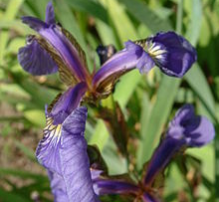
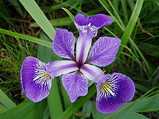
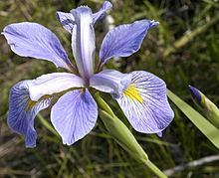
Example: Fisher Iris Dataset
Fisher (1936) used 150 measurements of flowers from 3 different species: Iris setosa (0), Iris virginica (1), Iris versicolor (2) collected by Anderson (1936)
Species | Sepal Length | Sepal Width | Petal Length | Petal Width
0 | 4.3 | 3.0 | 1.1 | 0.1
0 | 4.9 | 3.6 | 1.4 | 0.1
0 | 5.3 | 3.7 | 1.5 | 0.2
1 | 4.9 | 2.4 | 3.3 | 1.0
1 | 5.7 | 2.8 | 4.1 | 1.3
1 | 6.3 | 3.3 | 4.7 | 1.6
2 | 5.9 | 3.0 | 5.1 | 1.8
Images and full dataset: https://en.wikipedia.org/wiki/Iris_flower_data_set

Slide 10
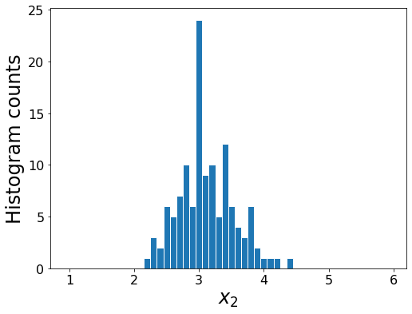
Density Estimation
Learn the “best” mapping of data to parameters for model
Iris data example: density of second column of features
$𝒟={\left\{x_{2}^{\left(i\right)}\right\}}_{i=1}^{N}$
Assume Gaussian
$X_{2} \sim 𝒩\left(μ, σ^{2}\right)$
Species | Sepal Length | Sepal Width | Petal Length | Petal Width
0 | 4.3 | 3.0 | 1.1 | 0.1
0 | 4.9 | 3.6 | 1.4 | 0.1
0 | 5.3 | 3.7 | 1.5 | 0.2
1 | 4.9 | 2.4 | 3.3 | 1.0
1 | 5.7 | 2.8 | 4.1 | 1.3
1 | 6.3 | 3.3 | 4.7 | 1.6
2 | 5.9 | 3.0 | 5.1 | 1.8
Images and full dataset: https://en.wikipedia.org/wiki/Iris_flower_data_set

Slide 11
Likelihood
Simple example with three i.i.d. samples of $X \sim 𝒩\left(μ, σ^{2}\right)$
$𝒟={\left\{x^{(i)}\right\}}_{i=1}^{3}$
Likelihood
$p(𝒟;θ)$
$=p\left(x^{\left(1\right)},x^{\left(2\right)},x^{\left(3\right)};μ^{\left(1\right)}, σ^{\left(1\right)},μ^{\left(2\right)}, σ^{\left(2\right)},μ^{\left(3\right)}, σ^{\left(3\right)}\right)$ Expand notation
$=p\left(x^{\left(1\right)},x^{\left(2\right)},x^{\left(3\right)};μ, σ\right)$ Identically distributed
$=p\left(x^{\left(1\right)};μ, σ\right) p\left(x^{\left(2\right)};μ, σ\right) p\left(x^{\left(3\right)};μ, σ\right)$ Independent
$=\prod_{i=1}^{3}{p\left(x^{\left(i\right)};μ, σ\right)}$

Slide 12
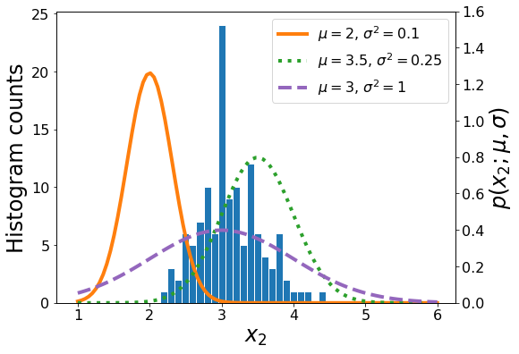
Maximum Likelihood Estimation
Likelihood
$p(𝒟;θ)=\prod_{i=1}^{N}{p\left(x_{2}^{(i)};μ, σ\right)}$
Which set of parameters is best?
$$X_{2}$$
Sepal Width
3.0
3.6
3.7
2.4
2.8
3.3
3.0

Slide 13
Maximum Likelihood Estimation
Likelihood
$p(𝒟;θ)=\prod_{i=1}^{N}{p\left(x_{2}^{(i)};μ, σ\right)}$
Likelihood function
$ℒ\left(θ;𝒟\right)=p(𝒟;θ)$
$ℒ\left(μ, σ;𝒟\right)=\prod_{i=1}^{N}{p\left(x_{2}^{(i)};μ, σ\right)}$
Maximum likelihood estimation
$\hat{θ}=\underset{θ}{argmax}ℒ\left(θ;𝒟\right)$
$\hat{μ}, \hat{σ}=\underset{μ, σ}{argmax}ℒ\left(μ, σ;𝒟\right)$

Slide 14
ML Tasks
Density estimation
$𝒟={\left\{x^{\left(i\right)}\right\}}_{i=1}^{N}$ $𝒟→θ$
Supervised learning
$𝒟={\left\{\left(y^{\left(i\right)},x^{\left(i\right)}\right)\right\}}_{i=1}^{N}$ $h\left(x\right)→\hat{y}$
Classification
Output labels
$y∈𝒴$, where $𝒴$ is discrete and order of values has no meaning
Regression
Output values
$y∈𝒴\text{, }\text{where} 𝒴$ is usually continuous, order of values has meaning

Slide 15
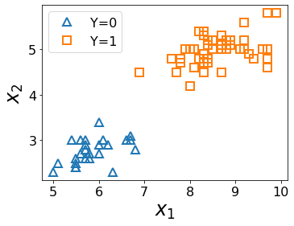
Classification
Predict species label from first two input measurements
$h\left(x\right)→\hat{y}$
Species | Sepal Length | Sepal Width
0 | 4.3 | 3.0
0 | 4.9 | 3.6
0 | 5.3 | 3.7
1 | 4.9 | 2.4
1 | 5.7 | 2.8
1 | 6.3 | 3.3
2 | 5.9 | 3.0
Images and full dataset: https://en.wikipedia.org/wiki/Iris_flower_data_set

Slide 16
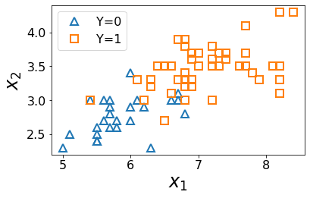
Classification
Predict species label from first two input measurements
$h\left(x\right)→\hat{y}$
Species | Sepal Length | Sepal Width
0 | 4.3 | 3.0
0 | 4.9 | 3.6
0 | 5.3 | 3.7
1 | 4.9 | 2.4
1 | 5.7 | 2.8
1 | 6.3 | 3.3
2 | 5.9 | 3.0
Images and full dataset: https://en.wikipedia.org/wiki/Iris_flower_data_set

Slide 17
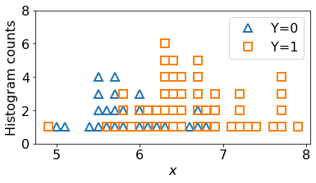
Classification
Predict species label from only one input measurement
$h\left(x\right)→\hat{y}$
Species | Sepal Length
0 | 4.3
0 | 4.9
0 | 5.3
1 | 4.9
1 | 5.7
1 | 6.3
2 | 5.9
Images and full dataset: https://en.wikipedia.org/wiki/Iris_flower_data_set

Slide 18
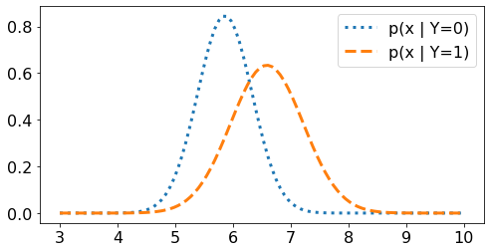
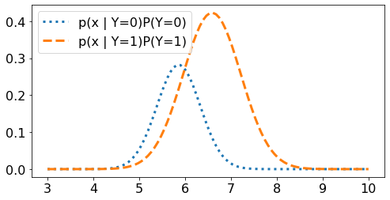
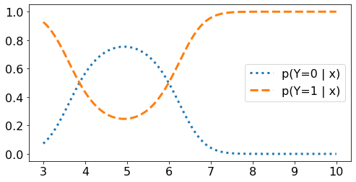
Classification
Predict species label from 1-dimensional input, $x$
$h\left(x\right)→\hat{y}$

Slide 19
Bayes Decision Rule
If we know the conditional probability $p(X | Y)$ and class priors $p(Y)$ we can determine the appropriate class by using Bayes rule:
function $h(x)$:
If $p\left(Y=1 ∣ x\right)≥p\left(Y=0 ∣ x\right)$
return 1
Else
return 0
Assuming 0,1 classification loss!

Slide 20
Bayes Decision Rule
If we know the conditional probability $p(X | Y)$ and class priors $p(Y)$ we can determine the appropriate class by using Bayes rule:
function $h(x)$:
If $p(x | Y=1)P(Y=1) ≥p(x | Y=0)P(Y=0)$
return 1
Else
return 0
Assuming 0,1 classification loss!

Slide 21
Optimal Classification Function
Find the best $h\left(x\right)→\hat{y}$ by searching in the space of hypothesis functions $h∈ℋ$.
Optimal classifier:
$$h^{∗}\left(x\right)= \underset{y}{argmax} P\left(Y=y ∣ X=x\right)$$
But why?

Slide 22
Optimal Decision Boundaries
Decision boundary
The set of points in the domain of the input ($x$) where the predicted classification changes
Two class decision boundary
So far, we have decided to let the decision boundary be all $x$ such that:
$$p\left(Y=0 \right| X=x) = p\left(Y=1 \right| X=x)$$
What assumptions are we making here?
This assumes that the cost of predicting it wrong is the same for both classes

Slide 23
Optimal Classification Function
Find the best $h\left(x\right)→\hat{y}$ by searching in the space of hypothesis functions $h∈ℋ$.
Optimal classifier:
$$h^{∗}\left(x\right)= \underset{y}{argmax} P\left(Y=y ∣ X=x\right)$$
But why?
Goal: find a prediction function $h^{∗}:𝒳→𝒴$ that minimizes the expected loss for randomly drawn test data $(X, Y)$
$$h^{∗}= \underset{h}{argmin} 𝔼_{XY}\left[L\left(Y, h\left(X\right)\right)\right]$$
$L(y, \hat{y})$ is the loss or cost of predicting $\hat{y}$ when the true value is $y$.

Slide 24
Classification
Predict species label from first two input measurements
$h\left(x\right)→\hat{y}$
Species | Sepal Length | Sepal Width
0 | 4.3 | 3.0
0 | 4.9 | 3.6
0 | 5.3 | 3.7
1 | 4.9 | 2.4
1 | 5.7 | 2.8
1 | 6.3 | 3.3
2 | 5.9 | 3.0
Images and full dataset: https://en.wikipedia.org/wiki/Iris_flower_data_set

Slide 25
Example: Cat and dog data

Slide 26
Exercise
Let’s say we gave an exam that had 3 different versions where the probability of different exams was modeled as a categorical random variable $Y$ and the scores from each exam were modeled as $X_{Y=k} \sim 𝒩(μ_{k},σ_{k}^{2})$.
We have the data from $N$ students taking some version of the exam:
$$𝒟={\left\{x^{\left(i\right)}, y^{\left(i\right)}\right\}}_{i=1}^{N}$$
One student was sick. We had them take one of the exams, they scored $x=95$, but we forgot which exam they took!!
How would you go about computing the probability of the exam type for this student?
$p\left(y ∣ x=95\right)=$

Slide 27
Generative Example
3 different versions: categorical random variable $Y$
Scores from each exam were modeled as $X_{Y=k} \sim 𝒩(μ_{k},σ_{k}^{2})$.
One student was sick. We had them take one of the exams, they scored $x=95$, but we forgot which exam they took!!
How would you go about computing the probability of the exam type for this student?
$p\left(y ∣ x=95\right)$

Slide 28
Poll 1
Let’s say we gave an exam that had 3 different versions where the probability of different exams was modeled as a categorical random variable $Y$ and the scores from each exam were modeled as $X_{Y=k} \sim 𝒩(μ_{k},σ_{k}^{2})$. $𝒟={\left\{x^{\left(i\right)}, y^{\left(i\right)}\right\}}_{i=1}^{N}$
How many parameters are in our model?
2
3
6
9
3N

Slide 29
Exercise
$Y \sim Categorical\left(π_{1},π_{2},π_{3}\right)$
$X_{Y=k} \sim 𝒩(μ_{k},σ_{k}^{2})$.
$𝒟={\left\{x^{\left(i\right)}, y^{\left(i\right)}\right\}}_{i=1}^{N}$
How would you go about computing the probability of the exam type for this student? $p\left(y ∣ x=95\right)$

Slide 30
Exercise
$Y \sim Categorical\left(π_{1},π_{2},π_{3}\right)$
$X_{Y=k} \sim 𝒩(μ_{k},σ_{k}^{2})$.
$𝒟={\left\{x^{\left(i\right)}, y^{\left(i\right)}\right\}}_{i=1}^{N}$
How would you go about computing the probability of the exam type for this student? $p\left(y ∣ x=95\right)$

Slide 31
Categorical Gaussian Generative Model
Estimating parameters
$Y \sim Categorical\left(π_{1},π_{2},π_{3}\right)$
$X_{Y=k} \sim 𝒩(μ_{k},σ_{k}^{2})$.
$𝒟={\left\{x^{\left(i\right)}, y^{\left(i\right)}\right\}}_{i=1}^{N}$

Slide 32
Categorical Gaussian Generative Model
Estimating parameters
$Y \sim Categorical\left(π_{1},π_{2},π_{3}\right)$
$X_{Y=k} \sim 𝒩(μ_{k},σ_{k}^{2})$.
$𝒟={\left\{x^{\left(i\right)}, y^{\left(i\right)}\right\}}_{i=1}^{N}$

Slide 33
Poll 2

Slide 34
Poll 3

Slide 35
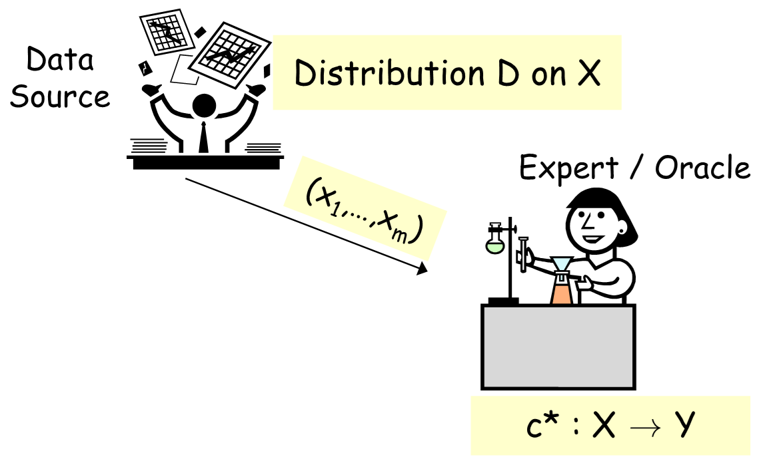
Generative vs Discriminative Modeling
Discriminative: modeling X → Y directly
Generative: Stronger modeling assumptions about where data came from

Slide 36
Generative vs Discriminative Modeling
Discriminative: model $p(y∣x, θ)$ directly
Learn parameters $θ$ from data
Generative: model $p\left(y ∣ θ_{class}\right)$ and $p\left(x ∣ {y, θ}_{class conditional}\right)$
Learn parameters $θ_{class}$ and $θ_{class conditional}$ from data
Use Bayes rule to compute $p(y | x, θ_{class}, θ_{class conditional})$
$p(y | x, θ_{class}, θ_{class conditional})∝p\left(x ∣ {y, θ}_{class conditional}\right)$ $p\left(y ∣ θ_{class}\right)$

Slide 37
Generative Story
News article topic classification
Document class: Business, Entertainment, Politics
Words in the document
SPAM classification
Document class: SPAM or not
Words in the document

Slide 38
Generative Story
Hand-written digits
Digit class: 0-9
Pixels in images

Slide 39
Generative vs Discriminative Modeling
Discriminative: $p(y∣x)$
Generative: $p(y | x)=α p(x, y)=α p\left(x ∣ y\right) p\left(y\right)$
Assumptions vs Data
Discriminative:
Generative:

Slide 40
(Quick) Language Models

Slide 41
Language Model
Generate highly probable next words
https://transformer.huggingface.co/doc/gpt2-large

Slide 42
Probability Models for Language
Example: Text completion
“artificial $⋅⋅⋅⋅⋅⋅⋅⋅⋅⋅⋅$”
$$\underset{word_{2}}{argmax}{ p(word_{2}∣artificial)}$$
Language Model
n-gram probability
$P\left(limb \right| artificial)$
$P\left(intelligence\right| artificial)$
$P\left(flavoring \right| artificial)$
…

Slide 43
Probability Models for Language
Example: Text completion
“This cereal contains artificial $⋅⋅⋅⋅⋅⋅⋅⋅⋅⋅⋅$”
$$\underset{word_{5}}{argmax}{ p(word_{5}∣This, cereal, contains, artificial)}$$
Language Model
n-gram probability
Number of n-gram parameters vs vocab size: 50,000 words (tokens)
1-gram 2-gram 5-gram

Slide 44
Probability Models for Language
“This cereal contains artificial $⋅⋅⋅⋅⋅⋅⋅⋅⋅⋅⋅$”
$$\underset{word_{5}}{argmax}{ p(word_{5}∣This, cereal, contains, artificial)}$$
Language Model
n-gram probability
Independence assumptions
1-gram 2-gram 5-gram
$${ w}_{1}$$
$${ w}_{2}$$
$${ w}_{3}$$
$${ w}_{4}$$
$${ w}_{5}$$
$${ w}_{1}$$
$${ w}_{2}$$
$${ w}_{3}$$
$${ w}_{4}$$
$${ w}_{5}$$
$${ w}_{1}$$
$${ w}_{2}$$
$${ w}_{3}$$
$${ w}_{4}$$
$${ w}_{5}$$

Slide 45
Naïve Bayes

Slide 46
Multivariate Generative Models
Hand-written digits: How many parameters?
$P\left(Y\right)$
$P\left(X ∣ Y=3\right)$
$=p\left(X_{1}, X_{2},…X_{64} ∣ Y=3\right)$
Naïve Bayes assumption (bag of pixels)
$P\left(Y\right)$
$P\left(X ∣ Y=3\right)$
$=p\left(X_{1} ∣ Y=3\right)p\left(X_{2} ∣ Y=3\right)…p(X_{64}∣Y=3)$

Slide 47
Conditional Independence and Naïve Bayes
Independence
Conditional independence

Slide 48
Conditional Independence
Example: Fire, Smoke, Alarm
Fire and Alarm are independent given Smoke
$P\left(A∣S, F\right)=P\left(A∣S\right)$
Image: http://ai.berkeley.edu/

Slide 49
Conditional Independence and Naïve Bayes
Independence
Conditional independence
Naïve Bayes assumption
$P\left(A∣B\right)=P\left(A\right)$
$P\left(B∣A\right)=P\left(B\right)$
$P\left(A, B\right)=P\left(A\right)P(B)$
$P\left(A∣B, C\right)=P\left(A∣C\right)$
$P\left(B∣A, C\right)=P\left(B∣C\right)$
$P\left(A, B∣C\right)=P\left(A∣C\right)P(B∣C)$

Slide 50
Naïve Bayes for Digits
$$y$$ | $$P(Y)$$
1 | 0.1
2 | 0.1
3 | 0.1
4 | 0.1
5 | 0.1
6 | 0.1
7 | 0.1
8 | 0.1
9 | 0.1
0 | 0.1
$$y$$ | $$P(X_{3,1}=1∣y)$$
1 | 0.01
2 | 0.05
3 | 0.05
4 | 0.30
5 | 0.80
6 | 0.90
7 | 0.05
8 | 0.60
9 | 0.50
0 | 0.80
$$y$$ | $$P(X_{5,5}=1∣y)$$
1 | 0.05
2 | 0.01
3 | 0.90
4 | 0.80
5 | 0.90
6 | 0.90
7 | 0.25
8 | 0.85
9 | 0.60
0 | 0.80

Slide 51
SPAM Classification
Breakout room exercise
https://tinyurl.com/301601spam
SPAM classification
$Y$: Binary random variable
Document is SPAM ($Y=1$) or not ($Y=0$)
$X_{m}$: Binary random variable
Word $m$ appears in document ($X_{m}=1$) or not ($X_{m}=0$)
Page 1: Estimate parameters from data
Page 2: Calculate probabilities of new sentence given page 1 parameters

Slide 52
SPAM Classification
Exercise
$$P(Y=0,X_{1},…,X_{M})$$ | $$P(Y=1,X_{1},…,X_{M})$$
$$P(Y=0∣X_{1},…,X_{M})$$ | $$P(Y=1∣X_{1},…,X_{M})$$

Slide 53
Reminder MLE for Bernoulli
Bernoulli distribution:
$Y∼Bern\left(φ\right)$
$p\left(y\right)= \left\{\begin{aligned}φ, y=1 \\ 1−φ, y=0\end{aligned}\right.$
What is the log likelihood for three i.i.d. samples, given parameter $z$?
$𝒟=\{y^{\left(1\right)}=1,y^{\left(2\right)}=1,$ $y^{\left(3\right)}=0\}$
$L\left(z\right)=φ⋅φ⋅(1−φ)$ $=\prod_{n}{ φ^{y^{\left(n\right)}}}{\left(1−φ\right)}^{\left(1−y^{(n)}\right)}$
$L\left(z\right)=φ^{2}⋅{\left(1−φ\right)}^{1}$ $=φ^{N_{y=1}}{\left(1−φ\right)}^{N_{y=0}}$

Slide 54
Naïve Bayes MLE
$𝒟={\left\{y^{\left(n\right)}, x^{(n)}\right\}}_{n=1}^{N}$
$y^{(n)}∈\{0,1\}$
$x^{(n)}∈{\left\{0,1\right\}}^{M}$
$φ∈[0,1]$
$Θ∈{\left[0,1\right]}^{Mx2}$
$L\left(ϕ, Θ\right)=p\left(𝒟 \right| ϕ, Θ)$
$=Π_{n=1}^{N} p\left(𝒟^{\left(n\right)} ∣ ϕ, Θ\right)$ i.i.d assumption
$=Π_{n=1}^{N} p\left(y^{\left(n\right)}, x^{\left(n\right)} ∣ ϕ, Θ\right)$
$=Π_{n=1}^{N} p\left(y^{\left(n\right)} ∣ ϕ\right) p\left(x^{\left(n\right)} ∣ y^{\left(n\right)}, Θ\right)$ Generative model
$=Π_{n=1}^{N} p\left(y^{\left(n\right)} ∣ ϕ\right) p\left(x_{1}^{(n)},x_{2}^{(n)},…,x_{M}^{(n)} ∣ y^{\left(n\right)}, Θ\right)$
$=Π_{n=1}^{N} p\left(y^{\left(n\right)} ∣ ϕ\right) Π_{m=1}^{M} p\left(x_{m}^{(n)} ∣ y^{\left(n\right)}, θ_{m,y}\right)$ Naïve Bayes

Slide 55
Naïve Bayes MLE
$𝒟={\left\{y^{\left(n\right)}, x^{(n)}\right\}}_{n=1}^{N}$
$y^{(n)}∈\{0,1\}$
$x^{(n)}∈{\left\{0,1\right\}}^{M}$
$φ∈[0,1]$
$Θ∈{\left[0,1\right]}^{Mx2}$
$L\left(ϕ, Θ\right)=p\left(𝒟 \right| ϕ, Θ)$
$=Π_{n=1}^{N} p\left(𝒟^{\left(n\right)} ∣ ϕ, Θ\right)$ i.i.d assumption
$=Π_{n=1}^{N} p\left(y^{\left(n\right)}, x^{\left(n\right)} ∣ ϕ, Θ\right)$
$=Π_{n=1}^{N} p\left(y^{\left(n\right)} ∣ ϕ\right) p\left(x^{\left(n\right)} ∣ y^{\left(n\right)}, Θ\right)$ Generative model
$=Π_{n=1}^{N} p\left(y^{\left(n\right)} ∣ ϕ\right) p\left(x_{1}^{(n)},x_{2}^{(n)},…,x_{M}^{(n)} ∣ y^{\left(n\right)}, Θ\right)$
$=Π_{n=1}^{N} p\left(y^{\left(n\right)} ∣ ϕ\right) Π_{m=1}^{M} p\left(x_{m}^{(n)} ∣ y^{\left(n\right)}, θ_{m,y}\right)$ Naïve Bayes
$=Π_{n=1}^{N} φ^{y^{(n)}}{\left(1−φ\right)}^{1−y^{(n)}} Π_{m=1}^{M} θ_{m,1}^{𝕀\left(y^{\left(n\right)}=1 ∧ x_{m}^{\left(n\right)}=1\right) }{\left(1−θ_{m,1}\right)}^{𝕀\left(y^{(n)}=1 ∧ x_{m}^{(n)}=0\right)}$
$θ_{m,0}^{𝕀\left(y^{\left(n\right)}=0 ∧ x_{m}^{\left(n\right)}=1\right) }{\left(1−θ_{m,0}\right)}^{𝕀\left(y^{(n)}=0 ∧ x_{m}^{(n)}=0\right)}$
$=φ^{N_{y=1}}{\left(1−φ\right)}^{N_{y=0}} Π_{m=1}^{M} θ_{m,1}^{N_{y=1,x_{m}=1} }{\left(1−θ_{m,1}\right)}^{N_{y=1,x_{m}=0}}θ_{m,0}^{N_{y=0,x_{m}=1} }{\left(1−θ_{m,0}\right)}^{N_{y=0,x_{m}=0}}$

Slide 56
Naïve Bayes MLE
$𝒟={\left\{y^{\left(i\right)}, x^{(i)}\right\}}_{i=1}^{N}$
$y^{(i)}∈\{0,1\}$
$x^{(i)}∈{\left\{0,1\right\}}^{M}$
$φ∈[0,1]$
$Θ∈{\left[0,1\right]}^{Mx2}$
$L\left(ϕ, Θ\right)=p\left(𝒟 \right| ϕ, Θ)$
$=Π_{i=1}^{N} p\left(𝒟^{\left(i\right)} ∣ ϕ, Θ\right)$ i.i.d assumption
$=Π_{i=1}^{N} p\left(y^{\left(i\right)}, x^{\left(i\right)} ∣ ϕ, Θ\right)$
$=Π_{i=1}^{N} p\left(y^{\left(i\right)} ∣ ϕ\right) p\left(x^{\left(i\right)} ∣ y^{\left(i\right)}, Θ\right)$ Generative model
$=Π_{i=1}^{N} p\left(y^{\left(i\right)} ∣ ϕ\right) p\left(x_{1}^{(i)},x_{2}^{(i)},…,x_{M}^{(i)} ∣ y^{\left(i\right)}, Θ\right)$
$=Π_{i=1}^{N} p\left(y^{\left(i\right)} ∣ ϕ\right) Π_{j=1}^{M} p\left(x_{j}^{(i)} ∣ y^{\left(i\right)}, θ_{j,y}\right)$ Naïve Bayes
$=Π_{i=1}^{N} φ^{y^{(i)}}{\left(1−φ\right)}^{1−y^{(i)}} Π_{j=1}^{M} θ_{j,1}^{𝕀\left(y^{\left(i\right)}=1 ∧ x_{j}^{\left(i\right)}=1\right) }{\left(1−θ_{j,1}\right)}^{𝕀\left(y^{(i)}=1 ∧ x_{j}^{(i)}=0\right)}$
$θ_{j,0}^{𝕀\left(y^{\left(i\right)}=0 ∧ x_{j}^{\left(i\right)}=1\right) }{\left(1−θ_{j,0}\right)}^{𝕀\left(y^{(i)}=0 ∧ x_{j}^{(i)}=0\right)}$
$=φ^{N_{y=1}}{\left(1−φ\right)}^{N_{y=0}} Π_{j=1}^{M} θ_{j,1}^{N_{y=1,x_{j}=1} }{\left(1−θ_{j,1}\right)}^{N_{y=1,x_{j}=0}}θ_{j,0}^{N_{y=0,x_{j}=1} }{\left(1−θ_{j,0}\right)}^{N_{y=0,x_{j}=0}}$

Slide 57
Generative Models
SPAM:
Class distribution: $Y∼ Bern(φ)$
Class conditional distribution: $X_{m}∼ Bern(θ_{m,y})$
Naïve Bayes $X_{i}$ conditionally independent $X_{j}$ given $Y$ for all $i≠j$
$$p(X_{i}, X_{j} | Y) = p(X_{i} | Y) | p(X_{j} | Y)$$
Digits:
Class distribution: $Y∼Categorical(φ)$
Class conditional distribution: $X_{m}∼ Bern(θ_{m,y})$
Naïve Bayes $X_{i}$ conditionally independent $X_{j}$ given $Y$ for all $i≠j$
$$p(X_{i}, X_{j} | Y) = p(X_{i} | Y) | p(X_{j} | Y)$$

Slide 58
Generative Models with Continuous Features
Iris dataset:
Class distribution: $Y∼ Bern(φ)$
Class conditional distribution: Multivariate Gaussian $X∼𝒩(μ_{y}, Σ_{y})$
Naïve Bayes assumption?

Slide 59
Poll 4
Iris dataset:
Class distribution: $Y∼Categorical(φ)$
Class conditional distribution: $X∼𝒩(μ_{y}, Σ_{y})$
Three classes
Using two input features $x∈R^{2}$
How many parameters are in our model?
3
6
7
9
15
18
920

Slide 60
Poll 5
Iris dataset:
Class distribution: $Y∼ Bern(φ)$
Class conditional distribution: $X∼𝒩(μ_{y}, Σ_{y})$
Naïve Bayes assumption?
Which of the following pairs of Gaussian class conditional distributions satisfy the Naïve Bayes assumptions? Select ALL that apply.
$μ_{y=0}=\left[\begin{aligned}−1 \\ 0\end{aligned}\right],Σ_{y=0}=\left[\begin{matrix}1 & 0 \\ 0 & 1\end{matrix}\right]$, $μ_{y=1}=\left[\begin{aligned}1 \\ 0\end{aligned}\right],Σ_{y=1}=\left[\begin{matrix}1 & 0 \\ 0 & 1\end{matrix}\right]$
$μ_{y=0}=\left[\begin{aligned}−1 \\ 0\end{aligned}\right],Σ_{y=0}=\left[\begin{matrix}1 & 0 \\ 0 & 1\end{matrix}\right]$, $μ_{y=1}=\left[\begin{aligned}1 \\ 0\end{aligned}\right],Σ_{y=1}=\left[\begin{matrix}3 & 0 \\ 0 & 3\end{matrix}\right]$
$μ_{y=0}=\left[\begin{aligned}−1 \\ 0\end{aligned}\right],Σ_{y=0}=\left[\begin{matrix}1 & −1 \\ 1 & 2\end{matrix}\right]$, $μ_{y=1}=\left[\begin{aligned}1 \\ 0\end{aligned}\right],Σ_{y=1}=\left[\begin{matrix}1 & −1 \\ 1 & 2\end{matrix}\right]$
$μ_{y=0}=\left[\begin{aligned}−1 \\ 0\end{aligned}\right],Σ_{y=0}=\left[\begin{matrix}1 & −1 \\ 1 & 2\end{matrix}\right]$, $μ_{y=1}=\left[\begin{aligned}1 \\ 0\end{aligned}\right],Σ_{y=1}=\left[\begin{matrix}1 & 0 \\ 0 & 1\end{matrix}\right]$

Slide 61
Poll 5
$μ_{y=0}=\left[\begin{aligned}−1 \\ 0\end{aligned}\right],Σ_{y=0}=\left[\begin{matrix}1 & 0 \\ 0 & 1\end{matrix}\right]$, $μ_{y=1}=\left[\begin{aligned}1 \\ 0\end{aligned}\right],Σ_{y=1}=\left[\begin{matrix}1 & 0 \\ 0 & 1\end{matrix}\right]$
$μ_{y=0}=\left[\begin{aligned}−1 \\ 0\end{aligned}\right],Σ_{y=0}=\left[\begin{matrix}1 & 0 \\ 0 & 1\end{matrix}\right]$, $μ_{y=1}=\left[\begin{aligned}1 \\ 0\end{aligned}\right],Σ_{y=1}=\left[\begin{matrix}3 & 0 \\ 0 & 3\end{matrix}\right]$
$μ_{y=0}=\left[\begin{aligned}−1 \\ 0\end{aligned}\right],Σ_{y=0}=\left[\begin{matrix}1 & −1 \\ 1 & 2\end{matrix}\right]$, $μ_{y=1}=\left[\begin{aligned}1 \\ 0\end{aligned}\right],Σ_{y=1}=\left[\begin{matrix}1 & −1 \\ 1 & 2\end{matrix}\right]$
$μ_{y=0}=\left[\begin{aligned}−1 \\ 0\end{aligned}\right],Σ_{y=0}=\left[\begin{matrix}1 & −1 \\ 1 & 2\end{matrix}\right]$, $μ_{y=1}=\left[\begin{aligned}1 \\ 0\end{aligned}\right],Σ_{y=1}=\left[\begin{matrix}1 & 0 \\ 0 & 1\end{matrix}\right]$

Slide 62
Class-conditional Gaussian Distributions
Iris dataset:
Class distribution: $Y∼ Bern(φ)$ (or Categorical)
Class conditional distribution: $X∼𝒩(μ_{y}, Σ_{y})$
Naïve Bayes assumption:
Linear Decision Boundary:
Quadradic Decision Boundary:

Slide 63
MLE vs MAP vs Generative vs Discriminative

