Slide 1

Course Update
Sun | Mon | Tue | Wed | Thu | Fri | Sat
2 | 3 | 4 | 5 HW8 Proj | 6 | 7 | 8
9 HW8 | 10 HW9 HW10 | 11 | 12 | 13 | 14 | 15
16 | 17 HW9 | 18 | 19 Prop | 20 | 21 | 22 HW10
23 | 24 | 25 | 26 MT2 | 27 | 28 | 29
30 | 1 | 2 | 3 | 4 | 5 Proj | 6
Current Plan (updated)
HW 8 (online)
Mini-project proposal
HW 9 (online)
HW 10 (written/prog)
Midterm 2
Mini-project

Slide 2
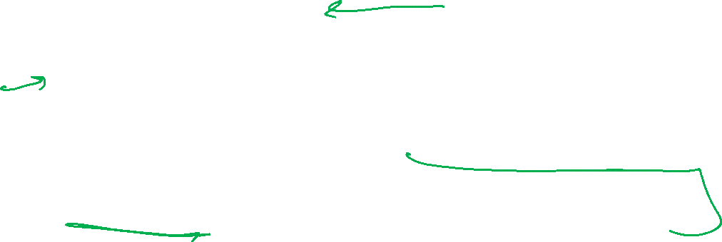
Plan
Last time
Unsupervised Learning: Dimensionality Reduction
Today
Recommender Systems
Unsupervised Learning: Clustering
    K-means
Next time
Unsupervised Learning: Clustering
    Gaussian mixture models and expectation maximization

Slide 3

10-315
Introduction to ML
Recommender Systems
Instructor: Pat Virtue

Slide 4
Recommender Systems
A Common Challenge:
  Assume you’re a company selling items of some sort: movies, songs, products, etc.
  Company collects millions of ratings from users of their items
  To maximize profit / user happiness, you want to recommend items that users are likely to want
Slide credit: CMU MLD Matt Gormley

Slide 5

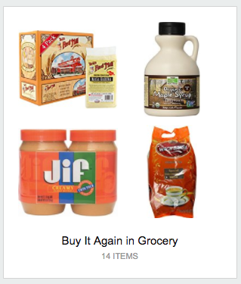
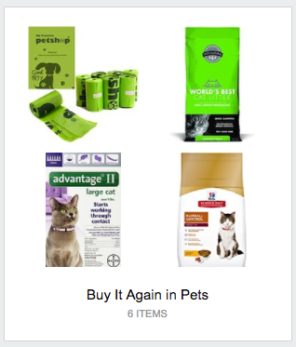

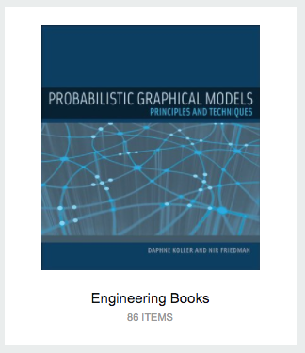
Recommender Systems
Slide credit: CMU MLD Matt Gormley

Slide 6
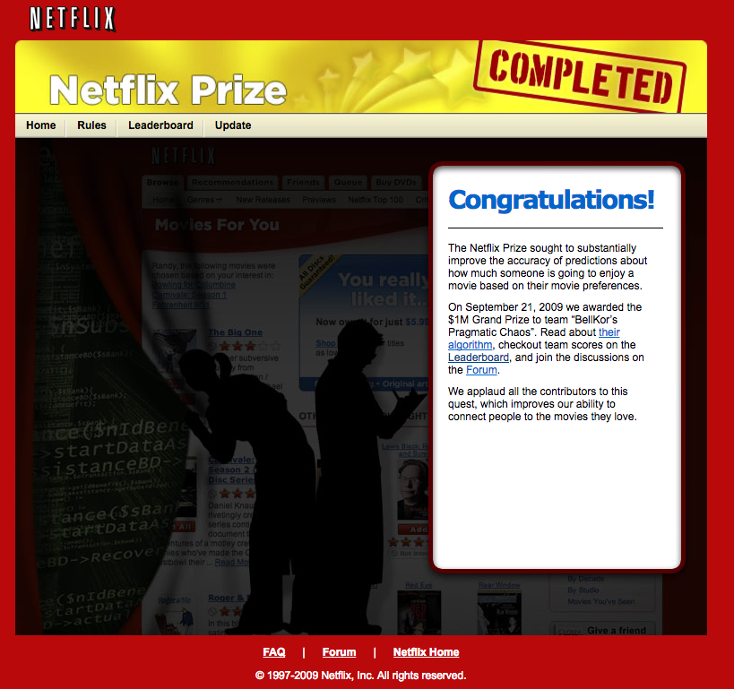
Recommender Systems
Slide credit: CMU MLD Matt Gormley

Slide 7

Recommender Systems
Slide credit: CMU MLD Matt Gormley

Slide 8
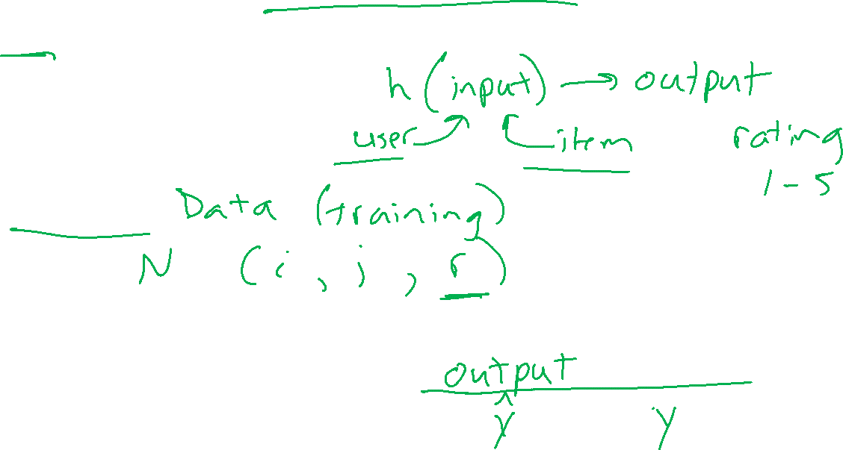
AI System Design: Movie Recommendation
Task
Experience
Performance measure

Slide 9
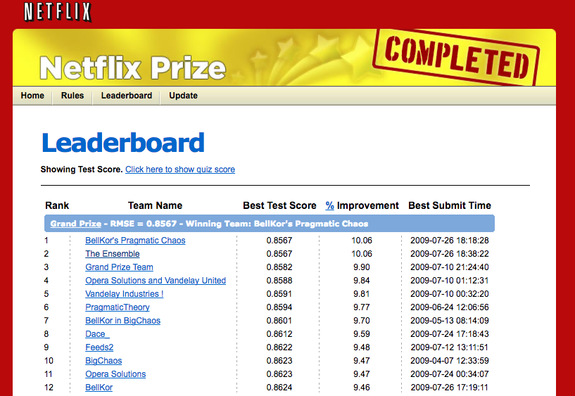
Recommender Systems
Problem Setup
500,000 users
20,000 movies
100 million ratings
Goal: To obtain lower root mean squared error (RMSE) than Netflix’s existing system on 3 million held out ratings
Slide credit: CMU MLD Matt Gormley

Slide 10
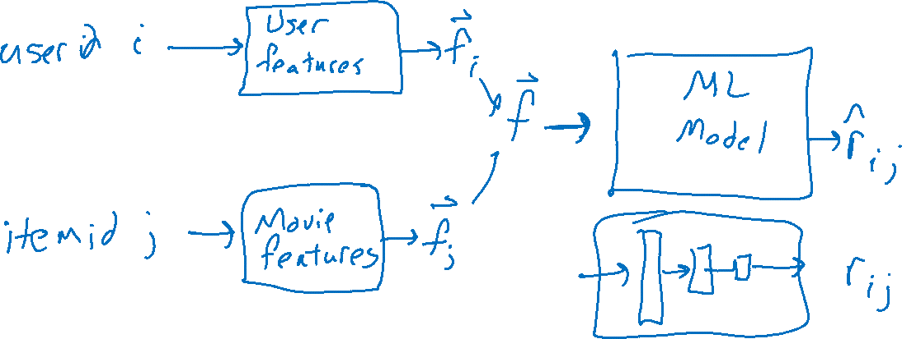
ML System Design: Movie Recommendation
Model

Slide 11
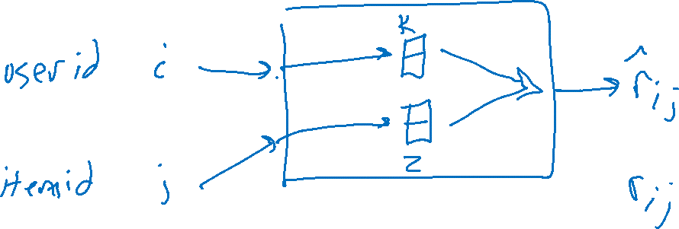
ML System Design: Movie Recommendation
Model

Slide 12
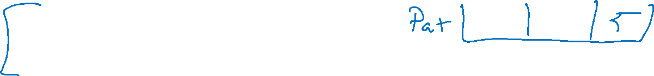
Recommender Systems
 | Doctor Strange | Star Trek: Beyond | Zootopia
Alita | 1 |  | 5
BB-8 | 3 | 4
C-3P0 | 3 | 5 | 2
Setup:
  Items:
  movies, songs, products, etc.
  (often many thousands)
  Users:
  watchers, listeners, purchasers, etc.
  (often many millions)
  Feedback:
  5-star ratings, not-clicking ‘next’, purchases, etc.
Challenge:
  Users only rate a small number of items (the user/item rating data is sparse)
Slide credit: CMU MLD Matt Gormley

Slide 13
Different Approaches
Item-based (Content filtering)
Features about each item
Given an item, other “close” items have similar values
e.g. Pandora.com, music genome project

Slide 14
Different Approaches
Item-based (Content filtering)
Features about each item
Given an item, other “close” items have similar values
e.g. Pandora.com, music genome project
User-based
Features about each user
Given a user, other “close” users have similar preferences
Market segmentation
Learning user-item relationship
Can be done without features on either user or item
Collaborative filtering techniques

Slide 15
Collaborative Filtering

Slide 16

Collaborative Filtering
Everyday Examples of Collaborative Filtering...
  Bestseller lists
  Top 40 music lists
  The “recent returns” shelf at the library
  Unmarked but well-used paths thru the woods
  The printer room at work
  “Read any good books lately?”
  …
Common insight: personal tastes are correlated
  If Alita and BB-8 both like X and Alita likes Y then BB-8 is more likely to like Y
  especially (perhaps) if BB-8 knows Alita
Slide from William Cohen

Slide 17
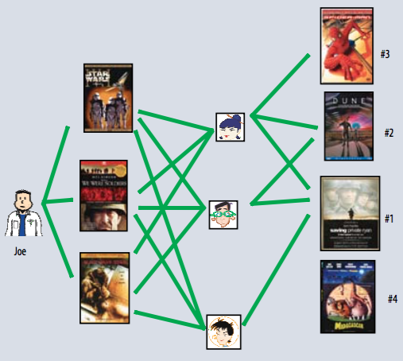
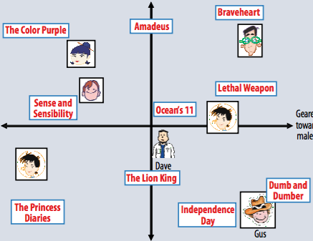

Two Types of Collaborative Filtering
1. Neighborhood Methods
2. Latent Factor Methods
Figures from Koren et al. (2009)

Slide 18
Two Types of Collaborative Filtering
1. Neighborhood Methods
In the figure, assume that a green line indicates the movie was watched
Algorithm:
Find neighbors based on similarity of movie preferences
Recommend movies that those neighbors watched
Figures from Koren et al. (2009)

Slide 19

Two Types of Collaborative Filtering
2. Latent Factor Methods
Assume that both movies and users can be mapped to the same feature space
Recommend a movie based on its proximity to the user in the feature (latent) space
Example algorithm: Matrix Factorization
Figures from Koren et al. (2009)

Slide 20
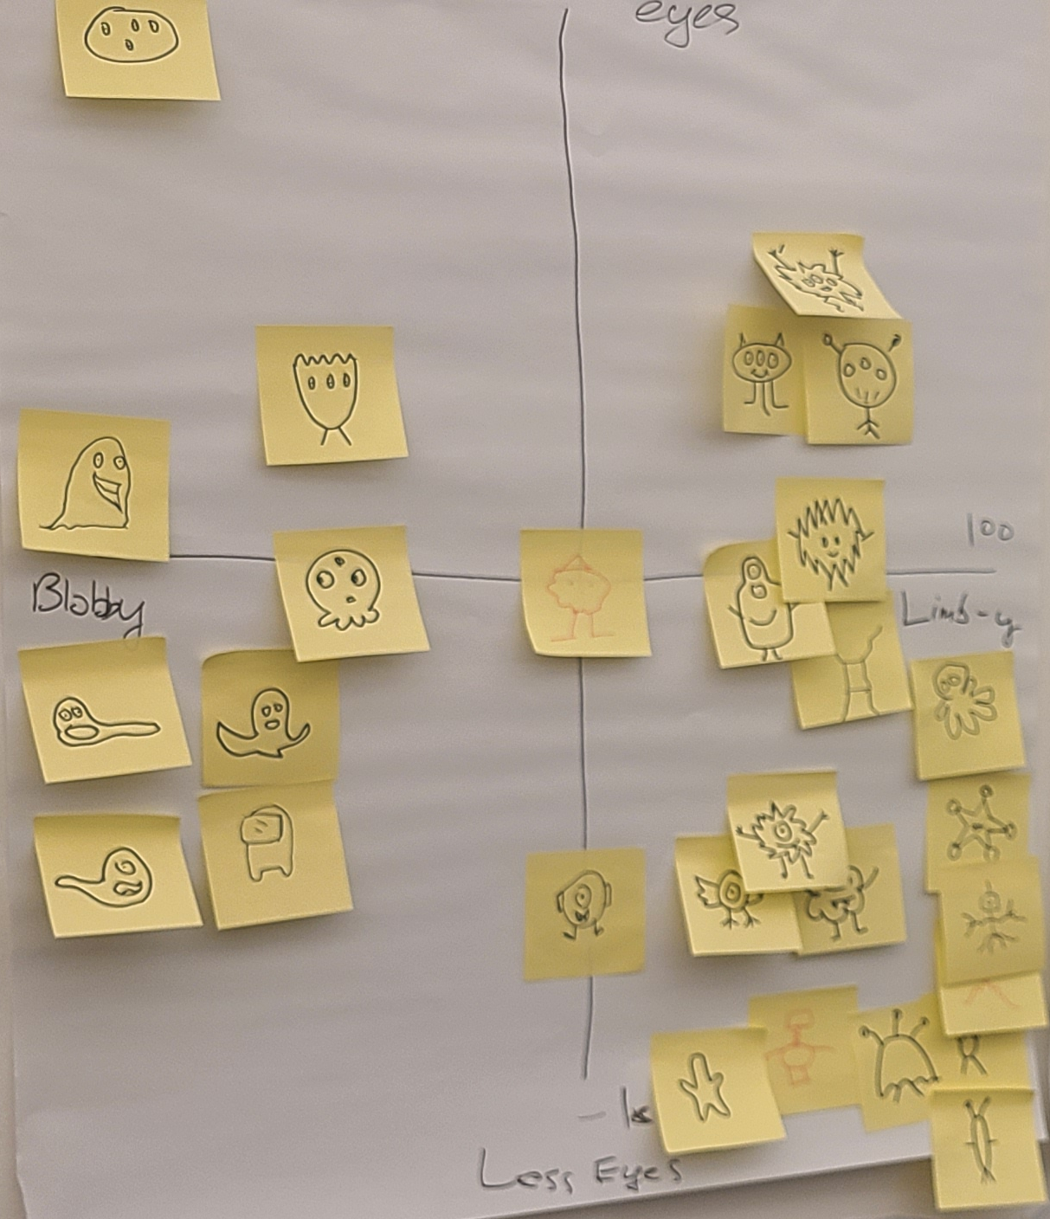
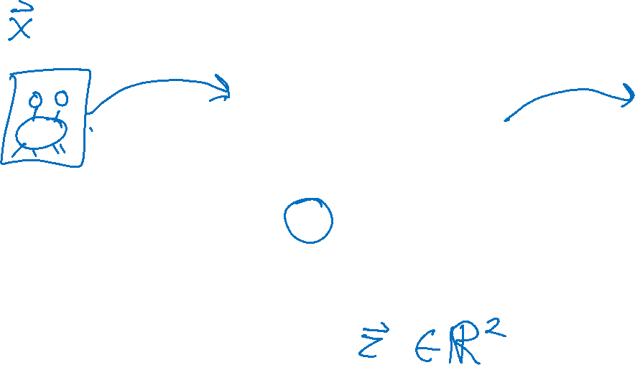
Background: Learn a Feature Space

Slide 21
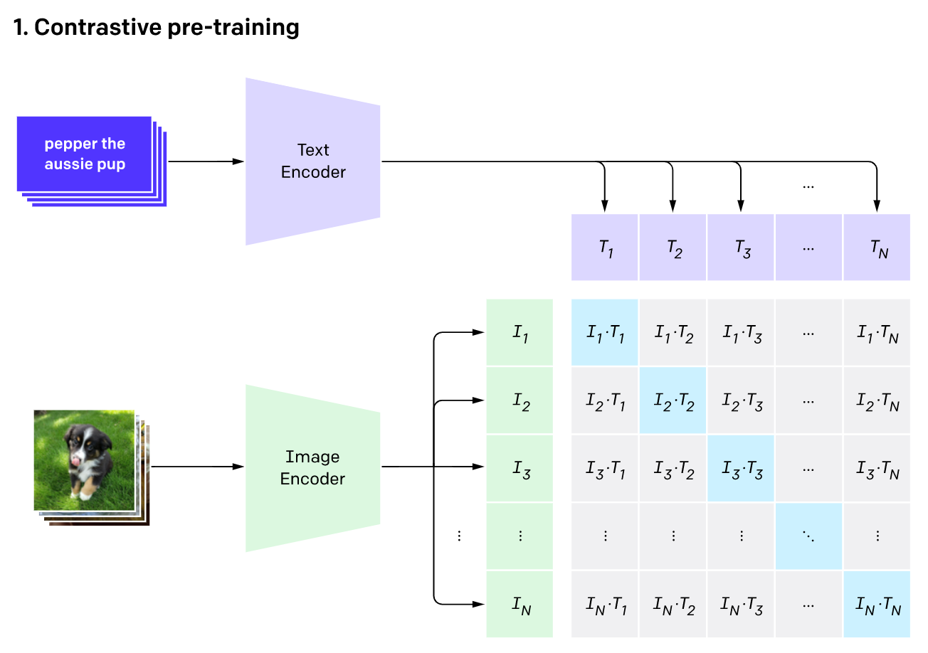
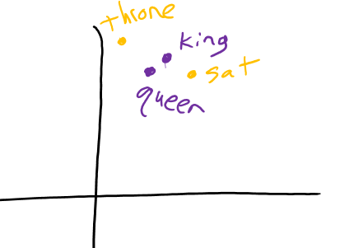
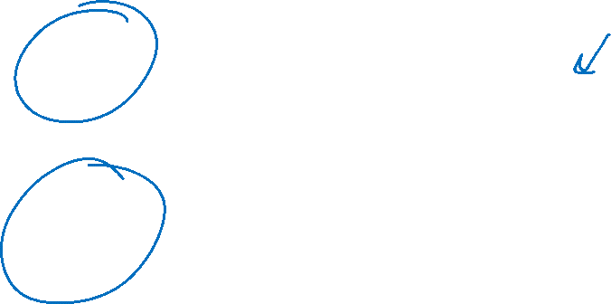
Background: Learn a Feature Space
Word2vec:
Feature space for words
CLIP:
Common feature space for text and images

Slide 22
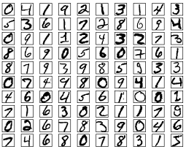


Background: Learn a Feature Space
Why might low dimensional embeddings be useful?
Example: MNIST digit classification with nearest neighbor

Slide 23
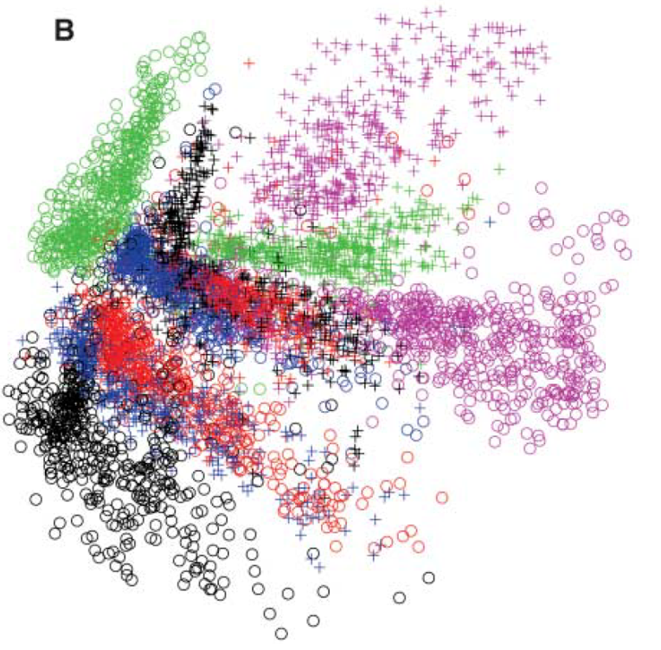

Background: Learn a Feature Space
Why might low dimensional embeddings be useful?
Example: MNIST digit classification with nearest neighbor
Image: Hinton & Salakhutdinov. Science 313.5786 (2006): 504-507.

Slide 24
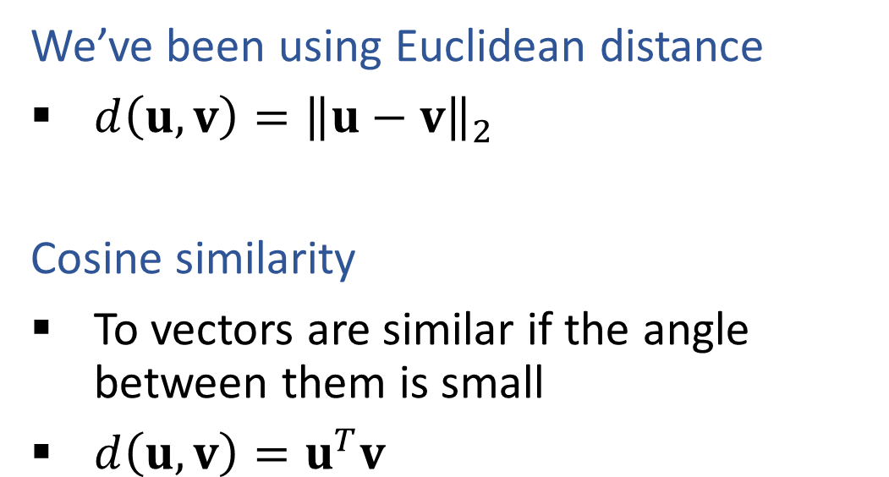
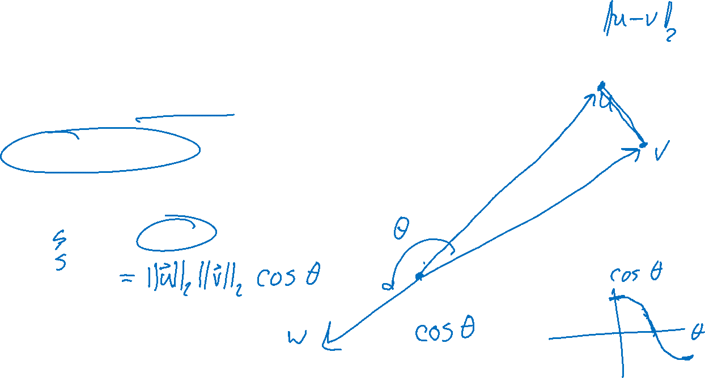
Background: Measure of Similarity
We’ve been using Euclidean distance
$d\left(u, v\right)={\left\|u−v\right\|}_{2}$
Cosine similarity
To vectors are similar if the angle between them is small
$d\left(u, v\right)=u^{T}v$
Image: Hinton & Salakhutdinov. Science 313.5786 (2006): 504-507.

Slide 25
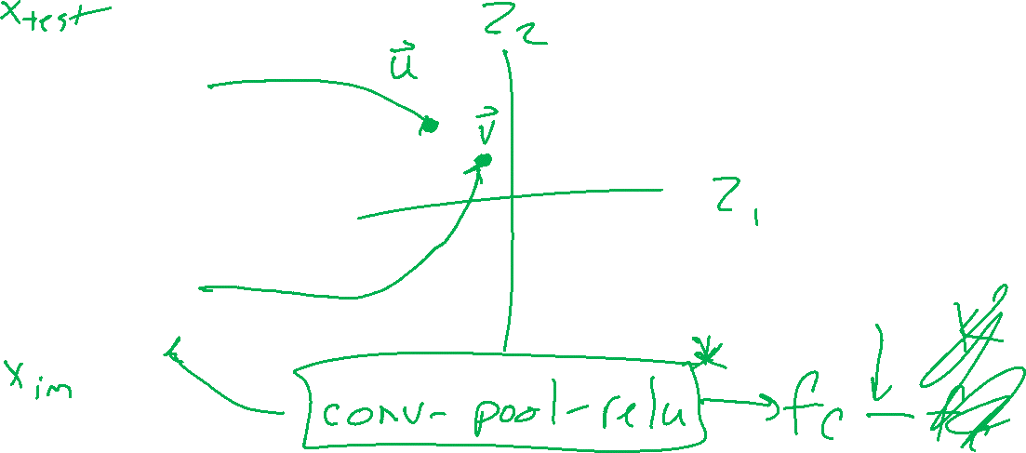
Background: Learn a Feature Space
CLIP: Common feature space for text and images

Slide 26
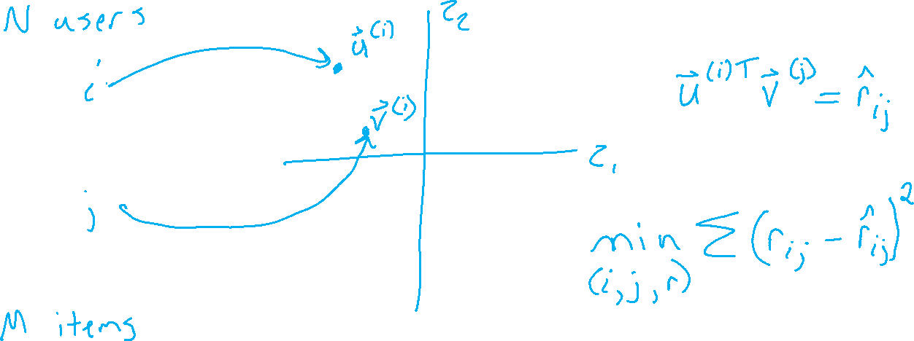
Recommender System: Matrix Factorization
Learning to map items and users to the same feature space

Slide 27
Recommender System: Matrix Factorization
Learning to map items and users to the same feature space

Slide 28
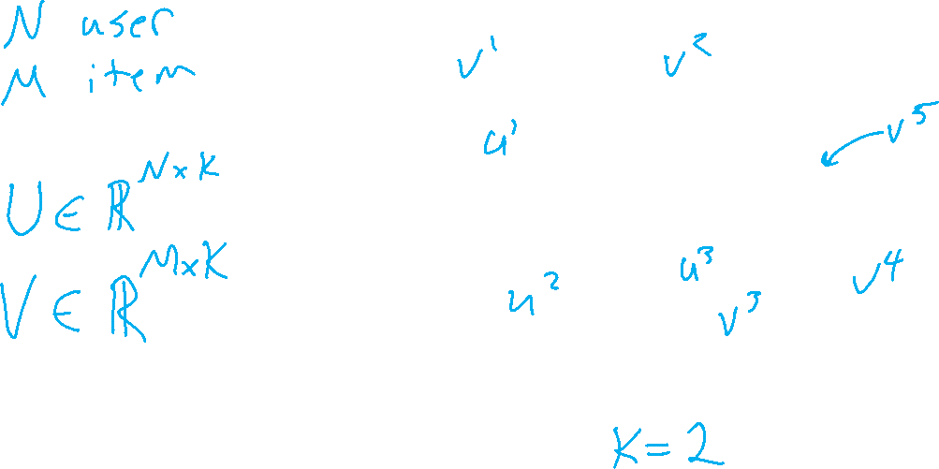
Recommender System: Matrix Factorization
Learning to map items and users to the same lower dimensional space
Figures from Koren et al. (2009)

Slide 29
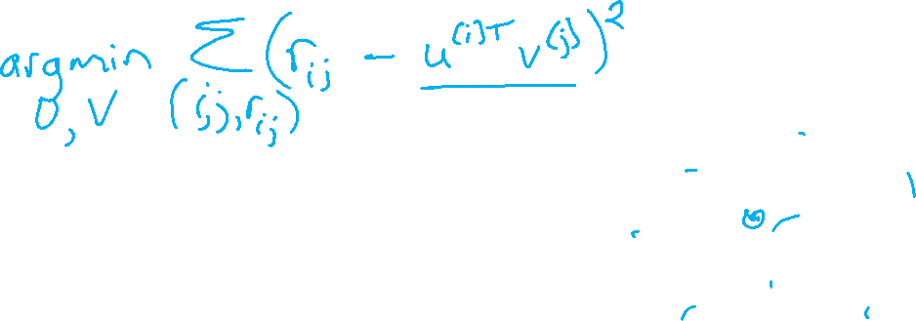

Recommender System: Matrix Factorization
Optimization: Objective function using only the labels we have

Slide 30
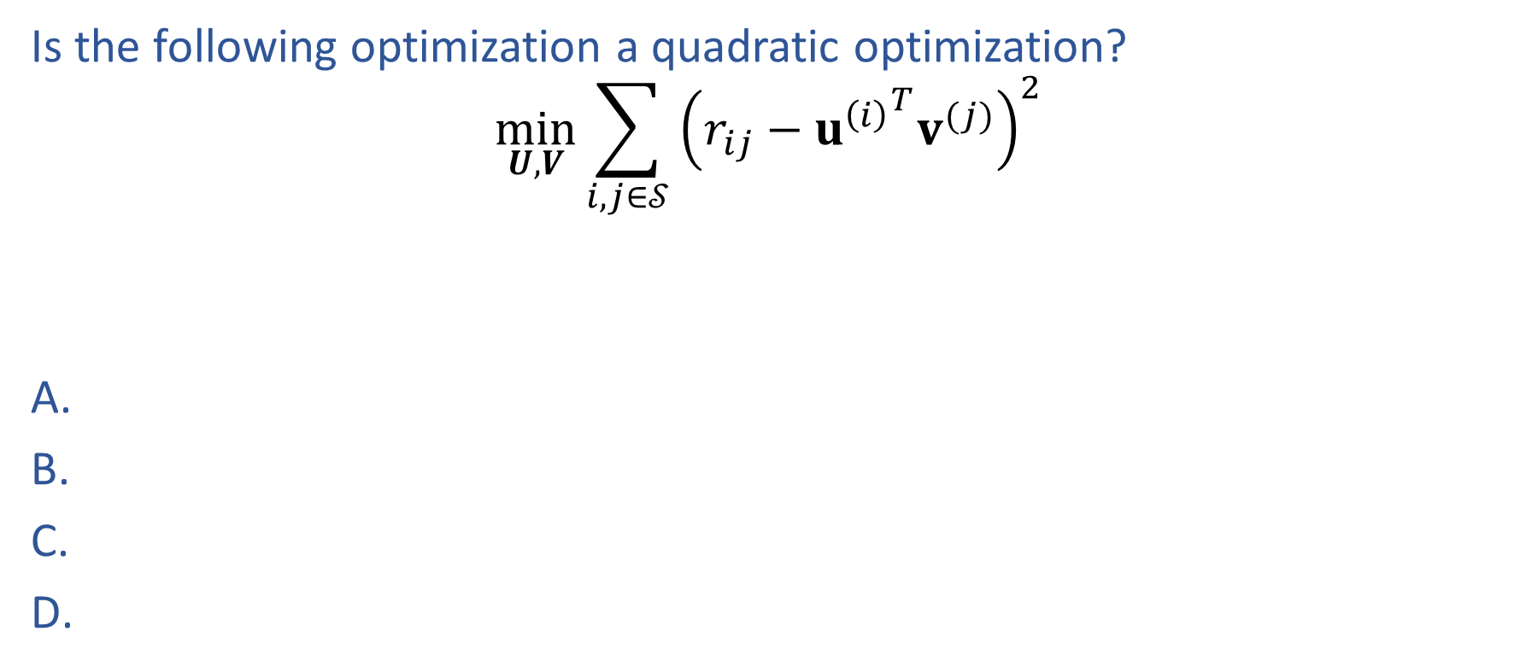
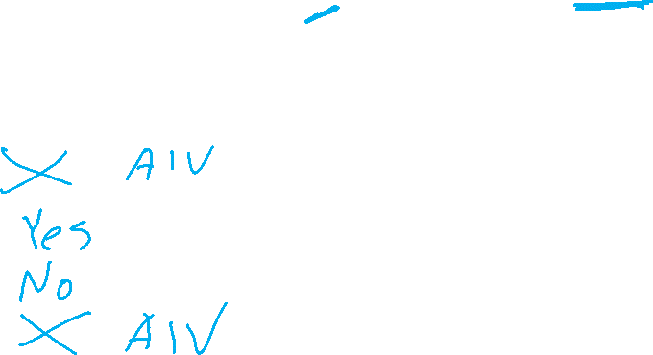
Poll 1
Is the following optimization a quadratic optimization?
$$\min_{U,V}{\sum_{i,j∈𝒮}{{\left(r_{ij}−{u^{\left(i\right)}}^{T}v^{(j)}\right)}^{2}}}$$

Slide 31
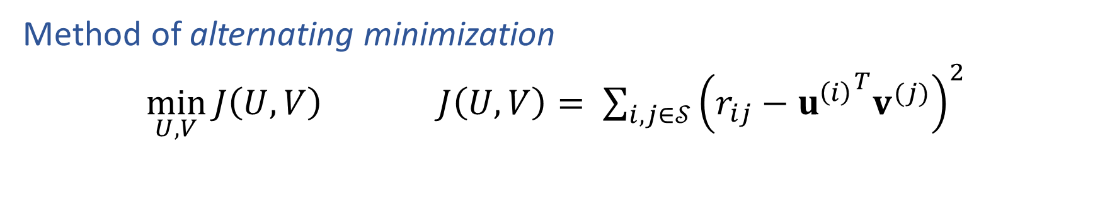
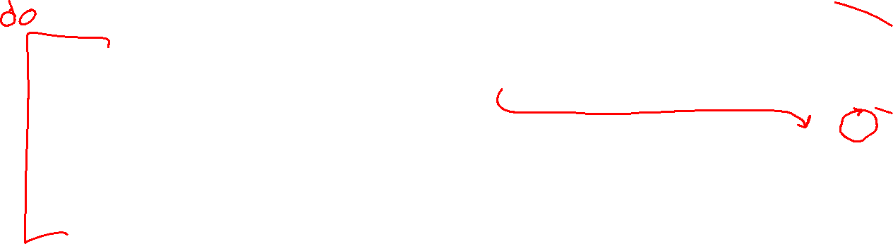
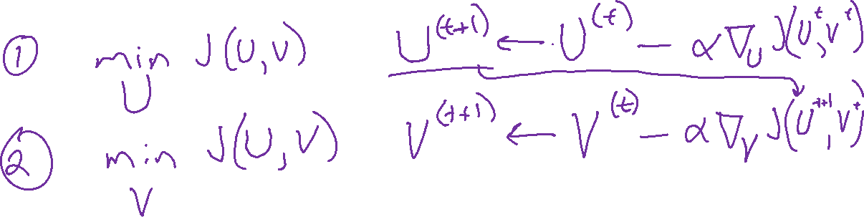
Matrix Factorization
Method of alternating minimization
$\min_{U,V}{J\left(U,V\right)}$ $J\left(U,V\right)= \sum_{i,j∈𝒮}{{\left(r_{ij}−{u^{\left(i\right)}}^{T}v^{(j)}\right)}^{2}}$

Slide 32
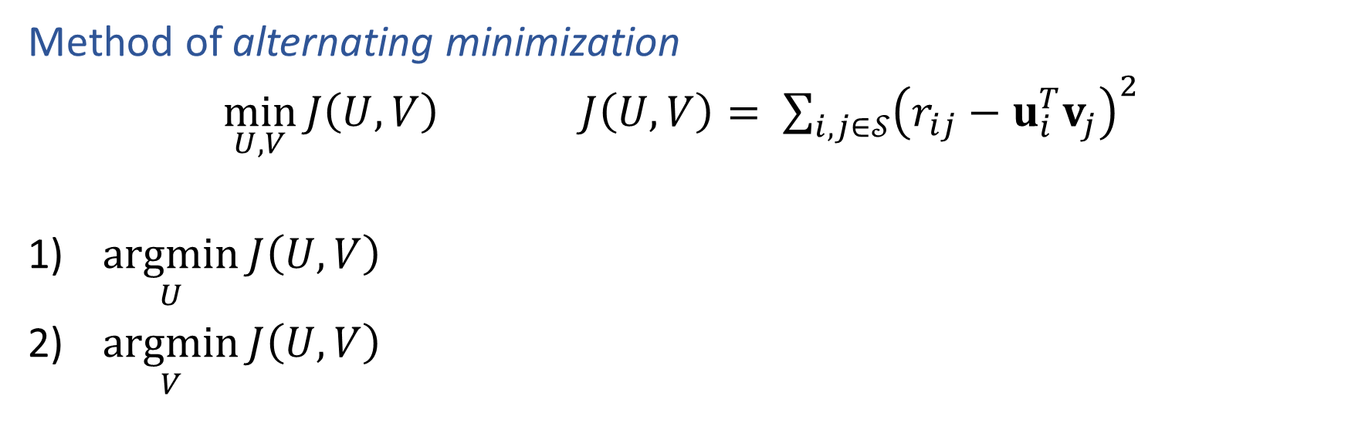
Matrix Factorization
Method of alternating minimization
$\min_{U,V}{J\left(U,V\right)}$ $J\left(U,V\right)= \sum_{i,j∈𝒮}{{\left(r_{ij}−u_{i}^{T}v_{j}\right)}^{2}}$
$\underset{U}{argmin}{J\left(U,V\right)}$
$\underset{V}{argmin}{J\left(U,V\right)}$

Slide 33
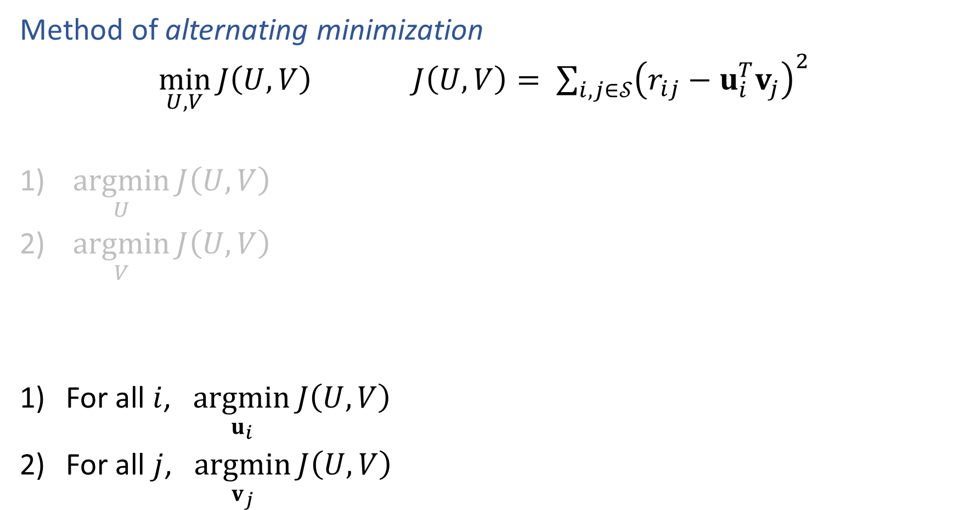
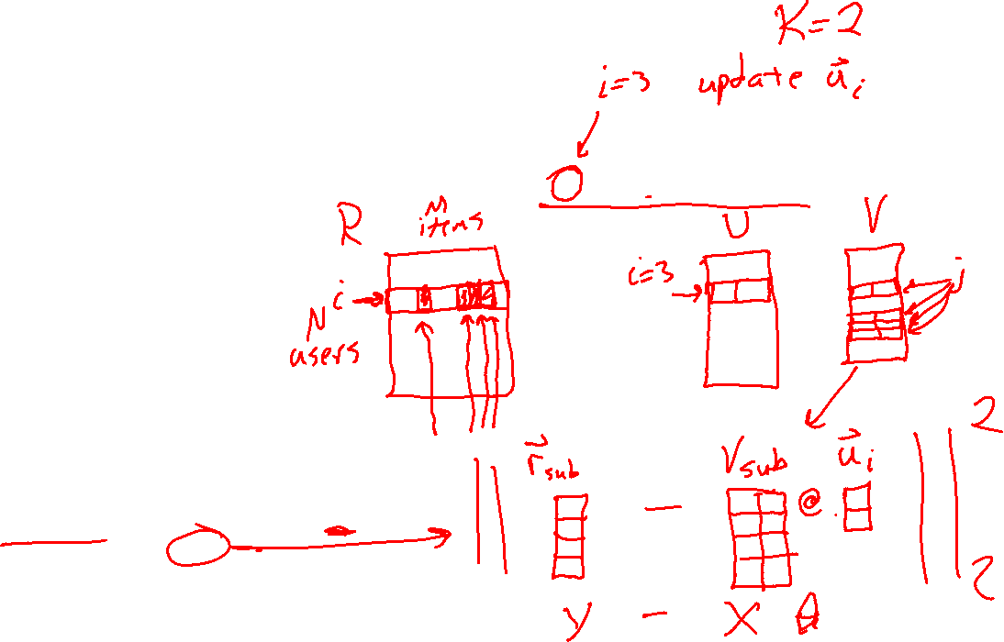
Matrix Factorization
Method of alternating minimization
$\min_{U,V}{J\left(U,V\right)}$ $J\left(U,V\right)= \sum_{i,j∈𝒮}{{\left(r_{ij}−u_{i}^{T}v_{j}\right)}^{2}}$
$\underset{U}{argmin}{J\left(U,V\right)}$
$\underset{V}{argmin}{J\left(U,V\right)}$
For all $i$, $\underset{u_{i}}{argmin}{J\left(U,V\right)}$
For all $j$, $\underset{v_{j}}{argmin}{J\left(U,V\right)}$

Slide 34
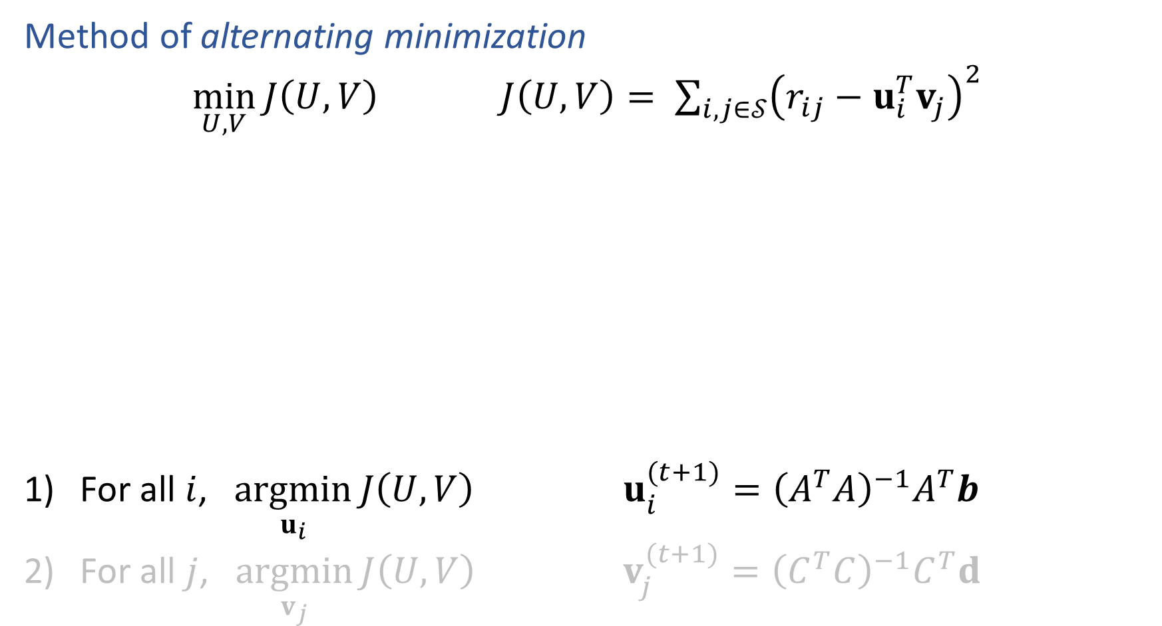
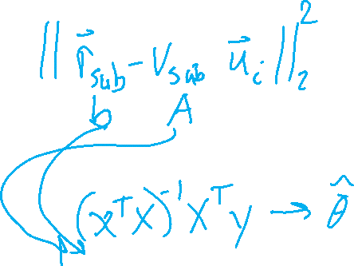
Matrix Factorization
Method of alternating minimization
$\min_{U,V}{J\left(U,V\right)}$ $J\left(U,V\right)= \sum_{i,j∈𝒮}{{\left(r_{ij}−u_{i}^{T}v_{j}\right)}^{2}}$
For all $i$, $\underset{u_{i}}{argmin}{J\left(U,V\right)}$ $u_{i}^{(t+1)}={\left(A^{T}A\right)}^{−1}A^{T}b$
For all $j$, $\underset{v_{j}}{argmin}{J\left(U,V\right)}$ $v_{j}^{(t+1)}={\left(C^{T}C\right)}^{−1}C^{T}d$

Slide 35
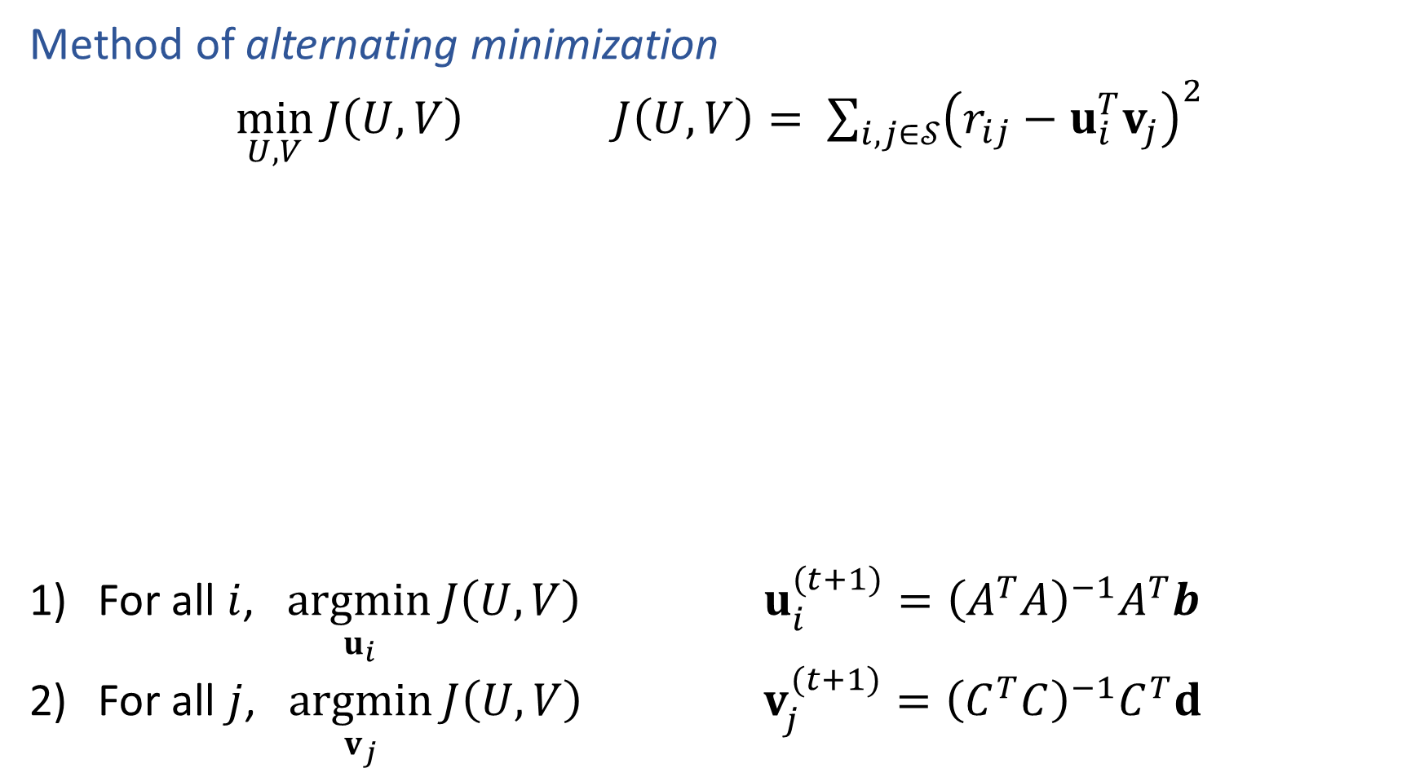
Matrix Factorization
Method of alternating minimization
$\min_{U,V}{J\left(U,V\right)}$ $J\left(U,V\right)= \sum_{i,j∈𝒮}{{\left(r_{ij}−u_{i}^{T}v_{j}\right)}^{2}}$
For all $i$, $\underset{u_{i}}{argmin}{J\left(U,V\right)}$ $u_{i}^{(t+1)}={\left(A^{T}A\right)}^{−1}A^{T}b$
For all $j$, $\underset{v_{j}}{argmin}{J\left(U,V\right)}$ $v_{j}^{(t+1)}={\left(C^{T}C\right)}^{−1}C^{T}d$

Slide 36
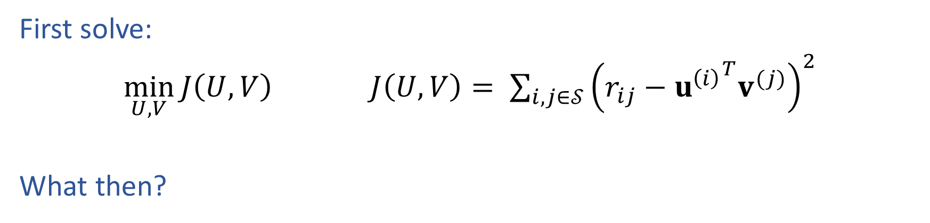
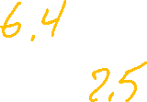
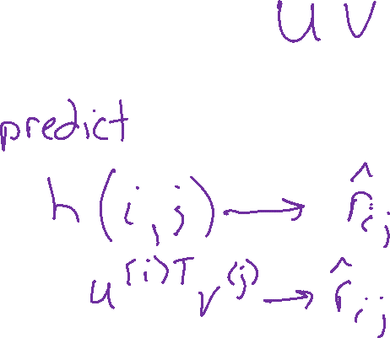
Matrix Factorization
First solve:
$\min_{U,V}{J\left(U,V\right)}$ $J\left(U,V\right)= \sum_{i,j∈𝒮}{{\left(r_{ij}−{u^{\left(i\right)}}^{T}v^{(j)}\right)}^{2}}$
What then?
 | Doctor Strange | Star Trek: Beyond | Zootopia
Alita | 1 |  | 5
BB-8 | 3 | 4
C-3P0 | 3 | 5 | 2

Slide 37
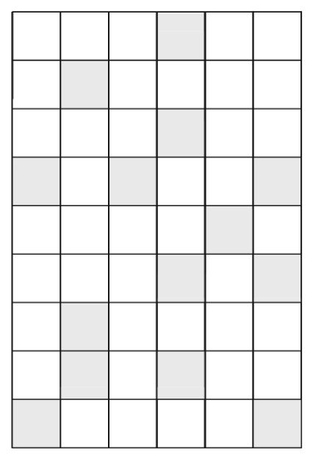
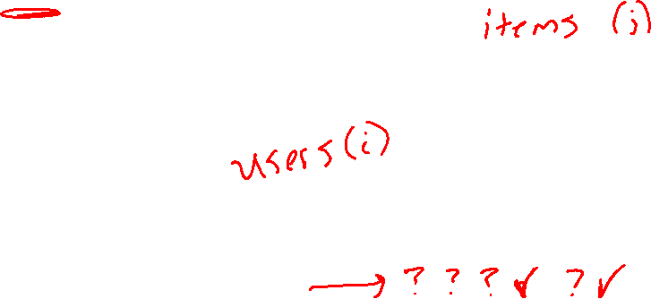
Matrix Factorization
First solve:
$\min_{U,V}{J\left(U,V\right)}$ $J\left(U,V\right)= \sum_{i,j∈𝒮}{{\left(r_{ij}−{u^{\left(i\right)}}^{T}v^{(j)}\right)}^{2}}$
What then?

Slide 38
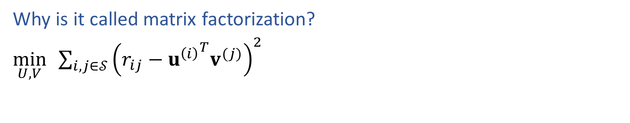
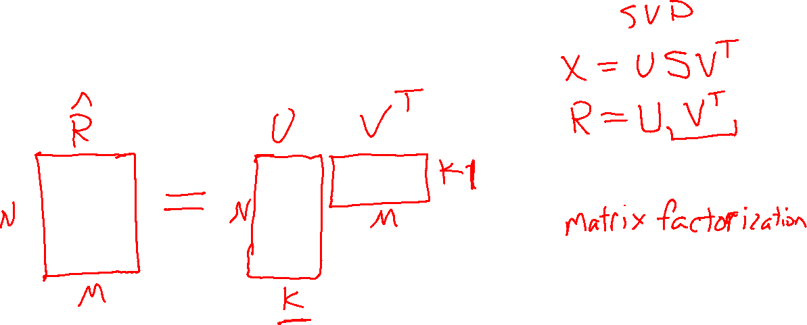
Recommender System: Matrix Factorization
Why is it called matrix factorization?
$\min_{U,V}{ }\sum_{i,j∈𝒮}{{\left(r_{ij}−{u^{\left(i\right)}}^{T}v^{(j)}\right)}^{2}}$

Slide 39
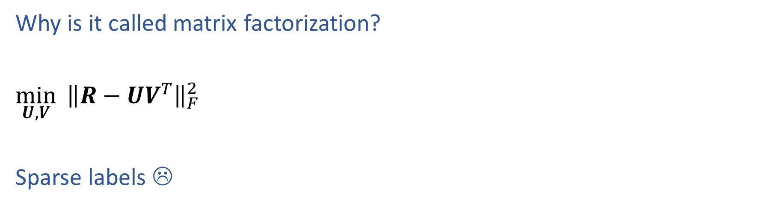

Recommender System: Matrix Factorization
Why is it called matrix factorization?
$\min_{U,V}{{ \left\|R−UV^{T}\right\|}_{F}^{2}}$
Sparse labels ☹
 | Doctor Strange | Star Trek: Beyond | Zootopia
Alita | 1 |  | 5
BB-8 | 3 | 4
C-3P0 | 3 | 5 | 2

Slide 40
Example: MF for Netflix Problem
Figures from Aggarwal (2016)

Slide 41
Regression vs. Collaborative Filtering
Regression
Collaborative Filtering
Figures from Aggarwal (2016)

Slide 42
Matrix Factorization: SVD
We could use SVD, but as you’ll see it has issues
 | Doctor Strange | Star Trek: Beyond | Zootopia
Alita | 1 |  | 5
BB-8 | 3 | 4
C-3P0 | 3 | 5 | 2
Alita
BB-8
C-3P0

Slide 43
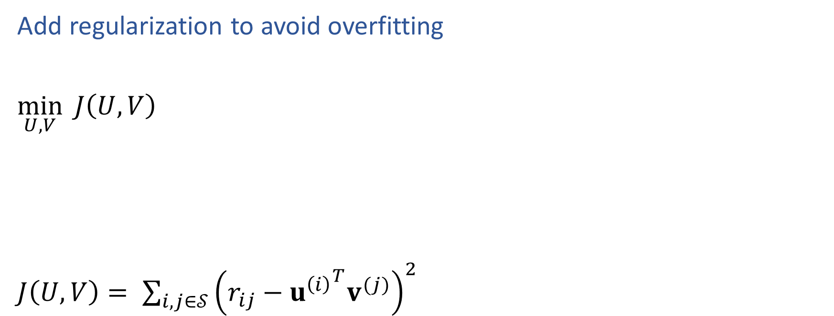
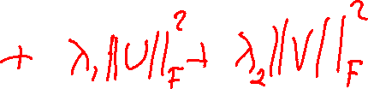
Matrix Factorization
Add regularization to avoid overfitting
$\min_{U,V}{ J\left(U,V\right)}$
$J\left(U,V\right)= \sum_{i,j∈𝒮}{{\left(r_{ij}−{u^{\left(i\right)}}^{T}v^{(j)}\right)}^{2}}$

Slide 44
Bias in Recommender Systems
What high-level problems can occur from recommender systems?

Slide 45
Summary
Recommender systems solve many real-world (*large-scale) problems
Collaborative filtering by matrix factorization (MF) is an efficient and effective approach
(Sparse matrix makes MF more challenging)
MF is just another example of a common recipe:
    define a model
    define an objective function
    optimize
Optimization
Use alternating minimization
Add regularization to avoid overfitting

