Slide 1
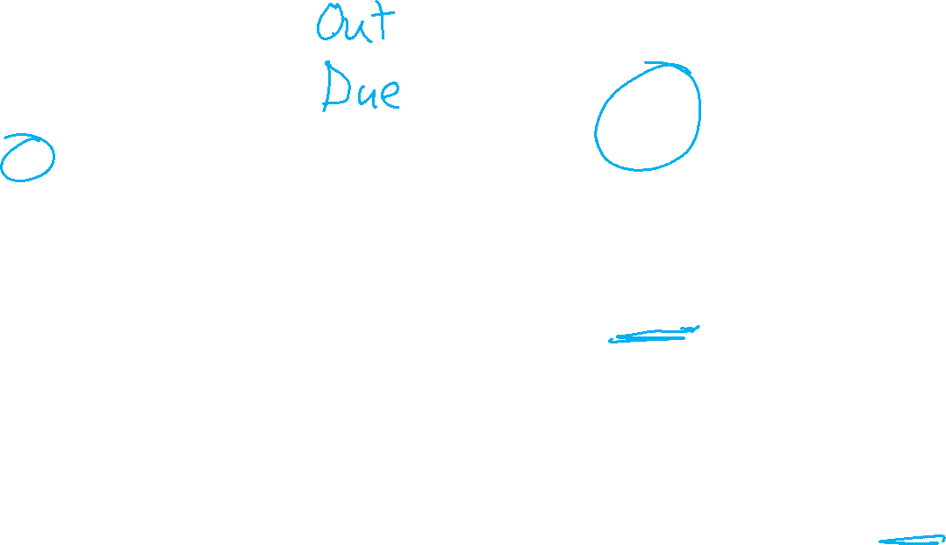
Course Update
Sun | Mon | Tue | Wed | Thu | Fri | Sat
2 | 3 | 4 | 5 HW8 Proj | 6 | 7 | 8
9 HW8 | 10 HW9 HW10 | 11 | 12 | 13 | 14 | 15
16 | 17 HW9 | 18 | 19 Prop | 20 | 21 | 22 HW10
23 | 24 | 25 | 26 MT2 | 27 | 28 | 29
30 | 1 | 2 | 3 | 4 | 5 Proj | 6
Current Plan (updated)
HW 8 (online)
Mini-project proposal
HW 9 (online)
HW 10 (written/prog)
Midterm 2
Mini-project

Slide 2

10-315
Introduction to ML
Clustering:
K-means
Instructor: Pat Virtue

Slide 3
Plan
Last time
Unsupervised Learning: Dimensionality Reduction
Today
Recommender Systems
Unsupervised Learning: Clustering
    K-means
Next time
Unsupervised Learning: Clustering
    Gaussian mixture models and expectation maximization

Slide 4
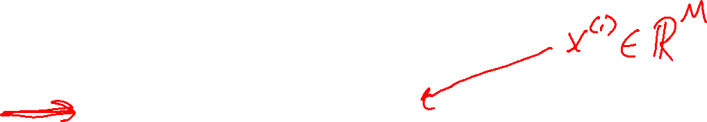
Learning Paradigms
Slide credit: CMU MLD, Matt Gormley

Slide 5
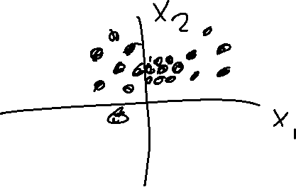
Clustering, Informal Goals
Goal: Automatically partition unlabeled data into groups of similar datapoints.
Question: When and why would we want to do this?
Useful for:
• Automatically organizing data.
• Understanding hidden structure in data.
• Preprocessing for further analysis.
• Representing high-dimensional data in a low-dimensional space (e.g., for visualization purposes).
Slide credit: CMU MLD Nina Balcan

Slide 6





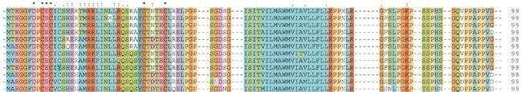
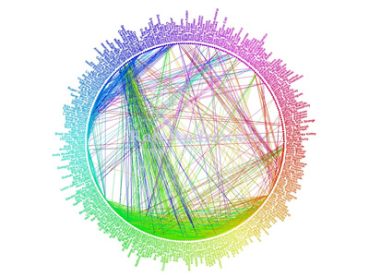
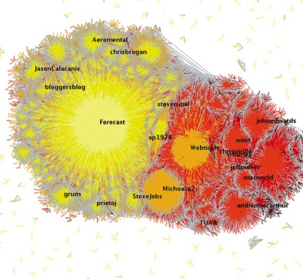
Applications (Clustering comes up everywhere…)
Cluster news articles or web pages or search results by topic.
Cluster protein sequences by function or genes according to expression profile.
Cluster users of social networks by interest (community detection).
Facebook network
Twitter Network
Slide credit: CMU MLD Nina Balcan

Slide 7

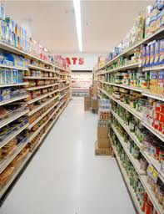
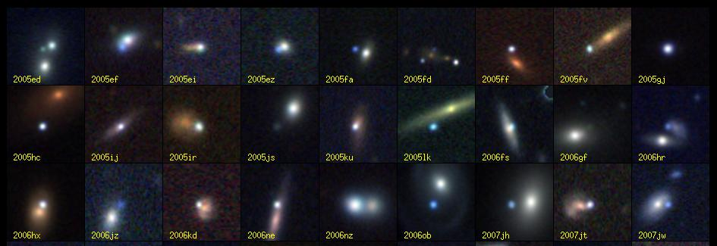
Applications (Clustering comes up everywhere…)
Cluster customers according to purchase history.
Cluster galaxies or nearby stars (e.g. Sloan Digital Sky Survey)
And many many more applications….
Slide credit: CMU MLD Nina Balcan

Slide 8
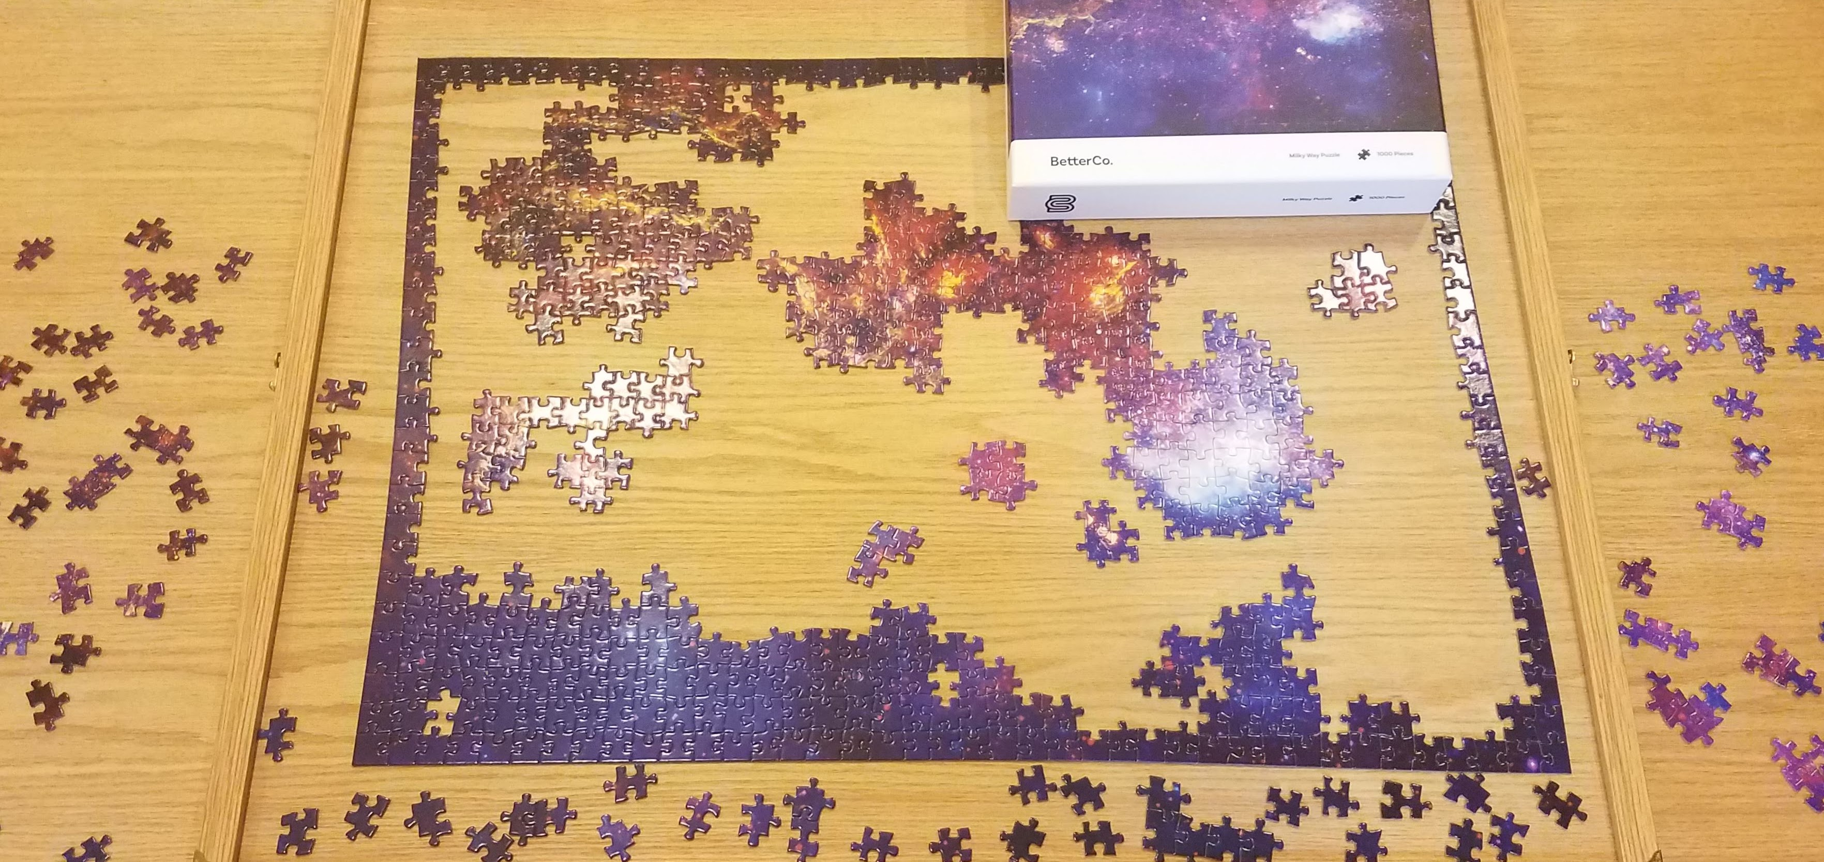
Clustering Applications
Jigsaw puzzles!

Slide 9
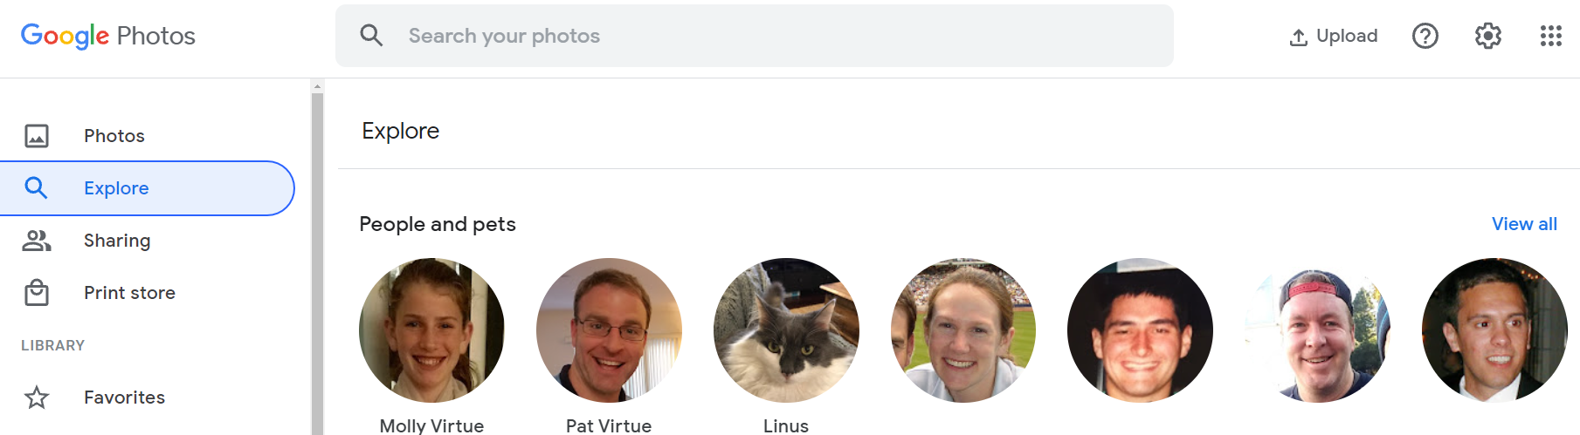
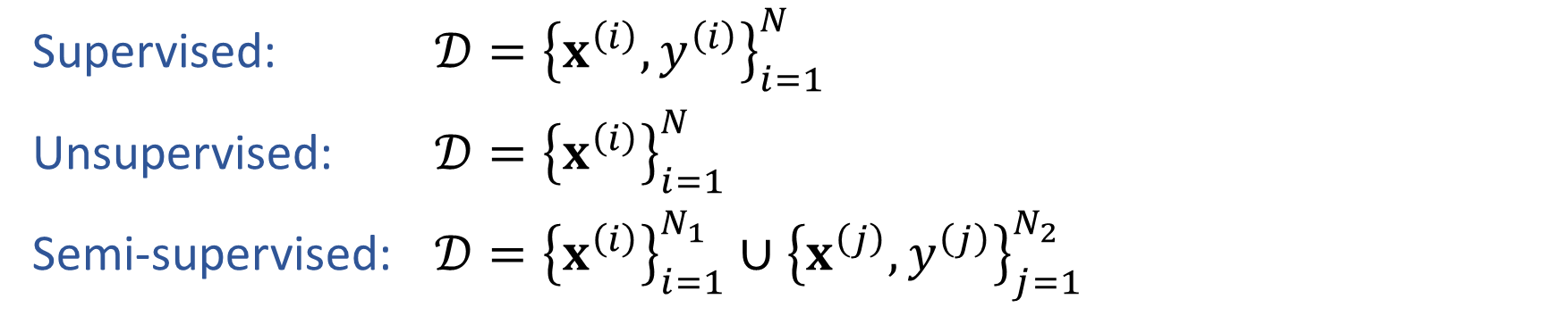
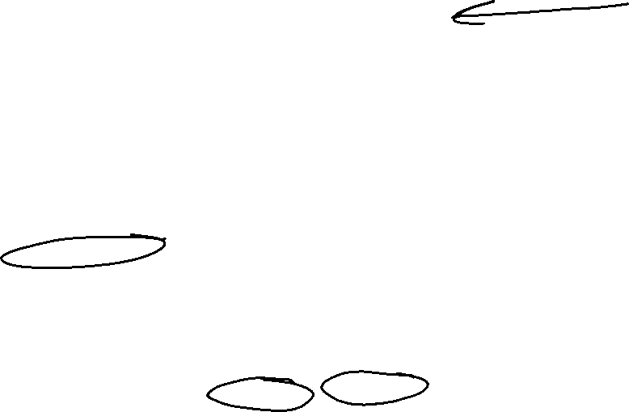
Semi-supervised Learning
Supervised: $𝒟={\left\{x^{\left(i\right)}, y^{\left(i\right)}\right\}}_{i=1}^{N}$
Unsupervised: $𝒟={\left\{x^{\left(i\right)}\right\}}_{i=1}^{N}$
Semi-supervised: $𝒟={\left\{x^{\left(i\right)}\right\}}_{i=1}^{N_{1}}∪{\left\{x^{\left(j\right)}, y^{\left(j\right)}\right\}}_{j=1}^{N_{2}}$

Slide 10
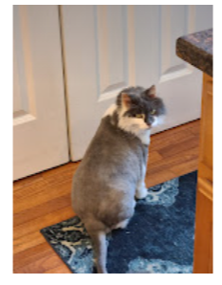
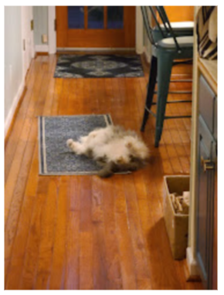
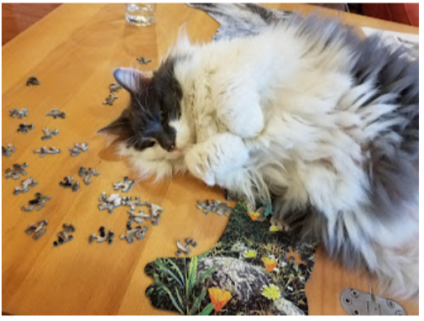
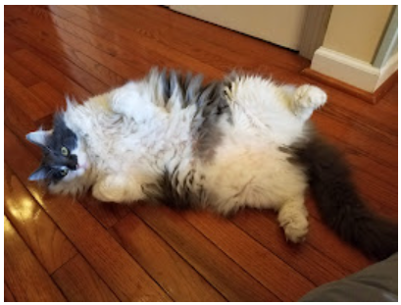
Semi-supervised Learning
Supervised: $𝒟={\left\{x^{\left(i\right)}, y^{\left(i\right)}\right\}}_{i=1}^{N}$
Unsupervised: $𝒟={\left\{x^{\left(i\right)}\right\}}_{i=1}^{N}$
Semi-supervised: $𝒟={\left\{x^{\left(i\right)}\right\}}_{i=1}^{N_{1}}∪{\left\{x^{\left(j\right)}, y^{\left(j\right)}\right\}}_{j=1}^{N_{2}}$

Slide 11
Semi-supervised Learning
Supervised: $𝒟={\left\{x^{\left(i\right)}, y^{\left(i\right)}\right\}}_{i=1}^{N}$
Unsupervised: $𝒟={\left\{x^{\left(i\right)}\right\}}_{i=1}^{N}$
Semi-supervised: $𝒟={\left\{x^{\left(i\right)}\right\}}_{i=1}^{N_{1}}∪{\left\{x^{\left(j\right)}, y^{\left(j\right)}\right\}}_{j=1}^{N_{2}}$

Slide 12
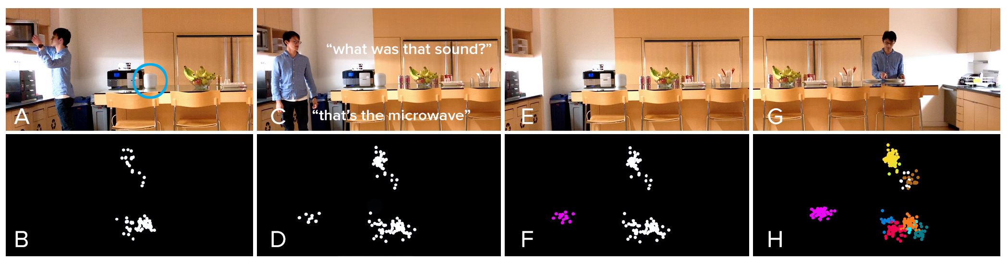
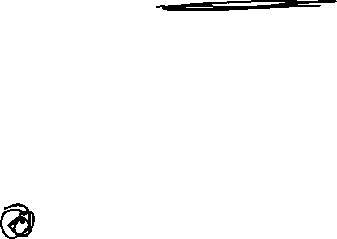
Semi-supervised Learning
Supervised: $𝒟={\left\{x^{\left(i\right)}, y^{\left(i\right)}\right\}}_{i=1}^{N}$
Unsupervised: $𝒟={\left\{x^{\left(i\right)}\right\}}_{i=1}^{N}$
Semi-supervised: $𝒟={\left\{x^{\left(i\right)}\right\}}_{i=1}^{N_{1}}∪{\left\{x^{\left(j\right)}, y^{\left(j\right)}\right\}}_{j=1}^{N_{2}}$
https://chrisharrison.net/index.php/Research/ListenLearner

Slide 13
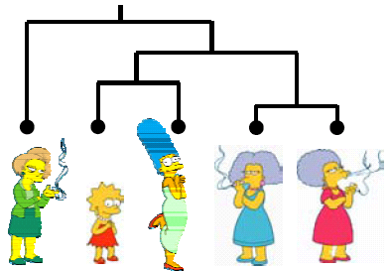
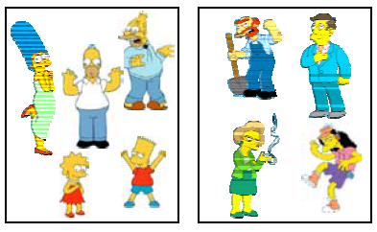
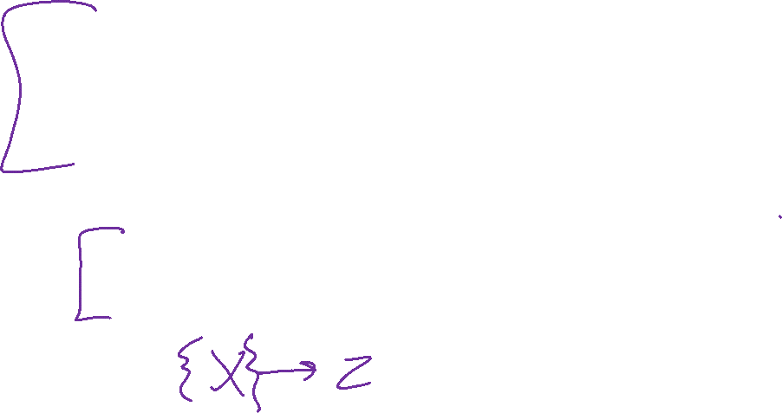
Clustering Algorithms
Hierarchical algorithms
    Bottom-up: Agglomerative Clustering
    Top-down: Divisive
Partition algorithms
    K means clustering
    Mixture-Model based clustering
Slide credit: CMU MLD Aarti Singh and Eric Xing

Slide 14
Hierarchical Clustering
Bottom-Up Agglomerative Clustering
  Starts with each object in a separate cluster, and repeat:
  Joins the most similar pair of clusters,
  Update the similarity of the new cluster to others
  until there is only one cluster.
  Greedy – less accurate but simple to implement
Top-Down divisive
  Starts with all the data in a single cluster, and repeat:
  Split each cluster into two using a partition algorithm
  Until each object is a separate cluster.
  More accurate but complex to implement
Slide credit: CMU MLD Aarti Singh and Eric Xing

Slide 15
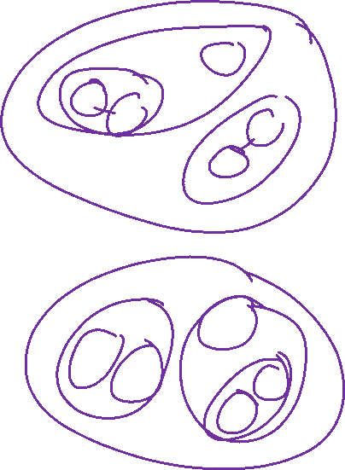
Hierarchical Clustering
Bottom-Up Agglomerative Clustering
  Starts with each object in a separate cluster, and repeat:
  Joins the most similar pair of clusters,
  Update the similarity of the new cluster to others
  until there is only one cluster.
  Greedy – less accurate but simple to implement
Top-Down divisive
  Starts with all the data in a single cluster, and repeat:
  Split each cluster into two using a partition algorithm
  Until each object is a separate cluster.
  More accurate but complex to implement
Slide credit: CMU MLD Aarti Singh and Eric Xing

Slide 16
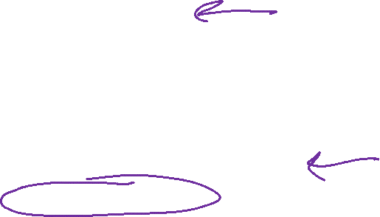
Partitioning Algorithms
Partitioning method: Construct a partition of N objects into a set of K clusters
Given: a set of objects and the number K
Find: a partition of K clusters that optimizes the chosen partitioning criterion
  Globally optimal: exhaustively enumerate all partitions
  Effective heuristic method: K-means algorithm
Slide credit: CMU MLD Aarti Singh

Slide 17
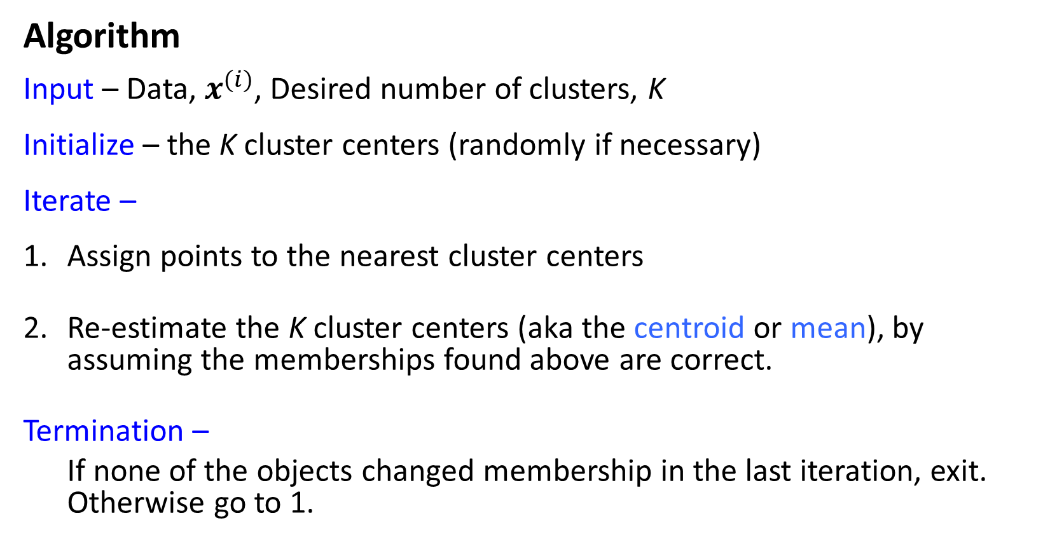
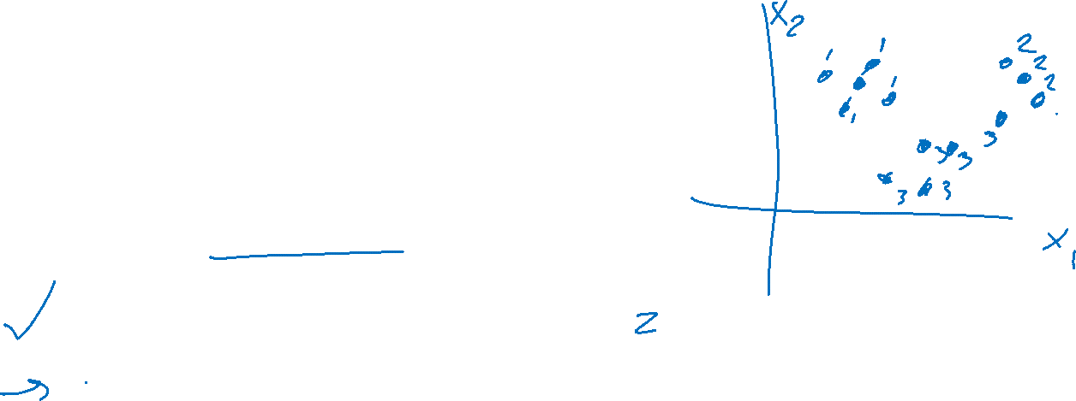
K-Means
Algorithm
Input – Data, $x^{(i)}$, Desired number of clusters, K
Initialize – the K cluster centers (randomly if necessary)
Iterate –
Assign points to the nearest cluster centers
Re-estimate the K cluster centers (aka the centroid or mean), by assuming the memberships found above are correct.
Termination –
If none of the objects changed membership in the last iteration, exit. Otherwise go to 1.
Slide credit: CMU MLD Aarti Singh

Slide 18
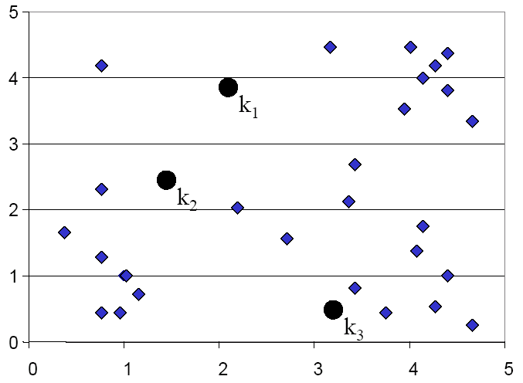
K-means Clustering: Assign points
Slide credit: CMU MLD Eric Xing

Slide 19
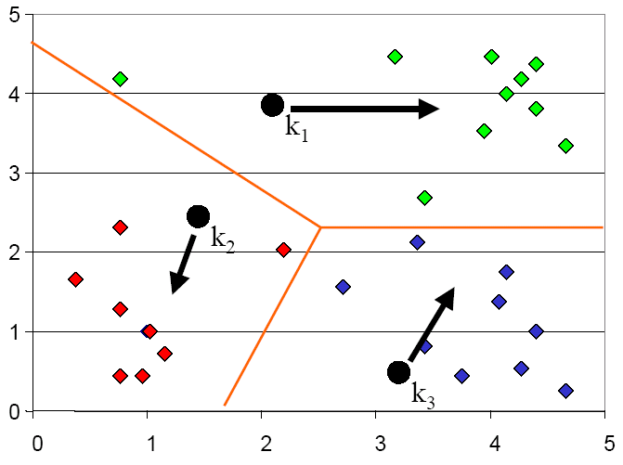
K-means Clustering: Update centers
Slide credit: CMU MLD Eric Xing

Slide 20
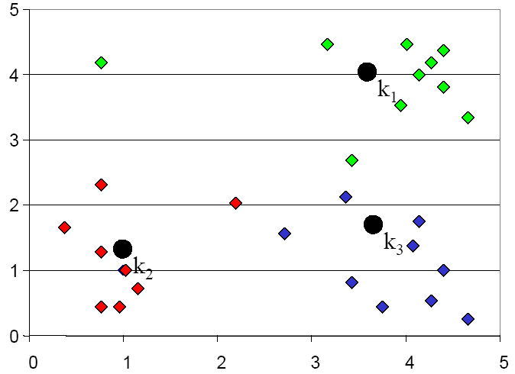
K-means Clustering: Assign points
Slide credit: CMU MLD Eric Xing

Slide 21
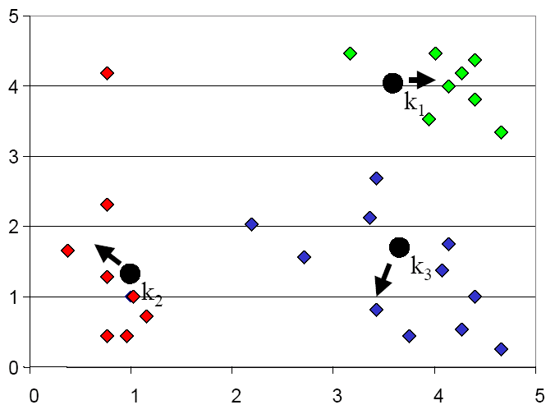
K-means Clustering: Update centers
Slide credit: CMU MLD Eric Xing

Slide 22
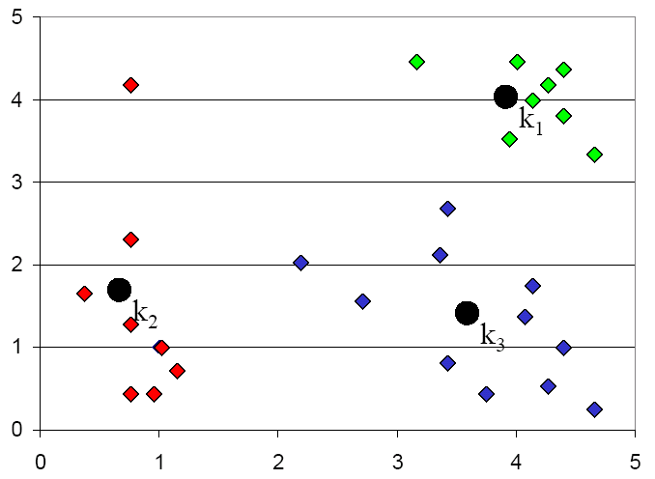
K-means Clustering: Assign points
Slide credit: CMU MLD Eric Xing

Slide 23
K-means Optimization
Optimization recipe
Formulate objective
Minimize objective
Slide credit: CMU MLD Matt Gormley

Slide 24
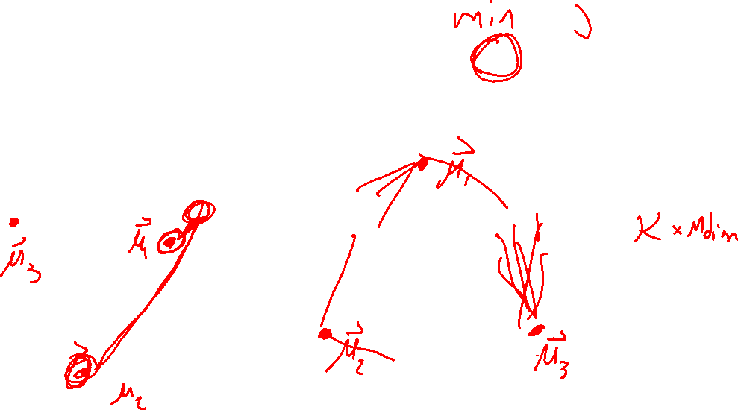
K-means Optimization
Question: Which of these partitions is “better”?
Slide credit: CMU MLD Matt Gormley

Slide 25
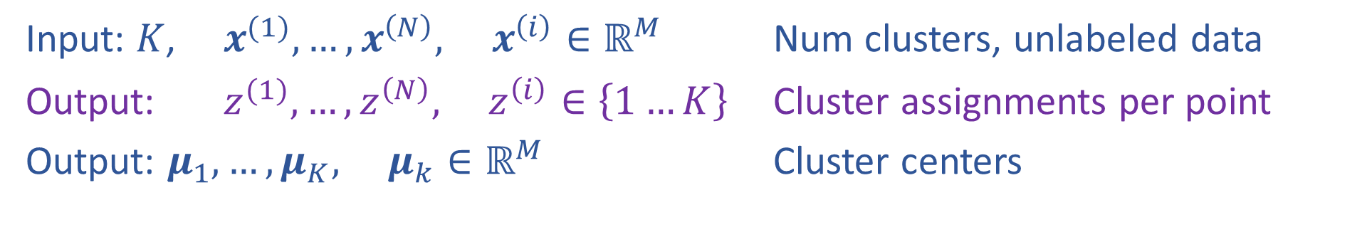
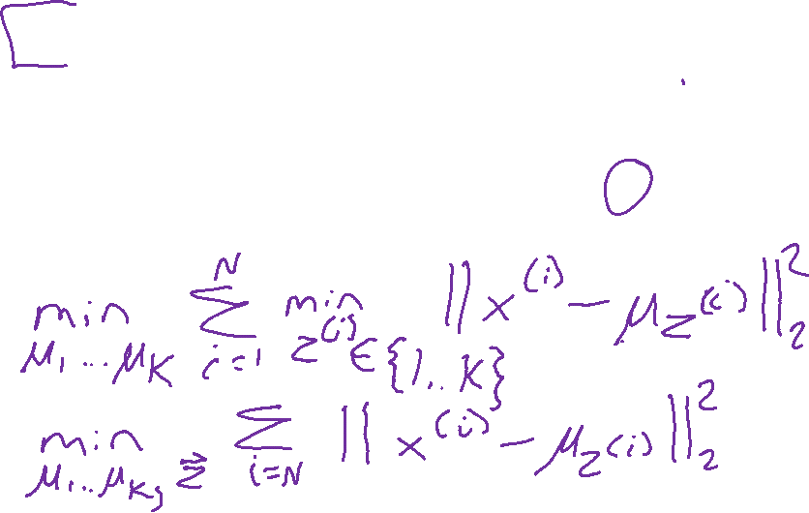
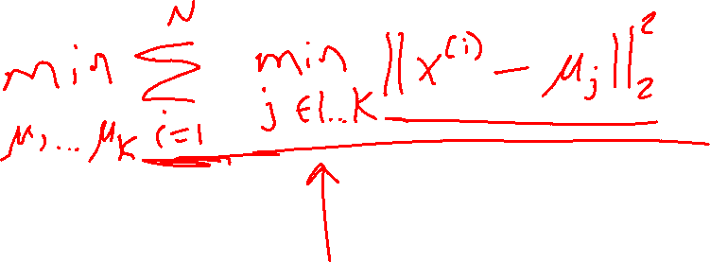
K-means Optimization
Input: $K$, $x^{(1)}, …, x^{\left(N\right)}, x^{\left(i\right)}∈ℝ^{M}$ Num clusters, unlabeled data
Output: $z^{(1)}, …,z^{\left(N\right)}, z^{\left(i\right)}∈\left\{1…K\right\}$ Cluster assignments per point
Output: $μ_{1}, …, μ_{K}, μ_{k}∈ℝ^{M}$ Cluster centers
Slide credit: CMU MLD Matt Gormley

Slide 26
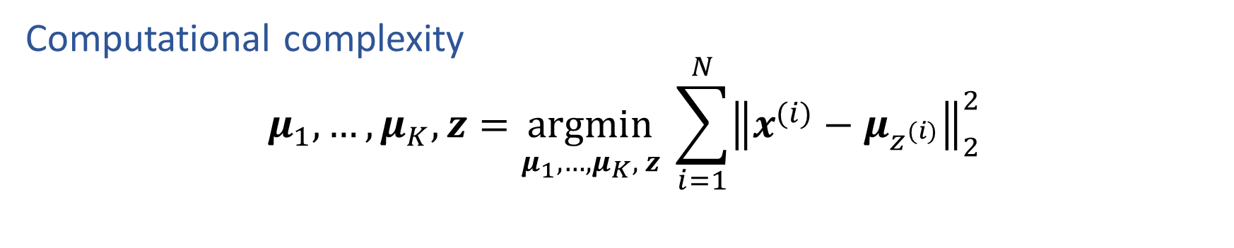
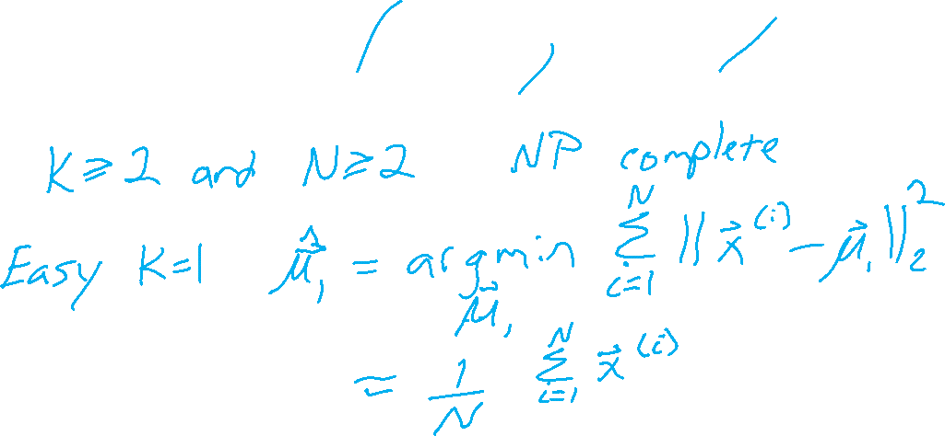
K-means Optimization
Computational complexity
$$μ_{1}, …, μ_{K},z=\underset{μ_{1}, …, μ_{K}, z}{argmin} \sum_{i=1}^{N}{{\left\|x^{(i)}−μ_{z^{(i)}}\right\|}_{2}^{2}}$$
Slide credit: CMU MLD Matt Gormley

Slide 27
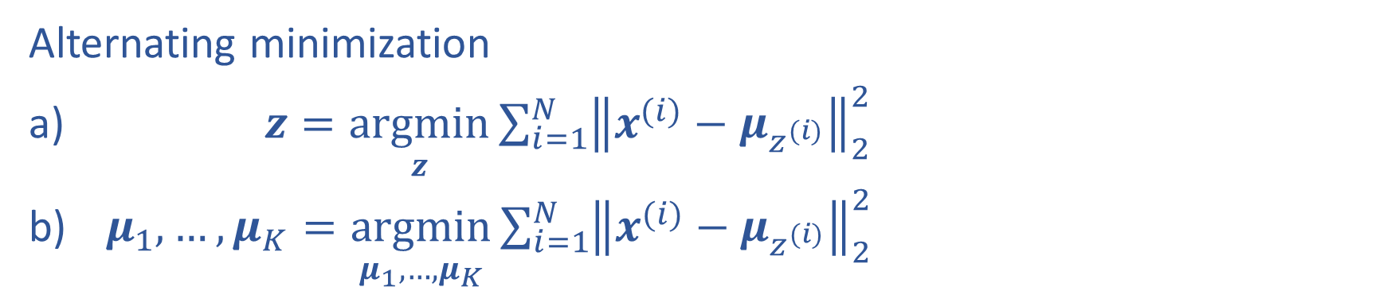
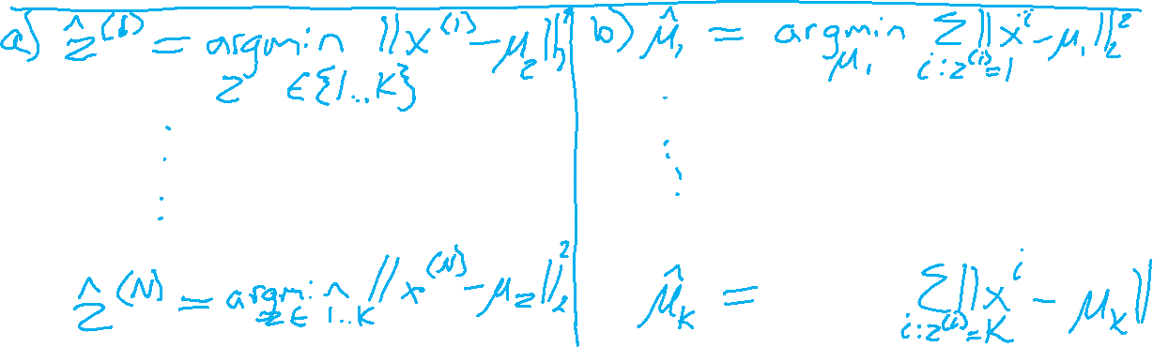
K-means Optimization
Alternating minimization
$z=\underset{z}{argmin}\sum_{i=1}^{N}{{\left\|x^{(i)}−μ_{z^{(i)}}\right\|}_{2}^{2}}$
$μ_{1}, …, μ_{K}=\underset{μ_{1}, …, μ_{K}}{argmin}\sum_{i=1}^{N}{{\left\|x^{(i)}−μ_{z^{(i)}}\right\|}_{2}^{2}}$

Slide 28
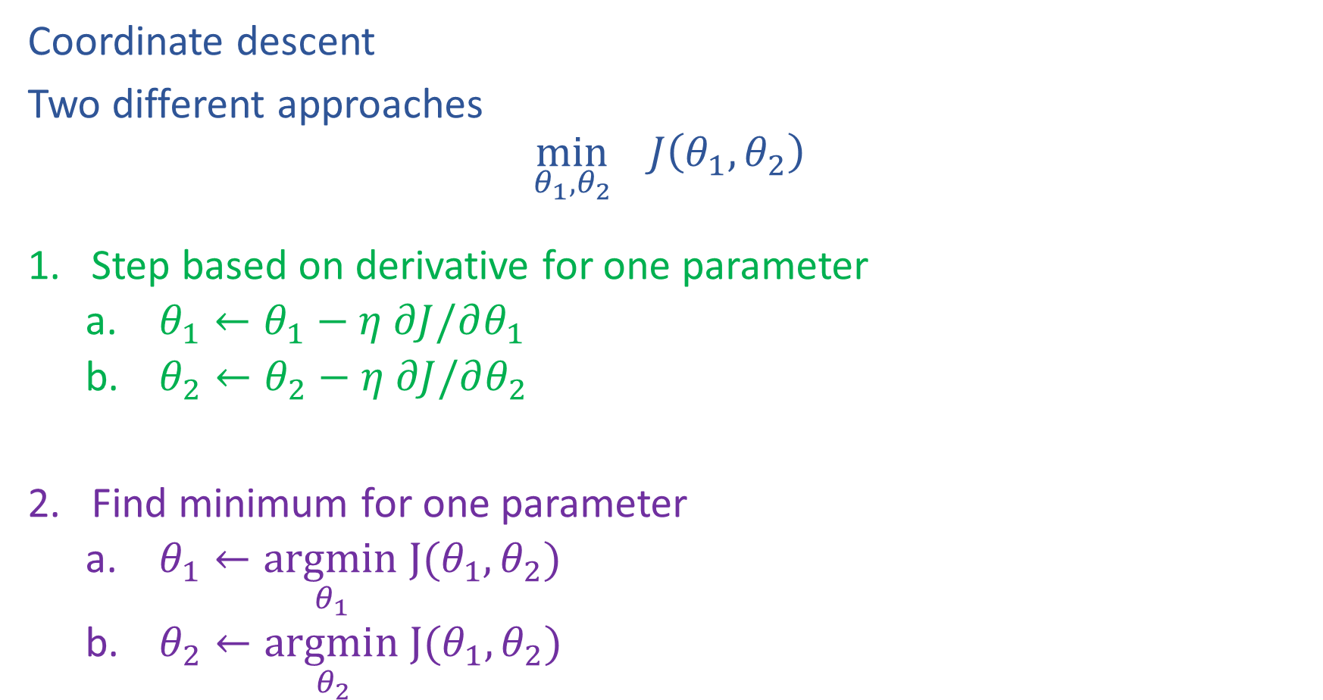
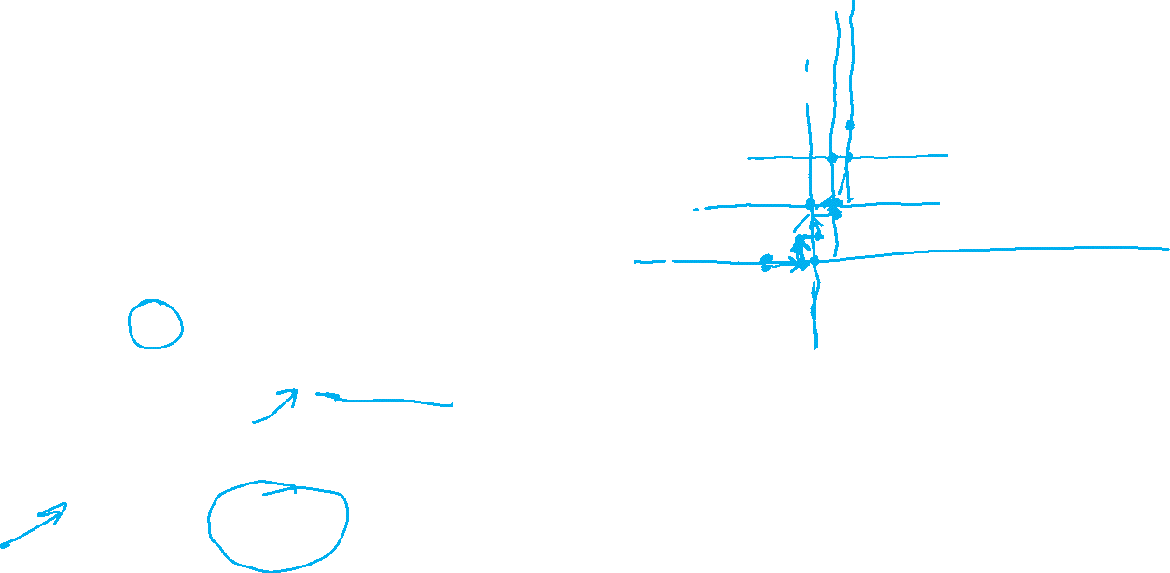
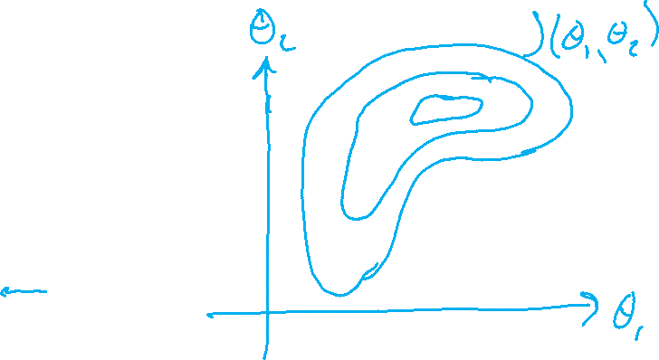
Alternating minimization
Coordinate descent
Two different approaches
$$\min_{θ_{1},θ_{2}}{ J\left(θ_{1},θ_{2}\right)}$$
Step based on derivative for one parameter
    $θ_{1}←θ_{1}−η ∂J/∂θ_{1}$
    $θ_{2}←θ_{2}−η ∂J/∂θ_{2}$
Find minimum for one parameter
    $θ_{1}←\underset{θ_{1} }{argmin}J(θ_{1},θ_{2})$
    $θ_{2}←\underset{θ_{2} }{argmin}J(θ_{1},θ_{2})$

Slide 29
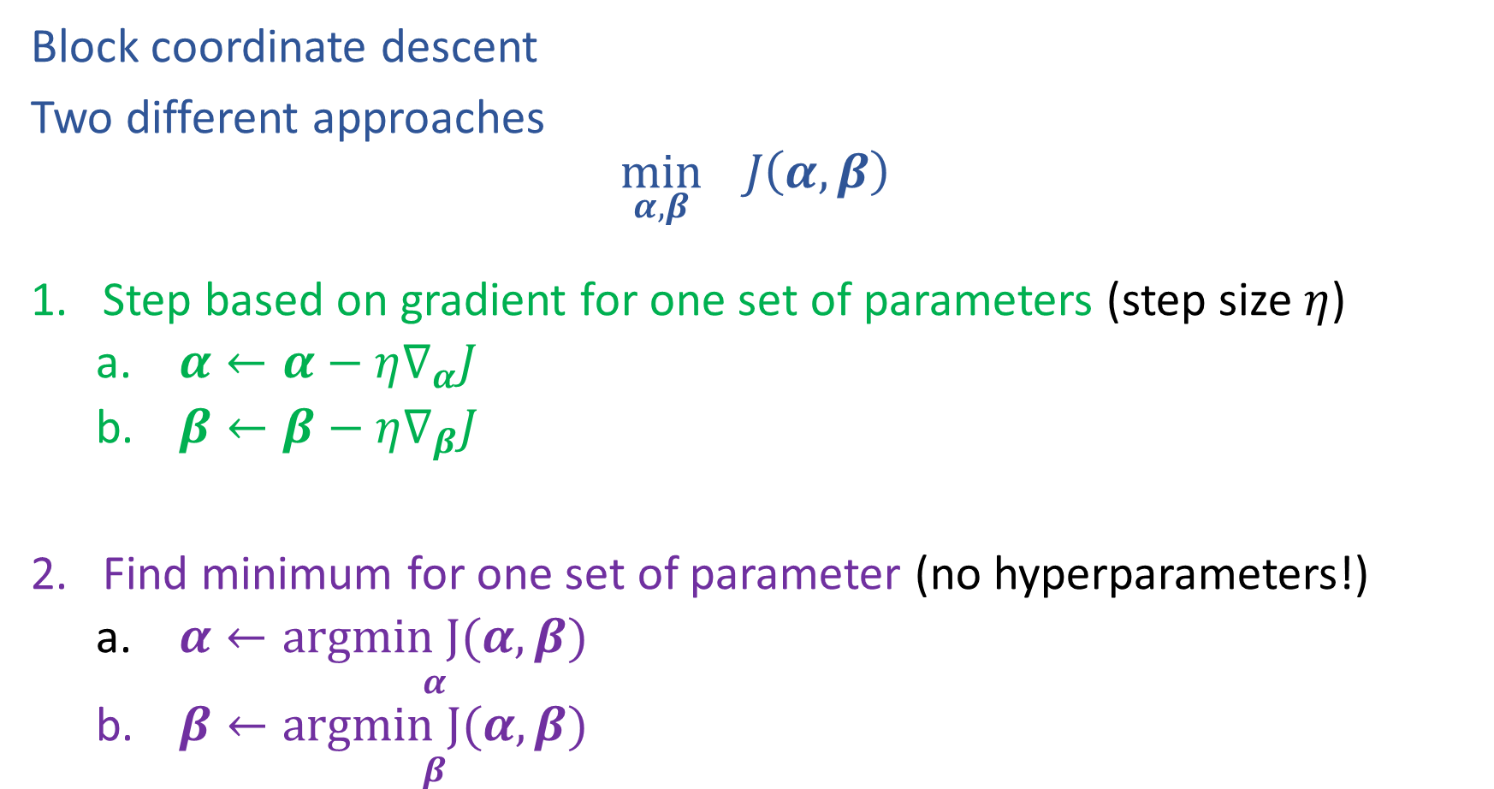
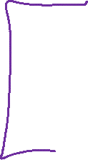
Alternating minimization
Block coordinate descent
Two different approaches
$$\min_{α,β}{ J\left(α,β\right)}$$
Step based on gradient for one set of parameters (step size $η$)
    $α←α−η∇_{α}J$
    $β←β−η∇_{β}J$
Find minimum for one set of parameter (no hyperparameters!)
    $α←\underset{α}{argmin J(α, β)}$
    $β←\underset{β}{argmin J(α, β)}$

Slide 30
Computational Complexity
At each iteration,
  Computing cluster centers: Each object gets added once to some cluster: O(N)
  Computing distance between each of the N objects and the K cluster centers is O(KN)
Assume these two steps are each done once for l iterations: O(lKN)
Slide credit: CMU MLD Aarti Singh
Notes:
Why does k-means converge? How many steps?

Slide 31
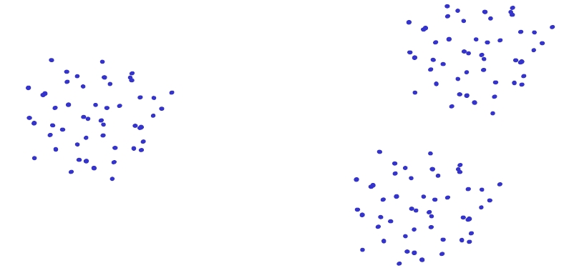
Issues: Seed Choice
Results are quite sensitive to seed selection.
Slide credit: CMU MLD Aarti Singh

Slide 32
Issues: Seed Choice
Results are quite sensitive to seed selection.
Slide credit: CMU MLD Aarti Singh

Slide 33
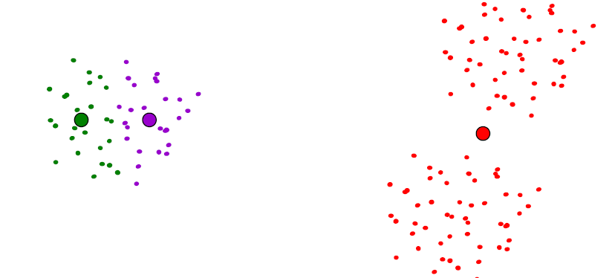
Issues: Seed Choice
Results are quite sensitive to seed selection.
Slide credit: CMU MLD Aarti Singh

Slide 34
Issues: Seed Choice
K-means always converges, but it may converge at a local optimum that is different from the global optimum, and in fact could be arbitrarily worse in terms of its objective.
Slide credit: CMU MLD Nina Balcan

Slide 35
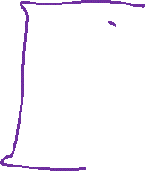
Issues: Seed Choice
Results can vary based on random seed selection.
Some seeds can result in poor convergence rate, or convergence to sub-optimal clustering.
  Try out multiple starting points (very important!!!)
  k-means ++ algorithm of Arthur and Vassilvitskii
  key idea: choose centers that are far apart
  (probability of picking a point as cluster center distance from nearest center picked so far)
Slide credit: CMU MLD Aarti Singh

Slide 36
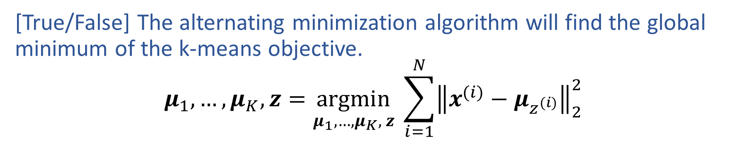
Poll 2
[True/False] The alternating minimization algorithm will find the global minimum of the k-means objective.
$$μ_{1}, …, μ_{K},z=\underset{μ_{1}, …, μ_{K}, z}{argmin} \sum_{i=1}^{N}{{\left\|x^{(i)}−μ_{z^{(i)}}\right\|}_{2}^{2}}$$

Slide 37
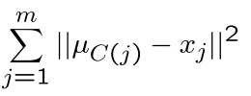
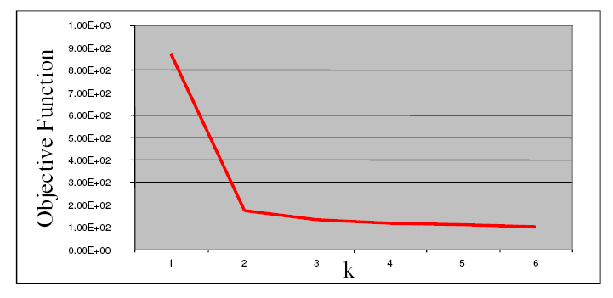

Other Issues
Number of clusters K
  Objective function
  Look for “Knee” in objective function
  Can you pick K by minimizing the objective over K?
Slide credit: CMU MLD Aarti Singh

Slide 38

(One) bad case for K-means
Clusters may overlap
Some clusters may be “wider” than others
Clusters may not be linearly separable
Slide credit: CMU MLD Aarti Singh

