Slide 1
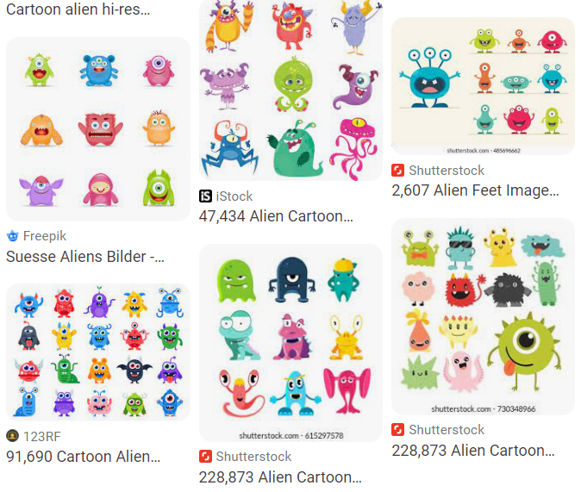
As you walk in
Welcome!
Help draw some aliens for our dataset today!
    See table up front
    Just stick figures, nothing quite this fancy →

Slide 2

10-315
Introduction to ML
Instructor: Pat Virtue

Slide 3
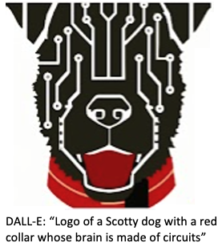
Today
Course team
ML framework
Elephants in the room (ChatGPT, DALL-E 2, …)
Alien exercise
ML Models
Autoencoders
More course info
Announcements

Slide 4
Course Logo Generation

Slide 5
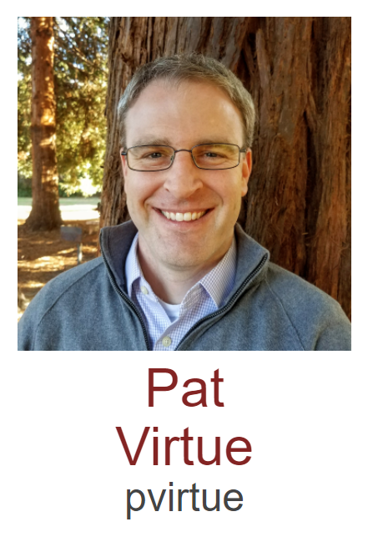
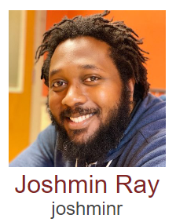
Course Team
Instructor
Education Associate

Slide 6
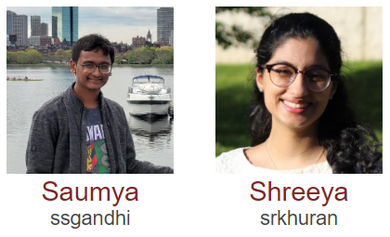
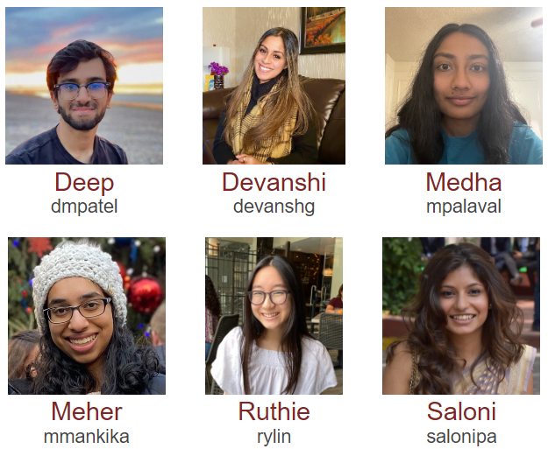
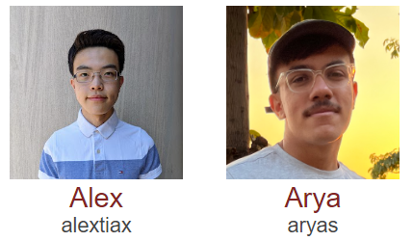
Course Team
Teaching Assistants

Slide 7
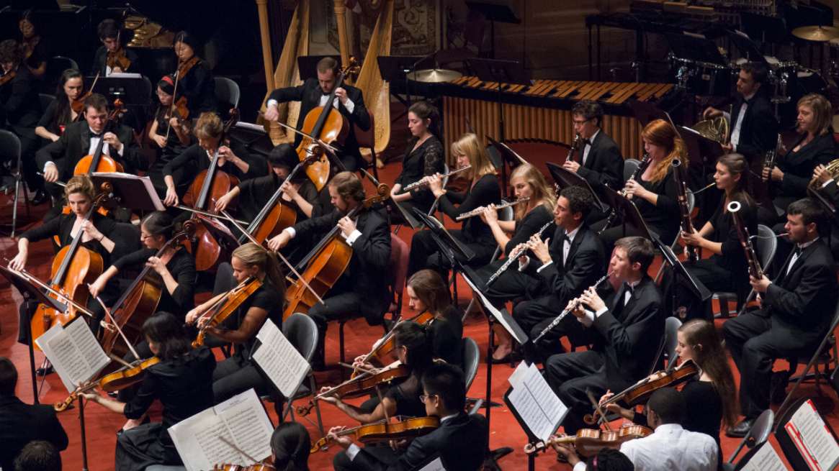
Course Team
Students!!

Slide 8

What is ML?
Domain of Interest
Computer Science
Computer Science
Machine Learning
Optimization
Optimization
Statistics
Statistics
Linear Algebra
Linear Algebra
Probability
Probability
Calculus
Calculus
Measure
Theory

Slide 9
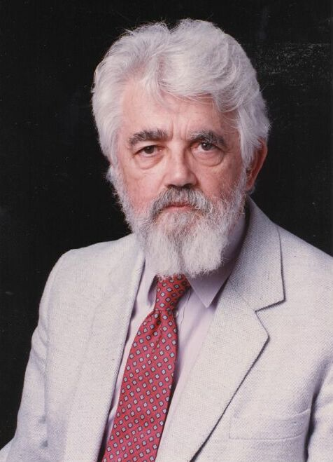
AI Definition by John McCarthy
What is artificial intelligence
  It is the science and engineering of making intelligent machines, especially intelligent computer programs
What is intelligence
  Intelligence is the computational part of the ability to achieve goals in the world
http://www-formal.stanford.edu/jmc/whatisai/whatisai.html

Slide 10
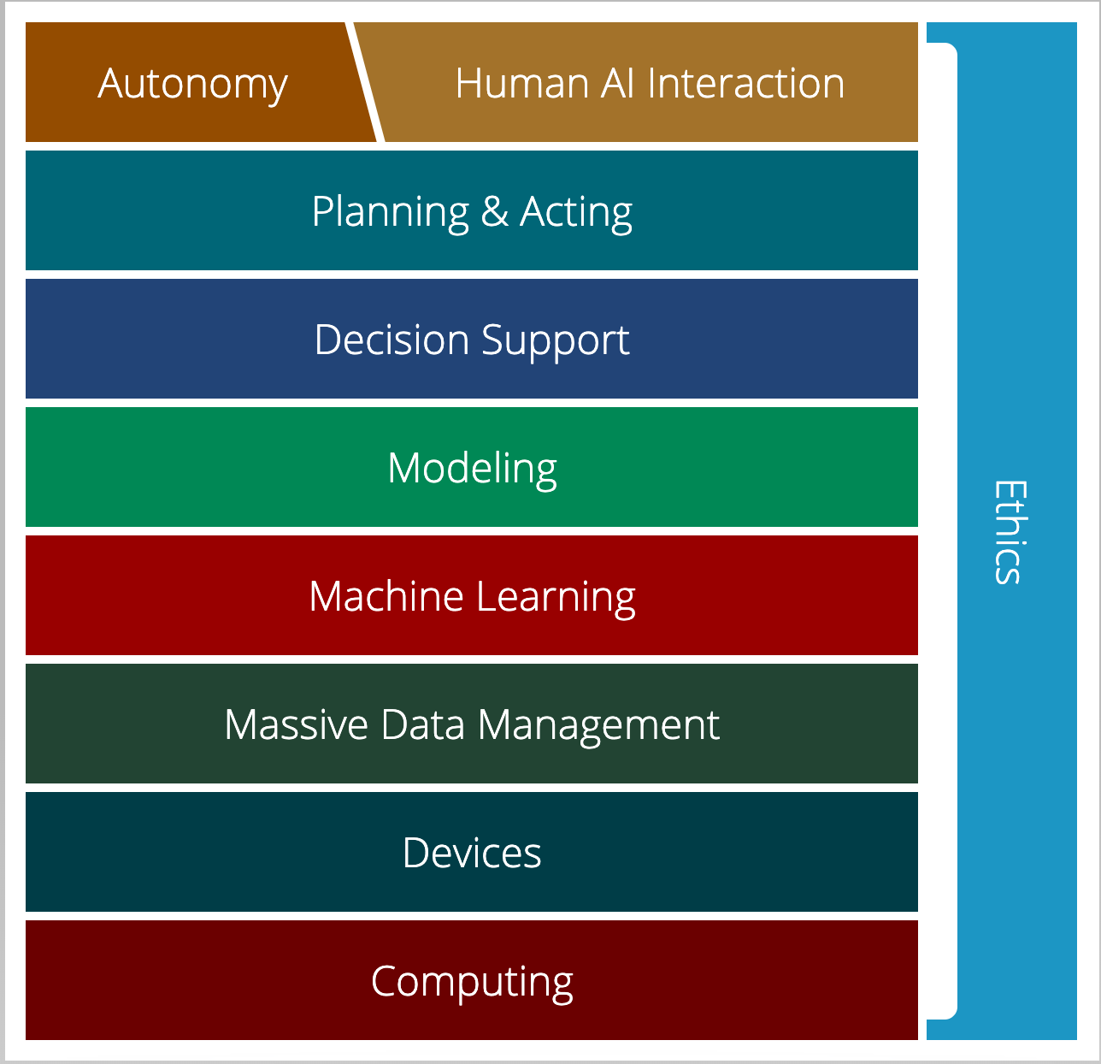
AI Stack for CMU AI
“AI must understand the human needs and it must make smart design decisions based on that understanding”
AI Stack
https://ai.cs.cmu.edu/about
Notes:
Proposed by Andrew Moore, CMU is using AI Stack to illustrate what they consider as AI. AI must understand the human needs and it must make smart design decisions based on that understanding. Despite the simple definition, though, AI isn't just one thing. It's a giant thing, built from technology blocks we call the AI Stack. At Carnegie Mellon, we view it as a toolbox — each block houses a set of technologies that scientists and researchers can reach for as they work on new initiatives. Expertise in all areas? Not required. Instead, we believe you can focus on one area and draw on other parts of the stack for help. Each block depends on the other for support. And AI endeavors that ignore parts of the stack won't succeed.

Slide 11
AI Stack for CMU AI
“Machine learning focuses on creating programs that learn from experience.”
“It advances computing through exposure to new scenarios, testing and adaptation, while using pattern- and trend-detection to help the computer make better decisions in similar, subsequent situations.”
AI Stack
https://ai.cs.cmu.edu/about

Slide 12
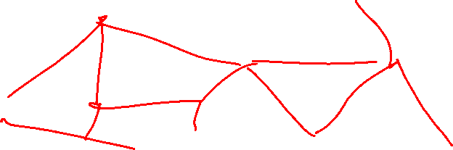
Artificial Intelligence vs Machine Learning?
Artificial Intelligence
Machine Learning
Deep Learning

Slide 13
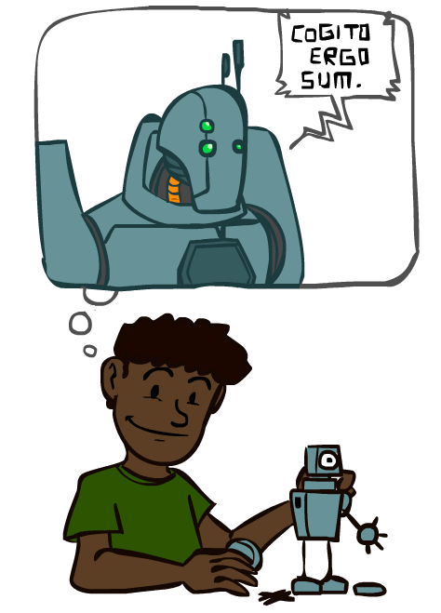
A Brief History of AI
Images: ai.berkeley.edu

Slide 14
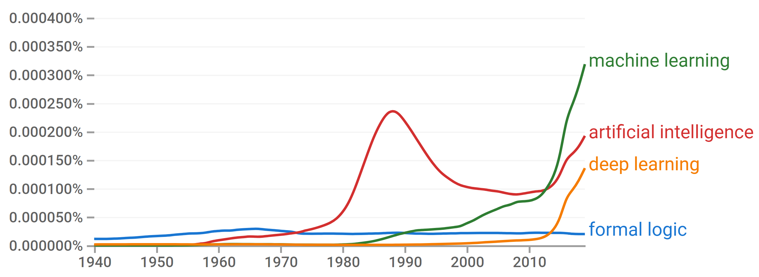

A Brief History of AI
Knowledge Based
Systems
1970-1990
Statistical Approaches
1990-
Deep Learning Era
2012-
AI
Excitement!
1950-1970
https://books.google.com/ngrams

Slide 15
A Brief History of AI
1940-1950: Early days
  1943: McCulloch & Pitts: Boolean circuit model of brain
  1950: Turing's “Computing Machinery and Intelligence”
1950—70: Excitement: Look, Ma, no hands!
  1950s: Early AI programs, including Samuel's checkers program, Newell & Simon's Logic Theorist, Gelernter's Geometry Engine
  1956: Dartmouth meeting: “Artificial Intelligence” adopted
1970—90: Knowledge-based approaches
  1969—79: Early development of knowledge-based systems
  1980—88: Expert systems industry booms
  1988—93: Expert systems industry busts: “AI Winter”
1990—: Statistical approaches
  Resurgence of probability, focus on uncertainty
  General increase in technical depth
  Agents and learning systems… “AI Spring”?
2012—: Deep learning
  2012: ImageNet & AlexNet
Images: ai.berkeley.edu
Notes:
Million dollar computer with less computation than your phone
MT was

Slide 16
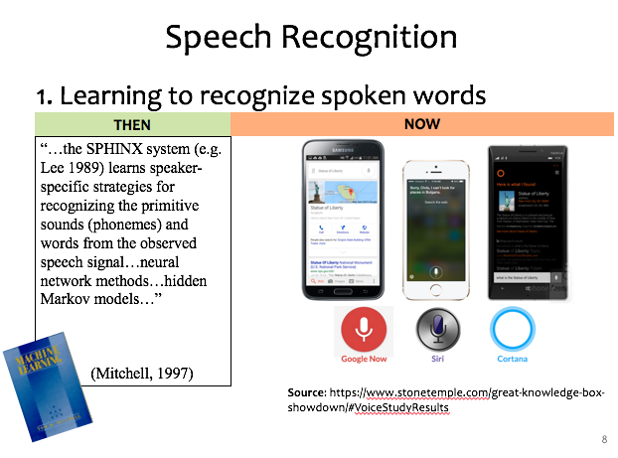
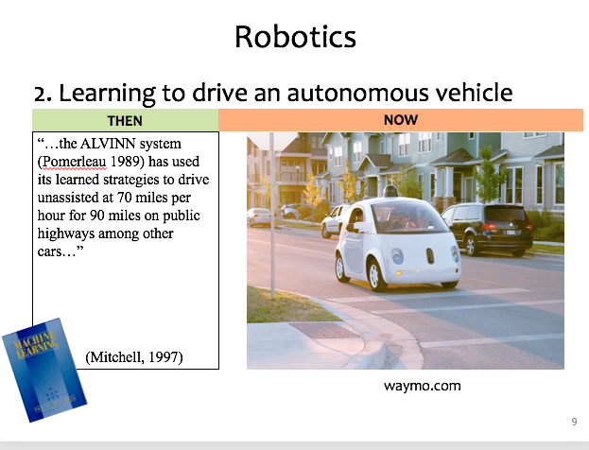
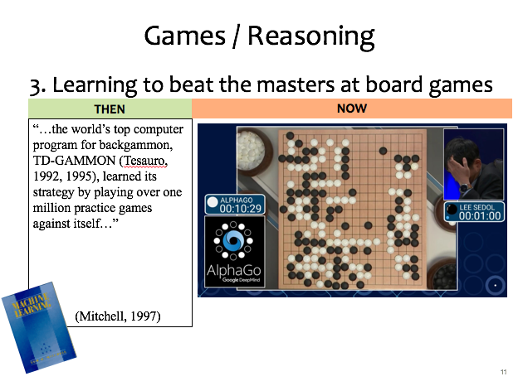
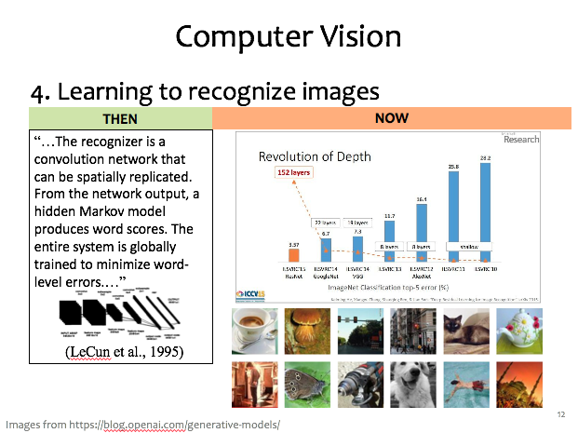
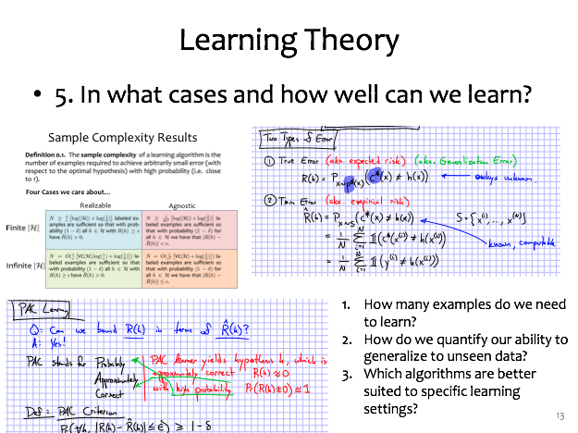

ML Applications?

Slide 17
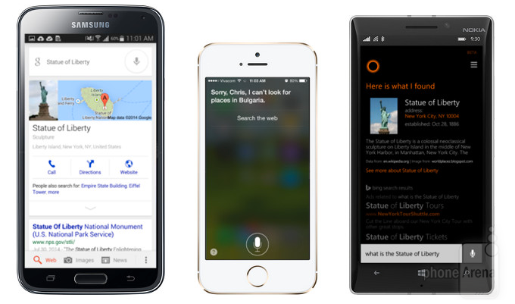

Speech Recognition
1. Learning to recognize spoken words
THEN
NOW
“…the SPHINX system (e.g. Lee 1989) learns speaker-specific strategies for recognizing the primitive sounds (phonemes) and words from the observed speech signal…neural network methods…hidden Markov models…”
(Mitchell, 1997)
Source: https://www.stonetemple.com/great-knowledge-box-
showdown/#VoiceStudyResults
Slide credit: CMU MLD Matt Gormley

Slide 18
Robotics
2. Learning to drive an autonomous vehicle
NOW
THEN
NOW
“…the ALVINN system (Pomerleau 1989) has used its learned strategies to drive unassisted at 70 miles per hour for 90 miles on public highways among other cars…”
(Mitchell, 1997)
https://www.geek.com/wp-content/uploads/2016/03/uber.jpg
waymo.com
Slide credit: CMU MLD Matt Gormley
Notes:
This a Google self-driving car; it looks really cute and friendly.
But these things weigh a *ton* and there is a person sitting inside this thing!
So this machine needs to know a lot about its environment, what actions to take, or policy to follow.
If a person were to enter the crosswalk, it would need to know how to slow down, or that person would learn a very uncomfortable lesson about physics

Slide 19
Games / Reasoning
3. Learning to beat the masters at board games
THEN
NOW
“…the world’s top computer program for backgammon, TD-GAMMON (Tesauro, 1992, 1995), learned its strategy by playing over one million practice games against itself…”
(Mitchell, 1997)
Slide credit: CMU MLD Matt Gormley

Slide 20
Computer Vision
4. Learning to recognize images
THEN
NOW
“…The recognizer is a convolution network that can be spatially replicated. From the network output, a hidden Markov model produces word scores. The entire system is globally trained to minimize word-level errors.…”
(LeCun et al., 1995)
Slide credit: CMU MLD Matt Gormley
Images from https://blog.openai.com/generative-models/

Slide 21
Learning Theory
5. In what cases and how well can we learn?
Slide credit: CMU MLD Matt Gormley
How many examples do we need to learn?
How do we quantify our ability to generalize to unseen data?
Which algorithms are better suited to specific learning settings?

Slide 22
Machine Learning and Statistics
Statistics is also about learning from data
Statistics has been around from much longer!
What’s the difference?
Until the mid 1990s:
Statistics:
  A branch of mathematics
  Emphasized rigor, correctness, provable properties (“is it correct?”)
  Was not very concerned with scaling
    Not much awareness of computational complexity
Machine Learning:
  A branch of Computer Science / AI
  Focus on heuristics, making things work in practice (“does it work?”)
  Not much awareness of statistical theory
Slide: CMU ML, Roni Rosenfeld

Slide 23

Machine Learning and Statistics
From the mid 1990s:
The two fields have effectively merged
  Carnegie Mellon has led the way!
ML is now often called “Statistical Machine Learning”
  There is very little non-statistical ML today
Slide: CMU ML, Roni Rosenfeld

Slide 24

Machine Learning Systems
Task
Experience
Performance measure

Slide 25
Machine Learning Framework
Formalize the task as a mapping from input to output
  Task examples will usually be pairs: (input, correct_output)
Formalize performance as an error measure
  or more generally, as an objective function (aka Loss function)
Examples:
  Medical Diagnosis
    mapping input to one of several classes/categories (aka classification)
  Predict tomorrow’s Temperature
    mapping input to a number (aka regression)
  Chance of Survival: From patient data to p(survive >= 5 years)
    mapping input to probability (aka logistic regression)
  Driving recommendation
    mapping input into a plan (aka Planning)
Slide: CMU ML, Roni Rosenfeld

Slide 26
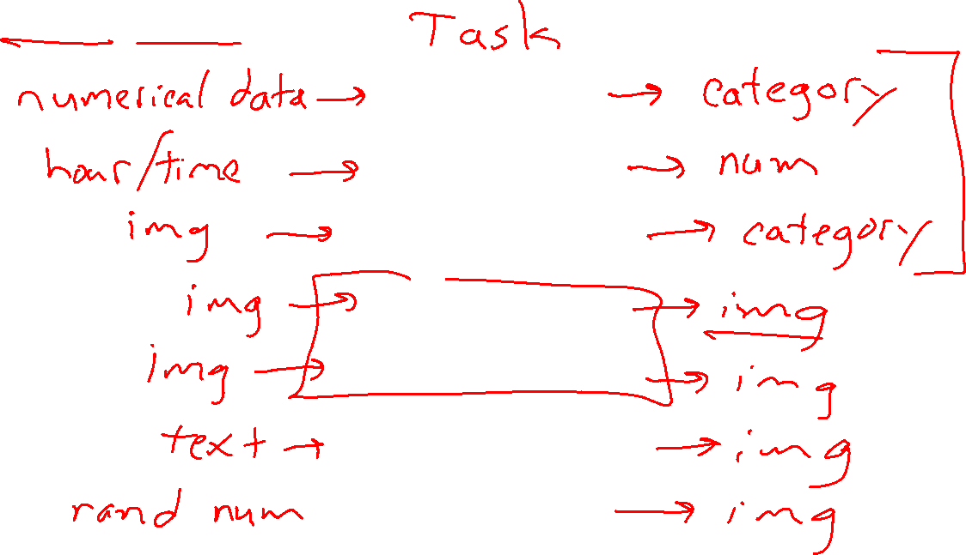
Input/Output Tasks
Iris classification
Traffic prediction
Image classification
Image denoising
Medical image recon
Text to image generation
Face generation

Slide 27
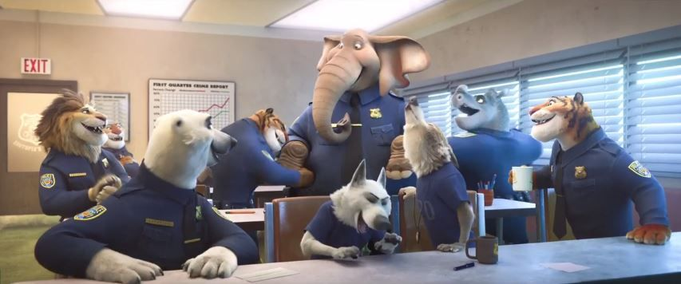
Elephant in the room
Image: Zootopia

Slide 28

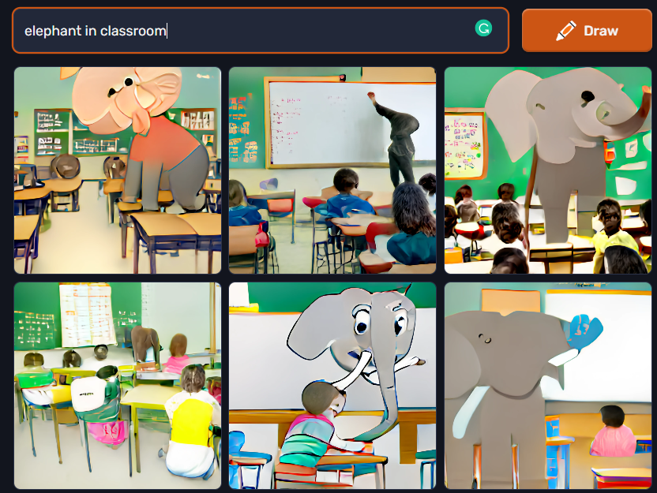
Elephant in the room
Image: Zootopia

Slide 29
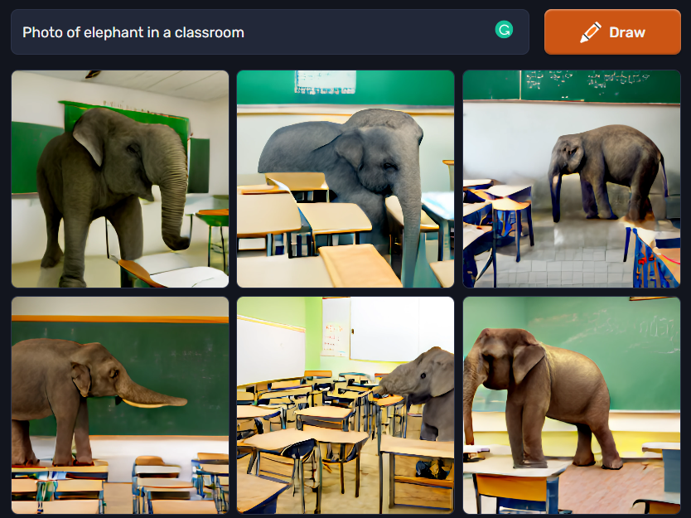
Elephant in the room
Image: Zootopia

Slide 30
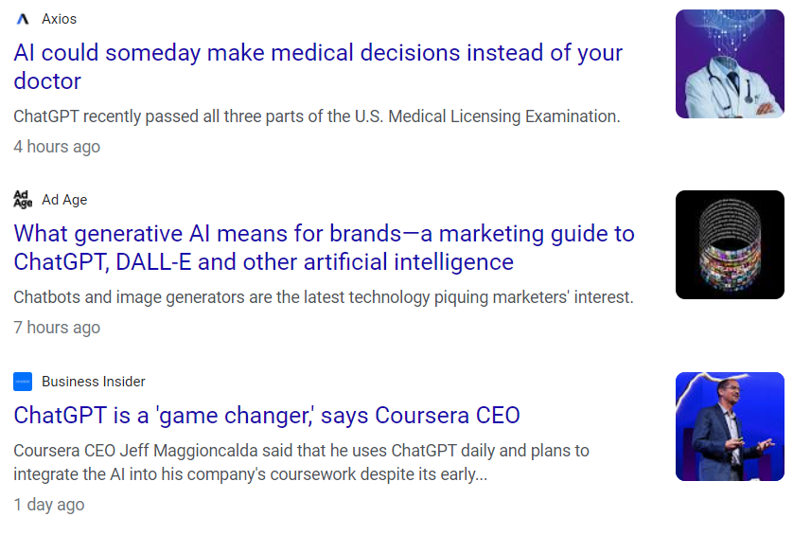
Elephant in the room
Image: Google News: “chatgpt”, 1/18/2023

Slide 31
Dimensionality Reduction
https://cs.stanford.edu/people/karpathy/convnetjs/demo/autoencoder.html

Slide 32
As you walk in
Welcome!
Help draw some aliens for our dataset today!
    See table up front
    Just stick figures, nothing quite this fancy →

Slide 33




Exercise: Human-defined Feature Space
Step1: Write a bunch of digits 0-9 on post-it notes

Slide 34

Exercise: Human-defined Feature Space
Step2: In groups, students try to organize digits on a 2-D coordinate plot
Optional: label the extreme ends of both coordinate axes

Slide 35
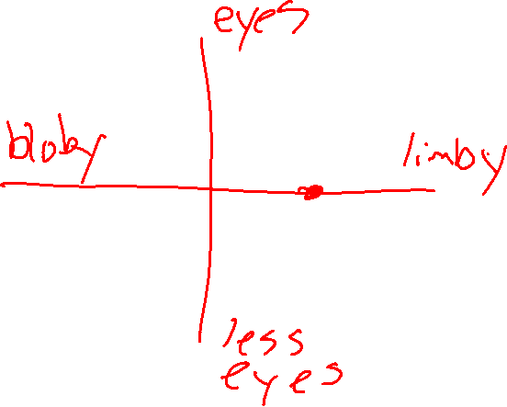
Exercise: Human-defined Feature Space
Step2: In groups, try to organize digits on a 2-D coordinate plot
Optional: label the extreme ends of both coordinate axes

Slide 36
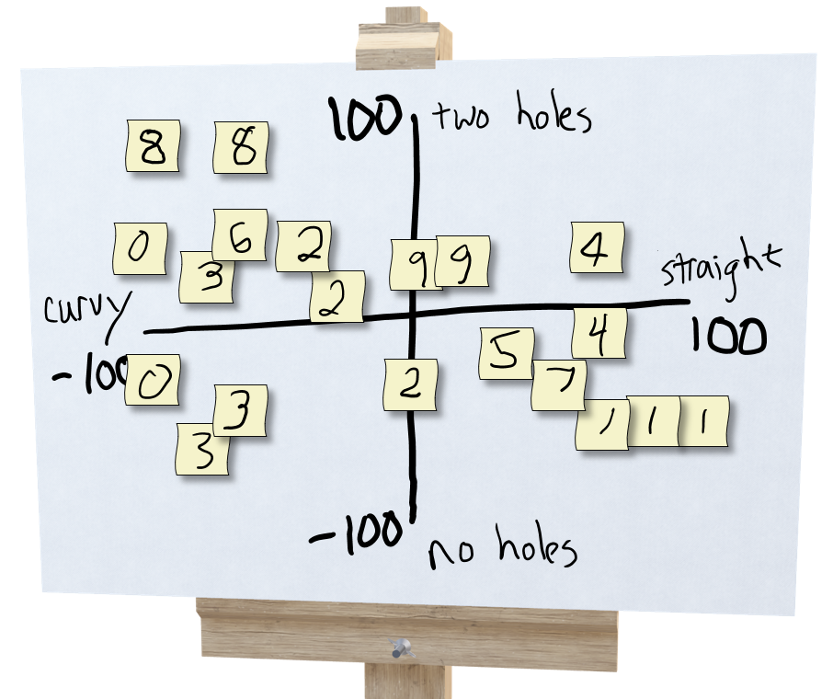
Exercise: Human-defined Feature Space
Step 3: Prediction!
Select three students: A,B,C
Student A draws a new digit and hands it to student B
Student B thinks about where to plot it and comes up with a 2-D coordinate, (x, y)
Student C looks at the coordinate and the plot (but not the drawing from A) and predicts the digit, 0-9

Slide 37
Exercise: Human-defined Feature Space
Step 4: Creation!
Select three students: A,B,C
Student A draws a new digit and hands it to student B
Student B thinks about where to plot it and comes up with a 2-D coordinate, (x, y)
Student C looks at the coordinate and the plot (but not the drawing from A) and draws a new digit

Slide 38
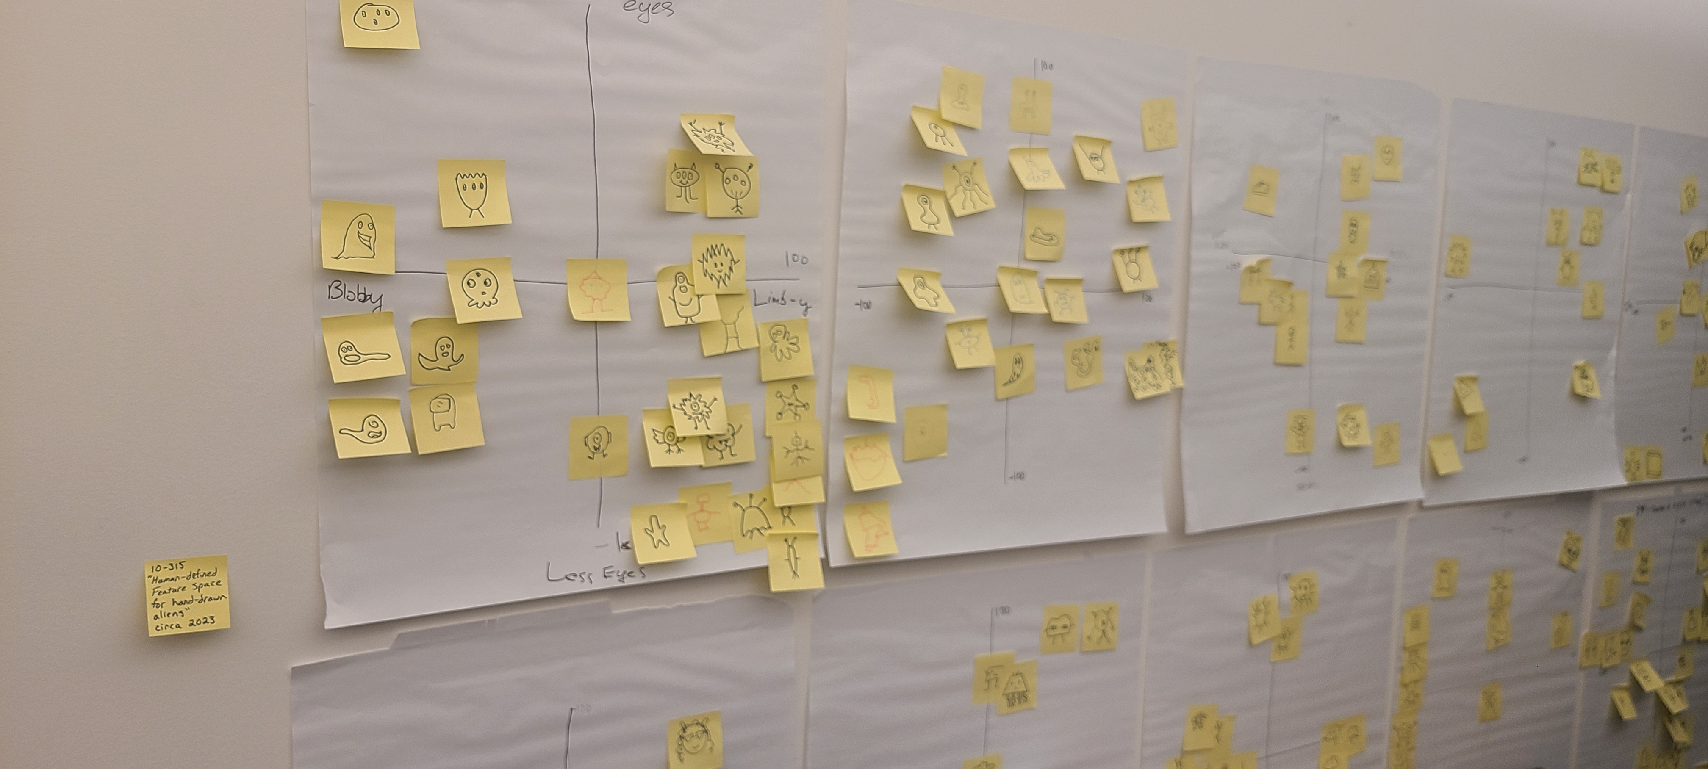
Exercise: Human-defined Feature Space

Slide 39
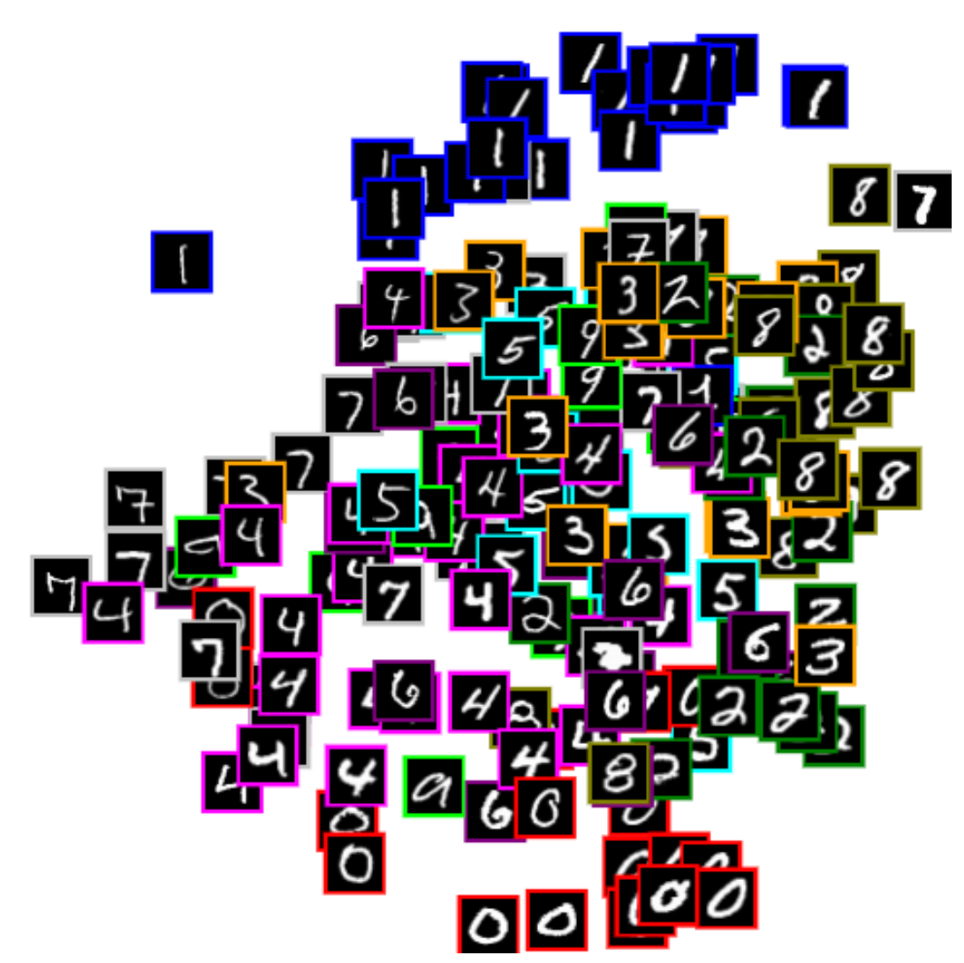





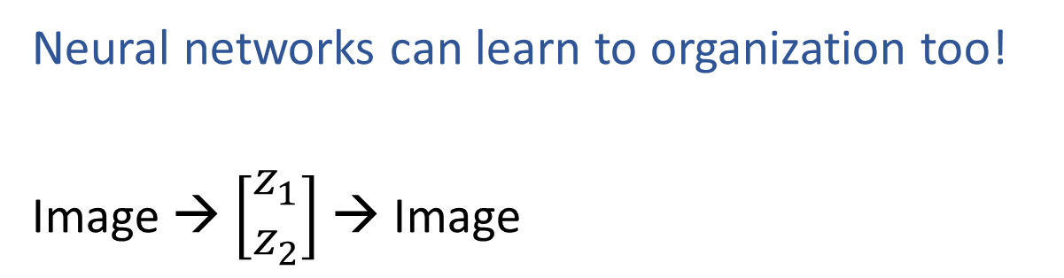
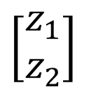
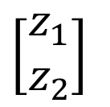

Learning to Organize Data
Neural networks can learn to organization too!
Image → $\left[\begin{aligned}z_{1} \\ z_{2}\end{aligned}\right]$ → Image
$$z_{2}$$
Net
Net
$$\left[\begin{aligned}z_{1} \\ z_{2}\end{aligned}\right]$$
Net
Net
$$\left[\begin{aligned}z_{1} \\ z_{2}\end{aligned}\right]$$
$$z_{1}$$
https://cs.stanford.edu/people/karpathy/convnetjs/demo/autoencoder.html

Slide 40


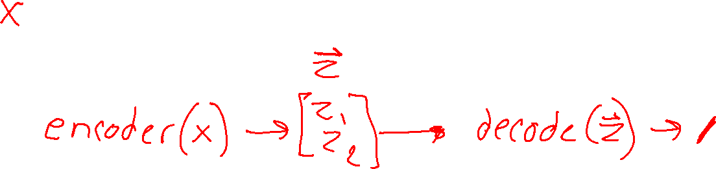
Digit Autoencoder
Demo: Using a learned feature space

Slide 41
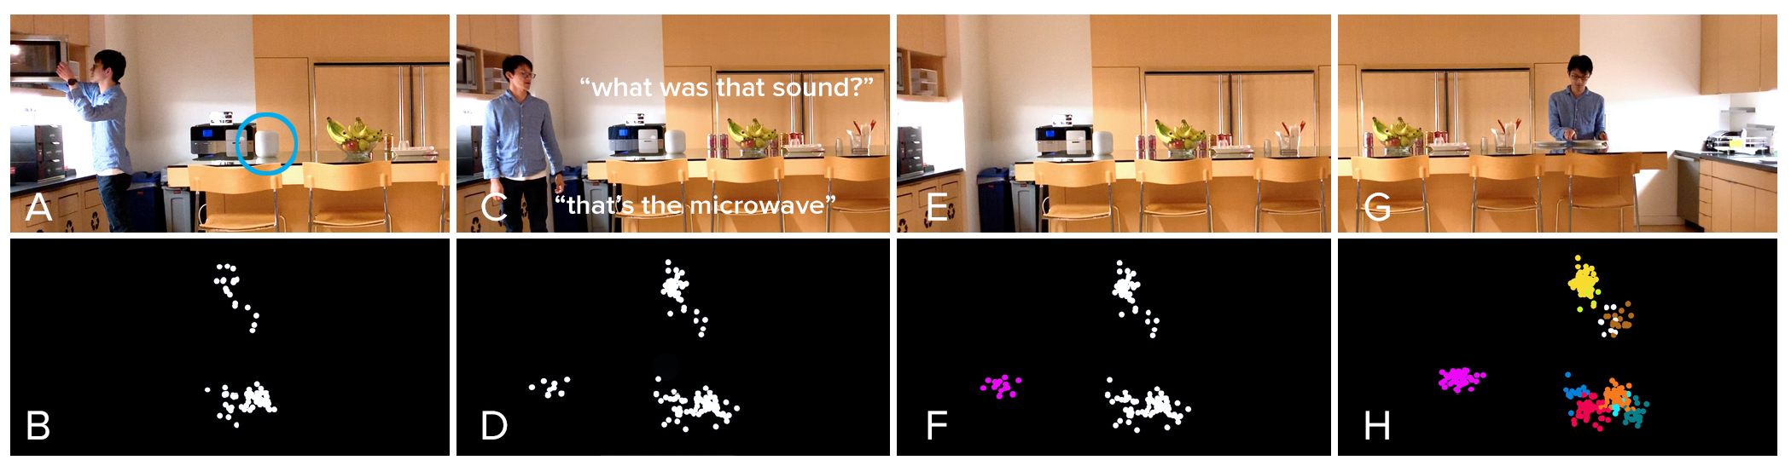
Listen Learner
Chris Harrison, CMU
https://chrisharrison.net/index.php/Research/ListenLearner

Slide 42
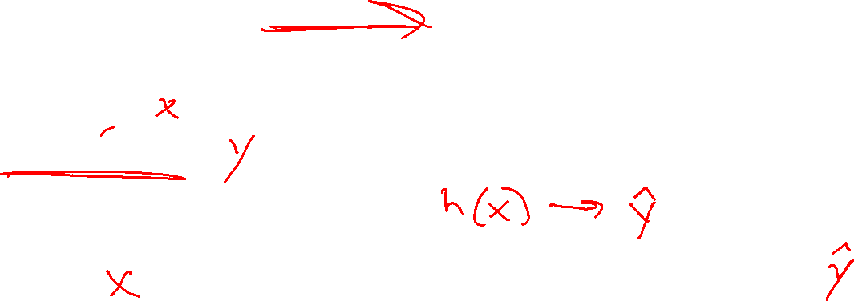
Machine Learning
Using (training) data to learn a model that we’ll later use for prediction
Training Data
Input and Measured Output
Model
Structure and Parameters
Training
Prediction
Input
Model
Predicted
Output

Slide 43
Autoencoder Model

Slide 44
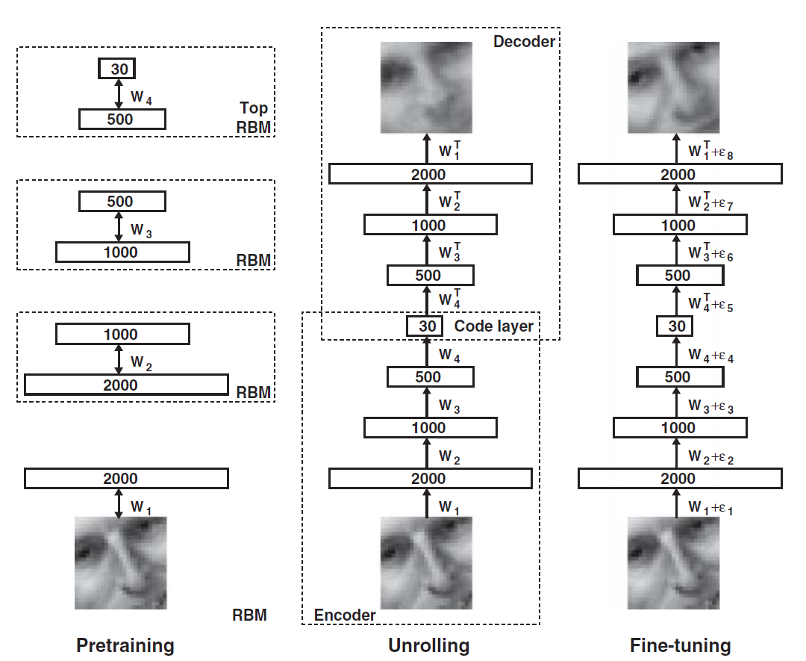

Dimensionality Reduction with Deep Learning
Hinton, Geoffrey E., and Ruslan R. Salakhutdinov.
"Reducing the dimensionality of data with neural networks.”
Science 313.5786 (2006): 504-507.

Slide 45

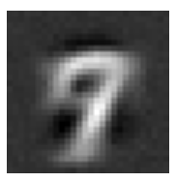
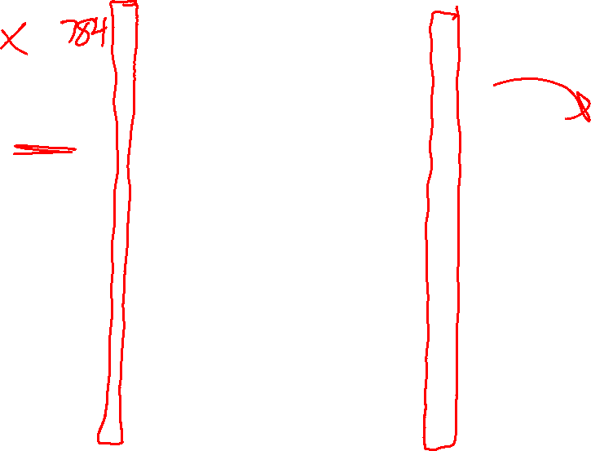
Digit Autoencoder
https://cs.stanford.edu/people/karpathy/convnetjs/demo/autoencoder.html
Layer 1
Layer 2
Layer 4
Layer 5
Layer 6
Input
28x28 = 784 pixels
Layer 3
50 neurons
50 neurons
784 neurons
50 neurons
50 neurons
2 neurons
Autoencoder network

Slide 46
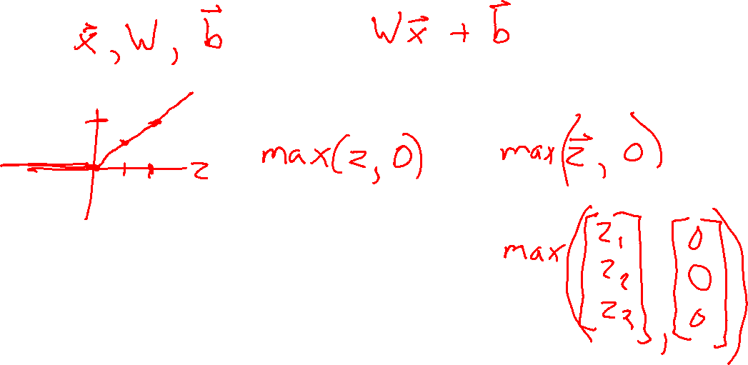
Digit Autoencoder
Math for autoencoder model
Linear layer
ReLU layer
Tanh layer

Slide 47




Course Information
Website: https://www.cs.cmu.edu/~10315
Canvas: canvas.cmu.edu
Gradescope: gradescope.com
Communication:
piazza.com
E-mail (if piazza doesn’t work):
joshminr@andrew.cmu.edu
pvirtue@andrew.cmu.edu

Slide 48

Course Information
Lectures
Pre-reading before week of lecture
Lectures are recorded
    Shared with our course and ML course staff only
Participation points earned by answering Piazza polls in lecture
Slides will be posted
Recitations
Recommended attendance
Not recorded, no participation points in recitation
Recitation materials are in-scope for quizzes and exams

Slide 49

Course Information
Office Hours
OH calendar on course website
OH-by-appointment requests are certainly welcome
Mental Health

Slide 50
Announcements
Updates for this week
HW1
    Out this evening
    Due Sat 1/28, 11:59 pm
Pick with pre-reading and check-point to get ready for next week
Policies up on website by tomorrow morning
Piazza polls will be practice today
    Use this to work out any kinks

