Slide 1
Plan
Cool stuff
Expectation-Maximization algorithm
    Gaussian mixture models for clustering
Kernels
    Linear regression
    Support vector machines
Duality
    Support vector machines

Slide 2

10-315
Introduction to ML
Nonparametric Regression and Kernels
Instructor: Pat Virtue

Slide 3
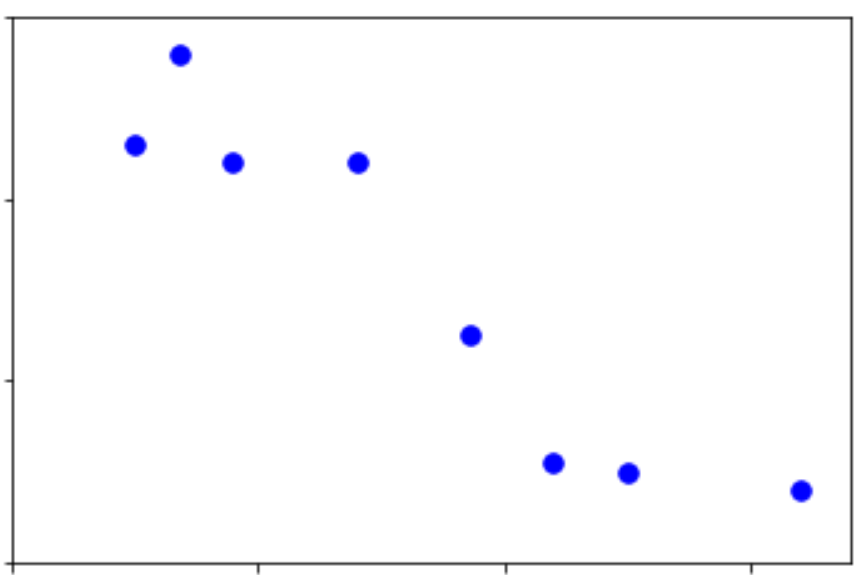
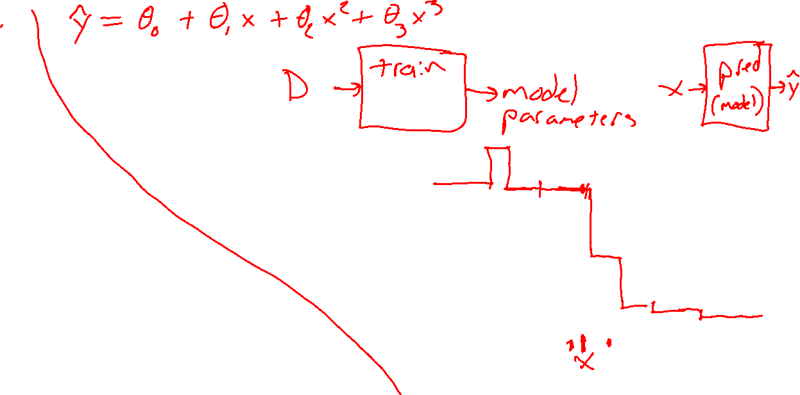
Parametric vs Nonparametric Regression
Output y
Output y
Input x
Input x

Slide 4

Parametric vs Nonparametric
Two different definitions
Statistics
A nonparametric model does not follow a specific distribution (thus doesn’t have parameters that define that distribution)
Machine learning
The number of parameters in a nonparametric model scales with the number of training data points

Slide 5

Parametric vs Nonparametric
Which models are nonparametric?
Statistics
does not follow a specific distribution
Machine learning
number of parameters scales with training
Linear regression
Logistic regression
Neural nets
Naïve Bayes
Discriminant analysis
K-nearest neighbor
Decision trees

Slide 6
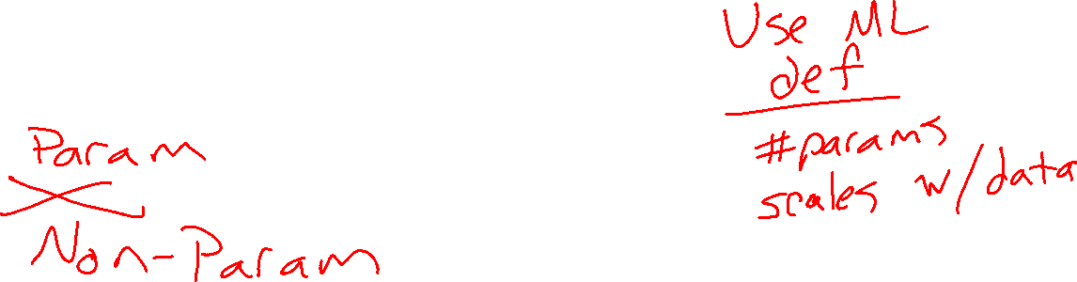
Poll 1
Are decision trees parametric or non-parametric?
Notes:
0

Slide 7
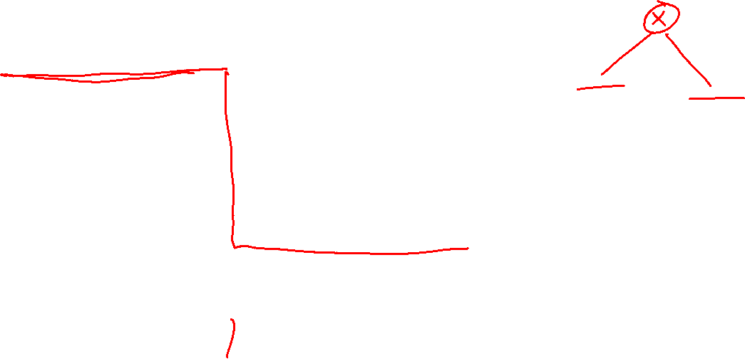
Nonparametric Regression
Decision Trees
Output y
Input x

Slide 8
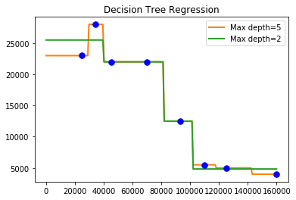
Nonparametric Regression
Decision Trees

Slide 9
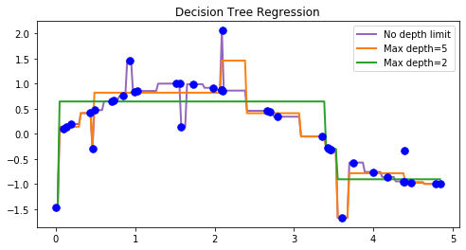
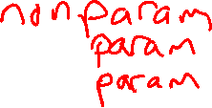
Nonparametric Regression
Decision Trees

Slide 10
Poll 1
Are decision trees parametric or non-parametric?
Notes:
0

Slide 11

Poll 1
Are decision trees parametric or non-parametric?
It depends :)
  If no limits on depth or reuse of attributes, then non-parametric
    Model complexity will grow with data
  If pruned/limited to fix size
    Parametric
  If attributes only used once
    Parametric; model complexity is limited by number of features
Trade-offs
  Non-parametric methods have very powerful representation capabilities
  But
    Easily overfit
    Can take up memory proportional to training size too
Notes:
0

Slide 12
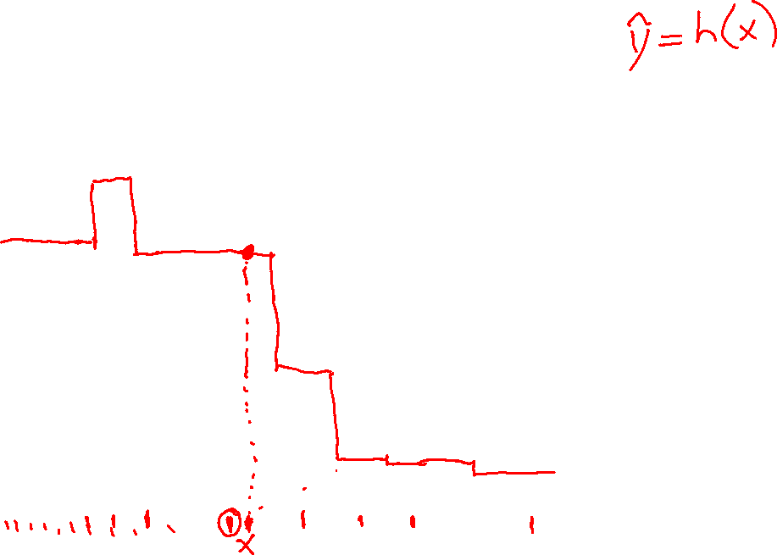
Nonparametric Regression
Nearest Neighbor
Output y
Input x

Slide 13
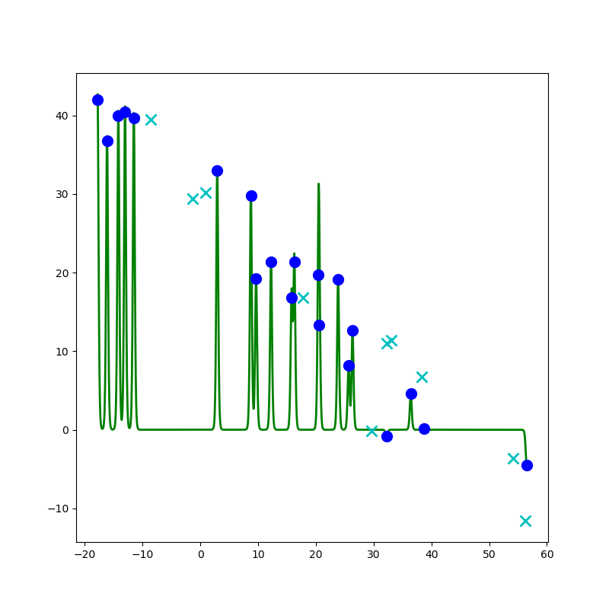
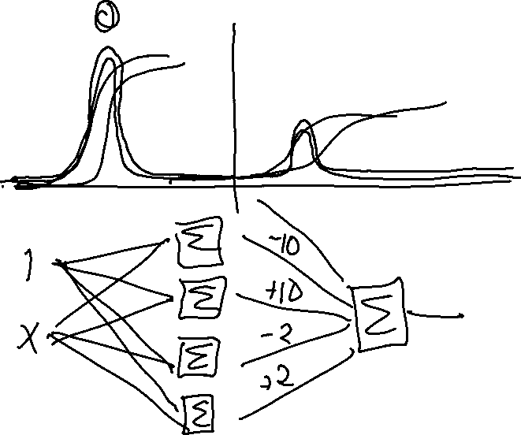
Nonparametric Regression
Neural Networks (nonparametric hack)

Slide 14

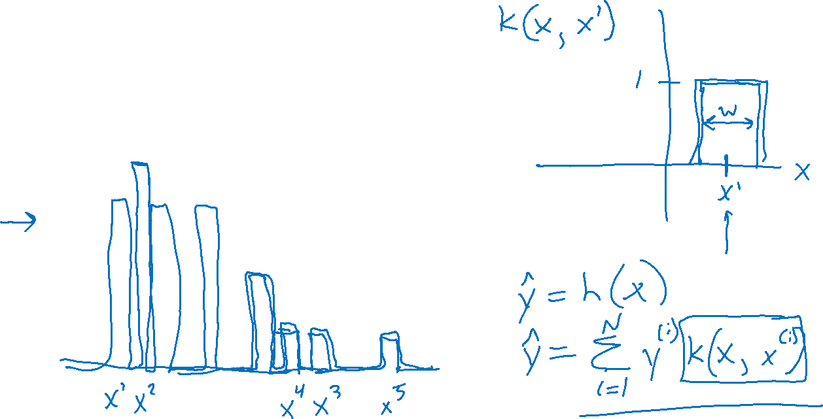
Nonparametric Regression
Kernel Regression
Output y
Input x

Slide 15
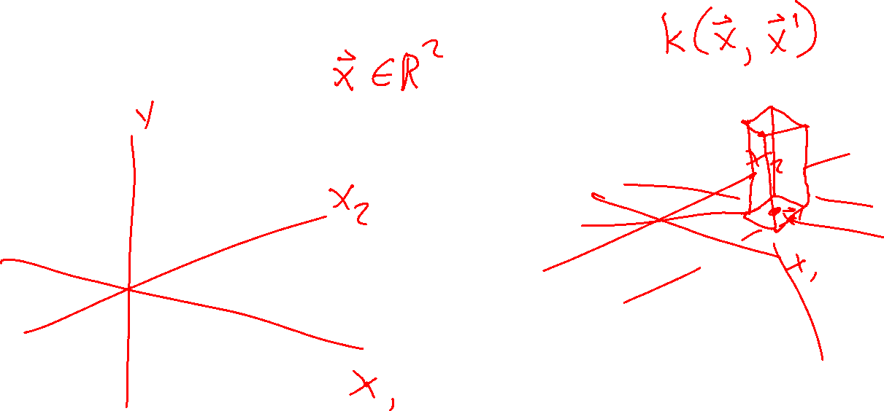
Nonparametric Regression
Kernel Regression

Slide 16
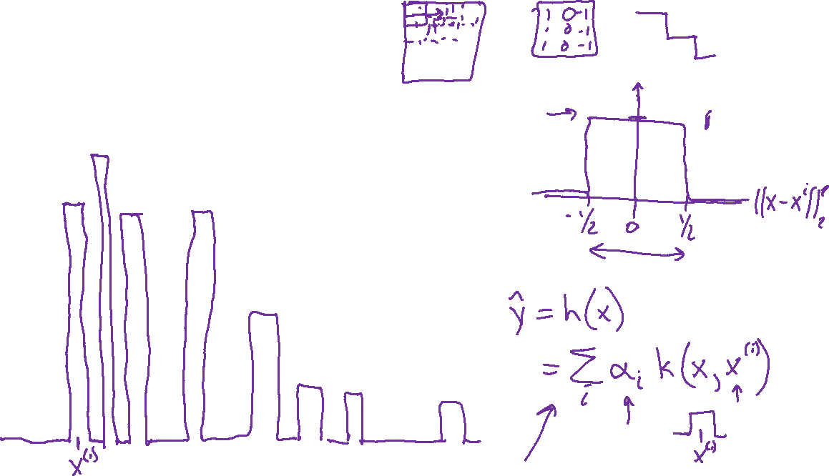
Nonparametric Regression
Kernel Regression
Output y
Input x

Slide 17

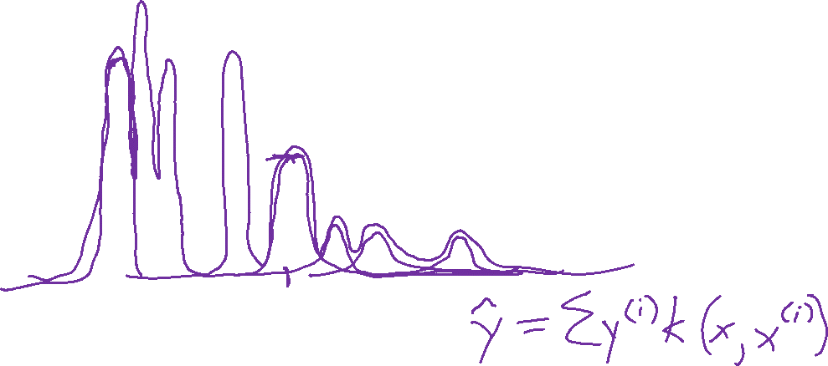
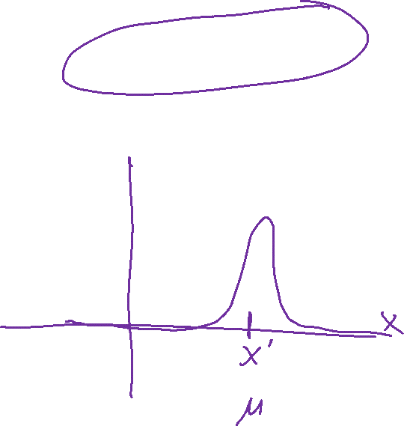

Nonparametric Regression
RBF Kernel function
$k\left(x, x′\right)=e^{\frac{{−\left\|x−x^{′}\right\|}_{2}^{2}}{2σ^{2}}}$
$=e^{{−γ\left\|x−x^{′}\right\|}_{2}^{2}}$
Kernel Regression
Output y
Input x

Slide 18
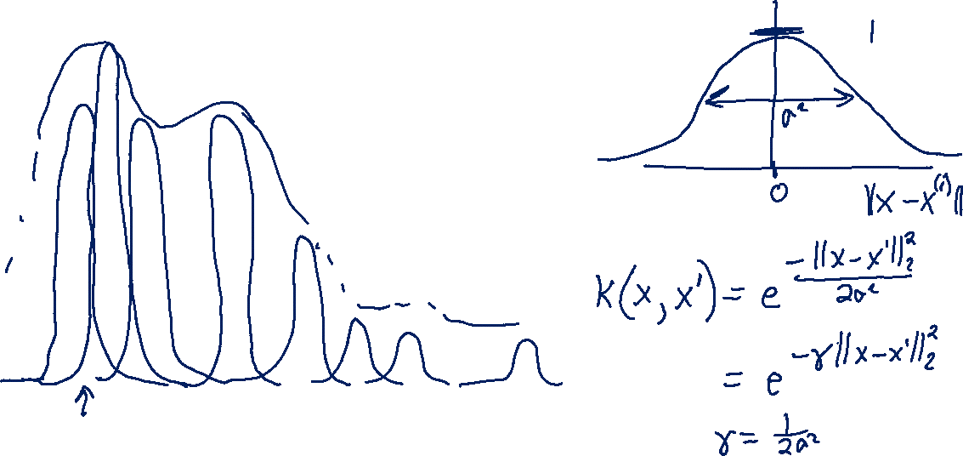
Nonparametric Regression
Kernel Regression
Output y
Input x

Slide 19
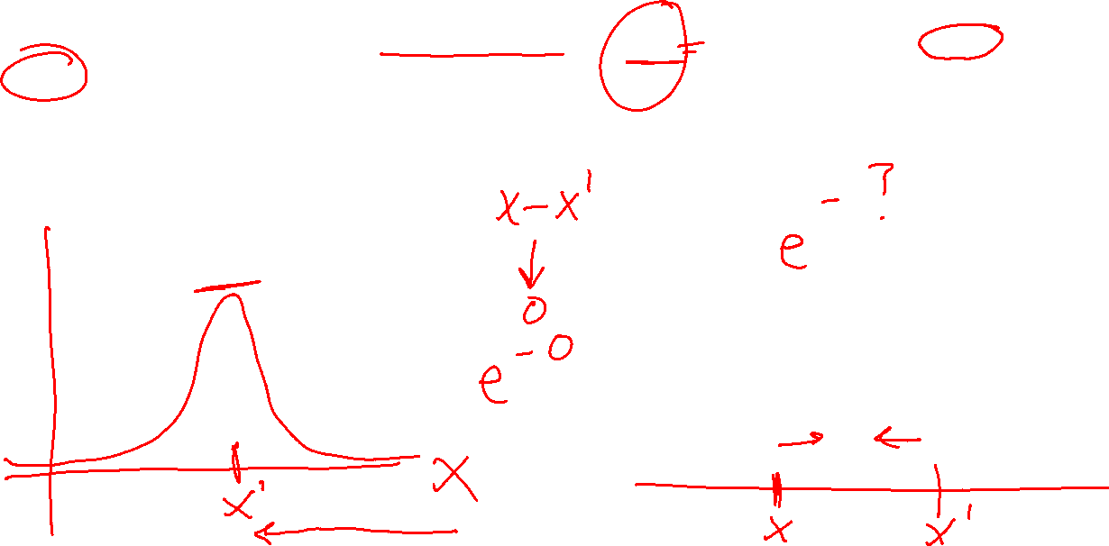
Poll 2
RBF Kernel function
$k\left(x, x′\right)=e^{\frac{{−\left\|x−x^{′}\right\|}_{2}^{2}}{2σ^{2}}}$
$=e^{{−γ\left\|x−x^{′}\right\|}_{2}^{2}}$
As x and x’ get closer the RBF function:
  Increases
  Decreases
  Stays the same
Notes:
0

Slide 20
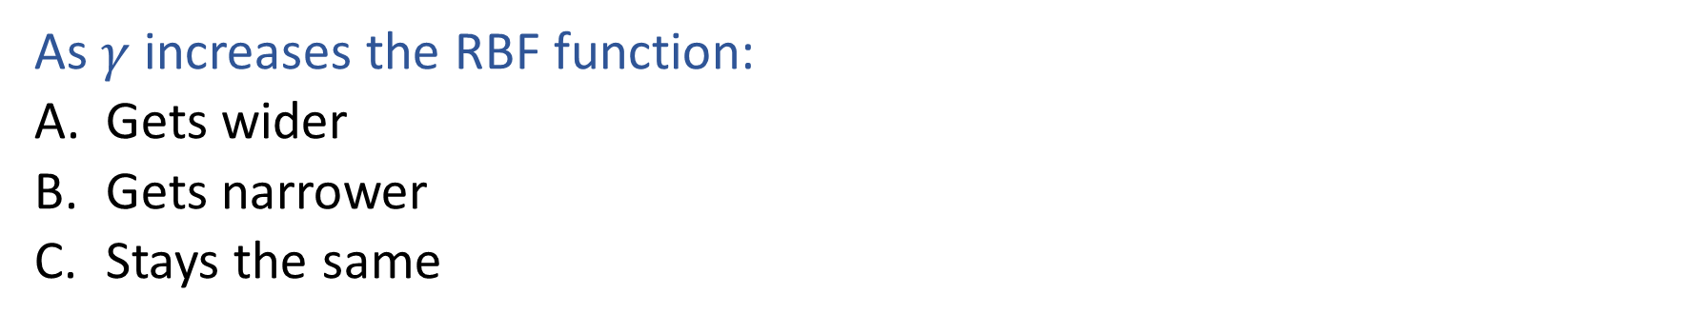
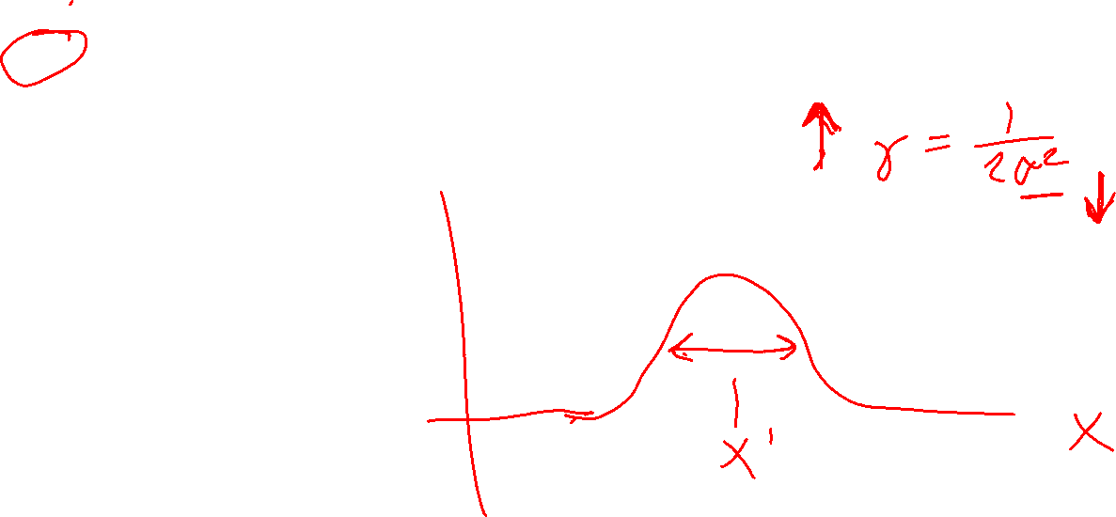
Poll 3
RBF Kernel function
$k\left(x, x′\right)=e^{\frac{{−\left\|x−x^{′}\right\|}_{2}^{2}}{2σ^{2}}}$
$=e^{{−γ\left\|x−x^{′}\right\|}_{2}^{2}}$
As $γ$ increases the RBF function:
  Gets wider
  Gets narrower
  Stays the same
Notes:
0

Slide 21
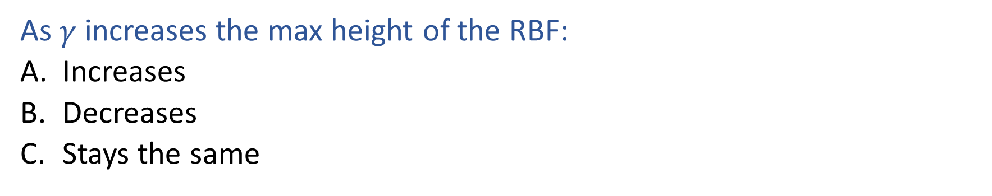
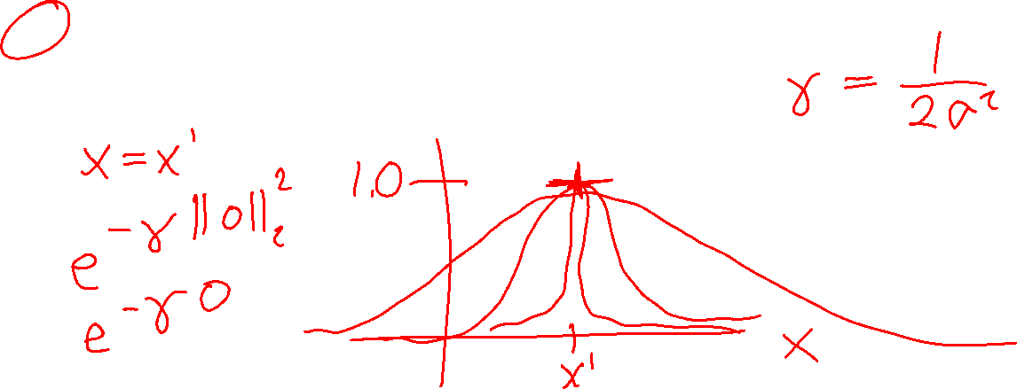
Poll 4
RBF Kernel function
$k\left(x, x′\right)=e^{\frac{{−\left\|x−x^{′}\right\|}_{2}^{2}}{2σ^{2}}}$
$=e^{{−γ\left\|x−x^{′}\right\|}_{2}^{2}}$
As $γ$ increases the max height of the RBF:
  Increases
  Decreases
  Stays the same
Notes:
0

Slide 22
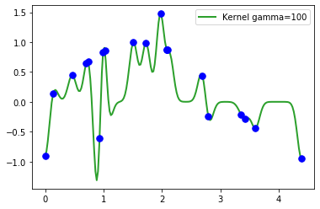
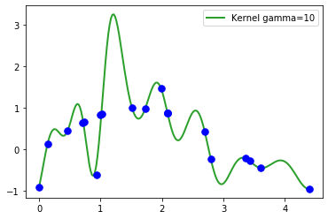
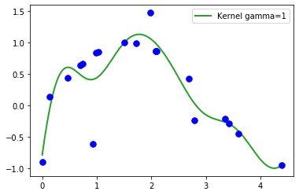
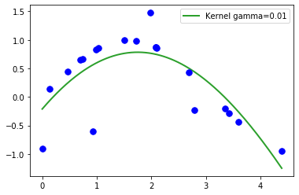
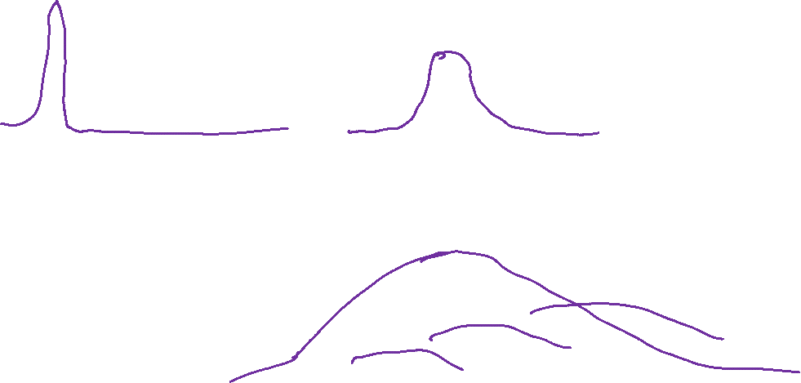

Kernel Regression

Slide 23
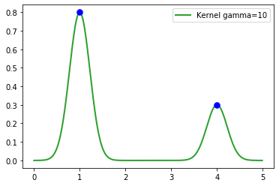
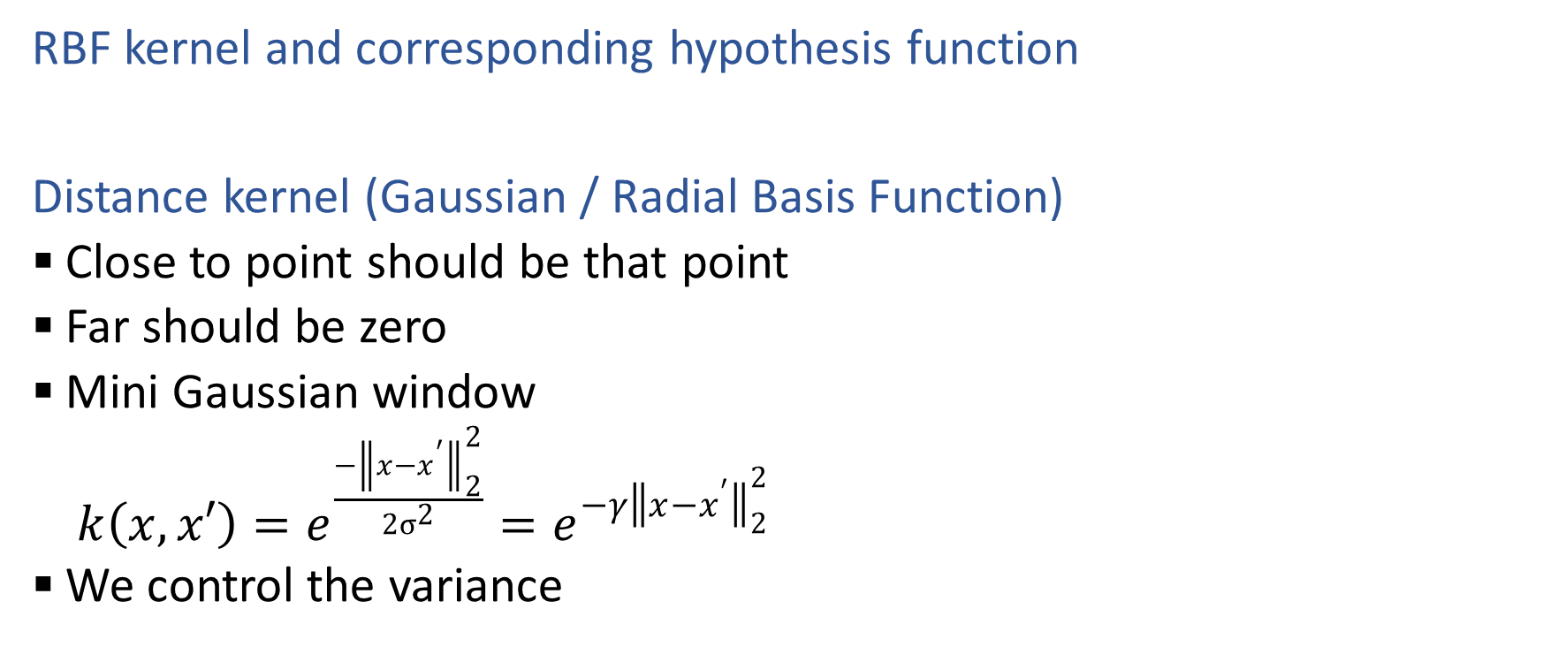

Kernel Regression
RBF kernel and corresponding hypothesis function
Distance kernel (Gaussian / Radial Basis Function)
  Close to point should be that point
  Far should be zero
  Mini Gaussian window
    $k\left(x, x′\right)=e^{\frac{{−\left\|x−x^{′}\right\|}_{2}^{2}}{2σ^{2}}}=e^{{−γ\left\|x−x^{′}\right\|}_{2}^{2}}$
  We control the variance

Slide 24
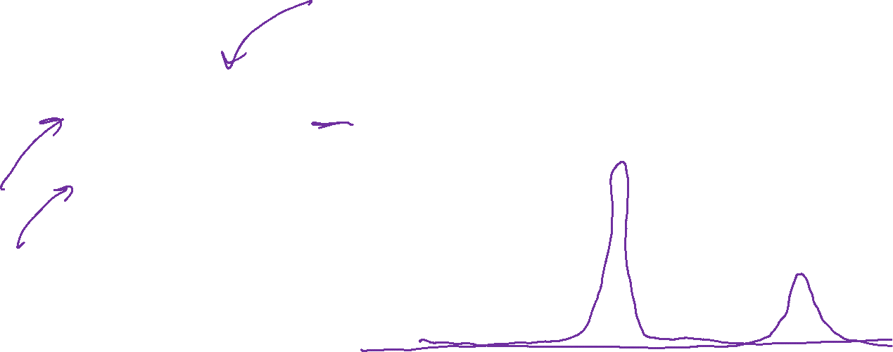
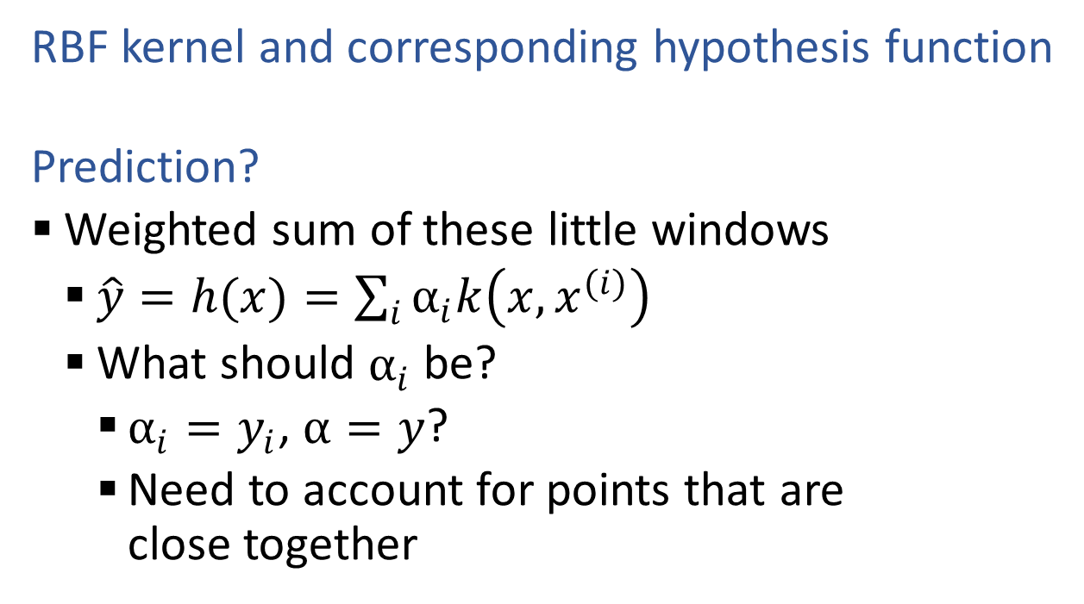

Kernel Regression
RBF kernel and corresponding hypothesis function
  Prediction?
  Weighted sum of these little windows
    $\hat{y}=h(x)=\sum_{i}{α_{i}k\left(x, x^{(i)}\right)}$
    What should $α_{i}$ be?
      $α_{i}=y_{i}$, $α=y$?
      Need to account for points that are close together

Slide 25
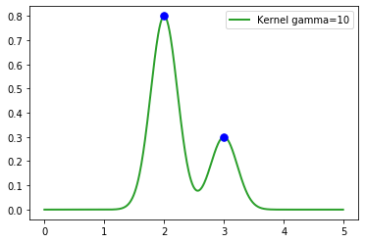

Kernel Regression
RBF kernel and corresponding hypothesis function
  Prediction?
  Weighted sum of these little windows
    $\hat{y}=h(x)=\sum_{i}{α_{i}k\left(x, x^{(i)}\right)}$
    What should $α_{i}$ be?
      $α_{i}=y_{i}$, $α=y$?
      Need to account for points that are close together

Slide 26
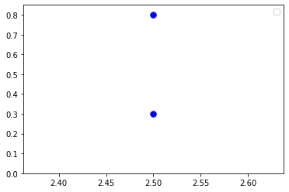
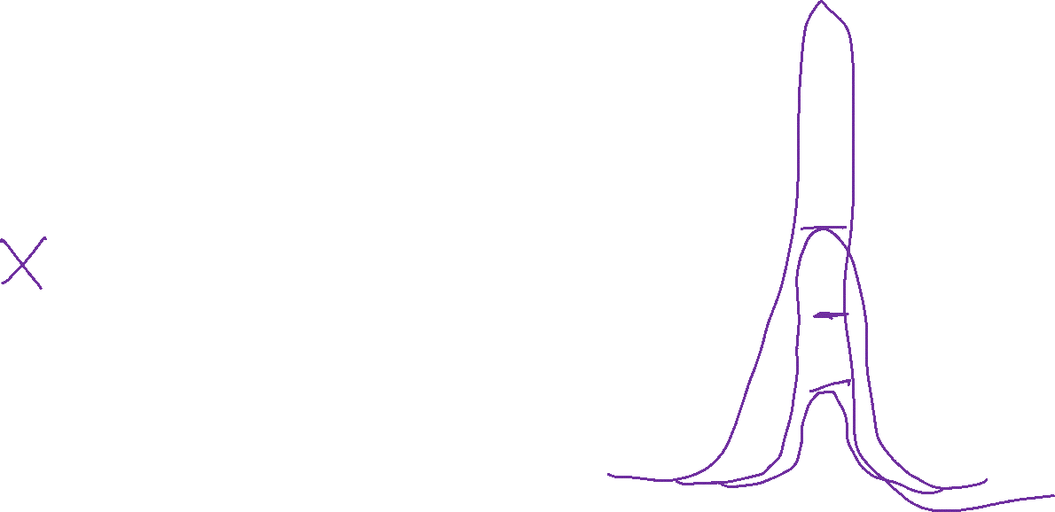
Kernel Regression
RBF kernel and corresponding hypothesis function
  Prediction?
  Weighted sum of these little windows
    $\hat{y}=h(x)=\sum_{i}{α_{i}k\left(x, x^{(i)}\right)}$
    What should $α_{i}$ be?
      $α_{i}=y_{i}$, $α=y$?
      Need to account for points that are close together

Slide 27
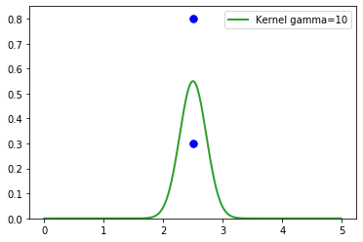
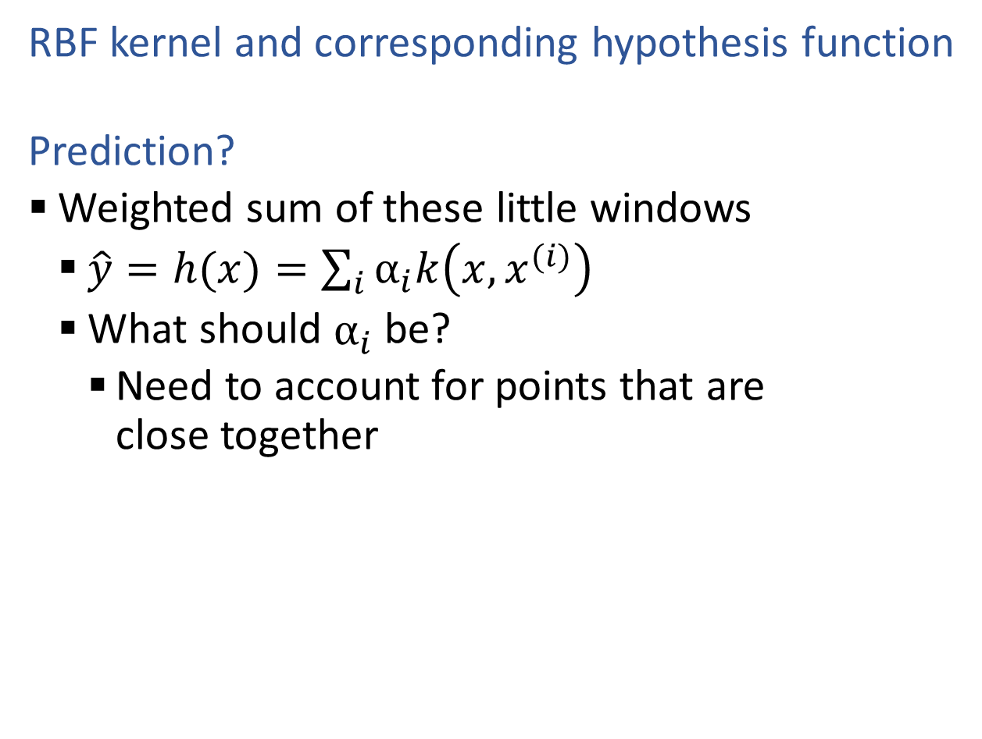
Kernel Regression
RBF kernel and corresponding hypothesis function
  Prediction?
  Weighted sum of these little windows
    $\hat{y}=h(x)=\sum_{i}{α_{i}k\left(x, x^{(i)}\right)}$
    What should $α_{i}$ be?
      Need to account for points that are close together

Slide 28
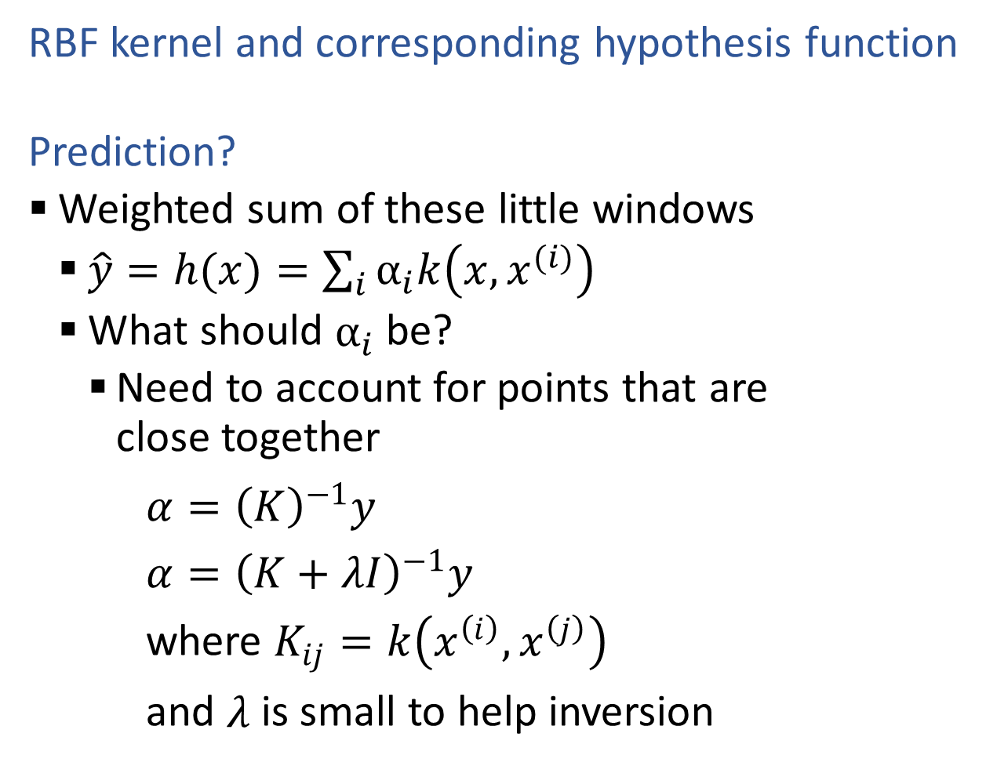
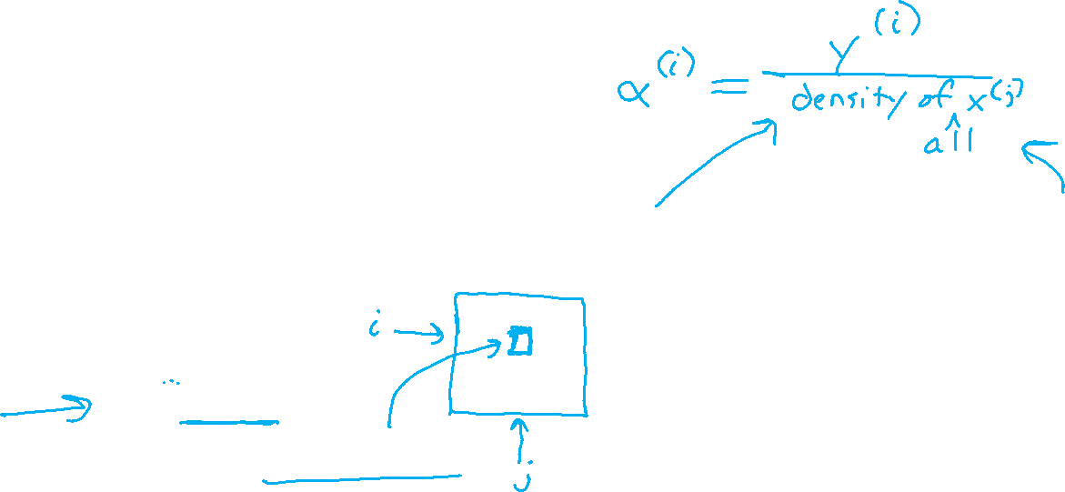
Kernel Regression
RBF kernel and corresponding hypothesis function
  Prediction?
  Weighted sum of these little windows
    $\hat{y}=h(x)=\sum_{i}{α_{i}k\left(x, x^{(i)}\right)}$
    What should $α_{i}$ be?
      Need to account for points that are close together
$α={\left(K\right)}^{−1}y$
$α={\left(K+λI\right)}^{−1}y$
where $K_{ij}=k\left(x^{\left(i\right)}, x^{\left(j\right)}\right)$
and $λ$ is small to help inversion

Slide 29
Kernelized Linear Regression

Slide 30
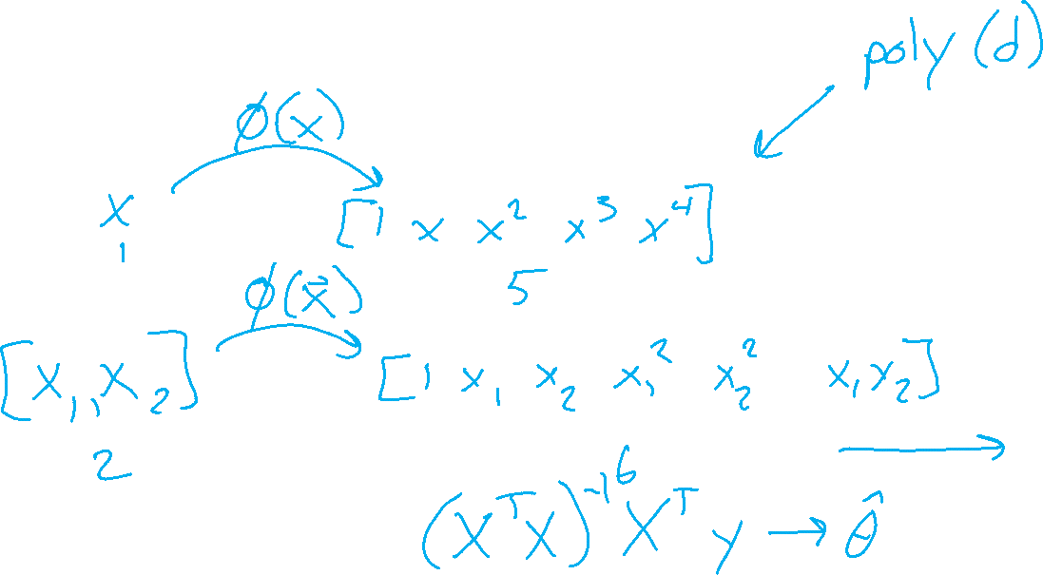
Reminder: Polynomial Linear Regression
Polynomial feature function

Slide 31
Reminder: Polynomial Linear Regression
Polynomial feature function
Least squares formulation
Least squares solution

Slide 32
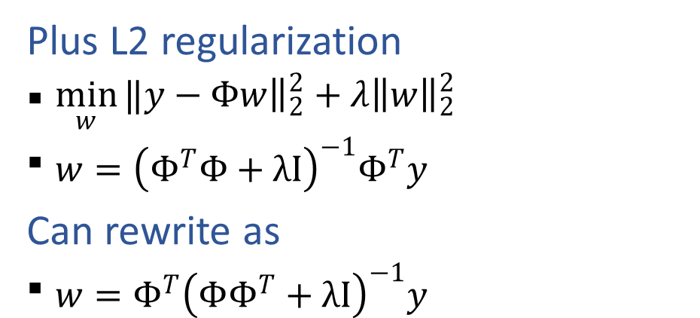
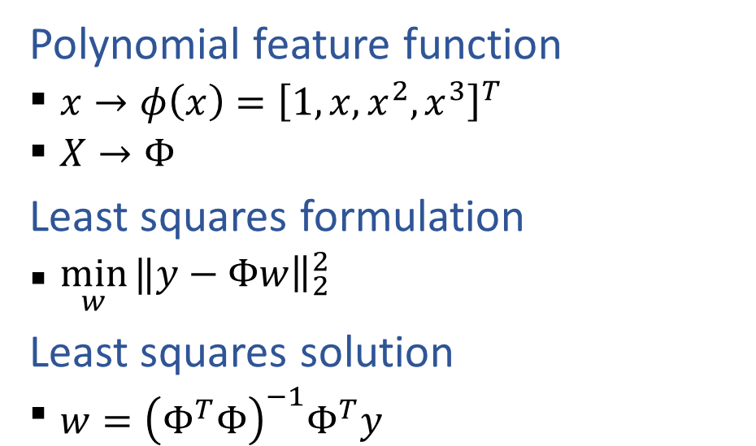
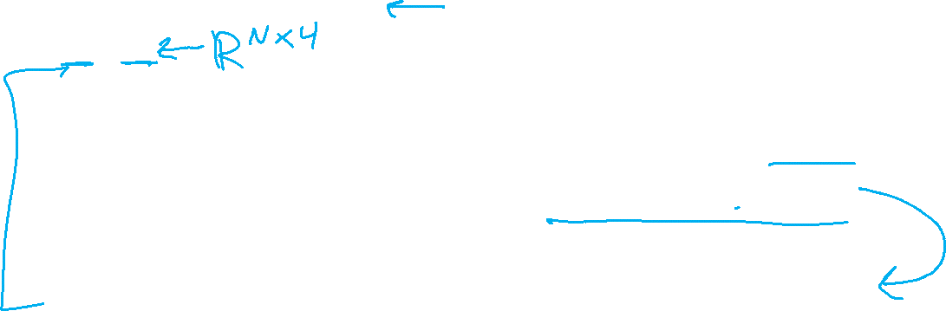
Reminder: Polynomial Linear Regression
Polynomial feature function
  $x→φ\left(x\right)={\left[1, x, x^{2}, x^{3}\right]}^{T}$
  $X→Φ$
Least squares formulation
  $\min_{w}{‖y−{\left.​Φw\right\|}_{2}^{2}}$
Least squares solution
  $w={\left(Φ^{T}Φ\right)}^{−1}Φ^{T}y$
Plus L2 regularization
  $\min_{w}{‖y−{\left.​Φw\right\|}_{2}^{2}}+λ{\left\|w\right\|}_{2}^{2}$
  $w={\left(Φ^{T}Φ+λI\right)}^{−1}Φ^{T}y$
Can rewrite as
  $w={Φ^{T}\left(ΦΦ^{T}+λI\right)}^{−1}y$

Slide 33

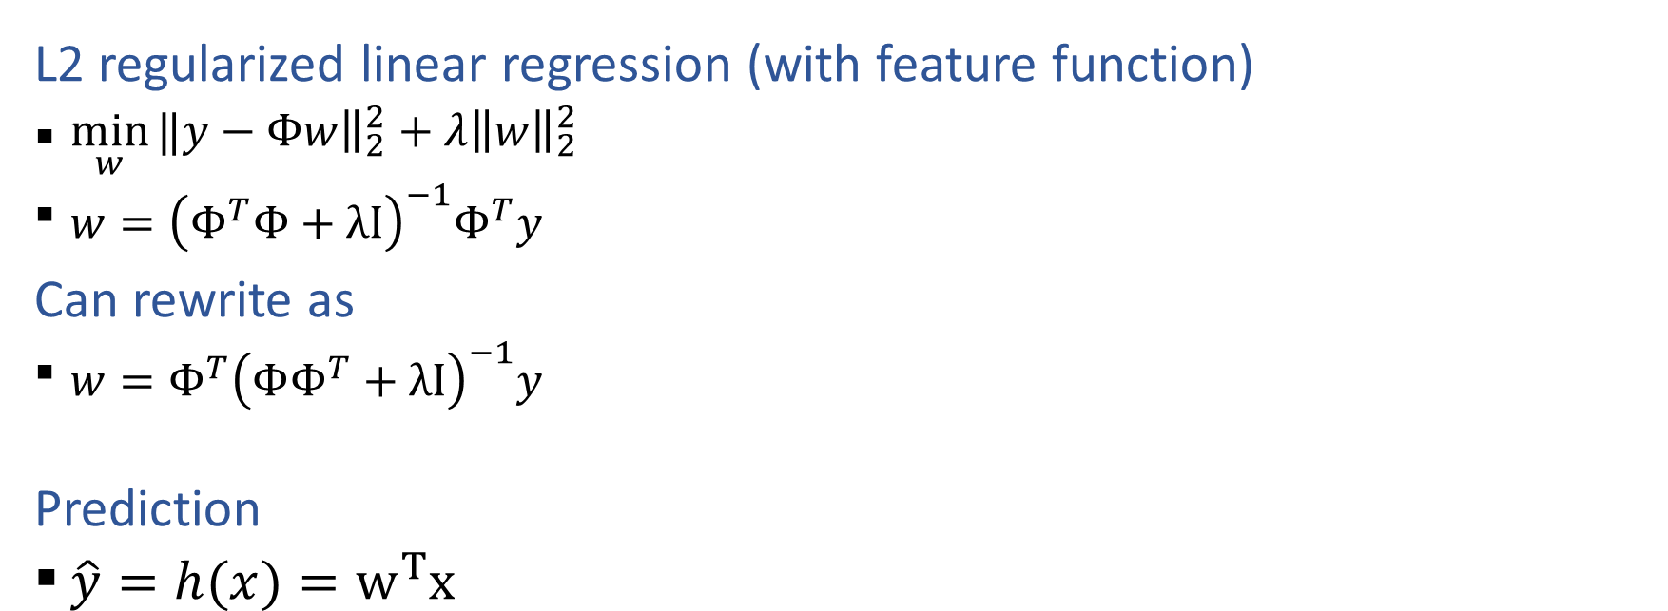
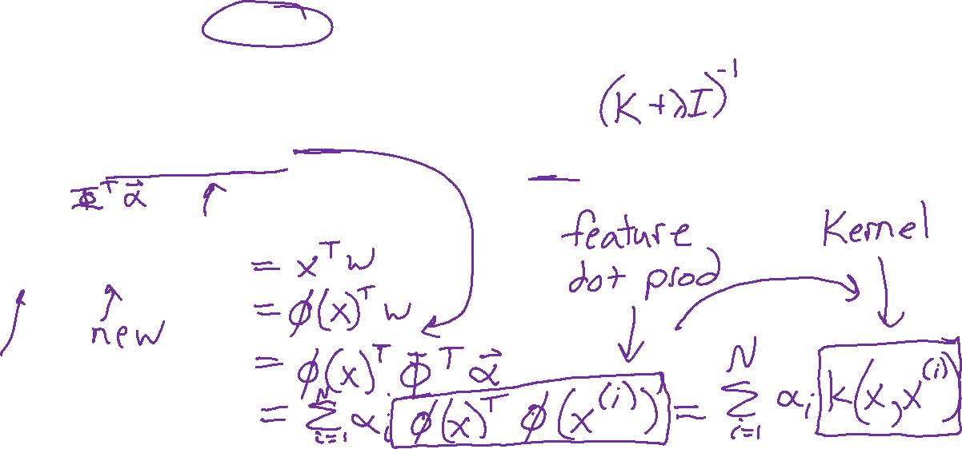
Kernelized Linear Regression
L2 regularized linear regression (with feature function)
  $\min_{w}{‖y−{\left.​Φw\right\|}_{2}^{2}}+λ{\left\|w\right\|}_{2}^{2}$
  $w={\left(Φ^{T}Φ+λI\right)}^{−1}Φ^{T}y$
Can rewrite as
  $w={Φ^{T}\left(ΦΦ^{T}+λI\right)}^{−1}y$
  Prediction
  $\hat{y}=h(x)=w^{T}x$
Let
  $α={\left(ΦΦ^{T}+λI\right)}^{−1}y$

Slide 34
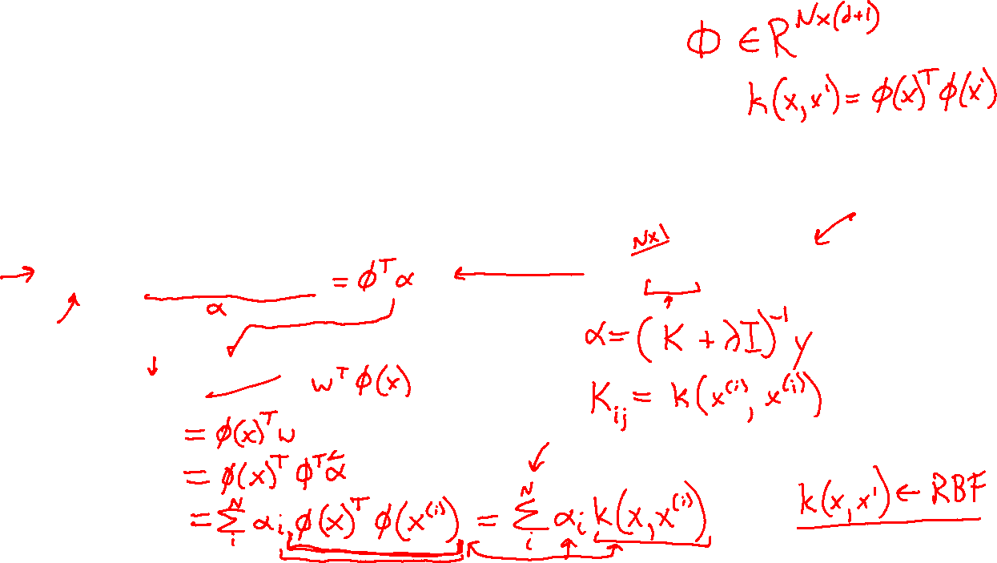
Kernelized Linear Regression
L2 regularized linear regression (with feature function)
  $\min_{w}{‖y−{\left.​Φw\right\|}_{2}^{2}}+λ{\left\|w\right\|}_{2}^{2}$
  $w={\left(Φ^{T}Φ+λI\right)}^{−1}Φ^{T}y$
Can rewrite as
  $w={Φ^{T}\left(ΦΦ^{T}+λI\right)}^{−1}y$
  Prediction
  $\hat{y}=h(x)=w^{T}x$
Let
  $α={\left(ΦΦ^{T}+λI\right)}^{−1}y$

Slide 35
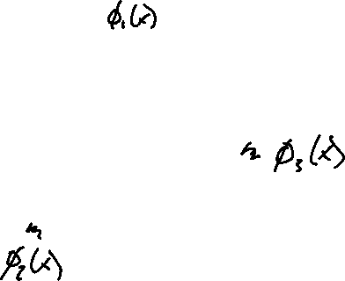
Example: Polynomial Kernel
https://www.youtube.com/watch?v=3liCbRZPrZA
Slide credit: CMU MLD Nina Balcan

Slide 36
Kernels: Motivation
Motivation #1: Inefficient Features
  Non-linearly separable data requires high dimensional representation
  Might be prohibitively expensive to compute or store
Motivation #2: Memory-based Methods
  k-Nearest Neighbors (KNN) for facial recognition allows a distance metric between images -- no need to worry about linearity restriction at all
Slide credit: CMU MLD Matt Gormley

Slide 37
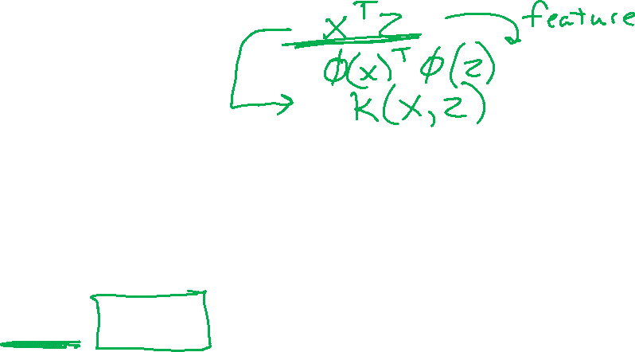
Kernel Methods
Key idea:
  Rewrite the algorithm so that we only work with dot products x^{T}z of feature vectors
  Replace the dot products x^{T}z with a kernel function k(x, z)
The kernel k(x,z) can be any legal definition of a dot product:
k(x, z) = φ(x) ^{T}φ(z) for any function φ: X → R^{D}
So we only compute the φ dot product implicitly
This “kernel trick” can be applied to many algorithms:
  classification: perceptron, SVM, …
  regression: ridge regression, …
  clustering: k-means, …
Slide credit: CMU MLD Matt Gormley

Slide 38
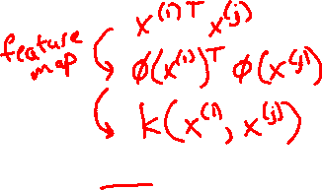
Kernel Methods
Key idea:
  Rewrite the algorithm so that we only work with dot products x^{T}z of feature vectors
  Replace the dot products x^{T}z with a kernel function k(x, z)
The kernel k(x,z) can be any legal definition of a dot product:
k(x, z) = φ(x) ^{T}φ(z) for any function φ: X → R^{D}
So we only compute the φ dot product implicitly
This “kernel trick” can be applied to many algorithms:
  classification: perceptron, SVM, …
  regression: ridge regression, …
  clustering: k-means, …
Slide credit: CMU MLD Matt Gormley

Slide 39
Kernel Methods
Q:
These are just non-linear features, right?
A:
Yes, but…
Q:
Can’t we just compute the feature transformation φ explicitly?
A:
That depends...
Slide credit: CMU MLD Matt Gormley
Q:
So, why all the hype about the kernel trick?
A:
Because the explicit features might either be prohibitively expensive to compute or infinite length vectors

Slide 40
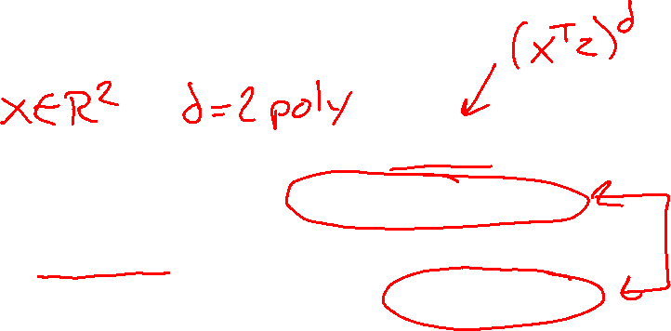
Example: Polynomial Kernel
Slide credit: CMU MLD Nina Balcan

Slide 41
Kernel Examples
Side Note: The feature space might not be unique!
Explicit representation #1:
Explicit representation #2:
These two different feature representations correspond to the same kernel function!
Slide credit: CMU MLD Nina Balcan

Slide 42

Kernel Examples
Name | Kernel Function (implicit dot product) | Feature Space (explicit dot product)
Linear |  | Same as original input space
Polynomial (v1) |  | All polynomials of degree d
Polynomial (v2) |  | All polynomials up to degree d
Gaussian (RBF) |  | Infinite dimensional space
Hyperbolic Tangent (Sigmoid) Kernel |  | (With SVM, this is equivalent to a 2-layer neural network)
Slide credit: CMU MLD Matt Gormley

