Slide 1


10-315
Introduction to ML
Decision Trees
Instructor: Pat Virtue

Slide 2
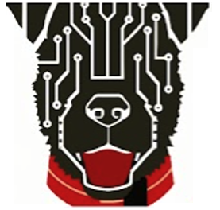
Today
Decision trees
K-Nearest Neighbor
Model Selection

Slide 3
Decision Tree
Fetal
Position
Medical Prediction
(Oversimplified example)
Vertex
Abnormal
Breech
Fetal
Distress
C-section
C-section
No
Yes
Previous
C-section
C-section
No
Yes
Natural
C-section

Slide 4
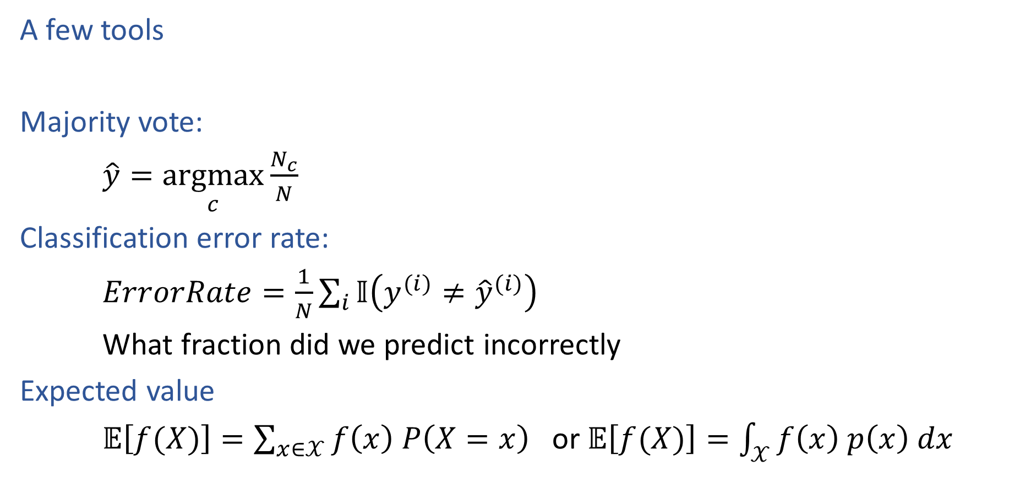
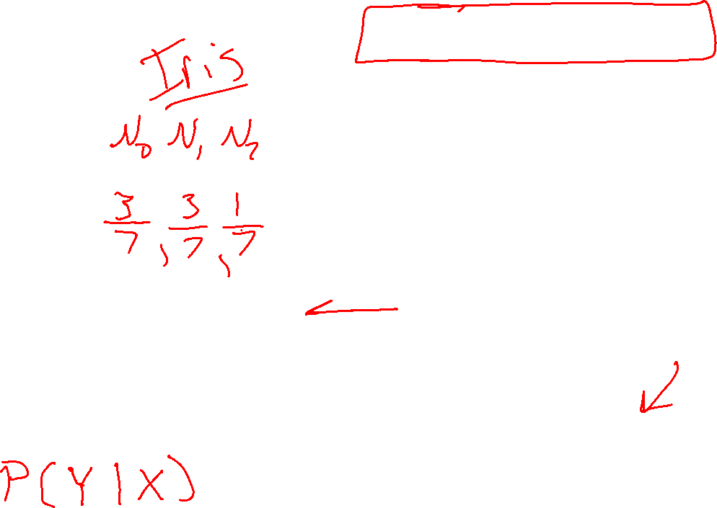
Decision Trees
Species | Sepal Length | Sepal Width | Petal Length | Petal Width
0 | 4.3 | 3.0 | 1.1 | 0.1
0 | 4.9 | 3.6 | 1.4 | 0.1
0 | 5.3 | 3.7 | 1.5 | 0.2
1 | 4.9 | 2.4 | 3.3 | 1.0
1 | 5.7 | 2.8 | 4.1 | 1.3
1 | 6.3 | 3.3 | 4.7 | 1.6
2 | 5.9 | 3.0 | 5.1 | 1.8
A few tools
Majority vote:
$\hat{y}=\underset{c}{argmax}{\frac{N_{c}}{N}}$
Classification error rate:
$ErrorRate=\frac{1}{N}\sum_{i}{𝕀\left(y^{(i)}≠{\hat{y}}^{(i)}\right)}$
What fraction did we predict incorrectly
Expected value
$𝔼\left[f(X)\right]=\sum_{x∈𝒳}{f\left(x\right) P\left(X=x\right)}$ or $𝔼\left[f(X)\right]=\int_{𝒳}{f\left(x\right) p\left(x\right) dx}$

Slide 5
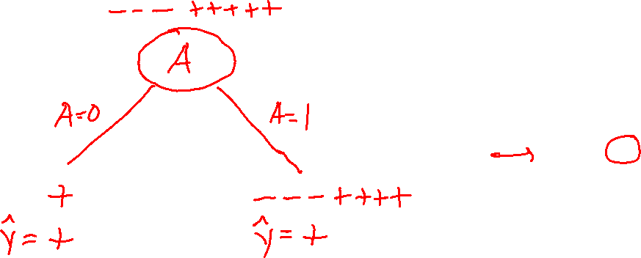
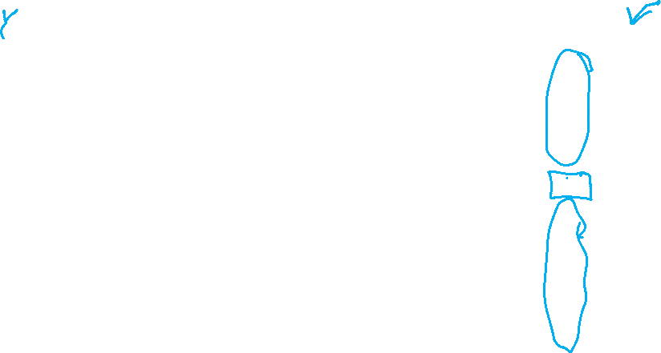
Decision Stumps
Split data based on a single attribute
Majority vote at leaves
Dataset:
Output Y, Attributes A, B, C
Y | A | B | C
- | 1 | 0 | 0
- | 1 | 0 | 1
- | 1 | 0 | o
+ | 0 | 0 | 1
+ | 1 | 1 | 0
+ | 1 | 1 | 1
+ | 1 | 1 | 0
+ | 1 | 1 | 1
Slide credit: CMU MLD Matt Gormley

Slide 6
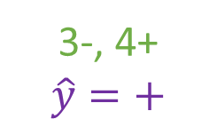
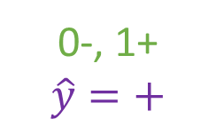
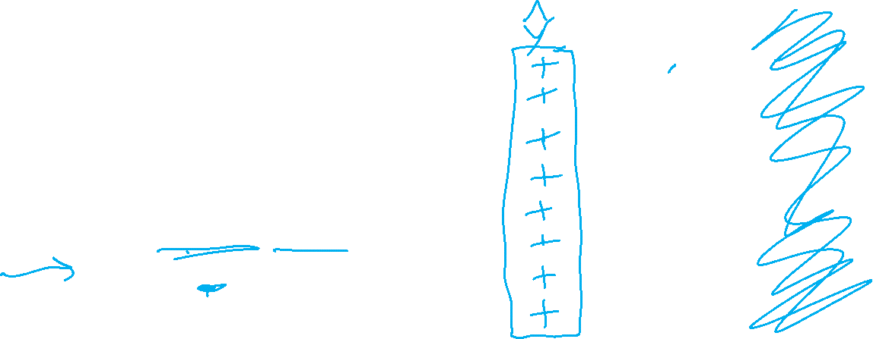
Decision Stumps
Split data based on a single attribute
Majority vote at leaves
Dataset:
Output Y, Attributes A, B, C
Y | A | B | C
- | 1 | 0 | 0
- | 1 | 0 | 1
- | 1 | 0 | o
+ | 0 | 0 | 1
+ | 1 | 1 | 0
+ | 1 | 1 | 1
+ | 1 | 1 | 0
+ | 1 | 1 | 1
3-, 5+
A
A=0
A=1
0-, 1+
$$\hat{y}=+$$
3-, 4+
$$\hat{y}=+$$
Error: ( 0 + 3 ) / 8
= 3/8
Slide credit: CMU MLD Matt Gormley

Slide 7
Poll 1
Splitting on which attribute {A, B, C} creates a decision stump with the lowest training error?
Dataset:
Output Y, Attributes A, B, C
Y | A | B | C
- | 1 | 0 | 0
- | 1 | 0 | 1
- | 1 | 0 | o
+ | 0 | 0 | 1
+ | 1 | 1 | 0
+ | 1 | 1 | 1
+ | 1 | 1 | 0
+ | 1 | 1 | 1
3-, 5+
A
A=0
A=1
0-, 1+
$$\hat{y}=+$$
3-, 4+
$$\hat{y}=+$$
Error: ( 0 + 3 ) / 8
= 3/8
Slide credit: CMU MLD Matt Gormley

Slide 8
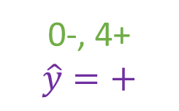
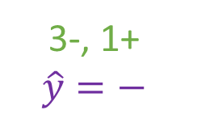

Poll 1
Splitting on which attribute {A, B, C} creates a decision stump with the lowest training error?
Answer: B
Dataset:
Output Y, Attributes A, B, C
Y | A | B | C
- | 1 | 0 | 0
- | 1 | 0 | 1
- | 1 | 0 | o
+ | 0 | 0 | 1
+ | 1 | 1 | 0
+ | 1 | 1 | 1
+ | 1 | 1 | 0
+ | 1 | 1 | 1
3-, 5+
B
B=0
B=1
3-, 1+
$$\hat{y}=−$$
0-, 4+
$$\hat{y}=+$$
Error: ( 1 + 0 ) / 8
= 1/8
Slide credit: CMU MLD Matt Gormley

Slide 9
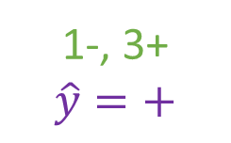
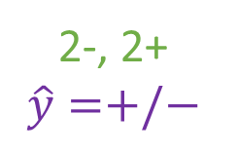
Poll 1
Splitting on which attribute {A, B, C} creates a decision stump with the lowest training error?
Answer: B
Dataset:
Output Y, Attributes A, B, C
Y | A | B | C
- | 1 | 0 | 0
- | 1 | 0 | 1
- | 1 | 0 | o
+ | 0 | 0 | 1
+ | 1 | 1 | 0
+ | 1 | 1 | 1
+ | 1 | 1 | 0
+ | 1 | 1 | 1
3-, 5+
C
C=0
C=1
2-, 2+
$$\hat{y}=+/−$$
1-, 3+
$$\hat{y}=+$$
Error: ( 2 + 1 ) / 8
= 3/8
Slide credit: CMU MLD Matt Gormley

Slide 10
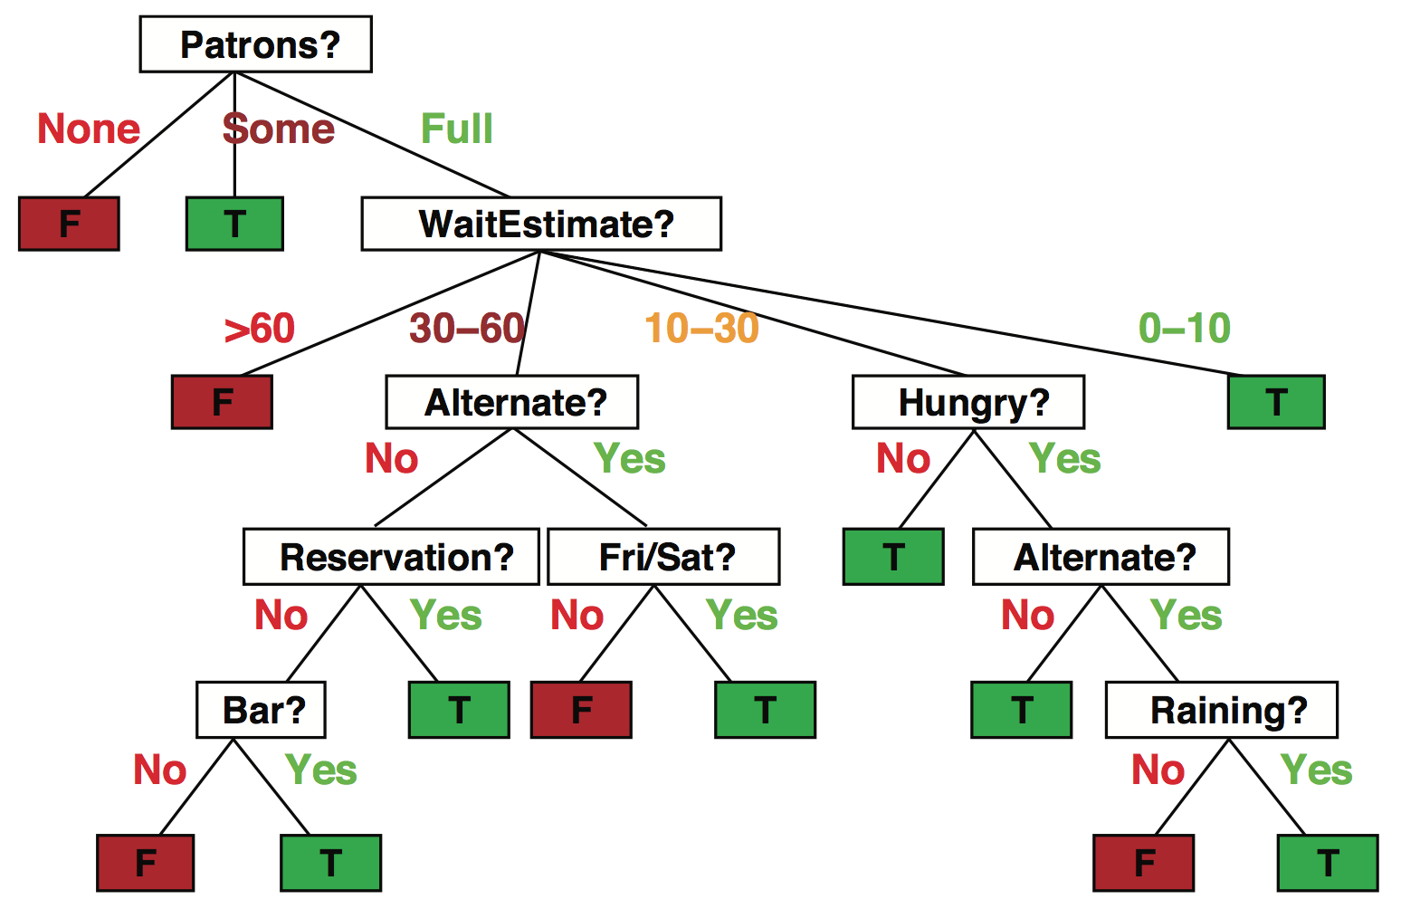
Decision trees
Popular representation for classifiers
  Even among humans!
I’ve just arrived at a restaurant: should I stay (and wait for a table) or go elsewhere?
Slide credit: ai.berkeley.edu

Slide 11
Decision trees
It’s Friday night and you’re hungry
You arrive at your favorite cheap but really cool happening burger place
It’s full and you have no reservation but there is a bar
The host estimates a 45 minute wait
There are alternatives nearby but it’s raining outside
Decision tree partitions the input space, assigns a label to each partition
Slide credit: ai.berkeley.edu

Slide 12

Problem Formulation
$x={\left[\begin{aligned}x_{1} \\ x_{2} \\ x_{3}\end{aligned}\right]=\left[x_{1},x_{2}, x_{3}\right]}^{T}$
$x_{1}∈\{Vertex, Breech, Abn\}$
$x_{2}∈\{Y,N\}$
$x_{3}∈\{Y,N\}$
$y∈\{Csection, Natural\}$
$\hat{y}=h(x)$
Medical Prediction
$Y$ $X_{1} X_{2}$ $X_{3}$
Outcome | Fetal Position | Fetal Distress | Previous C-sec
Natural | Vertex | N | N
C-section | Breech | N | N
Natural | Vertex | Y | Y
C-section | Vertex | N | Y
Natural | Abnormal | N | N

Slide 13
Decision Tree
Fetal
Position
Medical Prediction
(Oversimplified example)
Vertex
Abnormal
Breech
Fetal
Distress
C-section
C-section
No
Yes
Previous
C-section
C-section
No
Yes
Natural
C-section

Slide 14
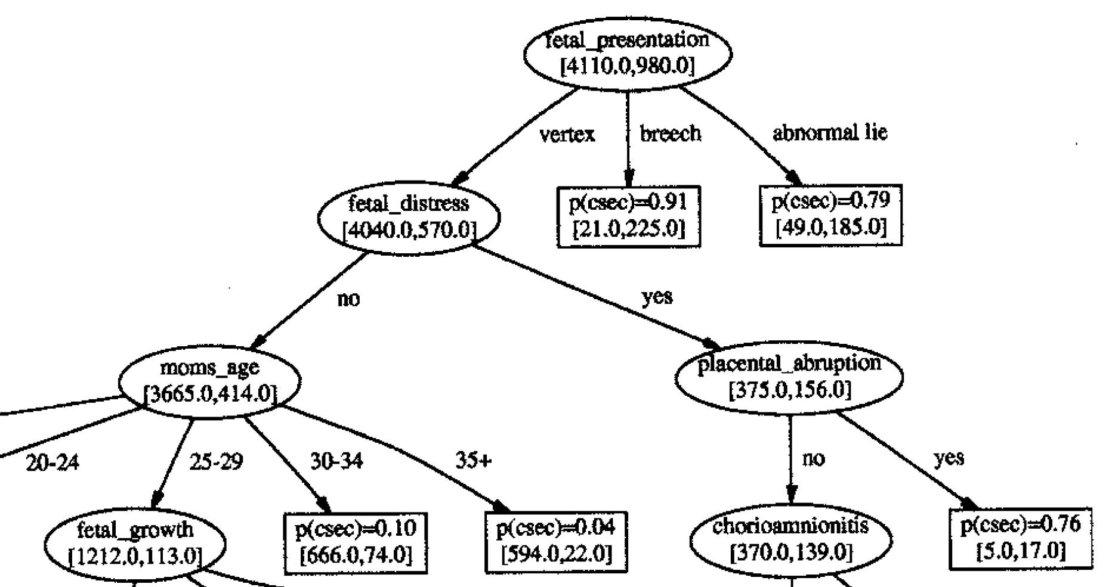
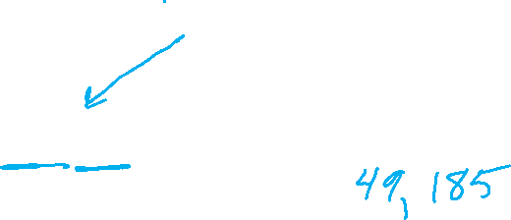
Tree to Predict C-Section Risk
Sims, C.J., Meyn, L., Caruana, R., Rao, R.B., Mitchell, T. and Krohn, M.
American journal of obstetrics and gynecology, 2000

Slide 15
Tree to Predict C-Section Risk
Slide credit: CMU MLD Tom Mitchell

Slide 16
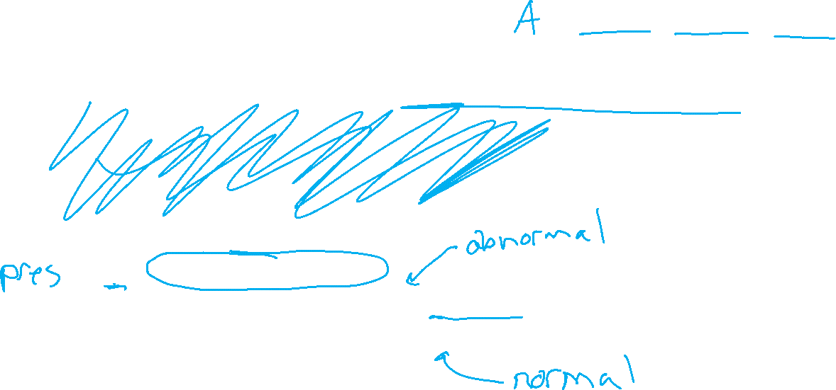
Building a Decision Tree
Function BuildTree(D,A)
# D: dataset at current node, A: current set of attributes
If empty(A) or all labels in D are the same
# Leaf node
class = most common class in D
else
# Internal node
a ⇐ bestAttribute(D,A)
LeftNode = BuildTree(D(a=1), A \ {a})
RightNode = BuildTree(D(a=0), A \ {a})
end
end

Slide 17
Poll 2
Dataset:
Output Y, Attributes A, B, C
Which of the following trees would be learned by the decision tree learning algorithm using “error rate” as the splitting criterion?
(Assume ties are broken alphabetically.)
Y | A | B | C
+ | 0 | 0 | 0
+ | 0 | 0 | 1
- | 0 | 1 | 0
+ | 0 | 1 | 1
- | 1 | 0 | 0
- | 1 | 0 | 1
- | 1 | 1 | 0
+ | 1 | 1 | 1
1
A
2
A
3
A
0
1
0
1
0
1
C
C
B
C
B
B
0
1
0
1
0
1
0
1
0
1
0
1
+
-
-
+
+
-
-
+
+
C
-
C
0
1
0
1
4
C
5
B
-
+
-
+
0
1
0
1
6
B
B
A
A
C
0
1
0
1
0
1
0
1
0
1
A
A
+
-
-
+
+
-
-
+
0
1
0
1
+
-
C
C
0
1
0
1
+
-
-
+
Slide credit: CMU MLD Matt Gormley

Slide 18
Poll 2
Dataset:
Output Y, Attributes A, B, C
Which of the following trees would be learned by the the decision tree learning algorithm using “error rate” as the splitting criterion?
(Assume ties are broken alphabetically.)
Y | A | B | C
+ | 0 | 0 | 0
+ | 0 | 0 | 1
- | 0 | 1 | 0
+ | 0 | 1 | 1
- | 1 | 0 | 0
- | 1 | 0 | 1
- | 1 | 1 | 0
+ | 1 | 1 | 1
1
A
2
A
3
A
0
1
0
1
0
1
C
C
B
C
B
B
0
1
0
1
0
1
0
1
0
1
0
1
+
-
-
+
+
-
-
+
+
C
-
C
0
1
0
1
4
C
5
B
-
+
-
+
0
1
0
1
6
B
B
A
A
C
0
1
0
1
0
1
0
1
0
1
A
A
+
-
-
+
+
-
-
+
0
1
0
1
+
-
C
C
0
1
0
1
+
-
-
+
Slide credit: CMU MLD Matt Gormley

Slide 19
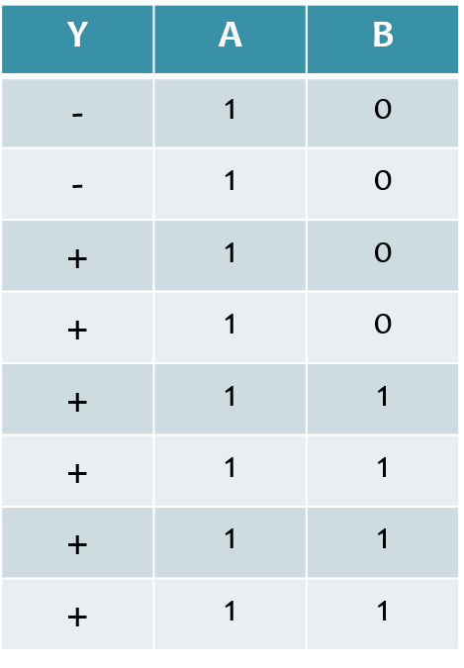
Poll 3
Dataset:
Output Y, Attributes A and B
Which attribute {A, B} would error rate select for the next split?
A
B
A or B (tie)
I don’t know
Slide credit: CMU MLD Matt Gormley

Slide 20
Poll 3
Dataset:
Output Y, Attributes A and B
Which attribute {A, B} would error rate select for the next split?
A
B
A or B (tie)
I don’t know
Slide credit: CMU MLD Matt Gormley

Slide 21
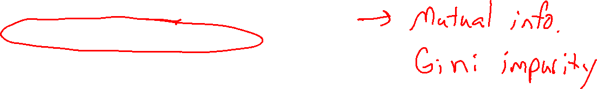
Building a Decision Tree
Function BuildTree(D,A)
# D: dataset at current node, A: current set of attributes
If empty(A) or all labels in D are the same
# Leaf node
class = most common class in D
else
# Internal node
a ⇐ bestAttribute(D,A)
LeftNode = BuildTree(D(a=1), A \ {a})
RightNode = BuildTree(D(a=0), A \ {a})
end
end

Slide 22
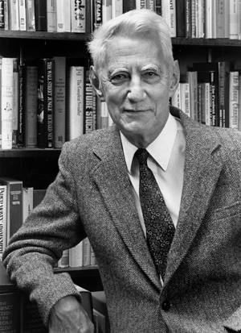
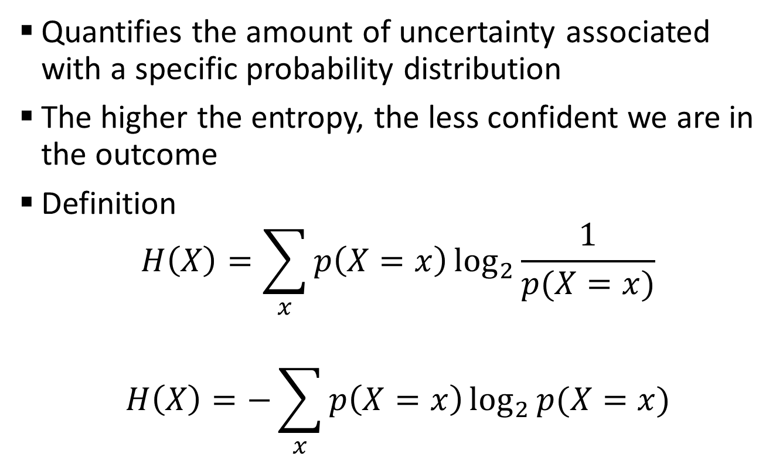
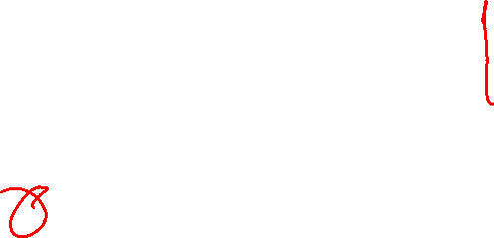
Entropy
Quantifies the amount of uncertainty associated with a specific probability distribution
The higher the entropy, the less confident we are in the outcome
Definition
$$H\left(X\right)=\sum_{x}{p\left(X=x\right)\log_{2}{\frac{1}{p(X=x)}}}$$
$$H\left(X\right)=−\sum_{x}{p\left(X=x\right)\log_{2}{p(X=x)}}$$
Claude Shannon (1916 – 2001), most of the work was done in Bell labs

Slide 23
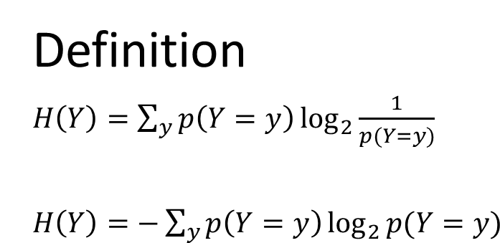
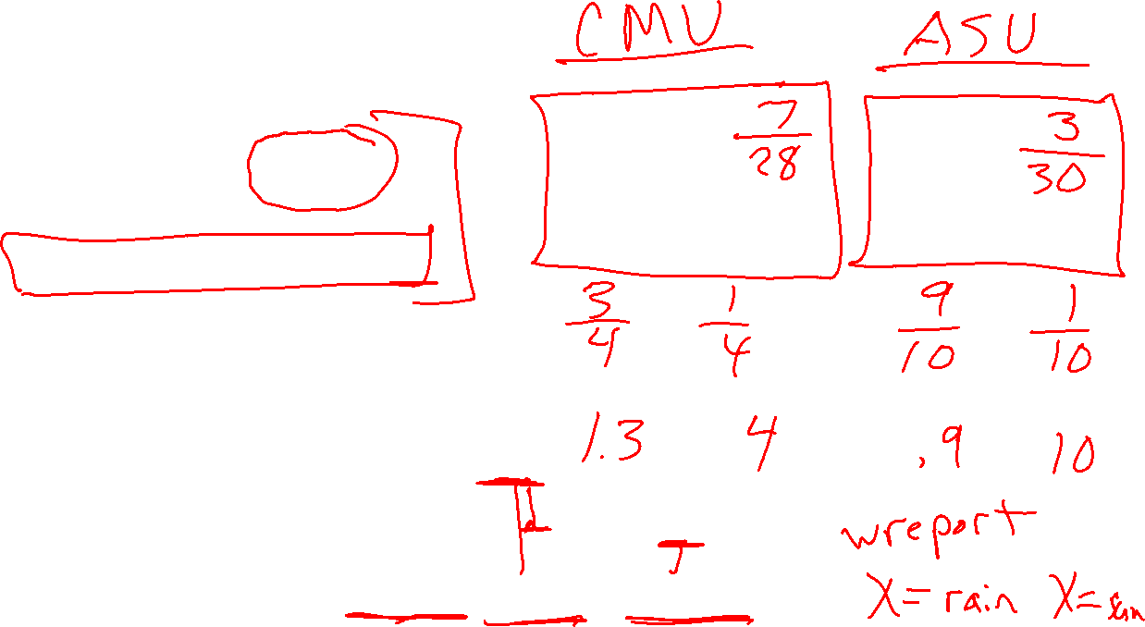
Entropy
Definition
$H\left(Y\right)=\sum_{y}{p\left(Y=y\right)\log_{2}{\frac{1}{p(Y=y)}}}$
$H\left(Y\right)=−\sum_{y}{p\left(Y=y\right)\log_{2}{p(Y=y)}}$

Slide 24
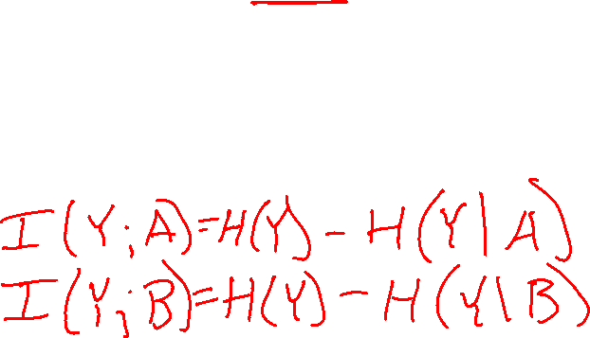
Mutual Information
Slide credit: CMU MLD Matt Gormley
Notes:
In the preamble: \usepackage[fleqn]{amsmath}
Entropy:
\begin{align*} H(Y) = - \sum_{y \in \Yc} P(Y=y) \log_2 P(Y=y) \end{align*}
Specific Conditional Entropy:
\begin{align*} H(Y \mid X=x) = - \sum_{y \in \Yc} P(Y=y \mid X=x) \log_2 P(Y=y \mid X=x) \end{align*}
Conditional Entropy:
\begin{align*} H(Y \mid X) = \sum_{x \in \Xc} P(X=x) H(Y \mid X=x) \end{align*}
Mutual Information:
\begin{align*} I(Y; X) = H(Y) - H(Y|X) = H(X) - H(X|Y) \end{align*}

Slide 25
Mutual Information
Slide credit: CMU MLD Matt Gormley
For a decision tree, we can use mutual information of the output class Y and some attribute X on which to split as a splitting criterion
Given a dataset D of training examples, we can estimate the required probabilities as…
Notes:
In the preamble: \usepackage[fleqn]{amsmath}
Entropy:
\begin{align*} H(Y) = - \sum_{y \in \Yc} P(Y=y) \log_2 P(Y=y) \end{align*}
Specific Conditional Entropy:
\begin{align*} H(Y \mid X=x) = - \sum_{y \in \Yc} P(Y=y \mid X=x) \log_2 P(Y=y \mid X=x) \end{align*}
Conditional Entropy:
\begin{align*} H(Y \mid X) = \sum_{x \in \Xc} P(X=x) H(Y \mid X=x) \end{align*}
Mutual Information:
\begin{align*} I(Y; X) = H(Y) - H(Y|X) = H(X) - H(X|Y) \end{align*}

Slide 26
Mutual Information
Entropy measures the expected # of bits to code one random draw from X.
For a decision tree, we want to reduce the entropy of the random variable we are trying to predict!
Slide credit: CMU MLD Matt Gormley
For a decision tree, we can use mutual information of the output class Y and some attribute X on which to split as a splitting criterion
Given a dataset D of training examples, we can estimate the required probabilities as…
Conditional entropy is the expected value of specific conditional entropy E_{P(X=x)}[H(Y | X = x)]
Informally, we say that mutual information is a measure of the following: If we know X, how much does this reduce our uncertainty about Y?
Notes:
In the preamble: \usepackage[fleqn]{amsmath}
Entropy:
\begin{align*} H(Y) = - \sum_{y \in \Yc} P(Y=y) \log_2 P(Y=y) \end{align*}
Specific Conditional Entropy:
\begin{align*} H(Y \mid X=x) = - \sum_{y \in \Yc} P(Y=y \mid X=x) \log_2 P(Y=y \mid X=x) \end{align*}
Conditional Entropy:
\begin{align*} H(Y \mid X) = \sum_{x \in \Xc} P(X=x) H(Y \mid X=x) \end{align*}
Mutual Information:
\begin{align*} I(Y; X) = H(Y) - H(Y|X) = H(X) - H(X|Y) \end{align*}

Slide 27
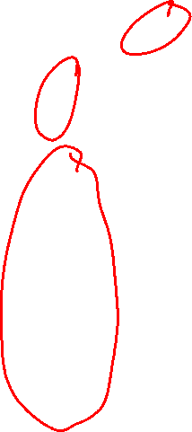
Splitting with Mutual Information
Which attribute {A, B} would mutual information select for the next split?
A
B
A or B (tie)
I don’t know
Dataset:
Output Y, Attributes A and B

Slide 28
Decision Tree Learning Example
Y | A | B
- | 1 | 0
- | 1 | 0
+ | 1 | 0
+ | 1 | 0
+ | 1 | 1
+ | 1 | 1
+ | 1 | 1
+ | 1 | 1
Slide credit: CMU MLD Matt Gormley

Slide 29
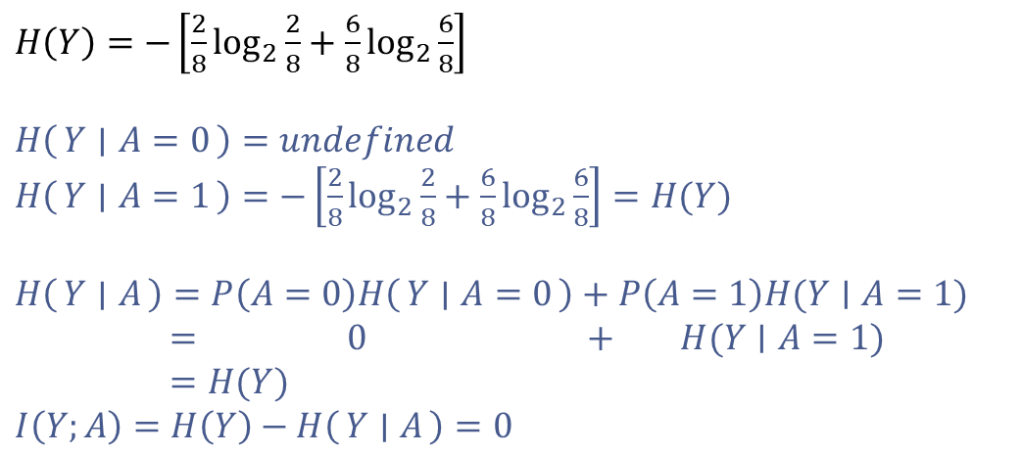
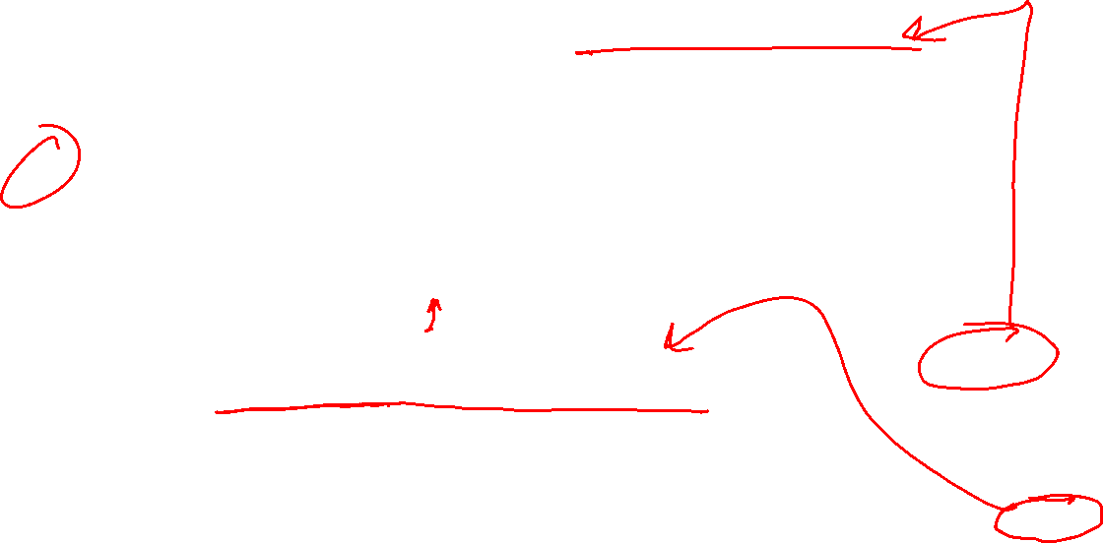
Decision Tree Learning Example
Y | A | B
- | 1 | 0
- | 1 | 0
+ | 1 | 0
+ | 1 | 0
+ | 1 | 1
+ | 1 | 1
+ | 1 | 1
+ | 1 | 1
$H\left(Y\right)=−\left[\frac{2}{8}\log_{2}{\frac{2}{8}}+\frac{6}{8}\log_{2}{\frac{6}{8}}\right]$
$H\left(Y ∣ A=0\right)=undefined$
$H\left(Y ∣ A=1\right)=−\left[\frac{2}{8}\log_{2}{\frac{2}{8}}+\frac{6}{8}\log_{2}{\frac{6}{8}}\right]=H(Y)$
$H\left(Y ∣ A\right)=P\left(A=0\right)H\left(Y ∣ A=0\right)+P\left(A=1\right)H(Y∣A=1)$
$= 0 + H(Y∣A=1)$
$=H(Y)$
$I\left(Y;A\right)=H\left(Y\right)−H\left(Y ∣ A\right)=0$
[2-, 6+]
A
A=0
A=1
[0-, 0+]
P(A=0) = 0
[2-, 6+]
P(A=1)=1
Slide credit: CMU MLD Matt Gormley

Slide 30
Decision Tree Learning Example
Y | A | B
- | 1 | 0
- | 1 | 0
+ | 1 | 0
+ | 1 | 0
+ | 1 | 1
+ | 1 | 1
+ | 1 | 1
+ | 1 | 1
[2-, 6+]
B
B=0
B=1
[2-, 2+]
P(B=0)=4/8
[0-, 4+]
P(B=1)=4/8
Slide credit: CMU MLD Matt Gormley

Slide 31
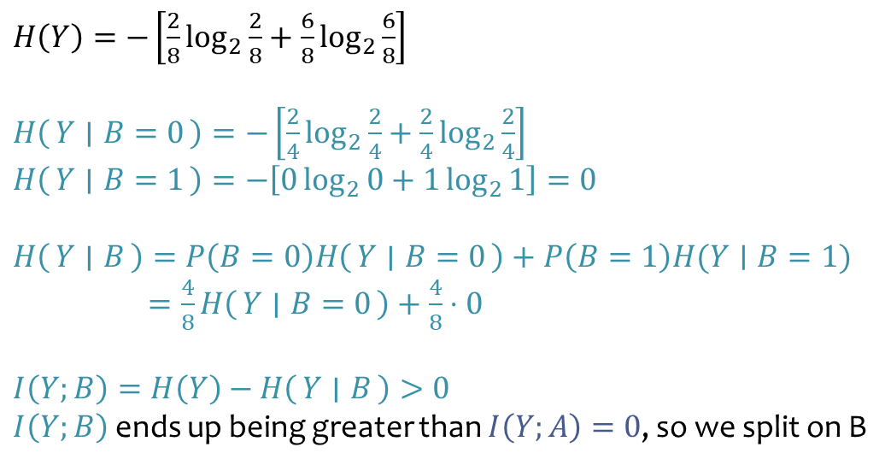
Decision Tree Learning Example
Y | A | B
- | 1 | 0
- | 1 | 0
+ | 1 | 0
+ | 1 | 0
+ | 1 | 1
+ | 1 | 1
+ | 1 | 1
+ | 1 | 1
$H\left(Y\right)=−\left[\frac{2}{8}\log_{2}{\frac{2}{8}}+\frac{6}{8}\log_{2}{\frac{6}{8}}\right]$
$H\left(Y ∣ B=0\right)=−\left[\frac{2}{4}\log_{2}{\frac{2}{4}}+\frac{2}{4}\log_{2}{\frac{2}{4}}\right]$
$H\left(Y ∣ B=1\right)=−\left[0\log_{2}{0}+1\log_{2}{1}\right]=0$
$H\left(Y ∣ B\right)=P\left(B=0\right)H\left(Y ∣ B=0\right)+P\left(B=1\right)H(Y∣B=1)$
$=\frac{4}{8}H\left(Y ∣ B=0\right)+\frac{4}{8}⋅0$
$I\left(Y;B\right)=H\left(Y\right)−H\left(Y ∣ B\right)>0$
$I\left(Y;B\right)$ ends up being greater than $I\left(Y;A\right)=0$, so we split on B
[2-, 6+]
B
B=0
B=1
[2-, 2+]
P(B=0)=4/8
[0-, 4+]
P(B=1)=4/8
Slide credit: CMU MLD Matt Gormley

Slide 32
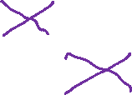
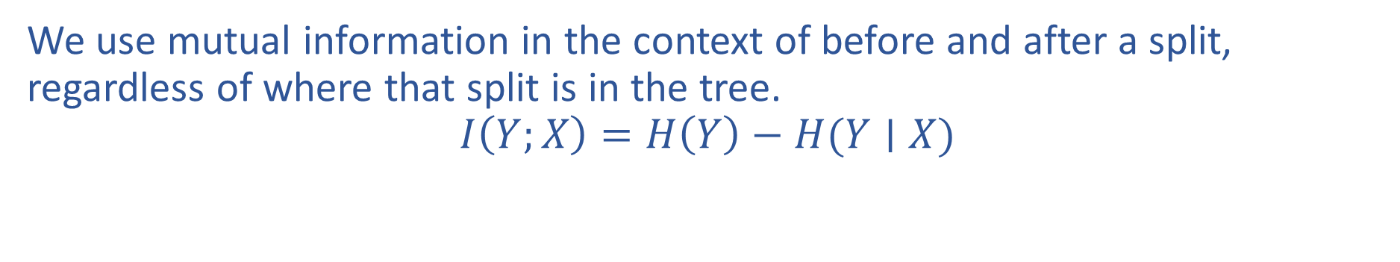
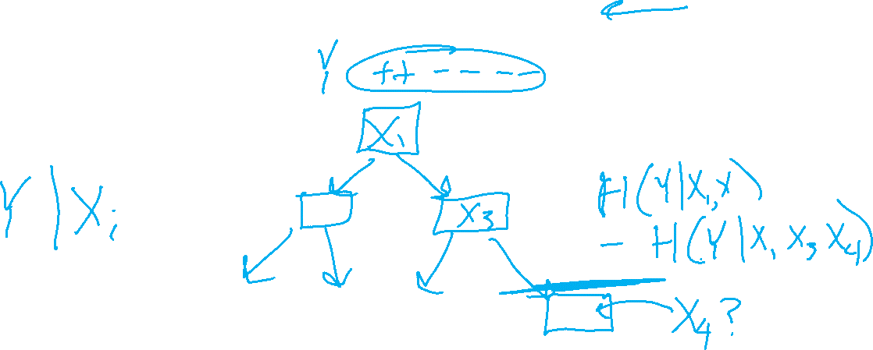
Mutual Information Notation
We use mutual information in the context of before and after a split, regardless of where that split is in the tree.
$$I\left(Y;X\right)=H\left(Y\right)−H(Y∣X)$$

