Slide 1

10-315
Introduction to ML
Nearest Neighbor and
Model Selection
Instructor: Pat Virtue

Slide 2

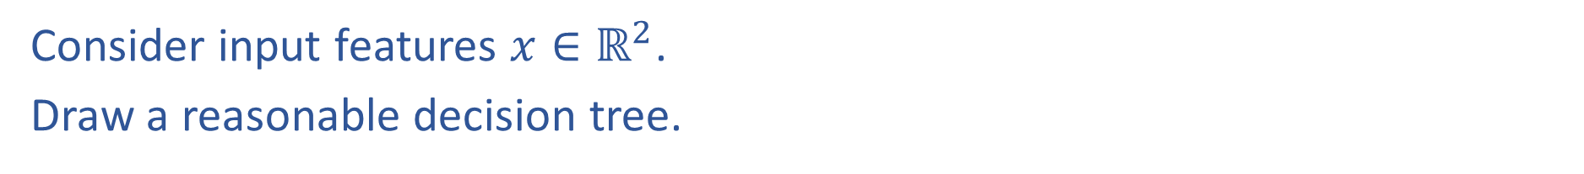
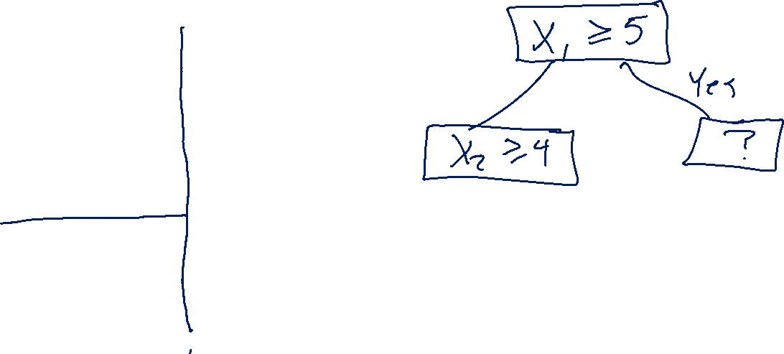

Decision Trees with Continuous Features
Consider input features $x∈ℝ^{2}$.
Draw a reasonable decision tree.
$$x_{2}$$
10
5
$$x_{1}$$
5
10

Slide 3
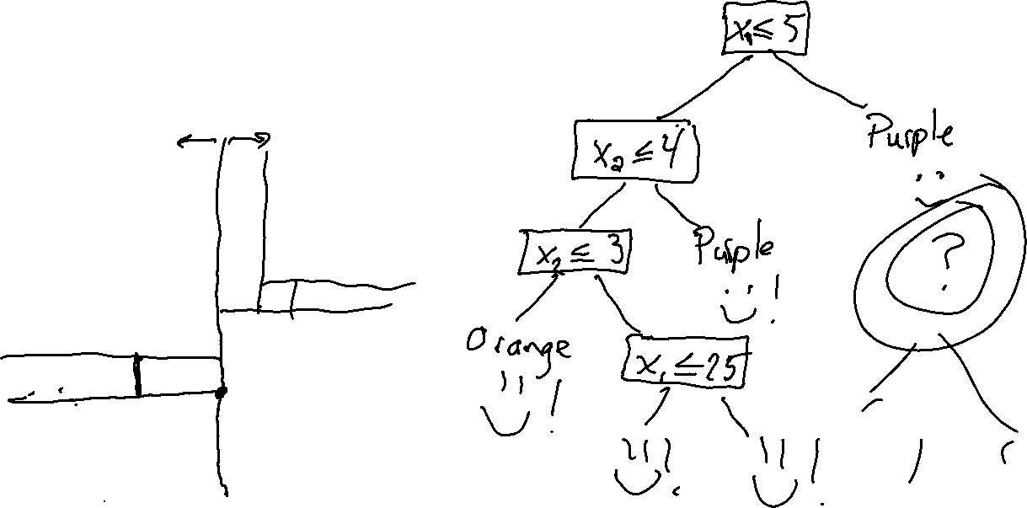
Decision Trees with Continuous Features
Consider input features $x∈ℝ^{2}$.
Draw a reasonable decision tree.
$$x_{2}$$
10
5
$$x_{1}$$
5
10

Slide 4
Poll 1
Decision tree generalization
Which of the following generalize best to unseen examples?
Small tree with low training accuracy
Large tree with low training accuracy
Small tree with high training accuracy
Large tree with high training accuracy

Slide 5
Poll 1
Decision tree generalization
Which of the following generalize best to unseen examples?
Small tree with low training accuracy
Large tree with low training accuracy
Small tree with high training accuracy
Large tree with high training accuracy

Slide 6
Poll 2
True or False:
For any dataset, you can find a decision tree that can perfectly classify the training data?

Slide 7
Nearest Neighbor Classifier
Test subject
Whales
Seals
Sharks

Slide 8
Nearest Neighbor Classifier
Test subject
Whales
Seals
Sharks

Slide 9
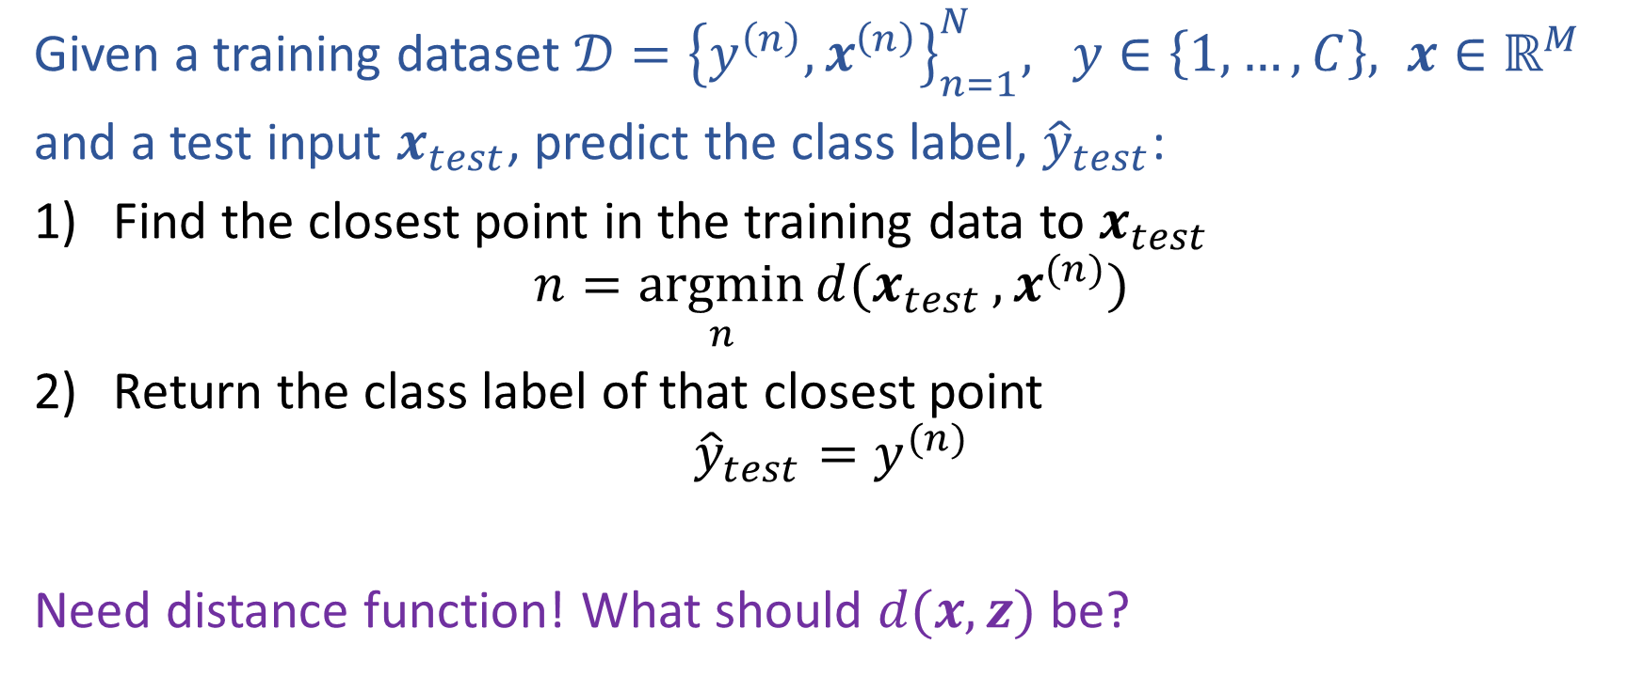

Nearest Neighbor Classification
Given a training dataset $𝒟={\left\{y^{\left(n\right)}, x^{\left(n\right)}\right\}}_{n=1}^{N}, y∈\left\{1,…,C\right\}, x∈ℝ^{M}$
and a test input $x_{test}$, predict the class label, ${\hat{y}}_{test}$:
Find the closest point in the training data to $x_{test}$
$$n=\underset{n}{argmin}{d(x_{test}}, x^{(n)})$$
Return the class label of that closest point
$${\hat{y}}_{test}=y^{(n)}$$
Need distance function! What should $d(x, z)$ be?

Slide 10
Fisher Iris Dataset
Fisher (1936) used 150 measurements of flowers from 3 different species: Iris setosa (0), Iris virginica (1), Iris versicolor (2) collected by Anderson (1936)
Species | Sepal Length | Sepal Width | Petal Length | Petal Width
0 | 4.3 | 3.0 | 1.1 | 0.1
0 | 4.9 | 3.6 | 1.4 | 0.1
0 | 5.3 | 3.7 | 1.5 | 0.2
1 | 4.9 | 2.4 | 3.3 | 1.0
1 | 5.7 | 2.8 | 4.1 | 1.3
1 | 6.3 | 3.3 | 4.7 | 1.6
1 | 6.7 | 3.0 | 5.0 | 1.7
Full dataset: https://en.wikipedia.org/wiki/Iris_flower_data_set

Slide 11
Fisher Iris Dataset
Fisher (1936) used 150 measurements of flowers from 3 different species: Iris setosa (0), Iris virginica (1), Iris versicolor (2) collected by Anderson (1936)
Species | Sepal Length | Sepal Width
0 | 4.3 | 3.0
0 | 4.9 | 3.6
0 | 5.3 | 3.7
1 | 4.9 | 2.4
1 | 5.7 | 2.8
1 | 6.3 | 3.3
1 | 6.7 | 3.0
Deleted two of the four features, so that input space is 2D
Full dataset: https://en.wikipedia.org/wiki/Iris_flower_data_set

Slide 12
Nearest Neighbor on Fisher Iris Data
Slide credit: CMU MLD Matt Gormley

Slide 13

Nearest Neighbor on Fisher Iris Data
Slide credit: CMU MLD Matt Gormley

Slide 14
Poll 3
Which methods can achieve zero training error on this dataset?
Decision trees
1-Nearest Neighbor
Both
Neither
If zero error, draw the decision boundary.
Otherwise, why not?
x₂
x₁

Slide 15
Poll 3
Which methods can achieve zero training error on this dataset?
Decision trees
1-Nearest Neighbor
Both
Neither
If zero error, draw the decision boundary.
Otherwise, why not?
x₂
x₁

Slide 16
Decision Boundaries
Decision tree
Nearest neighbor
x₂
x₂
x₁
x₁

Slide 17
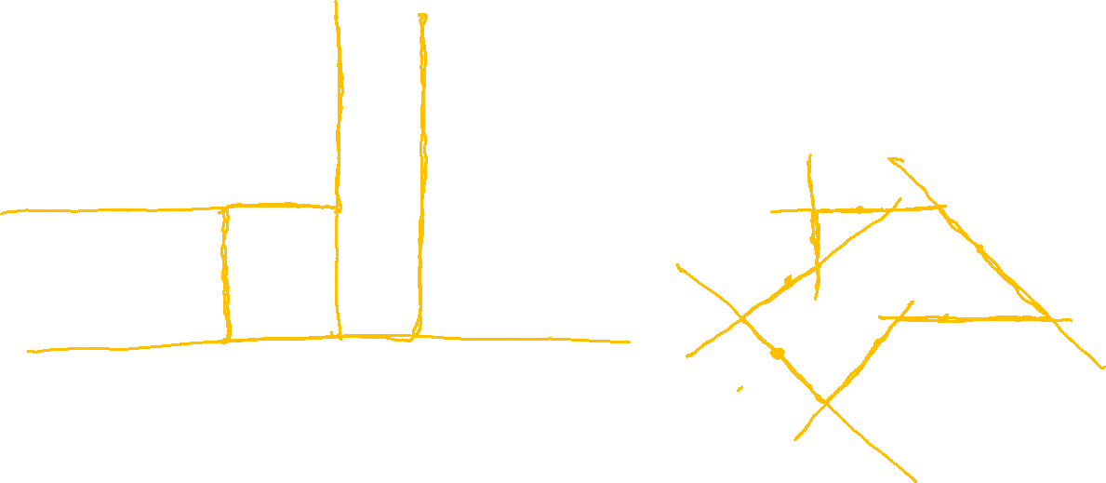
Decision Boundaries
Decision tree
Nearest neighbor
x₂
x₂
x₁
x₁

Slide 18
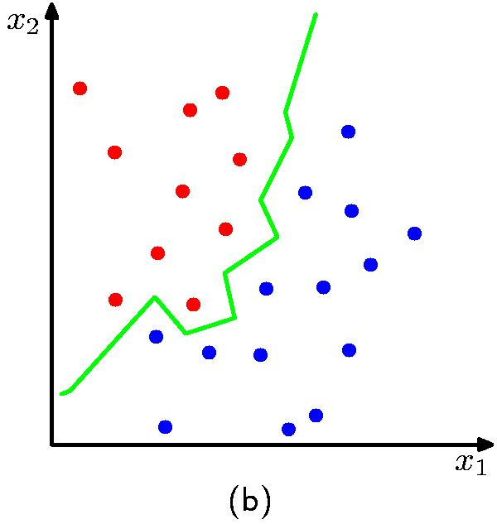
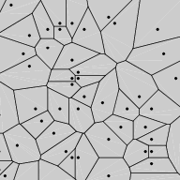
Nearest Neighbor Decision Boundary
1-nearest neighbor classifier decision boundary
Voronoi Diagram
K = 1

Slide 19

Poll 4
1-nearest neighbor will likely:
Overfit
Underfit
Neither (it’s a great learner!)

Slide 20
Poll 4
1-Nearest neighbor will likely:
Overfit
Underfit
Neither (it’s a great learner!)

Slide 21
Nearest Neighbor on Fisher Iris Data
Slide credit: CMU MLD Matt Gormley

Slide 22
Nearest Neighbor on Gaussian Data
Slide credit: CMU MLD Matt Gormley

Slide 23
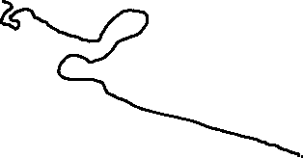
Nearest Neighbor on Gaussian Data
Slide credit: CMU MLD Matt Gormley

Slide 24
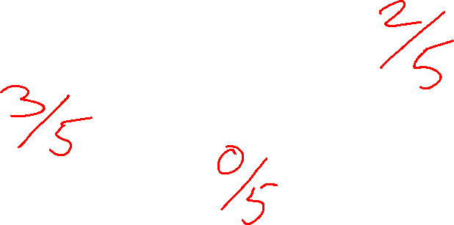
kNN classifier (k=5)
Test document
Whales
Seals
Sharks

Slide 25
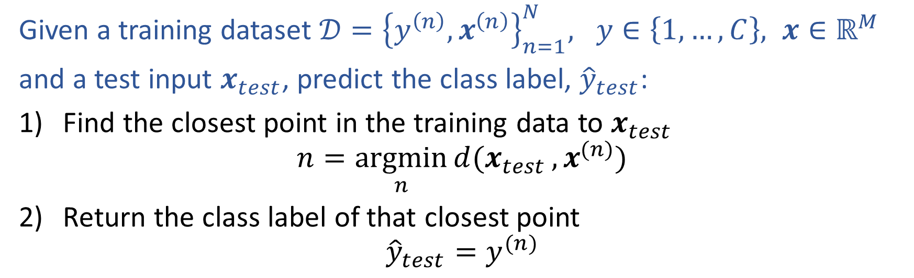
Nearest Neighbor Classification
Given a training dataset $𝒟={\left\{y^{\left(n\right)}, x^{\left(n\right)}\right\}}_{n=1}^{N}, y∈\left\{1,…,C\right\}, x∈ℝ^{M}$
and a test input $x_{test}$, predict the class label, ${\hat{y}}_{test}$:
Find the closest point in the training data to $x_{test}$
$$n=\underset{n}{argmin}{d(x_{test}}, x^{(n)})$$
Return the class label of that closest point
$${\hat{y}}_{test}=y^{(n)}$$

Slide 26
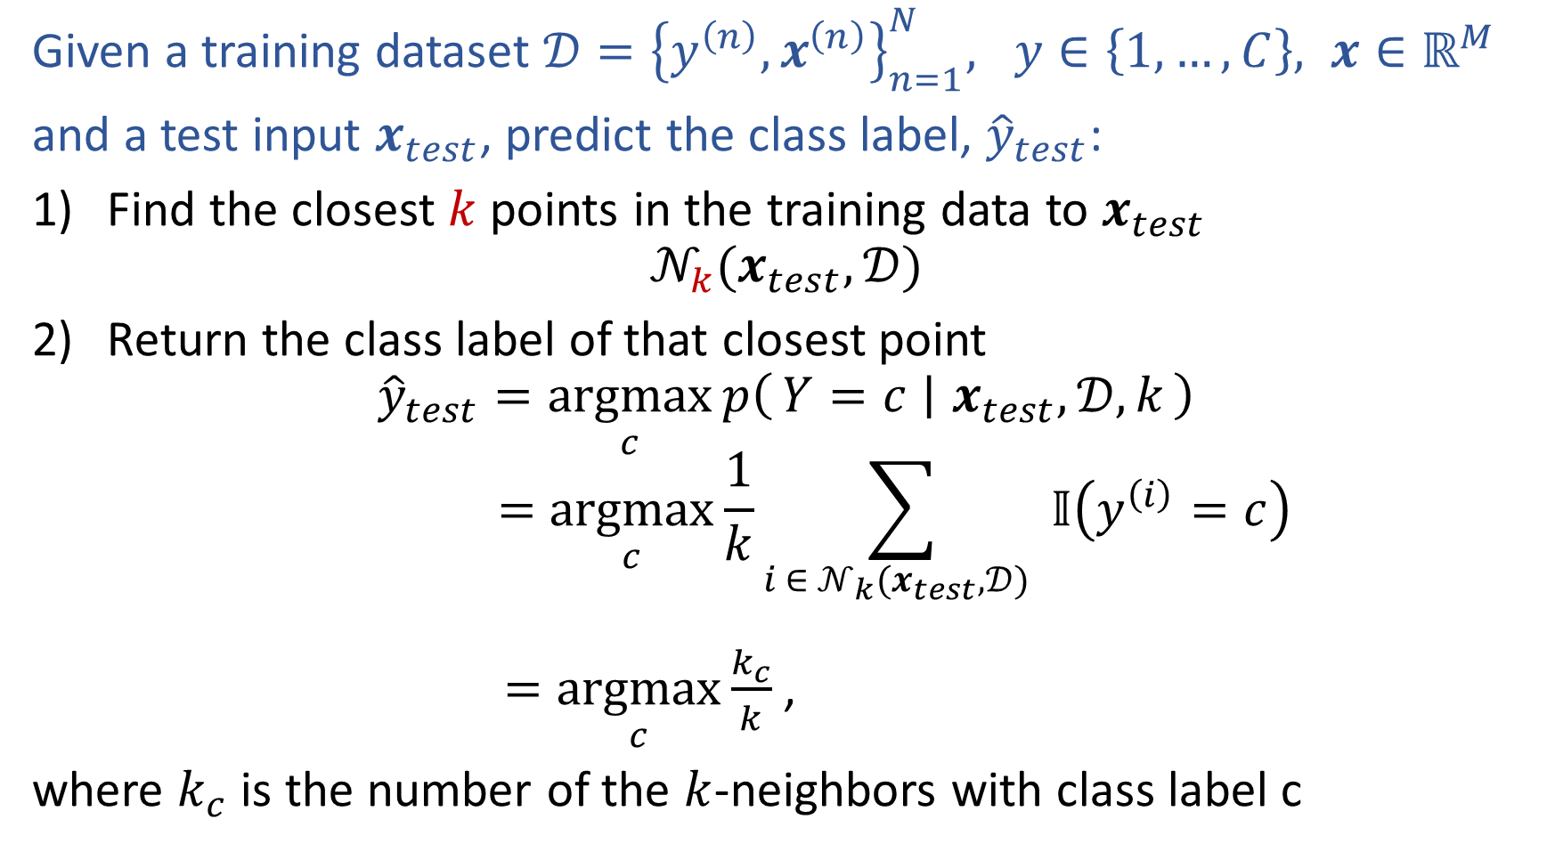
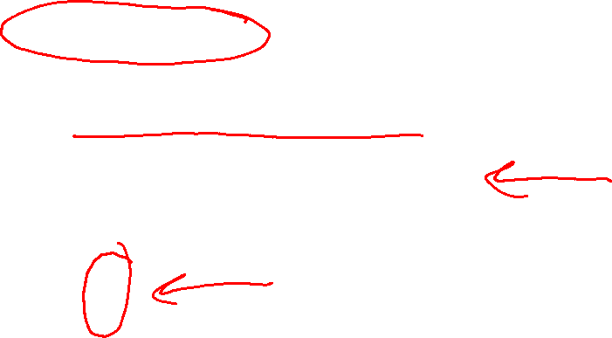
k-Nearest Neighbor Classification
Given a training dataset $𝒟={\left\{y^{\left(n\right)}, x^{\left(n\right)}\right\}}_{n=1}^{N}, y∈\left\{1,…,C\right\}, x∈ℝ^{M}$
and a test input $x_{test}$, predict the class label, ${\hat{y}}_{test}$:
Find the closest $k$ points in the training data to $x_{test}$
$$𝒩_{k}(x_{test},𝒟)$$
Return the class label of that closest point
$${\hat{y}}_{test}=\underset{c}{argmax}{p\left(Y=c ∣ x_{test},𝒟, k\right)}$$
$$=\underset{c}{argmax}{\frac{1}{k}\sum_{i ∈ 𝒩_{k}(x_{test},𝒟) }{𝕀\left(y^{\left(i\right)}=c\right)}}$$
$=\underset{c}{argmax}{\frac{k_{c}}{k}}$,
where $k_{c}$ is the number of the $k$-neighbors with class label c

Slide 27
1-Nearest Neighbor (kNN) classifier
Sports
Whales
Seals
Science
Sharks
Arts

Slide 28
2-Nearest Neighbor (kNN) classifier
Sports
Whales
Seals
Science
Sharks
Arts

Slide 29
3-Nearest Neighbor (kNN) classifier
Sports
Whales
Seals
Science
Sharks
Arts

Slide 30
5-Nearest Neighbor (kNN) classifier
Sports
Whales
Seals
Science
Sharks
Arts

Slide 31
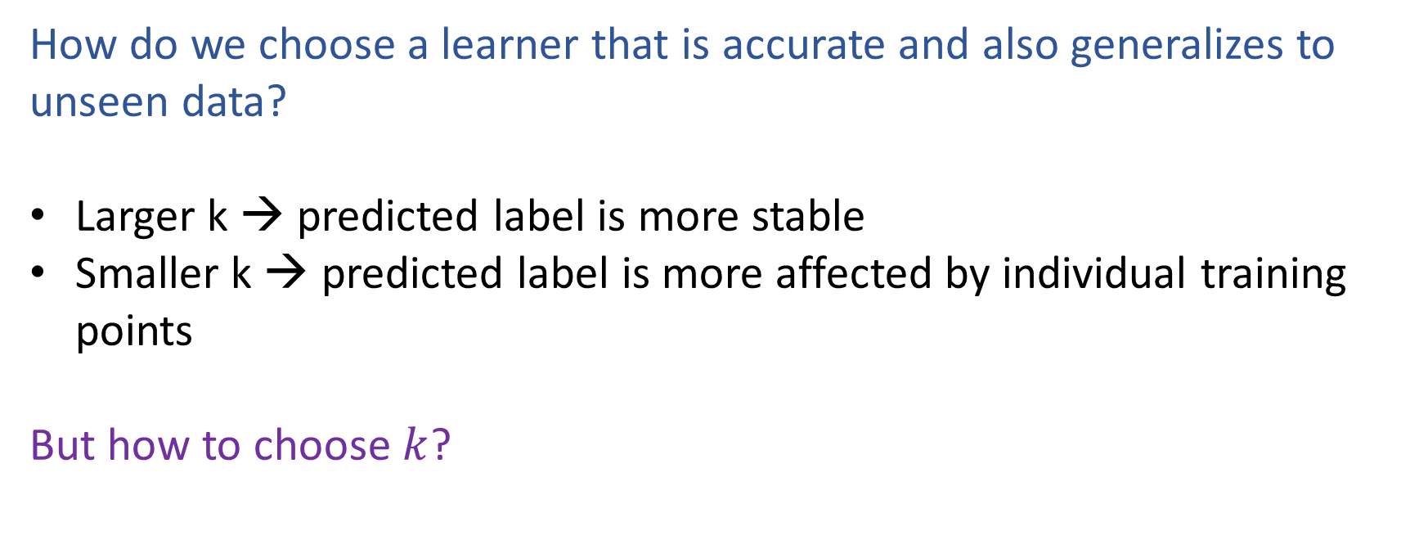

What is the best k?
How do we choose a learner that is accurate and also generalizes to unseen data?
Larger k → predicted label is more stable
Smaller k → predicted label is more affected by individual training points
But how to choose $k$?

Slide 32
k-NN on Fisher Iris Data
Special Case: Nearest Neighbor
Slide credit: CMU MLD Matt Gormley

Slide 33
k-NN on Fisher Iris Data
Slide credit: CMU MLD Matt Gormley

Slide 34
k-NN on Fisher Iris Data
Slide credit: CMU MLD Matt Gormley

Slide 35
k-NN on Fisher Iris Data
Slide credit: CMU MLD Matt Gormley

Slide 36
k-NN on Fisher Iris Data
Slide credit: CMU MLD Matt Gormley

Slide 37
k-NN on Fisher Iris Data
Slide credit: CMU MLD Matt Gormley

Slide 38
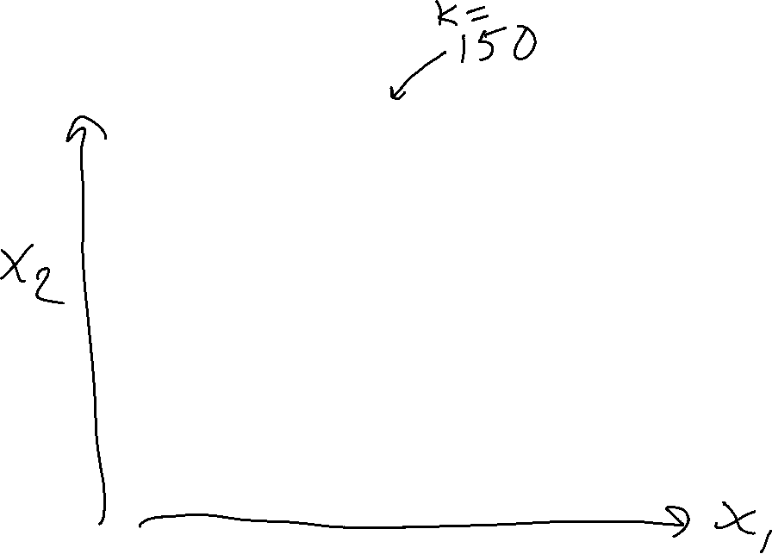
k-NN on Fisher Iris Data
Special Case: Majority Vote
Slide credit: CMU MLD Matt Gormley

Slide 39

k-NN: Remarks
Inductive Bias:
  Close points should have similar labels
  All dimensions are created equally!
Slide credit: CMU MLD Matt Gormley

Slide 40
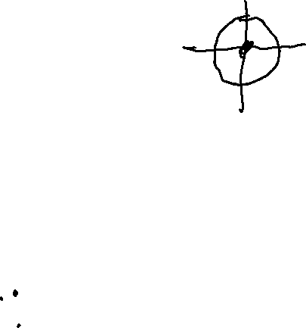
k-NN: Remarks
Inductive Bias:
  Close points should have similar labels
  All dimensions are created equally!
Example: two features for k-NN
big problem: feature scale could dramatically influence classification results
length (cm)
length (cm)
Slide credit: CMU MLD Matt Gormley
width (cm)
width (m)

Slide 41
k-NN: Remarks
Computational Efficiency:
Suppose we have N training examples, and each one has M features
Computational complexity for the special case where k=1:
Slide credit: CMU MLD Matt Gormley
Notes:
https://www.ri.cmu.edu/pub_files/pub1/moore_andrew_1991_1/moore_andrew_1991_1.pdf

Slide 42
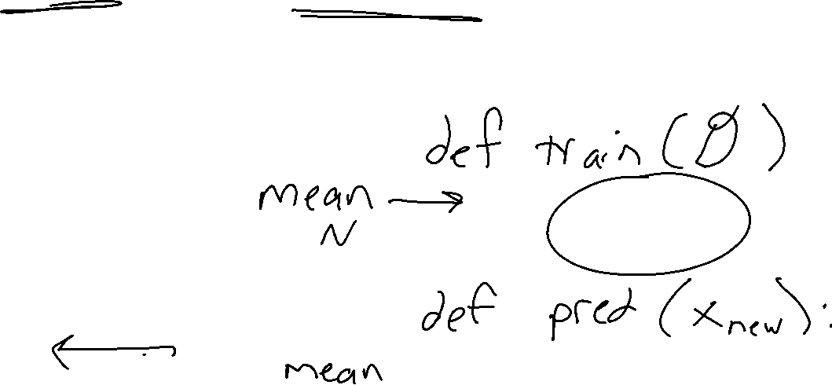
Poll 5 (train) and Poll 6 (predict)
Suppose we have N training examples, and each one has M features
Computational complexity for the special case where k=1:
O(1)
O(log N)
O(log M)
O(log NM)
O(N)
O(M)
O(NM)
O(N^2)
O(N^2M)

Slide 43
Poll 5 (train) and Poll 6 (predict)
Suppose we have N training examples, and each one has M features
Computational complexity for the special case where k=1:
O(1)
O(log N)
O(log M)
O(log NM)
O(N)
O(M)
O(NM)
O(N^2)
O(N^2M)

Slide 44
k-NN: Remarks
Computational Efficiency:
Suppose we have N training examples, and each one has M features
Computational complexity for the special case where k=1:
Task | Naive | k-d Tree
Train | O(1) | ~ O(M N log N)
Predict (one test example) | O(MN) | ~ O(2^{M} log N) on average
Problem: Very fast for small M, but very slow for large M
In practice: use stochastic approximations (very fast, and empirically often as good)
Slide credit: CMU MLD Matt Gormley
Notes:
https://www.ri.cmu.edu/pub_files/pub1/moore_andrew_1991_1/moore_andrew_1991_1.pdf

Slide 45
k-NN: Remarks
Computational Efficiency:
Suppose we have N training examples, and each one has M features
Computational complexity for the special case where k=1:
Task | Naive | k-d Tree
Train | O(1) | ~ O(M N log N)
Predict (one test example) | O(MN) | ~ O(2^{M} log N) on average
Problem: Very fast for small M, but very slow for large M
In practice: use stochastic approximations (very fast, and empirically often as good)
Slide credit: CMU MLD Matt Gormley
Notes:
https://www.ri.cmu.edu/pub_files/pub1/moore_andrew_1991_1/moore_andrew_1991_1.pdf

Slide 46
k-NN: Remarks
Theoretical Guarantees:
Cover & Hart (1967)
Let h(x) be a Nearest Neighbor (k=1) binary classifier. As the number of training examples N goes to infinity…
error_{true}(h) < 2 x Bayes Error Rate
“In this sense, it may be said that half the classification information in an infinite sample set is contained in the nearest neighbor.”
very informally, Bayes Error Rate can be thought of as:
‘the best you could possibly do’
Slide credit: CMU MLD Matt Gormley
Notes:
https://www.ri.cmu.edu/pub_files/pub1/moore_andrew_1991_1/moore_andrew_1991_1.pdf
Interesting because we are able to provide a bound on a quantity that we are not able to compute.

Slide 47
k-NN Learning Objectives
You should be able to…
Describe a dataset as points in a high dimensional space
Implement k-Nearest Neighbors with O(N) prediction
Describe the inductive bias of a k-NN classifier and relate it to feature scale
Sketch the decision boundary for a learning algorithm (compare k-NN and DT)

Slide 48
k-NN Learning Objectives
You should be able to…
Describe a dataset as points in a high dimensional space
Implement k-Nearest Neighbors with O(N) prediction
Describe the inductive bias of a k-NN classifier and relate it to feature scale
Sketch the decision boundary for a learning algorithm (compare k-NN and DT)
State Cover & Hart (1967)'s large sample analysis of a nearest neighbor classifier

Slide 49
Model Selection

Slide 50
Model Selection
WARNING:
In some sense, our discussion of model selection is premature.
The models we have considered thus far are fairly simple.
The models and the many decisions available to the data scientist wielding them will grow to be much more complex than what we’ve seen so far.
Slide credit: CMU MLD Matt Gormley

Slide 51
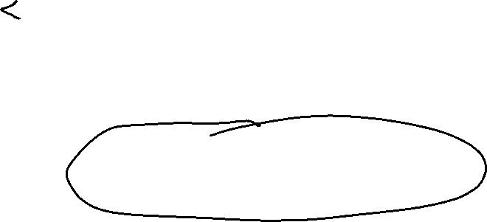
Model Selection
Statistics
Machine Learning
Def: a model defines the data generation process (i.e. a set or family of parametric probability distributions)
Def: model parameters are the values that give rise to a particular probability distribution in the model family
Def: learning (aka. estimation) is the process of finding the parameters that best fit the data
Def: hyperparameters are the parameters of a prior distribution over parameters
Def: (loosely) a model defines the hypothesis space over which learning performs its search
Def: model parameters are the numeric values or structure selected by the learning algorithm that give rise to a hypothesis
Def: the learning algorithm defines the data-driven search over the hypothesis space (i.e. search for good parameters)
Def: hyperparameters are the tunable aspects of the model, that the learning algorithm does not select
Slide credit: CMU MLD Matt Gormley

Slide 52
Model Selection
Example: Decision Tree
Machine Learning
model = set of all possible trees, possibly restricted by some hyperparameters (e.g. max depth)
parameters = structure of a specific decision tree
learning algorithm = ID3, CART, etc.
hyperparameters = max-depth, threshold for splitting criterion, etc.
Def: (loosely) a model defines the hypothesis space over which learning performs its search
Def: model parameters are the numeric values or structure selected by the learning algorithm that give rise to a hypothesis
Def: the learning algorithm defines the data-driven search over the hypothesis space (i.e. search for good parameters)
Def: hyperparameters are the tunable aspects of the model, that the learning algorithm does not select
Slide credit: CMU MLD Matt Gormley

Slide 53
Model Selection
Example: k-Nearest Neighbors
Machine Learning
model = set of all possible nearest neighbors classifiers
parameters = none
(KNN is an instance-based or non-parametric method)
learning algorithm = for naïve setting, just storing the data
hyperparameters = k, the number of neighbors to consider
Def: (loosely) a model defines the hypothesis space over which learning performs its search
Def: model parameters are the numeric values or structure selected by the learning algorithm that give rise to a hypothesis
Def: the learning algorithm defines the data-driven search over the hypothesis space (i.e. search for good parameters)
Def: hyperparameters are the tunable aspects of the model, that the learning algorithm does not select
Slide credit: CMU MLD Matt Gormley

Slide 54
Model Selection
Statistics
Machine Learning
Def: a model defines the data generation process (i.e. a set or family of parametric probability distributions)
Def: model parameters are the values that give rise to a particular probability distribution in the model family
Def: learning (aka. estimation) is the process of finding the parameters that best fit the data
Def: hyperparameters are the parameters of a prior distribution over parameters
Def: (loosely) a model defines the hypothesis space over which learning performs its search
Def: model parameters are the numeric values or structure selected by the learning algorithm that give rise to a hypothesis
Def: the learning algorithm defines the data-driven search over the hypothesis space (i.e. search for good parameters)
Def: hyperparameters are the tunable aspects of the model, that the learning algorithm does not select
If “learning” is all about picking the best parameters how do we pick the best hyperparameters?
Slide credit: CMU MLD Matt Gormley

Slide 55
Model Selection
Two very similar definitions:
  Def: model selection is the process by which we choose the “best” model from among a set of candidates
  Def: hyperparameter optimization is the process by which we choose the “best” hyperparameters from among a set of candidates (could be called a special case of model selection)
Both assume access to a function capable of measuring the quality of a model
Both are typically done “outside” the main training algorithm --- typically training is treated as a black box
Slide credit: CMU MLD Matt Gormley

Slide 56
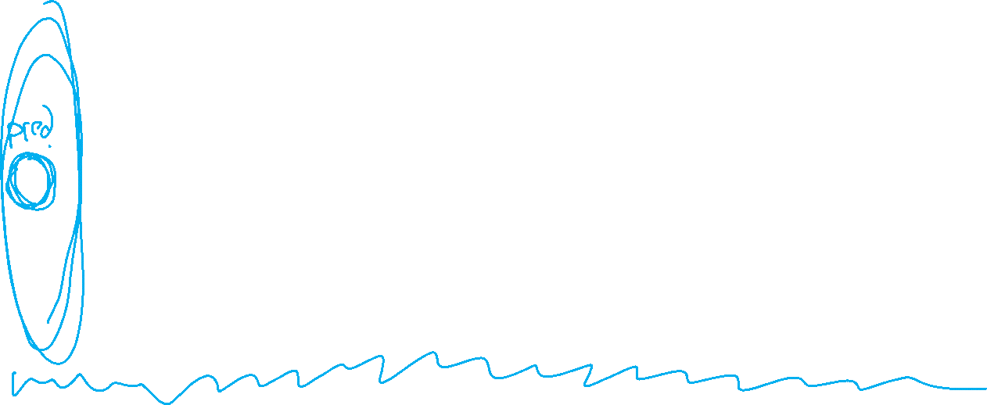
Experimental Design
 | Input | Output | Notes
Training | training dataset hyperparameters | best model parameters | We pick the best model parameters by learning on the training dataset for a fixed set of hyperparameters
Hyperparameter Optimization | training dataset validation dataset | best hyperparameters | We pick the best hyperparameters by learning on the training data and evaluating error on the validation error
Testing | test dataset hypothesis (i.e. fixed model parameters) | test error | We evaluate a hypothesis corresponding to a decision rule with fixed model parameters on a test dataset to obtain test error
Slide credit: CMU MLD Matt Gormley

Slide 57
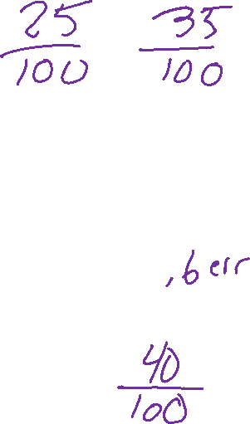
Special Cases of k-NN
k=1: Nearest Neighbor
k=N: Majority Vote
Slide credit: CMU MLD Matt Gormley

Slide 58
Example of Hyperparameter Optimization
Choosing k for k-NN
Slide credit: CMU MLD Matt Gormley

Slide 59
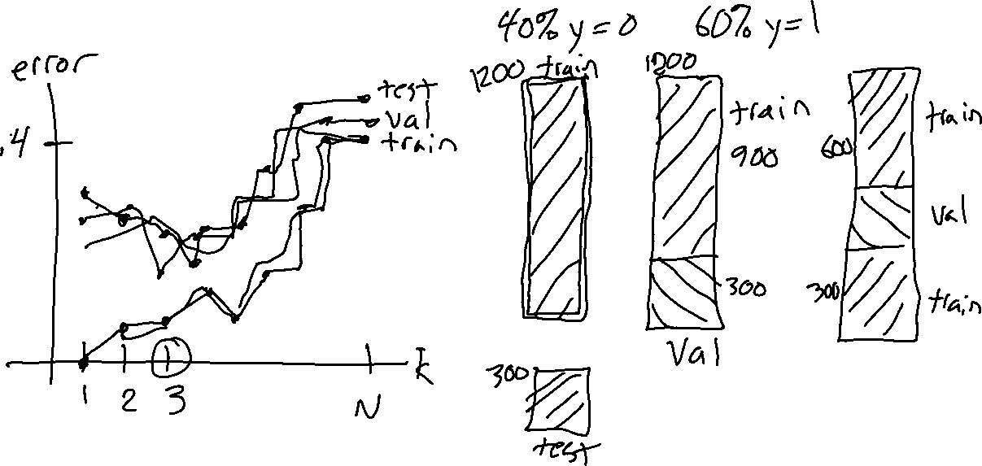
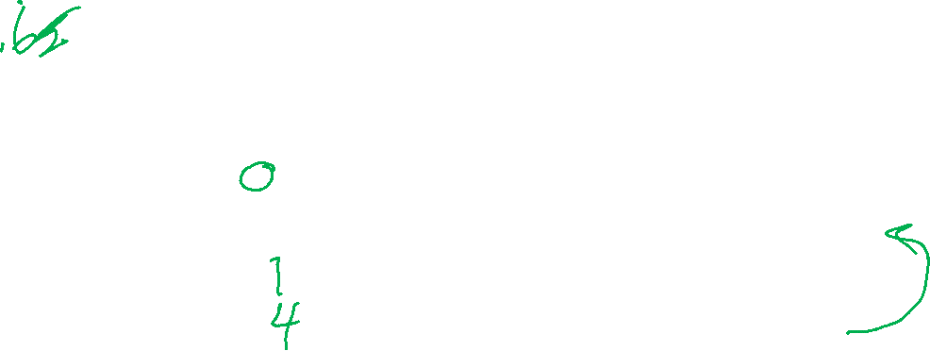
Example of Hyperparameter Optimization
Choosing k for k-NN
Slide credit: CMU MLD Matt Gormley

Slide 60
k-NN: Choosing k
Fisher Iris Data: varying the value of k
Slide credit: CMU MLD Matt Gormley

Slide 61
k-NN: Choosing k
Gaussian Data: varying the value of k
Slide credit: CMU MLD Matt Gormley

Slide 62
Validation
Why do we need validation?
  Choose hyperparameters
  Choose technique
  Help make any choices beyond our parameters
But now, we have another choice to make!
  How do we split training and validation?
Trade-offs
  More held-out data, better meaning behind validation numbers
  More held-out data, less data to train on!

Slide 63
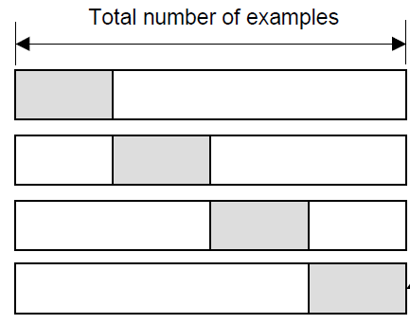
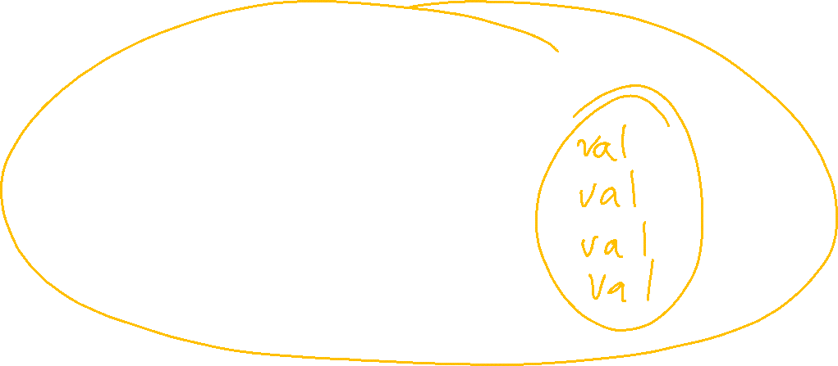
Cross-validation
K-fold cross-validation
Create K-fold partition of the dataset.
Do K runs: train using K-1 partitions and calculate validation error on remaining partition (rotating validation partition on each run).
Report average validation error
training
validation
Run 1
Run 2
Run K
Slide credit: CMU MLD Aarti Singh
TexPoint fonts used in EMF.
Read the TexPoint manual before you delete this box.: AAAAAAA

Slide 64
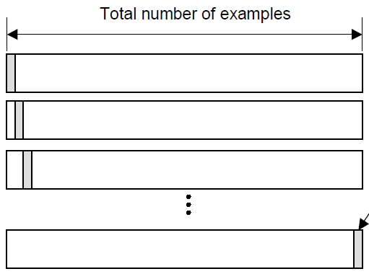
Cross-validation
Leave-one-out (LOO) cross-validation
Special case of K-fold with K=N partitions
Equivalently, train on N-1 samples and validate on only one sample per run for N runs
training
validation
Run 1
Run 2
Run K
Slide credit: CMU MLD Aarti Singh
TexPoint fonts used in EMF.
Read the TexPoint manual before you delete this box.: AAAAAAA

Slide 65
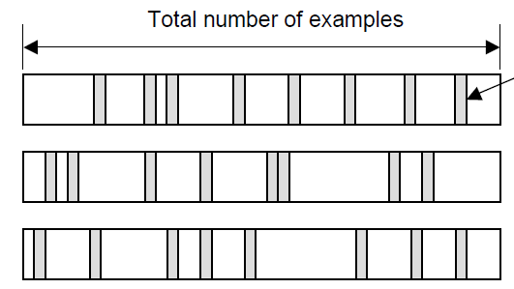
Cross-validation
Random subsampling
Randomly subsample a fixed fraction αN (0< α <1) of the dataset for validation.
Compute validation error with remaining data as training data.
Repeat K times
Report average validation error
training
validation
Run 1
Run 2
Run K
Slide credit: CMU MLD Aarti Singh
TexPoint fonts used in EMF.
Read the TexPoint manual before you delete this box.: AAAAAAA

Slide 66

Poll 7
Say you are choosing amongst 7 discrete values of a decision tree mutual information threshold, and you want to do K=5-fold cross-validation.
How many times do I have to train my model?
  1
  5
  7
  12
  35
  5⁷
Notes:
0

Slide 67
Poll 7
Say you are choosing amongst 7 discrete values of a decision tree mutual information threshold, and you want to do K=5-fold cross-validation.
How many times do I have to train my model?
  1
  5
  7
  12
  35
  5⁷
Notes:
0

Slide 68

Model Selection
WARNING (again):
  This section is only scratching the surface!
  Lots of methods for hyperparameter optimization: (to talk about later)
    Grid search
    Random search
    Bayesian optimization
    Graduate-student descent
    …
Main Takeaway:
  Model selection / hyperparameter optimization is just another form of learning
Slide credit: CMU MLD Matt Gormley

