Slide 1

10-315
Introduction to ML
Optimization and Linear Regression
Instructor: Pat Virtue

Slide 2
Machine Learning Paradigms
Slide credit: CMU MLD, Matt Gormley

Slide 3
Machine Learning Paradigms
Slide credit: CMU MLD, Matt Gormley

Slide 4
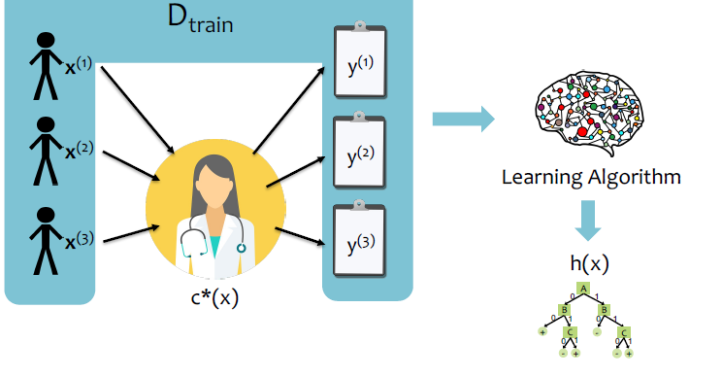
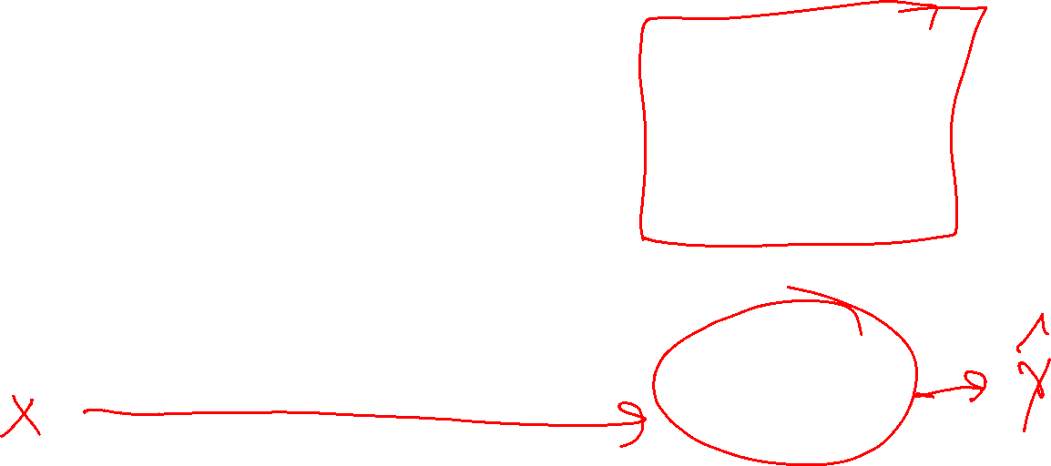
Machine Learning Data
Slide credit: CMU MLD, Matt Gormley

Slide 5
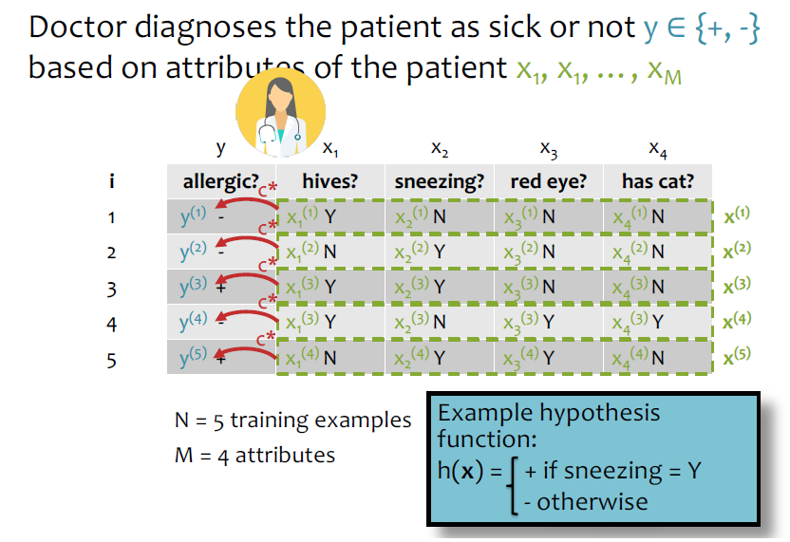
Machine Learning Data
Slide credit: CMU MLD, Matt Gormley

Slide 6
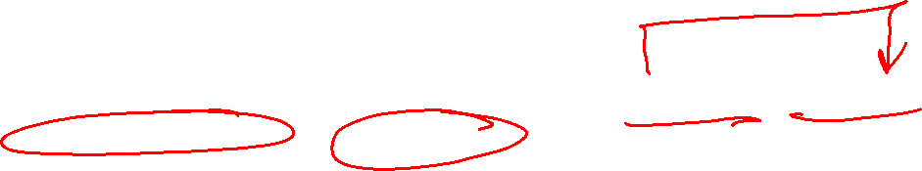
Machine Learning Paradigms
Slide credit: CMU MLD, Matt Gormley

Slide 7
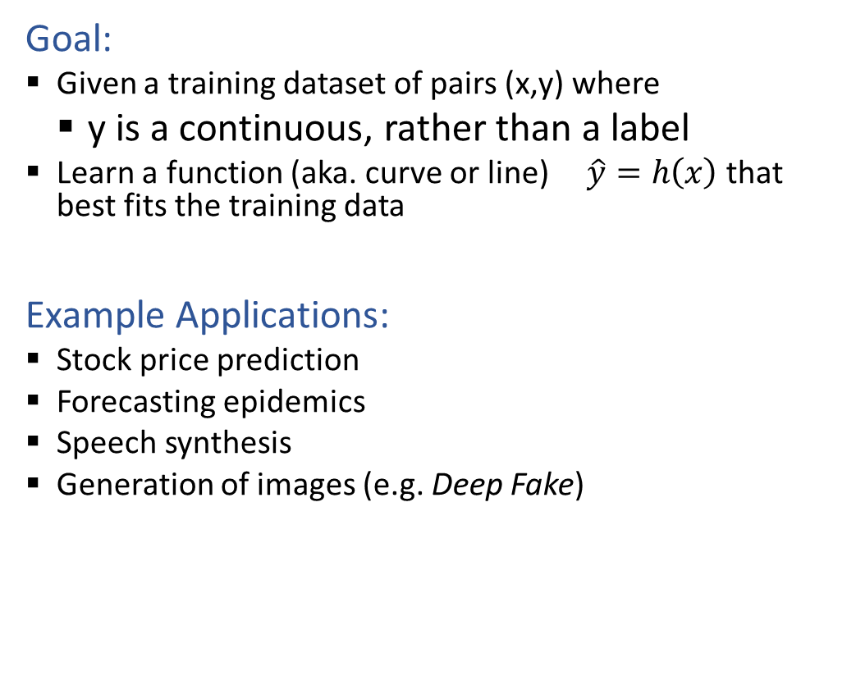
Regression
Goal:
  Given a training dataset of pairs (x,y) where
    y is a continuous, rather than a label
  Learn a function (aka. curve or line) $\hat{y}=h\left(x\right)$that best fits the training data
Example Applications:
  Stock price prediction
  Forecasting epidemics
  Speech synthesis
  Generation of images (e.g. Deep Fake)
Slide credit: CMU MLD Matt Gormley
Notes:
https://delphi.midas.cs.cmu.edu/files/brooks2015.pdf
https://pixabay.com/p-1781570/?no_redirect
https://deepdreamgenerator.com/#gallery

Slide 8

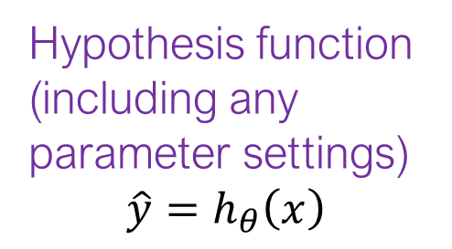
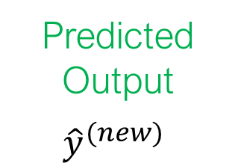



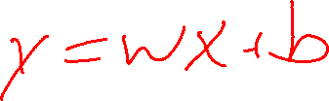
Machine Learning Models
Training data
Hypothesis function (including any parameter settings)
$$\hat{y}=h_{θ}\left(x\right)$$
Machine learning training algorithm
$$\begin{matrix}\left(x^{\left(1\right)},y^{\left(1\right)}\right) \\ \left(x^{\left(2\right)},y^{\left(2\right)}\right) \\ \left(x^{\left(3\right)},y^{\left(3\right)}\right) \\ ⋮\end{matrix}$$
Prediction
Hypothesis function
$$h_{θ}\left(x^{(new)}\right)$$
New input
$$x^{(new)}$$
Predicted
Output
$${\hat{y}}^{(new)}$$

Slide 9
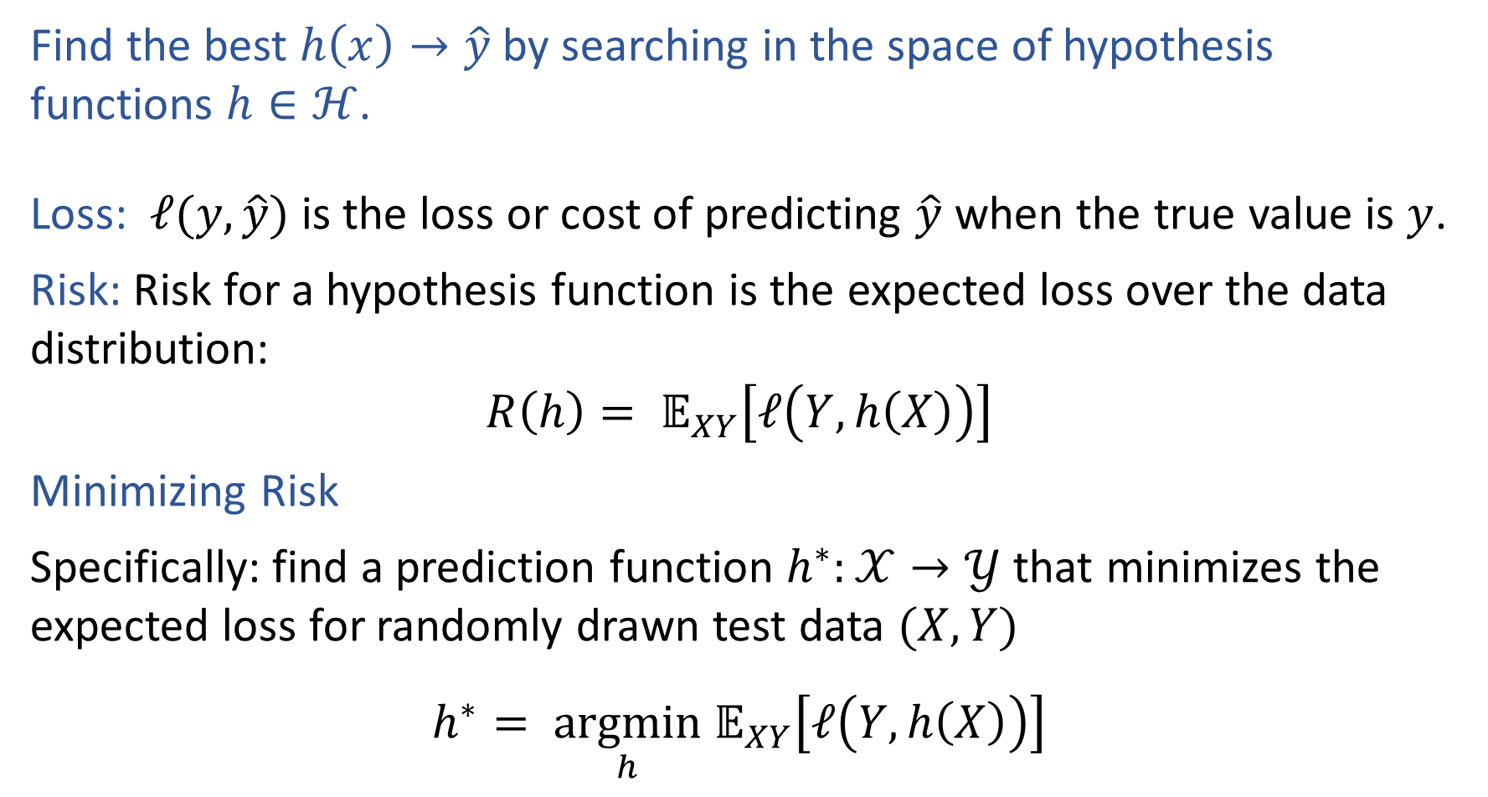

Optimization Formulation
Find the best $h\left(x\right)→\hat{y}$ by searching in the space of hypothesis functions $h∈ℋ$.
Loss: $ℓ(y, \hat{y})$ is the loss or cost of predicting $\hat{y}$ when the true value is $y$.
Risk: Risk for a hypothesis function is the expected loss over the data distribution:
$$R\left(h\right)= 𝔼_{XY}\left[ℓ\left(Y, h\left(X\right)\right)\right]$$
Minimizing Risk
Specifically: find a prediction function $h^{∗}:𝒳→𝒴$ that minimizes the expected loss for randomly drawn test data $(X, Y)$
$$h^{∗}= \underset{h}{argmin} 𝔼_{XY}\left[ℓ\left(Y, h\left(X\right)\right)\right]$$

Slide 10

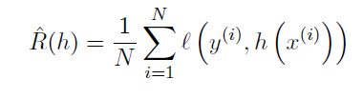


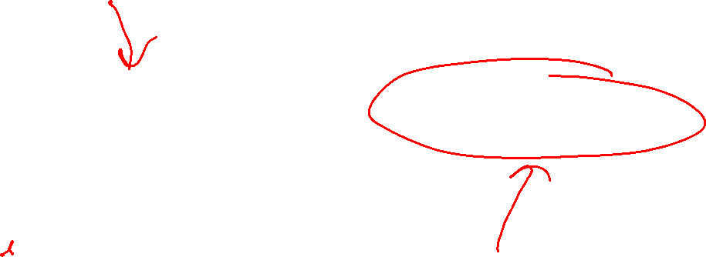
Empirical Risk Minimization
Risk
Empirical Risk
Empirical Risk Minimization

Slide 11

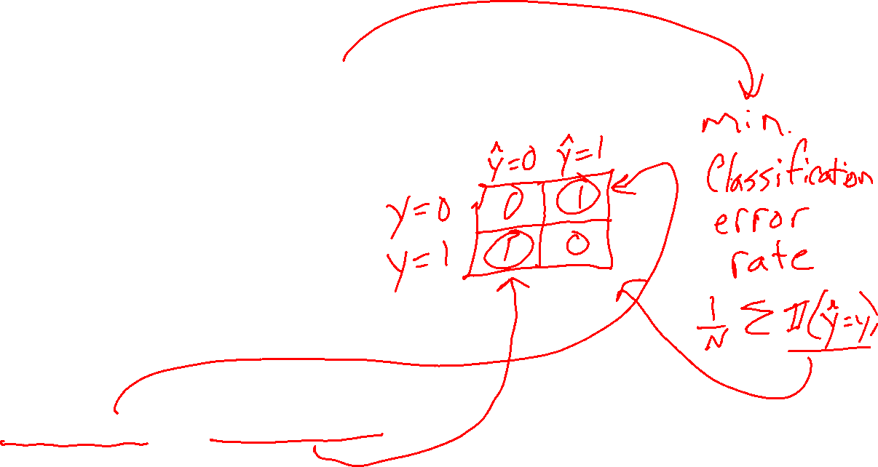
Loss Functions
$$h^{∗}= \underset{h}{argmin} 𝔼_{XY}\left[L\left(Y, h\left(X\right)\right)\right]$$
Loss function:
$L:𝒴×𝒴→ℝ$
Classification:
Two-class, 0,1 loss
Two-class, arbitrary loss
False positives and false negatives:

Slide 12
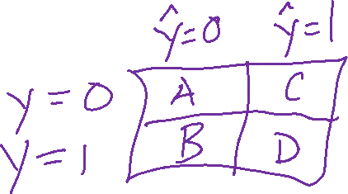

Poll 1
For a healthcare classification problem where:
Y=0 represents a negative test for cancer (healthy)
Y=1 represents a positive test for cancer (sick)
Which two-class loss value should be highest?
True negative
False negative
False positive
True positive

Slide 13
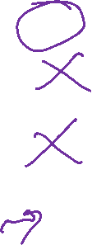
Poll 2
Does our decision tree algorithm (recursively finding the best attribute to split on a each node) find a hypothesis that minimizes empirical risk for zero-one loss?
Yes, always
Yes, but only when splitting with error rate
Yes, but only when splitting with mutual information
No

Slide 14
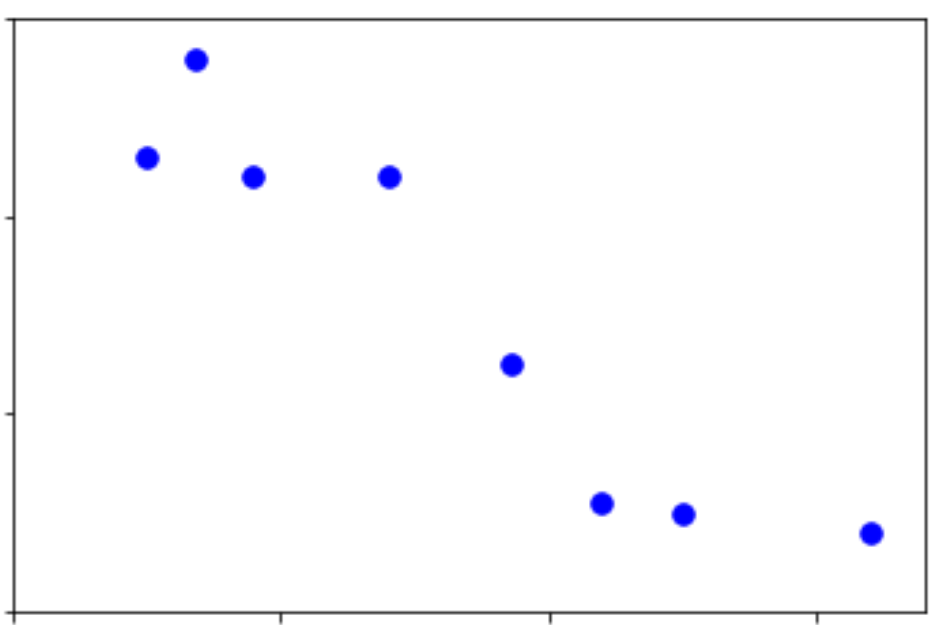

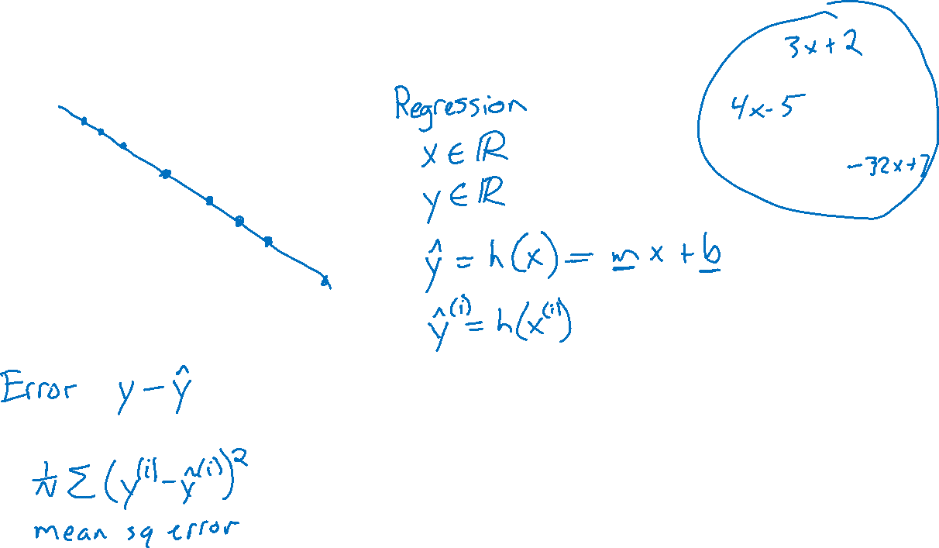
Linear Regression
Output y
Input x

Slide 15
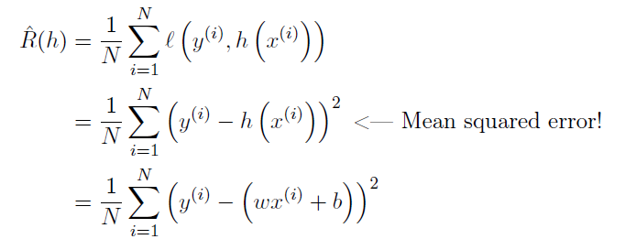
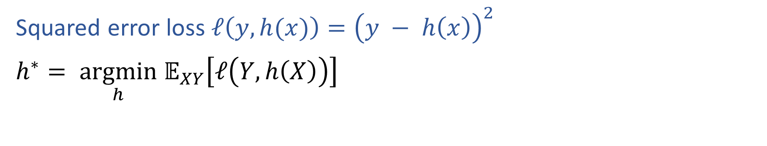

Risk in Regression
Squared error loss $ℓ\left(y, h(x)\right)={\left(y − h\left(x\right)\right)}^{2}$
$h^{∗}= \underset{h}{argmin} 𝔼_{XY}\left[ℓ\left(Y, h\left(X\right)\right)\right]$

Slide 16
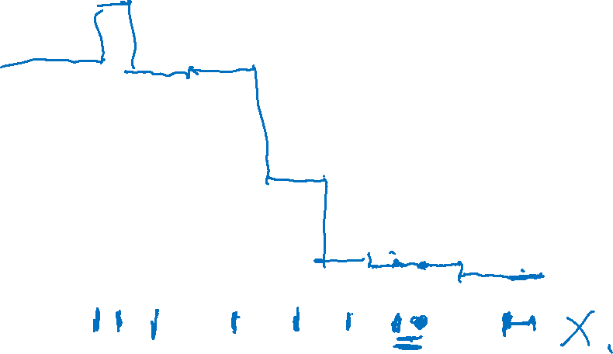
Not-so-linear Regression
Nearest neighbor
Output y
Input x

Slide 17
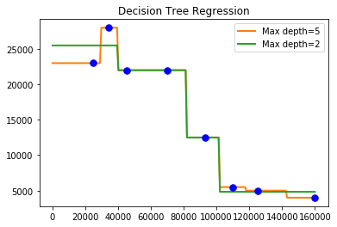
Not-so-linear Regression
Decision Trees

Slide 18
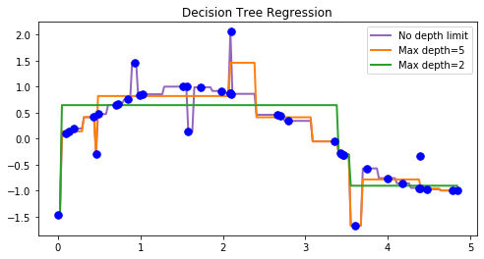
Not-so-linear Regression
Decision Trees

Slide 19
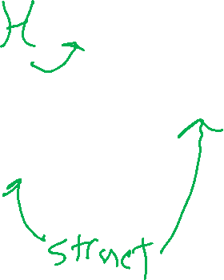
Linear Regression: Problem Formulation
Output y
Input x

Slide 20
Risk in Regression
Squared error loss $ℓ\left(y, h(x)\right)={\left(y − h\left(x\right)\right)}^{2}$
$h^{∗}= \underset{h}{argmin} 𝔼_{XY}\left[ℓ\left(Y, h\left(X\right)\right)\right]$

Slide 21
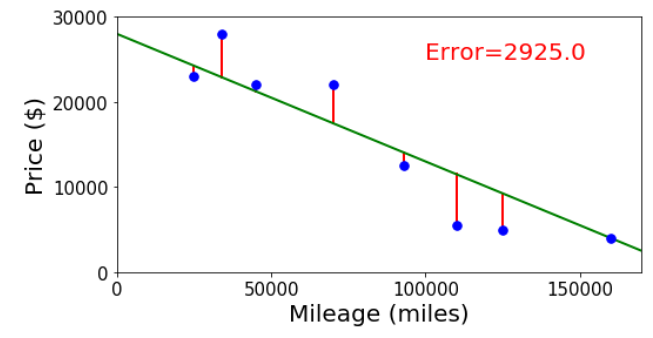
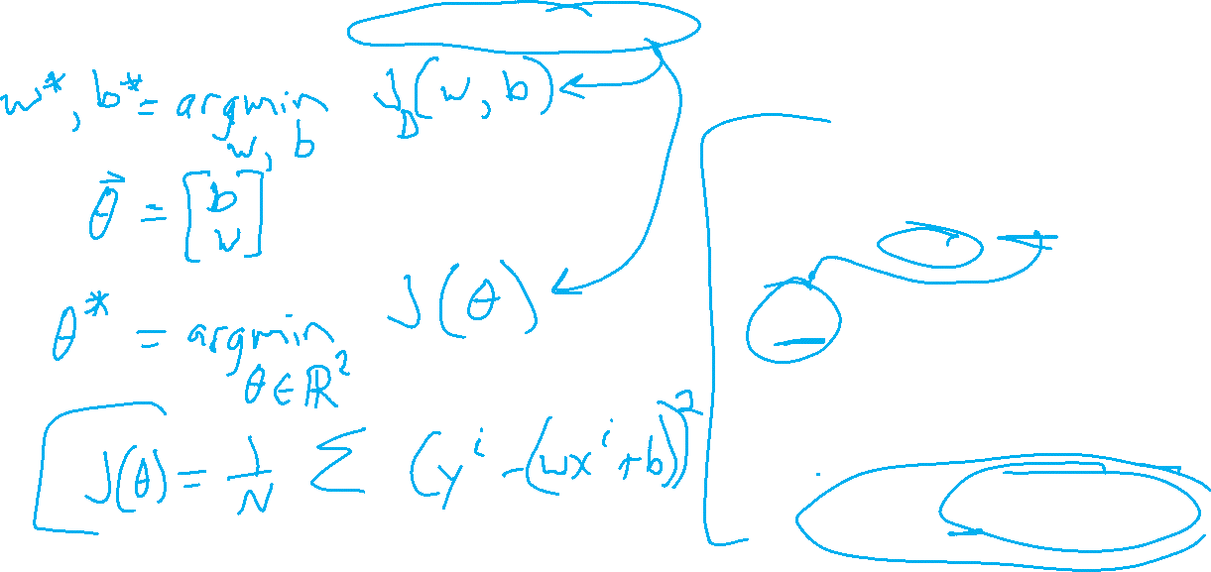
Linear Regression Optimzation
Finding the parameter values that minimize the mean squared error objective function

Slide 22
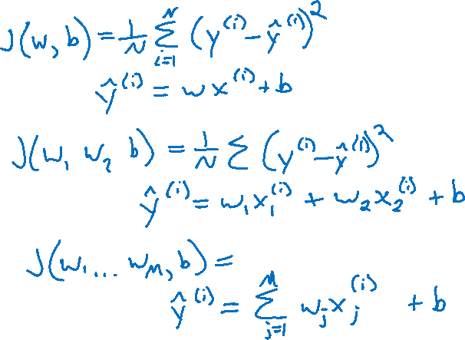
Linear Regression Optimzation
Finding the parameter values that minimize the mean squared error objective function

Slide 23
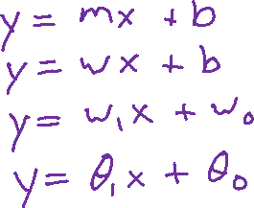
Poll 3
Linear regression. What is linear about it?
Select all that apply.
Always fits a linear (or affine) shape to the data
Linear objective function with respect to the input
Linear objective function with respect to the parameters
None of the above

Slide 24

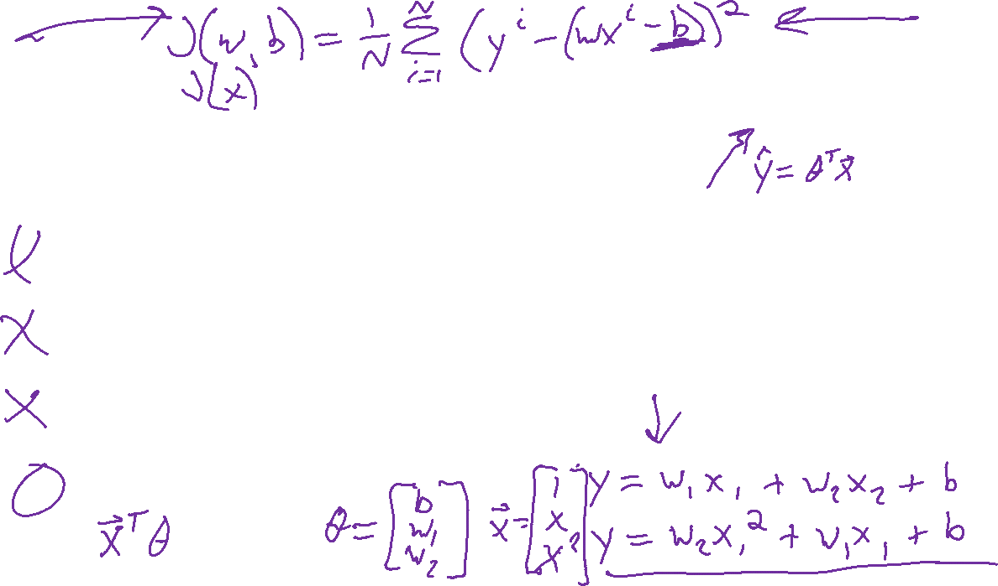

Poll 3
Linear regression. What is linear about it?
Select all that apply.
Always fits a linear (or affine) shape to the data
Linear objective function with respect to the input
Linear objective function with respect to the parameters
None of the above

Slide 25
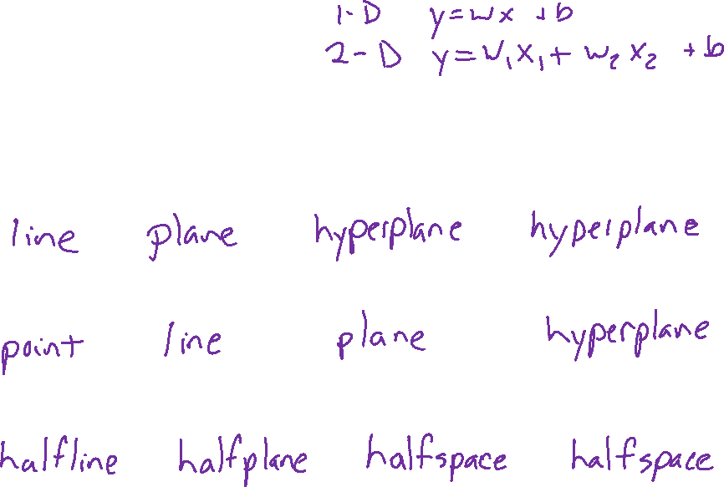




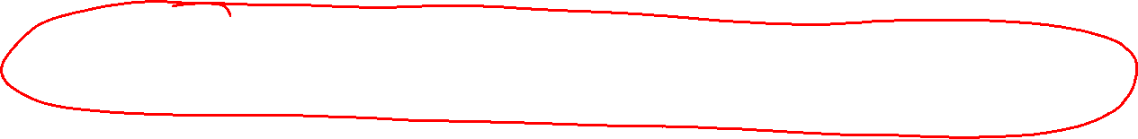

Linear in Higher Dimensions
What are these linear shapes called for 1-D, 2-D, 3-D, M-D input?
$$x∈ℝ$$
$$x∈ℝ^{2}$$
$$x∈ℝ^{3}$$
$$x∈ℝ^{M}$$
$y=w^{T}x+b$
$w^{T}x+b=0$
$w^{T}x+b≥0$

Slide 26
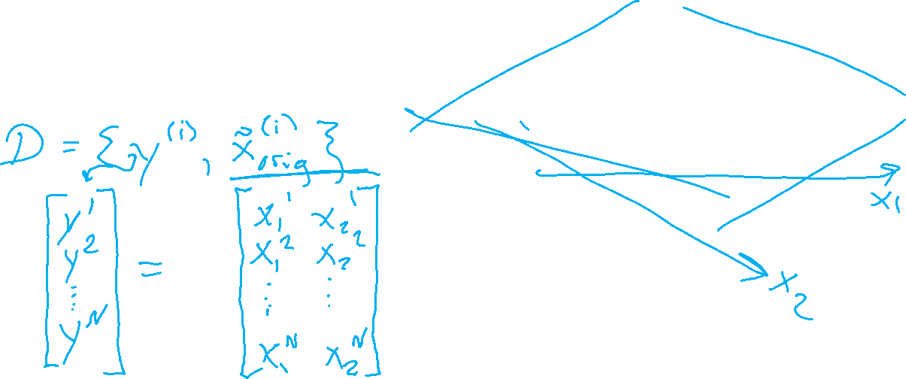
Linear Algebra Formulation
Constructing the design matrix

Slide 27

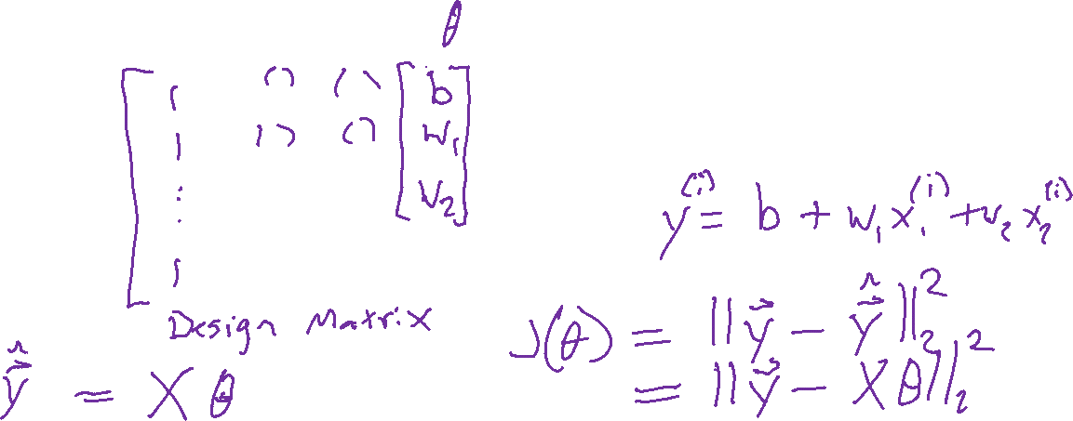
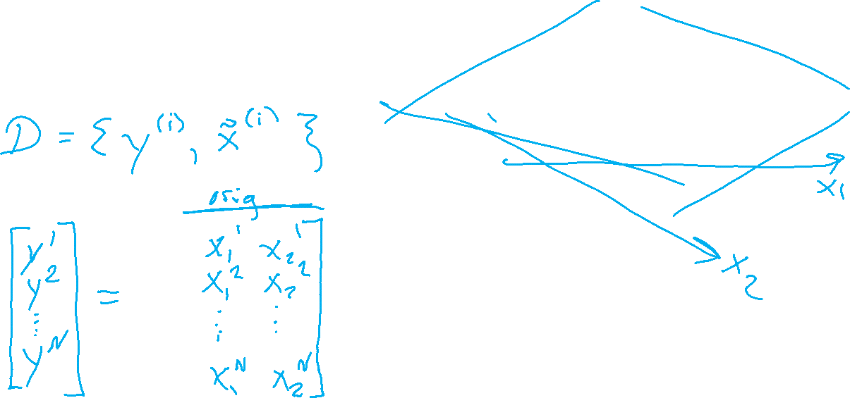
Linear Algebra Formulation
Constructing the design matrix

Slide 28
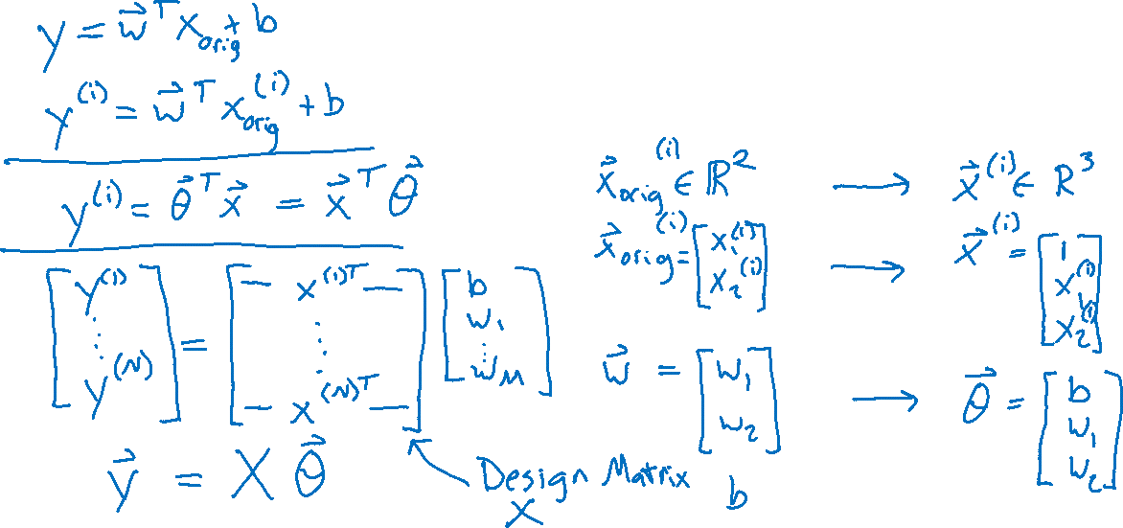
Linear Algebra Formulation
Constructing the design matrix

Slide 29
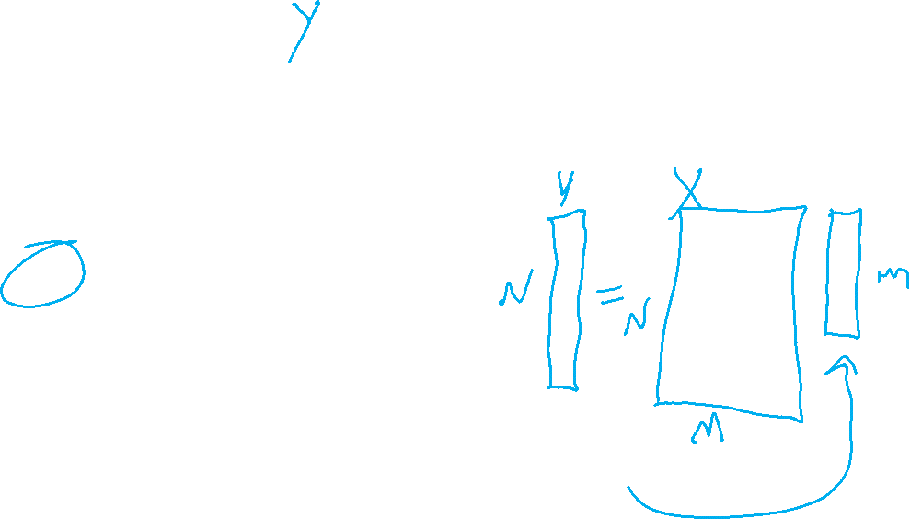
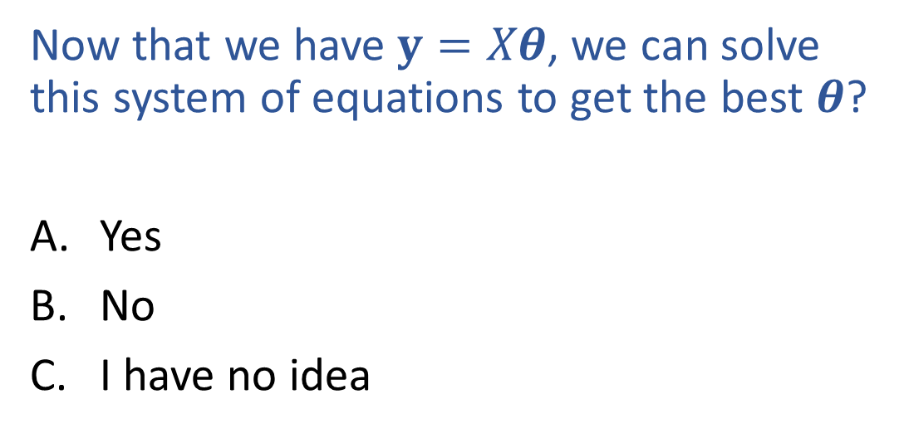

Poll 4
Now that we have $y=Xθ$, we can solve this system of equations to get the best $θ$?
Yes
No
I have no idea

Slide 30
Linear Regression
Linear algebra formulation

Slide 31

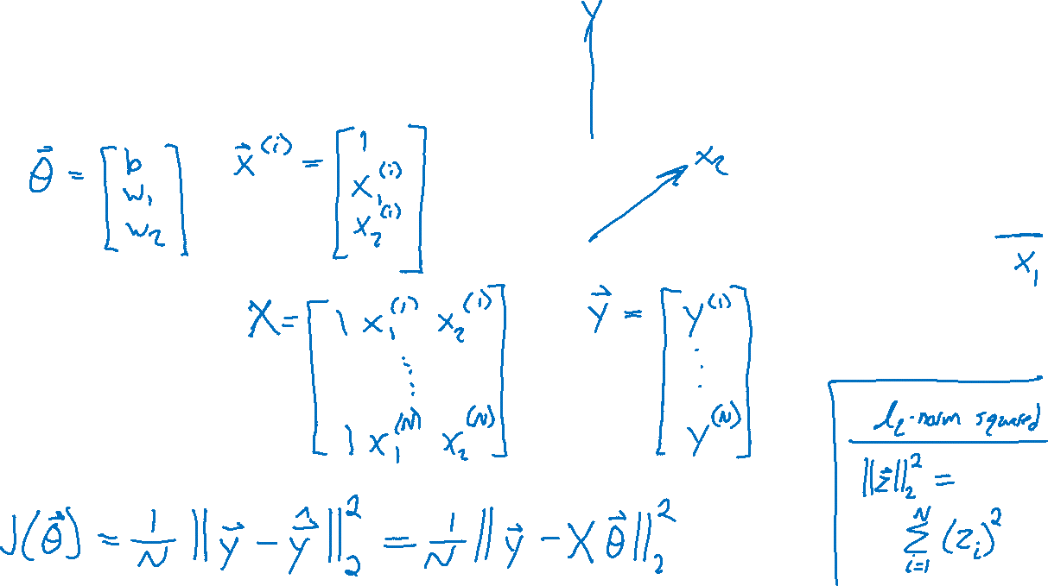
Linear Regression
Linear algebra formulation

Slide 32
Linear Regression
Optimizing the objective
From course website under lectures:
Demo: interactive_regression.ipynb
Exercise: interactive_blind_regression.ipynb

Slide 33

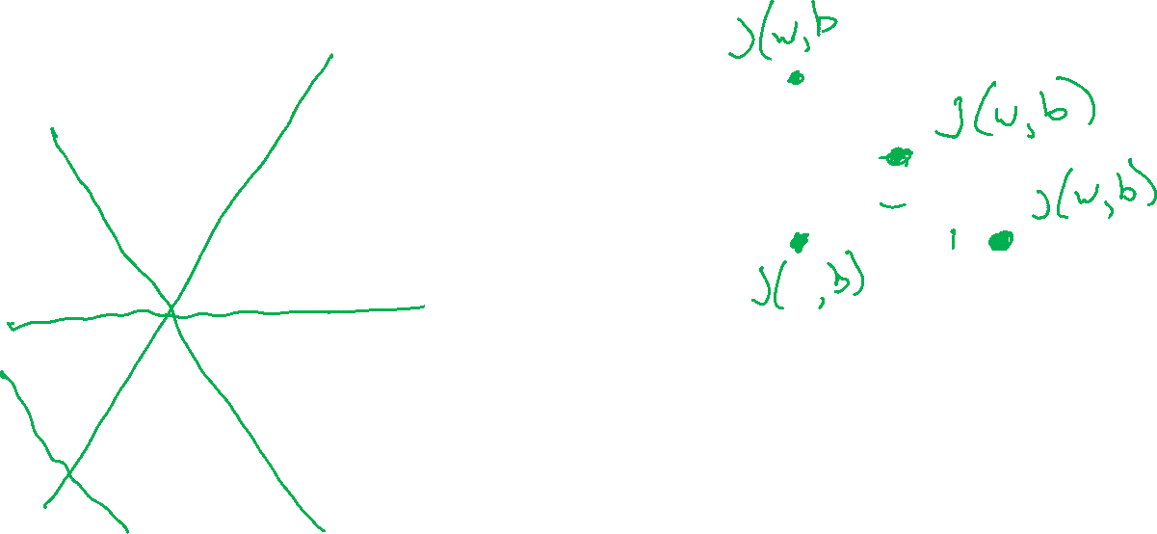
Linear Regression
$$J\left(w, b\right)=\frac{1}{2}\left[{\left(y^{(1)}−\left(wx^{(1)}+b\right)\right)}^{2}+{\left(y^{(2)}−\left(wx^{(2)}+b\right)\right)}^{2}\right]$$
Optimizing the objective
b
y
w
x

Slide 34
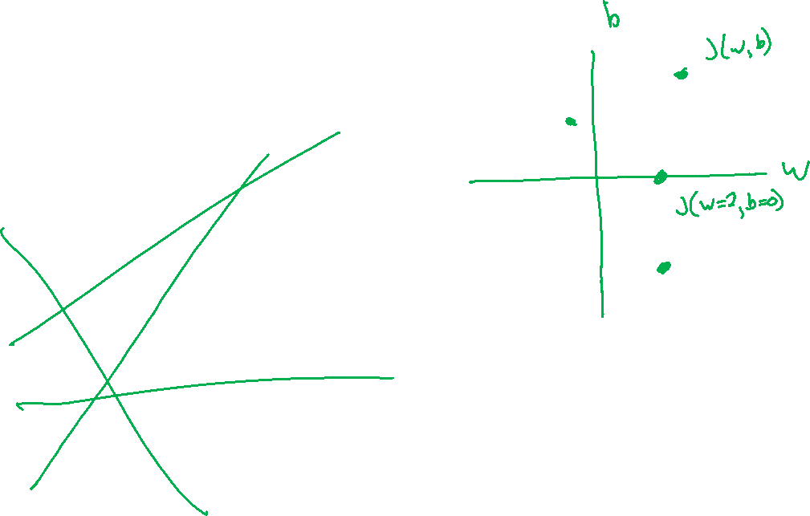
Linear Regression
$$J\left(w, b\right)=\frac{1}{2}\left[{\left(y^{(1)}−\left(wx^{(1)}+b\right)\right)}^{2}+{\left(y^{(2)}−\left(wx^{(2)}+b\right)\right)}^{2}\right]$$
Optimizing the objective
y
x

Slide 35
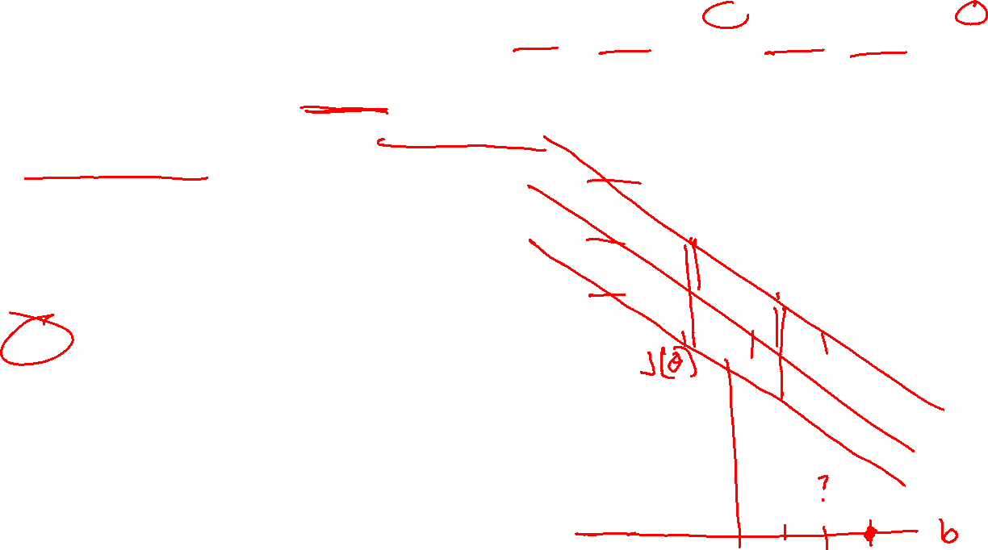
Poll 5
$$J\left(w, b\right)=\frac{1}{2}\left[{\left(y^{(1)}−\left(wx^{(1)}+b\right)\right)}^{2}+{\left(y^{(2)}−\left(wx^{(2)}+b\right)\right)}^{2}\right]$$
For fixed data and fixed slope, w, what shape do we get by plotting MSE objective vs intercept, b?
Line
Plane
Half-plane
Convex Parabola (U-shape)
Concave parabola (up-side-down U)
None of the above
y
x

Slide 36
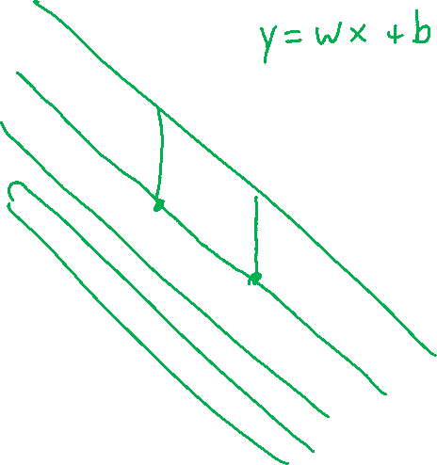
Poll 5
y
For fixed data and fixed slope, w, what shape do we get by plotting MSE objective vs intercept, b?
Line
Plane
Half-plane
Convex Parabola (U-shape)
Concave parabola (up-side-down U)
None of the above
x

Slide 37
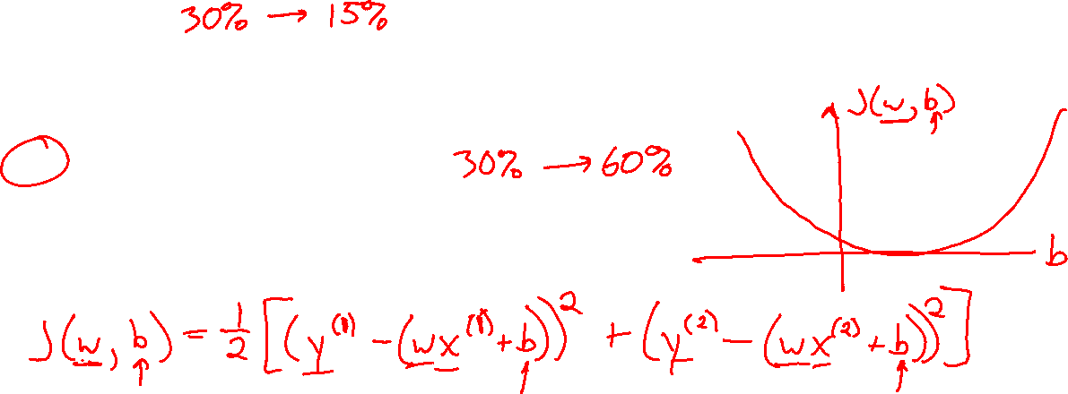

Poll 5
y
For fixed data and fixed slope, w, what shape do we get by plotting MSE objective vs intercept, b?
Line
Plane
Half-plane
Convex Parabola (U-shape)
Concave parabola (up-side-down U)
None of the above
x

Slide 38
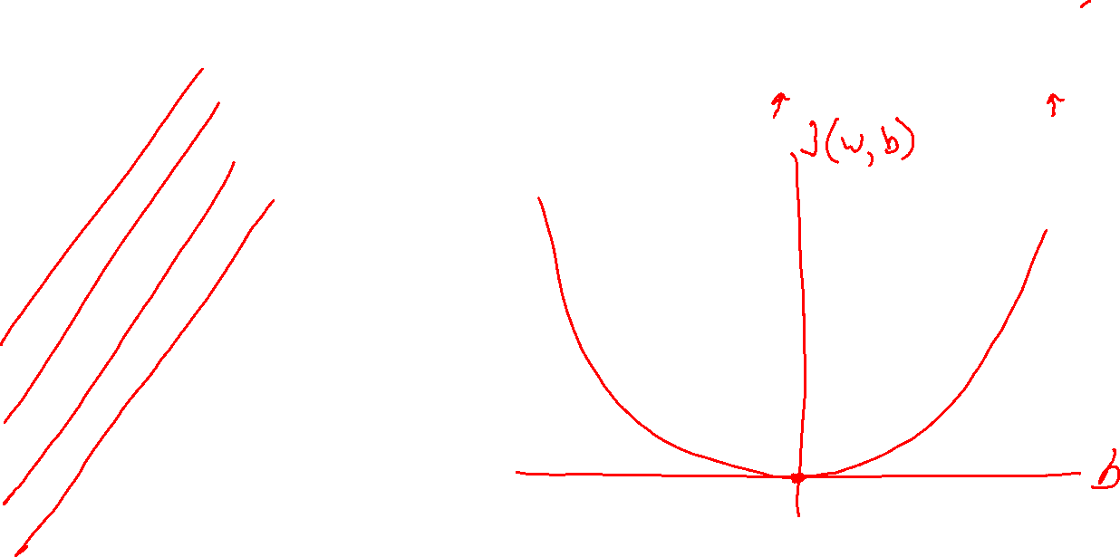
Linear Regression
$$J\left(w, b\right)=\frac{1}{2}\left[{\left(y^{(1)}−\left(wx^{(1)}+b\right)\right)}^{2}+{\left(y^{(2)}−\left(wx^{(2)}+b\right)\right)}^{2}\right]$$
Optimizing the objective
y
x

Slide 39
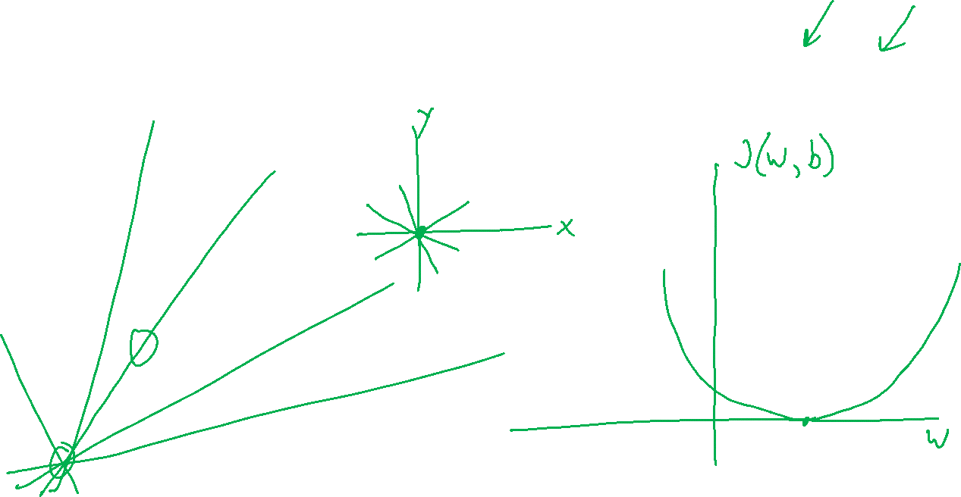
Linear Regression
$$J\left(w, b\right)=\frac{1}{2}\left[{\left(y^{(1)}−\left(wx^{(1)}+b\right)\right)}^{2}+{\left(y^{(2)}−\left(wx^{(2)}+b\right)\right)}^{2}\right]$$
Optimizing the objective
y
x

Slide 40
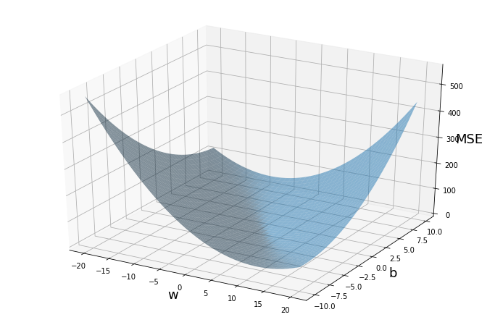
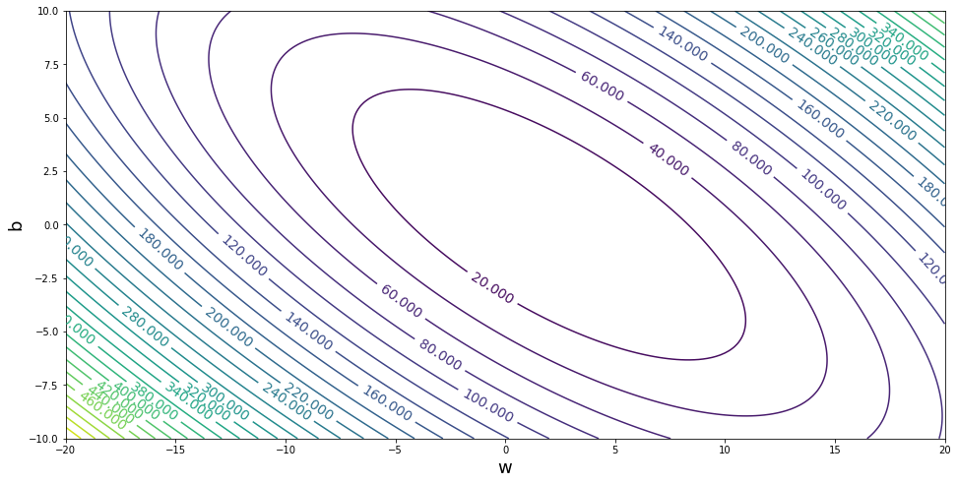


Linear Regression
Optimizing the objective

Slide 41



Optimization
Gradients

Slide 42

Optimization
Gradients

Slide 43
Calculus
Partial derivatives

Slide 44


Calculus with Linear Algebra
Vector in, scalar out
Gradient
$y=f(x)$ $y∈ℝ, x∈ℝ^{M}$

Slide 45










Calculus with Linear Algebra
Functions with linear algebra
$$y=f\left(\left[\begin{matrix}x_{1} \\ ⋮ \\ x_{M}\end{matrix}\right]\right)$$
$$y=f\left(\left[\begin{matrix}X_{1,1} & ⋯ & X_{1,L} \\ ⋮ & ⋱ & ⋮ \\ X_{M,1} & ⋯ & X_{M,L}\end{matrix}\right]\right)$$
$$y=f\left(x\right)$$
$$\left[\begin{matrix}\begin{aligned}y_{1} \\ \end{aligned} \\ \begin{aligned}⋮ \\ \end{aligned} \\ y_{N}\end{matrix}\right]=f\left(x\right)$$
$$\left[\begin{matrix}\begin{aligned}y_{1} \\ \end{aligned} \\ \begin{aligned}⋮ \\ \end{aligned} \\ y_{N}\end{matrix}\right]=f\left(\left[\begin{matrix}x_{1} \\ ⋮ \\ x_{M}\end{matrix}\right]\right)$$
$$\left[\begin{matrix}\begin{aligned}y_{1} \\ \end{aligned} \\ \begin{aligned}⋮ \\ \end{aligned} \\ y_{N}\end{matrix}\right]=f\left(\left[\begin{matrix}X_{1,1} & ⋯ & X_{1,L} \\ ⋮ & ⋱ & ⋮ \\ X_{M,1} & ⋯ & X_{M,L}\end{matrix}\right]\right)$$
$$\left[\begin{matrix}Y_{1,1} & ⋯ & Y_{1,K} \\ ⋮ & ⋱ & ⋮ \\ Y_{N,K} & ⋯ & Y_{N,K}\end{matrix}\right]=f\left(x\right)$$
$$\left[\begin{matrix}Y_{1,1} & ⋯ & Y_{1,K} \\ ⋮ & ⋱ & ⋮ \\ Y_{N,K} & ⋯ & Y_{N,K}\end{matrix}\right]=f\left(\left[\begin{matrix}x_{1} \\ ⋮ \\ x_{M}\end{matrix}\right]\right)$$
$$\left[\begin{matrix}Y_{1,1} & ⋯ & Y_{1,K} \\ ⋮ & ⋱ & ⋮ \\ Y_{N,K} & ⋯ & Y_{N,K}\end{matrix}\right]=f\left(\left[\begin{matrix}X_{1,1} & ⋯ & X_{1,L} \\ ⋮ & ⋱ & ⋮ \\ X_{M,1} & ⋯ & X_{M,L}\end{matrix}\right]\right)$$

Slide 46


Calculus with Linear Algebra
One way to think of it: bag of partial derivatives
$\left[\begin{matrix}\begin{aligned}y_{1} \\ \end{aligned} \\ \begin{aligned}⋮ \\ \end{aligned} \\ y_{N}\end{matrix}\right]=f\left(\left[\begin{matrix}x_{1} \\ ⋮ \\ x_{M}\end{matrix}\right]\right)$

Slide 47


Calculus with Linear Algebra
One way to think of it: bag of partial derivatives
$\left[\begin{matrix}\begin{aligned}y_{1} \\ \end{aligned} \\ \begin{aligned}⋮ \\ \end{aligned} \\ y_{N}\end{matrix}\right]=f\left(\left[\begin{matrix}x_{1} \\ ⋮ \\ x_{M}\end{matrix}\right]\right)$

Slide 48

Calculus with Linear Algebra
One way to think of it: bag of partial derivatives
$\left[\begin{matrix}Y_{1,1} & ⋯ & Y_{1,K} \\ ⋮ & ⋱ & ⋮ \\ Y_{N,K} & ⋯ & Y_{N,K}\end{matrix}\right]=f\left(\left[\begin{matrix}X_{1,1} & ⋯ & X_{1,L} \\ ⋮ & ⋱ & ⋮ \\ X_{M,1} & ⋯ & X_{M,L}\end{matrix}\right]\right)$

Slide 49


Calculus with Linear Algebra
One way to think of it: bag of partial derivatives
$\left[\begin{matrix}Y_{1,1} & ⋯ & Y_{1,K} \\ ⋮ & ⋱ & ⋮ \\ Y_{N,K} & ⋯ & Y_{N,K}\end{matrix}\right]=f\left(\left[\begin{matrix}X_{1,1} & ⋯ & X_{1,L} \\ ⋮ & ⋱ & ⋮ \\ X_{M,1} & ⋯ & X_{M,L}\end{matrix}\right]\right)$

Slide 50


Numerator Layout
$$y=f(x)$$ | $$x∈ℝ$$ | $$x∈ℝ^{M}$$ | $$X∈ℝ^{M×L}$$
$y∈ℝ$ | $$\frac{∂y}{∂x}∈ ℝ$$ | $$\frac{∂y}{∂x}∈ ℝ^{1×M}$$ Output by input | $$\frac{∂y}{∂X}∈ ℝ^{L×M}$$ Transpose of input
$y∈ℝ^{N}$ | $$\frac{∂y}{∂x}∈ ℝ^{N×1}$$ Output by input | $$\frac{∂y}{∂x}∈ ℝ^{N×M}$$ Output by input | $$\frac{∂y}{∂X}∈ ℝ^{?}$$ ?
$Y∈ℝ^{N×K}$ | $$\frac{∂Y}{∂x}∈ ℝ^{N×K}$$ Size of output | $$\frac{∂Y}{∂x}∈ ℝ^{?}$$ ? | $$\frac{∂Y}{∂X}∈ ℝ^{?}$$ ?

Slide 51


Denominator Layout
$$y=f(x)$$ | $$x∈ℝ$$ | $$x∈ℝ^{M}$$ | $$X∈ℝ^{M×L}$$
$y∈ℝ$ | $$\frac{∂y}{∂x}∈ ℝ$$ | $$\frac{∂y}{∂x}∈ ℝ^{M×1}$$ Input by output | $$\frac{∂y}{∂X}∈ ℝ^{M×L}$$ Size of input
$y∈ℝ^{N}$ | $$\frac{∂y}{∂x}∈ ℝ^{1×N}$$ Input by output | $$\frac{∂y}{∂x}∈ ℝ^{M×N}$$ Input by output | $$\frac{∂y}{∂X}∈ ℝ^{?}$$ ?
$Y∈ℝ^{N×K}$ | $$\frac{∂Y}{∂x}∈ ℝ^{K×N}$$ Transpose of output | $$\frac{∂Y}{∂x}∈ ℝ^{?}$$ ? | $$\frac{∂Y}{∂X}∈ ℝ^{?}$$ ?

Slide 52


Calculus with Linear Algebra
Jacobian: Vector in, vector out
Numerator-layout
$y=f(x)$ $y∈ℝ^{N}, x∈ℝ^{M}, \frac{∂y}{∂x}∈ℝ^{N×M}$

Slide 53


Calculus with Linear Algebra
Jacobian: Vector in, vector out
Numerator-layout
$y=f(x)$ $y∈ℝ^{N}, x∈ℝ^{M}, \frac{∂y}{∂x}∈ℝ^{N×M}$

Slide 54



Calculus with Linear Algebra
$$\left[\begin{matrix}\begin{aligned}y_{1} \\ \end{aligned} \\ \begin{aligned}⋮ \\ \end{aligned} \\ y_{N}\end{matrix}\right]=f\left(\left[\begin{matrix}x_{1} \\ ⋮ \\ x_{M}\end{matrix}\right]\right)$$
Numerator-layout vs denominator-layout
Vector in, vector out
$y=f(x)$ $y∈ℝ^{N}, x∈ℝ^{M}$ (assume $N>M$ for illustrative purposes)
Numerator layout | Denominator layout
Number of outputs $×$ number of inputs | Number of inputs $×$ number of outputs
$$\frac{∂y}{∂x}∈ℝ^{N×M}$$ | $$\frac{∂y}{∂x}∈ℝ^{M×N}$$

Slide 55


Calculus with Linear Algebra
$$y=f\left(\left[\begin{matrix}x_{1} \\ ⋮ \\ x_{M}\end{matrix}\right]\right)$$
Vector in, scalar out
Numerator-layout
$y=f(x)$ $y∈ℝ, x∈ℝ^{M}, \frac{∂y}{∂x}∈ℝ^{1×M}$

Slide 56


Calculus with Linear Algebra
$$y=f\left(\left[\begin{matrix}x_{1} \\ ⋮ \\ x_{M}\end{matrix}\right]\right)$$
Numerator-layout vs denominator-layout
Vector in, scalar out
$y=f(x)$ $y∈ℝ, x∈ℝ^{M}$
Numerator layout | Denominator layout
Number of outputs $×$ number of inputs | Number of inputs $×$ number of outputs
$$\frac{∂y}{∂x}∈ℝ^{1×M}$$ | $$\frac{∂y}{∂x}∈ℝ^{M×1}$$

Slide 57


Calculus with Linear Algebra
$$\left[\begin{matrix}\begin{aligned}y_{1} \\ \end{aligned} \\ \begin{aligned}⋮ \\ \end{aligned} \\ y_{N}\end{matrix}\right]=f\left(x\right)$$
Scalar in, vector out
Numerator-layout
$y=f(x)$ $y∈ℝ^{N}, x∈ℝ, \frac{∂y}{∂x}∈ℝ^{N×1}$

Slide 58



Calculus with Linear Algebra
$$y=f\left(\left[\begin{matrix}x_{1} \\ ⋮ \\ x_{M}\end{matrix}\right]\right)$$
Gradient: Vector in, scalar out
Transpose of numerator-layout
$y=f(x)$ $y∈ℝ, x∈ℝ^{M}, \frac{∂y}{∂x}∈ℝ^{1×M}, ∇_{x}f∈ℝ^{M×1}$

Slide 59


Calculus with Linear Algebra
$$y=f\left(\left[\begin{matrix}X_{1,1} & ⋯ & X_{1,L} \\ ⋮ & ⋱ & ⋮ \\ X_{M,1} & ⋯ & X_{M,L}\end{matrix}\right]\right)$$
Matrix in, scalar out
Numerator layout: Transpose of matrix dimensions
Denominator layout: Keep same dimensions as matrix
$y=f(X)$ $y∈ℝ, X∈ℝ^{N×M}, \frac{∂y}{∂X}∈ℝ^{N×M}$ (denominator layout)

Slide 60

Exercise
Suppose we have a function that takes in a vector and squares each element individually, returning another vector, $y=f\left(x\right)$.
$f\left(\left[\begin{aligned}x_{1} \\ x_{2} \\ x_{3}\end{aligned}\right]\right)→\left[\begin{aligned}x_{1}^{2} \\ x_{2}^{2} \\ x_{3}^{2}\end{aligned}\right]$ Example: $f\left(\left[\begin{aligned}7 \\ 3 \\ 5\end{aligned}\right]\right)→\left[\begin{aligned}49 \\ 9 \\ 25\end{aligned}\right]$
What is $∂y/∂x$? (use numerator layout)

Slide 61

Derivatives of Functions with Respect to Vectors

Slide 62

Numerator Layout
$$y=f(x)$$ | $$x∈ℝ$$ | $$x∈ℝ^{M}$$ | $$X∈ℝ^{M×L}$$
$y∈ℝ$ | $$\frac{∂y}{∂x}∈ ℝ$$ | $$\frac{∂y}{∂x}∈ ℝ^{1×M}$$ Output by input | $$\frac{∂y}{∂X}∈ ℝ^{L×M}$$ Transpose of input
$y∈ℝ^{N}$ | $$\frac{∂y}{∂x}∈ ℝ^{N×1}$$ Output by input | $$\frac{∂y}{∂x}∈ ℝ^{N×M}$$ Output by input | $$\frac{∂y}{∂X}∈ ℝ^{?}$$ ?
$Y∈ℝ^{N×K}$ | $$\frac{∂Y}{∂x}∈ ℝ^{N×K}$$ Size of output | $$\frac{∂Y}{∂x}∈ ℝ^{?}$$ ? | $$\frac{∂Y}{∂X}∈ ℝ^{?}$$ ?

Slide 63
Denominator Layout
$$y=f(x)$$ | $$x∈ℝ$$ | $$x∈ℝ^{M}$$ | $$X∈ℝ^{M×L}$$
$y∈ℝ$ | $$\frac{∂y}{∂x}∈ ℝ$$ | $$\frac{∂y}{∂x}∈ ℝ^{M×1}$$ Input by output | $$\frac{∂y}{∂X}∈ ℝ^{M×L}$$ Size of input
$y∈ℝ^{N}$ | $$\frac{∂y}{∂x}∈ ℝ^{1×N}$$ Input by output | $$\frac{∂y}{∂x}∈ ℝ^{M×N}$$ Input by output | $$\frac{∂y}{∂X}∈ ℝ^{?}$$ ?
$Y∈ℝ^{N×K}$ | $$\frac{∂Y}{∂x}∈ ℝ^{K×N}$$ Transpose of output | $$\frac{∂Y}{∂x}∈ ℝ^{?}$$ ? | $$\frac{∂Y}{∂X}∈ ℝ^{?}$$ ?

Slide 64



Linear Regression
Methods for optimizing the objective
Closed-form solution
$$J(w,b)$$
$$b$$
$$w$$

Slide 65


Linear Regression
Expanding objective before computing gradient
$J\left(θ\right)=\frac{1}{N}{\left\|y−Xθ\right\|}_{2}^{2}$
$=\frac{1}{N}{\left(y−Xθ\right)}^{T}\left(y−Xθ\right)$
$=\frac{1}{N}\left(y^{T}−θ^{T}X^{T}\right)\left(y−Xθ\right)$
$=\frac{1}{N}\left(y^{T}y −θ^{T}X^{T}y −y^{T}Xθ+θ^{T}X^{T}Xθ\right)$
$=\frac{1}{N}\left(y^{T}y −2θ^{T}X^{T}y+θ^{T}X^{T}Xθ\right)$

Slide 66


Linear Regression
Expanding objective before computing gradient
$J\left(θ\right)=\frac{1}{N}{\left\|y−Xθ\right\|}_{2}^{2}$

Slide 67

Linear Regression
Expanding objective before computing gradient
$J\left(θ\right)=\frac{1}{N}{\left\|y−Xθ\right\|}_{2}^{2}$
$=\frac{1}{N}{\left(y−Xθ\right)}^{T}\left(y−Xθ\right)$

Slide 68


Linear Regression
Expanding objective before computing gradient
$J\left(θ\right)=\frac{1}{N}{\left\|y−Xθ\right\|}_{2}^{2}$
$=\frac{1}{N}{\left(y−Xθ\right)}^{T}\left(y−Xθ\right)$
$=\frac{1}{N}\left(y^{T}−θ^{T}X^{T}\right)\left(y−Xθ\right)$

Slide 69

Linear Regression
Expanding objective before computing gradient
$J\left(θ\right)=\frac{1}{N}{\left\|y−Xθ\right\|}_{2}^{2}$
$=\frac{1}{N}{\left(y−Xθ\right)}^{T}\left(y−Xθ\right)$
$=\frac{1}{N}\left(y^{T}−θ^{T}X^{T}\right)\left(y−Xθ\right)$
$=\frac{1}{N}\left(y^{T}y −θ^{T}X^{T}y −y^{T}Xθ+θ^{T}X^{T}Xθ\right)$

Slide 70

Linear Regression
Expanding objective before computing gradient
$J\left(θ\right)=\frac{1}{N}{\left\|y−Xθ\right\|}_{2}^{2}$
$=\frac{1}{N}{\left(y−Xθ\right)}^{T}\left(y−Xθ\right)$
$=\frac{1}{N}\left(y^{T}−θ^{T}X^{T}\right)\left(y−Xθ\right)$
$=\frac{1}{N}\left(y^{T}y −θ^{T}X^{T}y −y^{T}Xθ+θ^{T}X^{T}Xθ\right)$
$=\frac{1}{N}\left(y^{T}y −2θ^{T}X^{T}y+θ^{T}X^{T}Xθ\right)$

Slide 71




Linear Regression
$\frac{∂z^{T}u}{∂z}=u$
-- or --
$\frac{∂z^{T}u}{∂z} =u^{T}$
Gradient of objective with respect to parameters
$J\left(θ\right)=\frac{1}{N}{\left\|y−Xθ\right\|}_{2}^{2}$
$=\frac{1}{N}\left(y^{T}y −2θ^{T}X^{T}y+θ^{T}X^{T}Xθ\right)$
$∇J\left(θ\right)=\frac{1}{N}$
$\frac{∂z^{T}Az}{∂z}=\left(A+A^{T}\right)z$
-- or --
$\frac{∂z^{T}Az}{∂z}=z^{T}\left(A+A^{T}\right)$

Slide 72

Linear Regression
$\frac{∂z^{T}u}{∂z}=u$
-- or --
$\frac{∂z^{T}u}{∂z} =u^{T}$
Gradient of objective with respect to parameters
$J\left(θ\right)=\frac{1}{N}{\left\|y−Xθ\right\|}_{2}^{2}$
$=\frac{1}{N}\left(y^{T}y −2θ^{T}X^{T}y+θ^{T}X^{T}Xθ\right)$
$∇J\left(θ\right)=\frac{1}{N}\left(0 −2X^{T}y+2θ^{T}X^{T}X\right)$
$\frac{∂z^{T}Az}{∂z}=\left(A+A^{T}\right)z$
-- or --
$\frac{∂z^{T}Az}{∂z}=z^{T}\left(A+A^{T}\right)$

Slide 73

Linear Regression
$\frac{∂z^{T}u}{∂z}=u$
-- or --
$\frac{∂z^{T}u}{∂z} =u^{T}$
Gradient of objective with respect to parameters
$J\left(θ\right)=\frac{1}{N}{\left\|y−Xθ\right\|}_{2}^{2}$
$=\frac{1}{N}\left(y^{T}y −2θ^{T}X^{T}y+θ^{T}X^{T}Xθ\right)$
$∇J\left(θ\right)=\frac{1}{N}\left(0 −2X^{T}y+2θ^{T}X^{T}X\right)$
$=\frac{1}{N}\left(0 −2X^{T}y+2X^{T}Xθ\right)$
$\frac{∂z^{T}Az}{∂z}=\left(A+A^{T}\right)z$
-- or --
$\frac{∂z^{T}Az}{∂z}=z^{T}\left(A+A^{T}\right)$

Slide 74

Linear Regression
$\frac{∂z^{T}u}{∂z}=u$
-- or --
$\frac{∂z^{T}u}{∂z} =u^{T}$
Gradient of objective with respect to parameters
$J\left(θ\right)=\frac{1}{N}{\left\|y−Xθ\right\|}_{2}^{2}$
$=\frac{1}{N}\left(y^{T}y −2θ^{T}X^{T}y+θ^{T}X^{T}Xθ\right)$
$∇J\left(θ\right)=\frac{1}{N}\left(0 −2X^{T}y+2θ^{T}X^{T}X\right)$
$=\frac{1}{N}\left(0 −2X^{T}y+2X^{T}Xθ\right)$
$=\frac{2}{N}\left(−X^{T}y+X^{T}Xθ\right)$
$\frac{∂z^{T}Az}{∂z}=\left(A+A^{T}\right)z$
-- or --
$\frac{∂z^{T}Az}{∂z}=z^{T}\left(A+A^{T}\right)$

Slide 75


Linear Regression
Closed-form solution
$∇J\left(θ\right)=\frac{2}{N}\left(−X^{T}y+X^{T}Xθ\right)$

Slide 76



Linear Regression
Closed-form solution
$∇J\left(θ\right)=\frac{2}{N}\left(−X^{T}y+X^{T}Xθ\right)$

Slide 77

Linear Regression
Number of solutions

Slide 78

A Note on Matrix Rank
Underlying dimensionality of the data

Slide 79
Linear Regression
Methods for optimizing the objective
Demo: interactive
Exercise: blind optimization

Slide 80


Linear Regression
Methods for optimizing the objective
Closed-form solution
Grid search
Random search
Gradient descent
Stochastic gradient descent (SGD)
Minibatch SGD
$$J(w,b)$$
$$b$$
$$w$$

Slide 81
Linear Regression
Methods for optimizing the objective
Closed-form solution
Grid search
Random search
Gradient descent
Stochastic gradient descent (SGD)
Minibatch SGD
$$J(w,b)$$
$$b$$
$$w$$

Slide 82


Optimization
Gradients

Slide 83


Optimization
Gradient descent

Slide 84

Linear Regression
Methods for optimizing the objective
Grid search
Random search
Closed-form solution
(Batch) Gradient descent
Stochastic gradient descent
$$J(w,b)$$
$$b$$
$$w$$

Slide 85

Linear Regression
Methods for optimizing the objective
Grid search
Random search
Closed-form solution
(Batch) Gradient descent
Stochastic gradient descent
$$J(w,b)$$
$$b$$
$$w$$

Slide 86


Linear Regression Gradient Descent
What happens in gradient descent when we have N=1,000,000 training points?
Output y
Input x

Slide 87

Linear Regression Gradient Descent
What happens in gradient descent when we have N=1,000,000 training points?
Output y
Input x

Slide 88

(Batch) Gradient Descent
—
M
Slide credit: CMU MLD Matt Gormley

Slide 89



Stochastic Gradient Descent (SGD)
We need a per-example objective:
Slide credit: CMU MLD Matt Gormley

Slide 90

Linear Regression
Optimizing the objective
y
x

Slide 91


Stochastic Gradient Descent

Slide 92


Stochastic Gradient Descent
Optimizing the objective for one point at a time
y
x

Slide 93



Stochastic Gradient Descent

Slide 94


Stochastic Gradient Descent
Optimizing the objective for one point at a time
y
x

Slide 95


Stochastic Gradient Descent

Slide 96

Stochastic Gradient Descent

Slide 97
Stochastic Gradient Descent (SGD)
We need a per-example objective:
Slide credit: CMU MLD Matt Gormley

Slide 98
Stochastic Gradient Descent (SGD)
In practice, it is common to implement SGD using sampling without replacement (i.e. shuffle({1,2,…N}), even though most of the theory is for sampling with replacement (i.e. Uniform({1,2,…N}).
We need a per-example objective:
Slide credit: CMU MLD Matt Gormley

Slide 99



Gradient Descent
Batch -> Mini-batch -> Stochastic
Basically, just a difference in how many training points are each time we compute a gradient (and then take a step with that gradient
(Batch) GD
Effective batch size = $N$
Mini-batch SGD
Batch size = $B$, e.g., $B=10$
SGD
Effective batch size = $1$

Slide 100

Convergence Curves
Def: an epoch is a single pass through the training data
For GD, only one update per epoch
For SGD, N updates per epoch
N = (# train examples)
Gradient Descent
SGD
Closed-form (normal eq.s)
SGD reduces MSE much more rapidly than GD
For GD / SGD, training MSE is initially large due to uninformed initialization
Slide credit: CMU MLD Matt Gormley and Eric P. Xing

