Slide 1

10-315
Introduction to ML
Logistic Regression
Instructor: Pat Virtue

Slide 2
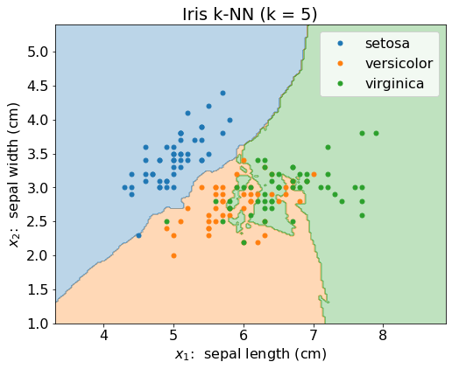
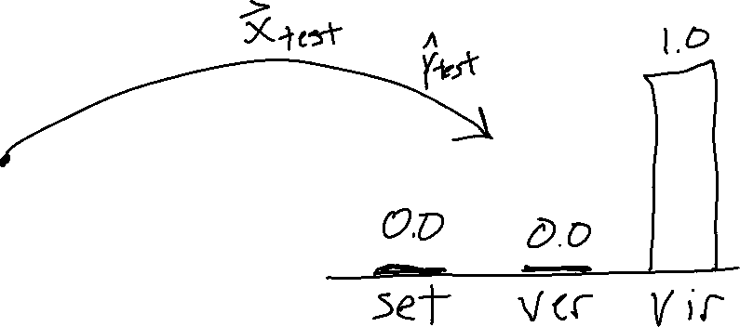
Classification Decisions
Predicting one specific class is troubling, especially when we know that there is some uncertainty in our prediction

Slide 3
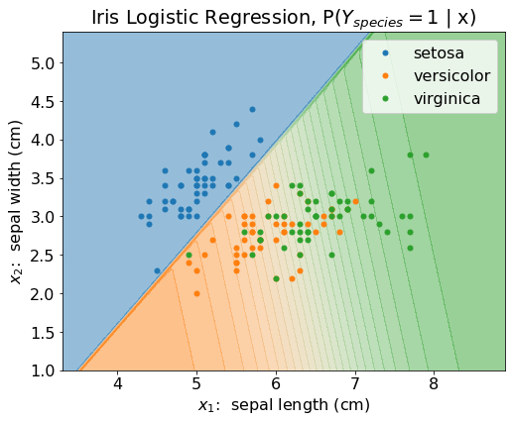
Classification Probability
Constructing a model than can return the probability of the output being a specific class could be incredibly useful

Slide 4





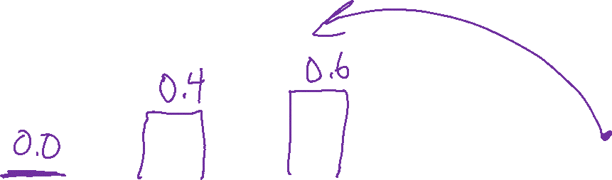
Classification Probability
Constructing a model than can return the probability of the output being a specific class could be incredibly useful
$$1.0$$
$$P(Y_{setosa}=1∣x)$$
$$P(Y_{vers}=1∣x)$$
$$P(Y_{virg}=1∣x)$$
We can still make decisions, .e.g,
$$\underset{k}{argmax} P(Y_{k}=1∣x)$$

Slide 5

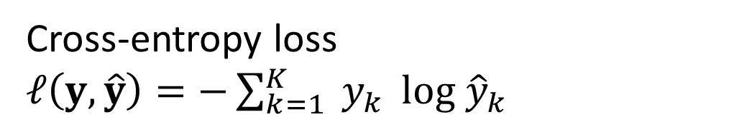
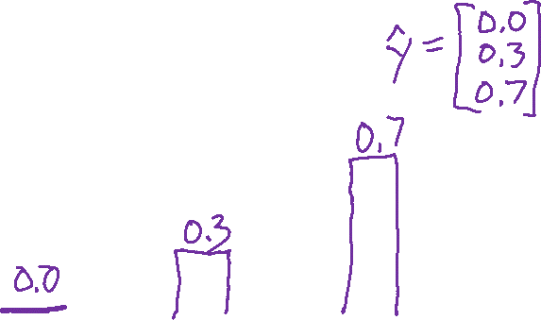

Loss for Probabilty Disributions
We need a way to compare how good/bad each prediction is
$$1.0$$
$$P(Y_{setosa}=1∣x)$$
$$P(Y_{vers}=1∣x)$$
$$P(Y_{virg}=1∣x)$$
Cross-entropy loss
$ℓ\left(y, \hat{y}\right)=−\sum_{k=1}^{K}{{ y}_{k}} log {\hat{y}}_{k}$

Slide 6



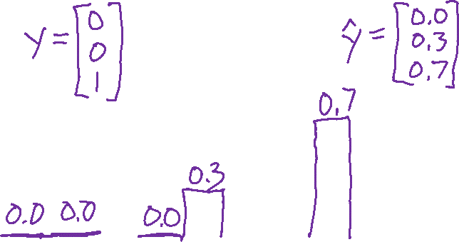


Loss for Probabilty Disributions
We need a way to compare how good/bad each prediction is
$$1.0$$
$$y_{1} {\hat{y}}_{1}$$
$$y_{2} {\hat{y}}_{2}$$
$$y_{3} {\hat{y}}_{3}$$
Cross-entropy loss
$ℓ\left(y, \hat{y}\right)=−\sum_{k=1}^{K}{{ y}_{k}} log {\hat{y}}_{k}$

Slide 7

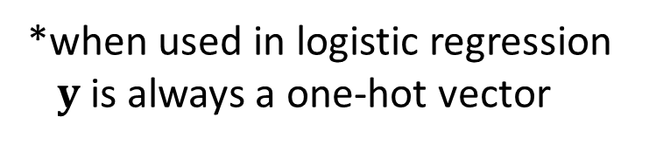
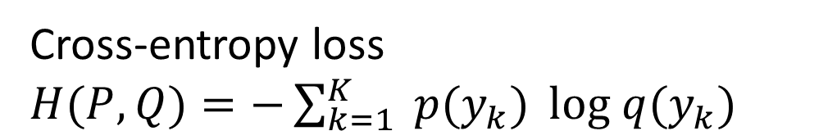



Loss for Probabilty Disributions
Cross-entropy more generally is a way to compare any to probability distributions*
*when used in logistic regression
$y$ is always a one-hot vector
$$1.0$$
$$p\left(y_{1}\right) q(y_{1})$$
$$p\left(y_{2}\right) q(y_{2})$$
$$p\left(y_{3}\right) q(y_{3})$$
Cross-entropy loss
$H(P,Q)=−\sum_{k=1}^{K}{{ p(y}_{k})} log q(y_{k})$

Slide 8

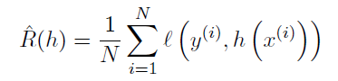
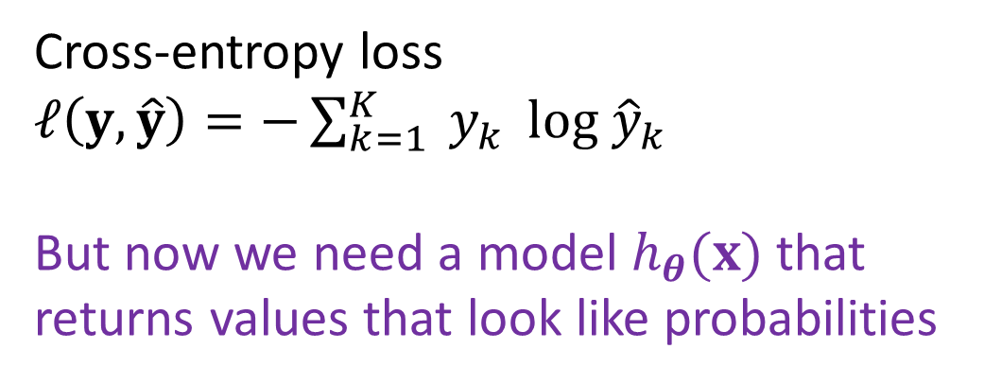
Empirical Risk Minimization
Still doing empirical risk minimization, just with a cross-enropy loss
Cross-entropy loss
$ℓ\left(y, \hat{y}\right)=−\sum_{k=1}^{K}{{ y}_{k}} log {\hat{y}}_{k}$
But now we need a model $h_{θ}(x)$ that returns values that look like probabilities

Slide 9

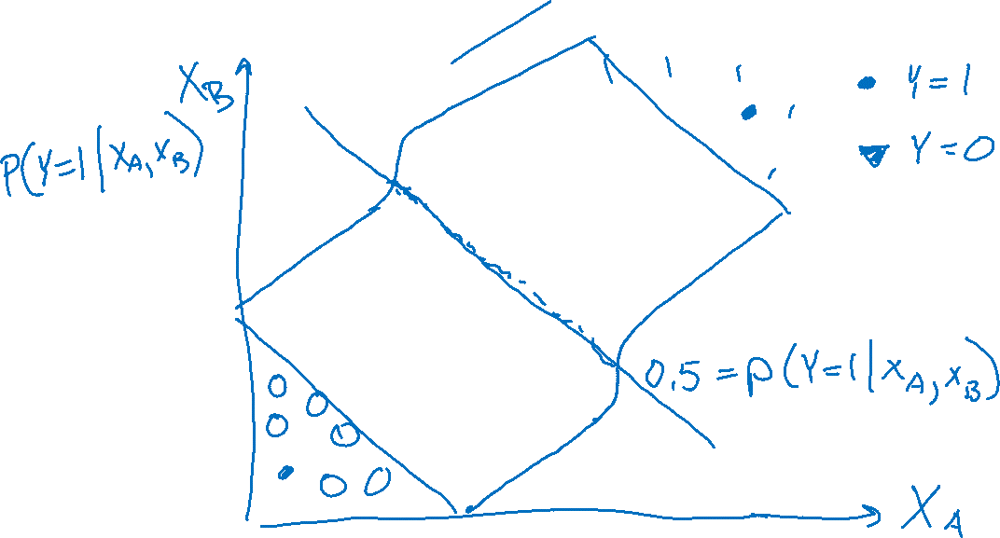
Prediction for Cancer Diagnosis
Learn to predict if a patient has cancer ($Y=1$) or not ($Y=0$) given the input of two test results, $X_{A}$ and $X_{B}$.

Slide 10

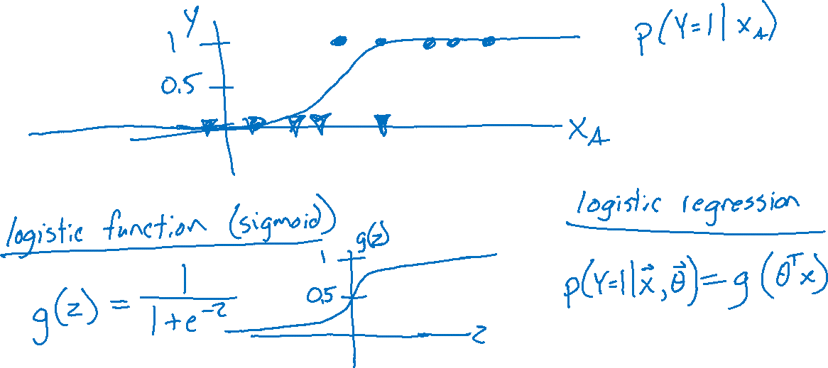
Prediction for Cancer Diagnosis
Learn to predict if a patient has cancer ($Y=1$) or not ($Y=0$) given the input of just one test result, $X_{A}$.

Slide 11
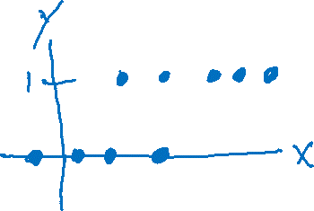
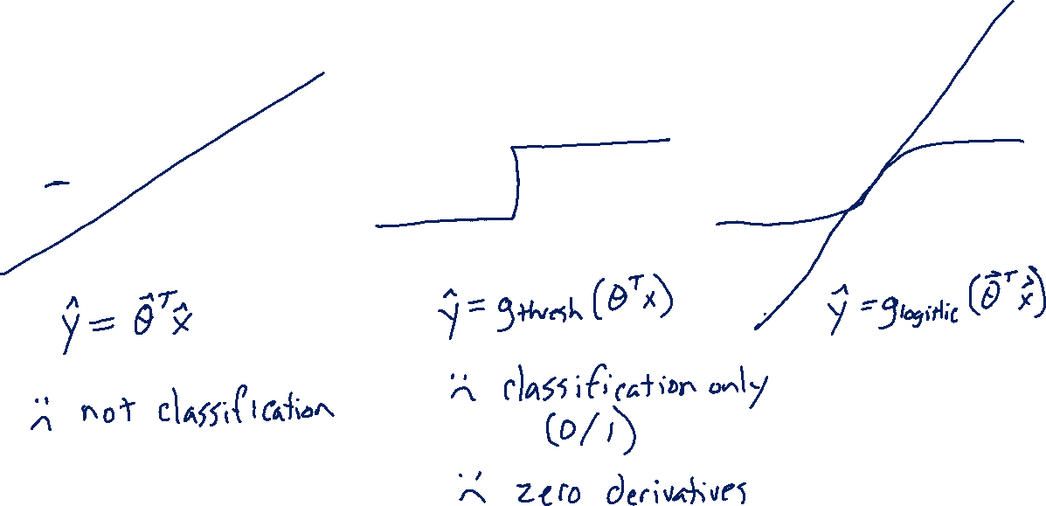
Building on a Linear Model
Linear vs Thresholded Linear vs Logistic Linear

Slide 12
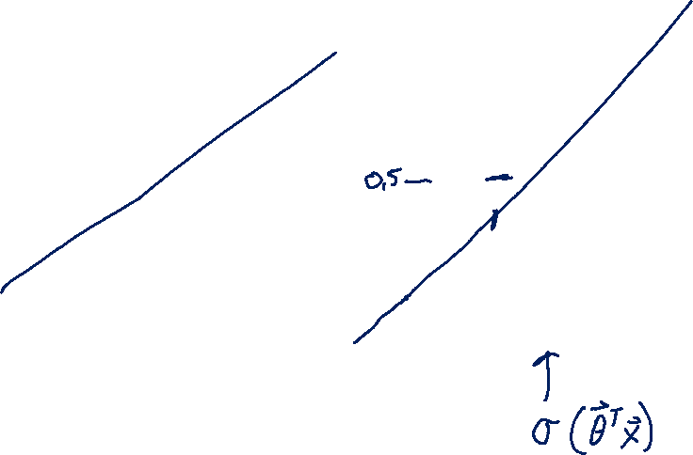
Building on a Linear Model
Linear vs Thresholded Linear vs Logistic Linear

Slide 13
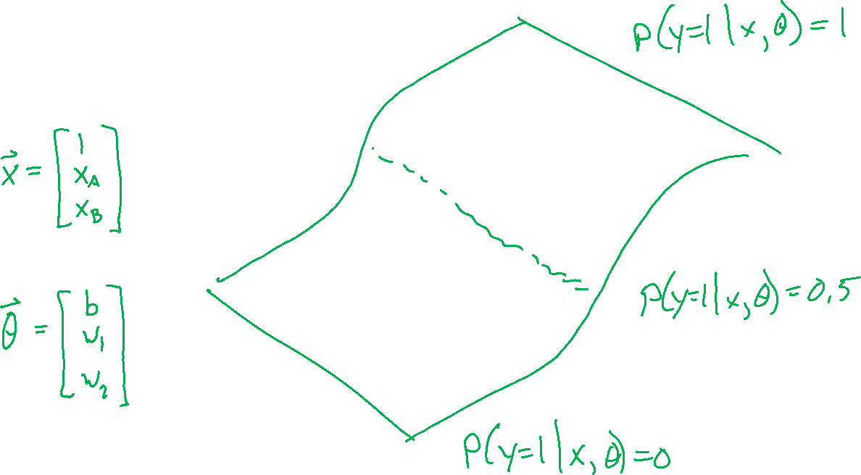
Building on a Linear Model

Slide 14
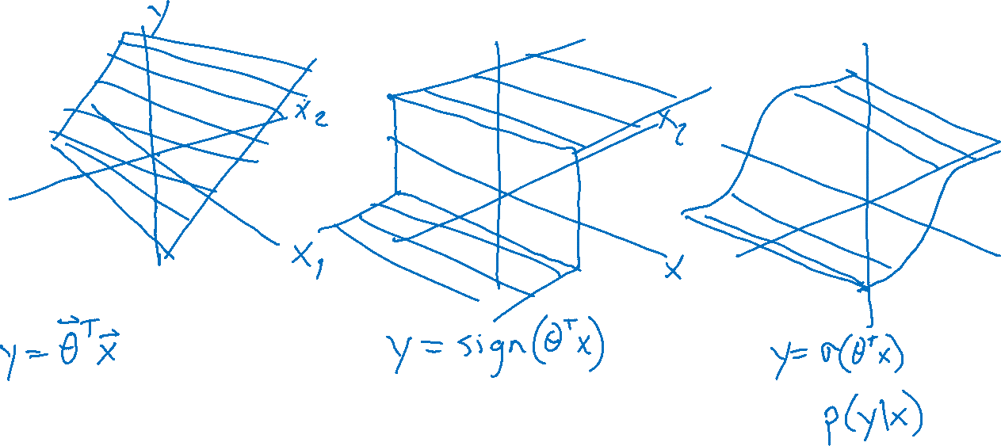
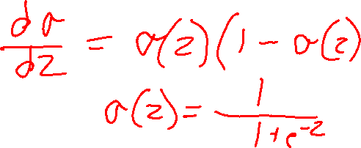
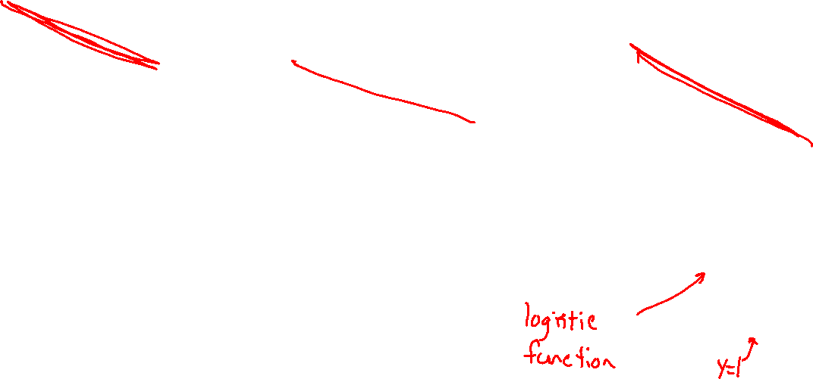
Building on a Linear Model

Slide 15
Logistic Regression
Slide credit: CMU MLD Matt Gormley

Slide 16

Logistic Regression
Slide credit: CMU MLD Matt Gormley

Slide 17
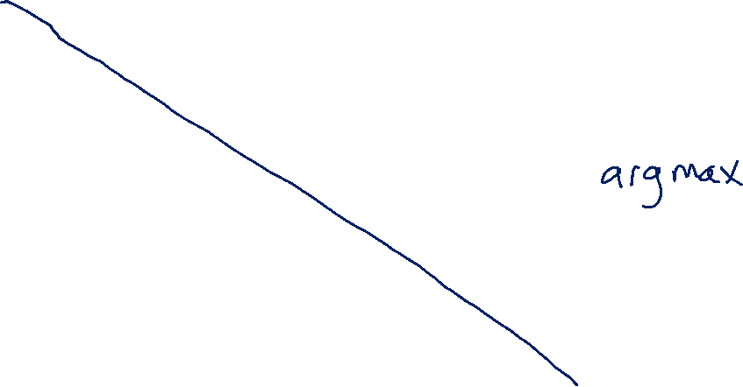
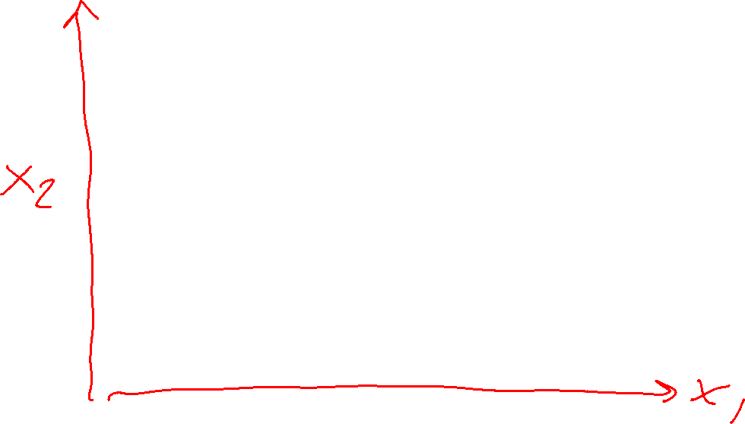
Logistic Regression Decision Boundary
Slide credit: CMU MLD Matt Gormley

Slide 18

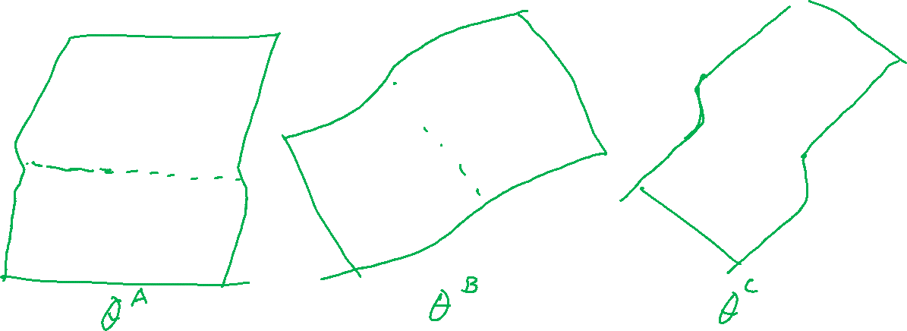
Optimizing a Model for Cancer Diagnosis
Learn to predict if a patient has cancer ($Y=1$) or not ($Y=0$) given the input of two test results, $X_{A}$, $X_{B}$. Note: bias term included in $x$.
$$p\left(Y=1 ∣ x, θ\right)=\frac{1}{1+e^{−θ^{T}x}}$$

Slide 19




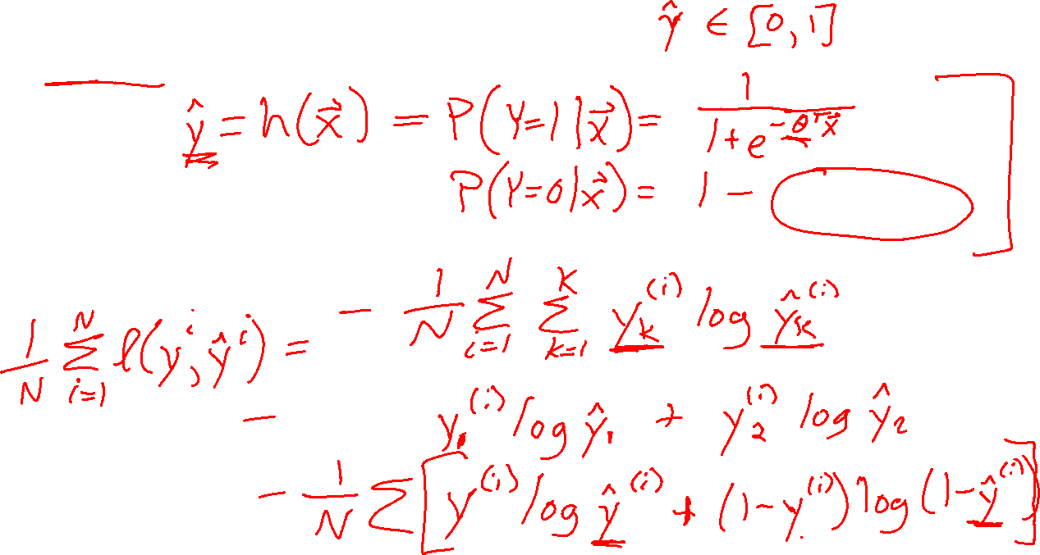
Binary Logistic Regression
Model
Objective function
Solve for $\hat{θ}$

Slide 20
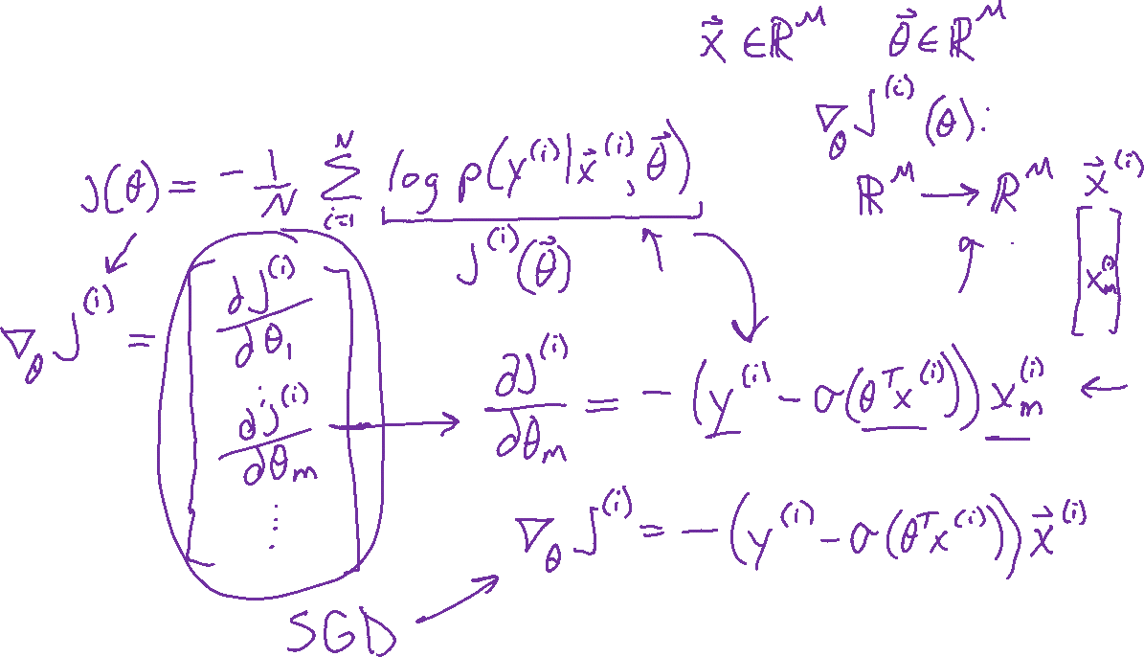
Binary Logistic Regression
Gradient

Slide 21
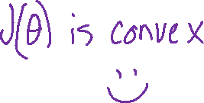

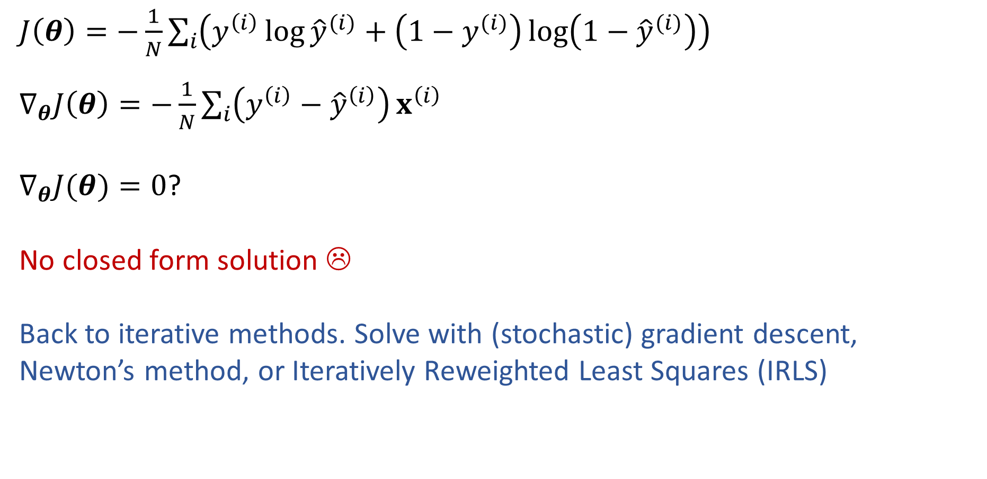

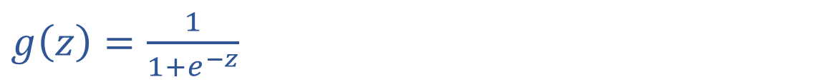
Solve Logistic Regression
$\hat{y}=g\left(θ^{T}x\right)$
$g\left(z\right)=\frac{1}{1+e^{−z}}$
$J\left(θ\right)=−\frac{1}{N}\sum_{i}{\left(y^{\left(i\right)}\log{{\hat{y}}^{(i)}}+\left(1−y^{(i)}\right)\log\left(1−{\hat{y}}^{(i)}\right)\right)}$
$∇_{θ}J\left(θ\right)=−\frac{1}{N}\sum_{i}{\left(y^{\left(i\right)}−{\hat{y}}^{\left(i\right)}\right)}x^{\left(i\right)}$
$∇_{θ}J(θ)=0$?
No closed form solution ☹
Back to iterative methods. Solve with (stochastic) gradient descent, Newton’s method, or Iteratively Reweighted Least Squares (IRLS)

Slide 22
Logistic Regression Decision Boundary
Slide credit: CMU MLD Matt Gormley

Slide 23
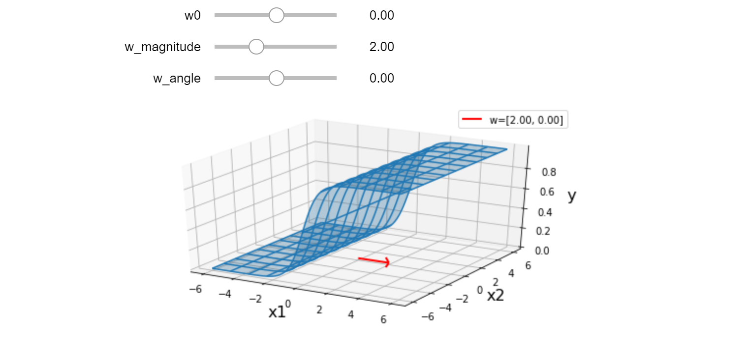
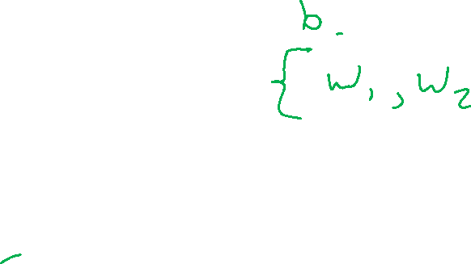
Exercise
Interact with the linear_logistic.ipynb posted on the course website schedule

Slide 24
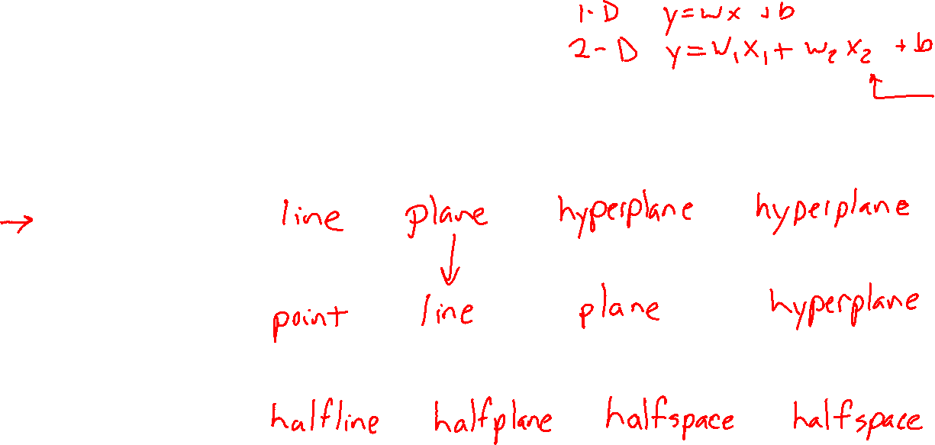






Linear in Higher Dimensions
What are these linear shapes called for 1-D, 2-D, 3-D, M-D input?
$$x∈ℝ$$
$$x∈ℝ^{2}$$
$$x∈ℝ^{3}$$
$$x∈ℝ^{M}$$
$y=w^{T}x+b$
$w^{T}x+b=0$
$w^{T}x+b≥0$

Slide 25
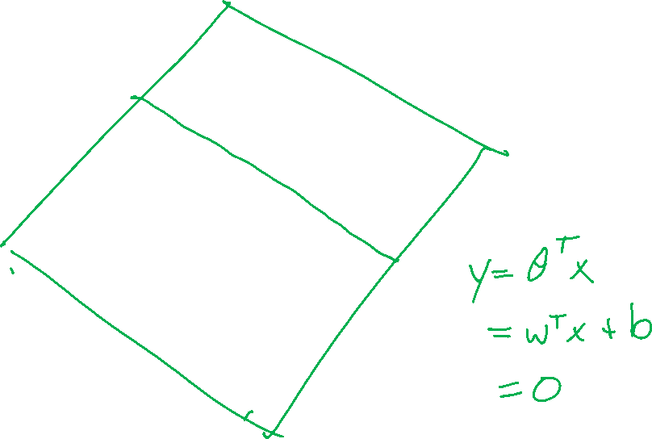
Logistic Regression
Slide credit: CMU MLD Matt Gormley
Notes:
Data are drawn from two Guassians.
There is irreducible error here b/c they overlap.
SHOW: 3D representation with piece of paper.

Slide 26
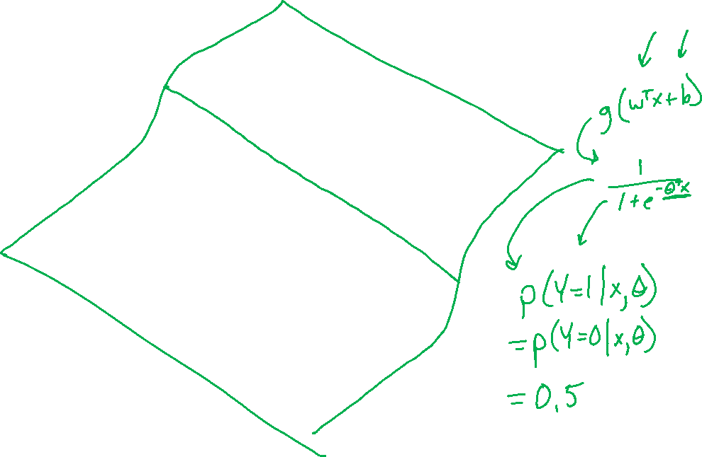
Logistic Regression
Slide credit: CMU MLD Matt Gormley

Slide 27
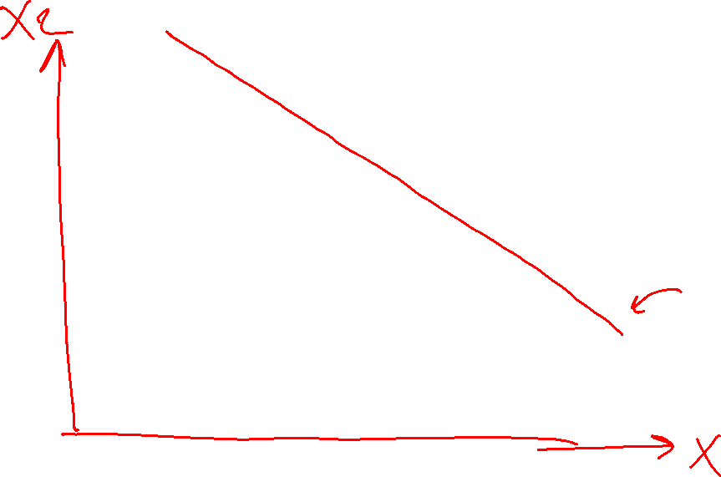
Logistic Regression
Slide credit: CMU MLD Matt Gormley

Slide 28
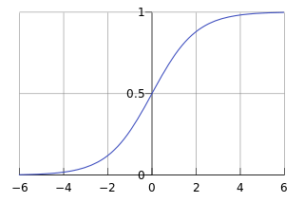

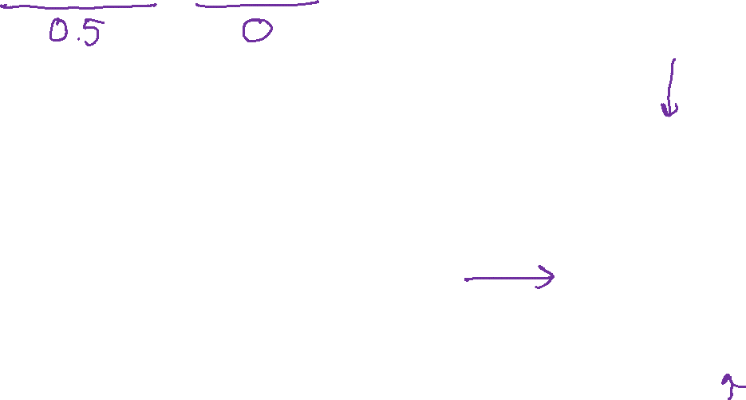

Poll 1
For a point $x$ on the decision boundary of logistic regression, does $g\left(w^{T}x+b\right)=w^{T}x+b$?
$$g\left(z\right)=\frac{1}{1+e^{−z}}$$

Slide 29
Multi-class Logistic Regression

Slide 30
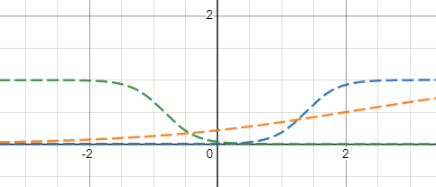
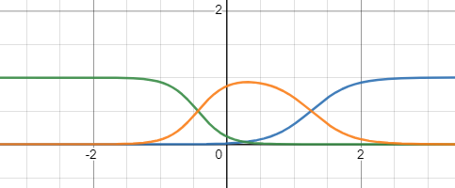
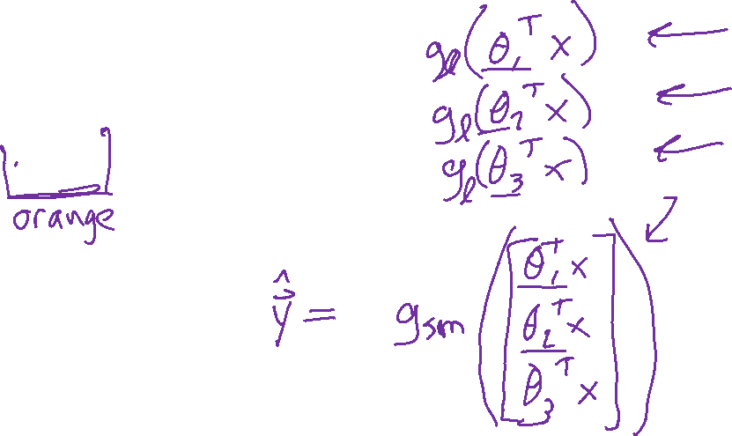
Multi-class Logistic Regression
Desmos Demo:
https://www.desmos.com/calculator/53bautbxjp

Slide 31
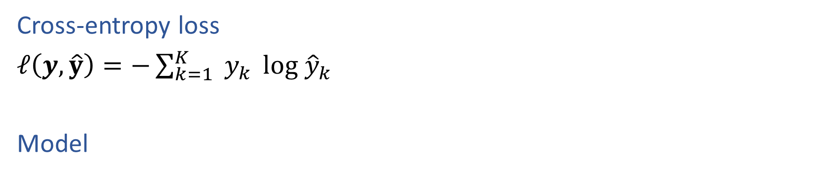
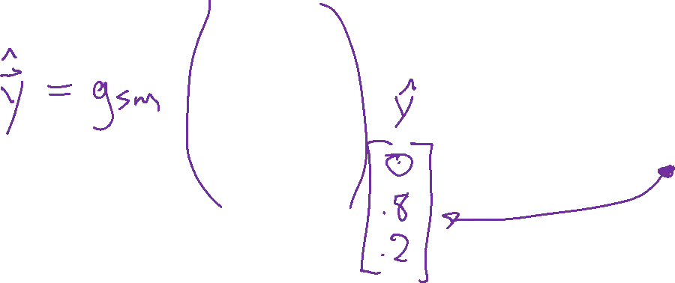
Multi-class Logistic Regression
Cross-entropy loss
$ℓ\left(y, \hat{y}\right)=−\sum_{k=1}^{K}{{ y}_{k}} log {\hat{y}}_{k}$
Model

Slide 32

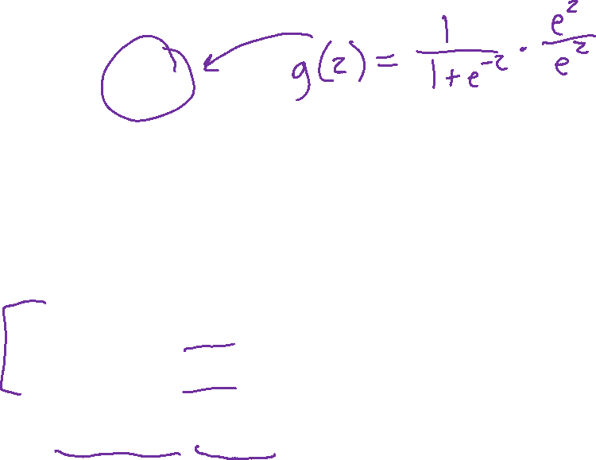
Prep: Multi-class Logistic Regression
Logistic function
$g\left(z\right)=\frac{e^{z}}{e^{z}+1}$
$p\left(Y=1 ∣ x,θ\right)=g\left(μ\right)=\frac{e^{μ}}{e^{μ}+1}$
$p\left(Y=0 ∣ x,θ\right)=1−g\left(μ\right)=1−\frac{e^{μ}}{e^{μ}+1}$
Probability distribution sums to 1
$\sum_{y}{p(Y=y∣x, θ)}$
$=p\left(Y=0 ∣ x,θ\right)+p\left(Y=1 ∣ x,θ\right)$
$= 1−\frac{e^{μ}}{e^{μ}+1}+ \frac{e^{μ}}{e^{μ}+1}=1$

Slide 33
Slide credit: CMU MLD Matt Gormley
Notes:
https://www.jpl.nasa.gov/edu/teach/activity/whats-causing-sea-level-rise-land-ice-vs-sea-ice/

Slide 34


Multi-class Logistic Regression
Slide credit: CMU MLD Matt Gormley

Slide 35


Logistic Function
Logistic (sigmoid) function converts value from $\left(−∞, ∞\right)→(0, 1)$
$$g\left(z\right)=\frac{1}{1+e^{−z}}=\frac{e^{z}}{e^{z}+1}$$
$g\left(z\right)$ and $1−g\left(z\right)$ sum to one
Example $2→g\left(2\right)=0.88$, 1-$g\left(2\right)=0.12$

Slide 36

Softmax Function
Softmax function convert each value in a vector of values
from $\left(−∞, ∞\right)→(0, 1)$, such that they all sum to one.
$$g{\left(z\right)}_{j}=\frac{e^{z_{j}}}{\sum_{k=1}^{K}{e^{z_{k}}}}$$
$\left[\begin{aligned}z_{1} \\ z_{2} \\ ⋮ \\ z_{K}\end{aligned}\right]→\left[\begin{aligned}e^{z_{1}} \\ e^{z_{2}} \\ ⋮ \\ e^{z_{K}}\end{aligned}\right]⋅\frac{1}{\sum_{k=1}^{K}{e^{z_{k}}}}$ Example $\left[\begin{aligned}−1 \\ 4 \\ 1 \\ −2 \\ 3\end{aligned}\right]→\left[\begin{aligned}0.0047 \\ 0.7008 \\ 0.0349 \\ 0.0017 \\ 0.2578\end{aligned}\right]$

Slide 37


Multiclass Predicted Probability
Multiclass logistic regression uses the parameters learned across all $K$ classes to predict the discrete conditional probability distribution of the output $Y$ given a specific input vector $x$
$\left[\begin{aligned}p(Y=1∣x, θ_{1},θ_{2}, θ_{3}) \\ p(Y=2∣x,θ_{1},θ_{2}, θ_{3}) \\ p(Y=3∣x,θ_{1},θ_{2}, θ_{3})\end{aligned}\right]=\left[\begin{aligned}e^{θ_{1}^{T}x} \\ e^{θ_{2}^{T}x} \\ e^{θ_{3}^{T}x}\end{aligned}\right]⋅\frac{1}{\sum_{k=1}^{K}{e^{θ_{k}^{T}x}}}$

Slide 38


Multiclass Predicted Probability
Multiclass logistic regression uses the parameters learned across all $K$ classes to predict the discrete conditional probability distribution of the output $Y$ given a specific input vector $x$

Slide 39
Logistic Regression with Polynomial Features

Slide 40


Exercise
Interact with the logistic_quadratic.ipynb posted on the course website schedule

Slide 41


Exercise
Interact with the logistic_quadratic.ipynb posted on the course website schedule

