Slide 1

Announcements
Assignments
HW4
Due Wed, 10/14, 11:59 pm
HW5
Plan: Out tomorrow
Due Mon, 10/26, 11:59 pm
Recitation
No recitation the next two Fridays ☹
We’ll post a worksheet for neural nets and record a walk-through
Survey

Slide 2

Introduction to Machine Learning Neural Networks
Instructor: Pat Virtue

Slide 3

Plan
Last Time
Neural Networks
Perceptron
Multilayer perceptron
Today
Neural Networks
Building blocks
Optimization
Composite functions and chain rule
Forward-backward passes
Matrix calculus

Slide 4
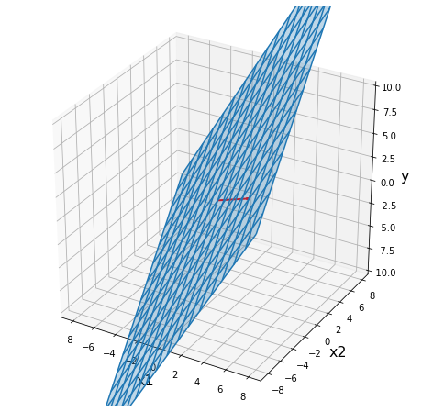
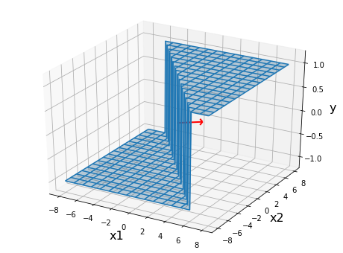
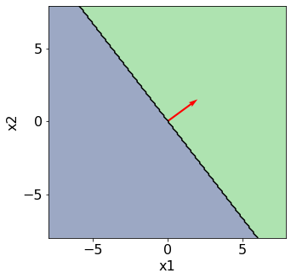
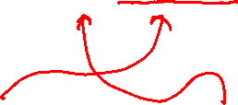
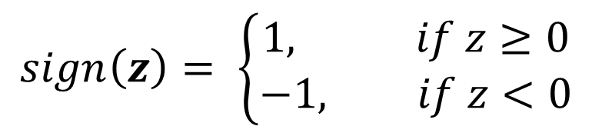

Perceptron
$$sign\left(z\right)= \left\{\begin{aligned}1, if z≥0 \\ −1, if z<0\end{aligned}\right.$$
Classification: Hard threshold on linear model
$$h\left(x\right)=sign\left(w^{T}x+b\right)$$

Slide 5
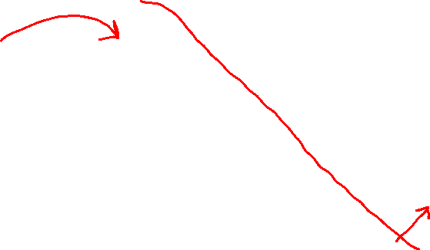


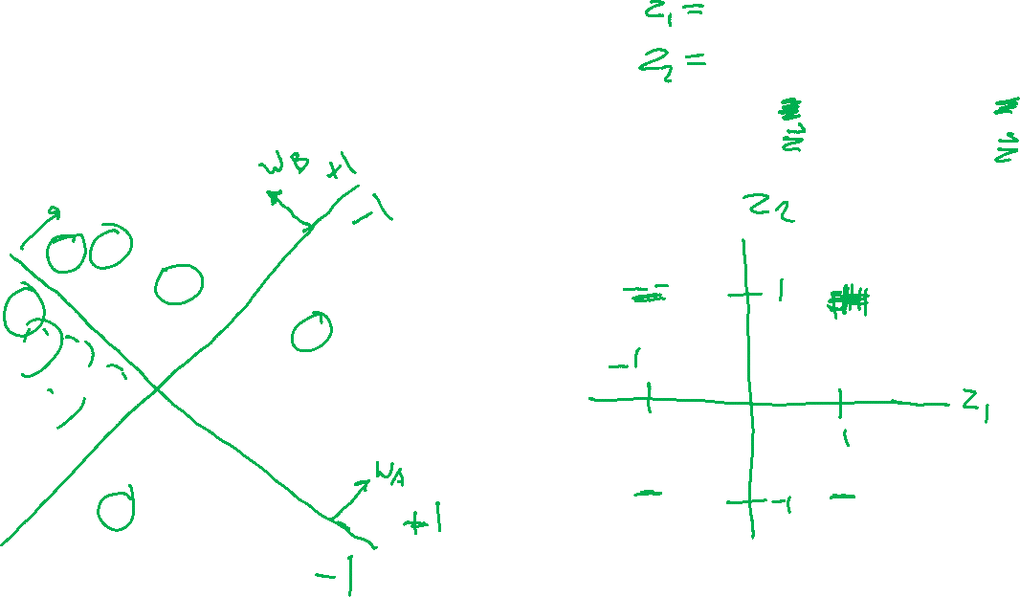
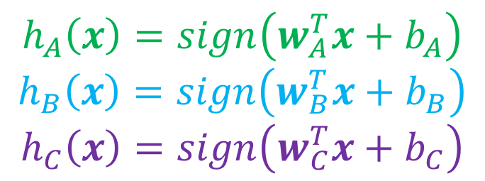
Classification Design Challenge
$$h_{A}\left(x\right)=sign\left(w_{A}^{T}x+b_{A}\right)$$
$$h_{B}\left(x\right)=sign\left(w_{B}^{T}x+b_{B}\right)$$
$$h_{C}\left(x\right)=sign\left(w_{C}^{T}x+b_{C}\right)$$
How could you configure three specific perceptrons to classify this data?
$$x2$$
$$x1$$

Slide 6
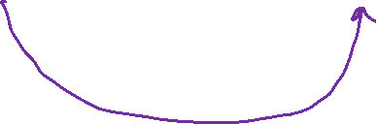
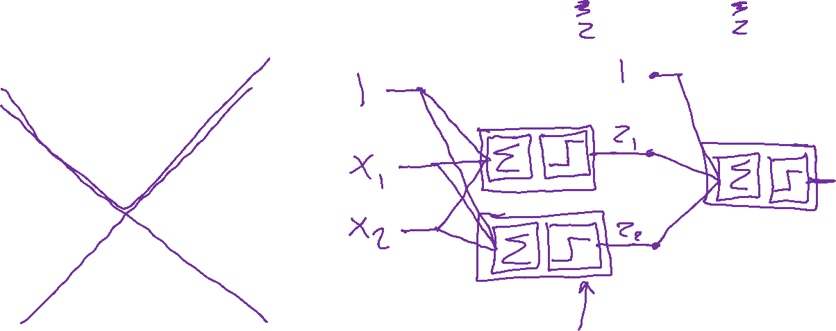
Classification Design Challenge
$$h_{A}\left(x\right)=sign\left(w_{A}^{T}x+b_{A}\right)$$
$$h_{B}\left(x\right)=sign\left(w_{B}^{T}x+b_{B}\right)$$
$$h_{C}\left(x\right)=sign\left(w_{C}^{T}x+b_{C}\right)$$
How could you configure three specific perceptrons to classify this data?
$$x2$$
$$x1$$

Slide 7
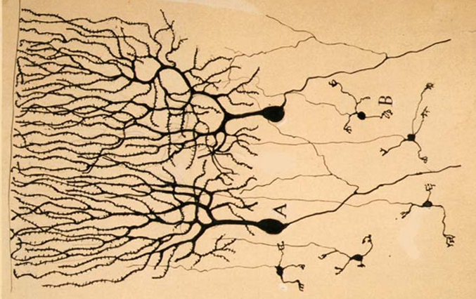

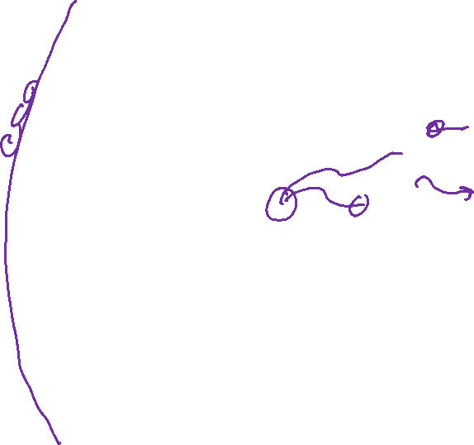
Neural Networks
Inspired by actual human brain
Output
Signal
Input Signal
DOG
CAT
TREE
CAR
SKY
Image: https://en.wikipedia.org/wiki/Neuron

Slide 8
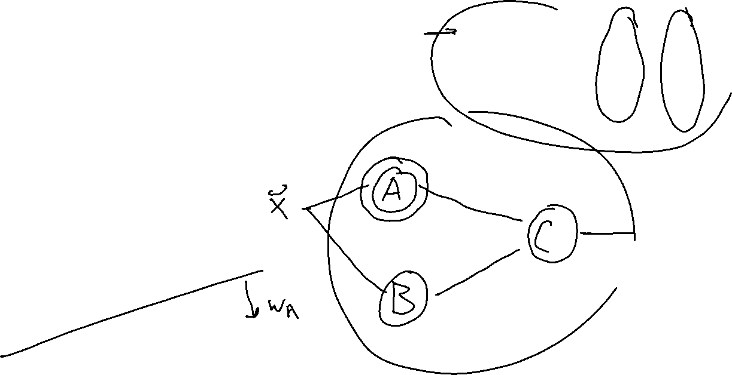
Classification Design Challenge
$$h_{A}\left(x\right)=sign\left(w_{A}^{T}x+b_{A}\right)$$
$$h_{B}\left(x\right)=sign\left(w_{B}^{T}x+b_{B}\right)$$
$$h_{C}\left(x\right)=sign\left(w_{C}^{T}x+b_{C}\right)$$
How could you configure three specific perceptrons to classify this data?
$$x2$$
$$x1$$

Slide 9
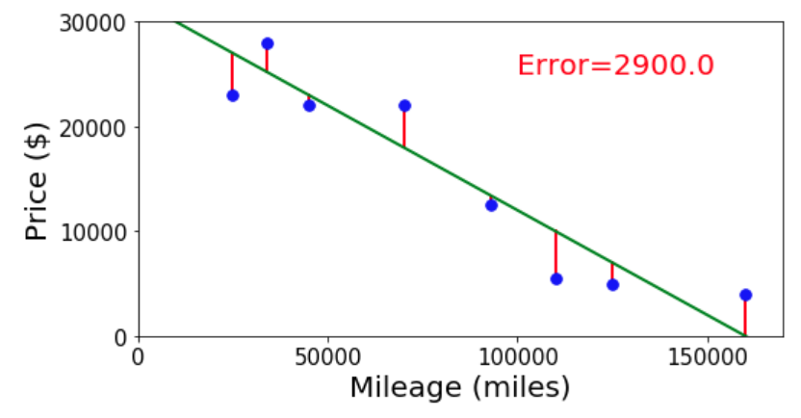
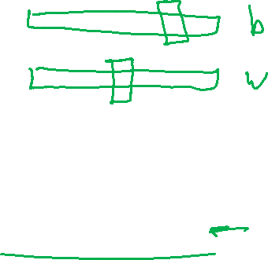
Neural Networks
Simple single neuron example:
Selling my car

Slide 10
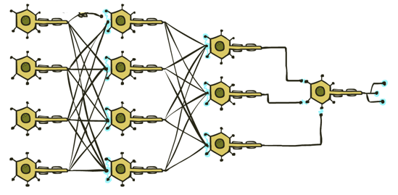

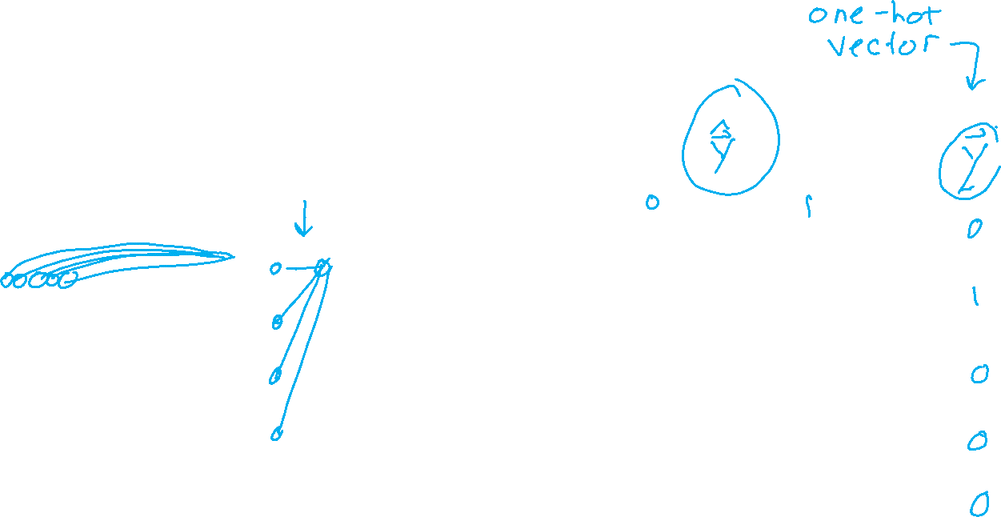
Neural Networks
Many layers of neurons, millions of parameters
Output
Signal
Input Signal
DOG
CAT
TREE
CAR
SKY

Slide 11

Neural Networks
Many layers of neurons, millions of parameters
Output
Signal
Input Signal
DOG
CAT
TREE
CAR
SKY

Slide 12

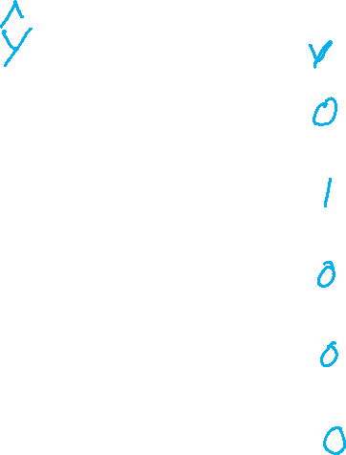
Neural Networks
Many layers of neurons, millions of parameters
Output
Signal
Input Signal
LEFT
RIGHT
UP
DOWN
BUTTON

Slide 13

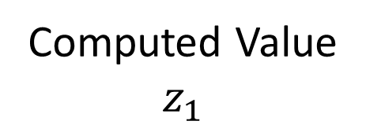

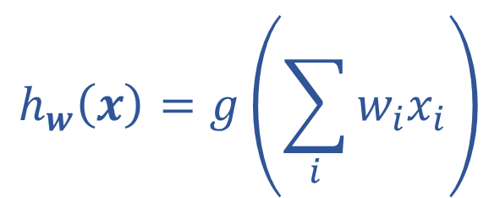
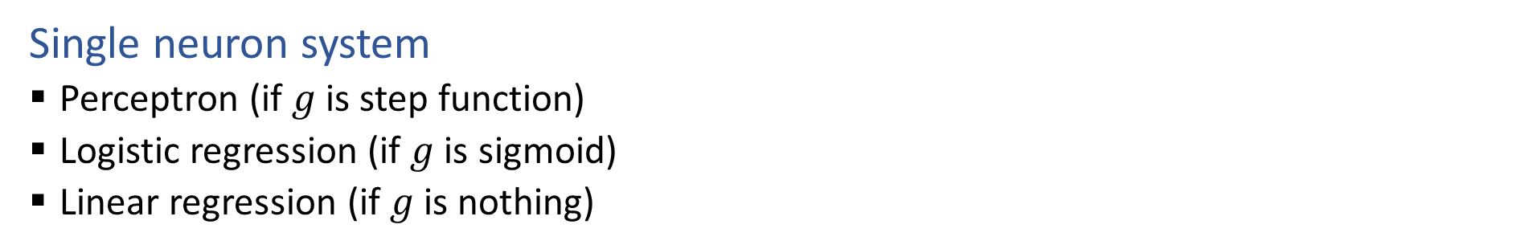







Single Neuron
Single neuron system
Perceptron (if $g$ is step function)
Logistic regression (if $g$ is sigmoid)
Linear regression (if $g$ is nothing)
$$x1$$
$$w1$$
Computed Value
$$z_{1}$$
True Label
$$y$$
$$∑$$
$$g$$
$$x2$$
$$h_{w}\left(x\right)=z_{1}$$
$$w2$$
$$h_{w}\left(x\right)=g\left(\sum_{i}{w_{i}x_{i}}\right)$$

Slide 14
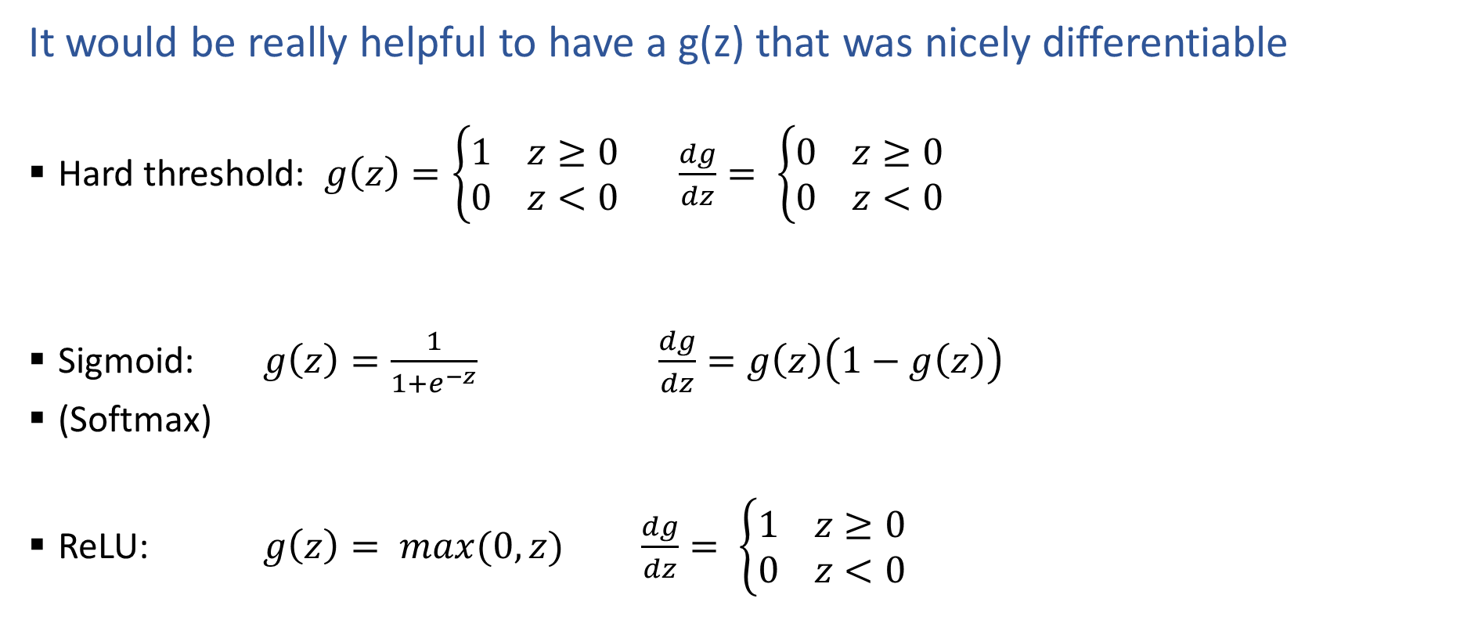
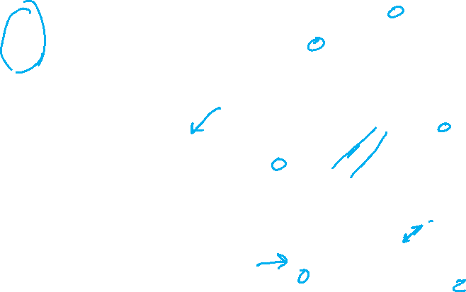
Activation Functions
It would be really helpful to have a g(z) that was nicely differentiable
Hard threshold: $g\left(z\right)=\left\{\begin{aligned}1 z≥0 \\ 0 z<0\end{aligned}\right.$ $\frac{dg}{dz}= \left\{\begin{aligned}0 z≥0 \\ 0 z<0\end{aligned}\right.$
Sigmoid: $g\left(z\right)=\frac{1}{1+e^{−z}}$ $\frac{dg}{dz}=g\left(z\right)\left(1−g\left(z\right)\right)$
(Softmax)
ReLU: $g\left(z\right)= max(0,z)$ $\frac{dg}{dz}= \left\{\begin{aligned}1 z≥0 \\ 0 z<0\end{aligned}\right.$

Slide 15
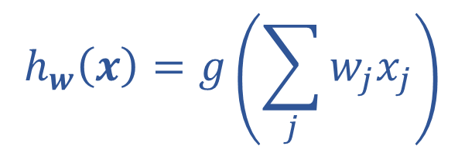
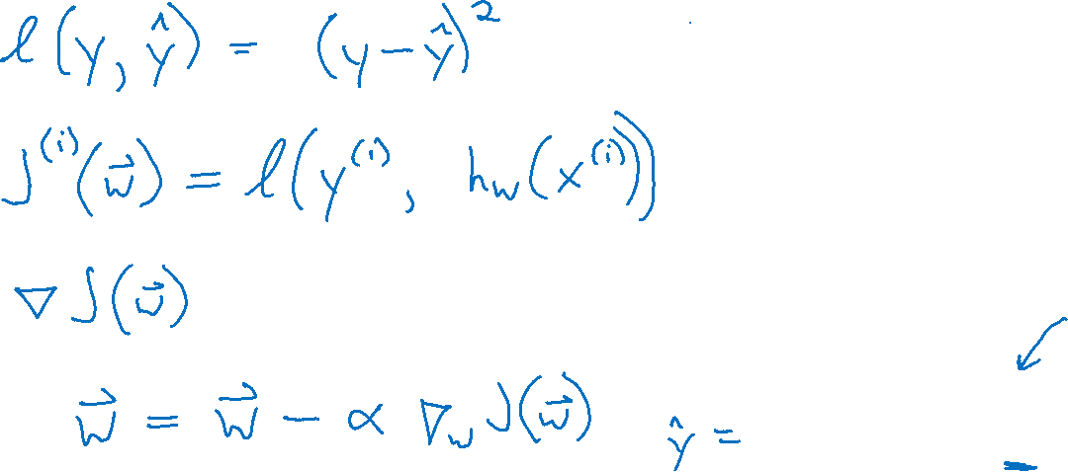
Optimizing
How do we find the “best” set of weights?
$$h_{w}\left(x\right)=g\left(\sum_{j}{w_{j}x_{j}}\right)$$

Slide 16

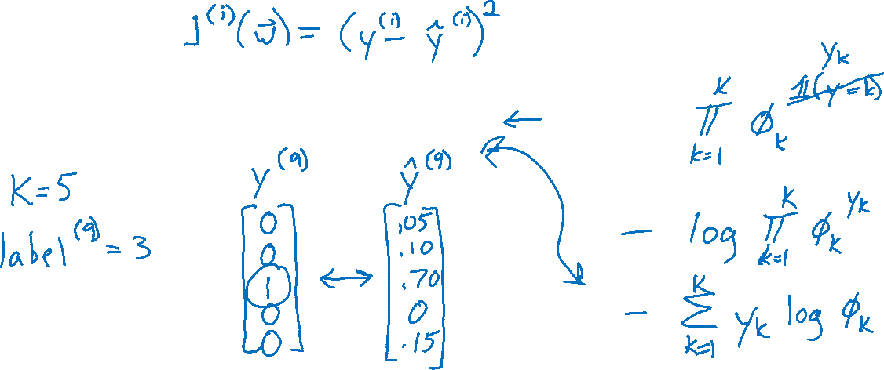
Loss Functions
Regression
Squared error: $ℓ\left(y, \hat{y}\right)={\left(y−\hat{y}\right)}^{2}$
Classification
Cross entropy: $ℓ\left(y, \hat{y}\right)=−\sum_{k}{ y_{k}\log{{\hat{y}}_{k}}}$

Slide 17
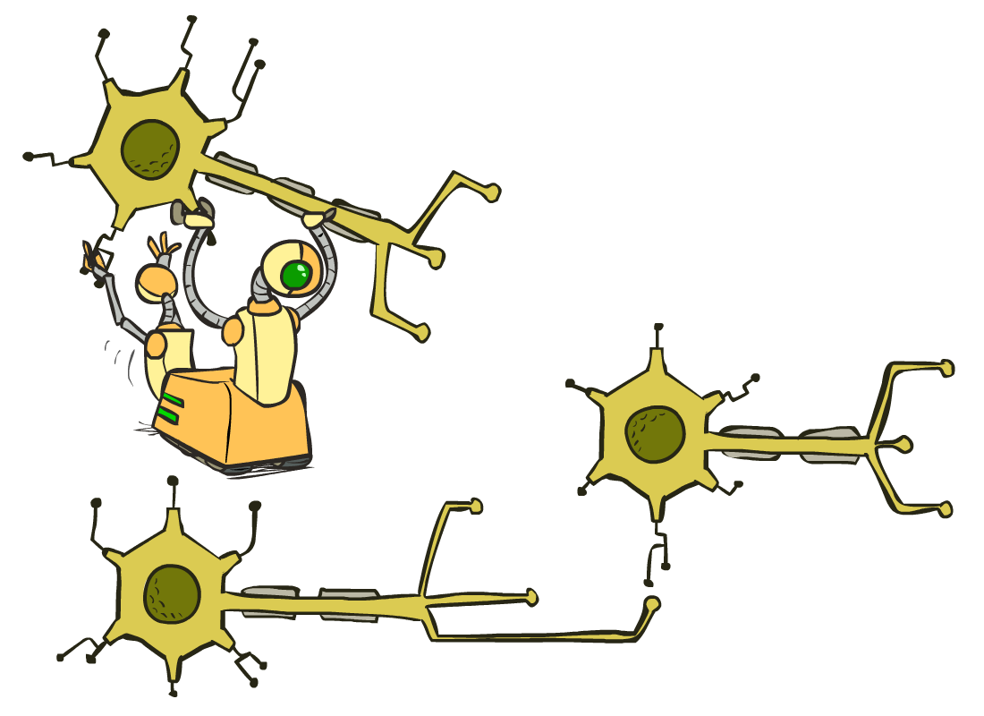
Multilayer Perceptrons
A multilayer perceptron is a feedforward neural network with at least one hidden layer (nodes that are neither inputs nor outputs)
MLPs with enough hidden nodes can represent any function
Slide from UC Berkeley AI

Slide 18










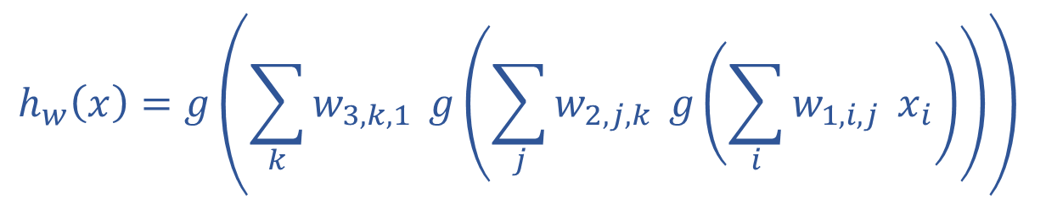



























Neural Network Equations
$$z11$$
$$w111$$
$$z21$$
$$x1$$
$$∑$$
$$g$$
$$w211$$
$$w112$$
$$w113$$
$$w212$$
$$z31$$
$$∑$$
$$g$$
$$w311$$
$$w121$$
$$w221$$
$$z12$$
$$z22$$
$$z41$$
$$x2$$
$$∑$$
$$g$$
$$∑$$
$$g$$
$$w123$$
$$w221$$
$$z32$$
$$w321$$
$$w131$$
$$∑$$
$$g$$
$$z13$$
$$z23$$
$$w232$$
$$x3$$
$$∑$$
$$g$$
w₁₃₃
$$h_{w}\left(x\right)=z_{4,1}$$
$z_{1,1}=x_{1}$
$z_{4,1}=g\left(\sum_{i}{w_{3,i,1} z_{3,i}}\right)$
$$h_{w}\left(x\right)=g\left(\sum_{k}{w_{3,k,1}} g\left(\sum_{j}{w_{2,j,k}} g\left(\sum_{i}{w_{1,i,j}} x_{i}\right)\right)\right)$$
$z_{3,1}=g\left(\sum_{i}{w_{2,i,1} z_{2,i}}\right)$
$z_{d,1}=g\left(\sum_{i}{w_{d−1,i,1} z_{d−1,i}}\right)$

Slide 19
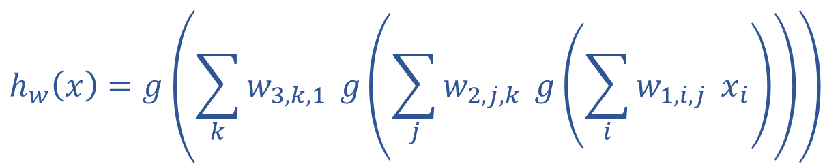
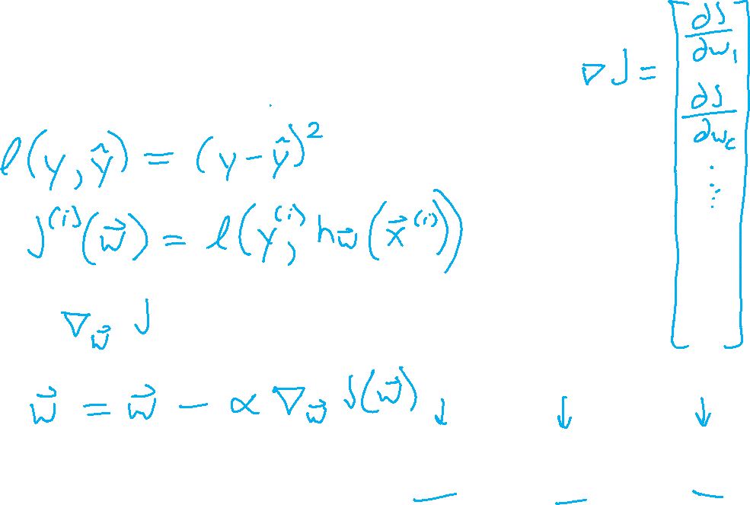
Optimizing
How do we find the “best” set of weights?
$$h_{w}\left(x\right)=g\left(\sum_{k}{w_{3,k,1}} g\left(\sum_{j}{w_{2,j,k}} g\left(\sum_{i}{w_{1,i,j}} x_{i}\right)\right)\right)$$

Slide 20
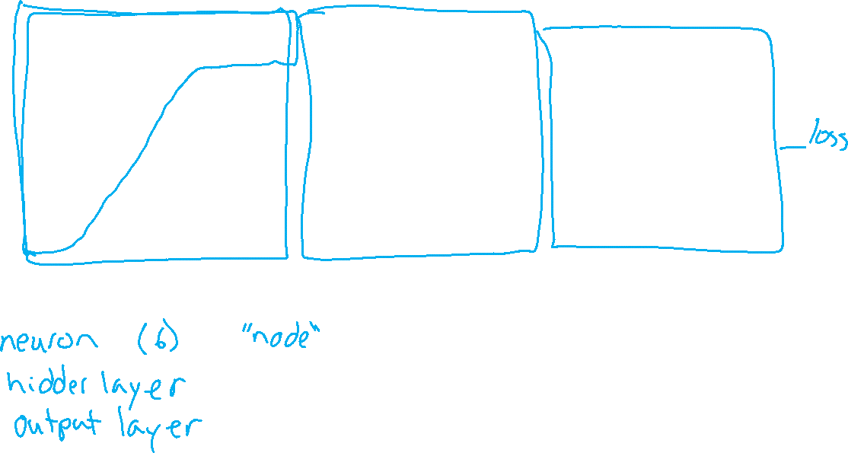
Neural Network Equations
$$z11$$
$$w111$$
$$z21$$
$$x1$$
$$∑$$
$$g$$
$$w211$$
$$w112$$
$$w113$$
$$w212$$
$$z31$$
$$∑$$
$$g$$
$$w311$$
$$w121$$
$$w221$$
$$z12$$
$$z22$$
$$z41$$
$$x2$$
$$∑$$
$$g$$
$$∑$$
$$g$$
$$w123$$
$$w221$$
$$z32$$
$$w321$$
$$w131$$
$$∑$$
$$g$$
$$z13$$
$$z23$$
$$w232$$
$$x3$$
$$∑$$
$$g$$
w₁₃₃
How do we describe this network?

Slide 21
Network Optimization Details

Slide 22
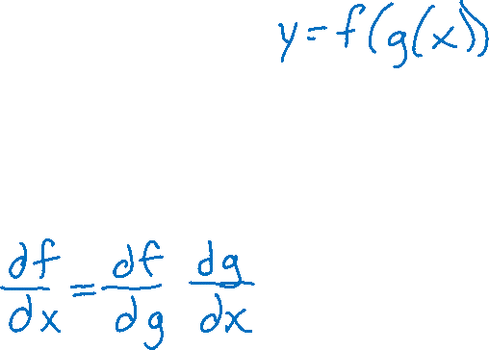
Reminder: Calculus Chain Rule (scalar version)
$$y=f\left(z\right)$$
$$z=g\left(x\right)$$
$$\frac{dy}{dx}=\frac{dy}{dz}\frac{dz}{dx}$$

Slide 23
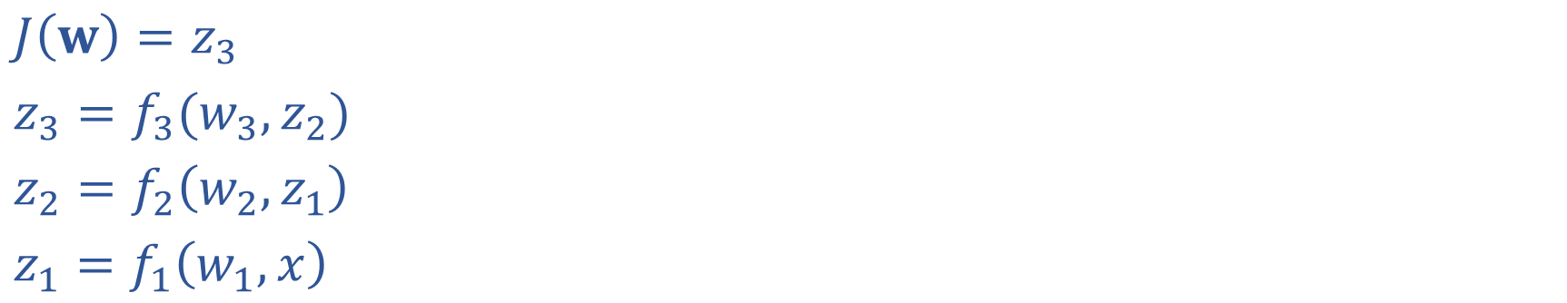
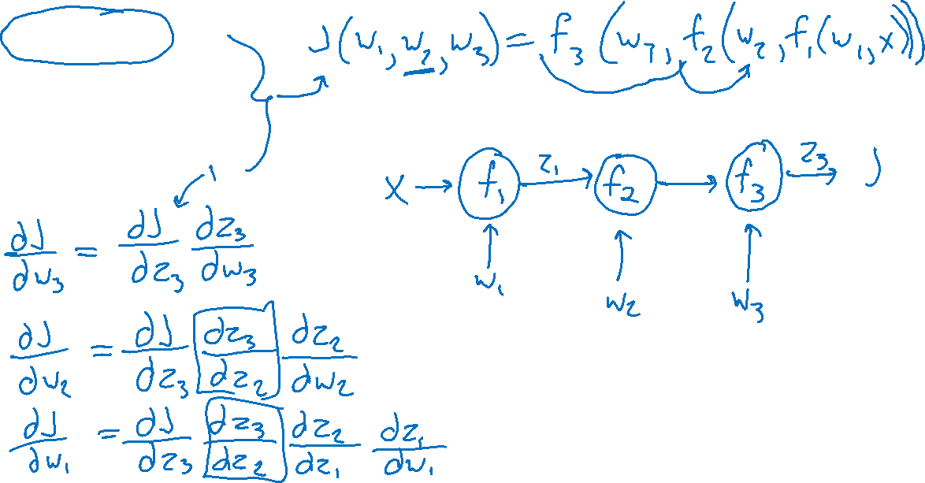
Network Optimization
$J\left(w\right)=z_{3}$
$z_{3}=f_{3}(w_{3}, z_{2})$
$z_{2}=f_{2}\left(w_{2}, z_{1}\right)$
$z_{1}=f_{1}\left(w_{1}, x\right)$

Slide 24
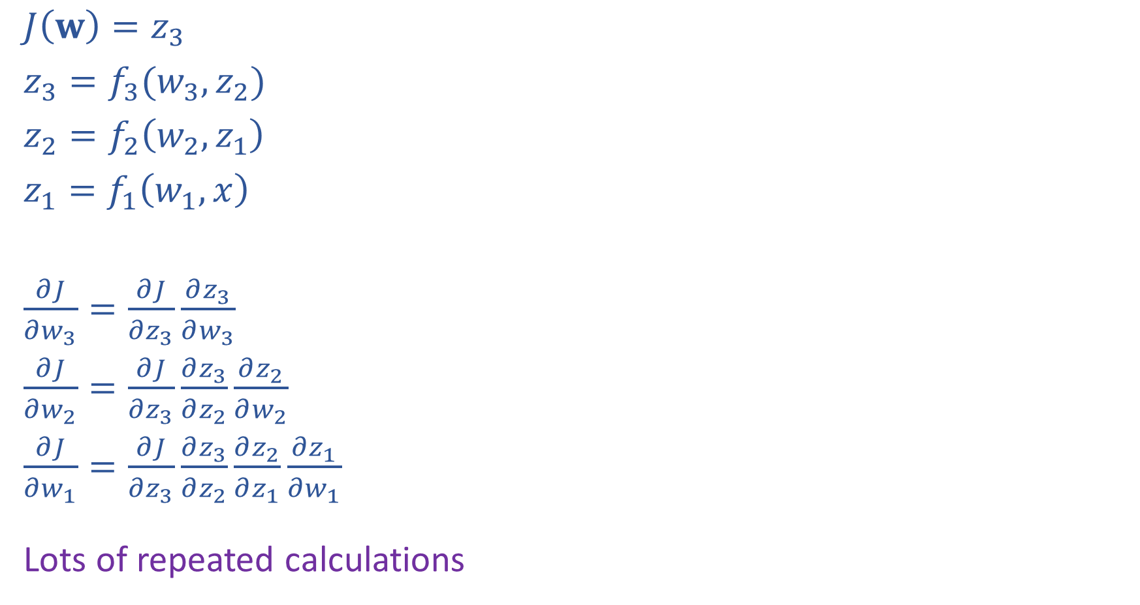
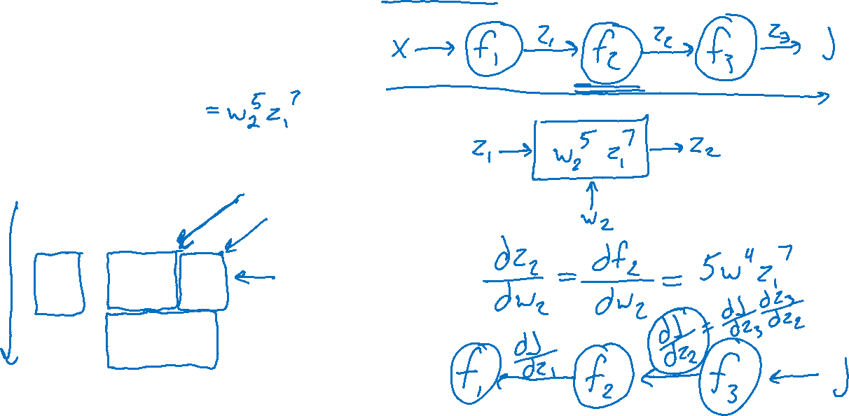
Network Optimization: Forward then Backwards
$J\left(w\right)=z_{3}$
$z_{3}=f_{3}(w_{3}, z_{2})$
$z_{2}=f_{2}\left(w_{2}, z_{1}\right)$
$z_{1}=f_{1}\left(w_{1}, x\right)$
$\frac{∂J}{∂w_{3}}=\frac{∂J}{∂z_{3}}\frac{∂z_{3}}{∂w_{3}}$
$\frac{∂J}{∂w_{2}}=\frac{∂J}{∂z_{3}}\frac{∂z_{3}}{∂z_{2}}\frac{∂z_{2}}{∂w_{2}}$
$\frac{∂J}{∂w_{1}}=\frac{∂J}{∂z_{3}}\frac{∂z_{3}}{∂z_{2}}\frac{∂z_{2}}{∂z_{1}}\frac{∂z_{1}}{∂w_{1}}$
Lots of repeated calculations

Slide 25
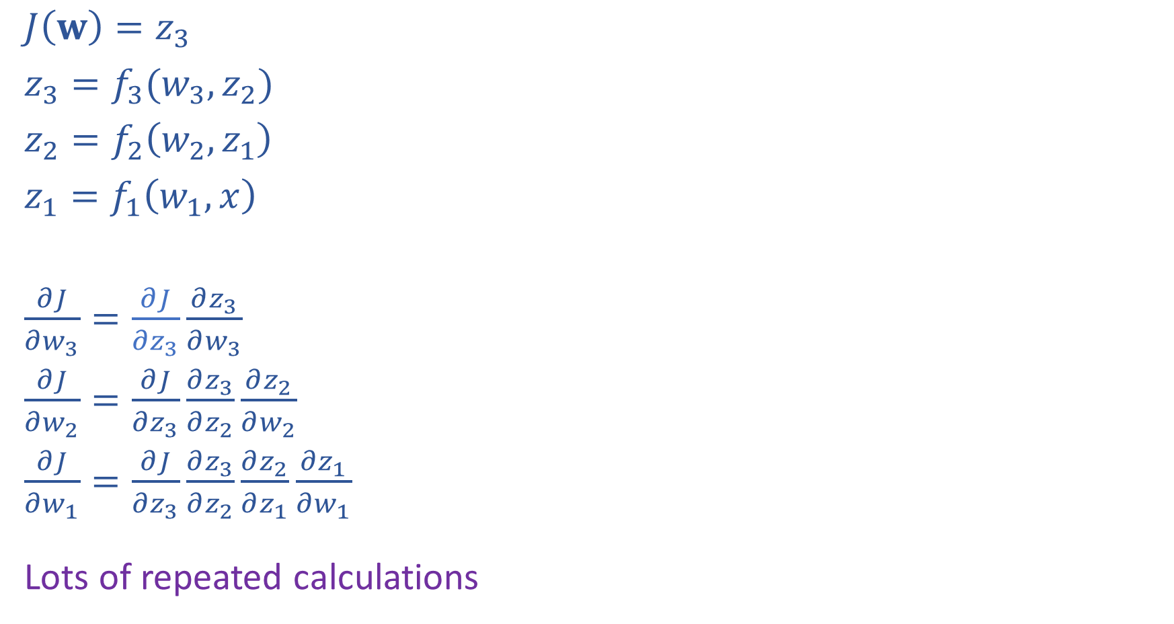
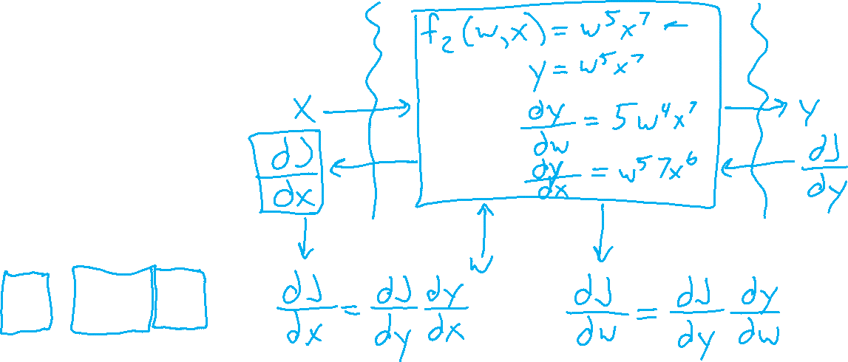
Network Optimization: Layer Implementation
$J\left(w\right)=z_{3}$
$z_{3}=f_{3}(w_{3}, z_{2})$
$z_{2}=f_{2}\left(w_{2}, z_{1}\right)$
$z_{1}=f_{1}\left(w_{1}, x\right)$
$\frac{∂J}{∂w_{3}}=\frac{∂J}{∂z_{3}}\frac{∂z_{3}}{∂w_{3}}$
$\frac{∂J}{∂w_{2}}=\frac{∂J}{∂z_{3}}\frac{∂z_{3}}{∂z_{2}}\frac{∂z_{2}}{∂w_{2}}$
$\frac{∂J}{∂w_{1}}=\frac{∂J}{∂z_{3}}\frac{∂z_{3}}{∂z_{2}}\frac{∂z_{2}}{∂z_{1}}\frac{∂z_{1}}{∂w_{1}}$
Lots of repeated calculations

Slide 26
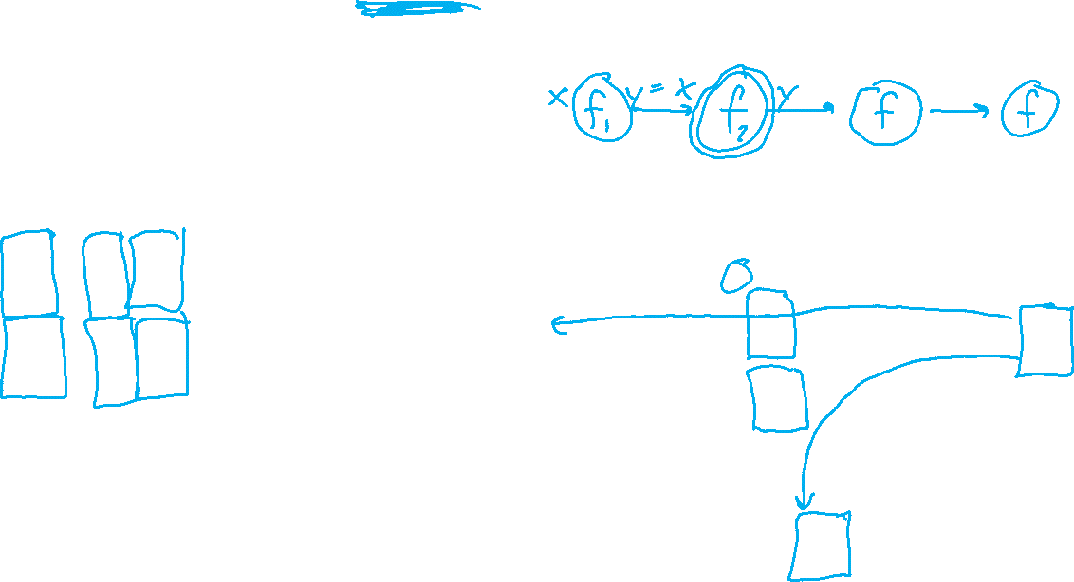
Backpropagation (so-far)
Compute derivatives per layer, utilizing previous derivatives
Objective: $J\left(w\right)$
Arbitrary layer: $y=f\left(x, w\right)$
Need:
$\frac{∂J}{∂x}=\frac{∂J}{∂y}\frac{∂y}{∂x}$
$\frac{∂J}{∂w}=\frac{∂J}{∂y}\frac{∂y}{∂w}$
$$x$$
Layer $y=f\left(x, w\right)$
$\frac{∂y}{∂x}$
$\frac{∂y}{∂w}$
$$y$$
$$\frac{∂J}{∂x}$$
$$\frac{∂J}{∂y}$$
$$w$$
$$\frac{∂J}{∂w}$$

Slide 27
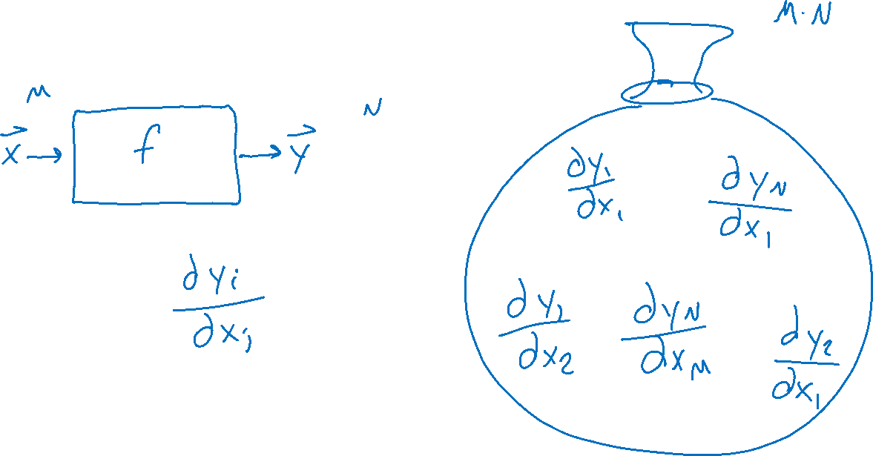
Matrix Calculus
One way to think of it: Bag of Derivatives

Slide 28
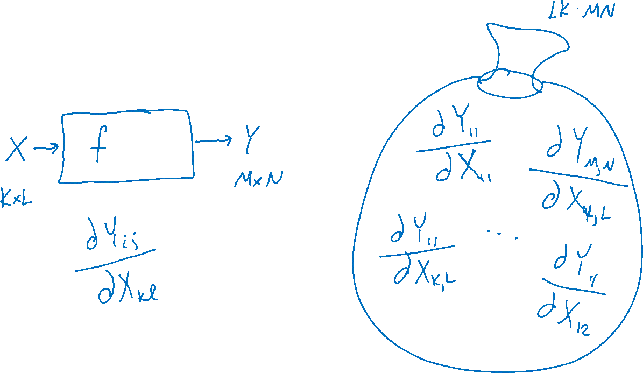
Matrix Calculus
One way to think of it: Bag of Derivatives

Slide 29
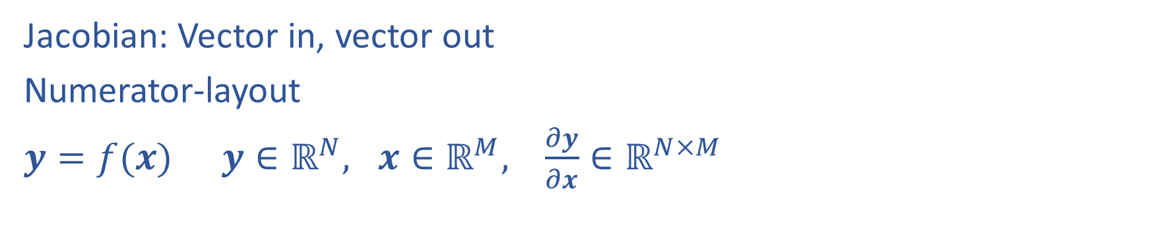
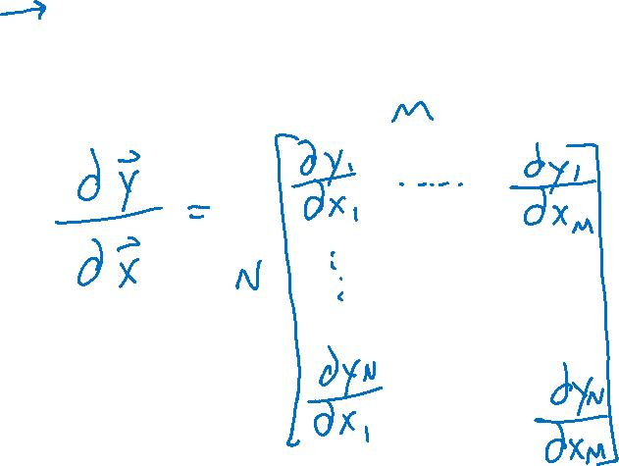
Matrix Calculus
Jacobian: Vector in, vector out
Numerator-layout
$y=f(x)$ $y∈ℝ^{N}, x∈ℝ^{M}, \frac{∂y}{∂x}∈ℝ^{N×M}$

Slide 30
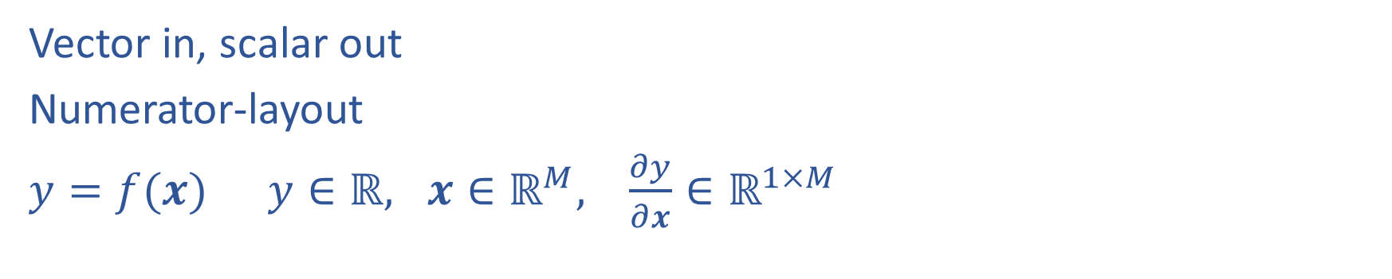
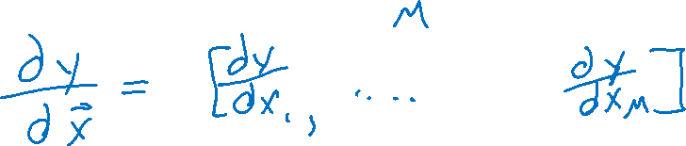
Matrix Calculus
Vector in, scalar out
Numerator-layout
$y=f(x)$ $y∈ℝ, x∈ℝ^{M}, \frac{∂y}{∂x}∈ℝ^{1×M}$

Slide 31
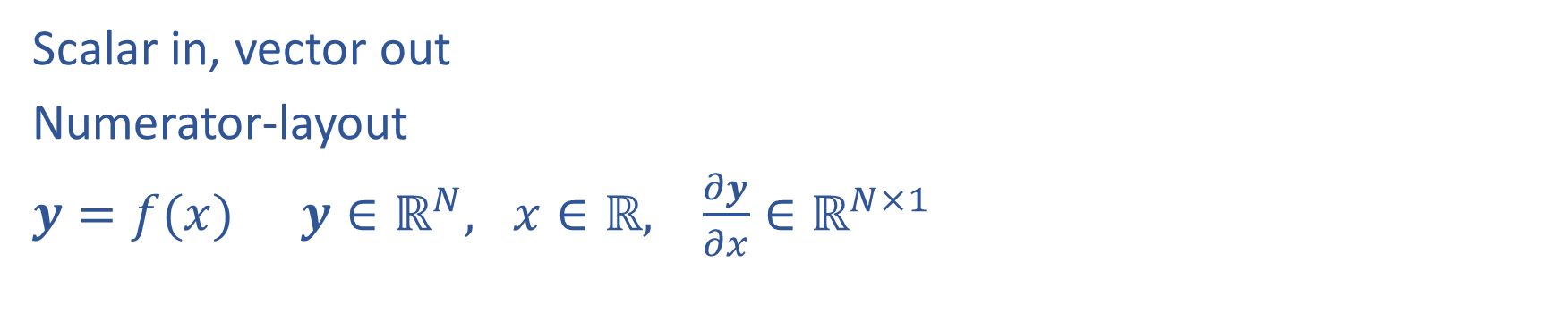
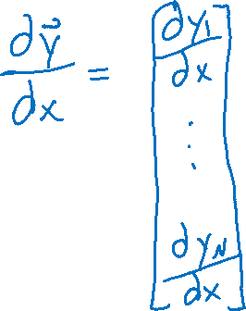
Matrix Calculus
Scalar in, vector out
Numerator-layout
$y=f(x)$ $y∈ℝ^{N}, x∈ℝ, \frac{∂y}{∂x}∈ℝ^{N×1}$

Slide 32
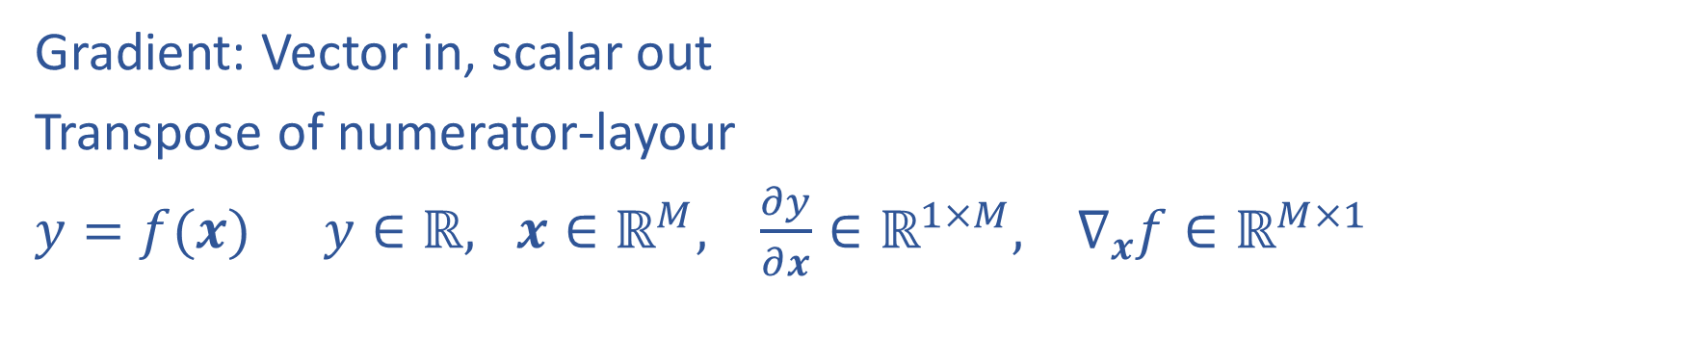

Matrix Calculus
Gradient: Vector in, scalar out
Transpose of numerator-layour
$y=f(x)$ $y∈ℝ, x∈ℝ^{M}, \frac{∂y}{∂x}∈ℝ^{1×M}, ∇_{x}f∈ℝ^{M×1}$

Slide 33


Matrix Calculus
Matrix in, scalar out
Keep same dimensions as matrix
$y=f(X)$ $y∈ℝ, X∈ℝ^{N×M}, \frac{∂y}{∂X}∈ℝ^{N×M}$

Slide 34


Multivariate Chain Rule
$z_{1}=g_{1}\left(x\right)=sin\left(x\right)$
$z_{2}=g_{2}\left(x\right)=x^{3}$
$y=f\left(z_{1}, z_{2}\right)=z_{1}^{4}e^{z_{2}}+5z_{1}+7z_{2}$

Slide 35


Multivariate Chain Rule
$z_{1}=g_{1}\left(x\right)=sin\left(x\right)$
$z_{2}=g_{2}\left(x\right)=x^{3}$
$y=f\left(z_{1}, z_{2}\right)=z_{1}z_{2}$

Slide 36

Calculus Chain Rule
Scalar:
$y=f\left(z\right)$
$z=g\left(x\right)$
$\frac{dy}{dx}=\frac{dy}{dz}\frac{dz}{dx}$
Multivariate:
$y=f\left(z\right)$
$z=g\left(x\right)$
$\frac{dy}{dx}=\sum_{j}{\frac{∂y}{∂z_{j}}\frac{∂z_{j}}{∂x}}$
Multivariate:
$y=f\left(z\right)$
$z=g\left(x\right)$
$\frac{dy_{i}}{dx_{k}}=\sum_{j}{\frac{∂y_{i}}{∂z_{j}}\frac{∂z_{j}}{∂x_{k}}}$

Slide 37
Network Optimization
$J\left(w\right)=z_{4}$
${z_{4}=f}_{4}\left(w_{D}, w_{E}, z_{2},z_{3}\right)$
$z_{3}=f_{3}\left(w_{C}, z_{1}\right)$
$z_{2}=f_{2}\left(w_{B}, z_{1}\right)$
$z_{1}=f_{1}\left(w_{A}, x\right)$
Need multivariate chain rule!

Slide 38
Network Optimization
$$\frac{∂J}{∂w_{E}}=\frac{∂J}{∂z_{4}}\frac{∂z_{4}}{∂w_{E}}$$
$$\frac{∂J}{∂w_{D}}=\frac{∂J}{∂z_{4}}\frac{∂z_{4}}{∂w_{D}}$$
$$\frac{∂J}{∂z_{3}}=\frac{∂J}{∂z_{4}}\frac{∂z_{4}}{∂z_{3}}$$
$$\frac{∂J}{∂z_{2}}=\frac{∂J}{∂z_{4}}\frac{∂z_{4}}{∂z_{2}}$$
$$\frac{∂J}{∂w_{C}}=\frac{∂J}{∂z_{3}}\frac{∂z_{3}}{∂w_{C}}$$
$$\frac{∂J}{∂w_{B}}=\frac{∂J}{∂z_{2}}\frac{∂z_{2}}{∂w_{B}}$$
$$\frac{∂J}{∂z_{1}}=\frac{∂J}{∂z_{2}}\frac{∂z_{2}}{∂z_{1}}+ \frac{∂J}{∂z_{3}}\frac{∂z_{3}}{∂z_{1}}$$
$$\frac{∂J}{∂w_{A}}=\frac{∂J}{∂z_{1}}\frac{∂z_{1}}{∂w_{A}}$$
$J\left(w\right)=z_{4}$
${z_{4}=f}_{4}\left(w_{D}, w_{E}, z_{2},z_{3}\right)$
$z_{3}=f_{3}\left(w_{C}, z_{1}\right)$
$z_{2}=f_{2}\left(w_{B}, z_{1}\right)$
$z_{1}=f_{1}\left(w_{A}, x\right)$
Need multivariate chain rule!
$$z_{2}$$
$$f_{2}$$
$$z_{1}$$
$$z_{4}$$
$$x$$
$$f_{1}$$
$$f_{4}$$
$$z_{3}$$
$$f_{3}$$

Slide 39
Backpropagation (updated)
Compute derivatives per layer, utilizing previous derivatives
Objective: $J\left(w\right)$
Arbitrary layer: $y=f\left(x, w\right)$
Init:
$\frac{∂J}{∂x}=0$
$\frac{∂J}{∂w}=0$
Compute:
$\frac{∂J}{∂x}+=\frac{∂J}{∂y}\frac{∂y}{∂x}$
$\frac{∂J}{∂w}+=\frac{∂J}{∂y}\frac{∂y}{∂w}$
$$x$$
Layer $y=f\left(x, w\right)$
$\frac{∂y}{∂x}$
$\frac{∂y}{∂w}$
$$y$$
$$\frac{∂J}{∂x}$$
$$\frac{∂J}{∂y}$$
$$w$$
$$\frac{∂J}{∂w}$$

Slide 40
Neural Networks Properties
Practical considerations
Large number of neurons
Danger for overfitting
Modelling assumptions vs data assumptions trade-off
Gradient descent can easily get stuck local optima
What if there are no non-linear activations?
A deep neural network with only linear layers can be reduced to an exactly equivalent single linear layer
Universal Approximation Theorem:
A two-layer neural network with a sufficient number of neurons can approximate any continuous function to any desired accuracy.

