Slide 1
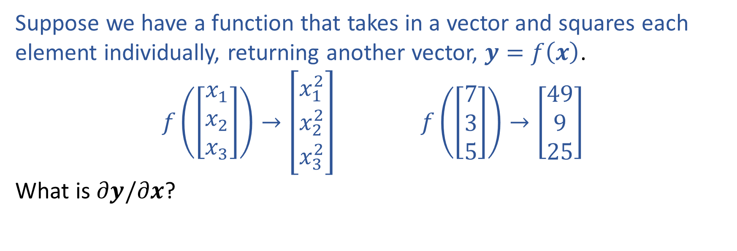

Warm-up as You Log In
Suppose we have a function that takes in a vector and squares each element individually, returning another vector, $y=f\left(x\right)$.
$f\left(\left[\begin{aligned}x_{1} \\ x_{2} \\ x_{3}\end{aligned}\right]\right)→\left[\begin{aligned}x_{1}^{2} \\ x_{2}^{2} \\ x_{3}^{2}\end{aligned}\right]$ $f\left(\left[\begin{aligned}7 \\ 3 \\ 5\end{aligned}\right]\right)→\left[\begin{aligned}49 \\ 9 \\ 25\end{aligned}\right]$
What is $∂y/∂x$?

Slide 2
Announcements
Assignments
HW5
Due Mon, 10/26, 11:59 pm
Start early
Recitation
No recitation this Friday

Slide 3

Introduction to Machine Learning Neural Networks
Instructor: Pat Virtue

Slide 4
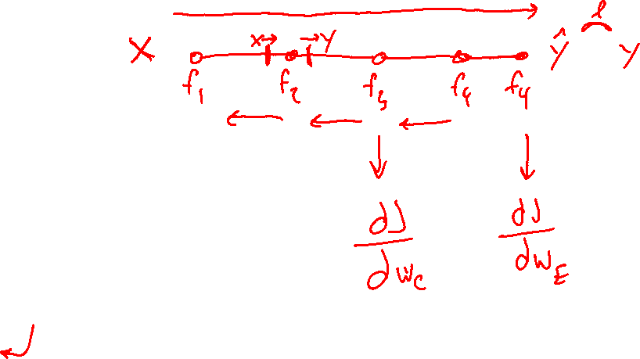
Plan
Last Time
Neural Networks
Building blocks
Optimization
Today
Neural Networks
Wrap-up calculus
Universal Approximation Theorem
Convolutional neural networks

Slide 5

Backpropagation (so-far)
Compute derivatives per layer, utilizing previous derivatives
Objective: $J\left(w\right)$
Arbitrary layer: $y=f\left(x, w\right)$
Need:
$\frac{∂J}{∂x}=\frac{∂J}{∂y}\frac{∂y}{∂x}$
$\frac{∂J}{∂w}=\frac{∂J}{∂y}\frac{∂y}{∂w}$
$$x$$
Layer $y=f\left(x, w\right)$
$\frac{∂y}{∂x}$
$\frac{∂y}{∂w}$
$$y$$
$$\frac{∂J}{∂x}$$
$$\frac{∂J}{∂y}$$
$$w$$
$$\frac{∂J}{∂w}$$

Slide 6
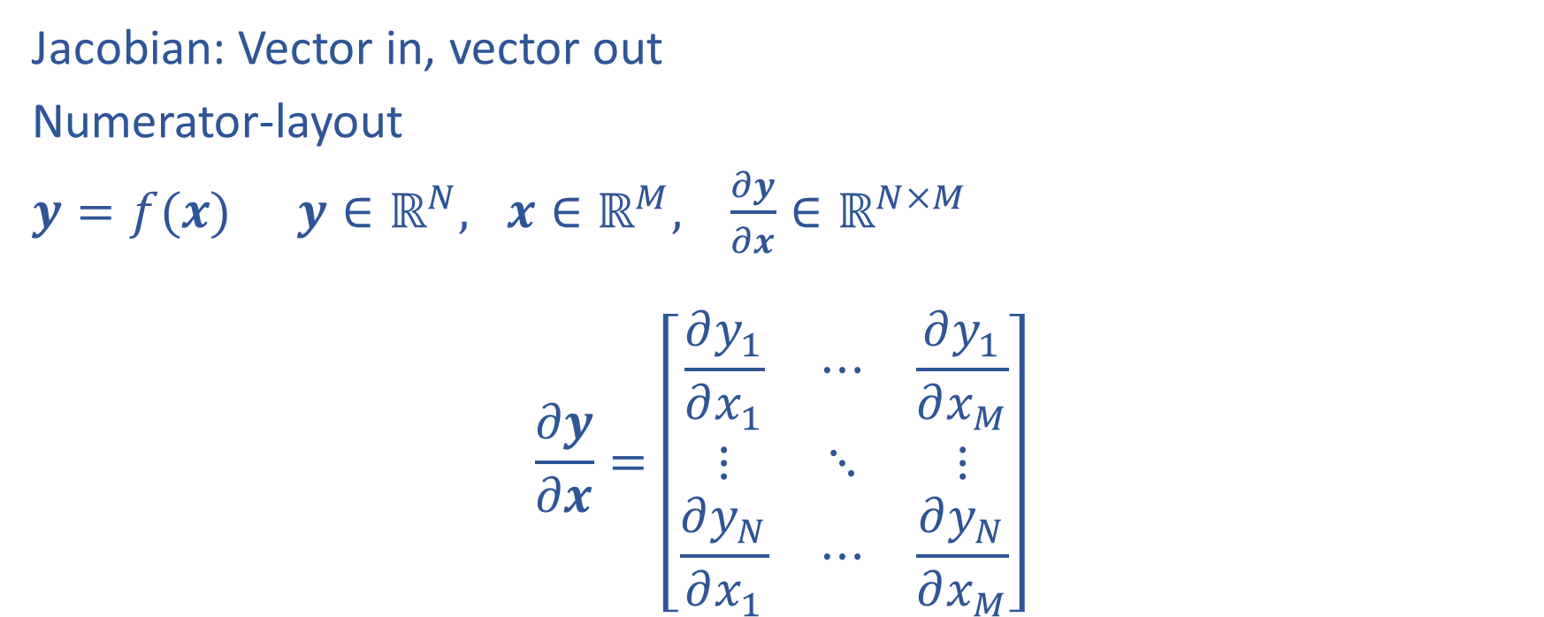
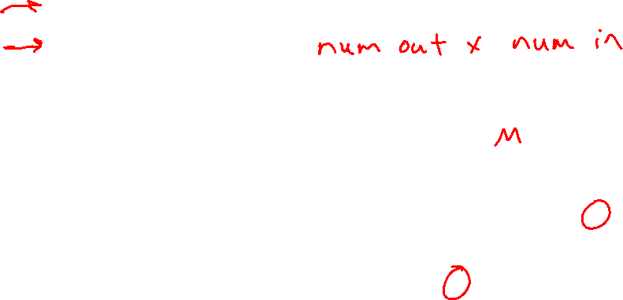
Matrix Calculus
Jacobian: Vector in, vector out
Numerator-layout
$y=f(x)$ $y∈ℝ^{N}, x∈ℝ^{M}, \frac{∂y}{∂x}∈ℝ^{N×M}$
$$\frac{∂y}{∂x}=\left[\begin{matrix}\frac{∂y_{1}}{∂x_{1}} & ⋯ & \frac{∂y_{1}}{∂x_{M}} \\ ⋮ & ⋱ & ⋮ \\ \frac{∂y_{N}}{∂x_{1}} & ⋯ & \frac{∂y_{N}}{∂x_{M}}\end{matrix}\right]$$

Slide 7
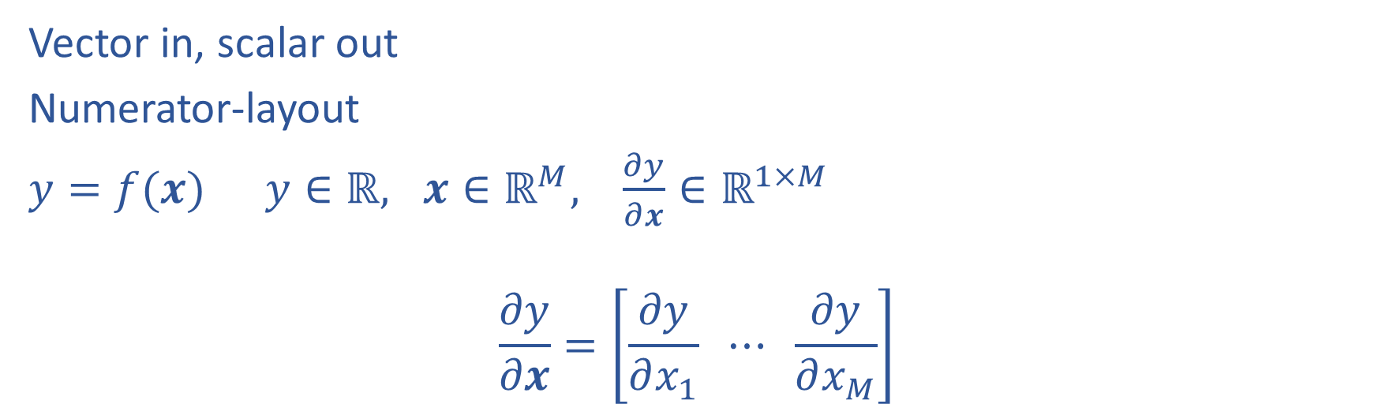
Matrix Calculus
Vector in, scalar out
Numerator-layout
$y=f(x)$ $y∈ℝ, x∈ℝ^{M}, \frac{∂y}{∂x}∈ℝ^{1×M}$
$$\frac{∂y}{∂x}=\left[\frac{∂y}{∂x_{1}} ⋯ \frac{∂y}{∂x_{M}}\right]$$

Slide 8
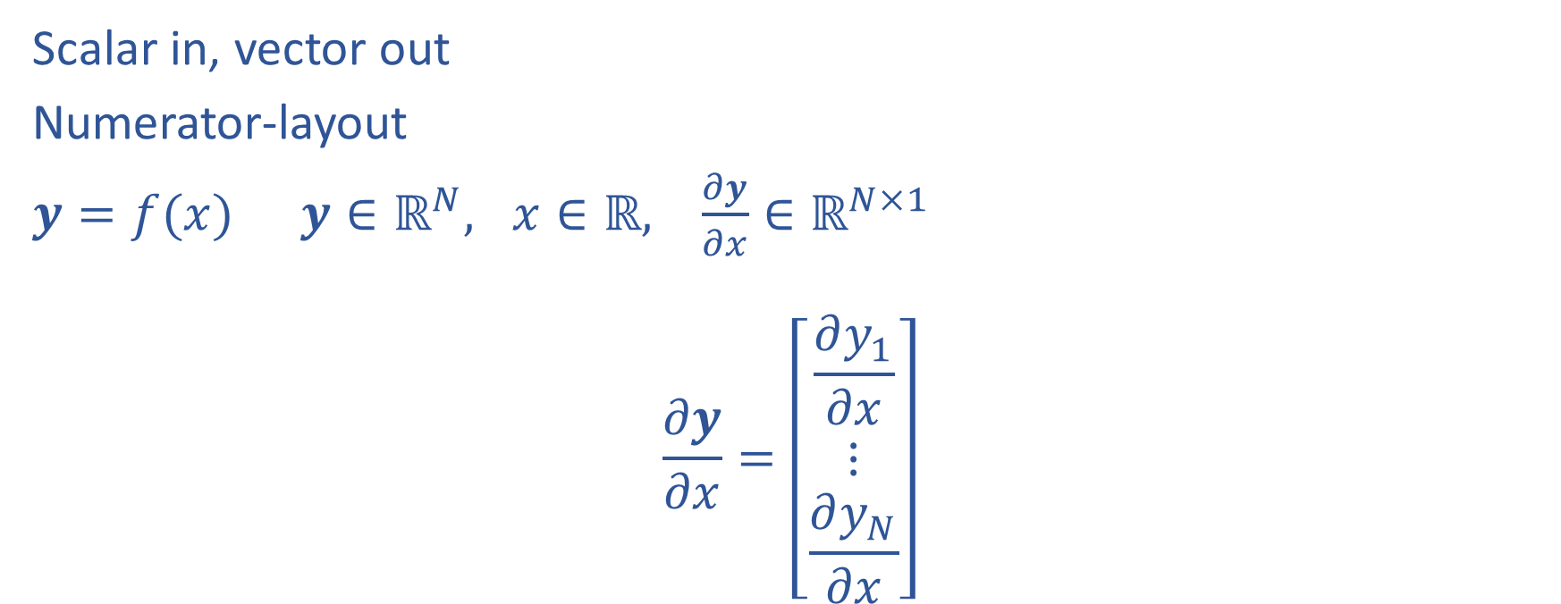
Matrix Calculus
Scalar in, vector out
Numerator-layout
$y=f(x)$ $y∈ℝ^{N}, x∈ℝ, \frac{∂y}{∂x}∈ℝ^{N×1}$
$$\frac{∂y}{∂x}=\left[\begin{aligned}\frac{∂y_{1}}{∂x} \\ ⋮ \\ \frac{∂y_{N}}{∂x}\end{aligned}\right]$$

Slide 9
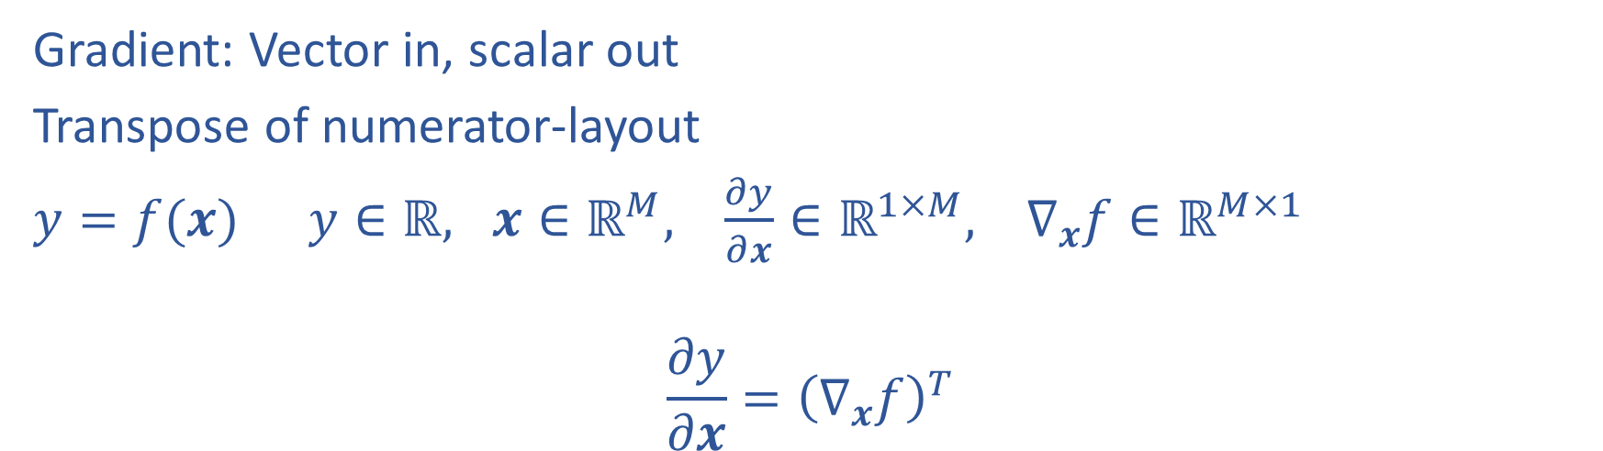
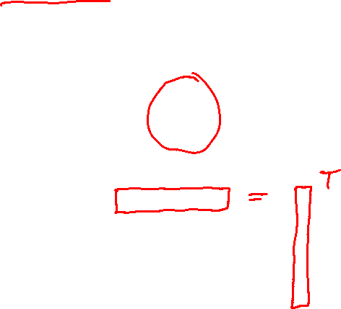
Matrix Calculus
Gradient: Vector in, scalar out
Transpose of numerator-layout
$y=f(x)$ $y∈ℝ, x∈ℝ^{M}, \frac{∂y}{∂x}∈ℝ^{1×M}, ∇_{x}f∈ℝ^{M×1}$
$$\frac{∂y}{∂x}={\left(∇_{x}f\right)}^{T}$$

Slide 10
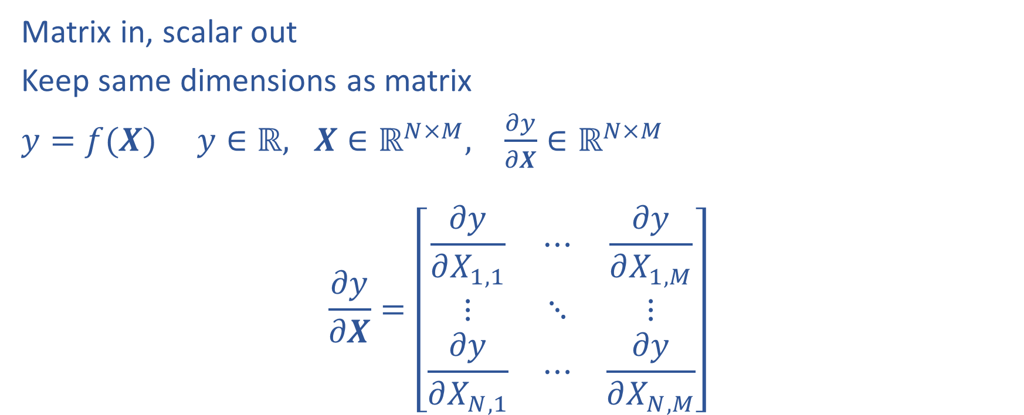
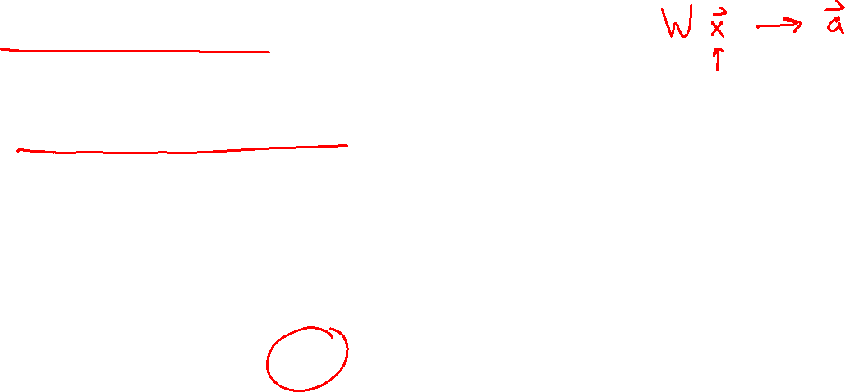
Matrix Calculus
Matrix in, scalar out
Keep same dimensions as matrix
$y=f(X)$ $y∈ℝ, X∈ℝ^{N×M}, \frac{∂y}{∂X}∈ℝ^{N×M}$
$$\frac{∂y}{∂X}=\left[\begin{matrix}\frac{∂y}{∂X_{1,1}} & ⋯ & \frac{∂y}{∂X_{1,M}} \\ ⋮ & ⋱ & ⋮ \\ \frac{∂y}{∂X_{N,1}} & ⋯ & \frac{∂y}{∂X_{N,M}}\end{matrix}\right]$$

Slide 11
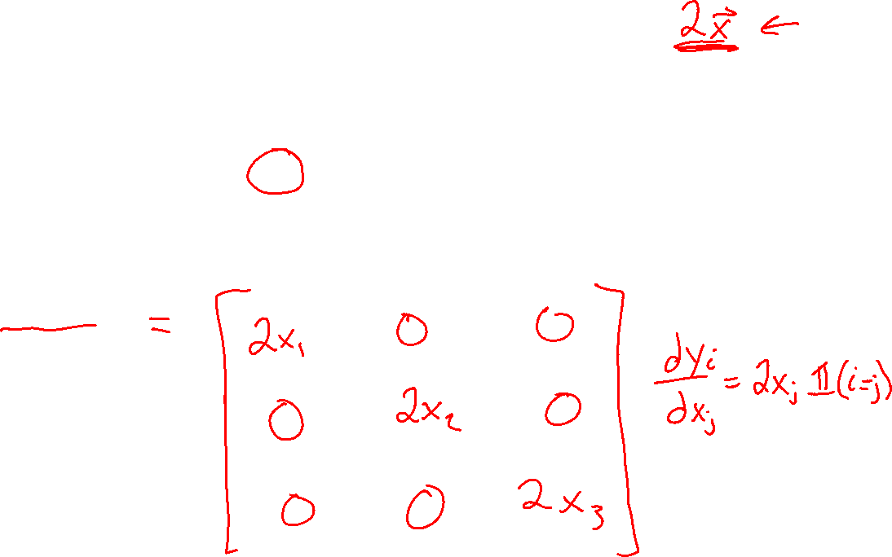
Warm-up as You Log In
Suppose we have a function that takes in a vector and squares each element individually, returning another vector, $y=f\left(x\right)$.
$f\left(\left[\begin{aligned}x_{1} \\ x_{2} \\ x_{3}\end{aligned}\right]\right)→\left[\begin{aligned}x_{1}^{2} \\ x_{2}^{2} \\ x_{3}^{2}\end{aligned}\right]$ $f\left(\left[\begin{aligned}7 \\ 3 \\ 5\end{aligned}\right]\right)→\left[\begin{aligned}49 \\ 9 \\ 25\end{aligned}\right]$
What is $∂y/∂x$?

Slide 12
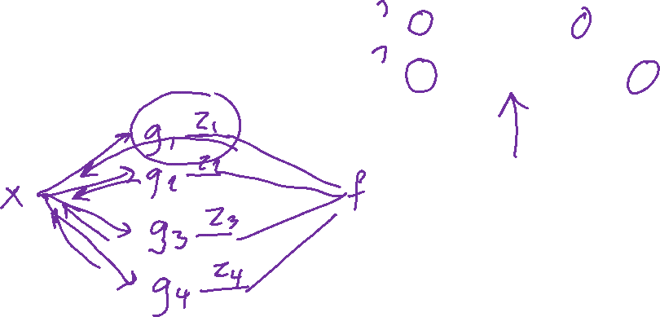
Calculus Chain Rule
Scalar:
$y=f\left(z\right)$
$z=g\left(x\right)$
$\frac{dy}{dx}=\frac{dy}{dz}\frac{dz}{dx}$
Multivariate:
$y=f\left(z\right)$
$z=g\left(x\right)$
$\frac{dy}{dx}=\sum_{j}{\frac{∂y}{∂z_{j}}\frac{∂z_{j}}{∂x}}$
Multivariate:
$y=f\left(z\right)$
$z=g\left(x\right)$
$\frac{dy_{i}}{dx_{k}}=\sum_{j}{\frac{∂y_{i}}{∂z_{j}}\frac{∂z_{j}}{∂x_{k}}}$

Slide 13
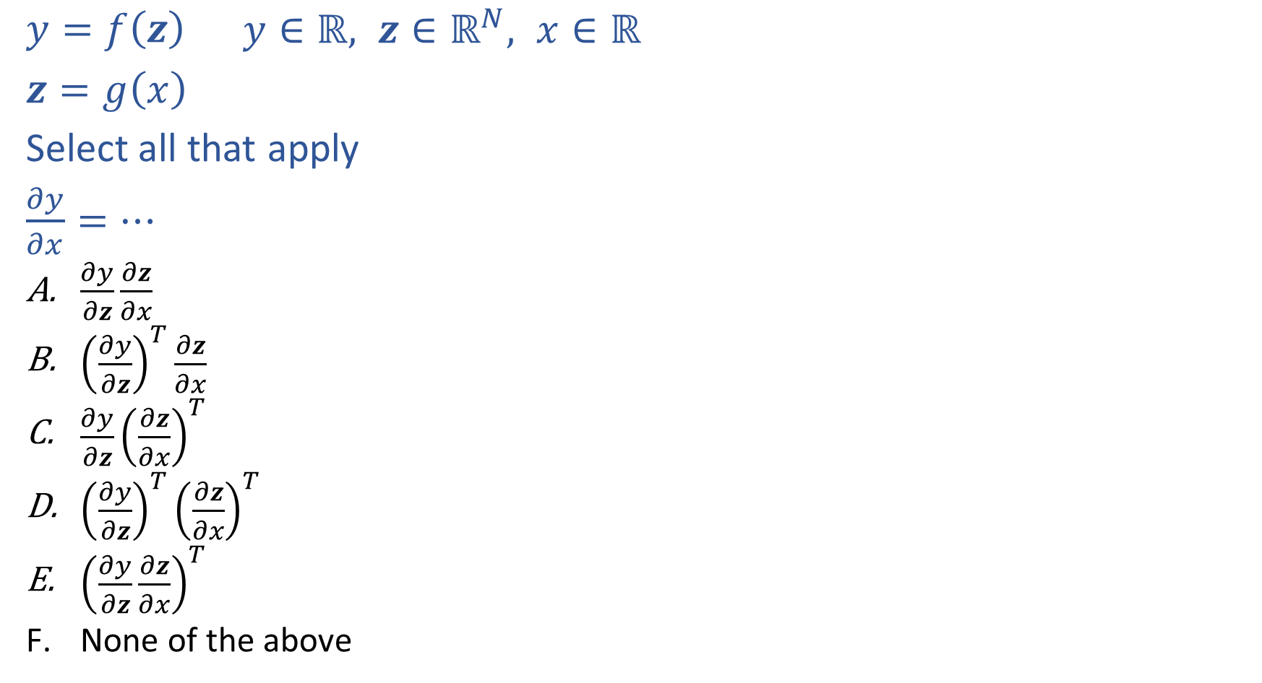
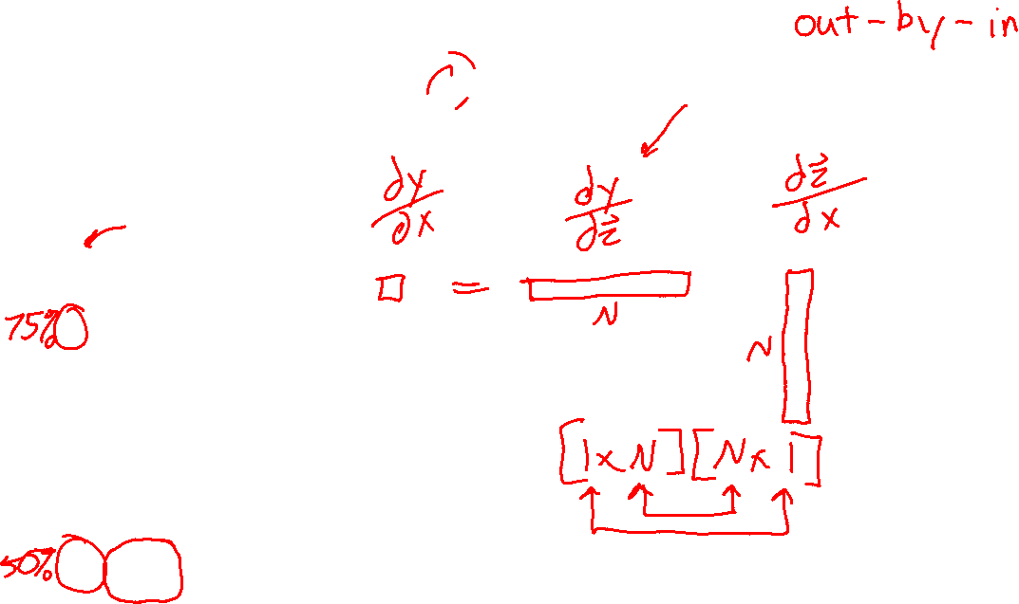
Piazza Poll 1
$y=f\left(z\right)$ $y∈ℝ, z∈ℝ^{N}, x∈ℝ$
$z=g\left(x\right)$
Select all that apply
$\frac{∂y}{∂x}=…$
$\frac{∂y}{∂z}\frac{∂z}{∂x}$
${\left(\frac{∂y}{∂z}\right)}^{T}\frac{∂z}{∂x}$
$\frac{∂y}{∂z}{\left(\frac{∂z}{∂x}\right)}^{T}$
${\left(\frac{∂y}{∂z}\right)}^{T}{\left(\frac{∂z}{∂x}\right)}^{T}$
${\left(\frac{∂y}{∂z}\frac{∂z}{∂x}\right)}^{T}$
None of the above

Slide 14
Piazza Poll 1
$y=f\left(z\right)$ $y∈ℝ, z∈ℝ^{N}, x∈ℝ$
$z=g\left(x\right)$
Select all that apply
$\frac{∂y}{∂x}=…$
$\frac{∂y}{∂z}\frac{∂z}{∂x}$
${\left(\frac{∂y}{∂z}\right)}^{T}\frac{∂z}{∂x}$
$\frac{∂y}{∂z}{\left(\frac{∂z}{∂x}\right)}^{T}$
${\left(\frac{∂y}{∂z}\right)}^{T}{\left(\frac{∂z}{∂x}\right)}^{T}$
${\left(\frac{∂y}{∂z}\frac{∂z}{∂x}\right)}^{T}$
None of the above

Slide 15
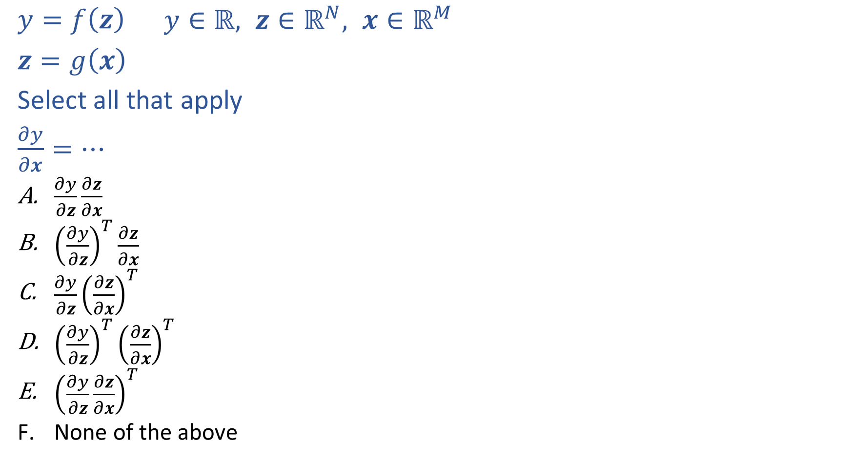
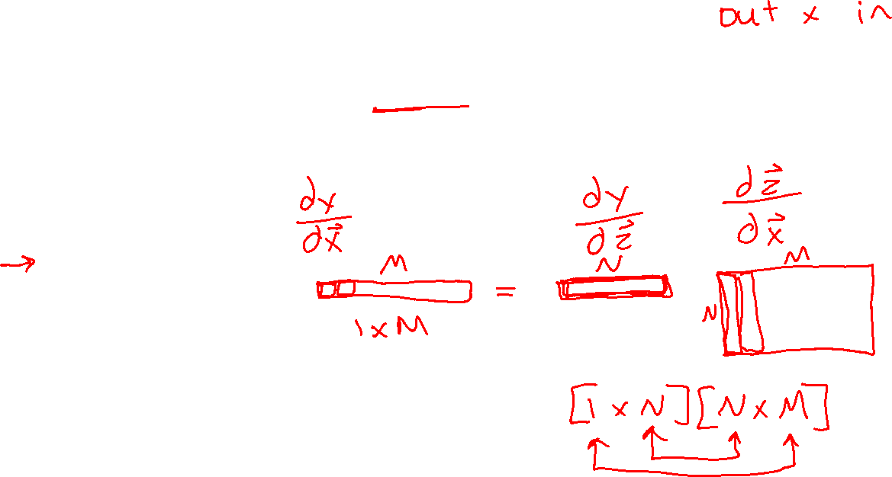
Piazza Poll 2
$y=f\left(z\right)$ $y∈ℝ, z∈ℝ^{N}, x∈ℝ^{M}$
$z=g\left(x\right)$
Select all that apply
$\frac{∂y}{∂x}=…$
$\frac{∂y}{∂z}\frac{∂z}{∂x}$
${\left(\frac{∂y}{∂z}\right)}^{T}\frac{∂z}{∂x}$
$\frac{∂y}{∂z}{\left(\frac{∂z}{∂x}\right)}^{T}$
${\left(\frac{∂y}{∂z}\right)}^{T}{\left(\frac{∂z}{∂x}\right)}^{T}$
${\left(\frac{∂y}{∂z}\frac{∂z}{∂x}\right)}^{T}$
None of the above

Slide 16
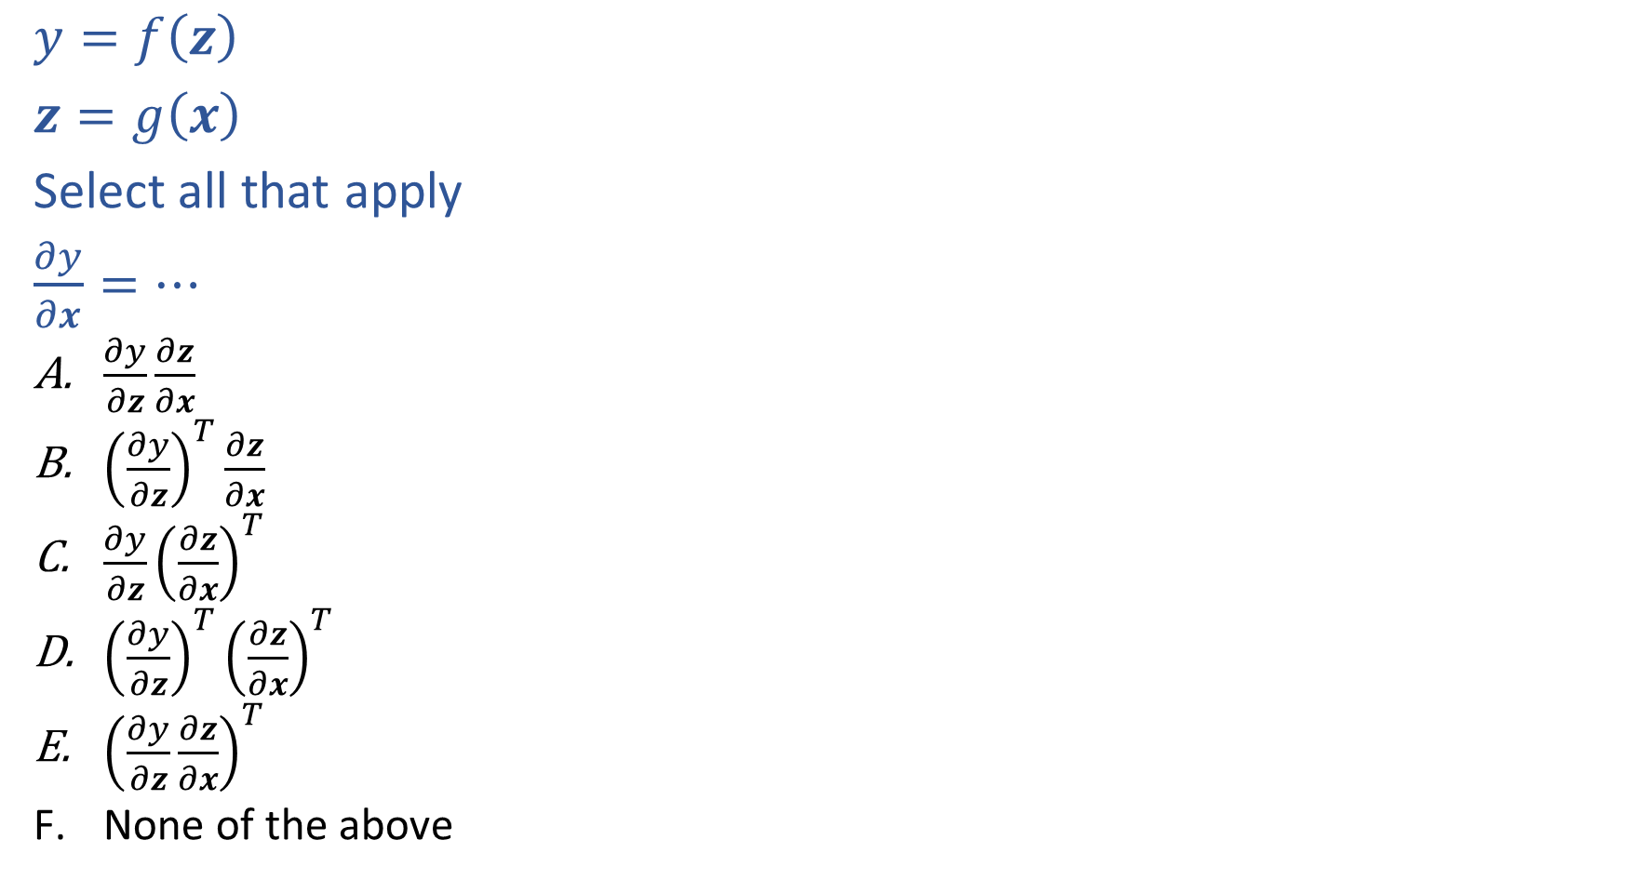
Piazza Poll 2
$y=f\left(z\right)$
$z=g\left(x\right)$
Select all that apply
$\frac{∂y}{∂x}=…$
$\frac{∂y}{∂z}\frac{∂z}{∂x}$
${\left(\frac{∂y}{∂z}\right)}^{T}\frac{∂z}{∂x}$
$\frac{∂y}{∂z}{\left(\frac{∂z}{∂x}\right)}^{T}$
${\left(\frac{∂y}{∂z}\right)}^{T}{\left(\frac{∂z}{∂x}\right)}^{T}$
${\left(\frac{∂y}{∂z}\frac{∂z}{∂x}\right)}^{T}$
None of the above

Slide 17
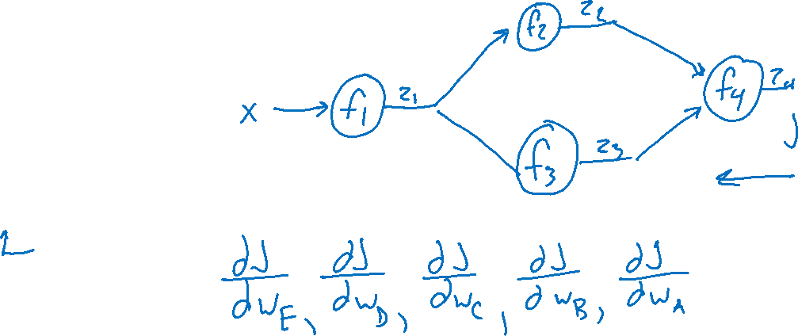
Network Optimization
$J\left(w\right)=z_{4}$
${z_{4}=f}_{4}\left(w_{D}, w_{E}, z_{2},z_{3}\right)$
$z_{3}=f_{3}\left(w_{C}, z_{1}\right)$
$z_{2}=f_{2}\left(w_{B}, z_{1}\right)$
$z_{1}=f_{1}\left(w_{A}, x\right)$
Need multivariate chain rule!

Slide 18
Network Optimization
$$\frac{∂J}{∂w_{E}}=\frac{∂J}{∂z_{4}}\frac{∂z_{4}}{∂w_{E}}$$
$$\frac{∂J}{∂w_{D}}=\frac{∂J}{∂z_{4}}\frac{∂z_{4}}{∂w_{D}}$$
$$\frac{∂J}{∂z_{3}}=\frac{∂J}{∂z_{4}}\frac{∂z_{4}}{∂z_{3}}$$
$$\frac{∂J}{∂z_{2}}=\frac{∂J}{∂z_{4}}\frac{∂z_{4}}{∂z_{2}}$$
$$\frac{∂J}{∂w_{C}}=\frac{∂J}{∂z_{3}}\frac{∂z_{3}}{∂w_{C}}$$
$$\frac{∂J}{∂w_{B}}=\frac{∂J}{∂z_{2}}\frac{∂z_{2}}{∂w_{B}}$$
$$\frac{∂J}{∂z_{1}}=\frac{∂J}{∂z_{2}}\frac{∂z_{2}}{∂z_{1}}+ \frac{∂J}{∂z_{3}}\frac{∂z_{3}}{∂z_{1}}$$
$$\frac{∂J}{∂w_{A}}=\frac{∂J}{∂z_{1}}\frac{∂z_{1}}{∂w_{A}}$$
$J\left(w\right)=z_{4}$
${z_{4}=f}_{4}\left(w_{D}, w_{E}, z_{2},z_{3}\right)$
$z_{3}=f_{3}\left(w_{C}, z_{1}\right)$
$z_{2}=f_{2}\left(w_{B}, z_{1}\right)$
$z_{1}=f_{1}\left(w_{A}, x\right)$
Need multivariate chain rule!
$$z_{2}$$
$$f_{2}$$
$$z_{1}$$
$$z_{4}$$
$$x$$
$$f_{1}$$
$$f_{4}$$
$$z_{3}$$
$$f_{3}$$

Slide 19
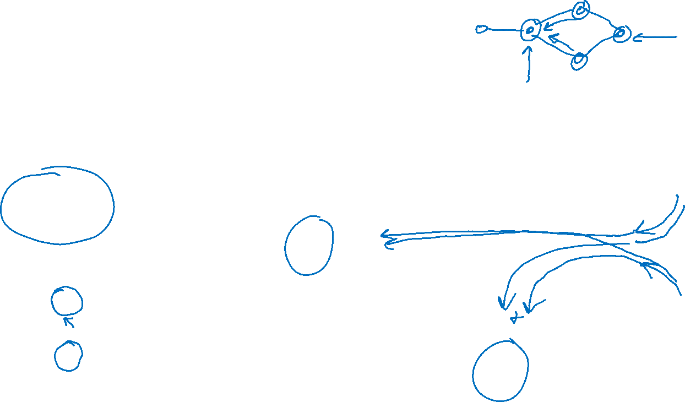
Backpropagation (updated)
Compute derivatives per layer, utilizing previous derivatives
Objective: $J\left(w\right)$
Arbitrary layer: $y=f\left(x, w\right)$
Init:
$\frac{∂J}{∂x}=0$
$\frac{∂J}{∂w}=0$
Compute:
$\frac{∂J}{∂x}+=\frac{∂J}{∂y}\frac{∂y}{∂x}$
$\frac{∂J}{∂w}+=\frac{∂J}{∂y}\frac{∂y}{∂w}$
$$x$$
Layer $y=f\left(x, w\right)$
$\frac{∂y}{∂x}$
$\frac{∂y}{∂w}$
$$y$$
$$\frac{∂J}{∂x}$$
$$\frac{∂J}{∂y}$$
$$w$$
$$\frac{∂J}{∂w}$$

Slide 20























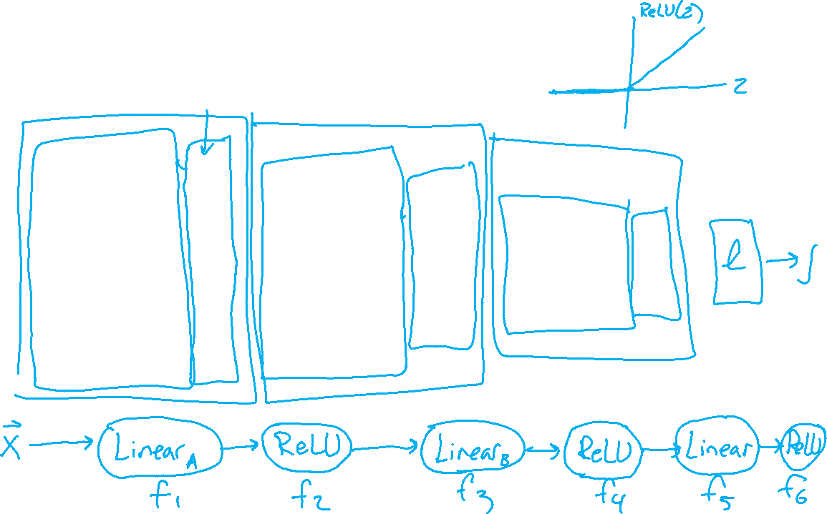










Neural Network Implementation
Which pieces to we treat as functions?
$$z11$$
$$w111$$
$$z21$$
$$x1$$
$$∑$$
$$g$$
$$w211$$
$$w112$$
$$w113$$
$$w212$$
$$z31$$
$$∑$$
$$g$$
$$w311$$
$$w121$$
$$w221$$
$$z12$$
$$z22$$
$$z41$$
$$x2$$
$$∑$$
$$g$$
$$∑$$
$$g$$
$$w123$$
$$w221$$
$$z32$$
$$w321$$
$$w131$$
$$∑$$
$$g$$
$$z13$$
$$z23$$
$$w232$$
$$x3$$
$$∑$$
$$g$$
w₁₃₃

Slide 21
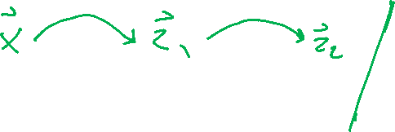
Neural Networks Properties
Practical considerations
Large number of neurons
Danger for overfitting
Modelling assumptions vs data assumptions trade-off
Gradient descent can easily get stuck local optima
What if there are no non-linear activations?
A deep neural network with only linear layers can be reduced to an exactly equivalent single linear layer
Universal Approximation Theorem:
A two-layer neural network with a sufficient number of neurons can approximate any continuous function to any desired accuracy.

Slide 22


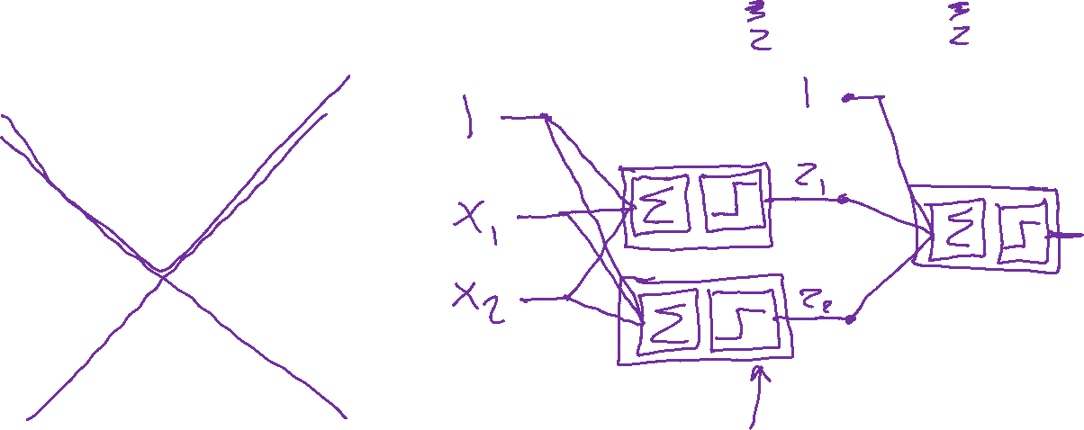
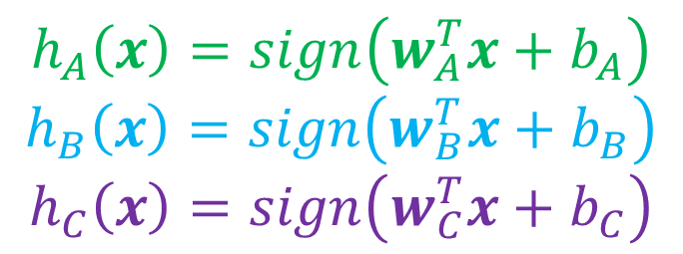
Classification Design Challenge
$$h_{A}\left(x\right)=sign\left(w_{A}^{T}x+b_{A}\right)$$
$$h_{B}\left(x\right)=sign\left(w_{B}^{T}x+b_{B}\right)$$
$$h_{C}\left(x\right)=sign\left(w_{C}^{T}x+b_{C}\right)$$
How could you configure three specific perceptrons to classify this data?
$$x2$$
$$x1$$

Slide 23
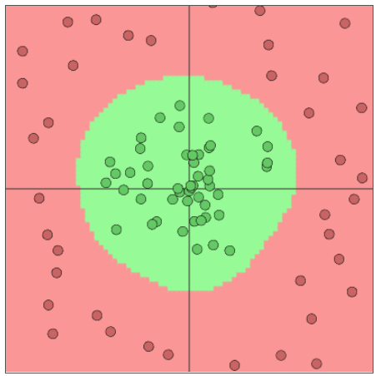
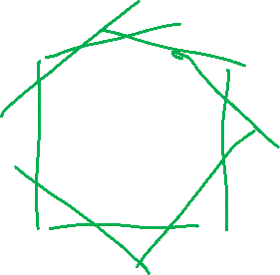
Network to Approximate Binary Classification
Approximate arbitrary decision boundary
https://cs.stanford.edu/people/karpathy/convnetjs/demo/classify2d.html

Slide 24
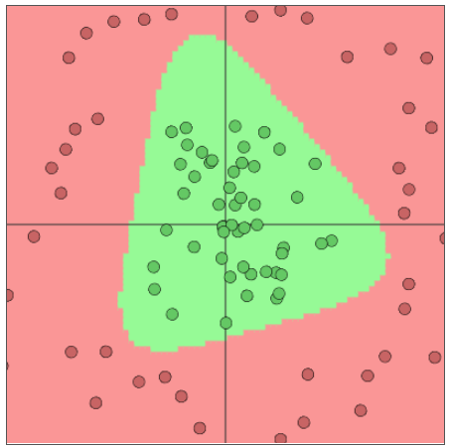
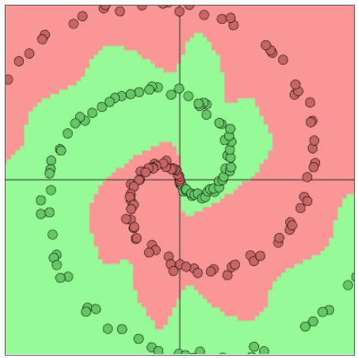
Network to Approximate Binary Classification
Approximate arbitrary decision boundary
https://cs.stanford.edu/people/karpathy/convnetjs/demo/classify2d.html

Slide 25
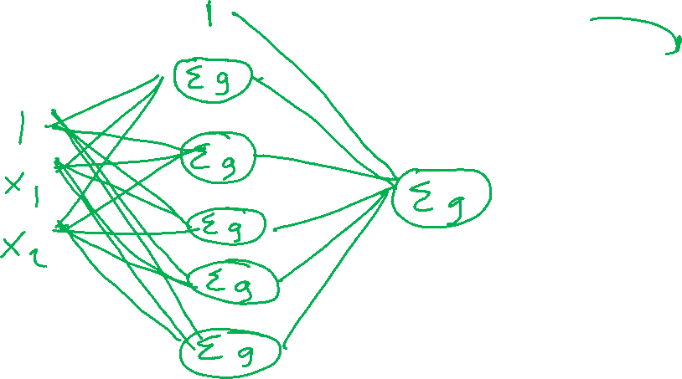
Network to Approximate Binary Classification
Approximate arbitrary decision boundary
https://cs.stanford.edu/people/karpathy/convnetjs/demo/classify2d.html

Slide 26
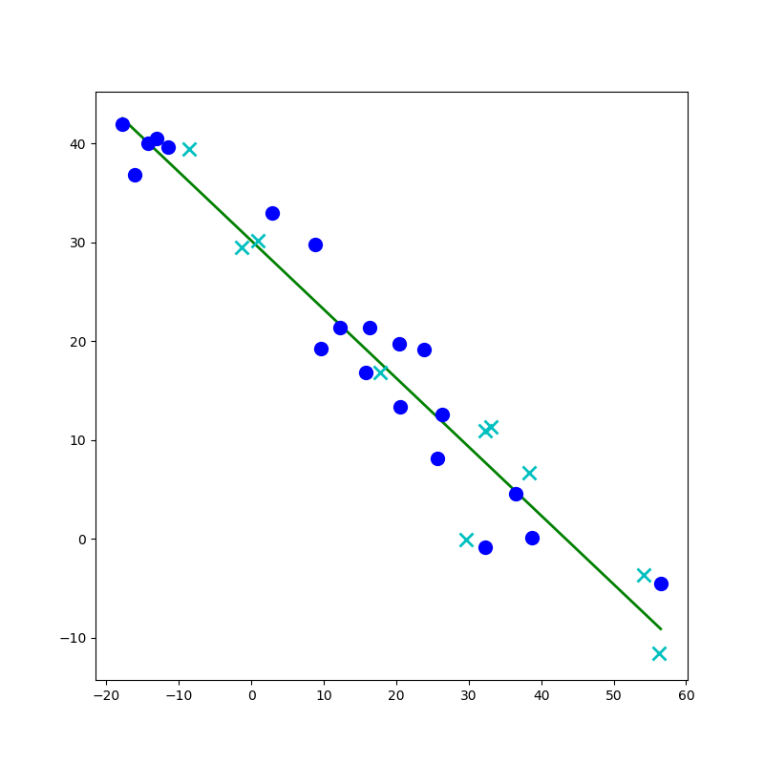
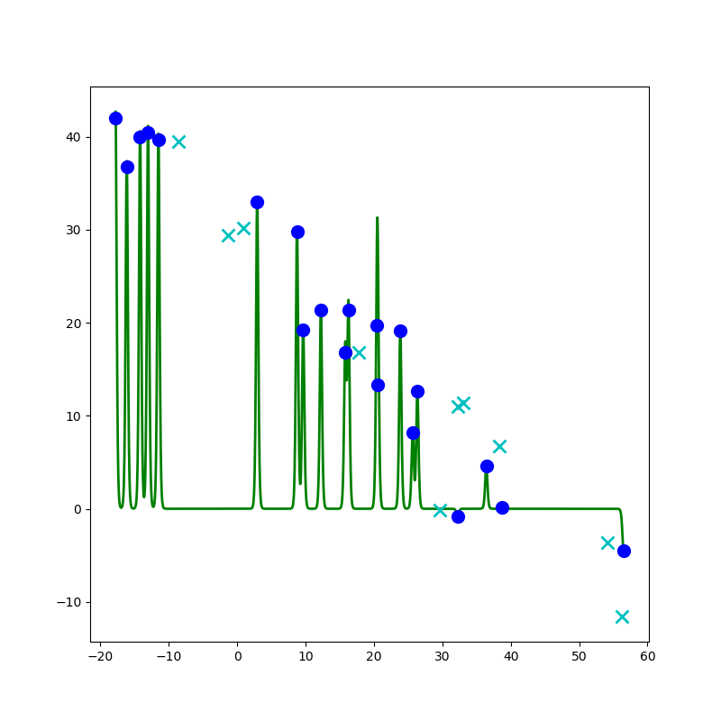
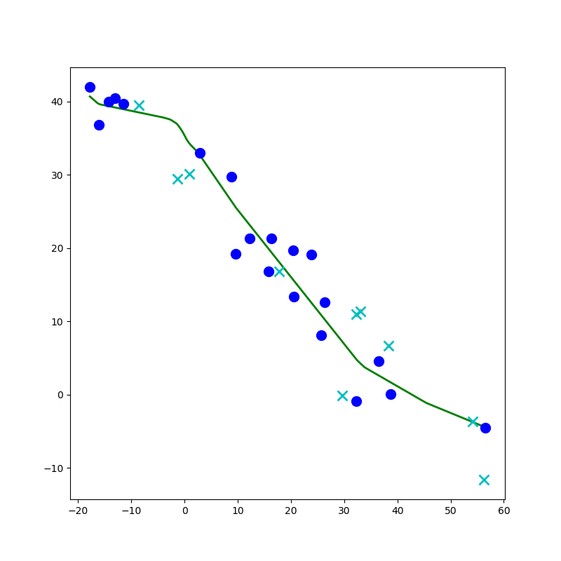
Network to Approximate a 1-D Function

Slide 27
Network to Approximate a 1-D Function
Design a network to approximate this function using:
Linear, Sigmoid, Step, or ReLU

Slide 28
Network to Approximate a 1-D Function
Design a network to approximate this function using:
Linear, Sigmoid, Step, or ReLU

Slide 29
Network to Approximate a 1-D Function

Slide 30
Convolutional Neural Nets

Slide 31
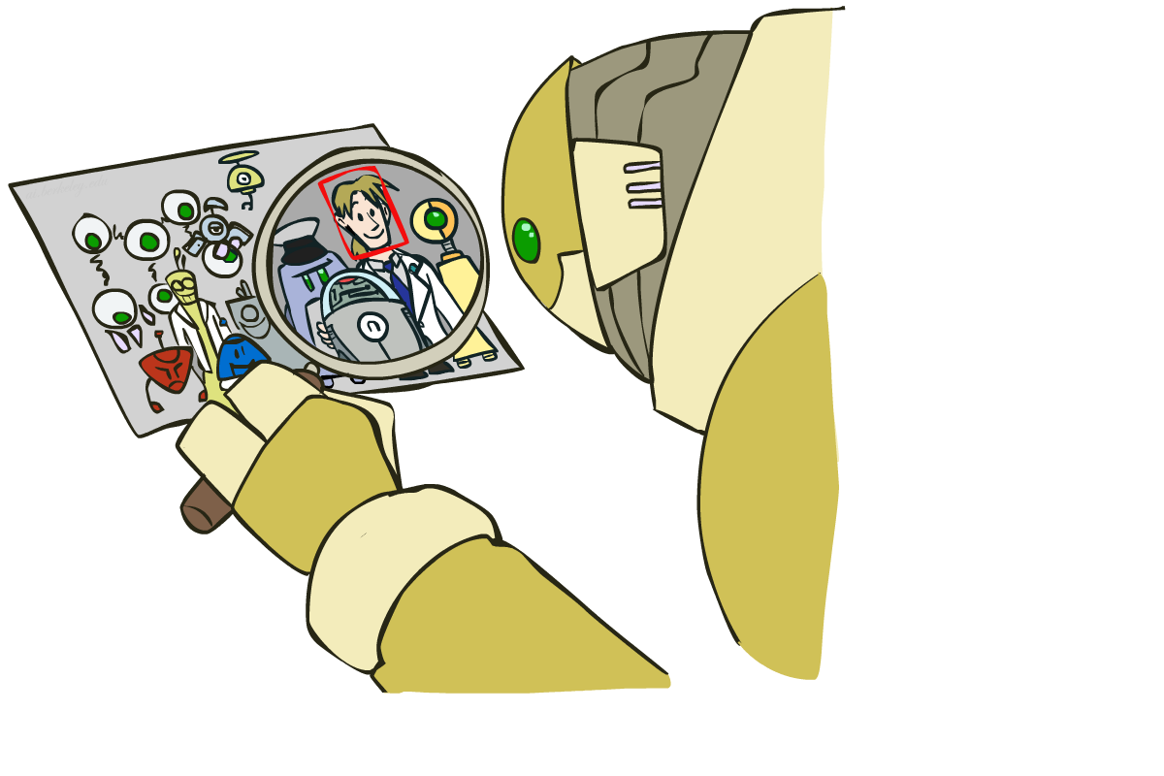
Computer Vision: How far along are we?

Slide 32
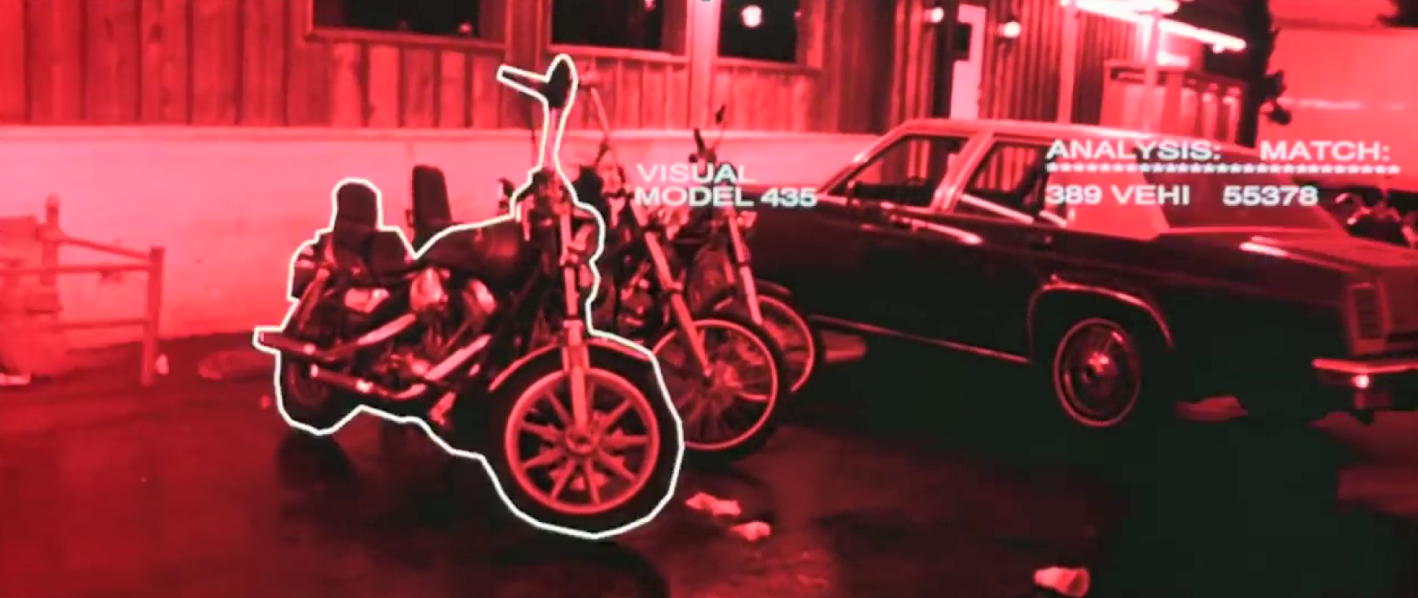
Computer Vision: How far along are we?
Terminator 2, 1991 https://www.youtube.com/watch?v=9MeaaCwBW28

Slide 33
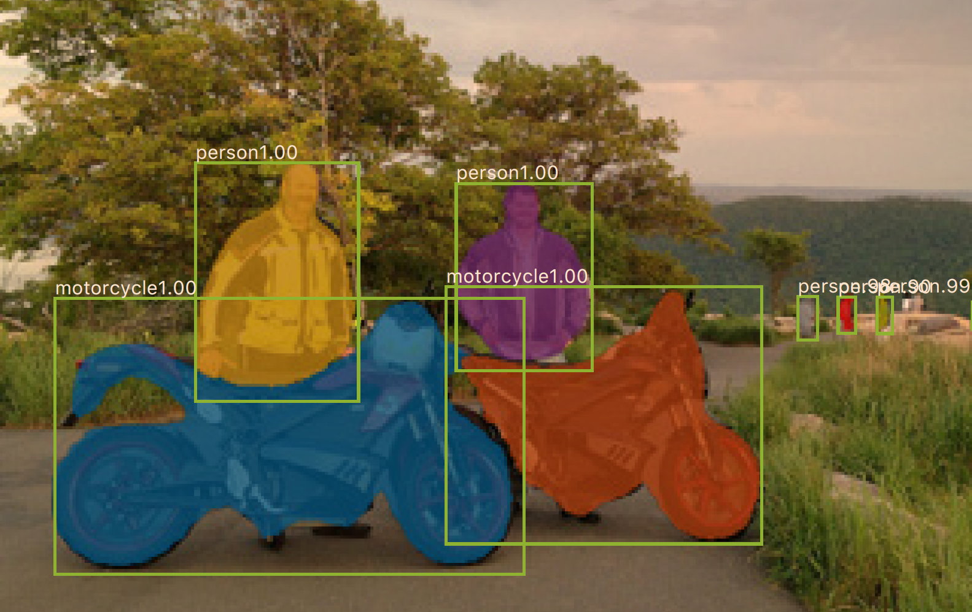
Computer Vision: How far along are we?
0.2 seconds per image
Mask R-CNN
He, Kaiming, et al. "Mask R-CNN." Computer Vision (ICCV), 2017 IEEE International Conference on. IEEE, 2017.

Slide 34
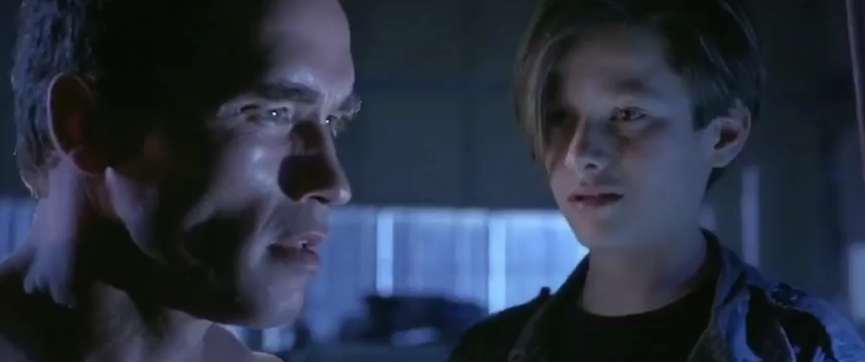
Computer Vision: How far along are we?
“My CPU is a neural net processor, a learning computer”
Terminator 2, 1991

Slide 35
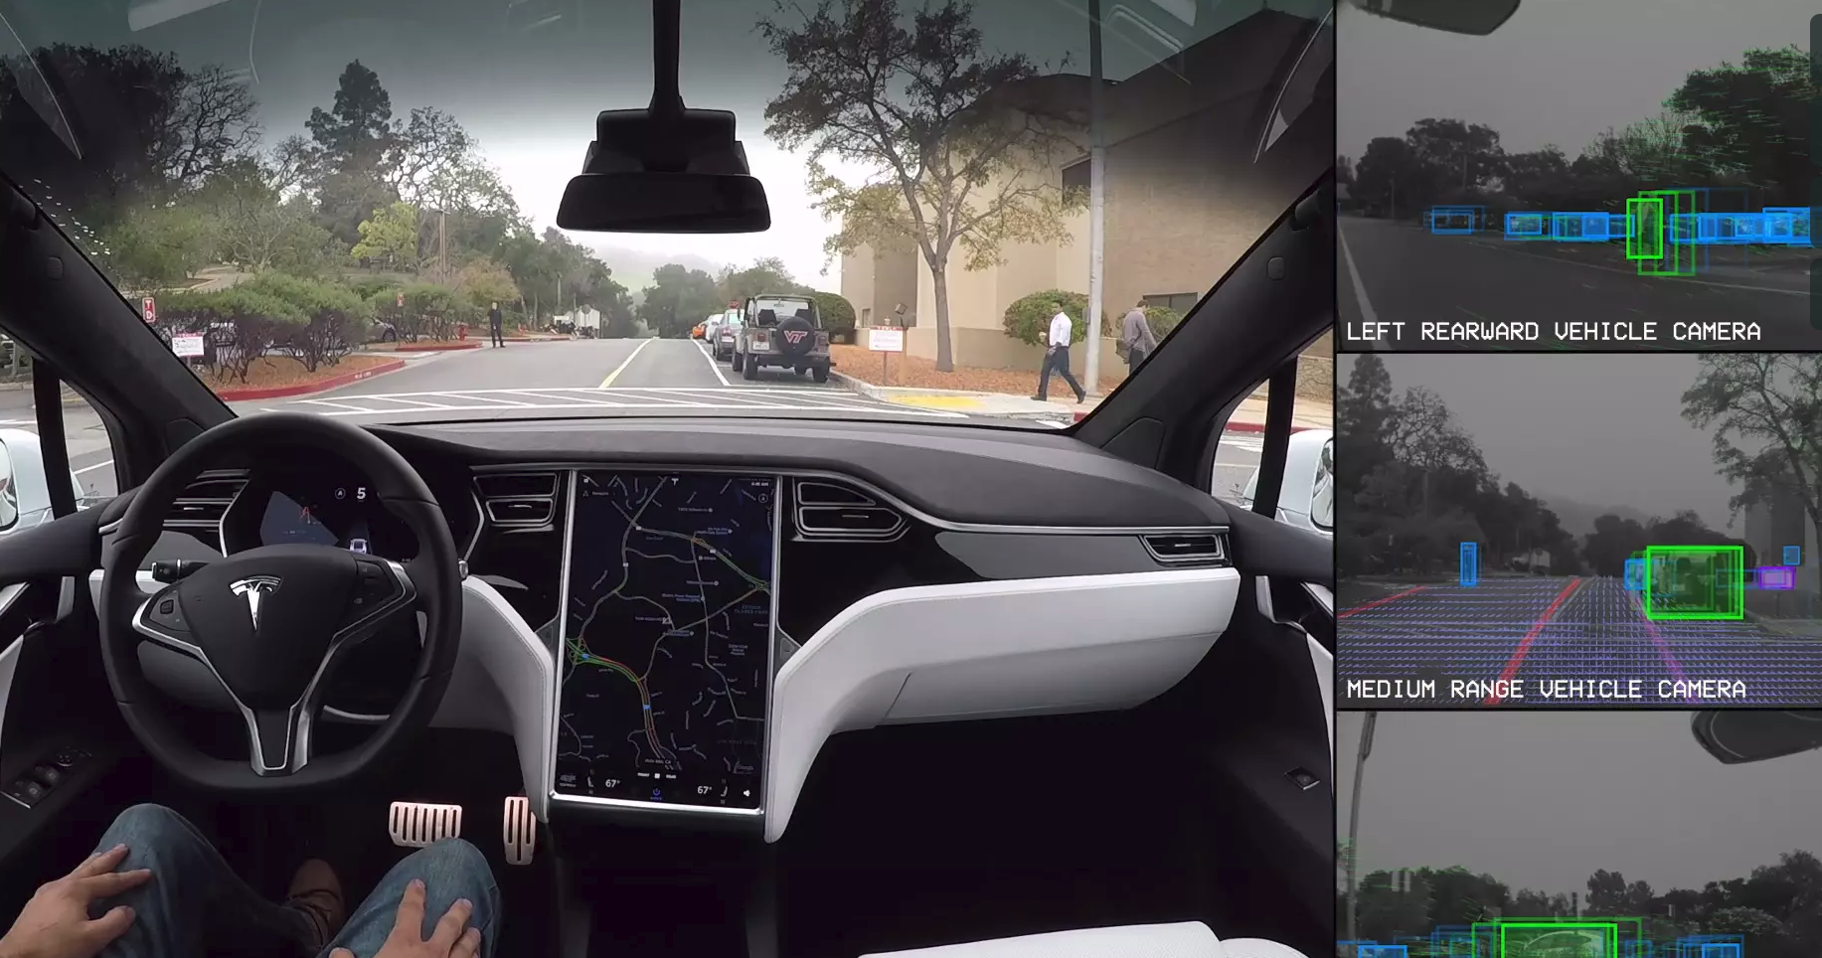
Computer Vision: Autonomous Driving
Tesla, Inc: https://vimeo.com/192179726

Slide 36
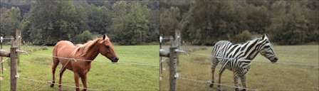
Computer Vision: Domain Transfer
CycleGAN
Jun-Yan Zhu*, Taesung Park*, Phillip Isola, and Alexei A. Efros. "Unpaired Image-to-Image Translation using Cycle-Consistent Adversarial Networks", ICCV 2017.

Slide 37
Outline
Measuring the current state of computer vision
Why convolutional neural networks
Old school computer vision
Image features and classification
Convolution “nuts and bolts”

Slide 38
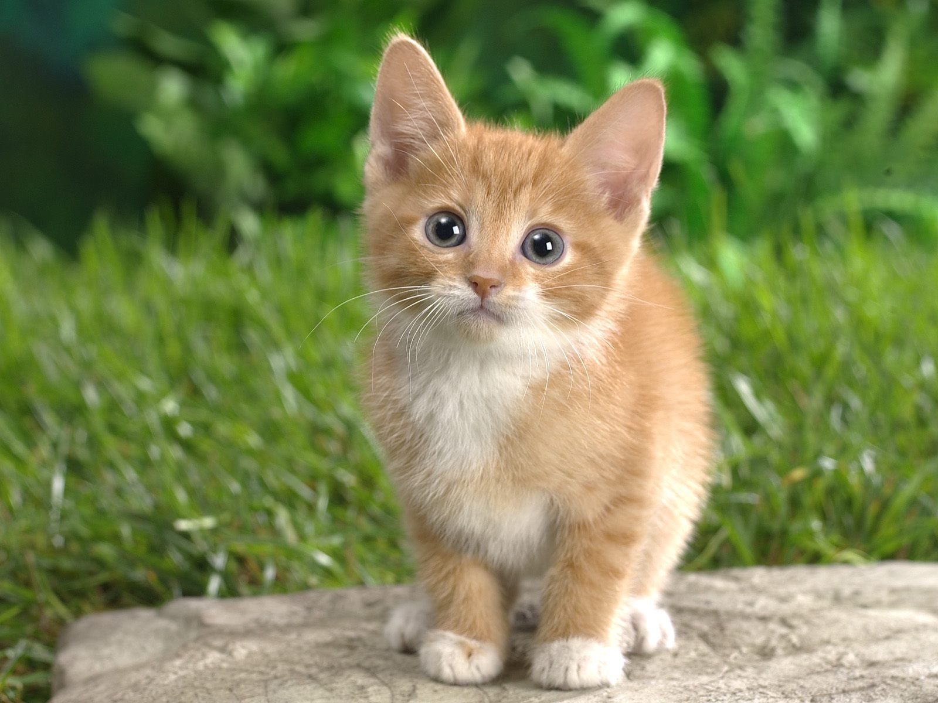
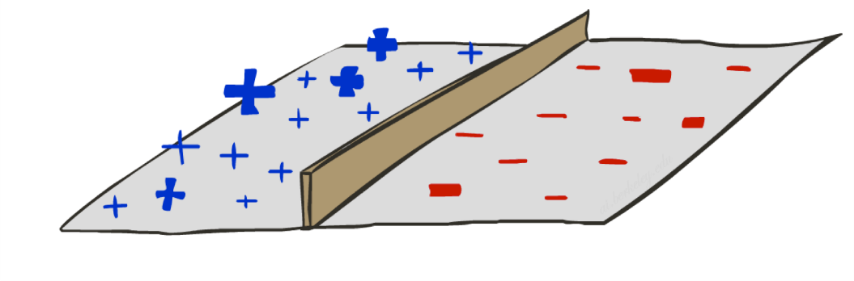
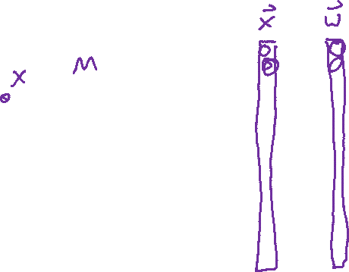
Image Classification
What’s the problem with just directly classifying raw pixels in high dimensional space?
Not CAT
CAT
CAT

Slide 39
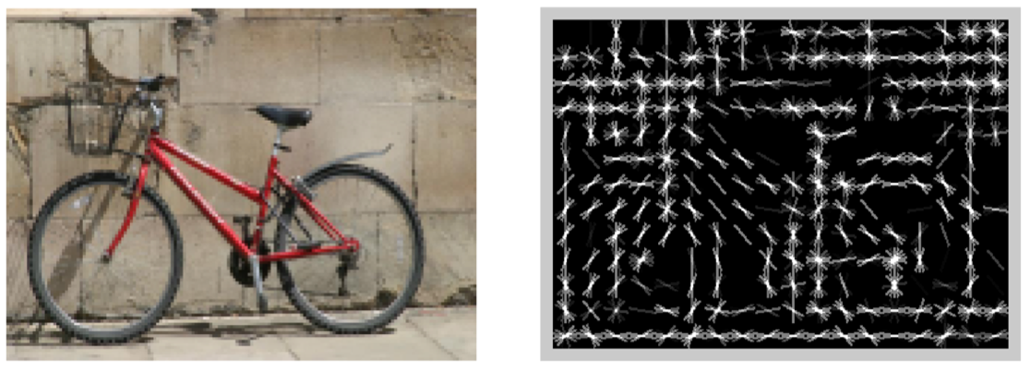
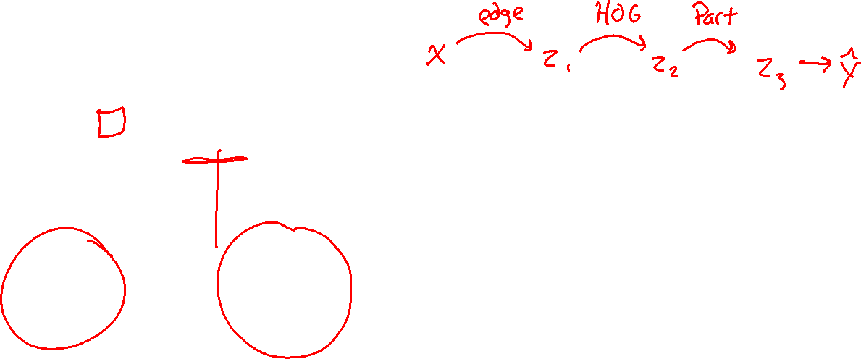
Image Classification
[Dalal and Triggs, 2005]

Slide 40

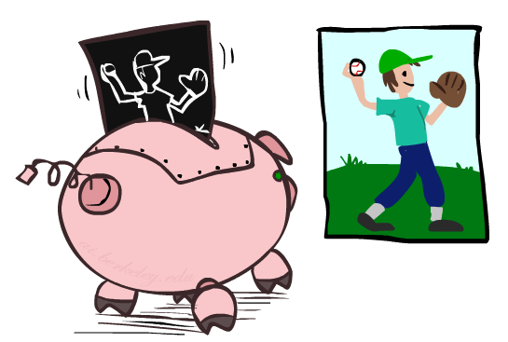

HoG Filter
HoG: Histogram of oriented gradients
[Dalal and Triggs, 2005]

Slide 41

Image Classification
HOG features passed to a linear classifier (logistic regression / SVM)
Not CAT
CAT
CAT

Slide 42
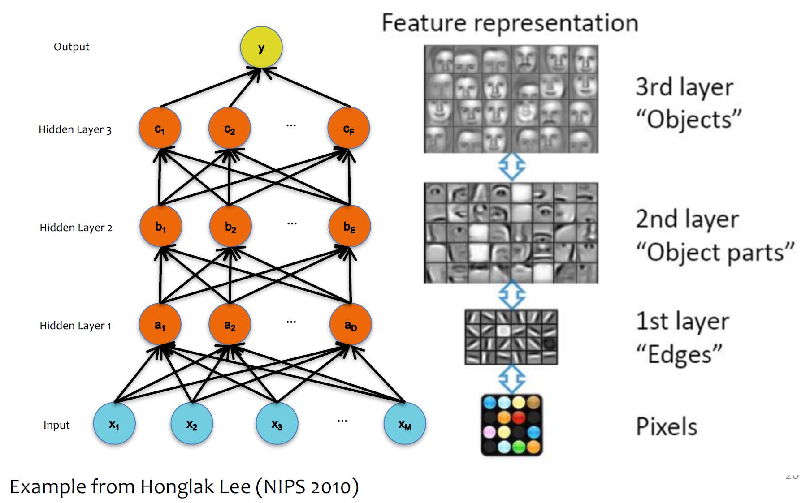
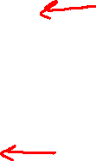
Classification: Learning Features

Slide 43
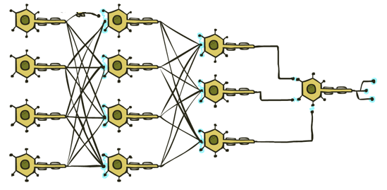

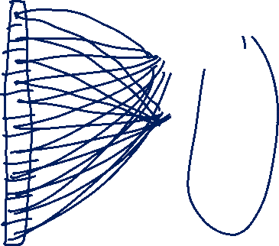
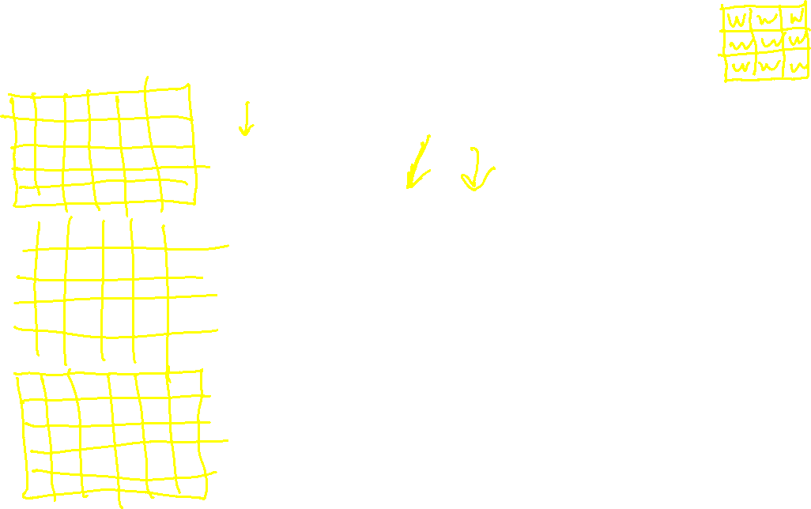
Classification: Deep Learning
Fully connected neural network?
CAT

Slide 44
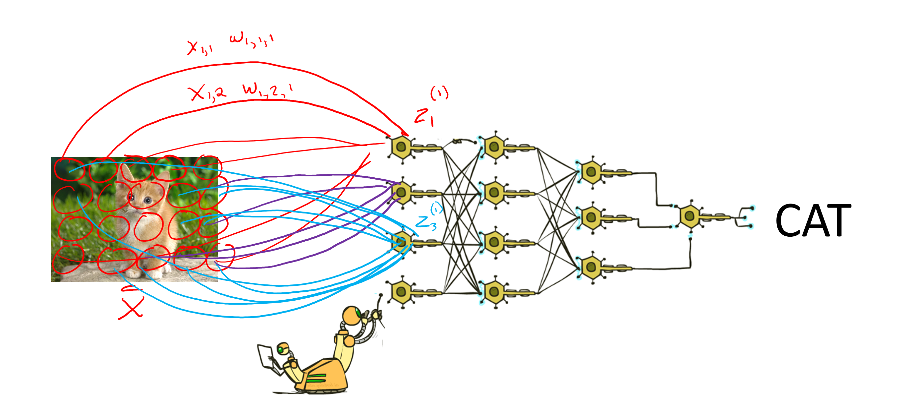
Classification: Deep Learning
CAT
Lost spatial content after first layer
Not spatially invariant
Too many weights to learn

Slide 45






Convolutional Neural Networks
Convolution
CAT

Slide 46


Convolution
-1 | 0 | 1
-1 | 0 | 1
-1 | 0 | 1

Slide 47

Convolution
0 | 0 | 0 | 1 | 1 | 1 | 1 | 0 | 0 | 0
0 | 0 | 0 | 1 | 1 | 1 | 1 | 0 | 0 | 0
0 | 0 | 0 | 1 | 1 | 1 | 1 | 0 | 0 | 0
0 | 0 | 0 | 1 | 1 | 1 | 1 | 0 | 0 | 0
0 | 0 | 0 | 1 | 1 | 1 | 1 | 0 | 0 | 0
0 | 0 | 0 | 1 | 1 | 1 | 1 | 0 | 0 | 0
0 | 0 | 0 | 1 | 1 | 1 | 1 | 0 | 0 | 0
0 | 0 | 0 | 1 | 1 | 1 | 1 | 0 | 0 | 0
0 | 0 | 0 | 1 | 1 | 1 | 1 | 0 | 0 | 0
0 | 0 | 0 | 1 | 1 | 1 | 1 | 0 | 0 | 0
-1 | 0 | 1
-1 | 0 | 1
-1 | 0 | 1

Slide 48

Convolution
-1 | 0 | 1
-1 | 0 | 1
-1 | 0 | 1

Slide 49


Convolution
Signal processing definition
$$z\left[i,j\right]= \sum_{u=−∞}^{∞}{\sum_{v=−∞}^{∞}{x\left[i−u, j−v\right]⋅w[u},v]}$$
Relaxed definition
Drop infinity; don’t flip kernel
$$z\left[i,j\right]= \sum_{u=0}^{K−1}{\sum_{v=0}^{K−1}{x\left[i+u, j+v\right]⋅w[u},v]}$$
-1 | 0 | 1
-2 | 0 | 2
-1 | 0 | 1

Slide 50


Convolution
Relaxed definition
$$z\left[i,j\right]= \sum_{u=0}^{K−1}{\sum_{v=0}^{K−1}{x\left[i+u, j+v\right]⋅w[u},v]}$$
for i in range(0, im_width - K + 1):
for j in range(0, im_height – K + 1):
im_out[i,j] = 0
for u in range(0, K):
for v in range(0, K):
im_out[i,j] += im[i+u, j+v] * kernel[u,v]
GPU!!
-1 | 0 | 1
-2 | 0 | 2
-1 | 0 | 1

Slide 51

Convolution: Padding
0 | 0 | 1 | 1 | 1 | 1 | 0 | 0
0 | 0 | 1 | 1 | 1 | 1 | 0 | 0
0 | 0 | 1 | 1 | 1 | 1 | 0 | 0
0 | 0 | 1 | 1 | 1 | 1 | 0 | 0
0 | 0 | 1 | 1 | 1 | 1 | 0 | 0
0 | 0 | 1 | 1 | 1 | 1 | 0 | 0
0 | 0 | 1 | 1 | 1 | 1 | 0 | 0
0 | 0 | 1 | 1 | 1 | 1 | 0 | 0
0 | 2 | 2 | 0 | 0 | -2 | -2 | 0
0 |  |  |  |  |  |  | 0
0 |  |  |  |  |  |  | 0
0 |  |  |  |  |  |  | 0
0 |  |  |  |  |  |  | 0
0 |  |  |  |  |  |  | 0
0 |  |  |  |  |  |  | 0
0 | 2 | 2 | 0 | 0 | -2 | -2 | 0
3 | 3 | 0 | 0 | -3 | -3
3 | 3 | 0 | 0 | -3 | -3
3 | 3 | 0 | 0 | -3 | -3
3 | 3 | 0 | 0 | -3 | -3
3 | 3 | 0 | 0 | -3 | -3
3 | 3 | 0 | 0 | -3 | -3

Slide 52





Piazza Poll 3 : Which kernel goes with which output image?
Input
K1
K2
K3
-1 | 0 | 1
-2 | 0 | 2
-1 | 0 | 1
-1 | -2 | -1
0 | 0 | 0
1 | 2 | 1
0 | 0 | -1 | 0
0 | -2 | 0 | 1
-1 | 0 | 2 | 0
0 | 1 | 0 | 0
Im1
Im2
Im3

Slide 53
Piazza Poll 3: Which kernel goes with which output image?
Input
K1
K2
K3
-1 | 0 | 1
-2 | 0 | 2
-1 | 0 | 1
-1 | -2 | -1
0 | 0 | 0
1 | 2 | 1
0 | 0 | -1 | 0
0 | -2 | 0 | 1
-1 | 0 | 2 | 0
0 | 1 | 0 | 0
Im1
Im2
Im3

Slide 54

Convolutional Neural Networks
Convolution
-1 | 0 | 1
-2 | 0 | 2
-1 | 0 | 1
-1 | -2 | -1
0 | 0 | 0
1 | 2 | 1
CAT
0 | 0 | -1 | 0
0 | -2 | 0 | 1
-1 | 0 | 2 | 0
0 | 1 | 0 | 0

Slide 55



Convolutional Neural Networks
Pooling
Convolution
-1 | 0 | 1
-2 | 0 | 2
-1 | 0 | 1
-1 | -2 | -1
0 | 0 | 0
1 | 2 | 1
0 | 0 | -1 | 0
0 | -2 | 0 | 1
-1 | 0 | 2 | 0
0 | 1 | 0 | 0

Slide 56

Convolution: Stride=2
0 | 0 | 0 | 1 | 1 | 1 | 1 | 0 | 0 | 0
0 | 0 | 0 | 1 | 1 | 1 | 1 | 0 | 0 | 0
0 | 0 | 0 | 1 | 1 | 1 | 1 | 0 | 0 | 0
0 | 0 | 0 | 1 | 1 | 1 | 1 | 0 | 0 | 0
0 | 0 | 0 | 1 | 1 | 1 | 1 | 0 | 0 | 0
0 | 0 | 0 | 1 | 1 | 1 | 1 | 0 | 0 | 0
0 | 0 | 0 | 1 | 1 | 1 | 1 | 0 | 0 | 0
0 | 0 | 0 | 1 | 1 | 1 | 1 | 0 | 0 | 0
0 | 0 | 0 | 1 | 1 | 1 | 1 | 0 | 0 | 0
0 | 0 | 0 | 1 | 1 | 1 | 1 | 0 | 0 | 0
.25 | .25
.25 | .25

Slide 57


Stride: Max Pooling
Stanford CS 231n, Spring 2017

Slide 58
Convolutional Neural Networks
Pooling
Convolution
-1 | 0 | 1
-2 | 0 | 2
-1 | 0 | 1
-1 | -2 | -1
0 | 0 | 0
1 | 2 | 1
0 | 0 | -1 | 0
0 | -2 | 0 | 1
-1 | 0 | 2 | 0
0 | 1 | 0 | 0

Slide 59



Convolutional Neural Networks
Pooling
Convolution
-1 | 0 | 1
-2 | 0 | 2
-1 | 0 | 1
-1 | -2 | -1
0 | 0 | 0
1 | 2 | 1
0 | 0 | -1 | 0
0 | -2 | 0 | 1
-1 | 0 | 2 | 0
0 | 1 | 0 | 0

Slide 60

Convolutional Neural Networks
Pooling
Convolution
-1 | 0 | 1
-2 | 0 | 2
-1 | 0 | 1
-1 | -2 | -1
0 | 0 | 0
1 | 2 | 1
0 | 0 | -1 | 0
0 | -2 | 0 | 1
-1 | 0 | 2 | 0
0 | 1 | 0 | 0

Slide 61


Convolutional Neural Networks
Lenet5 – Lecun, et al, 1998
Convnets for digit recognition
LeCun, Yann, et al. "Gradient-based learning applied to document recognition." Proceedings of the IEEE 86.11 (1998): 2278-2324.

Slide 62

Question:
How big many convolutional weights between S2 and C3?
S2: 6 channels @14x14
Conv: 5x5, pad=0, stride=1
C3: 16 channels @ 10x10

Slide 63

Question:
How big many convolutional weights between S2 and C3?
S2: 6 channels @14x14
Conv: 5x5, pad=0, stride=1
C3: 16 channels @ 10x10
One image in C3 is actually the result of a 3D convolution
Kernel_1: 6x5x5
C3_1: 1x10x10
S2: 6x14x14

Slide 64

Question:
How big many convolutional weights between S2 and C3?
S2: 6 channels @14x14
Conv: 5x5, pad=0, stride=1
C3: 16 channels @ 10x10
Each image in C3 convolved S2 convolved with a different 3D kernel
Kernel_2: 6x5x5
C3_2: 1x10x10
Kernel_1: 6x5x5
C3_1: 1x10x10
S2: 6x14x14

Slide 65
Question:
How big many convolutional weights between S2 and C3?
S2: 6 channels @14x14
Conv: 5x5, pad=0, stride=1
C3: 16 channels @ 10x10
The 16 images in C3 are the result of doing 16 3D convolutions of S2 with 16 different 6x5x5 kernels.
Assuming no bias term, this is 16x6x5x5 weights!
Kernels: 16@6x5x5
S2: 6x14x14
C3: 16@10x10

Slide 66


Convolutional Neural Networks
Alexnet – Lecun, et al, 2012
Convnets for image classification
More data & more compute power
Krizhevsky, Alex, Ilya Sutskever, and Geoffrey E. Hinton. "ImageNet classification with deep convolutional neural networks." NIPS, 2012.

Slide 67

CNNs for Image Recognition
Slide from Kaiming He

