Slide 1

Announcements
Assignments
HW5
Due Mon, 10/26, 11:59 pm
Start early
Recitation
No recitation this Friday
Educational Research
See section added to the end of the website

Slide 2
Plan
Last Time
Neural Networks
Calculus
Universal Approximation Theorem
Convolutional neural networks
Today
Wrap up convolutional neural networks
Learning Theory
Bias and variance
Learning theory model
Introduce PAC learning

Slide 3
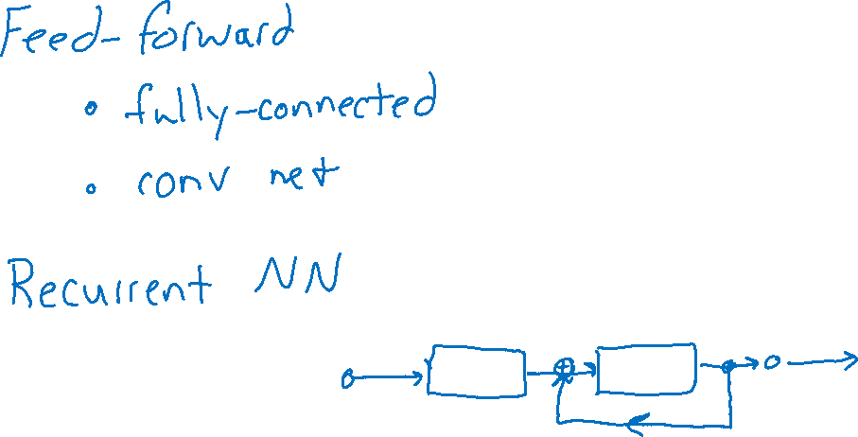
Wrap Up Neural Networks
Neural network slides

Slide 4

Introduction to Machine Learning Learning Theory
Instructor: Pat Virtue

Slide 5
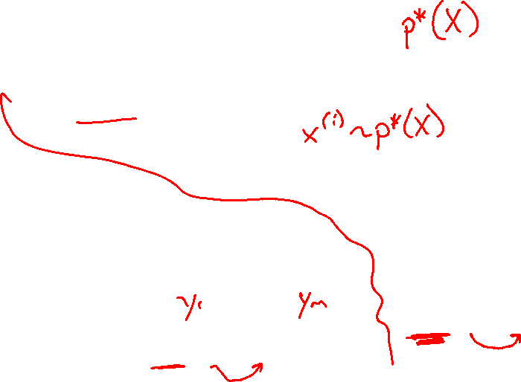
Model for Supervised Learning
Slide credit: CMU MLD Nina Balcan

Slide 6
Learning from Training Data
We want to learn from training data
But, we also want our hypothesis function to generalize well
How do we characterize and quantify these properties?
Bias and variance

Slide 7
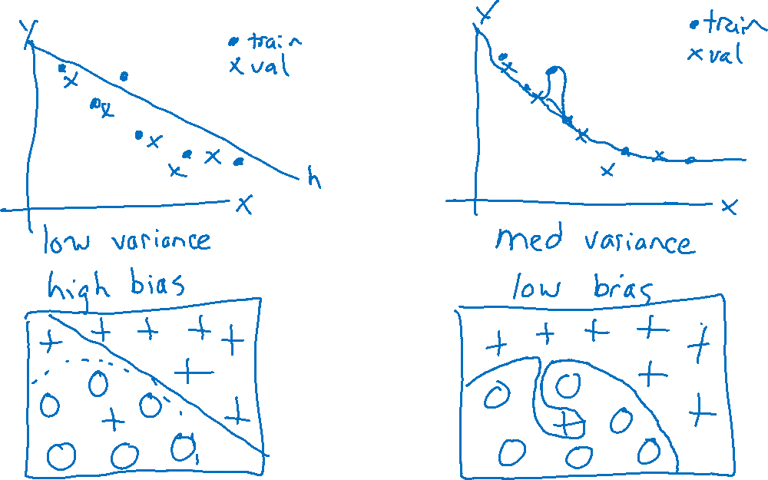
Bias and Variance Examples
Slide credit: Andrew Ng, Stanford

Slide 8
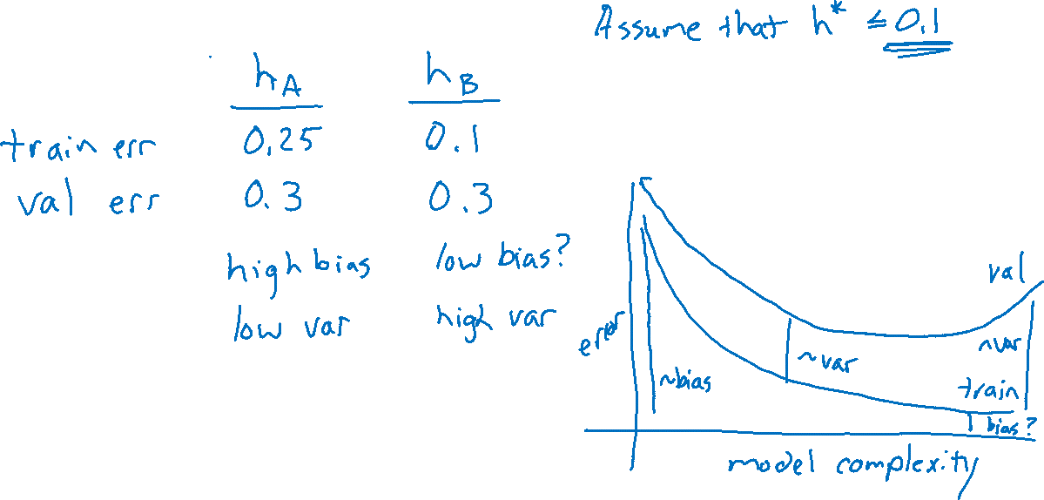
Bias and Variance Examples
Slide credit: Andrew Ng, Stanford

Slide 9
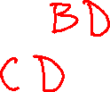

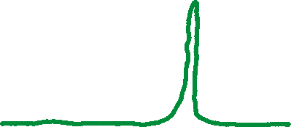


Piazza Polls 1 & 2
Poll 1: [SELECT TWO] Which have high variance?
Poll 2: [SELECT TWO] Which have high bias?
A.
B.
C.
D.

Slide 10
Questions
Given a classifier with zero training error, what can we say about true error (aka. generalization error)? (Sample Complexity, Realizable Case)
Given a classifier with low training error, what can we say about true error (aka. generalization error)? (Sample Complexity, Agnostic Case)
Is there a theoretical justification for regularization to avoid overfitting? (Structural Risk Minimization)
Slide credit: CMU MLD Matt Gormley

Slide 11
Model for Supervised Learning
Slide credit: CMU MLD Nina Balcan

Slide 12
Two Types of Error
1. True Error (aka. expected risk)
This quantity is always unknown
2. Train Error (aka. empirical risk)
We can measure this on the training data
Slide credit: CMU MLD Matt Gormley

Slide 13
PAC / SLT Model
Slide credit: CMU MLD Matt Gormley

Slide 14
Three Hypotheses of Interest
Question: True or False: h* and c* are always equal.
Slide credit: CMU MLD Matt Gormley

