Slide 1

Announcements
Assignments
HW6
Due Mon, 11/2, 11:59 pm
Midterm 2
Mon, 11/9, during lecture
See Piazza for details
Forms for conflicts / tech issues due Fri, 10/30
Fireside Chat about the CMU ML PhD Program
Fri, 10/30, 8:00 pm
See Piazza for details, including form to show interest

Slide 2
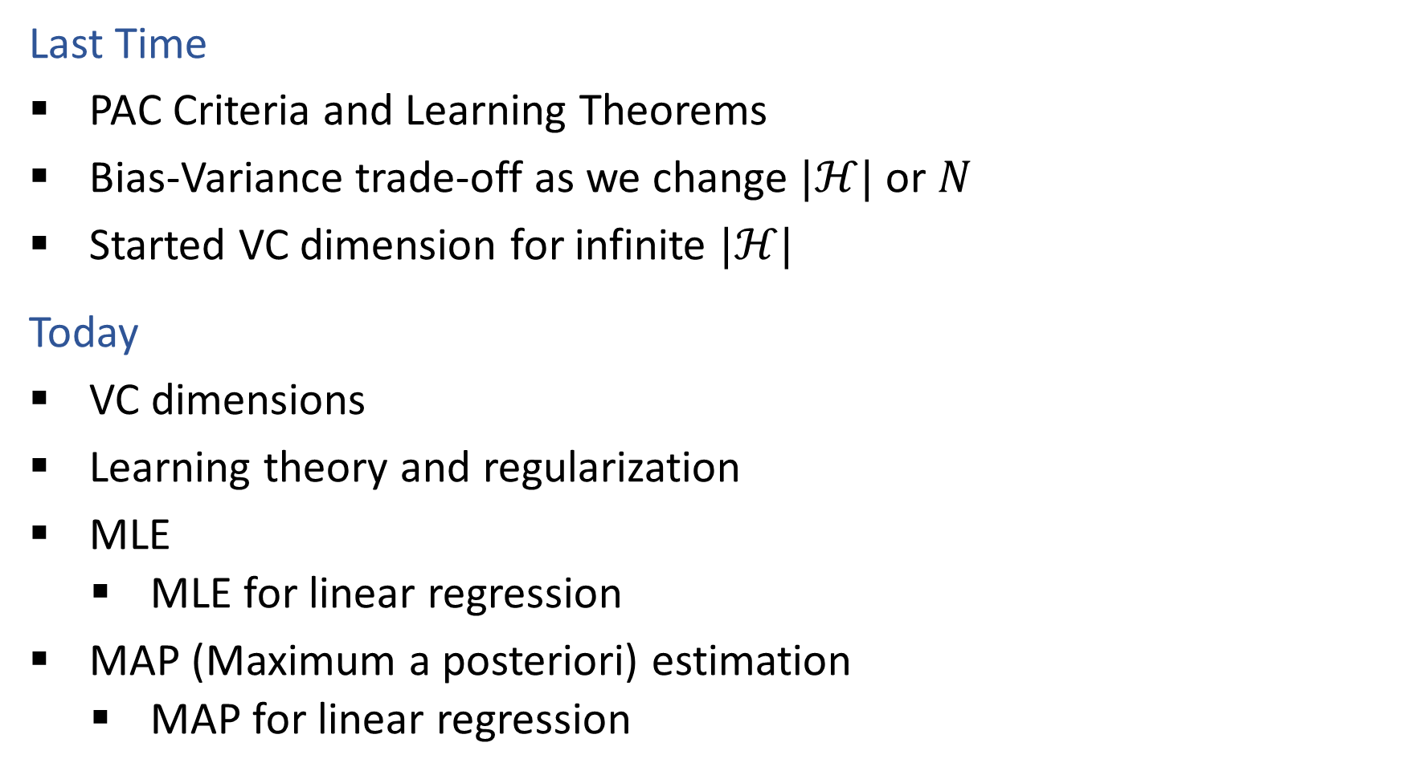
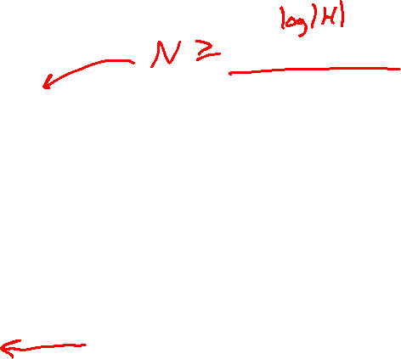
Plan
Last Time
PAC Criteria and Learning Theorems
Bias-Variance trade-off as we change $|ℋ|$ or $N$
Started VC dimension for infinite $|ℋ|$
Today
VC dimensions
Learning theory and regularization
MLE
MLE for linear regression
MAP (Maximum a posteriori) estimation
MAP for linear regression

Slide 3
Wrap up Learning Theory
Learning theory slides

Slide 4

Introduction to Machine Learning MLE & MAP
Instructor: Pat Virtue

Slide 5
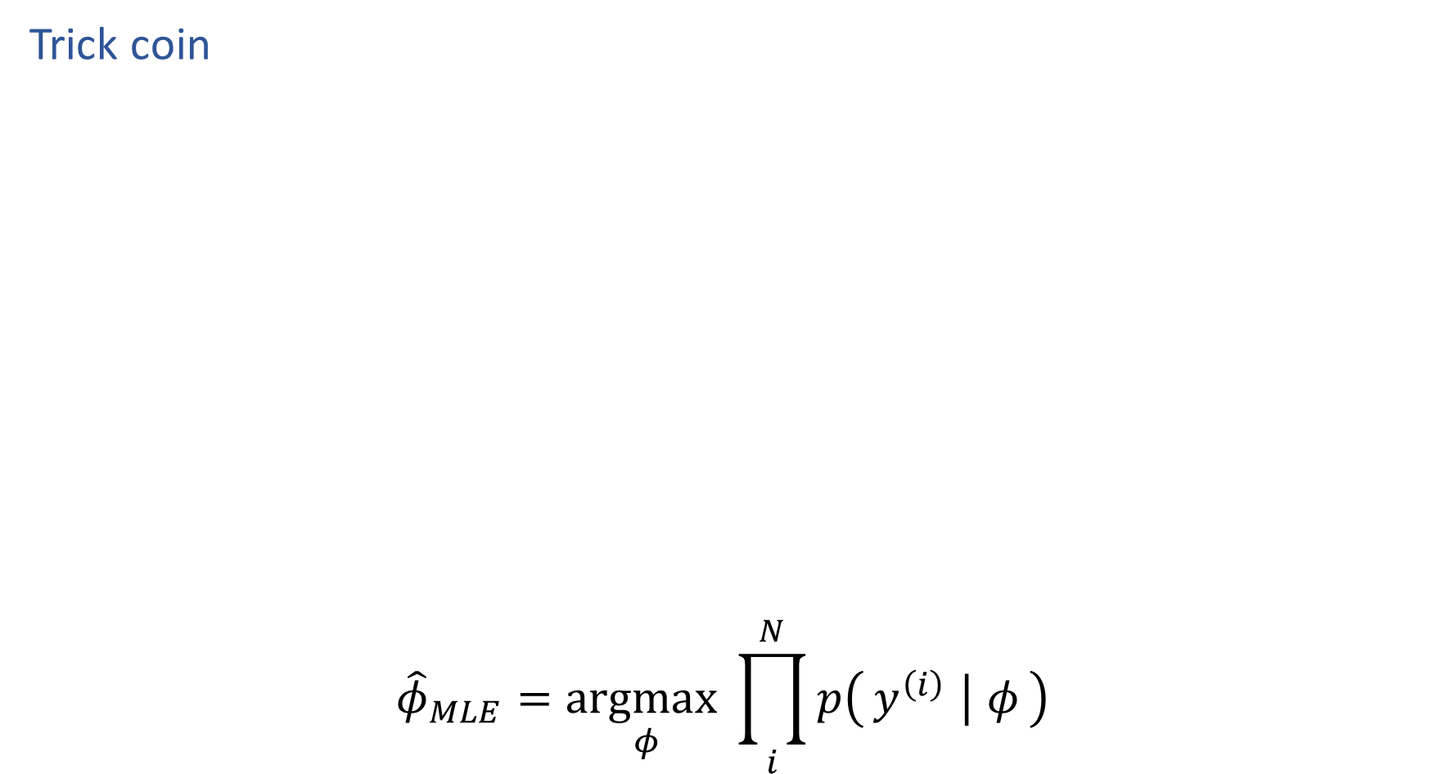

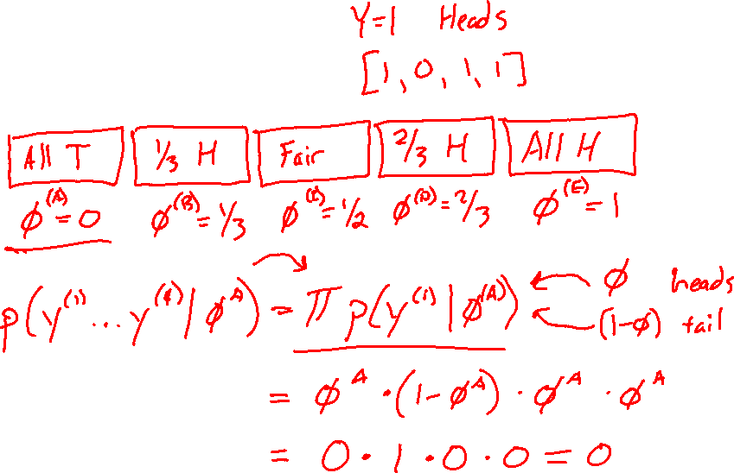
Reminder MLE
Trick coin
$${\hat{φ}}_{MLE}=\underset{φ}{argmax}\prod_{i}^{N}{p\left(y^{\left(i\right)} ∣ φ\right)}$$

Slide 6
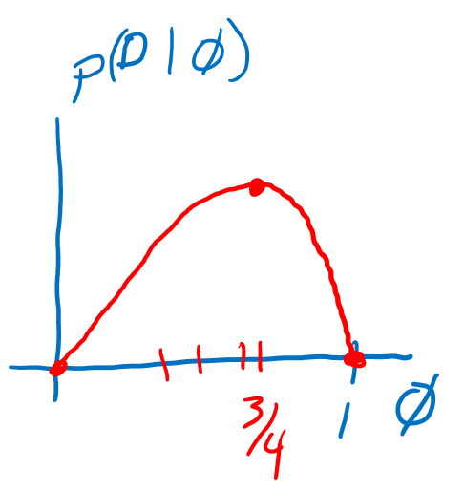
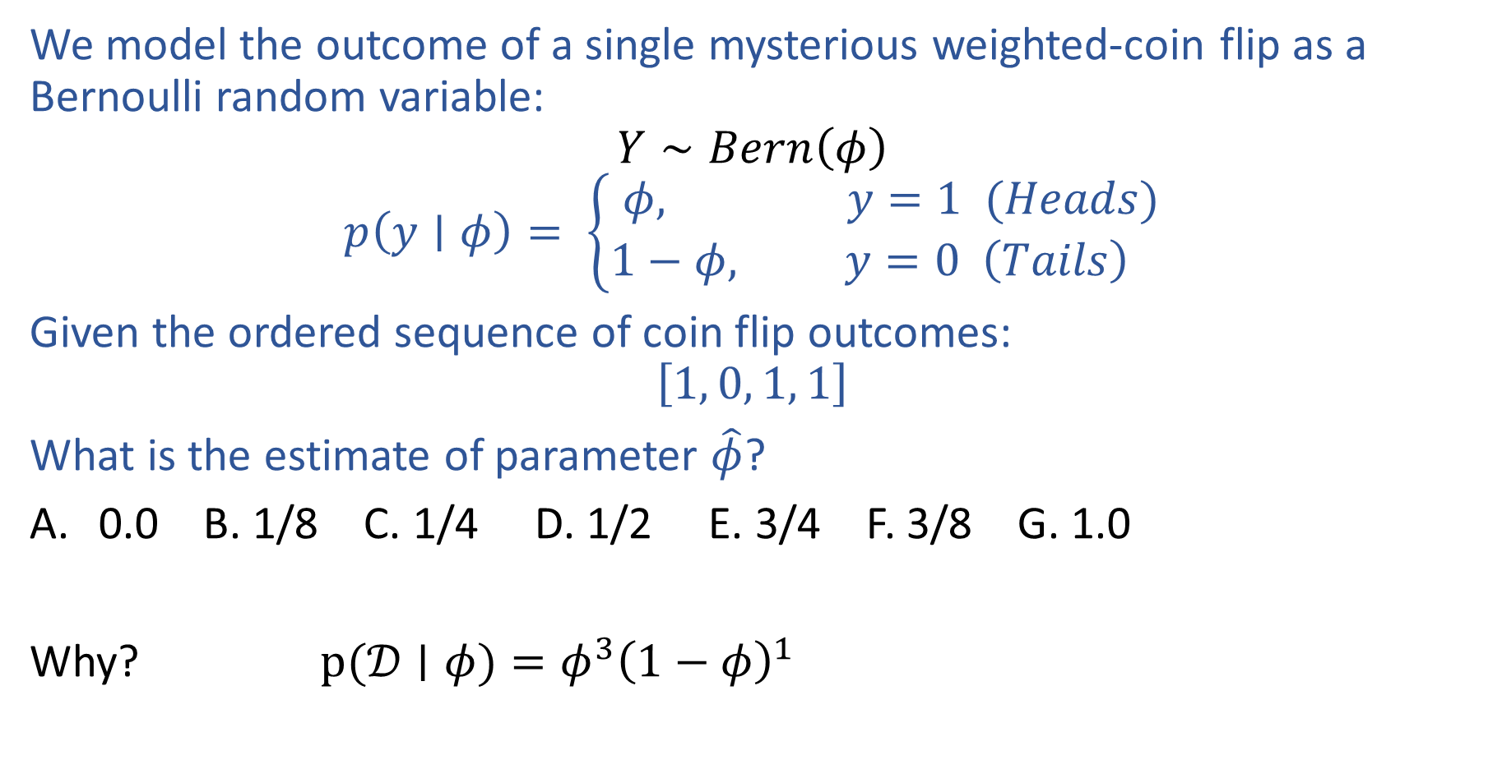
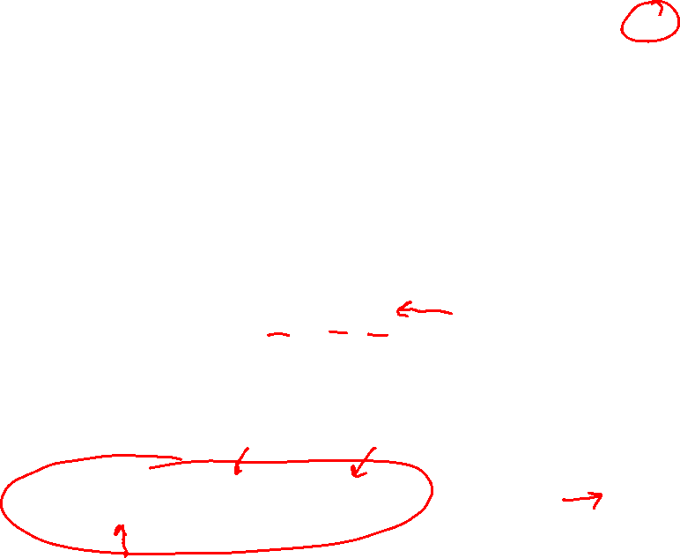
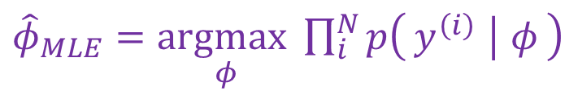
Previous Piazza Poll
${\hat{φ}}_{MLE}=\underset{φ}{argmax}\prod_{i}^{N}{p\left(y^{\left(i\right)} ∣ φ\right)}$
We model the outcome of a single mysterious weighted-coin flip as a Bernoulli random variable:
$$Y∼Bern\left(φ\right)$$
$$p\left(y∣φ\right)= \left\{\begin{aligned}φ, y=1 (Heads) \\ 1−φ, y=0 \left(Tails\right) \end{aligned}\right.$$
Given the ordered sequence of coin flip outcomes:
$$\left[1, 0, 1, 1\right]$$
What is the estimate of parameter $\hat{φ}$?
0.0 B. 1/8 C. 1/4 D. 1/2 E. 3/4 F. 3/8 G. 1.0
Why? $p(𝒟∣φ)=φ^{3}{\left(1−φ\right)}^{1}$

Slide 7

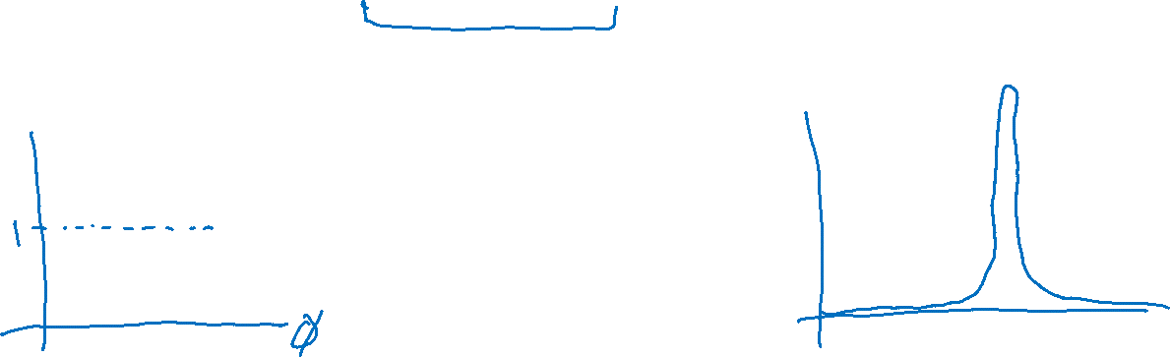
MLE as Data Increases
Given the ordered sequence of coin flip outcomes:
$$\left[1, 0, 1, 1\right]$$
$$p(𝒟∣φ)=\prod_{i}^{N}{p\left(y^{\left(i\right)} ∣ φ\right)} = φ^{N_{y=1}}{\left(1−φ\right)}^{N_{y=0}}$$
What happens as we flip more coins?

Slide 8
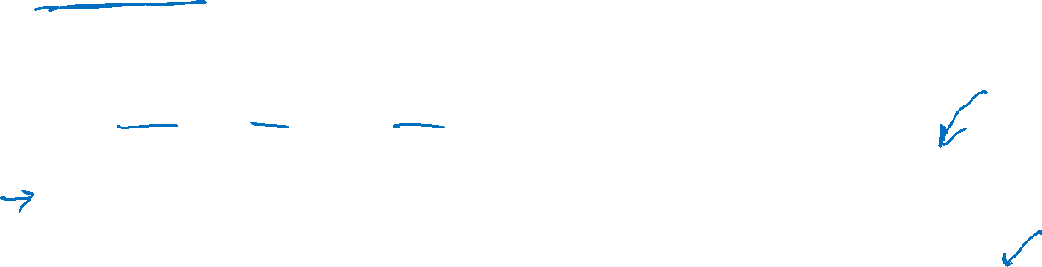
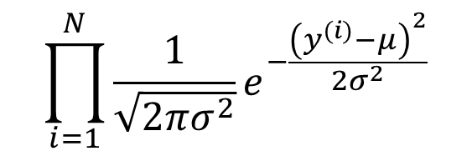
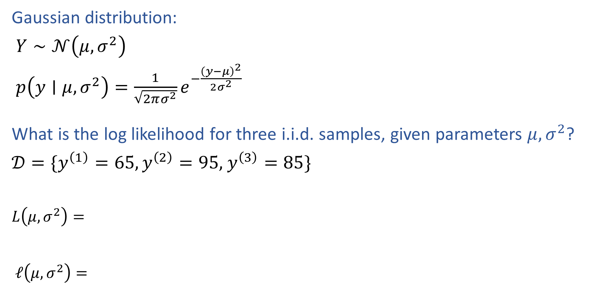
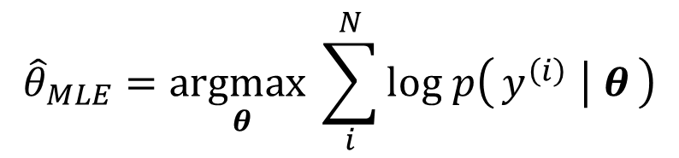
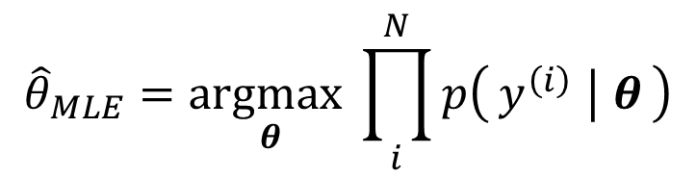
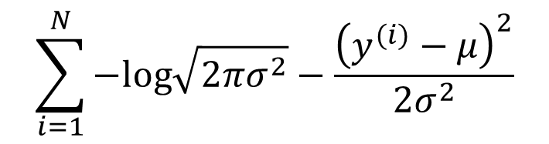
MLE for Gaussian
Gaussian distribution:
$Y∼𝒩\left(μ, σ^{2}\right)$
$p\left(y∣μ, σ^{2}\right)=\frac{1}{\sqrt{2πσ^{2}}}e^{−\frac{{\left(y−μ\right)}^{2}}{2σ^{2}}}$
What is the log likelihood for three i.i.d. samples, given parameters $μ, σ^{2}$?
$𝒟=\{y^{\left(1\right)}=65,y^{\left(2\right)}=95,$ $y^{\left(3\right)}=85\}$
$L\left(μ, σ^{2}\right)=$
$ℓ\left(μ, σ^{2}\right)=$
$$\prod_{i=1}^{N}{\frac{1}{\sqrt{2πσ^{2}}}e^{−\frac{{\left(y^{(i)}−μ\right)}^{2}}{2σ^{2}}}}$$
$${\hat{θ}}_{MLE}=\underset{θ}{argmax}\prod_{i}^{N}{p\left(y^{\left(i\right)} ∣ θ\right)}$$
$$\sum_{i=1}^{N}{−log\sqrt{2πσ^{2}}−\frac{{\left(y^{(i)}−μ\right)}^{2}}{2σ^{2}}}$$
$${\hat{θ}}_{MLE}=\underset{θ}{argmax}\sum_{i}^{N}{log p\left(y^{\left(i\right)} ∣ θ\right)}$$

Slide 9
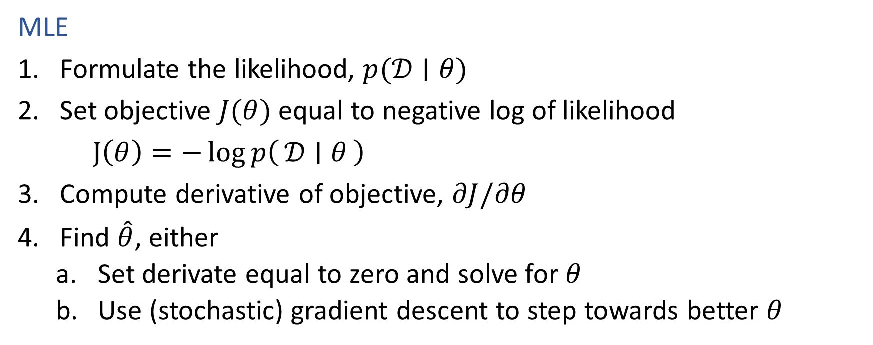
Recipe for Estimation
MLE
Formulate the likelihood, $p(𝒟∣θ)$
Set objective $J(θ)$ equal to negative log of likelihood
$J\left(θ\right)=−\log{p\left(𝒟 ∣ θ\right)}$
Compute derivative of objective, $∂J/∂θ$
Find $\hat{θ}$, either
Set derivate equal to zero and solve for $θ$
Use (stochastic) gradient descent to step towards better $θ$

Slide 10

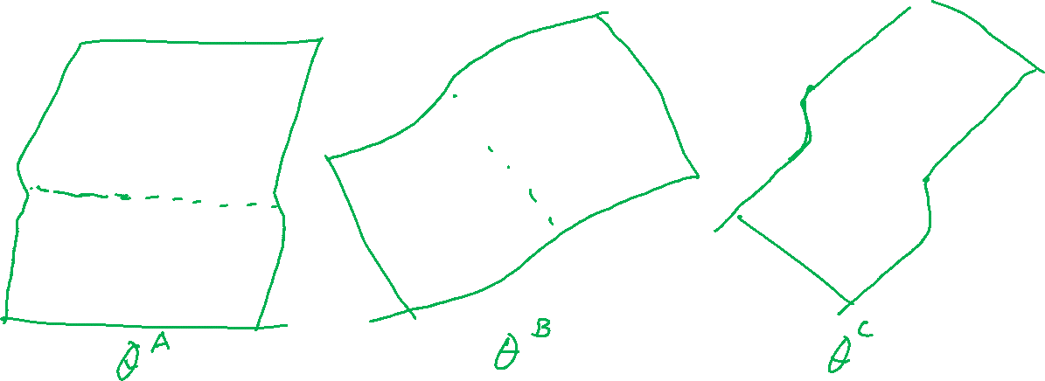
M(C)LE for Logistic Regression
Learn to predict if a patient has cancer ($Y=1$) or not ($Y=0$) given the input of just one test result, $X_{A}$.
$${\hat{θ}}_{MLE}=\underset{θ}{argmax}\prod_{i}^{N}{{\frac{1}{1+{e^{−θ^{T}x}}^{\left(i\right)}}}^{𝕀\left(y^{\left(i\right)}=1\right)}{\left(1−\frac{1}{1+{e^{−θ^{T}x}}^{\left(i\right)}}\right)}^{𝕀\left(y^{(i)}=0\right)}}$$

Slide 11

M(C)LE for Logistic Regression
Learn to predict if a patient has cancer ($Y=1$) or not ($Y=0$) given the input of just one test result, $X_{A}$.
$${\hat{θ}}_{MLE}=\underset{θ}{argmax}\prod_{i}^{N}{p\left(y^{\left(i\right)} ∣ x^{\left(i\right)}, θ\right)}$$

Slide 12
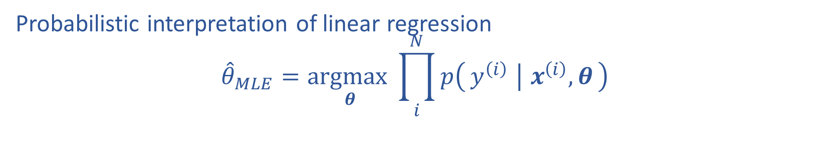
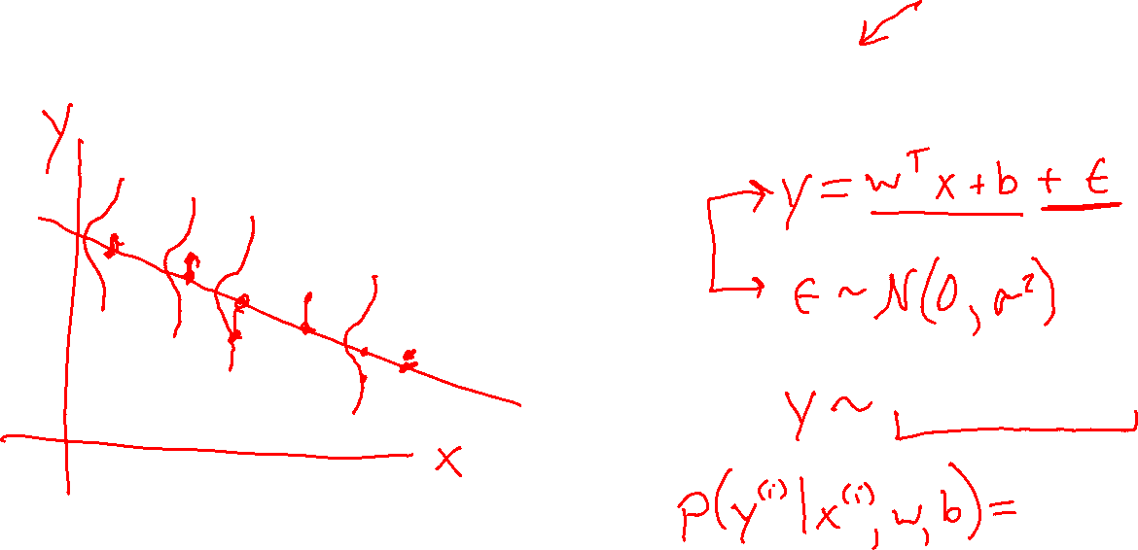
M(C)LE for Linear Regression
Probabilistic interpretation of linear regression
$${\hat{θ}}_{MLE}=\underset{θ}{argmax}\prod_{i}^{N}{p\left(y^{\left(i\right)} ∣ x^{\left(i\right)}, θ\right)}$$

Slide 13
From MLE to MAP

Slide 14
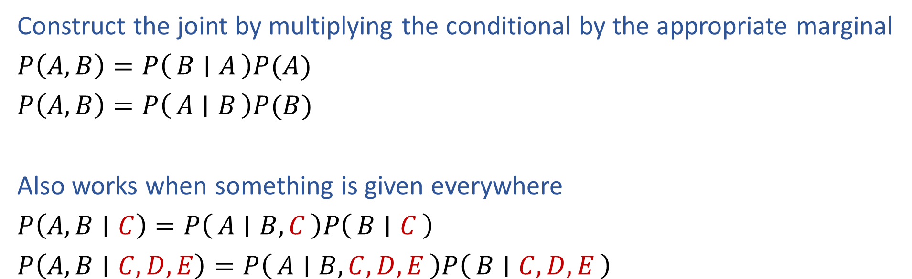
Product Rule
Construct the joint by multiplying the conditional by the appropriate marginal
$P\left(A,B\right)=P\left(B ∣ A\right)P(A)$
$P\left(A,B\right)=P\left(A ∣ B\right)P(B)$
Also works when something is given everywhere
$P\left(A,B∣C\right)=P\left(A ∣ B, C\right)P\left(B ∣ C\right)$
$P\left(A,B∣C, D, E\right)=P\left(A ∣ B, C, D, E\right)P\left(B ∣ C,D,E\right)$

Slide 15
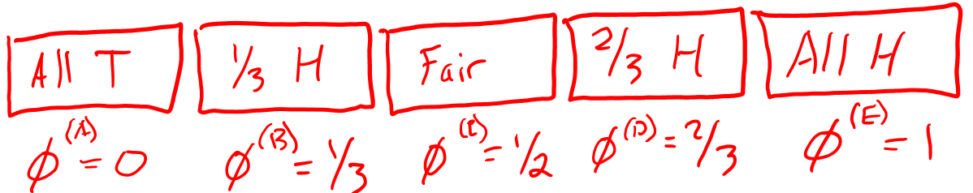
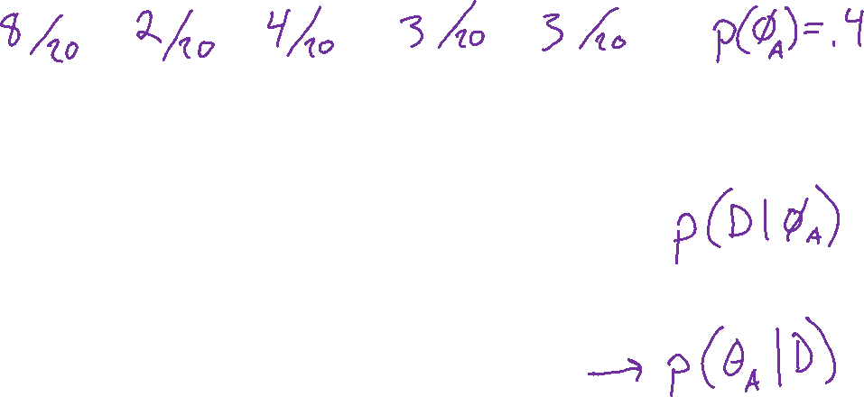
Coin Flipping Example
Trick coin: Suppose I know how many coins are in each container in the store. How can I use this information both before and after flipping coins?

Slide 16

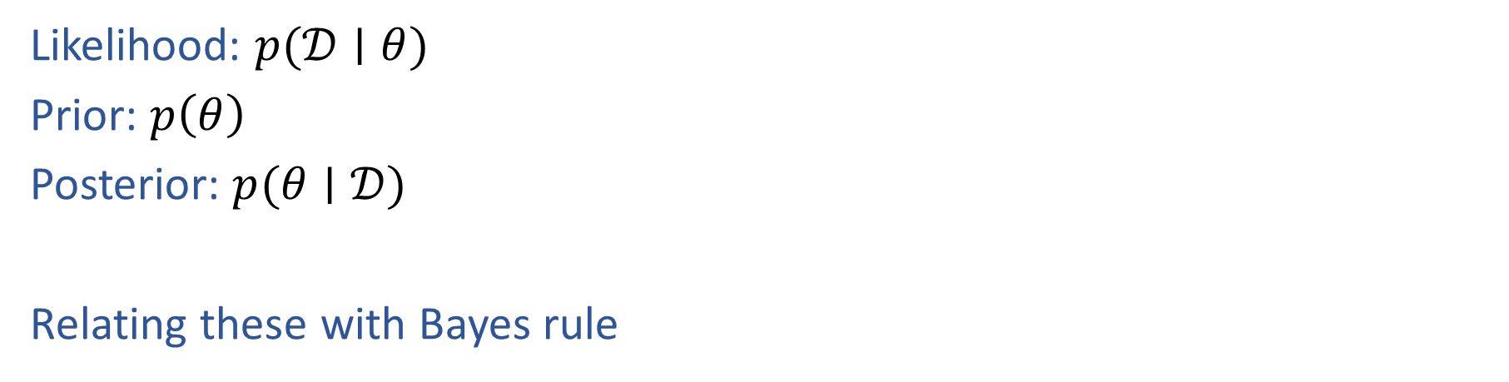
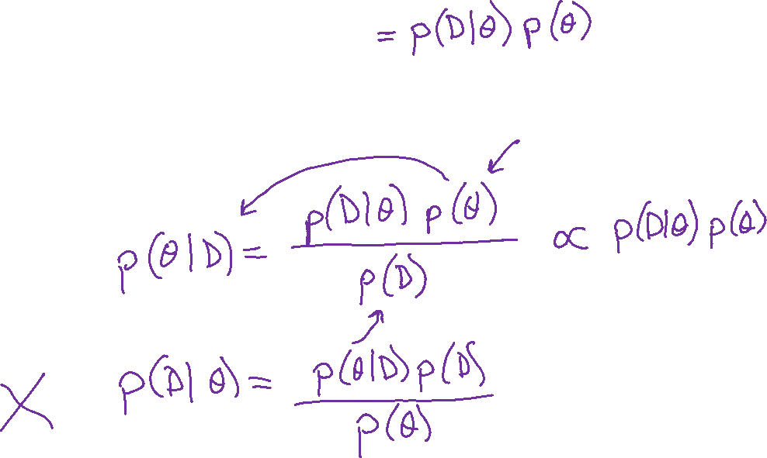
Likelihood, Prior, and Posterior
Joint: $p(𝒟,θ)$
Likelihood: $p(𝒟∣θ)$
Prior: $p\left(θ\right)$
Posterior: $p(θ∣𝒟)$
Relating these with Bayes rule

Slide 17
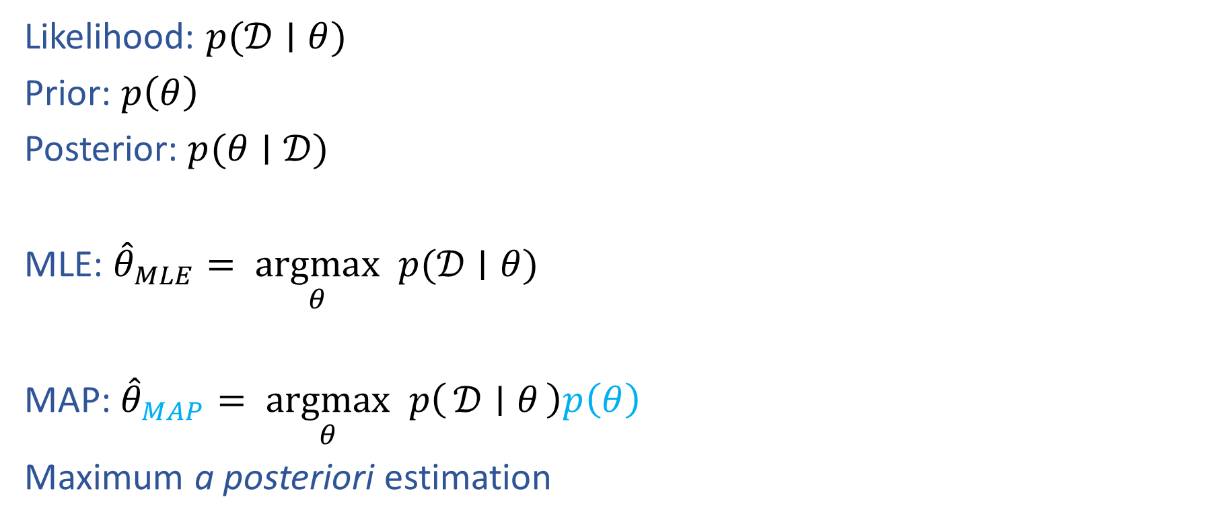
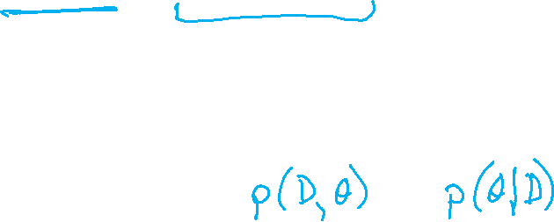

MLE and MAP
Joint: $p(𝒟,θ)$
Likelihood: $p(𝒟∣θ)$
Prior: $p\left(θ\right)$
Posterior: $p(θ∣𝒟)$
MLE: ${\hat{θ}}_{MLE}= \underset{θ}{argmax} p(𝒟∣θ)$
MAP: ${\hat{θ}}_{MAP}= \underset{θ}{argmax} p\left(𝒟 ∣ θ\right)p\left(θ\right)$
Maximum a posteriori estimation
$p\left(θ ∣ 𝒟\right)∝p\left(𝒟 ∣ θ\right)p(θ)$

Slide 18
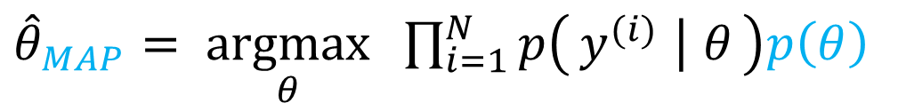
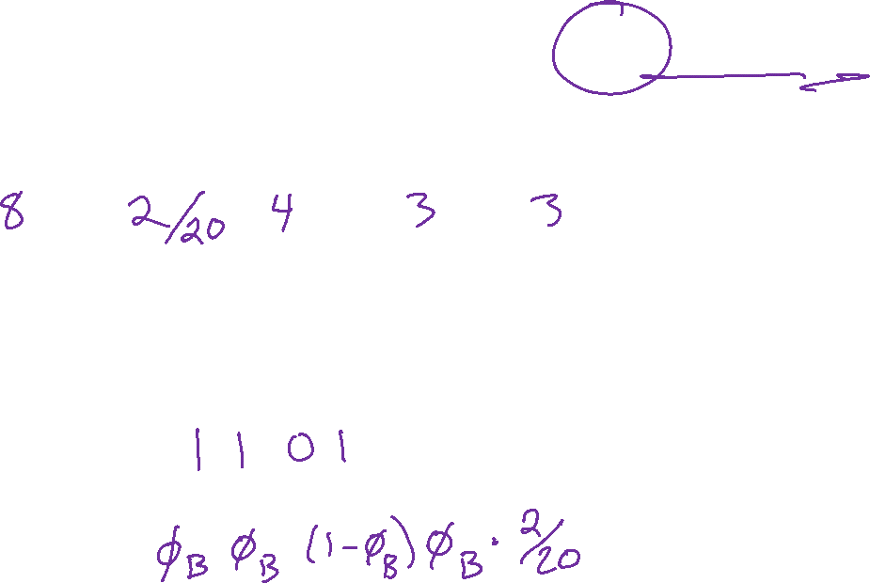
Coin Flipping Example
${\hat{θ}}_{MAP}= \underset{θ}{argmax} \prod_{i=1}^{N}{p\left(y^{(i)} ∣ θ\right)p\left(θ\right)}$
Trick coin: Suppose I know how many coins are in each container in the store. How can I use this information both before and after flipping coins?

Slide 19

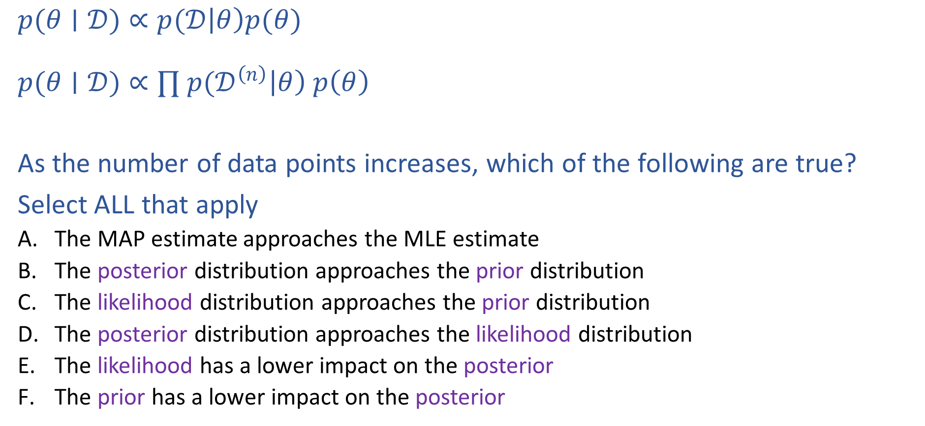
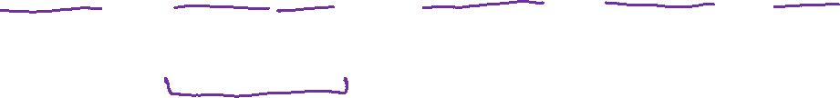
Piazza Poll 1:
$$posterior∝likelihood⋅prior$$
$p(θ∣𝒟)∝p(𝒟\left|θ\right)p(θ)$
$p(θ∣𝒟)∝∏ p(𝒟^{\left(n\right)}\left|θ\right) p\left(θ\right)$
As the number of data points increases, which of the following are true?
Select ALL that apply
The MAP estimate approaches the MLE estimate
The posterior distribution approaches the prior distribution
The likelihood distribution approaches the prior distribution
The posterior distribution approaches the likelihood distribution
The likelihood has a lower impact on the posterior
The prior has a lower impact on the posterior

Slide 20
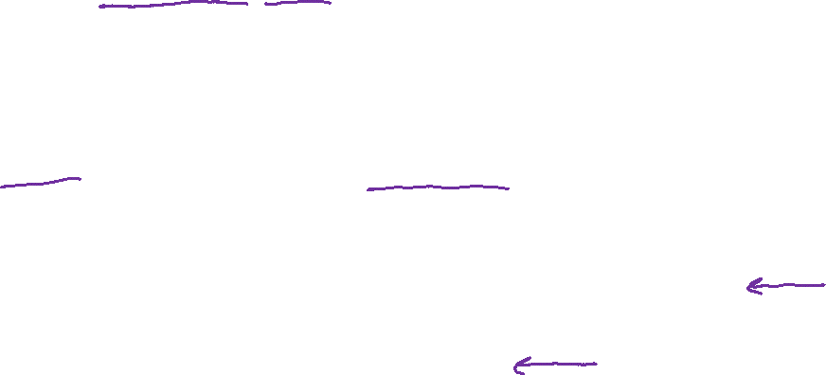
Piazza Poll 1:
$$posterior∝likelihood⋅prior$$
$p(θ∣𝒟)∝p(𝒟\left|θ\right)p(θ)$
$p(θ∣𝒟)∝∏ p(𝒟^{\left(n\right)}\left|θ\right) p\left(θ\right)$
As the number of data points increases, which of the following are true?
Select ALL that apply
The MAP estimate approaches the MLE estimate
The posterior distribution approaches the prior distribution
The likelihood distribution approaches the prior distribution
The posterior distribution approaches the likelihood distribution
The likelihood has a lower impact on the posterior
The prior has a lower impact on the posterior

Slide 21

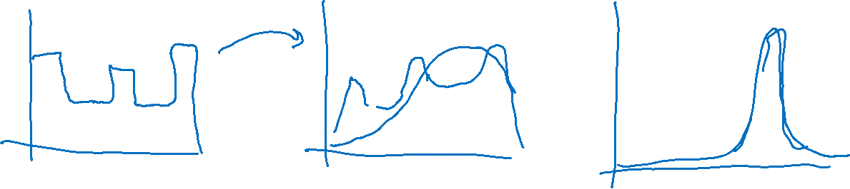
MAP as Data Increases
Given the ordered sequence of coin flip outcomes:
$$𝒟=\left[1, 0, 1, 1\right]$$
$$p\left(𝒟 ∣ φ\right)p(φ)=\prod_{i}^{N}{p\left(y^{\left(i\right)} ∣ φ\right)p\left(φ\right)} = φ^{N_{y=1}}{\left(1−φ\right)}^{N_{y=0}} p(φ)$$
What happens as we flip more coins?

Slide 22
Recipe for Estimation
MLE
Formulate the likelihood, $p(𝒟∣θ)$
Set objective $J(θ)$ equal to negative log of likelihood
$J\left(θ\right)=−\log{p\left(𝒟 ∣ θ\right)}$
Compute derivative of objective, $∂J/∂θ$
Find $\hat{θ}$, either
Set derivate equal to zero and solve for $θ$
Use (stochastic) gradient descent to step towards better $θ$

Slide 23
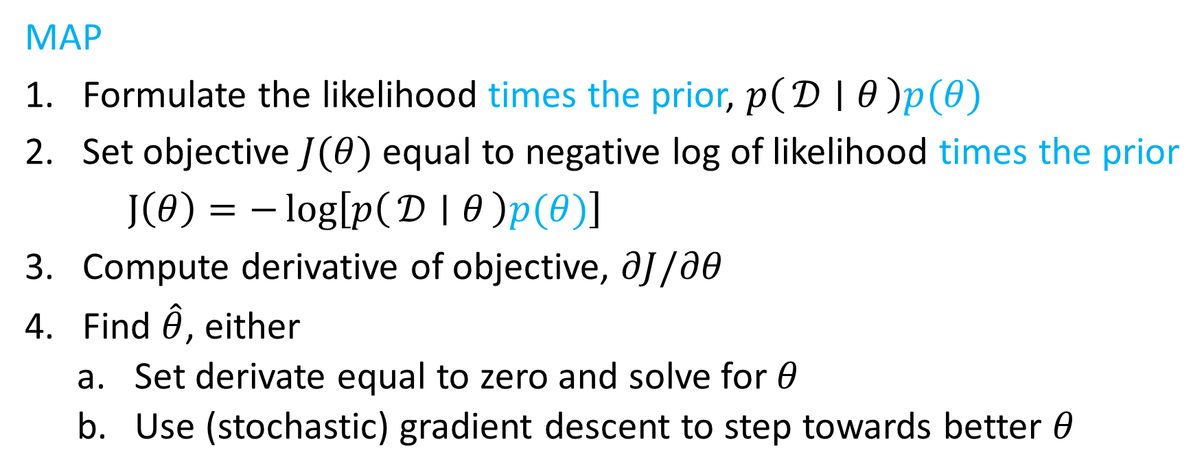
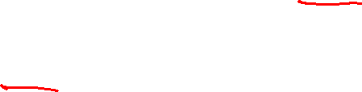
Recipe for Estimation
MAP
Formulate the likelihood times the prior, $p\left(𝒟 ∣ θ\right)p(θ)$
Set objective $J(θ)$ equal to negative log of likelihood times the prior
$J\left(θ\right)=−\log\left[p\left(𝒟 ∣ θ\right)p(θ)\right]$
Compute derivative of objective, $∂J/∂θ$
Find $\hat{θ}$, either
Set derivate equal to zero and solve for $θ$
Use (stochastic) gradient descent to step towards better $θ$

Slide 24

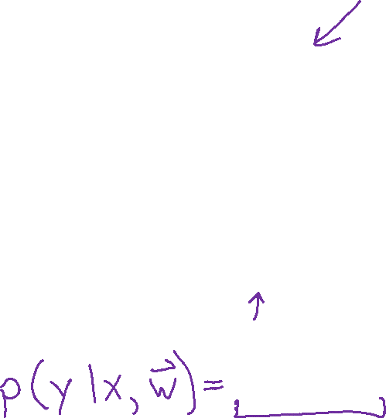
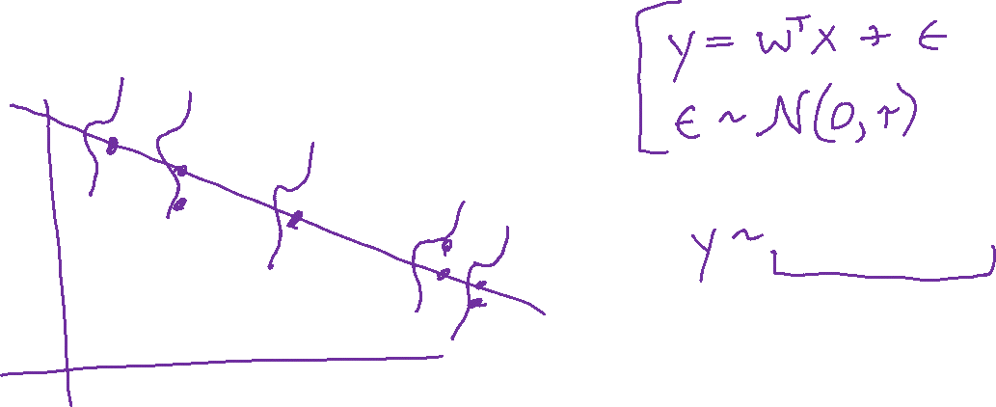
M(C)LE for Linear Regression
Probabilistic interpretation of linear regression
$${\hat{θ}}_{MLE}=\underset{θ}{argmax}\prod_{i}^{N}{p\left(y^{\left(i\right)} ∣ x^{\left(i\right)}, θ\right)}$$

Slide 25
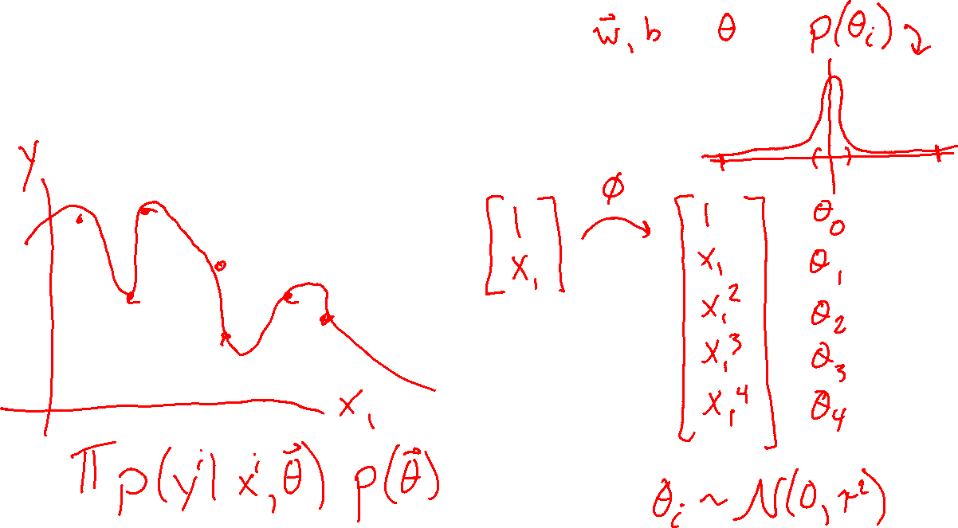
MAP for Linear Regression
What assumptions are we making about our parameters?

