Slide 1

Announcements
Assignments
HW6
Due Today, 11:59 pm
Midterm 2
Mon, 11/9, during lecture
See Piazza for details on practice exam tomorrow
Schedule change
Lecture on Friday instead of recitation

Slide 2


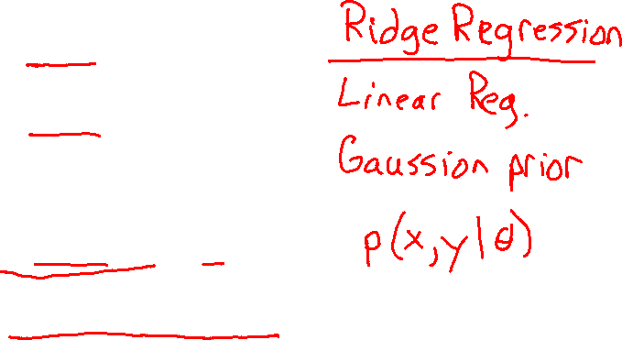
Plan
$\underset{θ}{argmax} p\left(x ∣ y, θ\right) p(y∣θ)$
$\underset{θ}{argmax} \prod_{m=1}^{M}{p\left(x_{m} ∣ y, θ\right) p(y∣θ)}$
Last Time
M(C)LE $\underset{θ}{argmax} p(y∣x, θ)$
MAP $\underset{θ}{argmax} p\left(y ∣ x, θ\right) p\left(θ\right)$
Today
Generative models
Naïve Bayes

Slide 3

Introduction to Machine Learning Generative Models & Naïve Bayes
Instructor: Pat Virtue

Slide 4
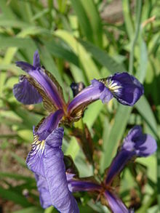
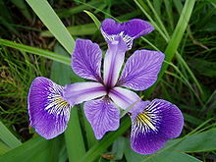
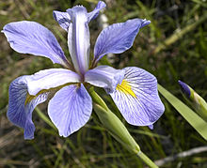
Recall: Fisher Iris Dataset
https://en.wikipedia.org/wiki/Iris_flower_data_set

Slide 5
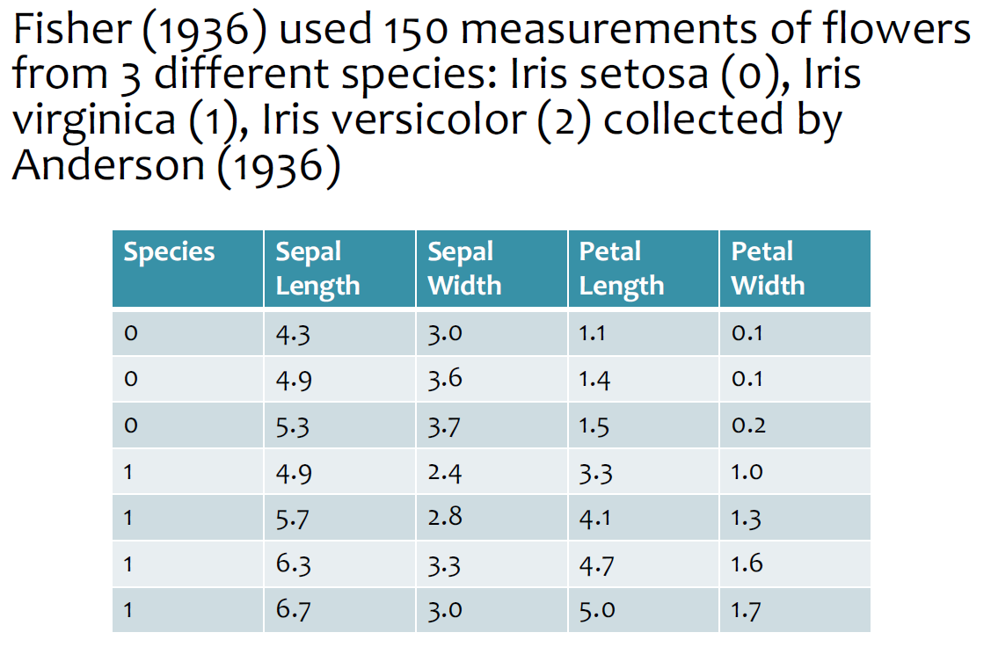

Recall: Fisher Iris Dataset
https://en.wikipedia.org/wiki/Iris_flower_data_set
Slides from Matt Gormley, CMU

Slide 6
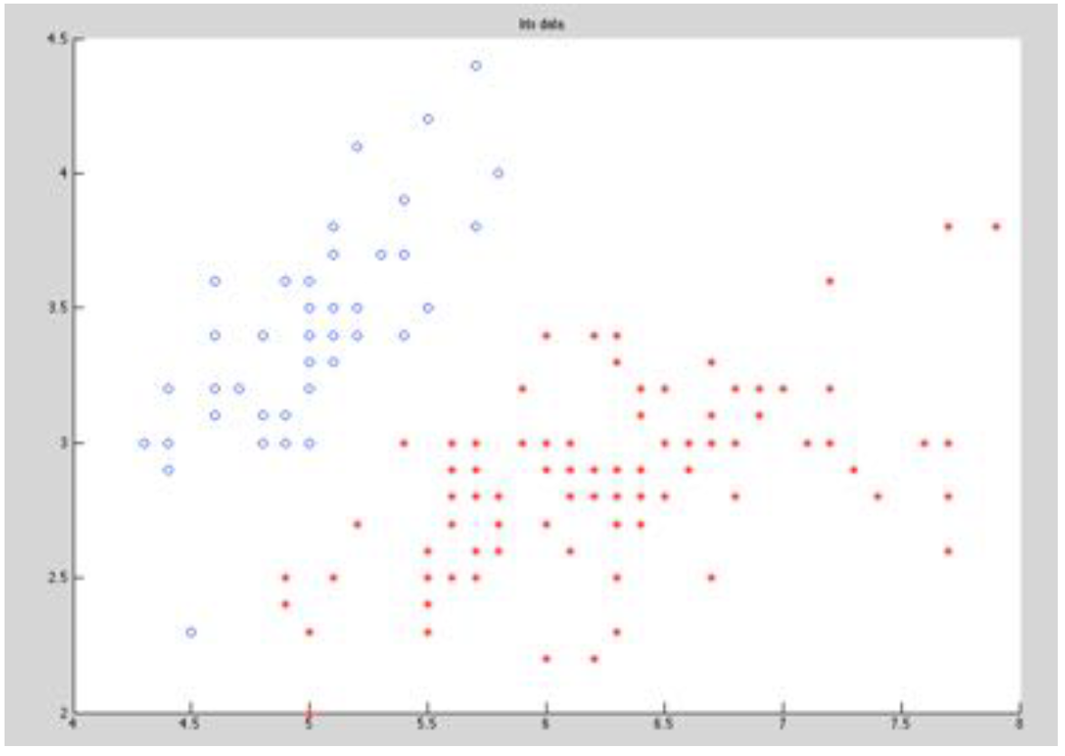
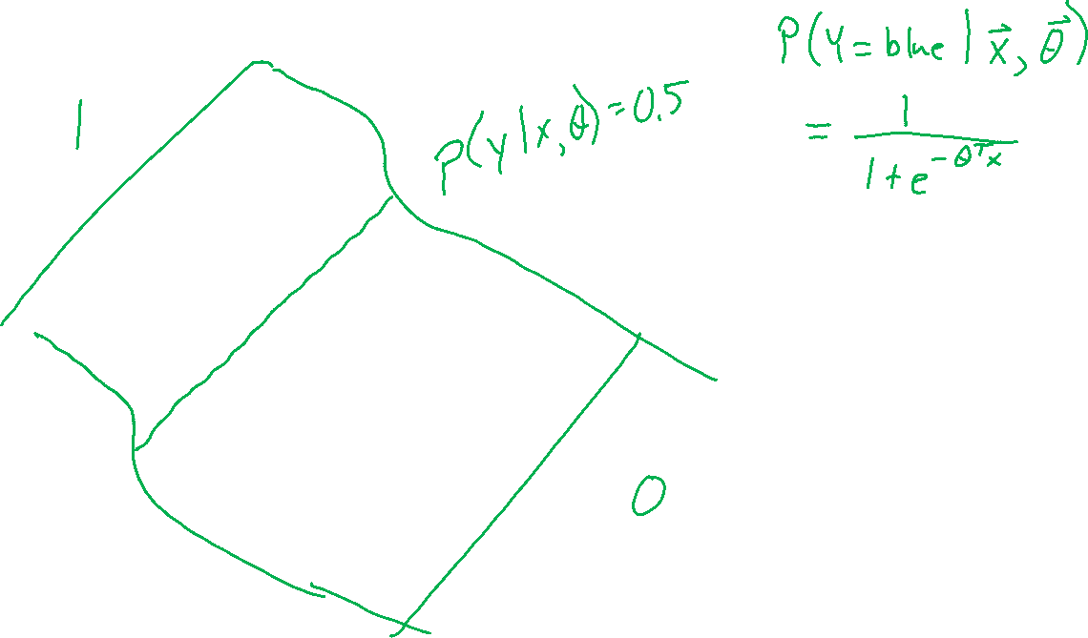
Modeling the Fisher Iris Dataset
Image: CMU MLD, William Cohen

Slide 7
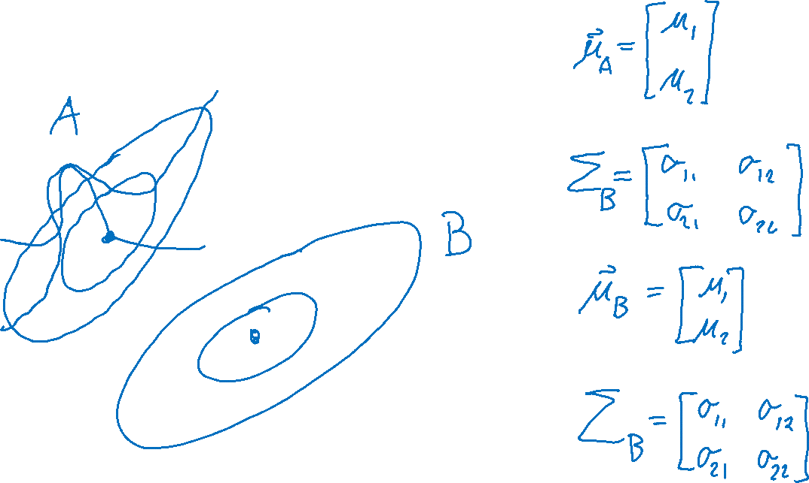
Modeling the Fisher Iris Dataset
Image: CMU MLD, William Cohen

Slide 8
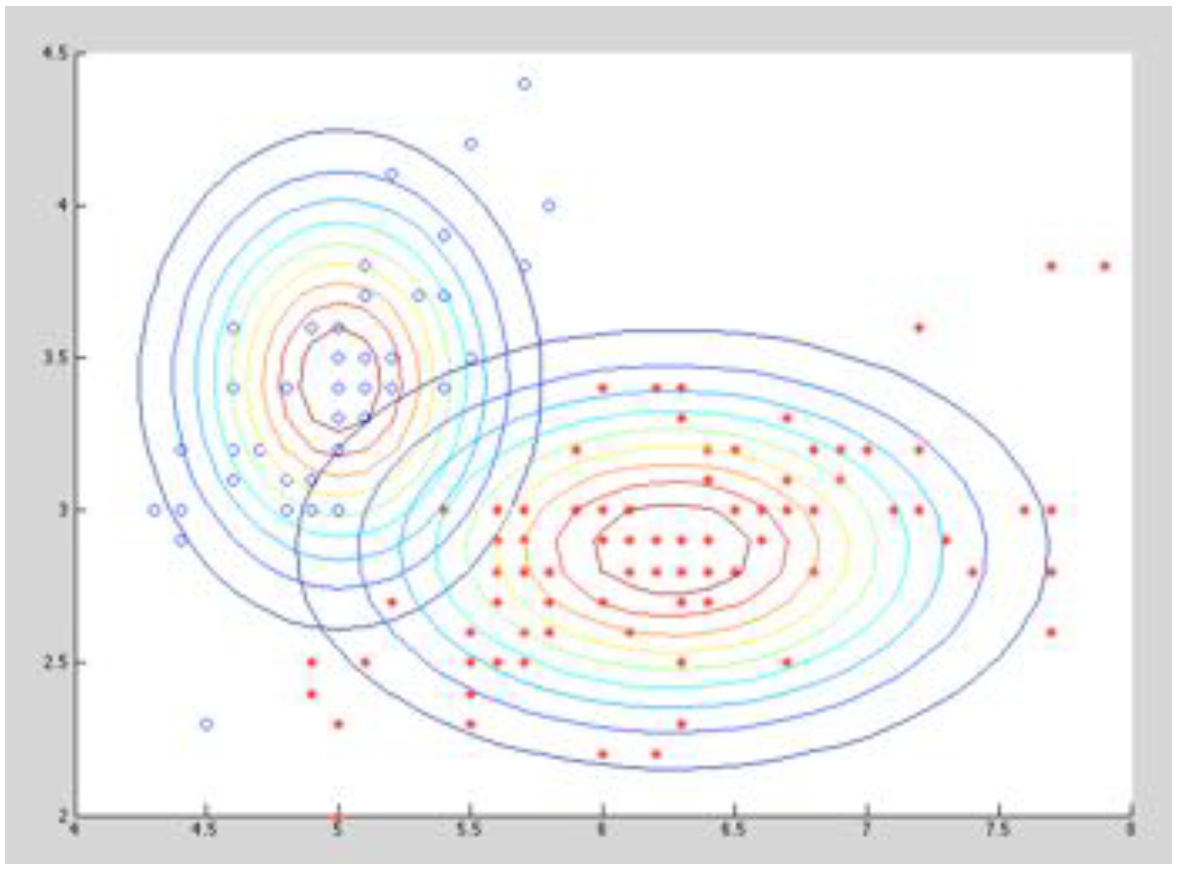
Modeling the Fisher Iris Dataset
Image: CMU MLD, William Cohen

Slide 9
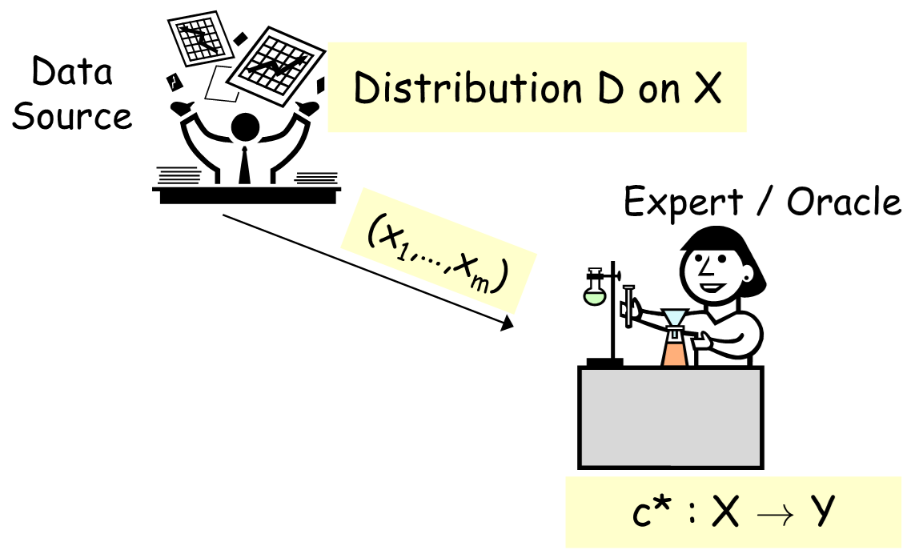
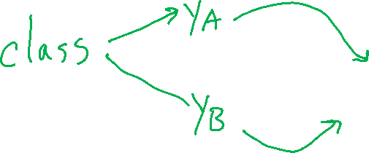
Generative vs Discriminative Modeling
Discriminative: modeling X → Y directly
Generative: Stronger modeling assumptions about where data came from

Slide 10
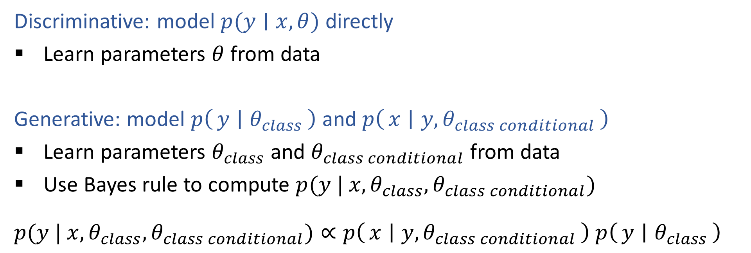
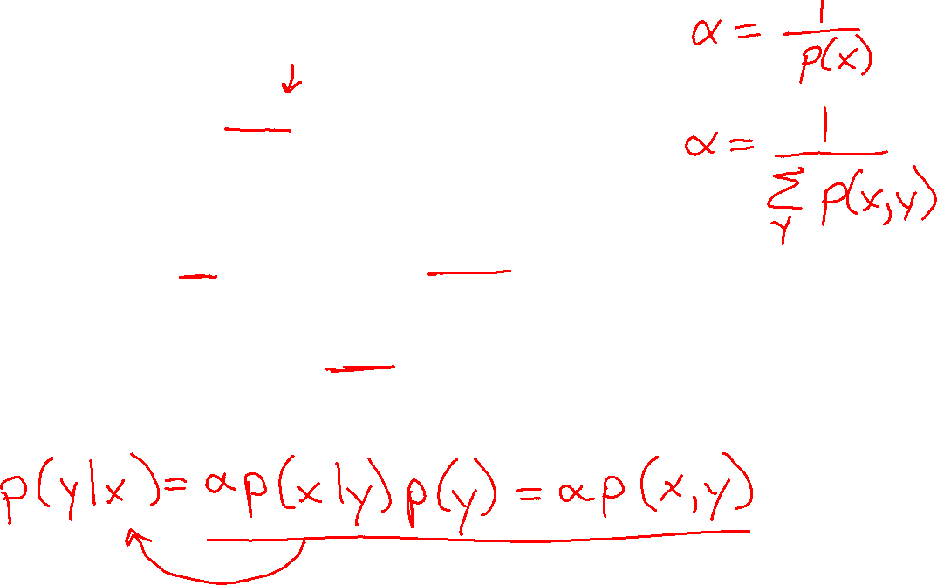
Generative vs Discriminative Modeling
Discriminative: model $p(y∣x, θ)$ directly
Learn parameters $θ$ from data
Generative: model $p\left(y ∣ θ_{class}\right)$ and $p\left(x ∣ {y, θ}_{class conditional}\right)$
Learn parameters $θ_{class}$ and $θ_{class conditional}$ from data
Use Bayes rule to compute $p(y | x, θ_{class}, θ_{class conditional})$
$p(y | x, θ_{class}, θ_{class conditional})∝p\left(x ∣ {y, θ}_{class conditional}\right)$ $p\left(y ∣ θ_{class}\right)$

Slide 11
Generative Story
News article topic classification
Document class: Business, Entertainment, Politics
Words in the document
SPAM classification
Document class: SPAM or not
Words in the document

Slide 12
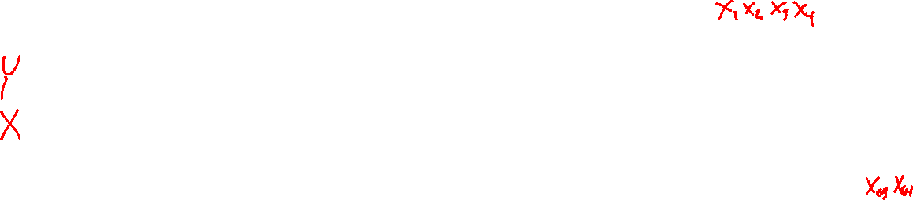
Generative Story
Hand-written digits
Digit class: 0-9
Pixels in images

Slide 13

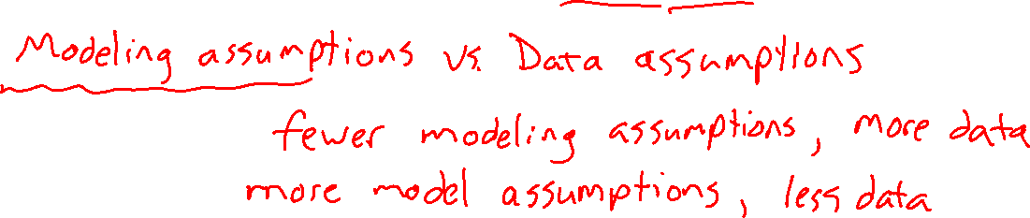
Generative vs Discriminative Modeling
Discriminative: $p(y∣x)$
Generative: $p(y | x)=α p(x, y)=α p\left(x ∣ y\right) p\left(y\right)$
Assumptions vs Data
Discriminative:
Generative:

Slide 14
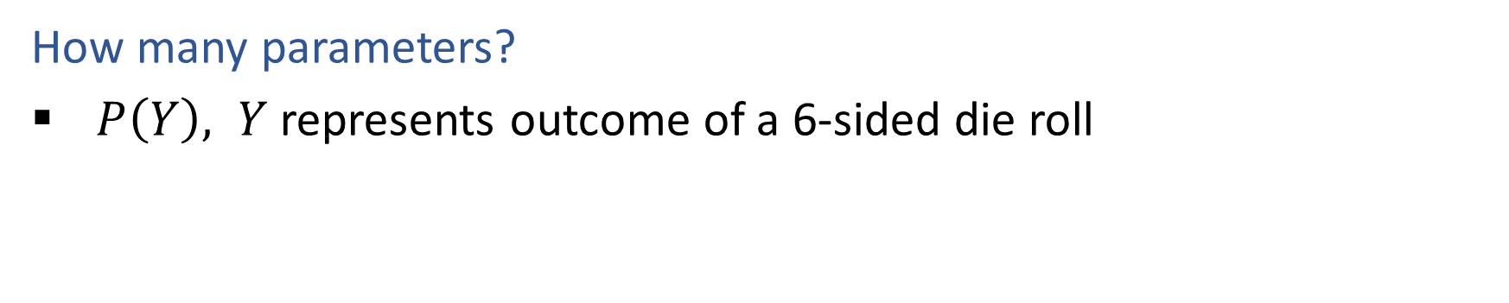
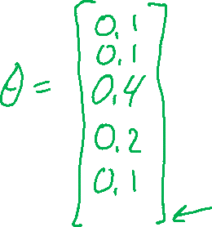
Quick Check
How many parameters?
$P\left(Y\right), Y$ represents outcome of a 6-sided die roll

Slide 15
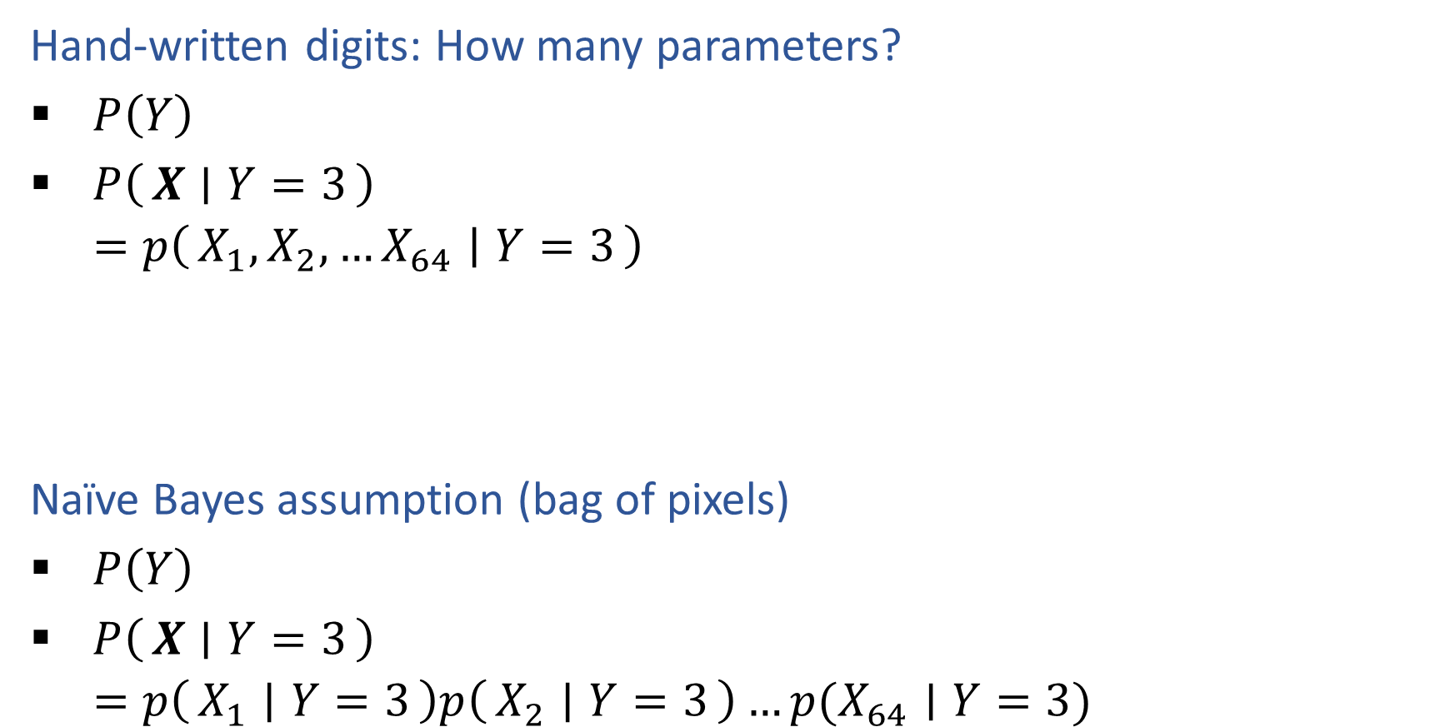
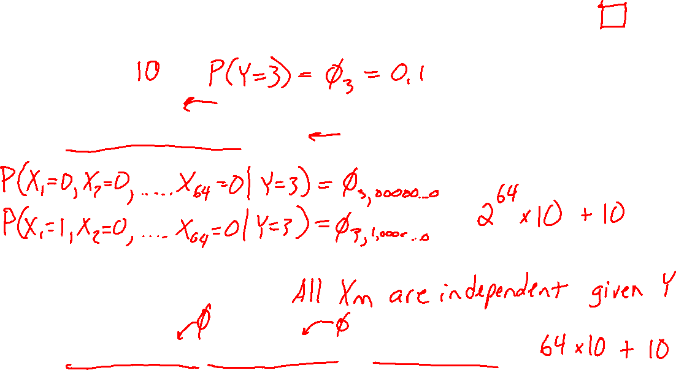
Multivariate Generative Models
Hand-written digits: How many parameters?
$P\left(Y\right)$
$P\left(X ∣ Y=3\right)$
$=p\left(X_{1}, X_{2},…X_{64} ∣ Y=3\right)$
Naïve Bayes assumption (bag of pixels)
$P\left(Y\right)$
$P\left(X ∣ Y=3\right)$
$=p\left(X_{1} ∣ Y=3\right)p\left(X_{2} ∣ Y=3\right)…p(X_{64}∣Y=3)$

Slide 16
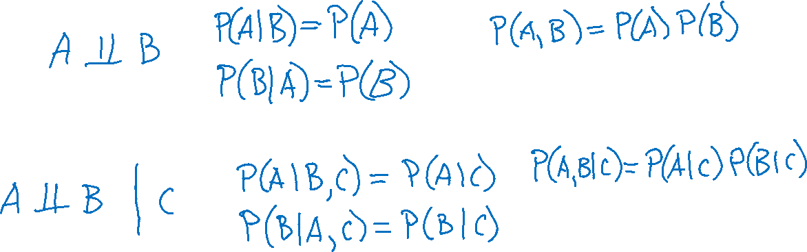
Conditional Independence and Naïve Bayes
Independence
Conditional independence

Slide 17
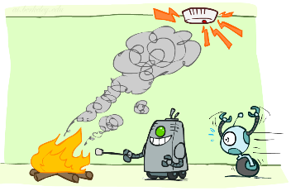
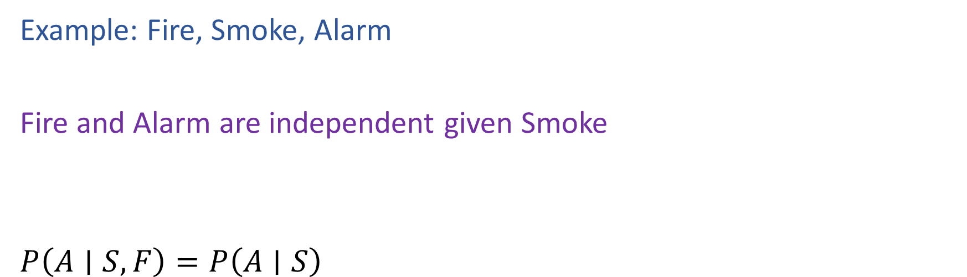
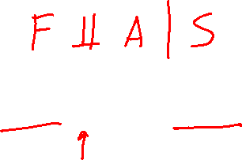
Conditional Independence
Example: Fire, Smoke, Alarm
Fire and Alarm are independent given Smoke
$P\left(A∣S, F\right)=P\left(A∣S\right)$
Image: http://ai.berkeley.edu/

Slide 18
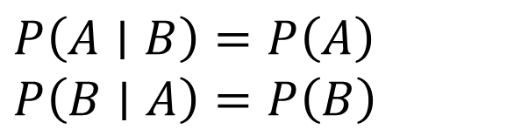
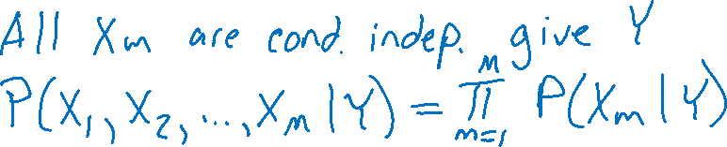


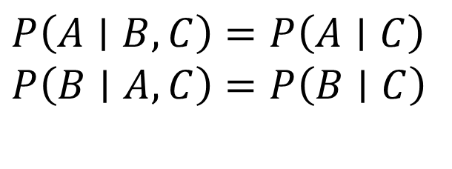
Conditional Independence and Naïve Bayes
Independence
Conditional independence
Naïve Bayes assumption
$P\left(A∣B\right)=P\left(A\right)$
$P\left(B∣A\right)=P\left(B\right)$
$P\left(A, B\right)=P\left(A\right)P(B)$
$P\left(A∣B, C\right)=P\left(A∣C\right)$
$P\left(B∣A, C\right)=P\left(B∣C\right)$
$P\left(A, B∣C\right)=P\left(A∣C\right)P(B∣C)$

Slide 19
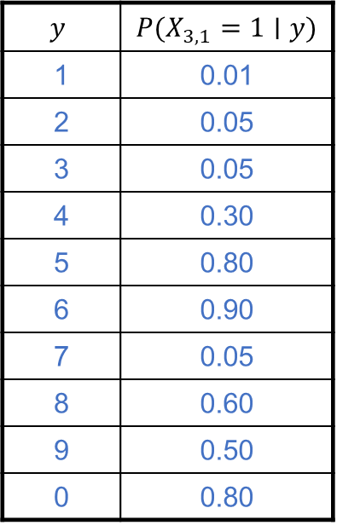
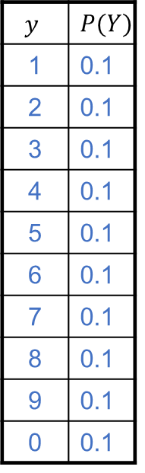

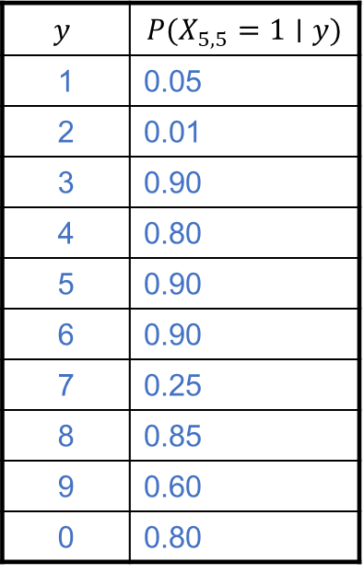
Naïve Bayes for Digits
$$y$$ | $$P(Y)$$
1 | 0.1
2 | 0.1
3 | 0.1
4 | 0.1
5 | 0.1
6 | 0.1
7 | 0.1
8 | 0.1
9 | 0.1
0 | 0.1
$$y$$ | $$P(X_{3,1}=1∣y)$$
1 | 0.01
2 | 0.05
3 | 0.05
4 | 0.30
5 | 0.80
6 | 0.90
7 | 0.05
8 | 0.60
9 | 0.50
0 | 0.80
$$y$$ | $$P(X_{5,5}=1∣y)$$
1 | 0.05
2 | 0.01
3 | 0.90
4 | 0.80
5 | 0.90
6 | 0.90
7 | 0.25
8 | 0.85
9 | 0.60
0 | 0.80

Slide 20
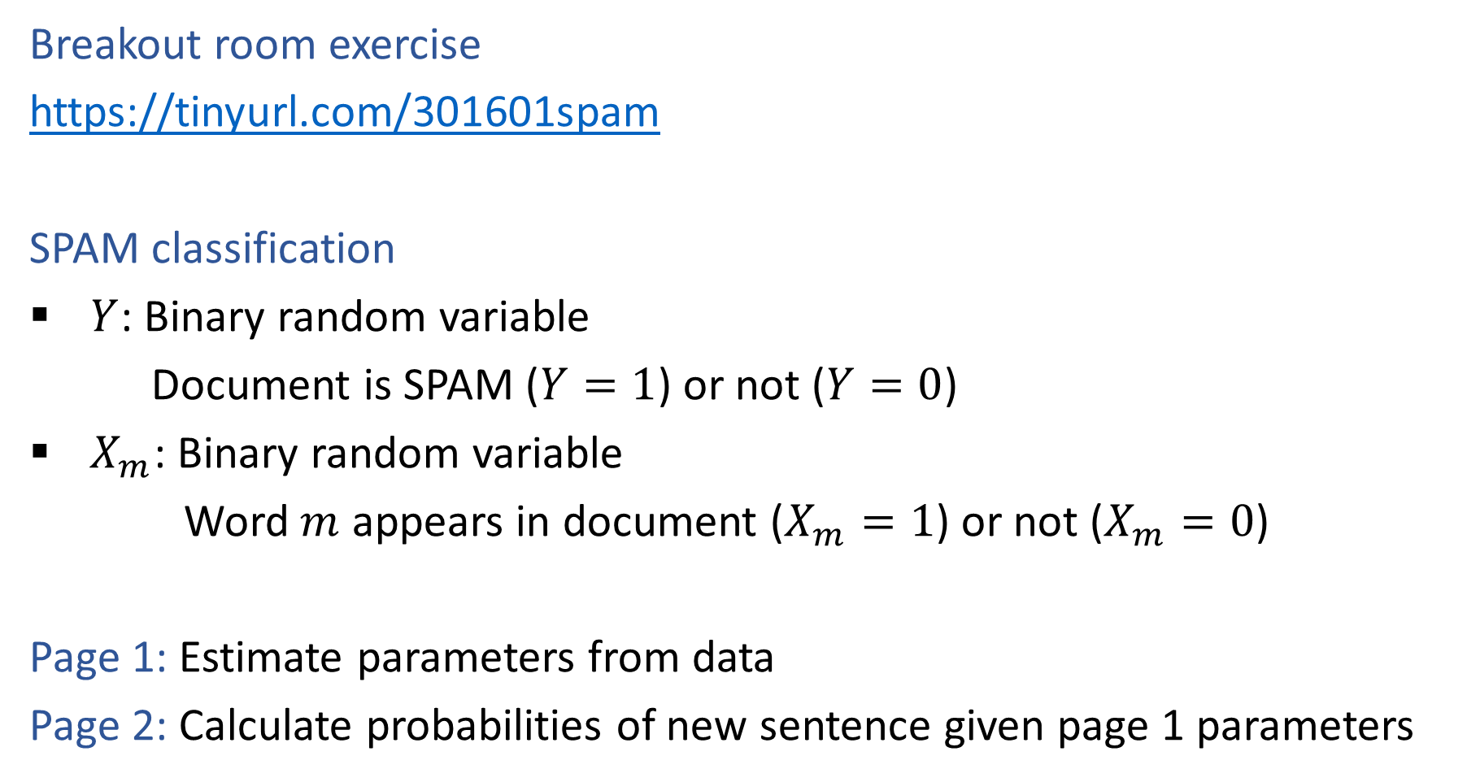
SPAM Classification
Breakout room exercise
https://tinyurl.com/301601spam
SPAM classification
$Y$: Binary random variable
Document is SPAM ($Y=1$) or not ($Y=0$)
$X_{m}$: Binary random variable
Word $m$ appears in document ($X_{m}=1$) or not ($X_{m}=0$)
Page 1: Estimate parameters from data
Page 2: Calculate probabilities of new sentence given page 1 parameters

Slide 21
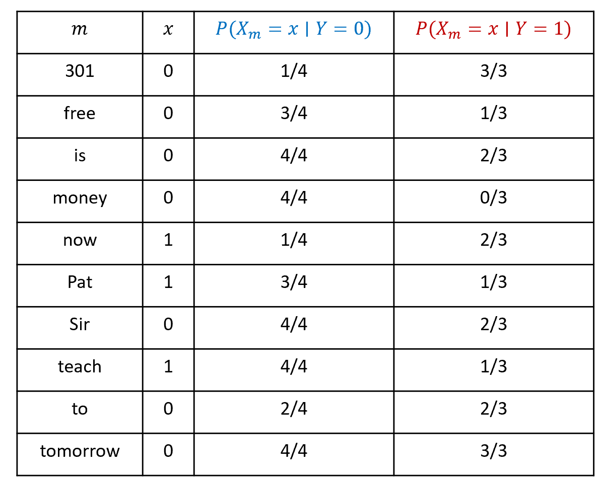
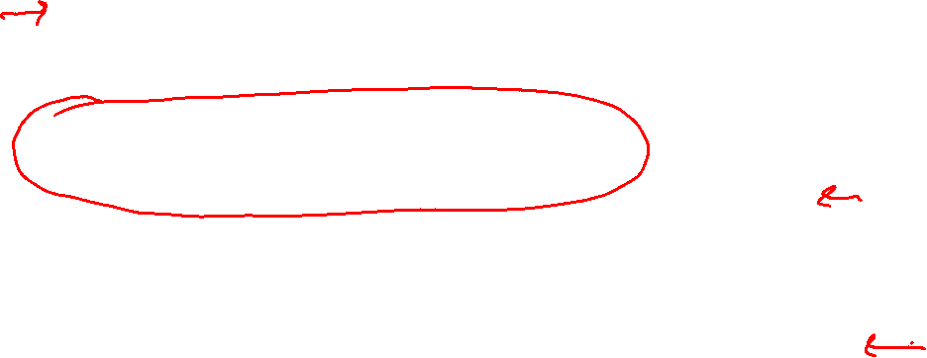
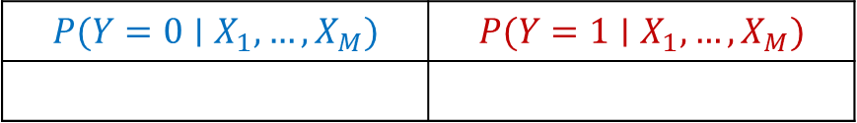
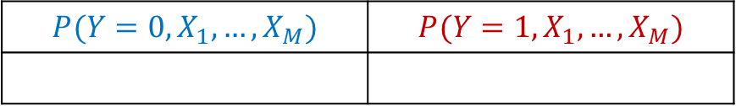
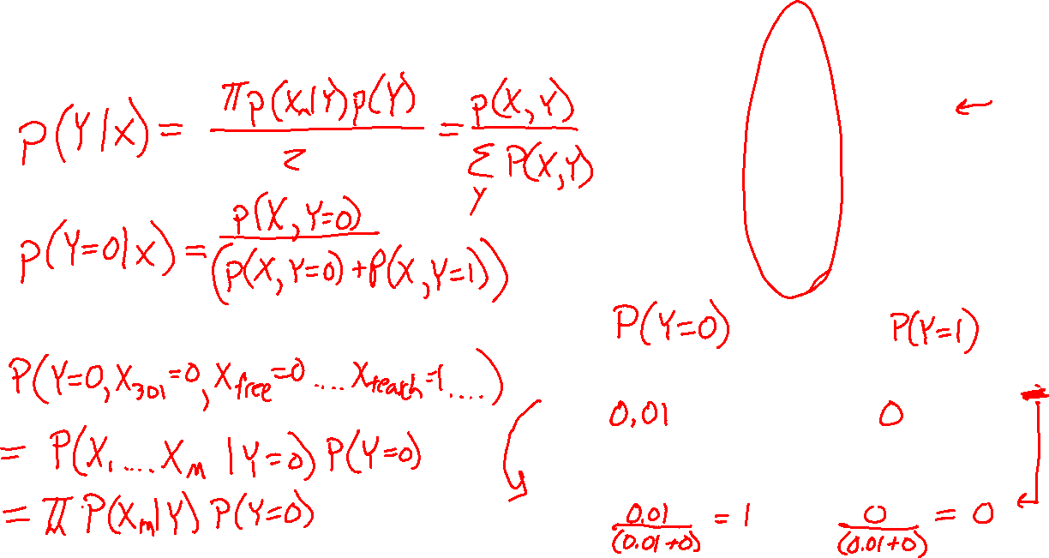
SPAM Classification
Breakout room exercise
$$P(Y=0,X_{1},…,X_{M})$$ | $$P(Y=1,X_{1},…,X_{M})$$
$$P(Y=0∣X_{1},…,X_{M})$$ | $$P(Y=1∣X_{1},…,X_{M})$$

Slide 22
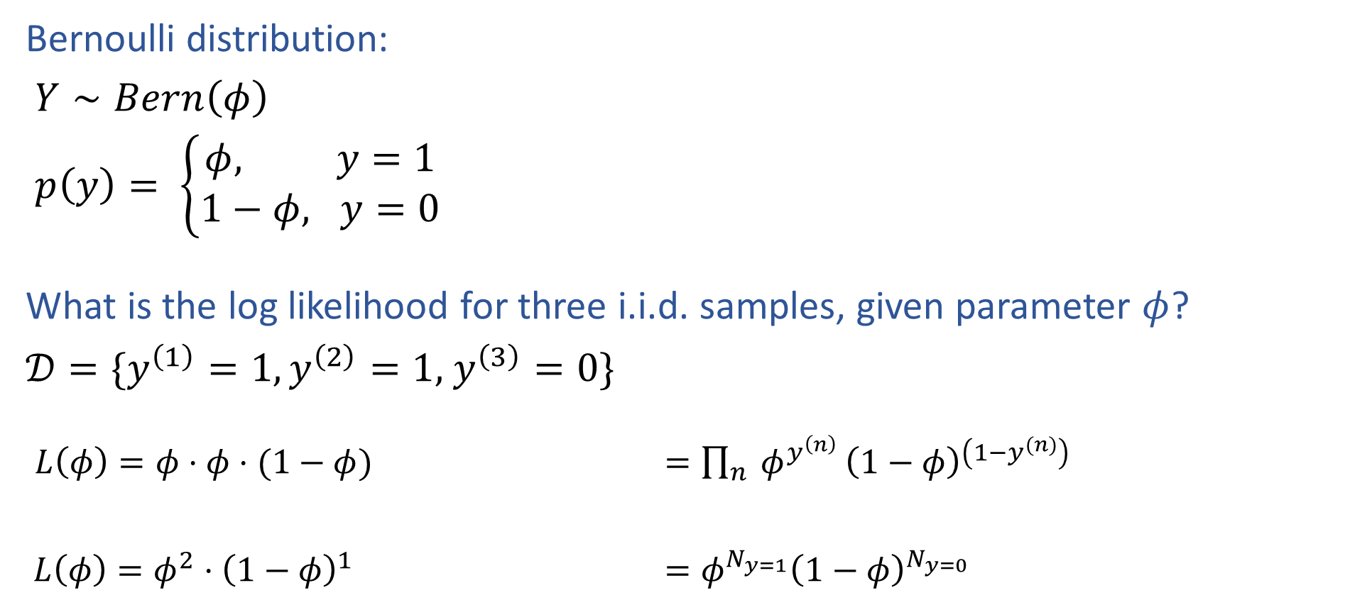


Reminder MLE for Bernoulli
Bernoulli distribution:
$Y∼Bern\left(φ\right)$
$p\left(y\right)= \left\{\begin{aligned}φ, y=1 \\ 1−φ, y=0\end{aligned}\right.$
What is the log likelihood for three i.i.d. samples, given parameter $φ$?
$𝒟=\{y^{\left(1\right)}=1,y^{\left(2\right)}=1,$ $y^{\left(3\right)}=0\}$
$L\left(φ\right)=φ⋅φ⋅(1−φ)$ $=\prod_{n}{ φ^{y^{\left(n\right)}}}{\left(1−φ\right)}^{\left(1−y^{(n)}\right)}$
$L\left(φ\right)=φ^{2}⋅{\left(1−φ\right)}^{1}$ $=φ^{N_{y=1}}{\left(1−φ\right)}^{N_{y=0}}$

Slide 23

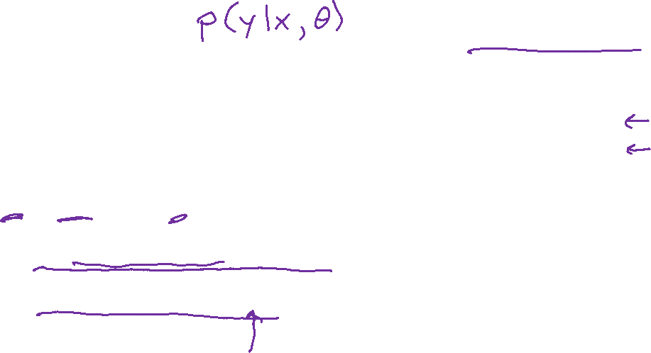
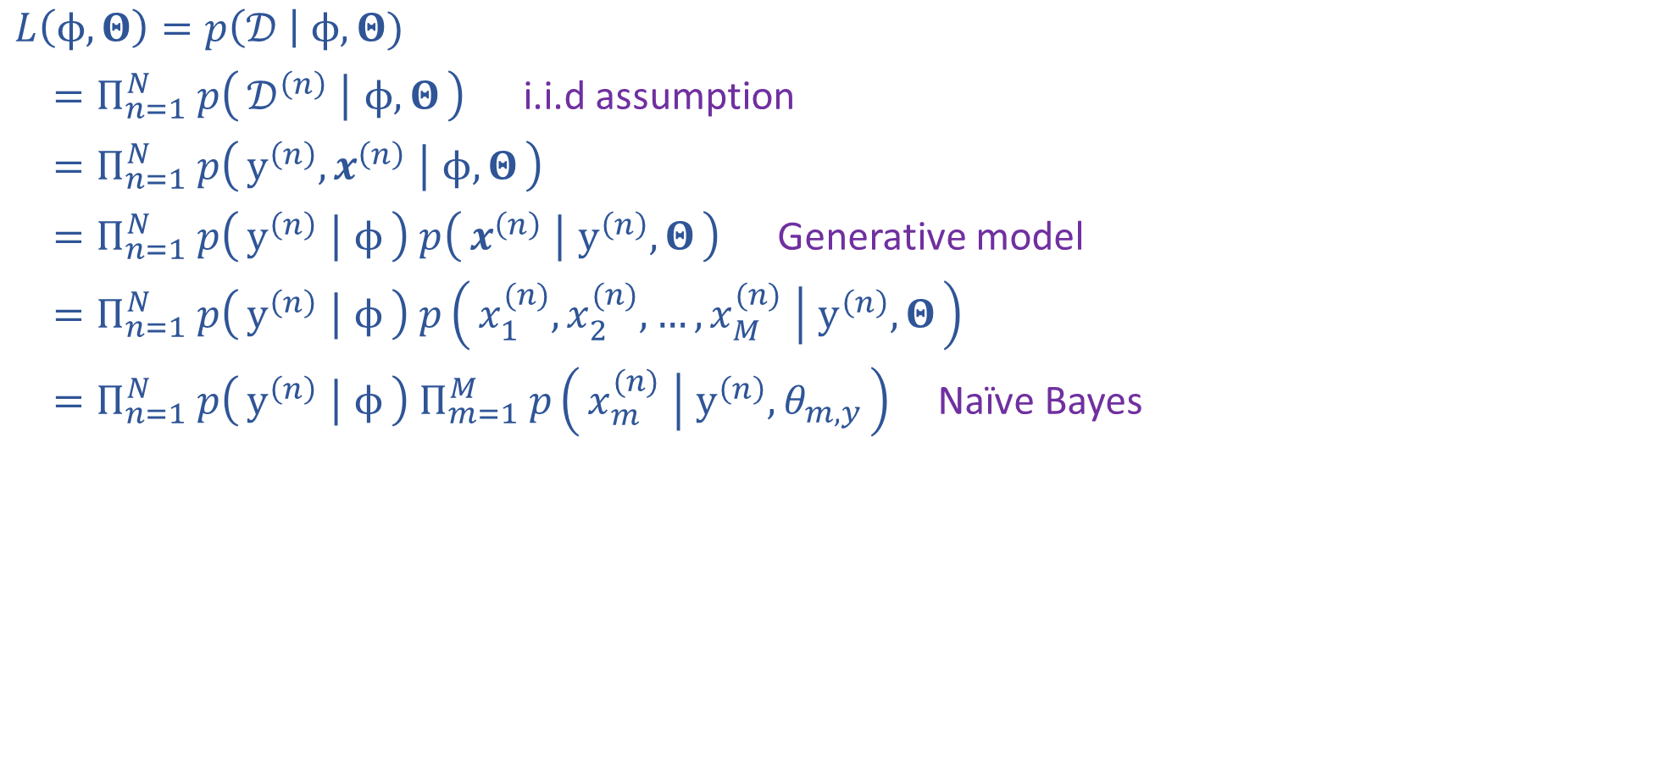

Naïve Bayes MLE
$𝒟={\left\{y^{\left(n\right)}, x^{(n)}\right\}}_{n=1}^{N}$
$y^{(n)}∈\{0,1\}$
$x^{(n)}∈{\left\{0,1\right\}}^{M}$
$φ∈[0,1]$
$Θ∈{\left[0,1\right]}^{Mx2}$
$L\left(ϕ, Θ\right)=p\left(𝒟 \right| ϕ, Θ)$
$=Π_{n=1}^{N} p\left(𝒟^{\left(n\right)} ∣ ϕ, Θ\right)$ i.i.d assumption
$=Π_{n=1}^{N} p\left(y^{\left(n\right)}, x^{\left(n\right)} ∣ ϕ, Θ\right)$
$=Π_{n=1}^{N} p\left(y^{\left(n\right)} ∣ ϕ\right) p\left(x^{\left(n\right)} ∣ y^{\left(n\right)}, Θ\right)$ Generative model
$=Π_{n=1}^{N} p\left(y^{\left(n\right)} ∣ ϕ\right) p\left(x_{1}^{(n)},x_{2}^{(n)},…,x_{M}^{(n)} ∣ y^{\left(n\right)}, Θ\right)$
$=Π_{n=1}^{N} p\left(y^{\left(n\right)} ∣ ϕ\right) Π_{m=1}^{M} p\left(x_{m}^{(n)} ∣ y^{\left(n\right)}, θ_{m,y}\right)$ Naïve Bayes

Slide 24
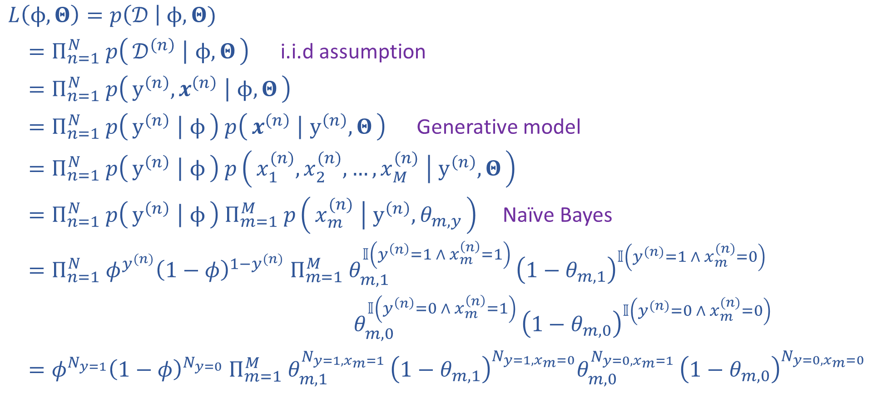
Naïve Bayes MLE
$𝒟={\left\{y^{\left(n\right)}, x^{(n)}\right\}}_{n=1}^{N}$
$y^{(n)}∈\{0,1\}$
$x^{(n)}∈{\left\{0,1\right\}}^{M}$
$φ∈[0,1]$
$Θ∈{\left[0,1\right]}^{Mx2}$
$L\left(ϕ, Θ\right)=p\left(𝒟 \right| ϕ, Θ)$
$=Π_{n=1}^{N} p\left(𝒟^{\left(n\right)} ∣ ϕ, Θ\right)$ i.i.d assumption
$=Π_{n=1}^{N} p\left(y^{\left(n\right)}, x^{\left(n\right)} ∣ ϕ, Θ\right)$
$=Π_{n=1}^{N} p\left(y^{\left(n\right)} ∣ ϕ\right) p\left(x^{\left(n\right)} ∣ y^{\left(n\right)}, Θ\right)$ Generative model
$=Π_{n=1}^{N} p\left(y^{\left(n\right)} ∣ ϕ\right) p\left(x_{1}^{(n)},x_{2}^{(n)},…,x_{M}^{(n)} ∣ y^{\left(n\right)}, Θ\right)$
$=Π_{n=1}^{N} p\left(y^{\left(n\right)} ∣ ϕ\right) Π_{m=1}^{M} p\left(x_{m}^{(n)} ∣ y^{\left(n\right)}, θ_{m,y}\right)$ Naïve Bayes
$=Π_{n=1}^{N} φ^{y^{(n)}}{\left(1−φ\right)}^{1−y^{(n)}} Π_{m=1}^{M} θ_{m,1}^{𝕀\left(y^{\left(n\right)}=1 ∧ x_{m}^{\left(n\right)}=1\right) }{\left(1−θ_{m,1}\right)}^{𝕀\left(y^{(n)}=1 ∧ x_{m}^{(n)}=0\right)}$
$θ_{m,0}^{𝕀\left(y^{\left(n\right)}=0 ∧ x_{m}^{\left(n\right)}=1\right) }{\left(1−θ_{m,0}\right)}^{𝕀\left(y^{(n)}=0 ∧ x_{m}^{(n)}=0\right)}$
$=φ^{N_{y=1}}{\left(1−φ\right)}^{N_{y=0}} Π_{m=1}^{M} θ_{m,1}^{N_{y=1,x_{m}=1} }{\left(1−θ_{m,1}\right)}^{N_{y=1,x_{m}=0}}θ_{m,0}^{N_{y=0,x_{m}=1} }{\left(1−θ_{m,0}\right)}^{N_{y=0,x_{m}=0}}$

Slide 25
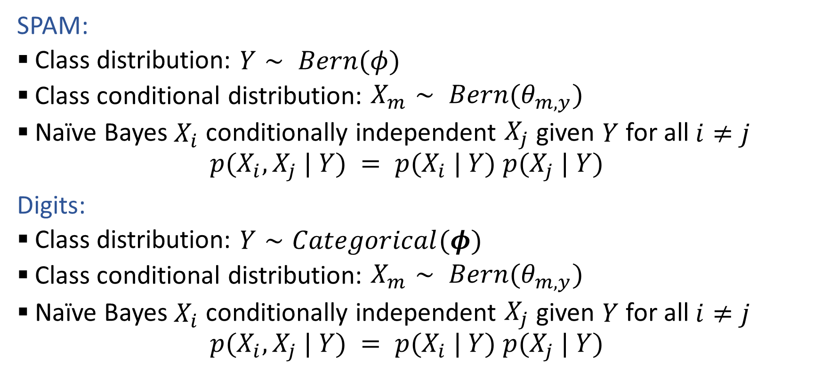
Generative Models
SPAM:
Class distribution: $Y∼ Bern(φ)$
Class conditional distribution: $X_{m}∼ Bern(θ_{m,y})$
Naïve Bayes $X_{i}$ conditionally independent $X_{j}$ given $Y$ for all $i≠j$
$$p(X_{i}, X_{j} | Y) = p(X_{i} | Y) p(X_{j} | Y)$$
Digits:
Class distribution: $Y∼Categorical(φ)$
Class conditional distribution: $X_{m}∼ Bern(θ_{m,y})$
Naïve Bayes $X_{i}$ conditionally independent $X_{j}$ given $Y$ for all $i≠j$
$$p(X_{i}, X_{j} | Y) = p(X_{i} | Y) p(X_{j} | Y)$$

Slide 26
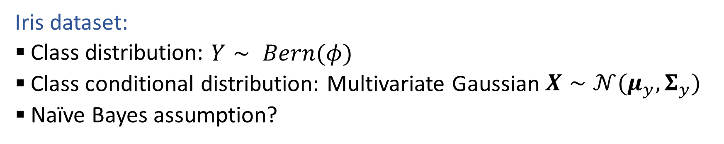
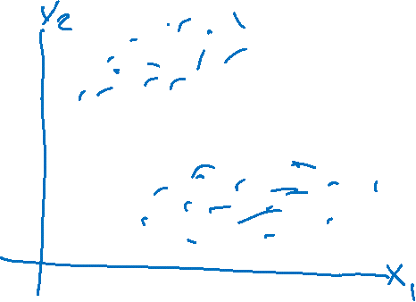
Generative Models with Continuous Features
Iris dataset:
Class distribution: $Y∼ Bern(φ)$
Class conditional distribution: Multivariate Gaussian $X∼𝒩(μ_{y}, Σ_{y})$
Naïve Bayes assumption?

Slide 27
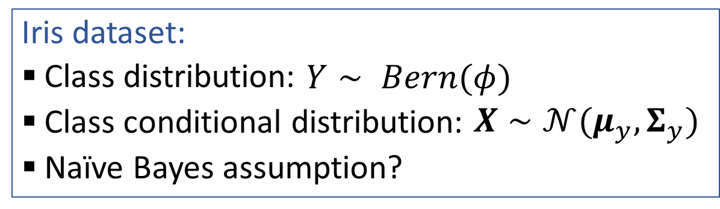
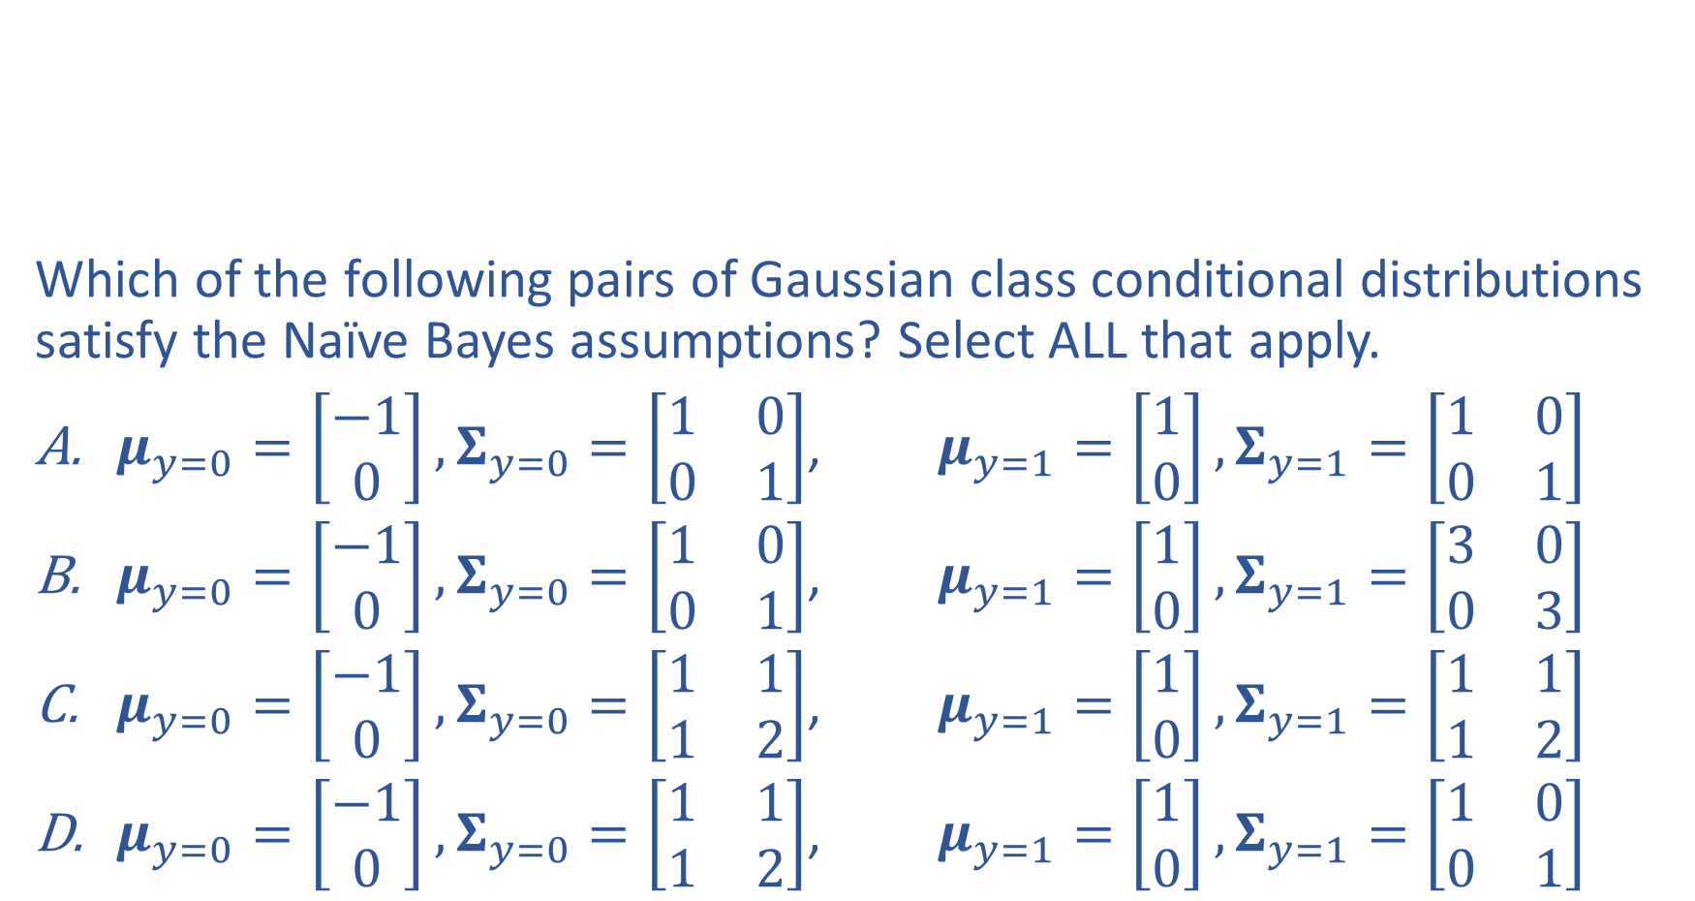

Piazza Poll 1
Iris dataset:
Class distribution: $Y∼ Bern(φ)$
Class conditional distribution: $X∼𝒩(μ_{y}, Σ_{y})$
Naïve Bayes assumption?
Which of the following pairs of Gaussian class conditional distributions satisfy the Naïve Bayes assumptions? Select ALL that apply.
$μ_{y=0}=\left[\begin{aligned}−1 \\ 0\end{aligned}\right],Σ_{y=0}=\left[\begin{matrix}1 & 0 \\ 0 & 1\end{matrix}\right]$, $μ_{y=1}=\left[\begin{aligned}1 \\ 0\end{aligned}\right],Σ_{y=1}=\left[\begin{matrix}1 & 0 \\ 0 & 1\end{matrix}\right]$
$μ_{y=0}=\left[\begin{aligned}−1 \\ 0\end{aligned}\right],Σ_{y=0}=\left[\begin{matrix}1 & 0 \\ 0 & 1\end{matrix}\right]$, $μ_{y=1}=\left[\begin{aligned}1 \\ 0\end{aligned}\right],Σ_{y=1}=\left[\begin{matrix}3 & 0 \\ 0 & 3\end{matrix}\right]$
$μ_{y=0}=\left[\begin{aligned}−1 \\ 0\end{aligned}\right],Σ_{y=0}=\left[\begin{matrix}1 & 1 \\ 1 & 2\end{matrix}\right]$, $μ_{y=1}=\left[\begin{aligned}1 \\ 0\end{aligned}\right],Σ_{y=1}=\left[\begin{matrix}1 & 1 \\ 1 & 2\end{matrix}\right]$
$μ_{y=0}=\left[\begin{aligned}−1 \\ 0\end{aligned}\right],Σ_{y=0}=\left[\begin{matrix}1 & 1 \\ 1 & 2\end{matrix}\right]$, $μ_{y=1}=\left[\begin{aligned}1 \\ 0\end{aligned}\right],Σ_{y=1}=\left[\begin{matrix}1 & 0 \\ 0 & 1\end{matrix}\right]$

Slide 28
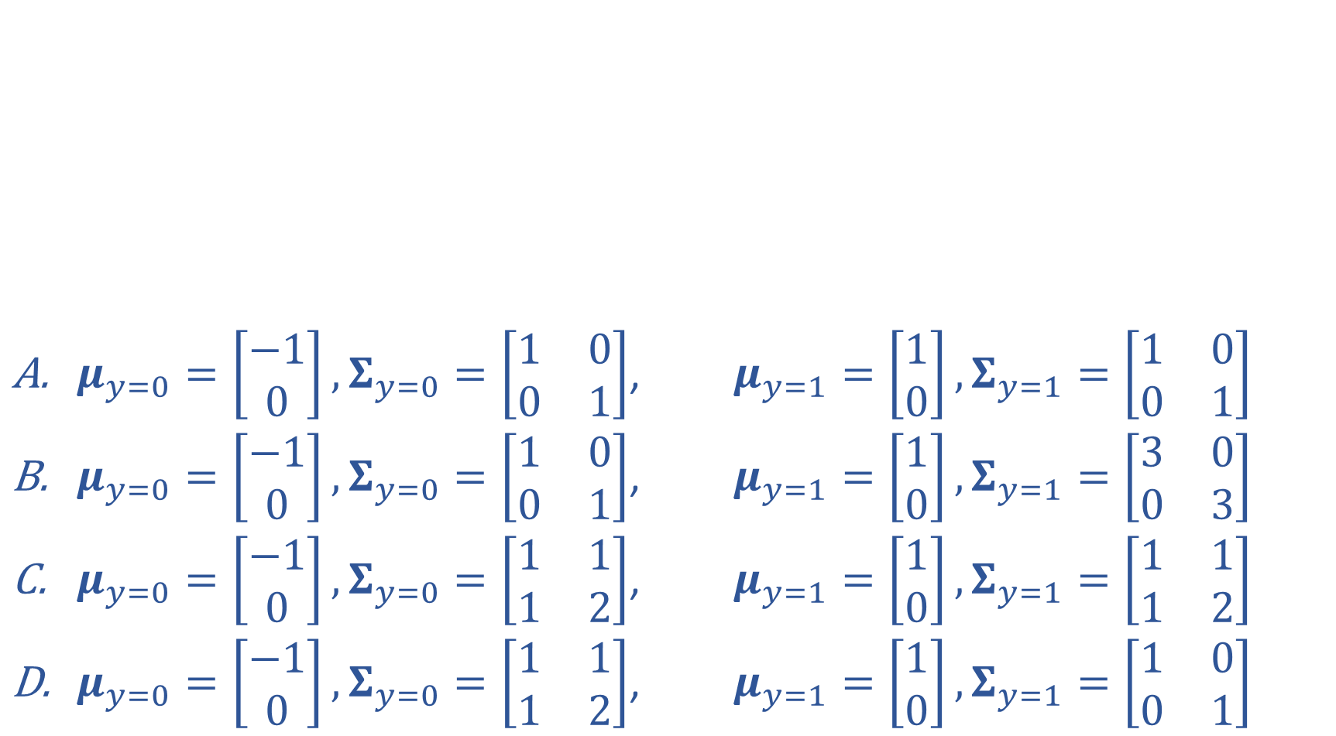
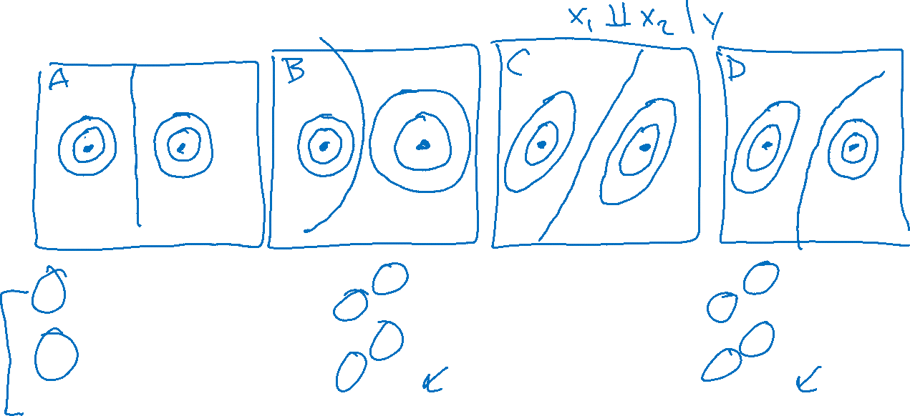
Piazza Poll 1
$μ_{y=0}=\left[\begin{aligned}−1 \\ 0\end{aligned}\right],Σ_{y=0}=\left[\begin{matrix}1 & 0 \\ 0 & 1\end{matrix}\right]$, $μ_{y=1}=\left[\begin{aligned}1 \\ 0\end{aligned}\right],Σ_{y=1}=\left[\begin{matrix}1 & 0 \\ 0 & 1\end{matrix}\right]$
$μ_{y=0}=\left[\begin{aligned}−1 \\ 0\end{aligned}\right],Σ_{y=0}=\left[\begin{matrix}1 & 0 \\ 0 & 1\end{matrix}\right]$, $μ_{y=1}=\left[\begin{aligned}1 \\ 0\end{aligned}\right],Σ_{y=1}=\left[\begin{matrix}3 & 0 \\ 0 & 3\end{matrix}\right]$
$μ_{y=0}=\left[\begin{aligned}−1 \\ 0\end{aligned}\right],Σ_{y=0}=\left[\begin{matrix}1 & 1 \\ 1 & 2\end{matrix}\right]$, $μ_{y=1}=\left[\begin{aligned}1 \\ 0\end{aligned}\right],Σ_{y=1}=\left[\begin{matrix}1 & 1 \\ 1 & 2\end{matrix}\right]$
$μ_{y=0}=\left[\begin{aligned}−1 \\ 0\end{aligned}\right],Σ_{y=0}=\left[\begin{matrix}1 & 1 \\ 1 & 2\end{matrix}\right]$, $μ_{y=1}=\left[\begin{aligned}1 \\ 0\end{aligned}\right],Σ_{y=1}=\left[\begin{matrix}1 & 0 \\ 0 & 1\end{matrix}\right]$

Slide 29


Class-conditional Gaussian Distributions
Iris dataset:
Class distribution: $Y∼ Bern(φ)$ (or Categorical)
Class conditional distribution: $X∼𝒩(μ_{y}, Σ_{y})$
Naïve Bayes assumption:
Linear Decision Boundary:
Quadradic Decision Boundary:

Slide 30

MLE vs MAP vs Generative vs Discriminative

