Slide 1

Warm up as you log in
Welcome!
Rename yourself in Zoom to append your house name
    e.g. Pat Virtue – House 0
    If you don’t yet know your house, no change needed ☺
    If you aren’t on Slack, see Piazza “Slack Link for the Houses”
Take student survey
    See Piazza “Student Survey”
Explore Zoom
    Find hand-raise icon in Participants
    Find Chat

Slide 2

Introduction to Machine Learning
Instructor: Pat Virtue

Slide 3
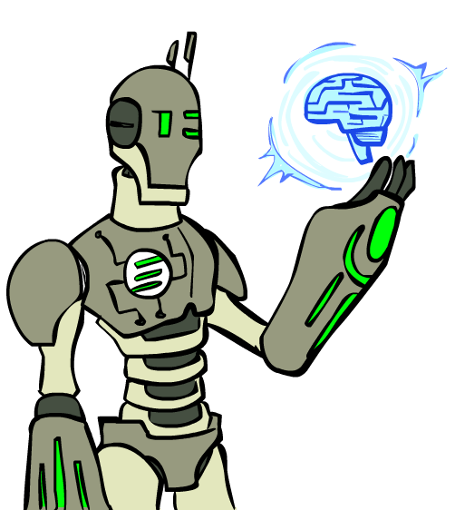
Today
Course Info
AI /ML Definitions and History
ML Problem Formulation
More Course Info
Images: ai.berkeley.edu

Slide 4
Breakout Rooms
Always
Video on
Unmute
Introduce yourself
Now
Start a conversation
    What is your major / program of study
    Are you new to CMU?

Slide 5



Course Information
Website: https://www.cs.cmu.edu/~10601
Canvas: canvas.cmu.edu
Gradescope: gradescope.com
Communication:
piazza.com
E-mail (if piazza doesn’t work):
EAs-10601-2020@mailman.srv.cs.cmu.edu
pvirtue@andrew.cmu.edu

Slide 6

Course Information
Lectures, Recitations, Office hours:
Lectures are recorded (but not recitation or OH)
    Shared with our course and ML course staff only
    Breakout rooms are not recorded
If you have a question:
    Use the Hand-raise icon in the participant window
If we’re asking you a question
    Use the Hand-raise icon in the participant window
    Or, just unmute and answer
If you’re talking:
    Turn your video on ☺
    Especially in cases when we are not recording

Slide 7
Course Information
Lectures and Recitations
You can attend any lecture section you want
You can attend any recitation section you want
Please register in SIO for the lecture and recitation you plan to attend
Midterm exams will be in lecture section
Participation Points
Primarily earned by answering Piazza Polls in live lecture
There are a few other ways to earn points too, stay tuned to Piazza for details

Slide 8
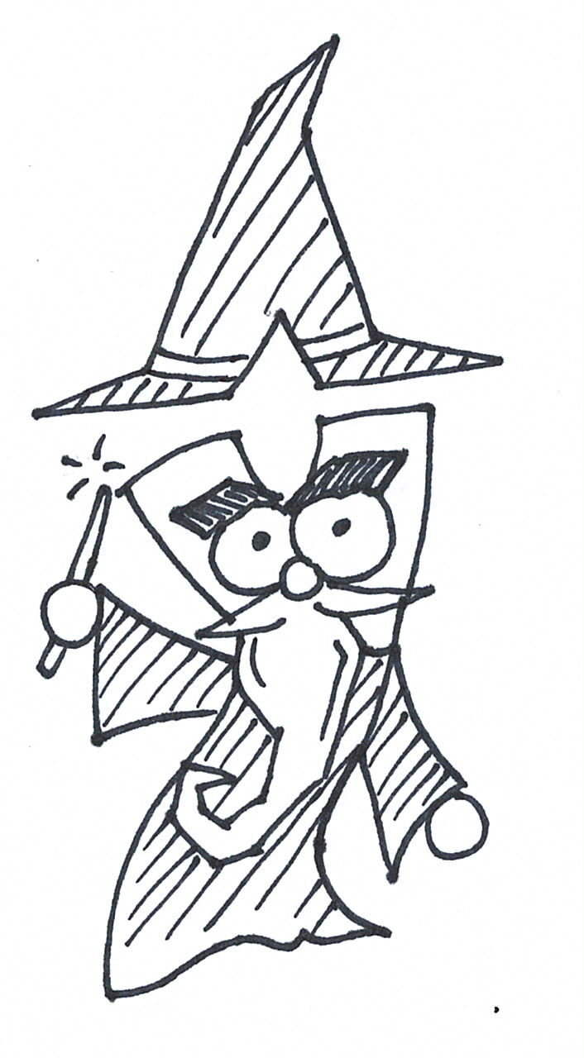
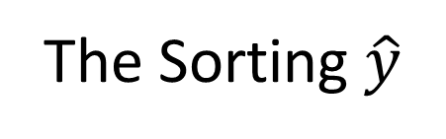
Houses
Slack
Communication within your House
See Piazza for invite link
Don’t worry if you haven’t been placed in your House Slack channel yet
Houses
Smaller group of students
    House spirit, Share concerns, Form study groups, Work on side projects
TA for each house
The Sorting $\hat{y}$

Slide 9
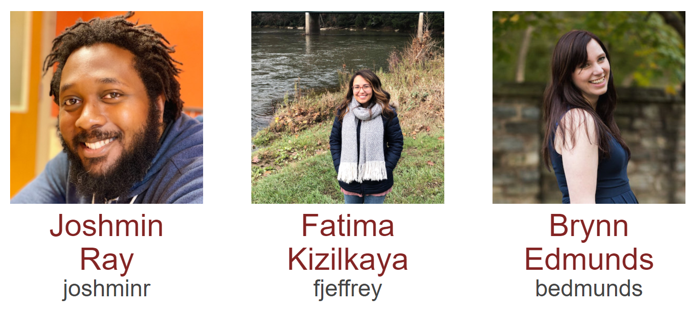
Course Team
Education Associates

Slide 10
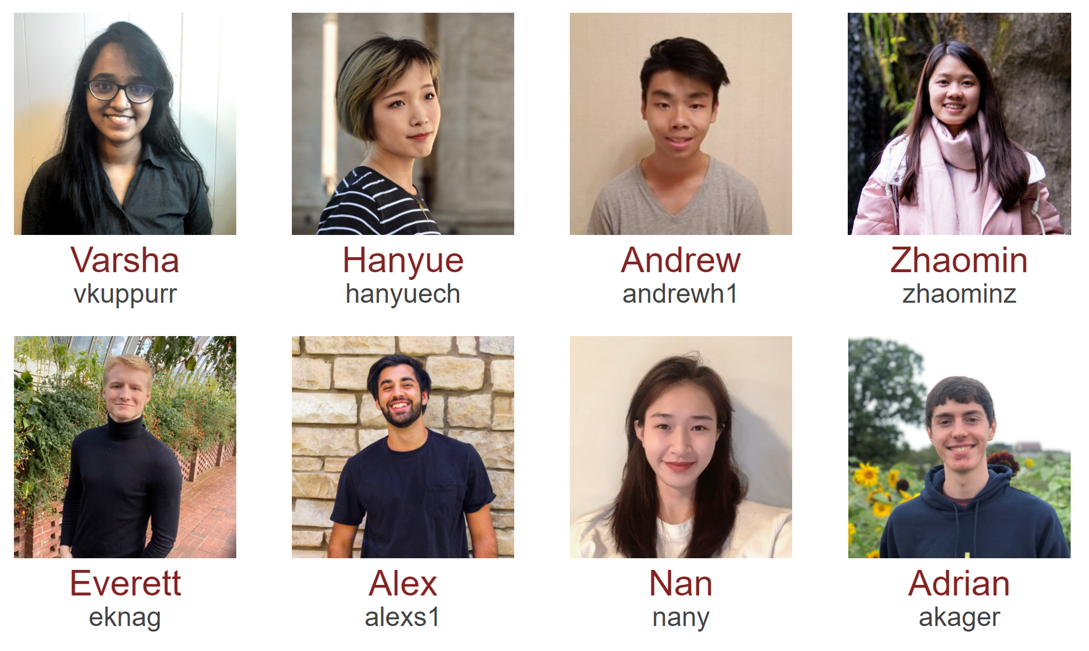
Course Team
Teaching Assistants

Slide 11
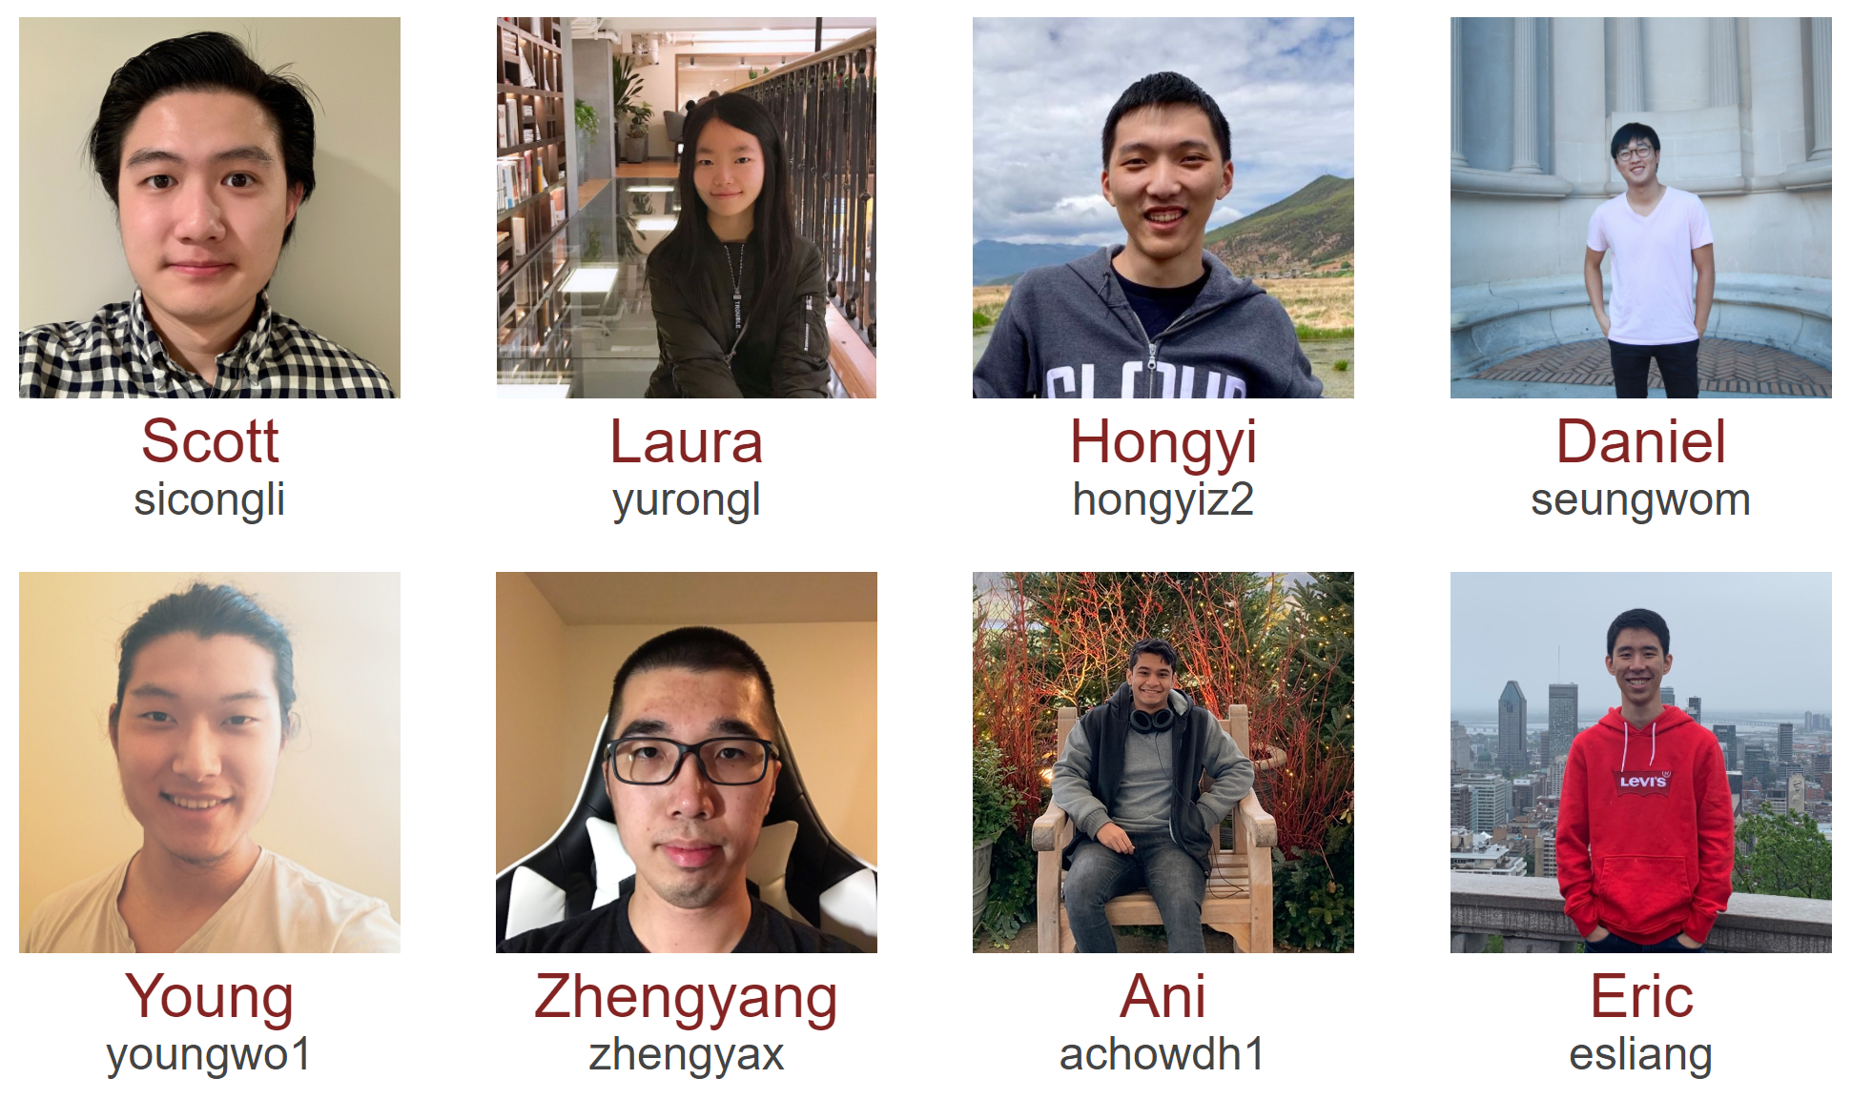
Course Team
Teaching Assistants

Slide 12

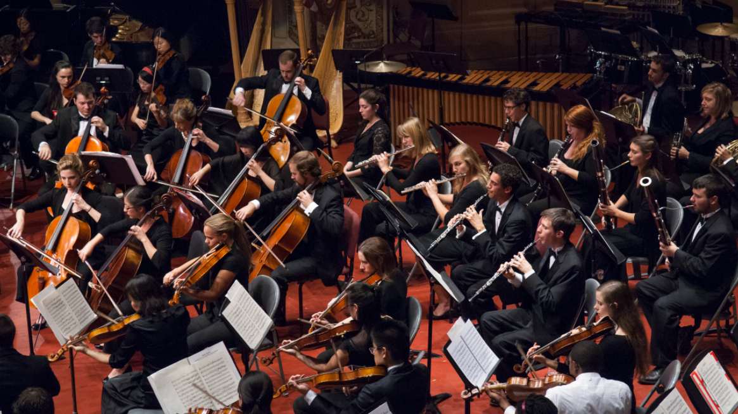
Course Team
Instructor
Students!!

Slide 13
AI in the News

Slide 14
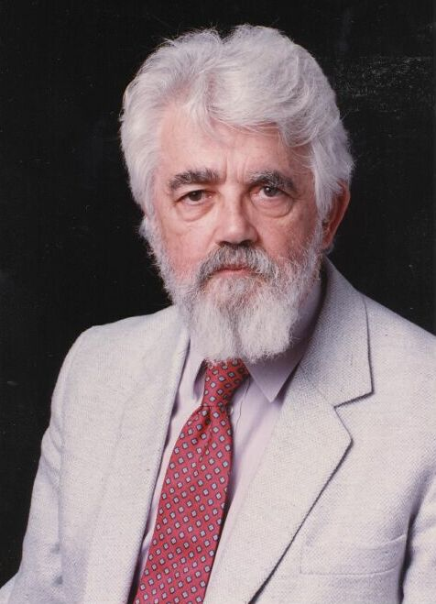
AI Definition by John McCarthy
What is artificial intelligence
  It is the science and engineering of making intelligent machines, especially intelligent computer programs
What is intelligence
  Intelligence is the computational part of the ability to achieve goals in the world
http://www-formal.stanford.edu/jmc/whatisai/whatisai.html

Slide 15
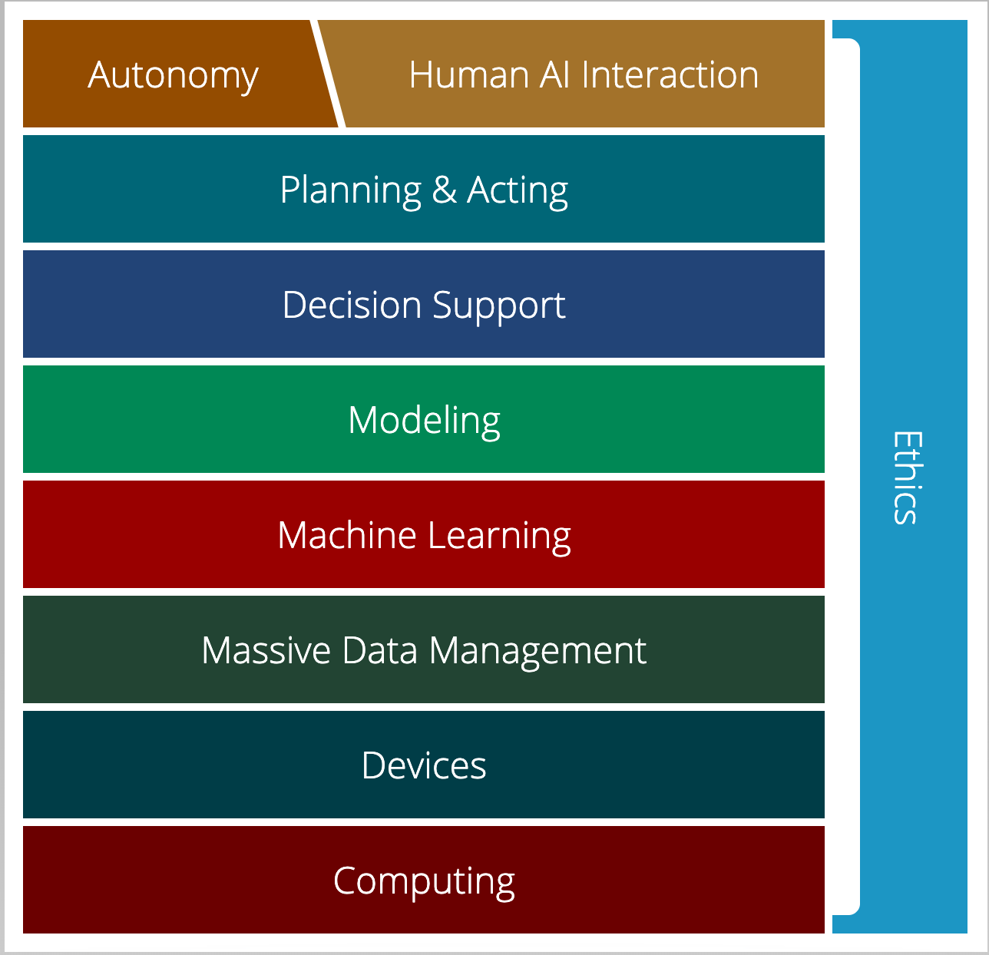
AI Stack for CMU AI
“AI must understand the human needs and it must make smart design decisions based on that understanding”
AI Stack
https://ai.cs.cmu.edu/about
Notes:
Proposed by Andrew Moore, CMU is using AI Stack to illustrate what they consider as AI. AI must understand the human needs and it must make smart design decisions based on that understanding. Despite the simple definition, though, AI isn't just one thing. It's a giant thing, built from technology blocks we call the AI Stack. At Carnegie Mellon, we view it as a toolbox — each block houses a set of technologies that scientists and researchers can reach for as they work on new initiatives. Expertise in all areas? Not required. Instead, we believe you can focus on one area and draw on other parts of the stack for help. Each block depends on the other for support. And AI endeavors that ignore parts of the stack won't succeed.

Slide 16

AI Stack for CMU AI
“Machine learning focuses on creating programs that learn from experience.”
“It advances computing through exposure to new scenarios, testing and adaptation, while using pattern- and trend-detection to help the computer make better decisions in similar, subsequent situations.”
AI Stack
https://ai.cs.cmu.edu/about

Slide 17
Artificial Intelligence vs Machine Learning?
Artificial Intelligence
Machine Learning
Deep Learning

Slide 18
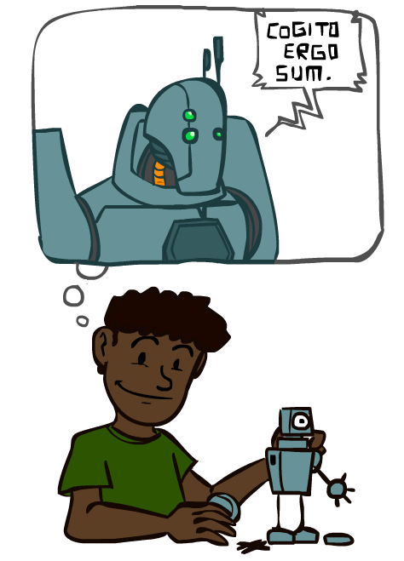
A Brief History of AI
Images: ai.berkeley.edu

Slide 19
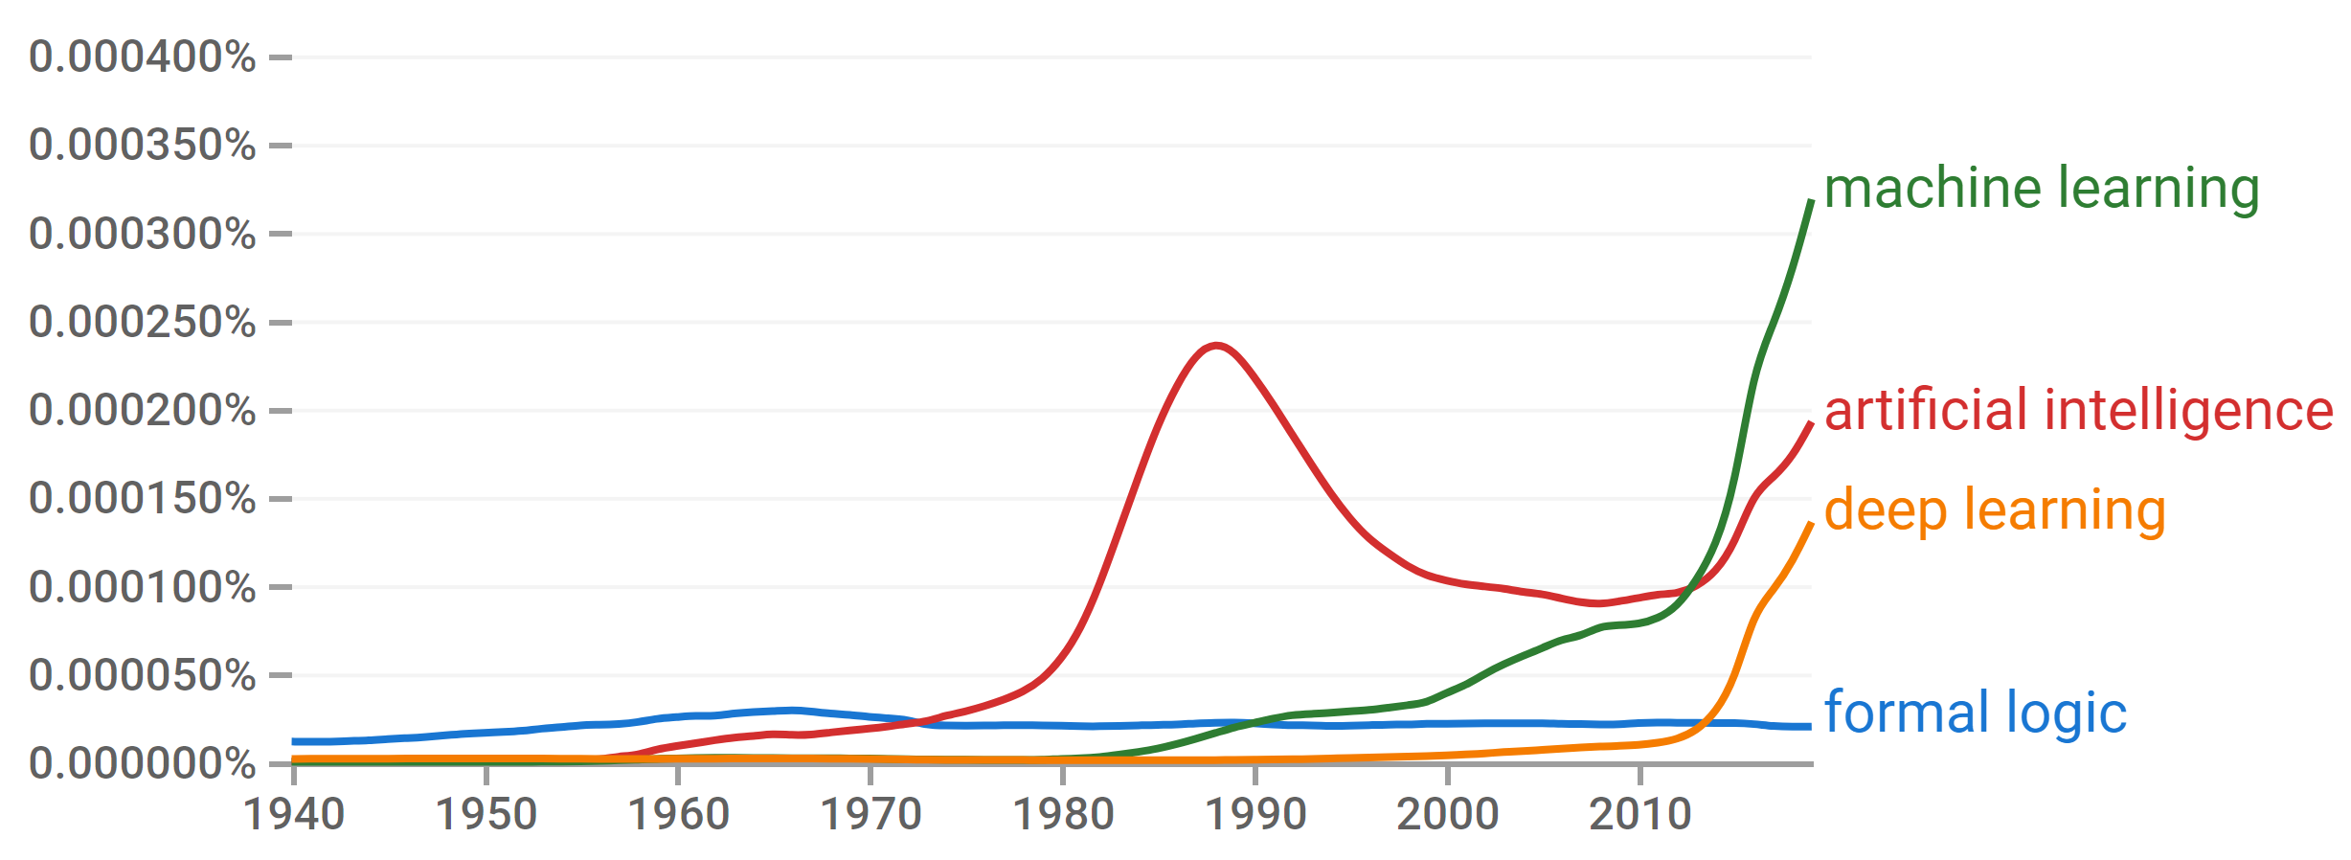
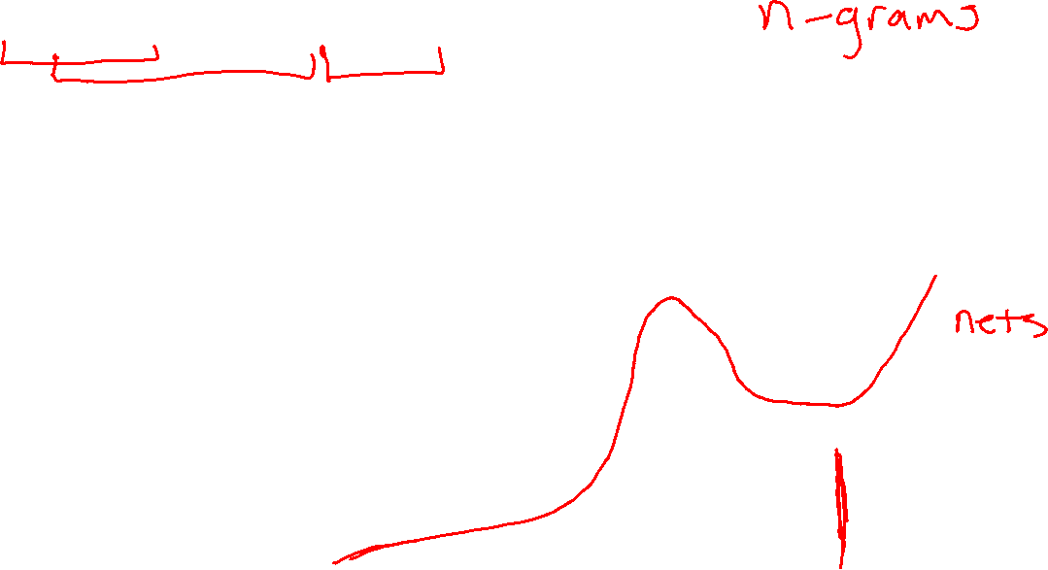
A Brief History of AI
Knowledge Based
Systems
1970-1990
Statistical Approaches
1990-
Deep Learning Era
2012-
AI
Excitement!
1950-1970
https://books.google.com/ngrams

Slide 20
A Brief History of AI
1940-1950: Early days
  1943: McCulloch & Pitts: Boolean circuit model of brain
  1950: Turing's “Computing Machinery and Intelligence”
1950—70: Excitement: Look, Ma, no hands!
  1950s: Early AI programs, including Samuel's checkers program, Newell & Simon's Logic Theorist, Gelernter's Geometry Engine
  1956: Dartmouth meeting: “Artificial Intelligence” adopted
1970—90: Knowledge-based approaches
  1969—79: Early development of knowledge-based systems
  1980—88: Expert systems industry booms
  1988—93: Expert systems industry busts: “AI Winter”
1990—: Statistical approaches
  Resurgence of probability, focus on uncertainty
  General increase in technical depth
  Agents and learning systems… “AI Spring”?
2012—: Deep learning
  2012: ImageNet & AlexNet
Images: ai.berkeley.edu
Notes:
Million dollar computer with less computation than your phone
MT was

Slide 21
Breakout Rooms
Always
Video on
Unmute
Introduce yourself
Now
Are we headed for another AI winter?

Slide 22
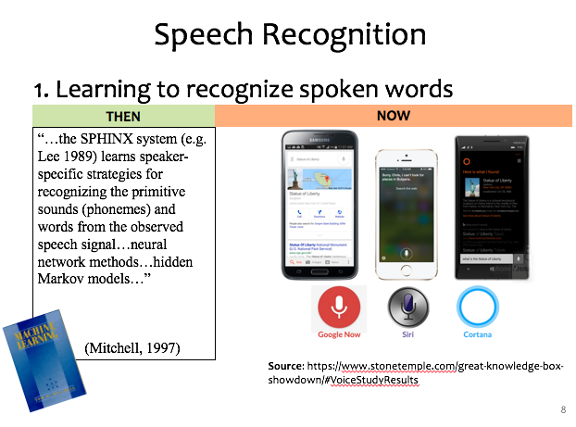
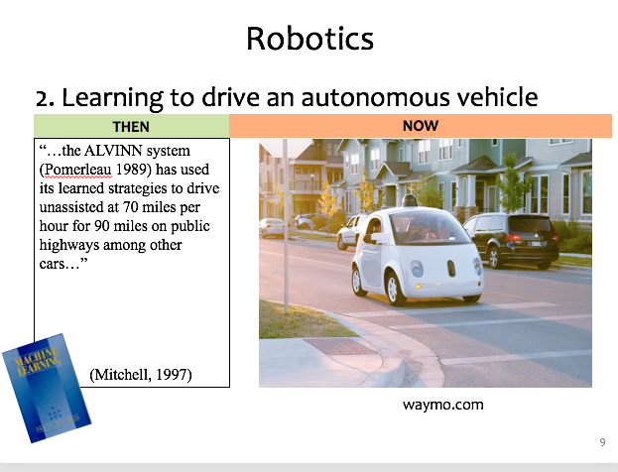
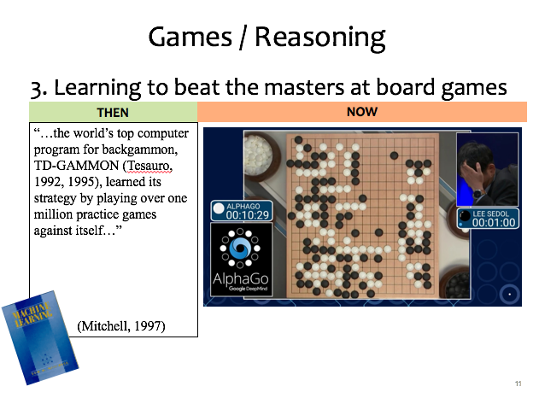
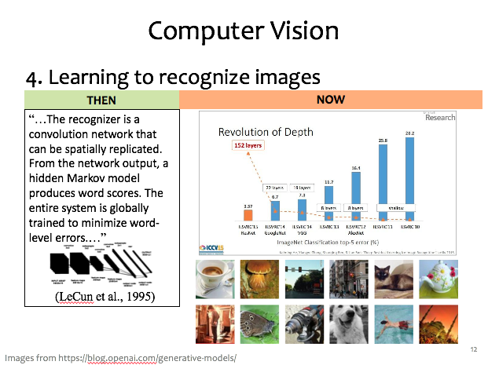
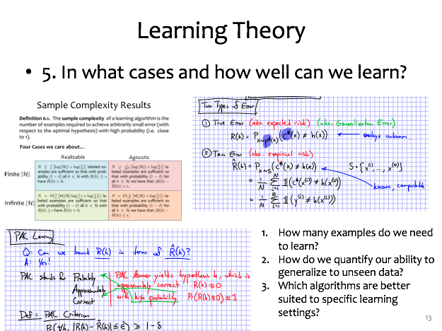
ML Applications?

Slide 23
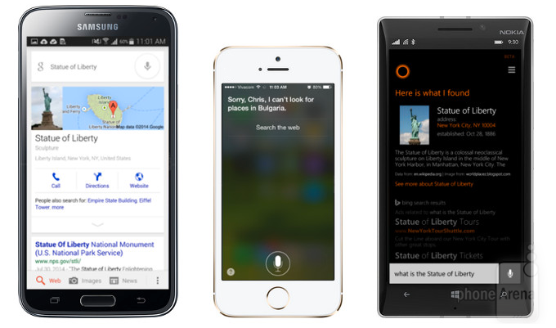


Speech Recognition
1. Learning to recognize spoken words
THEN
NOW
“…the SPHINX system (e.g. Lee 1989) learns speaker-specific strategies for recognizing the primitive sounds (phonemes) and words from the observed speech signal…neural network methods…hidden Markov models…”
(Mitchell, 1997)
Source: https://www.stonetemple.com/great-knowledge-box-
showdown/#VoiceStudyResults

Slide 24

Robotics
2. Learning to drive an autonomous vehicle
NOW
THEN
NOW
“…the ALVINN system (Pomerleau 1989) has used its learned strategies to drive unassisted at 70 miles per hour for 90 miles on public highways among other cars…”
(Mitchell, 1997)
https://www.geek.com/wp-content/uploads/2016/03/uber.jpg
waymo.com
Notes:
This a Google self-driving car; it looks really cute and friendly.
But these things weigh a *ton* and there is a person sitting inside this thing!
So this machine needs to know a lot about its environment, what actions to take, or policy to follow.
If a person were to enter the crosswalk, it would need to know how to slow down, or that person would learn a very uncomfortable lesson about physics

Slide 25

Games / Reasoning
3. Learning to beat the masters at board games
THEN
NOW
“…the world’s top computer program for backgammon, TD-GAMMON (Tesauro, 1992, 1995), learned its strategy by playing over one million practice games against itself…”
(Mitchell, 1997)

Slide 26

Computer Vision
4. Learning to recognize images
THEN
NOW
“…The recognizer is a convolution network that can be spatially replicated. From the network output, a hidden Markov model produces word scores. The entire system is globally trained to minimize word-level errors.…”
(LeCun et al., 1995)
Images from https://blog.openai.com/generative-models/

Slide 27
Learning Theory
5. In what cases and how well can we learn?
How many examples do we need to learn?
How do we quantify our ability to generalize to unseen data?
Which algorithms are better suited to specific learning settings?

Slide 28
Machine Learning and Statistics
Statistics is also about learning from data
Statistics has been around from much longer!
What’s the difference?
Until the mid 1990s:
Statistics:
  A branch of mathematics
  Emphasized rigor, correctness, provable properties (“is it correct?”)
  Was not very concerned with scaling
    Not much awareness of computational complexity
Machine Learning:
  A branch of Computer Science / AI
  Focus on heuristics, making things work in practice (“does it work?”)
  Not much awareness of statistical theory
Slide: CMU ML, Roni Rosenfeld

Slide 29
Machine Learning and Statistics
From the mid 1990s:
The two fields have effectively merged
  Carnegie Mellon has led the way!
ML is now often called “Statistical Machine Learning”
  There is very little non-statistical ML today
Slide: CMU ML, Roni Rosenfeld

Slide 30

AI Stack for CMU AI
“Machine learning focuses on creating programs that learn from experience.”
“It advances computing through exposure to new scenarios, testing and adaptation, while using pattern- and trend-detection to help the computer make better decisions in similar, subsequent situations.”
AI Stack
https://ai.cs.cmu.edu/about

Slide 31
Defining Learning Problems

Slide 32
Well-Posed Learning Problems
Three components <T,P,E>:
  Task, T
  Performance measure, P
  Experience, E
Definition of learning:
A computer program learns if its performance at tasks in T, as measured by P, improves with experience E.
Definition from (Mitchell, 1997)

Slide 33
Example Learning Problems
Learning to beat the masters at chess
  Task, T:
  Performance measure, P:
  Experience, E:
Notes:
T = playing chess
P = % games won in world tournament OR
% pieces taken
E = games against grand-masters (W/L)
games against self (W/L)
correct move for board state (move) [from book OR from grand-masters]

Slide 34
Example Learning Problems
Learning to respond to voice commands (Siri)
  Task, T:
  Performance measure, P:
  Experience, E:

Slide 35
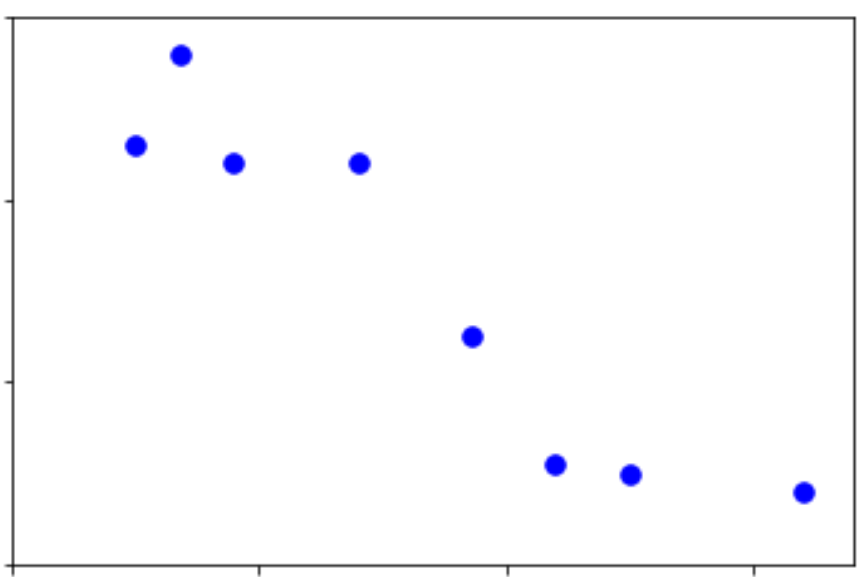
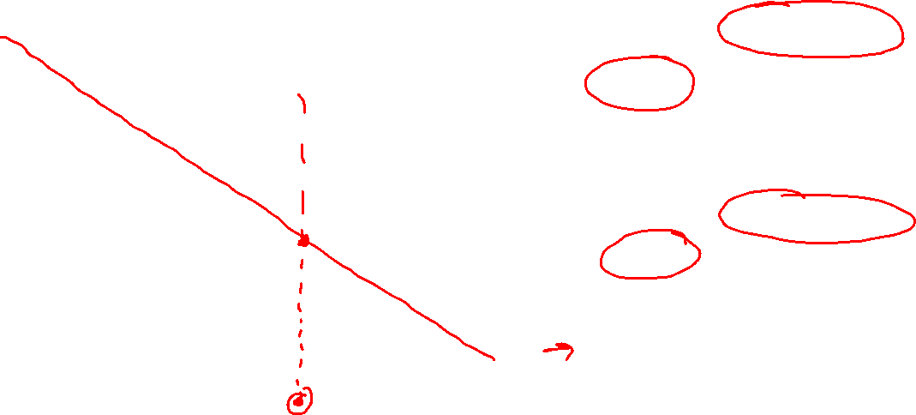
Data: Input, Output, and Assumptions
Input:
Discrete/Continuous?
Single/Multiple values?
Output:
Discrete/Continuous?
Single/Multiple values?
Assumptions?
Output y
Input x

Slide 36
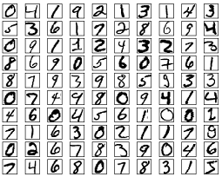

Data: Input, Output, and Assumptions
MNIST: Handwritten digits
Input:
Discrete/Continuous?
Single/Multiple values?
Output:
Discrete/Continuous?
Single/Multiple values?
Assumptions?
More robust examples: http://yann.lecun.com/exdb/lenet/index.html

Slide 37
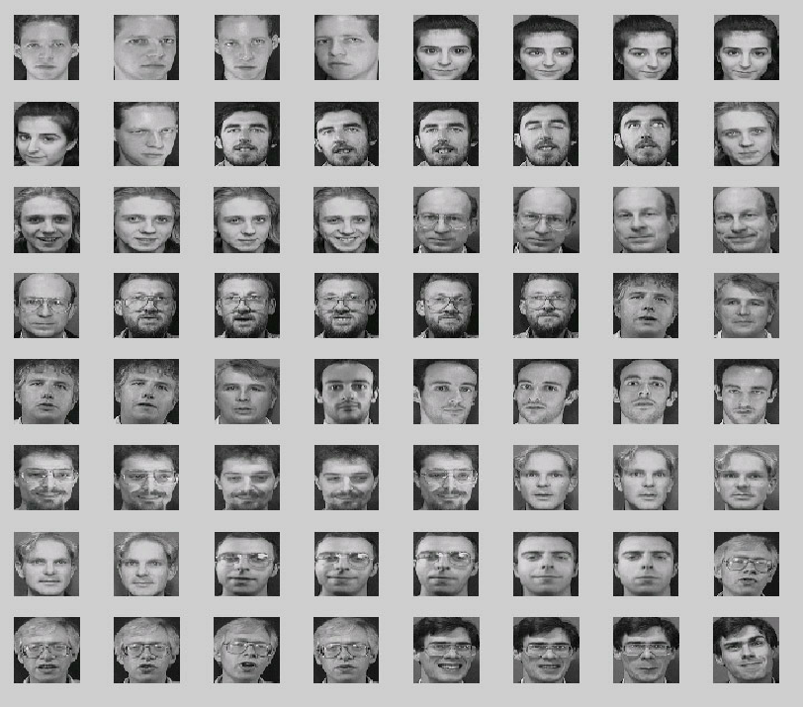
Assumptions
Face dataset

Slide 38
Breakout Rooms
Search internet to find:
ML Classification Dataset
    Discrete/unordered output
ML Regression Dataset
    Continuous output
Are the input values discrete/continuous?
Are the input values a single value or multiple values?
What assumptions might we make with these datasets?

Slide 39
Course Information
Website: https://www.cs.cmu.edu/~10601
Course Levels and Course Scope
Prerequisites
Teamwork
Mental health

