Slide 1

Announcements
Assignments
HW8: due Thu, 12/3, 11:59 pm
HW9
    Out Friday
    Due Wed, 12/9, 11:59 pm
    The two slip days are free (last possible submission Fri, 12/11, 11:59 pm)
Final Exam
Mon, 12/14
Stay tuned to Piazza for more details

Slide 2

Introduction to Machine Learning
Support Vector Machines
Instructor: Pat Virtue

Slide 3
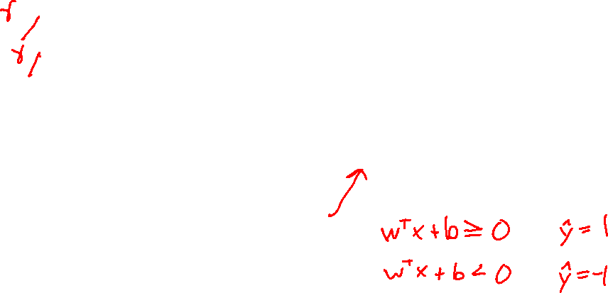
Support Vector Machines
Find linear separator with maximum margin

Slide 4
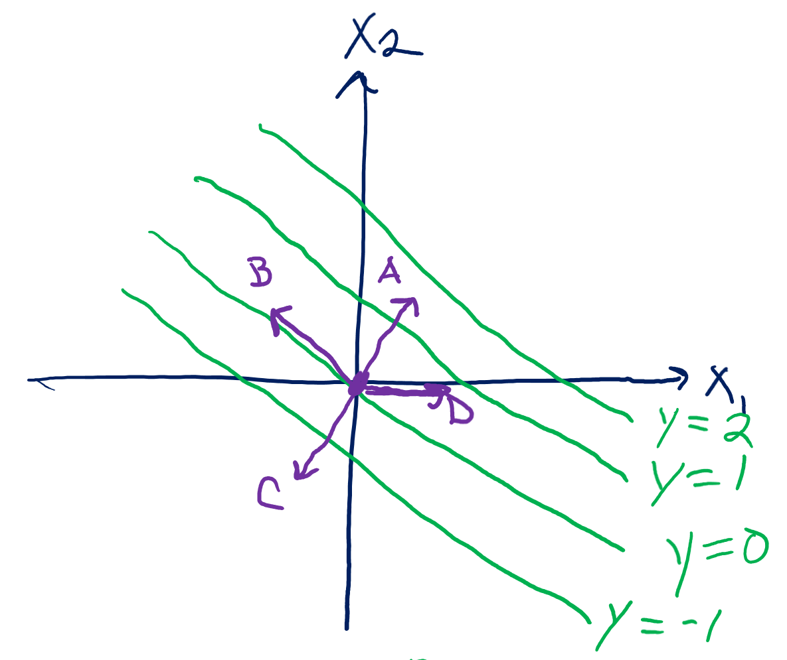
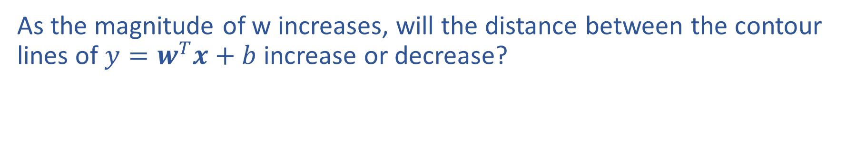

Previous Piazza Poll
As the magnitude of w increases, will the distance between the contour lines of $y=w^{T}x+b$ increase or decrease?

Slide 5






Support Vector Machines
Find linear separator with maximum margin
x₂
x₂
x₂
$$y=1$$
$$y=1$$
$$y=−1$$
x₁
$$y=−1$$
x₁
x₁
$$y=1$$
$$y=−1$$

Slide 6
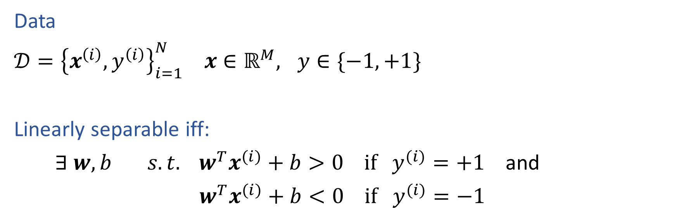
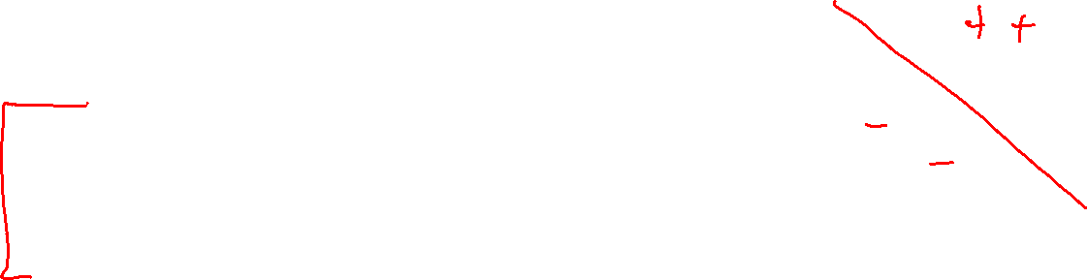
Linear Separability
Data
$𝒟={\left\{x^{\left(i\right)}, y^{\left(i\right)}\right\}}_{i=1}^{N} x∈ℝ^{M}, y∈\{−1, +1\}$
Linearly separable iff:
$∃ w, b s.t. w^{T}x^{(i)}+b>0 if y^{(i)}=+1$ and
$w^{T}x^{(i)}+b<0 if y^{(i)}=−1$
Slide credit: CMU MLD Matt Gormley

Slide 7
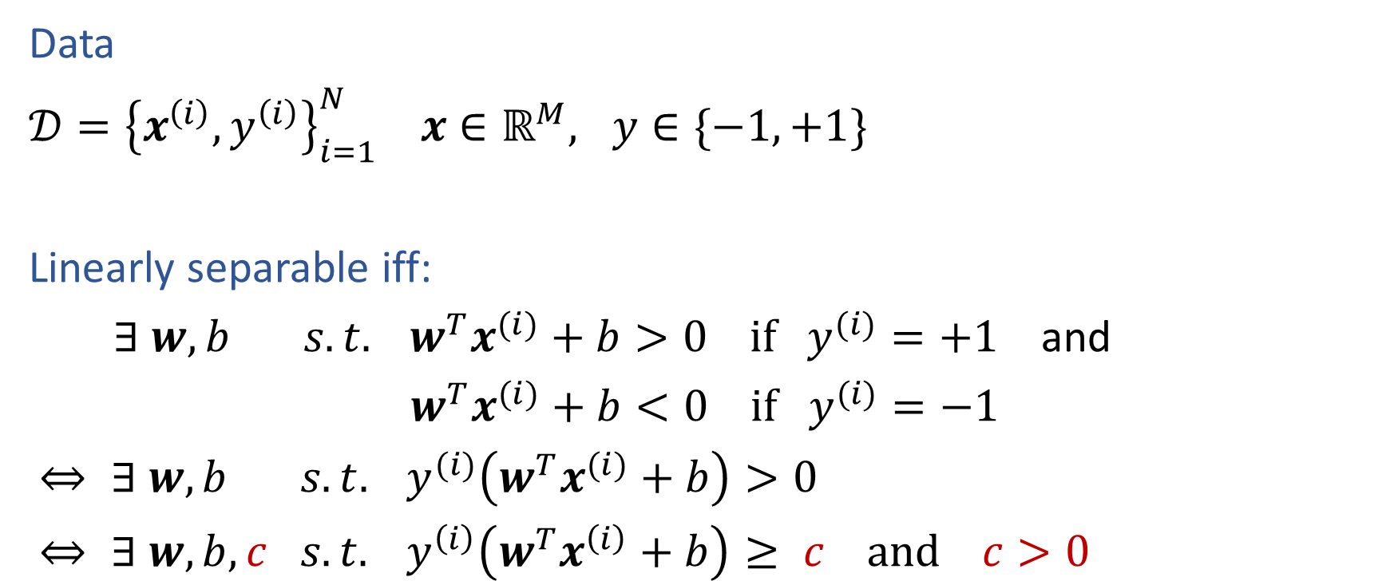
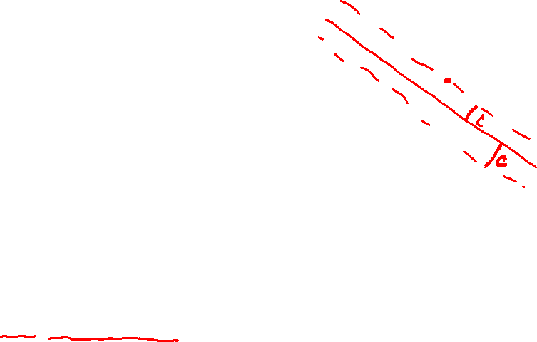
Linear Separability
Data
$𝒟={\left\{x^{\left(i\right)}, y^{\left(i\right)}\right\}}_{i=1}^{N} x∈ℝ^{M}, y∈\{−1, +1\}$
Linearly separable iff:
$∃ w, b s.t. w^{T}x^{(i)}+b>0 if y^{(i)}=+1$ and
$w^{T}x^{(i)}+b<0 if y^{(i)}=−1$
$⇔ ∃ w, b s.t. y^{(i)}\left(w^{T}x^{(i)}+b\right)>0$
$⇔ ∃ w, b,c s.t. y^{\left(i\right)}\left(w^{T}x^{\left(i\right)}+b\right)≥ c and c>0$
Slide credit: CMU MLD Matt Gormley

Slide 8
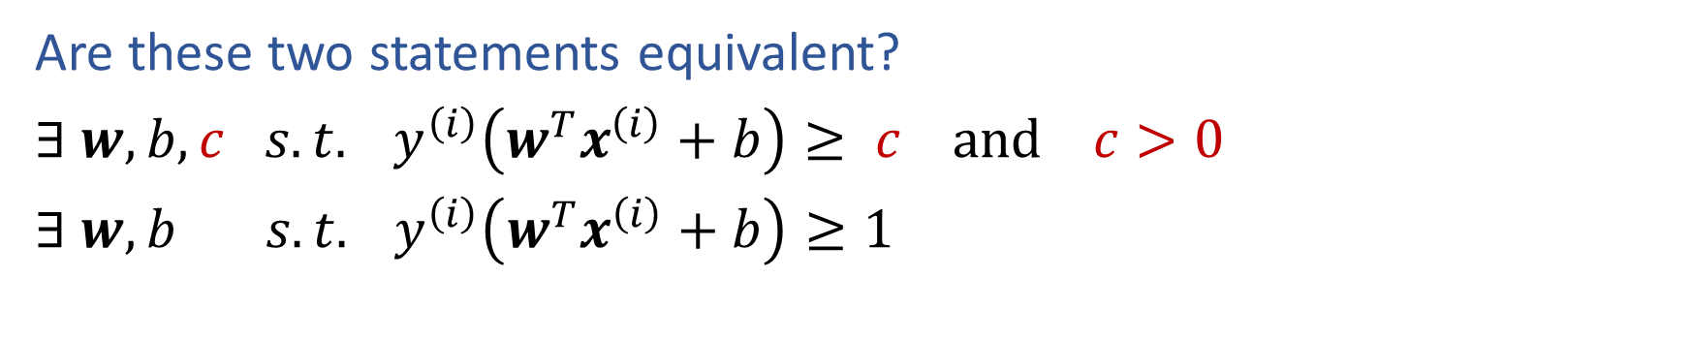
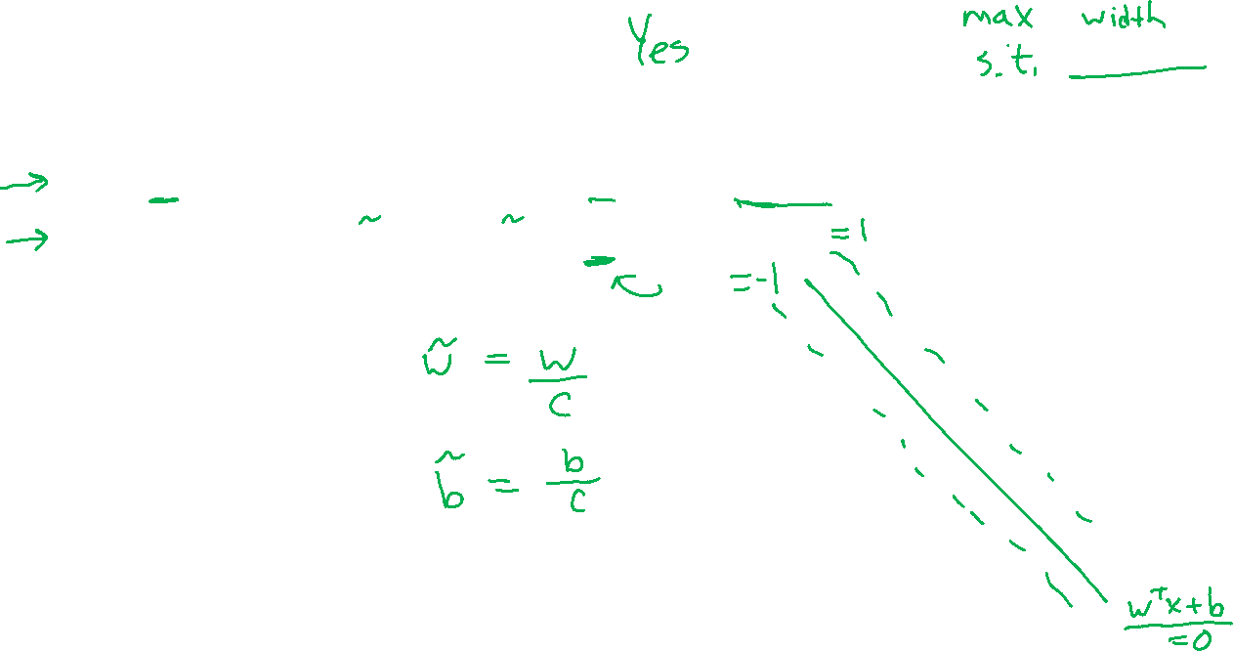
Piazza Poll 1
Are these two statements equivalent?
$∃ w, b,c s.t. y^{\left(i\right)}\left(w^{T}x^{\left(i\right)}+b\right)≥ c and c>0$
$∃ w, b s.t. y^{\left(i\right)}\left(w^{T}x^{\left(i\right)}+b\right)≥1$

Slide 9
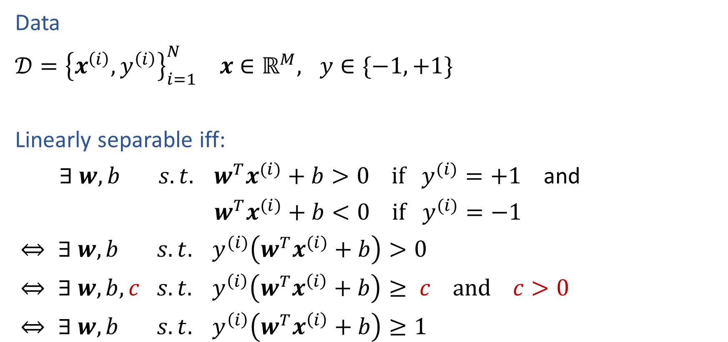
Linear Separability
Data
$𝒟={\left\{x^{\left(i\right)}, y^{\left(i\right)}\right\}}_{i=1}^{N} x∈ℝ^{M}, y∈\{−1, +1\}$
Linearly separable iff:
$∃ w, b s.t. w^{T}x^{(i)}+b>0 if y^{(i)}=+1$ and
$w^{T}x^{(i)}+b<0 if y^{(i)}=−1$
$⇔ ∃ w, b s.t. y^{(i)}\left(w^{T}x^{(i)}+b\right)>0$
$⇔ ∃ w, b,c s.t. y^{\left(i\right)}\left(w^{T}x^{\left(i\right)}+b\right)≥ c and c>0$
$⇔ ∃ w, b s.t. y^{\left(i\right)}\left(w^{T}x^{\left(i\right)}+b\right)≥1$
Slide credit: CMU MLD Matt Gormley

Slide 10
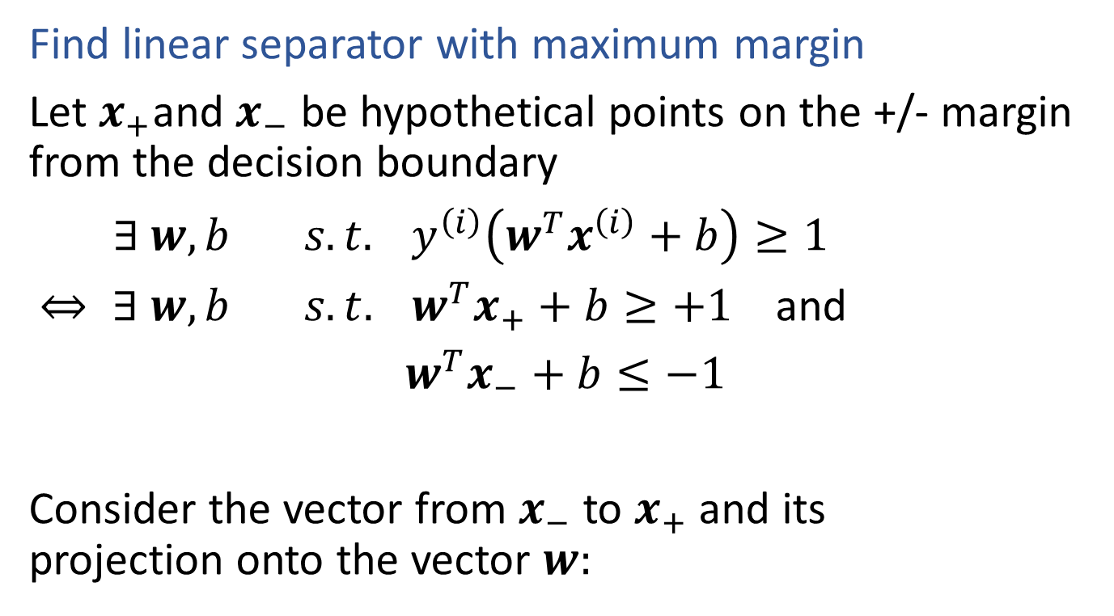
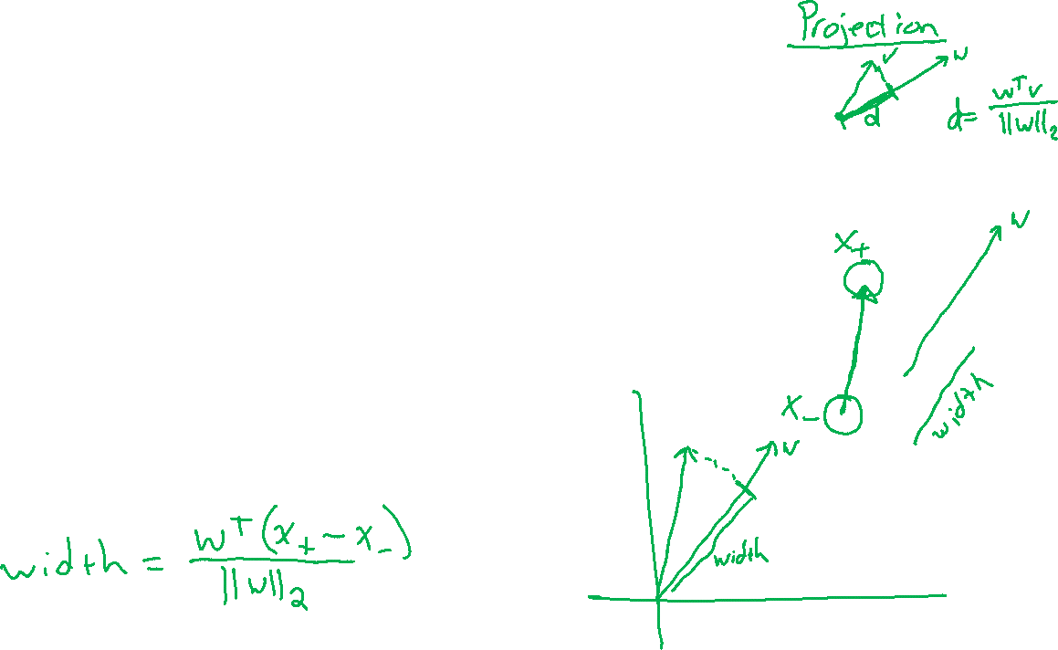
Support Vector Machines
Find linear separator with maximum margin
Let $x_{+}$and $x_{−}$ be hypothetical points on the +/- margin from the decision boundary
$∃ w, b s.t. y^{\left(i\right)}\left(w^{T}x^{\left(i\right)}+b\right)≥1$
$⇔ ∃ w, b s.t. w^{T}x_{+}+b≥+1$ and
$w^{T}x_{−}+b≤−1$
Consider the vector from $x_{−}$ to $x_{+}$ and its projection onto the vector $w:$

Slide 11
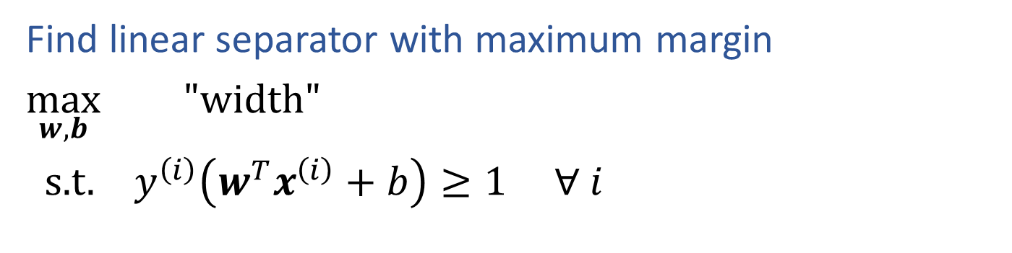
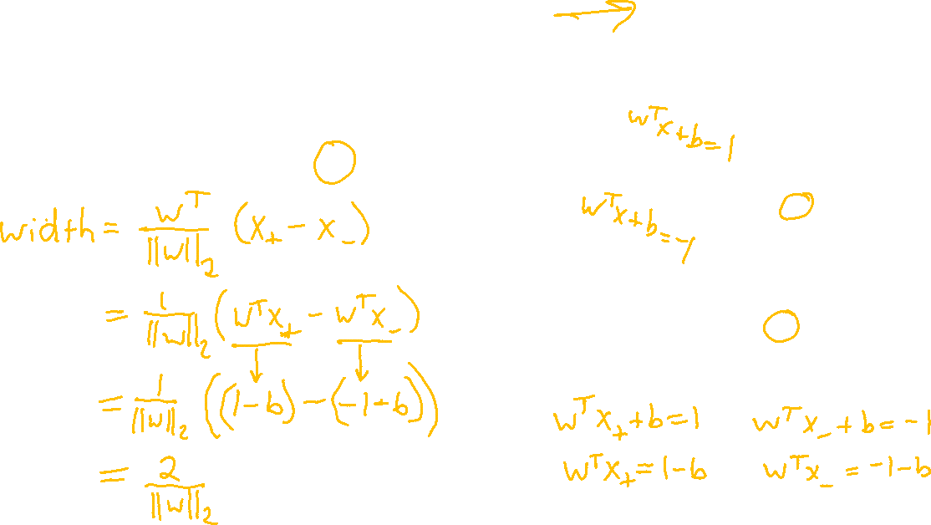

Support Vector Machines
$width= \frac{w^{T}}{{\left\|w\right\|}_{2}}(x_{+}$- $x_{−}$)
Find linear separator with maximum margin
$\max_{w,b}{ "width"}$
s.t. $y^{\left(i\right)}\left(w^{T}x^{\left(i\right)}+b\right)≥1 ∀ i$

Slide 12
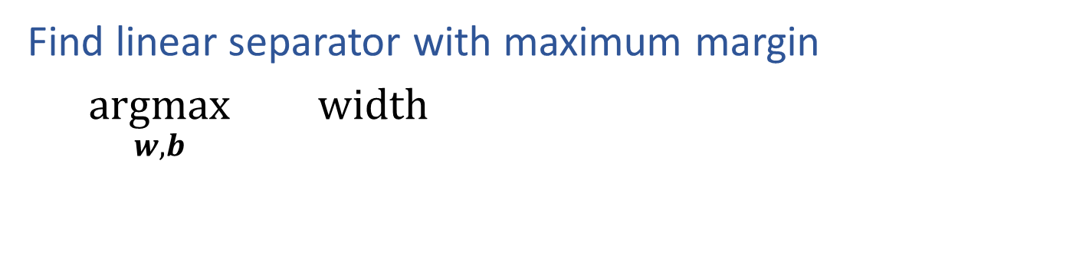

Support Vector Machines
$$width=\frac{2}{{\left\|w\right\|}_{2}}$$
Find linear separator with maximum margin
$\underset{w,b}{argmax}{ width}$

Slide 13
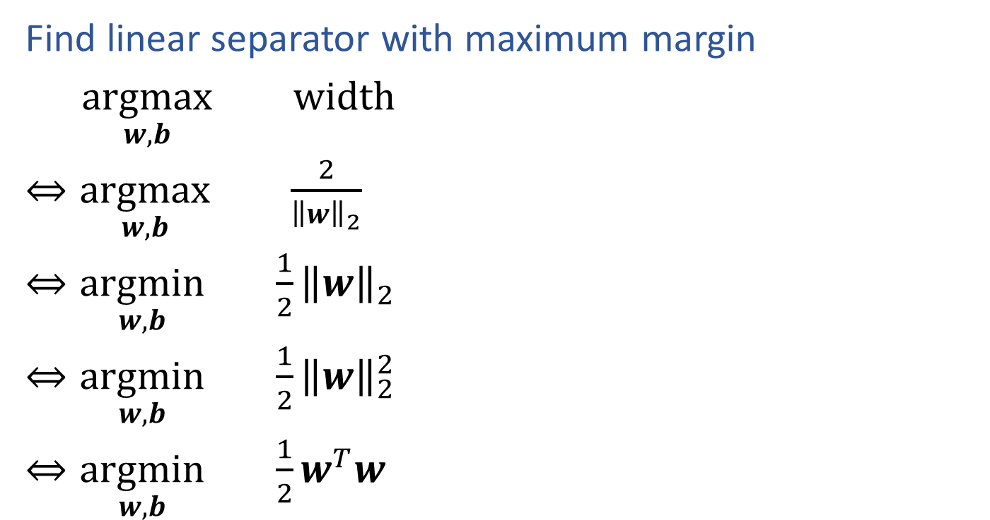
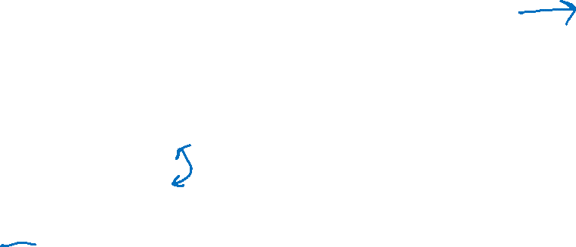

Support Vector Machines
$$width=\frac{2}{{\left\|w\right\|}_{2}}$$
Find linear separator with maximum margin
$\underset{w,b}{argmax}{ width}$
$⇔\underset{w,b}{argmax}{ \frac{2}{{\left\|w\right\|}_{2}}}$
$⇔\underset{w,b}{argmin}{ \frac{1}{2}{\left\|w\right\|}_{2}}$
$⇔\underset{w,b}{argmin}{ \frac{1}{2}{\left\|w\right\|}_{2}^{2}}$
$⇔\underset{w,b}{argmin}{ \frac{1}{2}w^{T}w}$

Slide 14
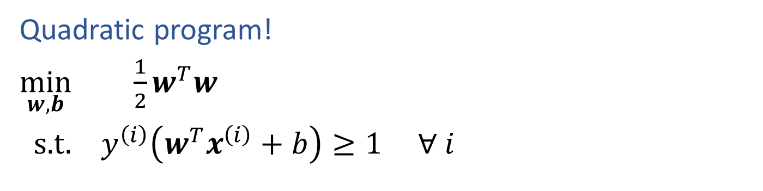
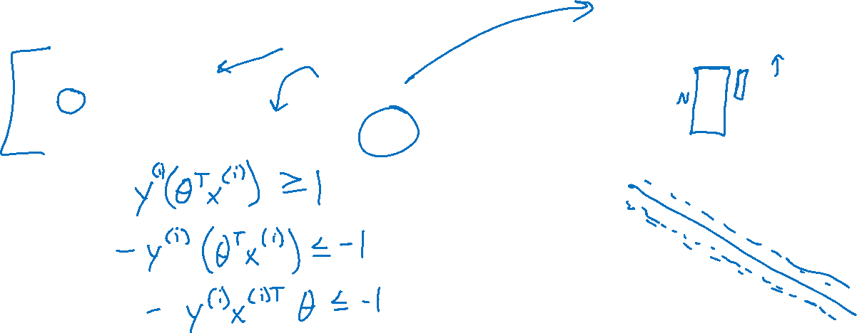
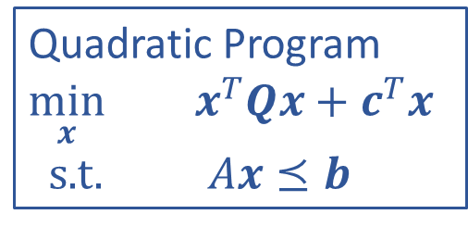
SVM Optimization
Quadratic Program
$\min_{x}{ x^{T}Qx+}$ $c^{T}x$
s.t. $Ax⪯b$
Quadratic program!
$\min_{w,b}{ \frac{1}{2}w^{T}w}$
s.t. $y^{\left(i\right)}\left(w^{T}x^{\left(i\right)}+b\right)≥1 ∀ i$

Slide 15
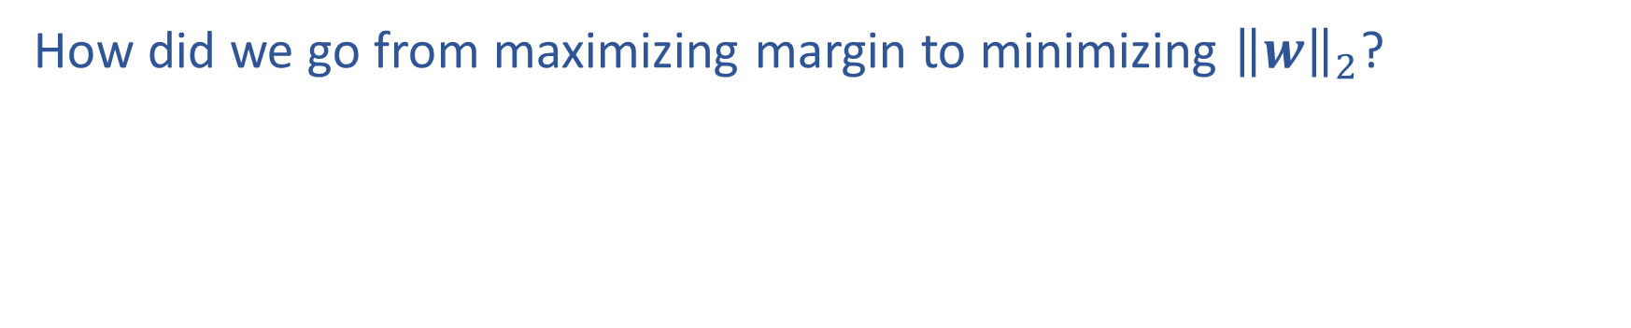
SVM Optimization
How did we go from maximizing margin to minimizing ${\left\|w\right\|}_{2}$?

Slide 16

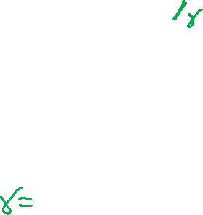



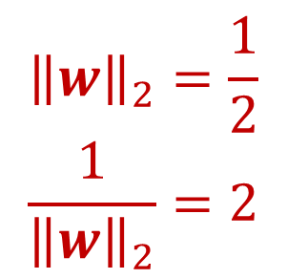

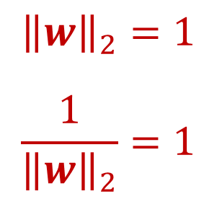

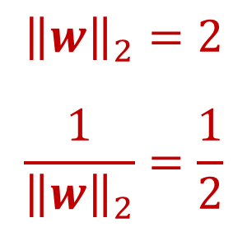
SVM Optimization
How did we go from maximizing margin to minimizing ${\left\|w\right\|}_{2}$?
x₂
x₂
x₂
$$y=1$$
$$y=1$$
$$y=−1$$
x₁
$$y=−1$$
x₁
x₁
$$y=1$$
$$y=−1$$
$${\left\|w\right\|}_{2}=2$$
$$\frac{1}{{\left\|w\right\|}_{2}}=\frac{1}{2}$$
$${\left\|w\right\|}_{2}=1$$
$$\frac{1}{{\left\|w\right\|}_{2}}=1$$
$${\left\|w\right\|}_{2}=\frac{1}{2}$$
$$\frac{1}{{\left\|w\right\|}_{2}}=2$$

Slide 17
Linear Separability
Data
$𝒟={\left\{x^{\left(i\right)}, y^{\left(i\right)}\right\}}_{i=1}^{N} x∈ℝ^{M}, y∈\{−1, +1\}$
Linearly separable iff:
$∃ w, b s.t. w^{T}x^{(i)}+b>0 if y^{(i)}=+1$ and
$w^{T}x^{(i)}+b<0 if y^{(i)}=−1$
Slide credit: CMU MLD Matt Gormley

Slide 18
Support Vector Machines
$width= \frac{w^{T}}{{\left\|w\right\|}_{2}}(x_{+}$- $x_{−}$)
Find linear separator with maximum margin
$\max_{w,b}{ "width"}$
s.t. $y^{\left(i\right)}\left(w^{T}x^{\left(i\right)}+b\right)≥1 ∀ i$

Slide 19

SVM Optimization
Quadratic Program
$\min_{x}{ x^{T}Qx+}$ $c^{T}x$
s.t. $Ax⪯b$
Quadratic program!
$\min_{w,b}{ \frac{1}{2}{\left\|w\right\|}_{2}^{2}}$
s.t. $y^{\left(i\right)}\left(w^{T}x^{\left(i\right)}+b\right)≥1 ∀ i$

Slide 20
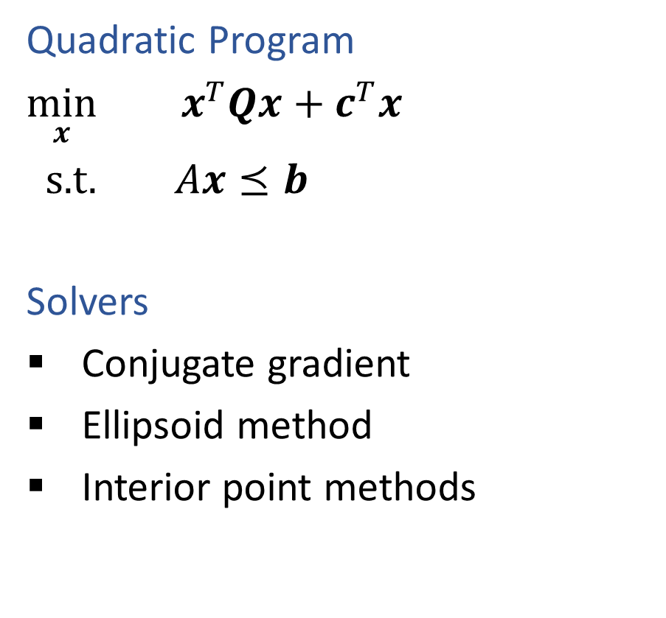


Constrained Optimization
Linear Program
$\min_{x}{ c^{T}x}$
s.t. $Ax⪯b$
Solvers
Simplex
Interior point methods
Quadratic Program
$\min_{x}{ x^{T}Qx+}$ $c^{T}x$
s.t. $Ax⪯b$
Solvers
Conjugate gradient
Ellipsoid method
Interior point methods

Slide 21
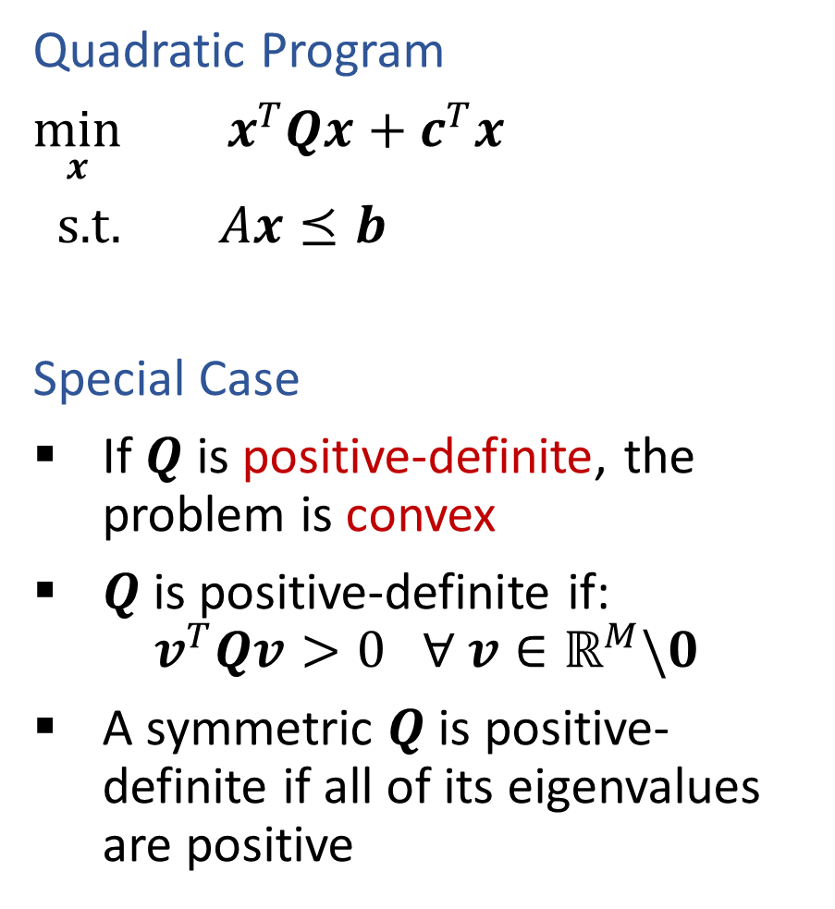
Constrained Optimization
Linear Program
$\min_{x}{ c^{T}x}$
s.t. $Ax⪯b$
Solvers
Simplex
Interior point methods
Quadratic Program
$\min_{x}{ x^{T}Qx+}$ $c^{T}x$
s.t. $Ax⪯b$
Special Case
If $Q$ is positive-definite, the problem is convex
$Q$is positive-definite if:
$$v^{T}Qv>0 ∀ v∈ℝ^{M}\backslash 0$$
A symmetric $Q$is positive-definite if all of its eigenvalues are positive

Slide 22

Support Vector Machines
Next steps
Different optimization formulation
    Primal → dual
    “Support vectors”
Support non-linear classification
    Feature maps
    Kernel trick
Support non-separable data
    Hard-margin SVM → soft-margin SVM

Slide 23
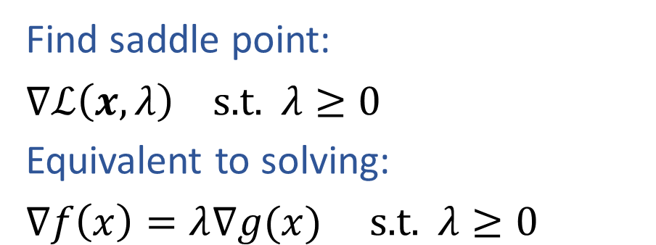
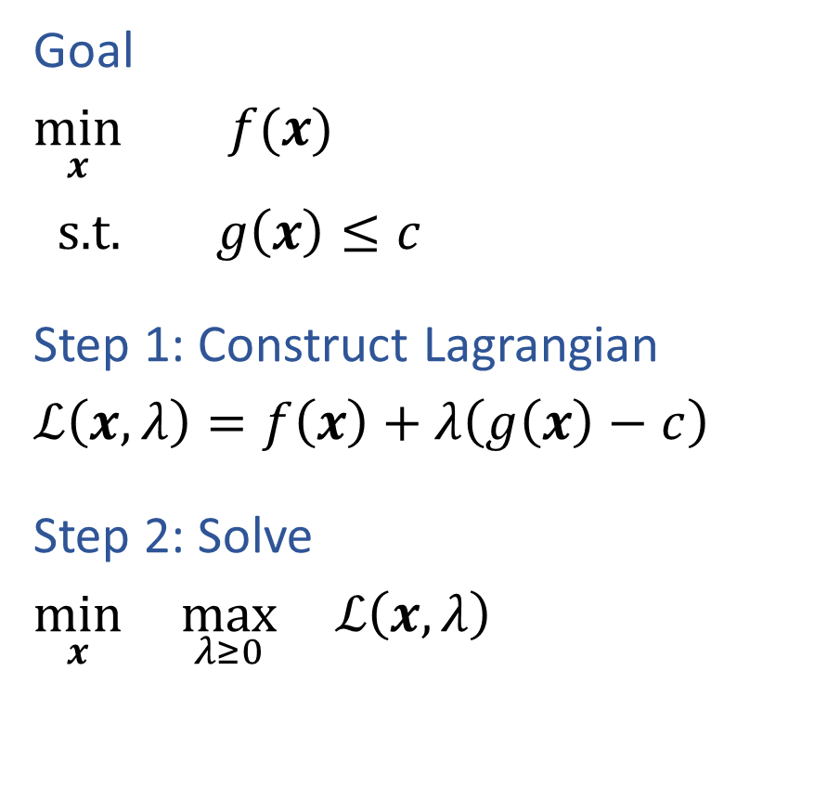
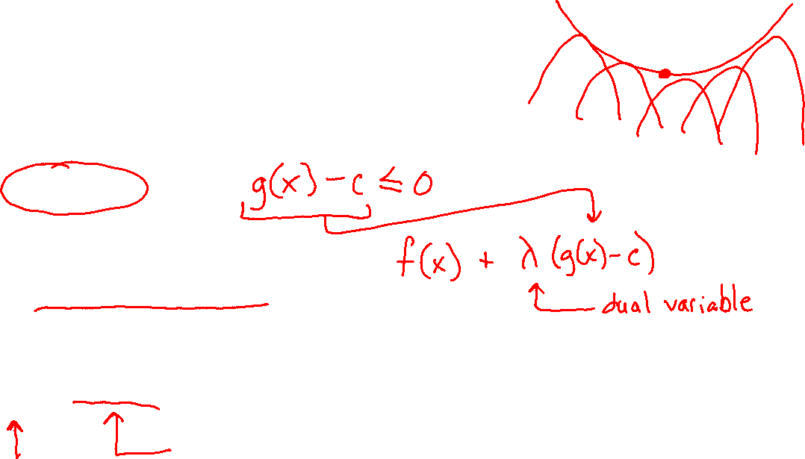
Method of Lagrange Multipliers
Goal
$\min_{x}{ f(x)}$
$\text{s}\text{.}\text{t}\text{. } g\left(x\right)≤c$
Step 1: Construct Lagrangian
$ℒ\left(x, λ\right)=f\left(x\right)+λ\left(g\left(x\right)−c\right)$
Step 2: Solve
$\min_{x}{ \max_{λ≥0}{ ℒ\left(x, λ\right)}}$
Find saddle point:
$∇ℒ\left(x, λ\right) \text{s}\text{.}\text{t}\text{.} λ≥0$
Equivalent to solving:
$∇f\left(x\right)=λ∇g(x) \text{s}\text{.}\text{t}\text{.} λ≥0$
Slide credit: CMU MLD Matt Gormley

Slide 24
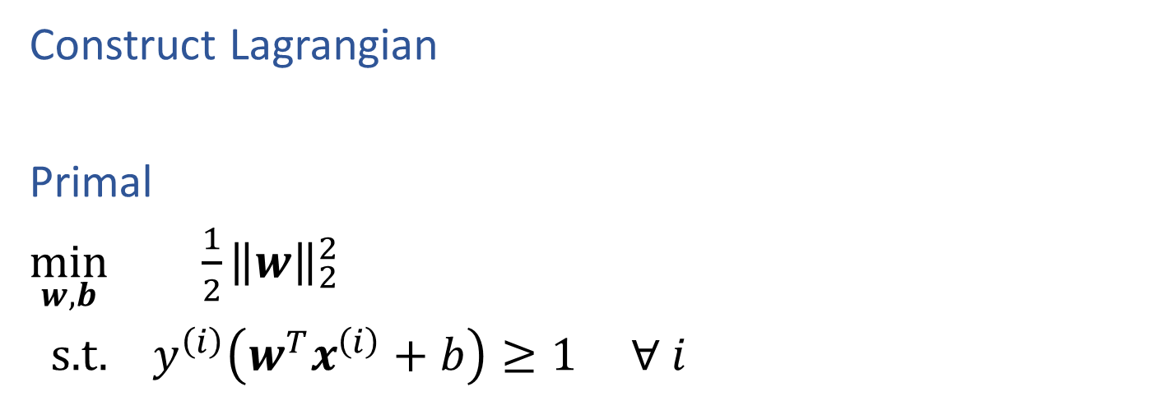
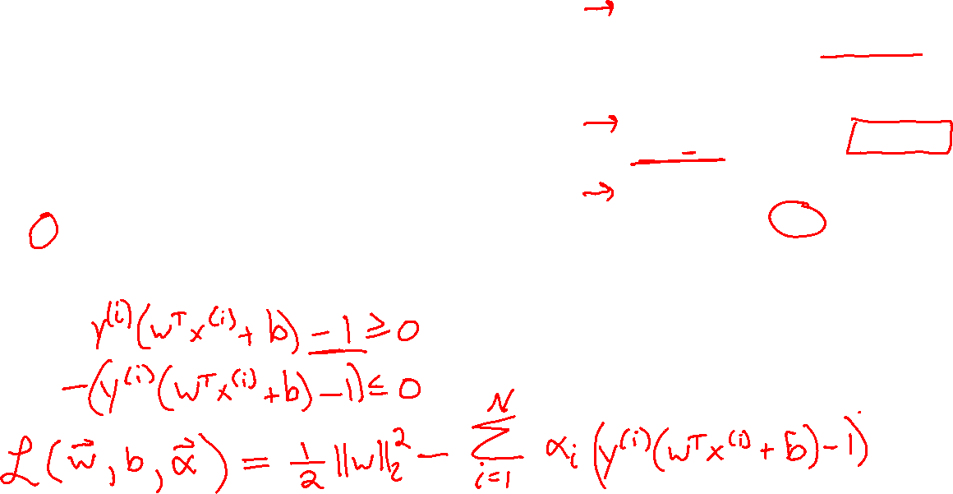
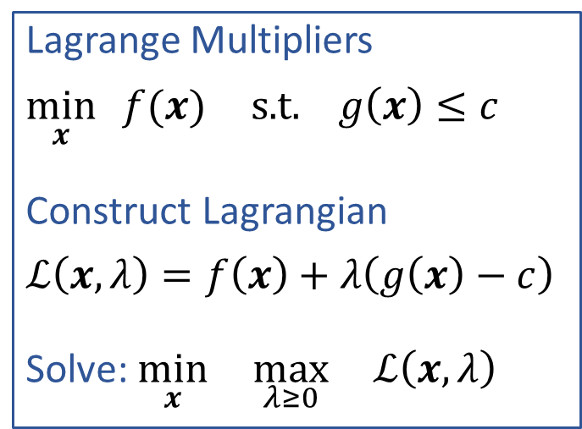
SVM Primal vs Dual
Lagrange Multipliers
$\min_{x}{ f(x)}$ $\text{s}\text{.}\text{t}\text{. } g\left(x\right)≤c$
Construct Lagrangian
$ℒ\left(x, λ\right)=f\left(x\right)+λ\left(g\left(x\right)−c\right)$
Solve: $\min_{x}{ \max_{λ≥0}{ ℒ\left(x, λ\right)}}$
Construct Lagrangian
Primal
$\min_{w,b}{ \frac{1}{2}{\left\|w\right\|}_{2}^{2}}$
s.t. $y^{\left(i\right)}\left(w^{T}x^{\left(i\right)}+b\right)≥1 ∀ i$

Slide 25
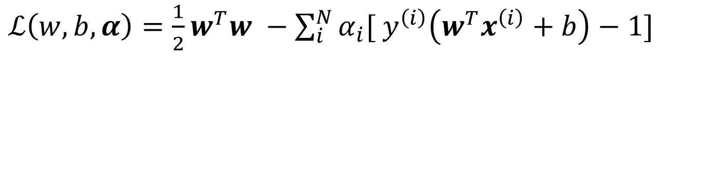
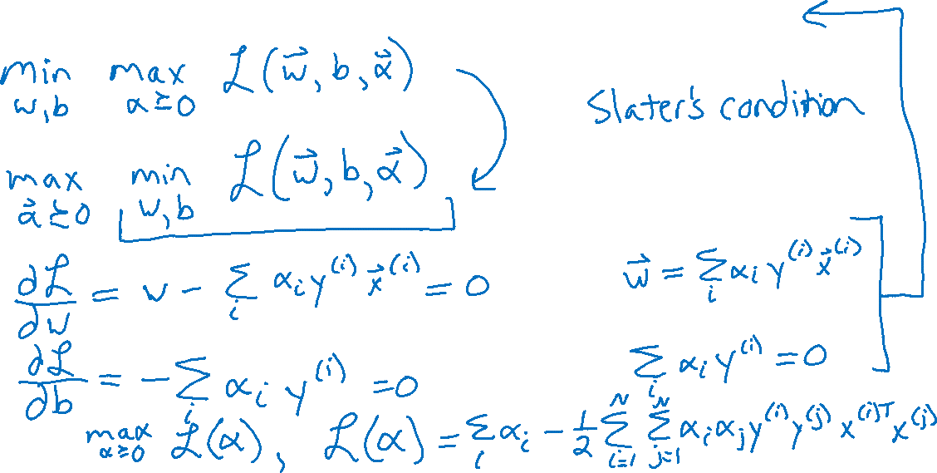
SVM Dual Optimization
$ℒ\left(w, b, α\right)=\frac{1}{2}w^{T}w −\sum_{i}^{N}{α_{i}[}$ $y^{\left(i\right)}\left(w^{T}x^{\left(i\right)}+b\right)−1]$

Slide 26
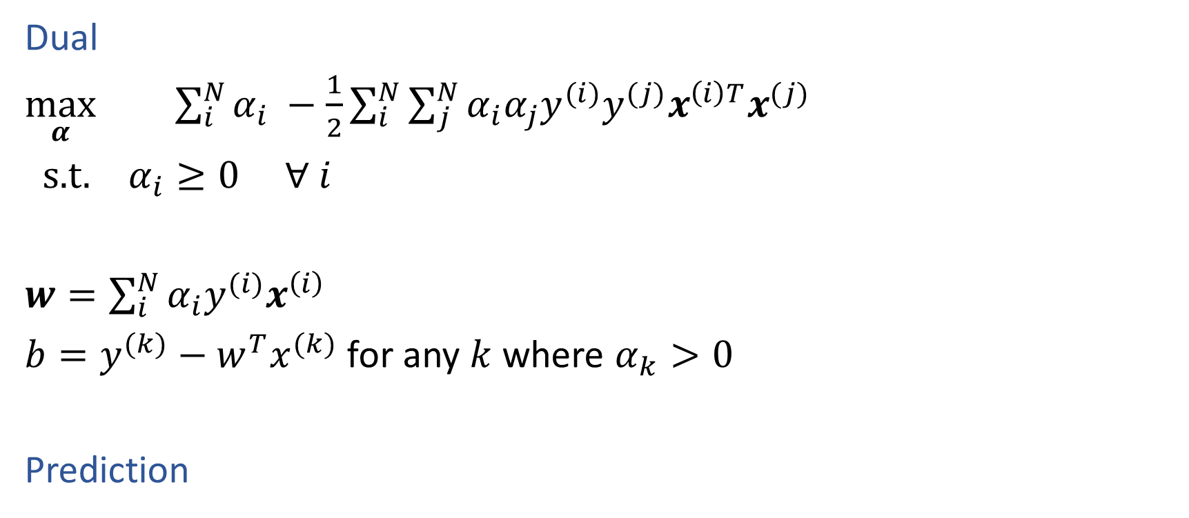
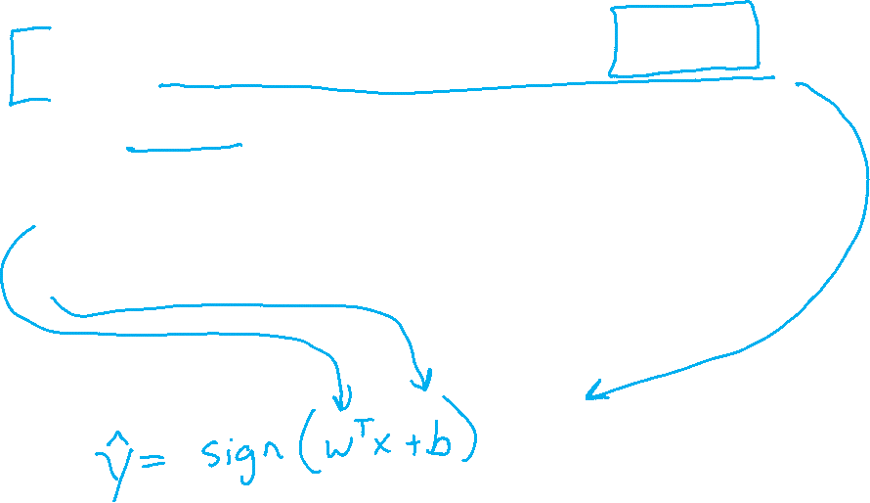
SVM Dual Optimization
Dual
$\max_{α}{ \sum_{i}^{N}{α_{i}} −\frac{1}{2}\sum_{i}^{N}{\sum_{j}^{N}{α_{i}α_{j}y^{(i)}y^{(j)}x^{\left(i\right)T}x^{(j)}}}}$
s.t. $α_{i}≥0 ∀ i$
$w=\sum_{i}^{N}{α_{i}y^{(i)}x^{\left(i\right)}}$
$b=y^{(k)}−w^{T}x^{(k)}$ for any $k$ where $α_{k}>0$
Prediction

Slide 27
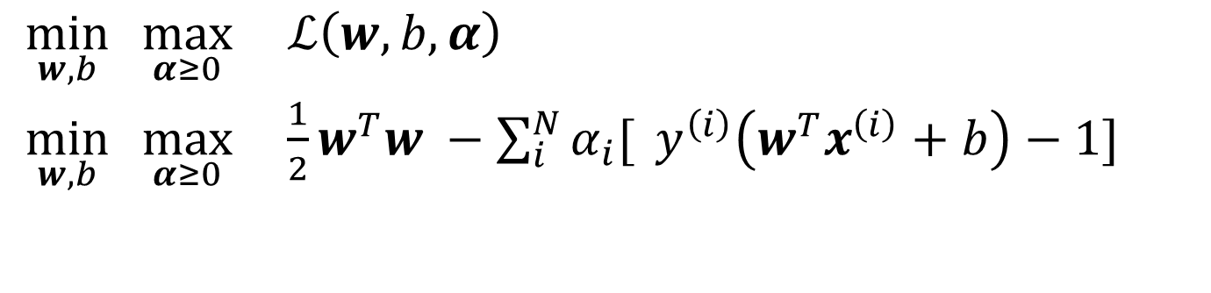
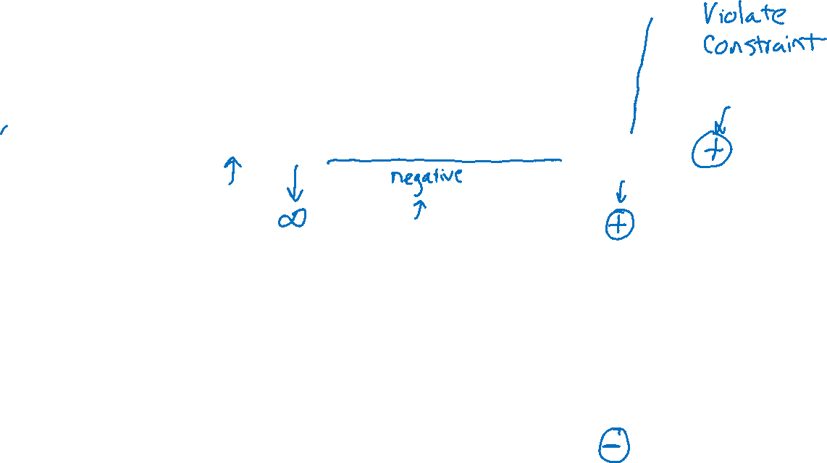
Dual SVM: Sparsity of dual solution
w^{T}x + b =1
$\min_{w,b}{\max_{α≥0}{ ℒ\left(w, b, α\right)}}$
$\min_{w,b}{\max_{α≥0}{ \frac{1}{2}w^{T}w −\sum_{i}^{N}{α_{i}[} y^{\left(i\right)}\left(w^{T}x^{\left(i\right)}+b\right)−1] }}$

Slide 28
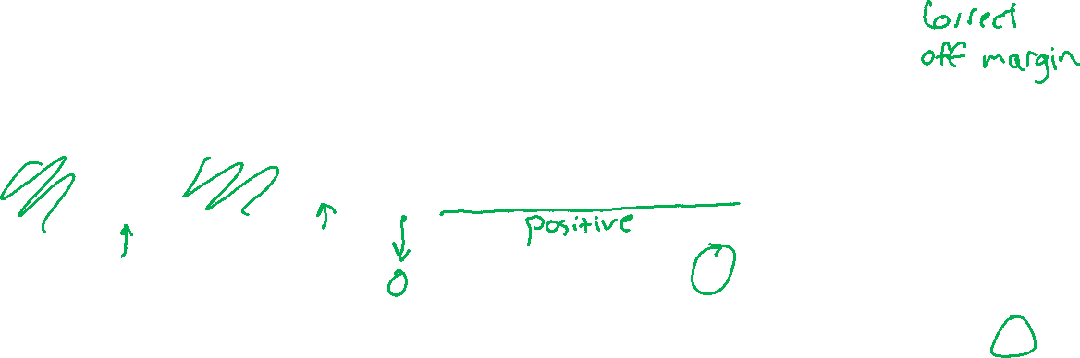
Dual SVM: Sparsity of dual solution
w^{T}x + b =1
$\min_{w,b}{\max_{α≥0}{ ℒ\left(w, b, α\right)}}$
$\min_{w,b}{\max_{α≥0}{ \frac{1}{2}w^{T}w −\sum_{i}^{N}{α_{i}[} y^{\left(i\right)}\left(w^{T}x^{\left(i\right)}+b\right)−1] }}$

Slide 29
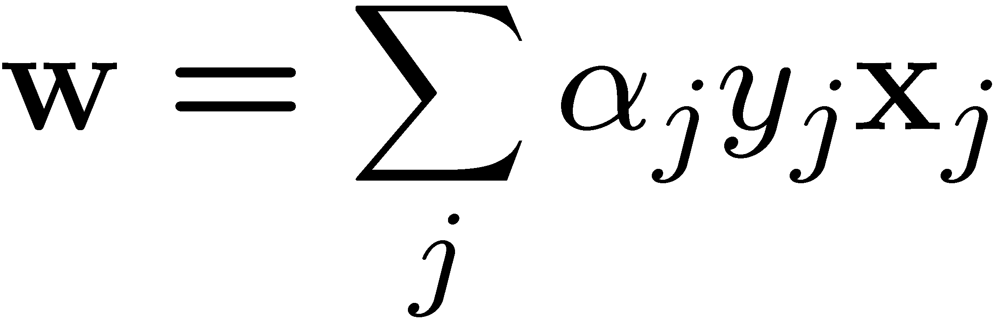
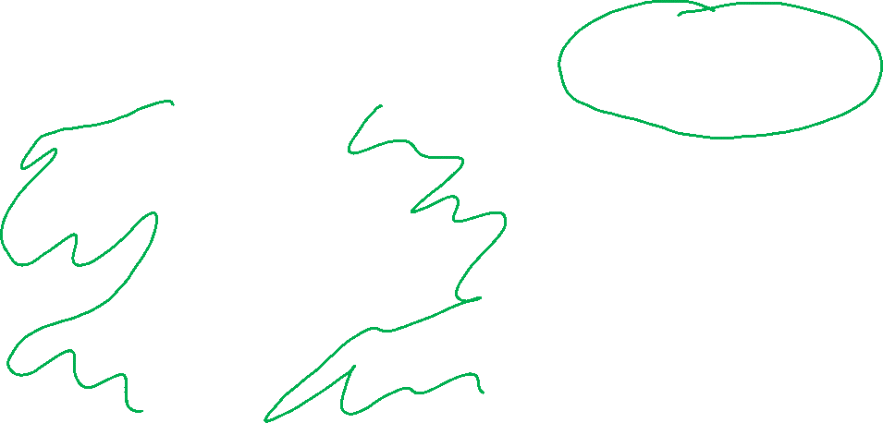
Dual SVM: Sparsity of dual solution
α_{j} = 0
α_{j} > 0
α_{j} = 0
Only few α_{j}s can be non-zero : where constraint is active and tight
(w.x_{j} + b)y_{j} = 1
Support vectors – training points j whose α_{j}s are non-zero
w.x + b = 0
α_{j} > 0
α_{j} > 0
α_{j} = 0
Slide credit: CMU MLD Aarti Singh

Slide 30
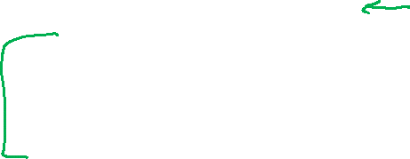
Support Vector Machines
Next steps
Different optimization formulation
    Primal → dual
    “Support vectors”
Support non-linear classification
    Feature maps
    Kernel trick
Support non-separable data
    Hard-margin SVM → soft-margin SVM

Slide 31
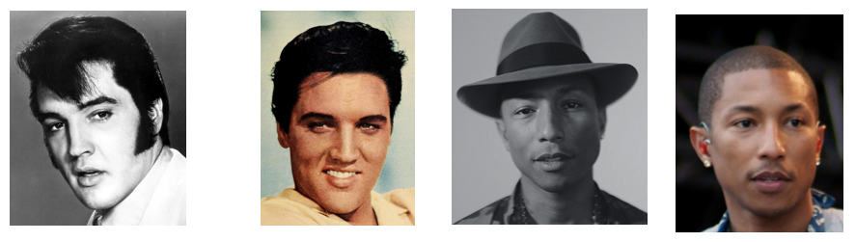
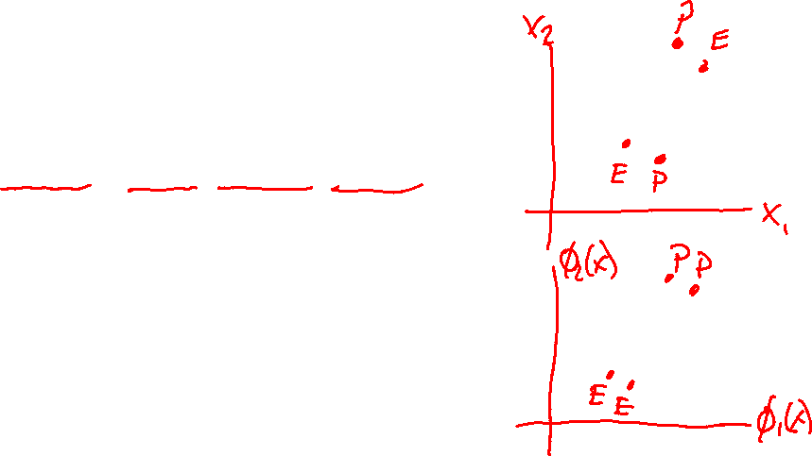
Kernels: Motivation
Most real-world problems exhibit data that is not linearly separable.
Example: pixel representation for Facial Recognition:
Q:
When your data is not linearly separable, how can you still use a linear classifier?
A:
Preprocess the data to produce nonlinear features

Slide 32
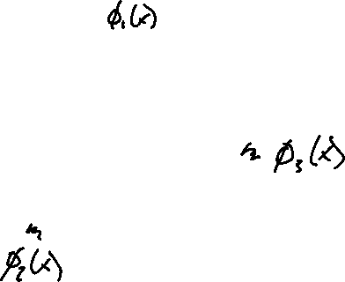
Example: Polynomial Kernel
https://www.youtube.com/watch?v=3liCbRZPrZA
Slide credit: CMU MLD Nina Balcan

Slide 33
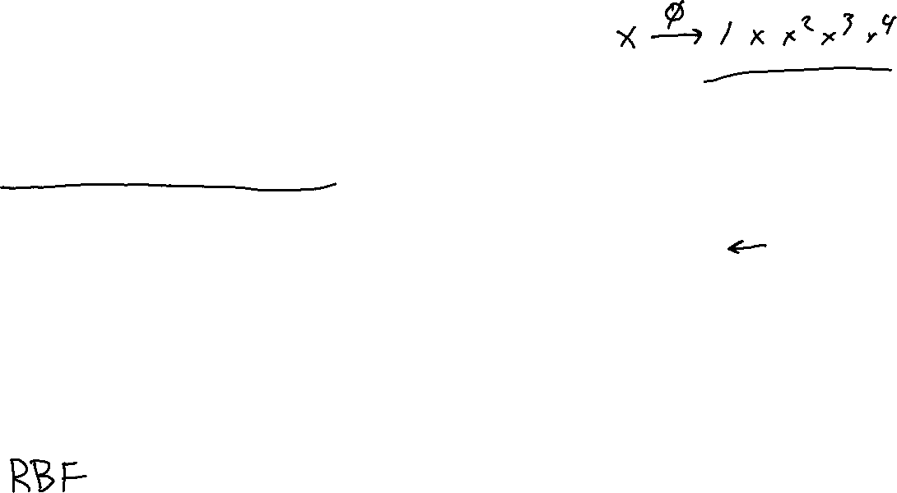
Kernels: Motivation
Motivation #1: Inefficient Features
  Non-linearly separable data requires high dimensional representation
  Might be prohibitively expensive to compute or store
Motivation #2: Memory-based Methods
  k-Nearest Neighbors (KNN) for facial recognition allows a distance metric between images -- no need to worry about linearity restriction at all

Slide 34
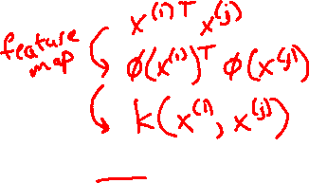
Kernel Methods
Key idea:
  Rewrite the algorithm so that we only work with dot products x^{T}z of feature vectors
  Replace the dot products x^{T}z with a kernel function k(x, z)
The kernel k(x,z) can be any legal definition of a dot product:
k(x, z) = φ(x) ^{T}φ(z) for any function φ: X → R^{D}
So we only compute the φ dot product implicitly
This “kernel trick” can be applied to many algorithms:
  classification: perceptron, SVM, …
  regression: ridge regression, …
  clustering: k-means, …

Slide 35

SVM: Kernel Trick
Hard-margin SVM (Primal)
Hard-margin SVM (Lagrangian Dual)
Suppose we do some feature engineering
Our feature function is ɸ
We apply ɸ to each input vector x
Slide credit: CMU MLD Matt Gormley

Slide 36
SVM: Kernel Trick
Hard-margin SVM (Lagrangian Dual)
Slide credit: CMU MLD Matt Gormley
We could replace the dot product of the two feature vectors in the transformed space with a function k(x,z)

Slide 37
SVM: Kernel Trick
Hard-margin SVM (Lagrangian Dual)
Slide credit: CMU MLD Matt Gormley
We could replace the dot product of the two feature vectors in the transformed space with a function k(x,z)

Slide 38

Kernel Methods
Key idea:
  Rewrite the algorithm so that we only work with dot products x^{T}z of feature vectors
  Replace the dot products x^{T}z with a kernel function k(x, z)
The kernel k(x,z) can be any legal definition of a dot product:
k(x, z) = φ(x) ^{T}φ(z) for any function φ: X → R^{D}
So we only compute the φ dot product implicitly
This “kernel trick” can be applied to many algorithms:
  classification: perceptron, SVM, …
  regression: ridge regression, …
  clustering: k-means, …

Slide 39
Kernel Methods
Q:
These are just non-linear features, right?
A:
Yes, but…
Q:
Can’t we just compute the feature transformation φ explicitly?
A:
That depends...
Slide credit: CMU MLD Matt Gormley
Q:
So, why all the hype about the kernel trick?
A:
Because the explicit features might either be prohibitively expensive to compute or infinite length vectors

Slide 40

Example: Polynomial Kernel
Slide credit: CMU MLD Nina Balcan

Slide 41

Kernel Examples
Side Note: The feature space might not be unique!
Explicit representation #1:
Explicit representation #2:
These two different feature representations correspond to the same kernel function!
Slide credit: CMU MLD Nina Balcan

Slide 42

Kernel Examples
Name | Kernel Function (implicit dot product) | Feature Space (explicit dot product)
Linear |  | Same as original input space
Polynomial (v1) |  | All polynomials of degree d
Polynomial (v2) |  | All polynomials up to degree d
Gaussian (RBF) |  | Infinite dimensional space
Hyperbolic Tangent (Sigmoid) Kernel |  | (With SVM, this is equivalent to a 2-layer neural network)
Slide credit: CMU MLD Matt Gormley

Slide 43
Kernels: Mercer’s Theorem
What functions are valid kernels that correspond to feature vectors ϕ(x)?
Answer: Mercer kernels for k(x, z) and
matrix K, where K_{i,j} = k(x^{(i)}, x^{(j)})
k(x, z) is continuous
K is symmetric
K is positive semi-definite, i.e. z^{T}Kz ≥ 0 for all z
Slide credit: CMU MLD Aarti Singh

Slide 44




SVMs with Kernels
Choose a set of features and kernel function
Solve dual problem to obtain support vectors α_{i}
At classification time, compute:
Classify as
Slide credit: CMU MLD Aarti Singh

Slide 45

RBF Kernel Example
Slide credit: CMU MLD Matt Gormley
RBF Kernel:

Slide 46
RBF Kernel Example
Slide credit: CMU MLD Matt Gormley
RBF Kernel:

Slide 47
RBF Kernel Example
Slide credit: CMU MLD Matt Gormley
RBF Kernel:

Slide 48
RBF Kernel Example
Slide credit: CMU MLD Matt Gormley
RBF Kernel:

Slide 49
RBF Kernel Example
Slide credit: CMU MLD Matt Gormley
RBF Kernel:

Slide 50
RBF Kernel Example
Slide credit: CMU MLD Matt Gormley
RBF Kernel:

Slide 51
RBF Kernel Example
Slide credit: CMU MLD Matt Gormley
RBF Kernel:

Slide 52
RBF Kernel Example
Slide credit: CMU MLD Matt Gormley
RBF Kernel:

Slide 53
RBF Kernel Example
Slide credit: CMU MLD Matt Gormley
RBF Kernel:

Slide 54
RBF Kernel Example
Slide credit: CMU MLD Matt Gormley
RBF Kernel:

Slide 55
RBF Kernel Example
Slide credit: CMU MLD Matt Gormley
RBF Kernel:

Slide 56

RBF Kernel Example
Slide credit: CMU MLD Matt Gormley
RBF Kernel:

Slide 57
RBF Kernel Example
KNN vs. SVM
Slide credit: CMU MLD Matt Gormley
RBF Kernel:

Slide 58
RBF Kernel Example
KNN vs. SVM
Slide credit: CMU MLD Matt Gormley
RBF Kernel:

Slide 59
RBF Kernel Example
KNN vs. SVM
Slide credit: CMU MLD Matt Gormley
RBF Kernel:

Slide 60
RBF Kernel Example
KNN vs. SVM
Slide credit: CMU MLD Matt Gormley
RBF Kernel:

Slide 61
Kernel Methods
Key idea:
  Rewrite the algorithm so that we only work with dot products x^{T}z of feature vectors
  Replace the dot products x^{T}z with a kernel function k(x, z)
The kernel k(x,z) can be any legal definition of a dot product:
k(x, z) = φ(x) ^{T}φ(z) for any function φ: X → R^{D}
So we only compute the φ dot product implicitly
This “kernel trick” can be applied to many algorithms:
  classification: perceptron, SVM, …
  regression: ridge regression, …
  clustering: k-means, …
Slide credit: CMU MLD Matt Gormley

Slide 62
SVM + Kernels: Takeaways
Maximizing the margin of a linear separator is a good training criteria
Support Vector Machines (SVMs) learn a max-margin linear classifier
The SVM optimization problem can be solved with black-box Quadratic Programming (QP) solvers
Learned decision boundary is defined by its support vectors
Kernel methods allow us to work in a transformed feature space without explicitly representing that space
The kernel-trick can be applied to SVMs, as well as many other algorithms
Slide credit: CMU MLD Matt Gormley

Slide 63

Support Vector Machines
Next steps
Different optimization formulation
    Primal → dual
    “Support vectors”
Support non-linear classification
    Feature maps
    Kernel trick
Support non-separable data
    Hard-margin SVM → soft-margin SVM

Slide 64
Support Vector Machines (SVMs)
Hard-margin SVM (Primal)
Hard-margin SVM (Lagrangian Dual)
Instead of minimizing the primal, we can maximize the dual problem
For the SVM, these two problems give the same answer (i.e. the minimum of one is the maximum of the other)
Definition: support vectors are those points x^{(i)} for which α^{(i)} ≠ 0
Slide credit: CMU MLD Matt Gormley

Slide 65

Soft-Margin SVM
w^{T}x + b =1
Hard-margin SVM (Primal)
Soft-margin SVM (Primal)
Slide credit: CMU MLD Matt Gormley

Slide 66

Soft-Margin SVM
Hard-margin SVM (Primal)
Hard-margin SVM (Lagrangian Dual)
Soft-margin SVM (Primal)
Soft-margin SVM (Lagrangian Dual)
Slide credit: CMU MLD Matt Gormley
We can also work with the dual of the soft-margin SVM

