Slide 1

As you login
Rename yourself in Zoom to *pre*-pend your house number
e.g. “0 – Pat Virtue”
Open Piazza (getting ready for polls)
Download preview slides from course website
Grab something to write with/on ☺

Slide 2
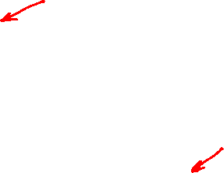
Announcements
Assignments
HW1 Feedback
HW2
Due Mon, 9/21, 11:59 pm
Mostly programming
Written component in LaTeX
Don’t delay on this on. OH will be *super* crowded as the deadline gets closer
Feeling behind already?
Ask for help now

Slide 3

Introduction to Machine Learning Decision Trees and Nearest Neighbor
Instructor: Pat Virtue

Slide 4
Plan
Last time
Decision trees
Recursive algorithm
Better splitting criteria (entropy, mutual information)
Today
Decision trees
Continuous features
Overfitting
Nearest neighbor methods
Next time
More nearest neighbor and model selection

Slide 5
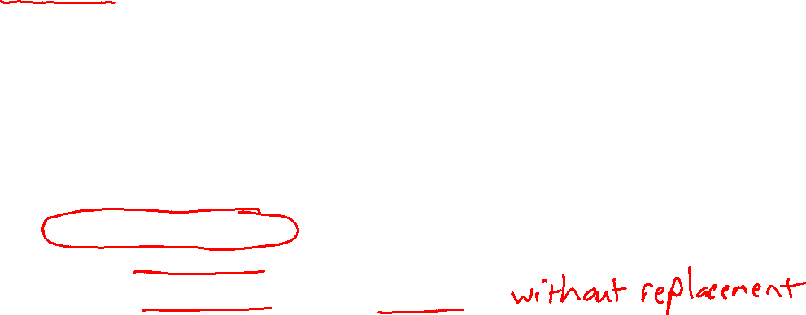
Building a Decision Tree
Function BuildTree(D,A)
# D: dataset at current node, A: current set of attributes
If empty(A) or all labels in D are the same
# Leaf node
class = most common class in D
else
# Internal node
a ⇐ bestAttribute(D,A)
LeftNode = BuildTree(D(a=1), A \ {a})
RightNode = BuildTree(D(a=0), A \ {a})
end
end

Slide 6
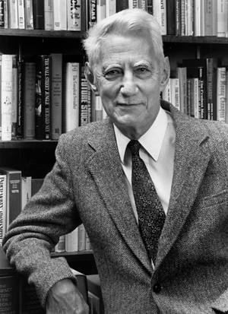
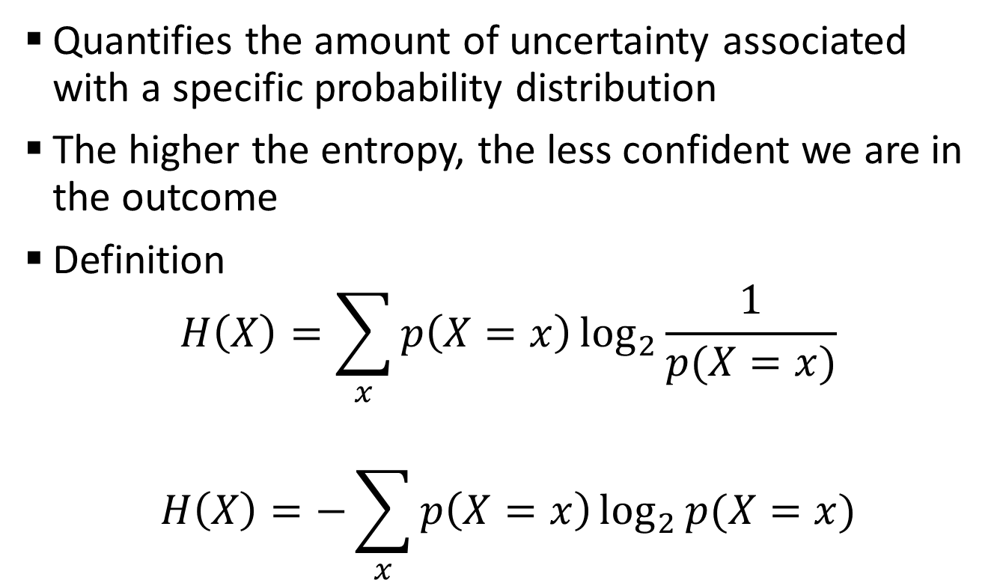
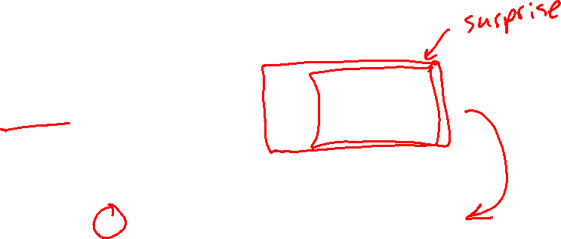
Entropy
Quantifies the amount of uncertainty associated with a specific probability distribution
The higher the entropy, the less confident we are in the outcome
Definition
$$H\left(X\right)=\sum_{x}{p\left(X=x\right)\log_{2}{\frac{1}{p(X=x)}}}$$
$$H\left(X\right)=−\sum_{x}{p\left(X=x\right)\log_{2}{p(X=x)}}$$
Claude Shannon (1916 – 2001), most of the work was done in Bell labs

Slide 7
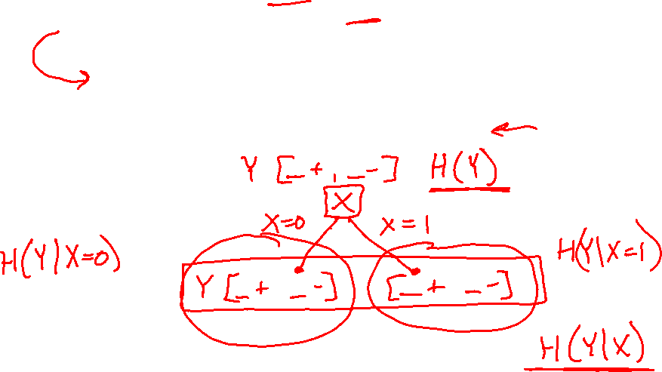
Mutual Information
Slide credit: CMU MLD Matt Gormley
Notes:
In the preamble: \usepackage[fleqn]{amsmath}
Entropy:
\begin{align*} H(Y) = - \sum_{y \in \Yc} P(Y=y) \log_2 P(Y=y) \end{align*}
Specific Conditional Entropy:
\begin{align*} H(Y \mid X=x) = - \sum_{y \in \Yc} P(Y=y \mid X=x) \log_2 P(Y=y \mid X=x) \end{align*}
Conditional Entropy:
\begin{align*} H(Y \mid X) = \sum_{x \in \Xc} P(X=x) H(Y \mid X=x) \end{align*}
Mutual Information:
\begin{align*} I(Y; X) = H(Y) - H(Y|X) = H(X) - H(X|Y) \end{align*}

Slide 8
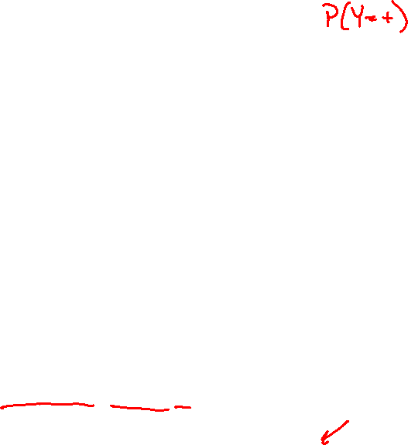
Mutual Information
Slide credit: CMU MLD Matt Gormley
For a decision tree, we can use mutual information of the output class Y and some attribute X on which to split as a splitting criterion
Given a dataset D of training examples, we can estimate the required probabilities as…
Notes:
In the preamble: \usepackage[fleqn]{amsmath}
Entropy:
\begin{align*} H(Y) = - \sum_{y \in \Yc} P(Y=y) \log_2 P(Y=y) \end{align*}
Specific Conditional Entropy:
\begin{align*} H(Y \mid X=x) = - \sum_{y \in \Yc} P(Y=y \mid X=x) \log_2 P(Y=y \mid X=x) \end{align*}
Conditional Entropy:
\begin{align*} H(Y \mid X) = \sum_{x \in \Xc} P(X=x) H(Y \mid X=x) \end{align*}
Mutual Information:
\begin{align*} I(Y; X) = H(Y) - H(Y|X) = H(X) - H(X|Y) \end{align*}

Slide 9
Mutual Information
Entropy measures the expected # of bits to code one random draw from X.
For a decision tree, we want to reduce the entropy of the random variable we are trying to predict!
Slide credit: CMU MLD Matt Gormley
For a decision tree, we can use mutual information of the output class Y and some attribute X on which to split as a splitting criterion
Given a dataset D of training examples, we can estimate the required probabilities as…
Conditional entropy is the expected value of specific conditional entropy E_{P(X=x)}[H(Y | X = x)]
Informally, we say that mutual information is a measure of the following: If we know X, how much does this reduce our uncertainty about Y?
Notes:
In the preamble: \usepackage[fleqn]{amsmath}
Entropy:
\begin{align*} H(Y) = - \sum_{y \in \Yc} P(Y=y) \log_2 P(Y=y) \end{align*}
Specific Conditional Entropy:
\begin{align*} H(Y \mid X=x) = - \sum_{y \in \Yc} P(Y=y \mid X=x) \log_2 P(Y=y \mid X=x) \end{align*}
Conditional Entropy:
\begin{align*} H(Y \mid X) = \sum_{x \in \Xc} P(X=x) H(Y \mid X=x) \end{align*}
Mutual Information:
\begin{align*} I(Y; X) = H(Y) - H(Y|X) = H(X) - H(X|Y) \end{align*}

Slide 10
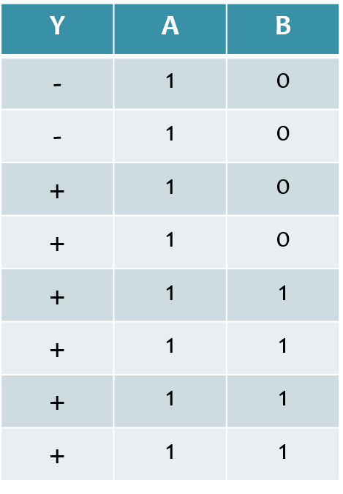
Splitting with Mutual Information
Which attribute {A, B} would mutual information select for the next split?
A
B
A or B (tie)
I don’t know
Dataset: Output Y, Attributes A and B

Slide 11
Decision Tree Learning Example
Y | A | B
- | 1 | 0
- | 1 | 0
+ | 1 | 0
+ | 1 | 0
+ | 1 | 1
+ | 1 | 1
+ | 1 | 1
+ | 1 | 1
Slide credit: CMU MLD Matt Gormley

Slide 12
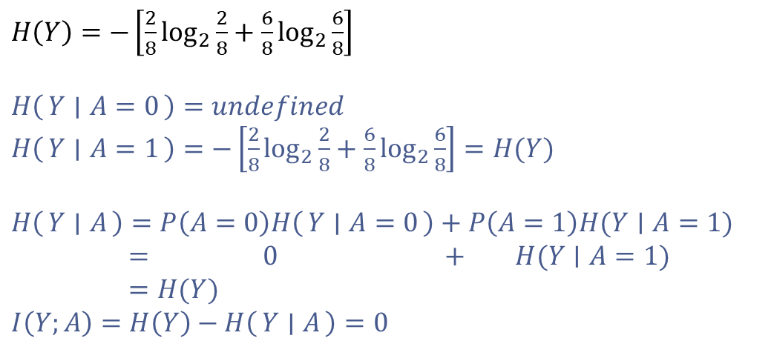
Decision Tree Learning Example
Y | A | B
- | 1 | 0
- | 1 | 0
+ | 1 | 0
+ | 1 | 0
+ | 1 | 1
+ | 1 | 1
+ | 1 | 1
+ | 1 | 1
$H\left(Y\right)=−\left[\frac{2}{8}\log_{2}{\frac{2}{8}}+\frac{6}{8}\log_{2}{\frac{6}{8}}\right]$
$H\left(Y ∣ A=0\right)=undefined$
$H\left(Y ∣ A=1\right)=−\left[\frac{2}{8}\log_{2}{\frac{2}{8}}+\frac{6}{8}\log_{2}{\frac{6}{8}}\right]=H(Y)$
$H\left(Y ∣ A\right)=P\left(A=0\right)H\left(Y ∣ A=0\right)+P\left(A=1\right)H(Y∣A=1)$
$= 0 + H(Y∣A=1)$
$=H(Y)$
$I\left(Y;A\right)=H\left(Y\right)−H\left(Y ∣ A\right)=0$
[2-, 6+]
A
A=0
A=1
[0-, 0+]
P(A=0) = 0
[2-, 6+]
P(A=1)=1
Slide credit: CMU MLD Matt Gormley

Slide 13
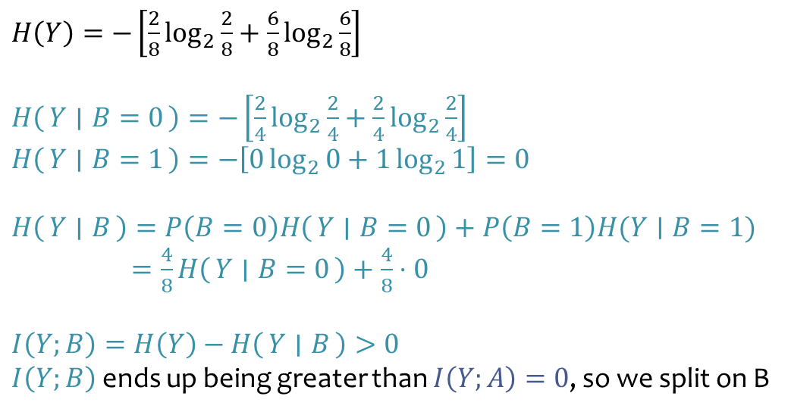
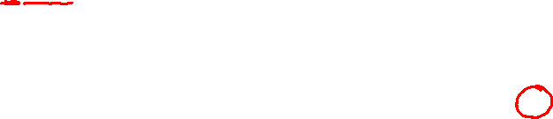
Decision Tree Learning Example
Y | A | B
- | 1 | 0
- | 1 | 0
+ | 1 | 0
+ | 1 | 0
+ | 1 | 1
+ | 1 | 1
+ | 1 | 1
+ | 1 | 1
$H\left(Y\right)=−\left[\frac{2}{8}\log_{2}{\frac{2}{8}}+\frac{6}{8}\log_{2}{\frac{6}{8}}\right]$
$H\left(Y ∣ B=0\right)=−\left[\frac{2}{4}\log_{2}{\frac{2}{4}}+\frac{2}{4}\log_{2}{\frac{2}{4}}\right]$
$H\left(Y ∣ B=1\right)=−\left[0\log_{2}{0}+1\log_{2}{1}\right]=0$
$H\left(Y ∣ B\right)=P\left(B=0\right)H\left(Y ∣ B=0\right)+P\left(B=1\right)H(Y∣B=1)$
$=\frac{4}{8}H\left(Y ∣ B=0\right)+\frac{4}{8}⋅0$
$I\left(Y;B\right)=H\left(Y\right)−H\left(Y ∣ B\right)>0$ $I\left(Y;B\right)$ ends up being greater than $I\left(Y;A\right)=0$, so we split on B
[2-, 6+]
B
B=0
B=1
[2-, 2+]
P(B=0)=4/8
[0-, 4+]
P(B=1)=4/8
Slide credit: CMU MLD Matt Gormley

Slide 14
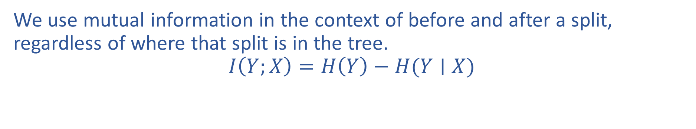
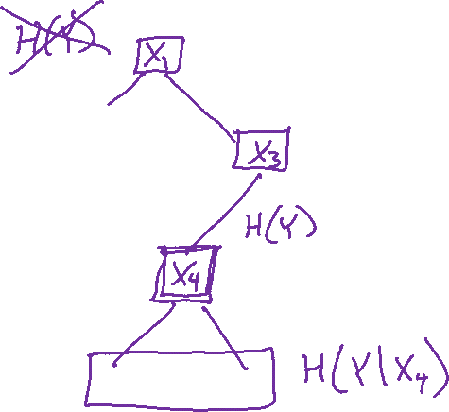
Mutual Information Notation
We use mutual information in the context of before and after a split, regardless of where that split is in the tree.
$$I\left(Y;X\right)=H\left(Y\right)−H(Y∣X)$$

Slide 15
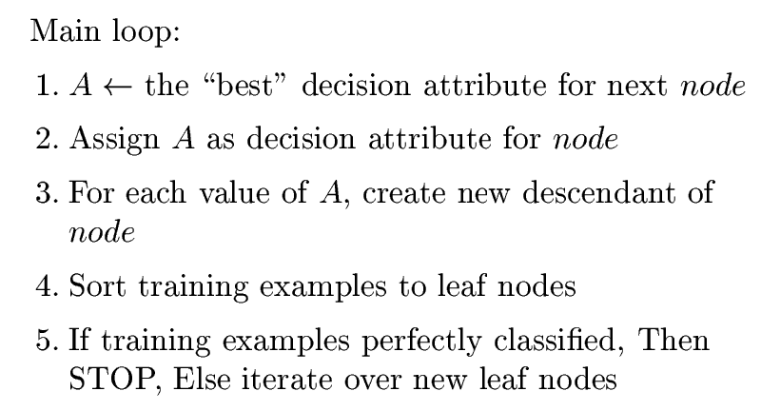
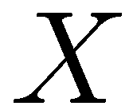
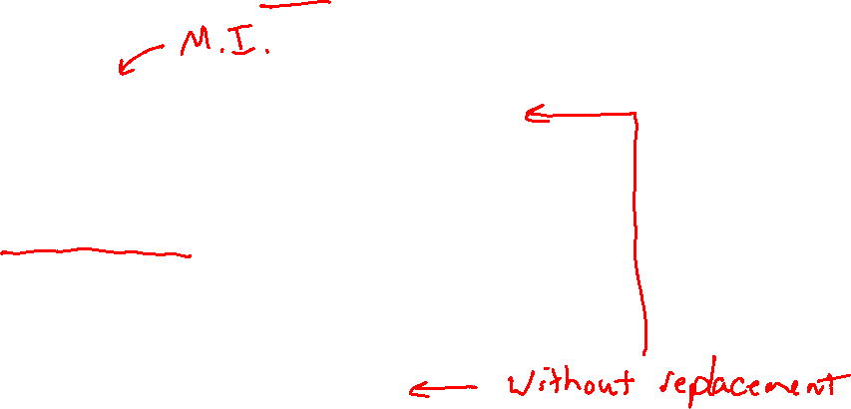
How to learn a decision tree
Top-down induction [ID3]
(Discrete features)
(steps 1-5) after removing current feature
6. When all features exhausted, assign majority label to the leaf node
Slide credit: CMU MLD Aarti Singh

Slide 16
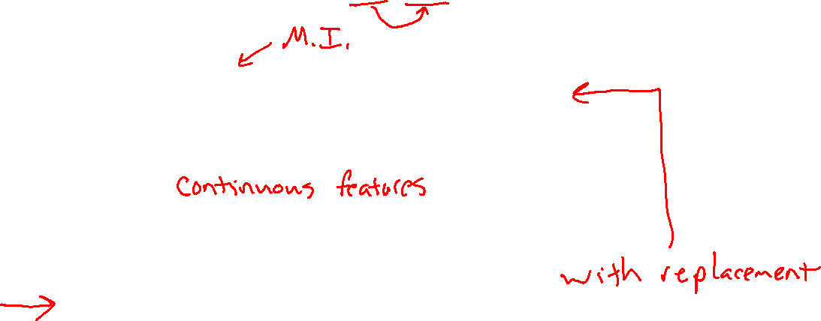
How to learn a decision tree
Top-down induction [ID3, C4.5, C5, …]
C4.5
6. Prune back tree to reduce overfitting
7. Assign majority label to the leaf node
Slide credit: CMU MLD Aarti Singh

Slide 17
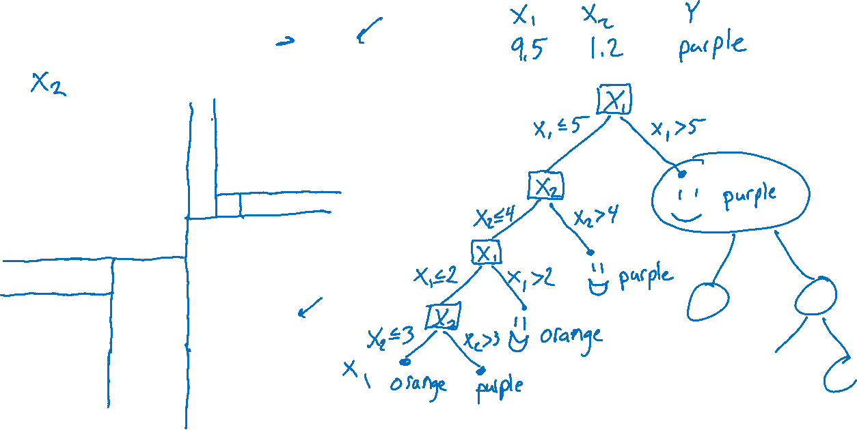
Continuous Features
Consider input features $x∈ℝ^{2}$
10
5
5
10

Slide 18
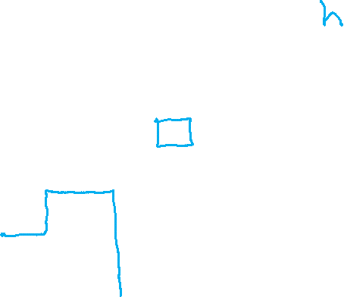
Generalization
Generalization: Ability to perform well on unseen data
10
5
5
10

Slide 19
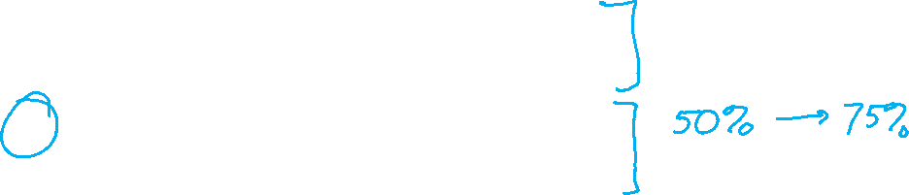
Piazza Poll 1
Decision tree generalization
Which of the following generalize best to unseen examples?
Small tree with low training accuracy
Large tree with low training accuracy
Small tree with high training accuracy
Large tree with high training accuracy

Slide 20
Piazza Poll 1
Decision tree generalization
Which of the following generalize best to unseen examples?
Small tree with low training accuracy
Large tree with low training accuracy
Small tree with high training accuracy
Large tree with high training accuracy

Slide 21
Overfitting and Underfitting
Underfitting
Overfitting
The model…
is too simple
is unable captures the trends in the data
exhibits too much bias
Example: majority-vote classifier (i.e. depth-zero decision tree)
Example: a toddler (that has not attended medical school) attempting to carry out medical diagnosis
The model…
is too complex
is fitting the noise in the data
or fitting random statistical fluctuations inherent in the “sample” of training data
Example: our “memorizer” algorithm responding to an “orange shirt” attribute
Example: medical student who simply memorizes patient case studies, but does not understand how to apply knowledge to new patients
Slide credit: CMU MLD Matt Gormley

Slide 22
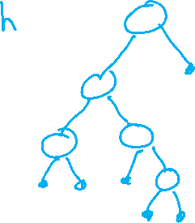
Overfitting
Consider a hypothesis h its…
…error rate over all training data: error(h, D_{train})
…error rate over all test data: error(h, D_{test})
…true error over all data: error_{true}(h)
We say h overfits the training data if…
Amount of overfitting =
error_{true}(h) > error(h, D_{train})
In practice, error_{true}(h) is unknown
error_{true}(h) – error(h, D_{train})
Slide credit: CMU MLD Tom Mitchell, Matt Gormley

Slide 23
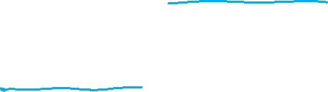
Overfitting
Consider a hypothesis h its…
…error rate over all training data: error(h, D_{train})
…error rate over all test data: error(h, D_{test})
…true error over all data: error_{true}(h)
We say h overfits the training data if…
Amount of overfitting =
In practice, error_{true}(h) is unknown
error_{true}(h) > error(h, D_{train})
error_{true}(h) – error(h, D_{train})
Slide credit: CMU MLD Tom Mitchell, Matt Gormley

Slide 24
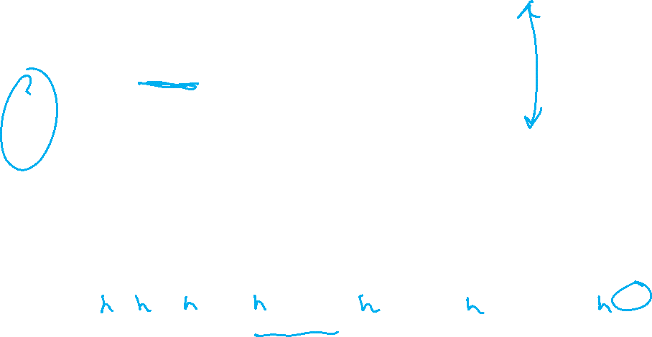
Overfitting in Decision Tree Learning
Figure from Tom Mitchell
Notes:
TODO: Mention underfitting here as well.

Slide 25
How to Avoid Overfitting?
Many strategies for picking simpler trees:
Fixed depth (e.g. ID3)
Fixed number of leaves
Mutual information threshold
Grow entire tree then prune
Slide credit: CMU MLD Aarti Singh

Slide 26
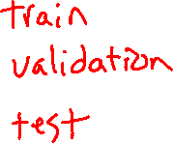
Slide from Tom Mitchell

Slide 27
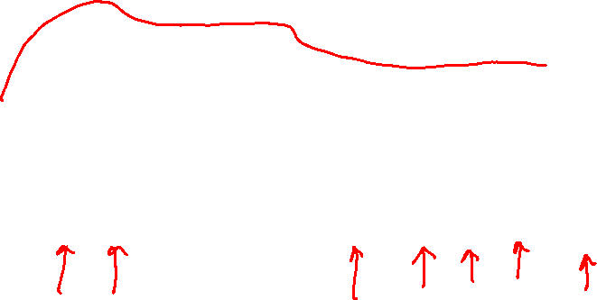
Slide from Tom Mitchell

Slide 28
IMPORTANT!
Later, we’ll learn that doing pruning on test data is the wrong thing to do.
Instead, use a third “validation” dataset.
Slide from Tom Mitchell

Slide 29

Inductive Bias
ID3 = Decision Tree Learning with Mutual Information and choosing attributes without replacement
Question: How does an ID3 tree generalize?
Definition:
We say that the inductive bias of a machine learning algorithm is the principal by which it generalizes to unseen examples
Inductive Bias of ID3:
Smallest tree that matches the data with high mutual information attributes near the top
Slide credit: CMU MLD Matt Gormley
Occam’s Razor: (restated for ML)
Prefer the simplest hypothesis that explains the data

Slide 30
Decision Trees (DTs) in the Wild
DTs are one of the most popular classification methods for practical applications
Reason #1: The learned representation is easy to explain a non-ML person
Reason #2: They are efficient in both computation and memory
DTs can be applied to a wide variety of problems including classification, regression, density estimation, etc.
Applications of DTs include…
medicine, molecular biology, text classification, manufacturing, astronomy, agriculture, and many others
Decision Forests learn many DTs from random subsets of features; the result is a very powerful example of an ensemble method (discussed later in the course)
Slide credit: CMU MLD Matt Gormley

Slide 31
DT Learning Objectives
You should be able to…
Implement Decision Tree training and prediction
Use effective splitting criteria for Decision Trees and be able to define entropy, conditional entropy, and mutual information
Explain the difference between memorization and generalization
Describe the inductive bias of a decision tree
Formalize a learning problem by identifying the input space, output space, hypothesis space
Explain the difference between true error and training error
Judge whether a decision tree is "underfitting" or "overfitting"
Implement a pruning or early stopping method to combat overfitting in Decision Tree learning

Slide 32
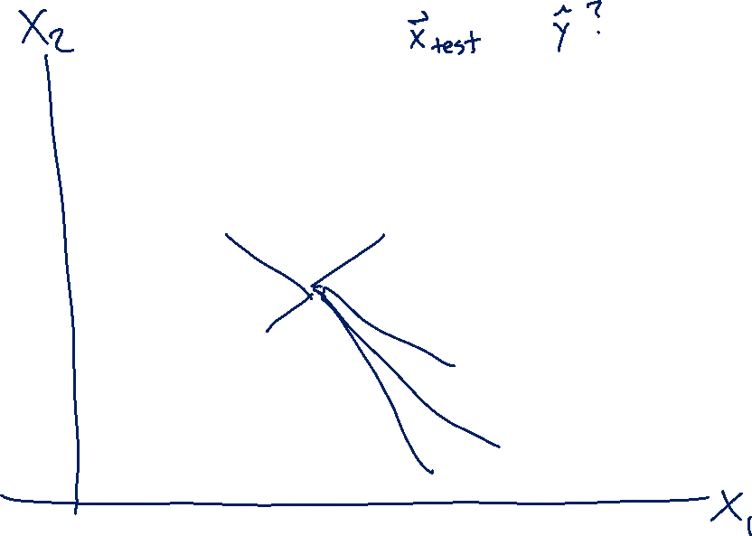
Nearest Neighbor Classifier
Test subject
Whales
Seals
Sharks

Slide 33
Nearest Neighbor Classifier
Test subject
Whales
Seals
Sharks

Slide 34
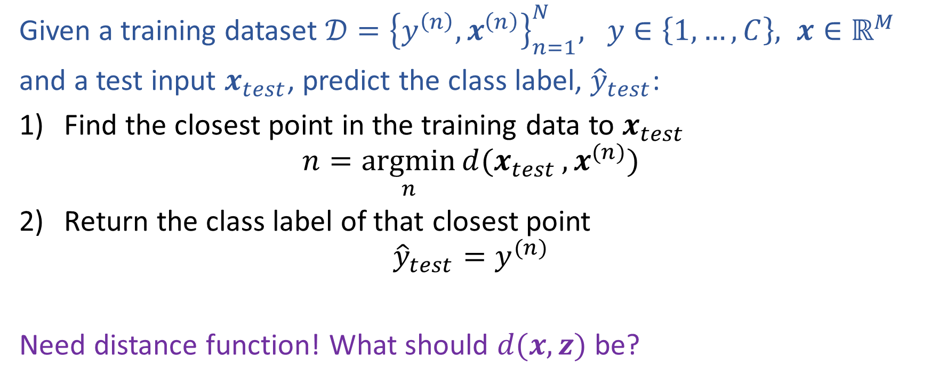
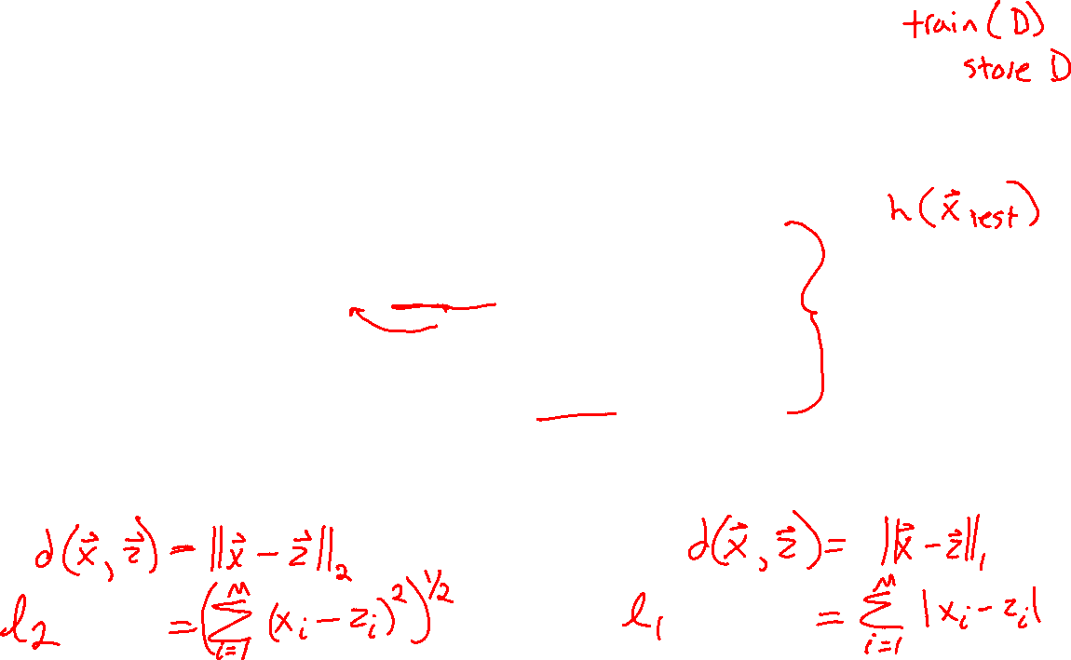
Nearest Neighbor Classification
Given a training dataset $𝒟={\left\{y^{\left(n\right)}, x^{\left(n\right)}\right\}}_{n=1}^{N}, y∈\left\{1,…,C\right\}, x∈ℝ^{M}$
and a test input $x_{test}$, predict the class label, ${\hat{y}}_{test}$:
Find the closest point in the training data to $x_{test}$
$$n=\underset{n}{argmin}{d(x_{test}}, x^{(n)})$$
Return the class label of that closest point
$${\hat{y}}_{test}=y^{(n)}$$
Need distance function! What should $d(x, z)$ be?

Slide 35
Fisher Iris Dataset
Fisher (1936) used 150 measurements of flowers from 3 different species: Iris setosa (0), Iris virginica (1), Iris versicolor (2) collected by Anderson (1936)
Species | Sepal Length | Sepal Width | Petal Length | Petal Width
0 | 4.3 | 3.0 | 1.1 | 0.1
0 | 4.9 | 3.6 | 1.4 | 0.1
0 | 5.3 | 3.7 | 1.5 | 0.2
1 | 4.9 | 2.4 | 3.3 | 1.0
1 | 5.7 | 2.8 | 4.1 | 1.3
1 | 6.3 | 3.3 | 4.7 | 1.6
1 | 6.7 | 3.0 | 5.0 | 1.7
Full dataset: https://en.wikipedia.org/wiki/Iris_flower_data_set

Slide 36
Fisher Iris Dataset
Fisher (1936) used 150 measurements of flowers from 3 different species: Iris setosa (0), Iris virginica (1), Iris versicolor (2) collected by Anderson (1936)
Species | Sepal Length | Sepal Width
0 | 4.3 | 3.0
0 | 4.9 | 3.6
0 | 5.3 | 3.7
1 | 4.9 | 2.4
1 | 5.7 | 2.8
1 | 6.3 | 3.3
1 | 6.7 | 3.0
Deleted two of the four features, so that input space is 2D
Full dataset: https://en.wikipedia.org/wiki/Iris_flower_data_set

Slide 37
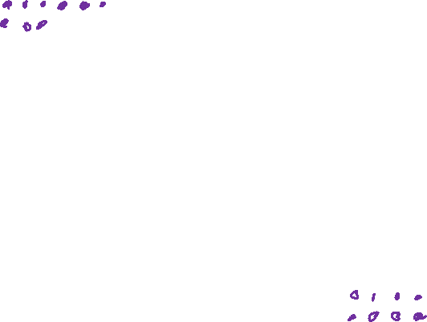
Nearest Neighbor on Fisher Iris Data
Slide credit: CMU MLD Matt Gormley

Slide 38
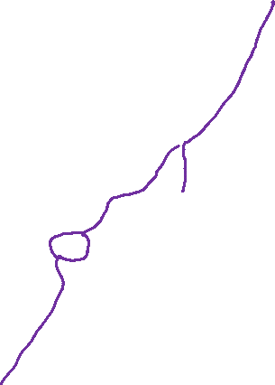
Nearest Neighbor on Fisher Iris Data
Slide credit: CMU MLD Matt Gormley

Slide 39
Nearest Neighbor on Gaussian Data
Slide credit: CMU MLD Matt Gormley

Slide 40
Nearest Neighbor on Gaussian Data
Slide credit: CMU MLD Matt Gormley

Slide 41
kNN classifier (k=5)
Test document
Whales
Seals
Sharks

Slide 42

Nearest Neighbor Classification
Given a training dataset $𝒟={\left\{y^{\left(n\right)}, x^{\left(n\right)}\right\}}_{n=1}^{N}, y∈\left\{1,…,C\right\}, x∈ℝ^{M}$
and a test input $x_{test}$, predict the class label, ${\hat{y}}_{test}$:
Find the closest point in the training data to $x_{test}$
$$n=\underset{n}{argmin}{d(x_{test}}, x^{(n)})$$
Return the class label of that closest point
$${\hat{y}}_{test}=y^{(n)}$$
Need distance function! What should $d(x, z)$ be?

Slide 43
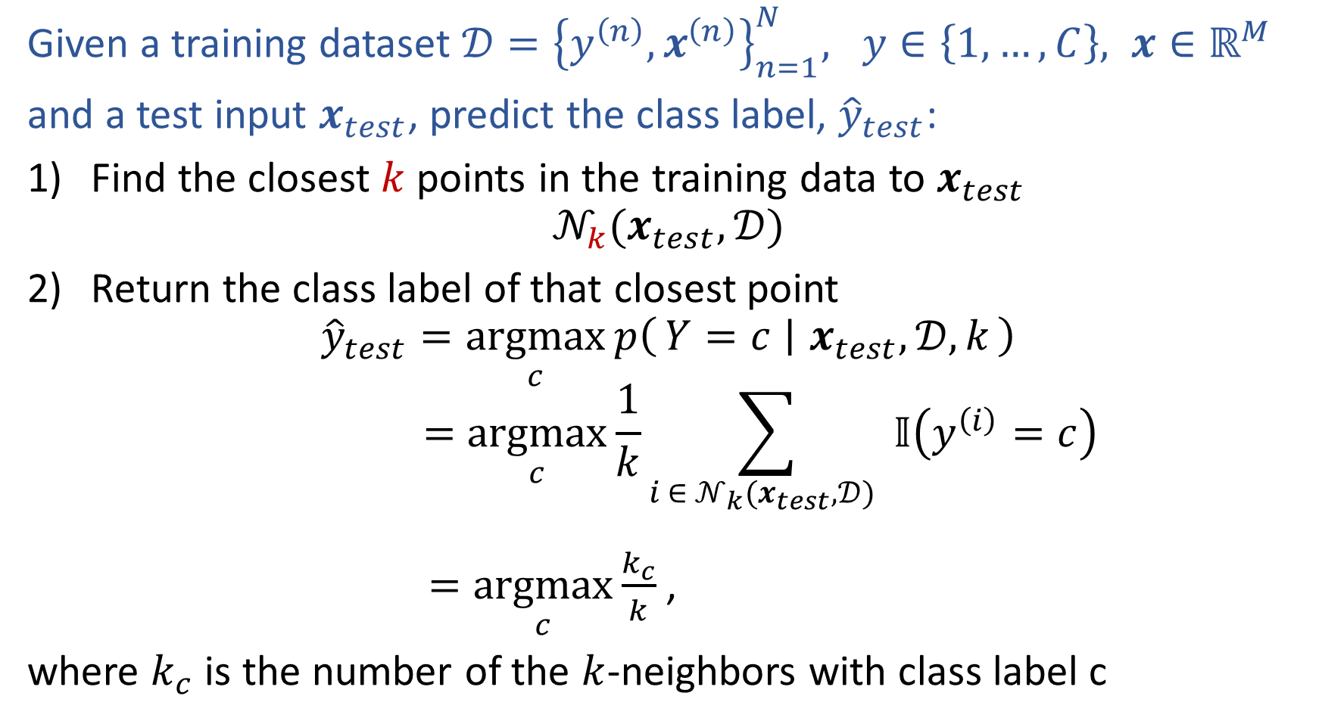
k-Nearest Neighbor Classification
Given a training dataset $𝒟={\left\{y^{\left(n\right)}, x^{\left(n\right)}\right\}}_{n=1}^{N}, y∈\left\{1,…,C\right\}, x∈ℝ^{M}$
and a test input $x_{test}$, predict the class label, ${\hat{y}}_{test}$:
Find the closest $k$ points in the training data to $x_{test}$
$$𝒩_{k}(x_{test},𝒟)$$
Return the class label of that closest point
$${\hat{y}}_{test}=\underset{c}{argmax}{p\left(Y=c ∣ x_{test},𝒟, k\right)}$$
$$=\underset{c}{argmax}{\frac{1}{k}\sum_{i ∈ 𝒩_{k}(x_{test},𝒟) }{𝕀\left(y^{\left(i\right)}=c\right)}}$$
$=\underset{c}{argmax}{\frac{k_{c}}{k}}$,
where $k_{c}$ is the number of the $k$-neighbors with class label c

Slide 44
1-Nearest Neighbor (kNN) classifier
Sports
Science
Arts

Slide 45
2-Nearest Neighbor (kNN) classifier
Sports
Science
Arts

Slide 46
3-Nearest Neighbor (kNN) classifier
Sports
Science
Arts

Slide 47
5-Nearest Neighbor (kNN) classifier
Sports
Science
Arts

Slide 48
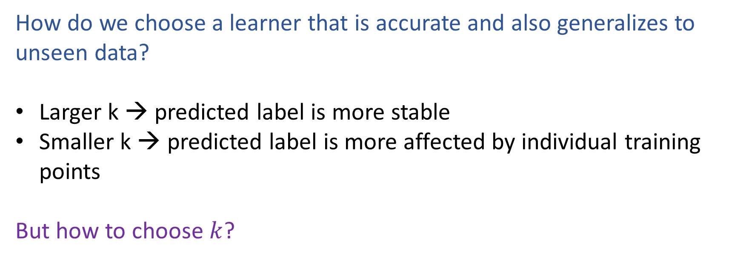
What is the best k?
How do we choose a learner that is accurate and also generalizes to unseen data?
Larger k → predicted label is more stable
Smaller k → predicted label is more affected by individual training points
But how to choose $k$?

