Slide 1
Demystifying AI Neural Networks
Instructor: Pat Virtue

Slide 2
Warm-up Exercise: Plotting Functions
Paper handout

Slide 3
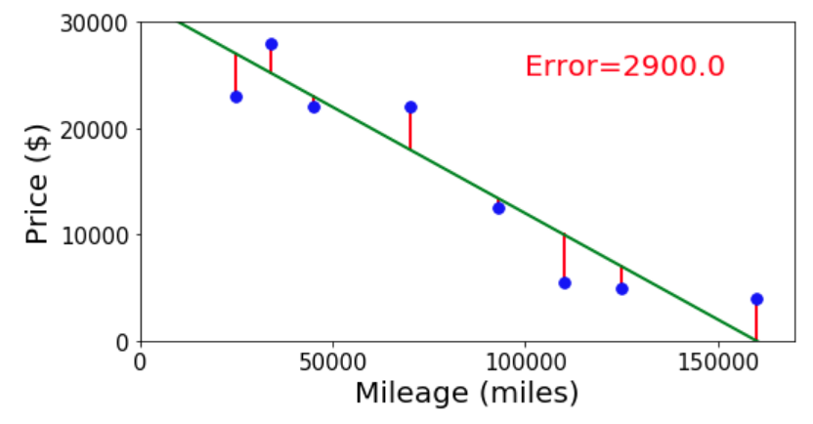
Linear Regression
Selling my car example

Slide 4
Regression for Non-linear data
Paper handout

Slide 5
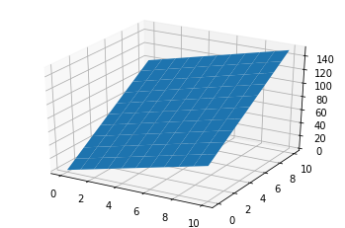
Linear Regression
With N-D inputs

Slide 6
Linear Regression
With N-D inputs
1-D linear function
$y=w_{1}x_{1}+b$
2-D linear function
$y=w_{1}x_{1}+w_{2}x_{2}+b$
3-D linear function
$y=w_{1}x_{1}+w_{2}x_{2}+w_{2}x_{2}+b$
N-D linear function
$y=\sum_{i=1}^{N}{w_{i}x_{i}}+b$

Slide 7
Network Diagrams
Linear functions
1-D linear function
$y=w_{1}x_{1}+b$
2-D linear function
$y=w_{1}x_{1}+w_{2}x_{2}+b$
3-D linear function
$y=w_{1}x_{1}+w_{2}x_{2}+w_{2}x_{2}+b$
N-D linear function
$y=\sum_{i=1}^{N}{w_{i}x_{i}}+b$

Slide 8
Linear Regression
Selling my car example

Slide 9
Linear plus ReLU
Rectified linear unit

Slide 10
Plotting Functions
Connecting functions
Plot the function f₃(x) vs x
f₁(x) = max(0, 1x + 2)
f₂(x) = max(0, 1x - 2)
f₃(x) = f₁(x) - f₂(x)

Slide 11
Neural Networks
https://www.cs.cmu.edu/~15181/tfp
Setup:
Switch to the regression dataset that looks like the letter M
Set the learning rate to 0.003
Steps:
Set up your architecture: add as many hidden layers and neurons per layer as you like
Click the play button
Observe the resulting fit and loss (mean squared error)
Repeat to try to use as few neurons a possible and still get a good fit

Slide 12
Three-neuron network
Connecting functions
Plot the function f₃(x) vs x
f₁(x) = max(0, 1x + 2)
f₂(x) = max(0, 1x - 2)
f₃(x) = f₁(x) - f₂(x)

Slide 13
Three-neuron network
Connecting functions
Plot the function f₃(x) vs x
f₁(x) = max(0, 1x + 2)
f₂(x) = max(0, 1x - 2)
f₃(x) = f₁(x) - f₂(x)

