Slide 1

Announcements
Assignments:
P3: Logic Plan
    Checkpoint Due Friday 3/3, 10 pm (tomorrow)
    All Due Friday 3/17, 10pm (after spring break)
HW6 (online)
    Due Tues 3/14, 10 pm

Slide 2
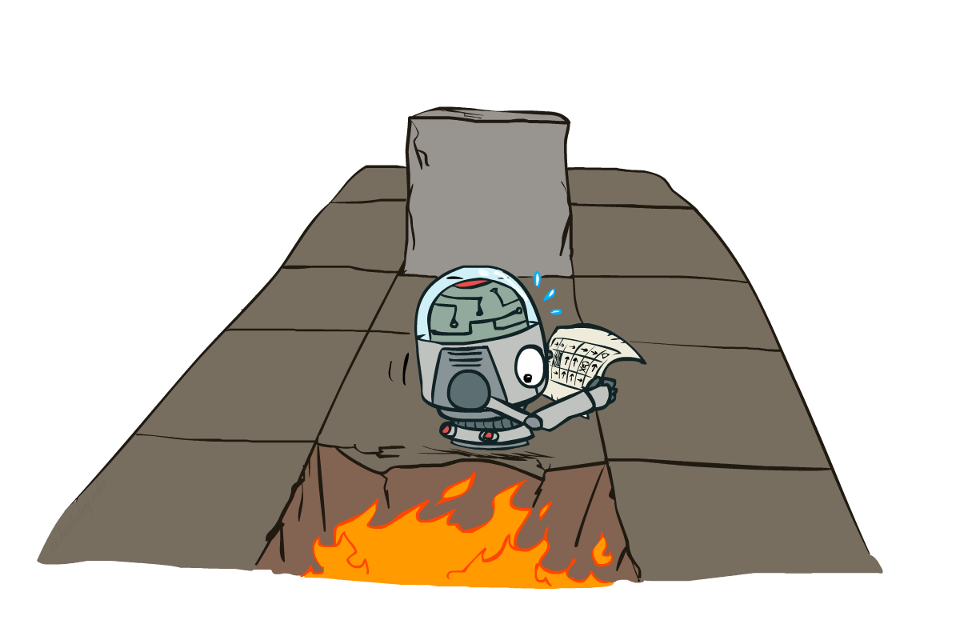
AI: Representation and Problem Solving
Markov Decision Processes II
Instructor: Stephanie Rosenthal
Slide credits: CMU AI and http://ai.berkeley.edu

Slide 3
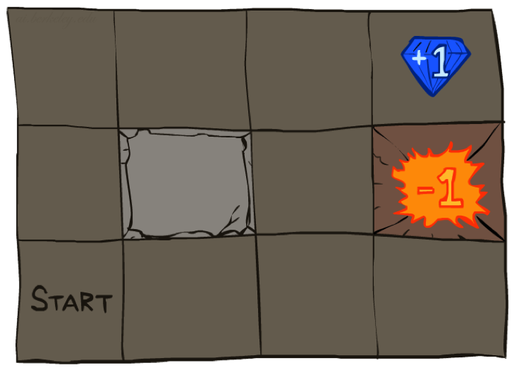




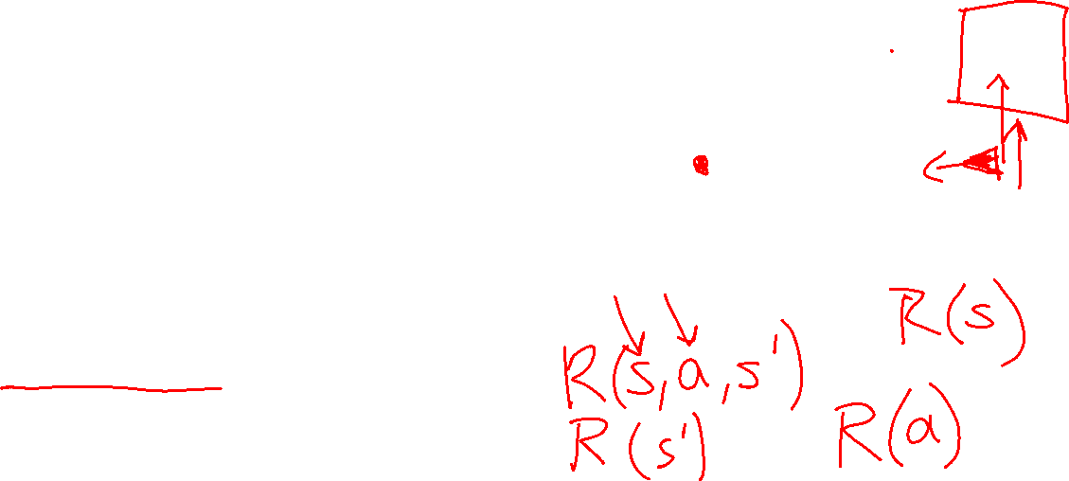
Recap: Grid World
A maze-like problem
  The agent lives in a grid
  Walls block the agent’s path
Noisy movement: actions do not always go as planned
  80% of the time, the action North takes the agent North
  10% of the time, North takes the agent West; 10% East
  If there is a wall in the direction the agent would have been taken, the agent stays put
The agent receives rewards each time step
  Small “living” reward each step (can be negative)
  Big rewards come at the end (good or bad)
Notes:
[cut demo of moving around in grid world program]

Slide 4
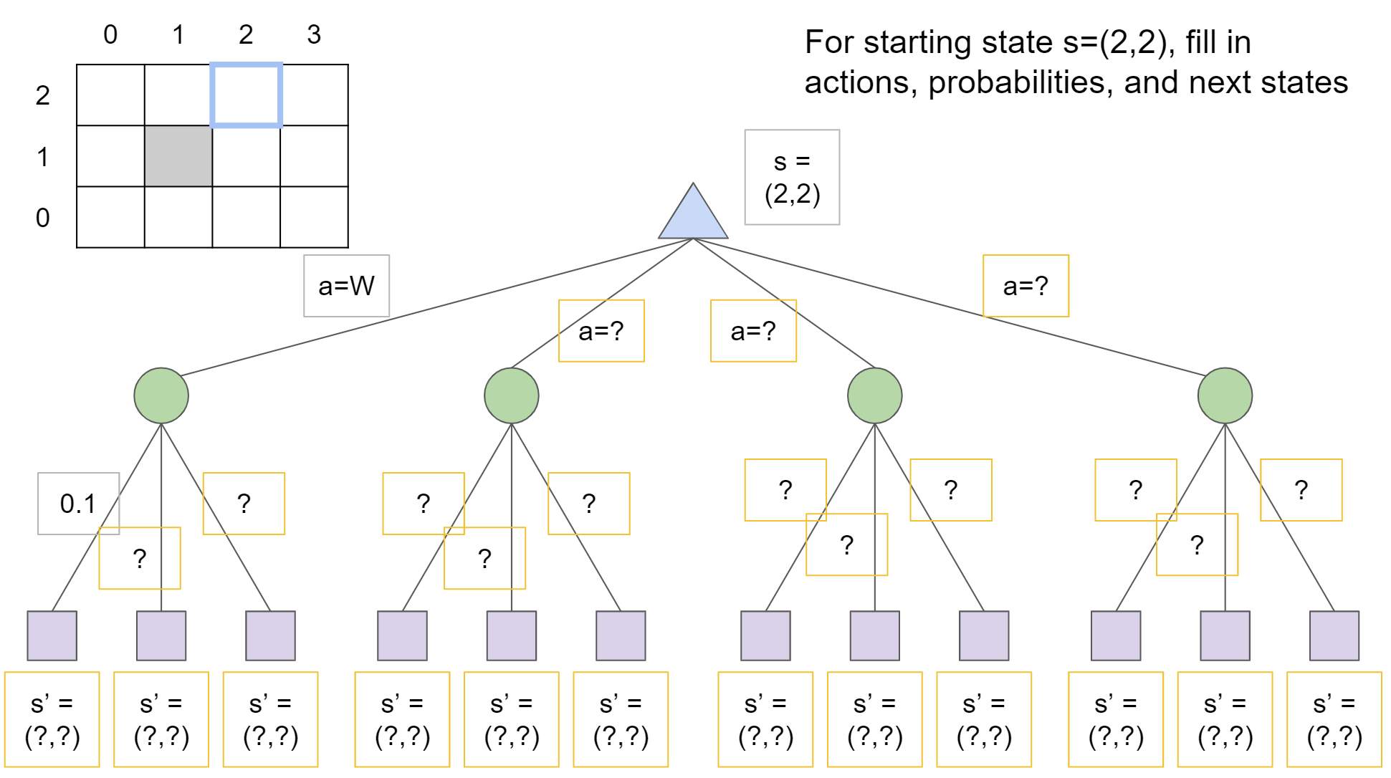
Grid World

Slide 5

Value Iteration
Start with V₀(s) = 0: no time steps left means an expected reward sum of zero
Given vector of V_{k}(s) values, do one ply of expectimax from each state:
Repeat until convergence
Theorem: will converge to unique optimal values
  Basic idea: approximations get refined towards optimal values
  Policy may converge long before values do
V_{k+1}(s)
a
s, a
s,a,s’
V_{k}(s’)
Notes:
Discuss computational complexity: S * A * S times number of iterations
Note: updates not in place [if in place, it means something else and not even clear what it means]

Slide 6
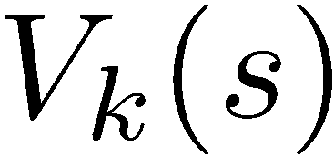
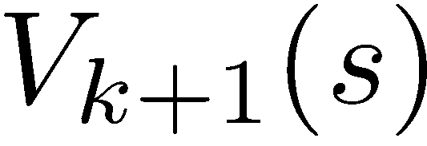
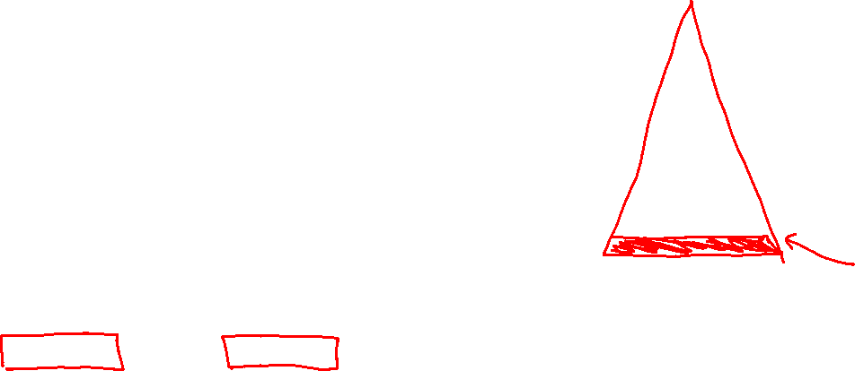
Value Iteration Convergence
How do we know the V_{k} vectors are going to converge?
Case 1: If the tree has maximum depth M, then V_{M} holds the actual untruncated values
Case 2: If the discount is less than 1
  Sketch: For any state V_{k} and V_{k+1} can be viewed as depth k+1 expectimax results in nearly identical search trees
  The difference is that on the bottom layer, V_{k+1} has actual rewards while V_{k} has zeros
  That last layer is at best all R_{MAX}
  It is at worst R_{MIN}
  But everything is discounted by γ^{k} that far out
  So V_{k} and V_{k+1} are at most γ^{k} max|R| different
  So as k increases, the values converge

Slide 7

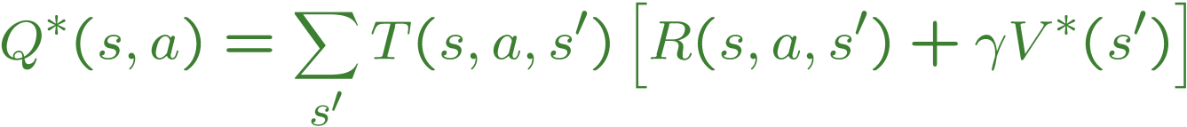
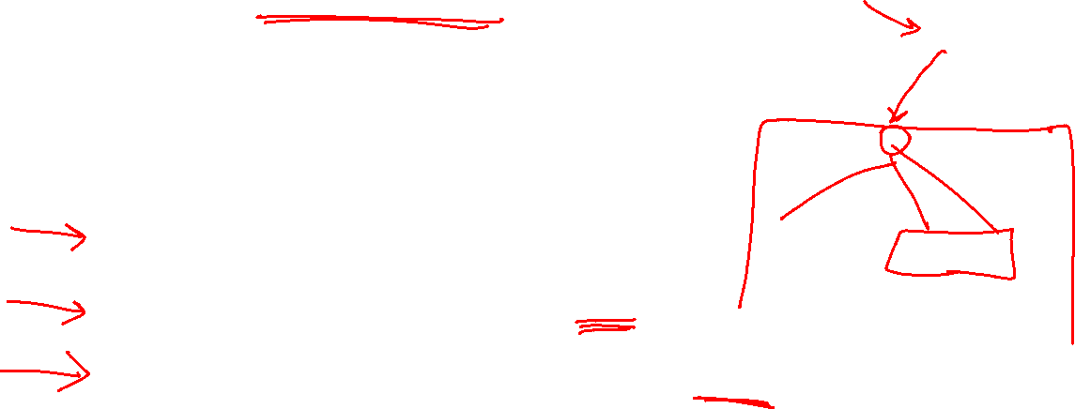
Values of States
Fundamental operation: compute the (expectimax) value of a state
  Expected utility under optimal action
  Average sum of (discounted) rewards
  This is just what expectimax computed!
Recursive definition of value:
s
a
s, a
s,a,s’
s’

Slide 8
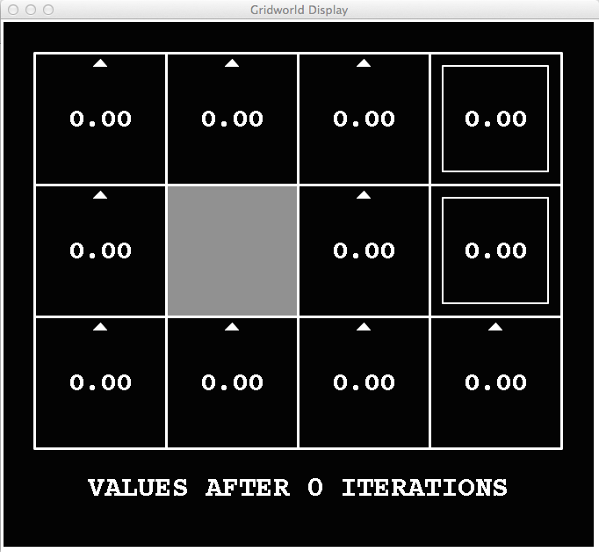
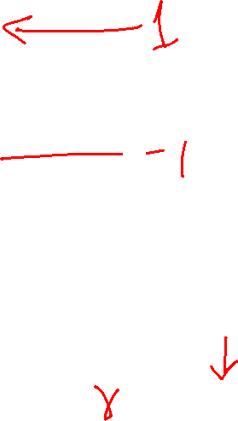
k=0
Noise = 0.2
Discount = 0.9
Living reward = 0
Notes:
Assuming zero living reward

Slide 9
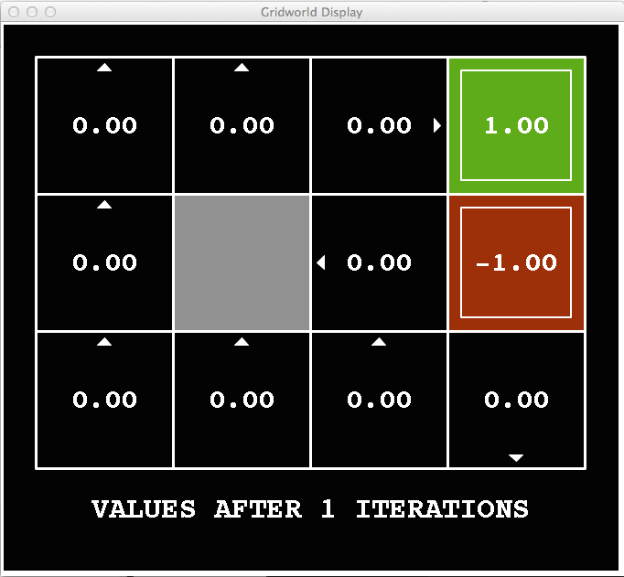

k=1
Noise = 0.2
Discount = 0.9
Living reward = 0
Notes:
Assuming zero living reward

Slide 10
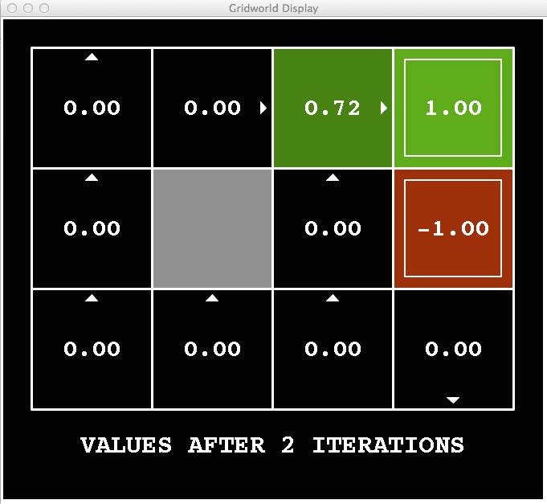
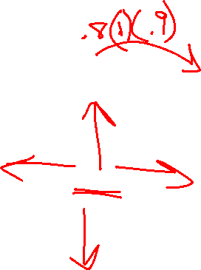
k=2
Noise = 0.2
Discount = 0.9
Living reward = 0
Notes:
Assuming zero living reward

Slide 11
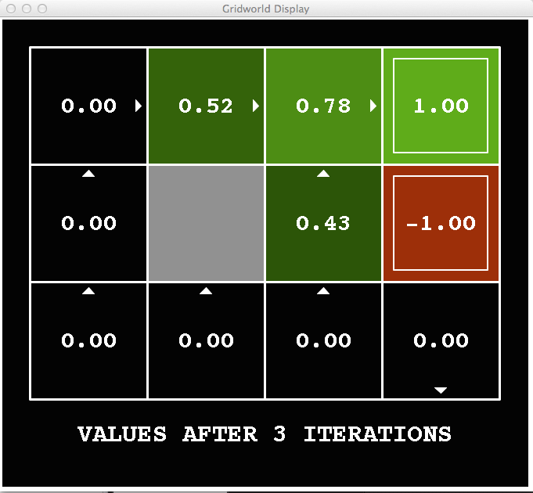
k=3
Noise = 0.2
Discount = 0.9
Living reward = 0
Notes:
Assuming zero living reward

Slide 12
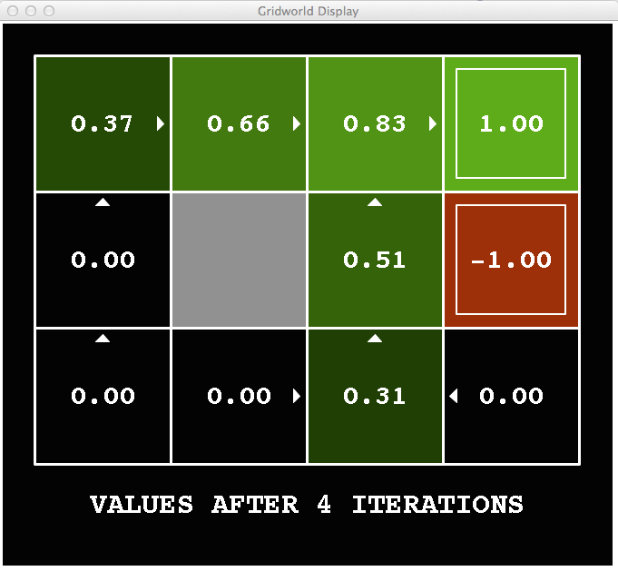
k=4
Noise = 0.2
Discount = 0.9
Living reward = 0
Notes:
Assuming zero living reward

Slide 13
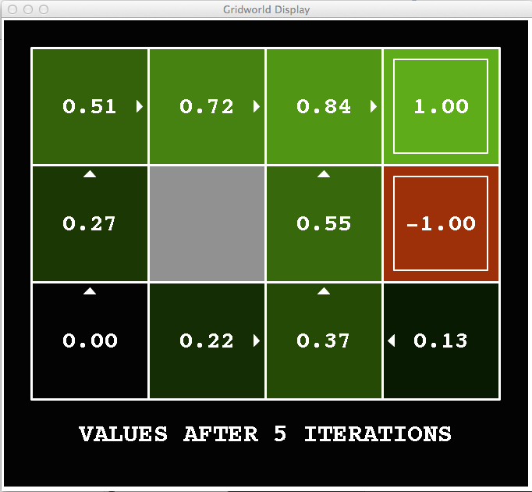
k=5
Noise = 0.2
Discount = 0.9
Living reward = 0
Notes:
Assuming zero living reward

Slide 14
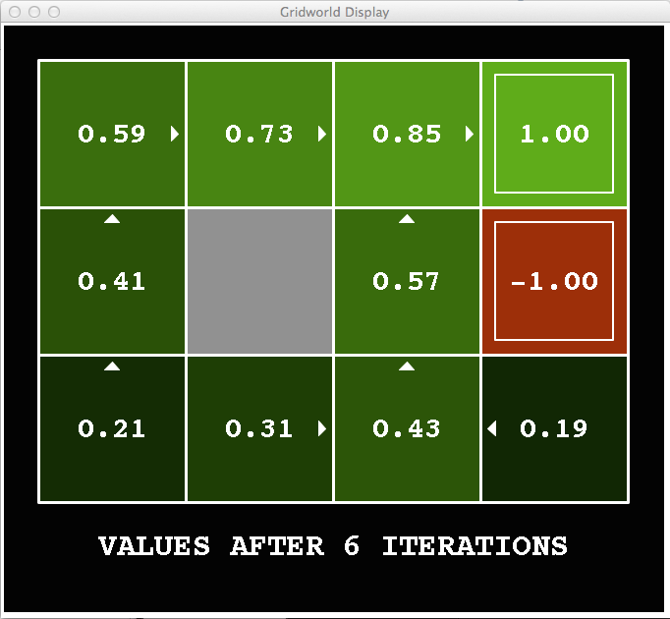
k=6
Noise = 0.2
Discount = 0.9
Living reward = 0
Notes:
Assuming zero living reward

Slide 15
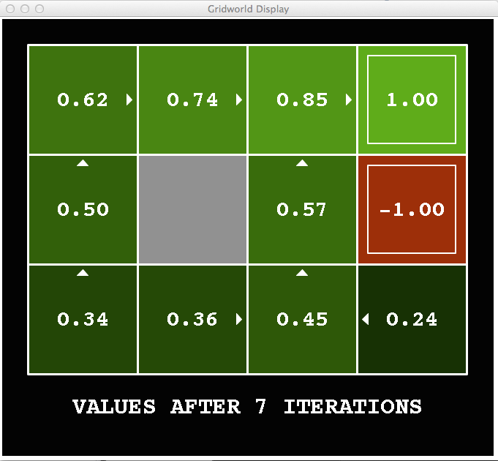
k=7
Noise = 0.2
Discount = 0.9
Living reward = 0
Notes:
Assuming zero living reward

Slide 16
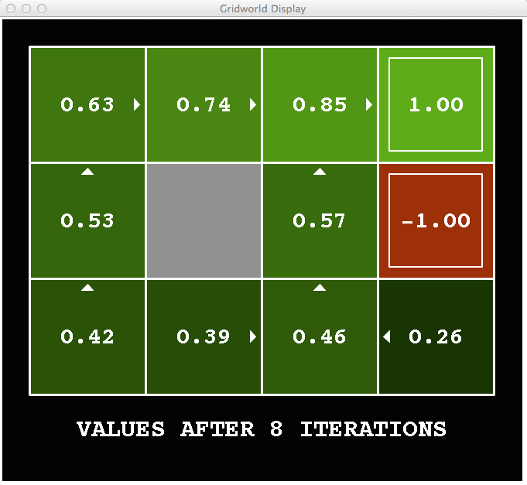
k=8
Noise = 0.2
Discount = 0.9
Living reward = 0
Notes:
Assuming zero living reward

Slide 17
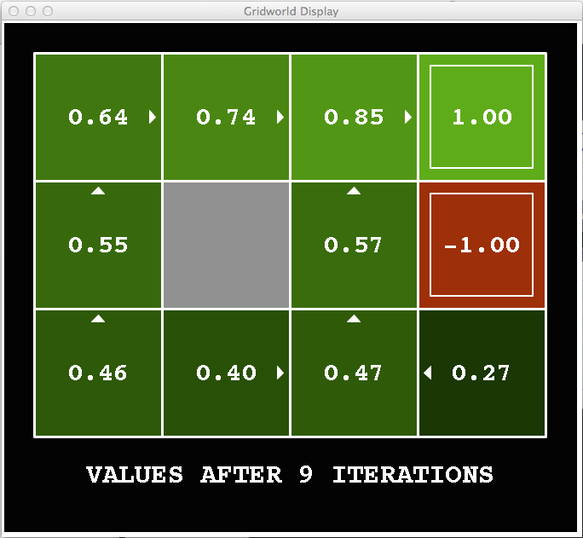
k=9
Noise = 0.2
Discount = 0.9
Living reward = 0
Notes:
Assuming zero living reward

Slide 18

k=10
Noise = 0.2
Discount = 0.9
Living reward = 0
Notes:
Assuming zero living reward

Slide 19

k=11
Noise = 0.2
Discount = 0.9
Living reward = 0
Notes:
Assuming zero living reward

Slide 20
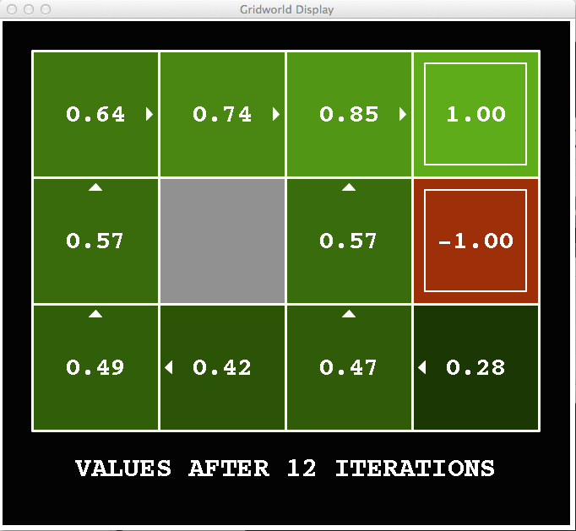
k=12
Noise = 0.2
Discount = 0.9
Living reward = 0
Notes:
Assuming zero living reward

Slide 21

k=100
Noise = 0.2
Discount = 0.9
Living reward = 0
Notes:
Assuming zero living reward

Slide 22
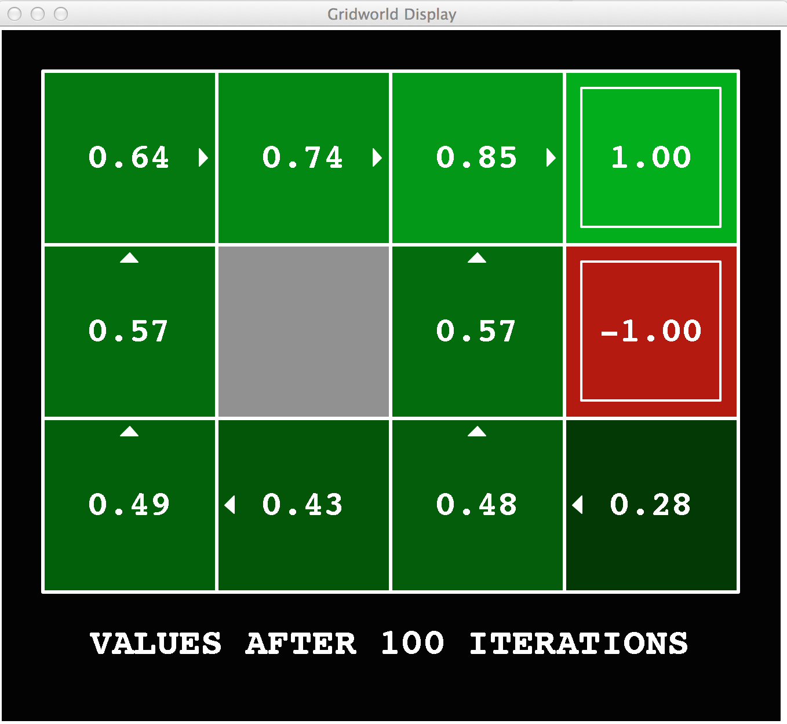
Gridworld Values V*

Slide 23
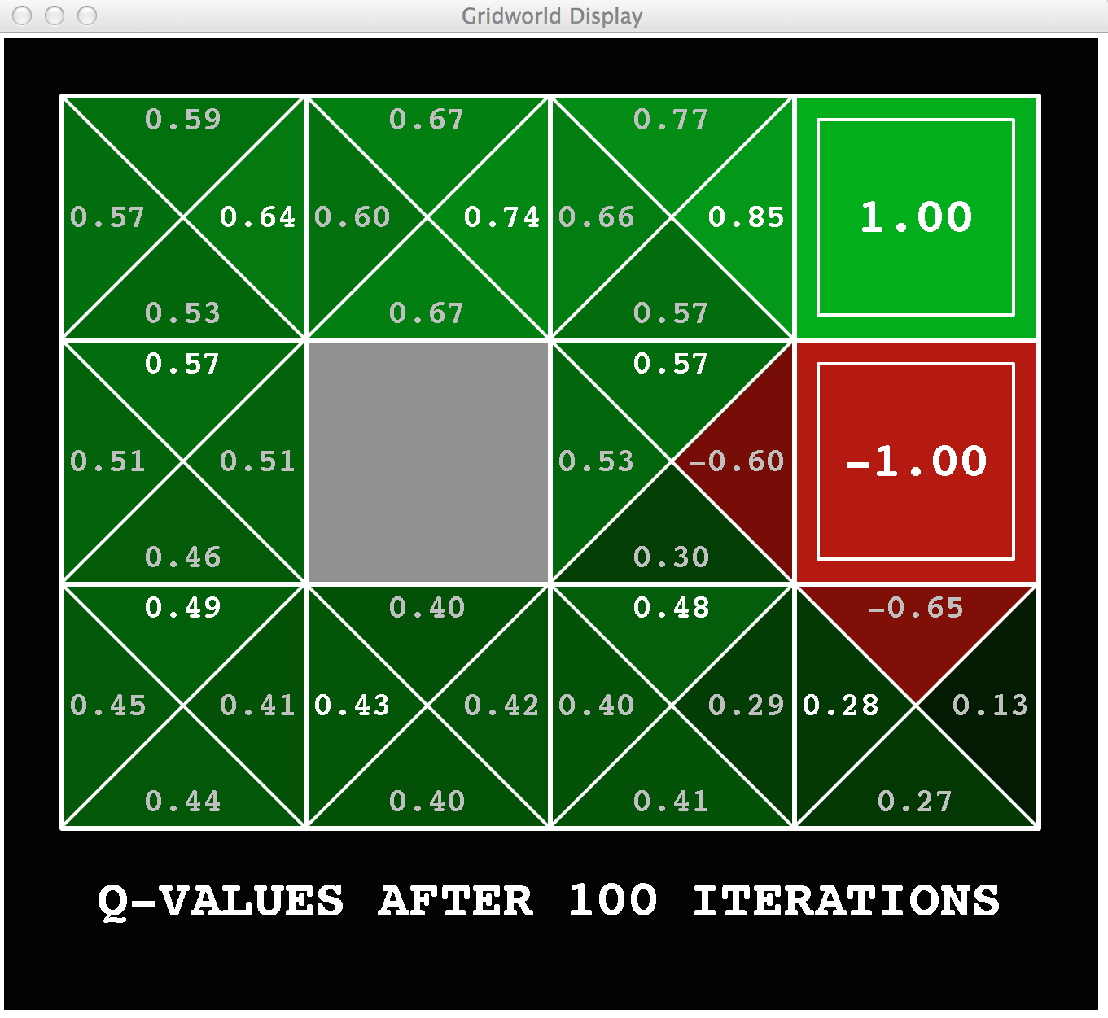
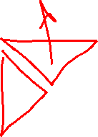
Gridworld: Q*

Slide 24

The Bellman Equations
How to be optimal:
Step 1: Take correct first action
Step 2: Keep being optimal

Slide 25


The Bellman Equations
s
Definition of “optimal utility” via expectimax recurrence gives a simple one-step lookahead relationship amongst optimal utility values
These are the Bellman equations, and they characterize optimal values in a way we’ll use over and over
a
s, a
s,a,s’
s’
Notes:
Let’s start by equations that characterize these quantities through mutual recursions. [step through this by writing on slide, one step at a time]
Recursive characterization of V* in terms of V*; not necessarily helpful; but it is a characterization.
Note: this is a set of equations that needs to be satisfied; but it could have multiple solutions (it does not, but at this stage of our knowledge it could).

Slide 26
Value Iteration
s
Bellman equations characterize the optimal values:
Value iteration computes them:
Value iteration is just a fixed point solution method
  … though the V_{k} vectors are also interpretable as time-limited values
a
s, a
s,a,s’
Notes:
Discuss computational complexity: S * A * S times number of iterations
Note: updates not in place [if in place, it means something else and not even clear what it means]

Slide 27
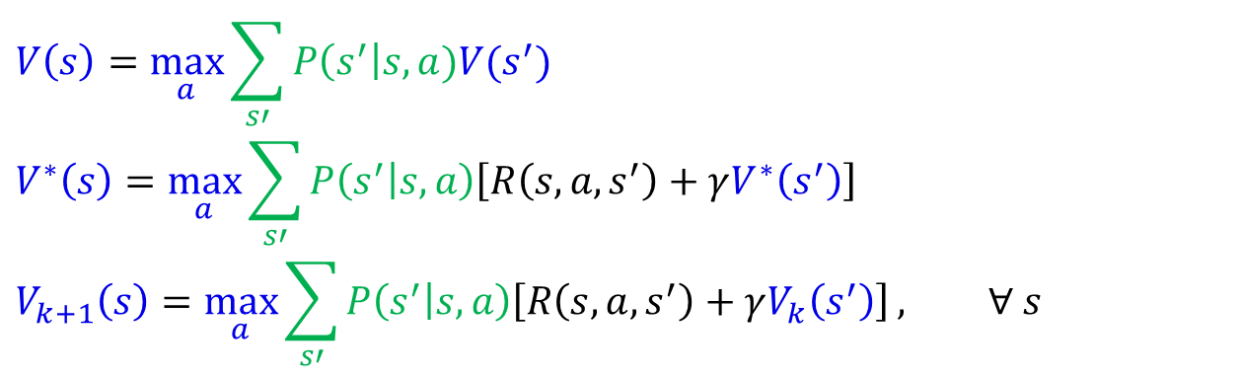
MDP Notation
$$V\left(s\right)=\max_{a}{\sum_{s′}{P\left(s^{′}\right|s,a)V(s^{′})}}$$
$$V^{∗}\left(s\right)=\max_{a}{\sum_{s′}{P\left(s^{′} | s,a\right)\left[R\left(s,a,s^{′}\right)+γV^{∗}\left(s^{′}\right)\right]}}$$
$$V_{k+1}\left(s\right)=\max_{a}{\sum_{s′}{P\left(s^{′} | s,a\right)\left[R\left(s,a,s^{′}\right)+γV_{k}\left(s^{′}\right)\right]}}, ∀ s$$
Standard expectimax:
Bellman equations:
Value iteration:

Slide 28


Solved MDP! Now what?
What are we going to do with these values??
$$V^{∗}\left(s\right)$$
$$Q^{∗}\left(s,a\right)$$

Slide 29
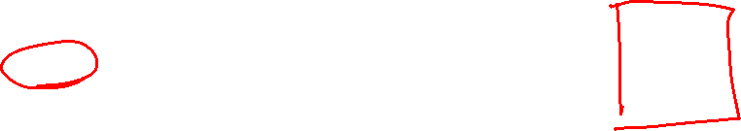
Poll 1
If you need to extract a policy, would you rather have
A) Values, B) Q-values?

Slide 30
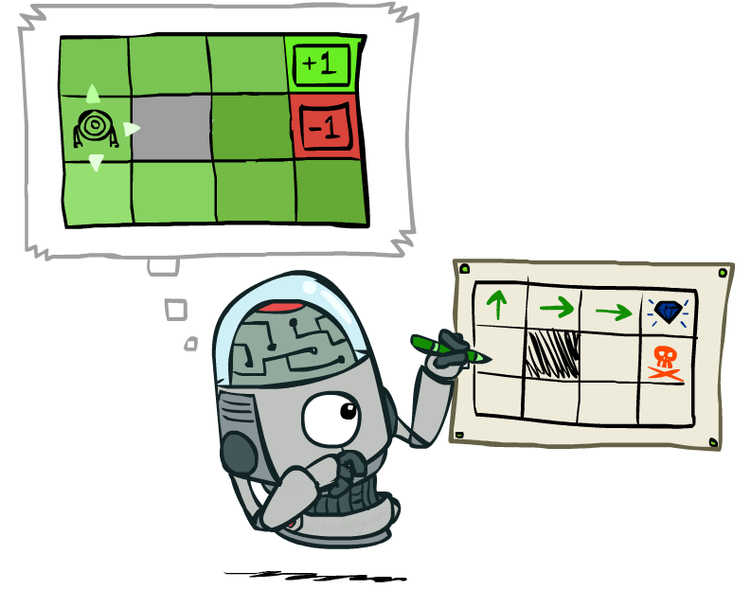
Policy Extraction

Slide 31
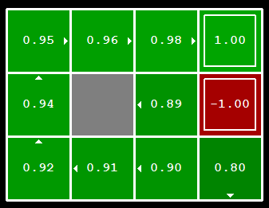

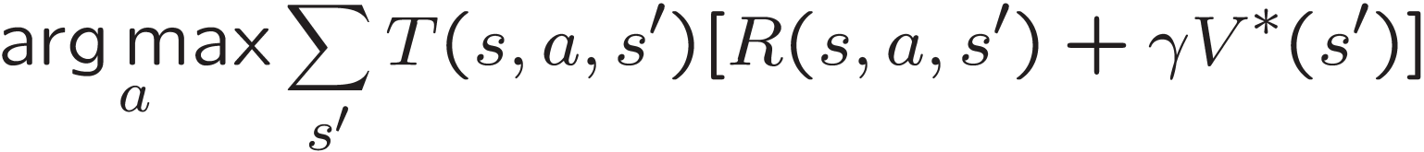
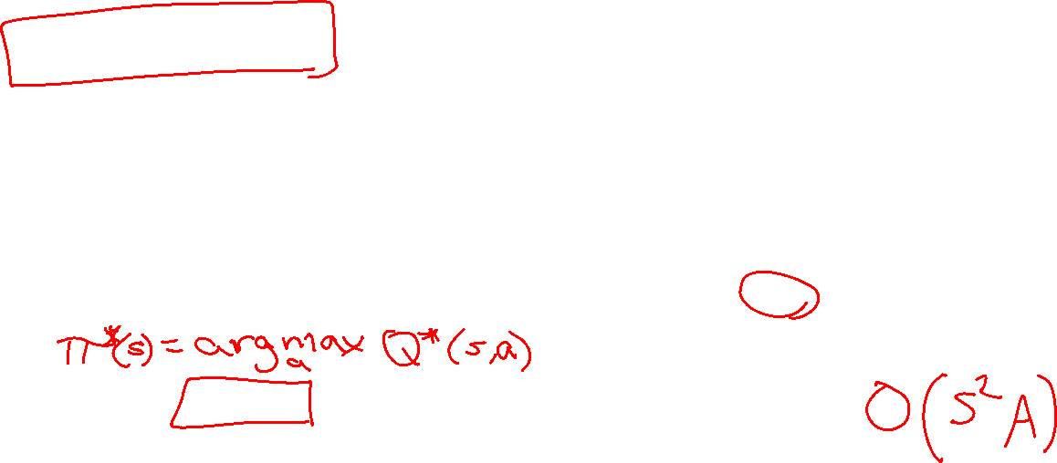
Policy Extraction - Computing Actions from Values
Let’s imagine we have the optimal values V*(s)
How should we act?
  It’s not obvious!
We need to do a mini-expectimax (one step)
This is called policy extraction, since it gets the policy implied by the values

Slide 32
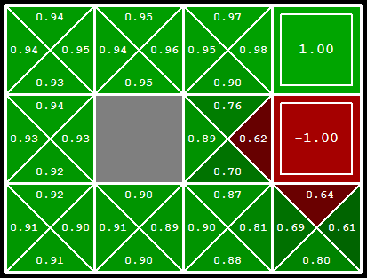
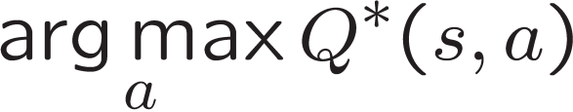
Computing Actions from Q-Values
Let’s imagine we have the optimal q-values:
How should we act?
  Completely trivial to decide!
Important lesson: actions are easier to select from q-values than values!

Slide 33
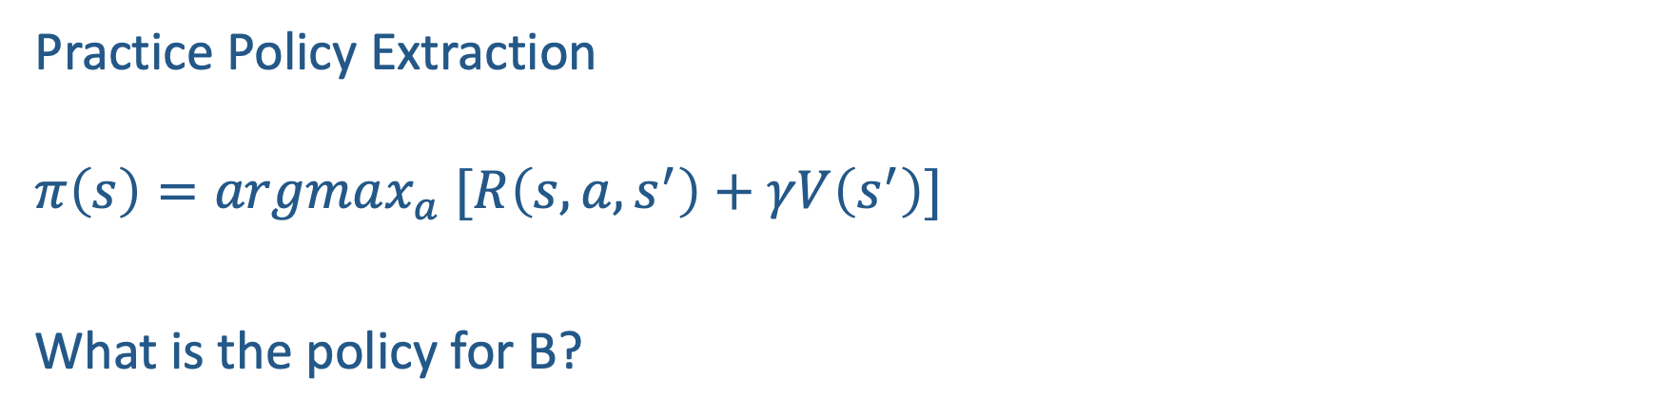
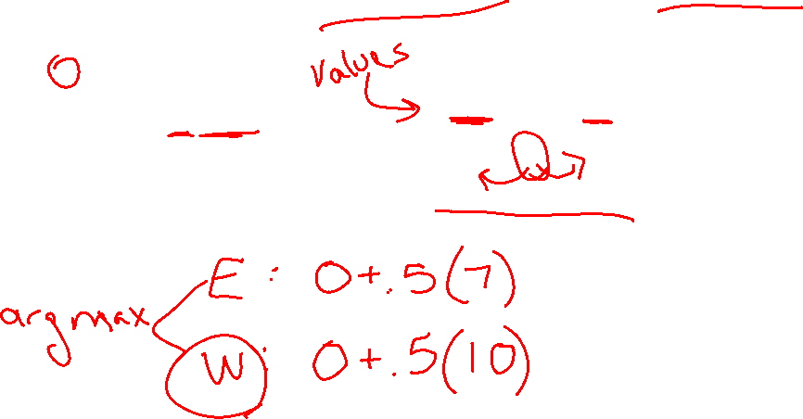
Poll 2
T (Terminal)
R(A, Exit, T) = 10
R(E, Exit, T) = 1
Practice Policy Extraction
$$π\left(s\right)=argmax_{a} [R\left(s,a,s^{′}\right)+γV\left(s^{′}\right)]$$
What is the policy for B?
A | B | C | D | E
10 3 7 5 1
Deterministic Actions: East and West
Gamma: 0.5

Slide 34
Value Iteration Notes
Value iteration repeats the Bellman updates:
Things to notice when running value iteration:
It’s slow – O(|S|²|A|) per iteration
The “max” at each state rarely changes
The optimal policy appears before the values converge (but we don’t know that the policy is optimal until the values converge)
s
a
s, a
s,a,s’
s’
Notes:
Demo steps through value iteration; snapshots of values shown on next slides.

Slide 35
k=6
Noise = 0.2
Discount = 0.9
Living reward = 0
Notes:
Assuming zero living reward

Slide 36
k=7
Noise = 0.2
Discount = 0.9
Living reward = 0
Notes:
Assuming zero living reward

Slide 37
k=8
Noise = 0.2
Discount = 0.9
Living reward = 0
Notes:
Assuming zero living reward

Slide 38
k=9
Noise = 0.2
Discount = 0.9
Living reward = 0
Notes:
Assuming zero living reward

Slide 39

k=10
Noise = 0.2
Discount = 0.9
Living reward = 0
Notes:
Assuming zero living reward

Slide 40

k=11
Noise = 0.2
Discount = 0.9
Living reward = 0
Notes:
Assuming zero living reward

Slide 41
k=12
Noise = 0.2
Discount = 0.9
Living reward = 0
Notes:
Assuming zero living reward

Slide 42
k=100
Noise = 0.2
Discount = 0.9
Living reward = 0
Notes:
Assuming zero living reward

Slide 43


Policy Iteration

Slide 44
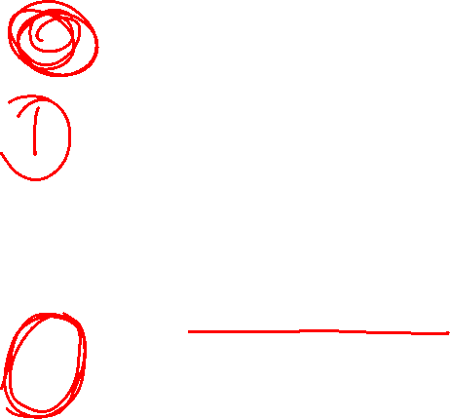
Two Methods for Solving MDPs
Value iteration + policy extraction
  Step 1: Value iteration: calculate values for all states by running one ply of the Bellman equations using values from previous iteration until convergence
  Step 2: Policy extraction: compute policy by running one ply of the Bellman equations using values from value iteration
Policy iteration
  Step 1: Policy evaluation: calculate values for some fixed policy (not optimal values!) until convergence
  Step 2: Policy improvement: update policy by running one ply of the Bellman equations using values from policy evaluation
  Repeat steps until policy converges

Slide 45

Policy Evaluation

Slide 46
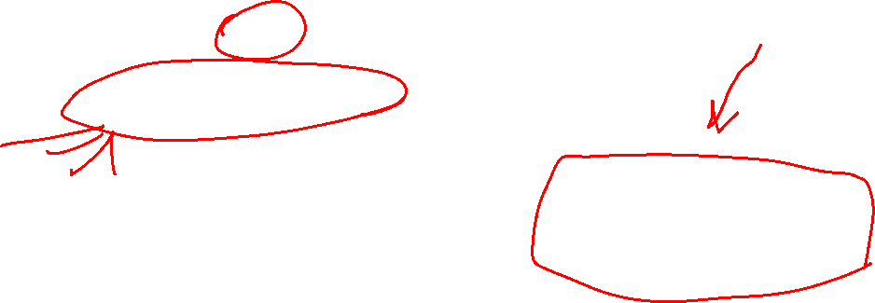
Fixed Policies
Do the optimal action
Do what π says to do
s
s
a
π(s)
s, a
s, π(s)
s,a,s’
s, π(s),s’
s’
s’
Expectimax trees max over all actions to compute the optimal values
If we fixed some policy π(s), then the tree would be simpler – only one action per state
  … though the tree’s value would depend on which policy we fixed

Slide 47
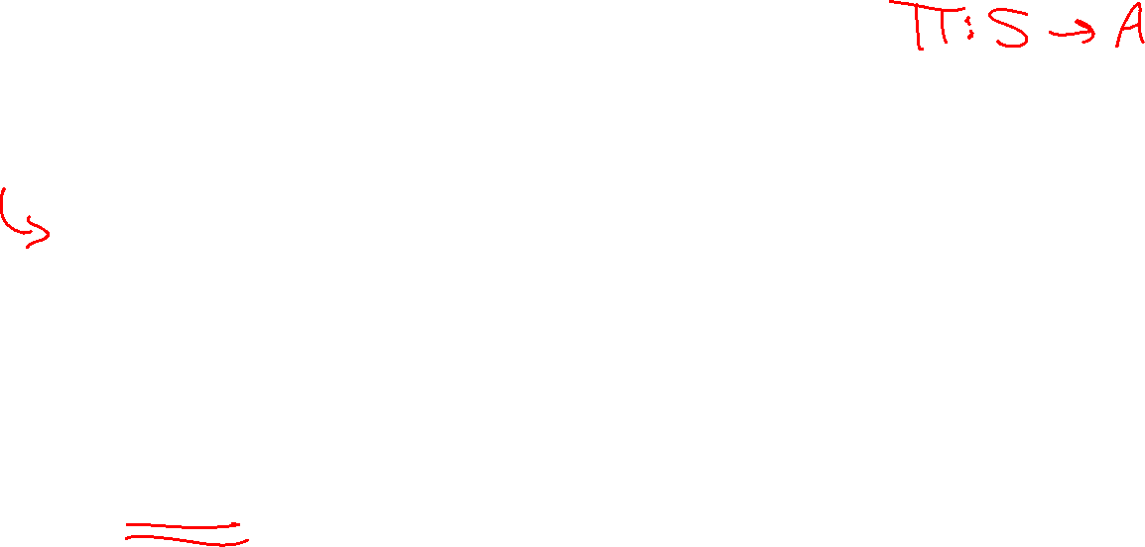
Policy Evaluation - Utilities for a Fixed Policy
Another basic operation: compute the utility of a state s under a fixed (generally non-optimal) policy
Define the utility of a state s, under a fixed policy π:
  V^{π}(s) = expected total discounted rewards starting in s and following π
Recursive relation (one-step look-ahead / Bellman equation):
s
π(s)
s, π(s)
s, π(s),s’
s’

Slide 48
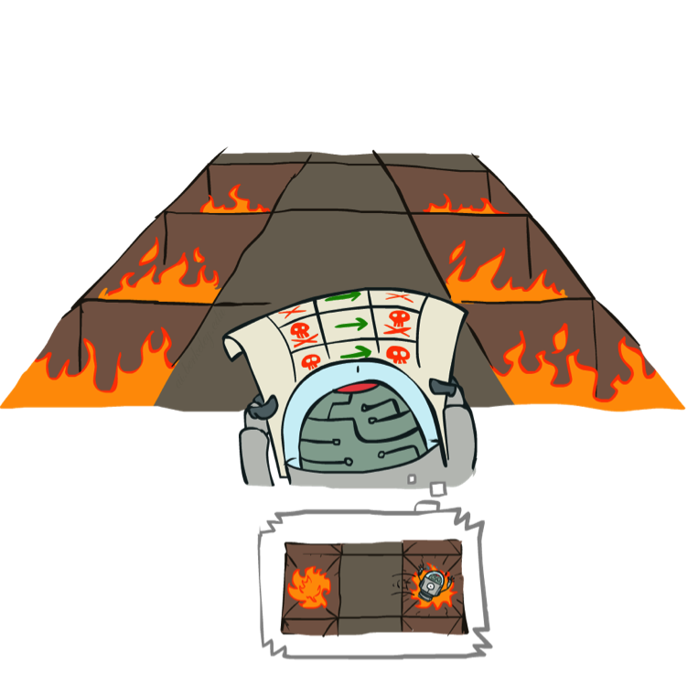
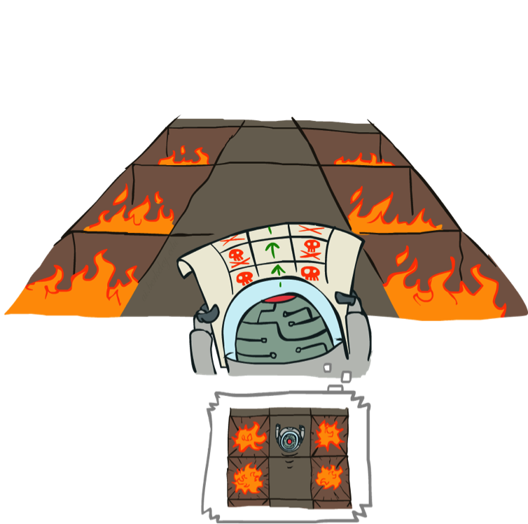
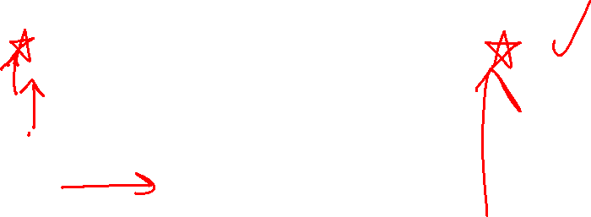
Example: Policy Evaluation
Always Go Right
Always Go Forward

Slide 49
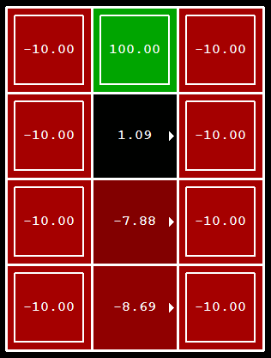
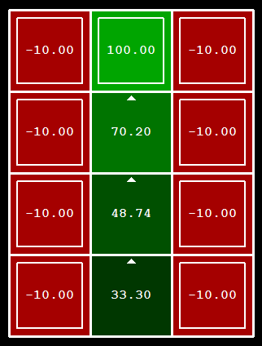
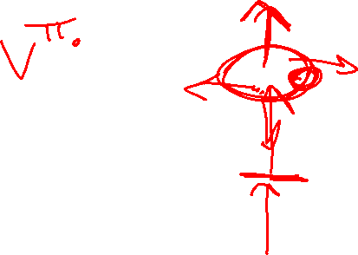
Example: Policy Evaluation
Always Go Right
Always Go Forward

Slide 50

Policy Evaluation
How do we calculate the V’s for a fixed policy π?
Idea 1: Turn recursive Bellman equations into updates
(like value iteration)
Efficiency: O(|S|²) per iteration
Idea 2: Without the maxes, the Bellman equations are just a linear system
  Solve with your favorite linear system solver
s
π(s)
s, π(s)
s, π(s),s’
s’

Slide 51

Policy Iteration
Alternative approach for optimal values:
  Step 1: Policy evaluation: calculate values for some fixed policy (not optimal values!) until convergence
  Step 2: Policy improvement: update policy by running one ply of the Bellman equations using values from policy evaluation
  Repeat steps until policy converges
This is policy iteration
  It’s still optimal!
  Can converge faster under some conditions

Slide 52
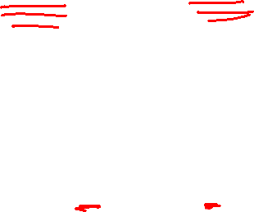
Policy Iteration:
Evaluation: For fixed current policy π, find values with policy evaluation:
  Iterate until values converge:
Improvement: For fixed values, get a better policy using policy extraction
  One-step look-ahead:

Slide 53
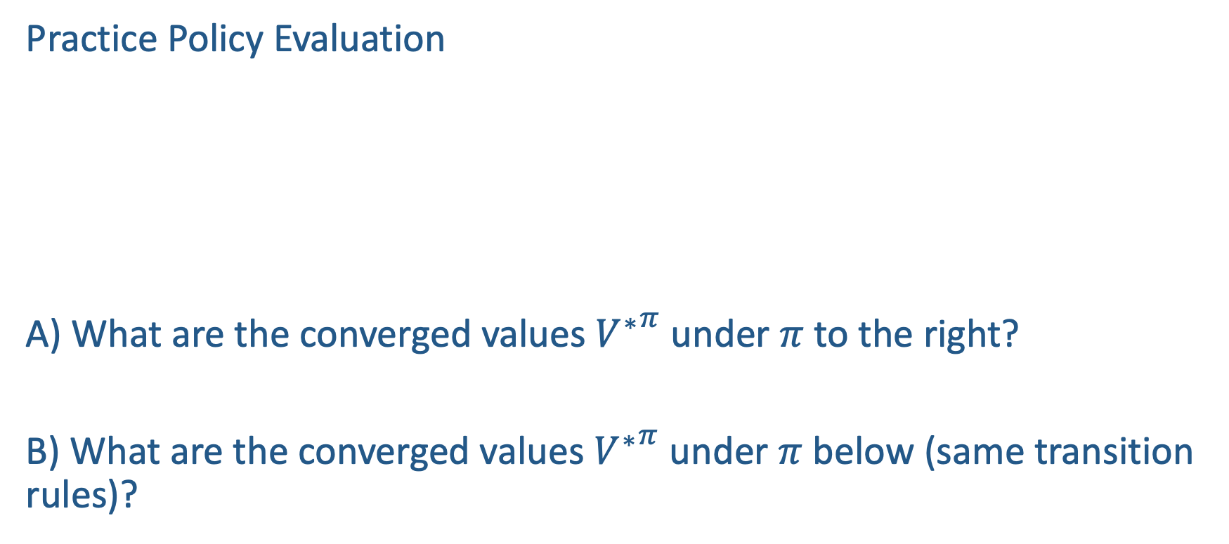
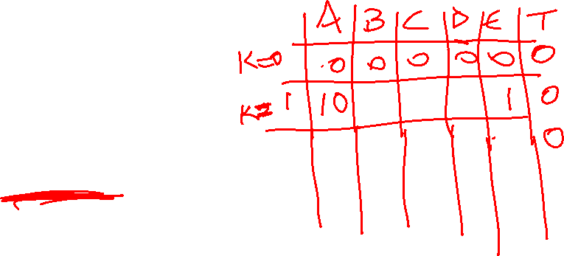
In-Class Activity
T (Terminal)
R(A, Exit, T) = 10
R(E, Exit, T) = 1
Practice Policy Evaluation
A) What are the converged values ${V^{∗}}^{π}$ under $π$ to the right?
B) What are the converged values ${V^{∗}}^{π}$ under $π$ below (same transition rules)?
A | B | C | D | E
Exit West West East Exit
Deterministic Actions: East and West
Gamma: 0.5
A | B | C | D | E
Exit East West East Exit
Notes:
Policy to the right:
V A B C D E. T
V0. 0 0 0. 0. 0. 0
V1 10. 0 0. 0 1 0
V2 10 5. 0 0.5 1. 0
V3 10 5 2.5 .5 1. 0
Policy below
V A B C D E. T
V0. 0 0 0. 0. 0. 0
V1 10. 0 0. 0 1 0
V2 10 0 0 0.5 1. 0

Slide 54
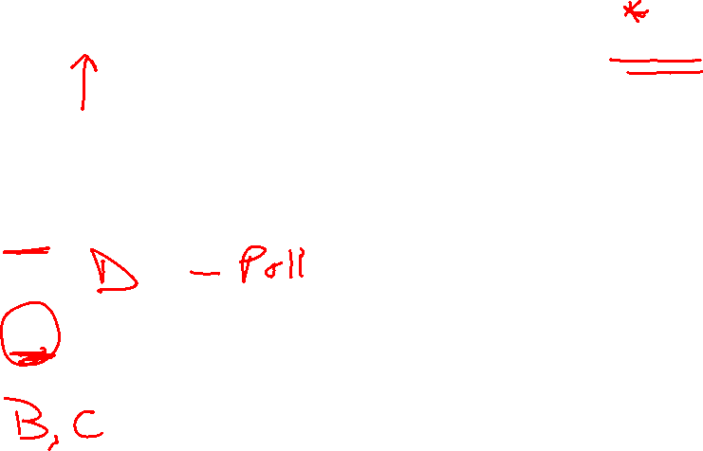
In-Class Activity 2
T (Terminal)
R(A, Exit, T) = 10
R(E, Exit, T) = 1
Practice Policy Improvement
C) Based on your answer to A, what is the new policy?
D) Based on your answer to B, what is the new policy?
A | B | C | D | E
Exit West West East Exit
Deterministic Actions: East and West
Gamma: 0.5
A | B | C | D | E
Exit East West East Exit
Notes:
West West West!
West East East!

Slide 55
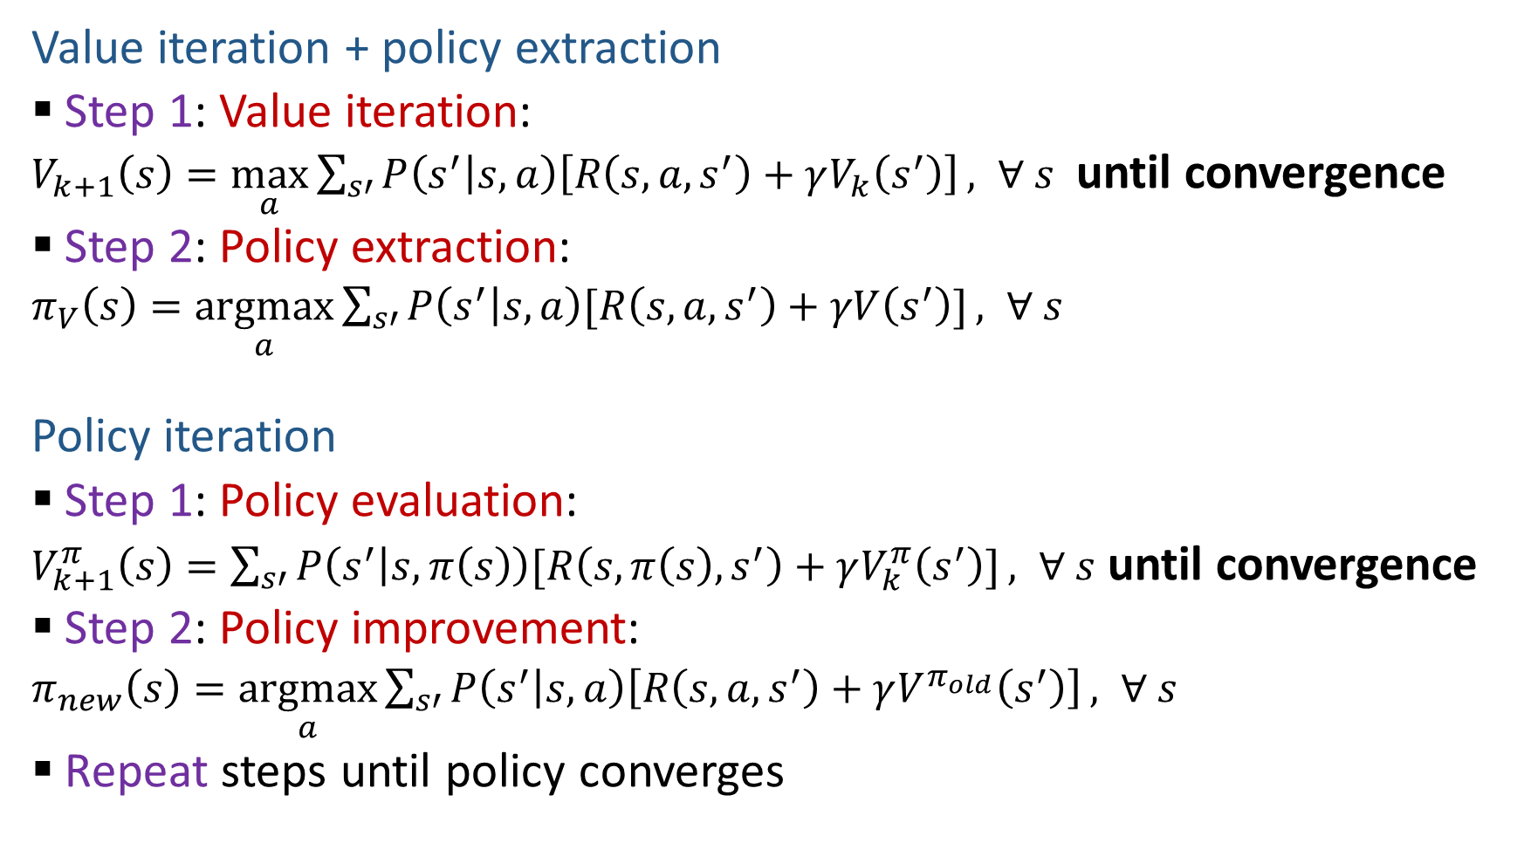
Two Methods for Solving MDPs
Value iteration + policy extraction
  Step 1: Value iteration:
  $V_{k+1}\left(s\right)=\max_{a}{\sum_{s′}{P\left(s^{′} | s,a\right)\left[R\left(s,a,s^{′}\right)+γV_{k}\left(s^{′}\right)\right]}}, ∀ s$ until convergence
  Step 2: Policy extraction:
  $π_{V}\left(s\right)=\underset{a}{argmax}{\sum_{s′}{P\left(s^{′} | s,a\right)[R\left(s,a,s^{′}\right)+γV\left(s^{′}\right)]}}, ∀ s$
Policy iteration
  Step 1: Policy evaluation:
  $V_{k+1}^{π}\left(s\right)=\sum_{s′}{P\left(s^{′} | s,π\left(s\right)\right)[R\left(s,π\left(s\right),s^{′}\right)+γV_{k}^{π}\left(s^{′}\right)]}, ∀ s$ until convergence
  Step 2: Policy improvement:
  $π_{new}\left(s\right)=\underset{a}{argmax}{\sum_{s′}{P\left(s^{′} | s,a\right)\left[R\left(s,a,s^{′}\right)+γV^{π_{old}}\left(s^{′}\right)\right]}}, ∀ s$
  Repeat steps until policy converges

Slide 56
Comparison
Both value iteration and policy iteration compute the same thing (all optimal values)
In value iteration:
  Every iteration updates both the values and (implicitly) the policy
  We don’t track the policy, but taking the max over actions implicitly recomputes it
In policy iteration:
  We do several passes that update values with fixed policy (each pass is fast because we consider only one action, not all of them; however we do many passes)
  After the policy is evaluated, a new policy is chosen (slow like a value iteration pass)
  The new policy will be better (or we’re done)
(Both are dynamic programs for solving MDPs)

Slide 57
Summary: MDP Algorithms
So you want to….
  Compute optimal values: use value iteration or policy iteration
  Compute values for a particular policy: use policy evaluation
  Turn your values into a policy: use policy extraction (one-step lookahead)
These all look the same!
  They basically are – they are all variations of Bellman updates
  They all use one-step lookahead expectimax fragments
  They differ only in whether we plug in a fixed policy or max over actions

Slide 58
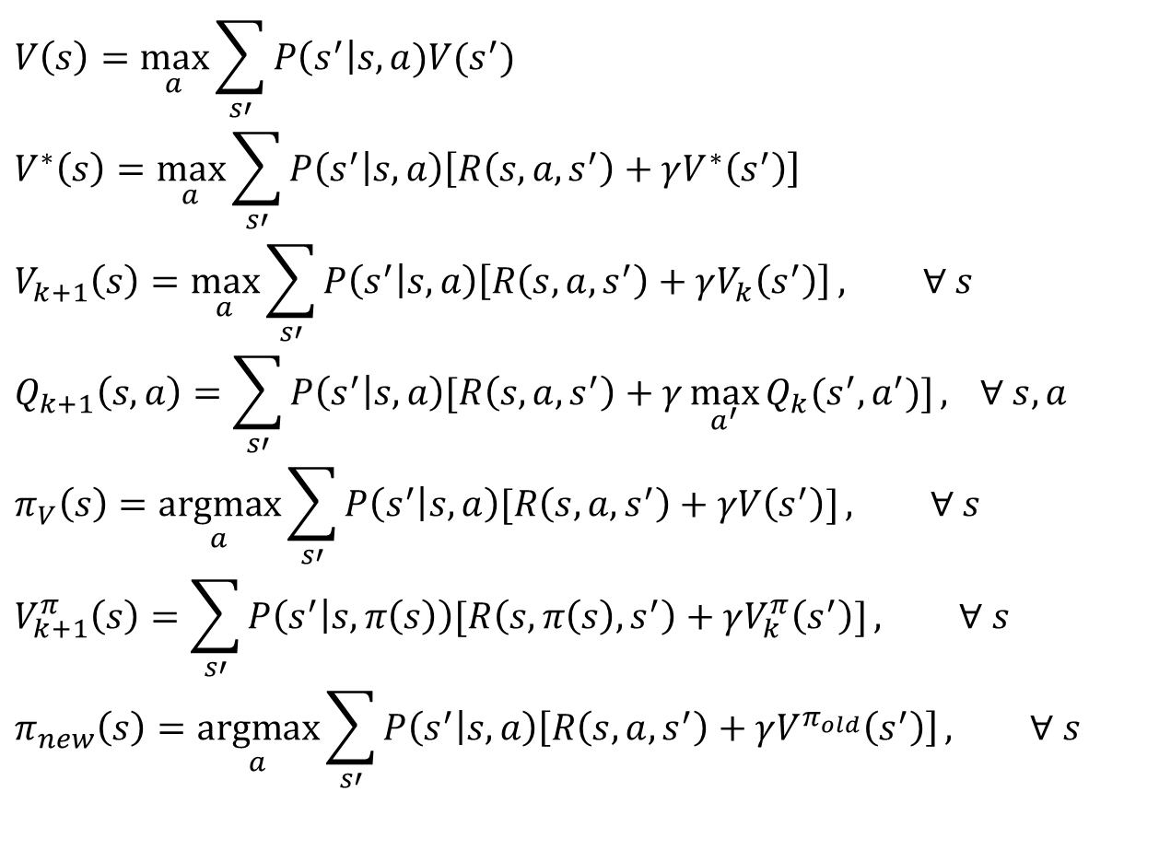
MDP Notation
$$V\left(s\right)=\max_{a}{\sum_{s′}{P\left(s^{′}\right|s,a)V(s^{′})}}$$
$$V^{∗}\left(s\right)=\max_{a}{\sum_{s′}{P\left(s^{′} | s,a\right)\left[R\left(s,a,s^{′}\right)+γV^{∗}\left(s^{′}\right)\right]}}$$
$$V_{k+1}\left(s\right)=\max_{a}{\sum_{s′}{P\left(s^{′} | s,a\right)\left[R\left(s,a,s^{′}\right)+γV_{k}\left(s^{′}\right)\right]}}, ∀ s$$
$$Q_{k+1}\left(s,a\right)=\sum_{s′}{P\left(s^{′} | s,a\right)[R\left(s,a,s^{′}\right)+γ\max_{a^{′}}{Q_{k}(s^{′},a^{′})]}, } ∀ s,a$$
$$π_{V}\left(s\right)=\underset{a}{argmax}{\sum_{s′}{P\left(s^{′} | s,a\right)[R\left(s,a,s^{′}\right)+γV\left(s^{′}\right)]}}, ∀ s$$
$$V_{k+1}^{π}\left(s\right)=\sum_{s′}{P\left(s^{′} | s,π\left(s\right)\right)[R\left(s,π\left(s\right),s^{′}\right)+γV_{k}^{π}\left(s^{′}\right)]}, ∀ s$$
$$π_{new}\left(s\right)=\underset{a}{argmax}{\sum_{s′}{P\left(s^{′} | s,a\right)\left[R\left(s,a,s^{′}\right)+γV^{π_{old}}\left(s^{′}\right)\right]}}, ∀ s$$
Standard expectimax:
Bellman equations:
Value iteration:
Q-iteration:
Policy extraction:
Policy evaluation:
Policy improvement:

Slide 59


MDP Notation
$$V\left(s\right)=\max_{a}{\sum_{s′}{P\left(s^{′}\right|s,a)V(s^{′})}}$$
$$V^{∗}\left(s\right)=\max_{a}{\sum_{s′}{P\left(s^{′} | s,a\right)\left[R\left(s,a,s^{′}\right)+γV^{∗}\left(s^{′}\right)\right]}}$$
$$V_{k+1}\left(s\right)=\max_{a}{\sum_{s′}{P\left(s^{′} | s,a\right)\left[R\left(s,a,s^{′}\right)+γV_{k}\left(s^{′}\right)\right]}}, ∀ s$$
$$Q_{k+1}\left(s,a\right)=\sum_{s′}{P\left(s^{′} | s,a\right)[R\left(s,a,s^{′}\right)+γ\max_{a^{′}}{Q_{k}(s^{′},a^{′})]}, } ∀ s,a$$
$$π_{V}\left(s\right)=\underset{a}{argmax}{\sum_{s′}{P\left(s^{′} | s,a\right)[R\left(s,a,s^{′}\right)+γV\left(s^{′}\right)]}}, ∀ s$$
$$V_{k+1}^{π}\left(s\right)=\sum_{s′}{P\left(s^{′} | s,π\left(s\right)\right)[R\left(s,π\left(s\right),s^{′}\right)+γV_{k}^{π}\left(s^{′}\right)]}, ∀ s$$
$$π_{new}\left(s\right)=\underset{a}{argmax}{\sum_{s′}{P\left(s^{′} | s,a\right)\left[R\left(s,a,s^{′}\right)+γV^{π_{old}}\left(s^{′}\right)\right]}}, ∀ s$$
Standard expectimax:
Bellman equations:
Value iteration:
Q-iteration:
Policy extraction:
Policy evaluation:
Policy improvement:

Slide 60
MDP Notation
$$V\left(s\right)=\max_{a}{\sum_{s′}{P\left(s^{′}\right|s,a)V(s^{′})}}$$
$$V^{∗}\left(s\right)=\max_{a}{\sum_{s′}{P\left(s^{′} | s,a\right)\left[R\left(s,a,s^{′}\right)+γV^{∗}\left(s^{′}\right)\right]}}$$
$$V_{k+1}\left(s\right)=\max_{a}{\sum_{s′}{P\left(s^{′} | s,a\right)\left[R\left(s,a,s^{′}\right)+γV_{k}\left(s^{′}\right)\right]}}, ∀ s$$
$$Q_{k+1}\left(s,a\right)=\sum_{s′}{P\left(s^{′} | s,a\right)[R\left(s,a,s^{′}\right)+γ\max_{a^{′}}{Q_{k}(s^{′},a^{′})]}, } ∀ s,a$$
$$π_{V}\left(s\right)=\underset{a}{argmax}{\sum_{s′}{P\left(s^{′} | s,a\right)[R\left(s,a,s^{′}\right)+γV\left(s^{′}\right)]}}, ∀ s$$
$$V_{k+1}^{π}\left(s\right)=\sum_{s′}{P\left(s^{′} | s,π\left(s\right)\right)[R\left(s,π\left(s\right),s^{′}\right)+γV_{k}^{π}\left(s^{′}\right)]}, ∀ s$$
$$π_{new}\left(s\right)=\underset{a}{argmax}{\sum_{s′}{P\left(s^{′} | s,a\right)\left[R\left(s,a,s^{′}\right)+γV^{π_{old}}\left(s^{′}\right)\right]}}, ∀ s$$
Standard expectimax:
Bellman equations:
Value iteration:
Q-iteration:
Policy extraction:
Policy evaluation:
Policy improvement:

Slide 61

MDP Notation
$$V\left(s\right)=\max_{a}{\sum_{s′}{P\left(s^{′}\right|s,a)V(s^{′})}}$$
$$V^{∗}\left(s\right)=\max_{a}{\sum_{s′}{P\left(s^{′} | s,a\right)\left[R\left(s,a,s^{′}\right)+γV^{∗}\left(s^{′}\right)\right]}}$$
$$V_{k+1}\left(s\right)=\max_{a}{\sum_{s′}{P\left(s^{′} | s,a\right)\left[R\left(s,a,s^{′}\right)+γV_{k}\left(s^{′}\right)\right]}}, ∀ s$$
$$Q_{k+1}\left(s,a\right)=\sum_{s′}{P\left(s^{′} | s,a\right)[R\left(s,a,s^{′}\right)+γ\max_{a^{′}}{Q_{k}(s^{′},a^{′})]}, } ∀ s,a$$
$$π_{V}\left(s\right)=\underset{a}{argmax}{\sum_{s′}{P\left(s^{′} | s,a\right)[R\left(s,a,s^{′}\right)+γV\left(s^{′}\right)]}}, ∀ s$$
$$V_{k+1}^{π}\left(s\right)=\sum_{s′}{P\left(s^{′} | s,π\left(s\right)\right)[R\left(s,π\left(s\right),s^{′}\right)+γV_{k}^{π}\left(s^{′}\right)]}, ∀ s$$
$$π_{new}\left(s\right)=\underset{a}{argmax}{\sum_{s′}{P\left(s^{′} | s,a\right)\left[R\left(s,a,s^{′}\right)+γV^{π_{old}}\left(s^{′}\right)\right]}}, ∀ s$$
Standard expectimax:
Bellman equations:
Value iteration:
Q-iteration:
Policy extraction:
Policy evaluation:
Policy improvement:

Slide 62
Next Time: Reinforcement Learning!

Slide 63



Double Bandits
Slide: ai.berkeley.edu

Slide 64
Double-Bandit MDP
No discount
100 time steps
Both states have the same value
Actions: Blue, Red
States: Win, Lose
0.25 $0
0.75
$2
W
L
0.25
$0
$1
1.0
$1
1.0
0.75 $2
Slide: ai.berkeley.edu

Slide 65
Offline Planning
No discount
100 time steps
Both states have the same value
Solving MDPs is offline planning
  You determine all quantities through computation
  You need to know the details of the MDP
  You do not actually play the game!
0.25 $0
Value
0.75
$2
0.25
$0
Play Red
150
W
L
$1
1.0
$1
1.0
0.75 $2
Play Blue
100
Slide: ai.berkeley.edu

Slide 66
Let’s Play!
$2
$2
$0
$2
$2
$2
$2
$0
$0
$0
Slide: ai.berkeley.edu

Slide 67
Online Planning
Rules changed! Red’s win chance is different.
?? $0
??
$2
W
L
??
$0
$1
1.0
$1
1.0
?? $2
Slide: ai.berkeley.edu

Slide 68
Let’s Play!
$0
$0
$0
$2
$0
$2
$0
$0
$0
$0
Slide: ai.berkeley.edu

Slide 69
What Just Happened?
That wasn’t planning, it was learning!
  Specifically, reinforcement learning
  There was an MDP, but you couldn’t solve it with just computation
  You needed to actually act to figure it out
Important ideas in reinforcement learning that came up
  Exploration: you have to try unknown actions to get information
  Exploitation: eventually, you have to use what you know
  Regret: even if you learn intelligently, you make mistakes
  Sampling: because of chance, you have to try things repeatedly
  Difficulty: learning can be much harder than solving a known MDP
Slide: ai.berkeley.edu

