Slide 1
Warm-up as you come in
Write the pseudo code for breadth first search and depth first search
  Iterative version, not recursive
class TreeNode
TreeNode[] children()
boolean isGoal()
BFS(TreeNode start)…
DFS(TreeNode start)…

Slide 2
Announcements
If you are not on Piazza, Gradescope, and Canvas
E-mail me: srosenth@andrew.cmu.edu
Recitation starting this Friday
Start P0 before recitation to make sure Python 3.10 is working for you
Choose any section for first two weeks
We’ll have you commit to a recitation section after the third week
Priority given to students in the section
Stay tuned to Piazza for form to informally switch sections if space

Slide 3
Announcements
Assignments:
P0: Python & Autograder Tutorial
    Due Friday 1/20, 10 pm
    No pairs, submit individually
    No OH on Fridays!
HW1 (online)
    Out
    Due Tuesday 1/24, 10 pm
P1 out Tuesday!
Remaining programming assignments may be done in pairs
Note about course grading…

Slide 4
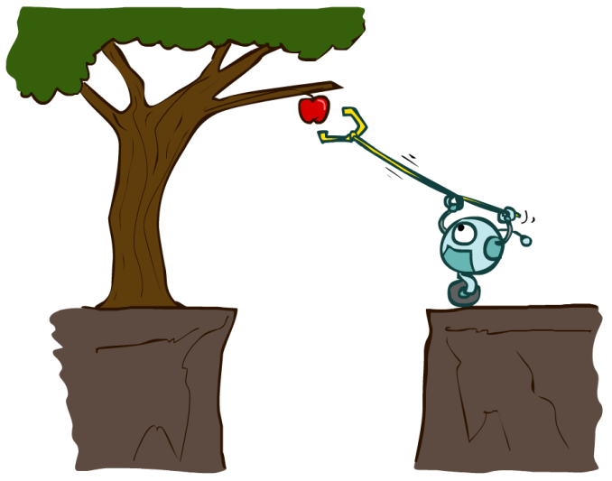
Designing Agents
An agent is an entity that perceives and acts.
Characteristics of the percepts and state, environment, and action space dictate techniques for selecting actions
This course is about:
  General AI techniques for a variety of problem types
  Learning to recognize when and how a new problem can be solved with an existing technique
Sensors
Agent
Percepts
Environment
?
Actuators
Actions

Slide 5
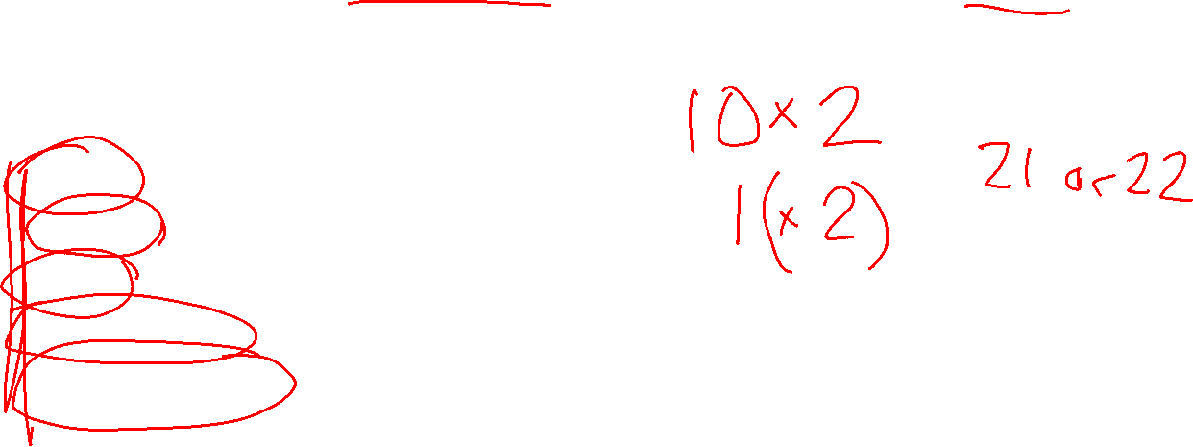
Missed Lecture 1 Activity
An agent controls the elevator in a 10-story building. On each floor, the doors can be open or closed. The elevator can also be ``moving'' between floors. How many states could the agent be in?
Single or Multi-agent?
Discrete or Continuous states?
Static or Dynamic environment?
Deterministic or Stochastic actions?
Fully observable or partially states?

Slide 6

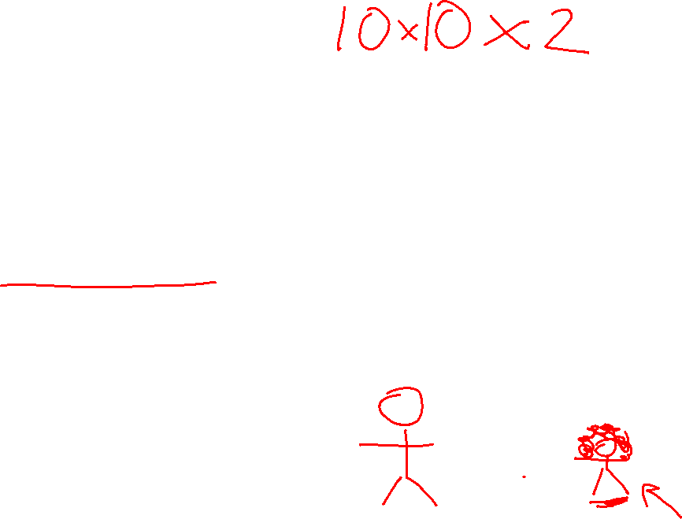
Missed Lecture 1 Activity
Hopscotch is a game where 10 squares are drawn and labeled 1-10. There is also a “start state” to stand on a throw a stone. A player throws the stone and then hops the squares in order, avoiding the one with the stone in it. Other players watch.
Consider the states where two players – scotcher and observer - and the stone are situated in the middle of the game. Ignore the state where the player is holding the stone, but do consider when they have not started jumping yet. Assume the game is played on a flat surface.
How many states are there in hopscotch?
Continuous or discrete states?
Start State

Slide 7
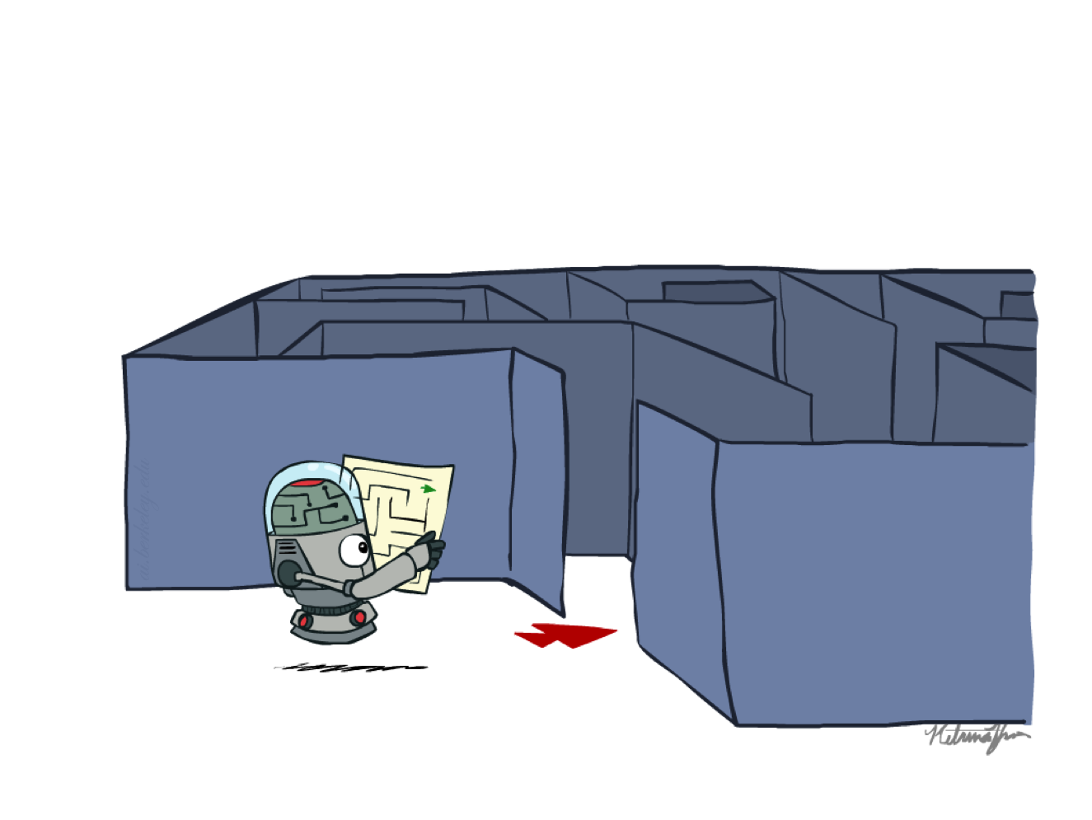
AI: Representation and Problem Solving
Agents and Search
Instructors: Stephanie Rosenthal
Slide credits: CMU AI, http://ai.berkeley.edu

Slide 8
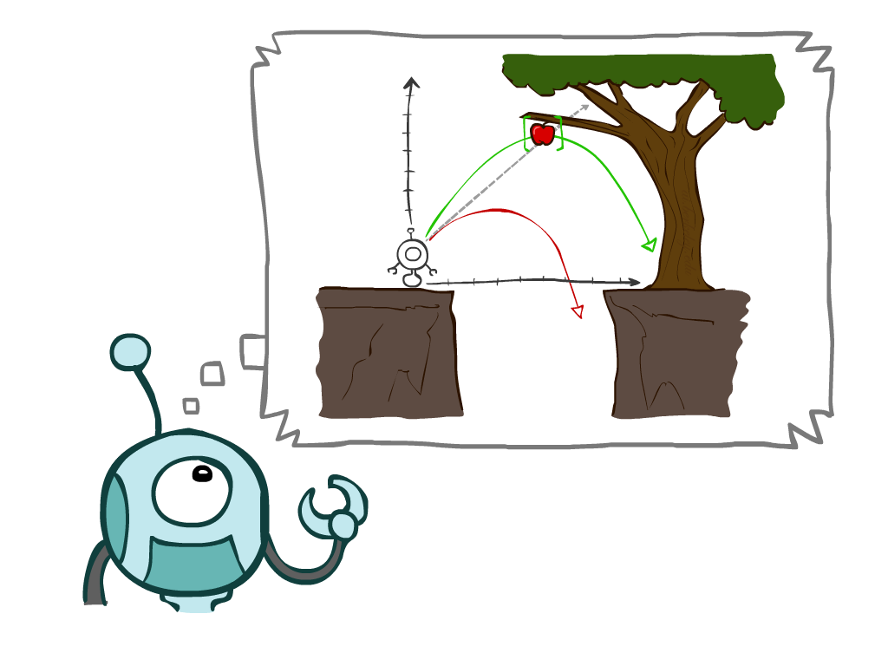
Today
Reflex vs Planning Agents
Search Problems
Uninformed Search Methods
  Depth-First Search
  Breadth-First Search
  Uniform-Cost Search
Notes:
General theme in the class:
A goal we have in mind.
A mathematical abstraction to formalize this
Algorithms that operate on these abstractions

Slide 9
Designing Agents
An agent is an entity that perceives and acts.
Characteristics of the percepts and state, environment, and action space dictate techniques for selecting actions
Sensors
Agent
Percepts
Environment
?
Actuators
Actions

Slide 10
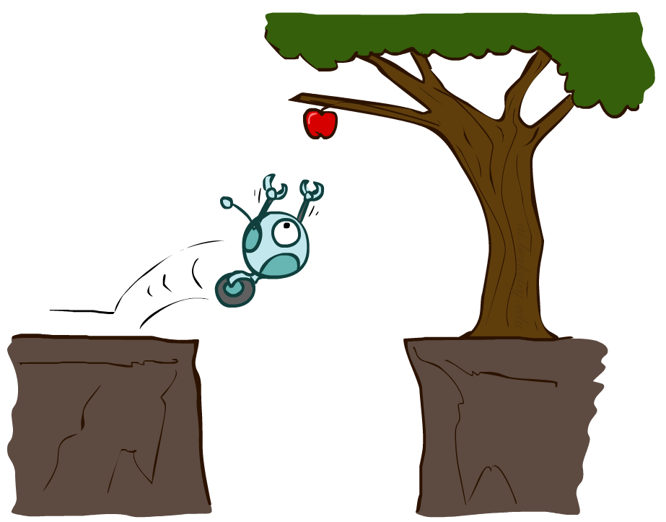

Reflex Agents
Reflex agents:
  Choose actions based on current/historic state
  Do not consider the future consequences of their actions
  May have memory or a model of the world’s current state
  Consider how the world IS
Can a reflex agent be rational?
Notes:
Examples: blinking your eye (not using your entire thinking capabilities), vacuum cleaner moving towards nearest dirt

Slide 11
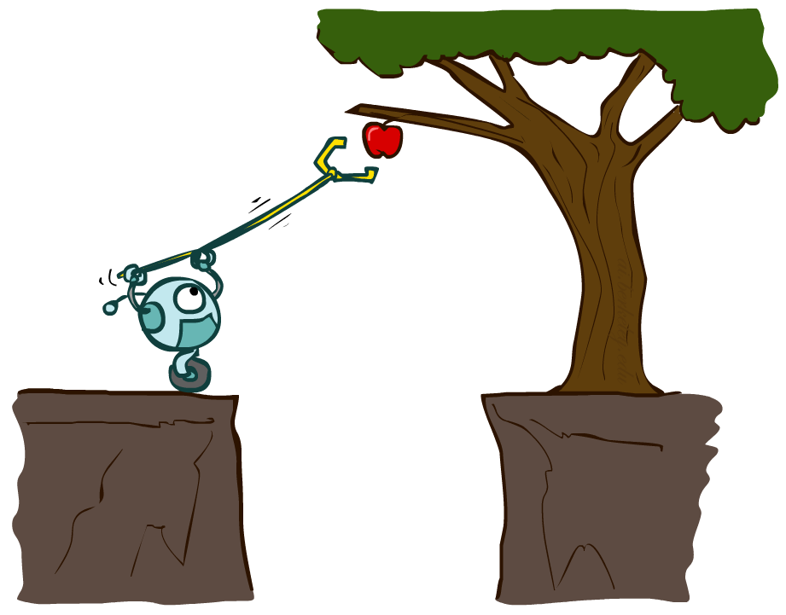
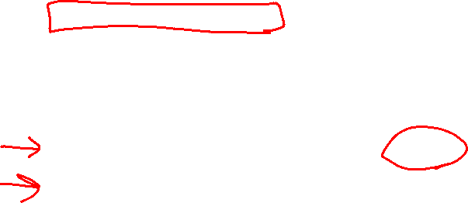
Agents that Plan Ahead
Planning agents:
  Decisions based on predicted consequences of actions
  Must have a transition model: how the world evolves in response to actions
  Must formulate a goal
  Consider how the world WOULD BE
Spectrum of deliberativeness:
  Generate complete, optimal plan offline, then execute
  Generate a simple, greedy plan, start executing, replan when something goes wrong

Slide 12

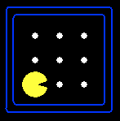





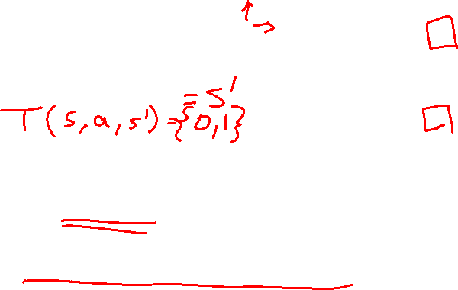
Search Problems
A search problem consists of:
  A state space
  For each state, a set
  Actions(s) of allowable actions
  A transition model Result(s,a)
  A step cost function c(s,a,s’)
  A start state and a goal test
A solution is a sequence of actions (a plan) which transforms the start state to a goal state
{N, E}
1
N
E
1
Notes:
Often comes back on exams
Goal test – sometimes more than one state that satisfies having achieved the goal, for example, “eat all the dots”
Abstraction

Slide 13

Example: Travelling in Romania
State space:
  Cities
Actions:
  Go to adjacent city
Transition model
  Result(A, Go(B)) = B
Step cost
  Distance along road link
Start state:
  Arad
Goal test:
  Is state == Bucharest?
Solution?
Notes:
Infinitely many solutions! Some better than others

Slide 14
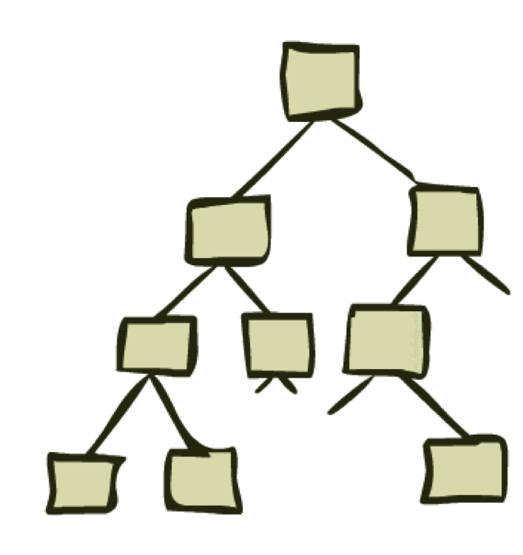
State Space Graphs and Search Trees

Slide 15
State Space Graphs
State space graph: A mathematical representation of a search problem
  Nodes are (abstracted) world configurations
  Arcs represent transitions resulting from actions
  The goal test is a set of goal nodes (maybe only one)
In a state space graph, each state occurs only once!
We can rarely build this full graph in memory (it’s too big), but it’s a useful idea

Slide 16

More Examples
Notes:
Typical exponential (or infinite) graph implicitly defined (AI)

Slide 17
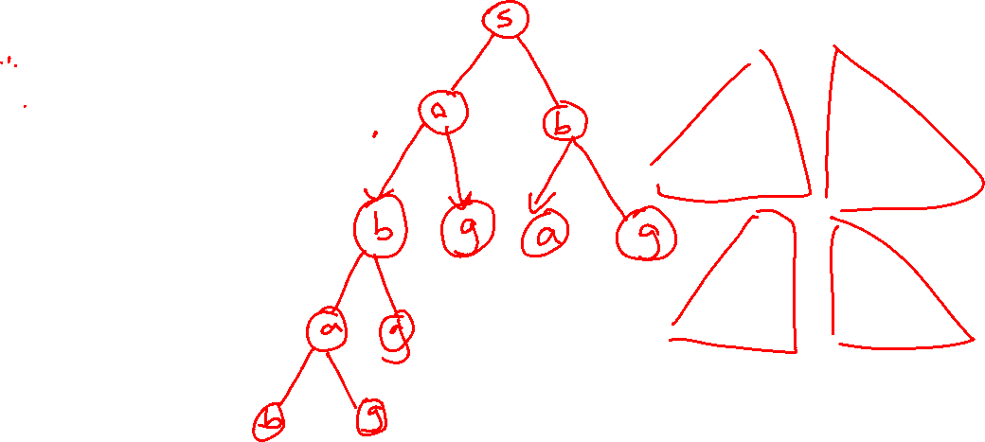
State Space Graphs vs. Search Trees
Consider this 4-state graph:
How big is its search tree (from S)?
S
a
a
b
S
G
b
G
G
a
b
G
a
b
G
∞
Important: Lots of repeated structure in the search tree!

Slide 18
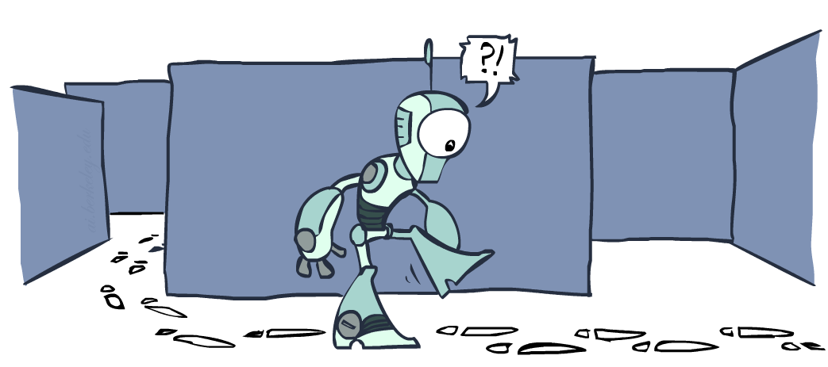
Tree Search vs Graph Search

Slide 19

function TREE_SEARCH(problem) returns a solution, or failure
initialize the frontier as a specific work list (stack, queue, priority queue)
add initial state of problem to frontier
loop do
if the frontier is empty then
return failure
choose a node and remove it from the frontier
if the node contains a goal state then
return the corresponding solution
for each resulting child from node
add child to the frontier

Slide 20
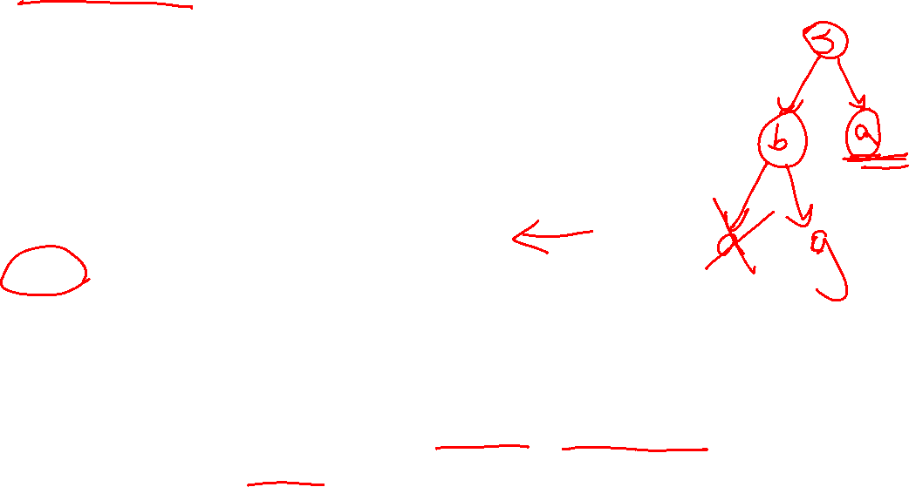
function GRAPH_SEARCH(problem) returns a solution, or failure
initialize the explored set to be empty
initialize the frontier as a specific work list (stack, queue, priority queue)
add initial state of problem to frontier
loop do
if the frontier is empty then
return failure
choose a node and remove it from the frontier
if the node contains a goal state then
return the corresponding solution
add the node state to the explored set
for each resulting child from node
if the child state is not already in the frontier or explored set then
add child to the frontier

Slide 21

Poll 1
What is the relationship between these sets of states after each loop iteration in GRAPH_SEARCH?
(Loop invariants!!!)
A
B
C
Explored
Never Seen
Explored
Never Seen
Explored
Never Seen
Frontier
Frontier
Frontier

Slide 22
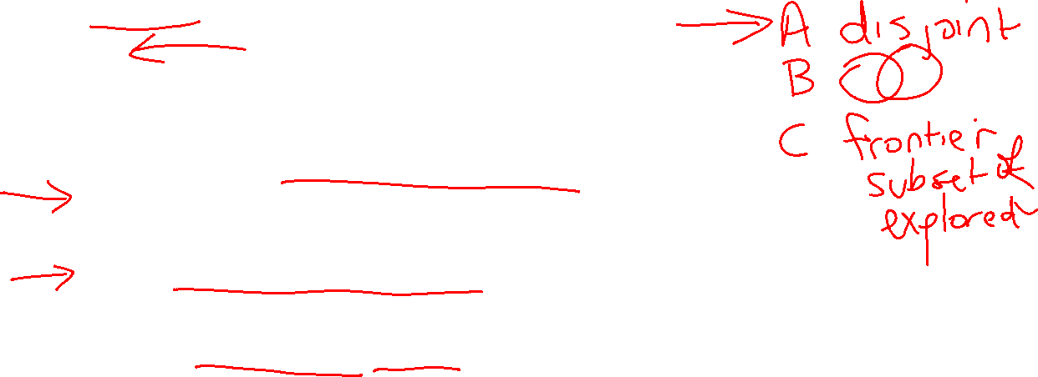
Poll 1
function GRAPH-SEARCH(problem) returns a solution, or failure
initialize the explored set to be empty
initialize the frontier as a specific work list (stack, queue, priority queue)
add initial state of problem to frontier
loop do
if the frontier is empty then
return failure
choose a node and remove it from the frontier
if the node contains a goal state then
return the corresponding solution
add the node state to the explored set
for each resulting child from node
if the child state is not already in the frontier or explored set then
add child to the frontier

Slide 23
A Note on Implementation
Nodes have
state, parent, action, path-cost
A child of node by action a has
state = result(node.state,a)
parent = node
action = a
path-cost = node.path_cost + step_cost(node.state, a, self.state)
Extract solution by tracing back parent pointers, collecting actions

Slide 24
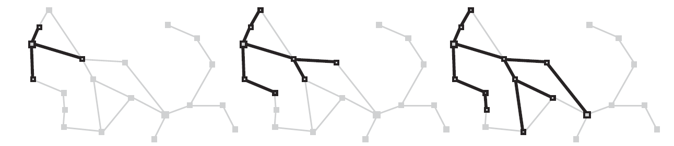
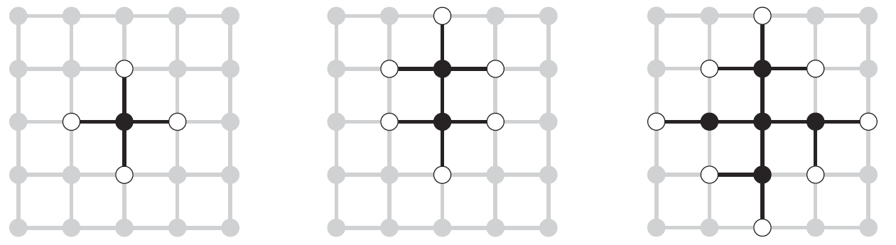

Graph Search
This graph search algorithm overlays a tree on a graph
The frontier states separate the explored states from never seen states
Images: AIMA, Figure 3.8, 3.9

Slide 25
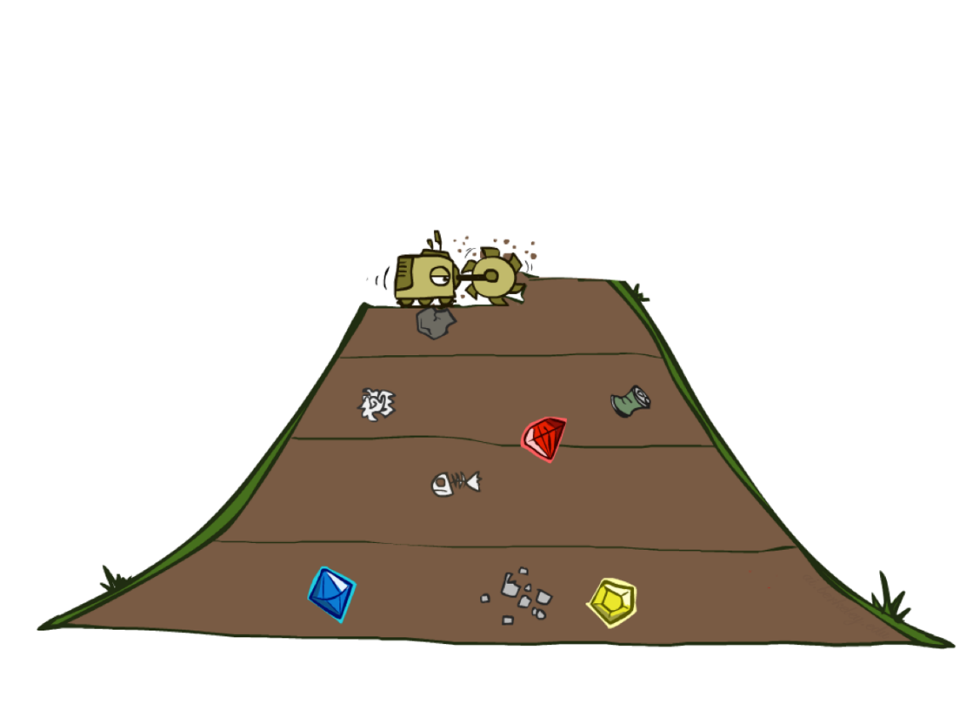
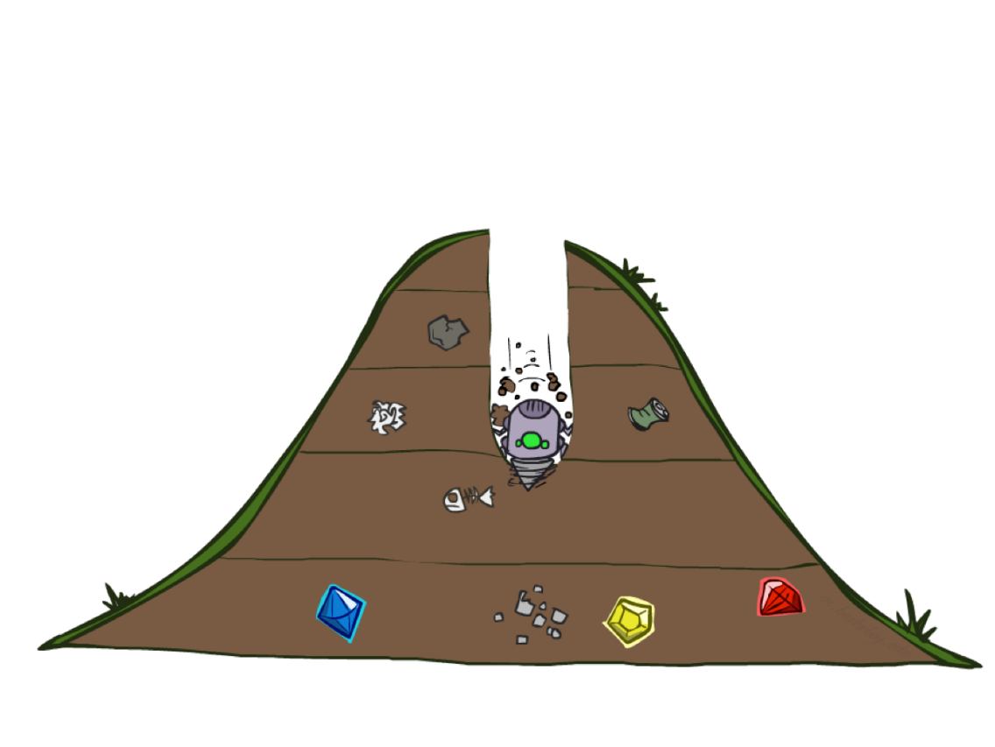
BFS vs DFS

Slide 26
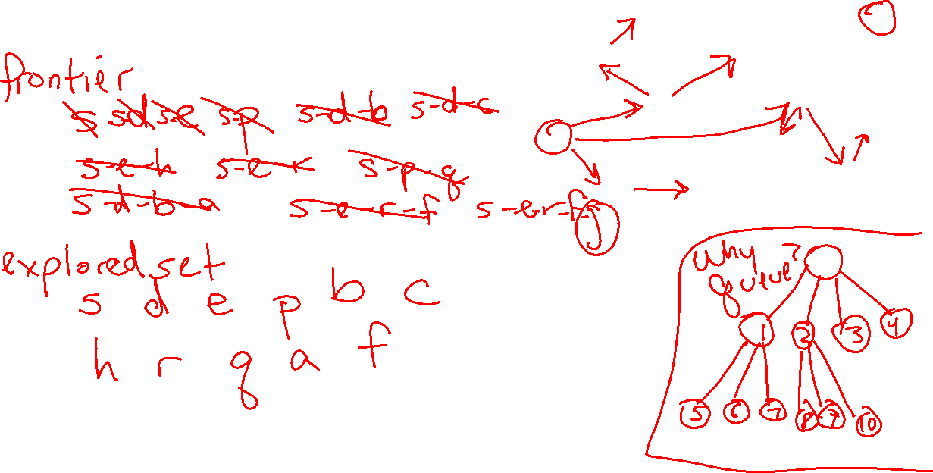
Walk-through BFS Graph Search
G
a
b
c
e
d
f
S
h
p
q
r

Slide 27
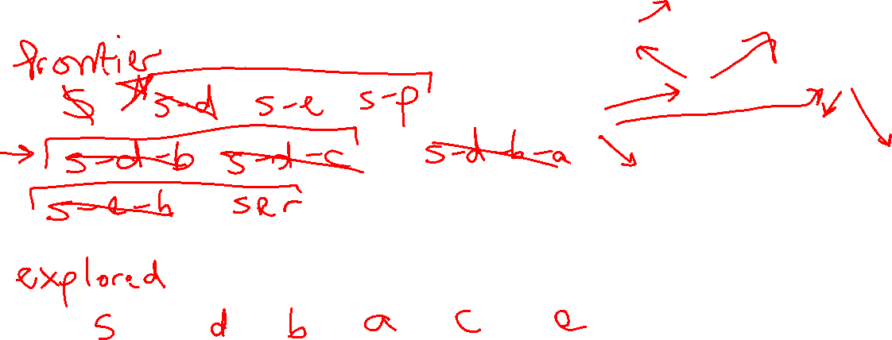
Walk-through DFS Graph Search
G
a
b
c
e
d
f
S
h
p
q
r

Slide 28
Depth-First (Tree) Search
Strategy: expand a deepest node first
Implementation: Frontier is a LIFO stack
a
G
a
c
b
c
b
e
d
e
d
f
f
S
h
h
p
p
r
q
r
q
S
d
e
p
b
c
e
h
r
q
a
a
h
r
p
q
f
p
q
f
q
c
G
q
c
G
a
a

Slide 29
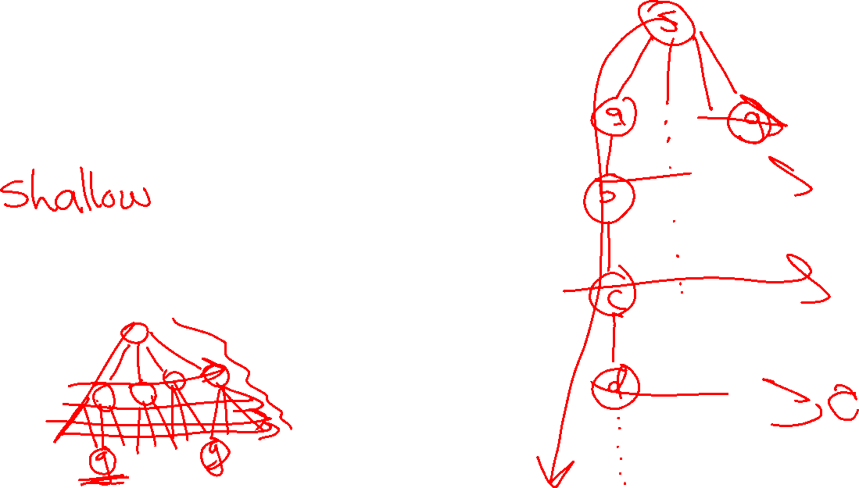
BFS vs DFS
When will BFS outperform DFS?
When will DFS outperform BFS?

Slide 30
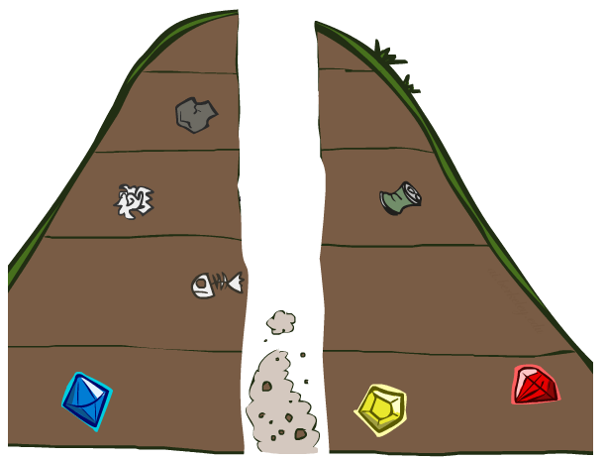
Search Algorithm Properties

Slide 31
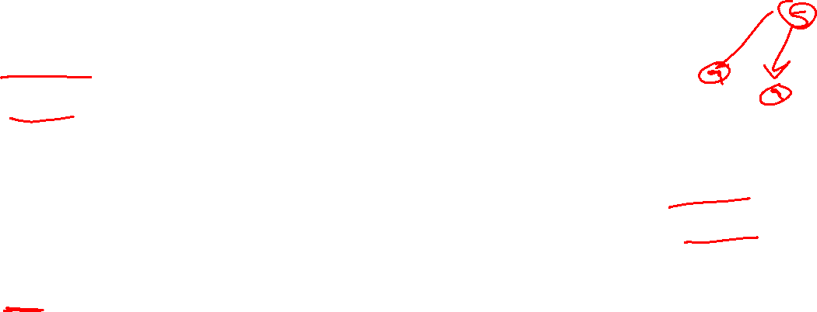
Search Algorithm Properties
Complete: Guaranteed to find a solution if one exists?
Optimal: Guaranteed to find the least cost path?
Time complexity?
Space complexity?
Cartoon of search tree:
  b is the branching factor
  m is the maximum depth
  solutions at various depths
Number of nodes in entire tree?
  1 + b + b² + …. b^{m} = O(b^{m})
1 node
b
…
b nodes
b² nodes
m tiers
b^{m} nodes

Slide 32
Search Algorithm Properties
Complete: Guaranteed to find a solution if one exists?
Optimal: Guaranteed to find the least cost path?
Time complexity?
Space complexity?
Cartoon of search tree:
  b is the branching factor
  m is the maximum depth
  solutions at various depths
Number of nodes in entire tree?
  1 + b + b² + …. b^{m} = O(b^{m})
1 node
b
…
b nodes
b² nodes
m tiers
b^{m} nodes

Slide 33

Think about it…
1 node
Are these the properties for BFS or DFS?
  Takes O(b^{m}) time
  Uses O(bm) space on frontier
  Complete with graph search
  Not optimal unless all goals are in the same level (and the same step cost everywhere)
b
…
b nodes
b² nodes
m tiers
b^{m} nodes

Slide 34
Depth-First Search (DFS) Properties
What nodes does DFS expand?
  Some left prefix of the tree.
  Could process the whole tree!
  If m is finite, takes time O(b^{m})
How much space does the frontier take?
  Only has siblings on path to root, so O(bm)
Is it complete? (always find a solution)
  m could be infinite, so only if we prevent cycles (graph search)
Is it optimal? (solution is “best”)
  No, it finds the “leftmost” solution, regardless of depth or cost
1 node
b
…
b nodes
b² nodes
m tiers
b^{m} nodes

Slide 35

Breadth-First Search (BFS) Properties
What nodes does BFS expand?
  Processes all nodes above shallowest solution
  Let depth of shallowest solution be s
  Search takes time O(b^{s})
How much space does the frontier take?
  Has roughly the last tier, so O(b^{s})
Is it complete?
  s must be finite if a solution exists, so yes!
Is it optimal?
  Only if costs are all the same (more on costs later)
1 node
b
…
b nodes
s tiers
b² nodes
b^{s} nodes
b^{m} nodes

Slide 36
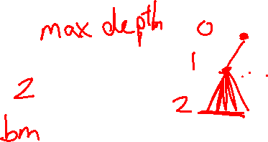
Iterative Deepening
Idea: get DFS’s space advantage with BFS’s time / shallow-solution advantages
  Run a DFS with depth limit 1. If no solution…
  Run a DFS with depth limit 2. If no solution…
  Run a DFS with depth limit 3. …..
Isn’t that wastefully redundant?
  Generally most work happens in the lowest level searched, so not so bad!
b
…

Slide 37
Iterative Deepening
Strategy: expand a deepest node first to a max depth, iteratively increase the depth
Implementation: Frontier is a LIFO stack
a
G
b
c
d
e
f
S
h
p
q
r
S
d
e
p
b
c
e
h
r
q
a
a
h
r
p
q
f
p
q
f
q
c
G
q
c
G
a
a

Slide 38
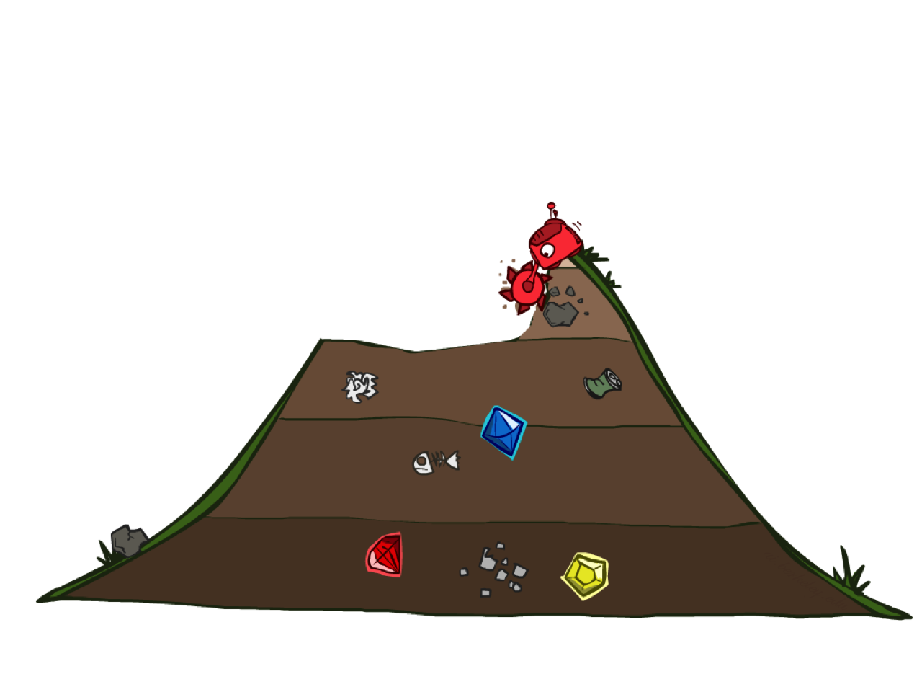
Uniform Cost Search

Slide 39
function GRAPH_SEARCH(problem) returns a solution, or failure
initialize the explored set to be empty
initialize the frontier as a specific work list (stack, queue, priority queue)
add initial state of problem to frontier
loop do
if the frontier is empty then
return failure
choose a node and remove it from the frontier
if the node contains a goal state then
return the corresponding solution
add the node state to the explored set
for each resulting child from node
if the child state is not already in the frontier or explored set then
add child to the frontier

Slide 40
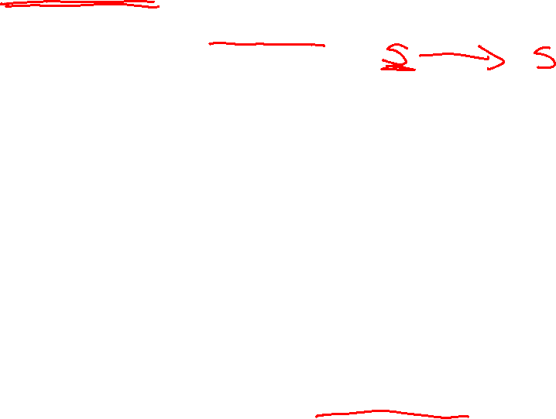
function UNIFORM-COST-SEARCH(problem) returns a solution, or failure
initialize the explored set to be empty
initialize the frontier as a priority queue using node path_cost as the priority
add initial state of problem to frontier with path_cost = 0
loop do
if the frontier is empty then
return failure
choose a node and remove it from the frontier
if the node contains a goal state then
return the corresponding solution
add the node state to the explored set
for each resulting child from node
if the child state is not already in the frontier or explored set then
add child to the frontier
else if the child is already in the frontier with higher path_cost then
replace that frontier node with child

Slide 41
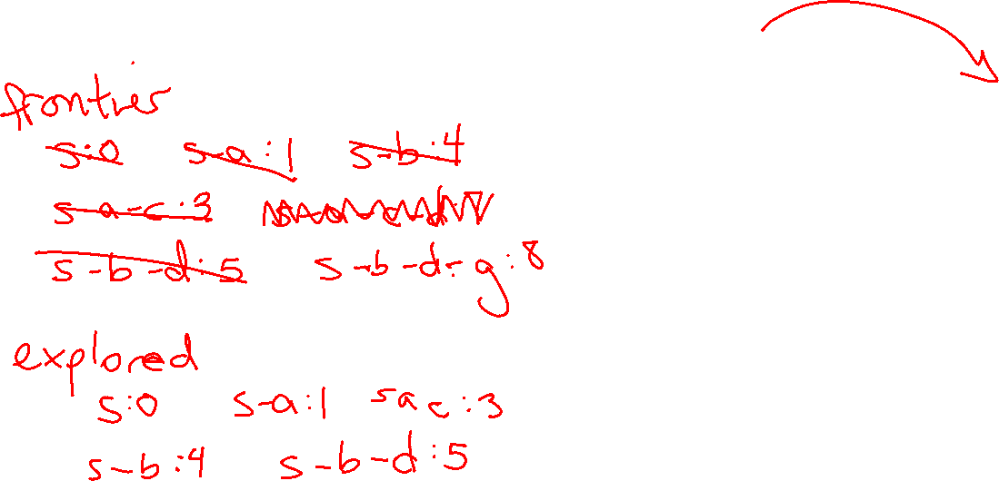
Walk-through UCS
2
C
A
G
4
1
3
S
B
D
4
1

Slide 42
Walk-through UCS
a
GOAL
2
2
b
c
3
2
1
8
2
e
3
d
f
START
9
8
2
h
1
4
2
p
4
r
q
15

Slide 43
In Class Activity!
Q1 – practice running graph search. What gets added to the explored list in what order?
Q2 - Amazon warehouses use robots to transport items to packers along the outside edge of the warehouse to reduce the amount of walking those packers must do. These robots need to plan their paths to their goals without hitting each other.
Think about how we would apply graph search to this multi-robot problem…

Slide 44
Summary
- Reflex vs Planning Agents
- Modeling state based on the problem you’re trying to solve
- Tree vs Graph Search
- BFS, DFS, UCS
- Branching factor, Search space (size of frontier)
- Completeness of search is whether it will always find A solution
- Optimality of search is whether it always finds the BEST solution
Extra slides below on search properties and iterative deepening

Slide 45
Breadth-First (Tree) Search
Strategy: expand a shallowest node first
Implementation: Frontier is a FIFO queue
a
G
b
c
d
e
f
S
h
p
q
r
S
d
e
p
Search
Tiers
b
c
e
h
r
q
a
a
h
r
p
q
f
p
q
f
q
c
G
q
c
G
a
a

Slide 46
Uniform Cost (Tree) Search
2
G
a
Strategy: expand a cheapest node first:
Frontier is a priority queue (priority: cumulative cost)
b
c
1
8
2
2
e
3
d
f
9
8
2
S
h
1
1
p
q
r
15
0
S
d
3
e
9
p
1
b
4
e
5
h
17
r
11
q
16
c
11
Cost contours
a
6
a
h
13
r
7
p
q
f
p
q
f
8
q
c
G
q
c
a
11
G
10
a

Slide 47
Uniform Cost Search (UCS) Properties
What nodes does UCS expand?
  Processes all nodes with cost less than cheapest solution!
  If that solution costs C* and arcs cost at least ε , then the “effective depth” is roughly C*/ε
  Takes time O(b^{C*/ε}) (exponential in effective depth)
How much space does the frontier take?
  Has roughly the last tier, so O(b^{C*/ε})
Is it complete?
  Assuming best solution has a finite cost and minimum arc cost is positive, yes!
Is it optimal?
  Yes! (Proof next lecture via A*)
b
c ≤ 1
…
C*/ε “tiers”
c ≤ 2
c ≤ 3

Slide 48
Uniform Cost Issues
Remember:
UCS explores increasing cost contours
The good:
UCS is complete and optimal!
The bad:
  Explores options in every “direction”
  No information about goal location
We’ll fix that soon!
…
c ≤ 1
c ≤ 2
c ≤ 3
Start
Goal

