Slide 1
Warm-up: What to eat?
We are trying healthy by finding the optimal amount of food to purchase.
We can choose the amount of stir-fry (ounce) and boba (fluid ounces).
Healthy Squad Goals
2000 $≤$ Calories $≤$ 2500
Sugar $≤$ 100 g
Calcium $≥$ 700 mg
Food | Cost | Calories | Sugar | Calcium
Stir-fry (per oz) | 1 | 100 | 3 | 20
Boba (per fl oz) | 0.5 | 50 | 4 | 70
What is the cheapest way to stay “healthy” with this menu?
How much stir-fry (ounce) and boba (fluid ounces) should we buy?

Slide 2
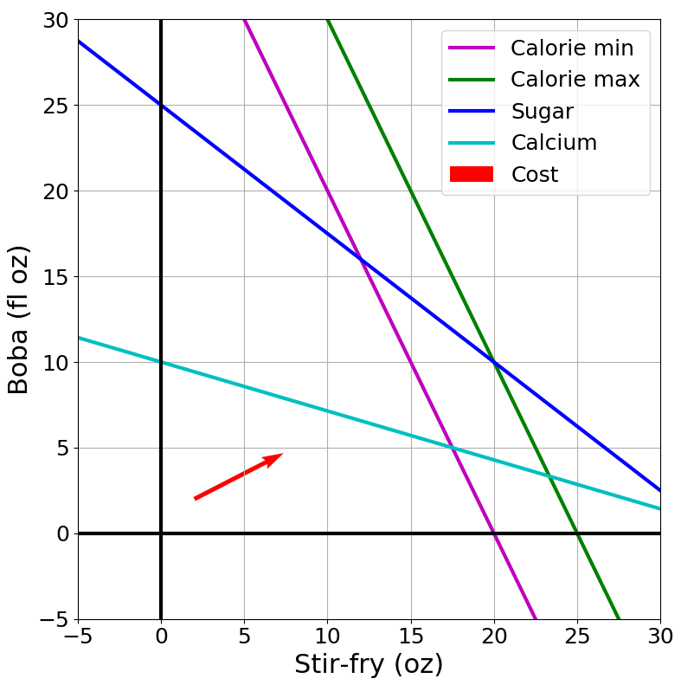

Slide 3
Announcements
Assignments:
HW3 (online)
Due Tonight, 10 pm
HW4 (online)
Due 2/14, 10 pm
P1: Search and Games due yesterday!!
P2: Linear/Integer Programming
Due 2/23, 10pm (1 week after the exam)
Exam 1 Feb 16!

Slide 4
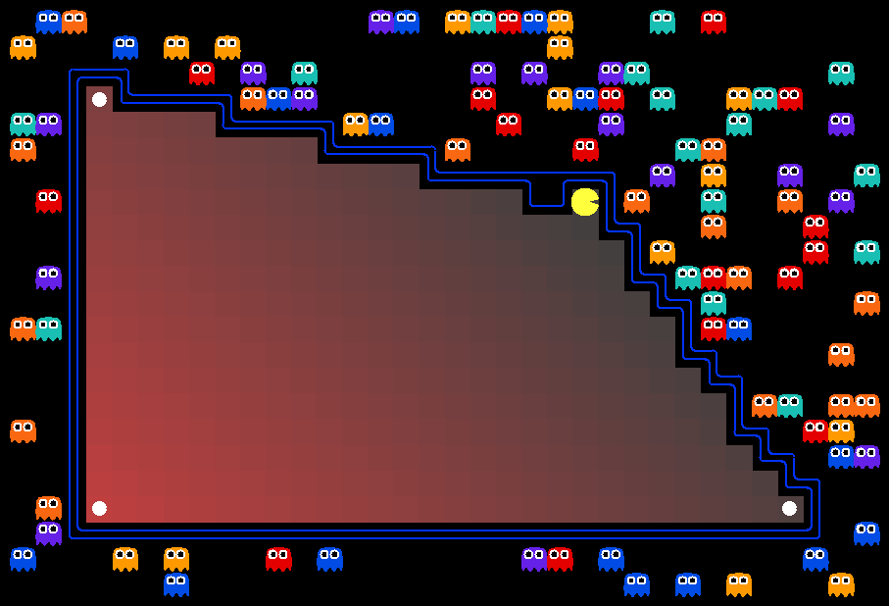
AI: Representation and Problem Solving
Linear Programming
Instructor: Stephanie Rosenthal
Slide credits: CMU AI with drawings from http://ai.berkeley.edu

Slide 5
Warm-up: What to eat?
We are trying healthy by finding the optimal amount of food to purchase.
We can choose the amount of stir-fry (ounce) and boba (fluid ounces).
Healthy Squad Goals
2000 $≤$ Calories $≤$ 2500
Sugar $≤$ 100 g
Calcium $≥$ 700 mg
Food | Cost | Calories | Sugar | Calcium
Stir-fry (per oz) | 1 | 100 | 3 | 20
Boba (per fl oz) | 0.5 | 50 | 4 | 70
What is the cheapest way to stay “healthy” with this menu?
How much stir-fry (ounce) and boba (fluid ounces) should we buy?

Slide 6
Optimization
Graphical Representation
Problem Description
Optimization Representation
$$\min_{x}{ c^{T}x}$$
s.t. $Ax⪯b$

Slide 7
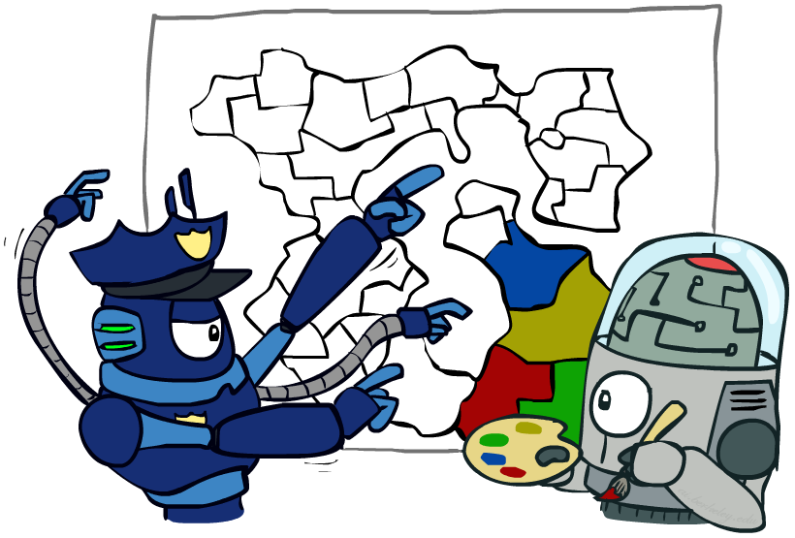
Constraint Satisfaction Problems
Map coloring
$\operatorname{Any}{ x}$
s.t. $x satisfies constraints$
Notation Alert!

Slide 8
Optimization Formulation
Diet Problem
$\operatorname{Any}{ x}$
s.t. $x satisfies constraints$
Healthy Squad Goals
2000 $≤$ Calories $≤$ 2500
Sugar $≤$ 100 g
Calcium $≥$ 700 mg
Food | Cost | Calories | Sugar | Calcium
Stir-fry (per oz) | 1 | 100 | 3 | 20
Boba (per fl oz) | 0.5 | 50 | 4 | 70
Notation Alert!

Slide 9
Optimization Formulation
Diet Problem
Objective
$\min_{x}{ cost(x)}$
s.t. $x satisfies constraints$
Healthy Squad Goals
2000 $≤$ Calories $≤$ 2500
Sugar $≤$ 100 g
Calcium $≥$ 700 mg
Food | Cost | Calories | Sugar | Calcium
Stir-fry (per oz) | 1 | 100 | 3 | 20
Boba (per fl oz) | 0.5 | 50 | 4 | 70
Notation Alert!

Slide 10
Optimization Formulation
Diet Problem
$\min_{x}{ cost(x)}$
s.t. $calories\left(x\right) contained$
$sugar\left(x\right)≤limit$
calcium$\left(x\right)≥limit$
Healthy Squad Goals
2000 $≤$ Calories $≤$ 2500
Sugar $≤$ 100 g
Calcium $≥$ 700 mg
Food | Cost | Calories | Sugar | Calcium
Stir-fry (per oz) | 1 | 100 | 3 | 20
Boba (per fl oz) | 0.5 | 50 | 4 | 70

Slide 11
Optimization Formulation
Diet Problem
$\min_{x_{1}, { x}_{2}}{ {1 x}_{1}+0.5 x_{2}}$
s.t. $100 x_{1}+50 x_{2}≥2000$
$100 x_{1}+50 x_{2}≤2500$
$3 x_{1}+ 4 x_{2}≤100$
$20 x_{1}+70 x_{2}≥700$
Healthy Squad Goals
2000 $≤$ Calories $≤$ 2500
Sugar $≤$ 100 g
Calcium $≥$ 700 mg
Food | Cost | Calories | Sugar | Calcium
Stir-fry (per oz) | 1 | 100 | 3 | 20
Boba (per fl oz) | 0.5 | 50 | 4 | 70
Notation Alert!

Slide 12
Optimization Formulation
Diet Problem
$\min_{x_{1}, { x}_{2}}{ {c_{1} x}_{1}+c_{2} x_{2}}$
s.t. $a_{1,1} x_{1}+a_{1,2} x_{2}≥b_{1}$
$a_{2,1} x_{1}+a_{2,2} x_{2}≤b_{2}$
$a_{3,1} x_{1}+a_{3,2} x_{2}≤b_{3}$
$a_{4,1} x_{1}+a_{4,2} x_{2}≥b_{4}$
Cost
$$c=\left[\begin{aligned}1 \\ 0.5\end{aligned}\right]$$
Stir-fry
Boba
Limit
$$A=\left[\begin{matrix}100 & 50 \\ \begin{aligned}100 \\ 3 \\ 20\end{aligned} & \begin{aligned}50 \\ 4 \\ 70\end{aligned}\end{matrix}\right]$$
$$b=\left[\begin{aligned}2000 \\ 2500 \\ 100 \\ 700\end{aligned}\right]$$
Calorie min
Calorie max
Sugar
Notation Alert!
Calcium

Slide 13
Optimization Formulation
Diet Problem
$\min_{x}{ c^{T}x}$
s.t. $a_{1,1} x_{1}+a_{1,2} x_{2}≥b_{1}$
$a_{2,1} x_{1}+a_{2,2} x_{2}≤b_{2}$
$a_{3,1} x_{1}+a_{3,2} x_{2}≤b_{3}$
$a_{4,1} x_{1}+a_{4,2} x_{2}≥b_{4}$
Cost
$$c=\left[\begin{aligned}1 \\ 0.5\end{aligned}\right]$$
Stir-fry
Boba
Limit
$$A=\left[\begin{matrix}100 & 50 \\ \begin{aligned}100 \\ 3 \\ 20\end{aligned} & \begin{aligned}50 \\ 4 \\ 70\end{aligned}\end{matrix}\right]$$
$$b=\left[\begin{aligned}2000 \\ 2500 \\ 100 \\ 700\end{aligned}\right]$$
Calorie min
Calorie max
Sugar
Notation Alert!
Calcium

Slide 14
Optimization Formulation
Diet Problem
$\min_{x}{ c^{T}x}$
s.t. $−a_{1,1} x_{1}−a_{1,2} x_{2}≤−b_{1}$
$a_{2,1} x_{1}+a_{2,2} x_{2}≤b_{2}$
$a_{3,1} x_{1}+a_{3,2} x_{2}≤b_{3}$
$−a_{4,1} x_{1}−a_{4,2} x_{2}≤−b_{4}$
Cost
$$c=\left[\begin{aligned}1 \\ 0.5\end{aligned}\right]$$
Stir-fry
Boba
Limit
$$A=\left[\begin{matrix}100 & 50 \\ \begin{aligned}100 \\ 3 \\ 20\end{aligned} & \begin{aligned}50 \\ 4 \\ 70\end{aligned}\end{matrix}\right]$$
$$b=\left[\begin{aligned}2000 \\ 2500 \\ 100 \\ 700\end{aligned}\right]$$
Calorie min
Calorie max
Sugar
Calcium

Slide 15
Optimization Formulation
Diet Problem
$\min_{x}{ c^{T}x}$
s.t. $a_{1,1} x_{1}+a_{1,2} x_{2}≤b_{1}$
$a_{2,1} x_{1}+a_{2,2} x_{2}≤b_{2}$
$a_{3,1} x_{1}+a_{3,2} x_{2}≤b_{3}$
$a_{4,1} x_{1}+a_{4,2} x_{2}≤b_{4}$
Cost
$$c=\left[\begin{aligned}1 \\ 0.5\end{aligned}\right]$$
Stir-fry
Boba
Limit
$$A=\left[\begin{matrix}−100 & −50 \\ \begin{aligned}100 \\ 3 \\ −20\end{aligned} & \begin{aligned}50 \\ 4 \\ −70\end{aligned}\end{matrix}\right]$$
$$b=\left[\begin{aligned}−2000 \\ 2500 \\ 100 \\ −700\end{aligned}\right]$$
Calorie min
Calorie max
Sugar
Calcium

Slide 16
Optimization Formulation
Diet Problem
$\min_{x}{ c^{T}x}$
s.t. $Ax⪯b$
Cost
$$c=\left[\begin{aligned}1 \\ 0.5\end{aligned}\right]$$
Stir-fry
Boba
Limit
$$A=\left[\begin{matrix}−100 & −50 \\ \begin{aligned}100 \\ 3 \\ −20\end{aligned} & \begin{aligned}50 \\ 4 \\ −70\end{aligned}\end{matrix}\right]$$
$$b=\left[\begin{aligned}−2000 \\ 2500 \\ 100 \\ −700\end{aligned}\right]$$
Calorie min
Calorie max
Sugar
Notation Alert!
Calcium

Slide 17
Poll 1
What has to increase to add more nutrition constraints?
$\min_{x}{ c^{T}x}$
s.t. $Ax⪯b$
Select all that apply
length $x$
length $c$
height $A$
width $A$
length $b$
Notes:
C and E

Slide 18
Poll 1
What has to increase to add more nutrition constraints?
$\min_{x}{ c^{T}x}$
s.t. $Ax⪯b$
$$A=\left[\begin{matrix}−100 & −50 \\ \begin{aligned}100 \\ 3 \\ −20\end{aligned} & \begin{aligned}50 \\ 4 \\ −70\end{aligned}\end{matrix}\right]$$
$$b=\left[\begin{aligned}−2000 \\ 2500 \\ 100 \\ −700\end{aligned}\right]$$
$$x=\left[\begin{aligned}x_{1} \\ x_{2}\end{aligned}\right]$$
$$c=\left[\begin{aligned}1 \\ 0.5\end{aligned}\right]$$

Slide 19
Poll 2
What has to increase to add more menu items?
$\min_{x}{ c^{T}x}$
s.t. $Ax⪯b$
Select all that apply
length $x$
length $c$
height $A$
width $A$
length $b$
Notes:
A, B, D

Slide 20
Poll 2
What has to increase to add more nutrition constraints?
$\min_{x}{ c^{T}x}$
s.t. $Ax⪯b$
$$A=\left[\begin{matrix}−100 & −50 \\ \begin{aligned}100 \\ 3 \\ −20\end{aligned} & \begin{aligned}50 \\ 4 \\ −70\end{aligned}\end{matrix}\right]$$
$$b=\left[\begin{aligned}−2000 \\ 2500 \\ 100 \\ −700\end{aligned}\right]$$
$$x=\left[\begin{aligned}x_{1} \\ x_{2}\end{aligned}\right]$$
$$c=\left[\begin{aligned}1 \\ 0.5\end{aligned}\right]$$

Slide 21
Poll 3
If $A∈ℝ^{M×N}$, which of the following also equals $N$?
$\min_{x}{ c^{T}x}$
s.t. $Ax⪯b$
Select all that apply
length $x$
length $c$
length $b$
Notation Alert!
Notes:
M rows and N columns
N must be anything multiplied next to A (X) and anything multiplied with x, C

Slide 22
Linear Programming
Linear objective with linear constraints
$\min_{x}.{ c^{T}x}$
s.t. $Ax⪯b$
As opposed to general optimization
$\min_{x}.{ f_{0}\left(x\right)}$
s.t. $f_{i}\left(x\right)≤0, i=1…M$
$a_{i}^{T}x=b_{i}, i=1…P$
Notes:
Linear constraints (vs general form which doesn’t have to be linear)
Some equality and some inequality

Slide 23
Linear Programming
Different formulations
Inequality form
General form
Standard form
$\min_{x}.{ c^{T}x}$
s.t. $Ax⪯b$
$\underset{x}{min.}{ c^{T}x}+d$
s.t. $Gx⪯h$
$Ax=b$
$\underset{x}{min.}{ c^{T}x}$
s.t. A$x=b$
$x ⪰0$
Important to pay attention to form!

Slide 24
Linear Programming
Different formulations
Inequality form
General form
Standard form
$\min_{x}.{ c^{T}x}$
s.t. $Ax⪯b$
$\underset{x}{min.}{ c^{T}x}+d$
s.t. $Gx⪯h$
$Ax=b$
$\underset{x}{min.}{ c^{T}x}$
s.t. A$x=b$
$x ⪰0$
Can switch between formulations!

Slide 25
Optimization
Graphical Representation
Problem Description
Optimization Representation
$$\min_{x}{ c^{T}x}$$
s.t. $Ax⪯b$

Slide 26
Graphics Representation
Geometry / Algebra I Quiz
What shape does this inequality represent?
$$a_{1} x_{1}+a_{2} x_{2}≤b_{1}$$
Notes:
Half plane (draw shape)

Slide 27
Graphics Representation
Geometry / Algebra I Quiz
What shape does this inequality represent?
$$a_{1} x_{1}+a_{2} x_{2}=b_{1}$$
$$a_{1} x_{1}+a_{2} x_{2}≤b_{1}$$
$a_{1,1} x_{1}+a_{1,2} x_{2}≤b_{1}$
$a_{2,1} x_{1}+a_{2,2} x_{2}≤b_{2}$
$a_{3,1} x_{1}+a_{3,2} x_{2}≤b_{3}$
$a_{4,1} x_{1}+a_{4,2} x_{2}≤b_{4}$
Notes:
Line, half plane, polygon

Slide 28
Poll 4
What is the relationship between the half plane:
$$a_{1} x_{1}+a_{2} x_{2}≤b_{1}$$
and the vector:
$${\left[a_{1}, a_{2}\right]}^{T}$$
$$x_{2}$$
Infeasible
II
Feasible
I
III
IV
$$x_{1}$$
Notes:
II is the correct one, pointing into the infeasible region (in the > direction)

Slide 29
Poll 5
Given the cost vector ${\left[c_{1}, c_{2}\right]}^{T}$ and initial point $x^{(0)}$,
Which unit vector step $△x$ will cause $x^{(1)}=x^{(0)}+△x$
to have the lowest cost $c^{T}x^{(1)}$?
II
I
$$c$$
III
IV
Notation Alert!
Notes:
IV

Slide 30
Cost Contours
Given the cost vector ${\left[c_{1}, c_{2}\right]}^{T}$ where will
$c^{T}x$ = 0 ?
$c^{T}x$ = 1 ?
$c^{T}x$ = 2 ?
$c^{T}x$ = -1 ?
$c^{T}x$ = -2 ?
Notes:
Parallel lines

Slide 31
Poll 6
As the magnitude of $c$ increases, the distance between
the contours lines of the objective $c^{T}x$:
Increases
Decreases
Notes:
decreases

