Slide 1

Announcements
Recitation change form closes tonight!
Assignments:
P2: Optimization
    Due Thurs 2/23, 10pm
HW4 (online)
    Covers LP, IP
    Due Tues 2/14, 10 pm (Happy Valentine’s Day)
EXAM 1 2/16!!

Slide 2
Plan
Last Time
Linear programming formulation
    Problem description
    Graphical representation
    Optimization representation
Today
Solving linear programs
Higher dimensions than just 2
Integer programs

Slide 3
From last time…

Slide 4

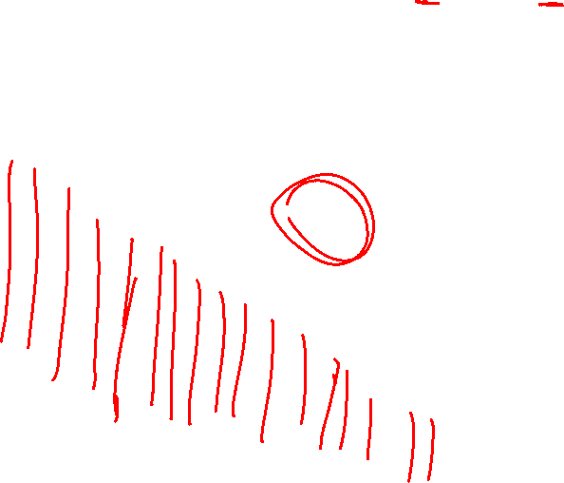


Poll 4 (already completed)
What is the relationship between the half plane:
$$a_{1} x_{1}+a_{2} x_{2}≤b_{1}$$
and the vector:
$${\left[a_{1}, a_{2}\right]}^{T}$$
$$x_{2}$$
Infeasible
II
Feasible
I
III
IV
$$x_{1}$$
Notes:
II is the correct one, pointing into the infeasible region (in the > direction)

Slide 5
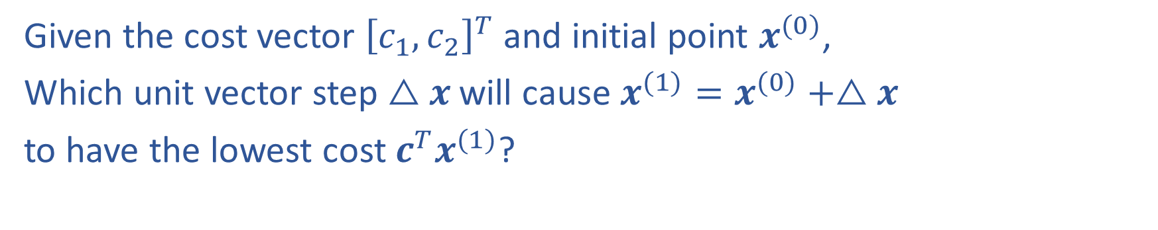
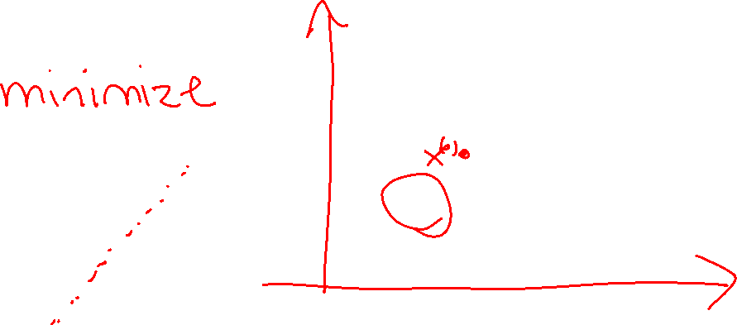

Question
Given the cost vector ${\left[c_{1}, c_{2}\right]}^{T}$ and initial point $x^{(0)}$,
Which unit vector step $△x$ will cause $x^{(1)}=x^{(0)}+△x$
to have the lowest cost $c^{T}x^{(1)}$?
II
I
$$c$$
III
IV
Notation Alert!
Notes:
IV

Slide 6
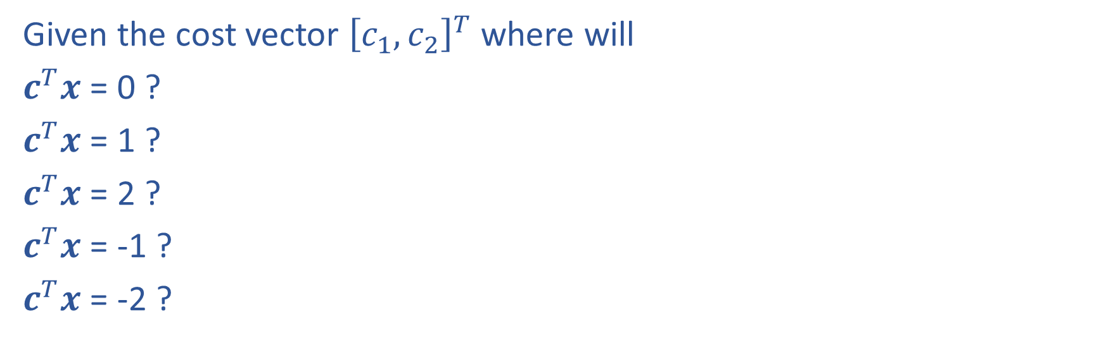
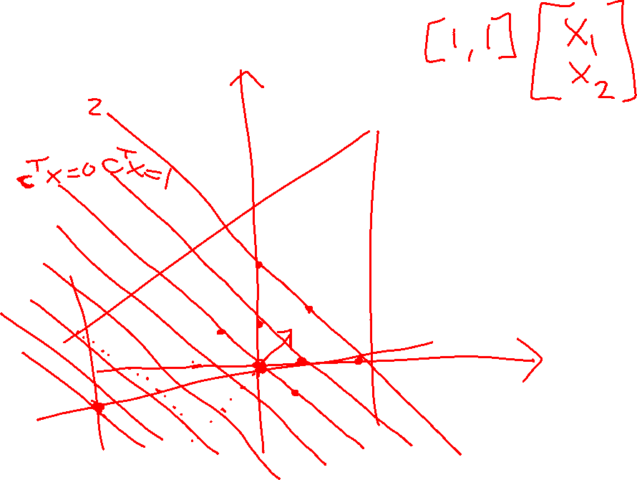
Cost Contours
Given the cost vector ${\left[c_{1}, c_{2}\right]}^{T}$ where will
$c^{T}x$ = 0 ?
$c^{T}x$ = 1 ?
$c^{T}x$ = 2 ?
$c^{T}x$ = -1 ?
$c^{T}x$ = -2 ?
Notes:
Parallel lines

Slide 7

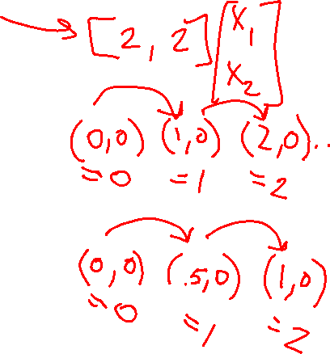
Question
As the magnitude of $c$ increases, the distance between
the contours lines of the objective $c^{T}x$:
Increases
Decreases
Notes:
decreases

Slide 8
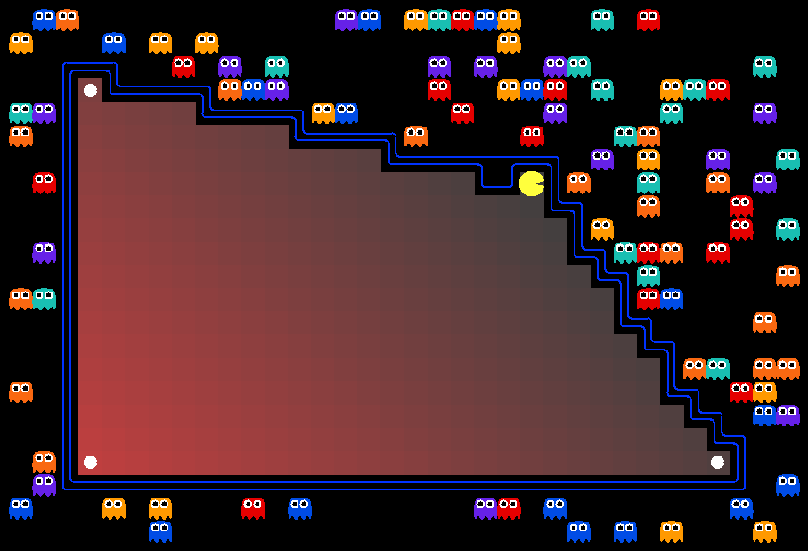
AI: Representation and Problem Solving
Integer Programming
Instructor: Stephanie Rosenthal
Slide credits: CMU AI with drawings from http://ai.berkeley.edu

Slide 9
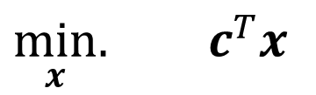
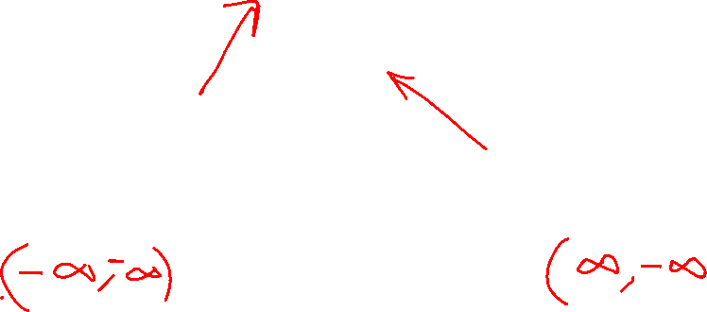
Solving a Linear Program
Inequality form, with no constraints
$\min_{x}.{ c^{T}x}$

Slide 10
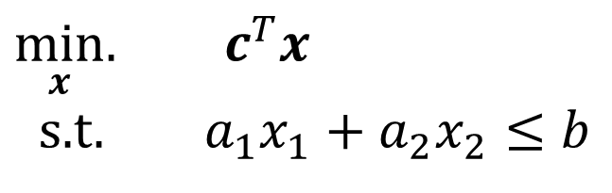
Solving a Linear Program
Inequality form, with one constraint
$\min_{x}.{ c^{T}x}$
s.t. $a_{1}x_{1}+a_{2}x_{2}≤b$

Slide 11

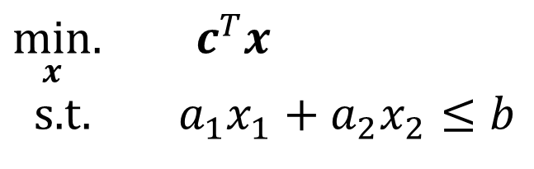
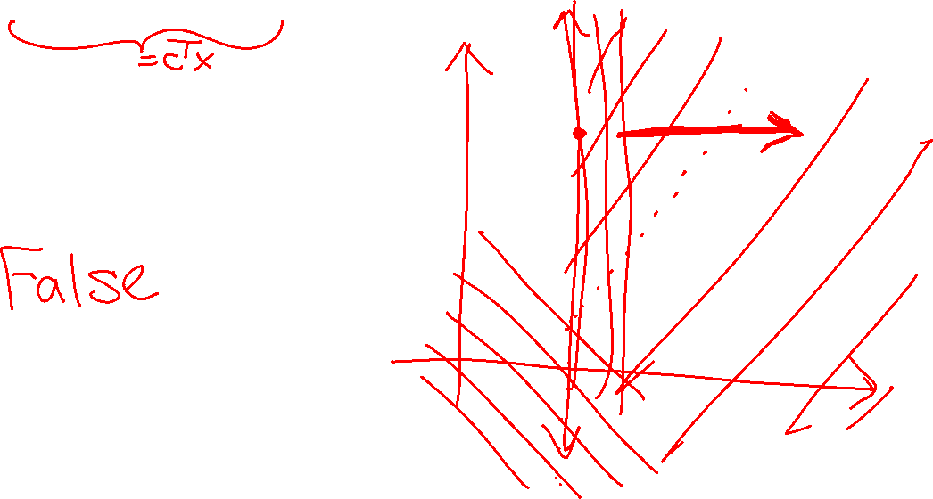
Poll 1
True or False: A minimizing LP with exactly one constraint, will always have a minimum objective at $−∞$.
$\min_{x}.{ c^{T}x}$
s.t. $a_{1}x_{1}+a_{2}x_{2}≤b$

Slide 12

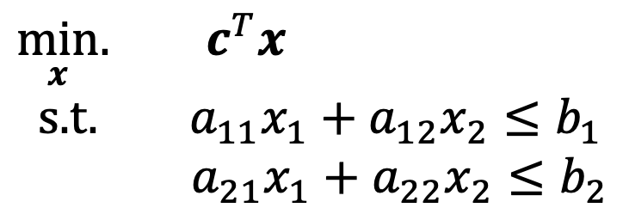
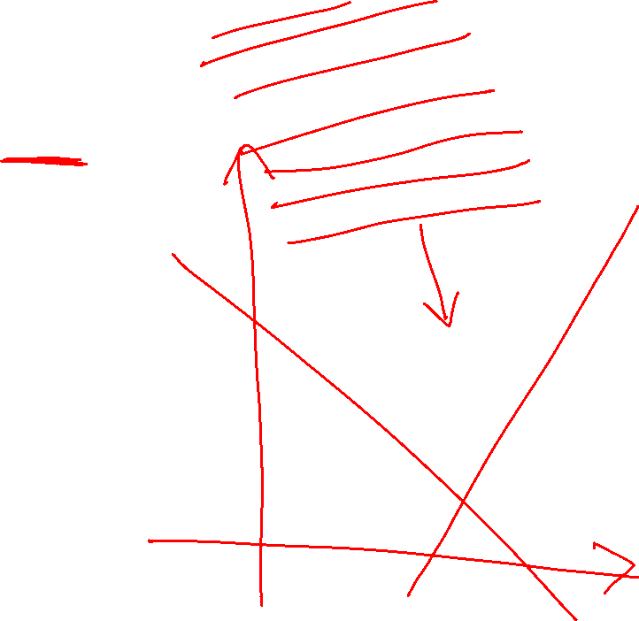
Question
True or False: A minimizing LP with exactly two constraints, will always have a minimum objective > $−∞$.
$\min_{x}.{ c^{T}x}$
s.t. $a_{11}x_{1}+a_{12}x_{2}≤b_{1}$
$a_{21}x_{1}+a_{22}x_{2}≤b_{2}$

Slide 13
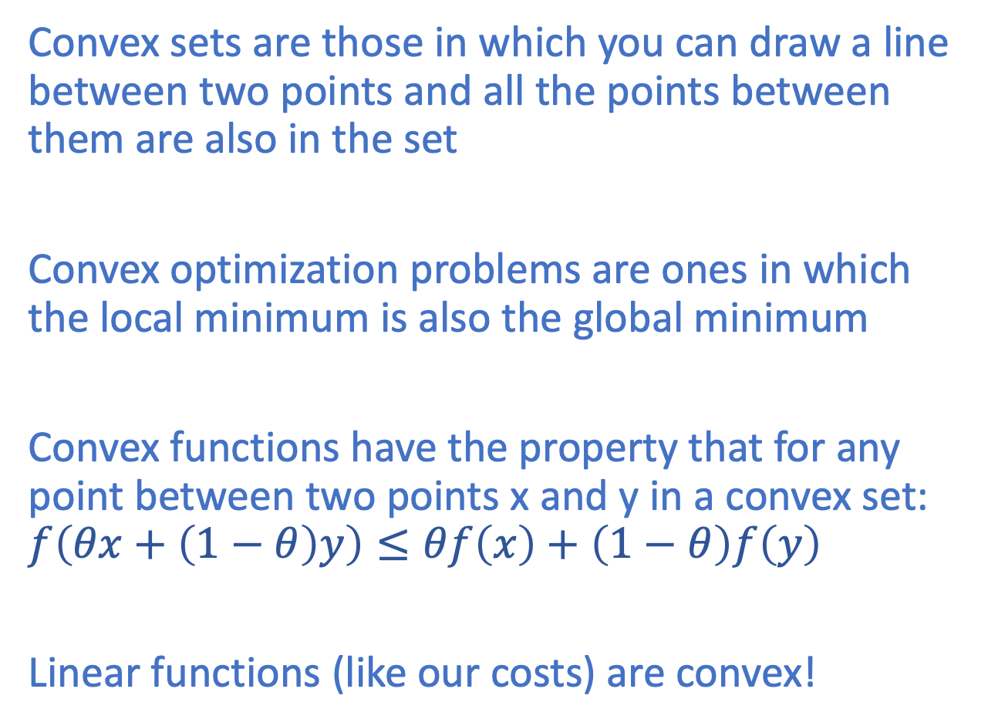
Convexity
Convex sets are those in which you can draw a line between two points and all the points between them are also in the set
Convex optimization problems are ones in which the local minimum is also the global minimum
Convex functions have the property that for any point between two points x and y in a convex set: $f\left(θx+\left(1−θ\right)y\right)≤θf\left(x\right)+\left(1−θ\right)f\left(y\right)$
Linear functions (like our costs) are convex!

Slide 14
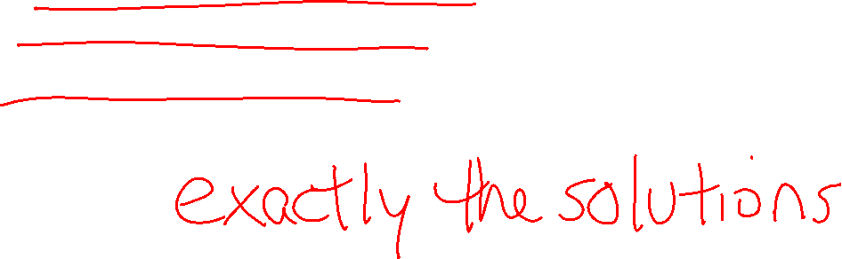
Convexity and LPs
LPs are constrained convex problems.
The constraints form a convex set
The objective function is convex
What does this tell us about the costs at the corners of a constrained polygon?

Slide 15
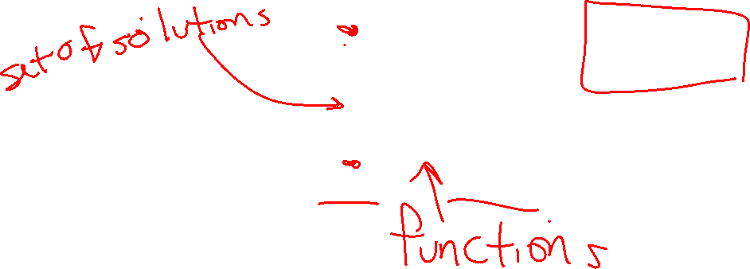
Bigger Picture
Constrained
Integer programming
Linear programming
Deep learning
Most machine learning
Unconstrained
Convex
Nonconvex

Slide 16
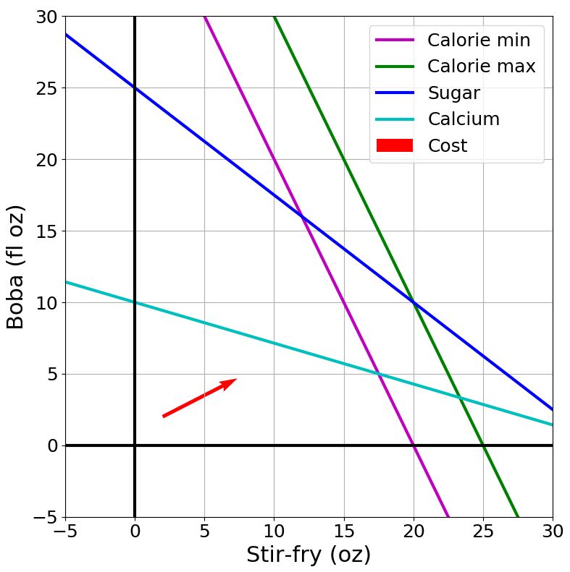

Convexity and LP Solutions
Solutions are at feasible intersections
of constraint boundaries!!

Slide 17

Solving an LP
Solutions are at feasible intersections
of constraint boundaries!!
Algorithm
Check objective at all feasible intersections
In more detail:
Enumerate all intersections
Keep only those that are feasible (satisfy all inequalities)
Return feasible intersection with the lowest objective value

Slide 18
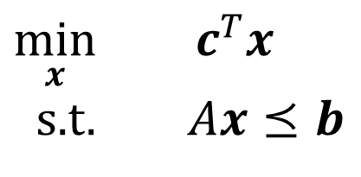
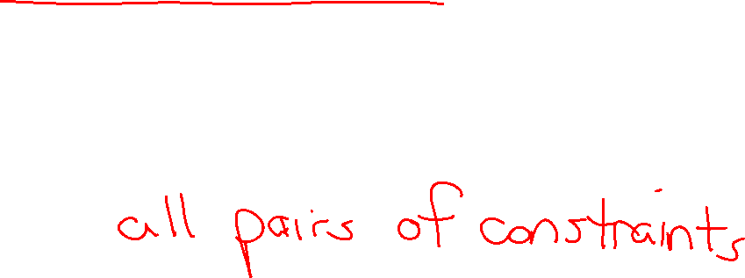
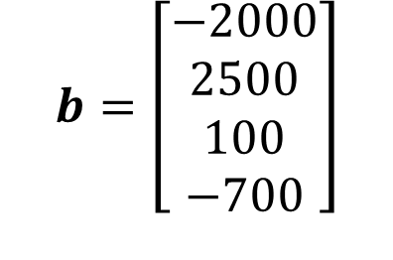
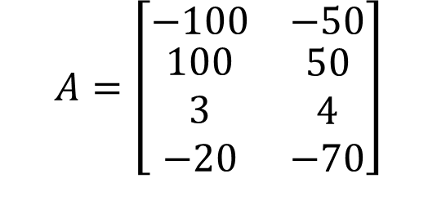
Solving an LP
But, how do we find the intersection between boundaries?
$$A=\left[\begin{matrix}−100 & −50 \\ \begin{aligned}100 \\ 3 \\ −20\end{aligned} & \begin{aligned}50 \\ 4 \\ −70\end{aligned}\end{matrix}\right]$$
$$b=\left[\begin{aligned}−2000 \\ 2500 \\ 100 \\ −700\end{aligned}\right]$$
Calorie min
$\min_{x}{ c^{T}x}$
s.t. $Ax⪯b$
Calorie max
Sugar
Calcium

Slide 19

Solving an LP
Solutions are at feasible intersections
of constraint boundaries!!
Algorithms
Check objective at all feasible intersections
Simplex

Slide 20
Solving an LP
Simplex algorithm
Start at a feasible intersection (if not trivial, can solve another LP to find one)
Define successors as “neighbors” of current intersection
  i.e., remove one row from our square subset of A, and add another row not in the subset; then check feasibility
Move to any successor with lower objective than current intersection
  If no such successors, we are done
Greedy local hill-climbing search! … but always finds optimal solution

Slide 21
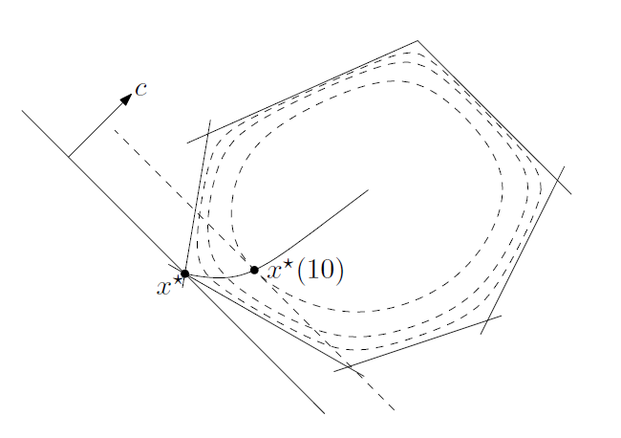
Solving an LP
Solutions are at feasible intersections
of constraint boundaries!!
Algorithms
Check objective at all feasible intersections
Simplex
Interior Point
Figure 11.2 from Boyd and Vandenberghe, Convex Optimization

Slide 22
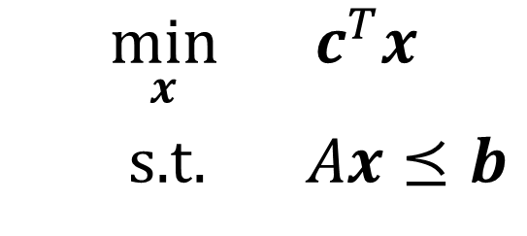
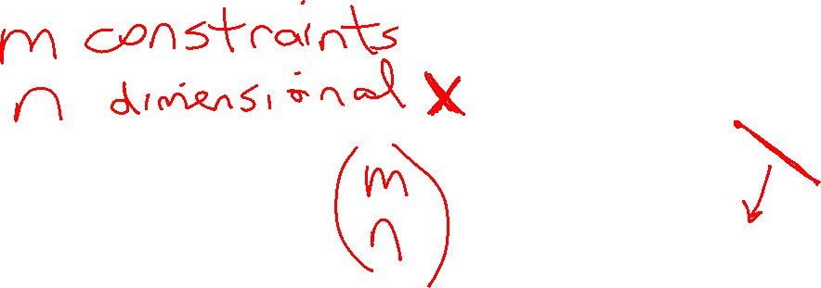
What about higher dimensions?
Problem Description
Graphical Representation
Optimization Representation
$$\min_{x}{ c^{T}x}$$
s.t. $Ax⪯b$

Slide 23

“Marty, you’re not thinking fourth-dimensionally”
https://www.youtube.com/watch?v=CUcNM7OsdsY

Slide 24
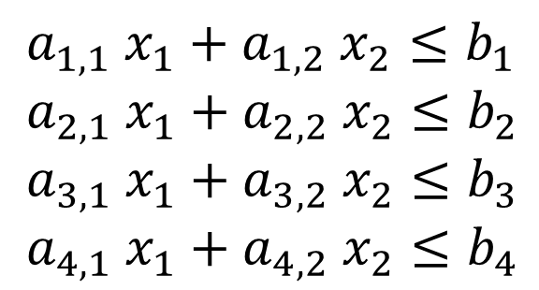


Shapes in higher dimensions
How do these linear shapes extend to 3-D, N-D?
$$a_{1} x_{1}+a_{2} x_{2}=b_{1}$$
$$a_{1} x_{1}+a_{2} x_{2}≤b_{1}$$
$a_{1,1} x_{1}+a_{1,2} x_{2}≤b_{1}$
$a_{2,1} x_{1}+a_{2,2} x_{2}≤b_{2}$
$a_{3,1} x_{1}+a_{3,2} x_{2}≤b_{3}$
$a_{4,1} x_{1}+a_{4,2} x_{2}≤b_{4}$

Slide 25


What are intersections in higher dimensions?
How do these linear shapes extend to 3-D, N-D?
$$A=\left[\begin{matrix}−100 & −50 \\ \begin{aligned}100 \\ 3 \\ −20\end{aligned} & \begin{aligned}50 \\ 4 \\ −70\end{aligned} \end{matrix}\right]$$
$$b=\left[\begin{aligned}−2000 \\ 2500 \\ 100 \\ −700\end{aligned}\right]$$
Calorie min
$\min_{x}{ c^{T}x}$
s.t. $Ax⪯b$
Calorie max
Sugar
Calcium

Slide 26


How do we find intersections in higher dimensions?
Still looking at subsets of $A$ matrix
$$A=\left[\begin{matrix}−100 & −50 \\ \begin{aligned}100 \\ 3 \\ −20\end{aligned} & \begin{aligned}50 \\ 4 \\ −70\end{aligned} \end{matrix}\right]$$
$$b=\left[\begin{aligned}−2000 \\ 2500 \\ 100 \\ −700\end{aligned}\right]$$
Calorie min
$\min_{x}{ c^{T}x}$
s.t. $Ax⪯b$
Calorie max
Sugar
Calcium

Slide 27
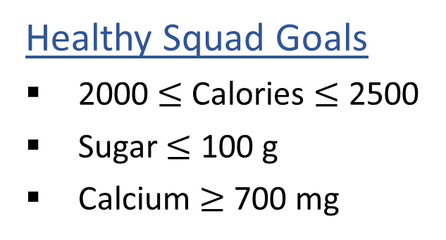
Linear Programming
We are trying to stay healthy by finding the optimal food to purchase.
We can choose the amount of stir-fry (ounce) and boba (fluid ounces).
Healthy Squad Goals
2000 $≤$ Calories $≤$ 2500
Sugar $≤$ 100 g
Calcium $≥$ 700 mg
Food | Cost | Calories | Sugar | Calcium
Stir-fry (per oz) | 1 | 100 | 3 | 20
Boba (per fl oz) | 0.5 | 50 | 4 | 70
What is the cheapest way to stay “healthy” with this menu?
How much stir-fry (ounce) and boba (fluid ounces) should we buy?

Slide 28

Linear Programming → Integer Programming
We are trying healthy by finding the optimal amount of food to purchase.
We can choose the amount of stir-fry (bowls) and boba (glasses).
Healthy Squad Goals
2000 $≤$ Calories $≤$ 2500
Sugar $≤$ 100 g
Calcium $≥$ 700 mg
Food | Cost | Calories | Sugar | Calcium
Stir-fry (per bowl) | 1 | 100 | 3 | 20
Boba (per glass) | 0.5 | 50 | 4 | 70
What is the cheapest way to stay “healthy” with this menu?
How much stir-fry (ounce) and boba (fluid ounces) should we buy?

Slide 29
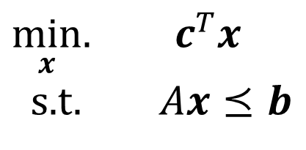
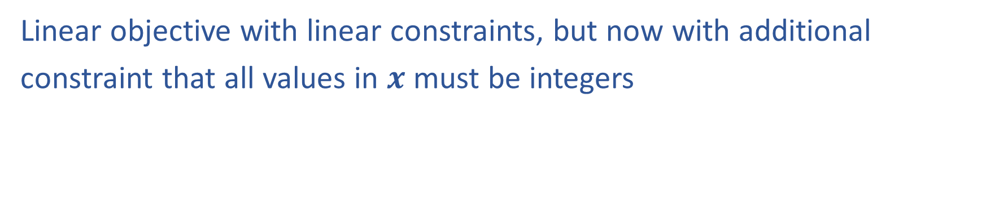
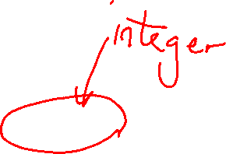
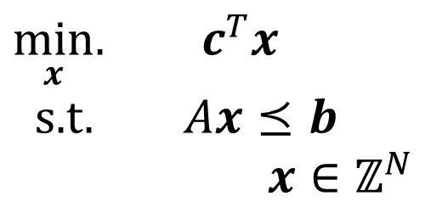
Linear Programming vs Integer Programming
Linear objective with linear constraints, but now with additional
constraint that all values in $x$ must be integers
$\min_{x}.{ c^{T}x}$
s.t. $Ax⪯b$
$\min_{x}.{ c^{T}x}$
s.t. $Ax⪯b$
$x∈ℤ^{N}$
We could also do:
Even more constrained: Binary Integer Programming
A hybrid: Mixed Integer Linear Programming
Notation Alert!

Slide 30

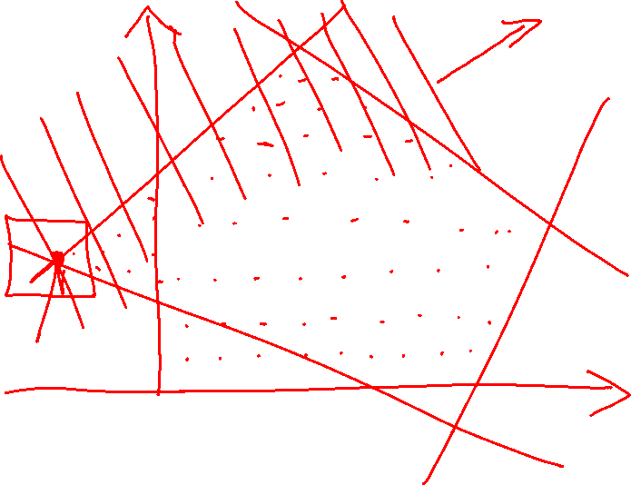
Integer Programming: Graphical Representation
Just add a grid of integer points onto our LP representation
$\min_{x}.{ c^{T}x}$
s.t. $Ax⪯b$
$x∈ℤ^{N}$

Slide 31
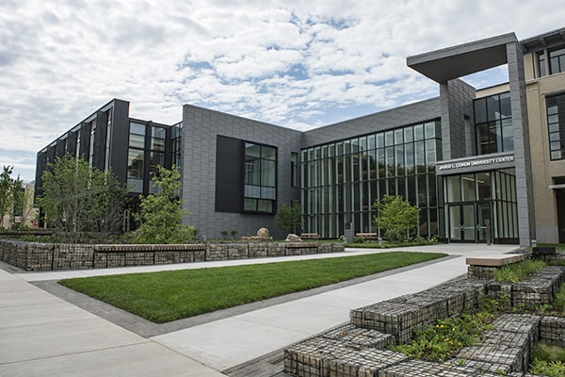
Integer Programming: Scheduling
How would we formulate our CSP as an integer program?
How would we could we solve it?
Notes:
One variable per club,room pair
Each could be 0 or 1
Sum over clubs of one room = 1
Sum over rooms of a club = 1

Slide 32
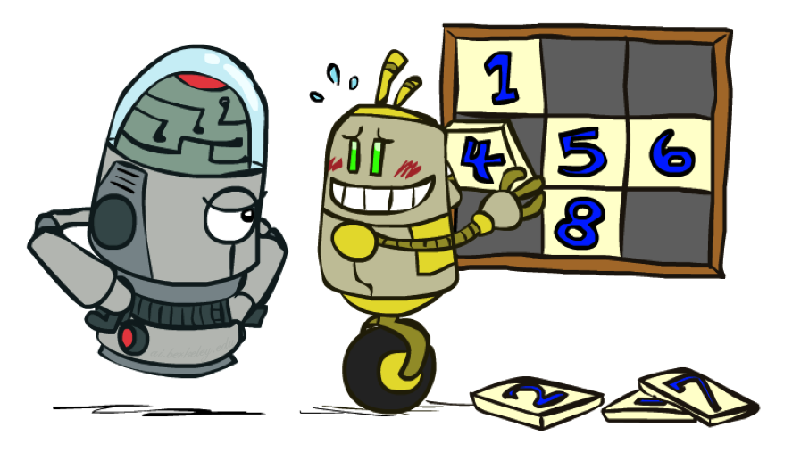

Convexity and IPs
Integer programs are not convex, but perhaps we can use the LP solvers to find solutions to integer programs?
Relax IP to LP by dropping integer constraints
$\min_{x}.{ c^{T}x}$
s.t. $Ax⪯b$
$x∈ℤ^{N}$
Remember heuristics?

Slide 33
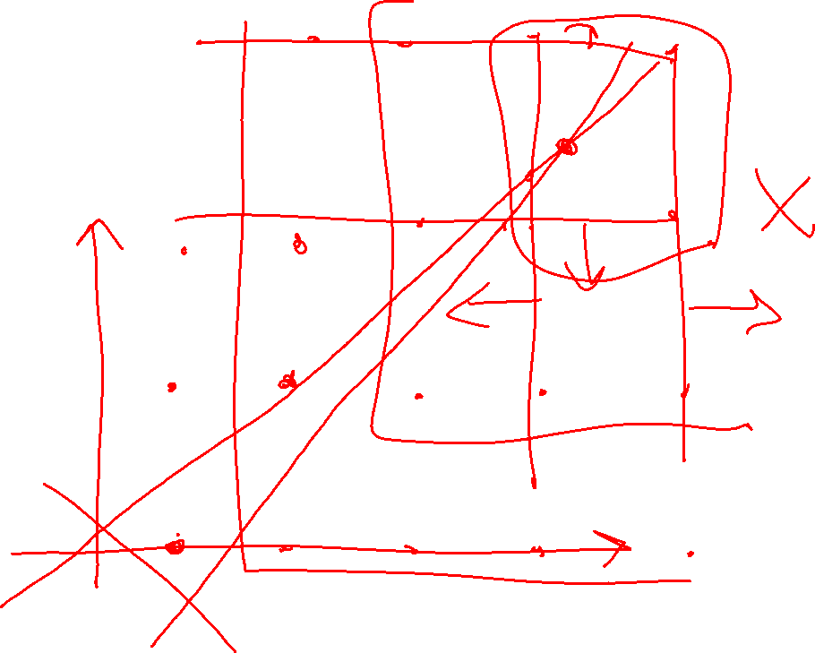
Poll 2:
True/False: It is sufficient to consider the integer points around the corresponding LP solution?

Slide 34
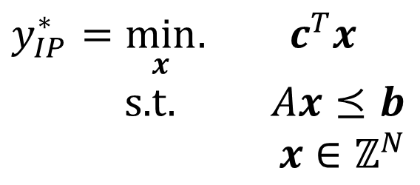
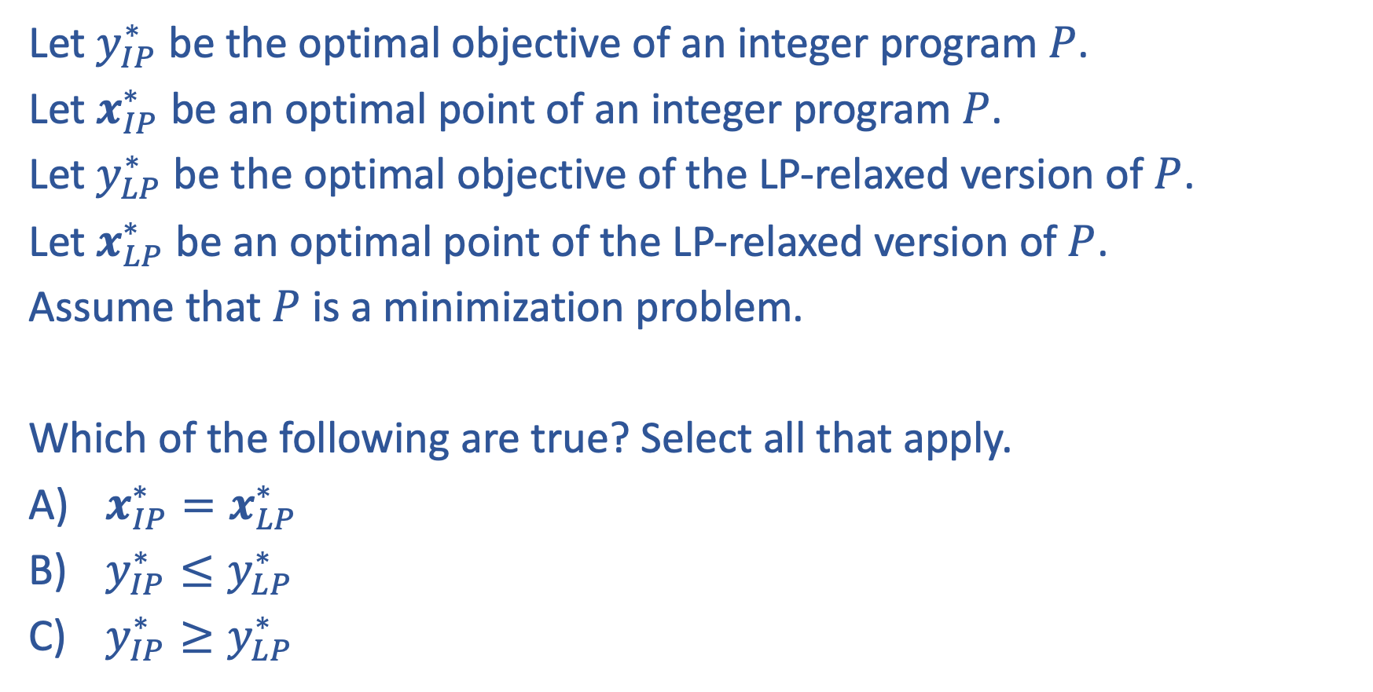

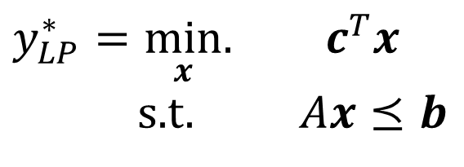
Poll 3:
Let $y_{IP}^{∗}$ be the optimal objective of an integer program $P$.
Let $x_{IP}^{∗}$ be an optimal point of an integer program $P$.
Let $y_{LP}^{∗}$ be the optimal objective of the LP-relaxed version of $P$.
Let $x_{LP}^{∗}$ be an optimal point of the LP-relaxed version of $P$.
Assume that $P$ is a minimization problem.
Which of the following are true? Select all that apply.
$x_{IP}^{∗}=x_{LP}^{∗}$
$y_{IP}^{∗}≤y_{LP}^{∗}$
$y_{IP}^{∗}≥y_{LP}^{∗}$
$y_{IP}^{∗}=\min_{x}.{ c^{T}x}$
s.t. $Ax⪯b$
$x∈ℤ^{N}$
$y_{LP}^{∗}=\min_{x}.{ c^{T}x}$
s.t. $Ax⪯b$

Slide 35
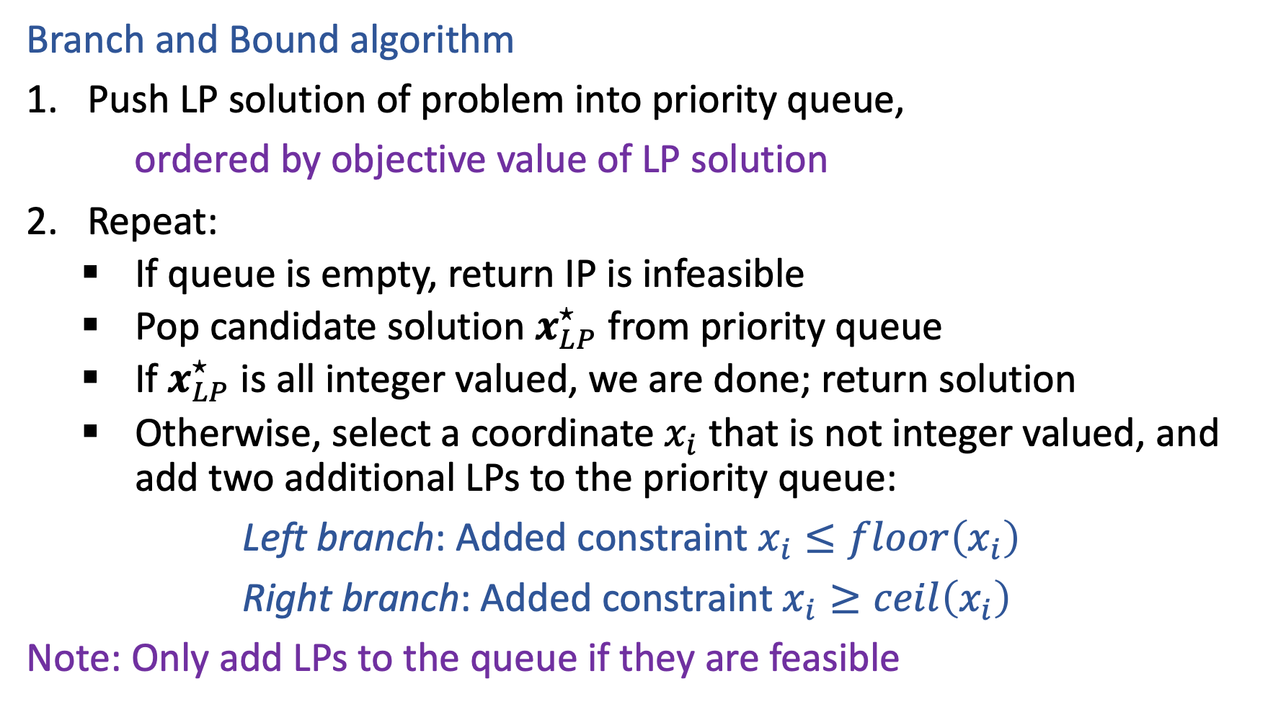
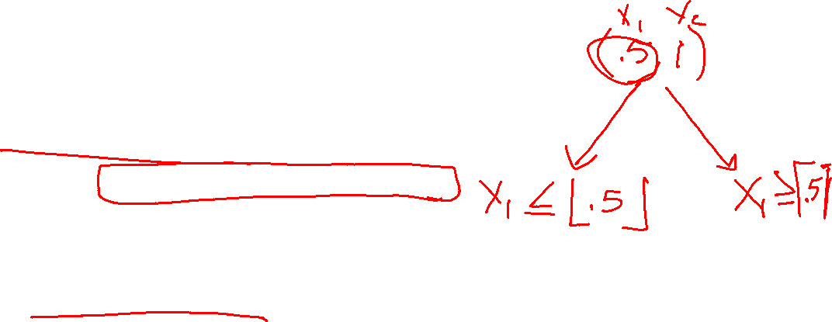
Solving an IP
Branch and Bound algorithm
Push LP solution of problem into priority queue,
ordered by objective value of LP solution
Repeat:
    If queue is empty, return IP is infeasible
    Pop candidate solution $x_{LP}^{⋆}$ from priority queue
    If $x_{LP}^{⋆}$ is all integer valued, we are done; return solution
    Otherwise, select a coordinate $x_{i}$ that is not integer valued, and add two additional LPs to the priority queue:
Left branch: Added constraint $x_{i}≤floor\left(x_{i}\right)$
Right branch: Added constraint $x_{i}≥ceil\left(x_{i}\right)$
Note: Only add LPs to the queue if they are feasible

Slide 36



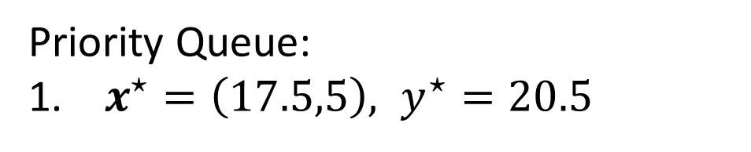
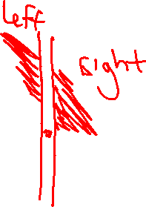
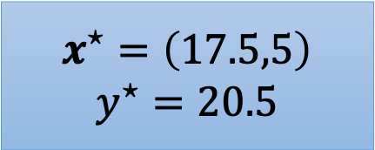
Branch and Bound Example
$$x^{⋆}=\left(17.5,5\right)$$
$$y^{⋆}=20.5$$
$$x_{1}≤17$$
$$x_{1}≥18$$
Priority Queue:
$x^{⋆}=\left(17.5,5\right), y^{⋆}=20.5$
$$c={\left[1, 0.6\right]}^{T}$$

Slide 37


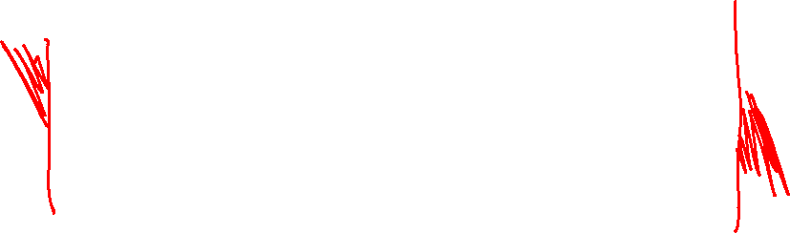
Branch and Bound Example
15
10
$$x_{1}≤17$$
$$x_{1}≥18$$
5
10
15
20
25
15
15
10
10
5
5
10
15
20
25
10
15
20
25

Slide 38




Branch and Bound Example
$$x^{⋆}=\left(17.5,5\right)$$
$$y^{⋆}=20.5$$
$$x_{1}≤17$$
$$x_{1}≥18$$
$$x^{⋆}=\left(17,6\right)$$
$$y^{⋆}=20.6$$
$$x^{⋆}=\left(18,4.85\right)$$
$$y^{⋆}=20.91$$
Priority Queue:
$x^{⋆}=\left(17,6\right), { y}^{⋆}=20.6$
$x^{⋆}=\left(18,4.85\right), y^{⋆}=20.91$
$$c={\left[1, 0.6\right]}^{T}$$

Slide 39


Activity + Poll
Constraints :
$$y=−1.4x+4.58$$
$$y=1.56x+3.41$$
$$y=−1.9x+12.16$$
$$y= .44x+4.21$$
(3.4,5.7)
(.2,4.3)
(4.5,3.61)
Priority Queue:
y
Poll 4: What is the LP solution?
Poll 5: What is the IP solution?
(2.7,0.8)
C =[-1,-3]
x
Notes:
LP* = -20.5 @ 3.4,5.7

Slide 40

Activity
Constraints :
$$y=−1.4x+4.58$$
$$y=1.56x+3.41$$
$$y=−1.9x+12.16$$
$$y= .44x+4.21$$
(3.4,5.7)
(.2,4.3)
(4.5,3.61)
Priority Queue:
-20.5: (3.4,5.7)
y
(2.7,0.8)
C =[-1,-3]
x
Notes:
CONSTRAIN ON X – draw picture
X<= 3 solution is (3,5.53) -19.59
X >=4 solution is (4,4.56) -17.68

Slide 41
Activity
Constraints :
$$y=−1.4x+4.58$$
$$y=1.56x+3.41$$
$$y=−1.9x+12.16$$
$$y= .44x+4.21$$
(3.4,5.7)
(.2,4.3)
(4.5,3.61)
Priority Queue:
-20.5: (3.4,5.7)
-19.6: (3,5.53) (x <= 3)
-17.7: (4,4.56) (x >=4)
y
(2.7,0.8)
C =[-1,-3]
x
Notes:
What gets dequeued and what do we constrain?

Slide 42

Activity
Constraints :
$$y=−1.4x+4.58$$
$$y=1.56x+3.41$$
$$y=−1.9x+12.16$$
$$y= .44x+4.21$$
(3.4,5.7)
(.2,4.3)
(4.5,3.61)
Priority Queue:
-20.5: (3.4,5.7)
-19.6: (3,5.53) (x <= 3)
-17.7: (4,4.56) (x >=4)
-18.0: (3,5) (x<=3,y<=5)
Inf: (x<=3,y>=6)
y
(2.7,0.8)
C =[-1,-3]
Why do we not need to recurse on -17.7?
x
Notes:
Pull -18 off and found the solution

