Slide 1
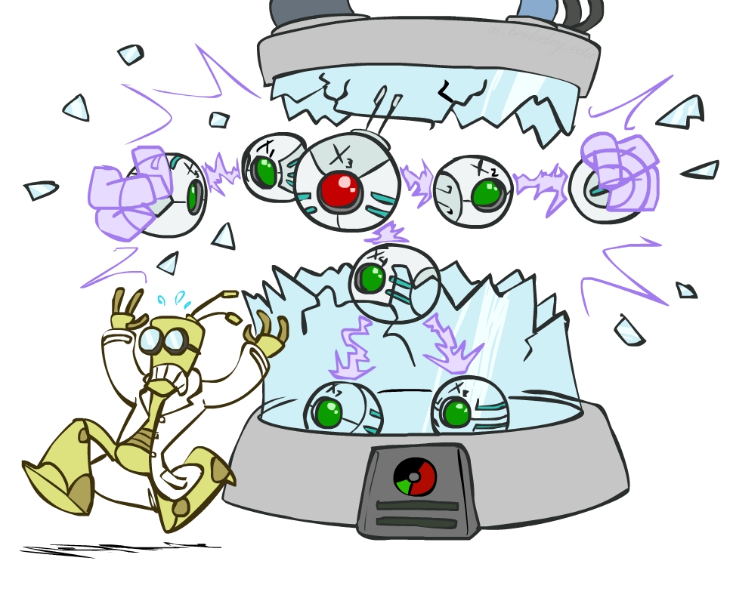
AI: Representation and Problem Solving
Bayes Nets: Independence
Instructor: Pat Virtue
Slide credits: CMU AI and http://ai.berkeley.edu

Slide 2

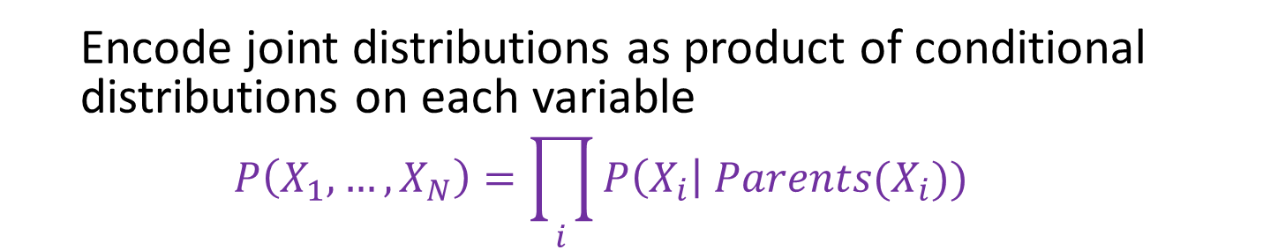



Bayesian Networks
Bayes net
One node per random variable
Directed-Acyclic-Graph
One CPT per node: P(node | Parents(node) )
$$A$$
$$B$$
$$C$$
$$D$$
$P\left(A, B, C, D\right)=P\left(A\right) P(B) P\left(C | A,B\right) P\left(D | C\right)$
  Encode joint distributions as product of conditional distributions on each variable
  $$P\left(X_{1},…,X_{N}\right)=\prod_{i}{P\left(X_{i}\right| Parents(X_{i})) }$$

Slide 3

Bayesian Networks
Bayes net
One node per random variable
Directed-Acyclic-Graph
One CPT per node: P(node | Parents(node) )
$$A$$
$$B$$
$$C$$
$$D$$
$$P\left(A, B, C, D\right)=P\left(A\right) P\left(B | A\right) P\left(C | A,B\right) P\left(D | A,B,C\right)$$
  Encode joint distributions as product of conditional distributions on each variable
  $$P\left(X_{1},…,X_{N}\right)=\prod_{i}{P\left(X_{i}\right| Parents(X_{i})) }$$

Slide 4
Bayesian Networks
Bayes net
One node per random variable
Directed-Acyclic-Graph
One CPT per node: P(node | Parents(node) )
$$A$$
$$B$$
$$C$$
$$D$$
$P\left(A, B, C, D\right)=P\left(A\right) P\left(B | A\right) P\left(C | A,B\right) P\left(D | C\right)$
  Encode joint distributions as product of conditional distributions on each variable
  $$P\left(X_{1},…,X_{N}\right)=\prod_{i}{P\left(X_{i}\right| Parents(X_{i})) }$$

Slide 5

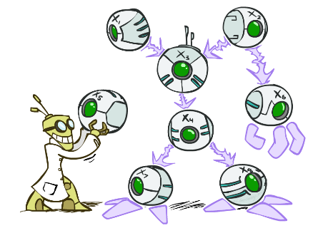

Bayes’ Nets: Big Picture
Two problems with using full joint distribution tables as our probabilistic models:
  Usually, the joint is WAY too big to represent explicitly
  Hard to learn (estimate) anything empirically about more than a few variables at a time
Bayes nets: a technique for describing complex joint distributions (models) using simple, local distributions (conditional probabilities)
  A type of probabilistic graphical models
  We describe how variables locally interact
  Local interactions chain together to give global, indirect interactions

Slide 6
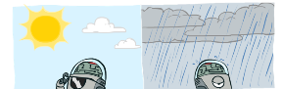
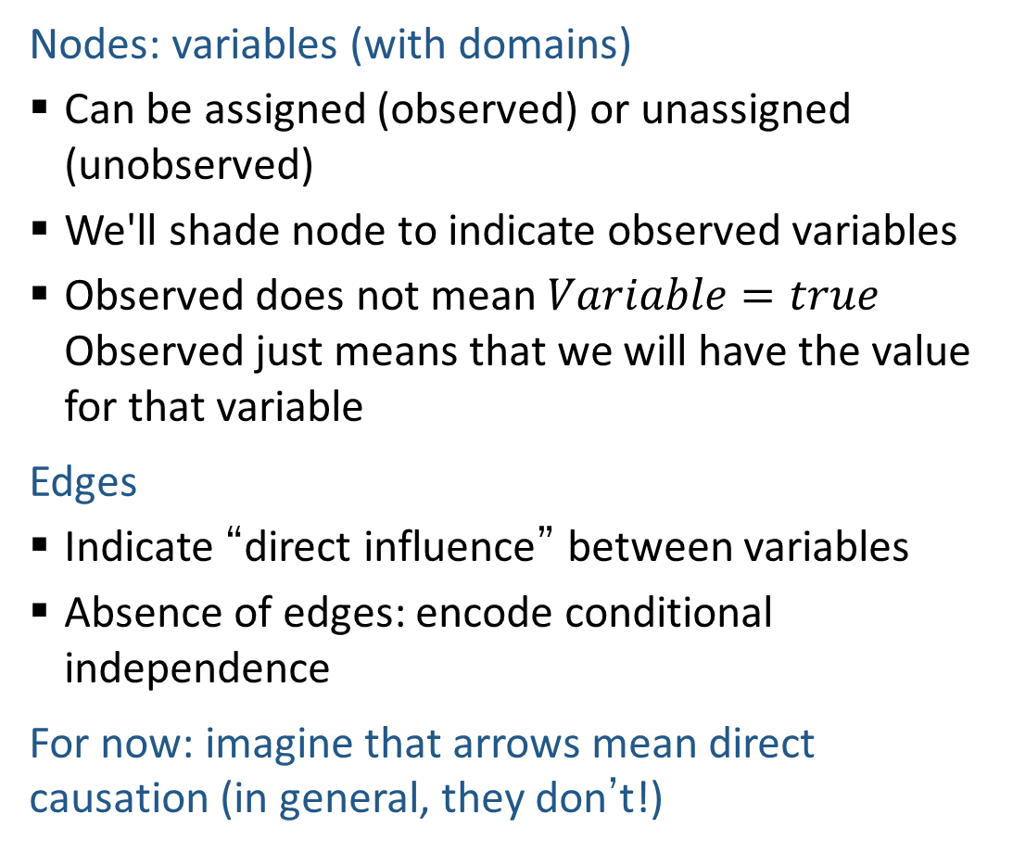
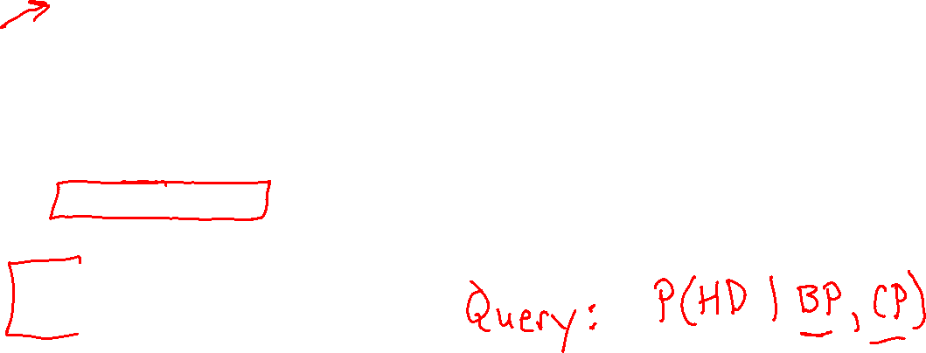
Graphical Model Notation
Nodes: variables (with domains)
  Can be assigned (observed) or unassigned (unobserved)
  We'll shade node to indicate observed variables
  Observed does not mean $Variable=true$ Observed just means that we will have the value for that variable
Edges
  Indicate “direct influence” between variables
  Absence of edges: encode conditional independence
For now: imagine that arrows mean direct causation (in general, they don’t!)
Weather
HeartDisease
BloodPressure
ChestPain

Slide 7


Maggie Makar, University of Michigan
Assistant Professor
Computer Science and Engineering
University of Michigan
https://mymakar.github.io/
Causally-motivated shortcut removal using auxiliary labels
M. Makar, B. Packer, D. Moldovan, D. Blalock, Y. Halpern, A. D'Amour
AIStats 2022 [paper]

Slide 8
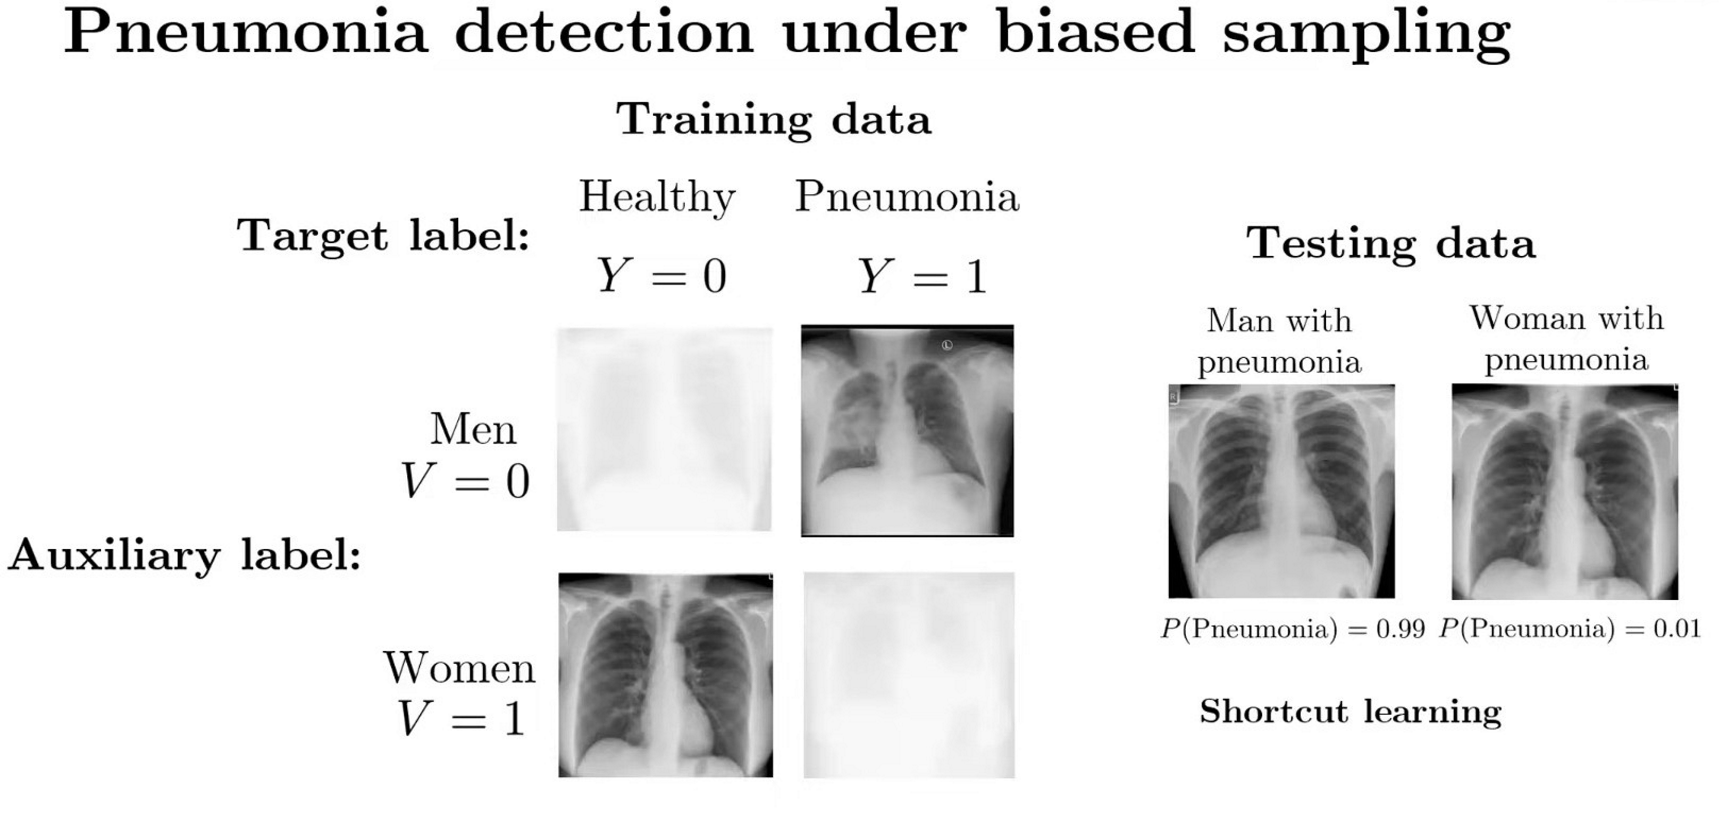
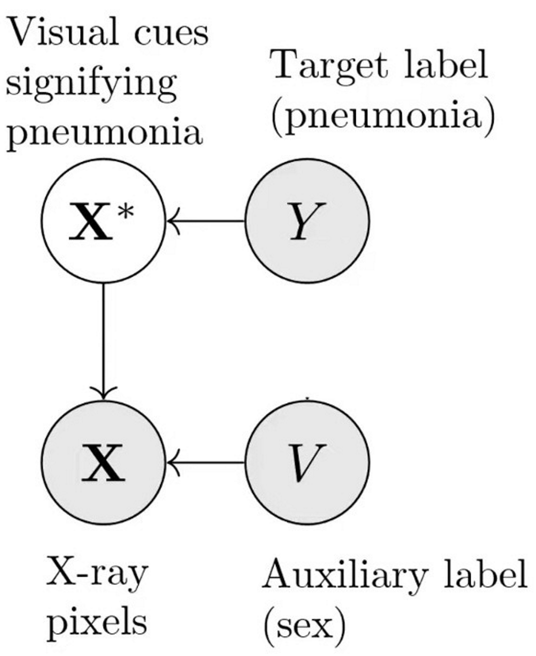
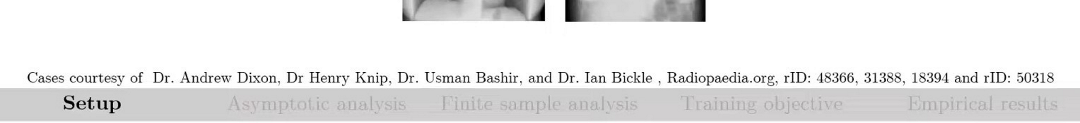

Causally-motivated shortcut removal using auxiliary labels
M. Makar, B. Packer, D. Moldovan, D. Blalock, Y. Halpern, A. D'Amour
AIStats 2022 [paper]

Slide 9



Danielle Belgrave, Microsoft Research
Vice President
AI/ML
GSK
https://www.daniellebelgrave.com
Developmental Profiles of Eczema, Wheeze, and Rhinitis:
Two Population-Based Birth Cohort Studies
Danielle Belgrave, et al. PLOS Medicine, 2014
https://journals.plos.org/plosmedicine/article?id=10.1371/journal.pmed.1001748

Slide 10
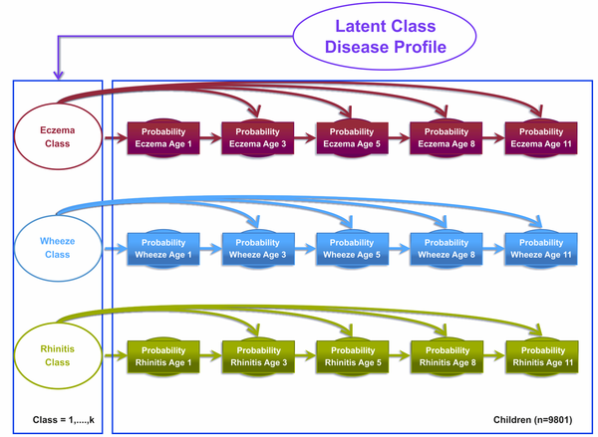

Danielle Belgrave, et al. PLOS Medicine, 2014
https://journals.plos.org/plosmedicine/article?id=10.1371/journal.pmed.1001748

Slide 11
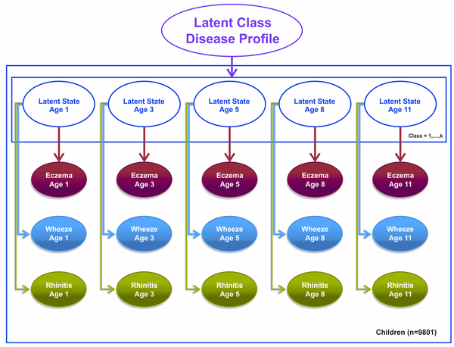
Danielle Belgrave, et al. PLOS Medicine, 2014
https://journals.plos.org/plosmedicine/article?id=10.1371/journal.pmed.1001748

Slide 12
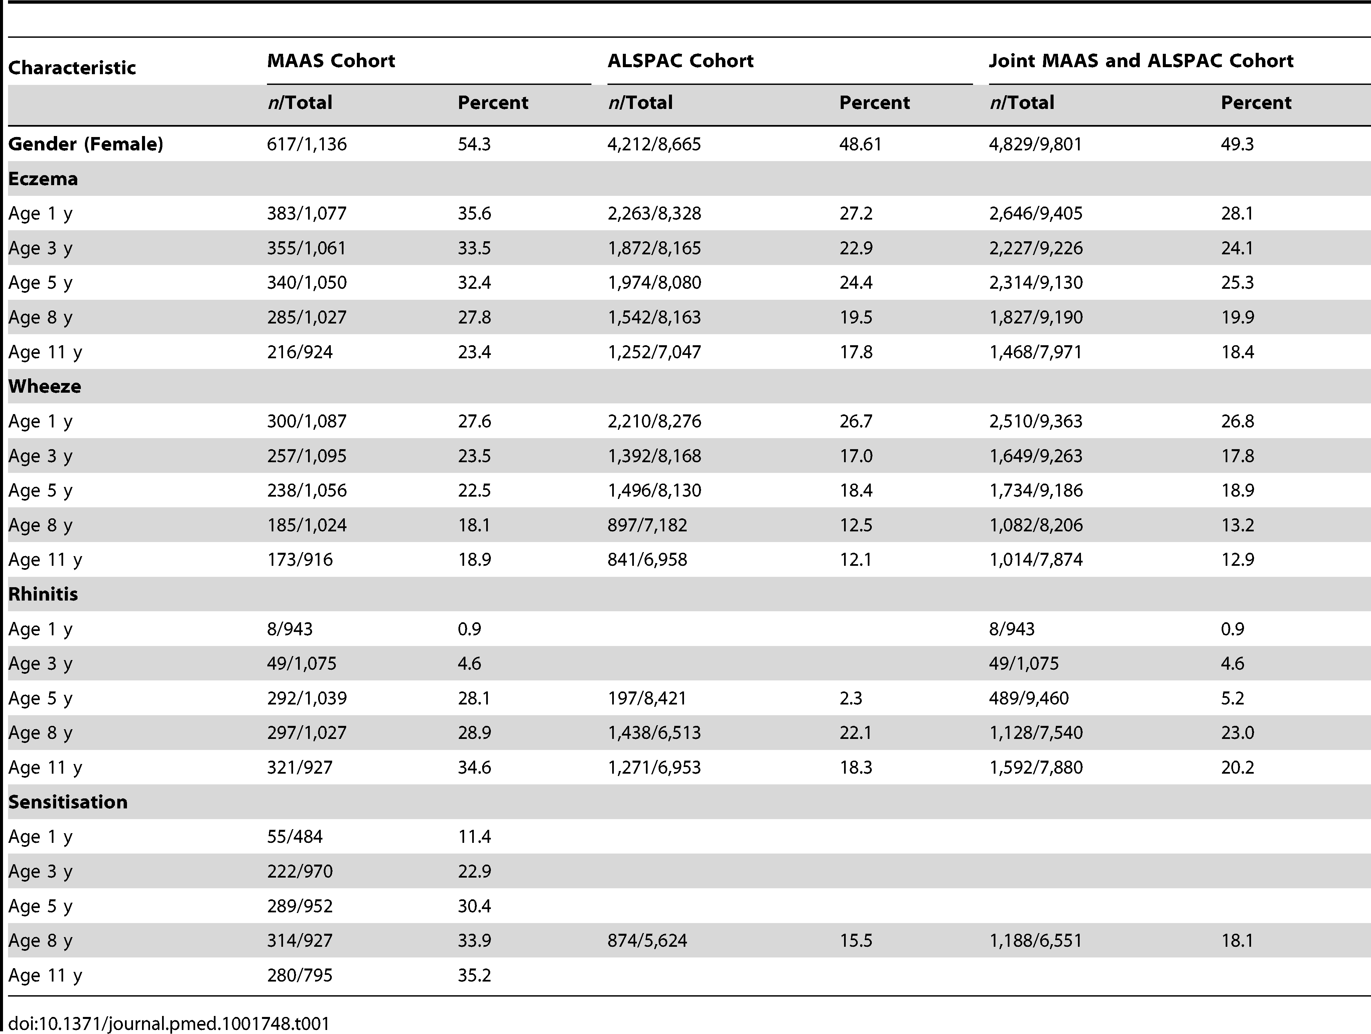
Danielle Belgrave, et al. PLOS Medicine, 2014
https://journals.plos.org/plosmedicine/article?id=10.1371/journal.pmed.1001748

Slide 13
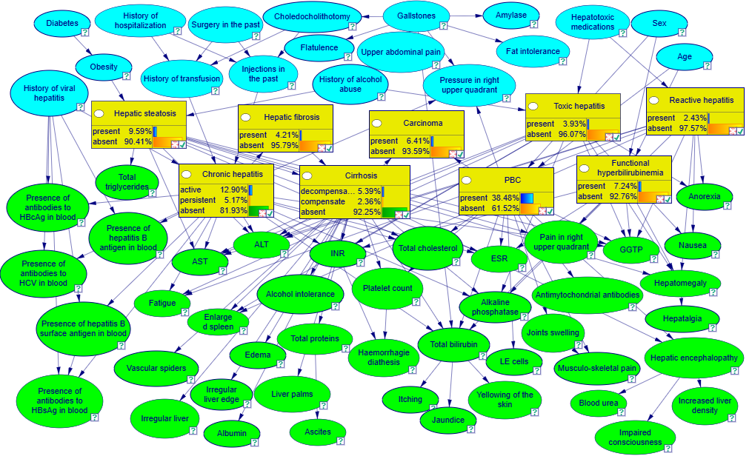
Example: Liver Disorders
https://demo.bayesfusion.com/bayesbox.html

Slide 14

Independence

Slide 15

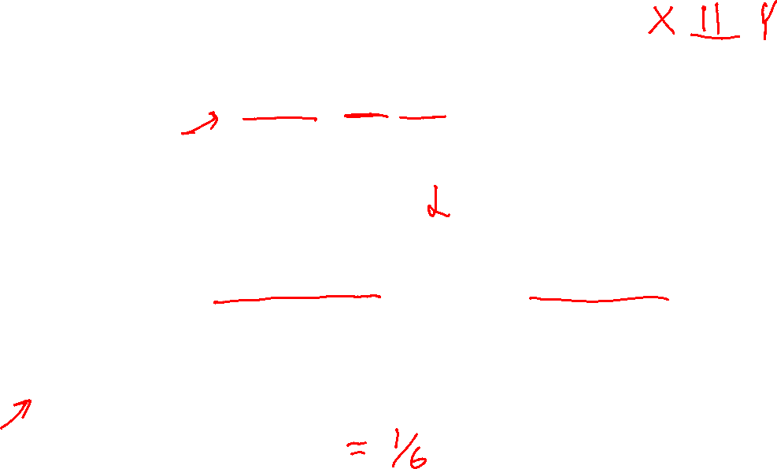
Independence
Two variables X and Y are independent if
∀x,y P(x, y) = P(x) P(y)
  This says that their joint distribution factors into a product of two simpler distributions
  Combine with product rule P(x,y) = P(x|y)P(y) we obtain another form:
  ∀x,y P(x | y) = P(x) or ∀x,y P(y | x) = P(y)
Example: two dice rolls R₁ and R₂
  P(R₁=5, R₂=5) = P(R₁=5) P(R₂=5) = 1/6 x 1/6 = 1/36
  P(R₂=5 | R₁=5) = P(R₂=5)

Slide 16

Example: Independence
n fair, independent coin flips:
P(X₁)
P(X₂)
P(X_{n})
H | 0.5
T | 0.5
H | 0.5
T | 0.5
H | 0.5
T | 0.5
P(X₁,X₂,...,X_{n})
2^{n}

Slide 17




Poll 1
Are T and W independent?
$$P(T)$$
T | P
hot | 0.5
cold | 0.5
$$P_{1}\left(T,W\right)$$
T | W | P
hot | sun | 0.4
hot | rain | 0.1
cold | sun | 0.2
cold | rain | 0.3
$$P(W)$$
W | P
sun | 0.6
rain | 0.4

Slide 18



Poll 1
Are T and W independent?
No
$$P(T)$$
T | P
hot | 0.5
cold | 0.5
$$P\left(T,W\right)$$
$P\left(T\right)P(W)$
T | W | P
hot | sun | 0.4
hot | rain | 0.1
cold | sun | 0.2
cold | rain | 0.3
T | W | P
hot | sun | 0.3
hot | rain | 0.2
cold | sun | 0.3
cold | rain | 0.2
$$P(W)$$
W | P
sun | 0.6
rain | 0.4

Slide 19
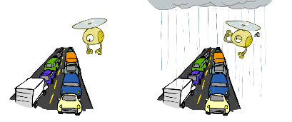
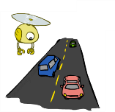
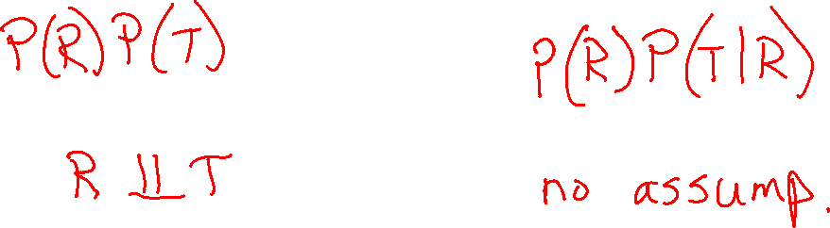
Example: Traffic
Variables:
  R: rain or not
  T: traffic or not
Model 1: independence
Why is an agent using model 2 better?
Model 2: rain affects traffic
R
R
T
T

Slide 20
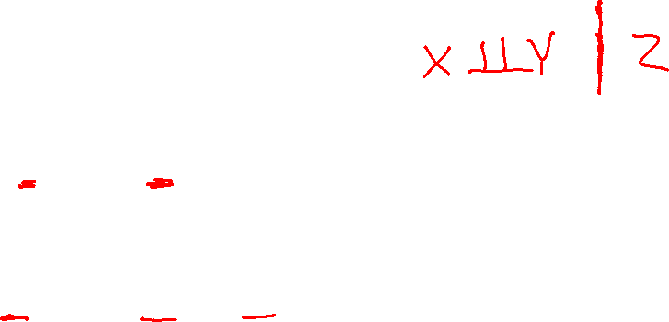
Conditional Independence
Absolute (unconditional) independence very rare (why?)
Conditional independence is our most basic and robust form of knowledge about uncertain environments.
X is conditionally independent of Y given Z
if and only if:
∀x,y,z P(x | y, z) = P(x | z)
or, equivalently, if and only if
∀x,y,z P(x, y | z) = P(x | z) P(y | z)

Slide 21
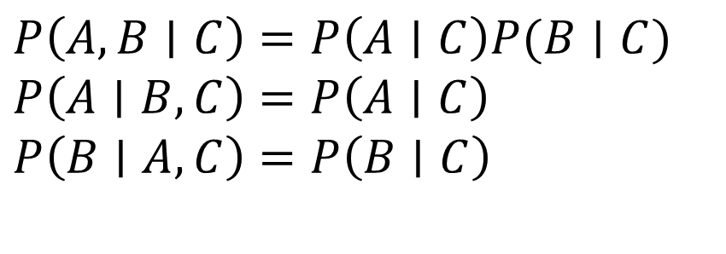
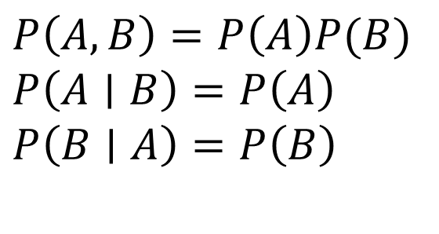
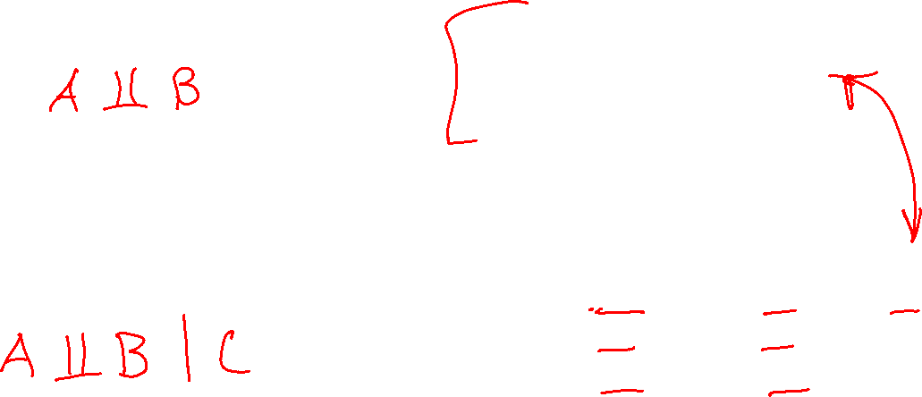
Independence Rules
Independence
If A and B are independent, then:
Conditional independence
If A and B are conditionally
independent given C, then:
$P\left(A, B\right)=P\left(A\right)P(B)$
$P\left(A∣B\right)=P\left(A\right)$
$P\left(B∣A\right)=P\left(B\right)$
$P\left(A, B∣C\right)=P\left(A∣C\right)P(B∣C)$
$P\left(A∣B, C\right)=P\left(A∣C\right)$
$P\left(B∣A, C\right)=P\left(B∣C\right)$

Slide 22
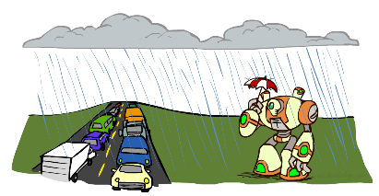
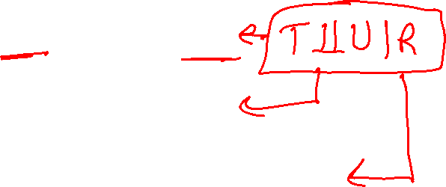
Conditional Independence
P(Traffic, Rain, Umbrella)
If it's rainining, the probability that there is traffic doesn't depend on whether see an umbrella:
  P(+traffic | +umbrella, +rain) = P(+traffic | +rain)
The same independence holds if it's not raining:
  P(+traffic | +umbrella, -rain) = P(+traffic| -rain)
Traffic is conditionally independent of Umbrella given Rain:
  P(Traffic | Umbrella, Rain) = P(Traffic | Rain)
Equivalent statements:
P(Umbrella | Traffic , Rain) = P(Umbrella | Rain)
P(Umbrella, Traffic | Rain) = P(Umbrella | Rain) P(Traffic | Rain)
One can be derived from the other easily

Slide 23




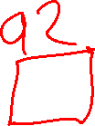













Poll 2
Match the product of CPTs to the Bayes net.
I.
II.
III.
$$A$$
$$A$$
$$B$$
$$A$$
$$B$$
$$C$$
$$B$$
$$C$$
$$C$$
  $$P\left(A\right) P\left(B | A\right) P\left(C | B\right)$$
  $$P\left(A\right) P\left(B | A\right) P\left(C | A\right)$$
  $$P\left(A\right) P\left(B\right) P\left(C | A, B\right)$$
  $$P\left(A\right) P\left(B\right) P\left(C | A, B\right)$$
  $$P\left(A\right) P\left(B | A\right) P\left(C | B\right)$$
  $$P\left(A\right) P\left(B | A\right) P\left(C | A\right)$$
  $$P\left(A\right) P\left(B | A\right) P\left(C | A\right)$$
  $$P\left(A\right) P\left(B\right) P\left(C | A, B\right)$$
  $$P\left(A\right) P\left(B | A\right) P\left(C | B\right)$$

Slide 24
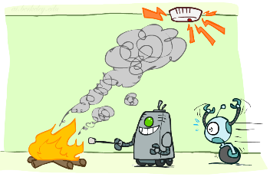
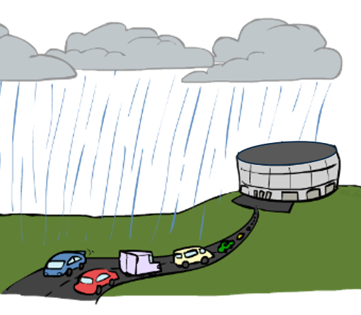










Conditional Independence Semantics
Common local releationships within a Bayes net
Causal Chain
Common Cause
Common Effect
$$R$$
$$R$$
$$H$$
$$S$$
$$F$$
$$A$$
$$T$$
$$U$$
$$T$$

Slide 25
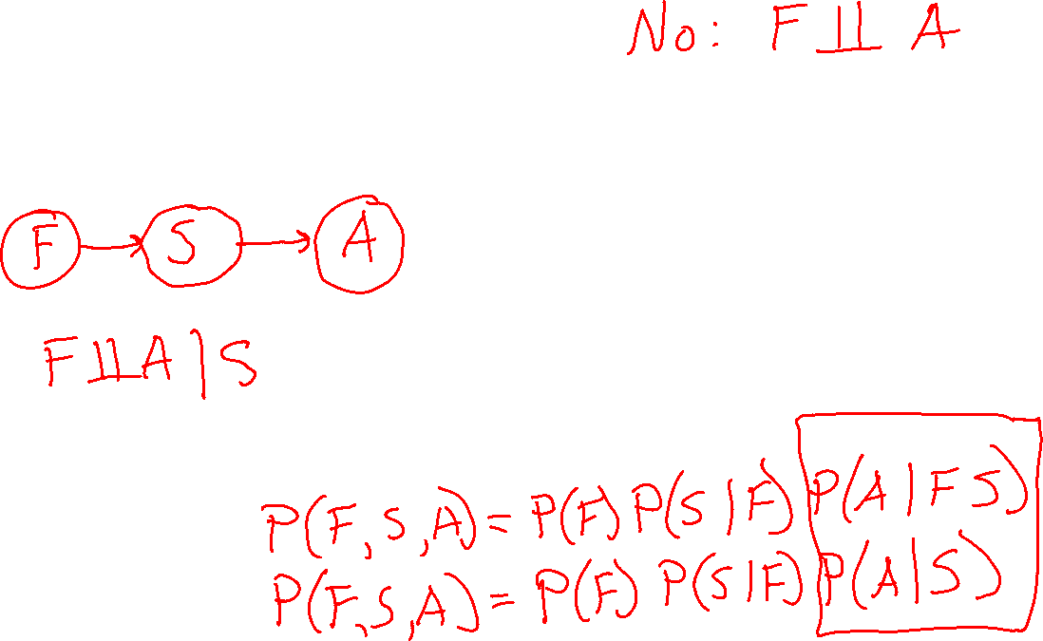
Causal Chain
Fire, Smoke, Alarm
Causal story to create Bayes net
Assumptions
Joint distribution

Slide 26



Common Cause
$$R$$
Chain rule:
P(x₁, x₂,…, x_{n}) = ∏_{i} P(x_{i} | x₁,…, x_{i-1})
Trivial decomposition:
P(Rain, Traffic, Umbrella) =
With assumption of conditional independence:
P(Raint, Traffic, Umbrella) =
Bayes nets / graphical models help us express conditional independence assumptions
$$T$$
$$U$$
Notes:
Will be obvious from ghostbusters example

Slide 27

Common Cause
$$R$$
Chain rule:
P(x₁, x₂,…, x_{n}) = ∏_{i} P(x_{i} | x₁,…, x_{i-1})
Trivial decomposition:
P(Rain, Traffic, Umbrella) = P(Rain) P(Traffic | Rain) P(Umbrella | Rain, Traffic)
With assumption of conditional independence:
P(Rain, Traffic, Umbrella) = P(Rain) P(Traffic | Rain) P(Umbrella | Rain)
Bayes nets / graphical models help us express conditional independence assumptions
$$T$$
$$U$$
Notes:
Will be obvious from ghostbusters example

Slide 28
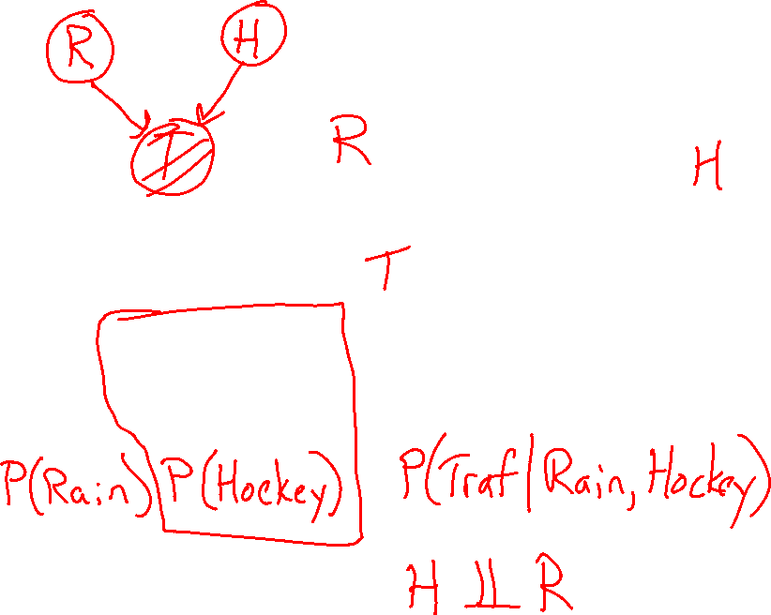
Common Effect
Chain rule:
P(x₁, x₂,…, x_{n}) = ∏_{i} P(x_{i} | x₁,…, x_{i-1})
Trivial decomposition:
P(Rain, Hockey, Traffic) = P(Rain) P(Hockey | Rain) P(Traffic | Rain, Hockey)
With assumption of conditional independence:
P(Rain, Hockey, Traffic) =
Bayes nets / graphical models help us express conditional independence assumptions
Notes:
Will be obvious from ghostbusters example

Slide 29



Common Effect
$$R$$
$$H$$
Chain rule:
P(x₁, x₂,…, x_{n}) = ∏_{i} P(x_{i} | x₁,…, x_{i-1})
Trivial decomposition:
P(Rain, Hockey, Traffic) = P(Rain) P(Hockey | Rain) P(Traffic | Rain, Hockey)
With assumption of conditional independence:
P(Rain, Hockey, Traffic) = P(Rain) P(Hockey) P(Traffic | Rain, Hockey)
Bayes nets / graphical models help us express conditional independence assumptions
$$T$$
Notes:
Will be obvious from ghostbusters example

Slide 30
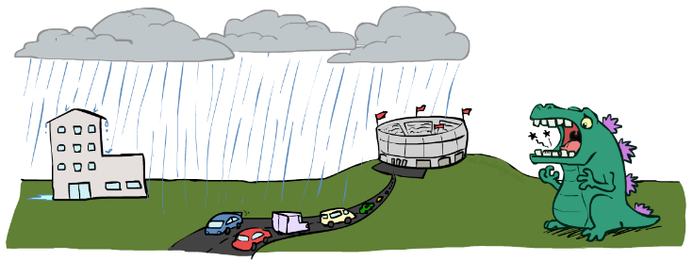
Example: Traffic II
Let’s build a causal Bayes net!
Variables
  T: Traffic
  R: It rains
  L: Low pressure
  D: Roof drips
  B: Ballgame
  C: Rain

Slide 31
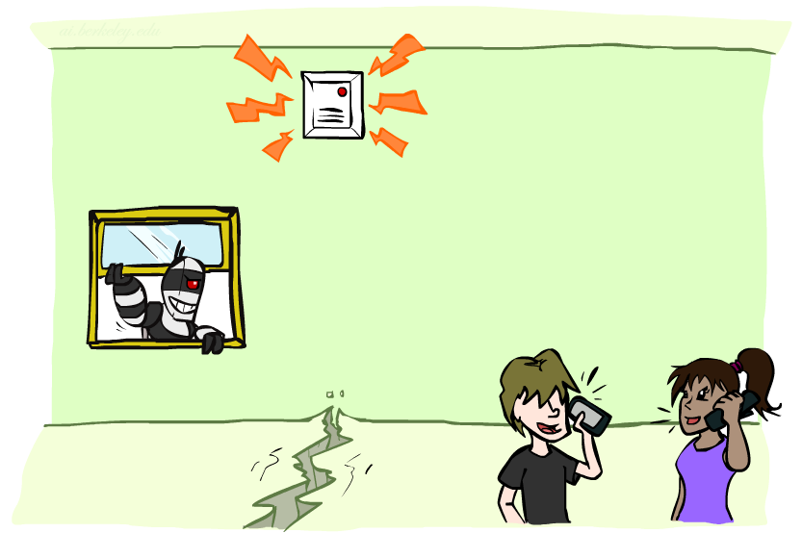
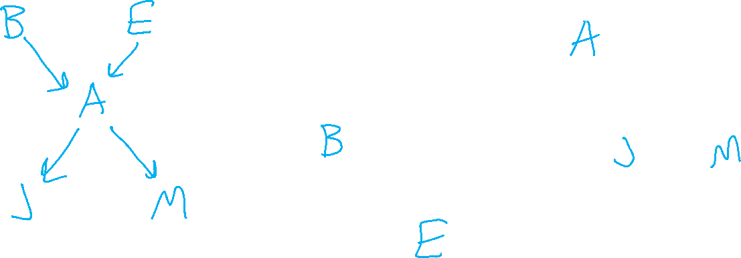
Example: Alarm Network
Variables
  B: Burglary
  A: Alarm goes off
  M: Mary calls
  J: John calls
  E: Earthquake!

Slide 32
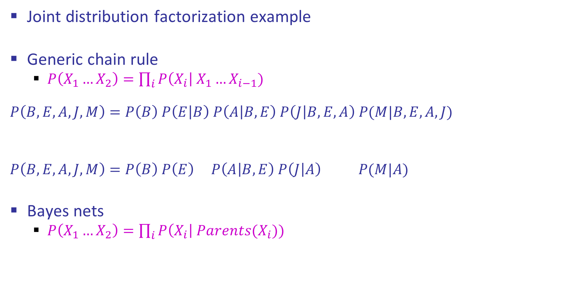

Example: Alarm Network
Joint distribution factorization example
Generic chain rule
  $P\left(X_{1}…X_{2}\right)=\prod_{i}{P\left(X_{i}\right| X_{1}…X_{i−1}) }$
  $$P\left(B,E,A,J,M\right)=P\left(B\right) P\left(E | B\right) P\left(A | B,E\right) P\left(J | B,E,A\right) P(M|B,E,A,J)$$
  $$P\left(B,E,A,J,M\right)=P\left(B\right) P\left(E\right) P\left(A | B,E\right) P\left(J | A\right) P(M|A)$$
Bayes nets
  $P\left(X_{1}…X_{2}\right)=\prod_{i}{P\left(X_{i}\right| Parents(X_{i})) }$
Burglary
Earthquake
Alarm
John calls
Mary calls

Slide 33
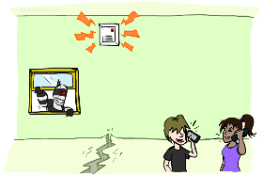
Example: Alarm Network
B | P(B)
+b | 0.001
-b | 0.999
E | P(E)
+e | 0.002
-e | 0.998
Burglary
Earthqk
Alarm
B | E | A | P(A|B,E)
+b | +e | +a | 0.95
+b | +e | -a | 0.05
+b | -e | +a | 0.94
+b | -e | -a | 0.06
-b | +e | +a | 0.29
-b | +e | -a | 0.71
-b | -e | +a | 0.001
-b | -e | -a | 0.999
John calls
Mary calls
A | J | P(J|A)
+a | +j | 0.9
+a | -j | 0.1
-a | +j | 0.05
-a | -j | 0.95
A | M | P(M|A)
+a | +m | 0.7
+a | -m | 0.3
-a | +m | 0.01
-a | -m | 0.99
Notes:
demo

Slide 34
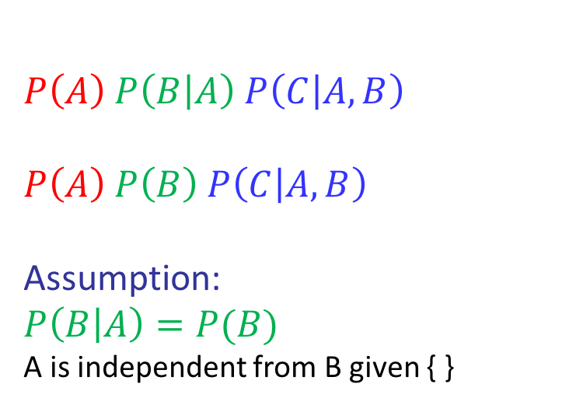
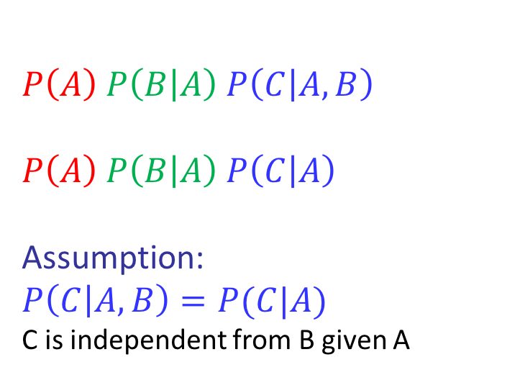

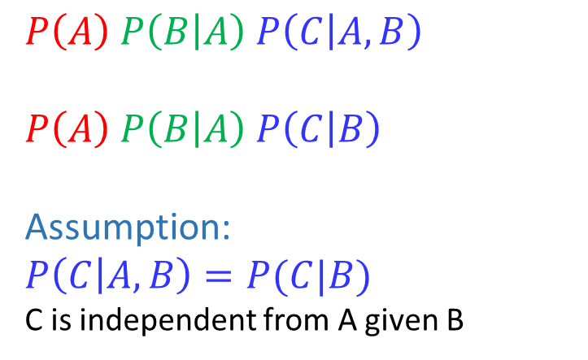
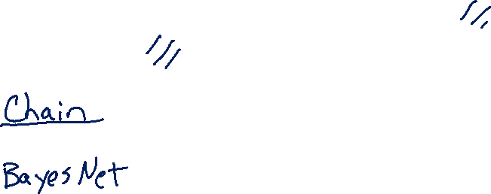
Conditional Independence Semantics
For the following Bayes nets, write the joint $P(A,B,C)$
  Using the chain rule (with top-down order A,B,C)
  Using Bayes net semantics (product of CPTs)
$$A$$
$$A$$
$$B$$
$$A$$
$$B$$
$$C$$
$$B$$
$$C$$
$$C$$
  $$P\left(A\right) P\left(B | A\right) P\left(C | A,B\right)$$
  $$P\left(A\right) P\left(B | A\right) P\left(C | B\right)$$
  Assumption:
  $$P\left(C | A,B\right)=P(C|B)$$
  C is independent from A given B
  $$P\left(A\right) P\left(B | A\right) P\left(C | A,B\right)$$
  $$P\left(A\right) P\left(B | A\right) P\left(C | A\right)$$
  Assumption:
  $$P\left(C | A,B\right)=P(C|A)$$
  C is independent from B given A
  $$P\left(A\right) P\left(B | A\right) P\left(C | A,B\right)$$
  $$P\left(A\right) P\left(B\right) P\left(C | A, B\right)$$
  Assumption:
  $$P\left(B | A\right)=P(B)$$
  A is independent from B given { }

Slide 35
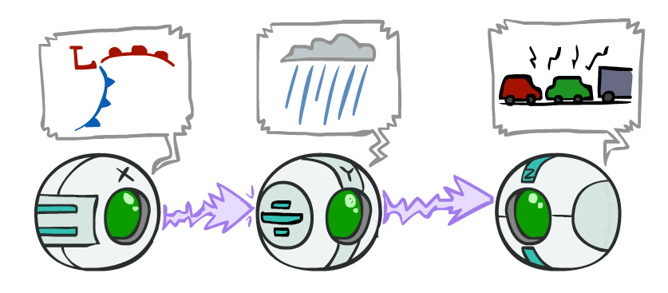
Causal Chains
Guaranteed X independent of Z ?
No!
One example set of CPTs for which X is not independent of Z is sufficient to show this independence is not guaranteed.
Example:
  Low pressure always causes rain
  Rain always causes traffic
  High pressure always causes
  No rain always causes no traffic
  In numbers:
  P( +y | +x ) = 1 P( +z | +y ) = 1
  P( -y | -x ) = 1 P( -z | -y ) = 1
This configuration is a “causal chain”
This configuration is a “causal chain”
X: Low pressure Y: Rain Z: Traffic

Slide 36
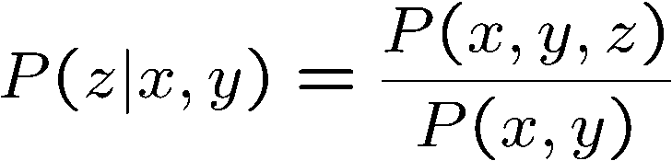
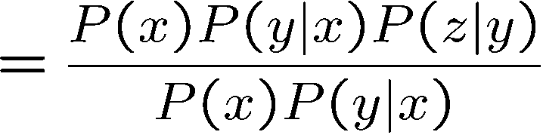

Causal Chains
This configuration is a “causal chain”
Guaranteed X independent of Z given Y?
  Evidence along the chain “blocks” the influence
X: Low pressure Y: Rain Z: Traffic
Yes!

Slide 37
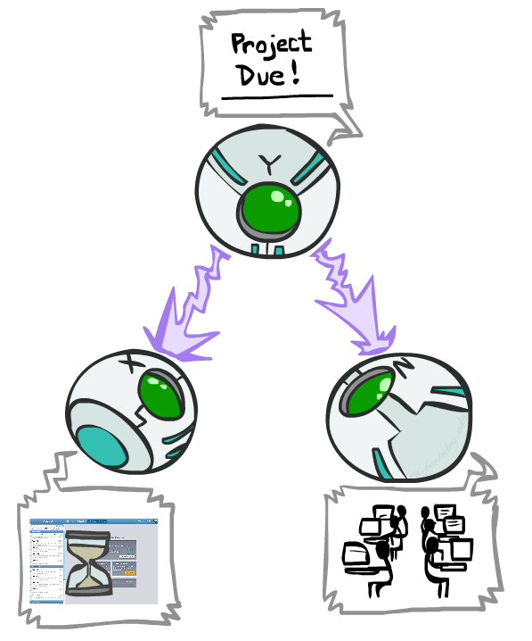
Common Cause
This configuration is a “common cause”
Guaranteed X independent of Z ? No!
  One example set of CPTs for which X is not independent of Z is sufficient to show this independence is not guaranteed.
  Example:
    Project due always causes both forums busy
    and OH full
    In numbers:
    P( +x | +y ) = 1 P( -x | -y ) = 1,
    P( +z | +y ) = 1 P( -z | -y ) = 1
Y: Project due
X: Forums busy
Z: OH full

Slide 38
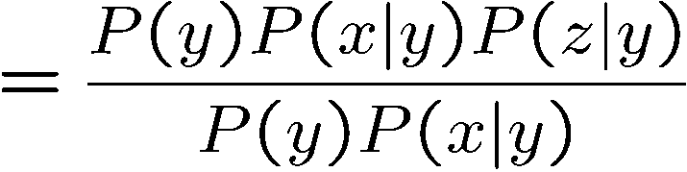
Common Cause
This configuration is a “common cause”
Guaranteed X and Z independent given Y?
  Observing the cause blocks influence between effects.
Y: Project due
X: Forums busy
Z: Lab full
Yes!

Slide 39
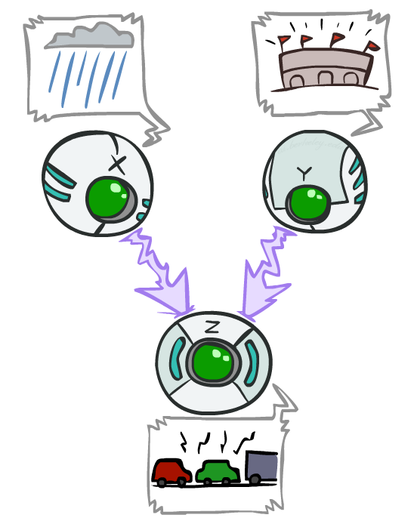
Common Effect
Last configuration: two causes of one effect (v-structures)
Are X and Y independent?
  Yes: the ballgame and the rain cause traffic, but they are not correlated
  Still need to prove they must be (try it!)
Are X and Y independent given Z?
  No: seeing traffic puts the rain and the ballgame in competition as explanation.
This is backwards from the other cases
  Observing an effect activates influence between possible causes.
X: Raining
Y: Ballgame
Z: Traffic

Slide 40
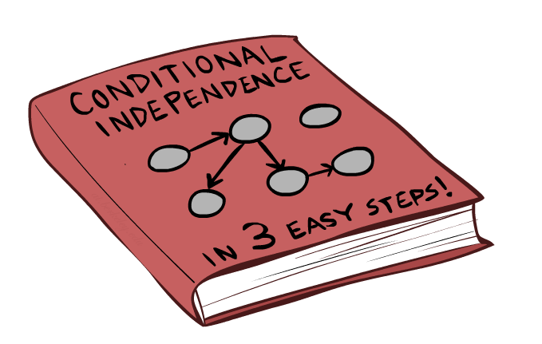
Bayes Net Independence

Slide 41


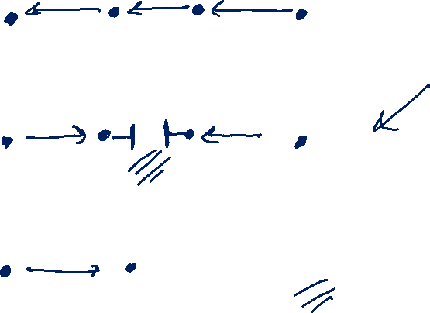













Answering Independence Questions
Is A independent from E?
Is A independent from E given C?
Is A independent from C given E?
$$A$$
$$B$$
$$C$$
$$D$$
$$E$$
$$A$$
$$B$$
$$C$$
$$D$$
$$E$$
$$A$$
$$B$$
$$C$$
$$D$$
$$E$$

Slide 42

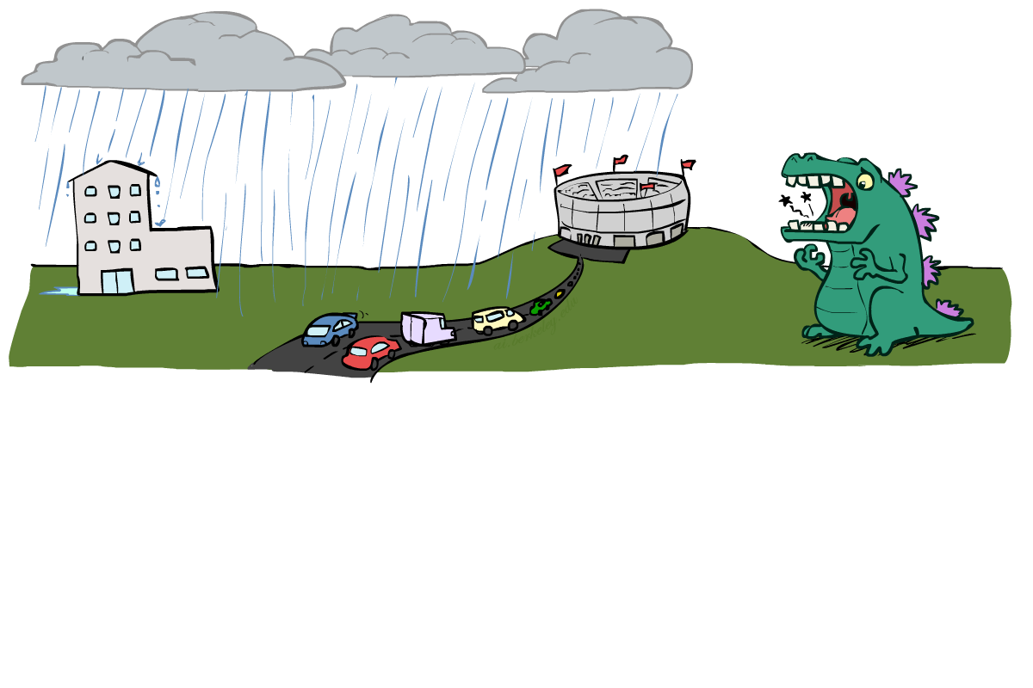
Reachability
L
Recipe: shade evidence nodes, look for paths in the resulting graph
Attempt 1: if two nodes are connected by an undirected path not blocked by a shaded node, they are conditionally independent
Almost works, but not quite
  Where does it break?
  Answer: the v-structure at T doesn’t count as a link in a path unless “active”
R
B
D
T

Slide 43
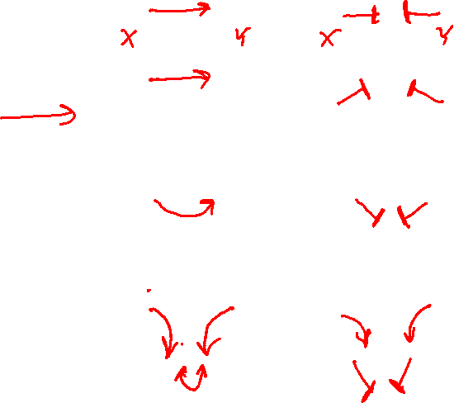
Active / Inactive Paths
Question: Are X and Y conditionally independent given evidence variables {Z}?
  Yes, if X and Y “d-separated” by Z
  Consider all (undirected) paths from X to Y
  No active paths = independence!
A path is active if each triple is active:
  Causal chain A → B → C where B is unobserved (either direction)
  Common cause A ← B → C where B is unobserved
  Common effect (aka v-structure)
  A → B ← C where B or one of its descendents is observed
All it takes to block a path is a single inactive segment
Active Paths
Inactive Paths

Slide 44

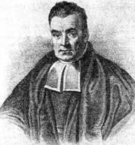
Bayes Ball
Question: Are X and Y conditionally independent given evidence variables {Z}?
Active Paths
Inactive Paths
Shachter, Ross D. "Bayes-Ball: Rational Pastime (for Determining Irrelevance and Requisite Information in Belief Networks and Influence Diagrams)." Proceedings of the Fourteenth conference on Uncertainty in Artificial Intelligence. 1998.

Slide 45
Bayes Ball
Question: Are X and Y conditionally independent given evidence variables {Z}?
  Shade in Z
  Drop a ball at X
  The ball can pass through any active path and is blocked by any inactive path (ball can move either direction on an edge)
  If the ball reaches Y, then X and Y are NOT conditionally independent given Z
Active Paths
Inactive Paths

Slide 46
Bayes Ball
Active Paths
Inactive Paths

Slide 47
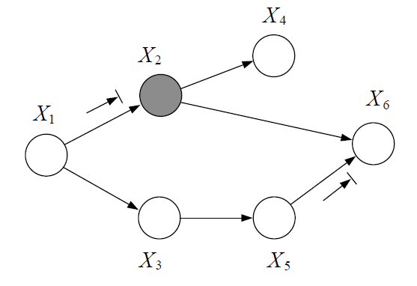

Poll 3
Is $X_{1}$ independent from $X_{6}$ given $X_{2}$?

Slide 48

Poll 3
Is $X_{1}$ independent from $X_{6}$ given $X_{2}$?
No, the Bayes ball can travel through $X_{3}$ and $X_{5}$.

Slide 49


Poll 4
Is $X_{2}$ independent from $X_{3}$ given $X_{1}$ and $X_{6}$?

Slide 50

Poll 4
Is $X_{2}$ independent from $X_{3}$ given $X_{1}$ and $X_{6}$?
No, the Bayes ball can travel through $X_{5}$ and $X_{6}$.

Slide 51




Conditional Independence Semantics
Every variable is conditionally independent of its non-descendants given its parents
$$U_{1}$$
$$U_{m}$$
$$X$$

Slide 52








Markov blanket
A variable’s Markov blanket consists of parents, children, children’s other parents
Every variable is conditionally independent of all other variables given its Markov blanket
$$U_{1}$$
$$U_{m}$$
$$X$$
$$Z_{1j}$$
$$Z_{nj}$$
$$Y_{1}$$
$$Y_{n}$$

Slide 53


Answer Any Query from Joint Distribution
Joint distributions are the best!
Problems with joints
We aren’t given the joint table
    Usually some set of conditional probability tables
Huge
    $n$ variables with $d$ values
    $d^{n}$ entries
Joint
Query
$$P\left(a \right| e)$$

Slide 54
Answer Any Query from Bayes Net
Bayes Net
Joint
Query
$$P\left(a \right| e)$$
$$P\left(A\right) P\left(B | A\right) P\left(C | A\right) P\left(D | C\right) P(E|C)$$

Slide 55
Next: Answer Any Query from Bayes Net
Bayes Net
Query
$$P\left(a \right| e)$$
$$P\left(A\right) P\left(B | A\right) P\left(C | A\right) P\left(D | C\right) P(E|C)$$

