Slide 1
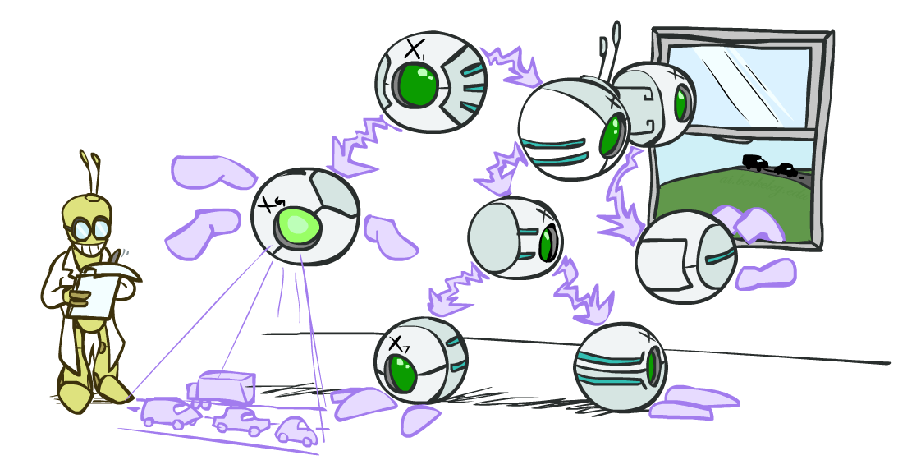
AI: Representation and Problem Solving
Bayes Nets Inference
Instructor: Pat Virtue
Slide credits: CMU AI and http://ai.berkeley.edu

Slide 2

Bayes Nets
Part I: Representation and Independence
Part II: Exact inference
  Enumeration (always exponential complexity)
  Variable elimination (worst-case exponential complexity, often better)
  Inference is NP-hard in general
Part III: Approximate Inference

Slide 3
Bayes Nets in the Wild
Wheel of Fortune

Slide 4

Bayes Nets in the Wild
Example: Speech Recognition
“artificial $⋅⋅⋅⋅⋅⋅⋅⋅⋅⋅⋅$”
Find most probable next word given “artificial” and the audio for second word.

Slide 5
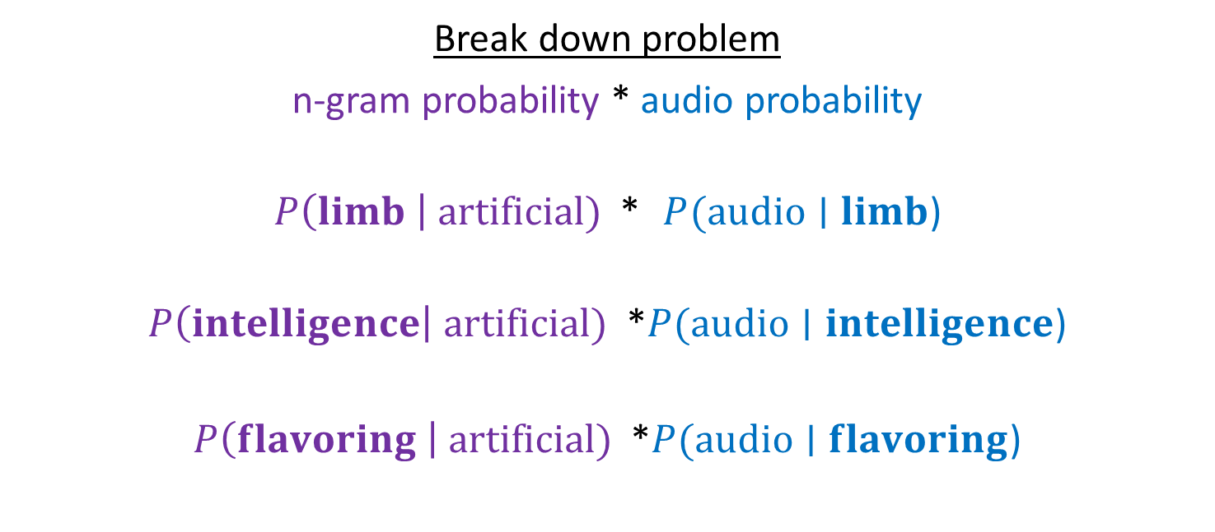
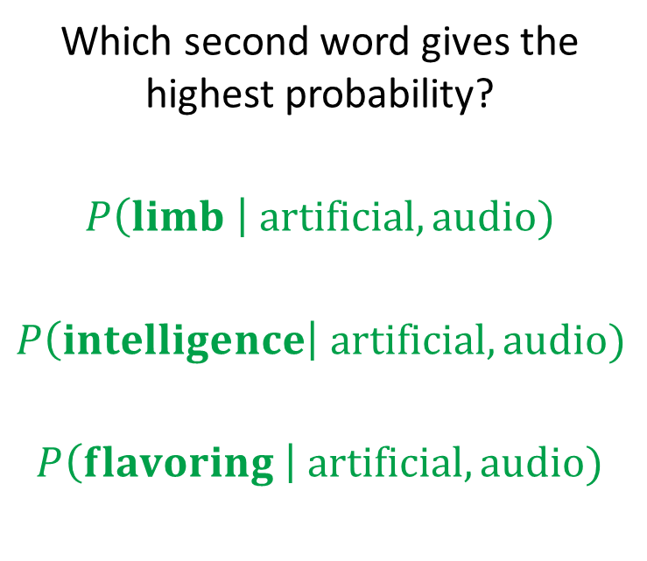
Bayes Nets in the Wild
Example: Speech Recognition
“artificial $⋅⋅⋅⋅⋅⋅⋅⋅⋅⋅⋅$”
Find most probable next word given “artificial” and the audio for second word.
Which second word gives the highest probability?
$$P\left(limb \right| artificial, audio)$$
$$P\left(intelligence\right| artificial, audio)$$
$$P\left(flavoring \right| artificial, audio)$$
Break down problem
n-gram probability * audio probability
$P\left(limb \right| artificial)$ * $P(audio∣limb$)
$P\left(intelligence\right| artificial)$ *$P(audio∣intelligence$)
$P\left(flavoring \right| artificial)$ *$P(audio∣flavoring$)

Slide 6
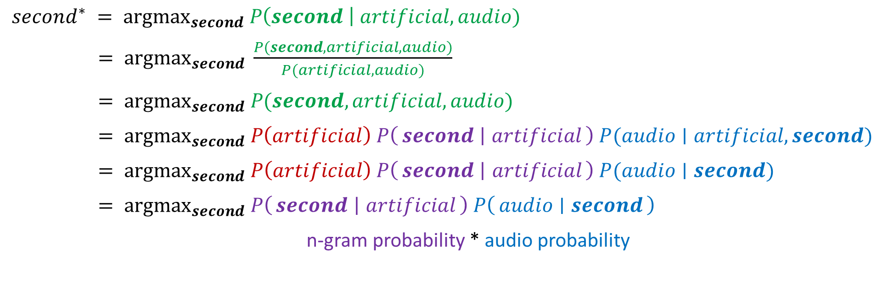
Bayes Nets in the Wild
$second^{∗} = {argmax}_{second} P\left(second \right| artificial, audio)$
$= {argmax}_{second} \frac{P(second, artificial, audio)}{P(artificial, audio)}$
$= {argmax}_{second} P(second, artificial, audio)$
$= {argmax}_{second} P\left(artificial\right) P\left(second ∣ artificial\right) P(audio∣artificial, second)$
$= {argmax}_{second} P\left(artificial\right) P\left(second ∣ artificial\right) P(audio∣second)$
$= {argmax}_{second} P\left(second ∣ artificial\right) P\left(audio ∣ second\right)$
n-gram probability * audio probability

Slide 7

Inference
Inference: calculating some useful quantity from a probability model (joint probability distribution)
Examples:
  Posterior marginal probability
    P(Q|e₁,..,e_{k})
    e.g., what disease might I have?
  Most likely explanation:
    argmax_{q,r,s} P(Q=q,R=r,S=s|e₁,..,e_{k})
    e.g., what was just said?

Slide 8

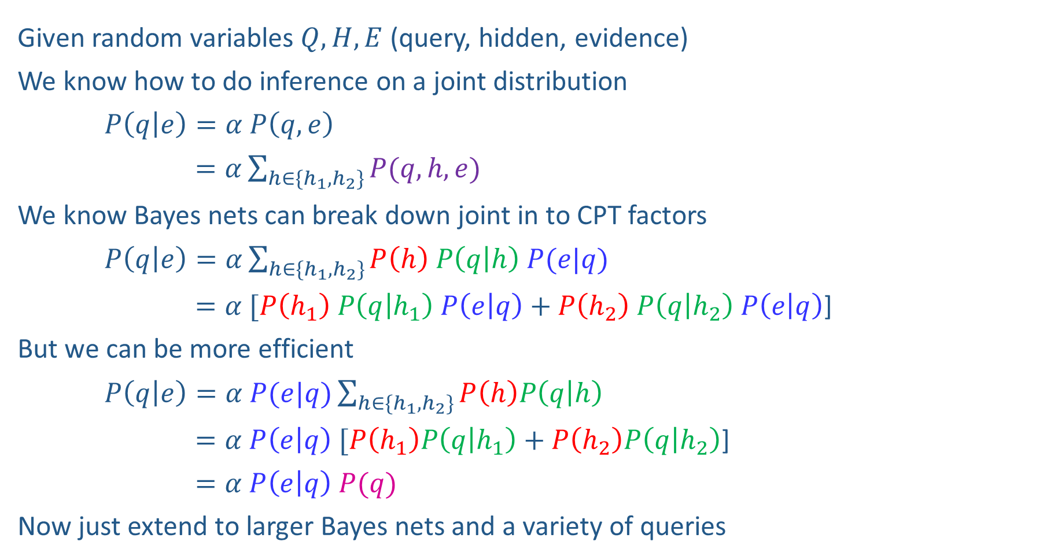


Inference Overview
Given random variables$Q, H, E$ (query, hidden, evidence)
We know how to do inference on a joint distribution
$P\left(q | e\right)=α P\left(q,e\right)$
$=α\sum_{h∈\{h_{1},h_{2}\}}{P(q,h,e)}$
We know Bayes nets can break down joint in to CPT factors
$P\left(q | e\right)=α\sum_{h∈\{h_{1},h_{2}\}}{P\left(h\right) P\left(q | h\right) P(e|q)}$
$=α [P\left(h_{1}\right) P\left(q | h_{1}\right) P\left(e | q\right)+P\left(h_{2}\right) P\left(q | h_{2}\right) P\left(e | q\right)$]
But we can be more efficient
$P\left(q | e\right)=α P(e|q)\sum_{h∈\{h_{1},h_{2}\}}{P\left(h\right)P\left(q | h\right) }$
$=α P\left(e | q\right) [P\left(h_{1}\right)P\left(q | h_{1}\right)+P\left(h_{2}\right)P\left(q | h_{2}\right)$]
$=α P\left(e | q\right) P(q)$
Now just extend to larger Bayes nets and a variety of queries
Enumeration
$$H$$
$$Q$$
$$E$$
Variable
Elimination

Slide 9
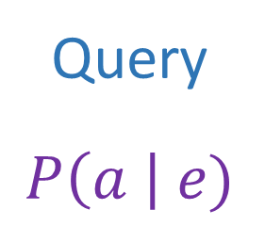
Answer Any Query from Bayes Net
Bayes Net
Joint
Query
$$P\left(a \right| e)$$
$$P\left(A\right) P\left(B | A\right) P\left(C | A\right) P\left(D | C\right) P(E|C)$$

Slide 10
Next: Answer Any Query from Bayes Net
Bayes Net
Query
$$P\left(a \right| e)$$
$$P\left(A\right) P\left(B | A\right) P\left(C | A\right) P\left(D | C\right) P(E|C)$$

Slide 11
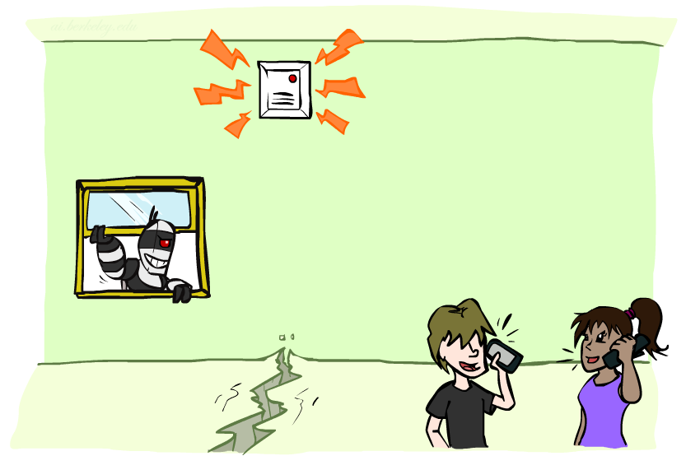
Example: Alarm Network
Variables
  B: Burglary
  A: Alarm goes off
  M: Mary calls
  J: John calls
  E: Earthquake!

Slide 12

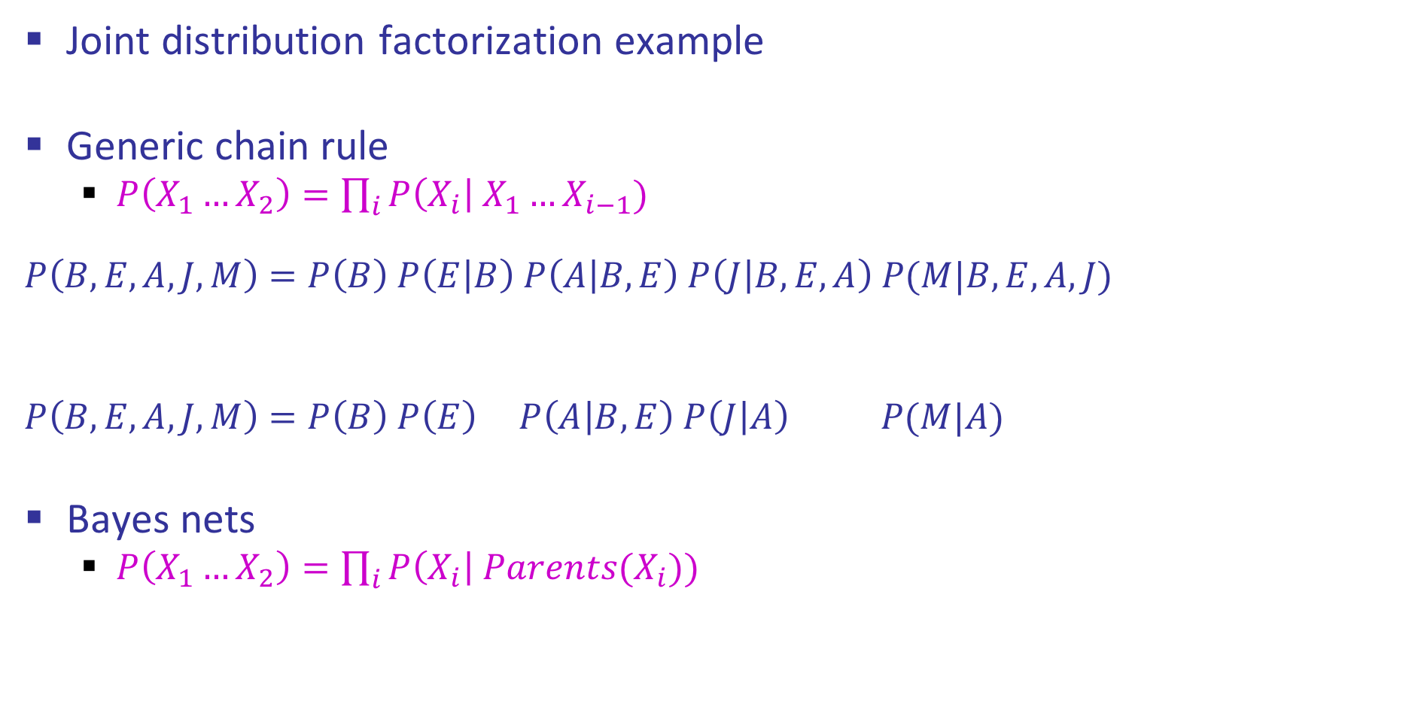
Example: Alarm Network
Joint distribution factorization example
Generic chain rule
  $P\left(X_{1}…X_{2}\right)=\prod_{i}{P\left(X_{i}\right| X_{1}…X_{i−1}) }$
  $$P\left(B,E,A,J,M\right)=P\left(B\right) P\left(E | B\right) P\left(A | B,E\right) P\left(J | B,E,A\right) P(M|B,E,A,J)$$
  $$P\left(B,E,A,J,M\right)=P\left(B\right) P\left(E\right) P\left(A | B,E\right) P\left(J | A\right) P(M|A)$$
Bayes nets
  $P\left(X_{1}…X_{2}\right)=\prod_{i}{P\left(X_{i}\right| Parents(X_{i})) }$
Burglary
Earthquake
Alarm
John calls
Mary calls

Slide 13
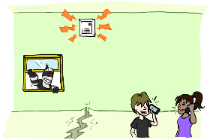

Example: Alarm Network
$P\left(+b, −e, −a, −j,−m\right)=$
B | P(B)
+b | 0.001
-b | 0.999
E | P(E)
+e | 0.002
-e | 0.998
Burglary
Earthqk
Alarm
B | E | A | P(A|B,E)
+b | +e | +a | 0.95
+b | +e | -a | 0.05
+b | -e | +a | 0.94
+b | -e | -a | 0.06
-b | +e | +a | 0.29
-b | +e | -a | 0.71
-b | -e | +a | 0.001
-b | -e | -a | 0.999
John calls
Mary calls
A | J | P(J|A)
+a | +j | 0.9
+a | -j | 0.1
-a | +j | 0.05
-a | -j | 0.95
A | M | P(M|A)
+a | +m | 0.7
+a | -m | 0.3
-a | +m | 0.01
-a | -m | 0.99
Notes:
demo

Slide 14
Example: Alarm Network
$$P\left(+b, −e, −a, −j,−m\right)=P\left(+b\right) ∗ P\left(−e\right) ∗ P\left(−a | +b, −e\right) ∗ P\left(−j | −a\right) ∗ P\left(−m | −a\right)$$
$=0.001 ∗ 0.998 ∗ 0.06 ∗ 0.95 ∗ 0.99$
$$P\left(+b, −e, −a, −j,−m\right)=P\left(−e\right) ∗ P\left(−a | +b, −e\right) ∗P\left(+b\right) ∗P\left(−j | −a\right) ∗ P\left(−m | −a\right)$$
$=0.998 ∗ 0.06 ∗ 0.001 ∗ 0.95 ∗ 0.99$
$$P\left(+b, −e, −a, −j,−m\right)=P\left(−e\right) ∗ P\left(−a | +b, −e\right) ∗P\left(+b\right) P\left(−j | −a\right) ∗ P\left(−m | −a\right)$$
$=0.998 ∗ 0.06 ∗ 0.0095 ∗ 0.99$
Multiplication order can change (commutativity)
Multiplication pairs don’t have to make sense (associativity)
Notes:
demo

Slide 15
Factor Tables
$$P\left(+b, −e, −a, −j,−m\right)=P\left(+b\right) ∗ P\left(−e\right) ∗ P\left(−a | +b, −e\right) ∗ P\left(−j | −a\right) ∗ P\left(−m | −a\right)$$
$=0.001 ∗ 0.998 ∗ 0.06 ∗ 0.95 ∗ 0.99$
$$P\left(B, E, A, J,M\right)=P(B)∗ P\left(E\right) ∗ P\left(A | B, E\right) ∗ P\left(J | A\right) ∗ P\left(M | A\right)$$
Notes:
demo

Slide 16
Inference by Enumeration in Bayes Net
Reminder of inference by enumeration:
  Any probability of interest can be computed by summing entries from the joint distribution
  Entries from the joint distribution can be obtained from a BN by multiplying the corresponding conditional probabilities
  P(B | j, m) = α P(B, j, m)
  = α ∑_{e,a} P(B, e, a, j, m)
  = α ∑_{e,a} P(B) P(e) P(a|B,e) P(j|a) P(m|a)
So inference in Bayes nets means computing sums of products of numbers: sounds easy!!
Problem: sums of exponentially many products!
B
E
A
J
M

Slide 17
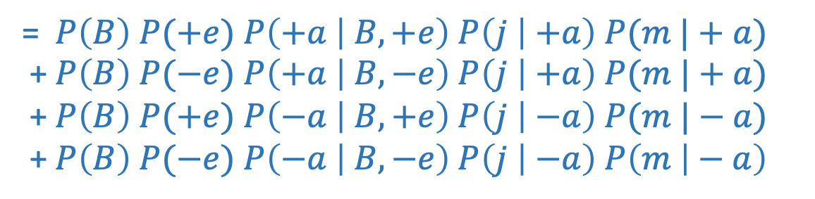
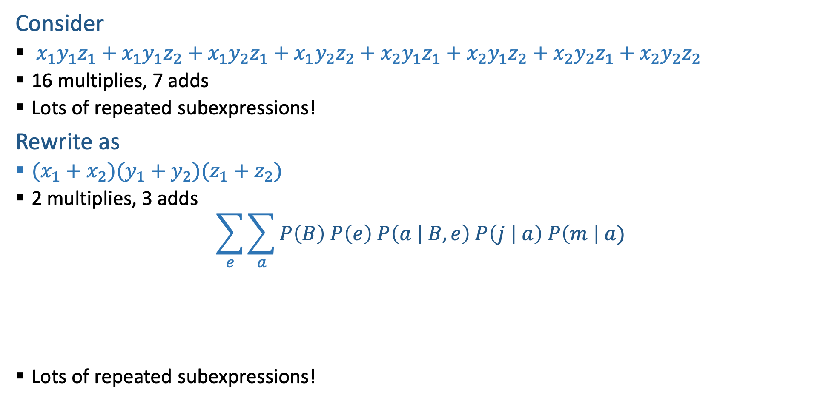
Can we do better?
Consider
  $x_{1}y_{1}z_{1}+x_{1}y_{1}z_{2}+x_{1}y_{2}z_{1}+x_{1}y_{2}z_{2}+x_{2}y_{1}z_{1}+x_{2}y_{1}z_{2}+x_{2}y_{2}z_{1}+x_{2}y_{2}z_{2}$
  16 multiplies, 7 adds
  Lots of repeated subexpressions!
Rewrite as
  $(x_{1}+x_{2})(y_{1}+y_{2})(z_{1}+z_{2})$
  2 multiplies, 3 adds
$$\sum_{e}{\sum_{a}{P\left(B\right) P\left(e\right) P\left(a | B,e\right) P\left(j | a\right) P\left(m \right| a)}}$$
  Lots of repeated subexpressions!
= $P\left(B\right) P(+e)$ $P\left(+a | B,+e\right) P\left(j | +a\right) P(m |+a)$
+ $P\left(B\right) P(−e)$ $P\left(+a | B,−e\right) P\left(j | +a\right) P(m |+a)$
+ $P\left(B\right) P(+e)$ $P\left(−a | B,+e\right) P\left(j | −a\right) P(m |−a)$
+ $P\left(B\right) P(−e)$ $P\left(−a | B,−e\right) P\left(j | −a\right) P\left(m | − a\right)$

Slide 18

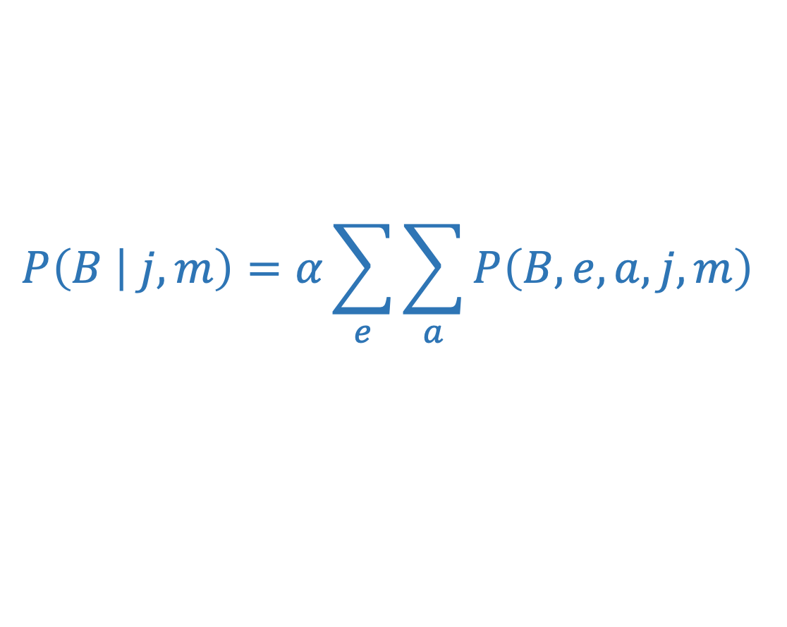

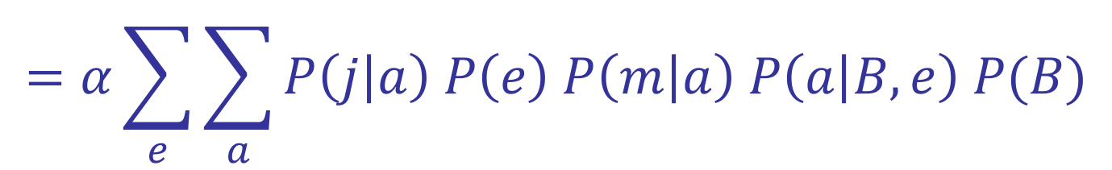






Variable elimination: The basic ideas
Move summations inwards as far as possible
$$P\left(B | j,m\right)=α\sum_{e}{\sum_{a}{P\left(B,e,a,j,m\right) }}$$
$$=α\sum_{e}{\sum_{a}{P\left(j | a\right) P\left(e\right) P\left(m | a\right) P\left(a | B,e\right) P(B)}}$$
$$\sum_{e}{ }$$
$$\sum_{a}{ }$$
$$=α$$
$$P\left(j | a\right)$$
$$P\left(e\right)$$
$$P(m|a)$$
$$P\left(a | B,e\right)$$
$$P\left(B\right)$$

Slide 19
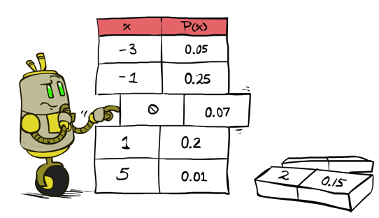
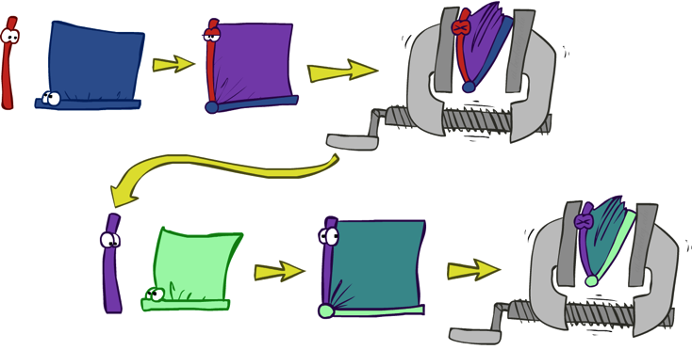


Variable Elimination
    Query: P(Q₁ ,.., Q_{m} |E₁=e₁,.., E_{k}=e_{k})
Start with initial factors:
  Local CPTs (but instantiated by evidence)
While there are still hidden variables (not Q_{i} or evidence):
  Pick a hidden variable H
  Join all factors mentioning H
  Eliminate (sum out) H
Join all remaining factors and normalize

Slide 20
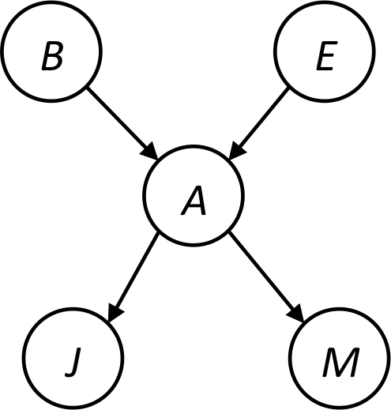


Example
Query P(B | j,m)
  P(B) P(E) P(A|B,E) P(j|A) P(m|A)
Choose A
  P(A|B,E)
  P(j|A)
  P(m|A)
  P(A,j,m|B,E)
  P(j,m|B,E)
  P(B) P(E) P(j,m|B,E)

Slide 21
Example
  P(B) P(E) P(j,m|B,E)
Choose E
  P(E)
  P(j,m|B,E)
  P(E,j,m|B)
  P(j,m|B)
  P(B) P(j,m|B)
Finish with B
  P(B)
  P(j,m|B)
  P(j,m,B)
Normalize
  P(B | j,m)

Slide 22
P(B | j, m)
See video: Math for Variable Elimination

Slide 23
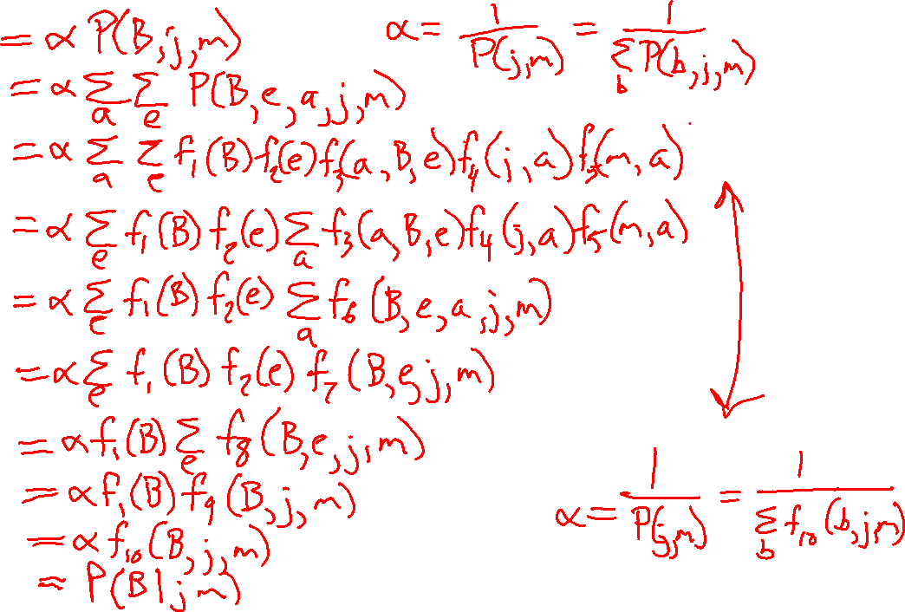
P(B | j, m)

Slide 24
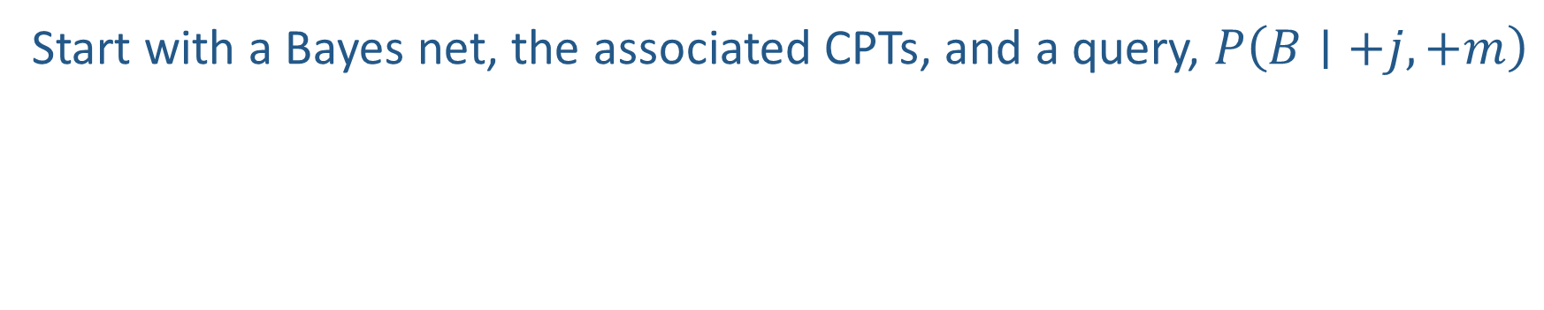
Example (with numbers!)
Start with a Bayes net, the associated CPTs, and a query, $P\left(B∣+j,+m\right)$
B | P(B)
+b | 0.001
-b | 0.999
E | P(E)
+e | 0.002
-e | 0.998
B
E
A
B | E | A | P(A|B,E)
+b | +e | +a | 0.95
+b | +e | -a | 0.05
+b | -e | +a | 0.94
+b | -e | -a | 0.06
-b | +e | +a | 0.29
-b | +e | -a | 0.71
-b | -e | +a | 0.001
-b | -e | -a | 0.999
J
M
A | J | P(J|A)
+a | +j | 0.9
+a | -j | 0.1
-a | +j | 0.05
-a | -j | 0.95
A | M | P(M|A)
+a | +m | 0.7
+a | -m | 0.3
-a | +m | 0.01
-a | -m | 0.99

Slide 25
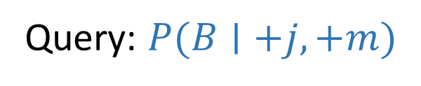
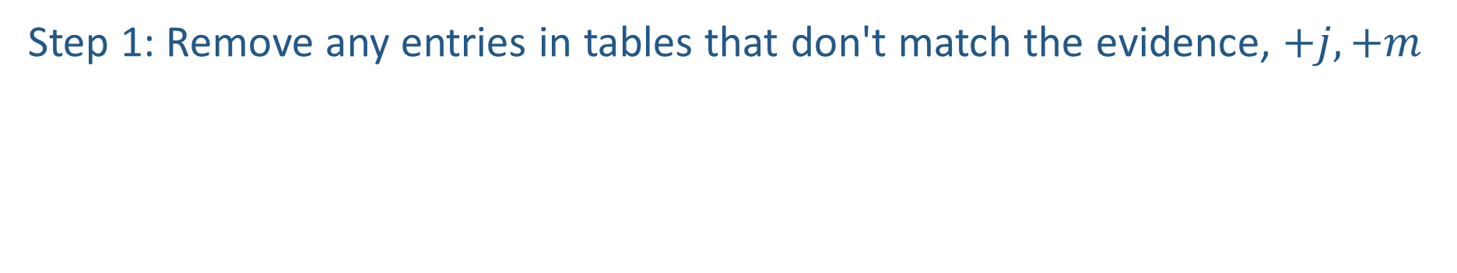
Example (with numbers!)
Query: $P(B∣+j,+m)$
Step 1: Remove any entries in tables that don't match the evidence, $+j, +m$
B | P(B)
+b | 0.001
-b | 0.999
E | P(E)
+e | 0.002
-e | 0.998
B
E
A
B | E | A | P(A|B,E)
+b | +e | +a | 0.95
+b | +e | -a | 0.05
+b | -e | +a | 0.94
+b | -e | -a | 0.06
-b | +e | +a | 0.29
-b | +e | -a | 0.71
-b | -e | +a | 0.001
-b | -e | -a | 0.999
J
M
A | J | P(J|A)
+a | +j | 0.9
+a | -j | 0.1
-a | +j | 0.05
-a | -j | 0.95
A | M | P(M|A)
+a | +m | 0.7
+a | -m | 0.3
-a | +m | 0.01
-a | -m | 0.99

Slide 26
Example (with numbers!)
Query: $P(B∣+j,+m)$
Step 1: Remove any entries in tables that don't match the evidence, $+j, +m$
B | P(B)
+b | 0.001
-b | 0.999
E | P(E)
+e | 0.002
-e | 0.998
B
E
A
B | E | A | P(A|B,E)
+b | +e | +a | 0.95
+b | +e | -a | 0.05
+b | -e | +a | 0.94
+b | -e | -a | 0.06
-b | +e | +a | 0.29
-b | +e | -a | 0.71
-b | -e | +a | 0.001
-b | -e | -a | 0.999
+j
+m
A | +j | P(+j|A)
+a | +j | 0.9
-a | +j | 0.05
A | +m | P(+m|A)
+a | +m | 0.7
-a | +m | 0.01

Slide 27
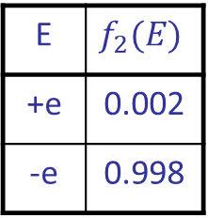
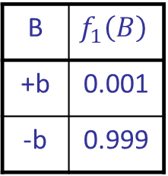
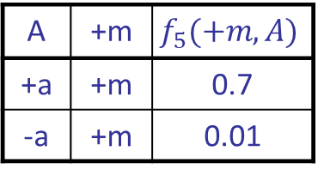
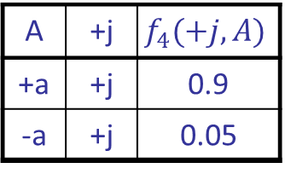
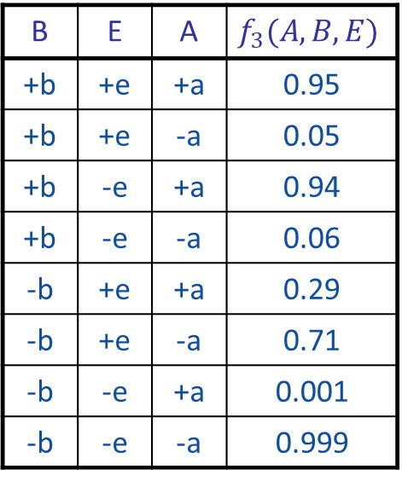
Example (with numbers!)
Query: $P(B∣+j,+m)$
Step 2: Think each table as just a factor table rather than probabilities
B | $$f_{1}\left(B\right)$$
+b | 0.001
-b | 0.999
E | $$f_{2}(E)$$
+e | 0.002
-e | 0.998
B
E
A
B | E | A | $$f_{3}(A, B,E)$$
+b | +e | +a | 0.95
+b | +e | -a | 0.05
+b | -e | +a | 0.94
+b | -e | -a | 0.06
-b | +e | +a | 0.29
-b | +e | -a | 0.71
-b | -e | +a | 0.001
-b | -e | -a | 0.999
+j
+m
A | +j | $$f_{4}(+j,A)$$
+a | +j | 0.9
-a | +j | 0.05
A | +m | $$f_{5}(+m,A)$$
+a | +m | 0.7
-a | +m | 0.01

Slide 28
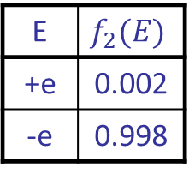
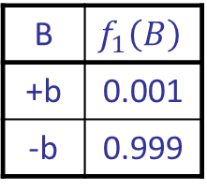
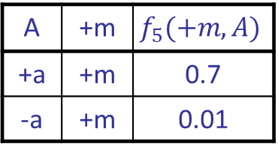
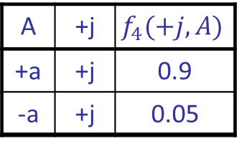
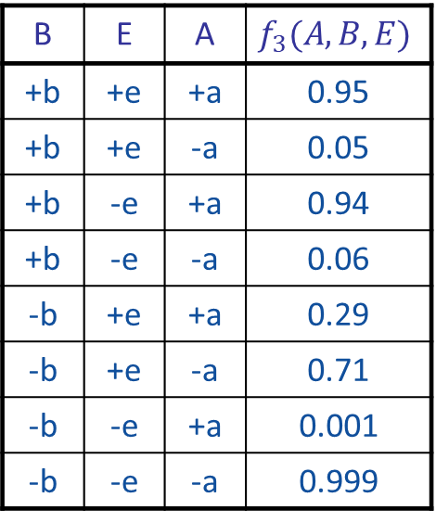
Example (with numbers!)
Query: $P(B∣+j,+m)$
Step 2: Think each table as just a factor table rather than probabilities
B | $$f_{1}\left(B\right)$$
+b | 0.001
-b | 0.999
E | $$f_{2}(E)$$
+e | 0.002
-e | 0.998
B | E | A | $$f_{3}(A, B,E)$$
+b | +e | +a | 0.95
+b | +e | -a | 0.05
+b | -e | +a | 0.94
+b | -e | -a | 0.06
-b | +e | +a | 0.29
-b | +e | -a | 0.71
-b | -e | +a | 0.001
-b | -e | -a | 0.999
A | +j | $$f_{4}(+j,A)$$
+a | +j | 0.9
-a | +j | 0.05
A | +m | $$f_{5}(+m,A)$$
+a | +m | 0.7
-a | +m | 0.01

Slide 29
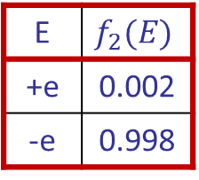
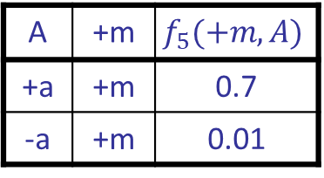
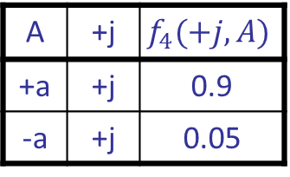
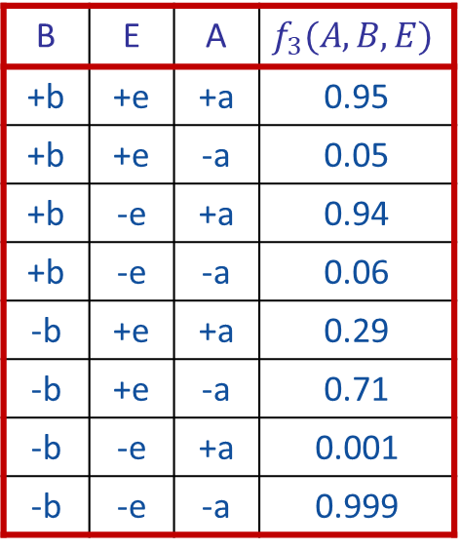
Example (with numbers!)
Query: $P(B∣+j,+m)$
Step 3(E): Eliminate hidden variable E (we chose E first this time)
i: Collect all factors tables associated with E
B | $$f_{1}\left(B\right)$$
+b | 0.001
-b | 0.999
E | $$f_{2}(E)$$
+e | 0.002
-e | 0.998
B | E | A | $$f_{3}(A, B,E)$$
+b | +e | +a | 0.95
+b | +e | -a | 0.05
+b | -e | +a | 0.94
+b | -e | -a | 0.06
-b | +e | +a | 0.29
-b | +e | -a | 0.71
-b | -e | +a | 0.001
-b | -e | -a | 0.999
A | +j | $$f_{4}(+j,A)$$
+a | +j | 0.9
-a | +j | 0.05
A | +m | $$f_{5}(+m,A)$$
+a | +m | 0.7
-a | +m | 0.01

Slide 30
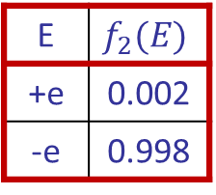
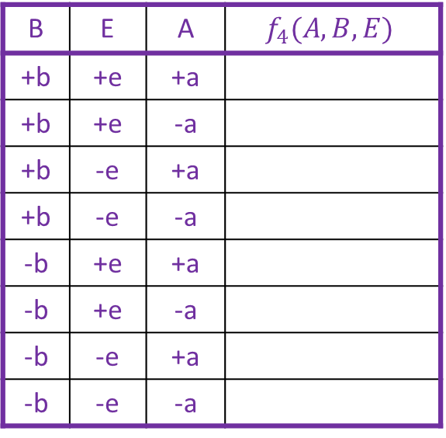
Example (with numbers!)
Query: $P(B∣+j,+m)$
Step 3(E): Eliminate hidden variable E
i: Collect all factors tables associated with E
ii: Create new factor table by multiplying them together
E | $$f_{2}(E)$$
+e | 0.002
-e | 0.998
B | E | A | $$f_{3}(A, B,E)$$
+b | +e | +a | 0.95
+b | +e | -a | 0.05
+b | -e | +a | 0.94
+b | -e | -a | 0.06
-b | +e | +a | 0.29
-b | +e | -a | 0.71
-b | -e | +a | 0.001
-b | -e | -a | 0.999
B | E | A | $$f_{4}(A, B,E)$$
+b | +e | +a
+b | +e | -a
+b | -e | +a
+b | -e | -a
-b | +e | +a
-b | +e | -a
-b | -e | +a
-b | -e | -a

Slide 31
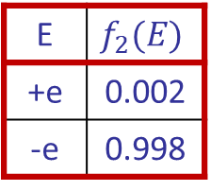
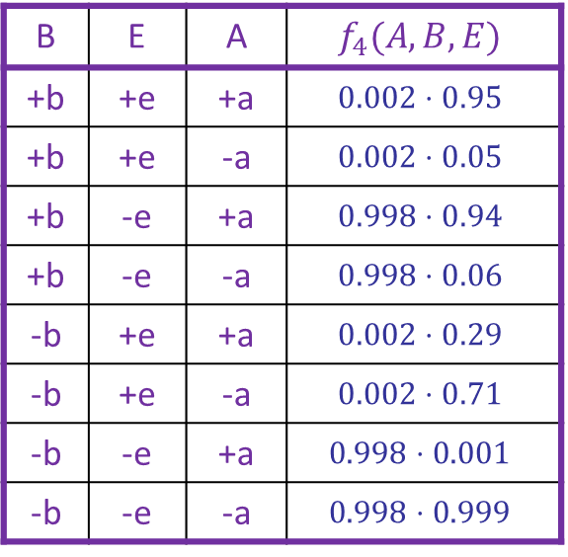
Example (with numbers!)
Query: $P(B∣+j,+m)$
Step 3(E): Eliminate hidden variable E
i: Collect all factors tables associated with E
ii: Create new factor table by multiplying them together
E | $$f_{2}(E)$$
+e | 0.002
-e | 0.998
B | E | A | $$f_{3}(A, B,E)$$
+b | +e | +a | 0.95
+b | +e | -a | 0.05
+b | -e | +a | 0.94
+b | -e | -a | 0.06
-b | +e | +a | 0.29
-b | +e | -a | 0.71
-b | -e | +a | 0.001
-b | -e | -a | 0.999
B | E | A | $$f_{4}(A, B,E)$$
+b | +e | +a | $$0.002⋅0.95$$
+b | +e | -a | $$0.002⋅0.05$$
+b | -e | +a | $$0.998⋅0.94$$
+b | -e | -a | $$0.998⋅0.06$$
-b | +e | +a | $$0.002⋅0.29$$
-b | +e | -a | $$0.002⋅0.71$$
-b | -e | +a | $$0.998⋅0.001$$
-b | -e | -a | $$0.998⋅0.999$$

Slide 32

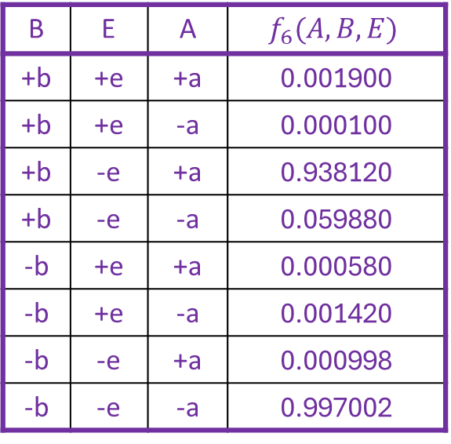
Example (with numbers!)
Query: $P(B∣+j,+m)$
Step 3(E): Eliminate hidden variable E
i: Collect all factors tables associated with E
ii: Create new factor table by multiplying them together
E | $$f_{2}(E)$$
+e | 0.002
-e | 0.998
B | E | A | $$f_{3}(A, B,E)$$
+b | +e | +a | 0.95
+b | +e | -a | 0.05
+b | -e | +a | 0.94
+b | -e | -a | 0.06
-b | +e | +a | 0.29
-b | +e | -a | 0.71
-b | -e | +a | 0.001
-b | -e | -a | 0.999
B | E | A | $$f_{6}(A, B,E)$$
+b | +e | +a | 0.001900
+b | +e | -a | 0.000100
+b | -e | +a | 0.938120
+b | -e | -a | 0.059880
-b | +e | +a | 0.000580
-b | +e | -a | 0.001420
-b | -e | +a | 0.000998
-b | -e | -a | 0.997002

Slide 33
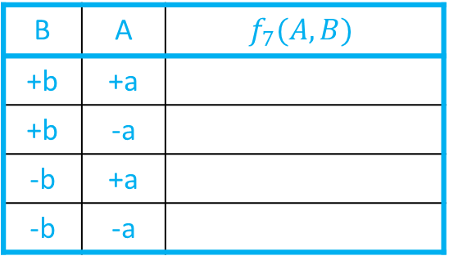
Example (with numbers!)
Query: $P(B∣+j,+m)$
Step 3(E): Eliminate hidden variable E
i: Collect all factors tables associated with E
ii: Create new factor table by multiplying them together
iii: Create another new factor by summing over E
B | A | $$f_{7}(A, B)$$
+b | +a
+b | -a
-b | +a
-b | -a
B | E | A | $$f_{6}(A, B,E)$$
+b | +e | +a | 0.001900
+b | +e | -a | 0.000100
+b | -e | +a | 0.938120
+b | -e | -a | 0.059880
-b | +e | +a | 0.000580
-b | +e | -a | 0.001420
-b | -e | +a | 0.000998
-b | -e | -a | 0.997002

Slide 34
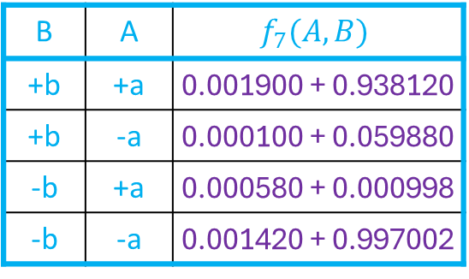
Example (with numbers!)
Query: $P(B∣+j,+m)$
Step 3(E): Eliminate hidden variable E
i: Collect all factors tables associated with E
ii: Create new factor table by multiplying them together
iii: Create another new factor by summing over E
B | A | $$f_{7}(A, B)$$
+b | +a | 0.001900 + 0.938120
+b | -a | 0.000100 + 0.059880
-b | +a | 0.000580 + 0.000998
-b | -a | 0.001420 + 0.997002
B | E | A | $$f_{6}(A, B,E)$$
+b | +e | +a | 0.001900
+b | +e | -a | 0.000100
+b | -e | +a | 0.938120
+b | -e | -a | 0.059880
-b | +e | +a | 0.000580
-b | +e | -a | 0.001420
-b | -e | +a | 0.000998
-b | -e | -a | 0.997002

Slide 35
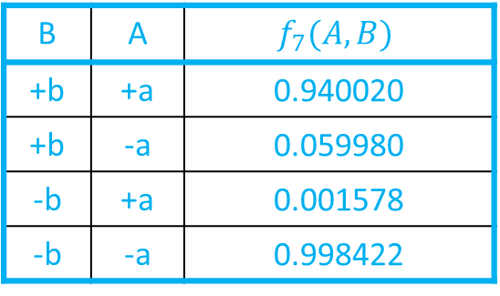
Example (with numbers!)
Query: $P(B∣+j,+m)$
Step 3(E): Eliminate hidden variable E
i: Collect all factors tables associated with E
ii: Create new factor table by multiplying them together
iii: Create another new factor by summing over E
B | A | $$f_{7}(A, B)$$
+b | +a | 0.940020
+b | -a | 0.059980
-b | +a | 0.001578
-b | -a | 0.998422
B | E | A | $$f_{6}(A, B,E)$$
+b | +e | +a | 0.001900
+b | +e | -a | 0.000100
+b | -e | +a | 0.938120
+b | -e | -a | 0.059880
-b | +e | +a | 0.000580
-b | +e | -a | 0.001420
-b | -e | +a | 0.000998
-b | -e | -a | 0.997002

Slide 36
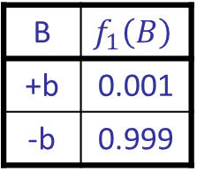
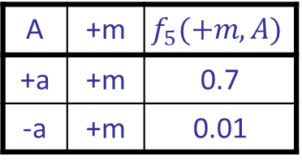
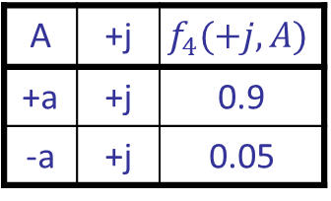
Example (with numbers!)
Query: $P(B∣+j,+m)$
Step 3(E): Eliminate hidden variable E (and return to list of tables)
B | $$f_{1}\left(B\right)$$
+b | 0.001
-b | 0.999
B | A | $$f_{7}(A, B)$$
+b | +a | 0.940020
+b | -a | 0.059980
-b | +a | 0.001578
-b | -a | 0.998422
A | +j | $$f_{4}(+j,A)$$
+a | +j | 0.9
-a | +j | 0.05
A | +m | $$f_{5}(+m,A)$$
+a | +m | 0.7
-a | +m | 0.01

Slide 37
Example (with numbers!)
Query: $P(B∣+j,+m)$
Step 3(A): Eliminate hidden variable A
B | $$f_{1}\left(B\right)$$
+b | 0.001
-b | 0.999
B | A | $$f_{7}(A, B)$$
+b | +a | 0.940020
+b | -a | 0.059980
-b | +a | 0.001578
-b | -a | 0.998422
A | +j | $$f_{4}(+j,A)$$
+a | +j | 0.9
-a | +j | 0.05
A | +m | $$f_{5}(+m,A)$$
+a | +m | 0.7
-a | +m | 0.01

Slide 38
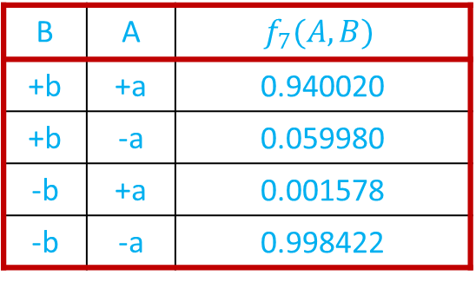
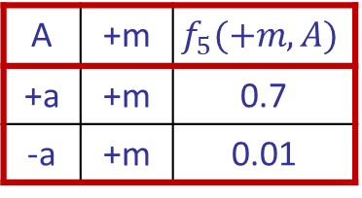
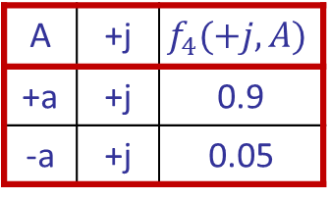
Example (with numbers!)
Query: $P(B∣+j,+m)$
Step 3(A): Eliminate hidden variable A
i: Collect all factors tables associated with A
B | $$f_{1}\left(B\right)$$
+b | 0.001
-b | 0.999
B | A | $$f_{7}(A, B)$$
+b | +a | 0.940020
+b | -a | 0.059980
-b | +a | 0.001578
-b | -a | 0.998422
A | +j | $$f_{4}(+j,A)$$
+a | +j | 0.9
-a | +j | 0.05
A | +m | $$f_{5}(+m,A)$$
+a | +m | 0.7
-a | +m | 0.01

Slide 39
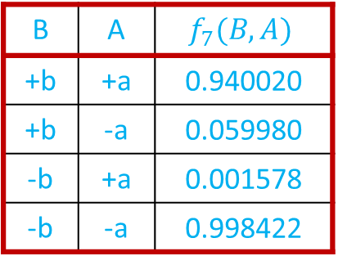
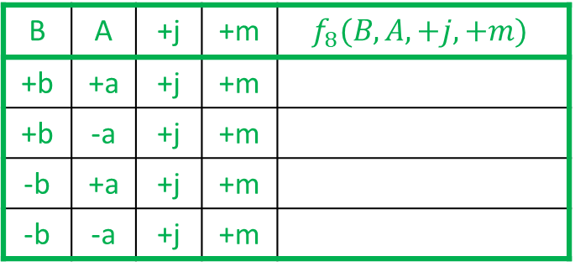
Example (with numbers!)
Query: $P(B∣+j,+m)$
Step 3(A): Eliminate hidden variable A
i: Collect all factors tables associated with A
ii: Create new factor table by multiplying them together
B | A | $$f_{7}(B, A)$$
+b | +a | 0.940020
+b | -a | 0.059980
-b | +a | 0.001578
-b | -a | 0.998422
A | +j | $$f_{4}(+j,A)$$
+a | +j | 0.9
-a | +j | 0.05
A | +m | $$f_{5}(+m,A)$$
+a | +m | 0.7
-a | +m | 0.01
B | A | +j | +m | $$f_{8}(B, A,+j,+m)$$
+b | +a | +j | +m
+b | -a | +j | +m
-b | +a | +j | +m
-b | -a | +j | +m

Slide 40

Example (with numbers!)
Query: $P(B∣+j,+m)$
Step 3(A): Eliminate hidden variable A
i: Collect all factors tables associated with A
ii: Create new factor table by multiplying them together
B | A | $$f_{7}(B, A)$$
+b | +a | 0.940020
+b | -a | 0.059980
-b | +a | 0.001578
-b | -a | 0.998422
A | +j | $$f_{4}(+j,A)$$
+a | +j | 0.9
-a | +j | 0.05
A | +m | $$f_{5}(+m,A)$$
+a | +m | 0.7
-a | +m | 0.01
B | A | +j | +m | $$f_{8}(B, A,+j,+m)$$
+b | +a | +j | +m | $$0.940020⋅0.9⋅0.7$$
+b | -a | +j | +m | $$0.059980⋅0.05⋅0.01$$
-b | +a | +j | +m | $$0.001578⋅0.9⋅0.7$$
-b | -a | +j | +m | $$0.998422⋅0.05⋅0.01$$

Slide 41

Example (with numbers!)
Query: $P(B∣+j,+m)$
Step 3(A): Eliminate hidden variable A
i: Collect all factors tables associated with A
ii: Create new factor table by multiplying them together
B | A | $$f_{7}(B, A)$$
+b | +a | 0.940020
+b | -a | 0.059980
-b | +a | 0.001578
-b | -a | 0.998422
A | +j | $$f_{4}(+j,A)$$
+a | +j | 0.9
-a | +j | 0.05
A | +m | $$f_{5}(+m,A)$$
+a | +m | 0.7
-a | +m | 0.01
B | A | +j | +m | $$f_{8}(B, A,+j,+m)$$
+b | +a | +j | +m | 0.592213
+b | -a | +j | +m | 0.000030
-b | +a | +j | +m | 0.000994
-b | -a | +j | +m | 0.000499

Slide 42

Example (with numbers!)
Query: $P(B∣+j,+m)$
Step 3(A): Eliminate hidden variable A
i: Collect all factors tables associated with A
ii: Create new factor table by multiplying them together
iii: Create another new factor by summing over A
B | +j | +m | $$f_{8}(B,+j,+m)$$
+b | +j | +m
-b | +j | +m
B | A | +j | +m | $$f_{8}(B, A,+j,+m)$$
+b | +a | +j | +m | 0.592213
+b | -a | +j | +m | 0.000030
-b | +a | +j | +m | 0.000994
-b | -a | +j | +m | 0.000499

Slide 43

Example (with numbers!)
Query: $P(B∣+j,+m)$
Step 3(A): Eliminate hidden variable A
i: Collect all factors tables associated with A
ii: Create new factor table by multiplying them together
iii: Create another new factor by summing over A
B | +j | +m | $$f_{8}(B,+j,+m)$$
+b | +j | +m | 0.592243
-b | +j | +m | 0.001493
B | A | +j | +m | $$f_{8}(B, A,+j,+m)$$
+b | +a | +j | +m | 0.592213
+b | -a | +j | +m | 0.000030
-b | +a | +j | +m | 0.000994
-b | -a | +j | +m | 0.000499

Slide 44
Example (with numbers!)
Query: $P(B∣+j,+m)$
Step 3(A): Eliminate hidden variable A (and return to list of tables)
B | $$f_{1}\left(B\right)$$
+b | 0.001
-b | 0.999
B | +j | +m | $$f_{8}(B,+j,+m)$$
+b | +j | +m | 0.592243
-b | +j | +m | 0.001493

Slide 45

Example (with numbers!)
Query: $P(B∣+j,+m)$
Step 4: Multiply remaining factor tables
B | $$f_{1}\left(B\right)$$
+b | 0.001
-b | 0.999
B | +j | +m | $$f_{8}(B,+j,+m)$$
+b | +j | +m | 0.592243
-b | +j | +m | 0.001493
B | +j | +m | $$f_{9}(B,+j,+m)$$
+b | +j | +m
-b | +j | +m

Slide 46

Example (with numbers!)
Query: $P(B∣+j,+m)$
Step 4: Multiply remaining factor tables
B | $$f_{1}\left(B\right)$$
+b | 0.001
-b | 0.999
B | +j | +m | $$f_{8}(B,+j,+m)$$
+b | +j | +m | 0.592243
-b | +j | +m | 0.001493
B | +j | +m | $$f_{9}(B,+j,+m)$$
+b | +j | +m | $$0.001⋅0.592243$$
-b | +j | +m | $$0.999⋅0.001493$$

Slide 47

Example (with numbers!)
Query: $P(B∣+j,+m)$
Step 4: Multiply remaining factor tables
B | $$f_{1}\left(B\right)$$
+b | 0.001
-b | 0.999
B | +j | +m | $$f_{8}(B,+j,+m)$$
+b | +j | +m | 0.592243
-b | +j | +m | 0.001493
B | +j | +m | $$f_{9}(B,+j,+m)$$
+b | +j | +m | $$0.000592$$
-b | +j | +m | $$0.001492$$

Slide 48


Example (with numbers!)
Query: $P(B∣+j,+m)$
Step 5: Normalize
B | +j | +m | $$P(B∣+j,+m)$$
+b | +j | +m
-b | +j | +m
B | +j | +m | $$f_{9}(B,+j,+m)$$
+b | +j | +m | $$0.000592$$
-b | +j | +m | $$0.001492$$
+j | +m | $$Z=f_{10}(+j,+m)$$
+j | +m | $0.000592$+$0.001492$

Slide 49

Example (with numbers!)
Query: $P(B∣+j,+m)$
Step 5: Normalize
B | +j | +m | $$P(B∣+j,+m)$$
+b | +j | +m
-b | +j | +m
B | +j | +m | $$f_{9}(B,+j,+m)$$
+b | +j | +m | $$0.000592$$
-b | +j | +m | $$0.001492$$
+j | +m | $$Z=f_{10}(+j,+m)$$
+j | +m | $$0.002084$$

Slide 50

Example (with numbers!)
Query: $P(B∣+j,+m)$
Step 5: Normalize
B | +j | +m | $$P(B∣+j,+m)$$
+b | +j | +m | $$0.000592/0.002084$$
-b | +j | +m | $$0.001492/0.002084$$
B | +j | +m | $$f_{9}(B,+j,+m)$$
+b | +j | +m | $$0.000592$$
-b | +j | +m | $$0.001492$$
+j | +m | $$Z=f_{10}(+j,+m)$$
+j | +m | $$0.002084$$

Slide 51


Example (with numbers!)
Query: $P(B∣+j,+m)$
Step 5: Normalize
B | +j | +m | $$P(B∣+j,+m)$$
+b | +j | +m | $$0.284172$$
-b | +j | +m | $$0.715828$$
B | +j | +m | $$f_{9}(B,+j,+m)$$
+b | +j | +m | $$0.000592$$
-b | +j | +m | $$0.001492$$
+j | +m | $$Z=f_{10}(+j,+m)$$
+j | +m | $$0.002084$$

Slide 52
Order matters
  Elimination Order: C, B, A, Z
    P(D) = α ∑_{z,a,b,c} P(D|z) P(z) P(a|z) P(b|z) P(c|z)
    = α ∑_{z} P(D|z) P(z) ∑_{a} P(a|z) ∑_{b} P(b|z) ∑_{c} P(c|z)
    Largest factor has 2 variables (D,Z)
  Elimination Order: Z, C, B, A
    P(D) = α ∑_{a,b,c,z} P(a|z) P(b|z) P(c|z) P(D|z) P(z)
    = α ∑_{a} ∑_{b} ∑_{c} ∑_{z} P(a|z) P(b|z) P(c|z) P(D|z) P(z)
    Largest factor has 4 variables (A,B,C,D) (or 5 if you count pre-summation over Z)
  In general, with n leaves, factor of size 2^{n}
Z
A
B
C
D

Slide 53
VE: Computational and Space Complexity
The computational and space complexity of variable elimination is determined by the largest factor (and it’s space that kills you)
The elimination ordering can greatly affect the size of the largest factor.
  E.g., previous slide’s example 2^{n} vs. 2
Does there always exist an ordering that only results in small factors?
  No!

Slide 54





















VE: Computational and Space Complexity
Inference in Bayes’ nets is NP-hard.
No known efficient probabilistic inference in general.

Slide 55
Bayes Nets
Part I: Representation and Independence
Part II: Exact inference
  Enumeration (always exponential complexity)
  Variable elimination (worst-case exponential complexity, often better)
  Inference is NP-hard in general
Part III: Approximate Inference

Slide 56
Additional Variable Elimination Slides

Slide 57

Variable elimination: The basic ideas
Move summations inwards as far as possible
  P(B | j, m) = α ∑_{e}∑_{a}P(B) P(e) P(a|B,e) P(j|a) P(m|a)
  = α P(B) ∑_{e} P(e) ∑_{a} P(a|B,e) P(j|a) P(m|a)
Do the calculation from the inside out
  I.e., sum over a first, then sum over e
  Problem: P(a|B,e) isn’t a single number, it’s a bunch of different numbers depending on the values of B and e
  Solution: use arrays of numbers (of various dimensions) with appropriate operations on them; these are called factors

Slide 58

Operation 1: Pointwise product
First basic operation: pointwise product of factors (similar to a database join, not matrix multiply!)
  New factor has union of variables of the two original factors
  Each entry is the product of the corresponding entries from the original factors
Example: P(A) x P(J|A) = P(A,J)
P(J|A)
P(A,J)
P(A)
A \ J | true | false
true | 0.9 | 0.1
false | 0.05 | 0.95
A \ J | true | false
true
false
 | 0.09 | 0.01
 | 0.045 | 0.855
true | 0.1
false | 0.9
x
=

Slide 59



Example: Making larger factors
Example: P(J|A) x P(M|A) = P(J,M|A)
P(J,M|A)
P(J|A)
P(M|A)
A \ J | true | false
true | 0.99 | 0.01
false | 0.145 | 0.855
A \ M | true | false
true | 0.97 | 0.03
false | 0.019 | 0.891
x
=
A=false
A=true

Slide 60
Example: Making larger factors
Example: f₁(U,V) x f₂(V,W) x f₃(W,X) = f₄(U,V,W,X)
Sizes: [10,10] x [10,10] x [10,10] = [10,10,10,10]
I.e., 300 numbers blows up to 10,000 numbers!
Factor blowup can make VE very expensive

Slide 61

Operation 2: Summing out a variable
Second basic operation: summing out (or eliminating) a variable from a factor
  Shrinks a factor to a smaller one
Example: ∑_{j} P(A,J) = P(A,j) + P(A,¬j) = P(A)
P(A,J)
P(A)
A \ J | true | false
true | 0.09 | 0.01
false | 0.045 | 0.855
Sum out J
true | 0.1
false | 0.9

Slide 62

Summing out from a product of factors
Project the factors each way first, then sum the products
  Example: ∑_{a} P(a|B,e) P(j|a) P(m|a)
  = P(a|B,e) P(j|a) P(m|a) + P(¬a|B,e) P(j|¬a) P(m|¬a)
  = P(a,j,m|B,e) + P(¬a,j,m|B,e)
  = P(j,m|B,e)

