Slide 1
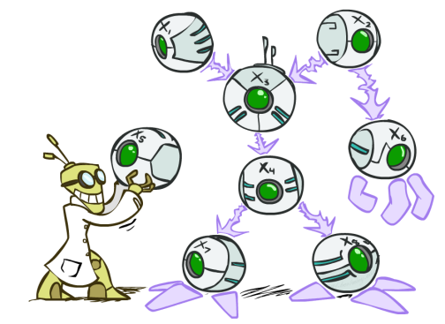
AI: Representation and Problem Solving
Bayes Nets Inference
Instructors: Tuomas Sandholm and Vincent Conitzer
Slide credits: CMU AI and http://ai.berkeley.edu

Slide 2
Announcements
HW8 (online) due tomorrow Thursday April 3
HW9 (online, written) released tomorrow Thursday April 3, due next Thursday April 10
No TA office hours during carnival EXCEPT Saturday April 5 12-2pm

Slide 3

Bayes Nets
Part I: Representation and Independence
Part II: Exact inference
  Enumeration (always exponential complexity)
  Variable elimination (worst-case exponential complexity, often better)
  Inference is NP-hard in general
Part III: Approximate Inference

Slide 4
Markov blanket
Markov blanket of X - subset of variables such that all other variables are independent of X conditioned on the blanket

Slide 5
Markov blanket
A variable’s Markov blanket consists of parents, children, children’s other parents
Every variable is conditionally independent of all other variables given its Markov blanket
GP3
P2
P1
P3
C
B
X
W
Z
A
C1
C2
GC2
5

Slide 6
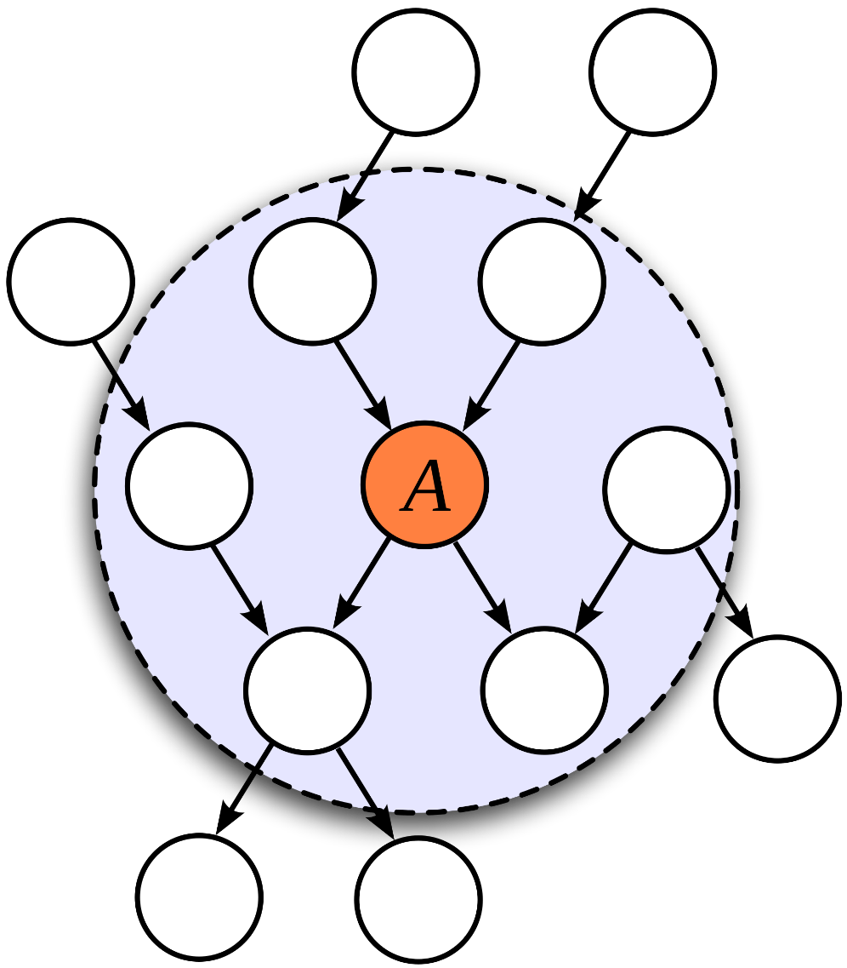
Markov blanket

Slide 7
Bayes Nets
Part I: Representation and Independence
Part II: Exact inference
  Enumeration (always exponential complexity)
  Variable elimination (worst-case exponential complexity, often better)
  Inference is NP-hard in general
Part III: Approximate Inference

Slide 8

Queries
What is the probability of this given what I know? $P\left(q ∣ e\right)$
What are the probabilities of all the possible outcomes (given what I know)? $P\left(Q ∣ e\right)$
Which outcome is the most likely outcome (given what I know)? ${argmax}_{q∈Q} P\left(q ∣ e\right)$

Slide 9

Queries
What is the probability of this given what I know? $P\left(q ∣ e\right)=\frac{P(q, e)}{P(e)}$
What are the probabilities of all the possible outcomes (given what I know)?
$P\left(Q ∣ e\right)=\frac{P\left(Q, e\right)}{P\left(e\right)}$
Which outcome is the most likely outcome (given what I know)?
${argmax}_{q∈Q} P\left(q ∣ e\right)={argmax}_{q∈Q}\frac{P\left(q, e\right)}{P\left(e\right)}$

Slide 10

Queries
What is the probability of this given what I know? $P\left(q ∣ e\right)=\frac{P(q, e)}{P(e)}=\frac{\sum_{h_{1}}{\sum_{h_{2}}{P\left(q, h_{1}, h_{2}, e\right)}}}{P(e)}$
What are the probabilities of all the possible outcomes (given what I know)?
$P\left(Q ∣ e\right)=\frac{P\left(Q, e\right)}{P\left(e\right)}=\frac{\sum_{h_{1}}{\sum_{h_{2}}{P\left(Q, h_{1}, h_{2}, e\right)}}}{P(e)}$
Which outcome is the most likely outcome (given what I know)?
${argmax}_{q∈Q} P\left(q ∣ e\right)={argmax}_{q∈Q}\frac{P\left(q, e\right)}{P\left(e\right)}={argmax}_{q∈Q}\frac{\sum_{h_{1}}{\sum_{h_{2}}{P\left(Q, h_{1}, h_{2}, e\right)}}}{P(e)}$

Slide 11

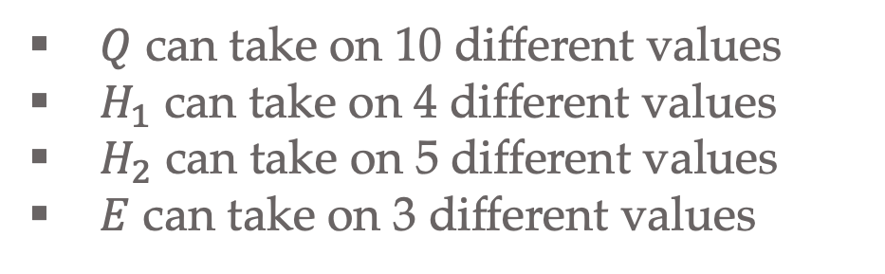
Poll 1
If we only have the joint table $P\left(Q,H_{1}, H_{2}, E\right)$, what is the minimum number of times we need to compute $P\left(e\right)$ to build $P\left(Q ∣ e\right)$?
$$P\left(Q ∣ e\right)=\frac{P\left(Q, e\right)}{P\left(e\right)}=\frac{\sum_{h_{1}}{\sum_{h_{2}}{P\left(Q, h_{1}, h_{2}, e\right)}}}{P(e)}$$
0
1
10
30
200
600
$Q$ can take on 10 different values
$H_{1}$ can take on 4 different values
$H_{2}$ can take on 5 different values
$E$ can take on 3 different values

Slide 12

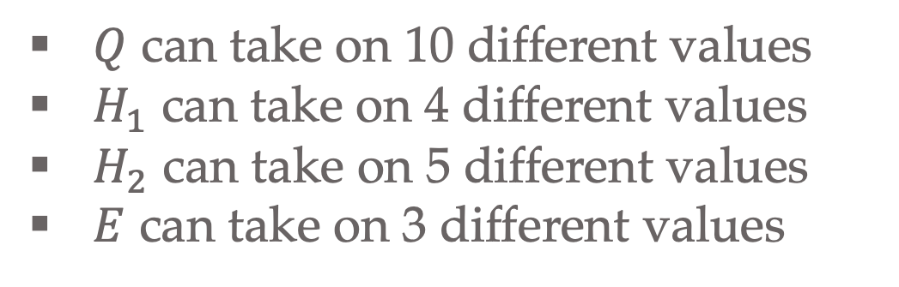
Poll 2
If we only have the joint table $P\left(Q,H_{1}, H_{2}, E\right)$, what is the minimum number of times we need to compute $P\left(e\right)$ to compute the following?
$${argmax}_{q∈Q} P\left(q ∣ e\right)=\frac{P\left(q, e\right)}{P\left(e\right)}=\frac{\sum_{h_{1}}{\sum_{h_{2}}{P\left(q, h_{1}, h_{2}, e\right)}}}{P(e)}$$
0
1
10
30
200
600
$Q$ can take on 10 different values
$H_{1}$ can take on 4 different values
$H_{2}$ can take on 5 different values
$E$ can take on 3 different values

Slide 13

Normalization
Sometimes we don’t care about exact probability and we skip $P(e)$
$P\left(Q ∣ e\right)=\frac{\sum_{h_{1}}{\sum_{h_{2}}{P\left(Q, h_{1}, h_{2}, e\right)}}}{P(e)}$
$P\left(Q ∣ e\right)=\frac{1}{Z}\sum_{h_{1}}{\sum_{h_{2}}{P\left(Q, h_{1}, h_{2}, e\right)}}$
$P\left(Q ∣ e\right)=α\sum_{h_{1}}{\sum_{h_{2}}{P\left(Q, h_{1}, h_{2}, e\right)}}$
$P\left(Q ∣ e\right)∝\sum_{h_{1}}{\sum_{h_{2}}{P\left(Q, h_{1}, h_{2}, e\right)}}$

Slide 14
Bayes Nets in the Wild
Example: Speech Recognition
“artificial $⋅⋅⋅⋅⋅⋅⋅⋅⋅⋅⋅$”
Find most probable next word given “artificial” and the audio for second word.

Slide 15

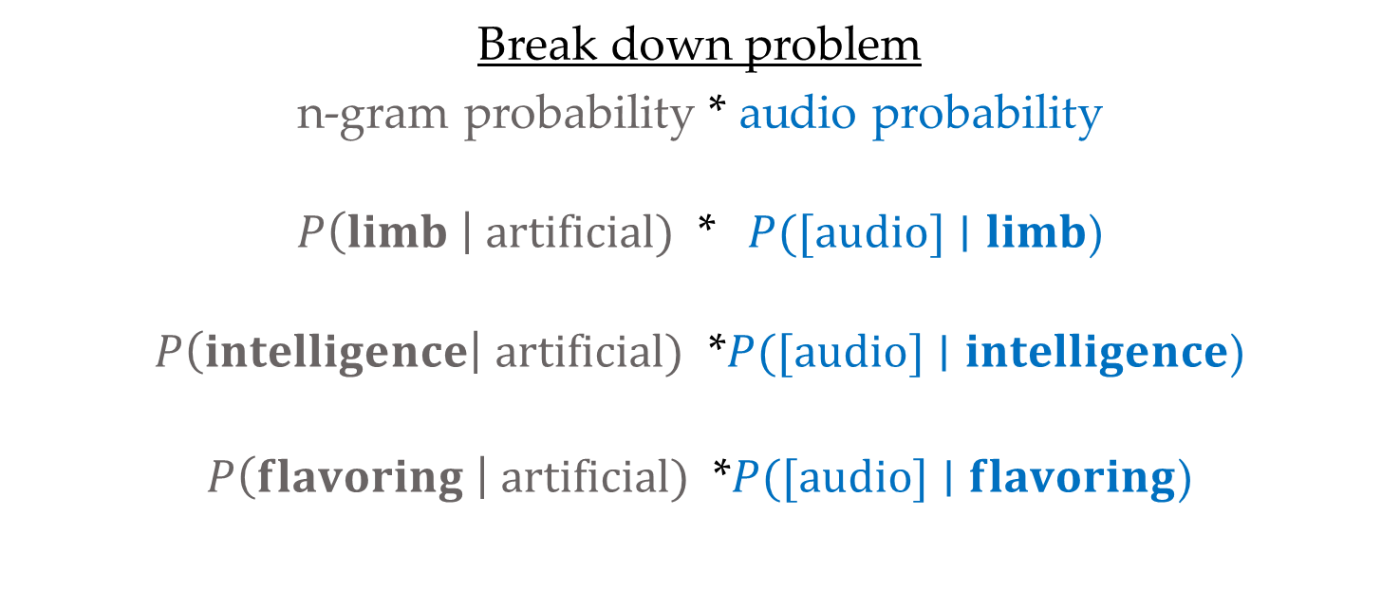
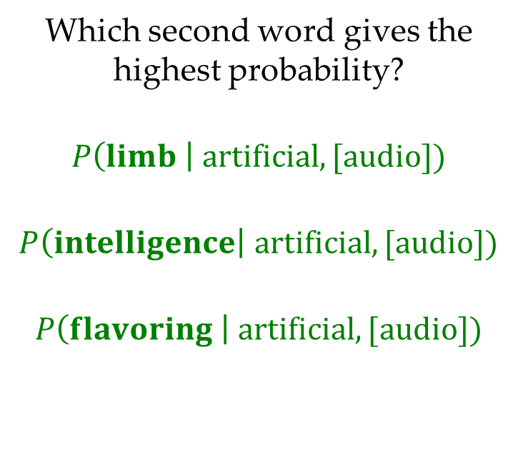
Bayes Nets in the Wild
Example: Speech Recognition
“artificial $⋅⋅⋅⋅⋅⋅⋅⋅⋅⋅⋅$”
Find most probable next word given “artificial” and the audio for second word.
Break down problem
n-gram probability * audio probability
$P\left(limb \right| artificial)$ * $P([audio]∣limb$)
$P\left(intelligence\right| artificial)$ *$P([audio]∣intelligence$)
$P\left(flavoring \right| artificial)$ *$P([audio]∣flavoring$)
Which second word gives the highest probability?
$$P\left(limb \right| artificial, [audio])$$
$$P\left(intelligence\right| artificial, [audio])$$
$$P\left(flavoring \right| artificial, [audio])$$

Slide 16
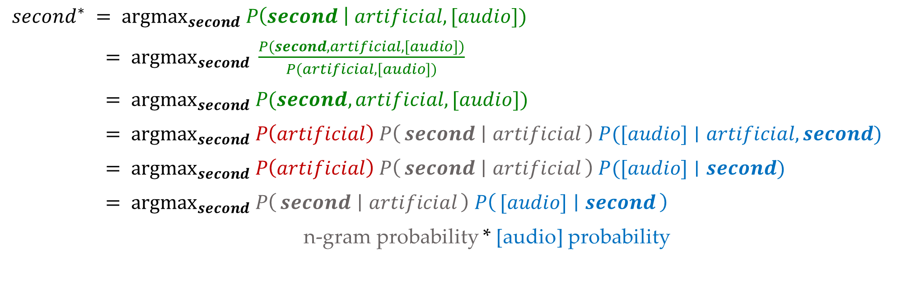
Bayes Nets in the Wild
$second^{∗} = {argmax}_{second} P\left(second \right| artificial, [audio])$
$= {argmax}_{second} \frac{P(second, artificial, [audio])}{P(artificial, [audio])}$
$= {argmax}_{second} P(second, artificial, [audio])$
$= {argmax}_{second} P\left(artificial\right) P\left(second ∣ artificial\right) P([audio]∣artificial, second)$
$= {argmax}_{second} P\left(artificial\right) P\left(second ∣ artificial\right) P([audio]∣second)$
$= {argmax}_{second} P\left(second ∣ artificial\right) P\left([audio] ∣ second\right)$
n-gram probability * [audio] probability

Slide 17

Inference
Inference: calculating some useful quantity from a probability model (joint probability distribution)
Examples:
  Posterior marginal probability
    P(Q|e₁,..,e_{k})
    e.g., what disease might I have?
  Most likely explanation:
    argmax_{q,r,s} P(Q=q,R=r,S=s|e₁,..,e_{k})
    e.g., what was just said?

Slide 18
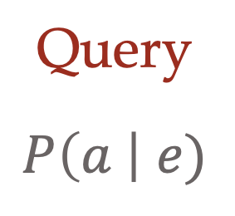
Answer Any Query from Bayes Net
Bayes Net
Joint
Query
$$P\left(a \right| e)$$
$$P\left(A\right) P\left(B | A\right) P\left(C | A\right) P\left(D | C\right) P(E|C)$$

Slide 19
Next: Answer Any Query from Bayes Net
Bayes Net
Query
$$P\left(a \right| e)$$
$$P\left(A\right) P\left(B | A\right) P\left(C | A\right) P\left(D | C\right) P(E|C)$$

Slide 20
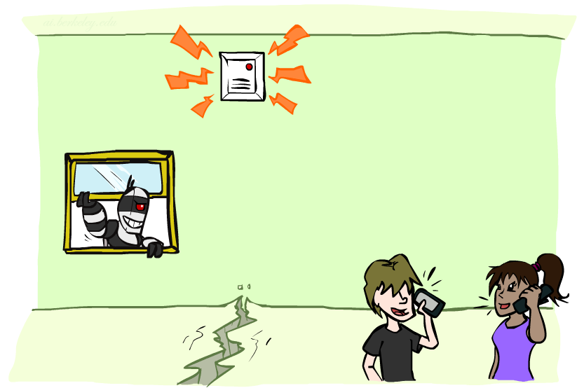
Example: Alarm Network
Variables
  B: Burglary
  A: Alarm goes off
  M: Mary calls
  J: John calls
  E: Earthquake!

Slide 21

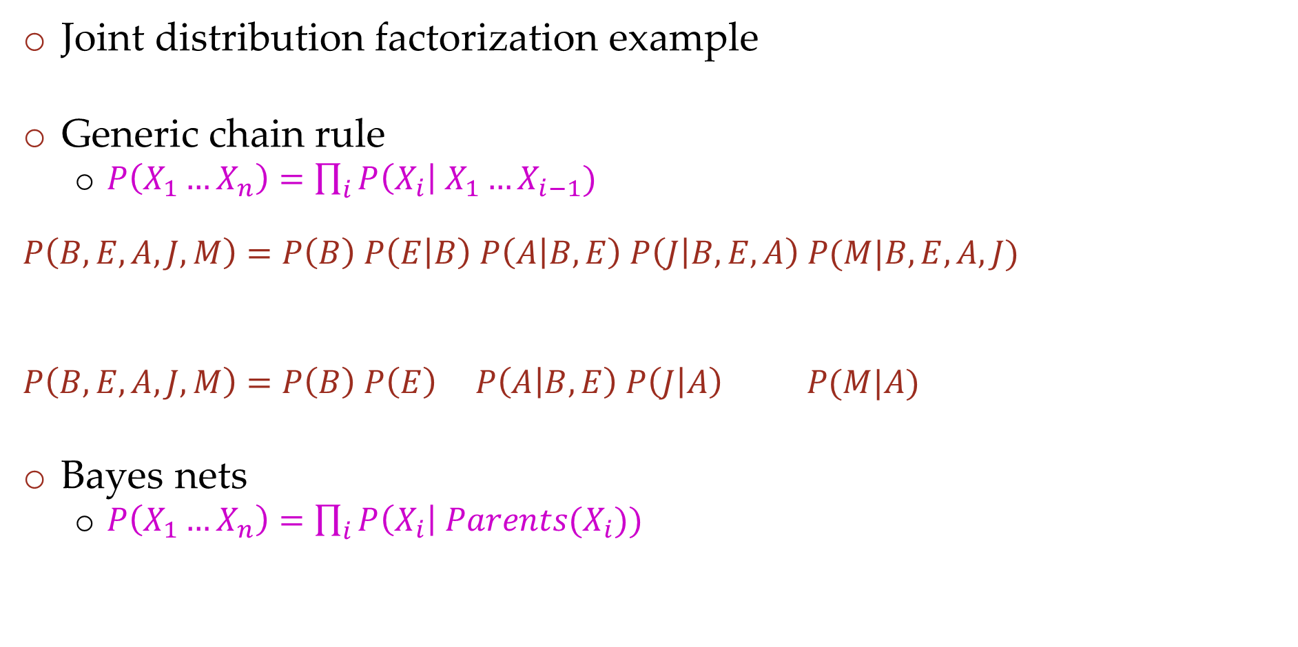
Example: Alarm Network
Joint distribution factorization example
Generic chain rule
  $P\left(X_{1}…X_{n}\right)=\prod_{i}{P\left(X_{i}\right| X_{1}…X_{i−1}) }$
  $$P\left(B,E,A,J,M\right)=P\left(B\right) P\left(E | B\right) P\left(A | B,E\right) P\left(J | B,E,A\right) P(M|B,E,A,J)$$
  $$P\left(B,E,A,J,M\right)=P\left(B\right) P\left(E\right) P\left(A | B,E\right) P\left(J | A\right) P(M|A)$$
Bayes nets
  $P\left(X_{1}…X_{n}\right)=\prod_{i}{P\left(X_{i}\right| Parents(X_{i})) }$
Burglary
Earthquake
Alarm
John calls
Mary calls

Slide 22
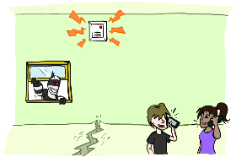
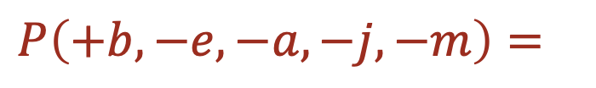
Example: Alarm Network
B | P(B)
+b | 0.001
-b | 0.999
E | P(E)
+e | 0.002
-e | 0.998
Burglary
Earthquake
$P\left(+b, −e, −a, −j,−m\right)=$
Alarm
B | E | A | P(A|B,E)
+b | +e | +a | 0.95
+b | +e | -a | 0.05
+b | -e | +a | 0.94
+b | -e | -a | 0.06
-b | +e | +a | 0.29
-b | +e | -a | 0.71
-b | -e | +a | 0.001
-b | -e | -a | 0.999
John calls
Mary calls
A | J | P(J|A)
+a | +j | 0.9
+a | -j | 0.1
-a | +j | 0.05
-a | -j | 0.95
A | M | P(M|A)
+a | +m | 0.7
+a | -m | 0.3
-a | +m | 0.01
-a | -m | 0.99
Notes:
demo

Slide 23
Example: Alarm Network
$$P\left(+b, −e, −a, −j,−m\right)=P\left(+b\right) ∗ P\left(−e\right) ∗ P\left(−a | +b, −e\right) ∗ P\left(−j | −a\right) ∗ P\left(−m | −a\right)$$
$=0.001 ∗ 0.998 ∗ 0.06 ∗ 0.95 ∗ 0.99$
$$P\left(+b, −e, −a, −j,−m\right)=P\left(−e\right) ∗ P\left(−a | +b, −e\right) ∗P\left(+b\right) ∗P\left(−j | −a\right) ∗ P\left(−m | −a\right)$$
$=0.998 ∗ 0.06 ∗ 0.001 ∗ 0.95 ∗ 0.99$
$$P\left(+b, −e, −a, −j,−m\right)=P\left(−e\right) ∗ P\left(−a | +b, −e\right) ∗P\left(+b\right) P\left(−j | −a\right) ∗ P\left(−m | −a\right)$$
$=0.998 ∗ 0.06 ∗ 0.0095 ∗ 0.99$
Multiplication order can change (commutativity)
Multiplication pairs don’t have to make sense (associativity)
Notes:
demo

Slide 24
Inference by Enumeration in Bayes Net
Inference by enumeration:
  Any probability of interest can be computed by summing entries from the joint distribution
  Entries from the joint distribution can be obtained from a BN by multiplying the corresponding conditional probabilities
  P(B | j, m) = α P(B, j, m)
  = α ∑_{e,a} P(B, e, a, j, m)
  = α ∑_{e,a} P(B) P(e) P(a|B,e) P(j|a) P(m|a)
So inference in Bayes nets means computing sums of products of numbers: sounds easy!!
Problem: sums of exponentially many products!
B
E
A
J
M

Slide 25
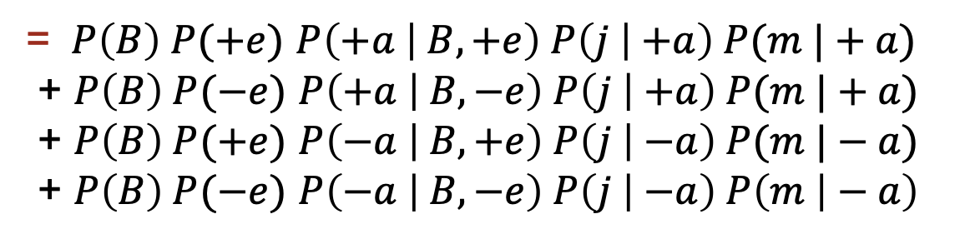
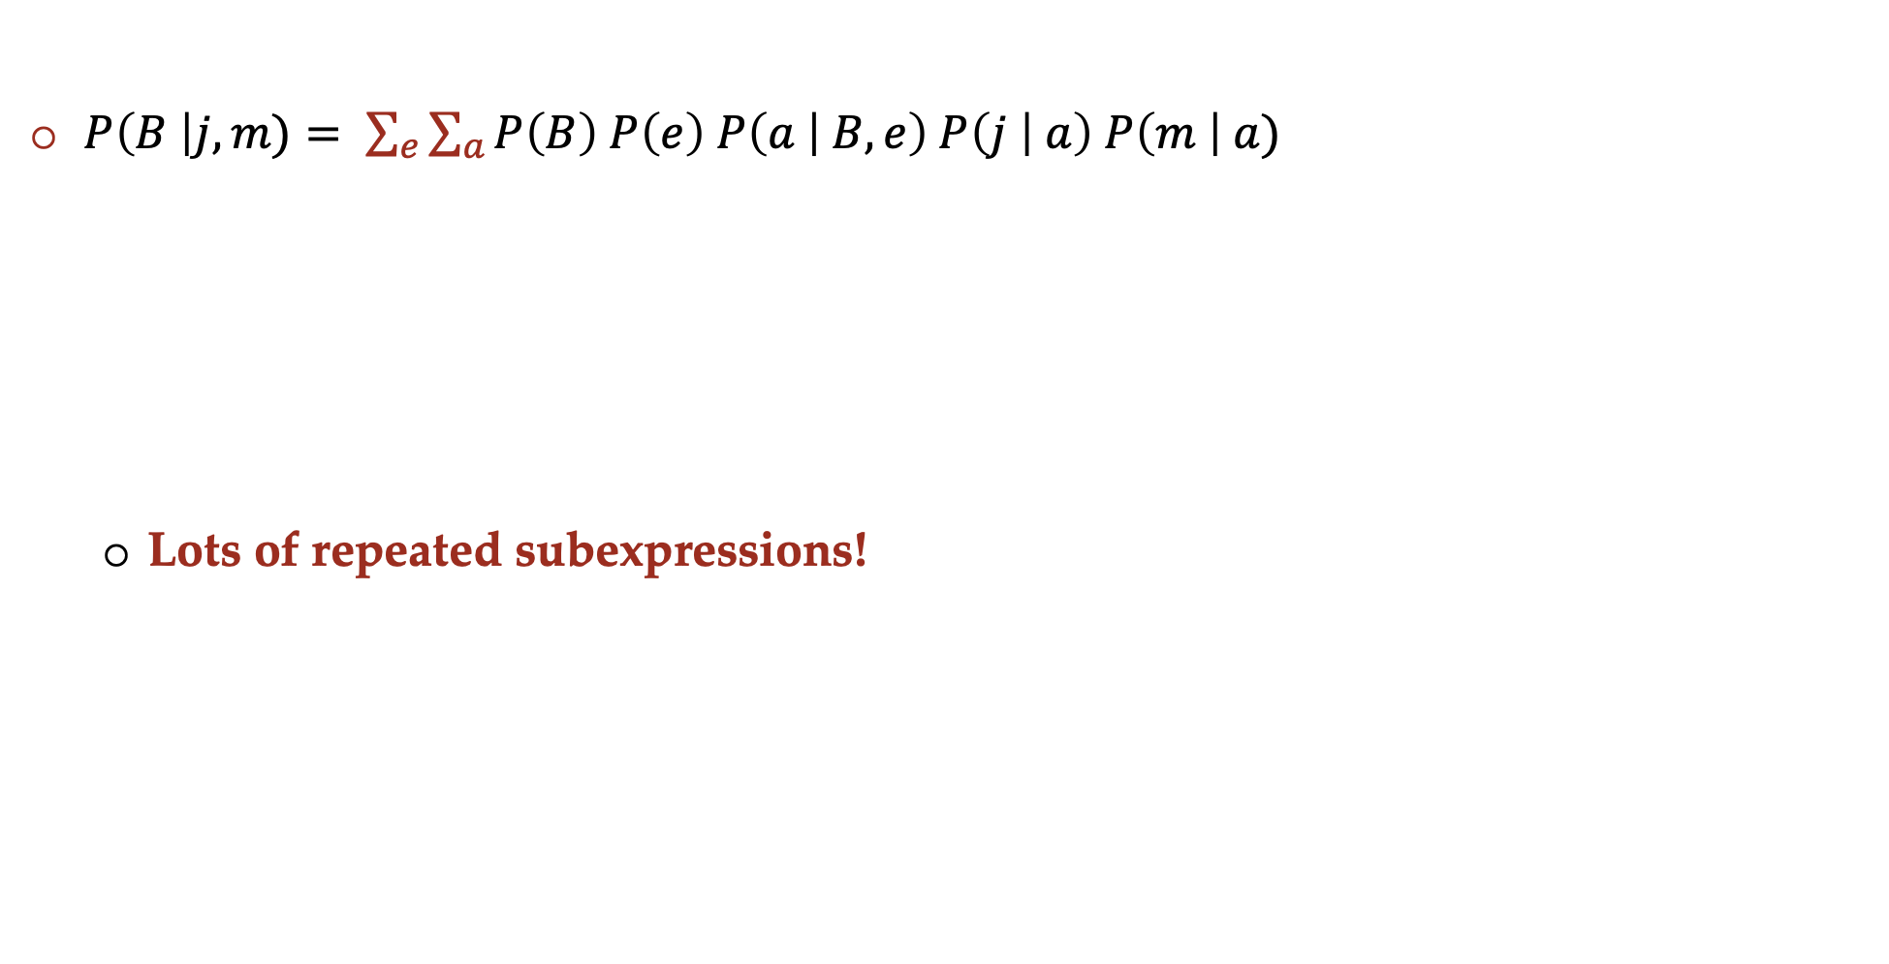
Can we do better?
$P\left(B \right|j, m)= \sum_{e}{\sum_{a}{P\left(B\right) P\left(e\right) P\left(a | B,e\right) P\left(j | a\right) P\left(m \right| a)}}$
  Lots of repeated subexpressions!
= $P\left(B\right) P(+e)$ $P\left(+a | B,+e\right) P\left(j | +a\right) P(m |+a)$
+ $P\left(B\right) P(−e)$ $P\left(+a | B,−e\right) P\left(j | +a\right) P(m |+a)$
+ $P\left(B\right) P(+e)$ $P\left(−a | B,+e\right) P\left(j | −a\right) P(m |−a)$
+ $P\left(B\right) P(−e)$ $P\left(−a | B,−e\right) P\left(j | −a\right) P\left(m | − a\right)$

Slide 26
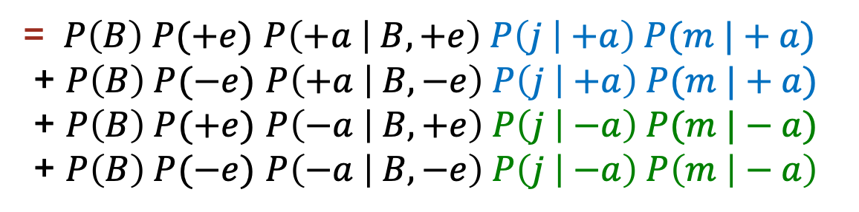
Can we do better?
$P\left(B \right|j, m)= \sum_{e}{\sum_{a}{P\left(B\right) P\left(e\right) P\left(a | B,e\right) P\left(j | a\right) P\left(m \right| a)}}$
  Lots of repeated subexpressions!
= $P\left(B\right) P(+e)$ $P\left(+a | B,+e\right) P\left(j | +a\right) P(m |+a)$
+ $P\left(B\right) P(−e)$ $P\left(+a | B,−e\right) P\left(j | +a\right) P(m |+a)$
+ $P\left(B\right) P(+e)$ $P\left(−a | B,+e\right) P\left(j | −a\right) P(m |−a)$
+ $P\left(B\right) P(−e)$ $P\left(−a | B,−e\right) P\left(j | −a\right) P\left(m | − a\right)$

Slide 27
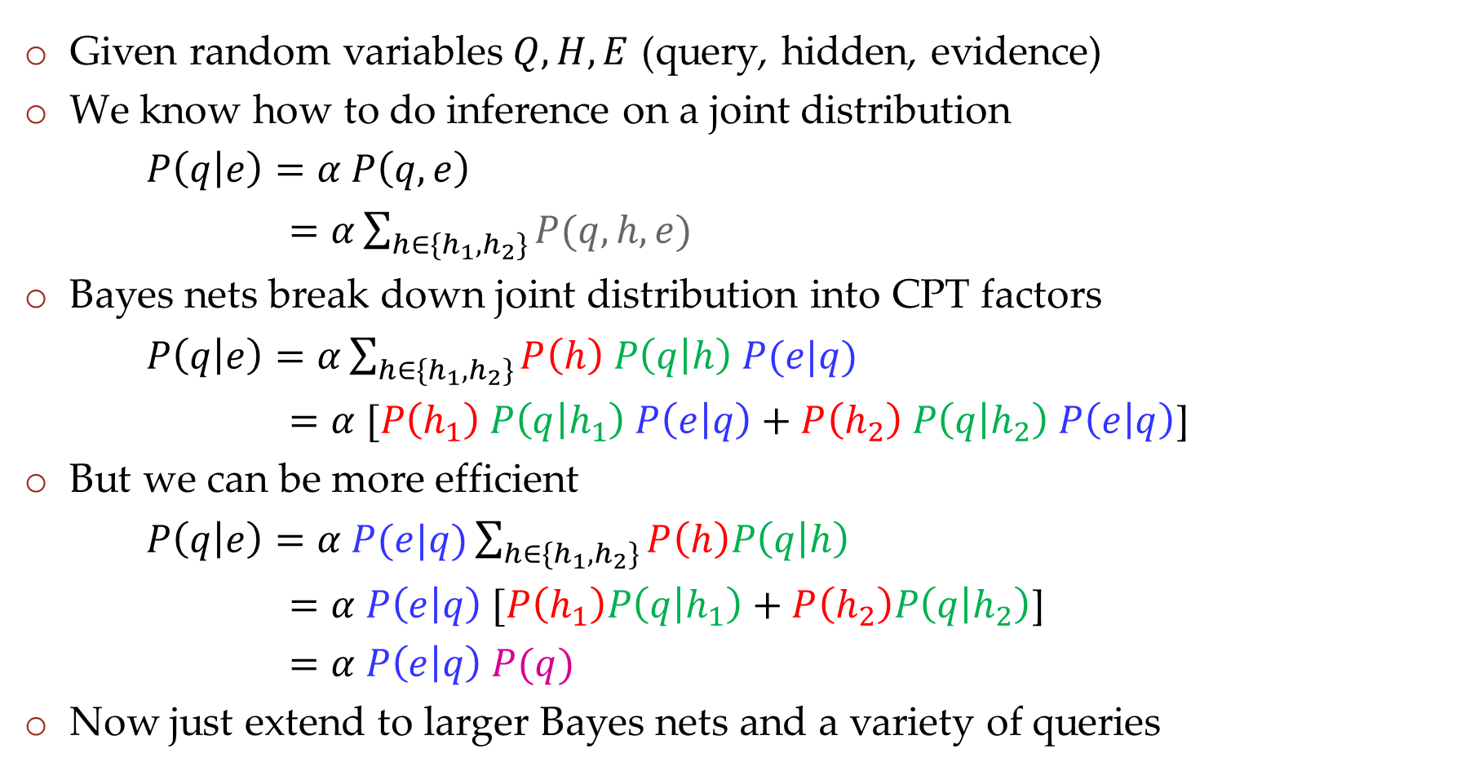
Inference Overview
Given random variables$Q, H, E$ (query, hidden, evidence)
We know how to do inference on a joint distribution
$P\left(q | e\right)=α P\left(q,e\right)$
$=α\sum_{h∈\{h_{1},h_{2}\}}{P(q,h,e)}$
Bayes nets break down joint distribution into CPT factors
$P\left(q | e\right)=α\sum_{h∈\{h_{1},h_{2}\}}{P\left(h\right) P\left(q | h\right) P(e|q)}$
$=α [P\left(h_{1}\right) P\left(q | h_{1}\right) P\left(e | q\right)+P\left(h_{2}\right) P\left(q | h_{2}\right) P\left(e | q\right)$]
But we can be more efficient
$P\left(q | e\right)=α P(e|q)\sum_{h∈\{h_{1},h_{2}\}}{P\left(h\right)P\left(q | h\right) }$
$=α P\left(e | q\right) [P\left(h_{1}\right)P\left(q | h_{1}\right)+P\left(h_{2}\right)P\left(q | h_{2}\right)$]
$=α P\left(e | q\right) P(q)$
Now just extend to larger Bayes nets and a variety of queries
Enumeration
$$H$$
$$Q$$
$$E$$
Variable
Elimination

Slide 28
Factor Tables
$$P\left(+b, −e, −a, −j,−m\right)=P\left(+b\right) ∗ P\left(−e\right) ∗ P\left(−a | +b, −e\right) ∗ P\left(−j | −a\right) ∗ P\left(−m | −a\right)$$
$=0.001 ∗ 0.998 ∗ 0.06 ∗ 0.95 ∗ 0.99$
$$P\left(+b, −e, −a, −j,−m\right)=P\left(−e\right) ∗ P\left(−a | +b, −e\right) ∗P\left(+b\right) P\left(−j | −a\right) ∗ P\left(−m | −a\right)$$
$=0.998 ∗ 0.06 ∗ 0.0095 ∗ 0.99$
Notes:
demo

Slide 29
Variable elimination: The basic ideas
Move summations inwards as far as possible
$$P\left(B | j,m\right)=α\sum_{e}{\sum_{a}{P\left(B,e,a,j,m\right) }}$$
$$=α\sum_{e}{\sum_{a}{P\left(j | a\right) P\left(e\right) P\left(m | a\right) P\left(a | B,e\right) P(B)}}$$

Slide 30
Variable elimination: The basic ideas
Move summations inwards as far as possible, inner sum is easier to compute
$$P\left(B | j,m\right)=α\sum_{e}{\sum_{a}{P\left(B,e,a,j,m\right) }}$$
$$=α\sum_{e}{\sum_{a}{P\left(j | a\right) P\left(e\right) P\left(m | a\right) P\left(a | B,e\right) P(B)}}$$
$$\sum_{e}{ }$$
$$\sum_{a}{ }$$
$$=α$$
$$P\left(B\right)$$
$$P\left(e\right)$$
$$P\left(j | a\right)$$
$$P(m|a)$$
$$P\left(a | B,e\right)$$

Slide 31
Variable Elimination
    Query: P(Q₁ ,.., Q_{m} |E₁=e₁,.., E_{k}=e_{k})
Start with initial factors:
  Local CPTs (but instantiated by evidence)
While there are still hidden variables (not Q_{i} or evidence):
  Pick a hidden variable H
  Join all factors mentioning H
  Eliminate (sum out) H
Join all remaining factors and normalize

Slide 32
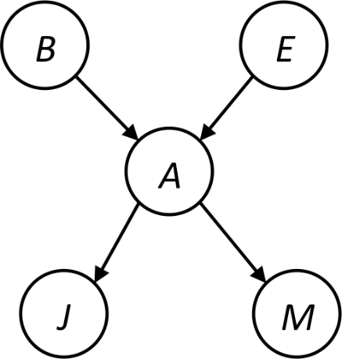
Example
Query P(B | j,m)
$$=α\sum_{e}{\sum_{a}{P\left(j | a\right) P\left(e\right) P\left(m | a\right) P\left(a | B,e\right) P(B)}}$$
Push summations inwards such that products that do not depend on the variable are pulled out of the sum.
$$=αP(B)\sum_{e}{P\left(e\right)\sum_{a}{P\left(j | a\right) P\left(m | a\right) P\left(a | B,e\right)}}$$

Slide 33
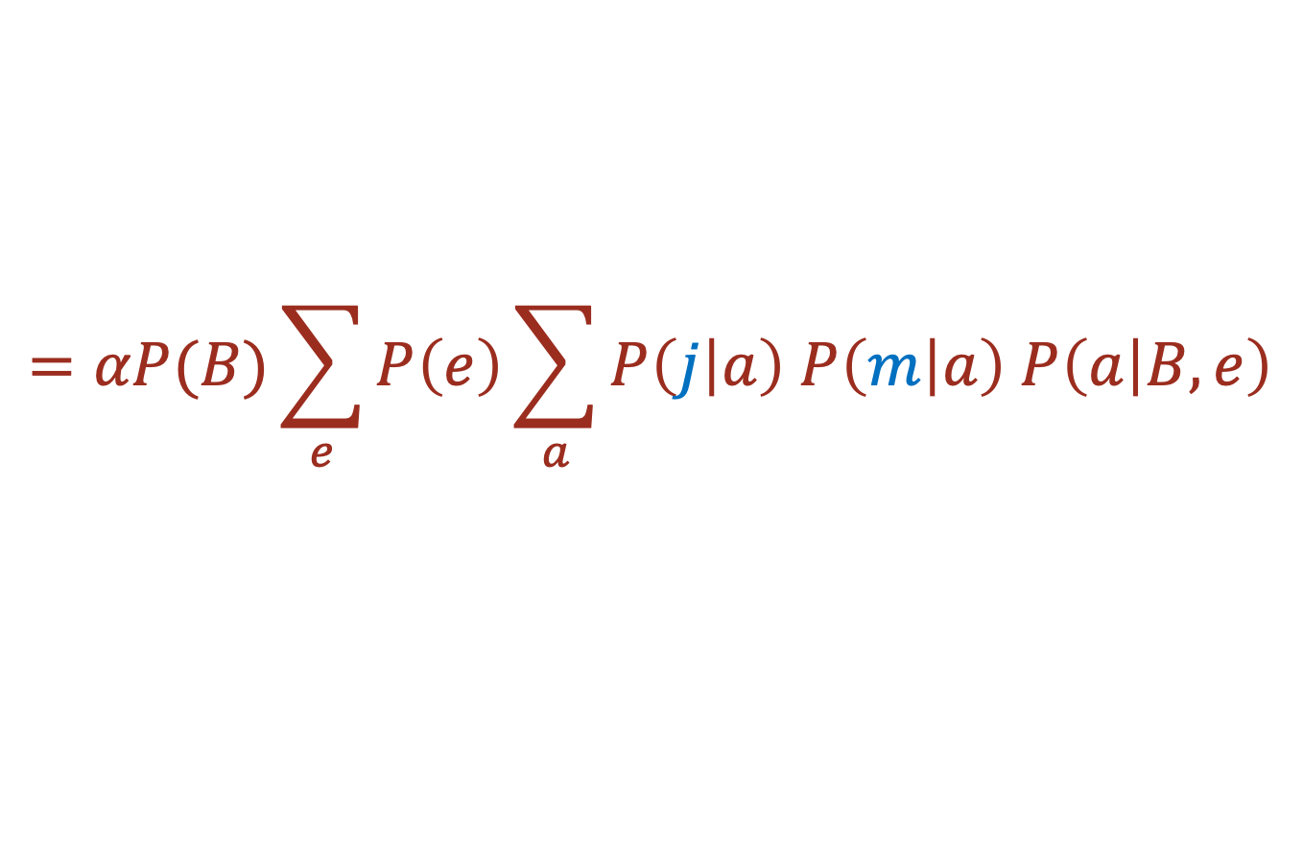
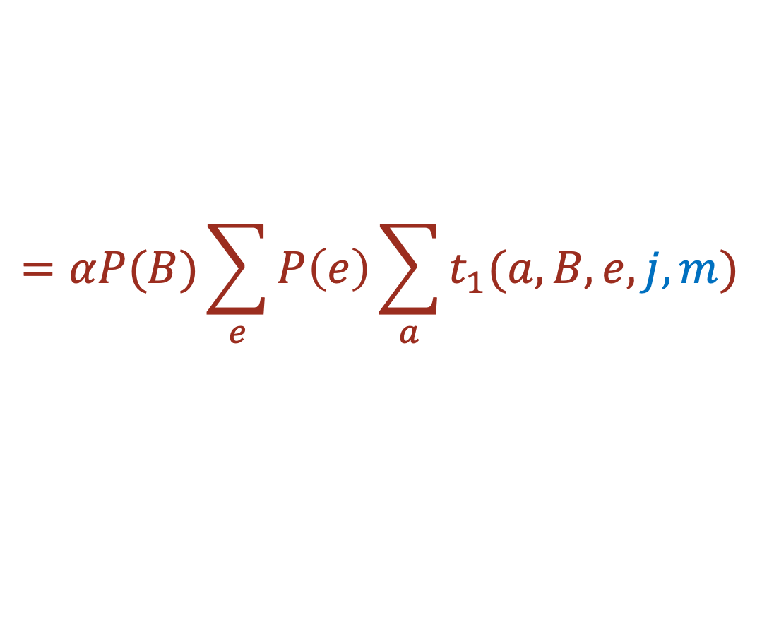
Example
Query P(B | j,m)
$$=αP(B)\sum_{e}{P\left(e\right)\sum_{a}{P\left(j | a\right) P\left(m | a\right) P\left(a | B,e\right)}}$$
Choose A (innermost sum)
  Create a table t₁ = P(A|B,E)P(j|A)P(m|A)
  How many entries does this table have?
$$=αP(B)\sum_{e}{P\left(e\right)\sum_{a}{t_{1}(a,B,e,j,m)}}$$

Slide 34
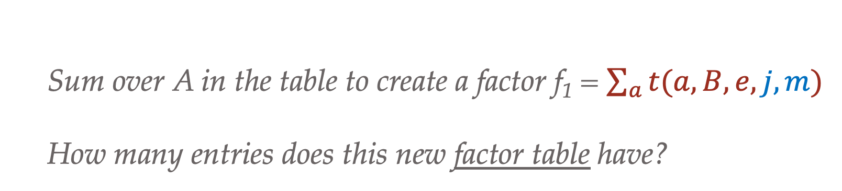
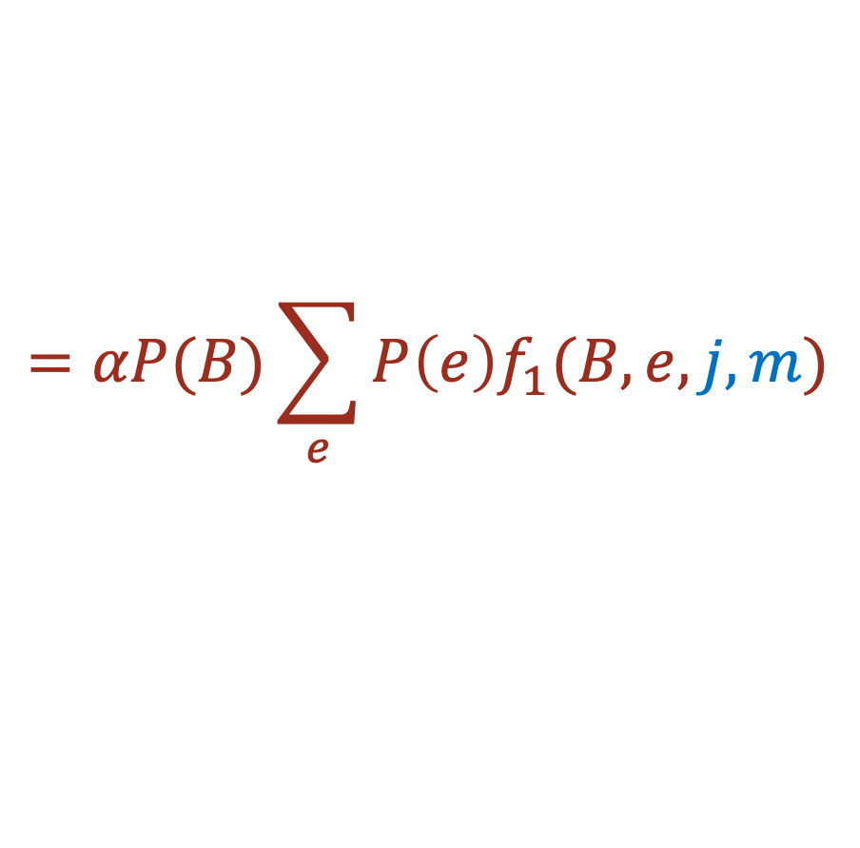
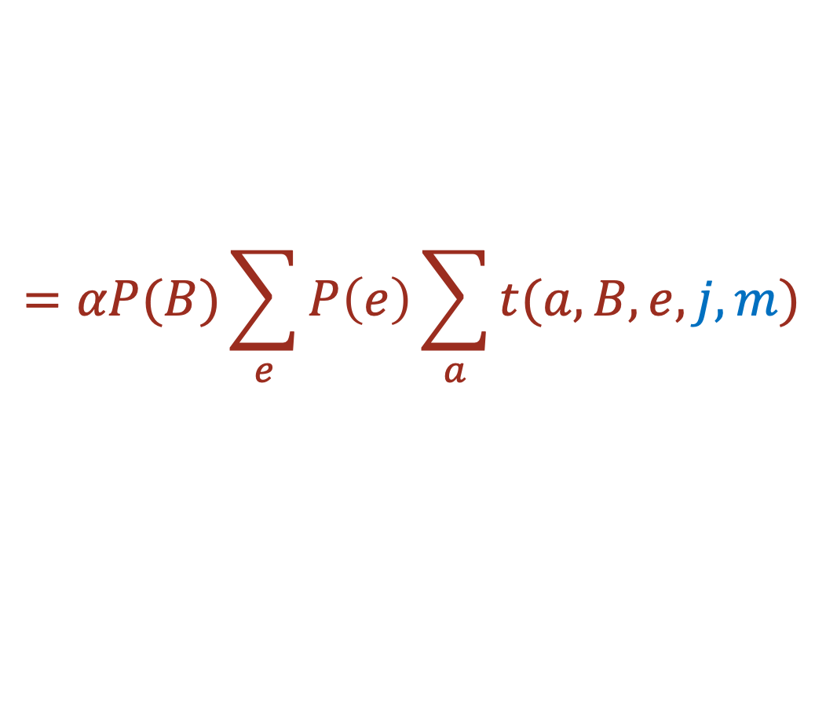
Example
Query P(B | j,m)
$$=αP(B)\sum_{e}{P\left(e\right)\sum_{a}{t(a,B,e,j,m)}}$$
Choose A (inner most sum)
  Sum over A in the table to create a factor f₁ = $\sum_{a}{t(a,B,e,j,m)}$
  How many entries does this new factor table have?
$$=αP(B)\sum_{e}{P\left(e\right)f_{1}(B,e,j,m)}$$

Slide 35

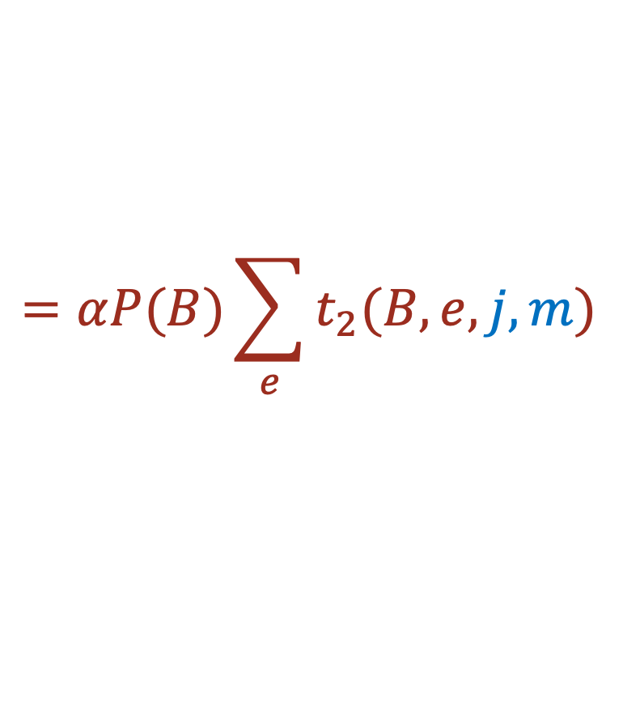
Example
$$=αP(B)\sum_{e}{P\left(e\right)f_{1}(B,e,j,m)}$$
Choose E (innermost sum)
  Create a table t₂ = P(E) f₁(B,E,j,m)
  How many entries does this table have?
$$=αP(B)\sum_{e}{t_{2}(B,e,j,m)}$$

Slide 36
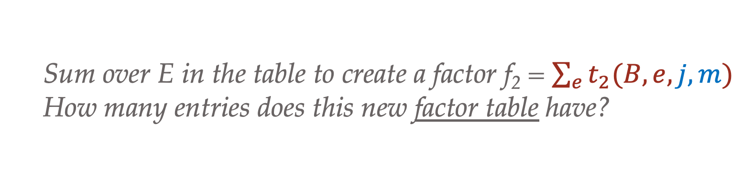
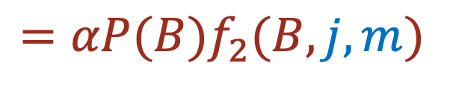

Example
$$=αP(B)\sum_{e}{t_{2}(B,e,j,m)}$$
Choose E (innermost sum)
  Sum over E in the table to create a factor f₂ = $\sum_{e}{t_{2}(B,e,j,m)}$
  How many entries does this new factor table have?
$$=αP(B)f_{2}(B,j,m)$$

Slide 37
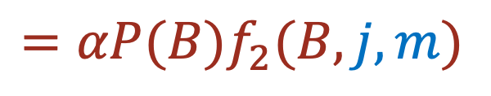
Example
$$=αP(B)f_{2}(B,j,m)$$
Multiply remaining probability to create joint probability P(B,j,m)
  How many entries does this probability table have?
Don’t forget the normalization to compute the conditional probability!
$$α=\frac{1}{Z}=\frac{1}{P\left(j,m\right)}=$$
$P\left(B | j,m\right)=αP(B,j,m)$

Slide 38
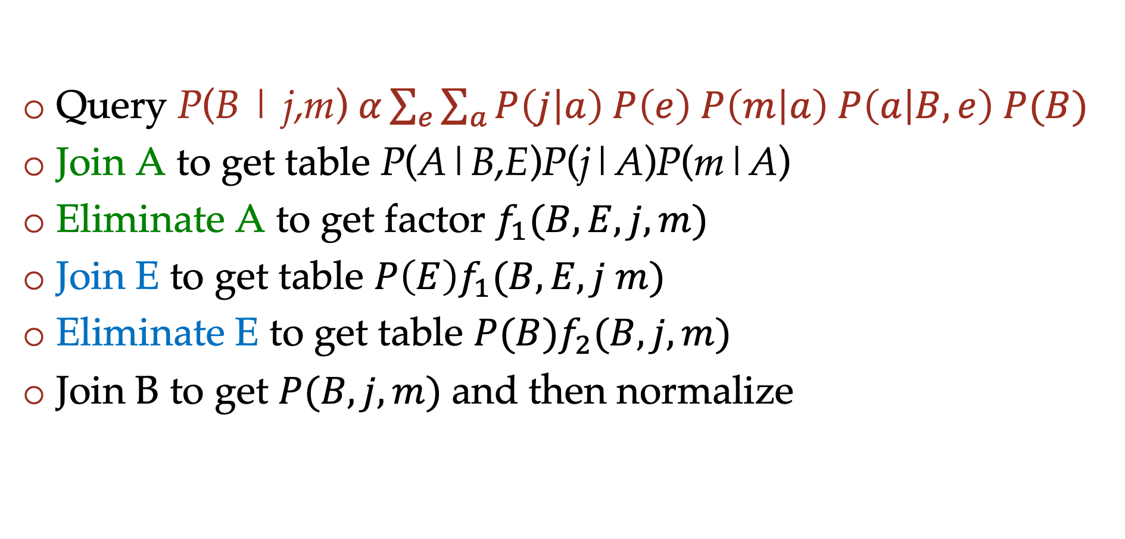
Example summary
Query P(B | j,m) $α\sum_{e}{\sum_{a}{P\left(j | a\right) P\left(e\right) P\left(m | a\right) P\left(a | B,e\right) P(B)}}$
Join A to get table P(A|B,E)P(j|A)P(m|A)
Eliminate A to get factor $f_{1}(B,E,j,m)$
Join E to get table $P\left(E\right)f_{1}(B, E, j m)$
Eliminate E to get table $P(B)f_{2}(B,j,m)$
Join B to get $P(B, j, m)$and then normalize

Slide 39
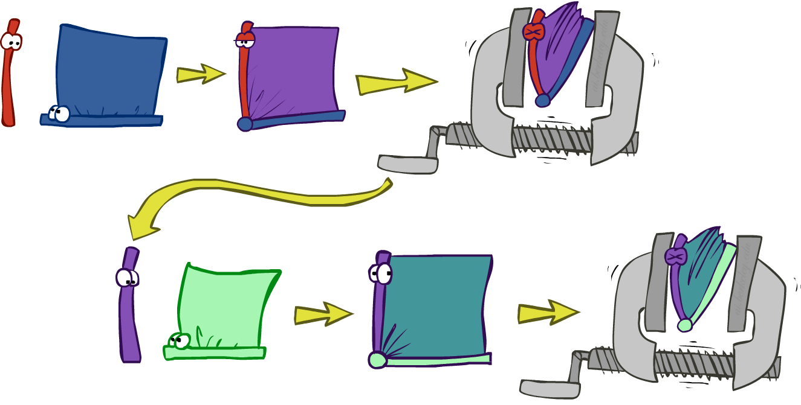
Variable elimination: The basic ideas
Move summations inwards as far as possible
  P(B | j, m) = α ∑_{e}∑_{a}P(B) P(e) P(a|B,e) P(j|a) P(m|a)
  = α P(B) ∑_{e} P(e) ∑_{a} P(a|B,e) P(j|a) P(m|a)
Do the calculation from the inside out
  I.e., sum over a first, then sum over e
  Problem: P(a|B,e) isn’t a single number, it’s a bunch of different numbers depending on the values of B and e
  Solution: use arrays of numbers (of various dimensions) with appropriate operations on them; these are called factors

Slide 40
Order matters
  Elimination Order: C, B, A, Z
    P(D) = α ∑_{z,a,b,c} P(D|z) P(z) P(a|z) P(b|z) P(c|z)
    = α ∑_{z} P(D|z) P(z) ∑_{a} P(a|z) ∑_{b} P(b|z) ∑_{c} P(c|z)
    Largest factor has 2 variables (D,Z)
  Elimination Order: Z, C, B, A
    P(D) = α ∑_{a,b,c,z} P(a|z) P(b|z) P(c|z) P(D|z) P(z)
    = α ∑_{a} ∑_{b} ∑_{c} ∑_{z} P(a|z) P(b|z) P(c|z) P(D|z) P(z)
    Largest factor has 4 variables (A,B,C,D)
  In general, with n leaves, factor of size 2^{n}
Z
A
B
C
D

Slide 41
VE: Computational and Space Complexity
The computational and space complexity of variable elimination is determined by the largest factor (and it’s space that kills you)
The elimination ordering can greatly affect the size of the largest factor.
  E.g., previous slide’s example 2^{n} vs. 2
Does there always exist an ordering that only results in small factors?
  No!

Slide 42





















VE: Computational and Space Complexity
Inference in Bayes’ nets is NP-hard.
No known efficient probabilistic inference in general.

Slide 43
Another example
R
Inference by Enumeration
Variable Elimination
T
L
Join on r
Join on r
Join on t
Eliminate r
Eliminate r
Join on t
Eliminate t
Eliminate t

Slide 44
New Example
Query P(E | m)
$$=α\sum_{b}{\sum_{a}{\sum_{j}{P\left(j | a\right) P\left(E\right) P\left(m | a\right) P\left(a | b,E\right) P(b)}}}$$
Push summations inwards such that products that do not depend on the variable are pulled out of the sum.
$$=αP\left(E\right)\sum_{b}{P(B)\sum_{a}{ P\left(m | a\right) P\left(a | b,E\right) \sum_{j}{P\left(j | a\right)}}}$$

Slide 45
Poll 3
How many entries does the factor that results after summing out the second variable (a) on the previous slide have?
0
1
2
4
6
8

Slide 46
P(B | j, m)
See video: Math for Variable Elimination

Slide 47
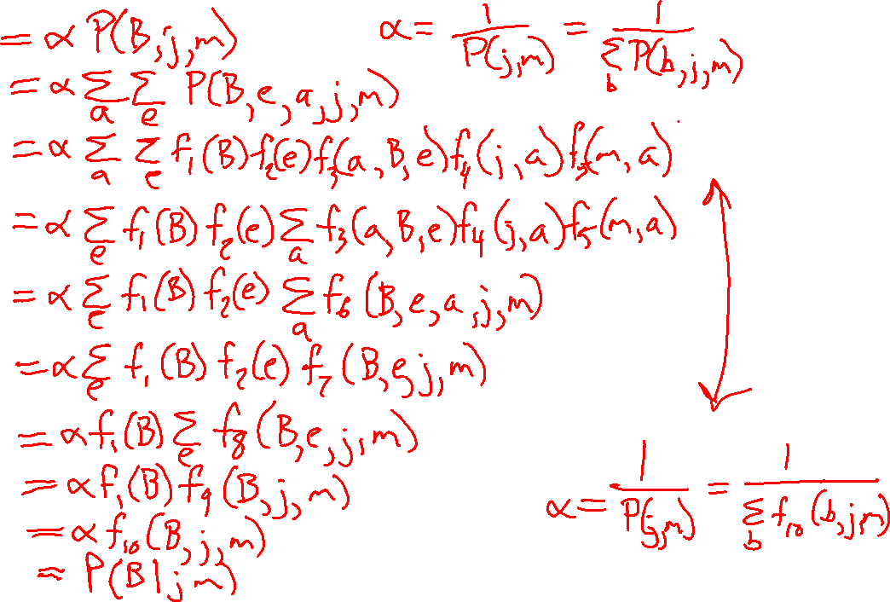
P(B | j, m)

Slide 48
Bayes Nets
Part I: Representation and Independence
Part II: Exact inference
  Enumeration (always exponential complexity)
  Variable elimination (worst-case exponential complexity, often better)
  Inference is NP-hard in general
Part III: Approximate Inference

Slide 49

Example (with numbers!)
Start with a Bayes net, the associated CPTs, and a query, $P\left(B∣+j,+m\right)$
B | P(B)
+b | 0.001
-b | 0.999
E | P(E)
+e | 0.002
-e | 0.998
B
E
A
B | E | A | P(A|B,E)
+b | +e | +a | 0.95
+b | +e | -a | 0.05
+b | -e | +a | 0.94
+b | -e | -a | 0.06
-b | +e | +a | 0.29
-b | +e | -a | 0.71
-b | -e | +a | 0.001
-b | -e | -a | 0.999
J
M
A | J | P(J|A)
+a | +j | 0.9
+a | -j | 0.1
-a | +j | 0.05
-a | -j | 0.95
A | M | P(M|A)
+a | +m | 0.7
+a | -m | 0.3
-a | +m | 0.01
-a | -m | 0.99

Slide 50
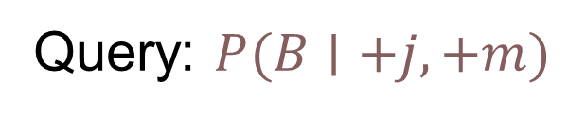
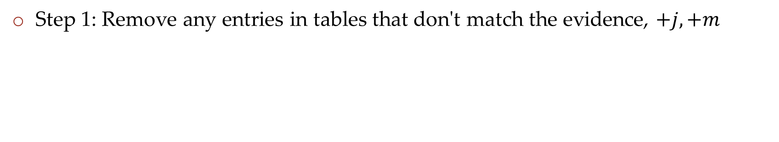
Example (with numbers!)
Query: $P(B∣+j,+m)$
Step 1: Remove any entries in tables that don't match the evidence, $+j, +m$
B | P(B)
+b | 0.001
-b | 0.999
E | P(E)
+e | 0.002
-e | 0.998
B
E
A
B | E | A | P(A|B,E)
+b | +e | +a | 0.95
+b | +e | -a | 0.05
+b | -e | +a | 0.94
+b | -e | -a | 0.06
-b | +e | +a | 0.29
-b | +e | -a | 0.71
-b | -e | +a | 0.001
-b | -e | -a | 0.999
J
M
A | J | P(J|A)
+a | +j | 0.9
+a | -j | 0.1
-a | +j | 0.05
-a | -j | 0.95
A | M | P(M|A)
+a | +m | 0.7
+a | -m | 0.3
-a | +m | 0.01
-a | -m | 0.99

Slide 51
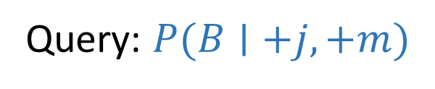
Example (with numbers!)
Query: $P(B∣+j,+m)$
Step 1: Remove any entries in tables that don't match the evidence, $+j, +m$
B | P(B)
+b | 0.001
-b | 0.999
E | P(E)
+e | 0.002
-e | 0.998
B
E
A
B | E | A | P(A|B,E)
+b | +e | +a | 0.95
+b | +e | -a | 0.05
+b | -e | +a | 0.94
+b | -e | -a | 0.06
-b | +e | +a | 0.29
-b | +e | -a | 0.71
-b | -e | +a | 0.001
-b | -e | -a | 0.999
+j
+m
A | +j | P(+j|A)
+a | +j | 0.9
-a | +j | 0.05
A | +m | P(+m|A)
+a | +m | 0.7
-a | +m | 0.01

Slide 52
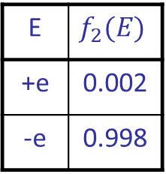
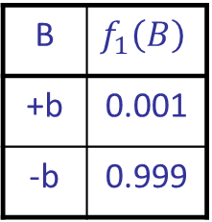
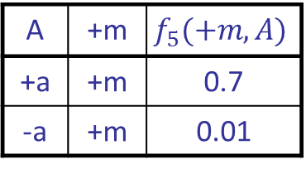
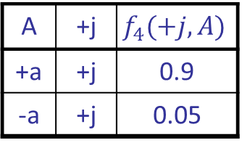
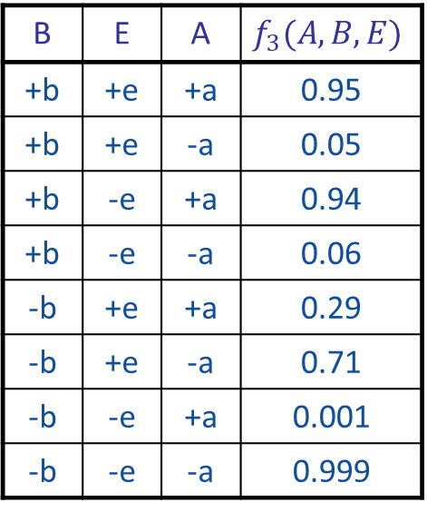
Example (with numbers!)
Query: $P(B∣+j,+m)$
Step 2: Think each table as just a factor table rather than probabilities
B | $$f_{1}\left(B\right)$$
+b | 0.001
-b | 0.999
E | $$f_{2}(E)$$
+e | 0.002
-e | 0.998
B
E
A
B | E | A | $$f_{3}(A, B,E)$$
+b | +e | +a | 0.95
+b | +e | -a | 0.05
+b | -e | +a | 0.94
+b | -e | -a | 0.06
-b | +e | +a | 0.29
-b | +e | -a | 0.71
-b | -e | +a | 0.001
-b | -e | -a | 0.999
+j
+m
A | +j | $$f_{4}(+j,A)$$
+a | +j | 0.9
-a | +j | 0.05
A | +m | $$f_{5}(+m,A)$$
+a | +m | 0.7
-a | +m | 0.01

Slide 53
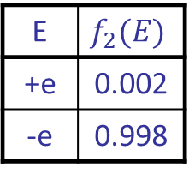
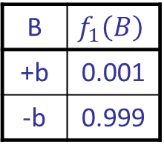
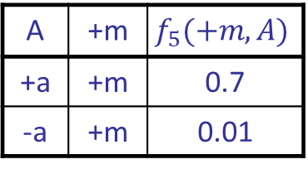
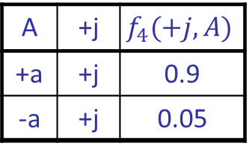
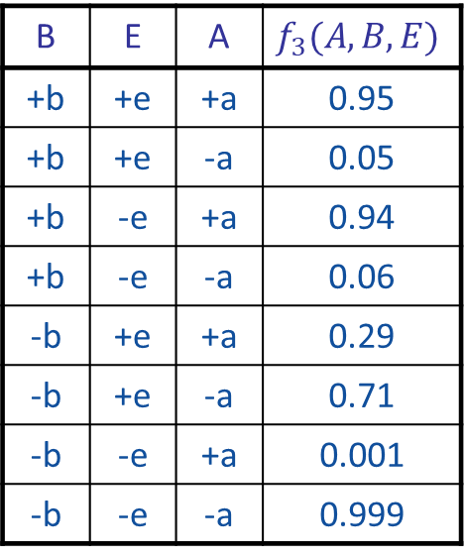
Example (with numbers!)
Query: $P(B∣+j,+m)$
Step 2: Think each table as just a factor table rather than probabilities
B | $$f_{1}\left(B\right)$$
+b | 0.001
-b | 0.999
E | $$f_{2}(E)$$
+e | 0.002
-e | 0.998
B | E | A | $$f_{3}(A, B,E)$$
+b | +e | +a | 0.95
+b | +e | -a | 0.05
+b | -e | +a | 0.94
+b | -e | -a | 0.06
-b | +e | +a | 0.29
-b | +e | -a | 0.71
-b | -e | +a | 0.001
-b | -e | -a | 0.999
A | +j | $$f_{4}(+j,A)$$
+a | +j | 0.9
-a | +j | 0.05
A | +m | $$f_{5}(+m,A)$$
+a | +m | 0.7
-a | +m | 0.01

Slide 54
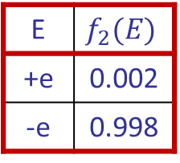



Example (with numbers!)
Query: $P(B∣+j,+m)$
Step 3(E): Eliminate hidden variable E (we chose E first this time)
i: Collect all factors tables associated with E
B | $$f_{1}\left(B\right)$$
+b | 0.001
-b | 0.999
E | $$f_{2}(E)$$
+e | 0.002
-e | 0.998
B | E | A | $$f_{3}(A, B,E)$$
+b | +e | +a | 0.95
+b | +e | -a | 0.05
+b | -e | +a | 0.94
+b | -e | -a | 0.06
-b | +e | +a | 0.29
-b | +e | -a | 0.71
-b | -e | +a | 0.001
-b | -e | -a | 0.999
A | +j | $$f_{4}(+j,A)$$
+a | +j | 0.9
-a | +j | 0.05
A | +m | $$f_{5}(+m,A)$$
+a | +m | 0.7
-a | +m | 0.01

Slide 55


Example (with numbers!)
Query: $P(B∣+j,+m)$
Step 3(E): Eliminate hidden variable E
i: Collect all factors tables associated with E
ii: Create new factor table by multiplying them together
E | $$f_{2}(E)$$
+e | 0.002
-e | 0.998
B | E | A | $$f_{3}(A, B,E)$$
+b | +e | +a | 0.95
+b | +e | -a | 0.05
+b | -e | +a | 0.94
+b | -e | -a | 0.06
-b | +e | +a | 0.29
-b | +e | -a | 0.71
-b | -e | +a | 0.001
-b | -e | -a | 0.999
B | E | A | $$f_{4}(A, B,E)$$
+b | +e | +a
+b | +e | -a
+b | -e | +a
+b | -e | -a
-b | +e | +a
-b | +e | -a
-b | -e | +a
-b | -e | -a

Slide 56


Example (with numbers!)
Query: $P(B∣+j,+m)$
Step 3(E): Eliminate hidden variable E
i: Collect all factors tables associated with E
ii: Create new factor table by multiplying them together
E | $$f_{2}(E)$$
+e | 0.002
-e | 0.998
B | E | A | $$f_{3}(A, B,E)$$
+b | +e | +a | 0.95
+b | +e | -a | 0.05
+b | -e | +a | 0.94
+b | -e | -a | 0.06
-b | +e | +a | 0.29
-b | +e | -a | 0.71
-b | -e | +a | 0.001
-b | -e | -a | 0.999
B | E | A | $$f_{4}(A, B,E)$$
+b | +e | +a | $$0.002⋅0.95$$
+b | +e | -a | $$0.002⋅0.05$$
+b | -e | +a | $$0.998⋅0.94$$
+b | -e | -a | $$0.998⋅0.06$$
-b | +e | +a | $$0.002⋅0.29$$
-b | +e | -a | $$0.002⋅0.71$$
-b | -e | +a | $$0.998⋅0.001$$
-b | -e | -a | $$0.998⋅0.999$$

Slide 57


Example (with numbers!)
Query: $P(B∣+j,+m)$
Step 3(E): Eliminate hidden variable E
i: Collect all factors tables associated with E
ii: Create new factor table by multiplying them together
E | $$f_{2}(E)$$
+e | 0.002
-e | 0.998
B | E | A | $$f_{3}(A, B,E)$$
+b | +e | +a | 0.95
+b | +e | -a | 0.05
+b | -e | +a | 0.94
+b | -e | -a | 0.06
-b | +e | +a | 0.29
-b | +e | -a | 0.71
-b | -e | +a | 0.001
-b | -e | -a | 0.999
B | E | A | $$f_{6}(A, B,E)$$
+b | +e | +a | 0.001900
+b | +e | -a | 0.000100
+b | -e | +a | 0.938120
+b | -e | -a | 0.059880
-b | +e | +a | 0.000580
-b | +e | -a | 0.001420
-b | -e | +a | 0.000998
-b | -e | -a | 0.997002

Slide 58

Example (with numbers!)
Query: $P(B∣+j,+m)$
Step 3(E): Eliminate hidden variable E
i: Collect all factors tables associated with E
ii: Create new factor table by multiplying them together
iii: Create another new factor by summing over E
B | A | $$f_{7}(A, B)$$
+b | +a
+b | -a
-b | +a
-b | -a
B | E | A | $$f_{6}(A, B,E)$$
+b | +e | +a | 0.001900
+b | +e | -a | 0.000100
+b | -e | +a | 0.938120
+b | -e | -a | 0.059880
-b | +e | +a | 0.000580
-b | +e | -a | 0.001420
-b | -e | +a | 0.000998
-b | -e | -a | 0.997002

Slide 59

Example (with numbers!)
Query: $P(B∣+j,+m)$
Step 3(E): Eliminate hidden variable E
i: Collect all factors tables associated with E
ii: Create new factor table by multiplying them together
iii: Create another new factor by summing over E
B | A | $$f_{7}(A, B)$$
+b | +a | 0.001900 + 0.938120
+b | -a | 0.000100 + 0.059880
-b | +a | 0.000580 + 0.000998
-b | -a | 0.001420 + 0.997002
B | E | A | $$f_{6}(A, B,E)$$
+b | +e | +a | 0.001900
+b | +e | -a | 0.000100
+b | -e | +a | 0.938120
+b | -e | -a | 0.059880
-b | +e | +a | 0.000580
-b | +e | -a | 0.001420
-b | -e | +a | 0.000998
-b | -e | -a | 0.997002

Slide 60

Example (with numbers!)
Query: $P(B∣+j,+m)$
Step 3(E): Eliminate hidden variable E
i: Collect all factors tables associated with E
ii: Create new factor table by multiplying them together
iii: Create another new factor by summing over E
B | A | $$f_{7}(A, B)$$
+b | +a | 0.940020
+b | -a | 0.059980
-b | +a | 0.001578
-b | -a | 0.998422
B | E | A | $$f_{6}(A, B,E)$$
+b | +e | +a | 0.001900
+b | +e | -a | 0.000100
+b | -e | +a | 0.938120
+b | -e | -a | 0.059880
-b | +e | +a | 0.000580
-b | +e | -a | 0.001420
-b | -e | +a | 0.000998
-b | -e | -a | 0.997002

Slide 61



Example (with numbers!)
Query: $P(B∣+j,+m)$
Step 3(E): Eliminate hidden variable E (and return to list of tables)
B | $$f_{1}\left(B\right)$$
+b | 0.001
-b | 0.999
B | A | $$f_{7}(A, B)$$
+b | +a | 0.940020
+b | -a | 0.059980
-b | +a | 0.001578
-b | -a | 0.998422
A | +j | $$f_{4}(+j,A)$$
+a | +j | 0.9
-a | +j | 0.05
A | +m | $$f_{5}(+m,A)$$
+a | +m | 0.7
-a | +m | 0.01

Slide 62
Example (with numbers!)
Query: $P(B∣+j,+m)$
Step 3(A): Eliminate hidden variable A
B | $$f_{1}\left(B\right)$$
+b | 0.001
-b | 0.999
B | A | $$f_{7}(A, B)$$
+b | +a | 0.940020
+b | -a | 0.059980
-b | +a | 0.001578
-b | -a | 0.998422
A | +j | $$f_{4}(+j,A)$$
+a | +j | 0.9
-a | +j | 0.05
A | +m | $$f_{5}(+m,A)$$
+a | +m | 0.7
-a | +m | 0.01

Slide 63



Example (with numbers!)
Query: $P(B∣+j,+m)$
Step 3(A): Eliminate hidden variable A
i: Collect all factors tables associated with A
B | $$f_{1}\left(B\right)$$
+b | 0.001
-b | 0.999
B | A | $$f_{7}(A, B)$$
+b | +a | 0.940020
+b | -a | 0.059980
-b | +a | 0.001578
-b | -a | 0.998422
A | +j | $$f_{4}(+j,A)$$
+a | +j | 0.9
-a | +j | 0.05
A | +m | $$f_{5}(+m,A)$$
+a | +m | 0.7
-a | +m | 0.01

Slide 64


Example (with numbers!)
Query: $P(B∣+j,+m)$
Step 3(A): Eliminate hidden variable A
i: Collect all factors tables associated with A
ii: Create new factor table by multiplying them together
B | A | $$f_{7}(B, A)$$
+b | +a | 0.940020
+b | -a | 0.059980
-b | +a | 0.001578
-b | -a | 0.998422
A | +j | $$f_{4}(+j,A)$$
+a | +j | 0.9
-a | +j | 0.05
A | +m | $$f_{5}(+m,A)$$
+a | +m | 0.7
-a | +m | 0.01
B | A | +j | +m | $$f_{8}(B, A,+j,+m)$$
+b | +a | +j | +m
+b | -a | +j | +m
-b | +a | +j | +m
-b | -a | +j | +m

Slide 65

Example (with numbers!)
Query: $P(B∣+j,+m)$
Step 3(A): Eliminate hidden variable A
i: Collect all factors tables associated with A
ii: Create new factor table by multiplying them together
B | A | $$f_{7}(B, A)$$
+b | +a | 0.940020
+b | -a | 0.059980
-b | +a | 0.001578
-b | -a | 0.998422
A | +j | $$f_{4}(+j,A)$$
+a | +j | 0.9
-a | +j | 0.05
A | +m | $$f_{5}(+m,A)$$
+a | +m | 0.7
-a | +m | 0.01
B | A | +j | +m | $$f_{8}(B, A,+j,+m)$$
+b | +a | +j | +m | $$0.940020⋅0.9⋅0.7$$
+b | -a | +j | +m | $$0.059980⋅0.05⋅0.01$$
-b | +a | +j | +m | $$0.001578⋅0.9⋅0.7$$
-b | -a | +j | +m | $$0.998422⋅0.05⋅0.01$$

Slide 66

Example (with numbers!)
Query: $P(B∣+j,+m)$
Step 3(A): Eliminate hidden variable A
i: Collect all factors tables associated with A
ii: Create new factor table by multiplying them together
B | A | $$f_{7}(B, A)$$
+b | +a | 0.940020
+b | -a | 0.059980
-b | +a | 0.001578
-b | -a | 0.998422
A | +j | $$f_{4}(+j,A)$$
+a | +j | 0.9
-a | +j | 0.05
A | +m | $$f_{5}(+m,A)$$
+a | +m | 0.7
-a | +m | 0.01
B | A | +j | +m | $$f_{8}(B, A,+j,+m)$$
+b | +a | +j | +m | 0.592213
+b | -a | +j | +m | 0.000030
-b | +a | +j | +m | 0.000994
-b | -a | +j | +m | 0.000499

Slide 67

Example (with numbers!)
Query: $P(B∣+j,+m)$
Step 3(A): Eliminate hidden variable A
i: Collect all factors tables associated with A
ii: Create new factor table by multiplying them together
iii: Create another new factor by summing over A
B | +j | +m | $$f_{8}(B,+j,+m)$$
+b | +j | +m
-b | +j | +m
B | A | +j | +m | $$f_{8}(B, A,+j,+m)$$
+b | +a | +j | +m | 0.592213
+b | -a | +j | +m | 0.000030
-b | +a | +j | +m | 0.000994
-b | -a | +j | +m | 0.000499

Slide 68

Example (with numbers!)
Query: $P(B∣+j,+m)$
Step 3(A): Eliminate hidden variable A
i: Collect all factors tables associated with A
ii: Create new factor table by multiplying them together
iii: Create another new factor by summing over A
B | +j | +m | $$f_{8}(B,+j,+m)$$
+b | +j | +m | 0.592243
-b | +j | +m | 0.001493
B | A | +j | +m | $$f_{8}(B, A,+j,+m)$$
+b | +a | +j | +m | 0.592213
+b | -a | +j | +m | 0.000030
-b | +a | +j | +m | 0.000994
-b | -a | +j | +m | 0.000499

Slide 69
Example (with numbers!)
Query: $P(B∣+j,+m)$
Step 3(A): Eliminate hidden variable A (and return to list of tables)
B | $$f_{1}\left(B\right)$$
+b | 0.001
-b | 0.999
B | +j | +m | $$f_{8}(B,+j,+m)$$
+b | +j | +m | 0.592243
-b | +j | +m | 0.001493

Slide 70

Example (with numbers!)
Query: $P(B∣+j,+m)$
Step 4: Multiply remaining factor tables
B | $$f_{1}\left(B\right)$$
+b | 0.001
-b | 0.999
B | +j | +m | $$f_{8}(B,+j,+m)$$
+b | +j | +m | 0.592243
-b | +j | +m | 0.001493
B | +j | +m | $$f_{9}(B,+j,+m)$$
+b | +j | +m
-b | +j | +m

Slide 71

Example (with numbers!)
Query: $P(B∣+j,+m)$
Step 4: Multiply remaining factor tables
B | $$f_{1}\left(B\right)$$
+b | 0.001
-b | 0.999
B | +j | +m | $$f_{8}(B,+j,+m)$$
+b | +j | +m | 0.592243
-b | +j | +m | 0.001493
B | +j | +m | $$f_{9}(B,+j,+m)$$
+b | +j | +m | $$0.001⋅0.592243$$
-b | +j | +m | $$0.999⋅0.001493$$

Slide 72

Example (with numbers!)
Query: $P(B∣+j,+m)$
Step 4: Multiply remaining factor tables
B | $$f_{1}\left(B\right)$$
+b | 0.001
-b | 0.999
B | +j | +m | $$f_{8}(B,+j,+m)$$
+b | +j | +m | 0.592243
-b | +j | +m | 0.001493
B | +j | +m | $$f_{9}(B,+j,+m)$$
+b | +j | +m | $$0.000592$$
-b | +j | +m | $$0.001492$$

Slide 73
Additional Variable Elimination Slides

Slide 74

Operation 1: Pointwise product
First basic operation: pointwise product of factors (similar to a database join, not matrix multiply!)
  New factor has union of variables of the two original factors
  Each entry is the product of the corresponding entries from the original factors
Example: P(A) x P(J|A) = P(A,J)
P(J|A)
P(A,J)
P(A)
A \ J | true | false
true | 0.9 | 0.1
false | 0.05 | 0.95
A \ J | true | false
true
false
 | 0.09 | 0.01
 | 0.045 | 0.855
true | 0.1
false | 0.9
x
=

Slide 75



Example: Making larger factors
Example: P(J|A) x P(M|A) = P(J,M|A)
P(J,M|A)
P(J|A)
P(M|A)
A \ J | true | false
true | 0.99 | 0.01
false | 0.145 | 0.855
A \ M | true | false
true | 0.97 | 0.03
false | 0.019 | 0.891
x
=
A=false
A=true

Slide 76
Example: Making larger factors
Example: f₁(U,V) x f₂(V,W) x f₃(W,X) = f₄(U,V,W,X)
Sizes: [10,10] x [10,10] x [10,10] = [10,10,10,10]
I.e., 300 numbers blows up to 10,000 numbers!
Factor blowup can make VE very expensive

Slide 77

Operation 2: Summing out a variable
Second basic operation: summing out (or eliminating) a variable from a factor
  Shrinks a factor to a smaller one
Example: ∑_{j} P(A,J) = P(A,j) + P(A,¬j) = P(A)
P(A,J)
P(A)
A \ J | true | false
true | 0.09 | 0.01
false | 0.045 | 0.855
Sum out J
true | 0.1
false | 0.9

Slide 78

Summing out from a product of factors
Project the factors each way first, then sum the products
  Example: ∑_{a} P(a|B,e) P(j|a) P(m|a)
  = P(+a|B,e) P(j|+a) P(m|+a) + P(-a|B,e) P(j|-a) P(m|-a)
  = P(+a,j,m|B,e) + P(-a,j,m|B,e)
  = P(j,m|B,e)

