Slide 1
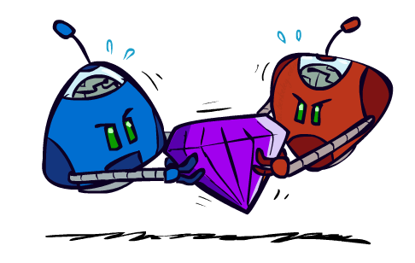
AI: Representation and Problem Solving
Game Theory: Equilibrium
Instructors: Tuomas Sandholm and Vincent Conitzer
Slide credits: CMU AI, Fei Fang
Image credit: ai.berkeley.edu

Slide 2




From Games to Game Theory
The study of mathematical models of conflict and cooperation between intelligent decision makers
Used in economics, political science, etc
John Nash
Winner of Nobel Memorial Prize in Economic Sciences
Notes:
We all play games, from … to … to party boardgames such as werewolf.
In most of the games, we have to play in a very strategic way to win.
Game theory is the study of strategic decision making.
More specifically, game theory is the study of mathematical models of conflict and cooperation between intelligent decision-makers. The games studied in game theory must have elements including the players, information, actions and payoffs.
Although the first known discussion of game theory is for a two-player card game, game theory is not only designed for entertaining games. Modern game theory has been used in economics and political science. Nobel Prize winner John Nash

Slide 3
Recall: Adversarial Search
Zero-sum, perfect information, two-player games with turn-taking
3
12
8
2
4
6
14
5
2

Slide 4
Payoff Matrices: Simultaneous Choice of Strategies
Rock-Paper-Scissors (RPS)
  Rock beats Scissors
  Scissors beats Paper
  Paper beats Rock
  2-player normal-form game with finite set of strategies (which are just individual actions in this example) chosen simultaneously
  represented in a (bi)matrix
  Player 1 is row player (typically first number)
  Player 2 is column player (typically second number)
Player 2
 | Rock | Paper | Scissors
Rock | 0, 0 | -1, 1 | 1, -1
Paper | 1, -1 | 0, 0 | -1, 1
Scissors | -1, 1 | 1, -1 | 0, 0
Player 1
Notes:
A two-player normal-form game with finite actions can be represented by a (bi)matrix
Player 1: Row player, Player 2: Column player
Often first number is for row player, second for column player

Slide 5

Rock, Paper, Scissors, Lizard, Spock
CBS, Big Bang Theory
https://www.youtube.com/watch?v=iSHPVCBsnLw
Image credit: https://www.snorgtees.com/rock-paper-scissors-lizard-spock

Slide 6
Classical Games and Payoff Matrices
Prisoner’s Dilemma (PD)
  If both Cooperate: 1 year in jail each
  If one Defect, one Cooperate: 0 year for (D), 3 years for (C)
  If both Defect: 2 years in jail each
  Let’s play!
Player 2
 | Cooperate | Defect
Cooperate | -1,-1 | -3,0
Defect | 0,-3 | -2,-2
Player 1
Notes:
Two members of a criminal gang are arrested and imprisoned. Each prisoner is in solitary confinement with no means of communicating with the other. The prosecutors lack sufficient evidence to convict the pair on the principal charge, but they have enough to convict both on a lesser charge. Simultaneously, the prosecutors offer each prisoner a bargain. Each prisoner is given the opportunity either to betray the other by testifying that the other committed the crime, or to cooperate with the other by remaining silent. The possible outcomes are:
If A and B each betray the other, each of them serves two years in prison
If A betrays B but B remains silent, A will be set free and B will serve three years in prison (and vice versa)
If A and B both remain silent, both of them will serve only one year in prison (on the lesser charge).

Slide 7
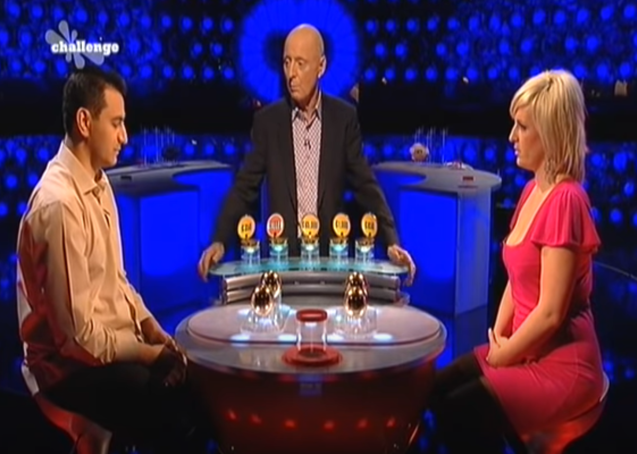
Variation: Split or Steal
https://www.youtube.com/watch?v=yM38mRHY150

Slide 8
Classical Games and Payoff Matrices
Football vs Concert (FvsC)
  Historically known as Battle of Sexes
  If football together: Alex ☺☺, Berry ☺
  If concert together: Alex ☺, Berry ☺☺
  If not together: Alex ☹, Berry ☹
Fill in the payoff matrix
Berry
 | Football | Concert
Football | 2,1 | 0,0
Concert | 0,0 | 1,2
Alex

Slide 9
Normal-Form Games
A game in normal form consists of the following elements
  Set of players
  Set of actions for each player
  Payoffs / Utility functions
    Determines the utility for each player given the actions chosen by all players (referred to as action profile)
  Bimatrix game is special case: two players, finite action sets
Players move simultaneously and the game ends immediately afterwards
Notes:
A normal-form game is a representation of a game in game theory. It directly specifies the set of players' strategies where a strategy is a complete plan of action for every stage of the game, regardless of whether that stage actually arises in play.

Slide 10
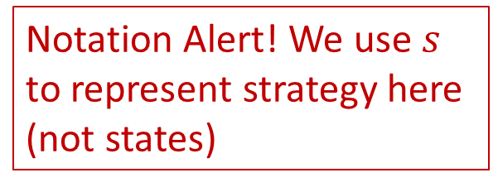
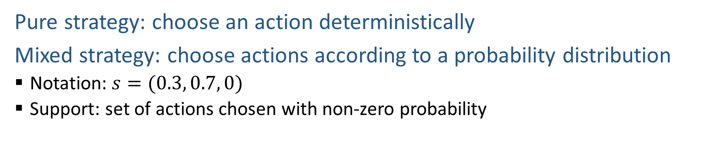
Strategy
Pure strategy: choose an action deterministically
Mixed strategy: choose actions according to a probability distribution
  Notation: $s=(0.3, 0.7, 0)$
  Support: set of actions chosen with non-zero probability
Notation Alert! We use $s$ to represent strategy here (not states)
Does your AI play a deterministic strategy or a mixed strategy?
What is the support size of your AI’s strategy?
Player 2
 | Rock | Paper | Scissors
Rock | 0, 0 | -1, 1 | 1, -1
Paper | 1, -1 | 0, 0 | -1, 1
Scissors | -1, 1 | 1, -1 | 0, 0
Player 1

Slide 11
Zero-sum vs General-sum
Zero-sum game
  No matter what actions are chosen by the players, the utilities for all the players sum up to zero (or a constant)
General-sum game
  The sum of utilities of all the players is not a constant
  Which ones are general-sum games?
Player 2
 | Cooperate | Defect
Cooperate | -1,-1 | -3,0
Defect | 0,-3 | -2,-2
Player 1
Player 2
 | Rock | Paper | Scissors
Rock | 0,0 | -1,1 | 1,-1
Paper | 1,-1 | 0,0 | -1,1
Scissor | -1,1 | 1,-1 | 0,0
Berry
Alex
 | Football | Concert
Football | 2,1 | 0,0
Concert | 0,0 | 1,2
Player 1

Slide 12
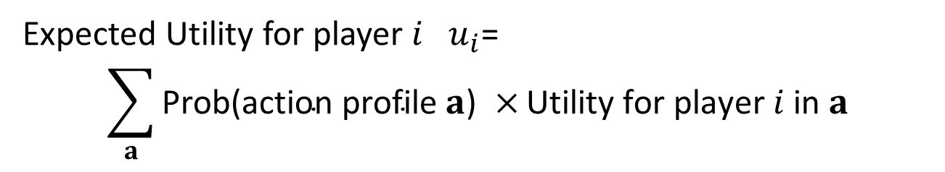
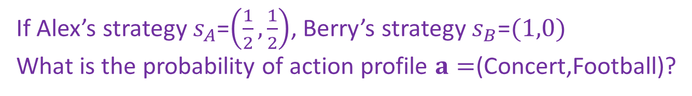
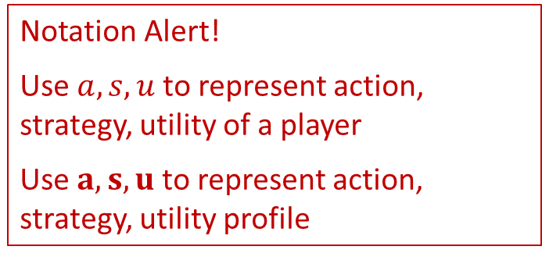
Expected Utility
Notation Alert!
Use $a, s,u$ to represent action, strategy, utility of a player
Use $a,s,u$ to represent action, strategy, utility profile
Given the strategies of all players,
Expected Utility for player $i$ $u_{i}$=
$$\sum_{a}{\text{Prob}\text{(}\text{action} \text{profile} a\text{) }×}\text{Utility} \text{for} \text{player} i \text{in} a$$
Can skip action profiles with probability $0$ or utility $0$
If Alex’s strategy $s_{A}$=$\left(\frac{1}{2},\frac{1}{2}\right)$, Berry’s strategy $s_{B}$=$(1,0)$
What is the probability of action profile $a=$(Concert,Football)?
Berry
What is Alex’s utility in this action profile?
 | Football | Concert
Football | 2,1 | 0,0
Concert | 0,0 | 1,2
Alex

Slide 13
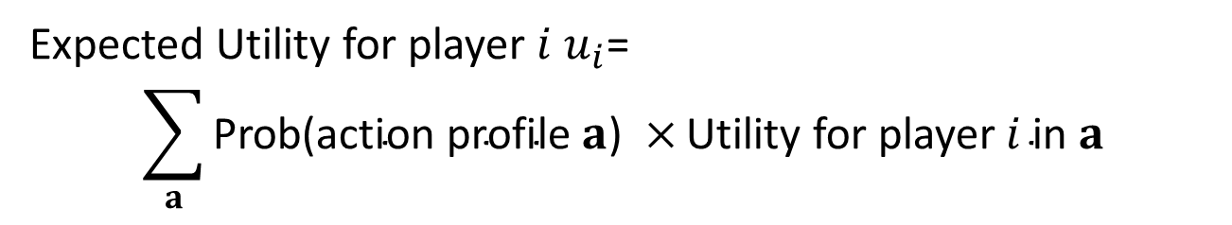

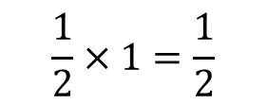
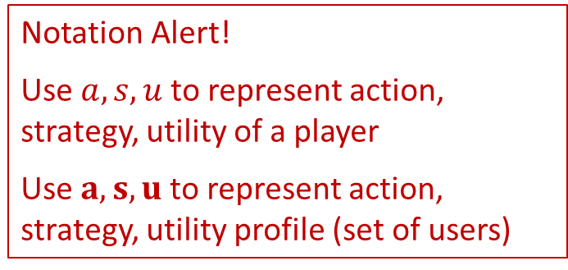
Expected Utility
Notation Alert!
Use $a, s,u$ to represent action, strategy, utility of a player
Use $a,s,u$ to represent action, strategy, utility profile (set of users)
Given the strategies of all players,
Expected Utility for player $i$ $u_{i}$=
$$\sum_{a}{\text{Prob}\text{(}\text{action} \text{profile} a\text{) }×}\text{Utility} \text{for} \text{player} i \text{in} a$$
Can skip action profiles with probability $0$ or utility $0$
If Alex’s strategy $s_{A}$=$\left(\frac{1}{2},\frac{1}{2}\right)$, Berry’s strategy $s_{B}$=$(1,0)$
What is the probability of action profile $a=$(Concert,Football)?
$$\frac{1}{2}×1=\frac{1}{2}$$
Berry
What is Alex’s utility in this action profile?
 | Football | Concert
Football | 2,1 | 0,0
Concert | 0,0 | 1,2
$$0$$
Alex

Slide 14
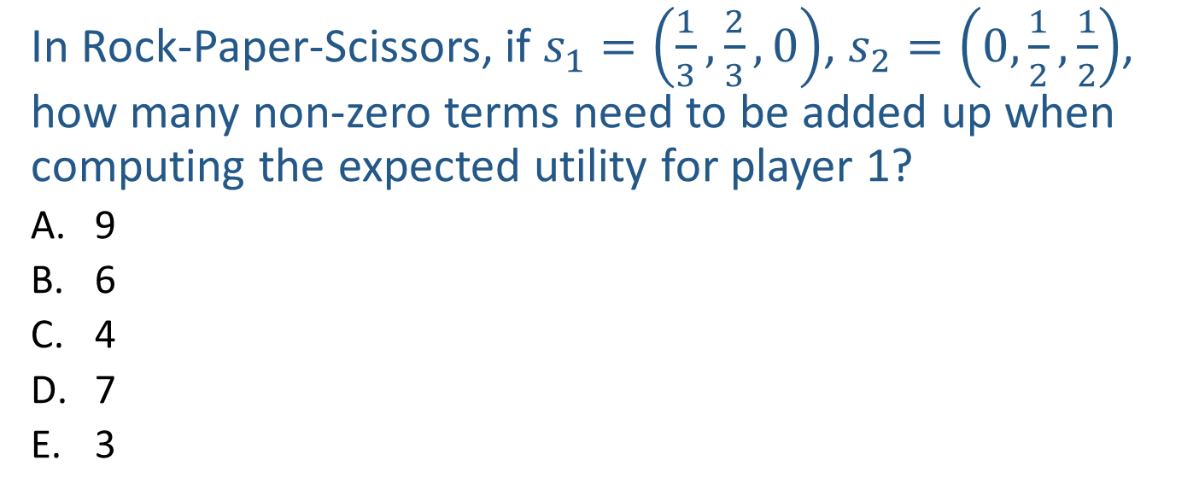
Poll 1
In Rock-Paper-Scissors, if $s_{1}=\left(\frac{1}{3},\frac{2}{3},0\right)$, $s_{2}=\left(0,\frac{1}{2},\frac{1}{2}\right)$, how many non-zero terms need to be added up when computing the expected utility for player 1?
  9
  6
  4
  7
  3
Player 2
 | Rock | Paper | Scissors
Rock | 0, 0 | -1, 1 | 1, -1
Paper | 1, -1 | 0, 0 | -1, 1
Scissors | -1, 1 | 1, -1 | 0, 0
Player 1
Notes:
E

Slide 15
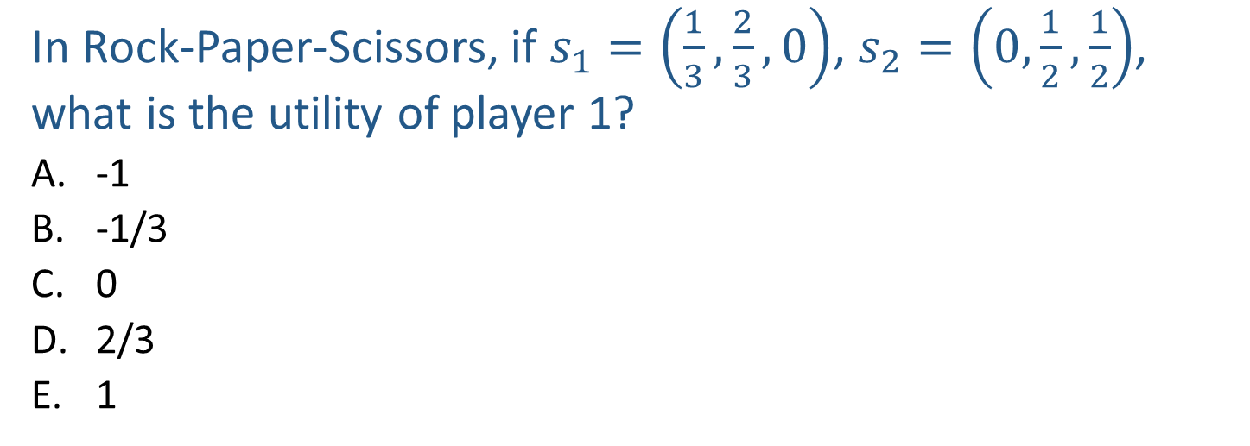
Poll 2
In Rock-Paper-Scissors, if $s_{1}=\left(\frac{1}{3},\frac{2}{3},0\right)$, $s_{2}=\left(0,\frac{1}{2},\frac{1}{2}\right)$, what is the utility of player 1?
  -1
  -1/3
  0
  2/3
  1
Player 2
 | Rock | Paper | Scissors
Rock | 0, 0 | -1, 1 | 1, -1
Paper | 1, -1 | 0, 0 | -1, 1
Scissors | -1, 1 | 1, -1 | 0, 0
Player 1
Notes:
B

Slide 16
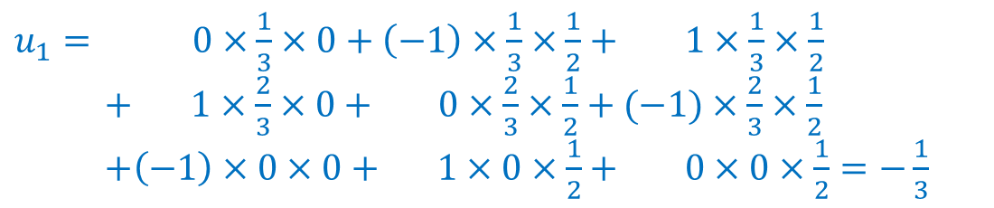
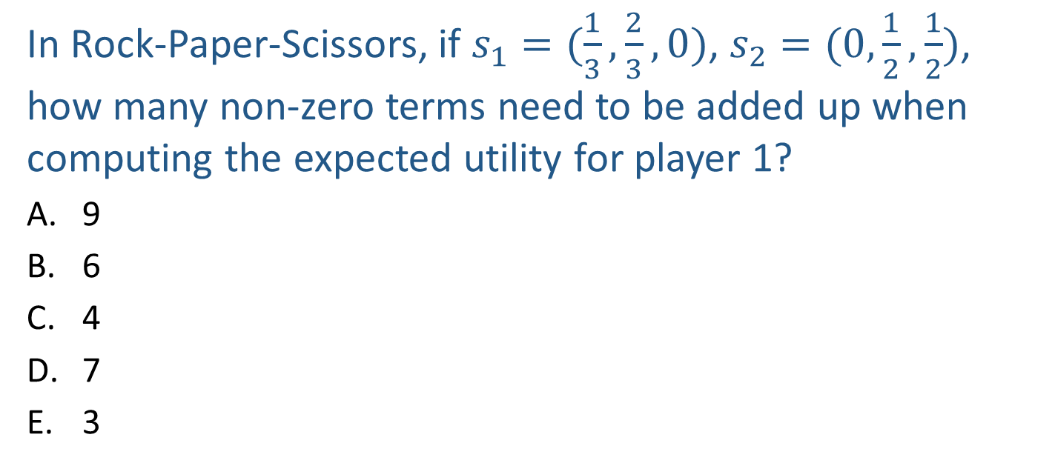
Poll 2
In Rock-Paper-Scissors, if $s_{1}=(\frac{1}{3},\frac{2}{3},0)$, $s_{2}=(0,\frac{1}{2},\frac{1}{2})$, how many non-zero terms need to be added up when computing the expected utility for player 1?
  9
  6
  4
  7
  3
$u_{1}= 0×\frac{1}{3}×0+\left(−1\right)×\frac{1}{3}×\frac{1}{2}+ 1×\frac{1}{3}×\frac{1}{2}$
$+ 1×\frac{2}{3}×0+ 0×\frac{2}{3}×\frac{1}{2}+(−1)×\frac{2}{3}×\frac{1}{2}$
$+\left(−1\right)×0×0+ 1×0×\frac{1}{2}+ 0×0×\frac{1}{2}=−\frac{1}{3}$
Player 2
 | Rock | Paper | Scissors
Rock | 0, 0 | -1, 1 | 1, -1
Paper | 1, -1 | 0, 0 | -1, 1
Scissors | -1, 1 | 1, -1 | 0, 0
Player 1

Slide 17
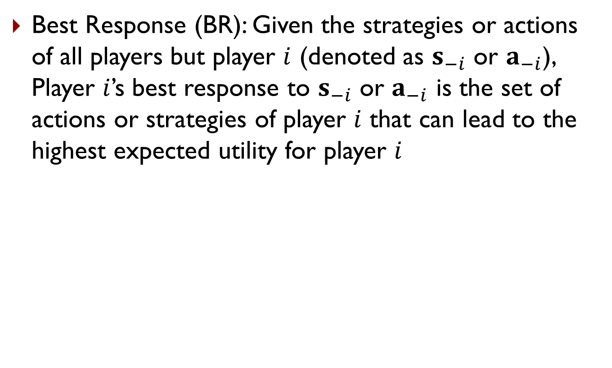
Best Response
Best Response (BR): Given the strategies or actions of all players but player $i$ (denoted as $s_{−i}$ or $a_{−i}$), Player $i$’s best response to $s_{−i}$ or $a_{−i}$ is the set of actions or strategies of player $i$ that can lead to the highest expected utility for player $i$
In RPS, what is Player 1’s best response to Rock (i.e., assuming Player 2 plays Rock)?
In Prisoner’s Dilemma, what is Player 1’s best response to Cooperate? What is Player 1’s best response to Defect?
Player 2
 | Cooperate | Defect
Cooperate | -1,-1 | -3,0
Defect | 0,-3 | -2,-2
Player 1

Slide 18
Best Response
Best Response (BR): Given the strategies or actions of all players but player $i$ (denoted as $s_{−i}$ or $a_{−i}$), Player $i$’s best response to $s_{−i}$ or $a_{−i}$ is the set of actions or strategies of player $i$ that can lead to the highest expected utility for player $i$
In RPS, what is Player 1’s best response to Rock (i.e., assuming Player 2 plays Rock)?
Paper
In Prisoner’s Dilemma, what is Player 1’s best response to Cooperate? What is Player 1’s best response to Defect?
Defect
Defect
Player 2
 | Cooperate | Defect
Cooperate | -1,-1 | -3,0
Defect | 0,-3 | -2,-2
Player 1

Slide 19
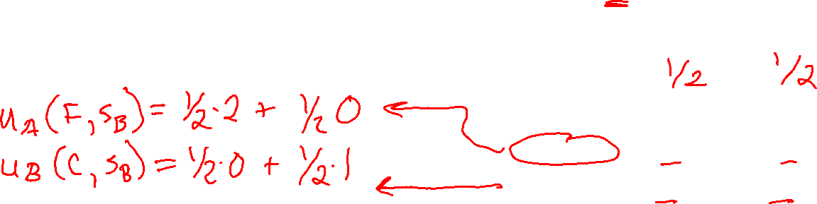
Best Response
Best Response (BR): Given the strategies or actions of all players but player $i$ (denoted as $s_{−i}$ or $a_{−i}$), Player $i$’s best response to $s_{−i}$ or $a_{−i}$ is the set of actions or strategies of player $i$ that can lead to the highest expected utility for player $i$
What is Alex’s best response to Berry’s mixed strategy $s_{B}=\left(\frac{1}{2},\frac{1}{2}\right)$?
Berry
 | Football | Concert
Football | 2,1 | 0,0
Concert | 0,0 | 1,2
Alex

Slide 20
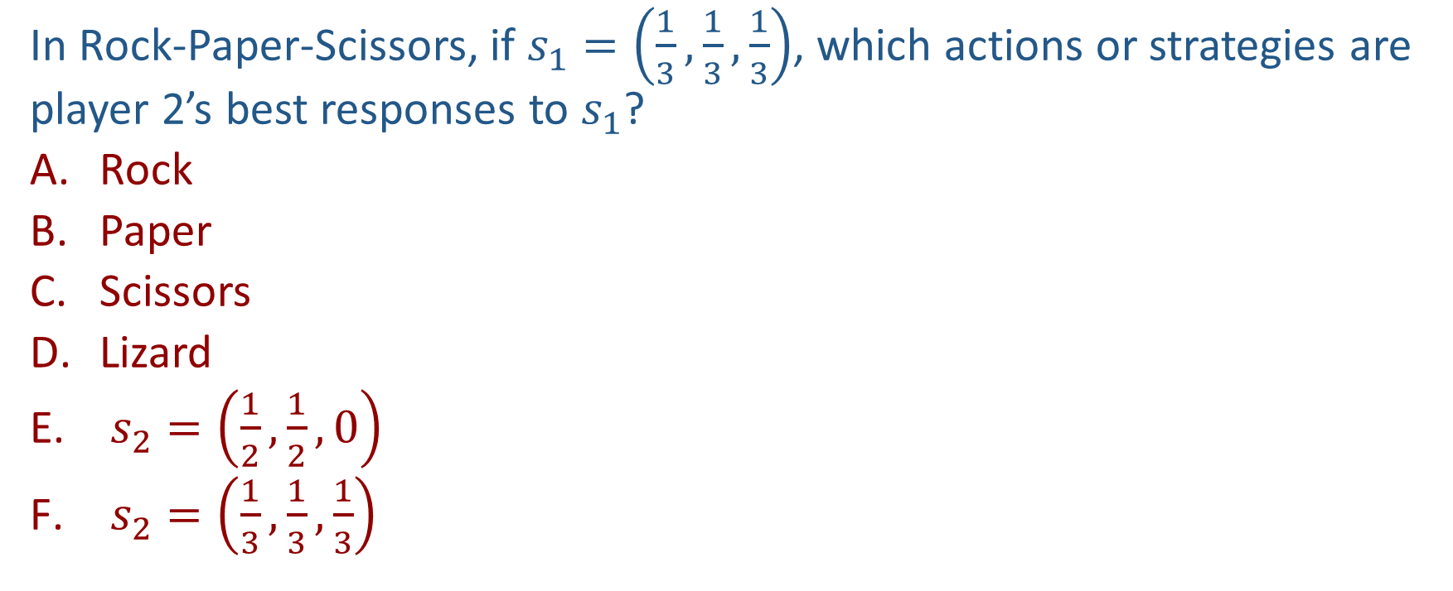
Poll 3
In Rock-Paper-Scissors, if $s_{1}=\left(\frac{1}{3},\frac{1}{3},\frac{1}{3}\right)$, which actions or strategies are player 2’s best responses to $s_{1}$?
  Rock
  Paper
  Scissors
  Lizard
  $s_{2}=\left(\frac{1}{2},\frac{1}{2},0\right)$
  $s_{2}=\left(\frac{1}{3},\frac{1}{3},\frac{1}{3}\right)$
Player 2
 | Rock | Paper | Scissors
Rock | 0, 0 | -1, 1 | 1, -1
Paper | 1, -1 | 0, 0 | -1, 1
Scissors | -1, 1 | 1, -1 | 0, 0
Player 1

Slide 21
Best Response
Theorem 1 (Nash 1951): A mixed strategy is a BR iff all actions in the support are a BR
Player 2
 | Rock | Paper | Scissors
Rock | 0, 0 | -1, 1 | 1, -1
Paper | 1, -1 | 0, 0 | -1, 1
Scissors | -1, 1 | 1, -1 | 0, 0
Player 1

Slide 22
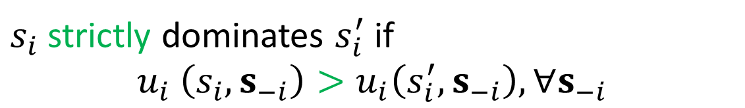

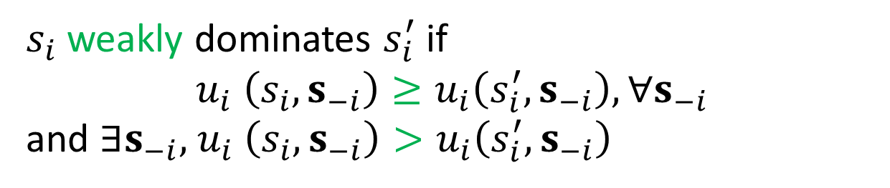
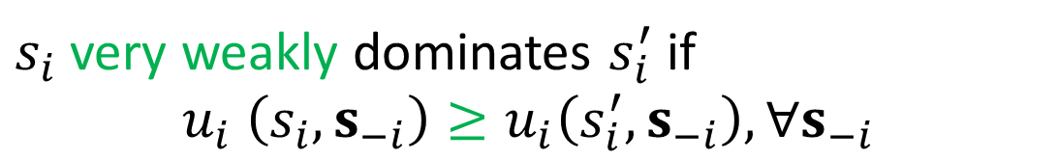
Dominance
$s_{i}$ and $s_{i}′$ are two strategies for player $i$
$s_{i}$ strictly dominates $s_{i}′$ if $s_{i}$ is always better than $s_{i}′$, no matter what strategies are chosen by other players
$s_{i}$ strictly dominates $s_{i}^{′}$ if
$$u_{i} \left(s_{i},s_{−i}\right)>u_{i}\left(s_{i}^{′},s_{−i}\right),∀s_{−i}$$
always better
$s_{i}$ very weakly dominates $s_{i}^{′}$ if
$$u_{i} \left(s_{i},s_{−i}\right)≥u_{i}\left(s_{i}^{′},s_{−i}\right),∀s_{−i}$$
never worse
$s_{i}$ weakly dominates $s_{i}^{′}$ if
$$u_{i} \left(s_{i},s_{−i}\right)≥u_{i}\left(s_{i}^{′},s_{−i}\right),∀s_{−i}$$
and $∃s_{−i}\text{, }u_{i} \left(s_{i},s_{−i}\right)>u_{i}\left(s_{i}^{′},s_{−i}\right)$
never worse and sometimes better

Slide 23
Dominance
Can you find any dominance relationships between the pure strategies in these games?
Player 2
 | Cooperate | Defect
Cooperate | -1,-1 | -3,0
Defect | 0,-3 | -2,-2
Player 2
Player 1
 | Rock | Paper | Scissors
Rock | 0,0 | -1,1 | 1,-1
Paper | 1,-1 | 0,0 | -1,1
Scissor | -1,1 | 1,-1 | 0,0
Berry
Player 1
 | Football | Concert
Football | 2,1 | 0,0
Concert | 0,0 | 1,2
Alex

Slide 24
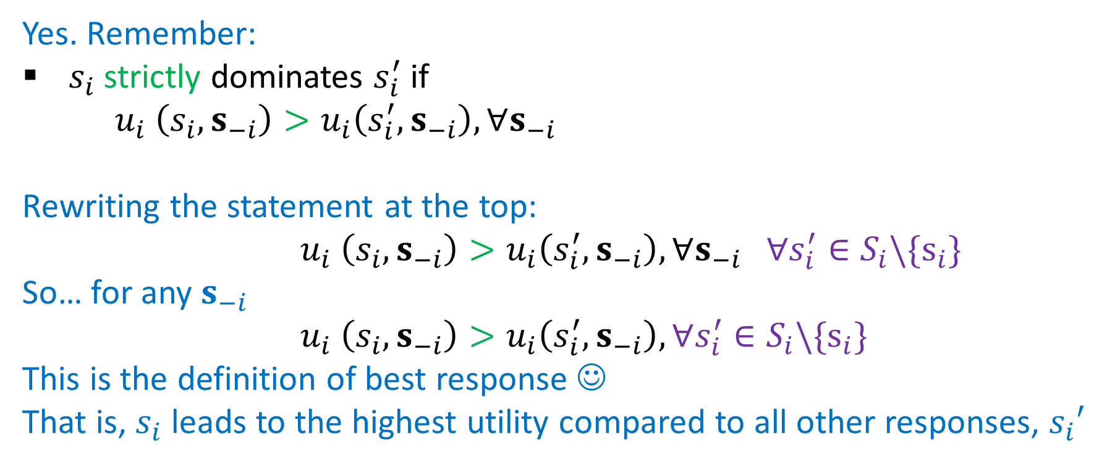
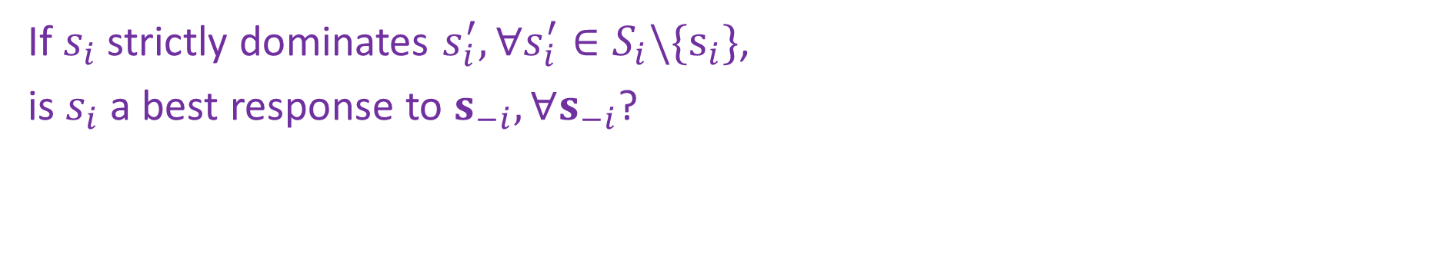
Dominance
If $s_{i}$ strictly dominates $s_{i}^{′},∀s_{i}^{′}∈S_{i}\backslash \{s_{i}\}$,
is $s_{i}$ a best response to $s_{−i},∀s_{−i}$?
Yes. Remember:
$s_{i}$ strictly dominates $s_{i}^{′}$ if
$u_{i} \left(s_{i},s_{−i}\right)>u_{i}\left(s_{i}^{′},s_{−i}\right),∀s_{−i}$
Rewriting the statement at the top:
$u_{i} \left(s_{i},s_{−i}\right)>u_{i}\left(s_{i}^{′},s_{−i}\right),∀s_{−i} ∀s_{i}^{′}∈S_{i}\backslash \{s_{i}\}$
So… for any $s_{−i}$
$u_{i} \left(s_{i},s_{−i}\right)>u_{i}\left(s_{i}^{′},s_{−i}\right),∀s_{i}^{′}∈S_{i}\backslash \{s_{i}\}$
This is the definition of best response ☺
That is, $s_{i}$ leads to the highest utility compared to all other responses, $s_{i}′$

Slide 25
Solution Concepts in Games
How should one player play and what should we expect all the players to play?
  Dominant strategy and dominant strategy equilibrium
  Nash Equilibrium
  (Minimax strategy)
  (Maximin strategy)
  (Stackelberg Equilibrium)

Slide 26
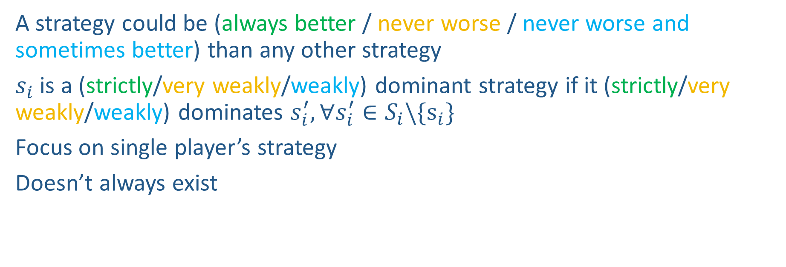
Dominant Strategy
A strategy could be (always better / never worse / never worse and sometimes better) than any other strategy
$s_{i}$ is a (strictly/very weakly/weakly) dominant strategy if it (strictly/very weakly/weakly) dominates $s_{i}^{′}, ∀s_{i}^{′}∈S_{i}\backslash \{s_{i}\}$
Focus on single player’s strategy
Doesn’t always exist
Is there a strictly dominant strategy for player 1 in PD?
Player 2
 | Cooperate | Defect
Cooperate | -1,-1 | -3,0
Defect | 0,-3 | -2,-2
Player 1

Slide 27
Dominant Strategy Equilibrium
Sometimes called dominant strategy solution
Every player plays a dominant strategy
Focus on strategy profile for all players
Doesn’t always exist
What is the dominant strategy equilibrium for PD?
Player 2
 | Cooperate | Defect
Cooperate | -1,-1 | -3,0
Defect | 0,-3 | -2,-2
Player 1

Slide 28
Solution Concepts in Games
How should one player play and what should we expect all the players to play?
  Dominant strategy and dominant strategy equilibrium
  Nash Equilibrium
  (Minimax strategy)
  (Maximin strategy)
  (Stackelberg Equilibrium)

Slide 29
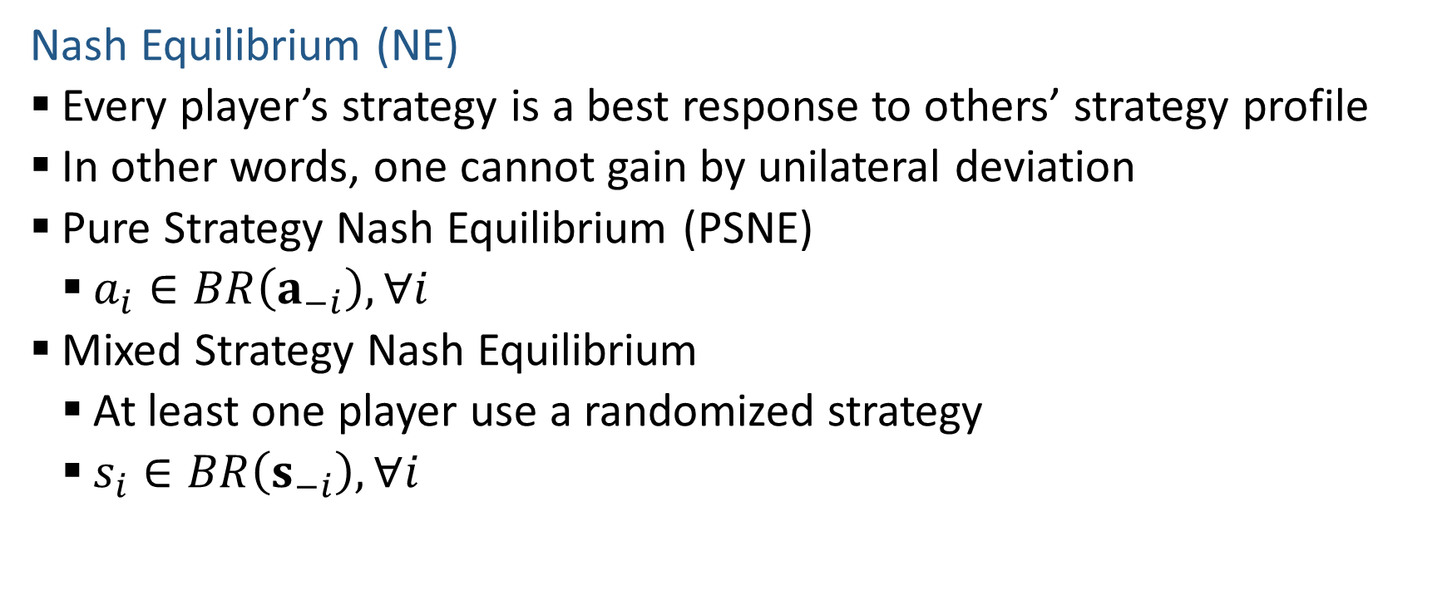
Nash Equilibrium
Nash Equilibrium (NE)
  Every player’s strategy is a best response to others’ strategy profile
  In other words, one cannot gain by unilateral deviation
  Pure Strategy Nash Equilibrium (PSNE)
    $a_{i}∈BR\left(a_{−i}\right),∀i$
  Mixed Strategy Nash Equilibrium
    At least one player use a randomized strategy
    $s_{i}∈BR\left(s_{−i}\right),∀i$

Slide 30
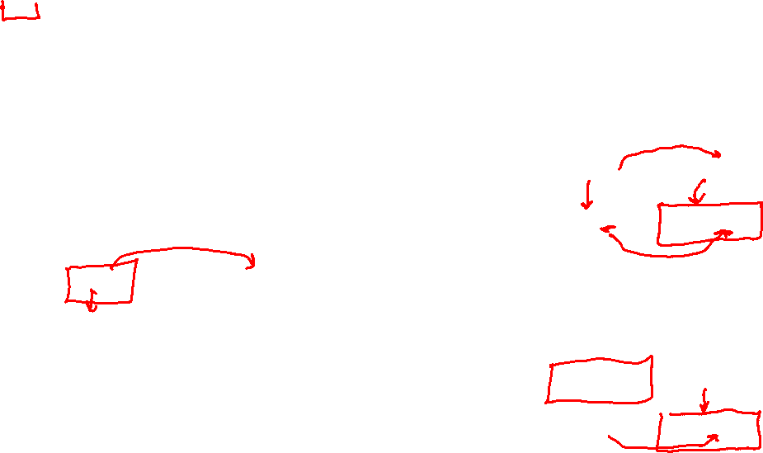
Nash Equilibrium
What are the PSNEs in these games?
What is the mixed strategy NE in RPS?
Player 2
 | Cooperate | Defect
Cooperate | -1,-1 | -3,0
Defect | 0,-3 | -2,-2
Player 1
Player 2
 | Rock | Paper | Scissors
Rock | 0,0 | -1,1 | 1,-1
Paper | 1,-1 | 0,0 | -1,1
Scissor | -1,1 | 1,-1 | 0,0
Berry
Player 1
Alex
 | Football | Concert
Football | 2,1 | 0,0
Concert | 0,0 | 1,2

Slide 31
Nash Equilibrium
What are the PSNEs in these games?
RPS: None. Prisoner’s Dilemma: (D,D). Football vs Concert: (F,F),(C,C)
What is the mixed strategy NE in RPS?
Player 2
 | Cooperate | Defect
Cooperate | -1,-1 | -3,0
Defect | 0,-3 | -2,-2
(1/3,1/3,1/3) for both players
Player 1
Player 2
 | Rock | Paper | Scissors
Rock | 0,0 | -1,1 | 1,-1
Paper | 1,-1 | 0,0 | -1,1
Scissor | -1,1 | 1,-1 | 0,0
Berry
Player 1
Alex
 | Football | Concert
Football | 2,1 | 0,0
Concert | 0,0 | 1,2

Slide 32
Nash Equilibrium
Theorem 2 (Nash 1951): NE always exists in finite games
  Finite number of players, finite number of actions
  NE: can be pure or mixed
  Proof: Through Brouwer's fixed point theorem

Slide 33
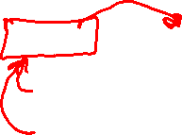
Find PSNE
Find pure strategy Nash Equilibrium (PSNE)
  Enumerate all action profile
  For each action profile, check if it is NE
    For each player, check other available actions to see if he should deviate
  Other approaches?
Player 2
 | L | C | R
U | 10, 3 | 1, 5 | 5, 4
M | 3, 1 | 2, 4 | 5, 2
D | 0, 10 | 1, 8 | 7, 0
Player 1
Notes:
for each player to see if there is no incentive for this player to deviate, i.e., there exists another action of this player that lead to higher payoff, given the actions of other players

Slide 34
Find PSNE
A strictly dominated strategy is one that is always worse than some other strategy
Strictly dominated strategies cannot be part of an NE
Why?
Which are the strictly dominated strategies for player 1?
How about player 2?
Player 2
 | L | C | R
U | 10, 3 | 1, 5 | 5, 4
M | 3, 1 | 2, 4 | 5, 2
D | 0, 10 | 1, 8 | 7, 0
Player 1
Notes:
None for 1. R for 2.

Slide 35

Find PSNE
A strictly dominated strategy is one that is always worse than some other strategy
Strictly dominated strategies cannot be part of an NE
Why?
Which are the strictly dominated strategies for player 1?
How about player 2?
Player 2
 | L | C | R
U | 10, 3 | 1, 5 | 5, 4
M | 3, 1 | 2, 4 | 5, 2
D | 0, 10 | 1, 8 | 7, 0
Player 1
$$≥$$

Slide 36

Find PSNE through Iterative Removal
Remove strictly dominated actions (pure strategies) and then find PSNE in the remaining game
Can have new strictly dominated actions in the remaining game!
Repeat the process until no actions can be removed
This is the Iterative Removal algorithm (also known as Iterative Elimination of Strictly Dominated Strategies)
Find PSNE in this game using iterative removal
Player 2
 | L | C | R
U | 10, 3 | 1, 5 | 5, 4
M | 3, 1 | 2, 4 | 5, 2
D | 0, 10 | 1, 8 | 7, 0
Player 1

Slide 37
Find PSNE through Iterative Removal
Remove strictly dominated actions (pure strategies) and then find PSNE in the remaining game
Can have new strictly dominated actions in the remaining game!
Repeat the process until no actions can be removed
This is the Iterative Removal algorithm (also known as Iterative Elimination of Strictly Dominated Strategies)
Find PSNE in this game using iterative removal
 | L | C | R
U | 10,3 | 1,5 | 5,4
M | 3,1 | 2,4 | 5,2
D | 0,10 | 1,8 | 7,0
 | L | C
U | 10,3 | 1,5
M | 3,1 | 2,4
D | 0,10 | 1,8
 | L | C
U | 10,3 | 1,5
M | 3,1 | 2,4
 | C
U | 1,5
M | 2,4
 | C
M | 2,4

Slide 38
Find PSNE through Iterative Removal
When the algorithm terminates, if the remaining game has only one action for each player, then that is the unique NE of the game and the game is called dominance solvable
  It may not be a dominant strategy equilibrium
When the remaining game has more than one action for some players, find PSNE in the remaining game
Order of removal does not matter
Player 2
 | L | C | R
U | 10,3 | 1,5 | 5,4
M | 3,1 | 2,4 | 5,2
D | 0,10 | 1,8 | 7,0
Player 1

Slide 39
Find Mixed Strategy Nash Equilibrium
Can we still apply iterative removal?
  Yes! The removed strategies cannot be part of any NE
  You can always apply iterative removal first
Notes:
, i.e., no strictly dominated strategies in the remaining game
Now assume you are given a 2 by 2 bimatrix game after iterative removal. Further, you are told that in a NE, all the actions are chosen with non-zero probability. What are the necessary conditions for a mixed strategy NE?
Check the FvsC game, in addition to PSNEs (F,F) and (C,C), there is a mixed strategy NE shown below.

Slide 40
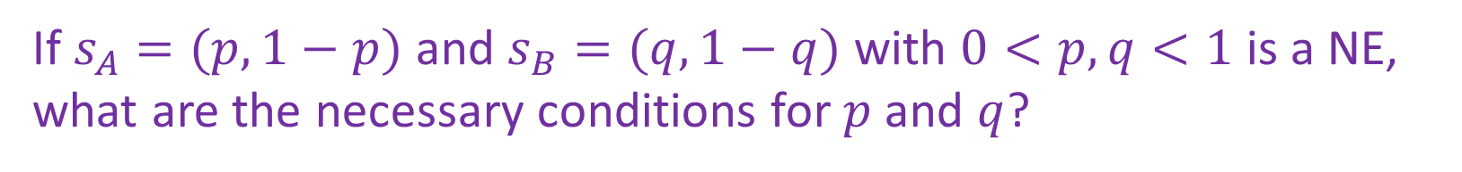
Find Mixed Strategy Nash Equilibrium
How to find mixed strategy NE (after iterative removal)?
(The presented technique is for 2x2 games.)
Berry
 | Football | Concert
Football | 2,1 | 0,0
Concert | 0,0 | 1,2
Alex
If $s_{A}=(p,1−p)$ and $s_{B}=(q,1−q)$ with $0<p,q<1$ is a NE, what are the necessary conditions for $p$ and $q$?
Notes:
, i.e., no strictly dominated strategies in the remaining game
Now assume you are given a 2 by 2 bimatrix game after iterative removal. Further, you are told that in a NE, all the actions are chosen with non-zero probability. What are the necessary conditions for a mixed strategy NE?
Check the FvsC game, in addition to PSNEs (F,F) and (C,C), there is a mixed strategy NE shown below.

Slide 41
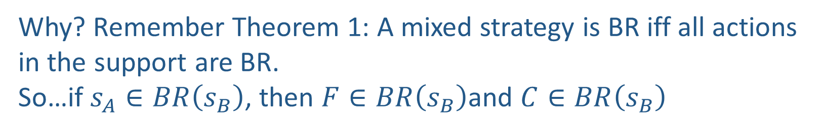


Find Mixed Strategy Nash Equilibrium
How to find mixed strategy NE (after iterative removal)?
Berry
 | Football | Concert
Football | 2,1 | 0,0
Concert | 0,0 | 1,2
Alex
If $s_{A}=(p,1−p)$ and $s_{B}=(q,1−q)$ with $0<p,q<1$ is a NE, what are the necessary conditions for $p$ and $q$?
$$u_{A}\left(F,s_{B}\right)=u_{A}\left(C,s_{B}\right)$$
$$u_{B}\left(s_{A},F\right)=u_{B}\left(s_{A},C\right)$$
Why? Remember Theorem 1: A mixed strategy is BR iff all actions in the support are BR.
So…if $s_{A}∈BR\left(s_{B}\right)$, then $F∈BR\left(s_{B}\right)$and $C∈BR\left(s_{B}\right)$
Notes:
, i.e., no strictly dominated strategies in the remaining game
Now assume you are given a 2 by 2 bimatrix game after iterative removal. Further, you are told that in a NE, all the actions are chosen with non-zero probability. What are the necessary conditions for a mixed strategy NE?
Check the FvsC game, in addition to PSNEs (F,F) and (C,C), there is a mixed strategy NE shown below.

Slide 42


Find Mixed Strategy Nash Equilibrium
How to find mixed strategy NE (after iterative removal)?
Berry
 | Football | Concert
Football | 2,1 | 0,0
Concert | 0,0 | 1,2
Alex
If $s_{A}=(p,1−p)$ and $s_{B}=(q,1−q)$ with $0<p,q<1$ is a NE, what are the necessary conditions for $p$ and $q$?
$$u_{A}\left(F,s_{B}\right)=u_{A}\left(C,s_{B}\right)$$
$$u_{B}\left(s_{A},F\right)=u_{B}\left(s_{A},C\right)$$
Notes:
, i.e., no strictly dominated strategies in the remaining game
Now assume you are given a 2 by 2 bimatrix game after iterative removal. Further, you are told that in a NE, all the actions are chosen with non-zero probability. What are the necessary conditions for a mixed strategy NE?
Check the FvsC game, in addition to PSNEs (F,F) and (C,C), there is a mixed strategy NE shown below.

Slide 43
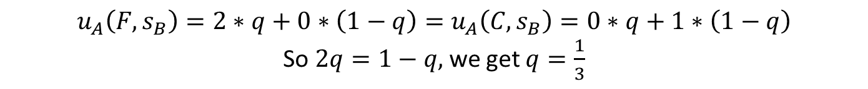

Find Mixed Strategy Nash Equilibrium
How to find mixed strategy NE (after iterative removal)?
Berry
 | Football | Concert
Football | 2,1 | 0,0
Concert | 0,0 | 1,2
Alex
If $s_{A}=(p,1−p)$ and $s_{B}=(q,1−q)$ with $0<p,q<1$ is a NE, what are the necessary conditions for $p$ and $q$?
$$u_{A}\left(F,s_{B}\right)=u_{A}\left(C,s_{B}\right)$$
$$u_{B}\left(s_{A},C\right)=u_{B}\left(s_{A},C\right)$$
$$u_{A}\left(F,s_{B}\right)=2∗q+0∗\left(1−q\right)=u_{A}\left(C,s_{B}\right)=0∗q+1∗\left(1−q\right)$$
So $2q=1−q,$ we get $q=\frac{1}{3}$
Similarly, $u_{B}\left(s_{A},F\right)=1∗p+0∗\left(1−p\right)=u_{B}\left(s_{A},C\right)=0∗p+2∗\left(1−p\right)$
So $p=2\left(1−p\right),$ we get $p=\frac{2}{3}$
Notes:
, i.e., no strictly dominated strategies in the remaining game
Now assume you are given a 2 by 2 bimatrix game after iterative removal. Further, you are told that in a NE, all the actions are chosen with non-zero probability. What are the necessary conditions for a mixed strategy NE?
Check the FvsC game, in addition to PSNEs (F,F) and (C,C), there is a mixed strategy NE shown below.

Slide 44
Solution Concepts in Games
How should one player play and what should we expect all the players to play?
  Dominant strategy and dominant strategy equilibrium
  Nash Equilibrium
  Minimax strategy
  Maximin strategy
  Stackelberg Equilibrium

Slide 45
Maximin and Minimax Strategy
Both focus on single player’s strategy
Maximin Strategy
  Maximize worst case expected utility
  Maximin value (also called safety level)
Minimax Strategy
  Minimize best case expected utility for the other player (just want to harm your opponent)
  Minimax value

Slide 46
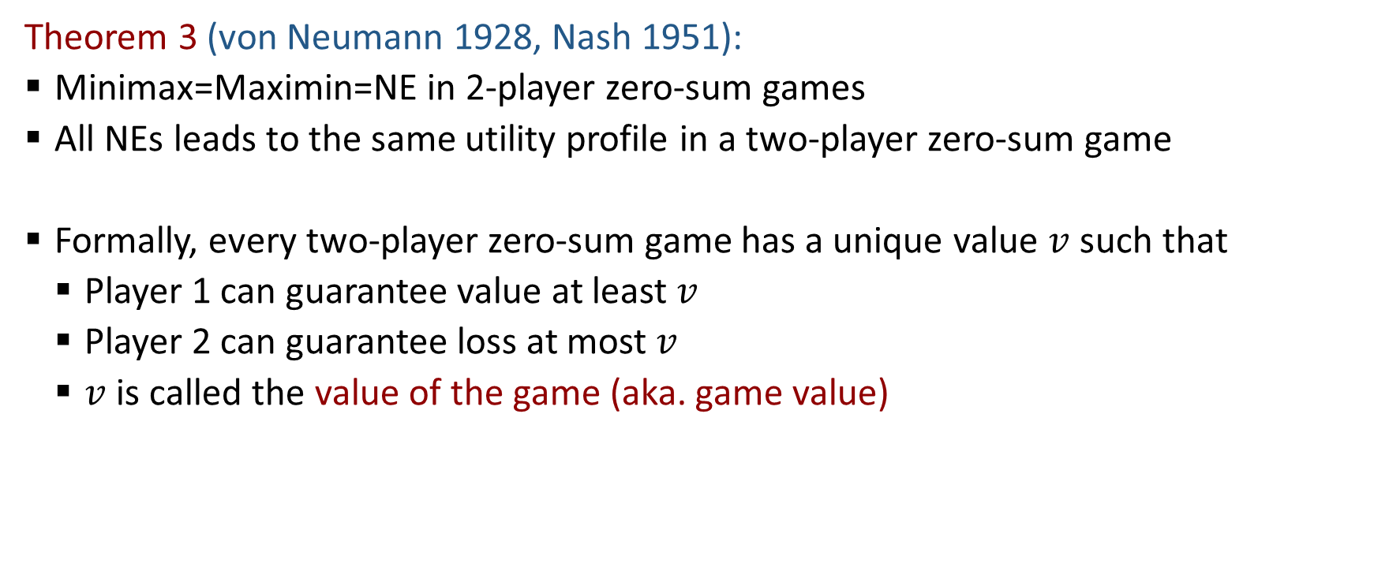
Minimax Theorem
Theorem 3 (von Neumann 1928, Nash 1951):
  Minimax=Maximin=NE in 2-player zero-sum games
  All NEs leads to the same utility profile in a two-player zero-sum game
  Formally, every two-player zero-sum game has a unique value $v$ such that
    Player 1 can guarantee value at least $v$
    Player 2 can guarantee loss at most $v$
    $v$ is called the value of the game (aka. game value)

Slide 47
Solution Concepts in Games
How should one player play and what should we expect all the players to play?
  Dominant strategy and dominant strategy equilibrium
  Nash Equilibrium
  Minimax strategy
  Maximin strategy
  Stackelberg Equilibrium

Slide 48
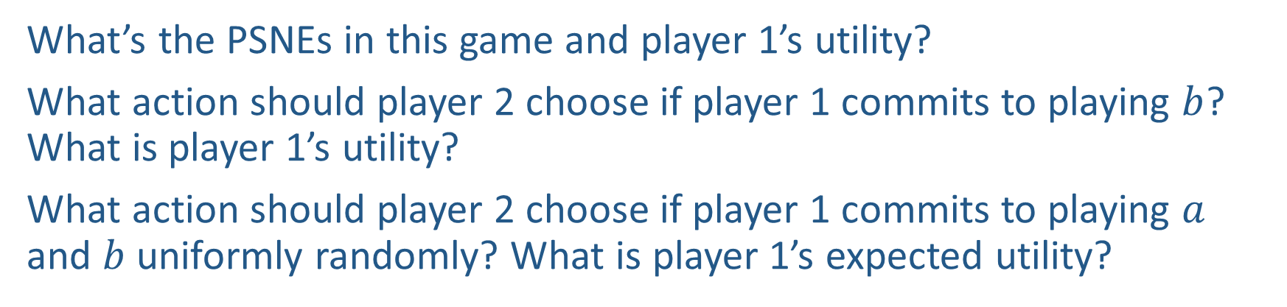
Power of Commitment
What’s the PSNEs in this game and player 1’s utility?
What action should player 2 choose if player 1 commits to playing $b$? What is player 1’s utility?
What action should player 2 choose if player 1 commits to playing $a$ and $b$ uniformly randomly? What is player 1’s expected utility?
Player 2
 | c | d
a | 2,1 | 4,0
b | 1,0 | 3,2
Player 1

Slide 49
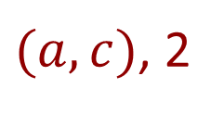
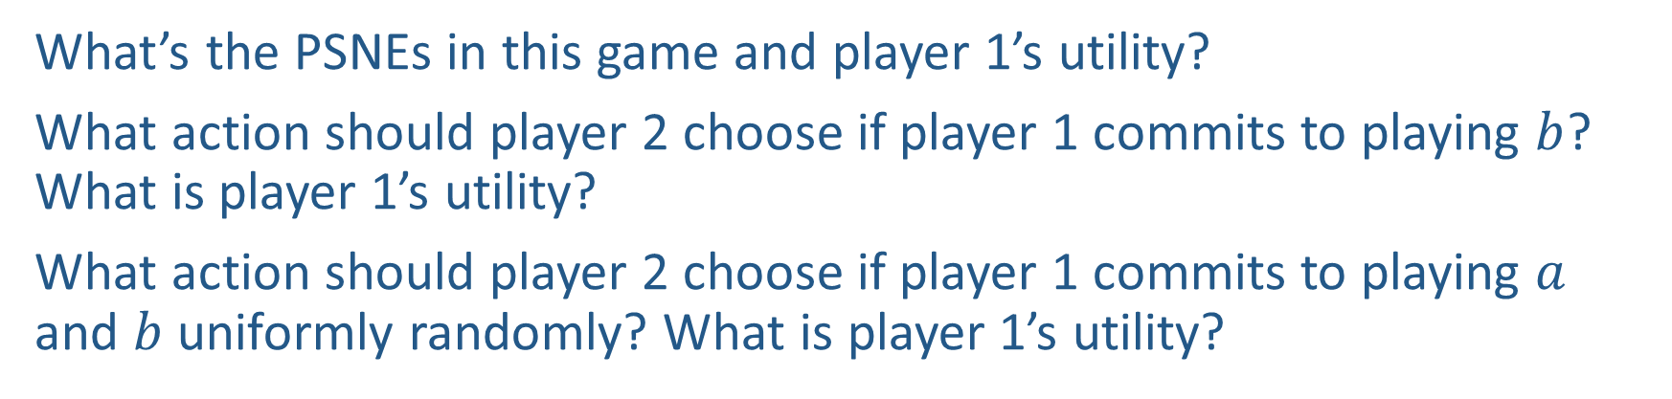
Power of Commitment
$(a,c)$, 2
What’s the PSNEs in this game and player 1’s utility?
What action should player 2 choose if player 1 commits to playing $b$? What is player 1’s utility?
What action should player 2 choose if player 1 commits to playing $a$ and $b$ uniformly randomly? What is player 1’s utility?
d, 3
d, 3.5
Player 2
 | c | d
a | 2,1 | 4,0
b | 1,0 | 3,2
Player 1

Slide 50
Stackelberg Equilibrium
Stackelberg Game
  Leader commits to a strategy first
  Follower responds after observing the leader’s strategy
Stackelberg Equilibrium
  Follower best responds to leader’s strategy
  Leader commits to a strategy that maximizes her utility assuming follower best responds
Player 2
 | c | d
a | 2,1 | 4,0
b | 1,0 | 3,2
Player 1

Slide 51
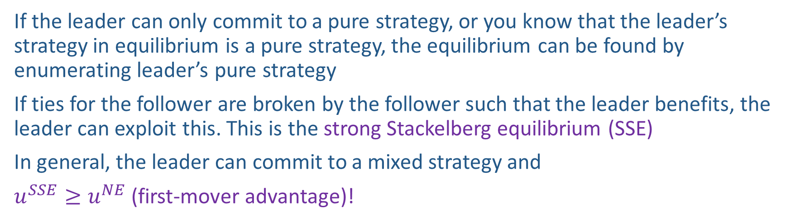
Stackelberg Equilibrium
If the leader can only commit to a pure strategy, or you know that the leader’s strategy in equilibrium is a pure strategy, the equilibrium can be found by enumerating leader’s pure strategy
If ties for the follower are broken by the follower such that the leader benefits, the leader can exploit this. This is the strong Stackelberg equilibrium (SSE)
In general, the leader can commit to a mixed strategy and
$u^{SSE}≥u^{NE}$ (first-mover advantage)!
Berry
Player 2
 | Football | Concert
Football | 2,1 | 0,0
Concert | 0,0 | 1,2
 | c | d
a | 2,1 | 4,0
b | 1,0 | 3,2
Alex
Player 1

