Slide 1
Modern Organ Exchanges:
Designs, Algorithms, and Opportunities
OR
AI Making Life-and-Death Decisions about Humans
OR
Longest-Running Application of AI for Good?
Tuomas Sandholm
Notes:
25 min + 5 min Q&A

Slide 2
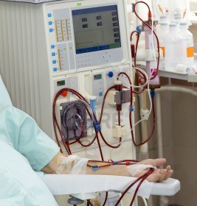
90,000+
Waiting for a kidney
in the U.S.
Notes:
<<frame the challenges of Kidney Dialysis for the audience:
Time to plan because of dialysis and healthy donors
Quality of life on dialysis is so low that many patients choose to stop treatment and die,
12% survive 10 years?>
<<How many patients died waiting for Kidney’s in the recent past?>>
<<Explain how widespread Kidney Exchange Challenges Are>>
<<Explain that you are the only person who didn’t get into Kidney Exchange research because of a personal connection to Kidney disorders…>>

Slide 3
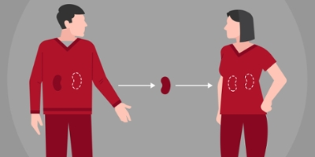
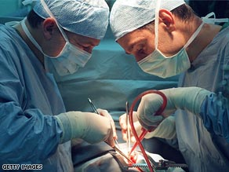
Live donation

Slide 4
Kidney exchange
Idea introduced in 1986 [Rapaport]
First exchange (NEPKE) started 2003-04 [Roth, Sönmez, Ünver, …]
Pair 1
Pair 2
Patient 1
Patient 2
Donor 1
Donor 2
Notes:
(Kidneys usually travel inside donors)

Slide 5
Objective of the batch problem:
Maximum weight combination of short disjoint cycles

Slide 6
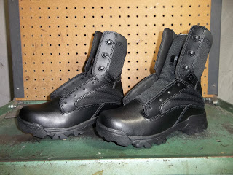
Other barter-exchange markets
Holiday Homes: Intervac
Books: Read It Swap It
General used goods:
Netcycler / swap.com
National Odd Shoe Exchange
Room exchange (e.g. dorm rooms)
Nurse shift exchange
Notes:
DVDs: Peerflix (2005-08)

Slide 7
Cap on cycle length
Why a cap?
  Transplants in a cycle must occur simultaneously
  Cycle may fail
Cap is typically 3
Notes:
Allowing longer cycles yields more and better matches
Change from 2-cycles to 3-cycles is significant
Change from 3-cycles to longer cycles is not

Slide 8
What if ?

Slide 9
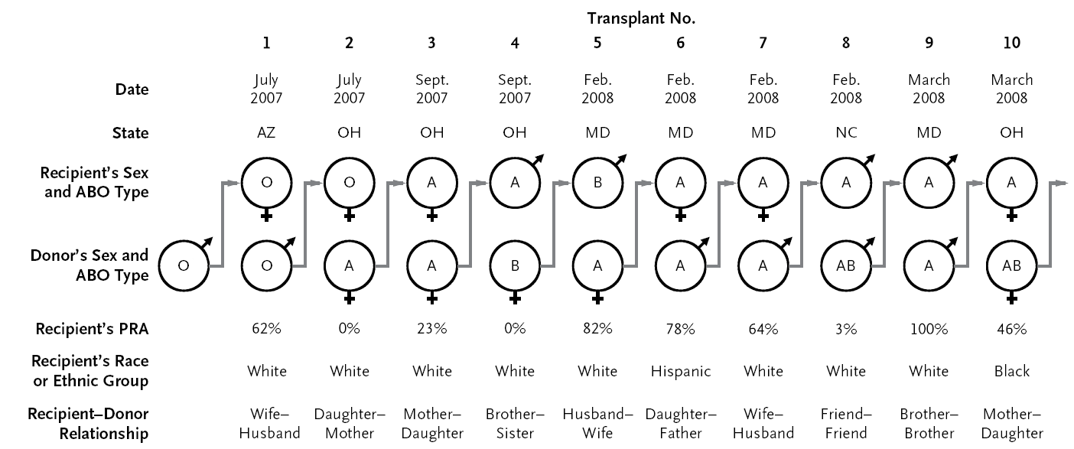
Never-ending altruist-donor (NEAD) chains
[With Rees et al. New England Journal of Medicine 2009]
First NEAD chain, generated by our algorithm:
NEAD chains have become the main modality of kidney exchange worldwide: >10,000 transplants
Notes:
10,000
(Different bridge donors can be weighted differently)

Slide 10

30-chain [New York Times 2/18/2012]
[National Kidney Registry]

Slide 11

Kidney exchanges use designs, algorithms, and software from my CMU lab
  Technology selected in 2008
  Licensed to UNOS for free
  National exchange went live in 2010
  Now includes 80% of the transplant centers in the US
  Match run every week
  Only US organ exchange that is fully algorithmically run
Previously:
  Alliance for Paired Donation
  Paired Donation Network

Slide 12
Solving the batch problem
NP-complete (even without chains) [Abraham, Blum, Sandholm, EC-07]
Novel branch-and-price algorithm enabled nationwide scaling [Abraham, Blum, Sandholm, EC-07]
…
Fastest current algorithm: [Dickerson, Manlove, Plaut, Sandholm, Trimble, EC-16]
  x_{ij} → x_{ijk}
  uses the extra constraints:
  “if an edge is used at position k+1 in chain, there must be an appropriate edge used at position k in that chain”
Notes:
This makes the bounding LP dramatically tighter and therefore leads to significantly smaller search trees.
(LOTS OF ADDITIONAL INTERESTING ISSUES ABOUT OPTIMIZATION UNDER VARIOUS DYNAMICS OF THE PROBLEM.)

Slide 13
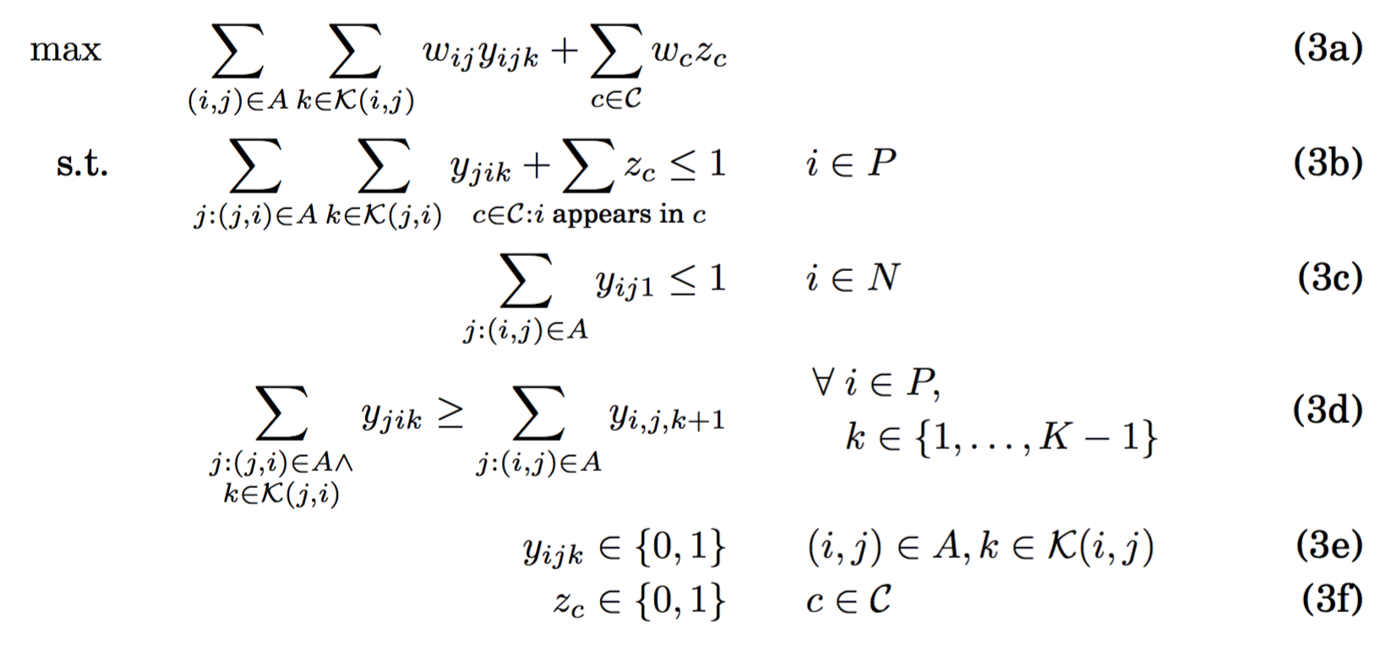
“Position-indexed” compact formulation for within-batch chain caps [Dickerson, Manlove, Plaut, Sandholm & Trimble, EC-16]
3a: max weight of edges in chains + weight of cycles
3b: each pair is in at most one chain or cycle
3c: each NDD has at most one used out-edge
3d: if an edge is used at position k+1 in chain, there must be an appropriate edge used at position k in that chain

Slide 14
Complexity of batch optimization problem
Theorem [Abraham, Blum, Sandholm EC-07]
NP-complete for any cycle length cap ≥ 3
  Solvable in polynomial time if cap=2 or cap=∞
Notes:
Even if no chains are allowed.
Why is optimality important?
Otherwise patients may die unnecessarily, may get worse transplants, and the solution can be unfair to people and centers for arbitrary reasons
Why not, since our algorithm scales to national level

Slide 15
Pre-2007 state of the art in kidney exchange clearing algorithms
Manual matching / greedy algorithms
(Weighted) maximum matching [Edmonds 1965]
CPLEX
Notes:
Memory is the bottleneck unlike in combinatorial auctions & expressive commerce

Slide 16
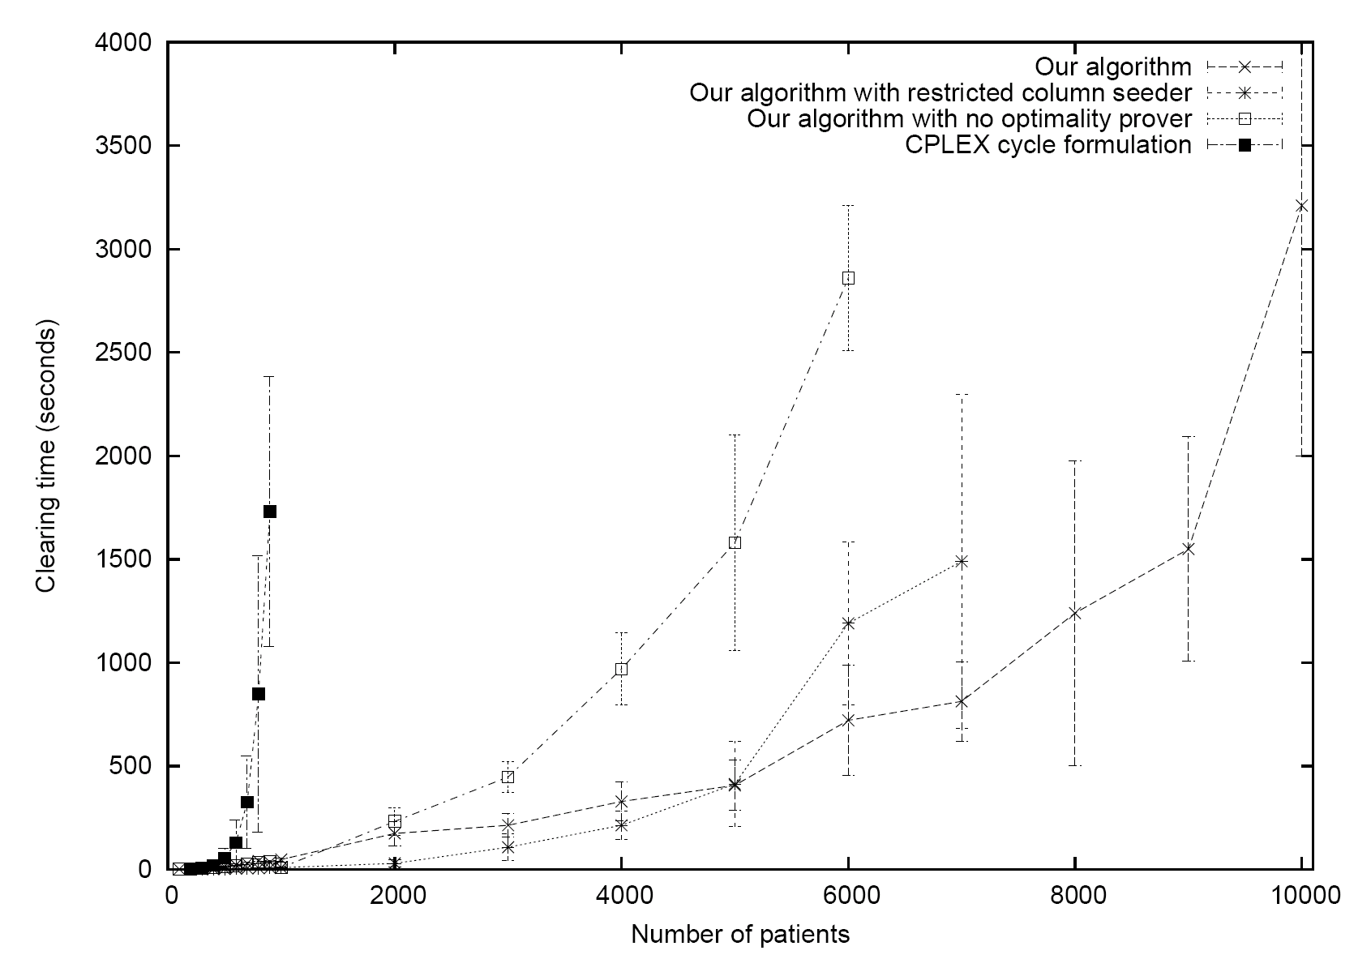
Our branch-and-price-based optimal algorithm enabled US-wide kidney exchange [Abraham, Blum & Sandholm EC-07]
Cycle cap = 3
Our algorithm
Our algorithm
with no
optimality
prover
CPLEX (cycle formulation)
Our algorithm
with no random
columns
Predicted size of US-wide kidney exchange
Notes:
No chains

Slide 17
UNOS has design constraints that private exchange don’t have
Must have transparent, broadly-agreed policies
Clearing algorithm / priority points must be transparent
AI must be autonomous (surgeons still have veto)
  Only kidney exchange in the US where decisions are made algorithmically
Have to work also with small transplant centers => slower turnaround time
…

Slide 18
Additional functionality for modern kidney exchanges supported by our algorithm and our later enhancements

Slide 19
Multiple willing donors per patient
All their edges included in input graph
Solver automatically uses at most one of the donors

Slide 20
Incorporating compatible pairs
Why?
  Patient can get a better kidney
  Others get more/better matches
Our algorithm supports this
  Could preprocess so patient can’t get worse kidney than her compatible donor brings

Slide 21
Weights on edges
Algorithm supports weights on edges (thus also on nodes)
Weights can represent, e.g.,
  Degrees of compatibility
  Projected life years (potentially quality-adjusted)
  Travel distance
  Wait time
  Transplanting children
  Transplanting sensitized, hard-to-match patients
Notes:
Tradeoffs between efficiency and fairness

Slide 22
Side constraints
Algorithm supports certain kinds of side constraints, e.g.,
  Center A does not want to be in cycles longer than 2
  Patient x does not want to be in a cycle longer than 2
  Center B does not want to participate in altruistic donor chains of length greater than 3
  …

Slide 23
Integrating the deceased donor wait list

Slide 24
Fielded kidney exchanges
NEPKE (started 2003-04, now closed)
United Network for Organ Sharing (UNOS)
Alliance for Paired Donation
Paired Donation Network (now closed)
National Kidney Registry
San Antonio
Mayo Clinic
St. Barnabas Compassionate Share
Netherlands
UK
Canada
Australia
Portugal
Israel
Sweden
…
~600 transplants
in US per year,
mainly via NEAD chains
Only US one that uses
purely algorithmic matching

Slide 25
Study of chains with Dickerson, J. & Procaccia, A., AAMAS-12

Slide 26
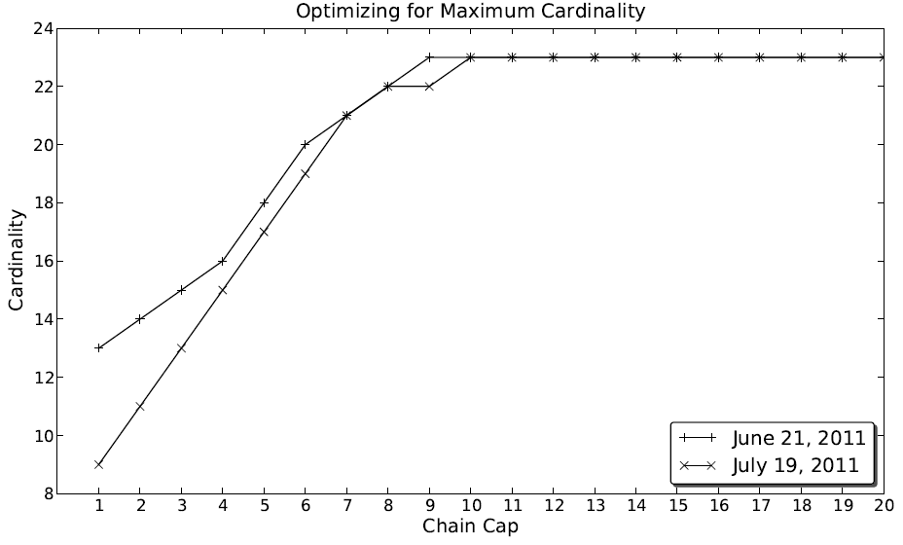
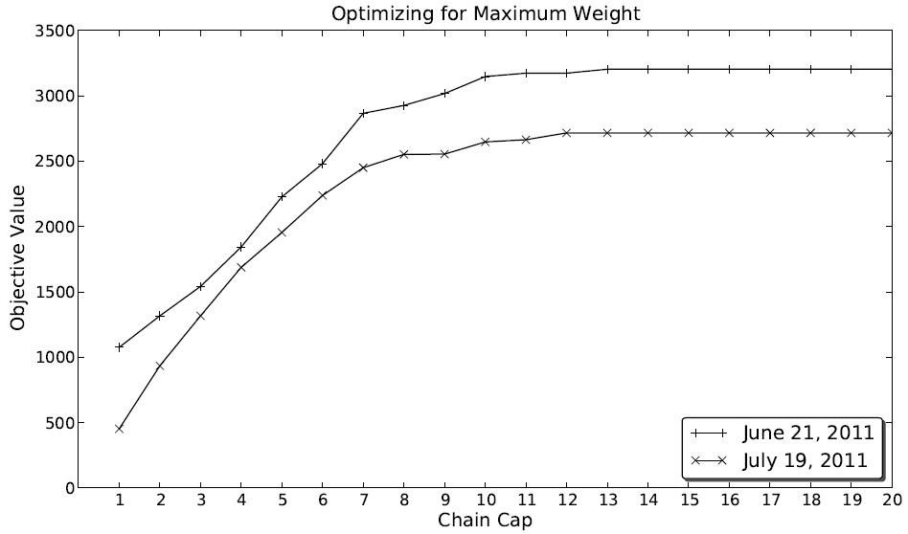
Impact of within-batch chain cap on UNOS data

Slide 27
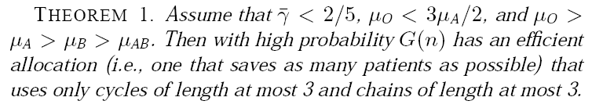
Theory: Short chains suffice
ABO-model with tissue type incompatibility
Large, unweighted graph

Slide 28
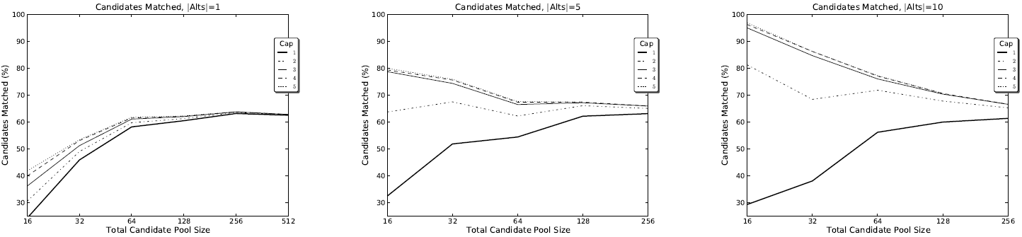
Why the discrepancy?
Possible reasons:
  Unweighted – not the (only) reason
  UNOS data not “large”
  Uniform tissue type incompatibility model not realistic
Experiments using Saidman et al. generator:
In dynamic experiments, a chain cap of 4 was best
Notes:
Tissue type incompatibility conditional on blood type compatibility < 40%.
Dynamic experiments: individual CPRA, crossmatch failures, closed chains, dynamic arrival & departure.
(In a different dynamic experiment in that paper, we follow current UNOS policy which, along with some special
cases discussed below, states that (i) chains started by non-O-type
altruists are always executed, while (ii) chains triggered by an Otype
altruist are executed only if they can be executed to length at
least 5 (before there is a crossmatch failure). We will experiment
with varying the value away from 5; we will call this parameter k.
Altruists are allowed choices. In the event that an O-type chain is
shorter than length 5, the UNOS policy allows for the altruist to decide
that the chain be executed anyway. This is due to the fact that
altruists do not want to stay in the candidate pool indefinitely, but
rather want to move on with their lives and other plans. In UNOS’s
experience running kidney exchange, altruists typically do not wish
to stay active in the pool for more than three months—instead opting
to donate directly to the deceased donor waiting list. While
exact data on this phenomenon are too sparse at the moment, our
experiments use the anecdotal rates (received through UNOS): 75%
probability of an altruist requesting execution of a short chain, and a
monthly altruist exit rate that corresponds to an expected presence
of two months in the pool for each altruist.)

Slide 29
Chains cause most of the batch clearing complexity in practice
…and “pricing problem” for chains is NP-complete [Plaut, Dickerson, Sandholm 2016]
=> Newer batch clearing algorithms

Slide 30
Modern optimal algorithms for batch problem
Based on branch-and-price framework:
  Branch-and-price, DFS pricing [Abraham, Blum, Sandholm EC-07]
  Branch-and-price, B-F pricing [Glorie et al. MSOM 14, Plaut, Dickerson, Sandholm AAAI-16]
  Branch-and-price, … [Klimentova et al. ICCSA-14, Manlove & O’Malley ACM JEA 14, Mak-Hau J. Comb Opt 15, ...]
Based on constraint generation:
  Basic, not scalable [Abraham, Blum, Sandholm EC-07]
  Based on PC-TSP (CG just for chains) [Anderson et al. PNAS 2015]
Compact formulations:
  Extended edge formulation [Constantino et al. EJOR 2014]
  Position-indexed [Dickerson, Manlove, Plaut, Sandholm, Trimble EC-16]
Notes:
PC-TSP & position indexed: Variables for cycles and edges.
Position indexed:
If an edge is used at position k+1 in chain, there must be an appropriate edge used at position k in that chain.
Polynomial #constraints, unlike in PC-TSP.
(Unlike extended edge formulation, does not require copies of the graph.)
(Extended edge formulation has poly #constraints and # vars, but weaker LP relaxation than position-indexed.)

Slide 31
Better batch algorithms, infinite chain caps
[Anderson et al. PNAS 2015]
Builds on the prize-collecting traveling salesperson problem [Balas, Networks 1989]
  PC-TSP: visit each city (patient-donor pair) exactly once, but with the additional option to pay some penalty to skip a city (penalized for leaving pairs unmatched)
They maintain decision variables for all cycles of length at most L, but build chains in the final solution from decision variables associated with individual edges
Then, an exponential number of constraints could be required to prevent the solver from including chains of length greater than K; these are generated incrementally until optimality is proved.
  Leverage cut generation from PC-TSP literature to provide stronger (i.e. tighter) IP formulation

Slide 32
Better batch algorithms under within-batch chain caps
[Glorie et al. MS&OM 2014, Plaut, Dickerson, Sandholm AAAI-16]
Idea: solve a structured alternate optimization problem that implicitly prices variables
Price (for max card, weight): w_{c} – Σ_{v in c} δ_{v}
  But: w_{c} = Σ_{e in c} w_{e}
Take G=(V,E), create G’=(V,E) s.t. all edges e = (u,v) are reweighted r_{e} = δ_{v} – w_{e}
  Positive price cycles in G = negative weight cycles in G’
Bellman-Ford finds shortest paths
  Undefined in graphs with negative weight
    Shortest path is NP-hard (reduce from Hamiltonian path:
      Set edge weights to -1, given edge (u,v) in E, ask if shortest path from u to v is weight 1-|V| → visits each vertex exactly once
    We only need some short path (or proof that no negative cycle exists)
  Now pricing runs in time O(|V||E|cap), but …

Slide 33
Pricing for chains is NP-complete
[Plaut, Dickerson, Sandholm AAAI-16 & ongoing]
Negative chain problem: Given a graph G = (V,E), where V = P + A, is there a path of negative weight (using each vertex at most once) starting at a vertex in A?

Slide 34
Pricing for chains is NP-complete
[Plaut, Dickerson, Sandholm AAAI-16 & ongoing]
Negative chain problem: Given a graph G = (V,E), where V = P + A, is there a path of negative weight (using each vertex at most once) starting at a vertex in A?

Slide 35
Proof
Reduce from Hamiltonian path.

Slide 36
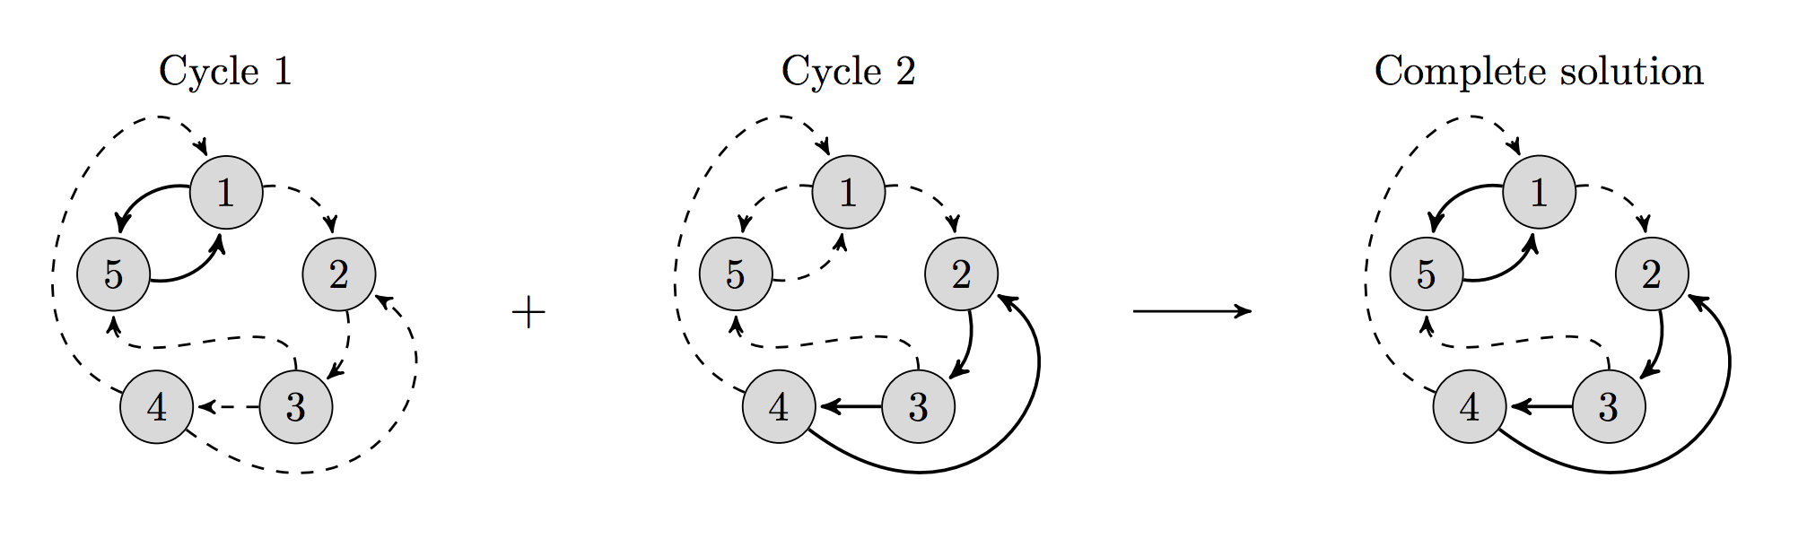
Compact formulations
[Constantino et al. EJOR 2014]
Previous models: exponential #constraints (CG methods)
or #variables (B&P methods)
Let L be upper bound on #cycles in a final matching
Create L copies of compatibility graph
Search for a single cycle or chain in each copy
  (Keep cycles/chains disjoint across graphs)

Slide 37
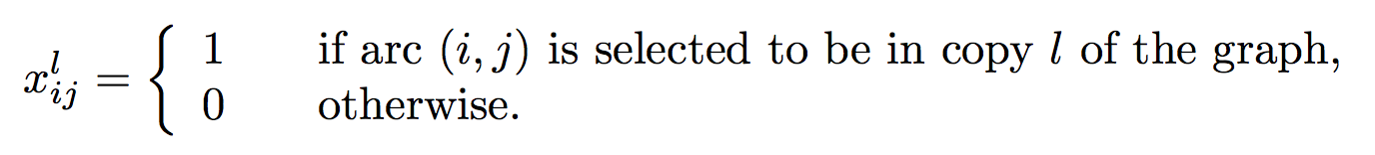
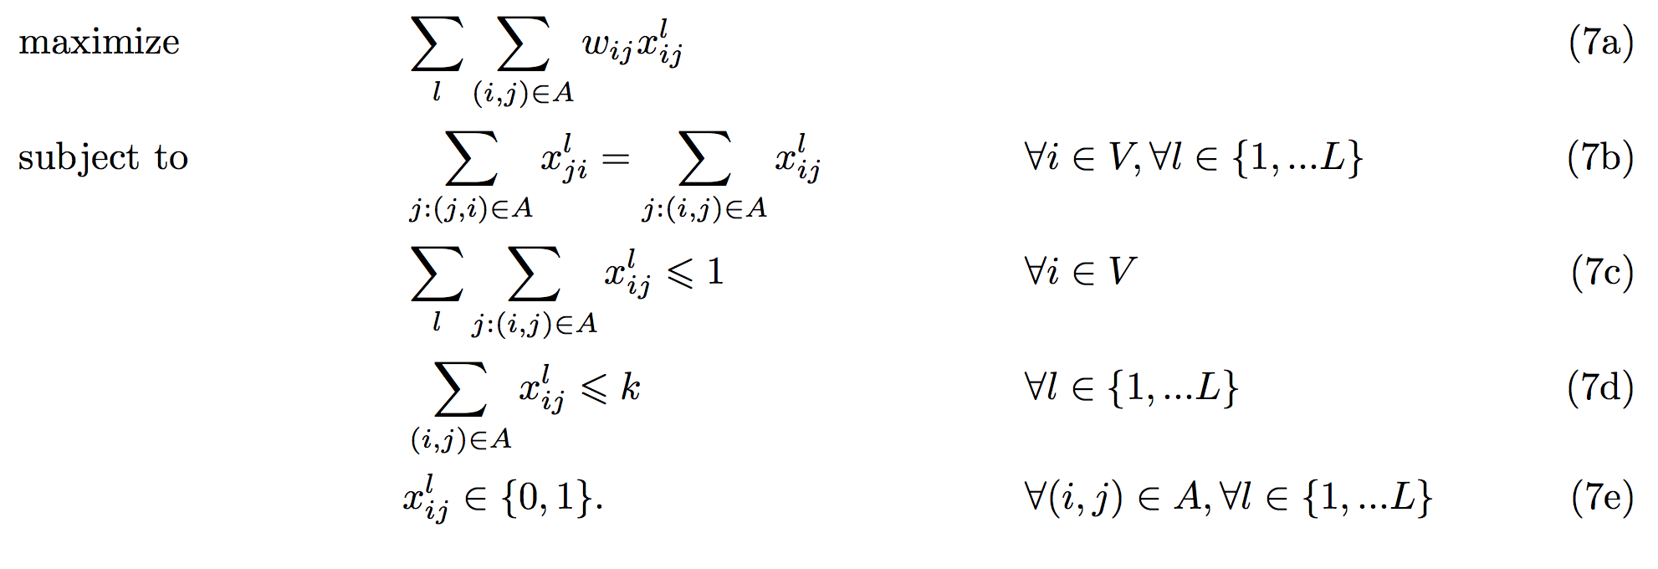
Compact formulations
[Constantino et al. EJOR 2014]
7a: max edge weights over all graph copies
7b: give a kidney <-> get a kidney within that copy
7c: only use a vertex once
7d: cycle cap
Poly #constraints and #variables!

Slide 38
Compact formulations for within-batch chain caps
[Dickerson, Manlove, Plaut, Sandholm, Trimble, EC-16]
Previous: edge is in a cycle/chain or not
  Weak LP relaxation
Idea: where in the cycle/chain does the edge exist?
  “Position indexed”

Slide 39
“Position-indexed” compact formulation for within-batch chain caps [Dickerson, Manlove, Plaut, Sandholm & Trimble, EC-16]
3a: max weight of edges in chains + weight of cycles
3b: each pair is in at most one chain or cycle
3c: each NDD has at most one used out-edge
3d: if an edge is used at position k+1 in chain, there must be an appropriate edge used at position k in that chain

Slide 40
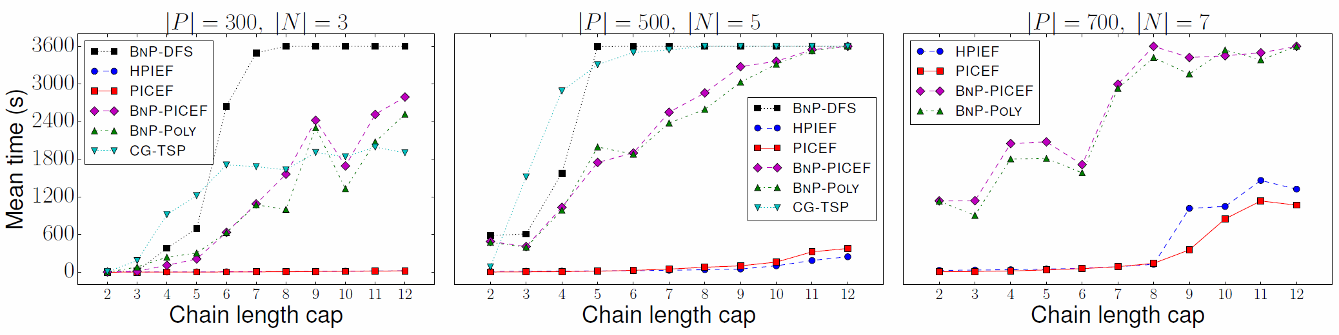

Slide 41
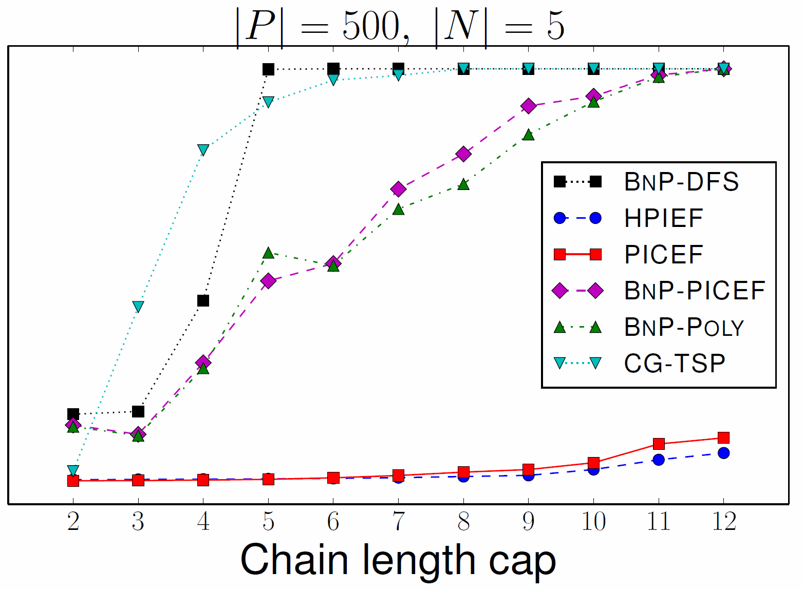
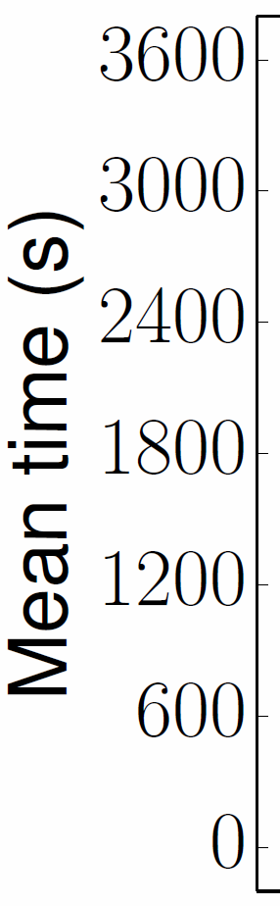
500 pairs and 5 altruists

Slide 42
Comparison of methods
[Dickerson, Manlove, Plaut, Sandholm, Trimble, ongoing]

Slide 43
Comparison of methods
[Dickerson, Manlove, Plaut, Sandholm, Trimble ongoing]

Slide 44
How to choose a formulation
Comparison of LP relaxations
  Column-generation-based tend to have tighter relaxations (so far!)
Business constraints
  Constraint-generation-based approaches outperform when feasible matching space is less constrained
    E.g., no chain cap …
  Column-generation-based approaches allow for more expressive objective functions (so far!)
    E.g., general stochastic matching

Slide 45
Dynamic kidney exchange

Slide 46
Dynamic kidney exchange
Kidney exchange is naturally dynamic
Can be described by the evolution of its graph:
  Additions, removals of edges and vertices
Vertex Removal | Edge Removal | Vertex/Edge Add
Transplant, this exchange | Matched, positive crossmatch | Normal entrance
Transplant, deceased donor waitlist | Matched, candidate refuses donor
Transplant, other exchange ("sniped") | Matched, donor refuses candidate
Death or illness | Pregnancy, sickness changes HLA
Altruist runs out of patience
Bridge donor reneges

Slide 47
A general dynamic model
Exits
Stays
Enters

Slide 48
Initial theoretical work
Ünver [RES 2010] studies minimizing avg wait time in kidney exchange
  2-cycles or no cycle cap; no chains
  No tissue type incompatibility
  No pairs expire
  Poisson arrivals
  Proves that simple dispatch rules are optimal
Zenios [Mgmt Sci 2002] studies maximizing avg quality-adjusted life years
  2-cycles only (no longer cycles, no chains)
  Only two types of patient-donor pairs
  Models exchange as a divisible birth and death process
  No matching aspects of the problem
  No patients expire, but long wait penalized by a fixed cost
  Optimal policy is analytically derived
    Limits the number of patients that can take part in exchange. Patients not admitted queue for altruistic donors (wait time here assumed zero)

Slide 49
Dynamic kidney exchange
Proposition. No prior-free algorithm can achieve competitive ratio better than 2 – (2/cycle cap) [Awasthi and Sandholm IJCAI-09]
=> Have algorithm use distributional information
Full stochastic optimization unscalable here
So, …

Slide 50
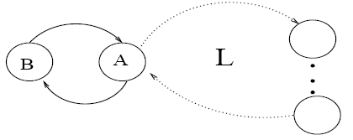
No good prior-free online algorithm (even for problem with just cycles)
[Awasthi and Sandholm IJCAI-09]
Proposition. No deterministic prior-free algorithm can achieve competitive ratio better than L/2
Proposition. No prior-free algorithm can achieve competitive ratio better than 2 – (2/L)
=> Have the algorithm use distributional information
But full stochastic optimization totally unscalable here

Slide 51
Family 1 of approaches
[Awasthi and Sandholm IJCAI-09]
At each step
  Draw sample trajectories
  Leverage our batch algorithm to pick an action, i.e., combination of cycles and chains (not policy)
Notes:
Not accurate: “Actions are cycles, not combinations of cycles”

Slide 52
Algorithm 1
Adaptation of REGRETS/CONSENSUS [Bent & van Hentenryck 04a,b, Mercier & van Hentenryck 07]
For each cycle c in G_{t}, score(c)=0
Generate scenarios s₁, …, s_{m}
For each scenario s_{i}
  S = solution to offline problem on {G_{t}, s_{i}}
  For each cycle c in G_{t},
    If c is in S, score(c)=score(c)+value(S)
    else score(c)=score(c) - δ
Using the batch ILP, find a set of vertex-disjoint cycles with maximum score, and return it

Slide 53
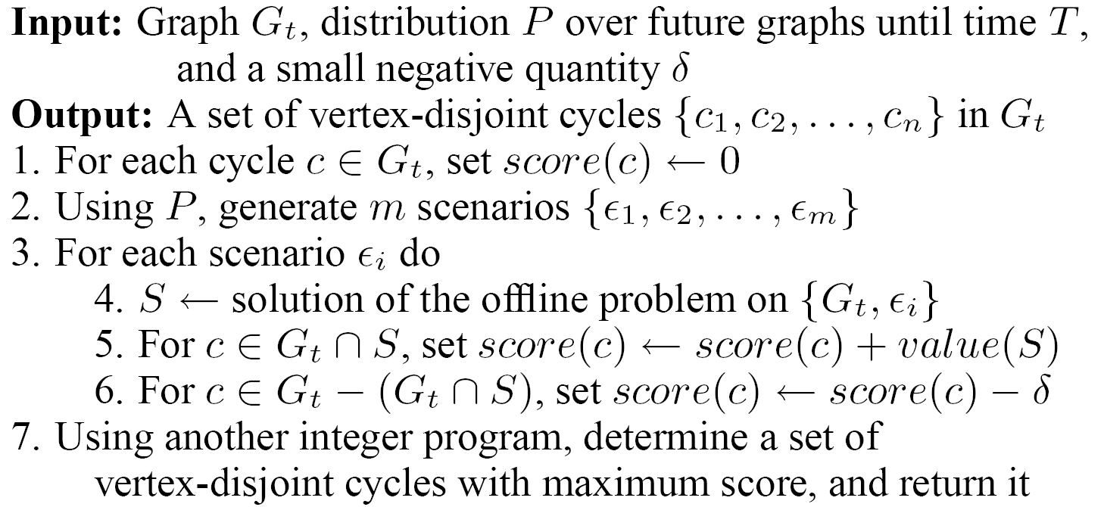
Algorithm 1
Adaptation of REGRETS/CONSENSUS
[Bent & van Hentenryck 04a,b, Mercier & van Hentenryck 07]

Slide 54
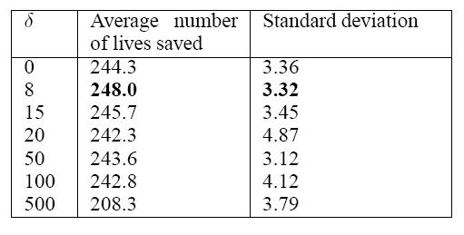
Interior value of δ was best

Slide 55
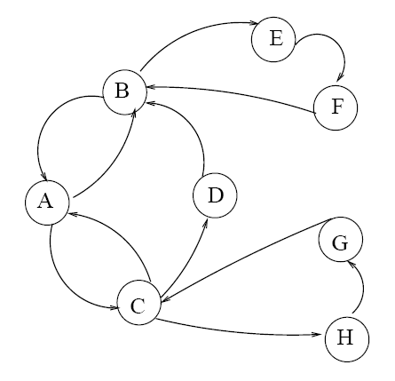
Algorithm 1 is not optimal
ABCD exist. In step 2, A disappears, and either EF or GH appear.
Optimal solution is cycle ACDB, but that is not optimal on any trajectory!

Slide 56
Best algorithm we were able to construct within Family 1
IDEA: Optimize the scenarios for each action separately instead of each scenario separately
For each cycle c in G_{t}, score(c)=0
Generate scenarios s₁, …, s_{m}
For each cycle and chain c in G_{t}
  For each scenario s_{i}
    S = solution to batch problem on {G_{t}-c, s_{i}}
    score(c)=score(c)+value(S)+value(c)
Using the batch solver, find a set of vertex-disjoint cycles and chains with maximum score, and return it
Experimental results:
  Dummy action helps
  Outperforms batch approach
  Scales to 500-600 pairs
See also [Chang et al. 00]
Notes:
We proved Algorithm 1 is not optimal.
The Improvement idea in Alg 2 is: Optimize the scenarios for each action separately instead of each scenario separately

Slide 57
Algorithm 2
See also [Chang et al. 00]
For each cycle c in G_{t}, score(c)=0
Generate scenarios s₁, …, s_{m}
For each cycle c in G_{t}
  For each scenario s_{i}
    S = solution to offline ILP on {G_{t}-c, s_{i}}
    score(c)=score(c)+value(S)+value(c)
Using ILP, find a set of vertex-disjoint cycles with maximum score

Slide 58
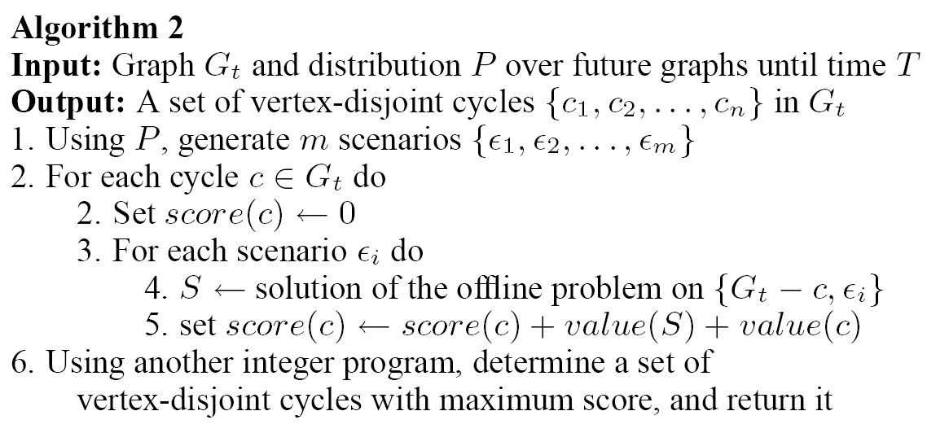
Algorithm 2
See also [Chang et al. 00]
We proved Algorithm 1 is not optimal
Improvement idea: Optimize the scenarios for each action separately instead of optimizing each scenario separately

Slide 59
Algorithm 3: Adaptation of AMSAA
[Mercier & van Hentenryck 08]
Global anticipatory gap (GAG) ~ no action good across scenarios
  This problem likely to have large GAG
  AMSAA designed for problems with large GAG; optimal in limit
Generate scenarios s₁, …, s_{m}
For each state σ // Construct an approximate MPD
  if σ is a final state, then v(σ) is offline solution in σ
  else v(σ) = avg value of offline solution over scenarios {s₁, …, s_{m}}, assuming no vertex dies
Solve the MDP using tree search starting at state G_{t}
For each cycle c in G_{t}, score(c)=Q(G_{t},c)
Using the batch ILP, find a set of vertex-disjoint cycles with maximum score, and return it

Slide 60
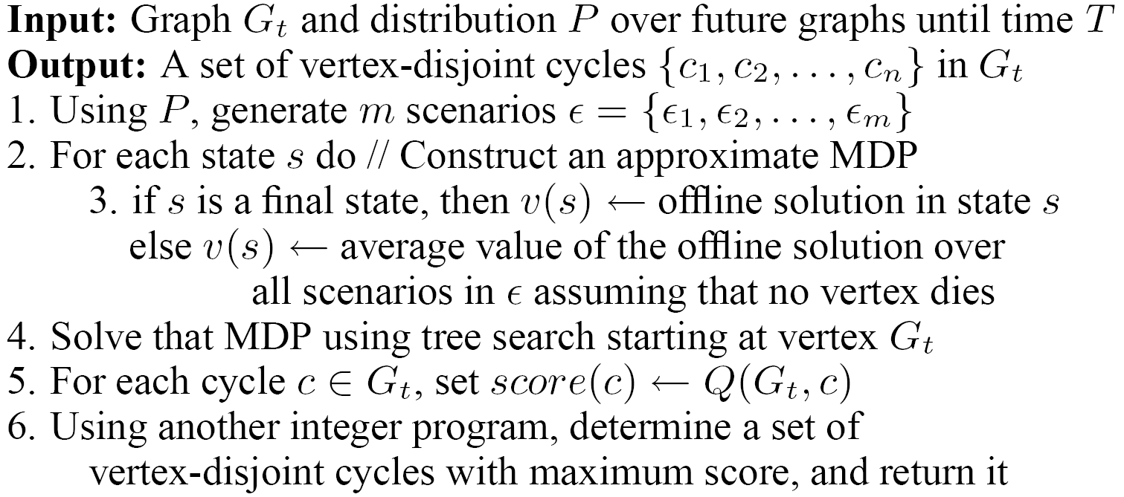
Algorithm 3: Adaptation of AMSAA [Mercier & van Hentenryck 08]
Global anticipatory gap (GAG) ~ no action is pretty good across scenarios
  This problem likely to have large GAG
  AMSAA was designed for problems with large GAG

Slide 61
Experimental setup for online tests
Real data set: 158 pairs, 11 altruistic donors, 4086 edges, highly sensitized
Artificial data set using [Saidman et al.] generator: 510 pairs, 25 altruistic donors, 15,400 edges
Death rate set so 12% survive 10 years
Dummy action (=inaction) allowed

Slide 62
Parameter tuning to scale to the large:
Experiments uncovered interesting tradeoffs
Number of sample trajectories
Lookahead depth (number of steps)
  For a given number of sample trajectories, interior optimum
Batch size
  Large => can look deep into the future (for given lookahead depth)
  Small => finer-grained decision making
We also tuned batch size for offline benchmark
Notes:
Real kidney exchanges don’t tune batch size.

Slide 63
Experimental results on trajectory-based algorithms
Dummy action helps (not needed in Algorithm 1)
Algorithm B outperforms Algorithms A and C
  Also, C (adaptation of AMSAA [Mercier & van Hentenryck 08]) doesn’t scale
Outperforms batch approach
Scales to 500-600 pairs

Slide 64
Experiments on trajectory-based algorithms
Compared 3 such algorithms
Outperform batch approach
Dummy action helps
Best one scaled to 500-600 pairs

Slide 65
Dummy Action
Algorithm 1 and offline algorithm can decide to wait anyway
For Algorithm 2, dummy action helped 2.2%
For Algorithm 3, dummy action helped 1.8%
Statistically significant

Slide 66
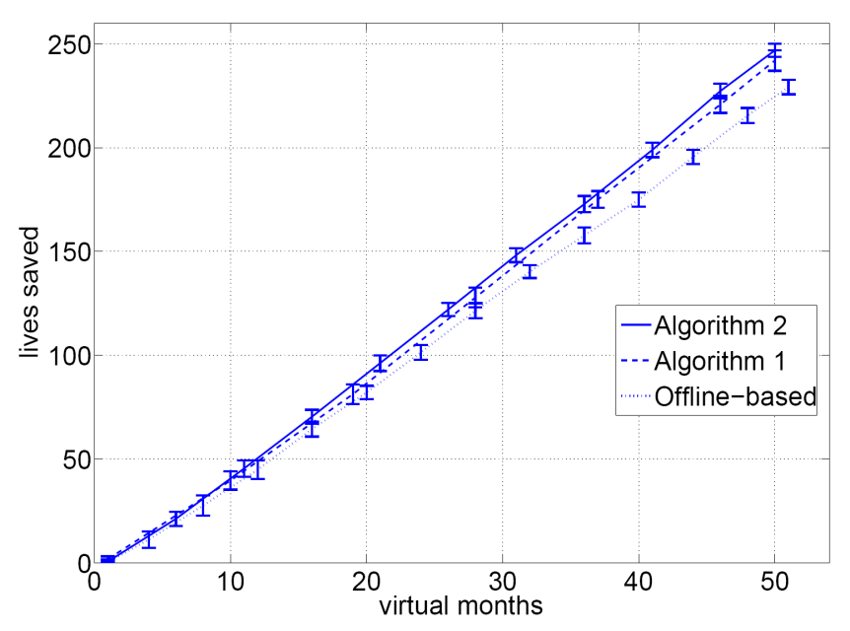
Performance of our online algorithms
On the real data, outperformed batch approach by 6.5% (std dev 1.7%)
On the large generated data, in steady state, outperformed batch approach by 13.0% (std dev 2.2%)
Pool less depleted

Slide 67
Family 2 of our approaches:
New approach to dynamic problems
[Dickerson, Procaccia, Sandholm AAAI-12, Dickerson & Sandholm AAAI-15]
Idea:
Learn the potential of each type of graph element
  E.g., vertex type, edge type, cycle type, or graph type
Adjust batch optimization objective by adding to the objective the potentials of elements not used in the current solution
Theory on how much associating potentials to larger elements can help
Experiments with vertex potentials based on blood type
  Using ParamILS/SMAC [Hutter, Hoos, Leyton-Brown & Stützle JAIR-09] to adjust the vector of potentials, which is evaluated in our realistic kidney exchange simulator

Slide 68
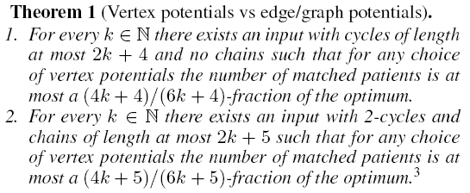
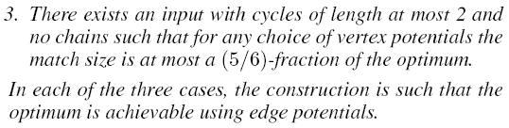

Slide 69
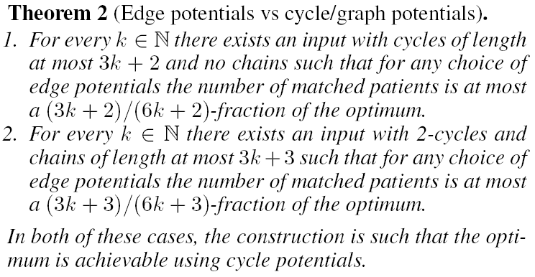

Slide 70
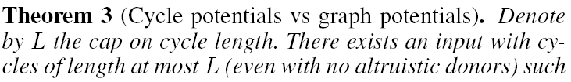


Slide 71
Experiment with vertex potentials
4 altruistic donor ABO types + 16 patient-donor pair ABO types
Learned vertex potentials using ParamILS (later, SMAC) [Hutter, Hoos, Leyton-Brown & Stützle JAIR-09]
Notes:
Used instance generator by Saidman et al. [2006]
Expiration for pairs & altruists: 12% survive 10 years
Each training instance had 95 pairs and 5 altruists arriving over 25 months

Slide 72
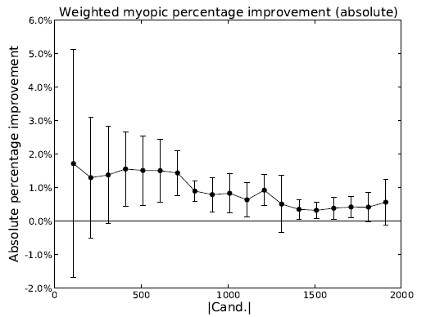
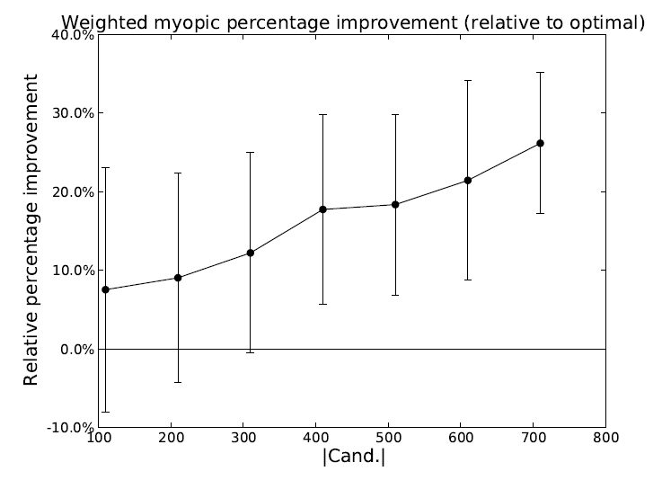
Experiment with vertex potentials
4 altruistic donor ABO types + 16 patient-donor pair ABO types
Learned vertex potentials using ParamILS (later, SMAC)
[Hutter, Hoos, Leyton-Brown & Stützle JAIR-09]
Results on test set (#altruists = 0.05 * |Candidates|):
Notes:
Used instance generator by Saidman et al. [2006]
Expiration for pairs & altruists: 12% survive 10 years
Each training instance had 95 pairs and 5 altruists arriving over 25 months

Slide 73
Failure-aware kidney exchange
[Dickerson, Procaccia & Sandholm,
EC-13, Management Science 2019]

Slide 74
Failure-aware kidney exchange
[Dickerson, Procaccia & Sandholm, EC-13, Management Science 2019]
Only 7-12% of planned transplants go into execution
We propose to find a solution that has maximum expected weight
  Each edge has a weight and a success probability
  Can’t just multiply weight and probability
We needed to develop a different optimal algorithm
  Based on branch-and-price
Notes:
To make the magnitude of the problem concrete, consider the data from the UNOS US-wide kidney exchange from its launch in October 2010 to when this data was tallied in June 2012. The algorithm had matched 270 patients, but only 19 of them had actually been transplanted and 18 were pending transplantation.\footnote{The algorithm matched some of the patients multiple times during the period. By June 2012, the pool had about 170 donors and 150 patients.} The rest of the planned transplants had failed to go to execution!
Now let us look at the failure reasons in more detail.
20\% of the failures had an unreported refusal reason. 40\% might have accepted the match, but could not because other legs in their cycle, or earlier legs in their chain, fell through. Of the remaining (40\%) of refused matches,
33\% refused due to positive crossmatch (or unacceptable antigens),
7\% due to the candidate being involved in another pending cycle or chain in some other kidney exchange, and
60\% due to a variety of other reasons, including a) the donor being unacceptable due to age, weight, or medical history, b) the donor refusing the candidate, c) the candidate being ill or not being able to be contacted, and d) the candidate already having received a transplant.

Slide 75
Motivation
Only 7-12% of planned transplants go into execution
We propose to find a solution that has maximum expected weight
  Each edge has a weight and a success probability
  Can’t just multiply weight and probability
Theorem. Under a random graph model (with ABO blood types, edge probability given blood compatibility Θ(1/#pairs), p_{fail} ϵ (0,1)), in the large, there almost surely exists a matching M’ such that for all maximum cardinality matchings M, U_{disc}(M’) ≥ U_{disc}(M) + Ω(#pairs)
Notes:
To make the magnitude of the problem concrete, consider the data from the UNOS US-wide kidney exchange from its launch in October 2010 to when this data was tallied in June 2012. The algorithm had matched 270 patients, but only 19 of them had actually been transplanted and 18 were pending transplantation.\footnote{The algorithm matched some of the patients multiple times during the period. By June 2012, the pool had about 170 donors and 150 patients.} The rest of the planned transplants had failed to go to execution!
Now let us look at the failure reasons in more detail.
20\% of the failures had an unreported refusal reason. 40\% might have accepted the match, but could not because other legs in their cycle, or earlier legs in their chain, fell through. Of the remaining (40\%) of refused matches,
33\% refused due to positive crossmatch (or unacceptable antigens),
7\% due to the candidate being involved in another pending cycle or chain in some other kidney exchange, and
60\% due to a variety of other reasons, including a) the donor being unacceptable due to age, weight, or medical history, b) the donor refusing the candidate, c) the candidate being ill or not being able to be contacted, and d) the candidate already having received a transplant.

Slide 76
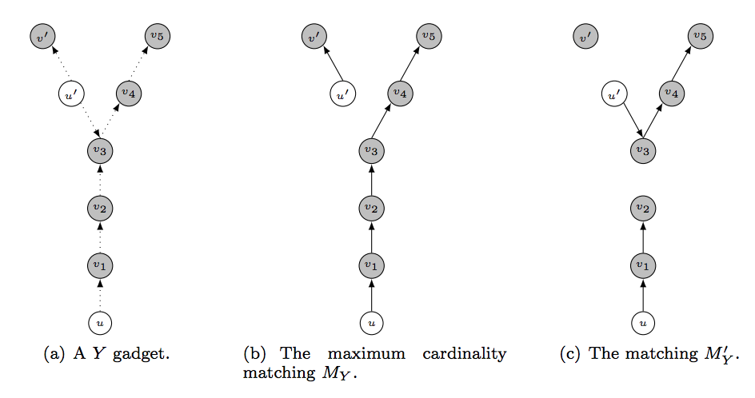
Proof sketch: Counting Y-gadgets
For every structure X of constant size, w.h.p. can find Ω(n) structures isomorphic to X and isolated from the rest of the graph
Label them (alt vs. pair): flip weighted coins, constant fraction are labeled correctly → constant × Ω(n) = Ω(n)
Direct the edges: flip 50/50 coins, constant fraction are entirely directed correctly → constant × Ω(n) = Ω(n)

Slide 77
Algorithm changes for probabilistic setting
Use chain extension in pricing problem
  Theorem. Don’t need to extend a chain by any #steps if optimistic infinite extension has negative value:
  Ordering heuristics for cycle and chain generation
Upper bound now hard
  Theorem. Discounted clearing NP-complete (even with no chains or cycle length cap)
  So, we use looser bound: solve with w’_{e} = (1-p_{fail}) w_{e}
Lower bound still easy
  Theorem. Discounted clearing with 2-cycles polytime
Optimistic future value of infinite extension
Donation to waitlist
Discounted utility of current chain
Pessimistic sum of LP dual values
Notes:
For ease of exposition, the formula assumes weights are 1.
Position-indexed formulation can handle probabilistic setting if failure probabilities are identical across edges.

Slide 78
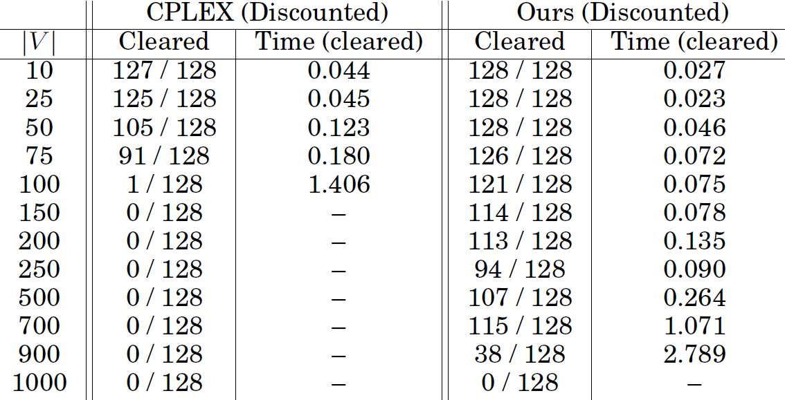
Scalability experiment
Time limit 1 hour; 8GB RAM; Saidman et al. generator; p_{fail} = 0.7; #altruists = 0.1*#pairs

Slide 79
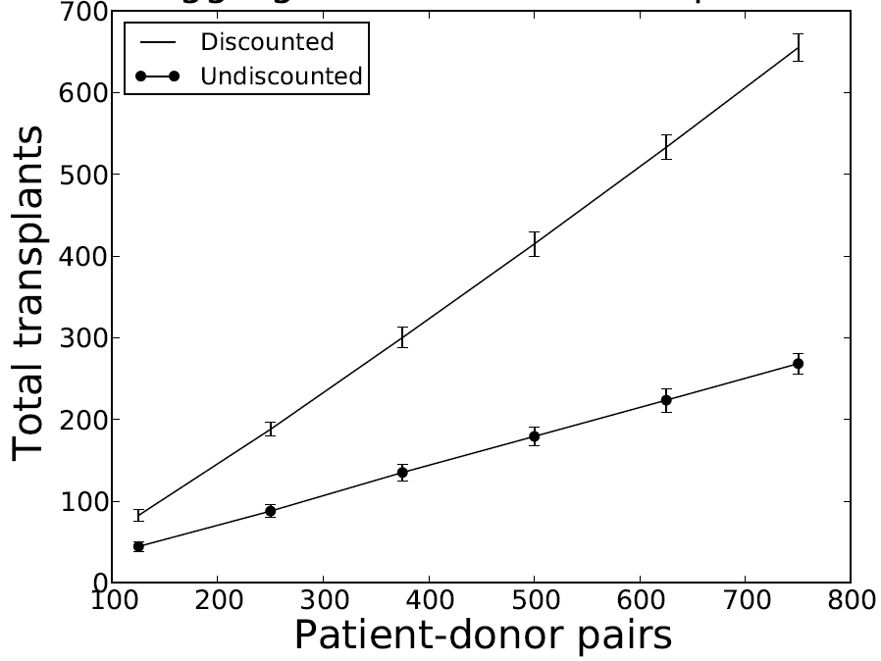
Dynamic experiment with failures
24 weeks; Bimodal failure probability; #altruists = 0.1 * #pairs
Probabilistic approach
Traditional approach

Slide 80
Motivation for robustness
Only 7% of the planned transplants go into execution
  20% of the failures had an unreported refusal reason
  40% might have accepted the match, but could not because other legs in their cycle, or earlier legs in their chain, fell through
  Of the remaining 40% of refused matches,
    33% refused due to positive crossmatch (or unacceptable antigens)
    7% due to the candidate being involved in another pending cycle or chain in some other kidney exchange
    60% due to a other reasons, including:
      donor being unacceptable due to age, weight, or medical history
      donor refusing the candidate
      candidate being ill or unable to be contacted
      candidate already having received a transplant
Notes:
To make the magnitude of the problem concrete, consider the data from the UNOS US-wide kidney exchange from its launch in October 2010 to when this data was tallied in June 2012. The algorithm had matched 270 patients, but only 19 of them had actually been transplanted and 18 were pending transplantation.\footnote{The algorithm matched some of the patients multiple times during the period. By June 2012, the pool had about 170 donors and 150 patients.} The rest of the planned transplants had failed to go to execution!
Now let us look at the failure reasons in more detail.
20\% of the failures had an unreported refusal reason. 40\% might have accepted the match, but could not because other legs in their cycle, or earlier legs in their chain, fell through. Of the remaining (40\%) of refused matches,
33\% refused due to positive crossmatch (or unacceptable antigens),
7\% due to the candidate being involved in another pending cycle or chain in some other kidney exchange, and
60\% due to a variety of other reasons, including a) the donor being unacceptable due to age, weight, or medical history, b) the donor refusing the candidate, c) the candidate being ill or not being able to be contacted, and d) the candidate already having received a transplant.

Slide 81
Pre-match edge testing
[Blum et al. EC-13 and EC-15]
Complementary idea: perform a small amount of testing before a match run to query for (non)existence of edges
  more extensive medical testing
  donor interviews
  surgeon interviews, etc.
For 2-cycles only: stochastic matching

Slide 82
The power of two crossmatches
[Blum et al. EC-13]
Cast as a general stochastic matching problem:
Initially: 2-cycles only (= undirected), at most 2 tests per vertex → polytime algorithm for this
Given a graph G(V,E), choose subset of edges S such that:
|M(S)| ≥ (1-ε) |M(E)|
Need: “sparse” S, where every vertex has O(1) incident tested edges

Slide 83
Pre-match testing in rounds
[Blum et al. EC-15]
What about testing a variable number of edges per vertex?
What if we can test edges, get feedback, test more?
What about 3-cycles, chains?
Cast as an adaptive stochastic k-set packing problem:
  Query edges in rounds, where each round tests at most one incident edge per vertex

Slide 84
General theoretical results
[Blum et al. EC-15]
Adaptive: select one edge per vertex per round, test, repeat
Stochastic matching:
(1-ε) approximation with O_{ε}(1) queries per vertex, in O_{ε}(1) rounds
Stochastic k-set packing:
(2/k – ε) approximation with O_{ε}(1) queries per vertex, in O_{ε}(1) rounds
Non-adaptive: select O(1) edges per vertex, test all at once
Stochastic matching:
(0.5-ε) approximation with O_{ε}(1) queries per vertex, in 1 round
Stochastic k-set packing:
(2/k – ε)² approximation with O_{ε}(1) queries per vertex, in 1 round

Slide 85
Adaptive algorithm
For R rounds, do:
Pick a max-cardinality matching M in graph G, minus already-queried edges that do not exist
Query all edges in M
Input Graph
r | Base graph | Matching picked | Result of queries
1:
2:

Slide 86
Intuition for adaptive algorithm
If at any round r, the best solution on edges queried so far is small relative to omniscient …
  ... then current structrure admits large number of unqueried, disjoint augmenting structures
  For k=2, simply augmenting paths
Augmenting structures might not exist, but can query in parallel in a single round
  Structures are constant size → exist with constant probability
  Structures are disjoint → queries are independent
  → Close a constant gap per round

Slide 87
UNOS Data
At p=0.5, one edge test per vertex → +21% OPT
Even 1 or 2 extra tests would result in a huge lift

Slide 88
Fairness
[Dickerson, Procaccia, Sandholm, AAMAS-14,
Dickerson & Sandholm 2014, 2015, ..…]

Slide 89
Present-day marginalization
Highly-sensitized patients have elevated antibody levels that negatively react to foreign tissue
  Harder to find a matching donor
CPRA score estimates % of incompatible donors
  0%: low sensitization, easy to find a match
  100%: high sensitization, hard to find a match
  Typical definition of highly sensitized is 80% (and increasing); 80% is what we will use below
17% of adult deceased-donor kidney waitlist is highly-sensitized
  ~60% in kidney exchange

Slide 90
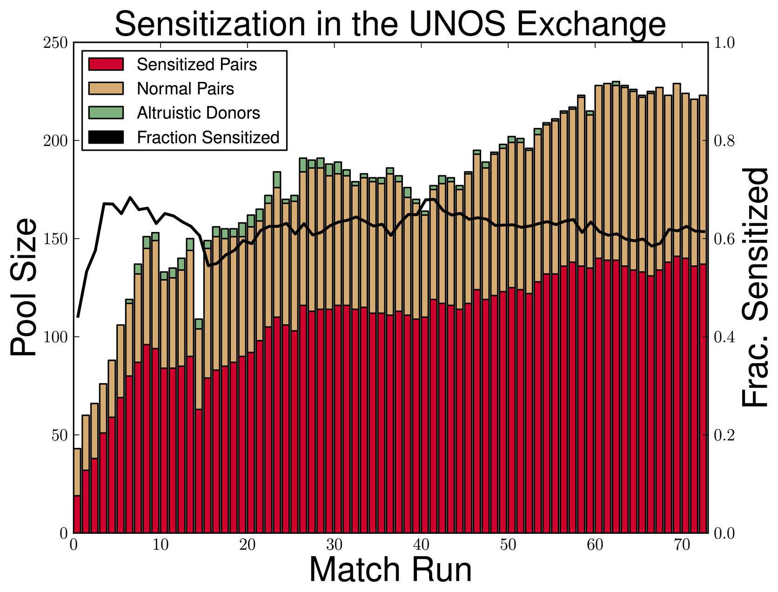

Slide 91
Our main theoretical result on fairness
Build on the assumptions of Ashlagi & Roth [EC-11]:
  ABO-blood type model, with realistic constraints on relative prevalence
  Highly and lowly-sensitized pairs
    p is average level of sensitization
    λ is fraction of pool that is highly sensitized
No chains
u_{H>L} : Utility equals number of patients matched iff matches maximum number of highly-sensitized pairs
Theorem:
Assuming λ ≥ (1-p), as graph size → ∞, w.p.1,
POF(u_{H>L}) ≤ 2 / 33
This is achieved using cycles of length at most 3.
POF(u_{H>L}) < 1.5% for US distribution.

Slide 92
From theory to practice
Theoretical assumptions (standard):
  Big graphs (“n → ∞”)
  Dense graphs (constant p, p_{L}, p_{H})
  Cycles (no chains)
  No post-match failures
  Simplified patient-donor features
Fairness criterion was extremely strict

Slide 93
Experiment on UNOS pool
[Dickerson, Procaccia, Sandholm. Towards Better and more Affordable Healthcare:
Incentives, Game Theory, and Artificial Intelligence Workshop 2014]
Notes:
Single failure probability

Slide 94
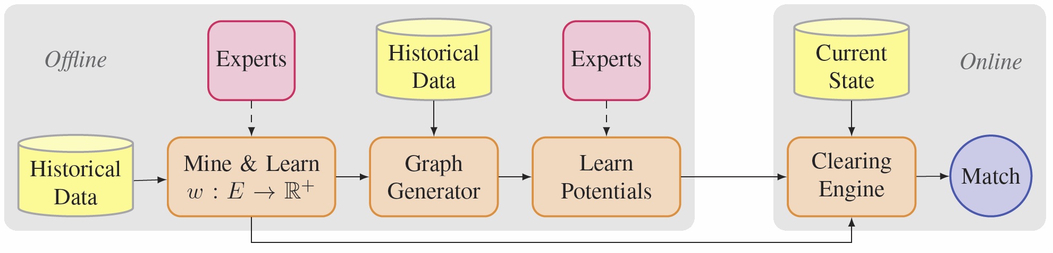
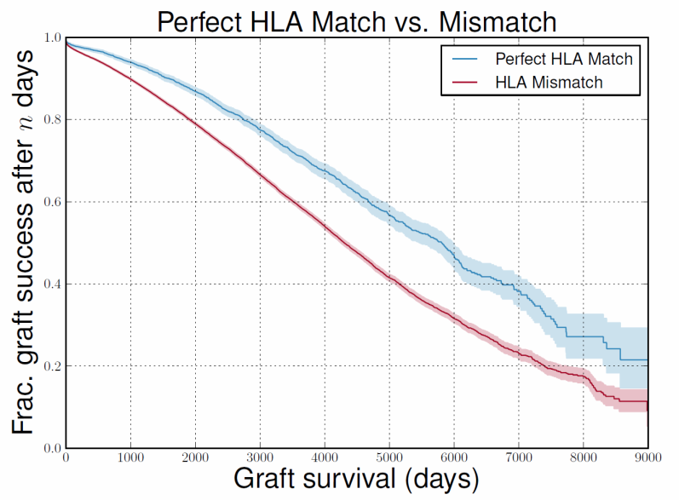
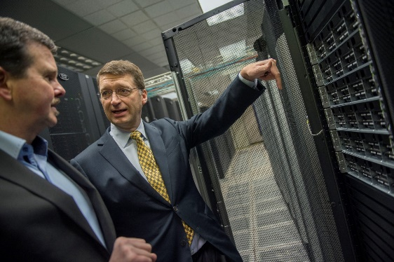
FutureMatch: Combining human value judgments, ML, and integer programming for automatically generating the best policy for large-scale dynamic problems
[Dickerson & S., AAAI-15]
Experiments with 3 objectives: max-graft-survival, max-cardinality, max-β-weighted-cardinality
E.g., for β=2, improves over
myopic in both #transplants
and #sensitized transplants
Notes:
On title only:
- Ends vs means (what are humans vs AI good at)
- Making a myopic optimization smart about the future => scalability of myopic optimization
- Sort of like policy gradient, except that there is no gradient, and the problem is so large and discrete that an IP needs to be solved even to execute one step of the policy.
- Fairness
AT END OF SLIDE: We have lots of new developments on kidney exchange that I don’t have time to discuss, but I will mention one research strand *beyond* kidneys…

Slide 95
Preference elicitation from multiple experts
To extract the value system from the multiple expert stakeholders, I designed a careful questionnaire with questions comparing small-case solutions
Experts are reluctant to answer, and even ask

Slide 96
Edge testing
Algorithms for better edge testing policies
  Blum, Dickerson, Haghtalab, Procaccia & Sandholm
  EC-15, Operations Research 2019
  McElfresh, Curry, Sandholm & Dickerson
  NeurIPS-20
Ongoing pilot with UNOS for prioritizing queries in UNOS’s donor pre-select tool

Slide 97
Transplant centers hide pairs and NDDs from exchange(s)
Why do centers do this?
  Logistical benefit
  Money
What fraction of locally matchable pairs/NDDs do centers hide?
  A: 100% [Stewart, Leishman, Sleeman, Monstello, Lunsford, Maghirang, Sandholm, Gentry, Formica, Friedewald, Andreoni. 2013. American Transplant Congress]
No mechanism design solution possible in static setting
[Roth, Sönmez, Ünver (2007a); Ashlagi, Fischer, Kash, Procaccia, GEB-13; Ashlagi & Roth (2014)]
Incentive-compatible, efficient, long-term-IR credit mechanism
[Hajaj, Dickerson, Hassidim, Sandholm, Sarne, AAAI-15]
  Matching favors centers that reveal more than their expected number of pairs/NDDs, and disfavors those who reveal fewer than that
  Supports chains and long cycles
  Assumes pairs and NDDs last for only one matching period

Slide 98

Liver lobe and cross-organ exchanges
Invented liver lobe and cross-organ exchange [Sandholm, UMass DLS-10]
Merging kidney and liver lobe exchanges produces a large benefit in theory and simulation [Dickerson & Sandholm, JAIR-17]
Fielding has started in the small, with manual matching, as it started with kidneys
  A few liver lobe swaps per year in the US
  First liver lobe - kidney swap took place in 2019
Liver lobe
Kidney
Notes:
serendipitous

Slide 99
Conclusions
Real organ exchanges have cycles, chains, weights, arrivals/departures, edge failures, fairness considerations, human value judgments, …
Scalable, flexible batch solver
Dynamic problem
  General-purpose trajectory-based online algorithms
  General purpose idea of how to use “potentials” to capture the future into batch optimization
  Both leverage distributional information and our offline algorithm
  Both outperform batch-based approach
Failure-aware probabilistic matching
Fairness
Futurematch: learning to do generalized matching in complex settings

Slide 100
Our ongoing research on organ exchange
Better algorithms that handle the dynamic problem with arrivals & departures
Better edge testing policies
Matching cadence: Race to bottom among exchanges [Das, Dickerson, Li, Sandholm, AMMA-15]
  Why allow multiple kidney exchanges in a country?
Better incentive schemes for transplant centers to reveal pairs
Multi-donor kidney exchange
  Current practice allows multiple donors listed, only one used
  Our new approaches allow multiple donors to be used in various ways
  [Sandholm, Farina, Dickerson, Leishman, Stewart, Formica, Thiessen, Kulkarni ATC-17;
  Farina, Dickerson, Sandholm IJCAI-17, AGT-17]
“Operation frames” [Farina, Dickerson, Sandholm IJCAI-17, AGT-17]
Other organs
  Liver & cross-organ exchange [Dickerson & Sandholm, GREEN-COPLAS-13, AAAI-14, JAIR-17]
  Lung “components” [Ergin, Sönmez, Ünver, draft 2014-15; Tang et al. 2015]
International exchanges
Optimized cooperation between the deceased-donor waiting list and kidney exchange
Starting a collaboration with Prof. Arman Kilic on optimizing the US heart allocation policy
Notes:
E.g., potentials based on more donor and patient features.
(Centers’ incentives to reveal pairs: Additional constraints in engine)
(Cross-exchange collaboration vs one exchange)
MULTI-DONOR:
We propose significant generalizations to kidney exchange. We allow more than one donor to donate in exchange for their desired patient receiving a kidney. We also allow for the possibility of a donor willing to donate if any of a number of patients receive kidneys. Furthermore, we combine these notions and generalize them. The generalization is to exchange among organ clubs, where a club is willing to donate organs outside the club if and only if the club receives organs from outside the club according to given specifications.
OPERATION FRAMES:
We also present the notion of operation frames that can be used to sequence the operations across batches, so better solutions over many batches are achieved while honoring the constraints within each batch. We present integer programming formulations for the market clearing problems for these new types of organ exchanges. Experiments show that in the single-donation setting, operation frames improve planning by 34%–51%. Allowing up to two donors to donate in exchange for one kidney donated to their designated patient yields a further increase in social welfare.

Slide 101
Our ongoing research on organ exchange
Better algorithms that handle the dynamic problem with arrivals & departures
Better edge testing policies
Matching cadence: Race to bottom among exchanges [Das, Dickerson, Li, Sandholm, AMMA-15]
  Why allow multiple kidney exchanges in a country?
Better incentive schemes for transplant centers to reveal pairs
Multi-donor kidney exchange
  Current practice allows multiple donors listed, only one used
  Our new approaches allow multiple donors to be used in various ways
  [Sandholm, Farina, Dickerson, Leishman, Stewart, Formica, Thiessen, Kulkarni ATC-17;
  Farina, Dickerson, Sandholm IJCAI-17, AGT-17]
“Operation frames” [Farina, Dickerson, Sandholm IJCAI-17, AGT-17]
Other organs
  Liver & cross-organ exchange [Dickerson & Sandholm, GREEN-COPLAS-13, AAAI-14, JAIR-17]
  Lung “components” [Ergin, Sönmez, Ünver, draft 2014-15; Tang et al. 2015]
International exchanges
Notes:
E.g., potentials based on more donor and patient features.
(Centers’ incentives to reveal pairs: Additional constraints in engine)
(Cross-exchange collaboration vs one exchange)
MULTI-DONOR:
We propose significant generalizations to kidney exchange. We allow more than one donor to donate in exchange for their desired patient receiving a kidney. We also allow for the possibility of a donor willing to donate if any of a number of patients receive kidneys. Furthermore, we combine these notions and generalize them. The generalization is to exchange among organ clubs, where a club is willing to donate organs outside the club if and only if the club receives organs from outside the club according to given specifications.
OPERATION FRAMES:
We also present the notion of operation frames that can be used to sequence the operations across batches, so better solutions over many batches are achieved while honoring the constraints within each batch. We present integer programming formulations for the market clearing problems for these new types of organ exchanges. Experiments show that in the single-donation setting, operation frames improve planning by 34%–51%. Allowing up to two donors to donate in exchange for one kidney donated to their designated patient yields a further increase in social welfare.

Slide 102
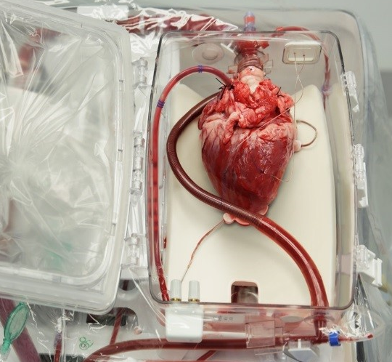
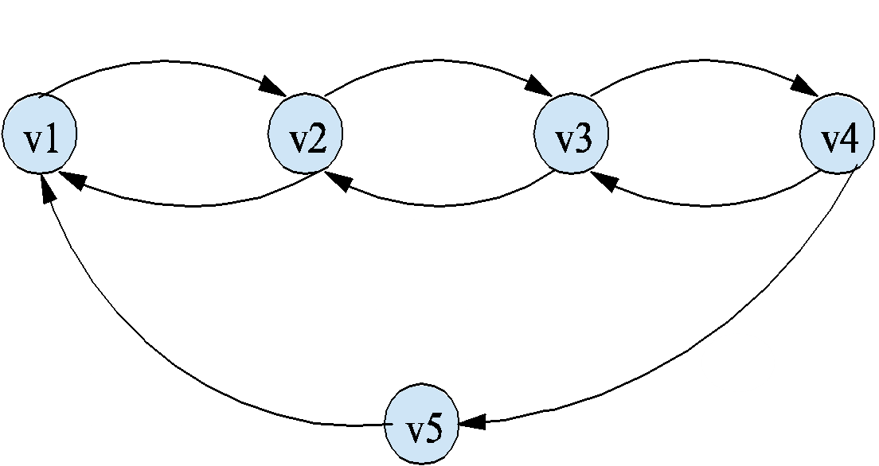
Some more of my future research on organ donation

Slide 103
Future work regarding fielding
Getting dynamic and failure-aware approach fielded
Better crossmatch prediction
Better edge testing policies & donor pre-select tools
Designing & fielding credit schemes
Insurance to pay for testing, etc.
International exchange
Exchanges beyond kidneys
In the US: Shutting down sniping manual private exchanges, and having one system (as there is for deceased donors)

Slide 104
Discussion
Work on real problem: 2- and 3-cycles, chains, dynamics, edge failures
We recently open-sourced the most realistic organ-exchange simulator
AI autonomy

