Slide 1

14-513
18-613

Slide 2
The Memory Hierarchy
18-213/18-613: Introduction to Computer Systems
9th Lecture, February 12, 2024

Slide 3
Today
The memory abstraction CSAPP 6.1.1
RAM : main memory building block CSAPP 6.1.1
Storage technologies and trends CSAPP 6.1.2-6.1.4
The memory hierarchy CSAPP 6.3
Working sets CSAPP 6.2
Locality of reference CSAPP 6.2
Caches CSAPP 6.4-6.5

Slide 4
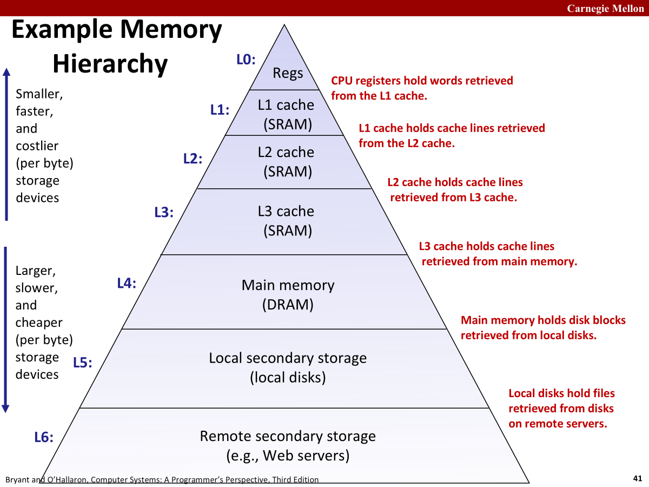
Today’s Goal
Make the system perform almost as if all of the memory is the fastest type of memory, while the average cost per byte is as if all of the memory is the cheapest kind of memory.

Slide 5
Writing & Reading Memory
Write
  Transfer data from CPU to memory
  movq %rax, 8(%rsp)
  “Store” operation
Read
  Transfer data from memory to CPU
  movq 8(%rsp), %rax
  “Load” operation
From 4th lecture

Slide 6
Traditional Bus Structure Connecting
CPU and Memory
A bus is a collection of parallel wires that carry address, data, and control signals.
Buses are typically shared by multiple devices.
CPU chip
Register file
ALU
System bus
Memory bus
Main
memory
Bus interface
I/O
bridge

Slide 7
Memory Read Transaction (1)
CPU places address A on the memory bus.
CPU chip
Register file
Load operation: movq A, %rax
ALU
%rax
Main memory
I/O bridge
A
0
Bus interface
x
A

Slide 8
Memory Read Transaction (2)
Main memory reads A from the memory bus, retrieves word x, and places it on the bus.
Register file
Load operation: movq A, %rax
ALU
%rax
Main memory
I/O bridge
x
0
Bus interface
x
A

Slide 9
Memory Read Transaction (3)
CPU read word x from the bus and copies it into register %rax.
Register file
Load operation: movq A, %rax
ALU
%rax
x
Main memory
I/O bridge
0
Bus interface
x
A

Slide 10
Memory Write Transaction (1)
CPU places address A on bus. Main memory reads it and waits for the corresponding data word to arrive.
Register file
Store operation: movq %rax, A
ALU
%rax
y
Main memory
I/O bridge
A
0
Bus interface
A

Slide 11
Memory Write Transaction (2)
CPU places data word y on the bus.
Register file
Store operation: movq %rax, A
ALU
%rax
y
Main memory
I/O bridge
y
0
Bus interface
A

Slide 12
Memory Write Transaction (3)
Main memory reads data word y from the bus and stores it at address A.
Register file
Store operation: movq %rax, A
ALU
%rax
y
Main memory
I/O bridge
0
Bus interface
y
A

Slide 13
Today
The memory abstraction CSAPP 6.1.1
RAM : main memory building block CSAPP 6.1.1
Storage technologies and trends CSAPP 6.1.2-6.1.4
The memory hierarchy CSAPP 6.3
Working sets CSAPP 6.2
Locality of reference CSAPP 6.2
Caches CSAPP 6.4-6.5

Slide 14
Random-Access Memory (RAM)
Key features
  RAM is traditionally packaged as a chip.
    or embedded as part of processor chip
  Basic storage unit is normally a cell (one bit per cell).
  Multiple RAM chips form a memory.
RAM comes in two varieties:
  SRAM (Static RAM)
  DRAM (Dynamic RAM)

Slide 15
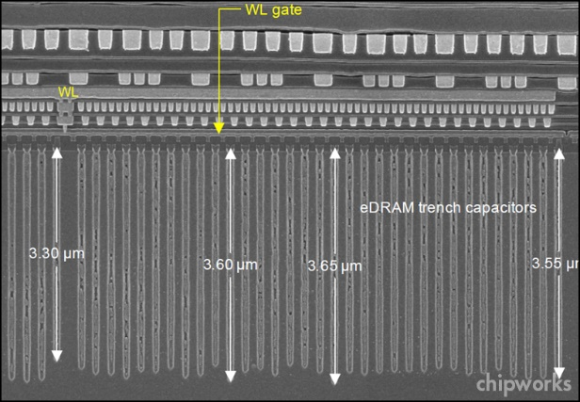
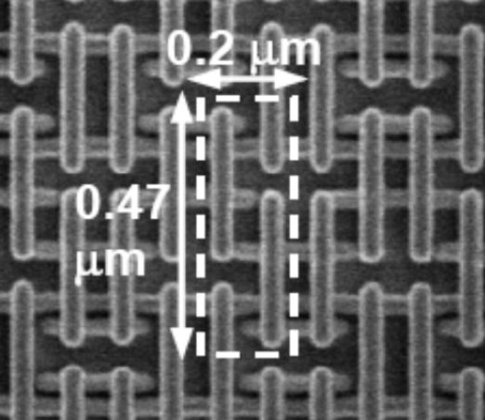
RAM Technologies
DRAM
1 Transistor + 1 capacitor / bit
  Capacitor oriented vertically
Must refresh state periodically
SRAM
6 transistors / bit
Holds state indefinitely (but will still lose data on power loss)

Slide 16
SRAM vs DRAM Summary
Trans. Access Needs Needs
per bit time refresh? EDC? Cost Applications
SRAM 6 or 8 1x No Maybe 100x Cache memories
DRAM 1 10x Yes Yes 1x Main memories,
frame buffers
EDC: Error detection and correction
Trends
  SRAM scales with semiconductor technology
    Reaching its limits
  DRAM scaling limited by need for minimum capacitance
    Aspect ratio limits how deep can make capacitor
    Also reaching its limits

Slide 17
Enhanced DRAMs
Operation of DRAM cell has not changed since its invention
  Commercialized by Intel in 1970.
DRAM cores with better interface logic and faster I/O :
  Synchronous DRAM (SDRAM)
    Uses a conventional clock signal instead of asynchronous control
  Double data-rate synchronous DRAM (DDR SDRAM)
    Double edge clocking sends two bits per cycle per pin
    Different types distinguished by size of small prefetch buffer:
      DDR (2 bits), DDR2 (4 bits), DDR3 (8 bits), DDR4 (16 bits)
    By 2010, standard for most server and desktop systems
    Intel Core i7 supports DDR3 and DDR4 SDRAM

Slide 18
Conventional DRAM Organization
d x w DRAM:
  d⋅ w total bits organized as d supercells of size w bits
16 x 8 DRAM chip (toy example)
cols
Memory
controller
0
1
2
3
2 bits
/
0
addr
1
rows
2
supercell
(2,1)
(to/from CPU)
3
8 bits
/
data
Internal row buffer
Notes:
~8kB rowbuffer

Slide 19
Reading DRAM Supercell (2,1)
Step 1(a): Row access strobe (RAS) selects row 2.
Step 1(b): Row 2 copied from DRAM array to row buffer.
16 x 8 DRAM chip
Cols
Memory
controller
RAS = 2
0
1
2
3
2
/
0
addr
1
Rows
2
8
/
3
data
Internal row buffer

Slide 20
Reading DRAM Supercell (2,1)
Step 2(a): Column access strobe (CAS) selects column 1.
Step 2(b): Supercell (2,1) copied from buffer to data lines, and eventually back to the CPU.
Step 3: All data written back to row to provide refresh
16 x 8 DRAM chip
Cols
Memory
controller
CAS = 1
0
1
2
3
2
/
0
addr
To CPU
1
Rows
2
supercell
(2,1)
3
8
/
data
supercell
(2,1)
Internal row buffer

Slide 21
Memory Modules
addr (row = i, col = j)
: supercell (i,j)
DRAM 0
64 MB
memory module
consisting of
eight 8Mx8 DRAMs
DRAM 7
bits
56-63
bits
48-55
bits
40-47
bits
32-39
bits
24-31
bits
16-23
bits
8-15
bits
0-7
63
63
56
56
55
55
48
48
47
47
40
40
39
39
32
32
31
31
24
24
23
23
16
16
15
15
8
8
7
7
0
0
Memory
controller
64-bit word main memory address A
64-bit word

Slide 22
Today
The memory abstraction CSAPP 6.1.1
RAM : main memory building block CSAPP 6.1.1
Storage technologies and trends CSAPP 6.1.2-6.1.4
The memory hierarchy CSAPP 6.3
Working sets CSAPP 6.2
Locality of reference CSAPP 6.2
Caches CSAPP 6.4-6.5

Slide 23
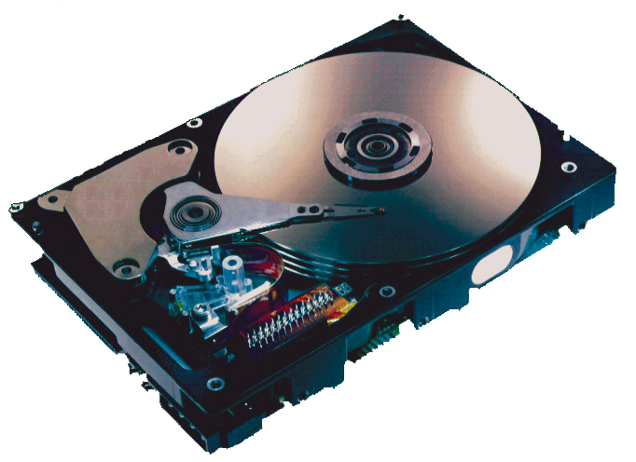
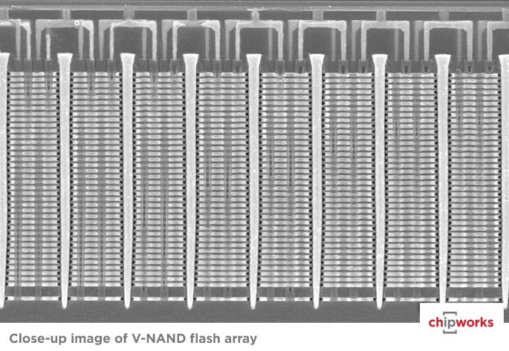
Storage Technologies
Magnetic Disks
Store on magnetic medium
Electromechanical access
Nonvolatile (Flash) Memory
Store as persistent charge
Implemented with 3-D structure
  100+ levels of cells
  3 bits data per cell

Slide 24
What’s Inside A Disk Drive?
Spindle
Arm
Platters
Actuator
Electronics
(including a
processor
and memory!)
SCSI
connector
Image courtesy of Seagate Technology

Slide 25
Disk Geometry
Disks consist of platters, each with two surfaces.
Each surface consists of concentric rings called tracks.
Each track consists of sectors separated by gaps.
Tracks
Surface
Track k
Gaps
Spindle
Sectors

Slide 26
Disk Capacity
Capacity: maximum number of bits that can be stored.
  Vendors express capacity in units of gigabytes (GB) or terabytes (TB), where 1 GB = 10⁹ Bytes and 1 TB = 10¹² Bytes
Capacity is determined by these technology factors:
  Recording density (bits/in): number of bits that can be squeezed into a 1 inch segment of a track.
  Track density (tracks/in): number of tracks that can be squeezed into a 1 inch radial segment.
  Areal density (bits/in²): product of
  recording and track density.
Tracks

Slide 27
Disk Operation (Single-Platter View)
The disk surface
spins at a fixed
rotational rate
The read/write head
is attached to the end
of the arm and flies over
the disk surface on
a thin cushion of air.
spindle
spindle
spindle
spindle
spindle
By moving radially, the arm can position the read/write head over any track.

Slide 28
Disk Operation (Multi-Platter View)
Read/write heads
move in unison
from cylinder to cylinder
Arm
Spindle

Slide 29
Disk Access – Service Time Components
After BLUE read
Seek for RED
Rotational latency
After RED read
Data transfer
Seek
Rotational
latency
Data transfer
Notes:
Goal:
Show the inefficeincy of current disk requests.
Conveyed Ideas:
Rotational latency is wasted time that can be used to service tasks
Background Information:
None.
Slide Background:
None.
Kill text and arrows

Slide 30
Disk Access Time
Average time to access some target sector approximated by:
  T_{access} = T_{avg seek} + T_{avg rotation} + T_{avg transfer}
Seek time (T_{avg seek})
  Time to position heads over cylinder containing target sector.
  Typical T_{avg seek} is 3—9 ms
Rotational latency (T_{avg rotation})
  Time waiting for first bit of target sector to pass under r/w head.
  T_{avg rotation} = 1/2 x 1/RPMs x 60 sec/1 min
  Typical rotational rate = 7,200 RPMs
Transfer time (T_{avg transfer})
  Time to read the bits in the target sector.
  T_{avg transfer} = 1/RPM x 1/(avg # sectors/track) x 60 secs/1 min
time for one rotation (in minutes)
fraction of a rotation to be read

Slide 31
Disk Access Time Example
Given:
  Rotational rate = 7,200 RPM
  Average seek time = 9 ms
  Avg # sectors/track = 400
Derived:
  T_{avg rotation} = 1/2 x (60 secs/7200 RPM) x 1000 ms/sec = 4 ms
  T_{avg transfer} = 60/7200 x 1/400 x 1000 ms/sec = 0.02 ms
  T_{access} = 9 ms + 4 ms + 0.02 ms
Important points:
  Access time dominated by seek time and rotational latency.
  First bit in a sector is the most expensive, the rest are free.
  SRAM access time is about 4 ns/doubleword, DRAM about 60 ns
    Disk is about 40,000 times slower than SRAM,
    2,500 times slower than DRAM.

Slide 32
I/O Bus
CPU chip
Register file
ALU
System bus
Memory bus
Main
memory
Bus interface
I/O
bridge
I/O bus
Expansion slots for
other devices such
as network adapters.
USB
controller
Graphics
adapter
Disk
controller
Mouse
Keyboard
Monitor
Disk

Slide 33
Reading a Disk Sector (1)
CPU chip
CPU initiates a disk read by writing a command, logical block number, and destination memory address to a port (address) associated with disk controller.
Register file
ALU
Main
memory
Bus interface
I/O bus
USB
controller
Graphics
adapter
Disk
controller
mouse
keyboard
Monitor
Disk

Slide 34
Reading a Disk Sector (2)
CPU chip
Register file
Disk controller reads the sector and performs a direct memory access (DMA) transfer into main memory.
ALU
Main
memory
Bus interface
I/O bus
USB
controller
Graphics
adapter
Disk
controller
Mouse
Keyboard
Monitor
Disk

Slide 35
Reading a Disk Sector (3)
CPU chip
When the DMA transfer completes, the disk controller notifies the CPU with an interrupt (i.e., asserts a special “interrupt” pin on the CPU).
Register file
ALU
Main
memory
Bus interface
I/O bus
USB
controller
Graphics
adapter
Disk
controller
Mouse
Keyboard
Monitor
Disk

Slide 36
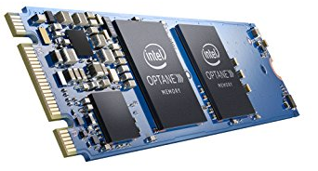
Nonvolatile Memories
DRAM and SRAM are volatile memories
  Lose information if powered off.
Nonvolatile memories retain value even if powered off
  Read-only memory (ROM): programmed during production
  Electrically eraseable PROM (EEPROM): electronic erase capability
  Flash memory: EEPROMs, with partial (block-level) erase capability
    Wears out after about 100,000 erasings
  3D XPoint (Intel Optane) & emerging NVMs
    New materials
Uses for Nonvolatile Memories
  Firmware programs stored in a ROM (BIOS, controllers for disks, network cards, graphics accelerators, security subsystems,…)
  Solid state disks (replacing rotating disks)
  Disk caches

Slide 37
Solid State Disks (SSDs)
I/O bus
Requests to read and
write logical disk blocks
Solid State Disk (SSD)
Flash
translation layer
DRAM
Buffer
Flash memory
Block 0
Block B-1
…
…
…
Page 0
Page 1
Page P-1
Page 0
Page 1
Page P-1
Pages: 512B to 4KB, Blocks: 32 to 128 pages
Data read/written in units of pages.
Page can be written only after its block has been erased.
A block wears out after about 100,000 repeated writes.

Slide 38
SSD Performance Characteristics
Benchmark of Samsung 940 EVO Plus
Sequential access faster than random access
  Common theme in the memory hierarchy
Random writes are somewhat slower
  Erasing a block takes a long time (~1 ms).
  Modifying a block page requires all other pages to be copied to new block.
  Flash translation layer allows accumulating series of small writes before doing block write.
https://ssd.userbenchmark.com/SpeedTest/711305/Samsung-SSD-970-EVO-Plus-250GB
Sequential read throughput 2,126 MB/s Sequential write tput 1,880 MB/s
Random read throughput 140 MB/s Random write tput 59 MB/s

Slide 39
SSD Tradeoffs vs Rotating Disks
Advantages
  No moving parts → faster, less power, more rugged
Disadvantages
  Have the potential to wear out
    Mitigated by “wear leveling logic” in flash translation layer
    E.g. Samsung 940 EVO Plus guarantees 600 writes/byte of writes before they wear out
    Controller migrates data to minimize wear level
  In 2022, about 2 times more expensive per byte
    1TB SSD is 8¢/GB. 1TB HDD is 4¢/GB. 12TB HDD is 3¢/GB
Applications
  Smartphones, laptops
  Increasingly common in desktops and servers

Slide 40
Today
The memory abstraction CSAPP 6.1.1
RAM : main memory building block CSAPP 6.1.1
Storage technologies and trends CSAPP 6.1.2-6.1.4
The memory hierarchy CSAPP 6.3
Working sets CSAPP 6.2
Locality of reference CSAPP 6.2
Caches CSAPP 6.4-6.5

Slide 41
Memory Hierarchies
Some fundamental and enduring properties of hardware and software:
  Fast storage technologies cost more per byte, have less capacity, and require more power (heat!).
  The gap between CPU and main memory speed is widening.
  Well-written programs tend to exhibit good locality.
These fundamental properties complement each other beautifully.
They suggest an approach for organizing memory and storage systems known as a memory hierarchy.

Slide 42
Example Memory
Hierarchy
L0:
Regs
CPU registers hold words retrieved from the L1 cache.
Smaller,
faster,
and
costlier
(per byte)
storage
devices
L1:
L1 cache
(SRAM)
L1 cache holds cache lines retrieved from the L2 cache.
L2:
L2 cache
(SRAM)
L2 cache holds cache lines
retrieved from L3 cache.
L3:
L3 cache
(SRAM)
L3 cache holds cache lines
retrieved from main memory.
Larger,
slower,
and
cheaper
(per byte)
storage
devices
L4:
Main memory
(DRAM)
Main memory holds disk blocks retrieved from local disks.
L5:
Local secondary storage
(local disks)
Local disks hold files retrieved from disks
on remote servers.
L6:
Remote secondary storage
(e.g., Web servers)
Notes:
Note: Text in red describes an inclusive memory hierarchy. Latest Intel CPUs have exclusive L2s, i.e. any data item in L2 is NOT in L3.

Slide 43
The CPU-Memory Gap
The gap widens between DRAM, disk, and CPU speeds.
Disk
SSD
DRAM
CPU
Effective CPU cycle time: accounts for parallelism within CPU (e.g., multiple cores per CPU)

Slide 44
Today
The memory abstraction CSAPP 6.1.1
RAM : main memory building block CSAPP 6.1.1
Storage technologies and trends CSAPP 6.1.2-6.1.4
The memory hierarchy CSAPP 6.3
Working sets CSAPP 6.2
Locality of reference CSAPP 6.2
Caches CSAPP 6.4-6.5

Slide 45
Working Sets
Think about working on the bomb lab. Maybe you have the write-up open in one window, the debugger open in another window, and an assembly reference in yet another window.
Think about eating a meal. You need room on the table for your fork, your knife, your plate, your napkin, and your glass.
The set of resources actively needed for a task are called the working set for the task.
Think about working on a plane.

Slide 46
Working Sets
If we can keep the working set for the active task in the fastest memory, the task will perform at the speed of the fastest memory.
This is true even if the working sets for inactive tasks that we are in slower memory.
If we don’t have the enough fast memory to hold the whole working set of the active task, we end up repeatedly paying the price to swap what we’ll need soon for we’ll need right now.
The cost of the initial, likely incremental, movement of the working set from slower memory to faster memory may be expensive, but it is often amortized to something negligible over the lifetime of the task.
Think about working on a plane.

Slide 47
Determining the Working Set
If the system can determine the working set, and it has enough fast memory, it can arrange to bring it into the fast memory or keep it there once it gets there.
  Sort of like setting the table
  Or leaving everything set up on the workbench at night to be ready for morning.
But, the processors doesn’t understand the task. It can’t see (much of) the future. It just does what it is told. It can’t know the working set.
  And the task, and therefore the associated working set, can change at any time.
But it can use heuristics to estimate or approximate it.
  Let’s talk about Locality: Spatial locality and Temporal locality.

Slide 48
Today
The memory abstraction CSAPP 6.1.1
RAM : main memory building block CSAPP 6.1.1
Storage technologies and trends CSAPP 6.1.2-6.1.4
The memory hierarchy CSAPP 6.3
Working sets CSAPP 6.2
Locality of reference CSAPP 6.2
Caches CSAPP 6.4-6.5

Slide 49
Locality:
A Heuristic for Approximating the Working Set
Principle of Locality: Programs tend to use data and instructions with addresses near or equal to those they have used recently
Temporal locality:
  Recently referenced items are likely
  to be referenced again in the near future
Spatial locality:
  Items with nearby addresses tend
  to be referenced close together in time

Slide 50
Locality Example
Temporal
sum = 0;
for (i = 0; i < n; i++)
sum += a[i];
return sum;
Spatial
Spatial or Temporal
Locality?
Data references
  Reference array elements in succession (stride-1 reference pattern).
  Reference variable sum each iteration.
Instruction references
  Reference instructions in sequence.
  Cycle through loop repeatedly.
spatial
temporal
spatial
temporal

Slide 51
Qualitative Estimates of Locality
Claim: Being able to look at code and get a qualitative sense of its locality is a key skill for a professional programmer.
Question: Does this function have good locality with respect to array a?
int sum_array_rows(int a[M][N])
{
int i, j, sum = 0;
for (i = 0; i < M; i++)
for (j = 0; j < N; j++)
sum += a[i][j];
return sum;
}
Hint: array layout
is row-major order
Answer: yes
Stride-1 reference
pattern
• • •
a
[0]
[0]
a
[0]
[N-1]
• • •
a
[1]
[0]
a
[1]
[N-1]
• • •
• • •
a
[M-1]
[0]
a
[M-1]
[N-1]

Slide 52
Locality Example
Question: Does this function have good locality with respect to array a?
int sum_array_cols(int a[M][N])
{
int i, j, sum = 0;
for (j = 0; j < N; j++)
for (i = 0; i < M; i++)
sum += a[i][j];
return sum;
}
Answer: no
Stride N reference
pattern
Note: If M is very small
then good locality. Why?
• • •
a
[0]
[0]
a
[0]
[N-1]
• • •
a
[1]
[0]
a
[1]
[N-1]
• • •
• • •
a
[M-1]
[0]
a
[M-1]
[N-1]

Slide 53
Locality Example
Question: Can you permute the loops so that the function scans the 3-d array a with a stride-1 reference pattern (and thus has good spatial locality)?
int sum_array_3d(int a[M][N][N])
{
int i, j, k, sum = 0;
for (i = 0; i < N; i++)
for (j = 0; j < N; j++)
for (k = 0; k < M; k++)
sum += a[k][i][j];
return sum;
}
$ time ./loopijk
real 0m2.765s
user 0m2.328s
sys 0m0.422s
$ time ./loopkij
real 0m1.651s
user 0m1.234s
sys 0m0.422s
Answer: make j the inner loop

Slide 54
What Makes Locality A Good Heuristic?
Remember that we care about spatial and temporal locality because they allow us to estimate the working set.
But, what makes them a particularly good way of doing that?
They are simple enough to implement efficiently in hardware without slowing things down too much
  Temporal locality can be managed by keeping the most recently used objects and letting go of the least recently used objects.
  Spatial locality is natural to model by maintaining blocks of nearby objects vs individual objects
  They can be learned quickly enough to be of value in the future
  They don’t require prior knowledge or understanding of the task.

Slide 55
Is Locality Always a Good Heursitic?
Spatial and temporal locality are heuristics. They are not necessarily applicable to all workloads.
As one example, consider streaming data to preprocess it enroute to an AI algorithm or other application.
  Spatial locality still applies: If we access one piece of data, we’re likely to access the next piece of data next.
  But, temporal locality no longer applies: Once we’ve seen it and processed it, we won’t look back
  The working set is a dynamically moving window.
In this situation, we might want to a heuristic that suggests, “After N sequential accesses, beginning prefetching ahead of the current accesses to overlap I/O and processing.”
  Future attraction: We see this in the OS paging system, for example.

Slide 56
Today
The memory abstraction CSAPP 6.1.1
RAM : main memory building block CSAPP 6.1.1
Storage technologies and trends CSAPP 6.1.2-6.1.4
The memory hierarchy CSAPP 6.3
Working sets CSAPP 6.2
Locality of reference CSAPP 6.2
Caches CSAPP 6.4-6.5

Slide 57
Caches
Cache: A smaller, faster storage device that acts as a staging area for a subset of the data in a larger, slower device.
Fundamental idea of a memory hierarchy:
  For each k, the faster, smaller device at level k serves as a cache for the larger, slower device at level k+1.
Why do memory hierarchies work?
  Because of locality, programs tend to access the data at level k more often than they access the data at level k+1.
  Thus, the storage at level k+1 can be slower, and thus larger and cheaper per bit.
Big Idea (Ideal): The memory hierarchy creates a large pool
of storage that costs as much as the cheap storage near the bottom, but that serves data to programs at the rate of the fast storage near the top.

Slide 58
General Cache Concepts
Smaller, faster, more expensive
memory caches a subset of
the blocks
Cache
8
4
9
14
10
3
Data is copied in block-sized transfer units
4
10
Larger, slower, cheaper memory
viewed as partitioned into “blocks”
Memory
0
1
2
3
4
4
5
6
7
8
9
10
10
11
12
13
14
15

Slide 59
General Cache Concepts: Hit
Request: 14
Data in block b is needed
Block b is in cache:
Hit!
Cache
8
9
14
3
14
Memory
0
1
2
3
4
5
6
7
8
9
10
11
12
13
14
15

Slide 60
General Cache Concepts: Miss
Request: 12
Data in block b is needed
Block b is not in cache:
Miss!
Cache
8
9
14
3
12
Block b is fetched from
memory
12
Request: 12
Block b is stored in cache
Placement policy:
determines where b goes
Replacement policy:
determines which block
gets evicted (victim)
Memory
0
1
2
3
4
5
6
7
8
9
10
11
12
12
13
14
15
Impact of spatial locality
on number of misses?

Slide 61
General Caching Concepts:
3 Types of Cache Misses
Compulsory miss
  Compulsory misses occur because the cache starts empty and this is the first reference to the block.
Capacity miss
  Occurs when the set of active cache blocks (working set) is larger than the cache.
Conflict miss
  Most caches limit blocks at level k+1 to a small subset (sometimes a singleton) of the block positions at level k.
    E.g. Block i at level k+1 must be placed in block (i mod 4) at level k.
  Conflict misses occur when the level k cache is large enough, but multiple data objects all map to the same level k block.
    E.g. Referencing blocks 0, 8, 0, 8, 0, 8, ... would miss every time.

Slide 62
Examples of Caching in the Mem. Hierarchy
Cache Type
What is Cached?
Where is it Cached?
Latency (cycles)
Managed By
Registers
4-8 byte words
CPU core
0
Compiler
TLB
Address translations
On-Chip TLB
0
Hardware MMU
L1 cache
64-byte blocks
On-Chip L1
4
Hardware
L2 cache
64-byte blocks
On-Chip L2
10
Hardware
Virtual Memory
4-KB pages
Main memory
100
Hardware + OS
Buffer cache
Parts of files
Main memory
100
OS
Disk cache
Disk sectors
Disk controller
100,000
Disk firmware
Network buffer cache
Parts of files
Local disk
10,000,000
NFS client
Browser cache
Web pages
Local disk
10,000,000
Web browser
Web cache
Web pages
Remote server disks
1,000,000,000
Web proxy server

Slide 63
Summary
The speed gap between CPU, memory and mass storage continues to widen and the average cost of a storage approximate our cheapest memory
Careful movement of data can allow us to have the average access approximate our fastest memory
  An understanding of the behavior of our work, including its working set, locality, etc, can enable us to facilitate this movement.
Memory hierarchies based on caching close the gap by exploiting locality.
Flash memory progress outpacing all other memory and storage technologies (DRAM, SRAM, magnetic disk)
  Able to stack cells in three dimensions

Slide 64
Supplemental slides

Slide 65
Storage Trends
SRAM
Metric 1985 1990 1995 2000 2005 2010 2015 2015:1985
$/MB 2,900 320 256 100 75 60 320 116
access (ns) 150 35 15 3 2 1.5 200 115
DRAM
Metric 1985 1990 1995 2000 2005 2010 2015 2015:1985
$/MB 880 100 30 1 0.1 0.06 0.02 44,000
access (ns) 200 100 70 60 50 40 20 10
typical size (MB) 0.256 4 16 64 2,000 8,000 16.000 62,500
Disk
Metric 1985 1990 1995 2000 2005 2010 2015 2015:1985
$/GB 100,000 8,000 300 10 5 0.3 0.03 3,333,333
access (ms) 75 28 10 8 5 3 3 25
typical size (GB) 0.01 0.16 1 20 160 1,500 3,000 300,000

Slide 66
CPU Clock Rates
Inflection point in computer history
when designers hit the “Power Wall”
1985 1990 1995 2003 2005 2010 2015 2015:1985
CPU 80286 80386 Pentium P-4 Core 2 Core i7(n) Core i7(h)
Clock
rate (MHz) 6 20 150 3,300 2,000 2,500 3,000 500
Cycle
time (ns) 166 50 6 0.30 0.50 0.4 0.33 500
Cores 1 1 1 1 2 4 4 4
Effective
cycle 166 50 6 0.30 0.25 0.10 0.08 2,075
time (ns)
(n) Nehalem processor
(h) Haswell processor

