Slide 1

14-513
18-613

Slide 2
Synchronization: Basic
18-213/18-613: Introduction to Computer Systems
23rd Lecture, November 28th, 2023

Slide 3
Today
Recap: Threads, races, and deadlocks
Sharing CSAPP 12.4
Mutual exclusion CSAPP 12.5
Semaphores CSAPP 12.5
Producer-Consumer Synchronization CSAPP 12.5

Slide 4
Traditional View of a Process
Process = process context + code, data, and stack
Process context
Code, data, and stack
Program context:
Data registers
Condition codes
Stack pointer (SP)
Program counter (PC)
SP
Stack
Shared libraries
brk
Run-time heap
Kernel context:
VM structures
Descriptor table
brk pointer
Read/write data
PC
Read-only code/data
0

Slide 5
Alternate View of a Process
Process = thread + code, data, and kernel context
Thread (main thread)
Code, data, and kernel context
Shared libraries
SP
Stack
brk
Run-time heap
Thread context:
Data registers
Condition codes
Stack pointer (SP)
Program counter (PC)
Read/write data
PC
Read-only code/data
0
Kernel context:
VM structures
Descriptor table
brk pointer

Slide 6
A Process With Multiple Threads
Multiple threads can be associated with a process
  Each thread has its own logical control flow
  Each thread shares the same code, data, and kernel context
  Each thread has its own stack for local variables
    but not protected from other threads
  Each thread has its own thread id (TID)
Thread 1 (main thread)
Thread 2 (peer thread)
Shared code and data
shared libraries
stack 1
stack 2
run-time heap
Thread 1 context:
Data registers
Condition codes
SP₁
PC₁
Thread 2 context:
Data registers
Condition codes
SP₂
PC₂
read/write data
read-only code/data
0
Kernel context:
VM structures
Descriptor table
brk pointer

Slide 7
Race conditions
Event A can happen either before or after event B
The program behaves differently depending on which one happens first
  Races are not necessarily bugs!
  Only if one of the possible behaviors is incorrect

Slide 8
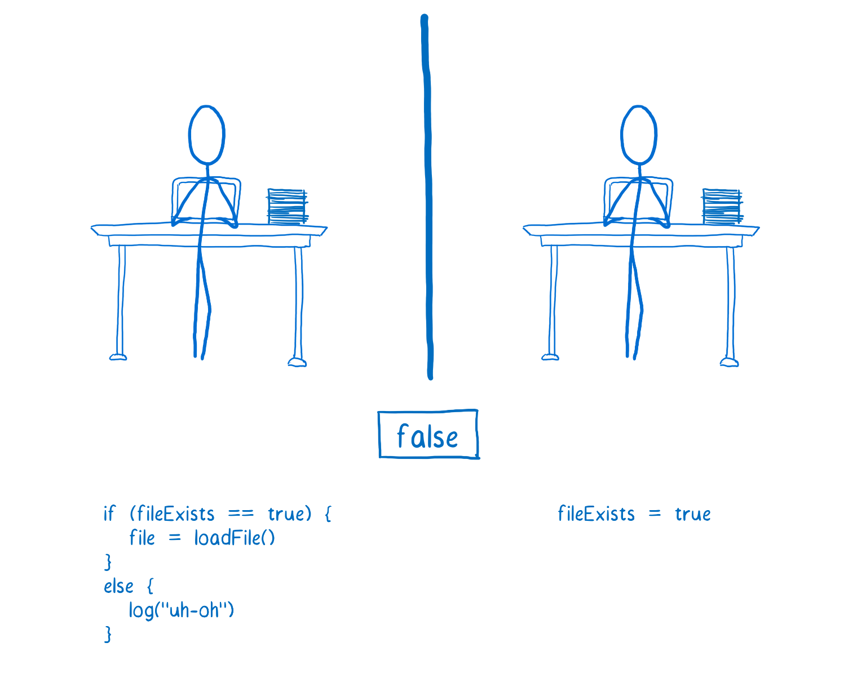
Race condition example
Lin Clark
https://hacks.mozilla.org/2017/06/avoiding-race-conditions-in-sharedarraybuffers-with-atomics/

Slide 9
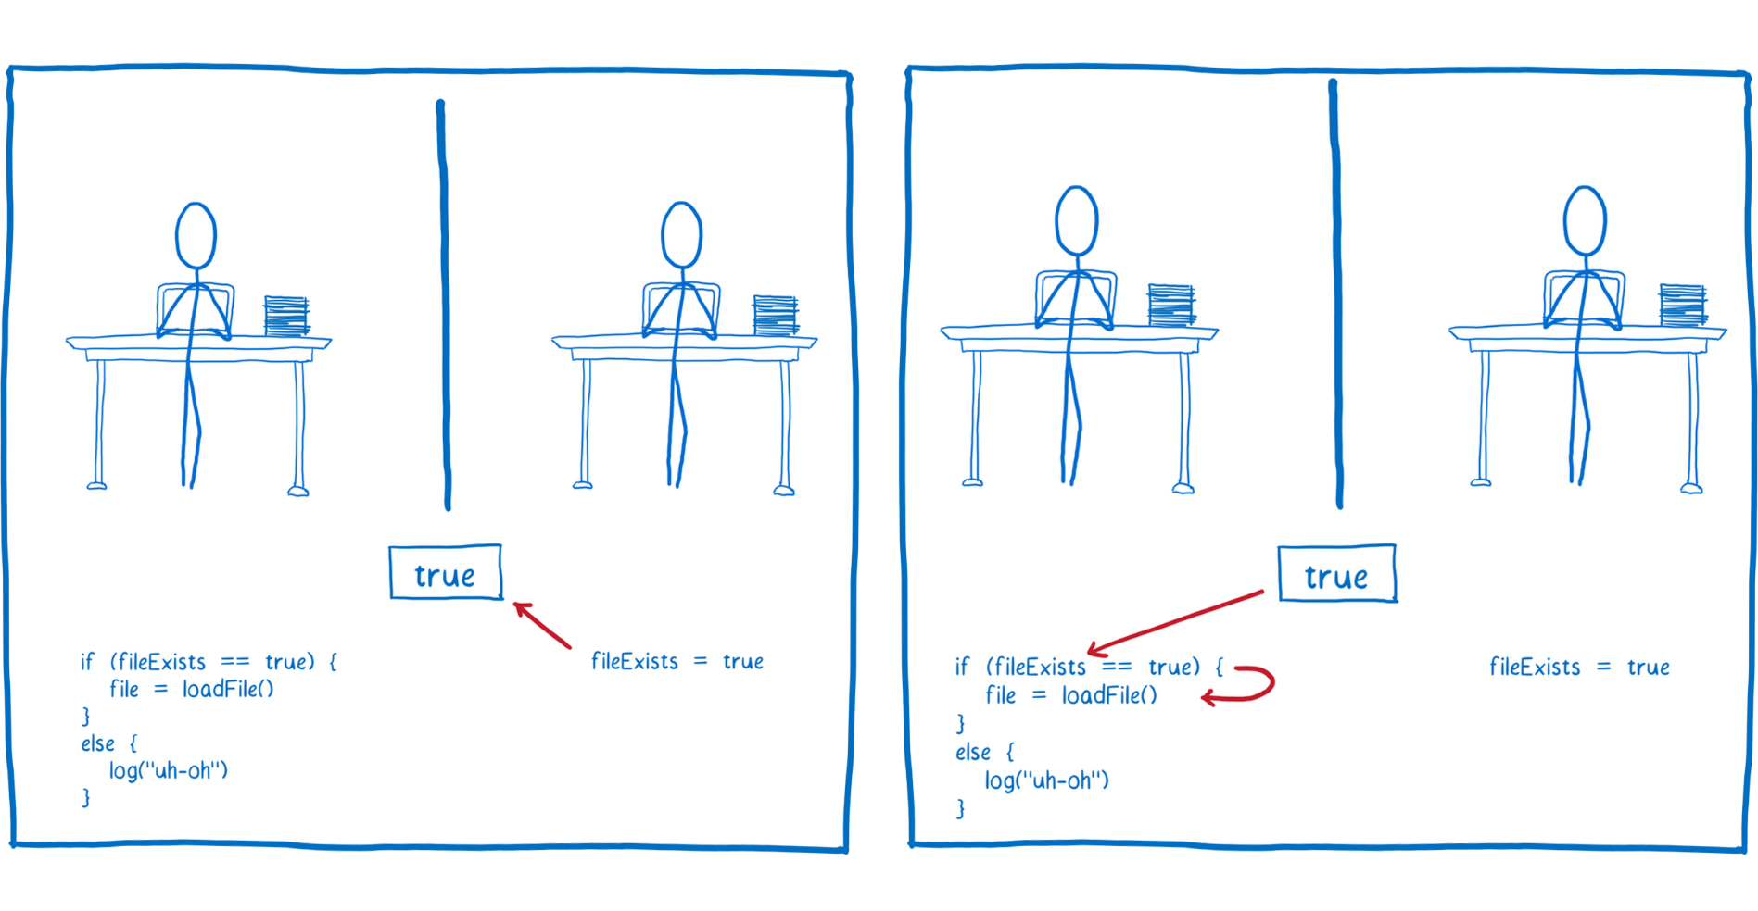
Race condition example
Lin Clark
https://hacks.mozilla.org/2017/06/avoiding-race-conditions-in-sharedarraybuffers-with-atomics/

Slide 10
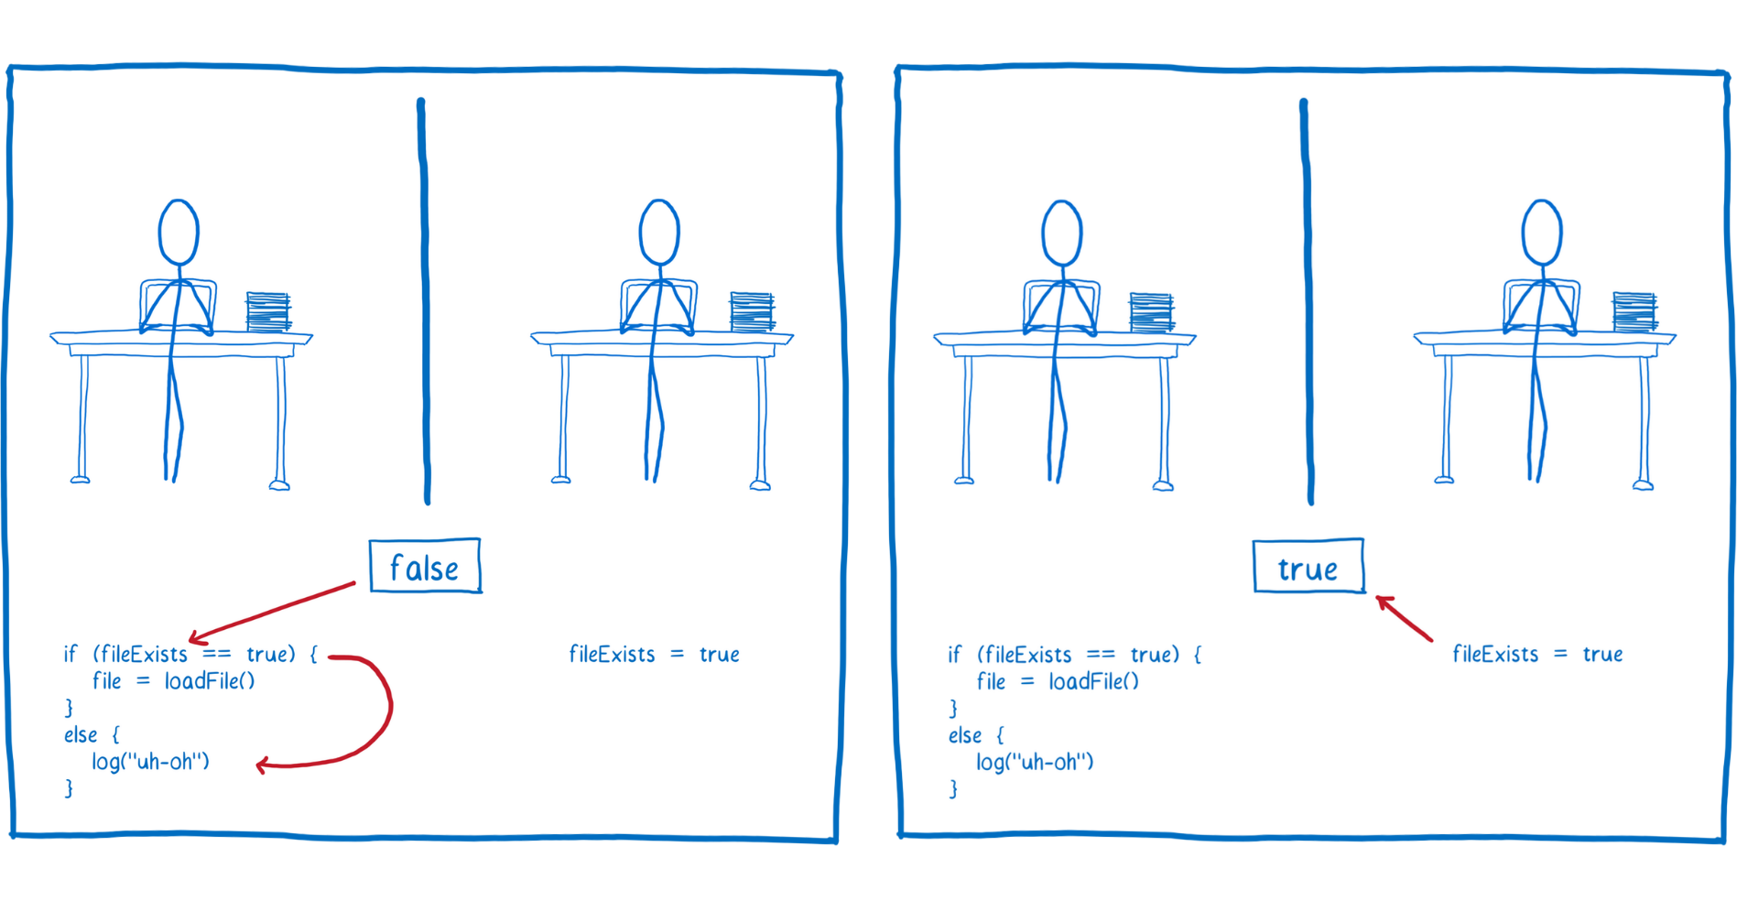
Race condition example
Lin Clark
https://hacks.mozilla.org/2017/06/avoiding-race-conditions-in-sharedarraybuffers-with-atomics/

Slide 11
More race condition examples
File is deleted, in between when a program checks whether the file exists, and when it opens the file
(“time-of-check to time-of-use” race)
Child exits before parent can add it to the job list (tsh)
Child thread reads variable after parent has changed it
(previous lecture)
Two threads update the same variable simultaneously
(later in this lecture)

Slide 12
Deadlock
Whenever two or more threads/processes/… are stuck waiting for each other to do something
In real life:
  Alice cannot put the groceries down until Bob opens the door
  Bob cannot open the door until Alice hands him the keys
  Alice cannot hand Bob the keys because she is holding the groceries
In programming:
  Client is waiting for server to send a message before it closes the connection
  Server is waiting for client to close the connection before it sends the message (server has a bug)
Deadlock is always a bug

Slide 13
Today
Recap: Threads, races, and deadlocks
Sharing
Mutual exclusion
Semaphores
Producer-Consumer Synchronization

Slide 14
Shared Variables in Threaded C Programs
Question: Which variables in a threaded C program are shared?
  The answer is not as simple as “global variables are shared” and
  “stack variables are private”
Def: A variable x is shared if and only if multiple threads reference some instance of x.
Requires answers to the following questions:
  What is the memory model for threads?
  How are instances of variables mapped to memory?
  How many threads might reference each of these instances?

Slide 15
Threads Memory Model: Conceptual
Multiple threads run within the context of a single process
Each thread has its own separate thread context
  Thread ID, stack, stack pointer, PC, condition codes, and GP registers
All threads share the remaining process context
  Code, data, heap, and shared library segments of the process virtual address space
  Open files and installed handlers
Thread 1
(private)
Thread 2
(private)
Shared code and data
stack 1
stack 2
shared libraries
Thread 1 context:
Data registers
Condition codes
SP₁
PC₁
Thread 2 context:
Data registers
Condition codes
SP₂
PC₂
run-time heap
read/write data
read-only code/data

Slide 16
Threads Memory Model: Actual
Separation of data is not strictly enforced:
  Register values are truly separate and protected, but…
  Any thread can read and write the stack of any other thread
The mismatch between the conceptual and operation model
is a source of confusion and errors
stack 1
stack 2
Virtual Address Space
Shared code and data
Thread 1
(private)
Thread 2
(private)
shared libraries
Thread 1 context:
Data registers
Condition codes
SP₁
PC₁
Thread 2 context:
Data registers
Condition codes
SP₂
PC₂
run-time heap
read/write data
read-only code/data

Slide 17
Example Program to Illustrate Sharing
char **ptr; /* global var */
int main(int argc, char *argv[])
{
long i;
pthread_t tid;
char *msgs[2] = {
"Hello from foo",
"Hello from bar"
};
ptr = msgs;
for (i = 0; i < 2; i++)
Pthread_create(&tid,
NULL,
thread,
(void *)i);
Pthread_exit(NULL);
}
void *thread(void *vargp)
{
long myid = (long)vargp;
static int cnt = 0;
printf("[%ld]: %s (cnt=%d)\n",
myid, ptr[myid], ++cnt);
return NULL;
}
Peer threads reference main thread’s stack
indirectly through global ptr variable
A common, but inelegant way to pass a single argument to a thread routine
sharing.c

Slide 18
Mapping Variable Instances to Memory
Global variables
  Def: Variable declared outside of a function
  Virtual memory contains exactly one instance of any global variable
Local variables
  Def: Variable declared inside function without static attribute
  Each thread stack contains one instance of each local variable
Local static variables
  Def: Variable declared inside function with the static attribute
  Virtual memory contains exactly one instance of any local static variable.

Slide 19
Mapping Variable Instances to Memory
Notation:
instance of
msgs in main
Global var: 1 instance (ptr [data])
Local vars: 1 instance (i.m, msgs.m)
char **ptr; /* global var */
int main(int main, char *argv[])
{
long i;
pthread_t tid;
char *msgs[2] = {
"Hello from foo",
"Hello from bar"
};
ptr = msgs;
for (i = 0; i < 2; i++)
Pthread_create(&tid,
NULL,
thread,
(void *)i);
Pthread_exit(NULL);
}
Local var: 2 instances (
myid.p0 [peer thread 0’s stack],
myid.p1 [peer thread 1’s stack]
)
void *thread(void *vargp)
{
long myid = (long)vargp;
static int cnt = 0;
printf("[%ld]: %s (cnt=%d)\n",
myid, ptr[myid], ++cnt);
return NULL;
}
Local static var: 1 instance (cnt [data])
sharing.c

Slide 20
Shared Variable Analysis
Which variables are shared?
Answer: A variable x is shared iff multiple threads reference at least one instance of x. Thus:
  ptr, cnt, and msgs are shared
  i and myid are not shared
Variable Referenced by Referenced by Referenced by
instance main thread? peer thread 0? peer thread 1?
ptr
cnt
i.m
msgs.m
myid.p0
myid.p1
yes
yes
yes
no
yes
yes
yes
no
no
yes
yes
yes
no
yes
no
no
no
yes
char **ptr; /* global var */
int main(int main, char *argv[]) {
long i; pthread_t tid;
char *msgs[2] = {"Hello from foo",
"Hello from bar" };
ptr = msgs;
for (i = 0; i < 2; i++)
Pthread_create(&tid,
NULL, thread,(void *)i);
Pthread_exit(NULL);}
void *thread(void *vargp)
{
long myid = (long)vargp;
static int cnt = 0;
printf("[%ld]: %s (cnt=%d)\n",
myid, ptr[myid], ++cnt);
return NULL;
}
Notes:
msgs.m accessed by peer thread via global ptr

Slide 21
Shared Variable Analysis
Which variables are shared?
Answer: A variable x is shared iff multiple threads reference at least one instance of x. Thus:
  ptr, cnt, and msgs are shared
  i and myid are not shared
Variable Referenced by Referenced by Referenced by
instance main thread? peer thread 0? peer thread 1?
ptr
cnt
i.m
msgs.m
myid.p0
myid.p1
yes
yes
yes
no
yes
yes
yes
no
no
yes
yes
yes
no
yes
no
no
no
yes

Slide 22
Synchronizing Threads
Shared variables are handy...
…but introduce the possibility of nasty synchronization errors.

Slide 23
badcnt.c: Improper Synchronization
/* Global shared variable */
volatile long cnt = 0; /* Counter */
int main(int argc, char **argv)
{
long niters;
pthread_t tid1, tid2;
niters = atoi(argv[1]);
Pthread_create(&tid1, NULL,
thread, &niters);
Pthread_create(&tid2, NULL,
thread, &niters);
Pthread_join(tid1, NULL);
Pthread_join(tid2, NULL);
/* Check result */
if (cnt != (2 * niters))
printf("BOOM! cnt=%ld\n", cnt);
else
printf("OK cnt=%ld\n", cnt);
exit(0);
}
/* Thread routine */
void *thread(void *vargp)
{
long j, niters =
*((long *)vargp);
for (j = 0; j < niters; j++)
cnt++;
return NULL;
}
linux> ./badcnt 10000
OK cnt=20000
linux> ./badcnt 10000
BOOM! cnt=13051
linux>
cnt should equal 20,000.
What went wrong?
badcnt.c

Slide 24
Assembly Code for Counter Loop
C code for counter loop in thread i
for (j = 0; j < niters; j++)
cnt++;
Asm code for thread i
movq (%rdi), %rcx
testq %rcx,%rcx
jle .L2
movl $0, %eax
.L3:
movq cnt(%rip),%rdx
addq $1, %rdx
movq %rdx, cnt(%rip)
addq $1, %rax
cmpq %rcx, %rax
jne .L3
.L2:
H_{i} : Head
L_{i} : Load cnt
U_{i} : Update cnt
S_{i} : Store cnt
T_{i} : Tail

Slide 25
Concurrent Execution
Key idea: In general, any sequentially consistent* interleaving is possible, but some give an unexpected result!
  I_{i} denotes that thread i executes instruction I
  %rdx_{i} is the content of %rdx in thread i’s context
i (thread)
instr_{i}
%rdx₁
%rdx₂
cnt
Note: One of many
possible interleavings
1
H₁
-
-
0
1
L₁
0
-
0
1
U₁
1
-
0
1
S₁
1
-
1
2
H₂
-
-
1
2
L₂
-
1
1
2
U₂
-
2
1
2
S₂
-
2
2
2
T₂
-
2
2
1
T₁
1
-
2
OK
*For now. In reality, on x86 even non-sequentially consistent interleavings are possible

Slide 26
Concurrent Execution
Key idea: In general, any sequentially consistent interleaving is possible, but some give an unexpected result!
  I_{i} denotes that thread i executes instruction I
  %rdx_{i} is the content of %rdx in thread i’s context
i (thread)
instr_{i}
%rdx₁
%rdx₂
cnt
1
H₁
-
-
0
Thread 1 critical section
1
L₁
0
-
0
1
U₁
1
-
0
1
S₁
1
-
1
Thread 2 critical section
2
H₂
-
-
1
2
L₂
-
1
1
2
U₂
-
2
1
2
S₂
-
2
2
2
T₂
-
2
2
1
T₁
1
-
2
OK

Slide 27
Concurrent Execution (cont)
Incorrect ordering: two threads increment the counter, but the result is 1 instead of 2
i (thread)
instr_{i}
%rdx₁
%rdx₂
cnt
1
H₁
-
-
0
1
L₁
0
-
0
1
U₁
1
-
0
2
H₂
-
-
0
2
L₂
-
0
0
1
S₁
1
-
1
1
T₁
1
-
1
2
U₂
-
1
1
2
S₂
-
1
1
2
T₂
-
1
1
Oops!
(badcnt will print “BOOM!”)

Slide 28
Concurrent Execution (cont)
How about this ordering?
We can analyze the behavior using a progress graph
i (thread)
instr_{i}
%rdx₁
%rdx₂
cnt
1
H₁
0
1
L₁
0
2
H₂
2
L₂
0
2
U₂
1
2
S₂
1
1
1
U₁
1
1
S₁
1
1
1
T₁
1
2
T₂
1
Oops again!

Slide 29
Progress Graphs
Thread 2
A progress graph depicts
the discrete execution
state space of concurrent
threads.
Each axis corresponds to
the sequential order of
instructions in a thread.
Each point corresponds to
a possible execution state
(Inst₁, Inst₂).
E.g., (L₁, S₂) denotes state
where thread 1 has
completed L₁ and thread
2 has completed S₂.
T₂
(L₁, S₂)
S₂
U₂
L₂
H₂
Thread 1
H₁
L₁
U₁
S₁
T₁

Slide 30
Trajectories in Progress Graphs
Thread 2
A trajectory is a sequence of legal state transitions that describes one possible concurrent execution of the threads.
Example:
H1, L1, U1, H2, L2, S1, T1, U2, S2, T2
T₂
S₂
U₂
L₂
H₂
Thread 1
H₁
L₁
U₁
S₁
T₁

Slide 31
Trajectories in Progress Graphs
Thread 2
A trajectory is a sequence of legal state transitions that describes one possible concurrent execution of the threads.
Example:
H1, L1, U1, H2, L2, S1, T1, U2, S2, T2
T₂
S₂
U₂
L₂
H₂
Thread 1
H₁
L₁
U₁
S₁
T₁

Slide 32
Critical Sections and Unsafe Regions
Thread 2
L, U, and S form a critical section with respect to the shared variable cnt
Instructions in critical sections (wrt some shared variable) should not be interleaved
Sets of states where such interleaving occurs form unsafe regions
T₂
S₂
critical section wrt cnt
U₂
Unsafe region
L₂
H₂
Thread 1
H₁
L₁
U₁
S₁
T₁
critical section wrt cnt

Slide 33
Critical Sections and Unsafe Regions
Thread 2
safe
T₂
Def: A trajectory is safe iff it does not enter any unsafe region
Claim: A trajectory is correct (wrt cnt) iff it is safe
S₂
critical section wrt cnt
U₂
Unsafe region
L₂
unsafe
H₂
Thread 1
H₁
L₁
U₁
S₁
T₁
critical section wrt cnt

Slide 34
badcnt.c: Improper Synchronization
/* Global shared variable */
volatile long cnt = 0; /* Counter */
int main(int argc, char **argv)
{
long niters;
pthread_t tid1, tid2;
niters = atoi(argv[1]);
Pthread_create(&tid1, NULL,
thread, &niters);
Pthread_create(&tid2, NULL,
thread, &niters);
Pthread_join(tid1, NULL);
Pthread_join(tid2, NULL);
/* Check result */
if (cnt != (2 * niters))
printf("BOOM! cnt=%ld\n", cnt);
else
printf("OK cnt=%ld\n", cnt);
exit(0);
}
/* Thread routine */
void *thread(void *vargp)
{
long j, niters =
*((long *)vargp);
for (j = 0; j < niters; j++)
cnt++;
return NULL;
}
Variable | main | thread1 | thread2
cnt | yes* | yes | yes
niters.m | yes | yes | yes
tid1.m | yes | no | no
j.1 | no | yes | no
j.2 | no | no | yes
niters.1 | no | yes | no
niters.2 | no | no | yes
badcnt.c

Slide 35
Quiz Time!
Canvas Quiz: Day 23 – Synchronization Basic

Slide 36
Today
Threads review
Sharing
Mutual exclusion
Semaphores
Producer-Consumer Synchronization

Slide 37
Enforcing Mutual Exclusion
Question: How can we guarantee a safe trajectory?
Answer: We must synchronize the execution of the threads so that they can never have an unsafe trajectory.
  i.e., need to guarantee mutually exclusive access for each critical section.
Classic solution:
  Mutex (pthreads)
  Semaphores (Edsger Dijkstra)
Other approaches (out of our scope)
  Condition variables (pthreads)
  Monitors (Java)

Slide 38
MUTual EXclusion (mutex)
Mutex: boolean synchronization variable
enum {locked = 0, unlocked = 1}
lock(m)
  If the mutex is currently not locked, lock it and return
  Otherwise, wait (spinning, yielding, etc) and retry
unlock(m)
  Update the mutex state to unlocked

Slide 39
MUTual EXclusion (mutex)
Mutex: boolean synchronization variable *
Swap(*a, b)
  [t = *a; *a = b; return t;]
  // Notation: what’s inside the brackets [ ] is indivisible (a.k.a. atomic)
  // by the magic of hardware / OS
Lock(m):
  while (swap(&m->state, locked) == locked) ;
Unlock(m):
  m->state = unlocked;
*For now. In reality, many other implementations and design choices (c.f., 15-410, 418, etc).

Slide 40
badcnt.c: Improper Synchronization
/* Global shared variable */
volatile long cnt = 0; /* Counter */
int main(int argc, char **argv)
{
long niters;
pthread_t tid1, tid2;
niters = atoi(argv[1]);
Pthread_create(&tid1, NULL,
thread, &niters);
Pthread_create(&tid2, NULL,
thread, &niters);
Pthread_join(tid1, NULL);
Pthread_join(tid2, NULL);
/* Check result */
if (cnt != (2 * niters))
printf("BOOM! cnt=%ld\n", cnt);
else
printf("OK cnt=%ld\n", cnt);
exit(0);
}
/* Thread routine */
void *thread(void *vargp)
{
long j, niters =
*((long *)vargp);
for (j = 0; j < niters; j++)
cnt++;
return NULL;
}
How can we fix this using synchronization?
badcnt.c

Slide 41
goodmcnt.c: Mutex Synchronization
Define and initialize a mutex for the shared variable cnt:
volatile long cnt = 0; /* Counter */
pthread_mutex_t mutex;
pthread_mutex_init(&mutex, NULL); // No special attributes
Surround critical section with lock and unlock:
for (i = 0; i < niters; i++) {
pthread_mutex_lock(&mutex);
cnt++;
pthread_mutex_unlock(&mutex);
}
linux> ./goodmcnt 10000
OK cnt=20000
linux> ./goodmcnt 10000
OK cnt=20000
linux>
Function | badcnt | goodmcnt
Time (ms) niters = 10⁶ | 12.0 | 214.0
Slowdown | 1.0 | 17.8
goodcnt.c

Slide 42
Why Mutexes Work
Thread 2
Provide mutually exclusive access to shared variable by surrounding critical section with lock and unlock operations
T₂
un(m)
S₂
U₂
Unsafe region
L₂
-1
lo(m)
0
H₂
1
0
0
0
Thread 1
H₁
lo(m)
L₁
U₁
S₁
un(m)
T₁
Initially
m = 1

Slide 43
Why Mutexes Work
Thread 2
Provide mutually exclusive access to shared variable by surrounding critical section with lock and unlock operations
Mutex invariant creates a forbidden region that encloses unsafe region and that cannot be entered by any trajectory.
T₂
un(m)
S₂
U₂
Unsafe region
L₂
lo(m)
0
H₂
1
0
0
0
Thread 1
H₁
lo(m)
L₁
U₁
S₁
un(m)
T₁
Initially: m = 1

Slide 44
Why Mutexes Work
Thread 2
Provide mutually exclusive access to shared variable by surrounding critical section with lock and unlock operations
Mutex invariant creates a forbidden region that encloses unsafe region and that cannot be entered by any trajectory.
T₂
un(m)
S₂
U₂
Unsafe region
L₂
0
lo(m)
0
1
0
H₂
1
0
0
0
Thread 1
H₁
lo(m)
L₁
U₁
S₁
un(m)
T₁
Initially: m = 1

Slide 45
Why Mutexes Work
Thread 2
1
1
0
0
0
0
1
1
Provide mutually exclusive access to shared variable by surrounding critical section with lock and unlock operations
Mutex invariant creates a forbidden region that encloses unsafe region and that cannot be entered by any trajectory.
T₂
1
1
0
0
0
0
1
1
un(m)
Forbidden region
0
0
0
0
S₂
0
0
0
0
U₂
Unsafe region
0
0
0
0
L₂
0
0
0
0
lo(m)
1
1
0
0
0
0
1
1
H₂
1
1
0
0
0
0
1
1
Thread 1
H₁
lo(m)
L₁
U₁
S₁
un(m)
T₁
Initially
m = 1

Slide 46
Today
Threads review
Sharing
Mutual exclusion
Semaphores
Producer-Consumer Synchronization

Slide 47
Semaphores
Semaphore: non-negative global integer synchronization variable. Manipulated by P and V operations.
P(s)
  If s is nonzero, then decrement s by 1 and return immediately.
    Test and decrement operations occur atomically (indivisibly)
  If s is zero, then suspend thread until s becomes nonzero and the thread is restarted by a V operation.
  After restarting, the P operation decrements s and returns control to the caller.
V(s):
  Increment s by 1.
    Increment operation occurs atomically
  If there are any threads blocked in a P operation waiting for s to become non-zero, then restart exactly one of those threads, which then completes its P operation by decrementing s.
Semaphore invariant: s ≥ 0

Slide 48
Semaphores
Semaphore: non-negative global integer synchronization variable
Manipulated by P and V operations:
  P(s): [ while (s == 0) wait(); s--; ]
    Dutch for “Proberen” (test)
  V(s): [ s++; ]
    Dutch for “Verhogen” (increment)
OS kernel guarantees that operations between brackets [ ] are executed indivisibly/atomically
    Only one P or V operation at a time can modify s.
    When while loop in P terminates, only that P can decrement s
Semaphore invariant: s ≥ 0

Slide 49
C Semaphore Operations
Pthreads functions:
#include <semaphore.h>
int sem_init(sem_t *s, 0, unsigned int val);} /* s = val */
int sem_wait(sem_t *s); /* P(s) */
int sem_post(sem_t *s); /* V(s) */
CS:APP wrapper functions:
#include "csapp.h”
void P(sem_t *s); /* Wrapper function for sem_wait */
void V(sem_t *s); /* Wrapper function for sem_post */

Slide 50
Using Semaphores to Coordinate Access to Shared Resources
Basic idea: Thread uses a semaphore operation to notify another thread that some condition has become true
  Use counting semaphores to keep track of resource state.
  Use binary semaphores to notify other threads.
The Producer-Consumer Problem
  Mediating interactions between processes that generate information and that then make use of that information

Slide 51
Producer-Consumer Problem
producer
thread
consumer
thread
shared
buffer
Common synchronization pattern:
  Producer waits for empty slot, inserts item in buffer, and notifies consumer
  Consumer waits for item, removes it from buffer, and notifies producer
Examples
  Multimedia processing:
    Producer creates video frames, consumer renders them
  Event-driven graphical user interfaces
    Producer detects mouse clicks, mouse movements, and keyboard hits and inserts corresponding events in buffer
    Consumer retrieves events from buffer and paints the display
Notes:
Close computers, etc. Ask students to sketch out the code.
Producer thread() { x = buf; … do stuff}
Consumer thread() {do stuff … buf = x; }
P -> Acquire / decrement
V -> Release / Increment

Slide 52
Producer-Consumer on 1-element Buffer
Maintain two semaphores: full + empty
full
0
empty
buffer
empty
1
full
1
full
buffer
empty
0

Slide 53
Producer-Consumer on 1-element Buffer
#include "csapp.h"
#define NITERS 5
void *producer(void *arg);
void *consumer(void *arg);
struct {
int buf; /* shared var */
sem_t full; /* sems */
sem_t empty;
} shared;
int main(int argc, char** argv) {
pthread_t tid_producer;
pthread_t tid_consumer;
/* Initialize the semaphores */
Sem_init(&shared.empty, 0, 1);
Sem_init(&shared.full, 0, 0);
/* Create threads and wait */
Pthread_create(&tid_producer, NULL,
producer, NULL);
Pthread_create(&tid_consumer, NULL,
consumer, NULL);
Pthread_join(tid_producer, NULL);
Pthread_join(tid_consumer, NULL);
return 0;
}
Initial
value

Slide 54
Producer-Consumer on 1-element Buffer
Initially: empty==1, full==0
Producer Thread
Consumer Thread
void *producer(void *arg) {
int i, item;
for (i=0; i<NITERS; i++) {
/* Produce item */
item = i;
printf("produced %d\n",
item);
/* Write item to buf */
P(&shared.empty);
shared.buf = item;
V(&shared.full);
}
return NULL;
}
void *consumer(void *arg) {
int i, item;
for (i=0; i<NITERS; i++) {
/* Read item from buf */
P(&shared.full);
item = shared.buf;
V(&shared.empty);
/* Consume item */
printf("consumed %d\n“, item);
}
return NULL;
}
Notes:
P(s): [while (s==0) wait(); s--;] // Producer: while not empty. Consumer: while not full.
V(s): [s++;] // Produce: mark as full. Consumer: mark as empty.

Slide 55
Why 2 Semaphores for 1-Entry Buffer?
Consider multiple producers & multiple consumers
Producers will contend with each other to get empty
Consumers will contend with each other to get full
P₁
C₁
•
•
•
shared
buffer
•
•
•
P_{n}
C_{m}
Producers
Consumers
empty
full
P(&shared.empty);
shared.buf = item;
V(&shared.full);
P(&shared.full);
item = shared.buf;
V(&shared.empty);

Slide 56
Producer-Consumer on an n-element Buffer
P₁
Between 0 and n elements
C₁
•
•
•
•
•
•
•••
P_{n}
C_{m}
Implemented using a shared buffer package called sbuf.

Slide 57
Circular Buffer (n = 10)
Store elements in array of size n
items: number of elements in buffer
Empty buffer:
  front = rear
Nonempty buffer
  rear: index of most recently inserted element
  front: (index of next element to remove – 1) mod n
Initially:
front
0
0
1
2
3
4
5
6
7
8
9
rear
0
items
0

Slide 58
Circular Buffer Operation (n = 10)
Insert 7 elements
Remove 5 elements
Insert 6 elements
Remove 8 elements
front
0
0
1
2
3
4
5
6
7
8
9
rear
7
items
7
front
5
0
1
2
3
4
5
6
7
8
9
rear
7
items
2
front
5
0
1
2
3
4
5
6
7
8
9
rear
3
items
8
front
3
0
1
2
3
4
5
6
7
8
9
rear
3
items
0

Slide 59
Sequential Circular Buffer Code
init(int v)
{
items = front = rear = 0;
}
insert(int v)
{
if (items >= n)
error();
if (++rear >= n) rear = 0;
buf[rear] = v;
items++;
}
int remove()
{
if (items == 0)
error();
if (++front >= n) front = 0;
int v = buf[front];
items--;
return v;
}

Slide 60
Producer-Consumer on an n-element Buffer
P₁
Between 0 and n elements
C₁
•
•
•
•
•
•
•••
P_{n}
C_{m}
Requires a mutex and two counting semaphores:
  mutex: enforces mutually exclusive access to the buffer and counters
  slots: counts the available slots in the buffer
  items: counts the available items in the buffer
Makes use of general semaphores
  Will range in value from 0 to n

Slide 61
sbuf Package - Declarations
#include "csapp.h”
typedef struct {
int *buf; /* Buffer array */
int n; /* Maximum number of slots */
int front; /* buf[front+1 (mod n)] is first item */
int rear; /* buf[rear] is last item */
sem_t mutex; /* Protects accesses to buf */
sem_t slots; /* Counts available slots */
sem_t items; /* Counts available items */
} sbuf_t;
void sbuf_init(sbuf_t *sp, int n);
void sbuf_deinit(sbuf_t *sp);
void sbuf_insert(sbuf_t *sp, int item);
int sbuf_remove(sbuf_t *sp);
sbuf.h

Slide 62
sbuf Package - Implementation
Initializing and deinitializing a shared buffer:
/* Create an empty, bounded, shared FIFO buffer with n slots */
void sbuf_init(sbuf_t *sp, int n)
{
sp->buf = Calloc(n, sizeof(int));
sp->n = n; /* Buffer holds max of n items */
sp->front = sp->rear = 0; /* Empty buffer iff front == rear */
Sem_init(&sp->mutex, 0, 1); /* Binary semaphore for locking */
Sem_init(&sp->slots, 0, n); /* Initially, buf has n empty slots */
Sem_init(&sp->items, 0, 0); /* Initially, buf has zero items */
}
/* Clean up buffer sp */
void sbuf_deinit(sbuf_t *sp)
{
Free(sp->buf);
}
sbuf.c

Slide 63
sbuf Package - Implementation
Inserting an item into a shared buffer:
/* Insert item onto the rear of shared buffer sp */
void sbuf_insert(sbuf_t *sp, int item)
{
P(&sp->slots); /* Wait for available slot */
P(&sp->mutex); /* Lock the buffer */
if (++sp->rear >= sp->n) /* Increment index (mod n) */
sp->rear = 0;
sp->buf[sp->rear] = item; /* Insert the item */
V(&sp->mutex); /* Unlock the buffer */
V(&sp->items); /* Announce available item */
}
sbuf.c
Notes:
Note: Initially, n slots available, so many producers succeed in parallel. However, the mutex ensures only one producer updates the buffer at time.

Slide 64
sbuf Package - Implementation
Removing an item from a shared buffer:
/* Remove and return the first item from buffer sp */
int sbuf_remove(sbuf_t *sp)
{
int item;
P(&sp->items); /* Wait for available item */
P(&sp->mutex); /* Lock the buffer */
if (++sp->front >= sp->n) /* Increment index (mod n) */
sp->front = 0;
item = sp->buf[sp->front]; /* Remove the item */
V(&sp->mutex); /* Unlock the buffer */
V(&sp->slots); /* Announce available slot */
return item;
}
sbuf.c
Notes:
Note that multiple items may be available at the same time.

Slide 65
Demonstration
See program produce-consume.c in code directory
10-entry shared circular buffer
5 producers
  Agent i generates numbers from 20*i to 20*i – 1.
  Puts them in buffer
5 consumers
  Each retrieves 20 elements from buffer
Main program
  Makes sure each value between 0 and 99 retrieved once

Slide 66
Summary
Programmers need a clear model of how variables are shared by threads.
Variables shared by multiple threads must be protected to ensure mutually exclusive access
  E.g., using mutex lock and unlock, semaphore P and V
Semaphores are a fundamental mechanism for enforcing mutual exclusion
  And can also support producer-consumer synchronization

