Slide 1
Lecture 3: History of Desktop Devices and their Interaction Techniques
Brad Myers
05-640: Interaction Techniques
Spring, 2025

Slide 2
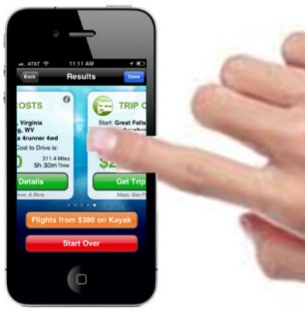
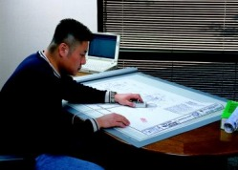
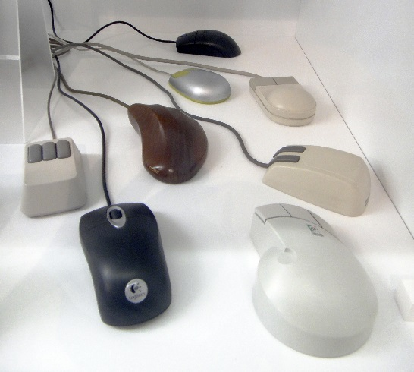
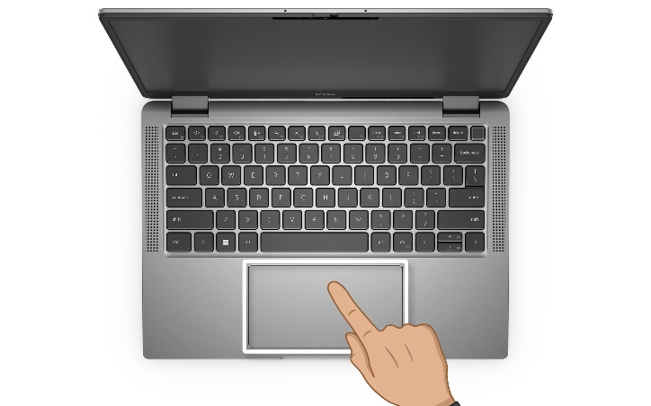
Explain Better
Last lecture, presented poorly: Direct / Indirect vs. Absolute vs. Relative
Absolute: 1-to-1 mapping between points on input device and positions on screen.
Upper left corner of input device = upper left corner of screen
Touching the input device in a particular place indicates the corresponding place on the screen
Examples: touch screen, digitizing tablet
Relative: movements on the input device move the cursor.
Touching the input device in a particular place does nothing to the position; only movements matter
Examples: mouse, the way most touchpads work
Direct: touch the screen
Example: touch screens on phones, tablets
All direct input devices are absolute
Indirect: input device is not the screen, but somewhere else
Examples: mouse, touchpads, digitizers
Some indirect devices, like touchpads can be either absolute or relative

Slide 3
Logistics
Course add date is Monday, 1/27/2025
So will support only students who are registered
45 students registered, 0 on waitlist
Everything through Canvas, including today’s quiz
Very few people have filled in the HW1 spreadsheet for devices – please don’t leave HW1 to last minute.
Only two people have run any participants using the Fitt’s Law software
Still have some mice available for borrowing for HW1
Please share the Contour and trackball
HW1 due and all devices returned to me on Mon, Feb. 3, 2025

Slide 4
Quiz!
On Canvas: https://canvas.cmu.edu/courses/45597/quizzes

Slide 5
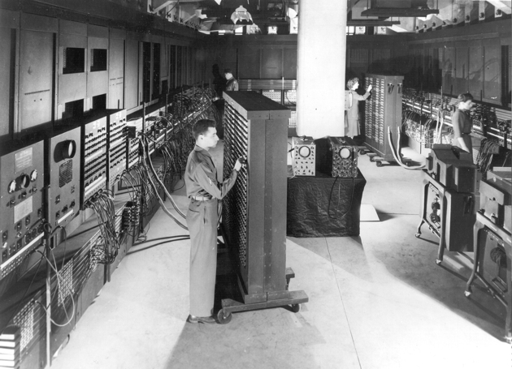
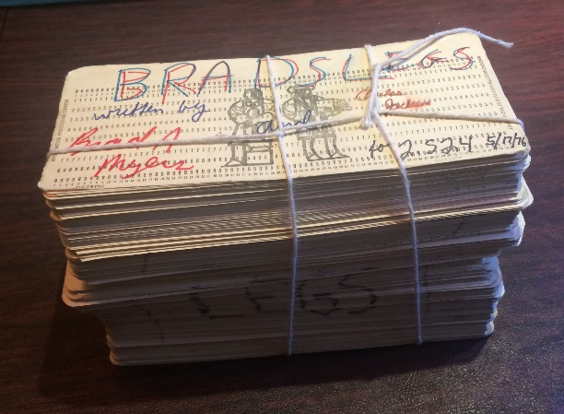
Computer Hardware
“Mainframes” – enormous computers (often a whole room), starting in 1940s
Often used by a single person at a time
Programmed with decks of “punched cards” or “paper tape”
(most picture credits are in the textbook)

Slide 6
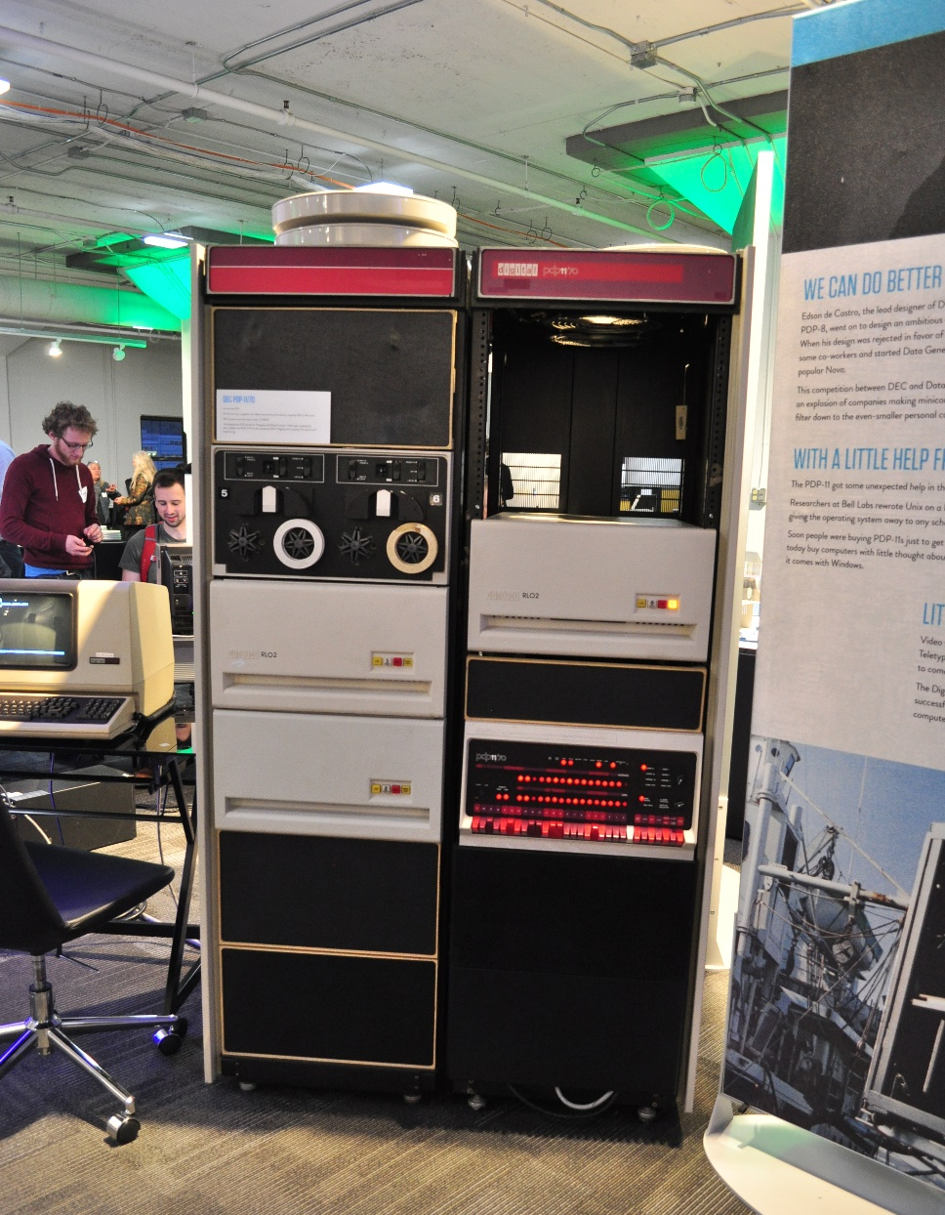
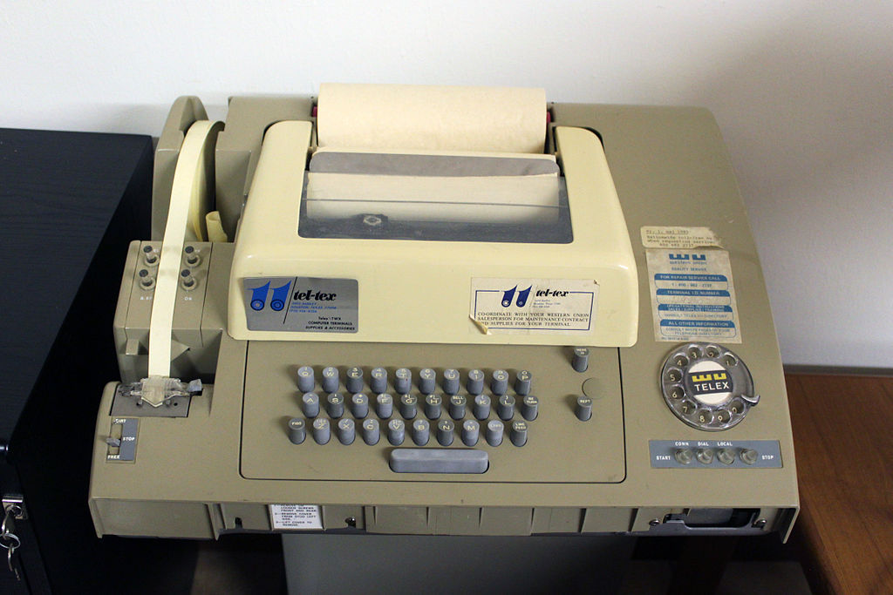
Time sharing & “Mini-computers”
“Time sharing” – big computer shared by multiple people, logged in remotely using wired phones – 1960s through 1980s
E.g., from “teletypes” or “character terminals”
“Mini-computers” appeared in 1970s
Refrigerator sized
Almost always time-shared
(Mainframes continued to be used by businesses, military, etc.)
DEC PDP-11
Source: https://commons.wikimedia.org/wiki/File:LCM_-_DEC_PDP-11-70_-_01.jpg
teletype machine with a paper tape reader and punch from the 1960s

Slide 7
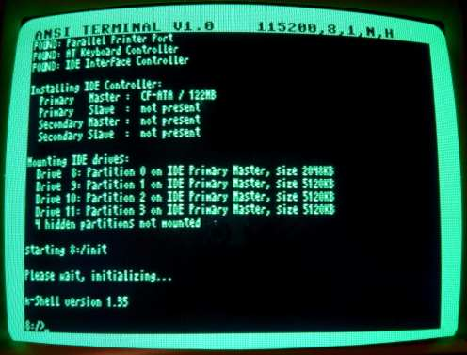
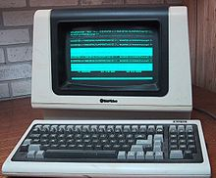
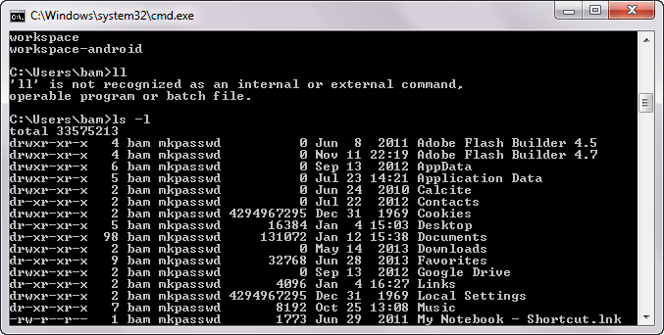
“Character Terminals”
Still around as “DOS cmd prompts” and console windows
But we are more interested in graphics….

Slide 8
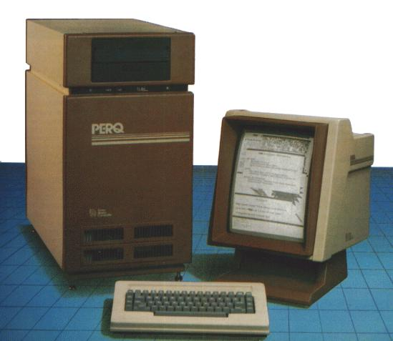
“Personal Workstations”
Used by one person at a time
About the size of a dishwashing machine, and typically had graphics display and a mouse
Examples:
Xerox Alto
Lisp Machines (LMI & Symbolics)
About 1979-1995
Sun, Apollo, PERQ, Silicon Graphics
About 1982 – 2000
Until PCs got to be just as powerful
About $10,000- $30,000 each
For scientists, engineers, programmers
Window managers

Slide 9
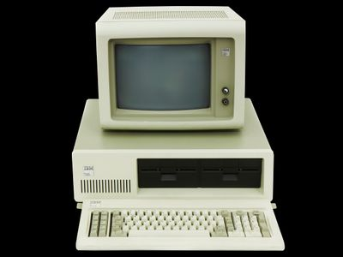
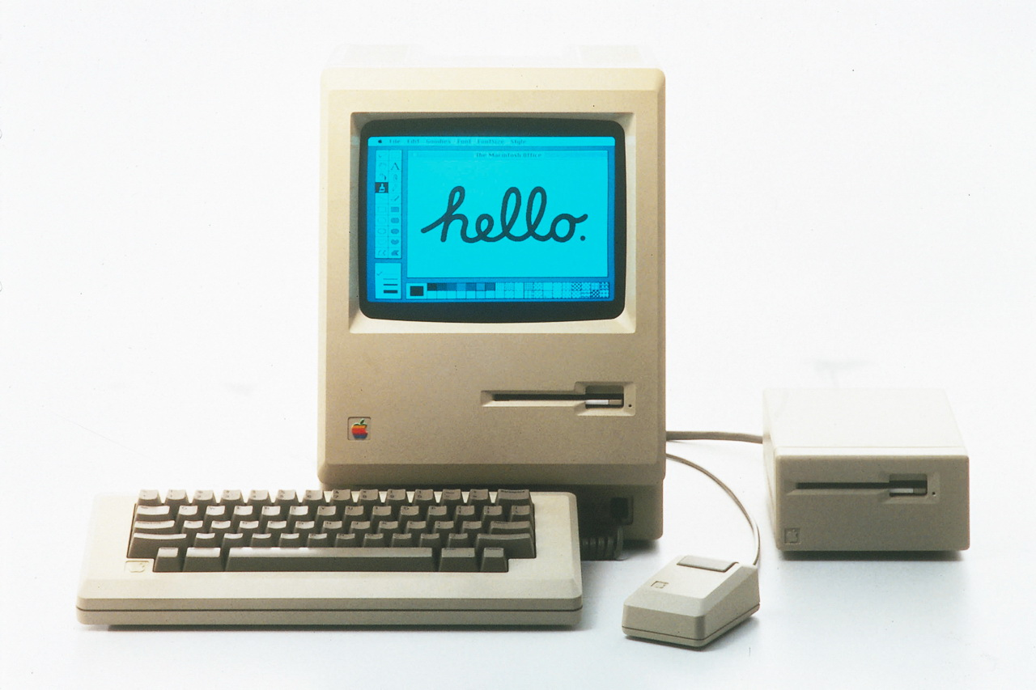
“Personal Computers (PCs)”
Starting in the 1980s
Personal (individual) computers that are smaller, less powerful and cheaper than workstations
E.g., IBM PCs (starting 1981), Apple Macintosh (1984)
Note: “PC” is used for (1) the name of this whole class of machines (including Macs), or (2) the hardware for the non-Apple machines, or (3) the Windows OS
Source: https://spectrum.ieee.org/how-the-ibm-pc-won-then-lost-the-personal-computer-market

Slide 10
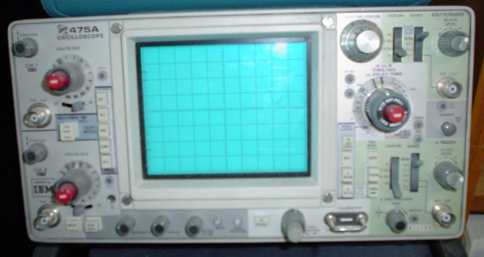
Who knows what this is?
Dates back before the 1930s
Notes:
Oscilloscope
http://en.wikipedia.org/wiki/File:Oscilloscope.jpg

Slide 11
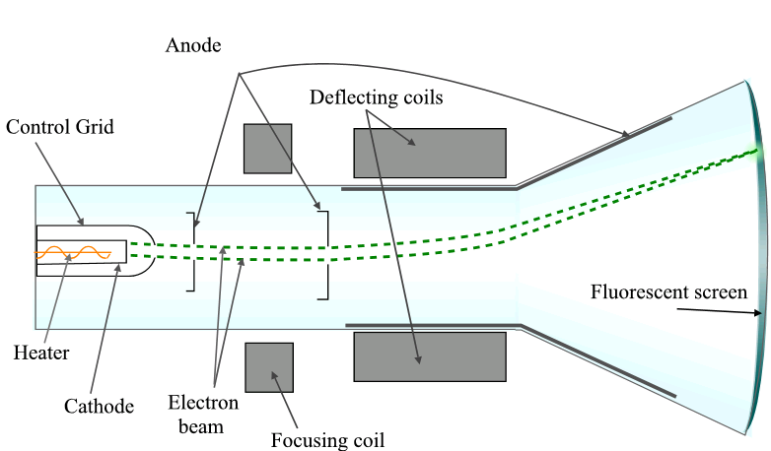
Cathode ray tube (CRT)
http://simple.wikipedia.org/wiki/Cathode_ray_tube

Slide 12
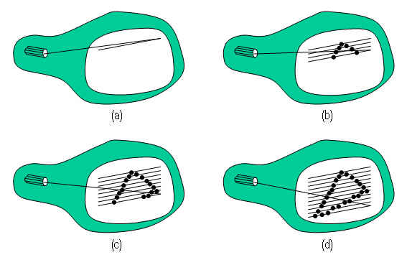
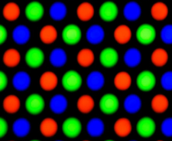
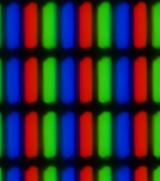
Output
Vector: beam draws the picture, repeatedly
“display list” contains list of what lines to draw
After vector drawing, came Raster Scan
Beam traces constant path across the entire screen, going on and off
Bitmapped displays
Bit in memory for each pixel on the screen
Memory was very expensive!
First: monochrome
Color
Multiple bits per pixel
LCDs, …
But output hardware isn’t particularly relevant to this course!

Slide 13
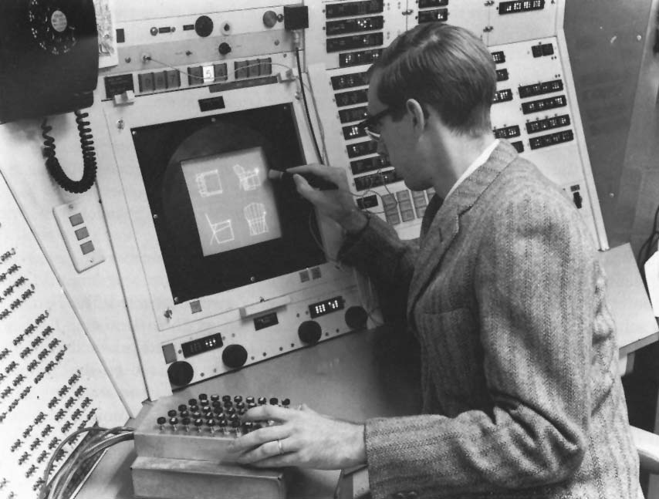
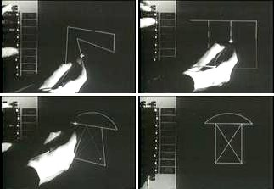
Ivan Sutherland’s Sketchpad, 1963
Important Systems

Slide 14
SketchPad, 1963
Lincoln Labs TX-2 computer
“Light pen” pointing device
Invented many important interaction techniques
Direct manipulation
Uses a “light pen”
“Rubber Band Lines”
Constraint-based drawing
Maintains connectivity of lines
Vertical, horizontal lines
Prototype-instance drawing
Master with multiple copies,
Can edit the master to affect all copies
Almost arbitrary scaling of the whole drawing
Lots of individual switches and knobs to control the drawings
3D drawings added by others to Sutherland’s original SketchPad program
Including hidden line elimination
First flow chart – graphical programming
Ivan’s brother: William “Bert” Sutherland!

Slide 15
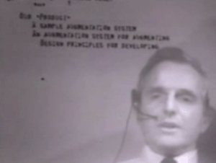
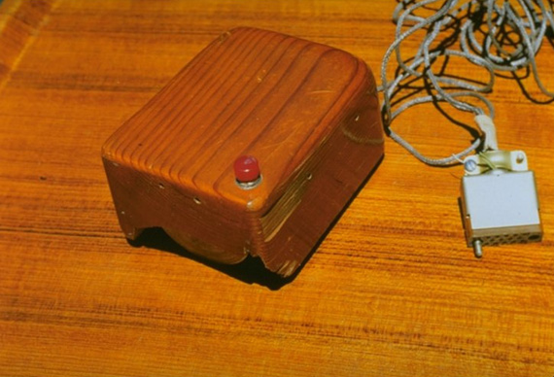
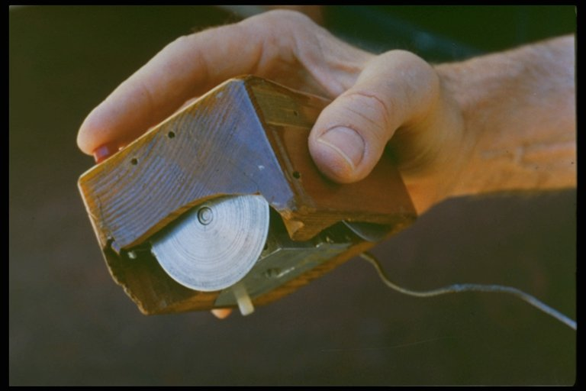
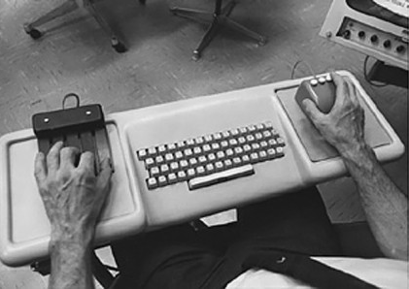
SRI and the Mouse
Stanford Research Institute (SRI)
Bill English and Doug Engelbart credited with the invention of the mouse W.K. English, D.C. Engelbart and M.L. Berman. “Display Selection Techniques for Text Manipulation,” IEEE Transactions on Human Factors in Electronics. Mar, 1967. HFE-8(1).
NLS, or the “oN-Line System”
"The Mother of All Demos” on December 9, 1968 at the Fall Joint Computer Conference in San Francisco
Never really had a decent user interface

Slide 16
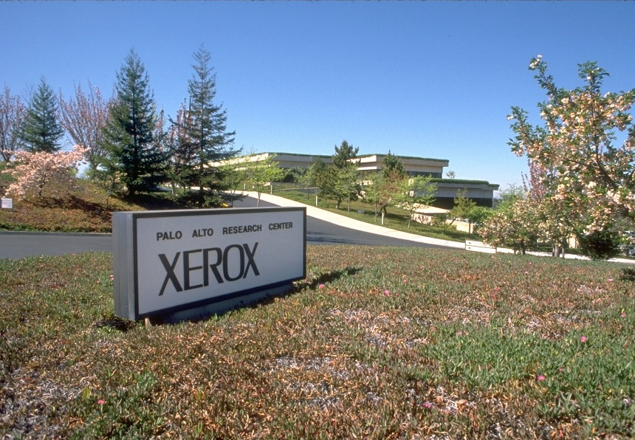
Xerox PARC
Palo Alto Research Center (PARC)
Founded by Xerox in 1970
Still exists today, as a semi-autonomous research lab
Incredible collection of talent
Hired many people from SRI, and many researchers and engineers
Incredible collection of inventions, 1970-1982
Hardware
Invented workstations, laser printing, the Ethernet
Only part that Xerox made money on
Bitmapped displays
Software
Invented many of the standard OS and systems principles
Object oriented programming (Smalltalk)
Model-View-Controller architecture
Interpress, a resolution-independent graphical page-description language and the precursor to PostScript
User Interfaces
(Also invented lots about Ubiquitous Computing in the 1990s – covered later)

Slide 17
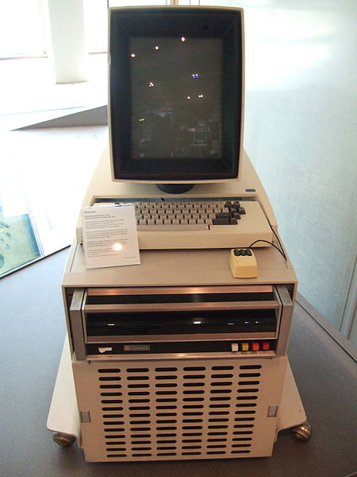
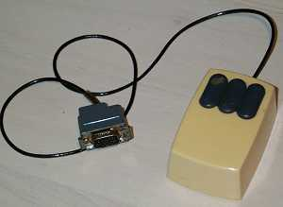
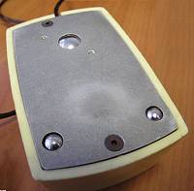
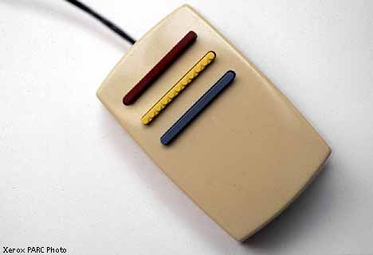
Xerox Alto Machine
Everyone else at the time was using mainframes or “mini computers” that were shared
“Time Sharing”
Alto was one of the first “personal workstations”
Starting about 1973
No operating system – each program had its own libraries and low-level access mechanisms
Three button mouse with two opposing roller wheels
Red, Yellow, Green vertically
Later replaced with left, middle, right, with single metal roller
Was secret for a long time, but later distributed to many universities

Slide 18
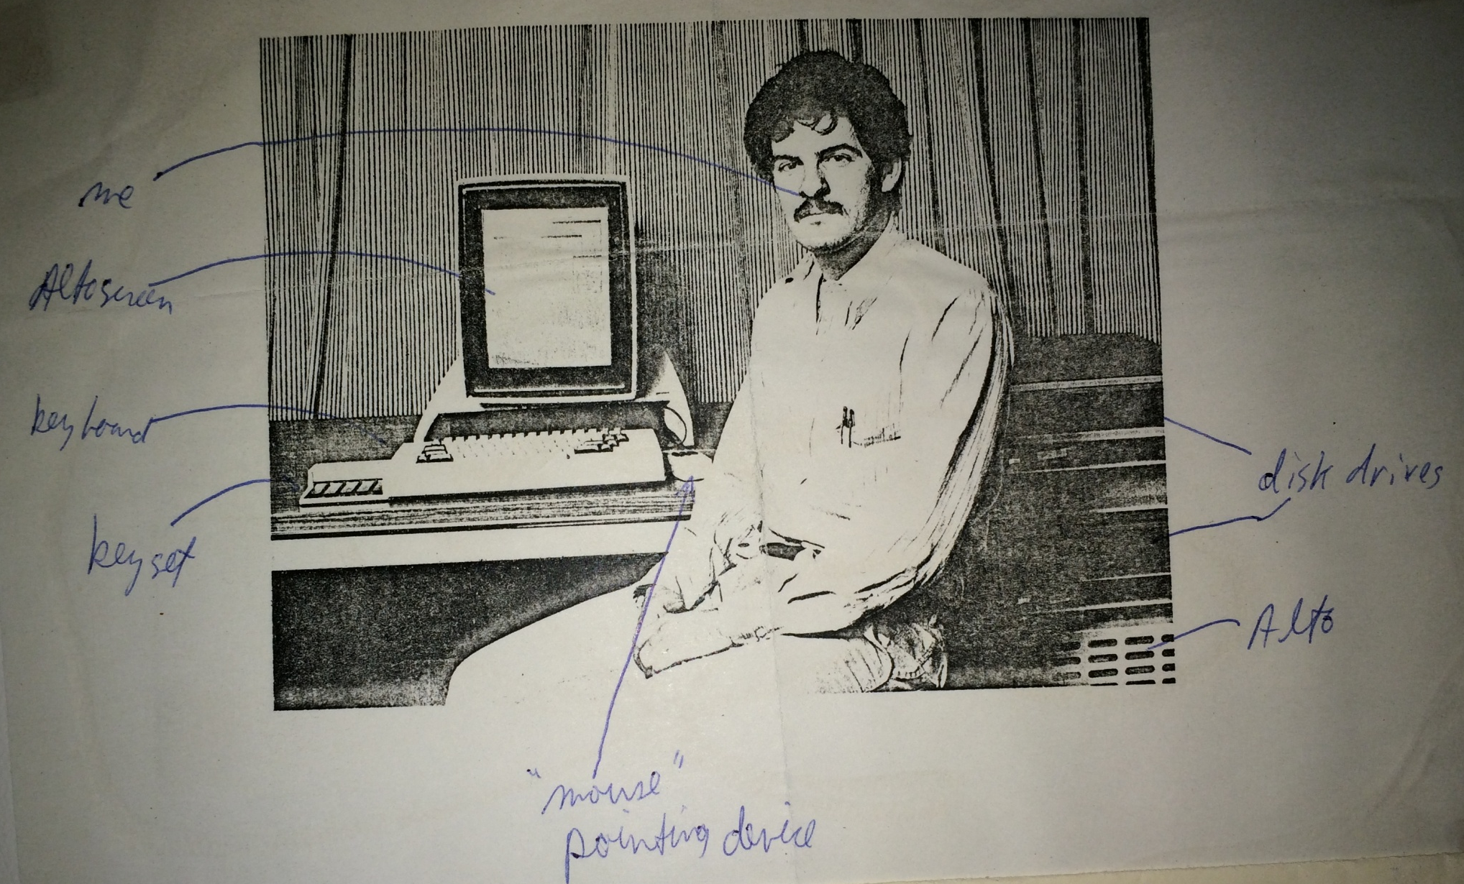
Brad Myers with an Alto, 1979
From my Dad’s scrapbook for that year, with my annotations!

Slide 19
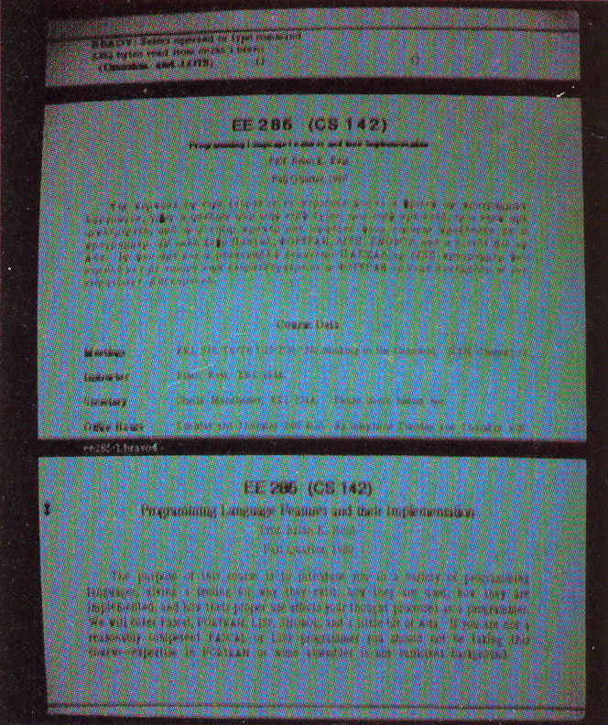
“Bravo”
Butler Lampson, Charles Simonyi and colleagues in 1974
Simonyi went to Microsoft and created Microsoft Word
First WYSIWYG text editing
Multiple fonts, bold, italics, etc.
Justification
Interaction techniques are quite different
Left mouse button – select character, middle – select word, right – extend selection
Left – scroll up, right – scroll down, middle - thumb
Highly moded commands:
“r” for replace, “d” delete, “I” insert, “ESC” for stop inserting, …
“EDIT”

Slide 20
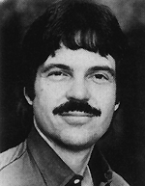
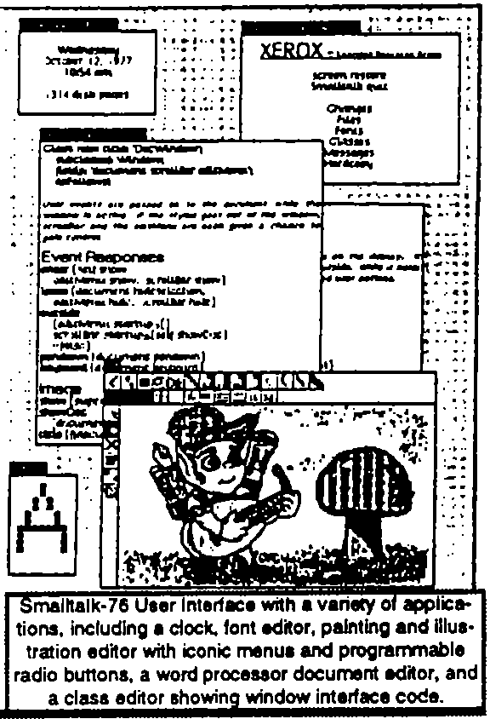
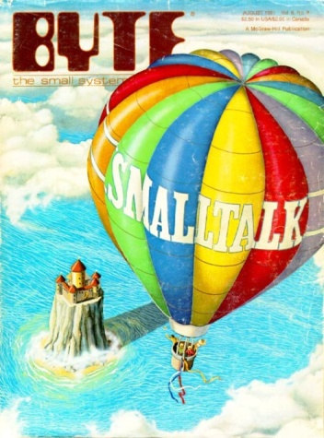
Smalltalk
Started about 1972 as the first purely object-oriented language by Alan Kay
Alan Kay proposed the idea of overlapping windows in his 1969 doctoral thesis
Overlapping windows first appeared in 1974 in the Smalltalk’74 system
Also used popup windows, scroll bars, etc.
Larry Tesler invented the “browser” for code for Smalltalk
Smalltalk’80 is best known – Byte article, generally released and described
I worked with Smalltalk in 1977
All the interaction techniques will be covered in the various topics

Slide 21
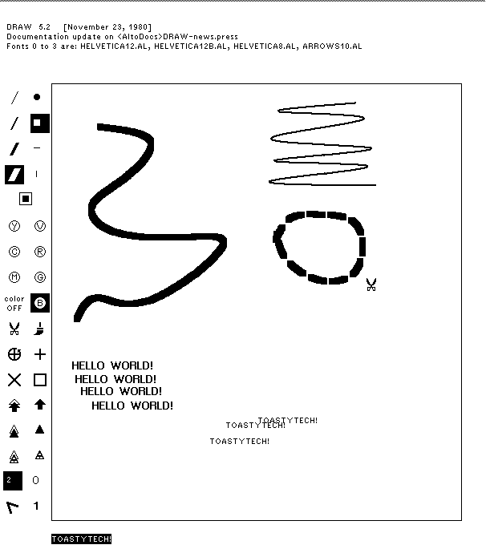
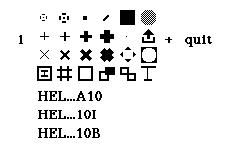
Various Drawing Programs
Draw – cubic splines for curves
Markup – in-place pop-up context menus
Source: http://toastytech.com/guis/saltodraw.png

Slide 22
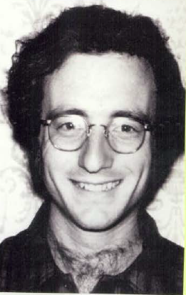
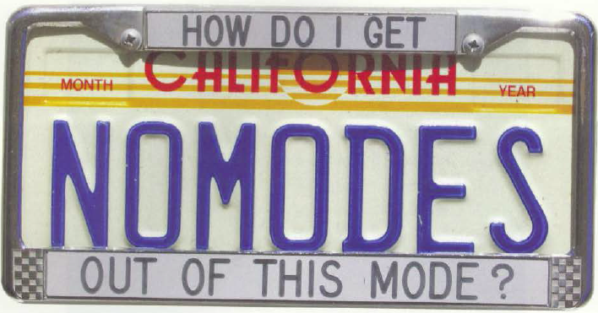
Larry Tesler
1945 – 2020
Xerox PARC 1973
Rejected highly moded interactions of Bravo
With Tim Mott, et. al, invented non-moded interactions for Gypsy editor including Copy and Paste about 1974
Added to Smalltalk editing
Apple in 1980
In charge of the Lisa design team
Video of his 2014 lecture: https://www.cs.cmu.edu/~bam/uicourse/ 2014inter/schedule.html#larrytesler

Slide 23
VisiCalc
First spreadsheet program, in 1977-8
Dan Bricklin (see Chapter 27) and Bob Frankston for the Apple II while they were students at MIT and the Harvard Business School
Character terminal

Slide 24
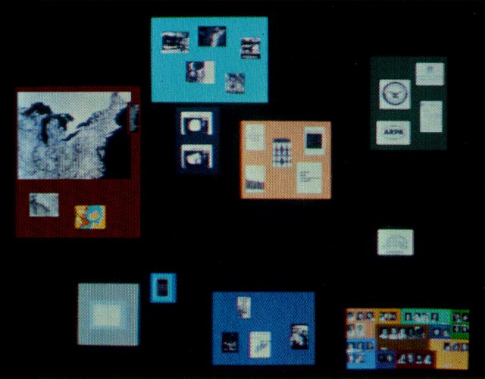
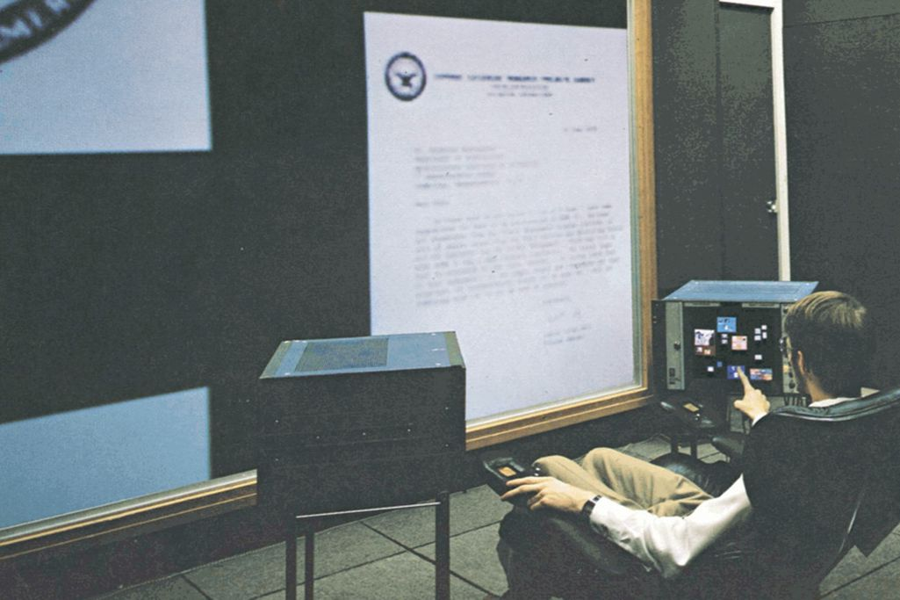
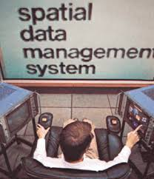
MIT’s SDMS
1978
Spatial Data Management System (SDMS) from MIT’s Architecture Machine Group (now Media Lab)
Zoomable user interface
First system to include clock, calendar, other accessories on the desktop as icons or tiny applications

Slide 25
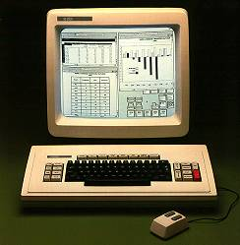
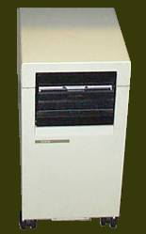
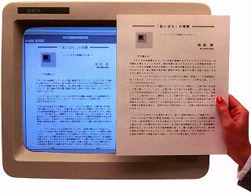
Xerox Star
Released 1982
Designed for executives
Too expensive for secretaries
Large team of designers who were not from PARC
Their building was next door to PARC
Extensive user interface studies guided designs
Key innovations to be covered later
Desktop metaphor
Many modern widgets
WYSIWYG editing and drawing
No PowerPoint or Spreadsheet programs
Mostly closed – only Xerox made applications
Too expensive and seemed slow
Images: http://toastytech.com/guis/star2.html

Slide 26
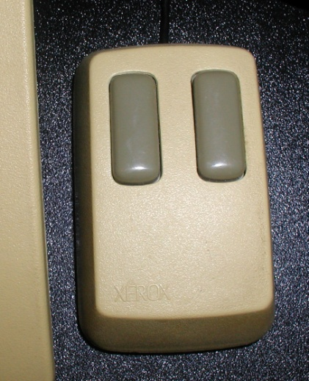
Star User Testing
"The design effort took more than six years .... The actual implementation involved from 20 to, eventually, 45 programmers over 3.5 years producing over 250,000 lines of highlevel code." [Harslem] By the time of the initial Star release, the Functional Test Group had performed over 15 distinct human-factors tests, using over 200 experimental subjects and lasting for over 400 hours (Figure 8). In addition, we applied a standard methodology to compare Star's text editing features to those of other systems [Roberts]. The group averaged 6 people (1 manager, 3 scientists, and 2 assistants) for about 3 years to perform this work.
-- [Bewley, CHI’1983]
One decision was to use a 2 button mouse!
Lots of special keyboard keys
See lecture by David Canfield Smith (icons) and Norm Cox (design): https://www.cs.cmu.edu/~bam/uicourse/05440inter/index.html#ixtinventors
Notes:
First real CHI conference

Slide 27
Apple
Xerox wanted to invest in Apple
In exchange, Steve Jobs got the right to use all of Xerox’s ideas
Steve & his team (Bill Atkinson) were given a demo of various Alto programs in 1979
Mouse
Smalltalk – overlapping windows – thought they updated
Bravo WYSIWYG editing
Apple hired Larry Tesler & others, 1980

Slide 28
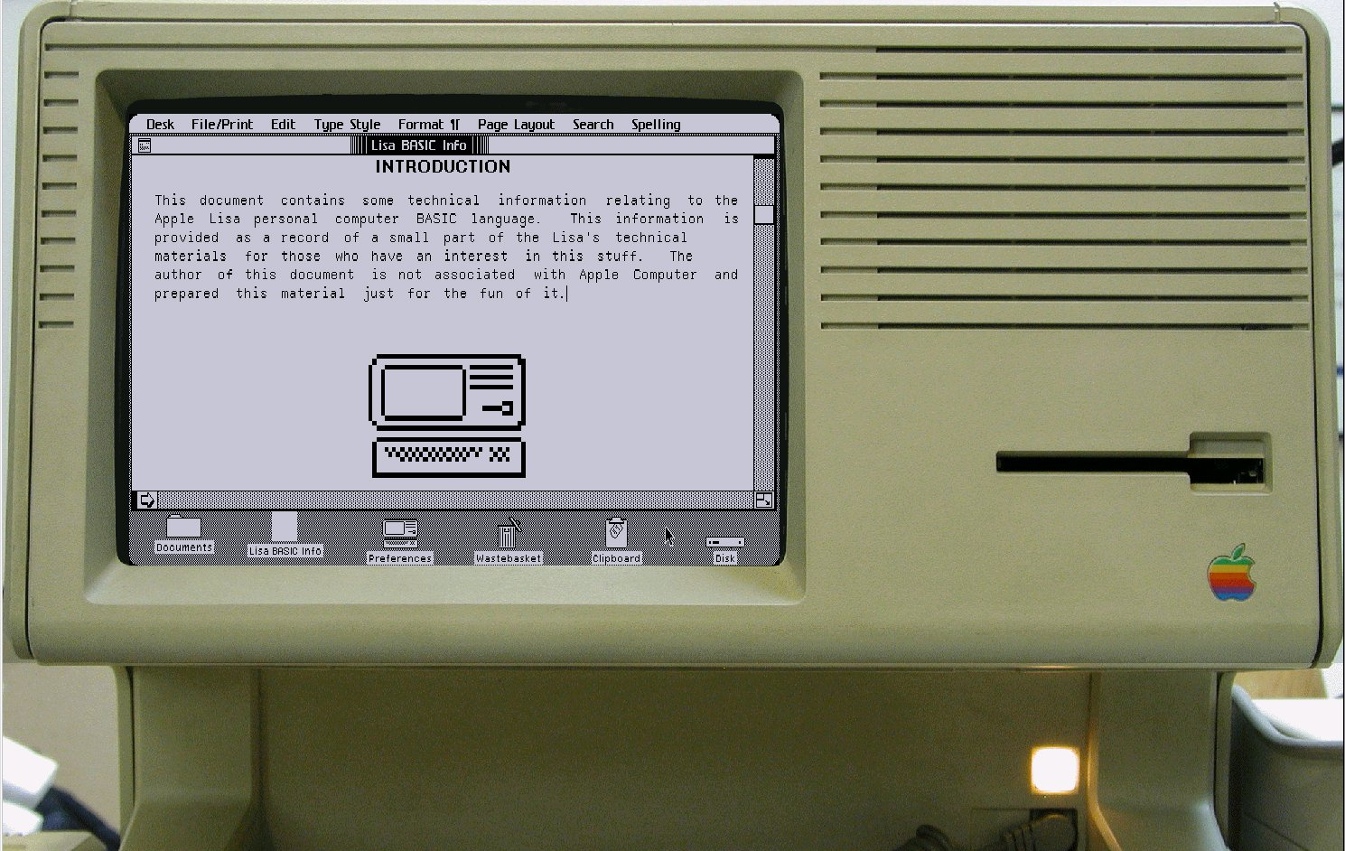
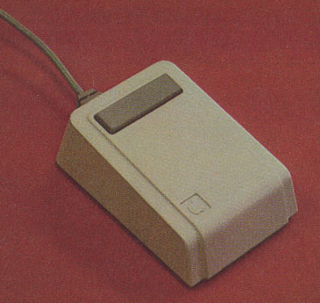
Apple “Lisa”
1983
Original design for desktop
Bill Atkinson & others
Novel pull-down menus (at top of screen)
Dialog boxes
Many other UI innovations
Doesn’t look or work like the Star
One button mouse
Amazing programming expertise to get it to work on a tiny, inexpensive machine
Image: http://toastytech.com/guis/lisa.html

Slide 29
Original Macintosh
1984
Much cheaper than Lisa
No harddisk – just one floppy
128 k-bytes of memory
Much of code re-implemented in assembly
Famous 1984 Super Bowl ad by Ridley Scott

Slide 30
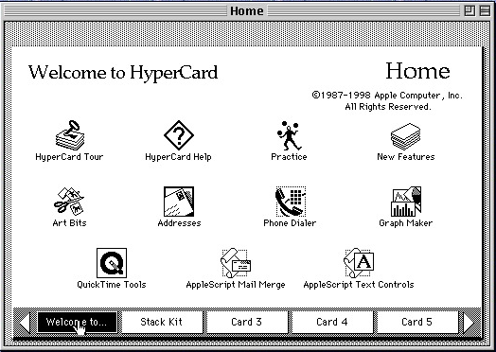
HyperCard
Bill Atkinson, 1987; see his 2019 lecture: https://www.cs.cmu.edu/~bam/uicourse/ 05440inter2019/schedule.html#billatkinson
Intention – “programming for the rest of us”
One of the first “prototyping” systems
But not used for many “real” applications
Many UI innovations
Tear off menus
Pages that overlay each other
Animated transitions
“Tabbed notebook” look&feel
Programmed in “HyperTalk”
English-like language

Slide 31
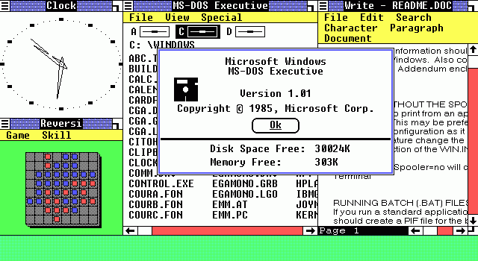
PCs & Windows
IBM PC – 1981
(IBM had missed the “minicomputer” phase dominated by DEC)
Used Microsoft’s DOS 1.0 and shipped with VisiCalc
Windows 1.0 released in Nov, 1985 as DOS extension
Tiled window manager
Windows 2.0 was overlapping 1987
Windows 3.0 in 1990, 3.1 in 1992
Was a real operating system
Added virtual memory, protected multiple processing, etc.
Windows 1 from Wikipedia

Slide 32
Other systems
NeXT – by Steve Jobs
Workstation OSs and Window Managers (SunWindows, Andrew, X, etc.)
World-Wide-Web

Slide 33
Interaction Styles
Textbook defines many kinds of interactions and UIs that use IxTs
With histories and important milestones
Many are covered in later lectures (e.g., text editing, gestures, 3D, XR, etc.)
Other key ones that are in wide use today:
Form fill-in
Direct Manipulation of graphical objects
Window Managers
Drawing and Painting Programs
Drawing = graphical objects maintain their integrity after being drawn
Painting = just pixels of colors after drawing
(Most painting systems are actually hybrids)
Spreadsheets
etc.

