Slide 1
Lecture 5:
Menus
(chapter 7 of textbook, & video)
Brad Myers
05-440/640: Interaction Techniques
Spring, 2025

Slide 2
Logistics
Required “reading” for this and future lectures includes video sections
All the Widgets video, vimeo or YouTube or download wmv file (600MB), sections: "Menus", "Palettes", "Buttons", "Radio buttons", "Checkboxes" (00:17:16 - 01:01:14), and "Forms and dialog boxes" (01:21:31 - 01:30:05)
Homework 1 is due Monday on Canvas as PDF
  https://www.cs.cmu.edu/~bam/uicourse/05440inter2025/hw1.html
Then start on Homework 2 on Menus
  Due 2 weeks later: Mon, Feb. 17, 2025
  Send me interesting menus!

Slide 3
What is a “Menu”?
My definition: “a widget that allows the user to choose one or more commands or values from a set of options” -- chapter 7
  Wikipedia: now: “In user interface design, a menu is a list of options presented to the user.”
    2022: “a menu is a list of options or commands presented to an operator by a computer or embedded system.”
    Previously said “communication system”
Includes “buttons”, “radio buttons”, “check boxes”, “palettes”, and other interaction techniques for choice
Not selecting objects in graphics editors, selecting cells in spreadsheets, etc.
  Also, not text entry
Choosing one or more of a set is one of the fundamental interaction operations:
  Foley & Wallace, 1974 – “A button is for selecting a system defined object such as an action to be performed…”
Hundreds of variations
Why menus?
  Takes advantage of “recognition rather than recall” – important guideline from HCI (Nielsen)

Slide 4
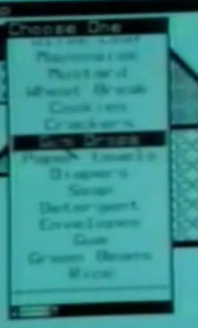
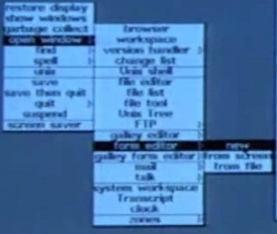

Definitions & Categories
(Regular) Menu – widgets that display a list of options where the options are visible, and the full option itself is highlighted to show it is selected.
Submenu – a menu that appears as a result of a previous menu item being selected
Popup menu – starts out not visible and becomes visible as the result of a user action, typically the user pressing a mouse button or on a touchscreen, then becomes invisible again
  Context menu – popup where the items in the menu depend on where click
Fixed menu – generally visible

Slide 5
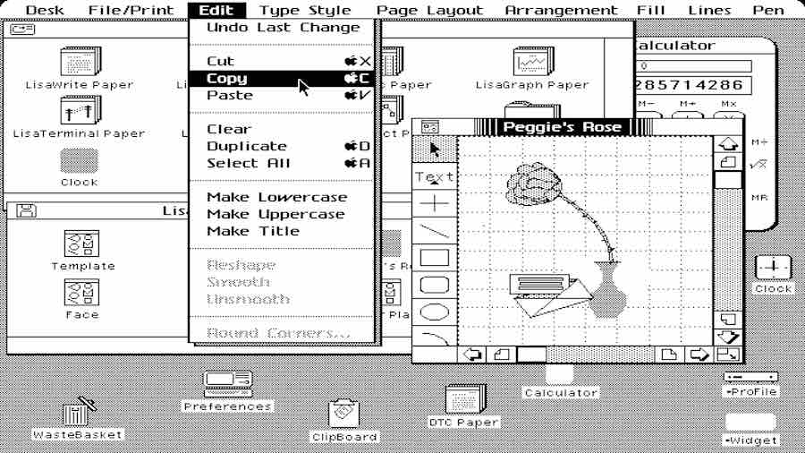
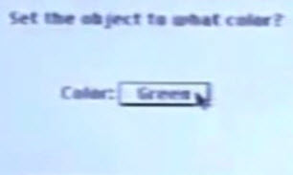
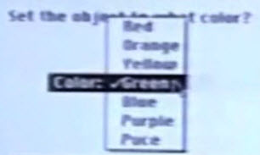
Definitions & Categories, cont.
Hierarchical Menu – tree of submenus
  Cascading Menu – submenus to the side, may be multiple levels
  Menu Bar (= Drop-Down Menu, menubar) – top menu is fixed and usually horizontal
Combo Box or Drop-Down List – (or option menu) button or text field with popup
Notes:
Conventional Menu Bar – acrobat

Slide 6

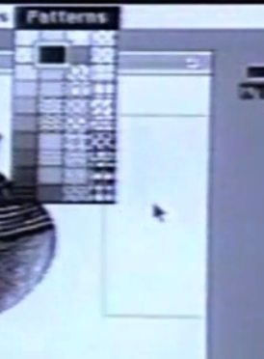
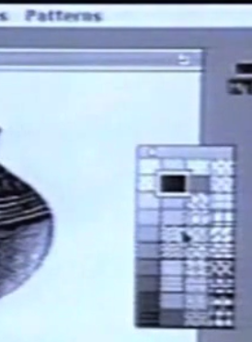
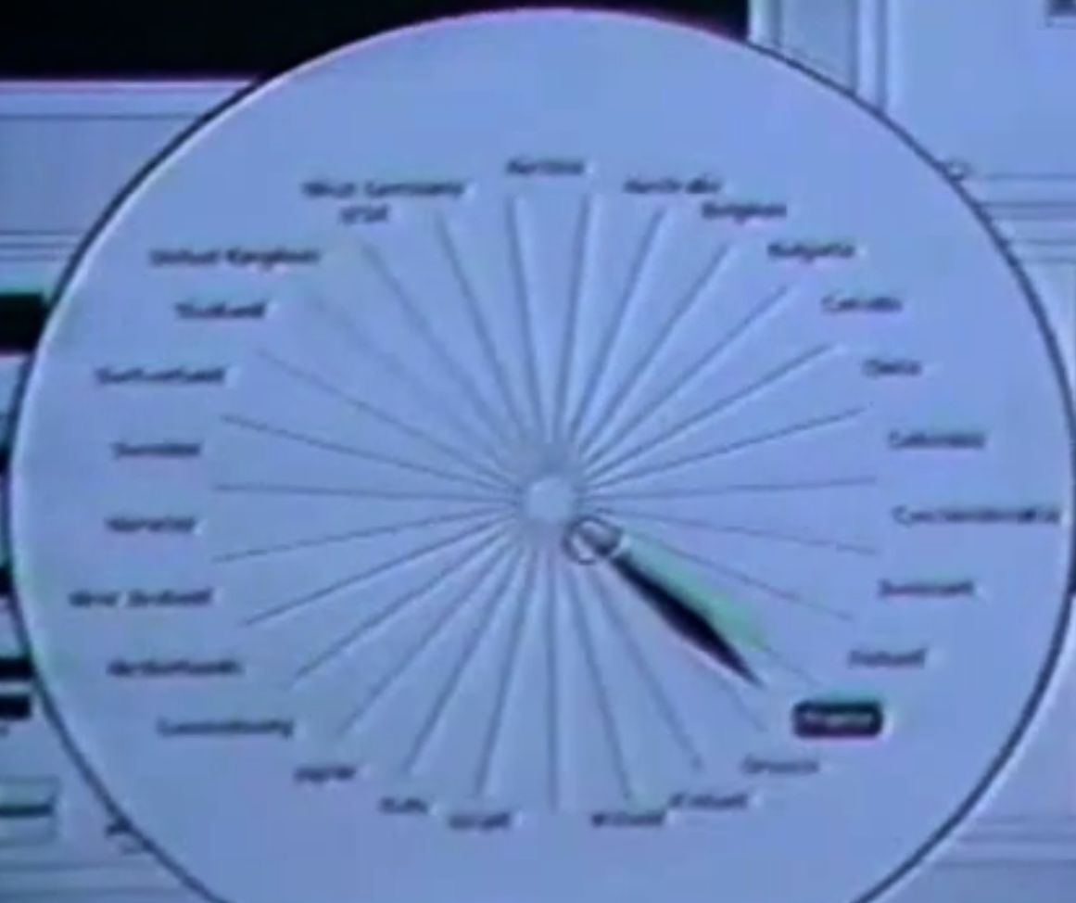
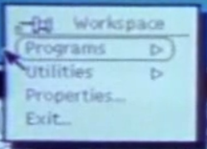
Definitions & Categories, cont.
Palette – a fixed menu, usually of icons or properties, that controls persistent modes or options
Tear-Off Menu (= Pinned Menu)
– submenu that can turn into a
fixed menu
Pie Menu – items in a circle

Slide 7

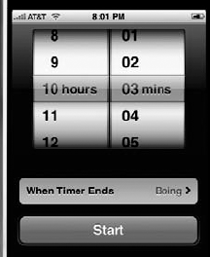


Definitions & Categories, cont.
Accordion Menu – submenus open in-place, one at a time
Spin Menu – (= spinner or roller menu), uses the metaphor of a wheel with the options printed on it, that rotates
Audio Menu or Phone Tree – no display
Button - a widget which triggers an event or designates a single value
  Physical or graphical
  Depicted as separate
Key – set of buttons for entering characters (keyboard, keypad)
Menu button – button to pop up a menu
Notes:
Accordion: https://www.upmc.com/healthcare-professionals/physicians
Hierarchical, and submenus: https://www.macys.com/?lid=glbtopnav_macys_icon-us

Slide 8
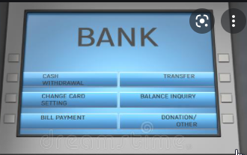
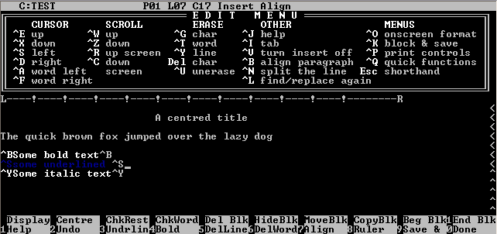
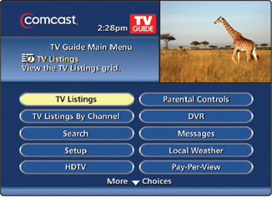
Definitions & Categories, cont.
Soft Keys – on-screen labels for physical buttons
On-Screen menus – on a TV, with remote
Checkbox – zero or more selected
  Label beside the graphic
Toggle switch

Slide 9
Definitions & Categories, cont.
Radio buttons – select exactly 1 selected
  Often circles
…any other names?

Slide 10

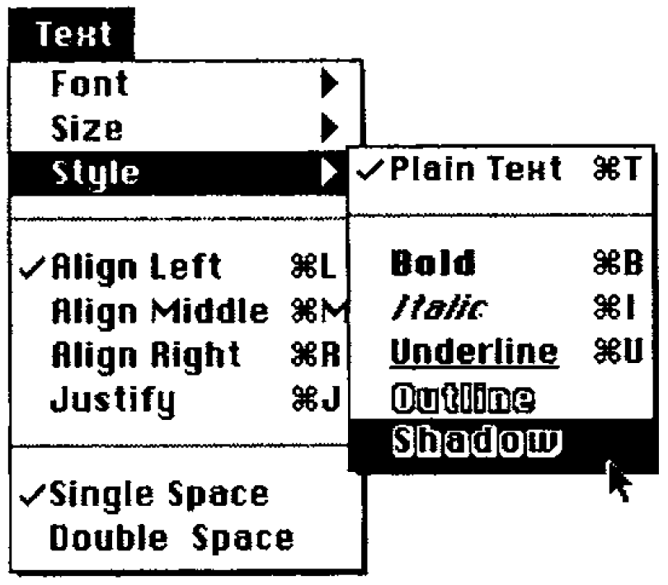

Taxonomy of Menu Design Dimensions
These affect which kind a designer would use
How many items can be selected?
  Radio buttons = 1; checkboxes = many
  Menus = either
    May have checkmarks for which is selected
  Partial selection
  Shift-key for all in a range
  Control-key for toggle

Slide 11
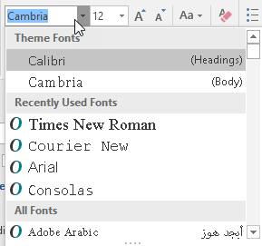
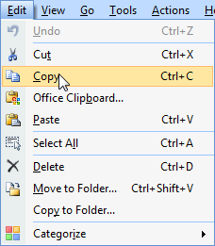
Taxonomy, cont.
How many items are there in the menu?
  Issues of different lengths of menus, and how this type of menus deals with this size (is the number of items: 2, 10, 50, 100, 1000, etc.)
  Scroll if too many
How are the items arranged in the menu?
  Arranged alphabetically (apple, bread, crackers, ...)
  Arranged in groups by topic (apple, pear, |,
  crackers, cheese ...). Another example is the
  typical Edit menu: Undo, Redo | Cut, Copy,
  Paste | ...
  Arranged hierarchically by topic (fruit>, snacks>, ...)
    Can the topic itself be selected?
  Arranged (apparently) randomly

Slide 12

Taxonomy, cont.
Fixed or Popup?
  Fixed menu, always on the screen.
  At the top edge of the screen, like on Macintosh, versus somewhere else, like on Windows.
  Also includes palettes, toolbars of icons, etc.
  Popup menu with a particular mouse button over any relevant object. For example, the right-mouse context menu.
  Popup menu from a specific icon or widget. E.g., an
  "option button" like for fonts
Invalid items removed or greyed out?
  Older systems removed invalid items
  Lisa & Macintosh greyed out
  Sometimes left in menu and give an error

Slide 13
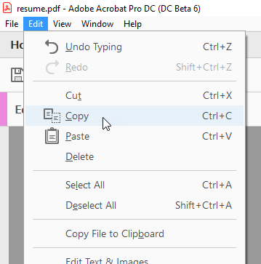
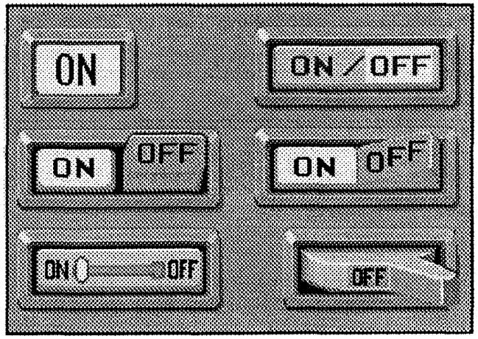
Taxonomy, cont.
Aborted or cancelled while operating?
  Almost always – move outside
  Sometimes hitting ESC key as well
Submenus?
  How does the user get to sub-menus, if any?
    Replace old menu with submenu? – rarely used anymore
    Slide out of an item to get its submenu.
    Click on an item to get its submenu.
Graphic Design (presentation)
  Highlight of selected item
  Show hover or interim selected
  How show difference between checkbox
  and radio button?

Slide 14
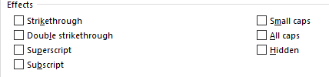

Taxonomy, cont.
Default value?
  E.g., what will be selected if hit <Enter>
Layout
  Horizontal list
  Vertical list
  Table
  Pie menus

Slide 15
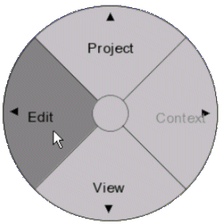
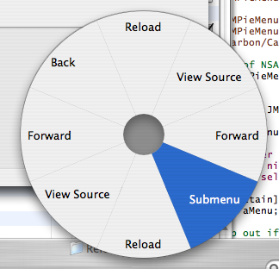
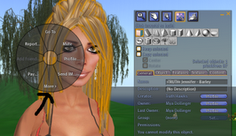

Pie Menus
J. Callahan, D. Hopkins, M. Weiser, and B. Shneiderman. 1988. An empirical comparison of pie vs. linear menus. In Proceedings of SIGCHI (CHI '88), J. J. O'Hare (Ed.). ACM, New York, NY, USA, 95-100. ACM ref
Shorter, and equal, distance to items
  Measured 15% increase in speed for 8 items
Lots of variants
  Submenus, interactions in and on menus, etc.
Lots of tradeoffs
  Size, precision that was needed
Don Hopkins later went to work at
Maxis on SimCity and The Sims
  Guest lecture in 2019

Slide 16
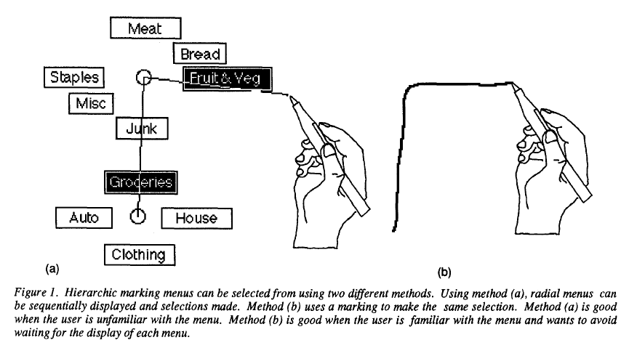
Variant of Pie menus: Marking Menus
Gordon Kurtenbach and William Buxton. 1993. The limits of expert performance using hierarchic marking menus. In Proceedings CHI '93. ACM, 482-487. http://dl.acm.org/citation.cfm?doid=169059.169426
Delayed appearance of menu graphic (1/3 sec) allows quicker invocation if remember the direction
  Up to 3.5 times faster than using the graphic menu
Hierarchical menus can be invoked
using a zig-zag stroke

Slide 17
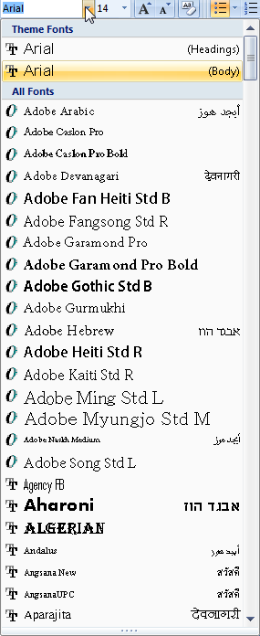
Taxonomy, cont.
Behaviors:
  How does the user interact with the menu:
  Which specific mouse buttons or keyboard keys?
  Can the user move from one item to another?
    Yes for regular menus, usually No for sets of buttons
  How is the menu initially invoked?
  How does the user interact with the items in the menu?
    Press and hold, move to item, release on item
    Press and release ("click") to start, click again to stop
  If the menu scrolls, how is that done?
  If there are multiple ways of using the same menus, then what are the alternatives. For example, are there keyboard accelerators? Do the menus work with the keyboard arrow keys?
  How many states does the menu have?

Slide 18

Menus date back to the beginning of computers
Sketchpad’s physical buttons for commands, 1963
  Not counting the knobs as “menus”

Slide 19
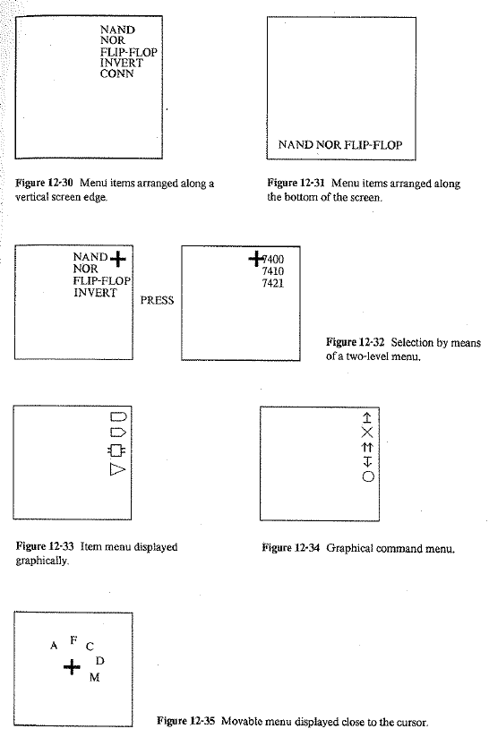
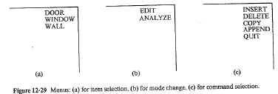
Various Menus from the 1960s
Including a Popup Pie Menu!
  NE Wiseman, HU Lemke, JO Hiles, “PIXIE: A new approach to graphical man-machine communication”, Proc. 1969 CAD Conf., IEE Conf. Pub 51, 1969, p. 463
  Mentioned in: William M. Newman and Robert F. Sproull (Eds.). 1979. Principles of Interactive Computer Graphics (2nd Ed.). McGraw-Hill, Inc., New York, NY.

Slide 20
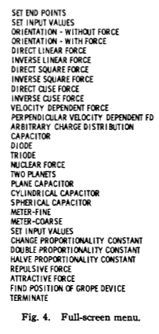
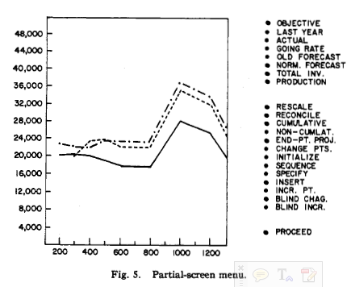
On Screen Menus
Foley & Wallace, 1974: “Menus can be used in two ways. Fig. 4 shows one which has temporarily replaced whatever had been displayed, while Fig. 5 shows one displayed with other material.”
  Designed to be selected with a light pen
  Also discusses only showing the relevant
  items

Slide 21
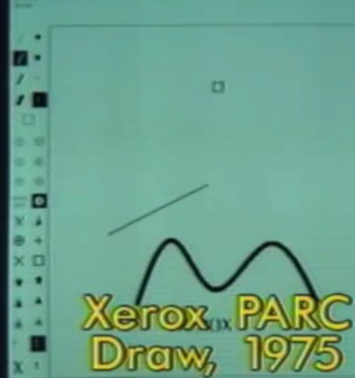
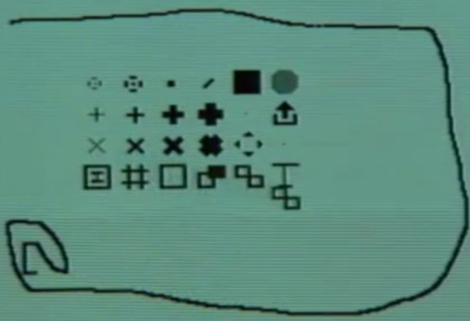
Xerox PARC Research Systems
Draw (1975) – fixed menus (palettes)
Markup (1974) – popup menus
  Unique one row at a time, see through

Slide 22
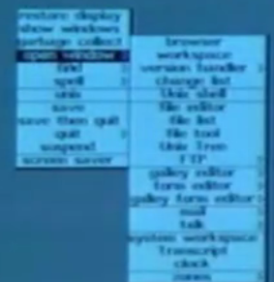
Smalltalk
1976
All menus are popup
Press and hold, release over the item
Submenus – press and release to get submenus
  Can be a long chain of submenus

Slide 23
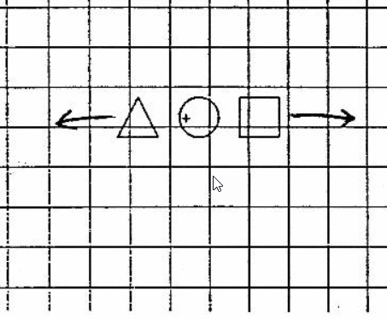
Bill Buxton’s menus
(Guest lecturer from 2022)
Whole menu moves, while selection point stays stationary.
1976

Slide 24
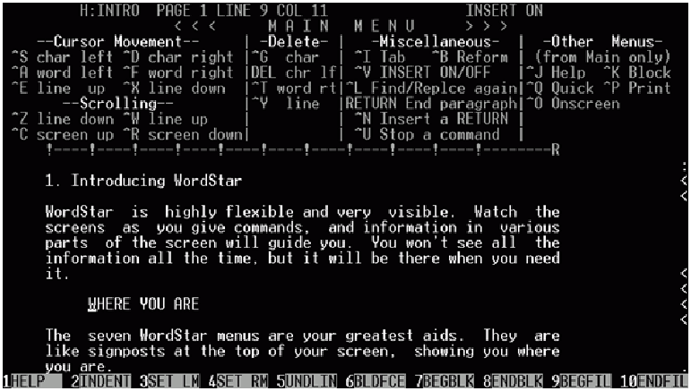
Soft keys
WordStar, June 1979
Mostly used
function keys
= “soft keys”

Slide 25
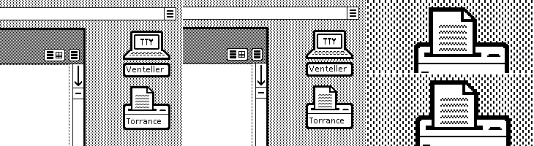

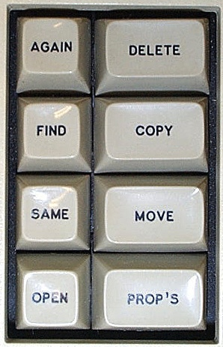
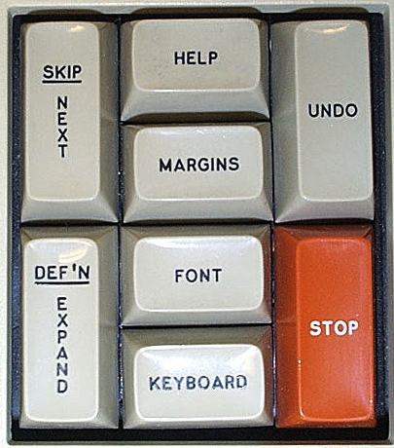
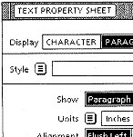

Xerox Star
1981
Command buttons
Menu buttons
  Didn’t need many commands since universal commands, and most were on special keys on the keyboard
    Top row could change functions
  Fewer capabilities
  Removes unavailable items
  Tried to get rid of even these
  menus
  Also in property Sheets (1985)
    Discussed in lecture 12

Slide 26
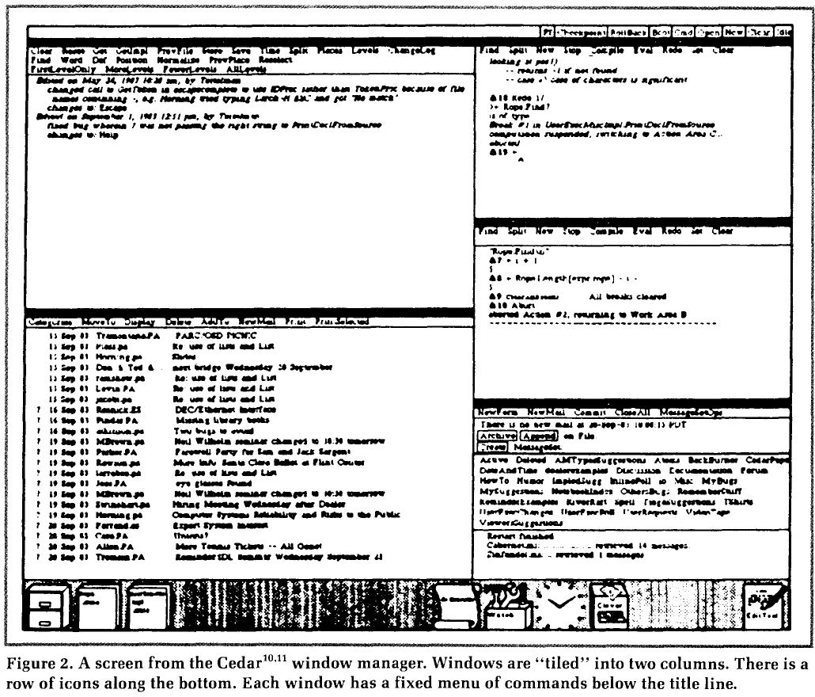
Cedar
1982
Tiled window manager
No covered window and no popup menus
All fixed menus

Slide 27
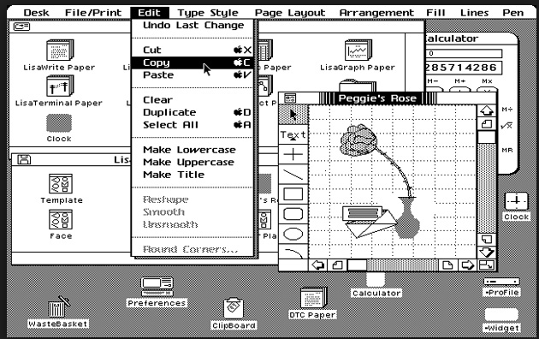
Lisa & Macintosh
1983-4
Menu bar
  Infinite Y-size (Fitts), easier to hit
Grayed out items
Items checked in menus
“…” if dialogs
Accelerators listed in menu
Flashing so can see what
selected
Submenus – only 1 level (Mac)

Slide 28
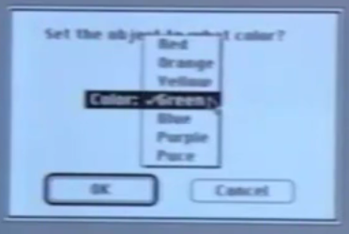
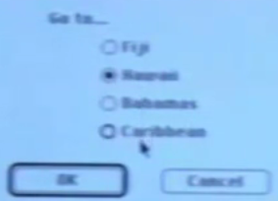
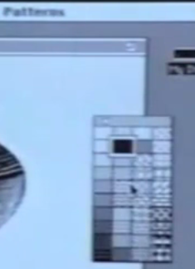
Other Lisa/Mac Widgets
Buttons; one can be default
“Popup menus” = combo boxes
“Radio” buttons, check boxes
  Interim feedback
HyperCard tear-off
menus (1987)

Slide 29
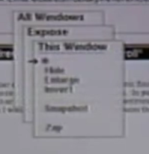
Andrew Toolkit popup menus
1985
Stack of menus
  Instead of pull-out hierarchy
Some design issues:
  Press and release does nothing
  “Mouse hole” to get back to where were
    Vs. Smalltalk – just click to repeat

Slide 30
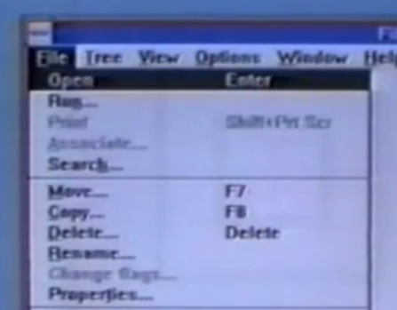
Microsoft
1988
3 different keyboard mechanisms
  Control-xxx or function keys
  ALT then letter (moded) = “mnemonics”
  Arrow keys then <Enter>
2 different mouse:
  Press-and-hold
  Click-click

Slide 31
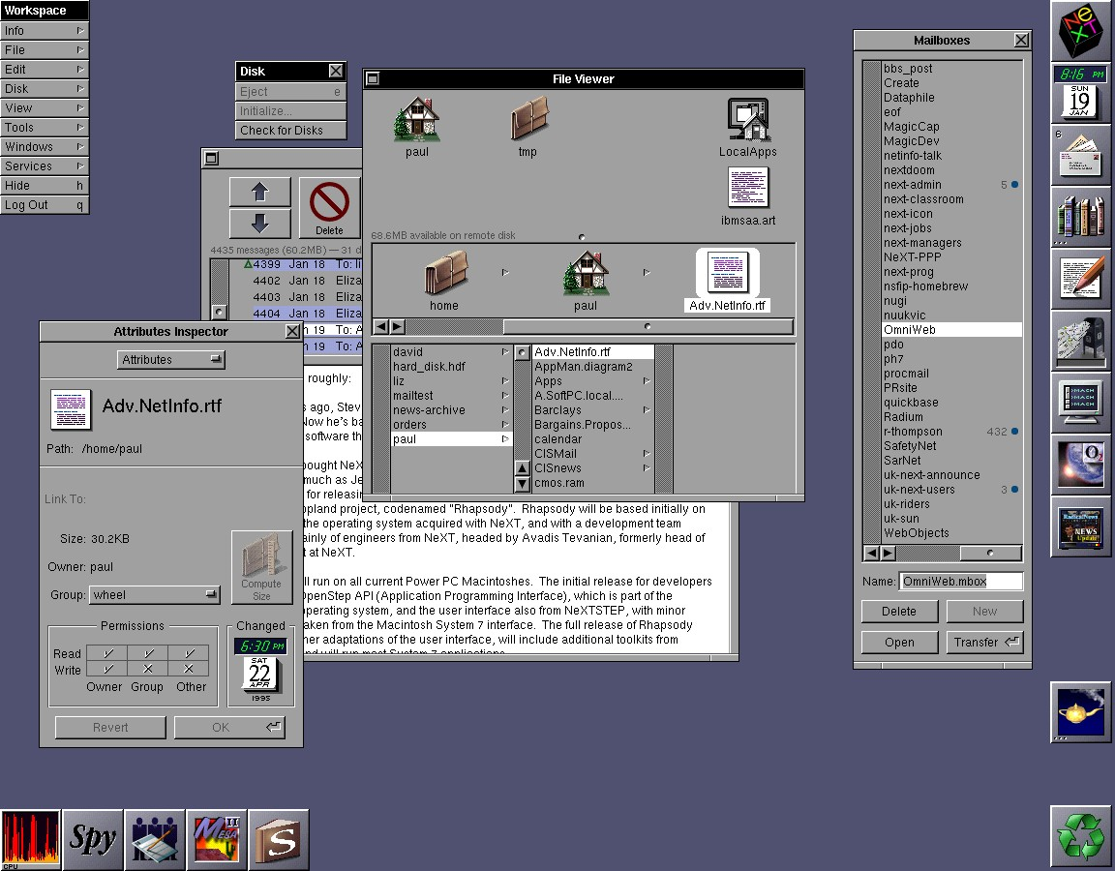
NeXT
1989
No menu bar
Fixed menu that can be moved around

Slide 32
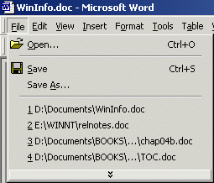
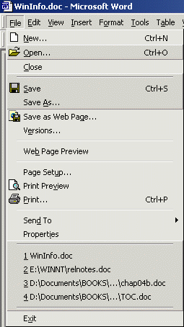


Office XP “Personalized Menus”
2001
Most frequently used in short version
Arrow to get the rest
  Would be interspersed, not at the end
Many people disabled them

Slide 33
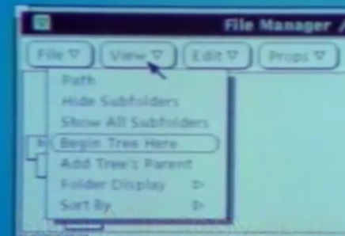
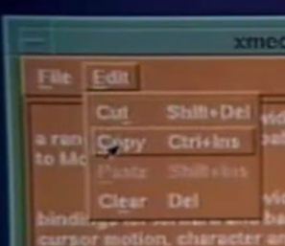
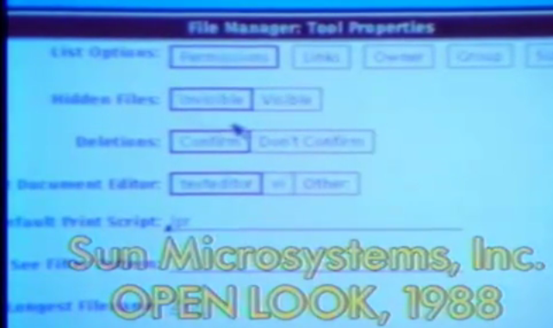

OpenLook & Motif
1988 & 1989
OpenLook: Look-and-feel for Unix from Sun in collaboration with Xerox
  Used some of Star look-and-feel
  Unusual pull-down menus with defaults
In competition with “Motif” which ended up winning
    From HP & DEC, etc.
    Better use of color, more 3D look
    Diamond vs. square
Notes:
Apple – Microsoft lawsuit, 1989

Slide 34



Palm Pilot
6 hard buttons
4 permanent buttons
On-screen buttons
  One is “menu”
Regular menu bar
Various kinds of option choices
Notes:
**stopped here, 2016

Slide 35





iPhone settings and menus
V1 – 2007
Genuinely new ways of interacting
  All finger sized
  Sliders for toggles
  Lots of hierarchical menus
  Spin menus
Starting with v7 – more stylized

Slide 36



Game Controllers and Consumer Electronics
Lots of buttons, arrow keys, joysticks
On-screen menus
Direct pointing with Wii

Slide 37



Standard Web page menus
Fixed menus of links
  Shneiderman counts all hyperlinks as “menus”
Pull out menus
Pull down menus
Accordion Menus – open and close
  Example: UPMC

Slide 38

Continues to be research on menus
Fisheye menus
Easier to roll-out to horizontal submenus
Menus on skin
Menus in VR
…

Slide 39
Recommendations on Menu Design
Hundreds of research studies on menu design choices
Whole old 368-page book just on menu design:
  Kent L. Norman, The Psychology of Menu Selection: Designing Cognitive Control at the Human/Computer Interface, Ablex Publishing Corporation, 1991, (ISBN: 0-89391-553-X), on-line
Shneiderman’s 2010 textbook has a 43-page chapter on Menus
  Ben Shneiderman and Catherine Plaisant. Designing the User Interface: Strategies for Effective Human-Computer Interaction (5th Edition). Reading, MA, Addison Wesley/Pearson. 2010.
Names must be “comprehensive and distinctive”
Logical hierarchy less error-prone and faster than random or alphabetical (64-item menus) [McDonald 1983]
  Hard to come up with good names
  Should be non-overlapping, familiar, distinct
  Can use “card sorting” to help elicit users’ categorization
  Especially when domain is familiar to users
  But this effect disappears with practice & familiarity [Card 82]
Can also be a network (graph) instead of a tree
  Multiple ways to get to same place

Slide 40

Issue: Breadth vs. Depth
When lots of items
  long menus, shallow depth = breadth
  Shorter menus, deeper = depth
[Norman 91] – breadth preferred over depth
  At most 3 levels deep or else users get lost and confused
[Jacko 1996] – errors and time increased as depth increased
  Users rated deep menus as more complex
Similar results for web site organizations [Larson 98]

Slide 41

Lots of Items
Long list or hierarchy?
  [Ceaparu, 2004] studied 645 items
  One alphabetical list or good categories
  Categories were significantly faster and preferred
Mixed results about reordering based on frequency of use
  [Mitchell 1989] – users were disoriented when reordered and slower
  [Greenberg 1985] – users were faster when most frequent were at top
  [Sears 1994] -- Combined, split menu works well = adaptive part plus all items

