Slide 1
Lecture 2:
Review of HTML and CSS
05-431/631 Software Structures for User Interfaces (SSUI)
Fall, 2021

Slide 2
Logistics
Monday is Labor Day – CMU Holiday, no classes
  Clara’s review session will be in the afternoon – how about 1:00pm?
  No office hour on this Monday
  Regular time, how about 10:15am Mondays?
Added Piazza to Canvas
  Added everyone? to Piazza
Homework 1 is available already, due 1 week from today
  I added it to Canvas

Slide 3

What they are
Html - Hypertext Markup Language
  Describes the content and structure
    And originally the look and behaviors
  Declarative
  oldest part: Invented by Tim Berners-Lee around 1991
CSS - Cascading Style Sheets
  Describe the look (“styles”)
  hierarchical, reusable definitions
  Declarative
  Started around 1996
JavaScript (JS)
  Originally by Netscape, called “LiveScript”
  from about 1995
  Renamed JavaScript for better publicity
  Imperative, Object-oriented programming language
HTML5 + CSS3 + JS around 2011
  Sufficient to build almost any regular UI
  No longer needed Flash, other plugins

Slide 4
What I will cover
Just a review
Lots of details for each language not covered
Excellent training and review sites online
  See schedule for some recommendations
Cover key structures and interactions here
  You can lookup the details as needed
Focus on the differences and how work together

Slide 5
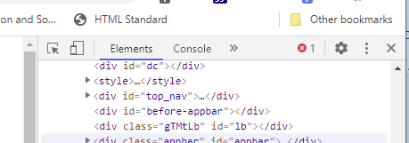
Useful for debugging all of these
Chrome debugger
  Bring up with F12 or ^shift-I on Windows
  Mac: Command+Option+I
Console, Elements, Sources, Styles – most useful
Inspect elements of the page
  right-click the element and select Inspect. Or press Command + Option + C (Mac) or Control + Shift + C (Windows, Linux,Chrome OS).
  Use “inspect” button
  Also note close: “x”
    Or F12 again
  Highlights code or elements –
  wherever mouse is

Slide 6
HTML

Slide 7
HTML - Syntax
tags with <xx> end with </xx>: <h1>big header</h1>
Content not in quotes
No escape character, use &qt; for >, &amp; for &
Multiple spaces, tabs and returns ignored, use <p> … </p> for paragraphs, <br/> for line breaks (/> since no closing tag),
&nbsp; for each extra space
  Single space often important, like <a href="">lnk</a>. ← no space before.
  But don’t use multiple spaces for formatting
Tags with parameters: <tag param1=“value1” param2=“value2”>
  Values in quotes, even if numbers (which often have units)
  Just spaces between
  Examples: <a href="SSUI-hw1.zip"> -- hyperlinks
  <img src="HW1-products-quickview.png" width="19%" height="19%" alt="example products quickview page" />
Comments: <!–- commented out -->
Names can contain hyphens: <p style="font-family:verdana">
Capitals rarely matter <li> = <LI>, but do sometimes - case sensitive about URLs, IDs, etc.
Browsers try hard to parse and display even if errors

Slide 8
Some important html elements
<p>
<ul> <ol> <li>
<em>, <strong>
<h1><h2>…
<div>
<span>
<table> <tr> <th> <td>
<image>
<a href=“”>

Slide 9
HTML – important tags
Top of file:
<html lang="en">
<head>
…
<link rel="stylesheet" href="style.css" />
<title>Homeworks …</title> -- important for bookmarks, icons, etc.
</head>
<body>
<h1>1st header</h1> … <h2>2nd level header</h2>
<p>…</p> <br/>
<ul> - unnumbered list <li>list item</li> <li>2nd</li>…</ul>
  <ol> - numbered list, <ol type="a">
<img src= "picture URL"/>
<a href="hyperlink URL"> -- may be a local or absolute reference
<div> … </div> - block-level element, used extensively (“division”)
<span> … </span> - text-level element, for a small number of words (or pictures)
  Usually these have parameters of the CSS class

Slide 10
HTML Tables
Used to be a key way to layout pages
  Not appropriate any more – use div that are placed
Still OK for tables, like the schedule
<table class="table table-bordered schedule-table">
<thead class="thead">
<tr>
<th>Num</th>
<th>Date</th>
<th>Class Content</th>
</tr>
</thead>
<tr>
<td>1</td>
….

Slide 11
ID of element
Elements can have an ID
  Must be unique per page
  Case sensitive
  Super useful!
<h2 id=“policies”>
Can be used as part of URL:
  <a href=“homeworks.html#policies">
Can be as reference for a style
  Style only applies to this particular element
Can be found in JavaScript:
  var policies = document.getElementById("policies");

Slide 12
HTML input tags
Usually wrapped in a <form>
<input type="value">
  Value can be button, checkbox, color (picker), date, …
  <input type="button" value="Click me" onclick="msg()">
Events and event handling in lecture 4
  Any html object can have an onclick action, as in homework, e.g., from JavaScript:
  element.addEventListener("click", funcToCall);

Slide 13
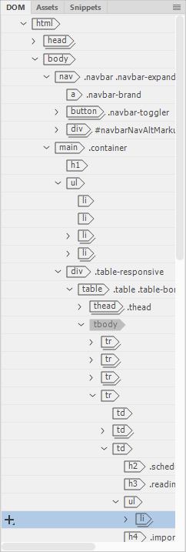
DOM
Document Object Model
Hierarchical structure of the web page document
Used by renderer, CSS and JavaScript
“Components”, “Containers”, “parent-child”
Often surprisingly deep
Can inspect with “Elements” of Chrome debugger

Slide 14
CSS

Slide 15
CSS syntax
selector {
prop1 : value1 ; /* comment */
prop2 : value2 ;
}
Completely different than html (closer to JS)
  Bracketed with { }
  No quotes for values
  “:” for assignment
  separated by “;”
  Comments as /* comment */
But names still can contain “-” : font-size

Slide 16
Options for “selector”
What this style is connected to
(1) Name by itself = html tag:
p {
color: red;
text-align: center;
}
(2) #ID for referencing IDs on the page
  Format just that one item
  #policies {
  text-align: right;
  }

Slide 17
CSS Classes
(3) can select a CSS class
  Note – not related to JS “class”
CSS class – name cannot start with a number
Reference in CSS file by starting with a period
    .slides {
    font-size: 1.25rem;
    font-weight: normal;
    font-style: normal;
    margin-top: 12px;
    margin-bottom: 12px;
    }
  Reference in html (no period): <h3 class="slides">
  Can reference more than one
    Separate with a space: <h3 class="slides homeworks“>

Slide 18
Selectors in CSS File
Can group more than one using comma
h1, h2, p {
text-align: center;
color: red;
}
Space used for descendent (anywhere down the hierarchy) = “”
  Any <p> inside a <div>:
  div p {
  background-color: yellow;
  }
Greater than “>” for immediate child only
  div > p {
  background-color: yellow;
  }
  <div>
  <p>Paragraph 1 in the div.</p>
  <section>
  <p>Paragraph 3 in the div.</p> <!-- not Child but is Descendant -->
  </section>
  </div>

Slide 19
More on selectors
Pseudo-classes for built-in states of elements
  :hover = while mouse is over it
  :link = unvisited hyperlink
  :visited = visited hyperlink
  :active = while mouse is pressed
  :root = top document, usually first in the CSS file
Designated with colon :
.mybutton:hover {
color: hotpink;
}
Can be combined, e.g., with class
a.mylinkclass:hover {
color: #ff0000;
}
  Only links marked with class mylinkclass will have hover
Specific order: a:hover MUST come after a:link and a:visited in the CSS definition in order to be effective! a:active MUST come after a:hover
a:hover MUST come after a:link and a:visited in the CSS definition in order to be effective! a:active MUST come after a:hover

Slide 20
Some units of measure for Values
in = inches, 1in = 96px = 2.54cm
px = pixels, 1px = 1/96th of 1in
pt = points, 1pt = 1/72 of 1in
% = percent, relative to the parent element, 50%
rem = relative to font-size of the root element
font-size: 1.25rem;
#a3 = hexadecimal (base 16) = 163 (10100011)

Slide 21


Some useful properties
color – text or foreground color
  background-color – behind the text (or background-image, etc.)
  Values = rgb(181, 43, 54);
    #ddd
    rgba(181, 43, 54, 0.05);
border-style: dotted, dashed, none, …
  border-bottom-style
border-width: 5px;
border-radius – rounded corners
border-collapse: collapse – esp. for tables

Slide 22
Positions and size
left, top, width, height, right, bottom
position:
  static – flows with other elements, default
  relative – to it’s parent
  fixed - relative to the viewport
  absolute – based on container that has a specific position (any that isn’t static)
  sticky – scrolls then sticks
Float: left or right or none
  Often used for pictures
  Text fills around it

Slide 23
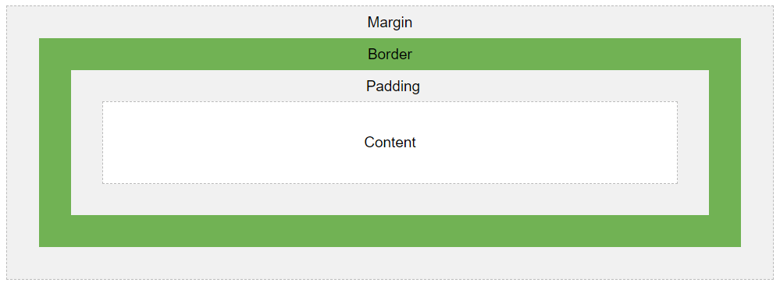
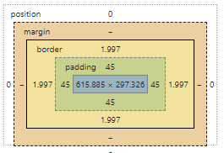
Margins & Padding
margin – all 4 margins
margin-top, margin-bottom, margin-right, margin-left
What about elements next to each other?
  Margin collapse = takes max of margin-bottom of first and margin-top of lower
  Right and left just add
padding – outside content, but inside margins
Also available at bottom of Chrome inspector “Styles” tab

Slide 24
Text
Text-align: center or left or right or justify
vertical-align: top or middle or bottom – useful in table cells
font-family: "Times New Roman", Times, serif;
font-style: normal or italic
font-weight: normal or bold
font-size: 14px or other units
text-decoration: none; - often used to remove underline for links
Notes:
STOPPED HERE

Slide 25
Special Properties
display: none; -- remove the element, often used when dynamically shown or hidden
visibility: hidden – remove element but leave its room
display: inline; -- override normal linefeed, e.g., to make <ul> lists horizontal
display: flex; - flexbox: put in a row or column
  justify-content: space-between; - spread out to fill the row
  flex-wrap: wrap; - multiple rows if don’t fit
transition: 0.5s; - animate change over ½ seconds

Slide 26
Adjusting to size of screen
For responsive web pages, that adjust based on size or orientation of the screen
.nav-item.divider { …
}
@media (max-width: 767px) {
.nav-item.divider {
display: none;
}
}
  Only used when width of browser window > 767px
  Overrides definitions just above, or adds to them
Can have multiple with different ranges

Slide 27
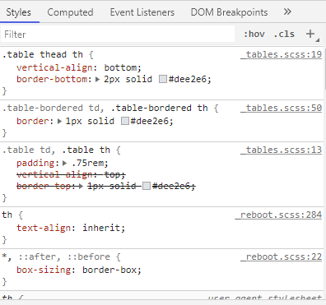
Cascading
Properties overridden
  E.g., vertical-align set in multiple places
  Inspector shows which ones in force
Source order – latest wins
Tag type < Class < ID
  More specific wins (right most)
Inherited from parent→ child, e.g.,
body { color: blue; }
will be inherited unless overridden
  Note: “inheritance” here is by component,
  not type
Can overrule with
!important;

Slide 28
Putting them together
Html
  Main file is */index.html
  Typically one html file per web page
  Each .html file references the needed JS and CSS files at the top
Put JavaScript into own file
  Often index.js or main.js unless a shared library
  Or directly in the html file <script> … </script>
  (Later with React-JS will be different)
CSS also in its own file
  Often style.css
  Also can be in the html file <style> … </style>

