Slide 1
Virus Propagation on Time-Varying Networks: Theory and Immunization Algorithms
B. Aditya Prakash*, Hanghang Tong* ^, Nicholas Valler+, Michalis Faloutsos+, Christos Faloutsos*
*Carnegie Mellon University, Pittsburgh USA
+University of California – Riverside USA
^ IBM Research, Hawthrone USA
ECML-PKDD 2010, Barcelona, Spain

Slide 2
Two fundamental questions
Strong Virus
Epidemic!
Q1: Threshold?

Slide 3
example (static graph)
Weak Virus
Small infection
Q1: Threshold?

Slide 4
Questions…
Which nodes to immunize?
?
?
Q2: Immunization
Notes:
Knight or armor or shield

Slide 5
Our Framework
Standard, static graph
Simple stochastic framework
Virus is ‘Flu-like’ (‘SIS’)
Underlying contact-network – ‘who-can-infect-whom’
Nodes (people/computers)
Edges (links between nodes)
OUR CASE:
Changes in time – alternating behaviors!
think day vs night

Slide 6
Reminder: ‘Flu-like’ (SIS)
‘S’ Susceptible (= healthy); ‘I’ Infected
No immunity (cured nodes -> ‘S’)
Infected by neighbor
Susceptible
Infected
Cured internally

Slide 7
SIS model (continued)
Virus birth rate β
Host cure rate δ
Healthy
Prob. δ
N2
Prob. β
N1
X
Prob. β
Infected
N3
Notes:
humans and ‘knights’, as before…

Slide 8
Alternating Behaviors
DAY
(e.g., work)
adjacency matrix
8
8

Slide 9
Alternating Behaviors
NIGHT
(e.g., home)
adjacency matrix
8
8

Slide 10
Outline
√Our Framework
√SIS epidemic model
√Time varying graphs
Problem Descriptions
Epidemic Threshold
Immunization
Conclusion

Slide 11
Formally, given
Healthy
Prob. δ
N2
SIS model
cure rate δ
infection rate β
Set of T arbitrary graphs
Prob. β
N1
X
Prob. β
Infected
N3
day
night
N
N
….weekend…..
N
N
Notes:
weekend

Slide 12
Find…
I
Q1: Epidemic Threshold:
Fast die-out?
above
below
t
Q2: Immunization
best k?
?
?

Slide 13
Q1: Threshold - Main result
NO epidemic if
eig (S) = < 1
Single number!
Largest eigenvalue of the “system matrix ”

Slide 14
NO epidemic if eig (S) = < 1
Details
S =
cure rate
infection rate
adjacency matrix
day
night
……..
N
N
Notes:
details

Slide 15
Q1: Simulation experiments
Synthetic
100 nodes
- Clique - Chain
MIT Reality Mining
104 mobile devices
September 2004 – June 2005
12-hr adjacency matrices
(day) (night)

Slide 16
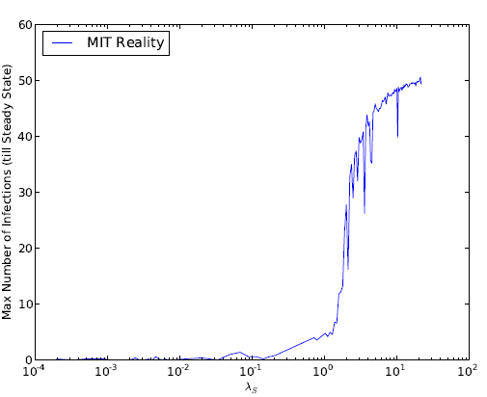
‘Take-off’ plots
Footprint (# infected @ steady state)
Synthetic
MIT Reality Mining
Our threshold
EPIDEMIC
EPIDEMIC
Our threshold
NO EPIDEMIC
NO EPIDEMIC
(log scale)

Slide 17
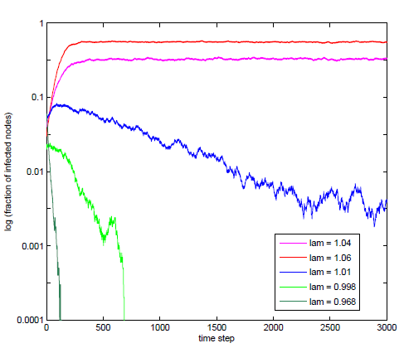
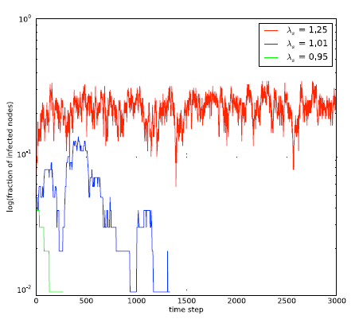
Time-plots
log(# infected)
Synthetic
MIT Reality Mining
ABOVE threshold
ABOVE threshold
AT threshold
AT threshold
BELOW threshold
BELOW threshold
Time
Notes:
write ‘below threshold’ for eig < 1
AT threshold
above threshold

Slide 18
Outline
√Motivation
√Our Framework
√SIS epidemic model
√Time varying graphs
√Problem Descriptions
√Epidemic Threshold
Immunization
Conclusion

Slide 19
Q2: Immunization
?
?
Our solution
reduce (== )
goal: max ‘eigendrop’ Δ
Comparison - But : No competing policy
We propose and evaluate many policies
Δ = _before - _after

Slide 20
Lower is better
Greedy-DavgA
Optimal
Greedy-S

Slide 21
Conclusion
….
Time-varying Graphs ,
SIS (flu-like) propagation model
√ Q1: Epidemic Threshold - < 1
Only first eigen-value of system matrix!
√ Q2: Immunization Policies – max. Δ
Optimal
Greedy-S
Greedy-DavgA
etc.

Slide 22
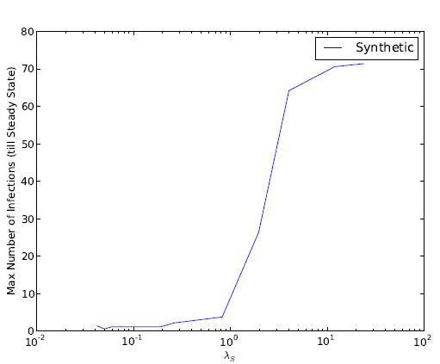
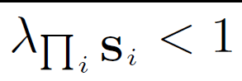
Our threshold
B. Aditya Prakash
http://www.cs.cmu.edu/~badityap
Any questions?

