Slide 1
Mining Billion-node Graphs
Christos Faloutsos
CMU

Slide 2
To do
E2.1: modeling time varying networks
Task I3.1: Methods for scalable mining of dynamic, heterogeneous information networks (Lead: Jiawei Han). This project is to answer the key research question: “What are the new principles and methods for mining distributed, incomplete, dynamic, and heterogeneous information networks to satisfy the end-user needs?”

Slide 3
Related Tasks for this presentation
E2.1
E3.1
I3.1

Slide 4
Big picture: large graph mining
Patterns / anomalies
Static graphs
Dynamic graphs
Weighted graphs
‘heterogeneous’ graphs (multiple-type nodes/edges)
Generators
Kronecker; Random Typing; Tensors
Influence/Virus Propagation

Slide 5
Big picture: large graph mining
Patterns / anomalies
Static graphs
Dynamic graphs
Weighted graphs
‘heterogeneous’ graphs (multiple-type nodes/edges)
Generators
Kronecker; Random Typing; Tensors
Influence/Virus Propagation
Duration of phonecalls (E2.1)
(I3.1)

Slide 6
Virus Propagation on Time-Varying Networks: Theory and Immunization Algorithms
B. Aditya Prakash*, Hanghang Tong* ^, Nicholas Valler+, Michalis Faloutsos+, Christos Faloutsos*
*Carnegie Mellon University, Pittsburgh USA
+University of California – Riverside USA
^ IBM Research, Hawthrone USA
demo
PKDD, 2010
INARC and IRC
ECML-PKDD 2010, Barcelona, Spain

Slide 7
Q1: threshold?
Strong Virus

Slide 8
Q1: threshold?
Strong Virus
Epidemic!

Slide 9
Q1: threshold?
Weak Virus

Slide 10
Q1: threshold?
Weak Virus
Small infection

Slide 11
Q2: Immunization?
Which nodes to immunize?
?
?
Notes:
Knight or armor or shield

Slide 12
Our Framework
Standard, static graph setting:
Simple stochastic framework (Flu-like – SIS’)
FIXED underlying contact-network – ‘who-can-infect-whom’
OUR CASE:
Changes in time – alternating behaviors!
E.g., day vs night

Slide 13
Reminder: ‘Flu-like’ (SIS)
‘S’ Susceptible (= healthy); ‘I’ Infected
No immunity (cured nodes -> ‘S’)
Infected by neighbor
Susceptible
Infected
Cured internally

Slide 14
SIS model (continued)
Virus birth rate β
Host cure rate δ
Healthy
Prob. δ
N2
Prob. β
N1
X
Prob. β
Infected
N3
Notes:
humans and ‘knights’, as before…

Slide 15
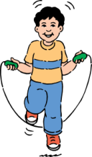
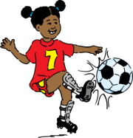
Alternating Behaviors
DAY
(e.g., work)
adjacency matrix
8
8

Slide 16
Alternating Behaviors
NIGHT
(e.g., home)
adjacency matrix
8
8

Slide 17
Outline
√Our Framework
√SIS epidemic model
√Time varying graphs
Problem Descriptions
Epidemic Threshold
Immunization
Conclusion

Slide 18
Formally, given
Healthy
Prob. δ
N2
SIS model
cure rate δ
infection rate β
Set of T arbitrary graphs
Prob. β
N1
X
Prob. β
Infected
N3
day
night
N
N
….weekend…..
N
N
Notes:
weekend

Slide 19
Find…
I
above
Q1: Epidemic Threshold:
Fast die-out?
below
t
Q2: Immunization
best k?
?
?

Slide 20
Q1: Threshold - Main result
NO epidemic if
eig (S) = λ_{S} < 1

Slide 21
Q1: Threshold - Main result
NO epidemic if
eig (S) = λ_{S} < 1
Single number!
Largest eigenvalue of the “system matrix ”

Slide 22
NO epidemic if eig (S) < 1
S = Π_{i} S_{i}
Details
cure rate
infection rate
adjacency matrix
day
night
……..
N
N
Notes:
details

Slide 23
Q1: Simulation experiments
Synthetic
100 nodes
Clique; Chain
MIT Reality Mining
104 mobile devices
September 2004 – June 2005
12-hr adjacency matrices

Slide 24
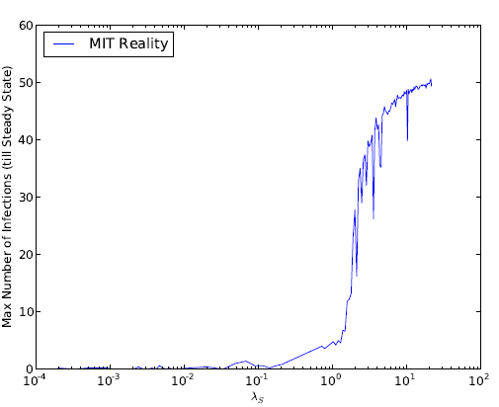
‘Take-off’ plots
Footprint (# infected @ steady state)
Synthetic
MIT Reality Mining
EPIDEMIC
Our threshold
EPIDEMIC
Our threshold
NO EPIDEMIC
NO EPIDEMIC
(log scale)

Slide 25
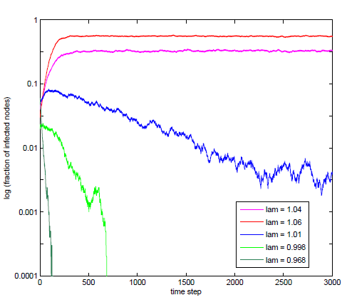
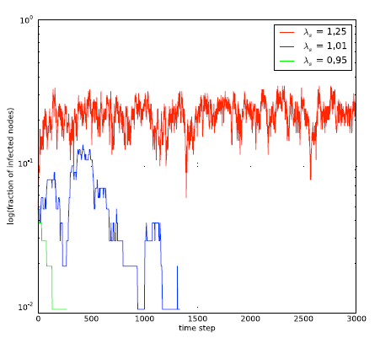
Time-plots
log(# infected)
Synthetic
MIT Reality Mining
>threshold
>threshold
@ threshold
@ threshold
< threshold
< threshold
Time
Notes:
write ‘below threshold’ for eig < 1
AT threshold
above threshold

Slide 26
Outline
√Motivation
√Our Framework
√SIS epidemic model
√Time varying graphs
√Problem Descriptions
√Epidemic Threshold
Immunization

Slide 27
Q2: Immunization
?
?
Our solution
reduce λ_{Πi Si} ( == λ )
goal: max ‘eigendrop’ Δλ
Comparison - But : No competing policy
We propose and evaluate many policies
Δλ = λ_before - λ _after

Slide 28
Lower is better
Greedy-DavgA
Optimal
Greedy-S

Slide 29
Conclusion
Time-varying Graphs
SIS (flu-like) propagation model
√ Q1: Epidemic Threshold - λ < 1
Only first eigen-value of system matrix!
√ Q2: Immunization Policies – max. Δλ
Optimal
Greedy-S
Greedy-DavgA
etc.

Slide 30
Goal: large graph mining
Patterns / anomalies
Static graphs
Dynamic graphs
Weighted graphs
‘heterogeneous’ graphs (multiple-type nodes/edges)
Generators
Kronecker; Random Typing; Tensors
Influence/Virus Propagation
Duration of phonecalls (E2.1)
✔
(I3.1)

Slide 31
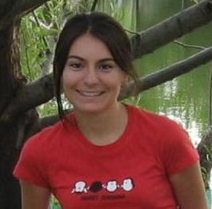
Duration of phonecalls
Surprising Patterns for the Call Duration Distribution of Mobile Phone Users
Pedro O. S. Vaz de Melo, Leman Akoglu, Christos Faloutsos, Antonio A. F. Loureiro
PKDD 2010

Slide 32
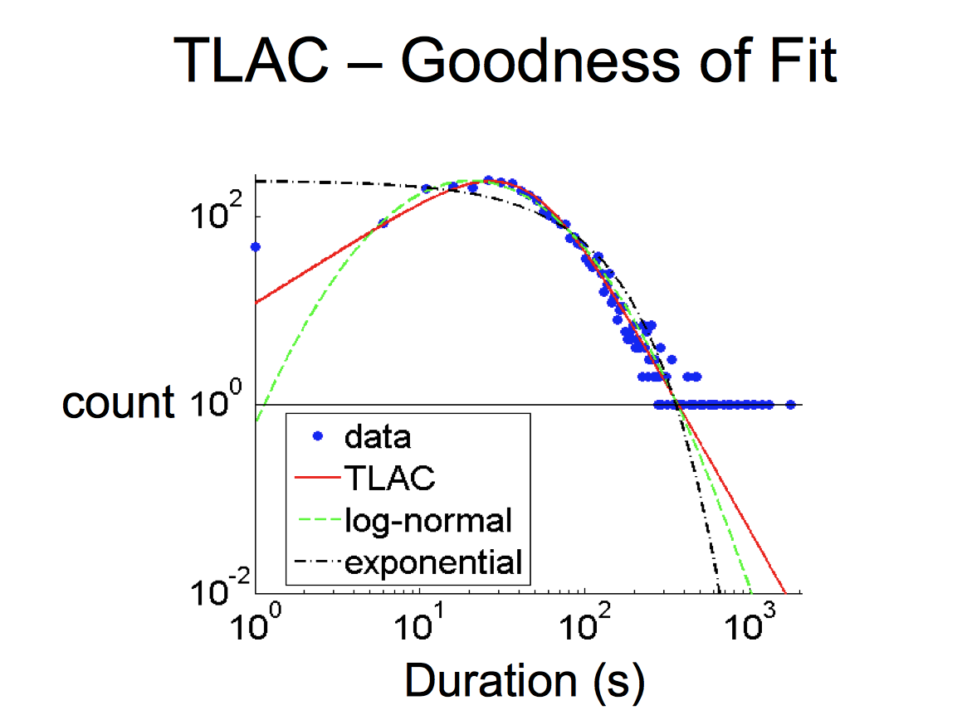
Probably, power law (?)
??

Slide 33
No Power Law!

Slide 34
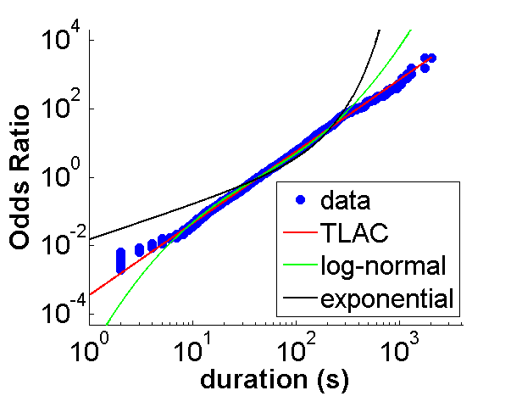
‘TLaC: Lazy Contractor’
The longer a task (phonecall) has taken,
The even longer it will take
Odds ratio=
Casualties(<x):
Survivors(>=x)
== power law

Slide 35
Data Description
Data from a private mobile operator of a large city
4 months of data
3.1 million users
more than 1 billion phone records
Among users with >30 phonecalls
96% followed TLAC
Rest: anomalies (too many 1h phonecalls)

Slide 36
Goal: large graph mining
Patterns / anomalies
Static graphs
Dynamic graphs
Weighted graphs
‘heterogeneous’ graphs (multiple-type nodes/edges)
Generators
Kronecker; Random Typing; Tensors
Influence/Virus Propagation
✔
Duration of phonecalls (E2.1)
✔
(I3.1)

Slide 37
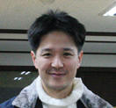
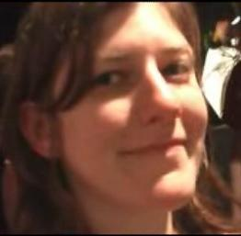
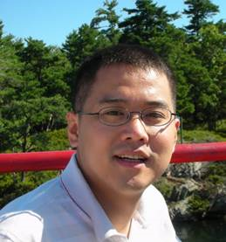
Project info
www.cs.cmu.edu/~pegasus
Chau,
Polo
McGlohon,
Mary
Tsourakakis,
Babis
Akoglu,
Leman
Kang, U
Prakash,
Aditya
Tong,
Hanghang
Thanks to: NSF IIS-0705359, IIS-0534205,
CTA-INARC; Yahoo (M45), LLNL, IBM, SPRINT, INTEL, HP

