Slide 1
Large Graph Mining
Christos Faloutsos
CMU

Slide 2
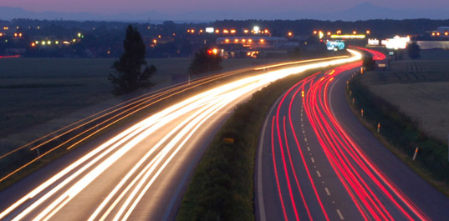
Roadmap
Introduction – Motivation
Past work:
  Big graph mining (‘Pegasus’/hadoop)
  Propagation / immunization
Ongoing & future work:
  (big) tensors
  brain data
Conclusions

Slide 3
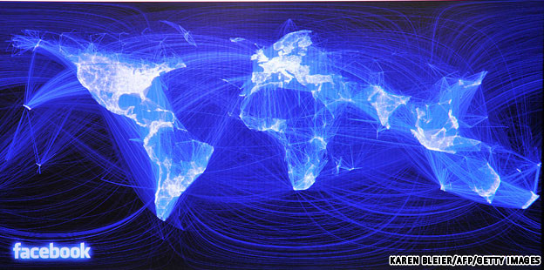
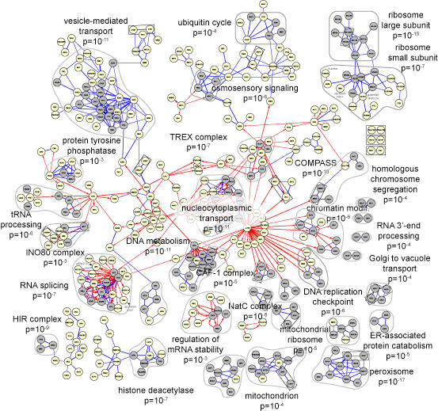
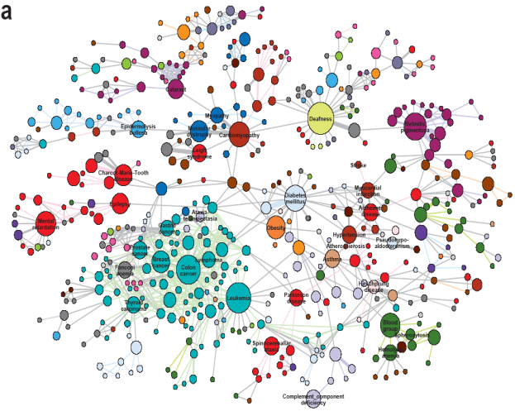
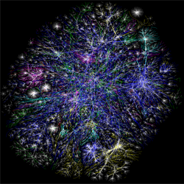
(Big) Graphs - Why study them?
Facebook [2010]
>1B nodes, >$10B
Gene Regulatory Network [Decourty 2008]
Human Disease Network [Barabasi 2007]
The Internet [2005]

Slide 4

(Big) Graphs - why study them?
web-log (‘blog’) news propagation
computer network security: email/IP traffic and anomaly detection
Recommendation systems
....
Many-to-many db relationship -> graph

Slide 5
Roadmap
Introduction – Motivation
Past work:
  Big graph mining (‘Pegasus’/hadoop)
  Propagation / immunization
Ongoing/future: (big) tensors / brain data
Conclusions

Slide 6
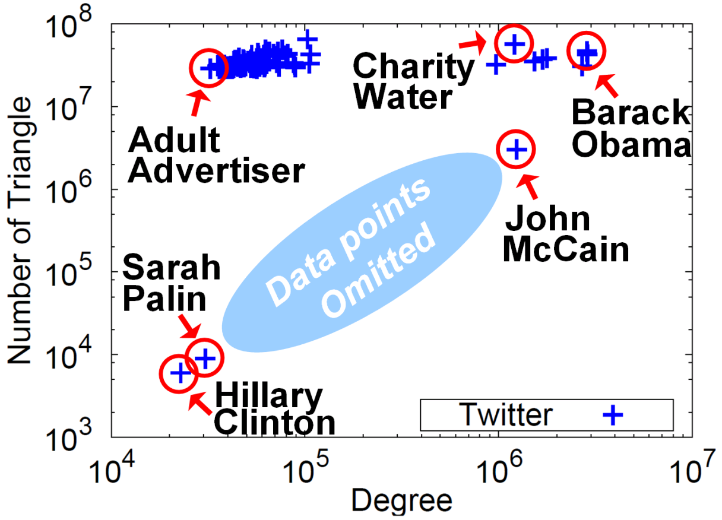


Triangle counting for large graphs?
Anomalous nodes in Twitter(~ 3 billion edges)
[U Kang, Brendan Meeder, +, PAKDD’11]
?
?
?
6

Slide 7
Triangle counting for large graphs?
Anomalous nodes in Twitter(~ 3 billion edges)
[U Kang, Brendan Meeder, +, PAKDD’11]
7

Slide 8
Triangle counting for large graphs?
Anomalous nodes in Twitter(~ 3 billion edges)
[U Kang, Brendan Meeder, +, PAKDD’11]
8

Slide 9
Triangle counting for large graphs?
Anomalous nodes in Twitter(~ 3 billion edges)
[U Kang, Brendan Meeder, +, PAKDD’11]
9

Slide 10
Roadmap
Introduction – Motivation
Past work:
  Big graph mining (‘Pegasus’/hadoop)
  Propagation / immunization
Ongoing & future work:
  (big) tensors
  brain data
Conclusions

Slide 11

Fractional Immunization of Networks
B. Aditya Prakash, Lada Adamic, Theodore
Iwashyna (M.D.), Hanghang Tong, Christos Faloutsos
SDM 2013, Austin, TX

Slide 12
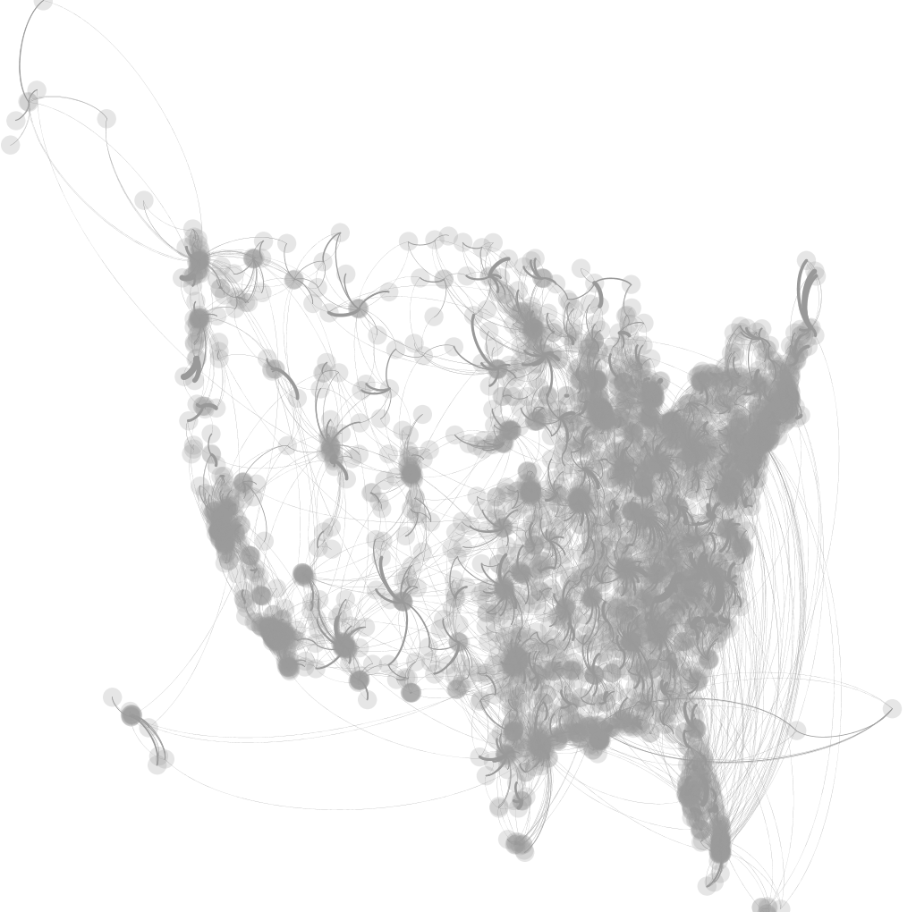

Whom to immunize?
Dynamical Processes over networks
Each circle is a hospital
~3,000 hospitals
More than 30,000 patients transferred
[US-MEDICARE NETWORK 2005]
Problem: Given k units of disinfectant, whom to immunize?

Slide 13
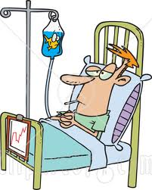
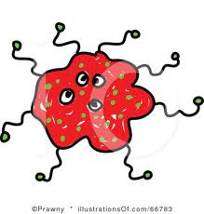
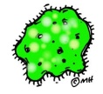
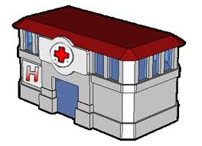
Fractional Asymmetric Immunization
Drug-resistant Bacteria (like XDR-TB)
Hospital
Another Hospital

Slide 14
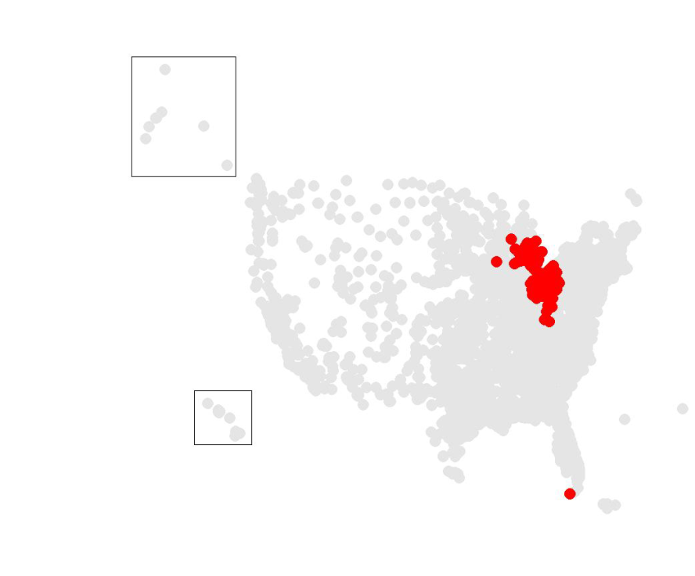
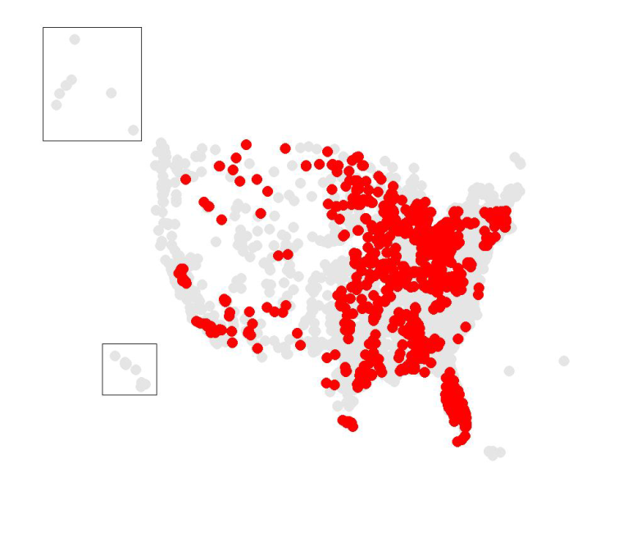
Whom to immunize?
~6x fewer!
[US-MEDICARE NETWORK 2005]
CURRENT PRACTICE
OUR METHOD
Hospital-acquired inf. : 99K+ lives, $5B+ per year

Slide 15
Running Time
Wall-Clock Time
> 1 week
≈
> 30,000x speed-up!
better
14 secs
Simulations
SMART-ALLOC

Slide 16
What is the ‘silver bullet’?
A: Try to decrease connectivity of graph
Q: how to measure connectivity?
A: first eigenvalue of adjacency matrix
Q1: why??
  Avg degree
  Max degree
  Diameter
  Modularity
  ‘Conductance’

Slide 17
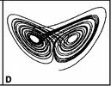
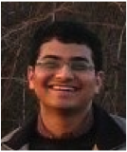

Threshold Conditions for Arbitrary Cascade Models on Arbitrary Networks
B. Aditya Prakash, Deepayan Chakrabarti, Michalis Faloutsos, Nicholas Valler, Christos Faloutsos
IEEE ICDM 2011, Vancouver extended version, in arxiv http://arxiv.org/abs/1004.0060
G2 theorem
~10 pages proof

Slide 18
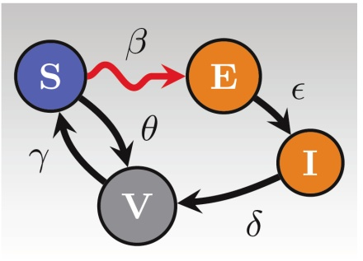
Our thresholds for some models
s = effective strength
s < 1 : below threshold
Models | Effective Strength (s) | Threshold (tipping point)
SIS, SIR, SIRS, SEIR | s = λ . | s = 1
SIV, SEIV | s = λ .
(H.I.V.) | s = λ .

Slide 19
Our thresholds for some models
s = effective strength
s < 1 : below threshold
No immunity
Temp.
immunity
Models | Effective Strength (s) | Threshold (tipping point)
SIS, SIR, SIRS, SEIR | s = λ . | s = 1
SIV, SEIV | s = λ .
(H.I.V.) | s = λ .
w/ incubation

Slide 20
Roadmap
Introduction – Motivation
Past work:
  Big graph mining (‘Pegasus’/hadoop)
  Propagation / immunization
Ongoing & future work:
  (big) tensors
  brain data
Conclusions

Slide 21
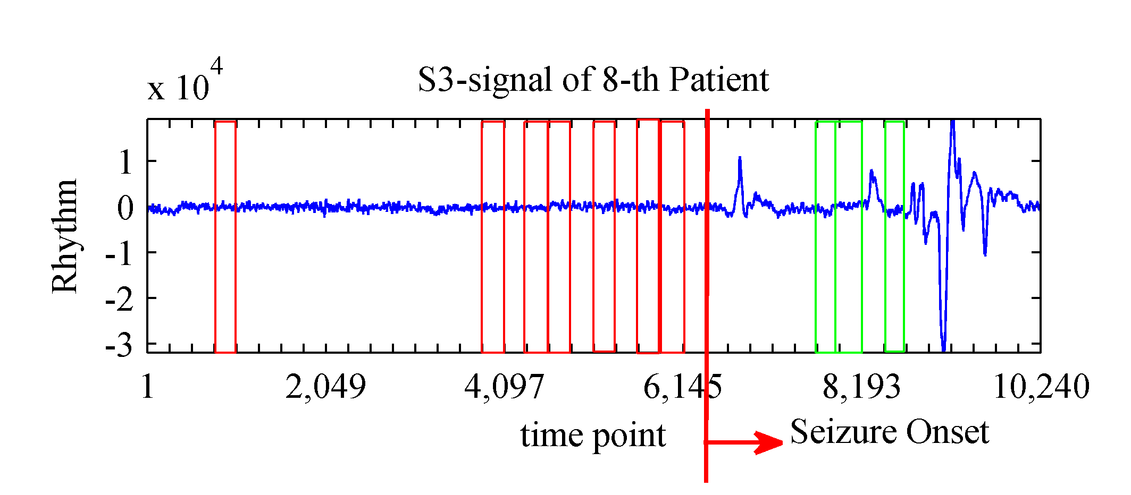
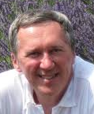
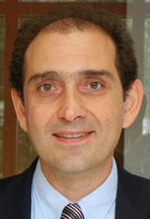
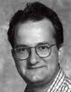
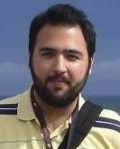
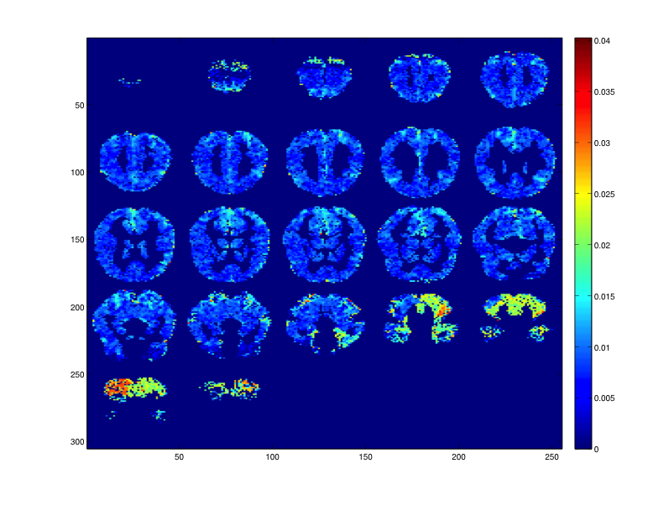
Brain data
Which neurons get activated by ‘bee’
How wiring evolves
Modeling epilepsy
Tom Mitchell
George Karypis
N. Sidiropoulos
V. Papalexakis

Slide 22
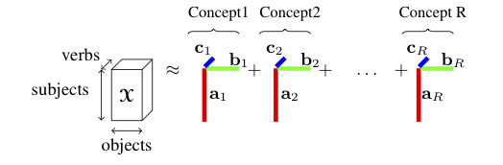
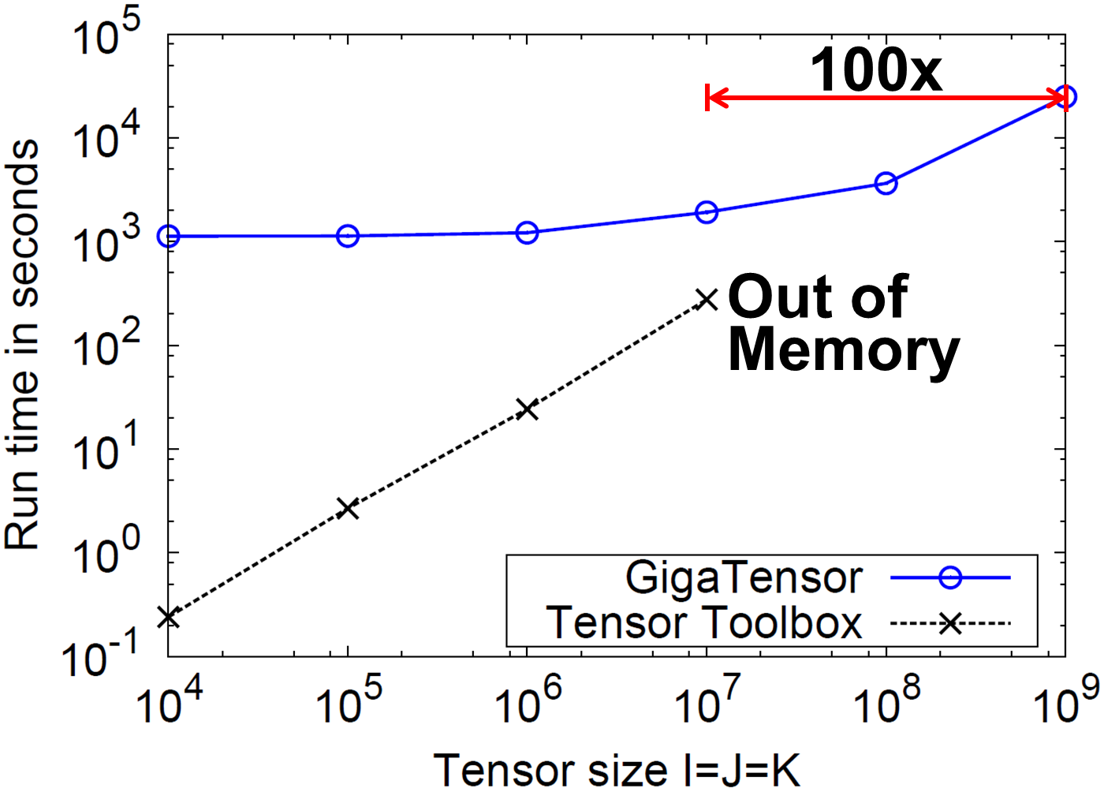
GigaTensor [KDD’12]
  NELL = never ending language learner – triplets like ‘obama’ ‘is president of’ ‘USA’ (ie, object-verb-subject)
  30M x 30M x 15M
  Find ‘concepts’ (= latent variables)

Slide 23
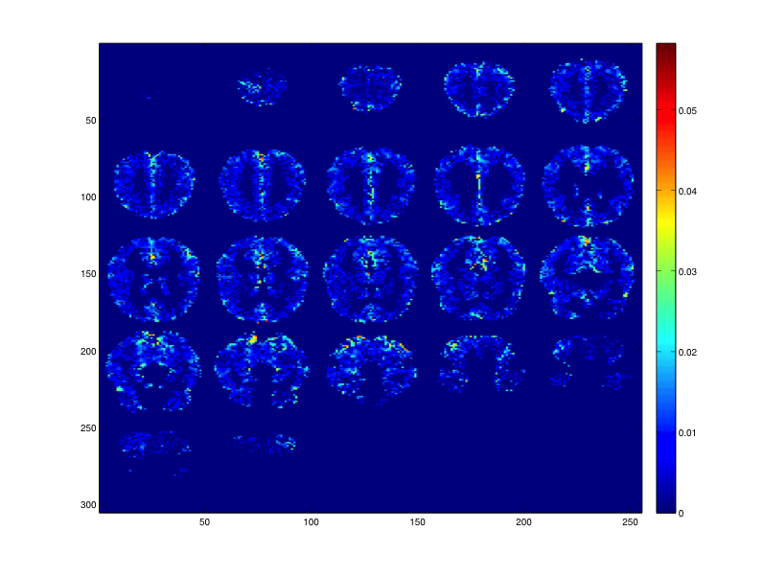
Preliminary results
60 words (‘bee’, ‘apple’, ‘hammer’)
80 questions (‘is it alive’, ‘can it hurt you’)
Brain-scan, for each word
 | Alive? | Can hurt you? | …
‘apple’
‘beetle’ | ✔
‘hammer’ |  | ✔

Slide 24
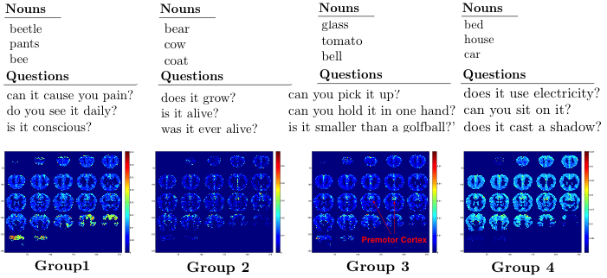
Preliminary results

Slide 25
Preliminary results
Premotor cortex

Slide 26

CONCLUSION#1 – Big data
Large datasets reveal patterns/outliers that are invisible otherwise

Slide 27
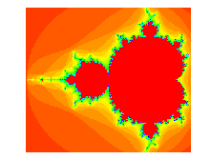


CONCLUSION #2 – Cross disciplinarity

Slide 28
CONCLUSION #2 – Cross disciplinarity
Thank you! Questions?

