Slide 1
Mining Large Graphs and Time Sequences:
Patterns, Anomalies, and Fraud Detection
Christos Faloutsos
CMU

Slide 2
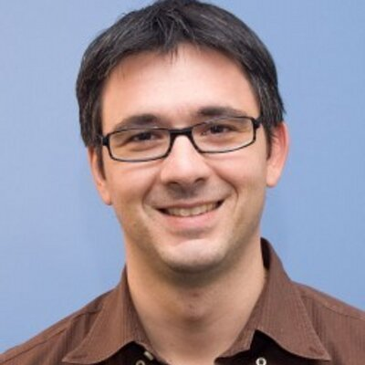
Thank you!
Alkis Polyzotis
Denise Olivera

Slide 3
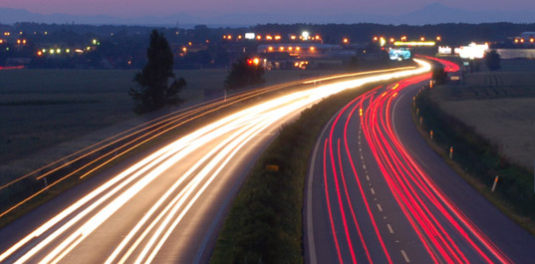
Roadmap
Introduction – Motivation
  Why study (big) graphs?
Part#1: Patterns in graphs
Part#2: time-evolving graphs; tensors
Part#3: time sequences
Conclusions

Slide 4





Graphs - why should we care?
>$10B; ~1B users

Slide 5
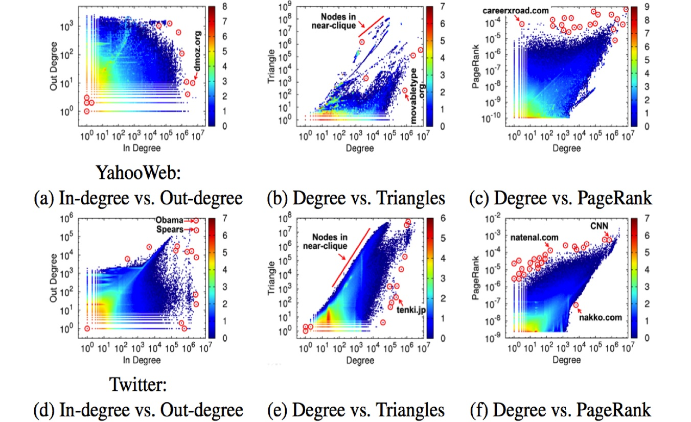

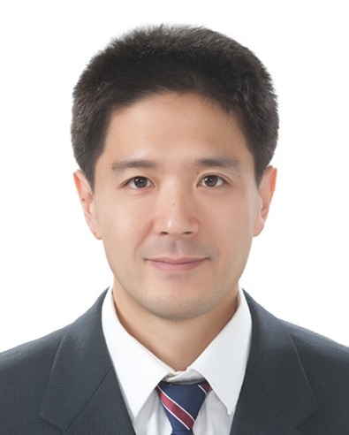

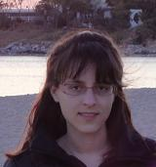
Graphs - why should we care?
~1B nodes (web sites)
~6B edges (http links)
‘YahooWeb graph’
U Kang, Jay-Yoon Lee, Danai Koutra, and Christos Faloutsos. Net-Ray: Visualizing and Mining Billion-Scale Graphs PAKDD 2014, Tainan, Taiwan.

Slide 6

Graphs - why should we care?
web-log (‘blog’) news propagation
computer network security: email/IP traffic and anomaly detection
Recommendation systems
....
Many-to-many db relationship -> graph

Slide 7
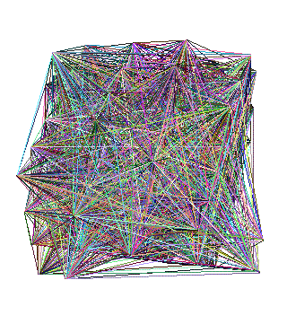

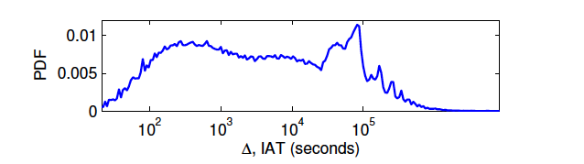
Motivating problems
P1: patterns? Fraud detection?
P2: patterns in time-evolving graphs / tensors
P3: time sequences
destination
source
time

Slide 8

Motivating problems
P1: patterns? Fraud detection?
P2: patterns in time-evolving graphs / tensors
P3: time sequences
Patterns anomalies
destination
source
time

Slide 9
Roadmap
Introduction – Motivation
  Why study (big) graphs?
Part#1: Patterns & fraud detection
Part#2: time-evolving graphs; tensors
Conclusions

Slide 10
Part 1:
Patterns, &
fraud detection

Slide 11
Laws and patterns
Q1: Are real graphs random?

Slide 12
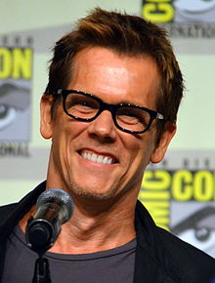
Laws and patterns
Q1: Are real graphs random?
A1: NO!!
  Diameter (‘6 degrees’; ‘Kevin Bacon’)
  in- and out- degree distributions
  other (surprising) patterns
So, let’s look at the data

Slide 13
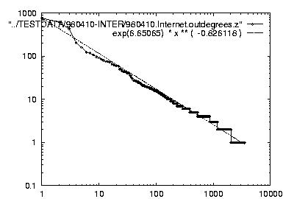
Solution# S.1
Power law in the degree distribution [Faloutsos x 3 SIGCOMM99]
internet domains
att.com
log(degree)
ibm.com
log(rank)

Slide 14
Solution# S.1
Power law in the degree distribution [Faloutsos x 3 SIGCOMM99]
internet domains
att.com
log(degree)
ibm.com
-0.82
log(rank)

Slide 15
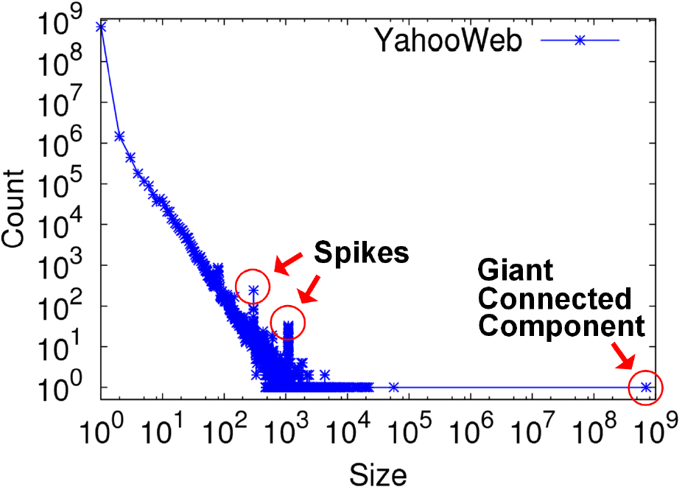
S2: connected component sizes
Connected Components – 4 observations:
Count
1.4B nodes
6B edges
Size

Slide 16
S2: connected component sizes
Connected Components
Count
1) 10K x
larger
than next
Size

Slide 17
S2: connected component sizes
Connected Components
Count
2) ~0.7B
singleton
nodes
Size

Slide 18
S2: connected component sizes
Connected Components
Count
3) SLOPE!
Size

Slide 19
S2: connected component sizes
Connected Components
Count
300-size cmpt
X 500.
Why?
1100-size cmpt
X 65.
Why?
4) Spikes!
Size

Slide 20
S2: connected component sizes
Connected Components
Count
suspicious
financial-advice sites
(not existing now)
Size

Slide 21
Roadmap
Introduction – Motivation
Part#1: Patterns in graphs
  Patterns: Degree; Triangles
  Anomaly/fraud detection
Part#2: time-evolving graphs; tensors
Part#3: time sequences
Conclusions

Slide 22
Solution# S.3: Triangle ‘Laws’
Real social networks have a lot of triangles

Slide 23
Solution# S.3: Triangle ‘Laws’
Real social networks have a lot of triangles
  Friends of friends are friends
Any patterns?
  2x the friends, 2x the triangles ?

Slide 24
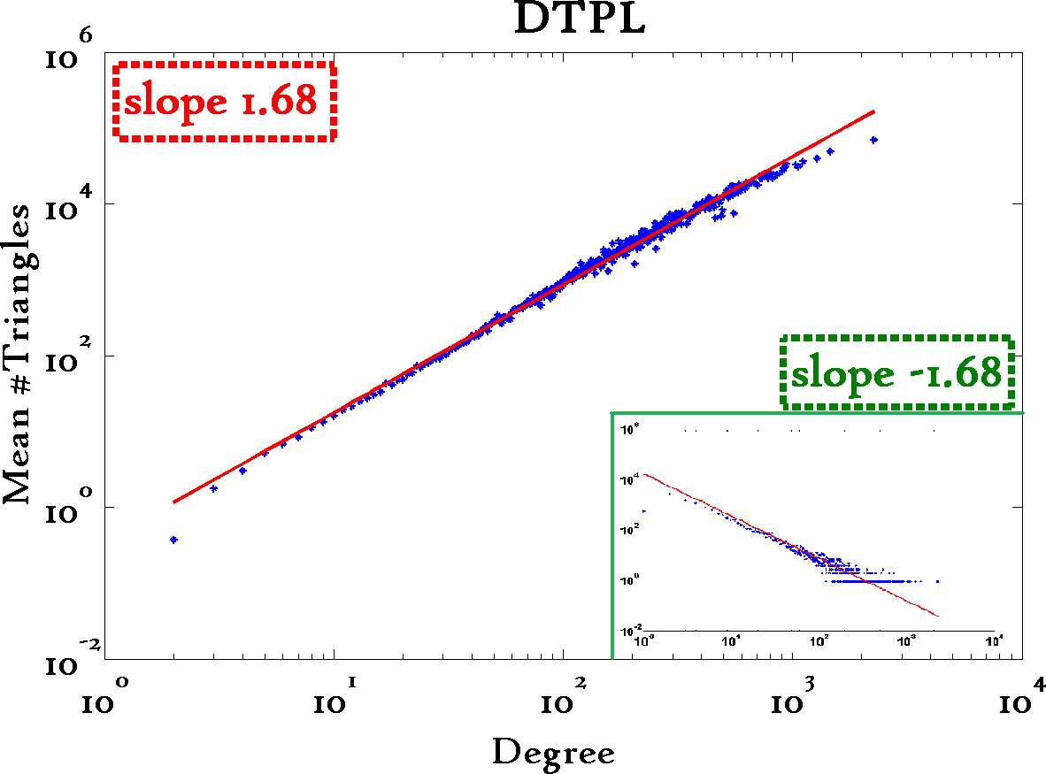
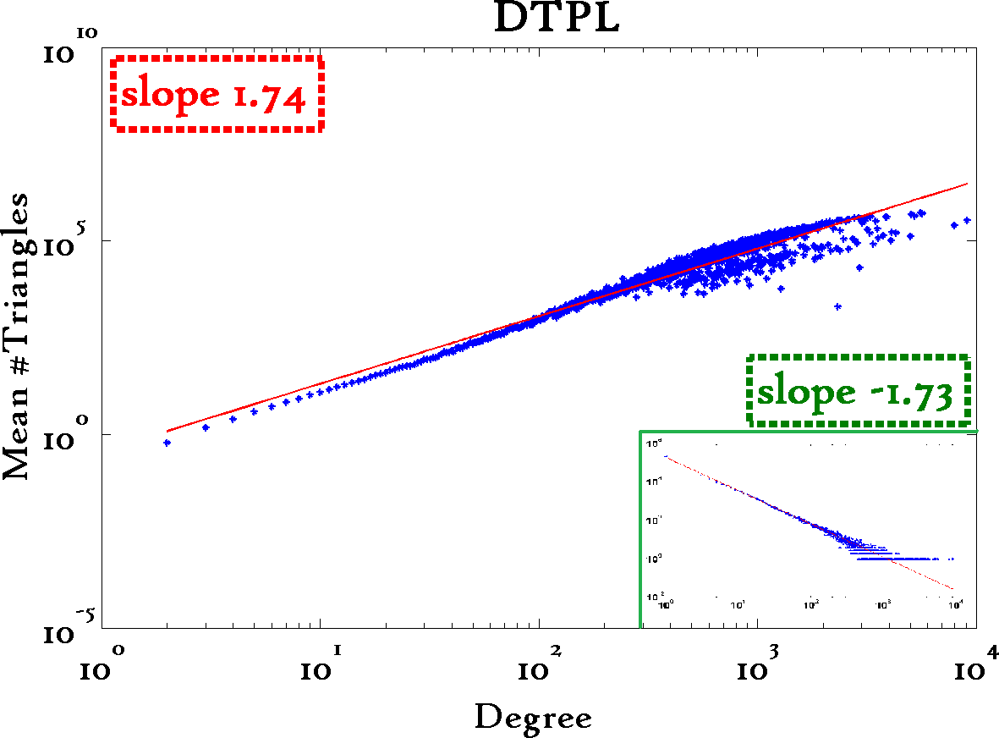
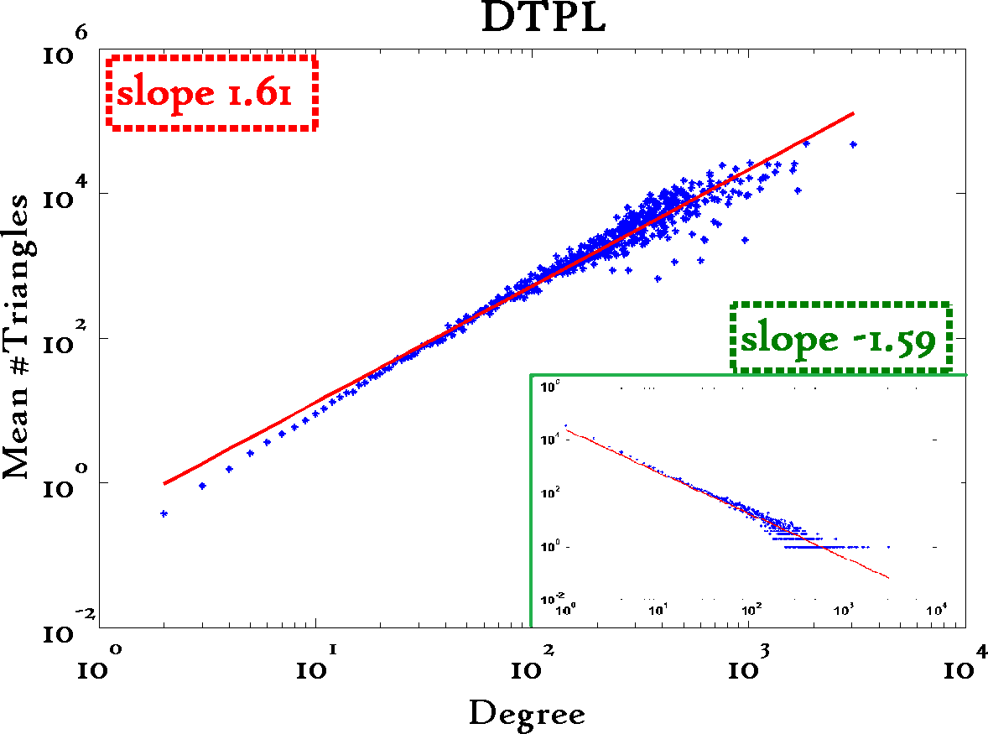
Triangle Law: #S.3
[Tsourakakis ICDM 2008]
Reuters
SN
X-axis: degree
Y-axis: mean # triangles
n friends -> ~n^{1.6} triangles
Epinions

Slide 25
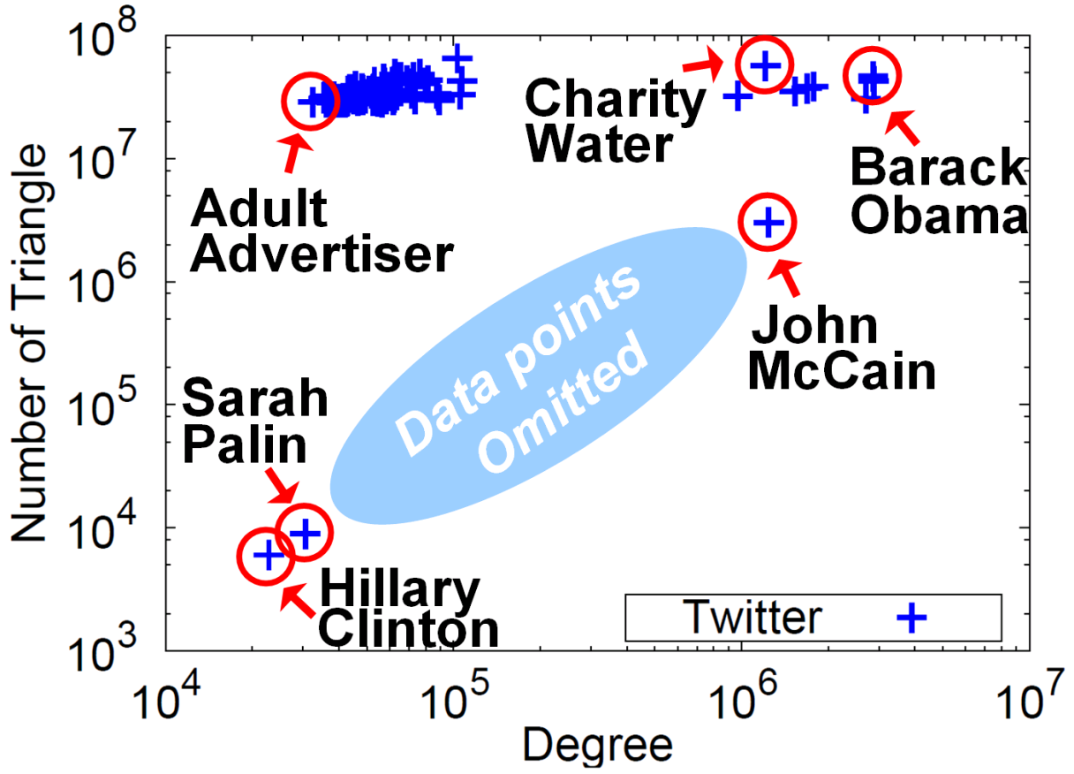


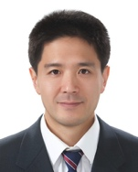

Triangle counting for large graphs?
Anomalous nodes in Twitter(~ 3 billion edges)
[U Kang, Brendan Meeder, +, PAKDD’11]
?
?
?
25

Slide 26
Triangle counting for large graphs?
Anomalous nodes in Twitter(~ 3 billion edges)
[U Kang, Brendan Meeder, +, PAKDD’11]
26

Slide 27
Triangle counting for large graphs?
Anomalous nodes in Twitter(~ 3 billion edges)
[U Kang, Brendan Meeder, +, PAKDD’11]
27

Slide 28
Triangle counting for large graphs?
Anomalous nodes in Twitter(~ 3 billion edges)
[U Kang, Brendan Meeder, +, PAKDD’11]
28

Slide 29
Triangle counting for large graphs?
Anomalous nodes in Twitter(~ 3 billion edges)
[U Kang, Brendan Meeder, +, PAKDD’11]
29

Slide 30
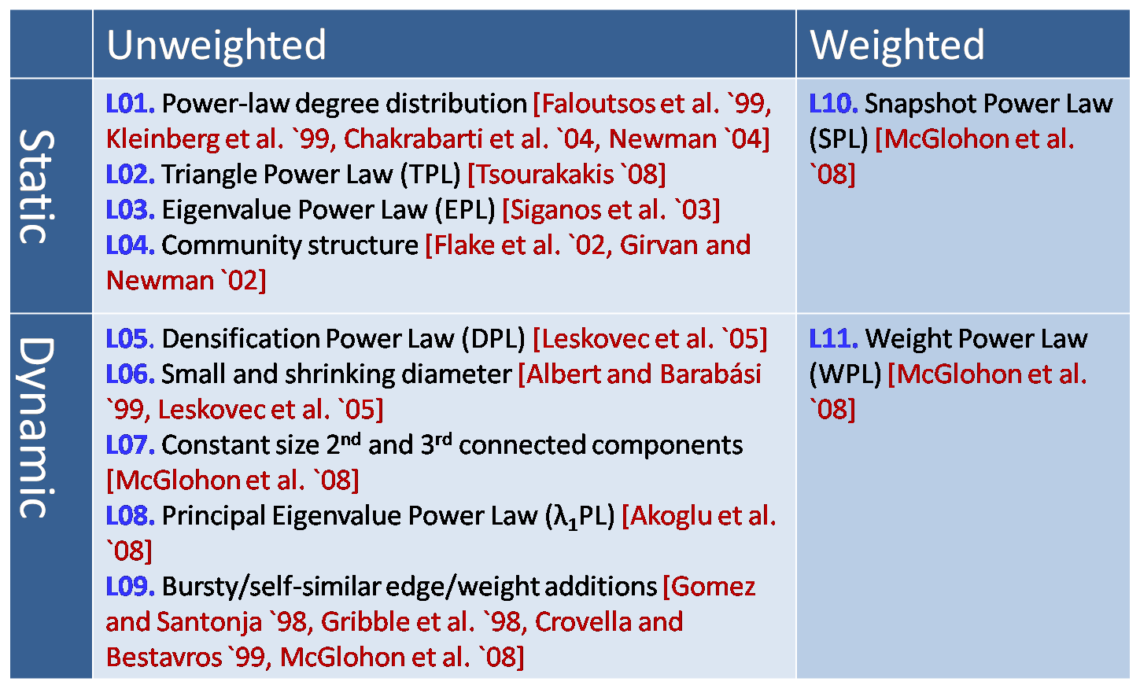
MORE Graph Patterns
✔
✔
✔
RTG: A Recursive Realistic Graph Generator using Random Typing Leman Akoglu and Christos Faloutsos. PKDD’09.

Slide 31
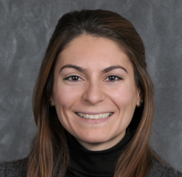
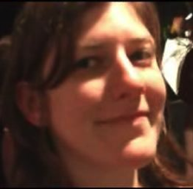


MORE Graph Patterns
Mary McGlohon, Leman Akoglu, Christos Faloutsos. Statistical Properties of Social Networks. in "Social Network Data Analytics” (Ed.: Charu Aggarwal)
Deepayan Chakrabarti and Christos Faloutsos, Graph Mining: Laws, Tools, and Case Studies Oct. 2012, Morgan Claypool.
http://www.cs.cmu.edu/~christos/TALKS/16-06-19-ICML/

Slide 32
Roadmap
Introduction – Motivation
Part#1: Patterns in graphs
  Patterns
  Anomaly / fraud detection
    Spectral methods (‘fBox’)
    Belief Propagation
Part#2: time-evolving graphs; tensors
Conclusions

Slide 33

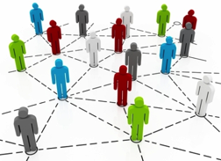

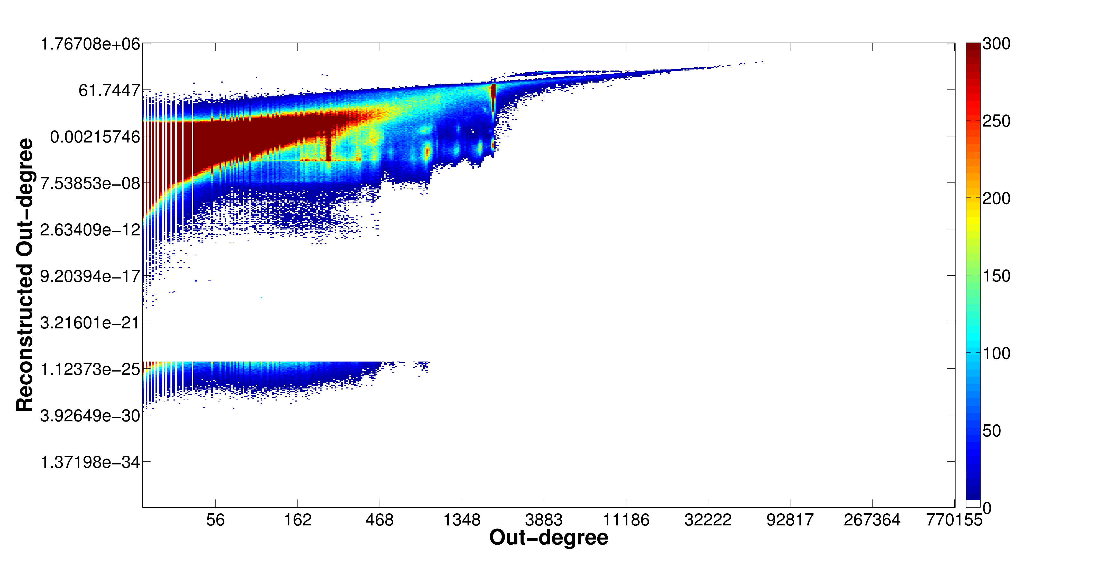
Problem: Social Network Link Fraud
Target: find “stealthy” attackers missed by other algorithms
Clique
41.7M nodes
1.5B edges
Bipartite
core

Slide 34



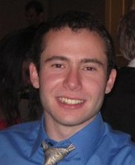
Problem: Social Network Link Fraud
Target: find “stealthy” attackers missed by other algorithms
Takeaway: use reconstruction error between true/latent representation!
Neil Shah, Alex Beutel, Brian Gallagher and Christos Faloutsos. Spotting Suspicious Link Behavior with fBox: An Adversarial Perspective. ICDM 2014, Shenzhen, China.
Notes:
Social networks with popularity incentives are plagued by the problem of link fraud, involving “bot” accounts falsely increasing popularity of a person or organization. These bots form cliques and bipartite cores in the graph structure. Several works have targeted the detection of large cases of fraud using spectral approaches like SVD, but fail to detect smaller, stealthier attacks due to computational restrictions on latent feature computation. Our approach, called fBox, leverages the reconstruction or projection error between latent, SVD representation and original graph representation to find anomalous bot accounts with high precision.

Slide 35
Roadmap
Introduction – Motivation
Part#1: Patterns in graphs
  Patterns
  Anomaly / fraud detection
    CopyCatch
    Spectral methods (‘fBox’, suspiciousness)
    Belief Propagation
Part#2: time-evolving graphs; tensors
Conclusions

Slide 36
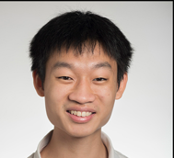

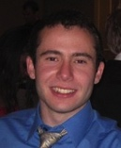

Suspicious Patterns in Event Data
?
2-modes
?
?
n-modes
A General Suspiciousness Metric for Dense Blocks in Multimodal Data, Meng Jiang, Alex Beutel, Peng Cui, Bryan Hooi, Shiqiang Yang, and Christos Faloutsos, ICDM, 2015.

Slide 37
Suspicious Patterns in Event Data
ICDM 2015
Which is more suspicious?
20,000 Users
Retweeting same 20 tweets
6 times each
All in 10 hours
225 Users
Retweeting same 1 tweet
15 times each
All in 3 hours
All from 2 IP addresses
vs.
Answer: volume * D_{KL}(p|| p_{background})

Slide 38

Suspicious Patterns in Event Data
ICDM 2015
Retweeting: “Galaxy Note Dream Project:
Happy Happy Life Traveling the World”

Slide 39
Roadmap
Introduction – Motivation
Part#1: Patterns in graphs
  Patterns
  Anomaly / fraud detection
    Spectral methods (‘fBox’)
    High-density sub-matrices
    Belief propagation
Part#2: time-evolving graphs; tensors
Part#3: time sequences
Conclusions

Slide 40

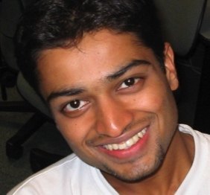
E-bay Fraud detection
w/ Polo Chau &
Shashank Pandit, CMU
[www’07]

Slide 41
E-bay Fraud detection

Slide 42
E-bay Fraud detection

Slide 43
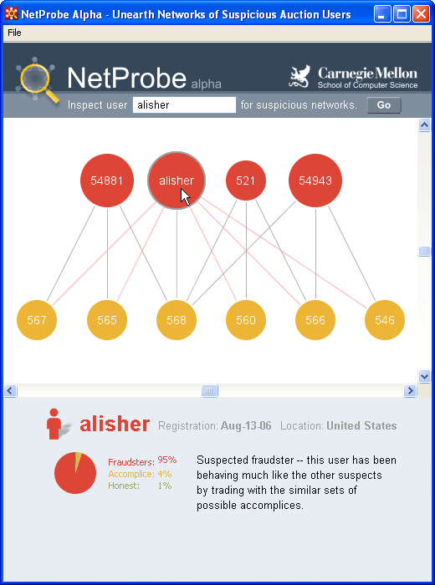
E-bay Fraud detection - NetProbe

Slide 44



Popular press
And less desirable attention:
E-mail from ‘Belgium police’ (‘copy of your code?’)

Slide 45
Roadmap
Introduction – Motivation
Part#1: Patterns in graphs
Part#2: time-evolving graphs; tensors
  P2.1: time-evolving graphs
  [P2.2: with side information (‘coupled’ M.T.F.)
  Speed]
Part#3: time sequences
Conclusions

Slide 46
Part 2:
Time evolving
graphs; tensors

Slide 47
Graphs over time -> tensors!
Problem #2.1:
  Given who calls whom, and when
  Find patterns / anomalies
johnson
smith

Slide 48
Graphs over time -> tensors!
Problem #2.1:
  Given who calls whom, and when
  Find patterns / anomalies

Slide 49
Graphs over time -> tensors!
Problem #2.1:
  Given who calls whom, and when
  Find patterns / anomalies
Tue
Mon

Slide 50
Graphs over time -> tensors!
Problem #2.1:
  Given who calls whom, and when
  Find patterns / anomalies
time
caller
callee

Slide 51
Graphs over time -> tensors!
Problem #2.1’:
  Given author-keyword-date
  Find patterns / anomalies
date
MANY more settings,
with >2 ‘modes’
author
keyword

Slide 52
Graphs over time -> tensors!
Problem #2.1’’:
  Given subject – verb – object facts
  Find patterns / anomalies
verb
MANY more settings,
with >2 ‘modes’
subject
object

Slide 53
Graphs over time -> tensors!
Problem #2.1’’’:
  Given <triplets>
  Find patterns / anomalies
mode3
MANY more settings,
with >2 ‘modes’
(and 4, 5, etc modes)
mode1
mode2

Slide 54
Roadmap
Introduction – Motivation
Part#1: Patterns in graphs
Part#2: time-evolving graphs; tensors
  P2.1: time-evolving graphs
  [P2.2: with side information (‘coupled’ M.T.F.)
  Speed]
Conclusions

Slide 55


Answer to both: tensor factorization
Recall: (SVD) matrix factorization: finds blocks
‘meat-eaters’
‘steaks’
‘vegetarians’
‘plants’
‘kids’
‘cookies’
M
products
N
users
+
+
~

Slide 56
Answer to both: tensor factorization
PARAFAC decomposition
politicians
artists
athletes
verb
subject
+
+
=
object

Slide 57
Answer: tensor factorization
PARAFAC decomposition
Results for who-calls-whom-when
  4M x 15 days
??
??
??
time
caller
+
+
=
callee

Slide 58
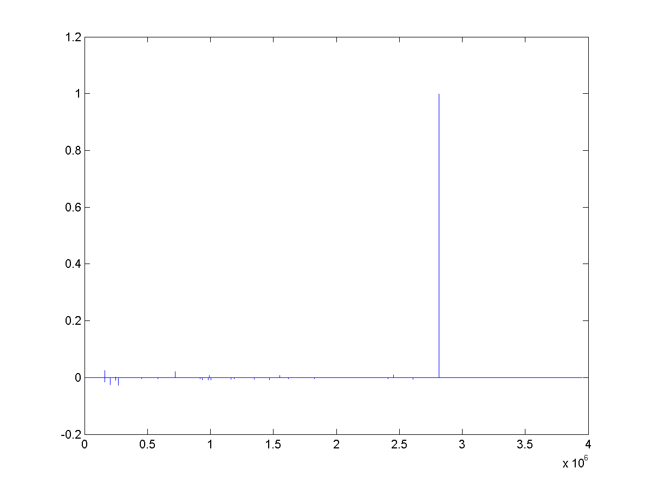
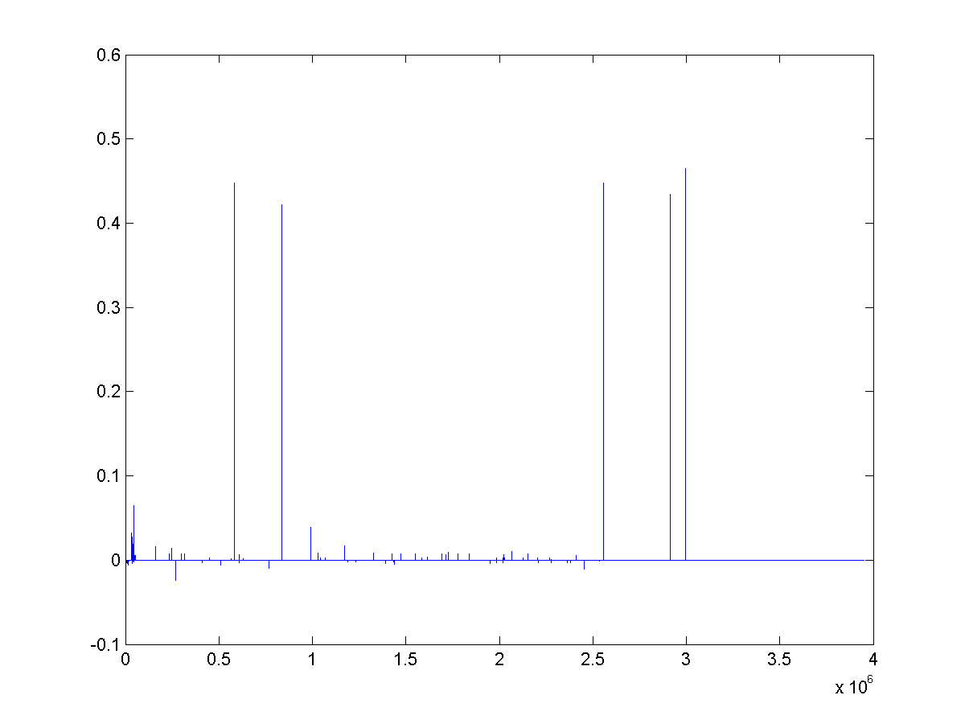
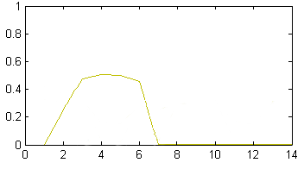
Anomaly detection in time-evolving graphs
=
Anomalous communities in phone call data:
  European country, 4M clients, data over 2 weeks
  ~200 calls to EACH receiver on EACH day!
1 caller
5 receivers
4 days of activity

Slide 59
Anomaly detection in time-evolving graphs
=
Anomalous communities in phone call data:
  European country, 4M clients, data over 2 weeks
  ~200 calls to EACH receiver on EACH day!
1 caller
5 receivers
4 days of activity

Slide 60
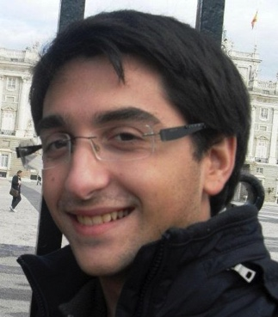

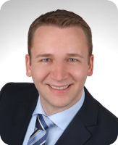
Anomaly detection in time-evolving graphs
=
Anomalous communities in phone call data:
  European country, 4M clients, data over 2 weeks
  ~200 calls to EACH receiver on EACH day!
Miguel Araujo, Spiros Papadimitriou, Stephan Günnemann, Christos Faloutsos, Prithwish Basu, Ananthram Swami,
Evangelos Papalexakis, Danai Koutra. Com2: Fast Automatic Discovery of Temporal (Comet) Communities. PAKDD 2014, Tainan, Taiwan.

Slide 61
Part 2: Conclusions
Time-evolving / heterogeneous graphs -> tensors
PARAFAC finds patterns
(GigaTensor/HaTen2 -> fast & scalable)
=

Slide 62
Part 3:
Time sequences

Slide 63
Roadmap
Introduction – Motivation
  Why study (big) graphs?
Part#1: Patterns in graphs
Part#2: time-evolving graphs; tensors
Part#3: time sequences
Acknowledgements and Conclusions

Slide 64



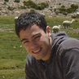
RSC: Mining and Modeling Temporal Activity in Social Media
Universidade
de São Paulo
KDD 2015 – Sydney, Australia
Alceu F. Costa* Yuto Yamaguchi Agma J. M. Traina
Caetano Traina Jr. Christos Faloutsos
*alceufc@icmc.usp.br

Slide 65

Pattern Mining: Datasets
Reddit Dataset Time-stamp from comments 21,198 users 20 Million time-stamps | Twitter Dataset Time-stamp from tweets 6,790 users 16 Million time-stamps
For each user we have:
Sequence of postings time-stamps: T = (t₁, t₂, t₃, …)
Inter-arrival times (IAT) of postings: (∆₁, ∆₂, ∆₃, …)
∆₁
∆₂
∆₃
time
t₁
t₂
t₃
t₄
Notes:
In this work we analyzed data from two services: reddit and twitter
For the reddit dataset we have time-stamp sequences from over 20k users and
For the twitter dataset we have time-stamp sequences from over 6k users
For each user had at least a sequence of at least 900 time-stamps.
For the twitter dataset the time-stamps were from tweets.
For the reddit dataset the time-stamps were from user comments.
From each sequence of time-stamps we also computed the IAT (inter-arrival time) between postings

Slide 66
Pattern Mining
Pattern 1: Distribution of IAT is heavy-tailed
  Users can be inactive for long periods of time before making new postings
IAT Complementary Cumulative Distribution Function (CCDF)
(log-log axis)
Reddit Users
Twitter Users
Notes:
The first pattern discovered from the datasets is the heavy tailed distribution of inter-arrival times.
The plots in this slide shows the tail part of the IAT distribution for reddit and twitter users in log-log axis.

Slide 67
Pattern Mining
Pattern 2: Bimodal IAT distribution
  ‘Active’/ ‘resting’ periods
Log-binned histogram of postings IAT
1st Mode (1min)
2nd Mode (3h)
Twitter Users
Notes:
The 2nd pattern we discovered is that the distribution of inter arrival times is bimodal.
The two figures at the bottom part of the slide shows the log-binned histogram of inter-arrival times of all Reddit and Twitter users.
We have a first mode at around 6min and the second mode at 2h mark.
This can be explained by users having
Highly active sections where they make more than one posting in a short interval of time
Resting periods (e.g. working or doing some other activity)

Slide 68
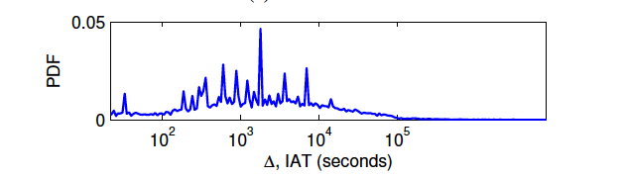
Human? Robots?
linear
log

Slide 69
Human? Robots?
2’
3h
1day
linear
log

Slide 70
Experiments: Can RSC-Spotter Detect Bots?
Precision vs. Sensitivity Curves
  Good performance: curve close to the top
Twitter
Precision > 94%
Sensitivity > 70%
With strongly imbalanced datasets
# humans >> # bots

Slide 71
Experiments: Can RSC-Spotter Detect Bots?
Precision vs. Sensitivity Curves
  Good performance: curve close to the top
Reddit
Precision > 96%
Sensitivity > 47%
With strongly imbalanced datasets
# humans >> # bots

Slide 72
Roadmap
Introduction – Motivation
  Why study (big) graphs?
Part#1: Patterns in graphs
Part#2: time-evolving graphs; tensors
Part#3: time sequences
Acknowledgements and Conclusions

Slide 73








Thanks
Disclaimer: All opinions are mine; not necessarily reflecting the opinions of the funding agencies
Thanks to: NSF IIS-0705359, IIS-0534205,
CTA-INARC; Yahoo (M45), LLNL, IBM, SPRINT, Google, INTEL, HP, iLab

Slide 74
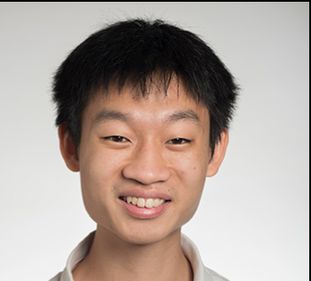

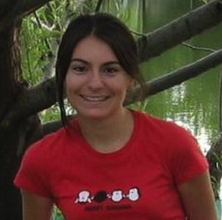

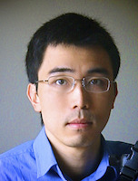
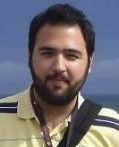
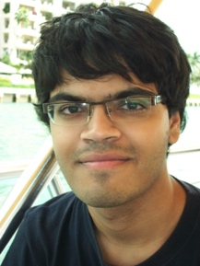


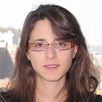
Cast
Akoglu,
Leman
Araujo,
Miguel
Beutel,
Alex
Chau,
Polo
Hooi,
Bryan
Koutra,
Danai
Papalexakis,
Vagelis
Shah,
Neil
Kang, U
Song,
Hyun Ah

Slide 75
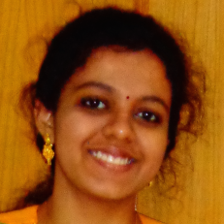

Cast
Akoglu,
Leman
Araujo,
Miguel
Beutel,
Alex
Chau,
Polo
Eswaran,
Dhivya
Hooi,
Bryan
Kang, U
Koutra,
Danai
Papalexakis,
Vagelis
Shah,
Neil
Shin,
Kijung
Song,
Hyun Ah

Slide 76


CONCLUSION#1 – Big data
Patterns Anomalies
Large datasets reveal patterns/outliers that are invisible otherwise

Slide 77
CONCLUSION#2 – tensors
powerful tool
=
1 caller
5 receivers
4 days of activity

Slide 78
Conclusion#3
Different footprints of real vs ‘robot’ users
linear
log

Slide 79

References
D. Chakrabarti, C. Faloutsos: Graph Mining – Laws, Tools and Case Studies, Morgan Claypool 2012
http://www.morganclaypool.com/doi/abs/10.2200/S00449ED1V01Y201209DMK006
Graph-based Anomaly Detection and Description: A Survey, Leman Akoglu, Hanghang Tong, Danai Koutra
http://arxiv.org/abs/1404.4679

Slide 80

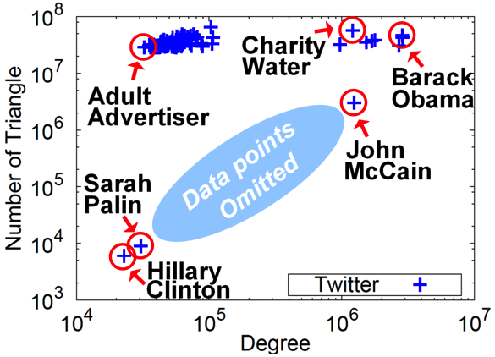
TAKE HOME MESSAGE:
Cross-disciplinarity
=

Slide 81
Thank you!
Cross-disciplinarity
=

Slide 82


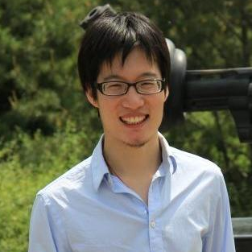
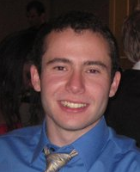
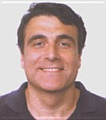
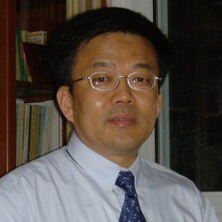

Catchsync: catch synchronized behavior in large directed graphs
Meng Jiang
Joint work with Peng Cui, Alex Beutel,
Christos Faloutsos and Shiqiang Yang
August 26, 2014 – NYC, USA
Notes:
Hello everyone, welcome to listen to our work. My name is Meng Jiang. I am from Tsinghua University in Beijing. Our work’s title is CatchSync: Catch Synchronized Behavior in Large Directed Graphs. This is a joint work with Peng Cui and Shiqiang Yang from Tsinghua, and Alex Beutel and Christos Faloutsos from Carnegie Mellon University.

Slide 83







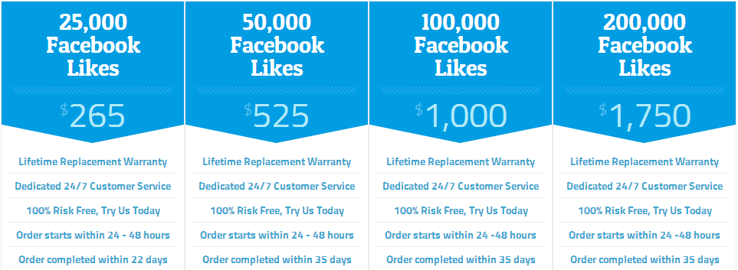


Fraud Detection: Graph Analysis Problem
[www.buyfollowz.org]
[buymorelikes.com]
Notes:
Fraud detection is an important problem for social networks. As the advertisements show here, there are some companies selling Twitter followers and Facebook “Likes” to inflate those numbers of their customers. How to catch the fraudsters can be considered as a graph analysis problem. We are looking for anomalous edges that are created by fraudulent behaviors instead of natural behaviors in the million-node graphs. For example, here we are trying to distinguish the botnets from the Simpson family.

Slide 84



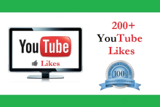
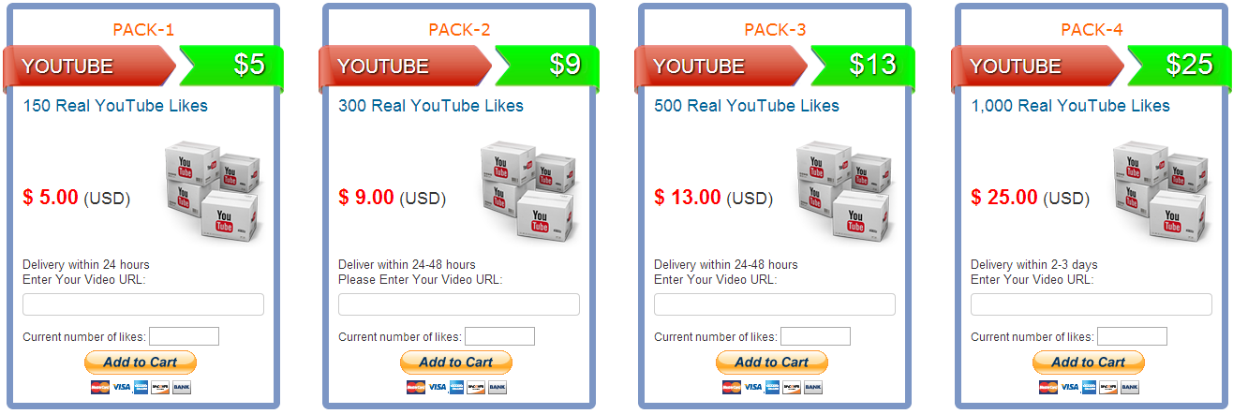






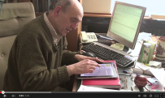
Fraud Detection: Graph Analysis Problem
[buycheaplikes.com]
[reviewsteria.com]
Notes:
Similar things happen in YouTube and Amazon networks. The companies also sell YouTube Likes and 5-star reviews. How to find the videos which buy fraudsters to look popular can also be formulated as a graph analysis problem.

Slide 85
Behavior-based Features
Follower
behavior
Followee
behavior
≈
≈
Out-degree
1st left singular vector
(Hubness)
2nd left singular vector
…
In-degree
1st right singular vector
(Authoritativeness)
2nd right singular vector
…
Notes:
To understand the behavior patterns, we first collect some behavior-based features. The behaviors could be follower behavior when we focus on out-going links and followee behaviors when we focus on in-coming links. If we do SVD on the adjacency matrix, the out-going links give us left singular vectors and the in-coming links give us right singular vectors. Here we use the two basic features of each type of links: out-degree and hubness which is the 1st left singular vector for follower behavior, and in-degree and authoritativeness which is the 1st right singular vector for followee behavior.

Slide 86
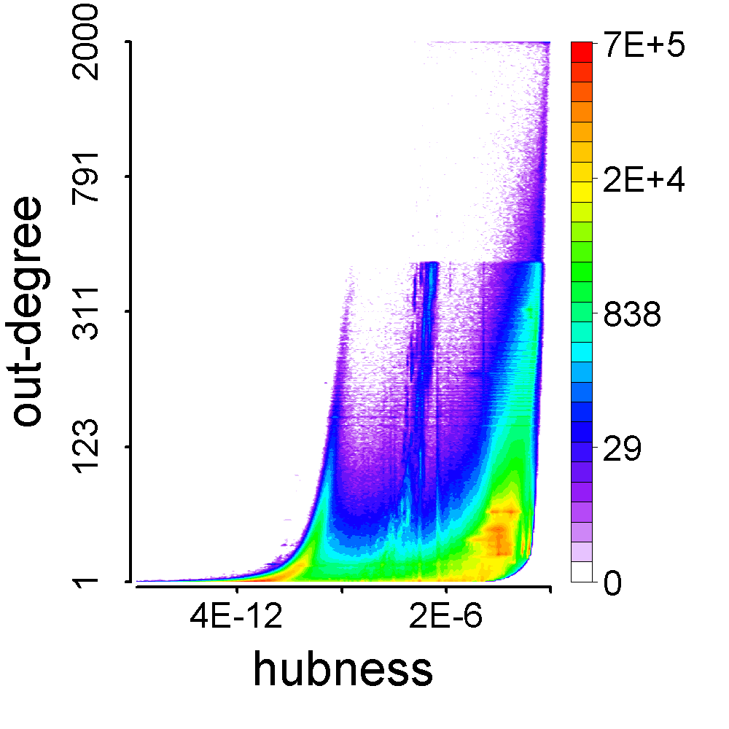
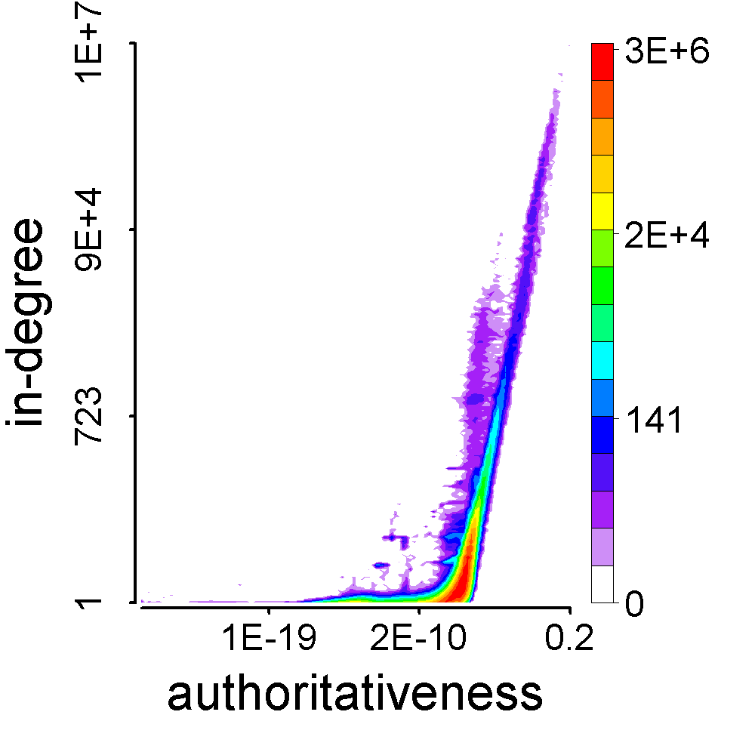
Behavior-based Feature Space
Follower
behavior
Followee
behavior
Notes:
Then we can plot the feature space of follower behavior and followee behavior. These are heat maps. X-axis is singular vector and Y-axis is the degree. Red for large population and purple for small. We can see anomalies in these feature space though we cannot tell why. Next we will compare the fraudsters and normal users in these feature spaces so that perhaps we can explain the anomalies.

Slide 87


Before CatchSync
Follower
behavior
Followee
behavior
Notes:
Also we check the feature space. Before CatchSync, we can see anomalies like stripes away from the major part.

Slide 88


After CatchSync
Follower
behavior
Followee
behavior
Notes:
After CatchSync, the stripes disappear. The suspicious accounts that we remove with CatchSync are exactly the anomalies in these feature spaces.

Slide 89




Q3: Is CatchSync Robust?
Popular
camouflage
Random
camouflage
Notes:
We do experiments on the synthetic data to test the precision and recall when there are popular camouflage or random camouflage. Our CatchSync is close to the ideal and much better than other graph-based methods. So we claim that CatchSync is robust to camouflage.

Slide 91


Introduction
Method
Experiments
Conclusion
Detecting Review Spam
Many existing methods detect fraudsters using dense subgraph detection.
Spectral methods
Clustering
Belief propagation
Notes:
Tell-tale sign of fraud: fraudsters must add many edges, creating unusually large and dense regions in the adjacency matrix
Multiple existing methods rely on dense subgraph detection to catch fraudsters

Slide 92


Introduction
Method
Experiments
Conclusion
Evading Detection
Attackers can evade detection using camouflage.
Notes:
Look for real-life examples/pictures showing camouflage?
Or: show twitter examples of hijacked user accounts

Slide 93
Introduction
Method
Experiments
Conclusion
Node suspiciousness
Products
0
0
B
1
Users
2
A
2
2
1
1
1
1
1
1
1
1
Node suspiciousness of (A,B) = 10

Slide 94
Introduction
Method
Experiments
Conclusion
Edge suspiciousness
Products
B
Users
2
2
2
2
A
2
2
2
2
2
2
2
Edge suspiciousness of (A,B) = 22

Slide 95
Introduction
Method
Experiments
Conclusion
Total suspiciousness
Products
0
0
1
B
Users
2
2
2
2
2
A
2
2
2
2
2
2
2
2
2
1
1
1
1
1
1
1
1
f(A,B) = 32
  f(A,B) = (edge susp.) + (node susp.)

Slide 96
Introduction
Method
Experiments
Conclusion
Greedy Algorithm
Products
B
0
0
1
Users
A
2
2
2
2
2
2
2
2
2
2
2
2
2
2
1
1
1
1
1
1
1
1
  Start with A, B as all users / products

Slide 97
Introduction
Method
Experiments
Conclusion
Greedy Algorithm
B
Products
0
0
1
Users
A
2
2
2
2
2
2
2
2
2
2
2
2
2
2
1
1
1
1
1
1
1
1
  Delete rows / columns greedily to maximize g

Slide 98
Introduction
Method
Experiments
Conclusion
Greedy Algorithm
Products
0
B
0
1
Users
A
2
2
2
2
2
2
2
2
2
2
2
2
2
2
1
1
1
1
1
1
1
1
  Delete rows / columns greedily to maximize g

Slide 99
Introduction
Method
Experiments
Conclusion
Greedy Algorithm
Products
0
0
B
1
Users
A
2
2
2
2
2
2
2
2
2
2
2
2
2
2
1
1
1
1
1
1
1
1
  Delete rows / columns greedily to maximize g

Slide 100
Introduction
Method
Experiments
Conclusion
Greedy Algorithm
Products
0
0
B
1
Users
2
2
2
2
2
A
2
2
2
2
2
2
2
2
2
1
1
1
1
1
1
1
1
  Delete rows / columns greedily to maximize g

Slide 101
Introduction
Method
Experiments
Conclusion
Experiments: Amazon data
  24K x 4K Amazon review graph
  Injected dense blocks with various types of camouflage
    None
    Random camouflage
    Biased camouflage
    Hijacked accounts
Notes:
Define Camouflage resistant metric
Desired properties:
Can be optimized in near-linear time
Can be optimized with theoretical guarantees
Camouflage-resistant
(get ticked off gradually)

Slide 102

Introduction
Method
Experiments
Conclusion
Experiments: Amazon data
Notes:
Define Camouflage resistant metric
Desired properties:
Can be optimized in near-linear time
Can be optimized with theoretical guarantees
Camouflage-resistant
(get ticked off gradually)

Slide 103
Introduction
Method
Experiments
Conclusion
Twitter data
Followees
Density = 4 x 10⁻⁷
Followers
4300
4000
Density = 0.66
Notes:
Define Camouflage resistant metric
Desired properties:
Can be optimized in near-linear time
Can be optimized with theoretical guarantees
Camouflage-resistant
(get ticked off gradually)

Slide 104


Introduction
Method
Experiments
Conclusion
Twitter data
Notes:
Define Camouflage resistant metric
Desired properties:
Can be optimized in near-linear time
Can be optimized with theoretical guarantees
Camouflage-resistant
(get ticked off gradually)

Slide 105


Introduction
Method
Experiments
Conclusion
Conclusion
Average suspiciousness metric
Theoretical guarantees
Effectiveness

