Slide 1
Data Mining – future directions, and past lessons
C. Faloutsos
CMU + Amazon (sabbatical)

Slide 2
Outline
Credit where credit is due (12 foils)
Future directions
Past lessons: Listen
  To the data
  To domain-experts
Conclusions
PAKDD'18
C. Faloutsos

Slide 3
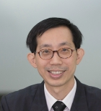
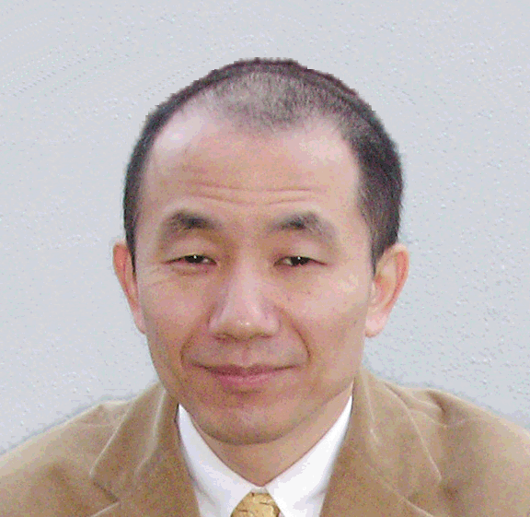
Thank you!
Prof. Ee-Peng Lim
Prof. Takashi Washio
PAKDD'18
C. Faloutsos

Slide 4
Steering Committee
Ee-Peng Lim
P. Krishna Reddy
Joshua Z. Huang
Longbing Cao
Jian Pei
Myra Spiliopoulou
Vincent S. Tseng
Tru Hoang Cao
Gill Dobbie
Kyuseok Shim
PAKDD'18
C. Faloutsos

Slide 5
GC and PC
Geoff Webb
Bao Ho
Dinh Phung
Vincent Tseng
PAKDD'18
C. Faloutsos

Slide 6
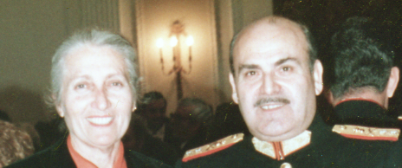
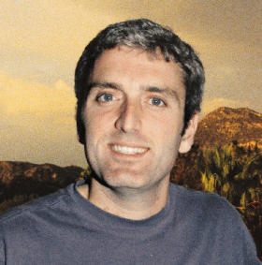
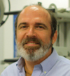
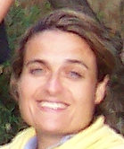
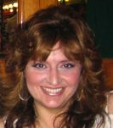
Family
Parents Nikos & Sophia
Siblings Michalis, Petros, Maria
Wife Christina
PAKDD'18
C. Faloutsos

Slide 7
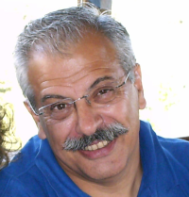
Academic ‘parent’
Christodoulakis, Stavros (T.U.C.)
PAKDD'18
C. Faloutsos

Slide 8

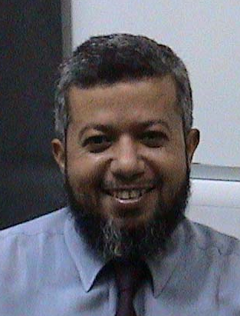

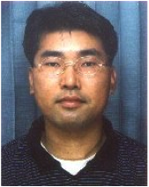


Academic ‘children’
King-Ip (David) Lin
Ibrahim Kamel
Flip Korn
Byoung-Kee Yi
Leejay Wu
Deepayan Chakrabarti
PAKDD'18
C. Faloutsos

Slide 9
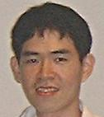
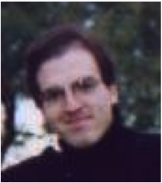
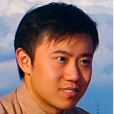
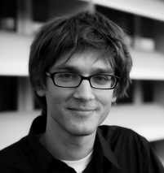

Academic ‘children’
Jia-Yu (Tim) Pan
Spiros Papadimitriou
Jimeng Sun
Jure Leskovec
Hanghang Tong
PAKDD'18
C. Faloutsos

Slide 10
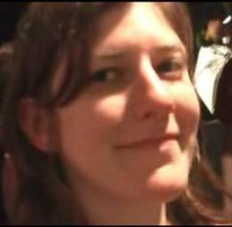
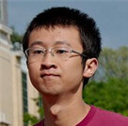
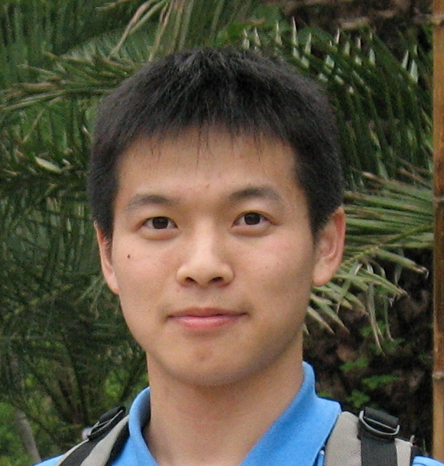
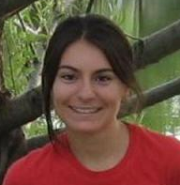


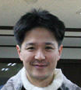
Academic ‘children’
Mary McGlohon
Fan Guo
Lei Li
Leman Akoglu
Dueng Horng (Polo) Chau
Aditya Prakash
U Kang
PAKDD'18
C. Faloutsos

Slide 11
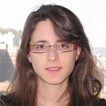
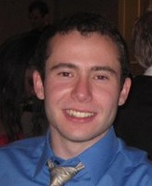
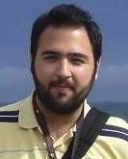
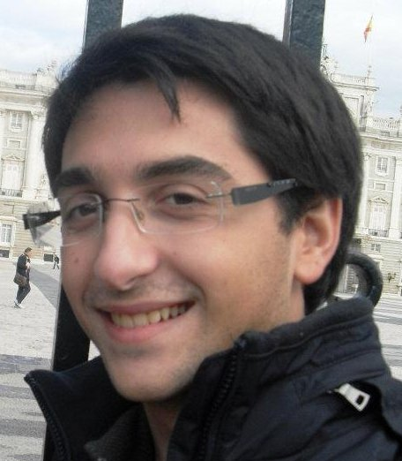
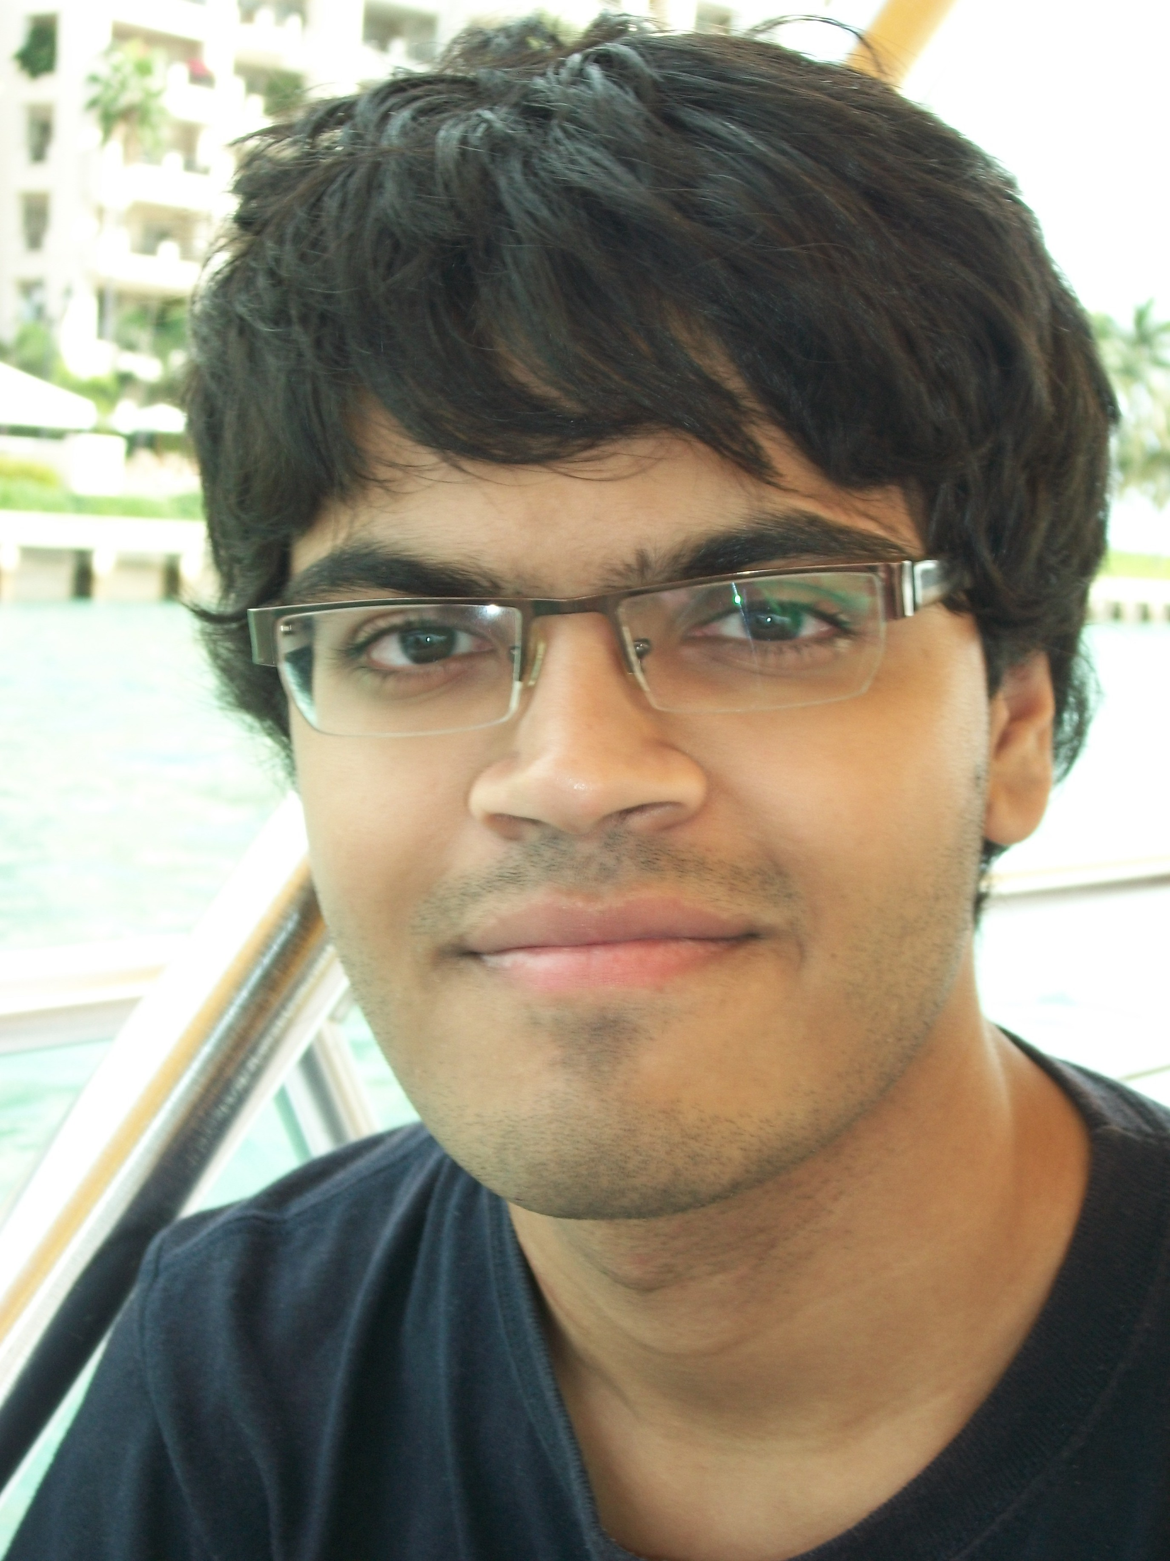
Academic ‘children’
Danai Koutra
Alex Beutel
Vagelis Papalexakis
Miguel Araujo
Neil Shah
PAKDD'18
C. Faloutsos

Slide 12
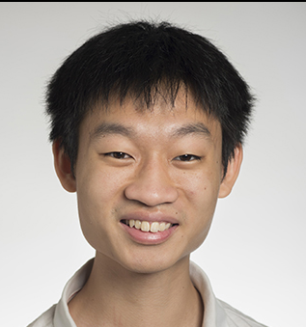
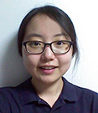
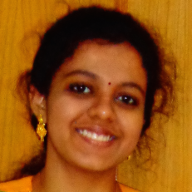
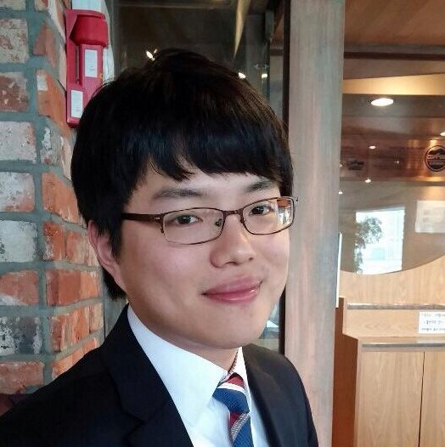
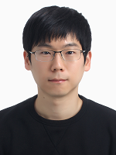
Academic ‘children’
Bryan Hooi
Hyun Ah Song
Dhivya Eswaran
Kijung Shin
Namyong Park
PAKDD'18
C. Faloutsos

Slide 13


Funding agencies/companies
NSF (Maria Zemankova, Frank Olken, ++)
DARPA, LLNL
IBM, MS, HP, INTEL, Y!, Google, Symantec, Sony, Fujitsu, …
Amazon
PAKDD'18
C. Faloutsos

Slide 14
Outline
Credit where credit is due
Future directions
Past lessons: Listen
  To the data
  To domain-experts
PAKDD'18
C. Faloutsos

Slide 15
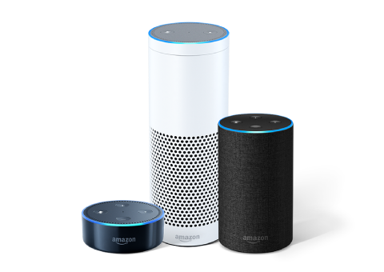
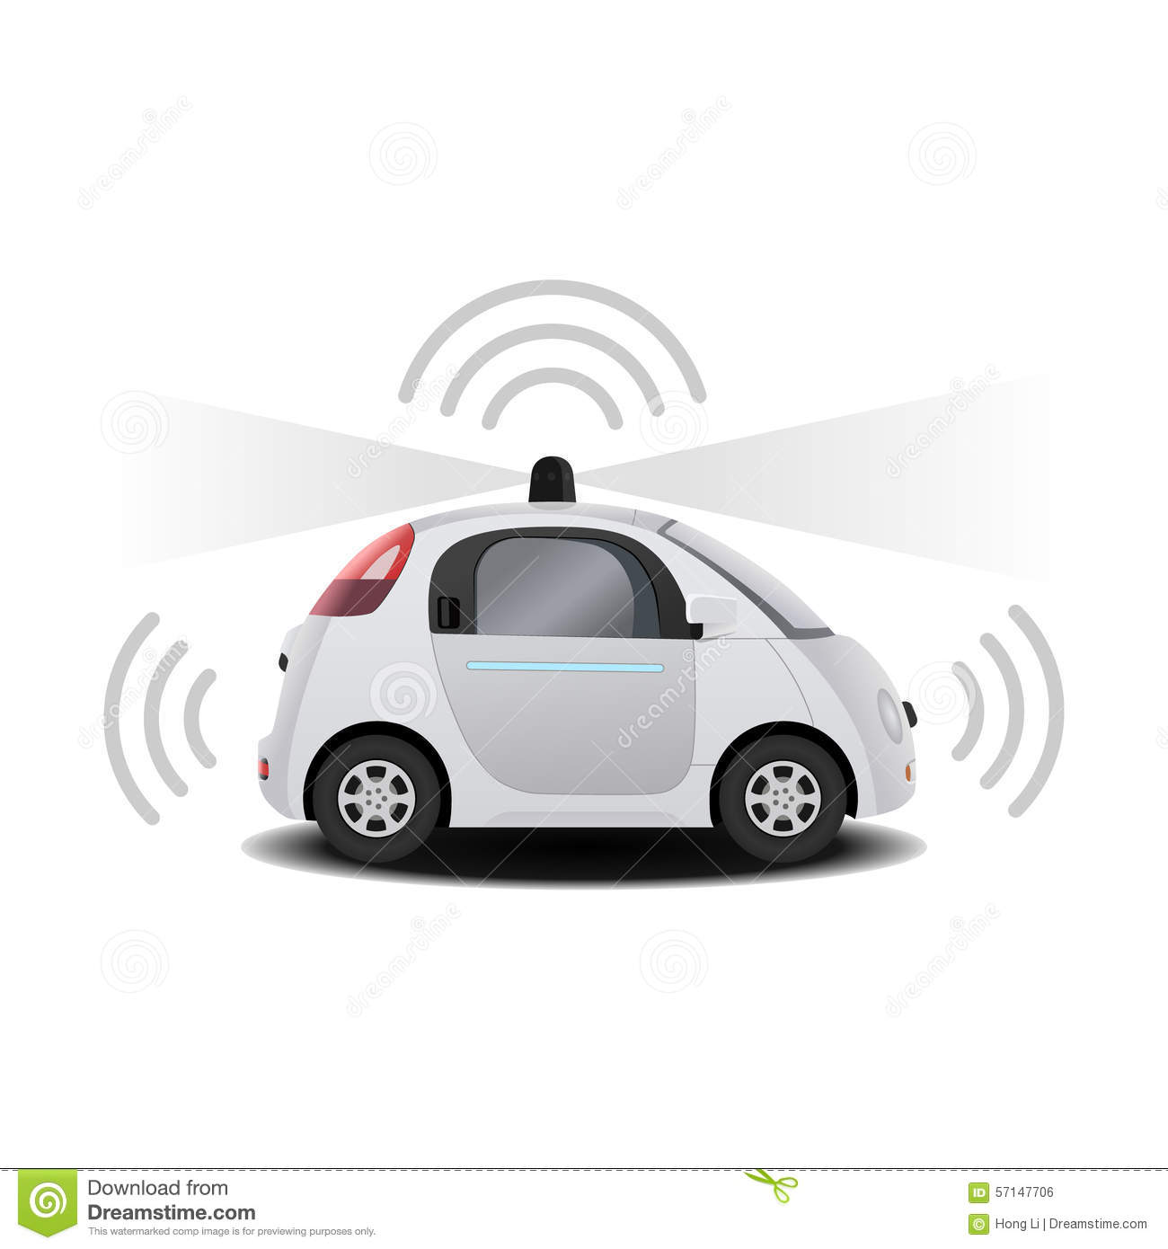
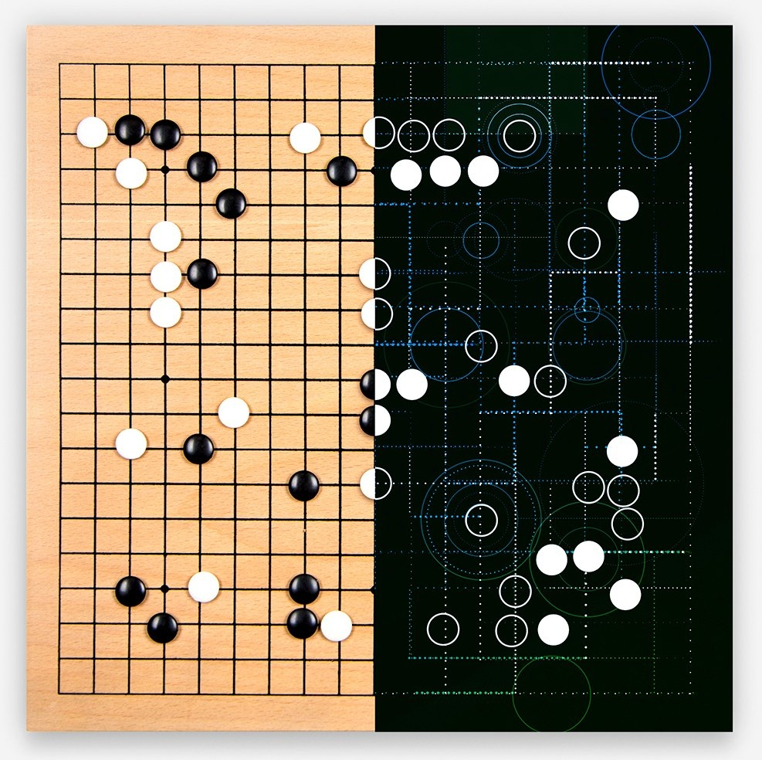
(Great time for Data Science)
Alexa/Siri/Cortana
Self-driving cars
Alpha-go
…
PAKDD'18
C. Faloutsos

Slide 16
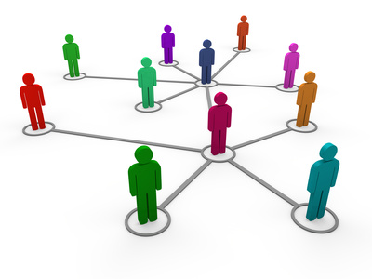
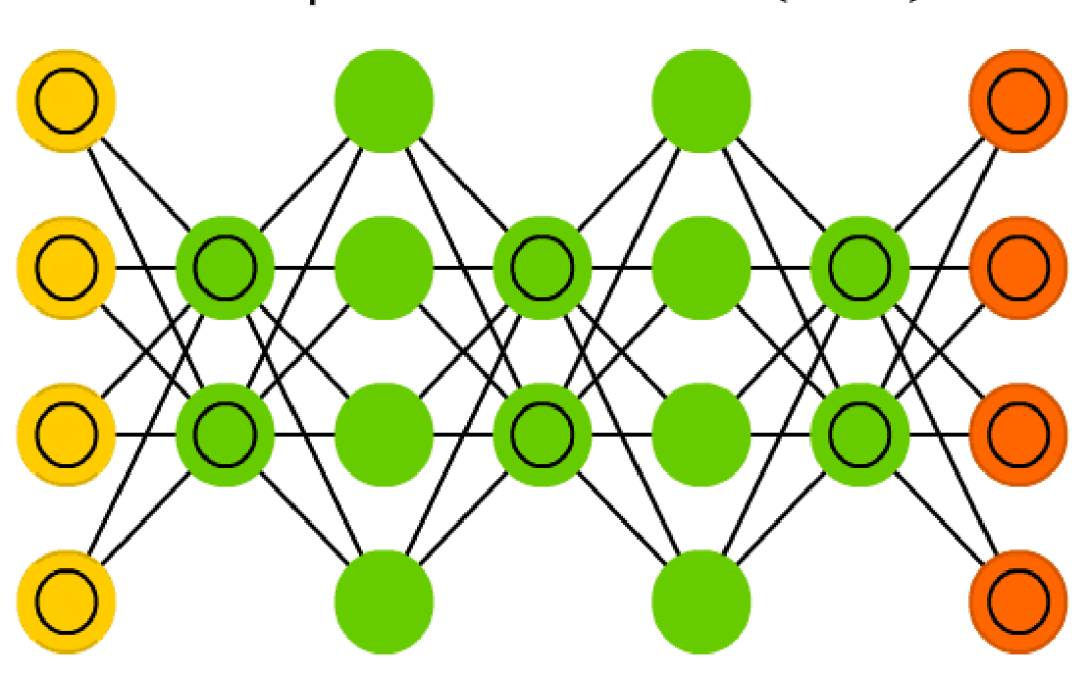
Future directions:
Time evolving graphs/networks
What has a DBN learned?
Explain the output
Visualization
PAKDD'18
C. Faloutsos

Slide 17


Future directions:
Time evolving graphs/networks
What has a DBN learned?
Explain the output
Visualization
PAKDD'18
C. Faloutsos

Slide 18
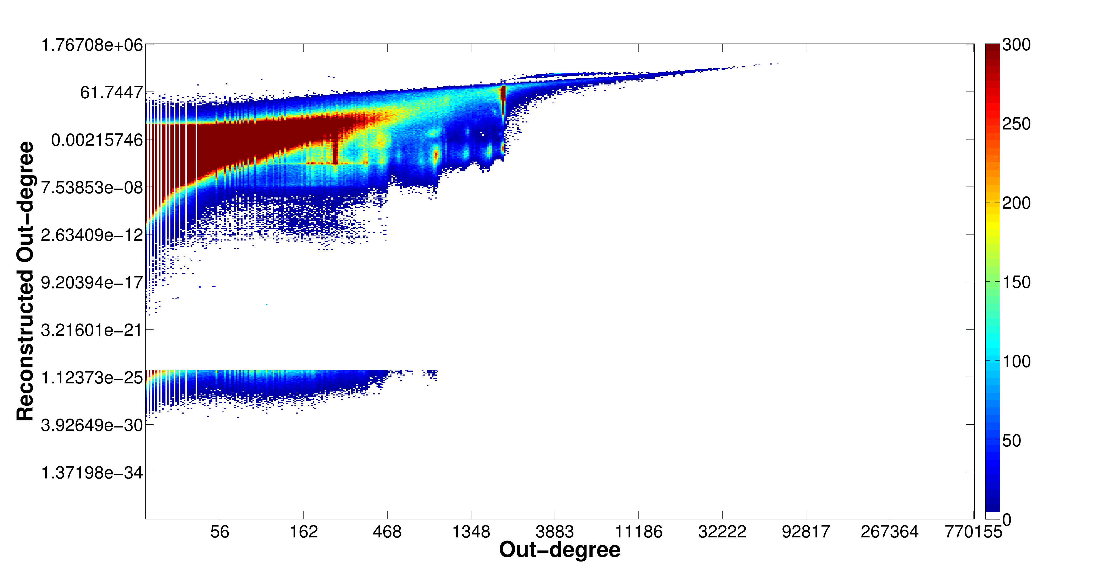
Future directions:
Time evolving graphs/networks
What has a DBN learned?
Explain the output
Visualization
PAKDD'18
C. Faloutsos

Slide 19
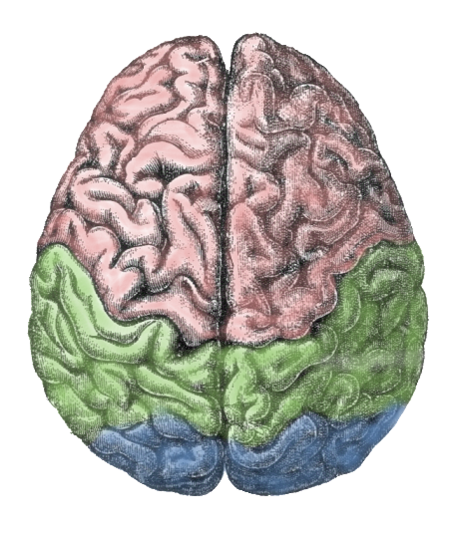
Future directions:
Time evolving graphs/networks
What has a DBN learned?
Explain the output
Visualization
[how the brain works]
PAKDD'18
C. Faloutsos

Slide 20
Outline
Credit where credit is due
Future directions
Past lessons: Listen
  To the data
    D1: Clean data: a myth
    D2: Surprises
  To domain-experts
PAKDD'18
C. Faloutsos

Slide 21
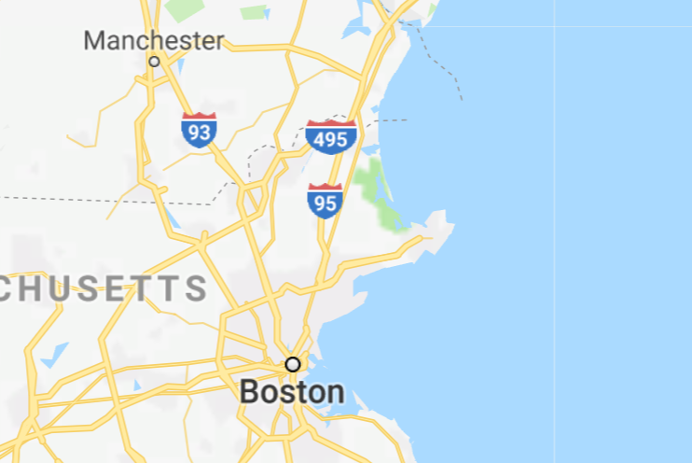

D1.1. Data & ‘cleanliness’
Taxis
PAKDD'18
C. Faloutsos

Slide 22
D1.1. Data & ‘cleanliness’
Taxis
  0.1%: in the ocean
  Longest taxi ride?
PAKDD'18
C. Faloutsos

Slide 23
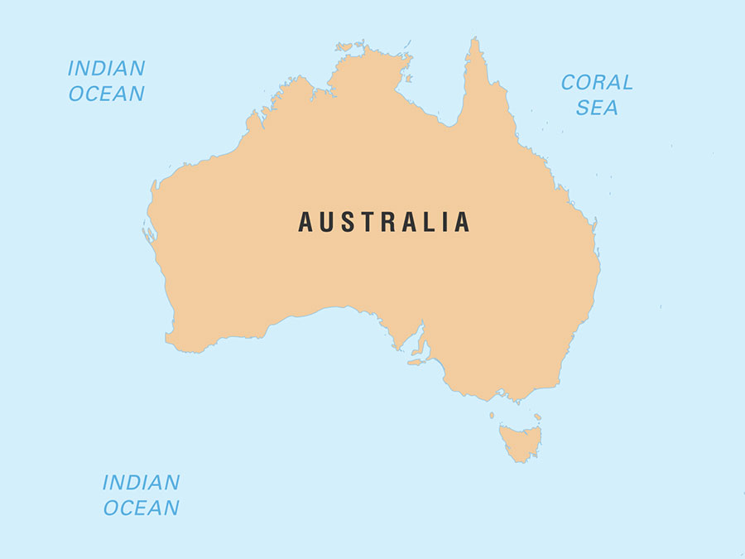
D1.1. Data & ‘cleanliness’
Taxis
  0.1%: in the ocean
  Longest taxi ride?
    6,000miles
2500mi
PAKDD'18
C. Faloutsos

Slide 24
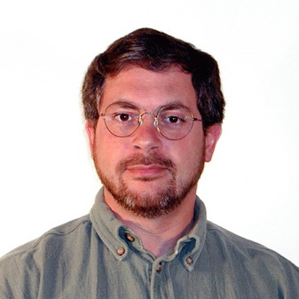
D1.2. Data & ‘cleanliness’
Patients: ‘mode’ of age?
Rich Caruana
PAKDD'18
C. Faloutsos

Slide 25
D1.2. Data & ‘cleanliness’
Patients: ‘mode’ of age?
  (99, or -99) for age
Similarly, age of customer: -1
PAKDD'18
C. Faloutsos

Slide 26
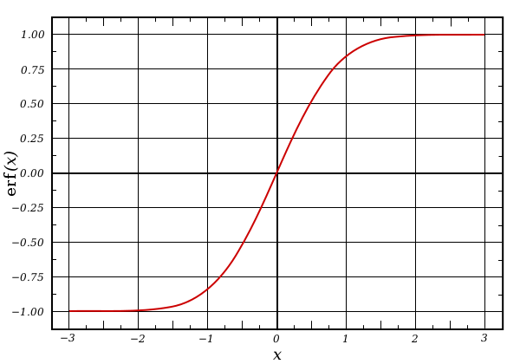
D1.2. Data & ‘cleanliness’
Patients: ‘mode’ of age?
  (99, or -99) for age
Similarly, age of customer: -1
  Fixing it -> $M in prediction accuracy
PAKDD'18
C. Faloutsos

Slide 27
D1.3. Data & ‘cleanliness’
Clicks, per hour of day
  NO periodicity
0h
24h
M3A: Model, MetaModel, and Anomaly Detection in Web Searches, Da-Cheng Juan, et al, https://arxiv.org/abs/1606.05978
PAKDD'18
C. Faloutsos

Slide 28
D1.3. Data & ‘cleanliness’
Clicks, per hour of day
  NO periodicity
BUT: single user, 1 query/10sec
  after removing him/her/it:
  YES
0h
24h
M3A: Model, MetaModel, and Anomaly Detection in Web Searches, Da-Cheng Juan, et al, https://arxiv.org/abs/1606.05978
PAKDD'18
C. Faloutsos

Slide 29
Outline
Credit where credit is due
Future directions
Past lessons: Listen
  To the data
    D1: Clean data: a myth
    D2: Surprises
  To domain-experts
PAKDD'18
C. Faloutsos

Slide 30
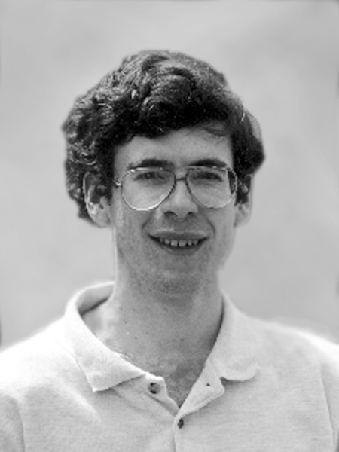
D2.1 Growth of graph diameter
with Jure Leskovec (CMU -> Stanford)
and Jon Kleinberg (Cornell – sabb. @ CMU)
Jure Leskovec, Jon Kleinberg and Christos Faloutsos: Graphs over Time: Densification Laws, Shrinking Diameters and Possible Explanations, KDD 2005

Slide 31
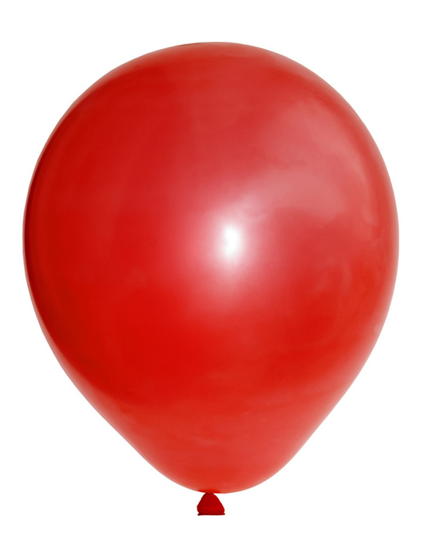
D2.1 Growth of graph diameter
Prior work on Power Law graphs hints at slowly growing diameter:
  [diameter ~ O( N^{1/3})]
  diameter ~ O(log N)
  diameter ~ O(log log N)
What is happening in real data?
diameter
Notes:
Diameter first, DPL second
Check diameter formulas
As the network grows the distances between nodes slowly grow

Slide 32
D2.1 Growth of graph diameter
Prior work on Power Law graphs hints at slowly growing diameter:
  [diameter ~ O( N^{1/3})]
  diameter ~ O(log N)
  diameter ~ O(log log N)
What is happening in real data?
Diameter shrinks over time

Slide 33
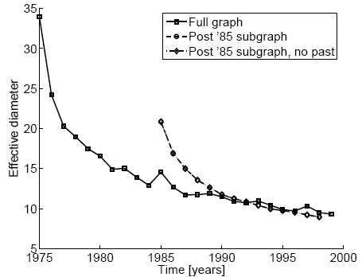
D2.1. Diameter – “Patents”
diameter
Patent citation network
25 years of data
@1999
  2.9 M nodes
  16.5 M edges
time [years]

Slide 34
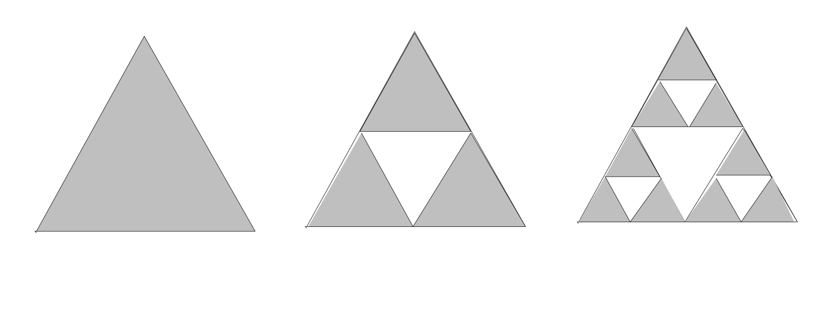
D2.2. How many clusters?
Eg.: clustering – k-means (or our favorite clustering algo)
How many clusters are in the Sierpinski triangle?
…
PAKDD'18
C. Faloutsos

Slide 35
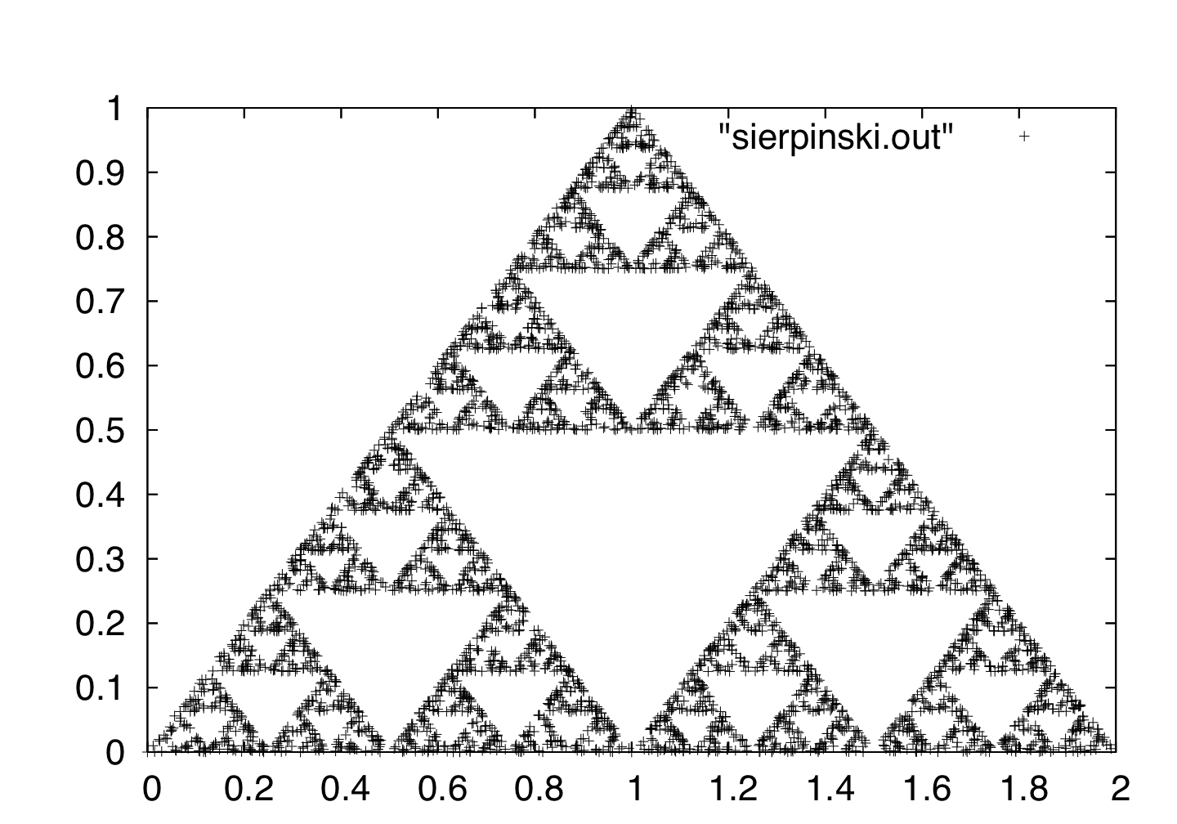
D2.2. How many clusters?
PAKDD'18
C. Faloutsos

Slide 36
D2.2. How many clusters?
K=3 clusters?
PAKDD'18
C. Faloutsos

Slide 37
D2.2. How many clusters?
K=3 clusters?
K=9 clusters?
PAKDD'18
C. Faloutsos

Slide 38
D2.2. How many clusters?
But, does self-similarity appear in real life?
PAKDD'18
C. Faloutsos

Slide 39
Outline
Credit where credit is due
Future directions
Past lessons: Listen
  To the data
  To domain-experts
    E1: fractals / self-similarity
    E2: power-laws
PAKDD'18
C. Faloutsos

Slide 40
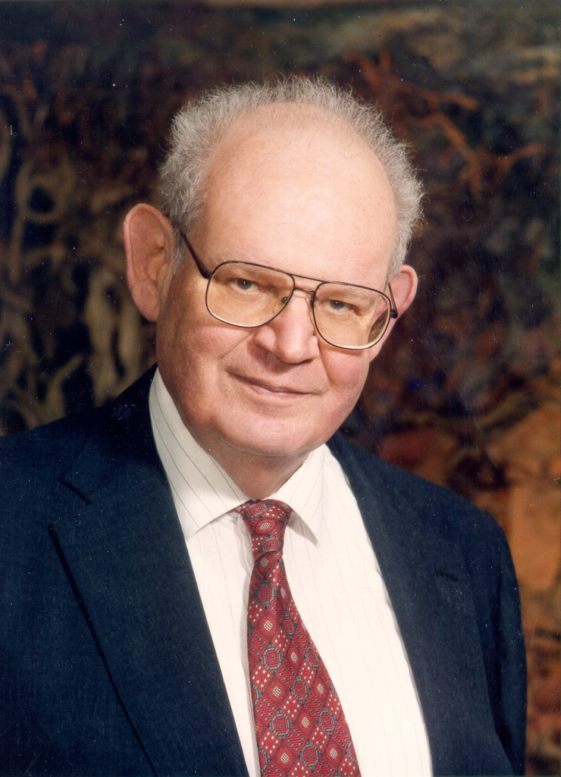
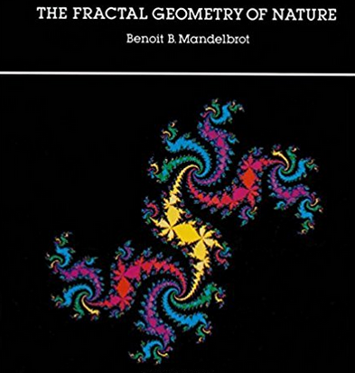
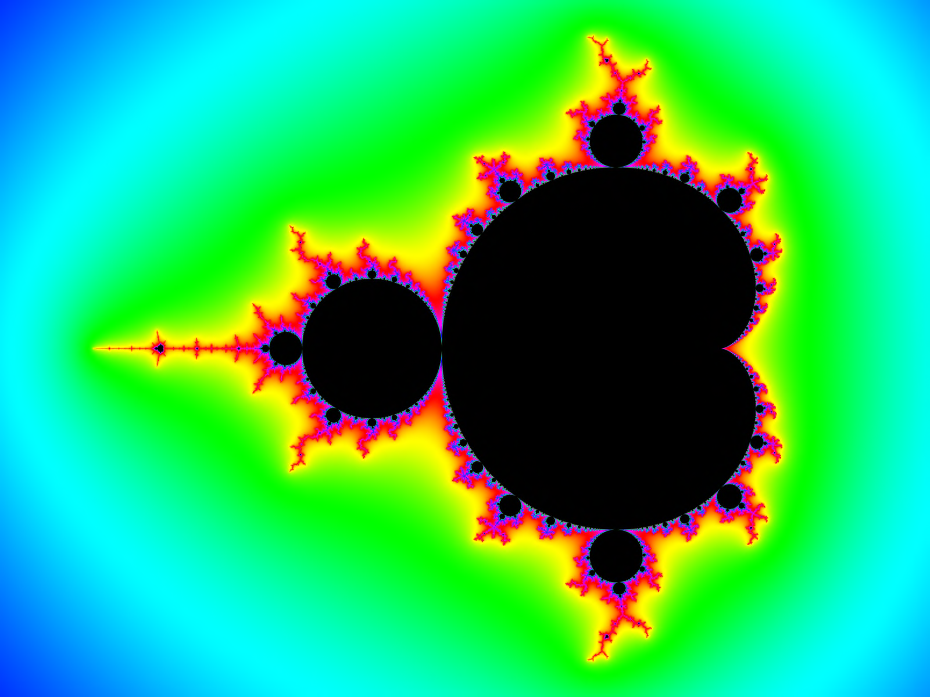
The Fractal geometry
of nature, 1982
B. Mandelbrot
2 pages of self-similar objects:
Bark of trees
Surface of mountains
Human lungs
Surface of mammalian brain
PAKDD'18
C. Faloutsos

Slide 41
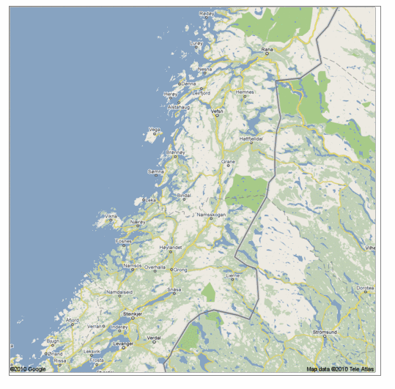
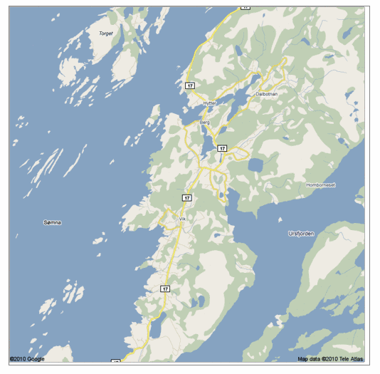
E1.1. Real, self similar dataset
PAKDD'18
C. Faloutsos

Slide 42
E1.1. Real, self similar dataset
PAKDD'18
C. Faloutsos

Slide 43
E1.1. Real, self similar dataset
PAKDD'18
C. Faloutsos

Slide 44
E1.1. Real, self similar dataset
PAKDD'18
C. Faloutsos

Slide 45

the red is true
origin: Norway
but most other coastlines are ‘self-similar’, too!
PAKDD'18
C. Faloutsos

Slide 46


E1.2. Disk traffic
disk traces: self-similar:
Mengzhi Wang, et. al.,Data Mining Meets Performance Evaluation: Fast Algorithms for Modeling Bursty Traffic, ICDE, 2002.
#bytes
time

Slide 47
E1.3. Web traffic
[Crovella, Bestavros, SIGMETRICS’96]
1000 sec; 100sec
10sec; 1sec

Slide 48
Outline
Credit where credit is due
Future directions
Past lessons: Listen
  To the data
  To domain-experts
    E1: fractals / self-similarity
    E2: power-laws
PAKDD'18
C. Faloutsos

Slide 49
Fractals <-> power laws, eg.:
#neighbors
(log)
a
y=xª
Radius (log)
N ( r ) = r ^{log(3)/log(2)} = r ^{1.58}
PAKDD'18
C. Faloutsos

Slide 50



E2.1. : 2x mass -> 2x food?
PAKDD'18
C. Faloutsos

Slide 51
E2.1. : 2x mass -> 2x food?
PAKDD'18
C. Faloutsos

Slide 52

Experts say:
Metabolic
rate
3/4
mass
PAKDD'18
C. Faloutsos
http://universe-review.ca /R10-35-metabolic.htm

Slide 53
Experts say:
Metabolic
rate
3/4
mass
PAKDD'18
C. Faloutsos
http://universe-review.ca /R10-35-metabolic.htm

Slide 54
Kleiberg’s law:
Metabolic
rate
3/4
mass
PAKDD'18
C. Faloutsos
http://universe-review.ca /R10-35-metabolic.htm

Slide 55
E2.2.: Triangle Patterns
Real social networks have a lot of triangles

Slide 56
E2.2.: Triangle Patterns
Real social networks have a lot of triangles
  Friends of friends are friends
Any patterns?
  2x the friends, 2x the triangles ?

Slide 57



E2.2.: Triangle Patterns
[Tsourakakis ICDM 2008]
Reuters
SN
X-axis: degree
Y-axis: mean # triangles
n friends -> ~n^{1.6} triangles
Epinions

Slide 58


Triangle counting for large graphs?
Anomalous nodes in Twitter(~ 3 billion edges)
[U Kang, Brendan Meeder, +, PAKDD’11]
58

Slide 59
Triangle counting for large graphs?
Anomalous nodes in Twitter(~ 3 billion edges)
[U Kang, Brendan Meeder, +, PAKDD’11]
59

Slide 60
Triangle counting for large graphs?
Anomalous nodes in Twitter(~ 3 billion edges)
[U Kang, Brendan Meeder, +, PAKDD’11]
60

Slide 61
Triangle counting for large graphs?
Anomalous nodes in Twitter(~ 3 billion edges)
[U Kang, Brendan Meeder, +, PAKDD’11]
61

Slide 62
Summary
Golden age of Data Science / Data Mining
Data:
  Never ‘clean’
  Often: surprises
Domain experts – cross-disciplinarity:
  Help us avoid surprises
PAKDD'18
C. Faloutsos

Slide 63

Parting joke:
A statistician, a data scientist, and a deep belief network expert, walk into a bar …
PAKDD'18
C. Faloutsos

Slide 64
Thank you!
PAKDD'18
C. Faloutsos

