Slide 1
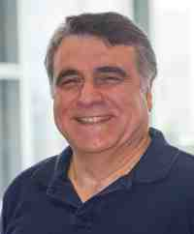
Mining graphs and time series: patterns, anomalies, and fraud detection
Part 2: Time Series
Indexing, Fourier, Wavelets
Christos Faloutsos
CMU SCS
https://www.cs.cmu.edu/~christos/TALKS/19-GoI

Slide 2

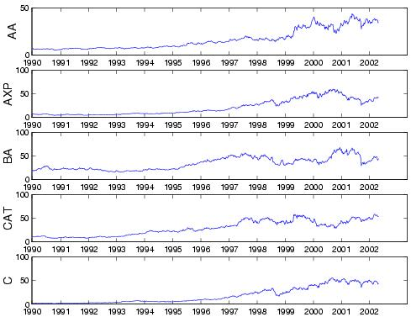
Problem:
Q: mine/forecast (one, or more)
time sequences

Slide 3


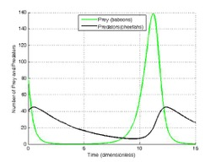


Answers
Similarity search: Euclidean/time-warping; feature extraction and SAMs
Periodicities: DFT/DWT
Linear Forecasting: AR (Box-Jenkins)
Non-linear forecasting: lag-plots
Gray-box modeling: Lotka-Volterra

Slide 4

Outline
Introduction
Part#1: Graphs and Tensors
Part#2: Time series
Part#3: extras (visualization, etc)
Conclusions

Slide 5
Detailed Outline
Motivation
Similarity Search and Indexing
DSP (Digital Signal Processing)
Linear Forecasting
Non-linear forecasting
Tensors
Conclusions

Slide 6
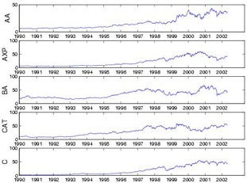
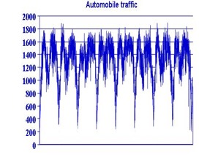
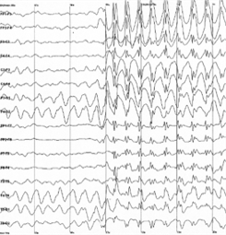
Problem definition
Given: one or more sequences
  x₁ , x₂ , … , x_{t} , …
  (y₁, y₂, … , y_{t}, …
  … )
Find
  Forecast; similar sequences
  patterns; clusters; outliers

Slide 7
Motivation - Applications
Financial, sales, economic series
Medical
  reactions to new drugs
  elderly care

Slide 8
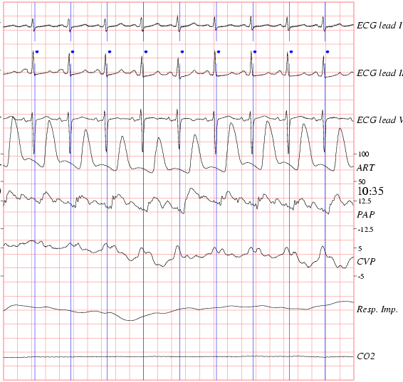
ECG - physionet.org

Slide 9
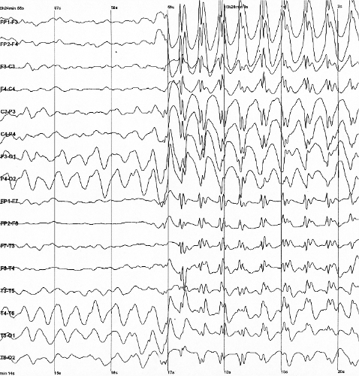

EEG - epilepsy
from wikipedia

Slide 10
Motivation - Applications (cont’d)
‘Smart house’
  sensors monitor temperature, humidity, air quality
video surveillance

Slide 11
Motivation - Applications (cont’d)
civil/automobile infrastructure
  bridge vibrations [Oppenheim+02]
  road conditions / traffic monitoring

Slide 12
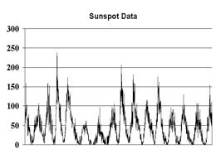
Motivation - Applications (cont’d)
Weather, environment/anti-pollution
  volcano monitoring
  air/water pollutant monitoring

Slide 13
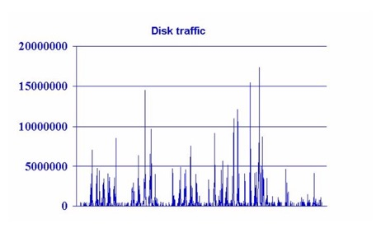
Motivation - Applications (cont’d)
Computer systems
  ‘Active Disks’ (buffering, prefetching)
  web servers (ditto)
  network traffic monitoring
  ...

Slide 14
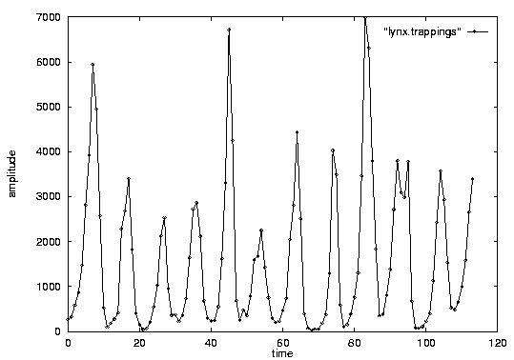
Problem #1:
Goal: given a signal (eg., #packets over time)
Find: patterns, periodicities, and/or compress
count
lynx caught per year
(packets per day;
temperature per day)
year

Slide 15
Problem#2: Forecast
Given x_{t}, x_{t-1}, …, forecast x_{t+1}
90
80
70
60
Number of packets sent
??
50
40
30
20
10
0
1
3
5
7
9
11
Time Tick
Notes:
What are co-evolving time sequences? We define them as a set of correlated time sequences possibly with some time lags.
Let us take an example. Here we have three sequences.
Taking a closer look, we can see that the blue sequence is the same as the red one except that it is a shifted version. Also, the green sequence is somehow correlated with the red one.
What we propose is to study them jointly, to take advantage of the existence of such correlations.

Slide 16
Problem#2’: Similarity search
Eg., Find a 3-tick pattern, similar to the last one
90
80
70
60
Number of packets sent
??
50
40
30
20
10
0
1
3
5
7
9
11
Time Tick
Notes:
What are co-evolving time sequences? We define them as a set of correlated time sequences possibly with some time lags.
Let us take an example. Here we have three sequences.
Taking a closer look, we can see that the blue sequence is the same as the red one except that it is a shifted version. Also, the green sequence is somehow correlated with the red one.
What we propose is to study them jointly, to take advantage of the existence of such correlations.

Slide 17
Problem #3:
Given: A set of correlated time sequences
Forecast ‘Sent(t)’
Notes:
What are co-evolving time sequences? We define them as a set of correlated time sequences possibly with some time lags.
Let us take an example. Here we have three sequences.
Taking a closer look, we can see that the blue sequence is the same as the red one except that it is a shifted version. Also, the green sequence is somehow correlated with the red one.
What we propose is to study them jointly, to take advantage of the existence of such correlations.

Slide 18

Important observations
Patterns, rules, forecasting and similarity indexing are closely related:
To do forecasting, we need
  to find patterns/rules
  compress
  to find similar settings in the past
to find outliers, we need to have forecasts
  (outlier = too far away from our forecast)

Slide 19
Outline
Motivation
Similarity Search and Indexing
DSP
Linear Forecasting
Non-linear forecasting
Tensors
Conclusions

Slide 20
Outline
Motivation
Similarity Search and Indexing
  distance functions: Euclidean;Time-warping
  indexing
  feature extraction
DSP
...

Slide 21

Problem:
Q: How similar are two sequences?

Slide 22

Answer:
Q: How similar are two sequences?
A: Euclidean distance (<-> cosine similarity)
...

Slide 23
Importance of distance functions
Subtle, but absolutely necessary:
A ‘must’ for similarity indexing (-> forecasting)
A ‘must’ for clustering
Two major families
  Euclidean and Lp norms
  Time warping and variations

Slide 24
Euclidean and Lp
...
L₁: city-block = Manhattan
L₂ = Euclidean
L∞

Slide 25
Observation #1
Time sequence -> n-d vector
Day-n
...
Day-2
Day-1

Slide 26
Observation #2
Day-n
Euclidean distance is closely related to
  cosine similarity
  dot product
  ‘cross-correlation’ function
...
Day-2
Day-1

Slide 27
Time Warping
allow accelerations - decelerations
  (with or w/o penalty)
THEN compute the (Euclidean) distance (+ penalty)
related to the string-editing distance

Slide 28
Time Warping
‘stutters’:

Slide 29
Other Distance functions
piece-wise linear/flat approx.; compare pieces [Keogh+01] [Faloutsos+97]
‘cepstrum’ (for voice [Rabiner+Juang])
  do DFT; take log of amplitude; do DFT again!
Allow for small gaps [Agrawal+95]

Slide 30
More distance functions.
Chen + Ng [vldb’04]: ERP ‘Edit distance with Real Penalty’: give a penalty to stutters
Keogh+ [kdd’04]: VERY NICE, based on information theory: compress each sequence (quantize + Lempel-Ziv), using the other sequences’ LZ tables
On The Marriage of Lp-norms and Edit Distance, Lei Chen, Raymond T. Ng:, VLDB’04
Towards Parameter-Free Data Mining, E. Keogh, S. Lonardi, C.A. Ratanamahatana, KDD’04

Slide 31
Conclusions
Prevailing distances:
  Euclidean and
  time-warping

Slide 32
Outline
Motivation
Similarity Search and Indexing
  distance functions
  indexing
  feature extraction
DSP
...

Slide 33
Important observations
Patterns, rules, forecasting and similarity indexing are closely related:
To do forecasting, we need
  to find patterns/rules
  compress
  to find similar settings in the past
to find outliers, we need to have forecasts
  (outlier = too far away from our forecast)

Slide 34
Outline
Motivation
Similarity Search and Indexing
  distance functions
  indexing
  feature extraction
DSP
...

Slide 35
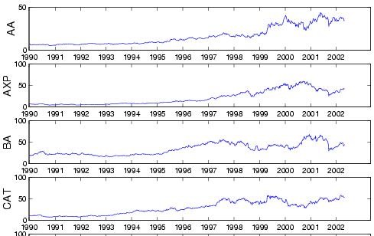

Problem:
Q: find quickly stocks like ‘C’ (or customers like ‘smith’)

Slide 36
Answer:
Q: find quickly stocks like ‘C’ (or customers like ‘smith’)
A: summarize seq. to a few numbers/features (eg., avg, stdv, Fourier coeff.)

Slide 37
Indexing
Problem:
given a set of time sequences,
find the ones similar to a desirable query sequence

Slide 38
$price
$price
1
365
day
$price
1
365
day
distance function: by expert
1
365
day

Slide 39
Idea: ‘GEMINI’
Eg., ‘find stocks similar to MSFT’
Seq. scanning: too slow
How to accelerate the search?
[Faloutsos96]

Slide 40
‘GEMINI’ - Pictorially
eg,. std
S1
F(S1)
1
365
day
F(Sn)
Sn
eg, avg
1
365
day

Slide 41
GEMINI
F(S1)
Solution: Quick-and-dirty' filter:
extract n features (numbers, eg., avg., etc.)
map into a point in n-d feature space
organize points with off-the-shelf spatial access method (‘SAM’)
discard false alarms
F(Sn)

Slide 42
Examples of GEMINI
Time sequences: DFT (up to 100 times faster) [SIGMOD94];
[Kanellakis+], [Mendelzon+]

Slide 43
Conclusions
Fast indexing: through GEMINI
  feature extraction and
  (off the shelf) Spatial Access Methods [Gaede+98]

Slide 44
Outline
Motivation
Similarity Search and Indexing
  distance functions
  indexing
  feature extraction
DSP
...

Slide 45
Outline
Motivation
Similarity Search and Indexing
  distance functions
  indexing
  feature extraction
    DFT, DWT, DCT (data independent)
    SVD, etc (data dependent)

Slide 46
Important observations
Patterns, rules, forecasting and similarity indexing are closely related:
To do forecasting, we need
  to find patterns/rules
  compress
  to find similar settings in the past
to find outliers, we need to have forecasts
  (outlier = too far away from our forecast)

Slide 47
Outline
Motivation
Similarity Search and Indexing
  distance functions
  indexing
  feature extraction
    DFT, DWT, DCT (data independent)
    SVD etc (data dependent)

Slide 48

Problem:
Q: how to extract features (commonalities)? (given the data)

Slide 49

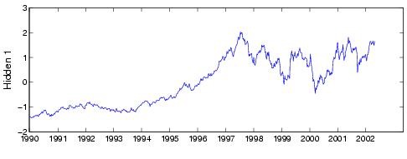
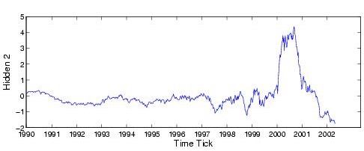
Answer
Q: how to extract features (commonalities)? (given the data)
A: SVD, ICA

Slide 50
SVD
THE optimal method for dimensionality reduction
  (under the Euclidean metric)

Slide 51
Motivation:
Find hidden variables
Alcoa
American Express
Boeing
Caterpillar
Find common hidden variables, and weights.
Citi Group
Dow Jones Industrial Average
Notes:
AA: Alcoa
AXP: American Express
BA: Boeing
CAT: Caterpillar
C: Citigroup

Slide 52
Singular Value Decomposition (SVD)
SVD (~LSI ~ KL ~ PCA ~ spectral analysis...)
LSI: S. Dumais; M. Berry
KL: eg, Duda+Hart
PCA: eg., Jolliffe
Details: [Press+],
[Faloutsos96]
day2
day1

Slide 53
SVD
Extremely useful tool
  (also behind PageRank/google and Kleinberg’s algorithm for hubs and authorities)

Slide 54
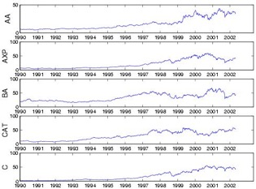
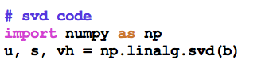
SVD
t₁
t_{n}
AA
AXP
~
U
Σ
V^{T}

Slide 55
SVD
1st behavior
t₁
t_{n}
AA
AXP
~
U
Σ
V^{T}

Slide 56
SVD
1st behavior
t₁
t_{n}
AA
2nd behavior
AXP
~
U
Σ
V^{T}

Slide 57
SVD
1st behavior
t₁
t_{n}
AA
2nd behavior
AXP
~
Participation weight of
row i to behavior j
U
Σ
V^{T}

Slide 58
Outline
Motivation
Similarity Search and Indexing
  distance functions
  indexing
  feature extraction
    DFT, DWT, DCT (data independent)
    SVD etc (data dependent), ICA

Slide 59

Citation
AutoSplit: Fast and Scalable Discovery of Hidden Variables in Stream and Multimedia Databases, Jia-Yu Pan, Hiroyuki Kitagawa, Christos Faloutsos and Masafumi Hamamoto
PAKDD 2004, Sydney, Australia

Slide 60





ICA = BSS
Independent Component Analysis =
Blind Source Separation =
‘cocktail party problem’

Slide 61
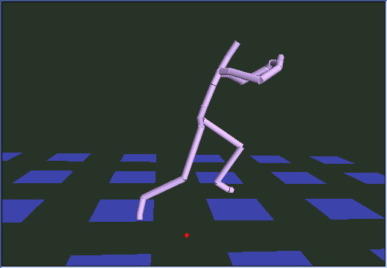
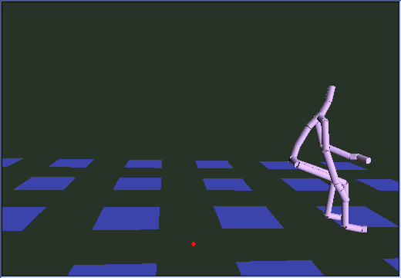
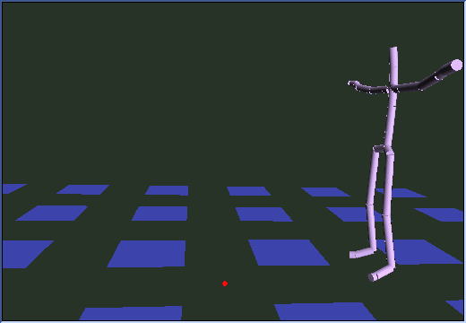
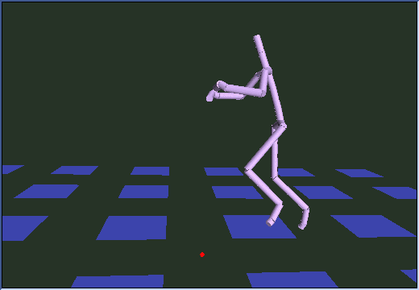
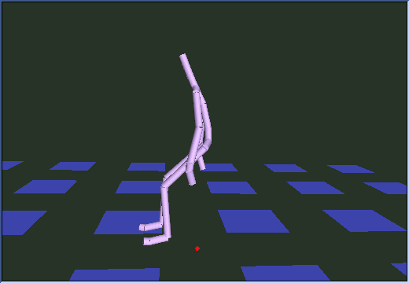
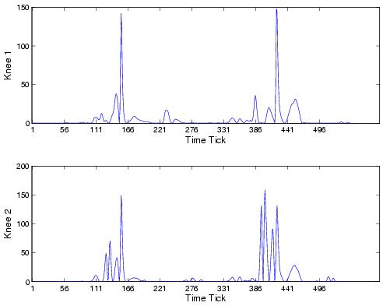
Motivation:
(Q1) Find patterns in data
Motion capture data (broad jumps)
Left Knee
Take-off
Right Knee
Landing
Energy exerted
Notes:
Sample at 60 Hz (550 ticks=9.2sec)

Slide 62
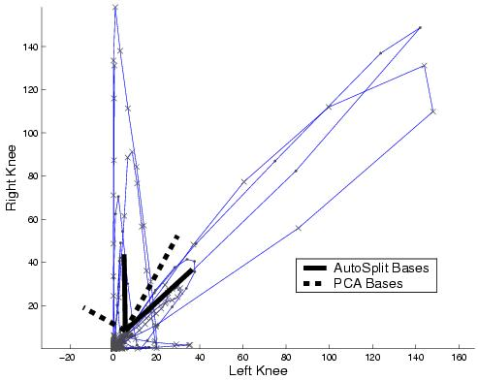
PCA sometimes misses essential features
Best SVD axis: not always meaningful!

Slide 63
Motivation:
(Q1) Find patterns in data
Right Knee
Human would say
  Pattern 1: along diagonal
  Pattern 2: along vertical axis
How to find these automatically?
60:1
Left Knee
1:1
Notes:
x:y= 15.51:14.12
X:y = -0.29:17.65

Slide 64
Motivation:
(Q2) Find hidden variables
Alcoa
American Express
Boeing
Caterpillar
Find common hidden variables, and weights.
Citi Group
Dow Jones Industrial Average
Notes:
AA: Alcoa
AXP: American Express
BA: Boeing
CAT: Caterpillar
C: Citigroup

Slide 65


Motivation:
(Q2) Find hidden variables
Caterpillar
Intel
?
B1,CAT
B2,INTC
B1,INTC
B2,CAT
?
?
Hidden variable 1
Hidden variable 2

Slide 66
Motivation:
(Q2) Find hidden variables
Caterpillar
Intel
0.94
0.64
0.63
0.03
“Hidden variable 1”
“Hidden variable 2”

Slide 67
Motivation:
(Q2) Find hidden variables
Caterpillar
Intel
0.94
0.64
0.63
0.03
“General trend”
“Internet bubble”

Slide 68


ICA: Like SVD, but sparse
1st behavior
2nd behavior
~
Stock#1
Stock#2
General trend
Internet bubble

Slide 69
ICA: Like SVD, but sparse
1st behavior
2nd behavior
~
Stock#1
Stock#2
General trend
Internet bubble

Slide 70
ICA: Like SVD, but sparse
1st behavior
2nd behavior
~
Stock#1
Stock#2
General trend
Internet bubble

Slide 71
ICA: Like SVD, but sparse
1st behavior
2nd behavior
~
Stock#1
Stock#2
General trend
Internet bubble

Slide 72
Answer
Q: how to extract features (commonalities)?
A: SVD, ICA

Slide 73
Books
William H. Press, Saul A. Teukolsky, William T. Vetterling and Brian P. Flannery: Numerical Recipes in C, Cambridge University Press, 1992, 2nd Edition. (Great description, intuition and code for SVD)
C. Faloutsos: Searching Multimedia Databases by Content, Kluwer Academic Press, 1996 (introduction to SVD, and GEMINI)

Slide 74
References
Agrawal, R., K.-I. Lin, et al. (Sept. 1995). Fast Similarity Search in the Presence of Noise, Scaling and Translation in Time-Series Databases. Proc. of VLDB, Zurich, Switzerland.
Babu, S. and J. Widom (2001). “Continuous Queries over Data Streams.” SIGMOD Record 30(3): 109-120.
Breunig, M. M., H.-P. Kriegel, et al. (2000). LOF: Identifying Density-Based Local Outliers. SIGMOD Conference, Dallas, TX.
Berry, Michael: http://www.cs.utk.edu/~lsi/

Slide 75
References
Ciaccia, P., M. Patella, et al. (1997). M-tree: An Efficient Access Method for Similarity Search in Metric Spaces. VLDB.
Foltz, P. W. and S. T. Dumais (Dec. 1992). “Personalized Information Delivery: An Analysis of Information Filtering Methods.” Comm. of ACM (CACM) 35(12): 51-60.
Guttman, A. (June 1984). R-Trees: A Dynamic Index Structure for Spatial Searching. Proc. ACM SIGMOD, Boston, Mass.

Slide 76
References
Gaede, V. and O. Guenther (1998). “Multidimensional Access Methods.” Computing Surveys 30(2): 170-231.
Gehrke, J. E., F. Korn, et al. (May 2001). On Computing Correlated Aggregates Over Continual Data Streams. ACM Sigmod, Santa Barbara, California.

Slide 77
References
Gunopulos, D. and G. Das (2001). Time Series Similarity Measures and Time Series Indexing. SIGMOD Conference, Santa Barbara, CA.
Eamonn J. Keogh, Themis Palpanas, Victor B. Zordan, Dimitrios Gunopulos, Marc Cardle: Indexing Large Human-Motion Databases. VLDB 2004: 780-791

Slide 78
References
Hatonen, K., M. Klemettinen, et al. (1996). Knowledge Discovery from Telecommunication Network Alarm Databases. ICDE, New Orleans, Louisiana.
Jolliffe, I. T. (1986). Principal Component Analysis, Springer Verlag.

Slide 79
References
Keogh, E. J., K. Chakrabarti, et al. (2001). Locally Adaptive Dimensionality Reduction for Indexing Large Time Series Databases. SIGMOD Conference, Santa Barbara, CA.
Kobla, V., D. S. Doermann, et al. (Nov. 1997). VideoTrails: Representing and Visualizing Structure in Video Sequences. ACM Multimedia 97, Seattle, WA.

Slide 80
References
Oppenheim, I. J., A. Jain, et al. (March 2002). A MEMS Ultrasonic Transducer for Resident Monitoring of Steel Structures. SPIE Smart Structures Conference SS05, San Diego.
Papadimitriou, C. H., P. Raghavan, et al. (1998). Latent Semantic Indexing: A Probabilistic Analysis. PODS, Seattle, WA.
Rabiner, L. and B.-H. Juang (1993). Fundamentals of Speech Recognition, Prentice Hall.

Slide 81
References
Traina, C., A. Traina, et al. (October 2000). Fast feature selection using the fractal dimension,. XV Brazilian Symposium on Databases (SBBD), Paraiba, Brazil.

Slide 82
References
Dennis Shasha and Yunyue Zhu High Performance Discovery in Time Series: Techniques and Case Studies Springer 2004
Yunyue Zhu, Dennis Shasha ``StatStream: Statistical Monitoring of Thousands of Data Streams in Real Time'‘ VLDB, August, 2002. pp. 358-369.
Samuel R. Madden, Michael J. Franklin, Joseph M. Hellerstein, and Wei Hong. The Design of an Acquisitional Query Processor for Sensor Networks. SIGMOD, June 2003, San Diego, CA.

Slide 83
References
Lawrence Saul & Sam Roweis. An Introduction to Locally Linear Embedding (draft)
Sam Roweis & Lawrence Saul. Nonlinear dimensionality reduction by locally linear embedding. Science, v.290 no.5500 , Dec.22, 2000. pp.2323--2326.
B. Shaw and T. Jebara. "Minimum Volume Embedding" . Artificial Intelligence and Statistics, AISTATS, March 2007.

Slide 84
References
Josh Tenenbaum, Vin de Silva and John Langford. A Global Geometric Framework for Nonlinear dimensionality Reduction. Science 290, pp. 2319-2323, 2000.

Slide 85
Part 2.2:
DSP (Digital
Signal Processing)

Slide 86
Outline
Motivation
Similarity Search and Indexing
DSP (DFT, DWT)
Linear Forecasting
Non-linear forecasting
Tensors
Conclusions

Slide 87
Outline
DFT
  Definition of DFT and properties
  how to read the DFT spectrum
DWT
  Definition of DWT and properties
  how to read the DWT scalogram

Slide 88
Important observations
Patterns, rules, forecasting and similarity indexing are closely related:
To do forecasting, we need
  to find patterns/rules
  compress
  to find similar settings in the past
to find outliers, we need to have forecasts
  (outlier = too far away from our forecast)

Slide 89

Problem
Q: How to summarize / extract few features
S1
Sn

Slide 90
Answer:
Q: How to summarize / extract few features
A1: Data dep.: SVD, ICA
A2: Data indep.: Fourier; Wavelets
✔︎
S1
Sn

Slide 91
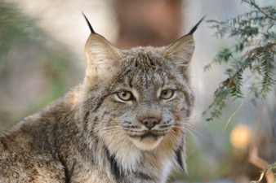
Introduction - Problem#1
Goal: given a signal (eg., packets over time)
Find: patterns and/or compress
count
lynx caught per year
(packets per day;
automobiles per hour)
year

Slide 92
What does DFT do?
A: highlights the periodicities

Slide 93
DFT: definition
Skip
For a sequence x₀, x₁, … x_{n-1}
the (n-point) Discrete Fourier Transform is
X₀, X₁, … X_{n-1} :
inverse DFT

Slide 94

DFT: Amplitude spectrum
Amplitude:
count
Ampl.
freq=0
freq=12
year
Freq.

Slide 95
DFT: Amplitude spectrum
count
Ampl.
freq=0
freq=12
year
Freq.

Slide 96
DFT: Amplitude spectrum
count
Ampl.
freq=0
freq=12
year
Freq.

Slide 97
DFT: Amplitude spectrum
excellent approximation, with only 2 frequencies!
so what?
Freq.

Slide 98
DFT: Amplitude spectrum
excellent approximation, with only 2 frequencies!
so what?
A1: (lossy) compression
A2: pattern discovery

Slide 99
DFT: Amplitude spectrum
excellent approximation, with only 2 frequencies!
so what?
A1: (lossy) compression
A2: pattern discovery

Slide 100
DFT - Conclusions
It spots periodicities (with the ‘amplitude spectrum’)
can be quickly computed (O( n log n)), thanks to the FFT algorithm.
standard tool in signal processing (speech, image etc signals)
(closely related to DCT and JPEG)

Slide 101
Outline
Motivation
Similarity Search and Indexing
DSP
  DFT
  DWT
    Definition of DWT and properties
    how to read the DWT scalogram

Slide 102
Problem #1:
Goal: given a signal (eg., #packets over time)
Find: patterns, periodicities, and/or compress
count
lynx caught per year
(packets per day;
virus infections per month)
year

Slide 103
Wavelets - DWT
DFT is great - but, how about compressing a spike?
value
time

Slide 104
Wavelets - DWT
DFT is great - but, how about compressing a spike?
A: Terrible - all DFT coefficients needed!
value
Ampl.
time
Freq.

Slide 105
Wavelets - DWT
DFT is great - but, how about compressing a spike?
A: Terrible - all DFT coefficients needed!
value
time

Slide 106
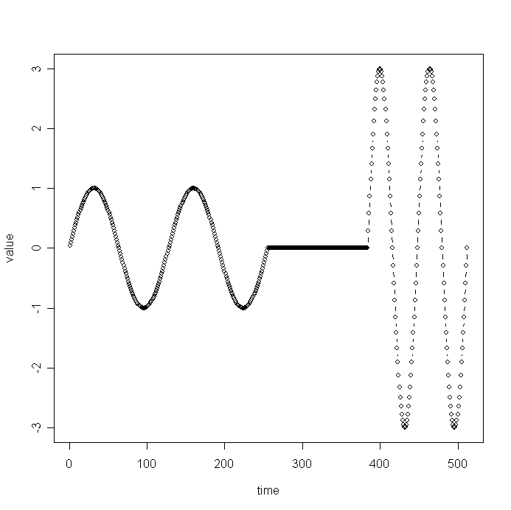
Wavelets - DWT
Similarly, DFT suffers on short-duration waves (eg., baritone, silence, soprano)
value
time

Slide 107
Wavelets - DWT
Solution#1: Short window Fourier transform (SWFT)
But: how short should be the window?
freq
value
time
time

Slide 108
Wavelets - DWT
Answer: multiple window sizes! -> DWT
Time
domain
DFT
SWFT
DWT
freq
time

Slide 109
Haar Wavelets
subtract sum of left half from right half
repeat recursively for quarters, eight-ths, ...

Slide 110
Wavelets - construction
Skip
x0 x1 x2 x3 x4 x5 x6 x7

Slide 111
Wavelets - construction
Skip
level 1
s1,0
d1,1
s1,1
.......
d1,0
+
-
x0 x1 x2 x3 x4 x5 x6 x7

Slide 112
Wavelets - construction
Skip
level 2
s2,0
d2,0
s1,0
d1,1
s1,1
.......
d1,0
+
-
x0 x1 x2 x3 x4 x5 x6 x7

Slide 113
Wavelets - construction
Skip
etc ...
s2,0
d2,0
s1,0
d1,1
s1,1
.......
d1,0
+
-
x0 x1 x2 x3 x4 x5 x6 x7

Slide 114
Wavelets - construction
Skip
Q: map each coefficient
on the time-freq. plane
f
s2,0
d2,0
t
s1,0
d1,1
s1,1
.......
d1,0
+
-
x0 x1 x2 x3 x4 x5 x6 x7

Slide 115
Wavelets - construction
Skip
Q: map each coefficient
on the time-freq. plane
f
s2,0
d2,0
t
s1,0
d1,1
s1,1
.......
d1,0
+
-
x0 x1 x2 x3 x4 x5 x6 x7

Slide 116
Haar wavelets - code
#!/usr/bin/perl5
# expects a file with numbers
# and prints the dwt transform
# The number of time-ticks should be a power of 2
# USAGE
# haar.pl <fname>
my @vals=();
my @smooth; # the smooth component of the signal
my @diff; # the high-freq. component
# collect the values into the array @val
while(<>){
@vals = ( @vals , split );
}
my $len = scalar(@vals);
my $half = int($len/2);
while($half >= 1 ){
for(my $i=0; $i< $half; $i++){
$diff [$i] = ($vals[2*$i] - $vals[2*$i + 1] )/ sqrt(2);
print "\t", $diff[$i];
$smooth [$i] = ($vals[2*$i] + $vals[2*$i + 1] )/ sqrt(2);
}
print "\n";
@vals = @smooth;
$half = int($half/2);
}
print "\t", $vals[0], "\n" ; # the final, smooth component

Slide 117
Wavelets - construction
Observation1:
  ‘+’ can be some weighted addition
  ‘-’ is the corresponding weighted difference (‘Quadrature mirror filters’)
Observation2: unlike DFT/DCT,
  there are *many* wavelet bases: Haar, Daubechies-4, Daubechies-6, Coifman, Morlet, Gabor, ...

Slide 118
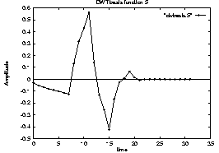
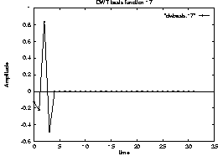
Wavelets - how do they look like?
E.g., Daubechies-4

Slide 119
Wavelets - how do they look like?
E.g., Daubechies-4
?
?

Slide 120
Wavelets - how do they look like?
E.g., Daubechies-4

Slide 121
Outline
Motivation
Similarity Search and Indexing
DSP
  DFT
  DWT
    Definition of DWT and properties
    how to read the DWT scalogram

Slide 122
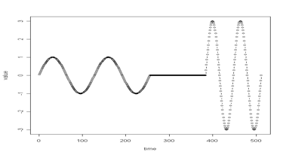
Wavelets - Drill#1:
Q: baritone/silence/soprano - DWT?
f
t
value
time

Slide 123
Wavelets - Drill#1:
Q: baritone/silence/soprano - DWT?
f
t
value
time

Slide 124
Wavelets - Drill#2:
Q: spike - DWT?
f
t

Slide 125
Wavelets - Drill#2:
Q: spike - DWT?
0.00 0.00 0.71 0.00
0.00 0.50
-0.35
0.35
f
t

Slide 126
Wavelets - Drill#3:
Q: weekly + daily periodicity, + spike - DWT?
f
t

Slide 127
Wavelets - Drill#3:
Q: weekly + daily periodicity, + spike - DWT?
f
t

Slide 128
Wavelets - Drill#3:
Q: weekly + daily periodicity, + spike - DWT?
f
t

Slide 129
Wavelets - Drill#3:
Q: weekly + daily periodicity, + spike - DWT?
f
t

Slide 130
Wavelets - Drill#3:
Q: weekly + daily periodicity, + spike - DWT?
f
t

Slide 131
Wavelets - Drill#3:
Q: DFT?
DWT
DFT
f
f
t
t

Slide 132
Wavelets in action

Slide 133
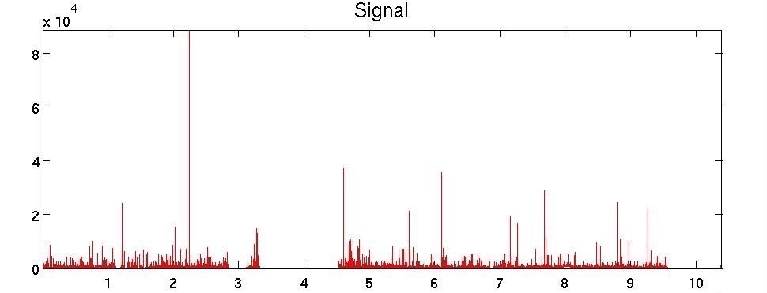

More examples (BGP updates)
#updates
time
BGP-lens: Patterns and Anomalies in Internet Routing Updates B. Aditya Prakash et al, SIGKDD 2009

Slide 134
More examples (BGP updates)
#updates
time
BGP-lens: Patterns and Anomalies in Internet Routing Updates B. Aditya Prakash et al, SIGKDD 2009

Slide 135
More examples (BGP updates)
#updates
time
BGP-lens: Patterns and Anomalies in Internet Routing Updates B. Aditya Prakash et al, SIGKDD 2009

Slide 136
More examples (BGP updates)
#updates
Given a time series: 1) PLOT IT
time
BGP-lens: Patterns and Anomalies in Internet Routing Updates B. Aditya Prakash et al, SIGKDD 2009

Slide 137
More examples (BGP updates)
Given a time series: 1) PLOT IT
2) DFT / DWT

Slide 138
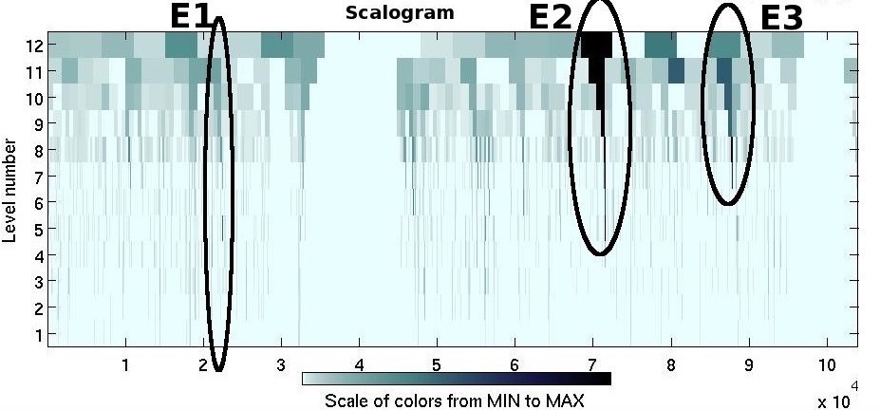
More examples (BGP updates)
Low freq.:
omitted
f
t
freq.

Slide 139
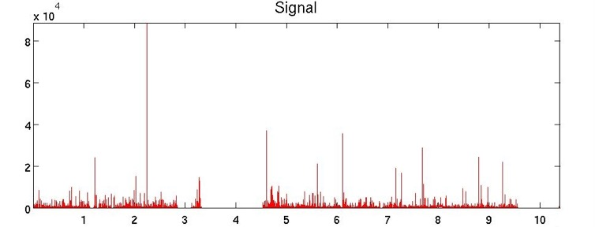
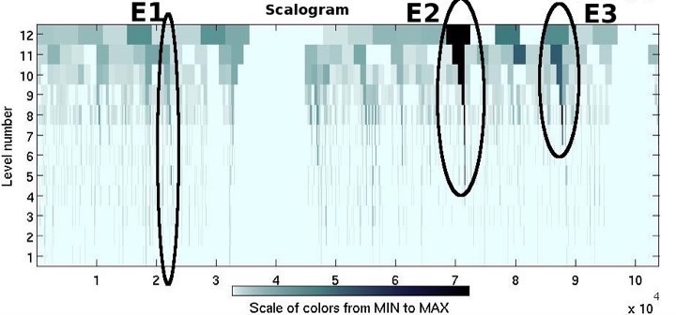
More examples (BGP updates)
??
freq.

Slide 140
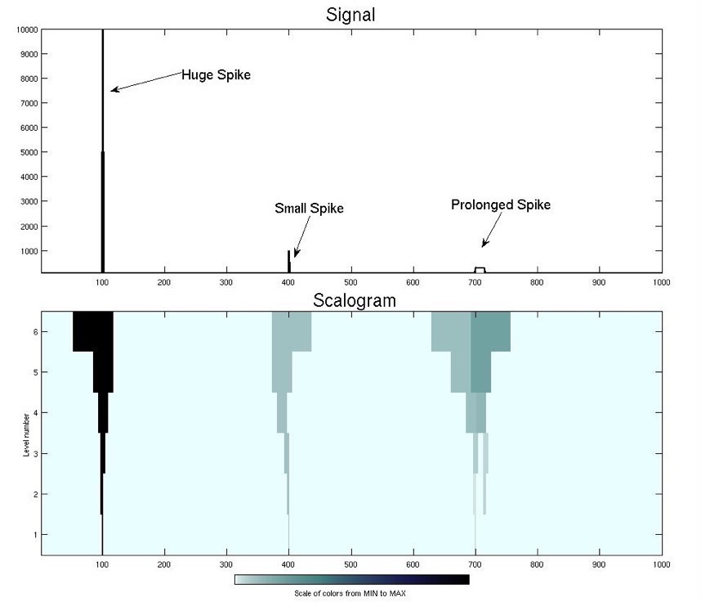
More examples (BGP updates)
‘Prolonged
spike’
f
freq.
t

Slide 141
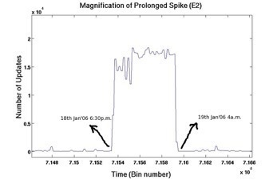
More examples (BGP updates)
15K msgs, for several hours: 6pm-4am
freq.

Slide 142
More examples (BGP updates)
15K msgs, for several hours: 6pm-4am
freq.
Given a time series: 1) PLOT IT
2) DFT / DWT

Slide 143


Advantages of Wavelets
Better compression (better RMSE with same number of coefficients - used in JPEG-2000)
fast to compute (usually: O(n)!)
good for ‘spikes’
good for de-noising
mammalian eye and ear: Gabor wavelets

Slide 144
Overall Conclusions
DFT spots periodicities
DWT : multi-resolution - matches processing of mammalian ear/eye better
Both: powerful tools for compression, pattern detection in real signals

Slide 145
Resources: software and urls
xwpl: open source wavelet package from Yale, with excellent GUI
http://monet.me.ic.ac.uk/people/gavin/java/waveletDemos.html : wavelets and scalograms

Slide 146
Books
William H. Press, Saul A. Teukolsky, William T. Vetterling and Brian P. Flannery: Numerical Recipes in C, Cambridge University Press, 1992, 2nd Edition. (Great description, intuition and code for DFT, DWT)
C. Faloutsos: Searching Multimedia Databases by Content, Kluwer Academic Press, 1996 (introduction to DFT, DWT)

Slide 147
Additional Reading
[Gilbert+01] Anna C. Gilbert, Yannis Kotidis and S. Muthukrishnan and Martin Strauss, Surfing Wavelets on Streams: One-Pass Summaries for Approximate Aggregate Queries, VLDB 2001

