Slide 1
Fraud detection in real-life graphs
Christos Faloutsos
CMU

Slide 2
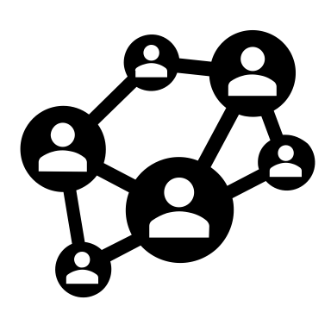
Outline
Intro – motivation
Fraud types in
F1) E-commerce
F2) Financial networks
F3) Social networks
F4) Phone-call graphs
‘TgraphSpot’: ML+Viz tool
Case #1
Case #2
Notes:
Specifically we will show an example of each of these fraud types and suspicious networks.

Slide 3
Graphs are everywhere!
E-commerce
Social networks
Cyber-security
…
Notes:
Graphs are Everywhere,’ in the next slides, we will provide examples of each of these areas. In E-commerce, graphs optimize product connections and customer preferences, enhancing user experience. Moving to Social Networks, graphs underpins the complex web of online interactions and relationships. Concerning Cyber-security, we'll examine how graphs are pivotal in detecting threats and securing networks, and lastly, in Bio-informatics, graphs play a crucial role in understanding complex biological data and networks.

Slide 4
e-commerce examples
Who-buys-what
Who sells what
Who reviews what
…
…
Notes:
But other graphs can be built from ecommerce, who sells what Who Reviews What’ connecting products with sellers and customer reviews, offering insights into consumer satisfaction and influencing future purchasing decisions.

Slide 5
Social networks
Who-friends-whom
Who-follows-whom
Who-retweets-whom
Notes:
Moving deeper, 'Who Follows Whom' graphs shed light on one-way relationships, often signifying interest or influence dynamics. Lastly, 'Who Retweets Whom' provides insights into information flow and viral trends, highlighting how content and opinions propagate through these complex social webs."

Slide 6
Cyber-security
Which_machine - connects_to - what
…
<subject> related-to <object> : graph
…
…
Notes:
Graphs are the one of themost important tools to map network topologies and understanding 'Which Machine Connects to What.' This visual representation allows for the detection of unusual patterns or anomalies in network traffic, indicating potential security breaches or threats. By analyzing these connections, cybersecurity experts can identify vulnerable points, monitor for unauthorized access, and bolster defenses against sophisticated cyber attacks."

Slide 7
Outline
Intro – motivation
Fraud types in
F1) E-commerce
F2) Financial networks
F3) Social networks
F4) Phone-call graphs
‘TgraphSpot’: ML+Viz tool
Case #1
Case #2
Notes:
Specifically we will show an example of each of these fraud types and suspicious networks.

Slide 8
Outline
Intro – motivation
Fraud types in
F1) E-commerce
F1.1) ‘brushing’
F1.2) buyer-seller collusion
F1.3) fake reviews
F2) Financial networks
F3) …
Notes:
Specifically we will show an example of each of these fraud types and suspicious networks.

Slide 9
F1: Fraud in e-commerce
F1.1. ‘brushing’ (Wikipedia; WSJ )
Un-wanted packages – why?
…

Slide 10
F1: Fraud in e-commerce
F1.1. ‘brushing’ (Wikipedia; WSJ )
Un-wanted packages – why?
A: to boost sales (‘trending products’)
…

Slide 11
Outline
Intro – motivation
Fraud types in
F1) E-commerce
F1.1) ‘brushing’
F1.2) buyer-seller collusion
F1.3) fake reviews
F2) Financial networks
F3) …
Notes:
Specifically we will show an example of each of these fraud types and suspicious networks.

Slide 12
F1: Fraud in e-commerce
F1.2: buyer-seller collusion
E-bay fraud detection
w/ Polo Chau &
Shashank Pandit, CMU
[www’07]

Slide 13
E-bay Fraud detection

Slide 14
E-bay Fraud detection

Slide 15
E-bay Fraud detection - NetProbe

Slide 16
Popular press
And less desirable attention:
E-mail from ‘Belgium police’ (‘copy of your code?’)

Slide 17
Outline
Intro – motivation
Fraud types in
F1) E-commerce
F1.1) ‘brushing’
F1.2) buyer-seller collusion
F1.3) fake reviews
F2) Financial networks
F3) …
Notes:
Specifically we will show an example of each of these fraud types and suspicious networks.

Slide 18
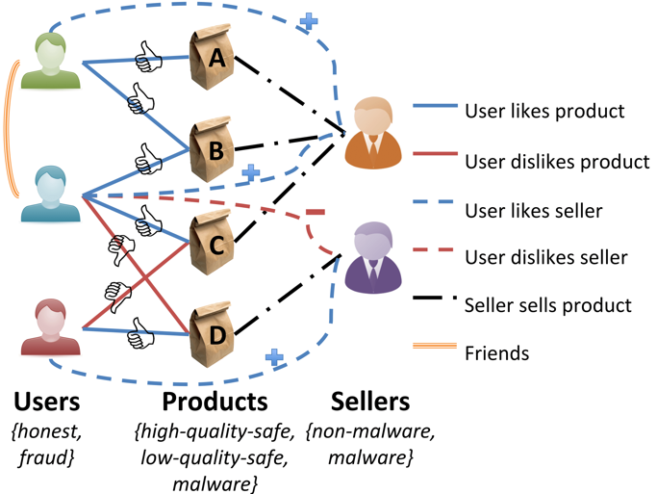
F1: Fraud in e-commerce
Details
Given a heterogeneous graph on users, products, sellers and positive/negative ratings with “seed labels”
Find the top k most fraudulent users, products and sellers
Dhivya Eswaran, Stephan Günnemann, Christos Faloutsos, Disha Makhija, Mohit Kumar, “ZooBP: Belief Propagation for Heterogeneous Networks”, VLDB 2017

Slide 19
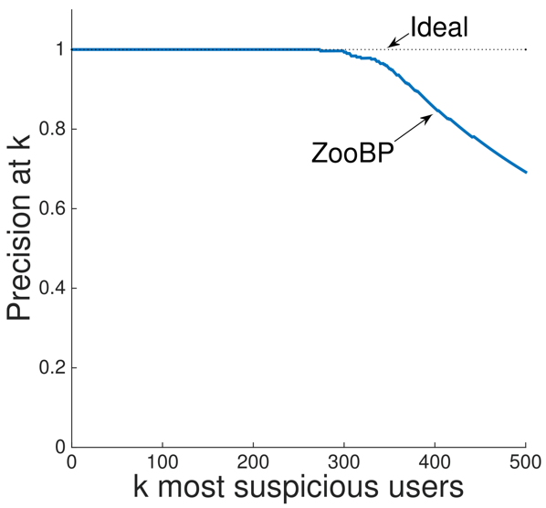
F1: Fraud in e-commerce
F1.3 Fake reviews -> ‘zooBP’
Near 100% precision on top 300 users (Flipkart)
Flagged users: suspicious
400 ratings in 1 sec
5000 good ratings and no bad ratings
Dhivya Eswaran, Stephan Günnemann, Christos Faloutsos, Disha Makhija, Mohit Kumar, “ZooBP: Belief Propagation for Heterogeneous Networks”, VLDB 2017

Slide 20
F1: Fraud in e-commerce
F1.3 Fake reviews -> ‘zooBP’
Near 100% precision on top 300 users (Flipkart)
Flagged users: suspicious
400 ratings in 1 sec
5000 good ratings and no bad ratings
Dhivya Eswaran, Stephan Günnemann, Christos Faloutsos, Disha Makhija, Mohit Kumar, “ZooBP: Belief Propagation for Heterogeneous Networks”, VLDB 2017

Slide 21
F1: Fraud in e-commerce
F1.3 Fake reviews -> ‘zooBP’
Near 100% precision on top 300 users (Flipkart)
Flagged users: suspicious
400 ratings in 1 sec
5000 good ratings and no bad ratings
Dhivya Eswaran, Stephan Günnemann, Christos Faloutsos, Disha Makhija, Mohit Kumar, “ZooBP: Belief Propagation for Heterogeneous Networks”, VLDB 2017

Slide 22
Outline
Intro – motivation
Fraud types in
F1) E-commerce
F2) Financial networks
F3) Social networks
F4) Phone-call graphs
‘TgraphSpot’: ML+Viz tool
Case #1
Case #2
Notes:
Specifically we will show an example of each of these fraud types and suspicious networks.

Slide 23
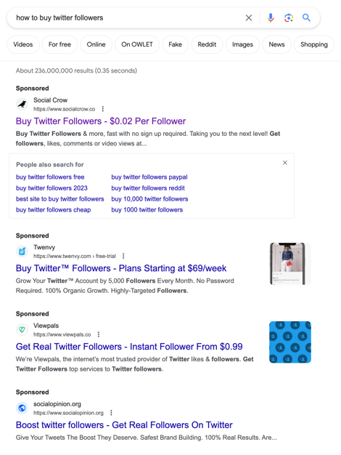
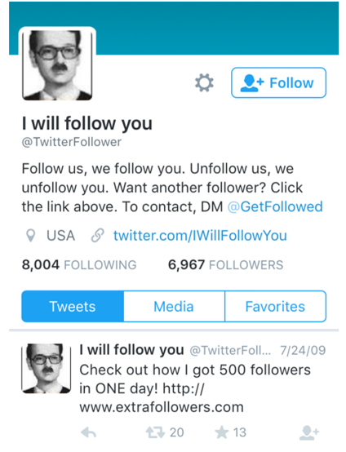
F3: Fraud in social networks
F3.1. Fake twitter followers
$0.02 Per Follower
FRAUDAR:Bounding Graph Fraud …; B. Hooi, H.A. Song, A. Beutel, N. Shah, K. Shin, C. Faloutsos, KDD 2016 (best paper)
Notes:
In social network fraud, the creation of fake Twitter followers represents a key tactic, where fraudsters boost their follower counts to falsely enhance their online presence or influence. This strategy not only misguides the public and potential sponsors but also provides the fraudsters with unjust advantages, such as increased credibility and potential for lucrative commercial deals or political leverage. This can be easily purchased onlne as you can see in the slide

Slide 24
F3) Fraud in social networks
F3.1 – fake follower types
Honest
Premium Fraud
Frem. Fraud
The Many Faces of Link Fraud, Neil Shah, Hemank Lamba, Alex Beutel, Christos Faloutsos, arxiv 2017

Slide 25
Outline
Intro – motivation
Fraud types in
F1) E-commerce
F2) Financial networks
F3) Social networks
F4) Phone-call graphs
‘TgraphSpot’: ML+Viz tool
Case #1
Case #2
Notes:
Specifically we will show an example of each of these fraud types and suspicious networks.

Slide 26
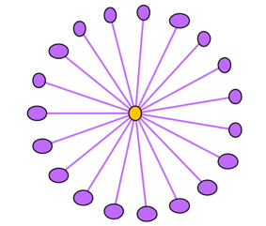
F4) Phonecall graphs
F4.1) Telemarketers
F4.2) ‘wangiri’ ‘one-ring scam’
Europol; AT&T
F4.3) Telephony Denial of Service (TDoS)(DHS)
1 ring
…
Notes:
If we think of Normal telecom subscribers will have a graph reseembling a near click , forming some triangles and bellonging to a limited group of communities. Some fraud patterns create odd graphs, like bad telemarketers (robocalling) and wangiri. The first creates a star shape network full outbound while the second creates an outbound star with some inbound edges. Wangirim calls are made from very expensive numbers, they ring once and disconnect before the end user haves the chance to answer the call. If the users tries to return the missed call, he will be charged a very expensive fee. Lastly, Telephony denial of service or Tdos. This is basically a extorsion type of fraud, where fraudster flood the destination numbers with calls, to the point he will not be able to do or receive calls, typically this is done to national emergency numbers or business that have a high depency on phone lines. Fraudsters will only stop if the customer pays. Depending on the Type of TDoS, this can be a star with heavy weigth on all edges or a node with a out degree of one, with heavy weight.

Slide 27
Outline
Intro – motivation
Fraud types in
F1) E-commerce
F2) Financial networks
F3) Social networks
F4) Phone-call graphs
‘TgraphSpot’: ML+Viz tool
Case #1
Case #2
Notes:
Specifically we will show an example of each of these fraud types and suspicious networks.

Slide 28
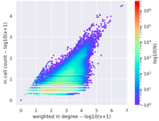
TgraphSpot: Fast and Effective Anomaly Detection for Time-Evolving Graphs IEEE BigData, 2022
Mirela Cazzolato^{1,2}, Saranya Vijayakumar¹, Xinyi Zheng¹,
Namyong Park¹, Meng-Chieh Lee¹, Pedro Fidalgo^{3,4},
Bruno Lages³, Agma J. M. Traina², Christos Faloutsos¹
Open source:
https://github.com/mtcazzolato/tgraph-spot
Video: https://youtu.be/jI1adN-BQuo?t=1537
Notes:
Hello. I’m Mirela Cazzolato. I’m from Carnegie Mellon University and today I’m going to present our work: TgraphSpot: Fast and Effective anomaly detection for time-evolving graphs

Slide 29
Authors
Mirela Cazzolato
Pedro Fidalgo
Saranya Vijayakumar
Bruno Lages
Xinyi Zheng
Agma Traina
Namyong Park
Christos Faloutsos
Meng-Chieh Jeremy Lee

Slide 30
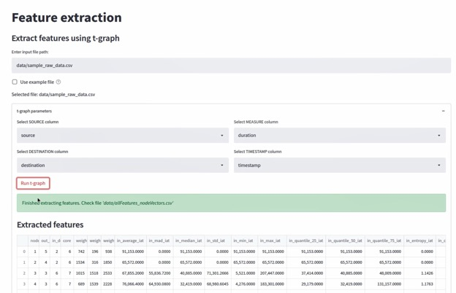
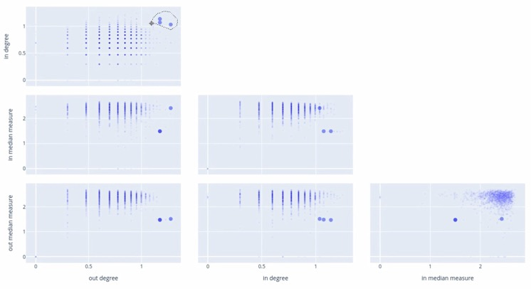
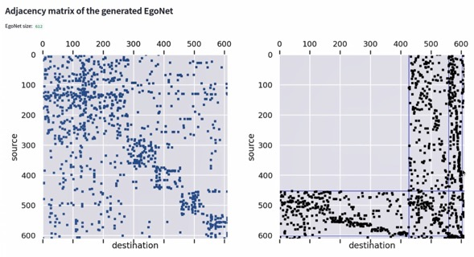
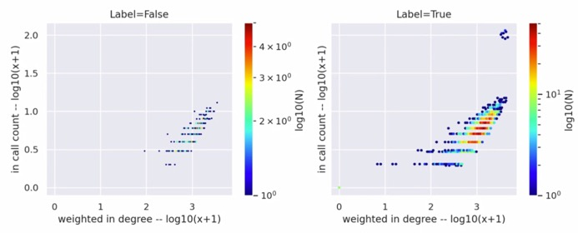
System Overview - current
Feature extraction
Select nodes for
further investigation
Feature visualization
Deep Dive: EgoNet
Video: https://youtu.be/jI1adN-BQuo?t=1537

Slide 31
Conclusions
Many types of fraud
In several settings
Data/graph mining and visualization help
SVD
BP
Tensors
…

